Slide 1
Java-based Container Configuration
How to use annotations in your Java code to configure the Spring container

Slide 2
Basic Concepts @Bean and @Configuration
The central artifacts in Spring’s new Java-configuration support are @Configuration-annotated classes and @Bean -annotated methods.
The @Bean annotation is used to indicate that a method instantiates, configures, and initializes a new object to be managed by the Spring IoC container.

Slide 3
Basic Concepts @Bean and @Configuration
Annotating a class with @Configuration indicates that its primary purpose is as a source of bean definitions.
@Configuration classes let inter-bean dependencies be defined by calling other @Bean methods in the same class.

Slide 4
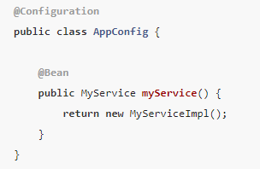

Basic Concepts @Bean and @Configuration
The simplest possible @Configuration class reads as follows
The preceding AppConfig class is equivalent to the following Spring <beans/> XML

Slide 5
Instantiating the Spring Container by Using AnnotationConfigApplicationContext
AnnotationConfigApplicationContext is a standalone application context which accepts annotated classes as input.
For instance, @Configuration or @Component. Beans can be looked up with scan() or registered with register().

Slide 6
Instantiating the Spring Container by Using AnnotationConfigApplicationContext
When @Configuration classes are provided as input, the @Configuration class itself is registered as a bean definition and all declared @Bean methods within the class are also registered as bean definitions.
When @Component and JSR-330 classes are provided, they are registered as bean definitions, and it is assumed that DI metadata such as @Autowired or @Inject are used within those classes where necessary.

Slide 7
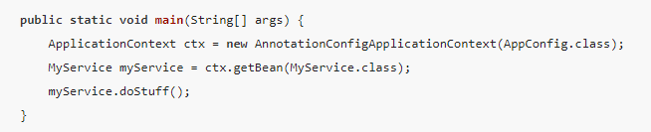
AnnotationConfigApplicationContext

Slide 8
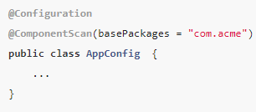
Enabling Component Scanning
To enable component scanning, you can annotate your @Configuration class as follows
The com.acme package is scanned to look for any @Component-annotated classes, and those classes are registered as Spring bean definitions within the container.

Slide 9
@Bean Annotation
@Bean is a method-level annotation and a direct analog of the XML <bean/> element.
The annotation supports some of the attributes offered by <bean/>, such as:
init-method
destroy-method
autowiring
name.
You can use the @Bean annotation in a @Configuration -annotated or in a @Component -annotated class.

Slide 10
Declaring a Bean
To declare a bean, you can annotate a method with the @Bean annotation.
You use this method to register a bean definition within an ApplicationContext of the type specified as the method’s return value.
By default, the bean name is the same as the method name.

Slide 11
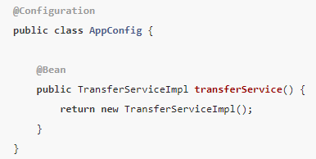

Declaring a Bean
Both declarations make a bean named transferService available in the
ApplicationContext, bound to an object instance of type TransferServiceImpl

Slide 12
Bean Dependencies
A @Bean-annotated method can have an arbitrary number of parameters that describe the dependencies required to build that bean.

Slide 13
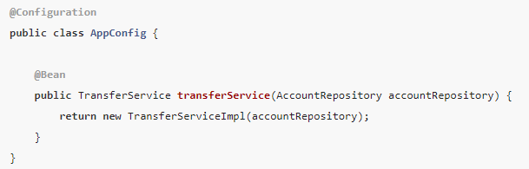
Bean Dependencies
For instance, if our TransferService requires an AccountRepository, we can materialize that dependency with a method parameter.
The resolution mechanism is pretty much identical to constructor-based dependency injection.

Slide 14
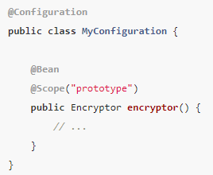
Bean Scope
Spring includes the @Scope annotation so that you can specify the scope of a bean.
The default scope is singleton, but you can override this with the @Scope annotation.

Slide 15
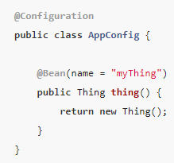
Customizing Bean Naming
By default, configuration classes use a @Bean method’s name as the name of the resulting bean.
This functionality can be overridden, however, with the name attribute

Slide 16
@Configuration annotation
@Configuration is a class-level annotation indicating that an object is a source of bean definitions.
@Configuration classes declare beans through public @Bean annotated methods.
Calls to @Bean methods on @Configuration classes can also be used to define inter-bean dependencies.

Slide 17
@Import Annotation
Much as the <import/> element is used within Spring XML files to aid in modularizing configurations
The @Import annotation allows for loading @Bean definitions from another configuration class

Slide 18
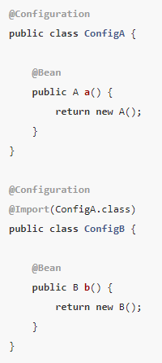
@Import Annotation
Rather than needing to specify both ConfigA.class and
ConfigB.class when instantiating the context, only ConfigB needs to be supplied explicitly

