Slide 1
Spring Boot Profiles and Test

Slide 2
Environment Abstraction
The Environment interface is an abstraction integrated in the container that models two key aspects of the application environment:
profiles
properties.

Slide 3
Profile
A profile is a named, logical group of bean definitions to be registered with the container only if the given profile is active.
Beans may be assigned to a profile whether defined in XML or with annotations.
The role of the Environment object with relation to profiles is in determining which profiles (if any) are currently active, and which profiles (if any) should be active by default.

Slide 4
Properties
Properties play an important role in almost all applications and may originate from a variety of sources.
The role of the Environment object with relation to properties is to provide the user with a convenient service interface for configuring property sources and resolving properties from them.
Notes:
Properties play an important role in almost all applications and may originate from a variety of sources: properties files, JVM system properties, system environment variables, JNDI, servlet context parameters, ad-hoc Properties objects, Map objects, and so on.

Slide 5
Bean Definition Profiles
Bean definition profiles provide a mechanism in the core container that allows for registration of different beans in different environments.

Slide 6
Bean Definition Profiles
The word, “environment,” can mean different things to different users, and this feature can help with many use cases, including:
Working against an in-memory datasource in development versus looking up that same datasource from JNDI when in QA or production.
Registering monitoring infrastructure only when deploying an application into a performance environment.
Registering customized implementations of beans for customer A versus customer B deployments.

Slide 7
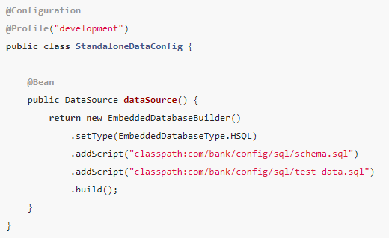
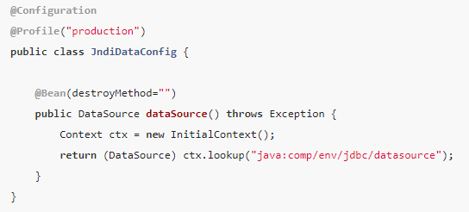
@Profile Annotation
The @Profile annotation lets you indicate that a component is eligible for registration when one or more specified profiles are active.

Slide 8
@Profile Annotation
If a @Configuration class is marked with @Profile, all of the @Bean methods and @Import annotations associated with that class are bypassed unless one or more of the specified profiles are active.
@Profile can also be declared at the method level to include only one particular bean of a configuration class

Slide 9
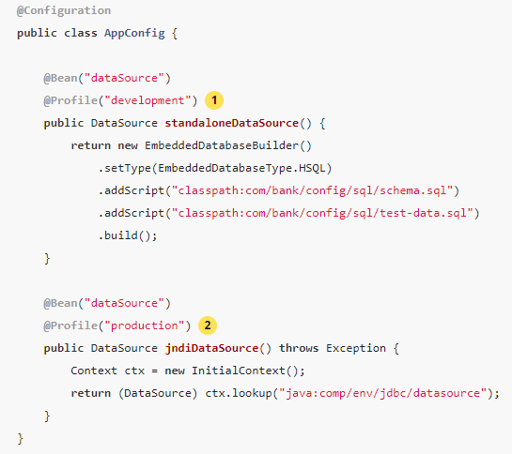
@Profile Annotation
Notes:
The standaloneDataSource method is available only in the development profile.
The jndiDataSource method is available only in the production profile.

Slide 10
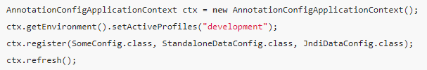
Activating a Profile
Activating a profile can be done in several ways, but the most straightforward is to do it programmatically against the Environment API which is available through an ApplicationContext.

Slide 11
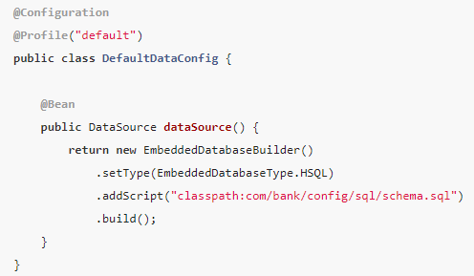
Default Profile
The default profile represents the profile that is enabled by default.
If any profile is enabled, the default profile does not apply.

Slide 12
Profile-specific Properties
In addition to application.properties files, profile-specific properties can also be defined by using the following naming convention: application-{profile}.properties.
The Environment has a set of default profiles (by default, [default]) that are used if no active profiles are set.
In other words, if no profiles are explicitly activated, then properties from application-default.properties are loaded.
Profile-specific properties are loaded from the same locations as standard application.properties, with profile-specific files always overriding the non-specific ones, whether or not the profile-specific files are inside or outside your packaged jar.

Slide 13
Spring - Integration Testing
The Spring TestContext Framework supports full integration with JUnit 4 through a custom runner.
By annotating test classes with @RunWith(SpringJUnit4ClassRunner.class) or the shorter @RunWith(SpringRunner.class) variant, we can write standard JUnit 4 unit and integration tests.
That means we can have full support of spring context loading and dependency injection of the beans in our tests.

Slide 14
@ContextConfiguration
@ContextConfiguration loads an ApplicationContext for Spring integration test.
@ContextConfiguration can load ApplicationContext using XML resource or the JavaConfig annotated with @Configuration.
The @ContextConfiguration annotation can also load a component annotated with @Component, @Service, @Repository etc.

Slide 15
@DirtiesContext
The Spring @DirtiesContext removes the dirty ApplicationContext from context cache associated with the test.
The test can modify the context such as modifying the state of singleton bean, modifying the state of an embedded database etc.
Using @DirtiesContext we can clear the context cache and hence subsequent tests that request the same context will get new context.
The @DirtiesContext can be used at class level as well as method level in integration tests classes.

Slide 16
@DirtiesContext -- the supported test phases
BEFORE_METHOD: It is used at method level with methodMode. Current context will be removed and recreated just before this method execution.
AFTER_METHOD: It is used at method level with methodMode. Current context will be removed and recreated just after this method execution.

Slide 17
@DirtiesContext -- the supported test phases
BEFORE_EACH_TEST_METHOD: It is used at class level with classMode. Current context will be removed and recreated before every test method execution of this integration test class.
AFTER_EACH_TEST_METHOD: It is used at class level with classMode. Current context will be removed and recreated after every test method execution of this integration test class.

Slide 18
@DirtiesContext -- the supported test phases
BEFORE_CLASS: It is used at class level with classMode. In the test class hierarchy, the context will be removed and recreated before current test class execution.
AFTER_CLASS: It is used at class level with classMode. In the test class hierarchy, the context will be removed and recreated after current test class execution.

Slide 19
@Sql Annotation
The @Sql annotation executes SQL scripts and SQL statements using datasource for testing.
The @SqlConfig helps to parse SQL scripts configured via @Sql annotation.

Slide 20
@ActiveProfiles
@ActiveProfiles is a class-level annotation that is used to activate profiles while loading ApplicationContext in Spring integration test.

