Slide 1
Spring Security

Slide 2
Spring Security Model
Spring Security defines a framework for security
Implemented using Servlet filters in the background
Two methods of securing a Web app: declarative and programmatic

Slide 3
Spring Security with Servlet Filters
Servlet Filters are used to pre-process / post-process web requests
Servlet Filters can route web requests based on security logic
Spring provides a bulk of security functionality with servlet filters

Slide 4
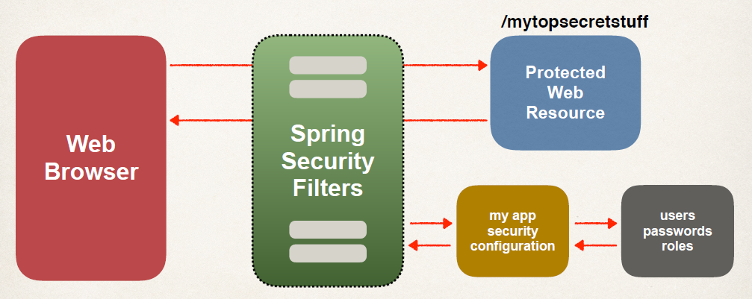
Spring Security Overview

Slide 5
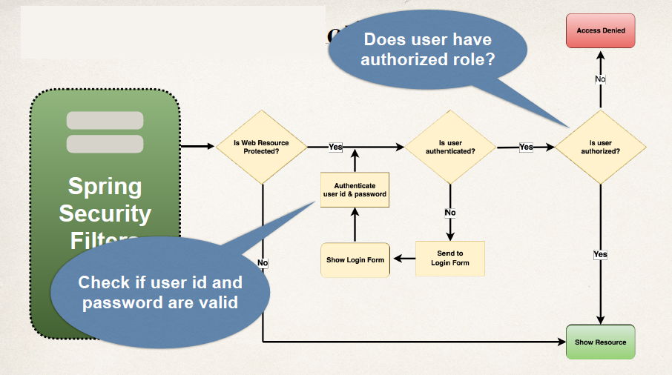
Spring Security in Action

Slide 6
Security Concepts
Authentication
Check user id and password with credentials stored in app / db
Authorization
Check to see if user has an authorized role

Slide 7
Declarative Security
Define application’s security constraints in configuration
All Java config (@Configuration, no xml)
Spring XML config
Provides separation of concerns between application code and security

Slide 8
Programmatic Security
Spring Security provides an API for custom application coding
Provides greater customization for specific app requirements

Slide 9
Different Login Methods
HTTP Basic Authentication
Default login form
Spring Security provides a default login form
Custom login form
your own look-and-feel, HTML + CSS

Slide 10
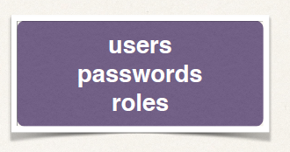
Authentication and Authorization
In-memory
JDBC
LDAP
Custom / Pluggable
others …

Slide 11
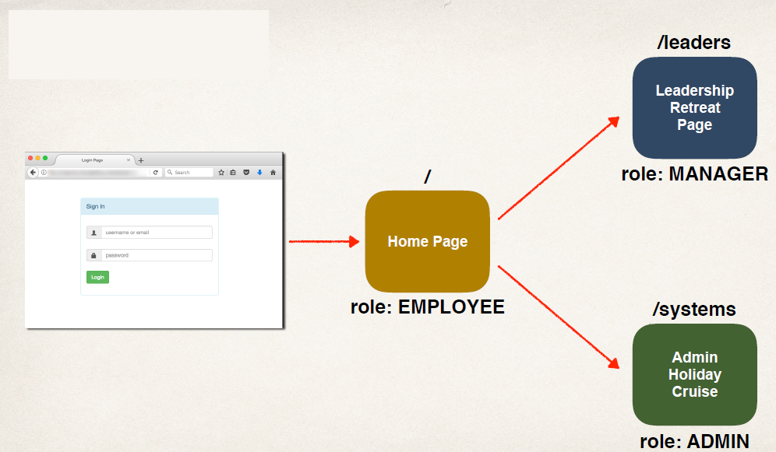
Our Example

Slide 12
Scheduling
To schedule job in spring boot application to run periodically, spring boot provides @EnableScheduling and @Scheduled annotations.
Add @EnableScheduling annotation to your spring boot application class.
@EnableScheduling is a Spring Context module annotation.
It internally imports the SchedulingConfiguration via the @Import(SchedulingConfiguration.class) instruction

Slide 13
Scheduling
Scheduling a Task with Fixed Rate
Scheduling a Task with Fixed Delay
Scheduling a Task With Fixed Rate and Initial Delay
Scheduling a Task using Cron Expression

