Slide 1
Spring WebFlux

Slide 2
Spring WebFlux
The original web framework included in the Spring Framework, Spring Web MVC, was purpose-built for the Servlet API and Servlet containers.
The reactive-stack web framework, Spring WebFlux, was added later in version 5.0.
It is fully non-blocking, supports Reactive Streams back pressure, and runs on such servers as Netty, Undertow, and Servlet 3.1+ containers.
Both web frameworks mirror the names of their source modules (spring-webmvc and spring-webflux) and co-exist side by side in the Spring Framework.
Each module is optional.
Applications can use one or the other module or, in some cases, both — for example, Spring MVC controllers with the reactive WebClient.

Slide 3
Reactive Programming
Reactive programming is a programming paradigm that promotes an asynchronous, non-blocking, event-driven approach to data processing.
Reactive programming involves modeling data and events as observable data streams and implementing data processing routines to react to the changes in those streams.

Slide 4
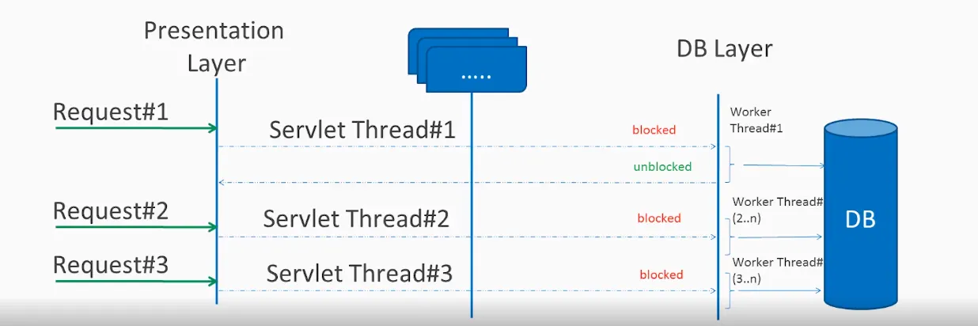
Blocking request processing
In traditional MVC applications, when a request come to server, a servlet thread is created.
It delegates the request to worker threads for I/O operations such as database access etc.
During the time worker threads are busy, servlet thread (request thread) remain in waiting status and thus it is blocked.
It is also called synchronous request processing.

Slide 5
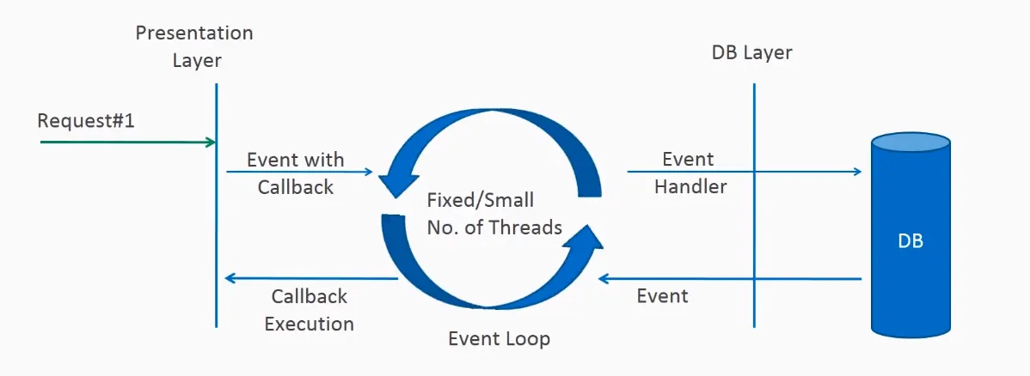
Non-blocking request processin
In non-blocking or asynchronous request processing, no thread is in waiting state.
There is generally only one request thread receiving the request.
All incoming requests come with a event handler and call back information.
Request thread delegates the incoming requests to a thread pool (generally small number of threads) which delegate the request to it’s handler function and immediately start processing other incoming requests from request thread.
When the handler function is complete, one of thread from pool collect the response and pass it to the call back function.

Slide 6
What is reactive programming?
The term, “reactive,” refers to programming models that are built around reacting to changes.
It is build around publisher-subscriber pattern (observer pattern).
In reactive style of programming, we make a request for resource and start performing other things.
When the data is available, we get the notification along with data inform of call back function.
In callback function, we handle the response as per application/user needs.

Slide 7
What is reactive programming?
One important thing to remember is back pressure.
In non-blocking code, it becomes important to control the rate of events so that a fast producer does not overwhelm its destination.
Reactive web programming is great for applications that have streaming data, and clients that consume it and stream it to their users.
It is not great for developing traditional CRUD applications.
If you’re developing the next Facebook or Twitter with lots of data, a reactive API might be just what you’re looking for.

Slide 8
Reactive Streams API
The new Reactive Streams API was created by engineers from Netflix, Pivotal, Lightbend, RedHat, Twitter, and Oracle, among others and is now part of Java 9.
It defines four interfaces:
Publisher
Subscriber
Subscription
Processor

Slide 9
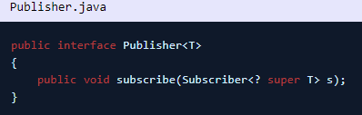
Publisher
Emits a sequence of events to subscribers according to the demand received from its subscribers.
A publisher can serve multiple subscribers.
It has a single method

Slide 10
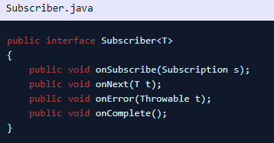
Subscriber
Receives and processes events emitted by a Publisher.
Please note that no notifications will be received until Subscription#request(long) is called to signal the demand.
It has four methods to handle various kind of responses received.

Slide 11
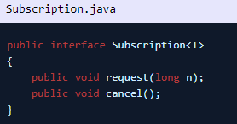
Subscription
Defines a one-to-one relationship between a Publisher and a Subscriber.
It can only be used once by a single Subscriber.
It is used to both signal desire for data and cancel demand (and allow resource cleanup).

Slide 12
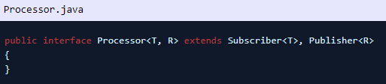
Processor
Represents a processing stage consisting of both a Subscriber and a Publisher and obeys the contracts of both.

Slide 13
What is Spring WebFlux
Spring WebFlux is parallel version of Spring MVC and supports fully non-blocking reactive streams.
It support the back pressure concept and uses Netty as inbuilt server to run reactive applications.
If you are familiar with Spring MVC programming style, you can easily work on webflux also.
Spring webflux uses project reactor as reactive library.
Reactor is a Reactive Streams library and, therefore, all of its operators support non-blocking back pressure.
It is developed in close collaboration with Spring.

Slide 14

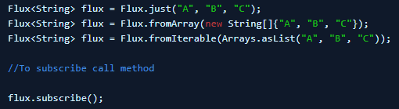
What is Spring WebFlux
Spring WebFlux heavily uses two publishers :
Mono: Returns 0 or 1 element.
Flux: Returns 0…N elements. A Flux can be endless, meaning that it can keep emitting elements forever.
Also it can return a sequence of elements and then send a completion notification when it has returned all of its elements.

Slide 15
What is Spring WebFlux
In Spring WebFlux, we call reactive APIs/functions that return monos and fluxes and your controllers will return monos and fluxes.
When you invoke an API that returns a mono or a flux, it will return immediately.
The results of the function call will be delivered to you through the mono or flux when they become available.

