Slide 1
Selenium Testing

Slide 2
What is Selenium Testing?
Selenium Automates Browsers, What you do with this power is entirely up to you
Selenium is a set of open-source web automation tools that leverages the power of web browsers and helps in automating workflows of how users interact with the web application within the browser.

Slide 3
Components of Selenium
Selenium is not just an automation tool.
It is a suite of tools, and each tool in the suite have specific unique capabilities that help in designing and development of automation framework.
All these components can be either used individually or can be paired with one another to achieve a level of test automation

Slide 4
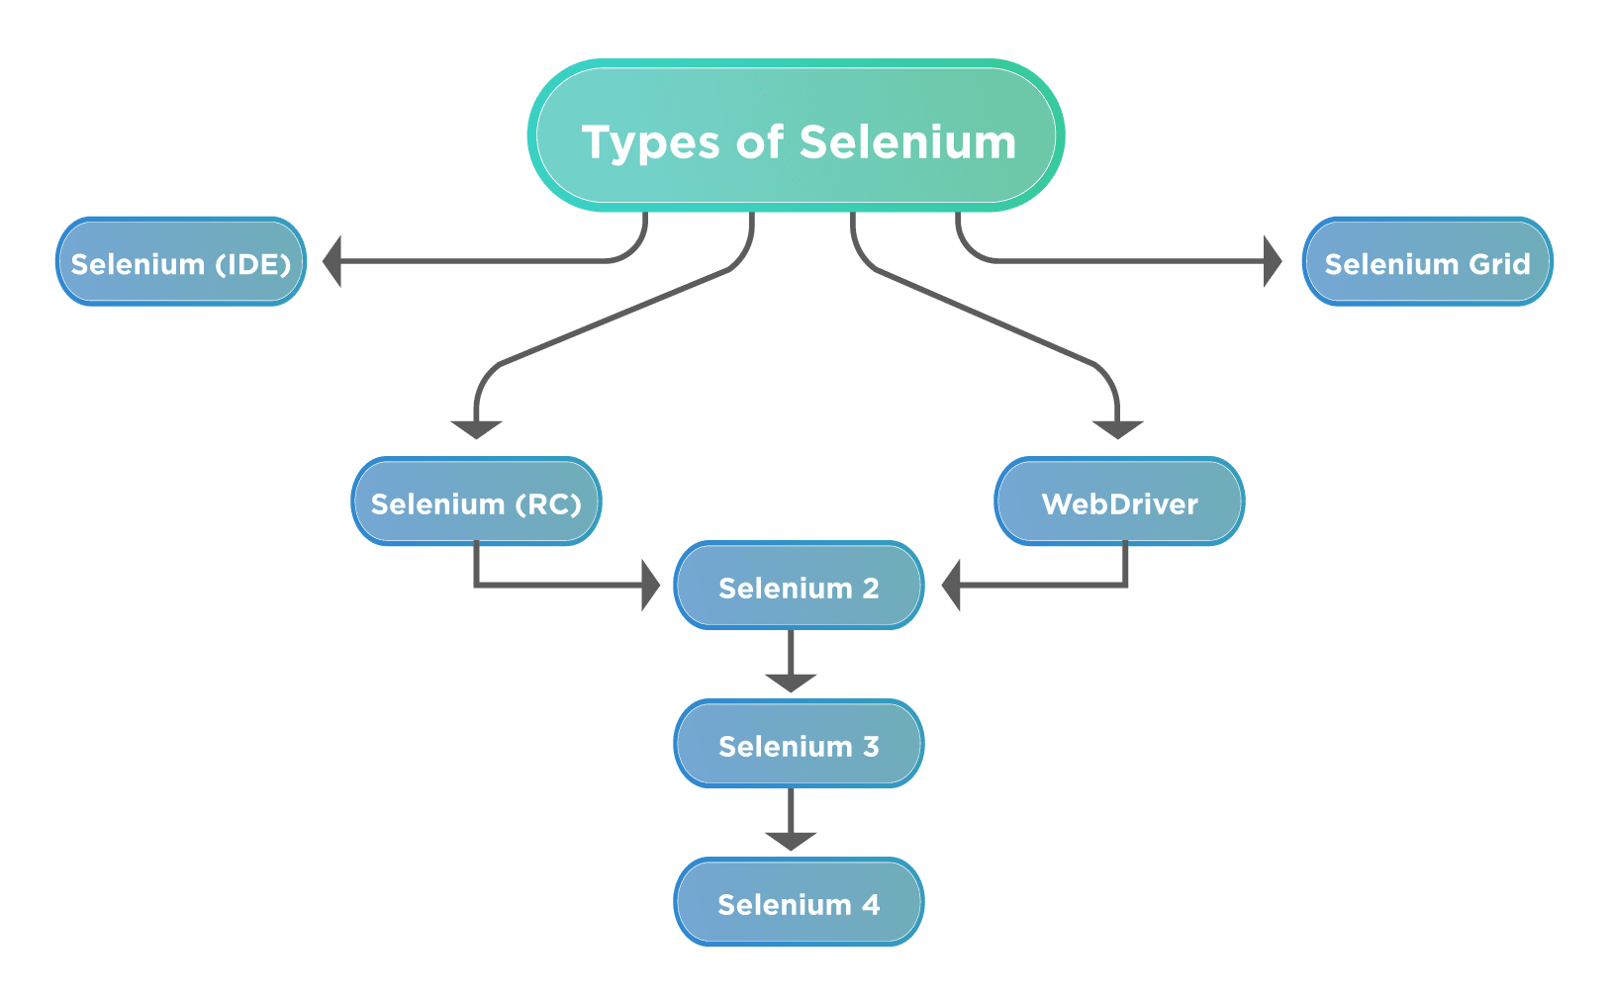
Components of Selenium

Slide 5
Selenium IDE
Selenium IDE is an extension available for both Firefox and Chrome, which has the record and replay functionality available.
Selenium IDE also now has the capability of exporting the code in various predefined languages.
It also gives the ability to use one test case inside another.

Slide 6
Selenium Remote Control (RC)
Selenium RC is a server that acts as a middle man between the user and the browser that needs to interact.
RC uses Javascript to work with browsers while allowing the users to write code in the language of their choice.
It was the main version of Selenium for some time.
Selenium RC had issues with the One Origin Policy and deprecated in favor of WebDriver.

Slide 7
Selenium WebDriver
Selenium WebDriver is the most commonly used component of Selenium.
WebDriver allows users to write custom code in their language of choice and interact with the browser of their choice, through browser-specific drivers.
WebDriver works on the OS level and uses a Protocol called JSONWireProtocol to communicate with browsers.

Slide 8
Selenium Grid
Selenium GRID allows users to run tests on different machines, with different browsers and OS simultaneously, which gives the ability to run tests in parallel, as such saving a lot of time and resources of testing on several machines.

