Slide 1
Selenium WebDriver Architecture

Slide 2
Selenium WebDriver
Selenium WebDriver is a set of open-source APIs, which provided the capabilities to interact with any of the modern web-browsers and then, in-turn to automate the user actions with that browser.
It is an essential component of the Selenium family.

Slide 3
Selenium WebDriver for Web Automation
Feature* | Description
Dynamic Web Page Automation | Selenium WebDriver can automate dynamic websites where the content of pages changes by user actions.
Works Close to Browser | Browser vendors ship their WebDriver implementation. Hence they are tightly coupled to the browser giving a better testing experience.
Technology Agnostic | Selenium WebDriver allows you to automate the test cases for all the web applications, irrespective of the technology used for the development of the application under test.
Mimics Real User | Selenium WebDriver allows QA to mimic user actions on the websites. Selenium WebDriver can mimic typical user actions like form filling, clicking, double-clicking, key-press, as well as advanced user actions like drag and drop, click and hold, etc.

Slide 4
Selenium WebDriver for Web Automation
Feature* | Description
Supports Cross Browser Testing | Selenium WebDriver has the most significant advantage when doing cross-browser testing - where a QA can test for the same website, using the same piece of code on different browsers. It enables the verification and validation of test cases on multiple sets of browsers at the same time.
Supports parallel Execution | If there are more scripts to be executed on multiple browsers, then doing them one by one is time-consuming. So Selenium WebDriver allows parallel execution, using frameworks like TestNG, so that execution of test cases is faster. This allows large scale execution of test cases in a short time.
View Execution Results | Selenium WebDriver allows a QA to view the live execution of the automated test run on the computer system as well as on any other CI/CD pipeline machine by supporting functionalities like the screenshot, video-recording of test cases, etc.
Supports modern development techniques | Selenium WebDriver integrates very well with modern Software Development principles like Behaviour Driven Development via integration with the Cucumber library.

Slide 5
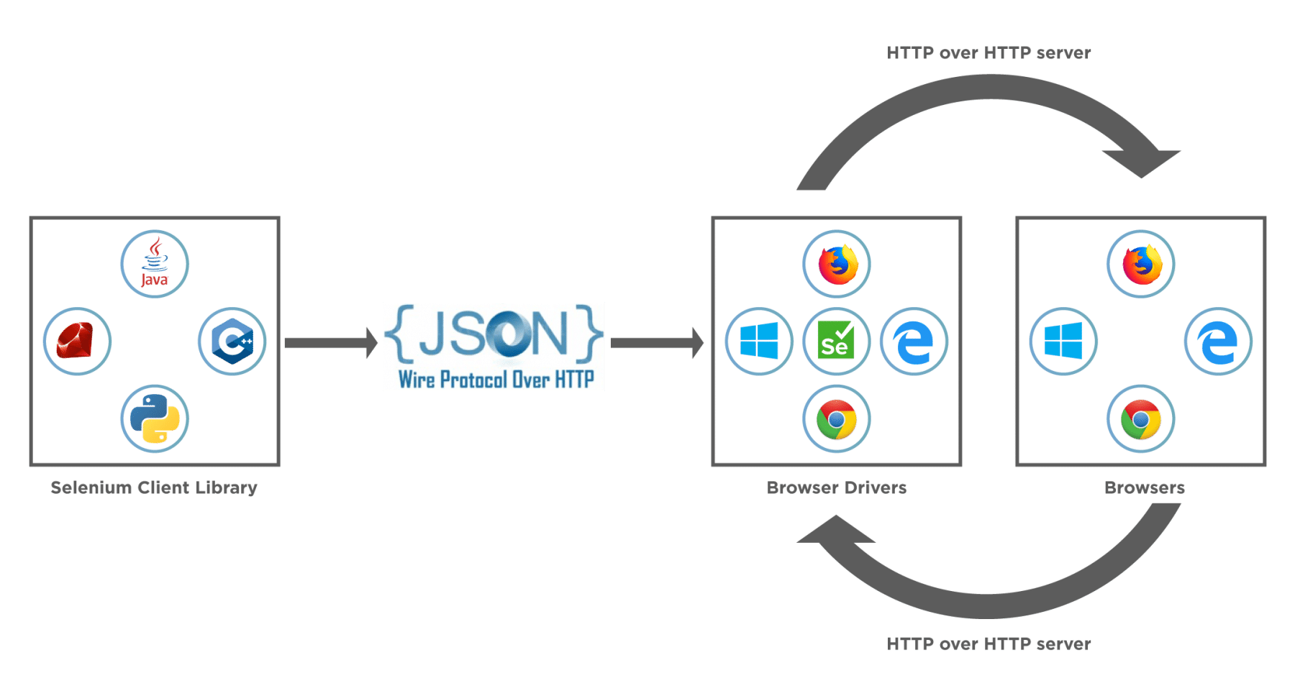
Selenium WebDriver Architecture

Slide 6
Selenium WebDriver Architecture
Selenium WebDriver Client Libraries / Language Bindings – Software Testers want to select languages that they are comfortable with. Since WebDriver Architecture supports different languages, so there are bindings available for a range of languages like Java, C#, Python, Ruby, PHP, etc. Anyone who has a basic knowledge of working with any programming language can get specific language bindings and can start off. This is how Selenium Achitecture provides flexibility to testers to do automation in their comfort zone.
JSON WIRE PROTOCOL - As per the Selenium Architecture above, the JSON Wire Protocol facilitates all the communication that is happening in Selenium between the browser and the code. This is the heart of Selenium. JSON Wire Protocol provides a medium for data transfer using a RESTful (Representational State Transfer) API which provides a transport mechanism and defines a RESTful web service using JSON over HTTP.

Slide 7
Selenium WebDriver Architecture
Browser Drivers – Since there are various browsers that are supported by Selenium, each browser has its own implementation of the W3C standard that Selenium provides. As such browser-specific binaries are available that are specific to the browser and hides the implementation logic from the end-user. JSONWire protocol establishes a connection between the browser binaries and the client libraries.
Browsers – Selenium will be only able to run tests on the browsers if they are locally installed, either on the local machine or on the server machines. So browser installation is necessary.

Slide 8
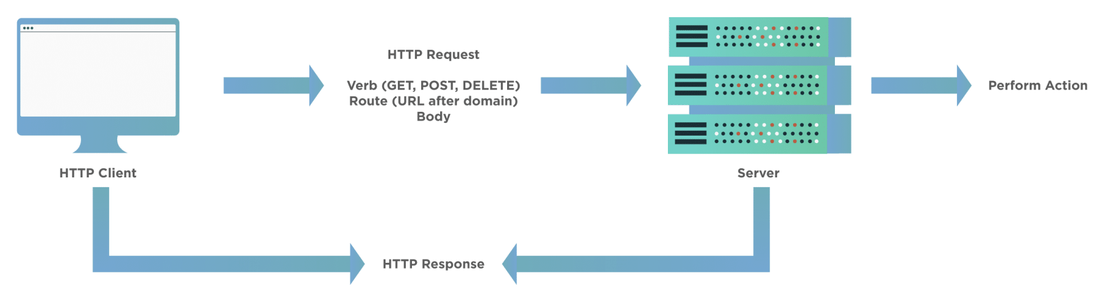
How Selenium WebDriver works

Slide 9
How Selenium WebDriver works
An HTTP request generates, and it goes to the respective browser driver (Chrome, IE, Firefox). There is an individual request for each Selenium command.
The browser driver receives the request through an HTTP server.
The HTTP server decides which actions/instructions need to execute on the browser.
The browser executes the instructions/steps as decided above.
The HTTP server then receives the execution status and then sends back the status to an automation script, which then shows the result ( as passed or an exception or error).

Slide 10
How to use Selenium WebDriver for Web Automation
Selenium WebDriver provides a very seamless, user-friendly, and code friendly approach to automation using various browsers.
Since it supports most of the major browser vendors, it's just a matter of using the respective browser driver and browser and setting up Selenium to use the same.
For any Selenium test script, there are generally the following steps, which apply to all the test cases and all the applications under test (AUT):

Slide 11
How to use Selenium WebDriver for Web Automation
Create an instance of WebDriver specific to the Browser
Navigate to the desired Web page which needs to be automated
Locate an HTML element on the Web page
Perform an action on an HTML element
Run tests and record test results using a test framework

