Slide 1
Find elements using Selenium WebDriver?

Slide 2
Find elements using Selenium WebDriver
To interact with WebElements, we first have to find or locate these elements on the webpage.
We can find elements on a web page by specifying the attributes such as Id of the element or class name of the element and such other parameters.
These alternatives using which we can find elements on a webpage are called locator strategies.

Slide 3
Selenium Locators
Locator | Description
id | finds elements by ID attribute. The search value given should match the ID attribute.
name | Finds or Locates elements based on the NAME attribute. The name attribute is used to match the search value.
class name | Finds elements that match the class name specified. Note that compound classes are not allowed as strategy names.
tag name | Finds or Locates elements having tag names that match the search value.
CSS selector | Matches CSS selector to find the element.
XPath | Matches XPath expression to the search value and based on that the element is located.
link text | Here the visible text whose anchor elements are to be found is matched with the search value.
partial link text | Here also we match the visible text with the search value and find the anchor value. If we are matching multiple elements, only the first entry will be selected.

Slide 4
XPath in Selenium
For automating any Web Applications, locating web elements is one of the first steps.
We need some unique attributes such as id, name, className, etc. to identify the HTML elements.
Sometimes, either due to dynamic web elements or poor development practices, there are no unique attributes associated with the Web Elements, and there comes the role of XPath.
As we know, when a web page loads in a browser, it generates a DOM (Document Object Model) structure.
XPath is the query language that queries objects in the DOM.

Slide 5
What is XPath
XML Path or commonly known as XPath, is a query language for XML documents.
It is made of path expression governed by some pre-defined conditions.
XPath can be effectively used to identify and locate almost any element present on a web page.
It is quite helpful while working on a dynamic web page where the web element's unique attributes are not constant.

Slide 6
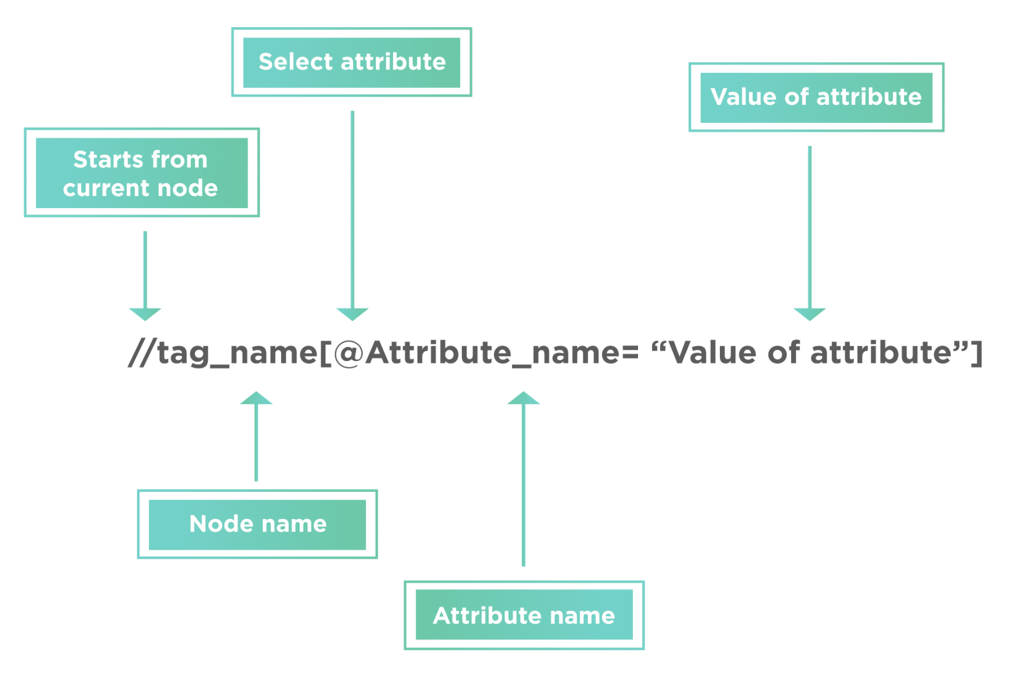
Syntax of XPath
XPath finds any element within a webpage by using DOM. So, its syntax is also made up of DOM attributes and tags,
The XPath syntax generally starts with “//” double slash. That is to say, it will begin with the current node defined by the tag name.
The next part is tag_name; it denotes the HTML tag name of the node.
Subsequently, anything present inside the node encloses in the square brackets.
Additionally, the “@” sign selects the attribute.
Moreover, the “Attribute_name” is the name of the attribute of the node.
And, the “Value of attribute” denotes the attribute value from the node.

Slide 7
different types of XPaths in Selenium
Locating a web element using an Absolute XPath.
Absolute XPath is the direct way of finding the element. Moreover, it starts from the first/root node of the XML/HTML document and goes all the way to the required node following one node at a time.
Locating a web element using Relative XPath.
Relative XPath starts from any node inside the HTML DOM; it need not start from the root node. It beings with a double forward slash.

Slide 8
CSS Selectors in Selenium
CSS Selectors are one of the locator strategies offered by Selenium to identify the web elements.
The CSS Selectors mainly use the character sequence pattern, which identifies the web elements based on their HTML structure.

Slide 9

How to create a CSS Selector
node is the tag name of the HTML element, which needs to locate.
attribute_name is the name of the attribute which can locate the element.
attribute_value is the value of the attribute, which can locate the element.

Slide 10
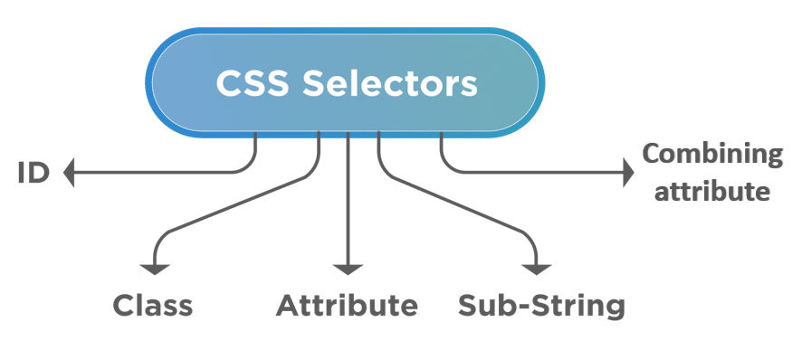
different ways to create CSS Selectors

Slide 11
create a CSS Selector using ID attribute
input[id='firstName’]
The ‘# ’ sign symbolizes the ‘ID ’ in CSS Selector. So, we can directly write ‘# ’ followed by the value of the "id " attribute.
input#firstName

Slide 12
create a CSS Selector using class attribute
textarea[class='form-control’]
Another way of writing the CSS expression for a class attribute is by using the dot (.) symbol to represent the class.
textarea.form-control

