Slide 1
Spring Overview

Slide 2
Spring in a Nutshell
Very popular framework for building Java applications.
Initially a simpler and lightweight alternative to J2EE.
Provides a large number of helper classes … makes things easier

Slide 3
What’s New in Spring 5
Updated minimum requirements for Java 8 or higher
Deprecated legacy integration for: Tiles, Velocity, Portlet, Guava etc
Upgraded Spring MVC to use new versions of Servlet API 4.0
Added new reactive programming framework: Spring WebFlux

Slide 4
What about Spring 4 ???
Some of you may have projects at your job that are still using Spring 4
No worries,
Spring 5 just added new features …
But core Spring 4 features are still the same :-)

Slide 5
Why Spring?
Simplify Java Enterprise Development
Spring Website – Official
https://spring.io/

Slide 6
Goals of Spring
Lightweight development with Java POJOs (Plain-Old-Java-Objects)
Dependency injection to promote loose coupling
Declarative programming with Aspect-Oriented-Programming (AOP)
Minimize boilerplate Java code

Slide 7
Spring Architecture
The Spring Framework consists of features organized into about 20 modules.
These modules are grouped into
Core Container
Data Access/Integration
Web
AOP (Aspect Oriented Programming)
Instrumentation
Test.

Slide 8
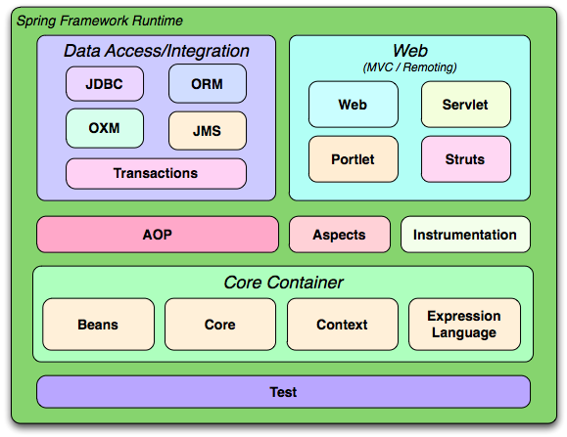
Spring Architecture

Slide 9
Coding Scenario
App should be configurable
Easily change the coach for another sport
Track and Field, Hockey, Cricket, Tennis, Gymnastics etc …
getDailyWorkout()
MyApp
BaseballCoach

Slide 10
Coding Scenario
MyApp.java: main method
BaseballCoach.java
Coach.java
TrackCoach.java

Slide 11
Inversion of Control (IoC)
The approach of outsourcing the construction and management of objects.

Slide 12
Inversion of Control (IoC)
Obtain a Coach Object
MyApp
Object Factory
configuration
BaseballCoach
TrackCoach
TennisCoach

Slide 13
Inversion of Control (IoC)
Obtain a Coach Object
MyApp
Spring
Object Factory
configuration
BaseballCoach
TrackCoach
TennisCoach

Slide 14
Spring Container
Primary functions
Create and manage objects (Inversion of Control)
Inject object’s dependencies (Dependency Injection)
Spring
Object Factory

Slide 15
Configuring Spring Container
XML configuration file (legacy, but most legacy apps still use this)
Java Annotations
Java Source Code

Slide 16
Spring Development Process
Configure your Spring Beans
Create a Spring Container
Retrieve Beans from Spring Container

Slide 17
Configure your Spring Beans
<beans …>
<bean id="myCoach" class="com.jasdhir.springdemo.BaseballCoach"> </bean> </beans>

Slide 18
Create a Spring Container
Spring container is generically known as ApplicationContext
Specialized implementations
ClassPathXmlApplicationContext
AnnotationConfigApplicationContext
GenericWebApplicationContext

Slide 19
Create a Spring Container
ClassPathXmlApplicationContext context = new ClassPathXmlApplicationContext("applicationContext.xml");

Slide 20
Retrieve Beans from Container
// retrieve bean from spring container
Coach theCoach = context.getBean("myCoach", Coach.class);
<bean id="myCoach" class="com.jasdhir.springdemo.BaseballCoach"> </bean>

Slide 21
Spring Dependency Injection
The dependency inversion principle.
The client delegates to calls to another object the responsibility of providing its
dependencies.

Slide 22


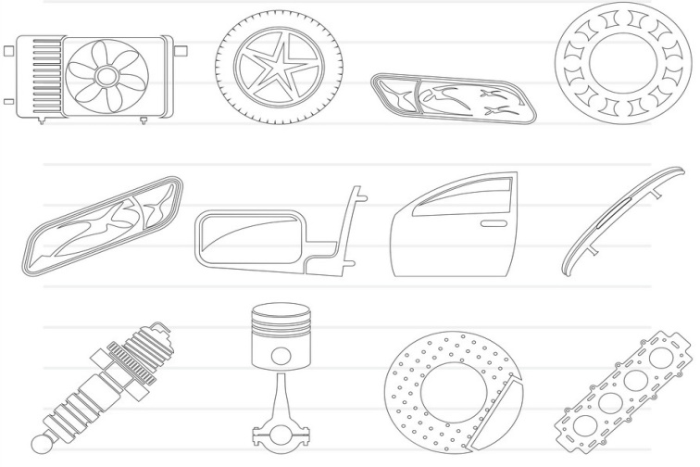
Spring Dependency Injection (Car Factory)
Obtain a Car Object
Spring
Car Factory
Dependencies

Slide 23
Spring Container
Primary functions
Create and manage objects (Inversion of Control)
Inject object’s dependencies (Dependency Injection)

Slide 24
Example
Our Coach already provides daily workouts
Now will also provide daily fortunes
New helper: FortuneService
This is a dependency
Coach
FortuneService

Slide 25
Injection Types
There are many types of injection with Spring
The two most common
Constructor Injection
Setter Injection

Slide 26
Constructor Injection

Slide 27
Setter Injection

Slide 28
Injecting Literal Values

Slide 29
Injecting Values from Properties File

Slide 30
Bean Scopes
Scope refers to the lifecycle of a bean
How long does the bean live?
How many instances are created?
How is the bean shared?

Slide 31
Default Scope: Singleton
Spring Container creates only one instance of the bean, by default
It is cached in memory
All requests for the bean
will return a SHARED reference to the SAME bean

Slide 32
Default Scope: Singleton
<beans … >
<bean id="myCoach"
class="com.jasdhir.springdemo.TrackCoach">
…
</bean>
</beans>

Slide 33
Default Scope: Singleton
Spring
Coach theCoach = context.getBean("myCoach", Coach.class);
...
Coach alphaCoach = context.getBean("myCoach", Coach.class);
TrackCoach

Slide 34
Explicitly Specify Bean Scope
<beans … >
<bean id="myCoach"
class="com.jasdhir.springdemo.TrackCoach"
scope="singleton">
…
</bean>
</beans>

Slide 35
Spring Bean Scopes
Scope | Description
singleton | (Default) Scopes a single bean definition to a single object instance for each Spring IoC container.
prototype | Scopes a single bean definition to any number of object instances.
request | Scopes a single bean definition to the lifecycle of a single HTTP request. That is, each HTTP request has its own instance of a bean created off the back of a single bean definition. Only valid in the context of a web-aware Spring ApplicationContext.
session | Scopes a single bean definition to the lifecycle of an HTTP Session. Only valid in the context of a web-aware Spring ApplicationContext.
application | Scopes a single bean definition to the lifecycle of a ServletContext. Only valid in the context of a web-aware Spring ApplicationContext.
websocket | Scopes a single bean definition to the lifecycle of a WebSocket. Only valid in the context of a web-aware Spring ApplicationContext.

Slide 36
Prototype Scope
<beans … >
<bean id="myCoach"
class="com.jasdhir.springdemo.TrackCoach"
scope="prototype">
…
</bean>
</beans>

Slide 37
Prototype Scope
Spring
Coach theCoach = context.getBean("myCoach", Coach.class);
...
Coach alphaCoach = context.getBean("myCoach", Coach.class);
TrackCoach
TrackCoach

Slide 38
Bean Lifecycle
Container Started
Bean
Instantiated
Dependencies
Injected
Internal Spring
Processing
Bean Is Ready For Use
Container Is Shutdown
Your Custom
Init Method
STOP
Your Custom
Destroy Method

Slide 39
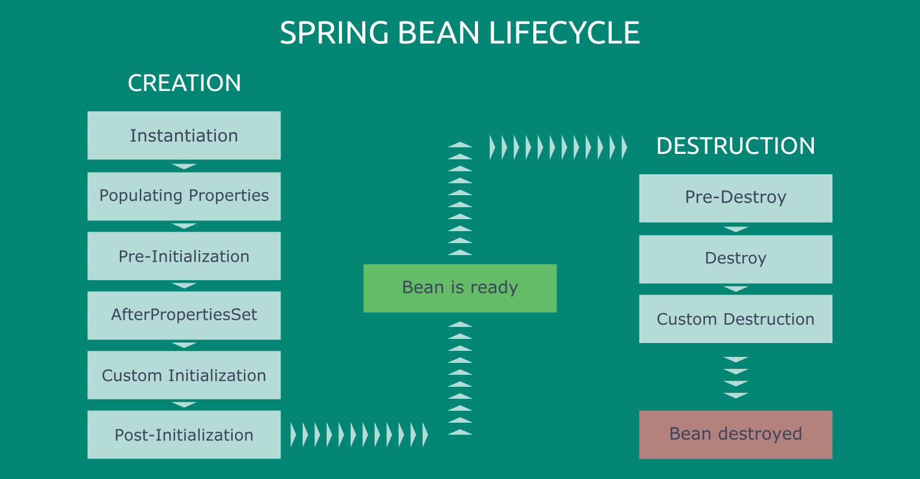
Bean Lifecycle
Instantiate
Populate properties
setBeanName
setBeanFactory
pre-init PostProcessor
afterPropertiesSet
custom init
post-init PostProcessor
in use
Destroy
custom destroy

Slide 40
Bean Creation Phases
Instantiation | This is where everything starts for a bean. Spring instantiates bean objects just like we would manually create a Java object instance.
Populating Properties | After instantiating objects, Spring scans the beans that implement Aware interfaces and starts setting relevant properties.
Pre-Initialization | Spring’s BeanPostProcessors get into action in this phase. The postProcessBeforeInitialization() methods do their job. Also, @PostConstruct annotated methods run right after them.
AfterPropertiesSet | Spring executes the afterPropertiesSet() methods of the beans which implement InitializingBean.
Custom Initialization | Spring triggers the initialization methods that we defined in the initMethod attribute of our @Beanannotations.
Post-Initialization | Spring’s BeanPostProcessors are in action for the second time. This phase triggers the postProcessAfterInitialization() methods.

Slide 41
Bean Destruction Phases
Pre-Destroy | Spring triggers@PreDestroy annotated methods in this phase.
Destroy | Spring executes the destroy() methods of DisposableBean implementations.
Custom Destruction | We can define custom destruction hooks with the destroyMethod attribute in the @Bean annotation and Spring runs them in the last phase.

Slide 42
Bean Lifecycle Methods
You can add custom code during bean initialization
Calling custom business logic methods
Setting up handles to resources (db, sockets, file etc)
You can add custom code during bean destruction
Calling custom business logic method
Clean up handles to resources (db, sockets, files etc)

Slide 43
Init: method configuration
<beans … >
<bean id="myCoach"
class="com.jasdhir.springdemo.TrackCoach"
init-method="doMyStartupStuff">
…
</bean>
</beans>

Slide 44
Destroy: method configuration
<beans … >
<bean id="myCoach"
class="com.jasdhir.springdemo.TrackCoach"
init-method="doMyStartupStuff"
destroy-method="doMyCleanupStuff">
…
</bean>
</beans>

