Slide 1
Spring Cloud

Slide 2
Microservices
Microservice architectures are the ‘new normal’.
Building small, self-contained, ready to run applications can bring great flexibility and added resilience to your code.
Spring Boot’s many purpose-built features make it easy to build and run your microservices in production at scale.
And don’t forget, no microservice architecture is complete without Spring Cloud ‒ easing administration and boosting your fault-tolerance.

Slide 3
Spring Cloud
Developing distributed systems can be challenging.
Complexity is moved from the application layer to the network layer and demands greater interaction between services.
Making your code ‘cloud-native’ means dealing with 12-factor issues such as external configuration, statelessness, logging, and connecting to backing services.
The Spring Cloud suite of projects contains many of the services you need to make your applications run in the cloud.

Slide 4
The Twelve Factors
Codebase
One codebase tracked in revision control, many deploys
Dependencies
Explicitly declare and isolate dependencies
Config
Store config in the environment
Backing services
Treat backing services as attached resources
Build, release, run
Strictly separate build and run stages
Processes
Execute the app as one or more stateless processes
Port binding
Export services via port binding
Concurrency
Scale out via the process model
Disposability
Maximize robustness with fast startup and graceful shutdown
Dev/prod parity
Keep development, staging, and production as similar as possible
Logs
Treat logs as event streams
Admin processes
Run admin/management tasks as one-off processes

Slide 5
Spring Cloud
The distributed nature of microservices brings challenges.
Spring helps you mitigate these.
With several ready-to-run cloud patterns, Spring Cloud can help with service discovery, load-balancing, circuit-breaking, distributed tracing, and monitoring.
It can even act as an API gateway.

Slide 6
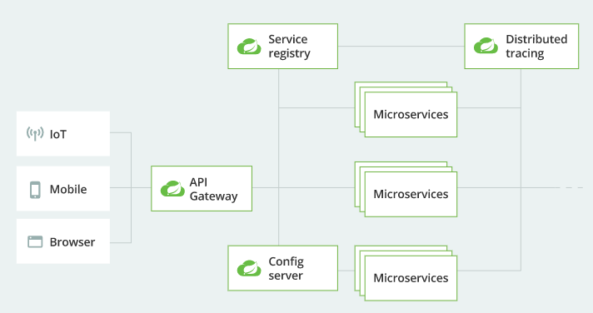
Spring Cloud

Slide 7
Service discovery
In the cloud, applications can’t always know the exact location of other services.
A service registry, such as Netflix Eureka, or a sidecar solution, such as HashiCorp Consul, can help.
Spring Cloud provides DiscoveryClient implementations for popular registries such as Eureka, Consul, Zookeeper, and even Kubernetes' built-in system.
There’s also a Spring Cloud Load Balancer to help you distribute the load carefully among your service instances.

Slide 8
API gateway
With so many clients and servers in play, it’s often helpful to include an API gateway in your cloud architecture.
A gateway can take care of securing and routing messages, hiding services, throttling load, and many other useful things.
Spring Cloud Gateway gives you precise control of your API layer, integrating Spring Cloud service discovery and client-side load-balancing solutions to simplify configuration and maintenance.

Slide 9
Cloud configuration
In the cloud, configuration can’t simply be embedded inside the application.
The configuration has to be flexible enough to cope with multiple applications, environments, and service instances, as well as deal with dynamic changes without downtime.
Spring Cloud Config is designed to ease these burdens and offers integration with version control systems like Git to help you keep your configuration safe.

Slide 10
Circuit breakers
Distributed systems can be unreliable. Requests might encounter timeouts or fail completely.
A circuit breaker can help mitigate these issues, and Spring Cloud Circuit Breaker gives you the choice of three popular options: Resilience4J, Sentinel, or Hystrix.

Slide 11
Tracing
Debugging distributed applications can be complex and take a long time.
For any given failure, you might need to piece together traces of information from several independent services.
Spring Cloud Sleuth can instrument your applications in a predictable and repeatable way.
And when used in conjunction with Zipkin, you can zero in on any latency problems you might have.

Slide 12
Testing
In the cloud, you get extra points for having reliable, trustworthy, stable APIs—but getting there can be a journey.
Contract-based testing is one technique that high-performing teams often use to stay on track.
It helps by formalizing the content of APIs and building tests around them to ensure code remains in check.
Spring Cloud Contract provides contract-based testing support for REST and messaging-based APIs with contracts written in Groovy, Java, or Kotlin.

