Slide 1
Spring Data JPA

Slide 2
Spring Data
We have already utilized the Data Access Object (DAO) Layer to handle communication of data between our application and our repository.
This DAO layer usually consists of a lot of boilerplate code, and as such can and should be simplified.
There are numerous reasons to simplify this code, including a decrease in the number of artifacts that need to be defined and maintained, consistency of data access patters, consistency of configuration, and quicker implementation for updated repository data.

Slide 3
Spring Data
The Spring Data module takes this simplification one step further by providing standard implementation for common DAO methods allowing for the removal of the DAO implementation and only requiring the definition of the DAO interface methods.
In order to leverage the Sping Data programming model with JPA, a DAO interface should extend the Spring JpaRepository interface from the org.springframework.data.jpa.repository package

Slide 4
Spring Data
Note that it is possible to create a basic CRUD application by extending the spring CrudRepository interface (from the org.springframework.data.repository package), though this only provides an interface for generic CRUD operations on a repository, and does not leverage the JPA.

Slide 5
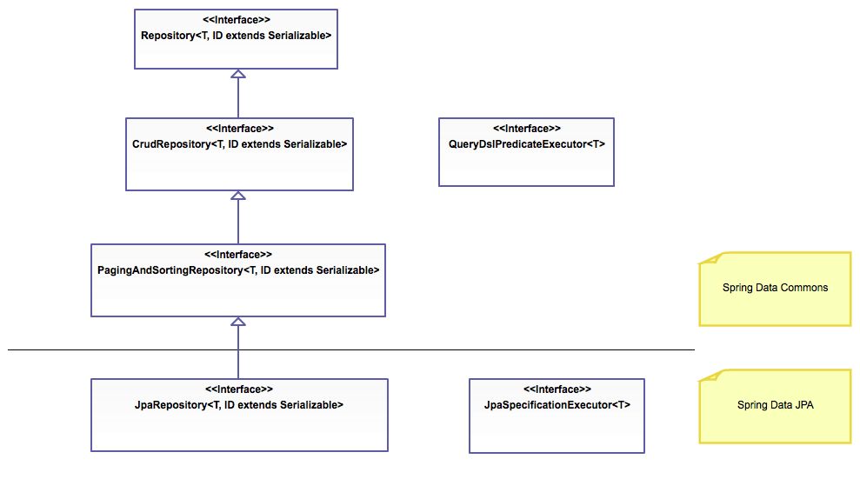
Spring Data

Slide 6
Spring Data
Implementation of the Spring JpaRepository provides the following:
Sophisticated support to build repositories based on Spring and JPA
Support for QueryDSL predicates and thus type-safe JPA queries
QueryDSL is a framework which enables statically typed SQL-like queries, instead of requiring inline string queries or external XML files.
Transparent auditing of Domain class

Slide 7
Spring Data
Pagination (sequential numbering) support
Dynamic query execution
Support for integration of custom data access code
Validation of @Query annotated queries during bootstrapping
Support for XML based entity mapping
JavaConfig based repository configuration by introducing @EnableJpaRepositories

Slide 8
Spring Data Annotations
Annotation | Purpose
@Transactional | Configure how the database transaction behaves.
@NoRepositoryBean | Creates and interface that provides common methods for child repositories
@param | Parameters can be passed to queries defined with @query
@id | Marks a field in a model class as the primary key
@transient | Mark a field as transient, to be ignored by the data store engine during reads and writes
@CreatedBy, @LastModifiedBy | Auditing annotations that will automatically filled with the current principal
@CreatedDate, @LastModifiedDate | Auditing annotations that will automatically fill with current date
@query | Supply a JPQL query for repository methods

Slide 9
Transaction Management
When designing database transactions to be performed in Java or any other programming language other than SQL, it is important to consider that multiple transactions will performed simultaneously.
Managing all of these transactions can be tedious and cumbersome becuase it requires complicated strategies for read/write locking and thread management.
JDBC and connection pool utilities like Hikari have built-in tools for handling these issues, but still will require a lot of boiler plate code to achieve the consistency required for your data.

Slide 10
@Transactional
When using Spring and Spring ORM or Spring Data your chosen ORM can be configured to use a transaction manager that will automatically handle transaction propagation, and isolation, commit, and rollback.
Assuming you understand how to configure Spring to use Hibernate and a TransactionManager, utilizing the management tools is as simple as annotating a class or method with @Transactional.

Slide 11
@Transactional
For best practice usage @Transactional should be used on your @Service beans since a transaction is a unit of work with its success or failure directly tied to the requirements of the application and not necessrarily to the model.
The side-effects of a transaction can be assumed to be either commit or rollback therefore the model will be consistent, but the @Service will be required to react accordingly.

Slide 12
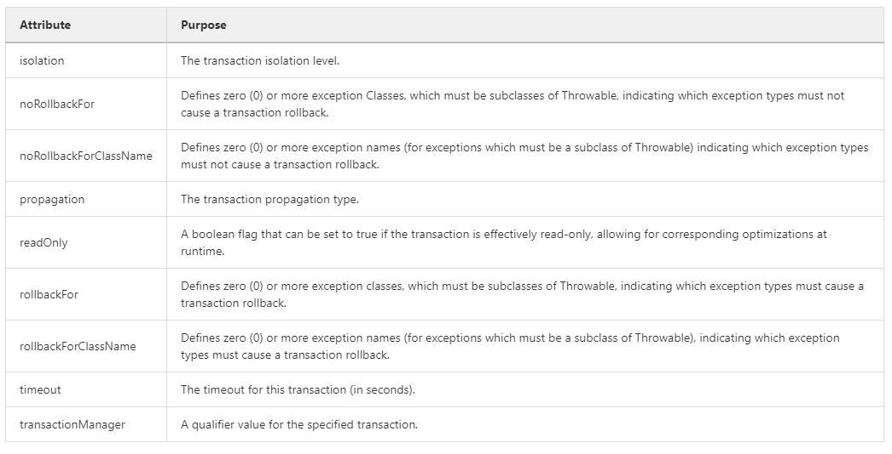
@Transactional - attributes

Slide 13
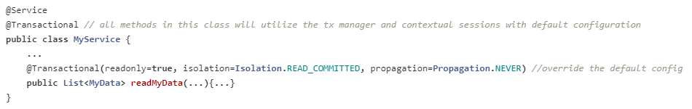
@Transactional Usage
@Transactional can be used on classes or methods or both. In this example, the class uses the transaction manager with default configuration, but the method overrides the default configuration.

Slide 14
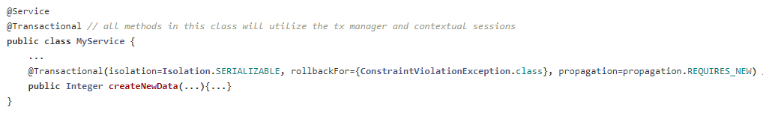
@Transactional Usage
The code demonstrates how to configure the transaction manager with a list of exceptions that must cause a rollback to be triggered.
Normally the transaction manager will always rollback for any RuntimeException or RuntimeException subclass (unchecked exceptions) however, the transaction manager will not automatically rollback for Exception (checked exceptions)

Slide 15
Transaction propagation
When designing database transactions to be performed in Java or any other programming language other than SQL, it is important to ask this question, "How will transactions behave over multiple method calls"? If Method1 calls `Method2, how will transactions propagate.

Slide 16
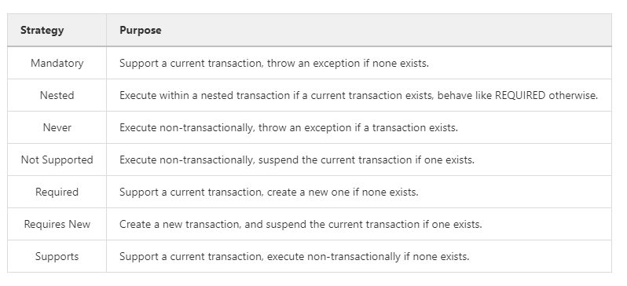
Transaction propagation - Strategy

Slide 17
Spring Transaction Management
Designing transactions and ensuring consistency isn't necessarily trivial, but using a transaction manager can help aleviate some of the more complex tasks such as read/write locking and thread management.
As we know Spring integrates with Hibernate with reasonable ease and integrating a transaction manager is a matter of configuring Hibernate to do so.
So how is transaction propagation performed?

Slide 18
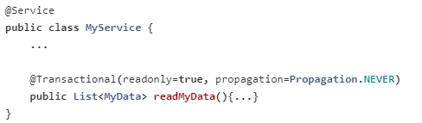
Propagation Usage
The code use the transaction manager to create a read only, transactionless transaction state.
Generally speaking readonly operations are idempotent and safe so an argument for never having a transaction present can be made.

Slide 19
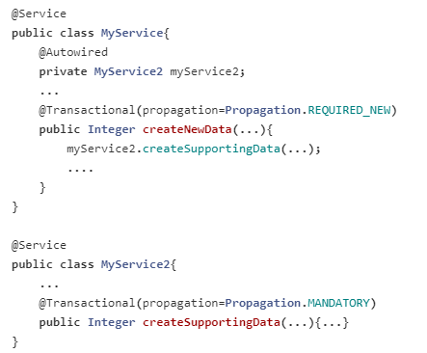
Propagation Usage

Slide 20
Propagation Usage
The above code creates a more complicated situation.
From the MyService perspective, it is easy to see that the createNewData method will require a new transaction be created, but the dependency on MyService2 complicates the operation.
The example simplifies the problem by assuming that createSupportingData of MyService2 not only requires a transaction, but will fail if one isn't present.
Essentially the example creates a situation where the data write for MyService is contingent on the data write from MyService2 at the transaction level, using this strategy we have created an atomic multioperational transaction which will increase the likely hood of maintaining a consistent state.

Slide 21
Validation
Validation, or the act of checking/verifying validity or accuracy of something, is an important consideration for any web application, with various pros and cons.
In general validation should not be tied to the web tier, it should be easy to localize, and it should be loosely coupled with any available validators.

Slide 22
Validation and Spring
Spring provides a basic yet eminently usable Validator interface which can work in every layer of an application.
Additionally, when validating information, it is useful to utilize Data binding, which allows user input to be dynamically bound to custom models for each application.
Within the Spring validation package, both the Validator interface as well as a DataBinder objects exist to address both.
Note that Although this package is primarily used within the MVC framework, it is not limited to it.

Slide 23
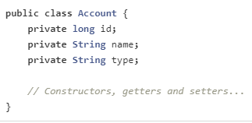
Validation and Spring
The Spring Validator interface, as its name implies, can be used to validate objects.
The interface works using a Spring Framework Errors objects so that, while validating, validators can report these validation failures to this Errors object

Slide 24
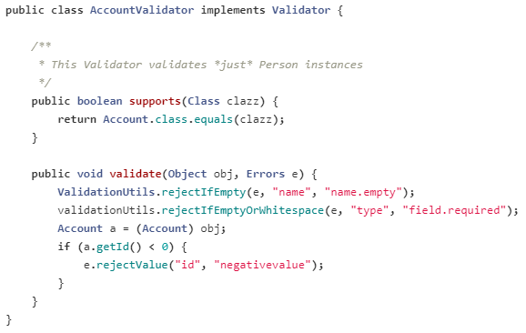
Validation and Spring
In order to create the validation behavior, we must implement the Validator interface from the org.springframework.validation package and provide a definition for the public boolean supports(Class) method and the public void validate (Object, org.springframework.validation.Errors) method

Slide 25
Validation and Spring
The ValidationUtils class provides various methods which can be used to produce a variety of Errors objects.
For example, the rejectIfEmpty will register to the errors object if the value name is empty, while the rejectifEmptyOrWhitespace method registers when the type is either empty or contains whitespace.
Though it is possible to implement a single validator class for an application, it is better to encapsulate validation logic for each class with its own Validator implementation.

Slide 26
Spring Errors
The Spring Errors interface stores and exposes information about data-binding and validation errors for objects.
This interface defines a static NESTED_PATH_SEPARATOR String, which details the nested path for properties on a model or bean.
For example: "account.id" or "account.type" correspond to the values of that data on an "account" object.
If an object is more complex (such as a map, or property of an object nested within a class), this path separator can also provide this information: "customer.address.streetName".
Here, the customer object has an address object with a property called "streetName".
In addition, Errors objects can output error messages by using a MessageSource. In the examples above, this is done by using the error code given when rejecting the field. Custom logic can then be provided in your Errors object.

Slide 27
DataBinder and @Valid
As of Spring 3, an instance of the DataBinder object can be configured with a Validator.
Once configured the Validator may be invoked by invoking the validate() method of a DataBinder object.
Any validation errors will then automatically be added to a BindingResult object of the DataBinder.

Slide 28
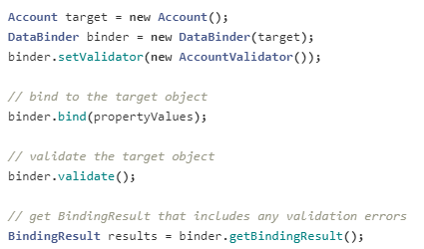
DataBinder and @Valid

Slide 29
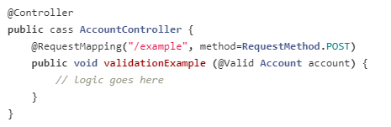
DataBinder and @Valid
Moreover, as of Spring 3, the Spring MVC has the ability to automatically validate @Controller inputs through the use of the @Valid annotation so long as the validator for a model has been configured

Slide 30
Hibernate Validator
Although you can provide your own custom validation, the Hibernate Validator is the standard validation implementation.
It is also worth noting that hibernate includes its own specific constraints and annotations, and use of this validator is not dependent on the hibernate ORM.
To utilize this validator implementation you should add version 4.3.1 the following dependencies to your project
The hibernate validator provides an implementation on various, useful constraints such as @NotNull, @Min and @Max

Slide 31
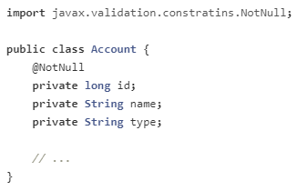
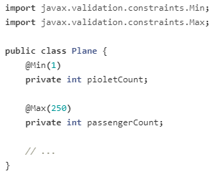
Hibernate Validator

