Slide 1
Getting Started with MongoDB

Slide 2
Introduction to MongoDB
MongoDB is an open-source, cross-platform, distributed document database.
MongoDB is developed by MongoDB Inc. and categorized as a NoSQL database.

Slide 3
MongoDB - Easy to use
MongoDB is a document-oriented database.
It uses the concept of the document to store data, which is more flexible than the row concept in the relational database management system (RDBMS).
A document allows you to represent complex hierarchical relationships with a single record.
MongoDB doesn’t require predefined schemas that allow you to add to or remove fields from documents more quickly.

Slide 4
MongoDB - Designed to scale out
When the database grows, you’ll have a challenge of how to scale it. There are two common ways:
Scaling up – upgrade the current server to a bigger one with more resources (CPU, RAM, etc). However, getting a bigger server means increasing more costs.
Scaling out – purchase additional servers and add them to the cluster. This is cheaper and more scalable than scaling up. The downside is that it takes more effort to manage multiple servers than a big one.
MongoDB was designed to scale out.
MongoDB allows you to split data across many servers.
It also automatically manages the load balancing across the cluster, redistributing data, and routing updates to the correct servers.

Slide 5
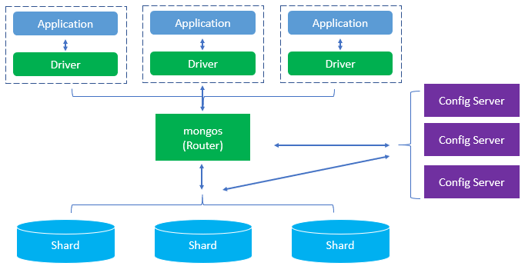
MongoDB - Designed to scale out
The following picture illustrates how MongoDB scale-out using sharding across multiple servers.

Slide 6
MongoDB - Rich Features
MongoDB allows you to insert, update, and delete, and select data. In addition, it supports other features including:
Indexing
Aggregation
Specify collection and index types
File Storage

Slide 7
MongoDB - High performance
MongoDB was designed to maintain the high performance from both architecture and feature perspectives.
The philosophy of MongoDB is to create a full-featured database that is scalable, flexible, and fast.

Slide 8
MongoDB editions - MongoDB has three editions
MongoDB Community Server :
The MongoDB Community Edition is free and available on Windows, Linux, and macOS.
MongoDB Community Edition uses the Server Side Public License (SSPL). It means that if you offer MongoDB as a service to the public, you need to open the source code of the software that makes the service works e.g., administration and monitoring tools. Otherwise, you need to pay for the enterprise subscription.
If you use the MongoDB Community Edition as a component of your application, not the final product, you are free to use it.
MongoDB Enterprise Server :
MongoDB Enterprise Server is a commercial edition of MongoDB as a part of the MongoDB Enterprise Advanced subscription.
MongoDB Atlas :
MongoDB Atlas is a global cloud database service. It is a database as a service that allows you to focus on building apps rather than spending time managing the databases.
MongoDB Atlas is available on common cloud platforms such as AWS, Azure, and GCP. MongoDB Atlas has a free tier for your experiments.

Slide 9

MongoDB Architecture

Slide 10
Replication
A replica set in MongoDB is a group of mongod processes that maintain the same data set.
Replica sets provide redundancy and high availability, and are the basis for all production deployments.

Slide 11
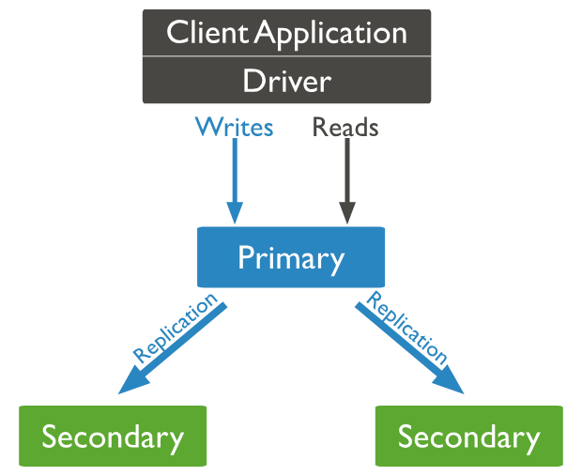
Replication in MongoDB
A replica set is a group of mongod instances that maintain the same data set.
A replica set contains several data bearing nodes and optionally one arbiter node.
Of the data bearing nodes, one and only one member is deemed the primary node, while the other nodes are deemed secondary nodes.
The primary node receives all write operations.
The secondaries replicate the primary's oplog and apply the operations to their data sets such that the secondaries' data sets reflect the primary's data set.
If the primary is unavailable, an eligible secondary will hold an election to elect itself the new primary.

Slide 12
MongoDB Clusters
In contrast to a single-server MongoDB database, a MongoDB cluster allows a MongoDB database to either horizontally scale across many servers with sharding, or to replicate data ensuring high availability with MongoDB replica sets, therefore enhancing the overall performance and reliability of the MongoDB cluster

Slide 13
What are clusters in MongoDB?
In the context of MongoDB, “cluster” is the word usually used for either a replica set or a sharded cluster.
A replica set is the replication of a group of MongoDB servers that hold copies of the same data; this is a fundamental property for production deployments as it ensures high availability and redundancy, which are crucial features to have in place in case of failovers and planned maintenance periods.
A sharded cluster is also commonly known as horizontal scaling, where data is distributed across many servers.
The main purpose of sharded MongoDB is to scale reads and writes along multiple shards.

Slide 14
Sharding
Sharding is a method for distributing data across multiple machines.
MongoDB uses sharding to support deployments with very large data sets and high throughput operations.
There are two methods for addressing system growth:
vertical and horizontal scaling.
Vertical Scaling involves increasing the capacity of a single server, such as using a more powerful CPU, adding more RAM, or increasing the amount of storage space.
Horizontal Scaling involves dividing the system dataset and load over multiple servers, adding additional servers to increase capacity as required.
MongoDB supports horizontal scaling through sharding.

Slide 15
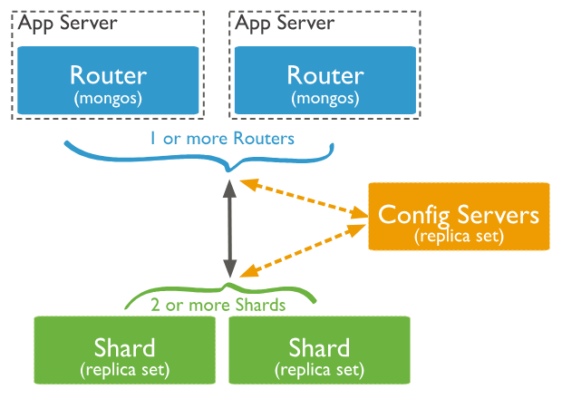
Sharded Cluster
A MongoDB sharded cluster consists of the following components:
shard: Each shard contains a subset of the sharded data. Each shard can be deployed as a replica set.
mongos: The mongos acts as a query router, providing an interface between client applications and the sharded cluster. Starting in MongoDB 4.4, mongos can support hedged reads to minimize latencies.
config servers: Config servers store metadata and configuration settings for the cluster
MongoDB shards data at the collection level, distributing the collection data across the shards in the cluster.

Slide 16
Shard Keys
The shard key is either a single indexed field or multiple fields covered by a compound index that determines the distribution of the collection's documents among the cluster's shards.
MongoDB uses the shard key to distribute the collection's documents across shards. The shard key consists of a field or multiple fields in the documents.

Slide 17
Advantages of Sharding
Reads / Writes
MongoDB distributes the read and write workload across the shards in the sharded cluster, allowing each shard to process a subset of cluster operations. Both read and write workloads can be scaled horizontally across the cluster by adding more shards.
Storage Capacity
Sharding distributes data across the shards in the cluster, allowing each shard to contain a subset of the total cluster data. As the data set grows, additional shards increase the storage capacity of the cluster.
High Availability
The deployment of config servers and shards as replica sets provide increased availability.
Even if one or more shard replica sets become completely unavailable, the sharded cluster can continue to perform partial reads and writes.

