Slide 1
MongoDB Basics
Understand some basic concepts of MongoDB such as documents, collections, databases, and namespaces

Slide 2
Data Formats
In MongoDB, you will often deal with JSON and BSON formats.

Slide 3
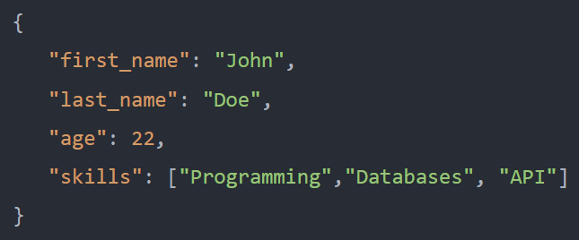
JSON
JSON stands for JavaScript Object Notation.
JSON syntax is based on a subset of JavaScript ECMA-262 3rd edition.
A JSON document is a collection of fields and values in a structured format. For example:

Slide 4
BSON
BSON stands for Binary JSON, which is a binary-coded serialization of JSON-like documents.

Slide 5
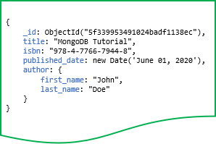
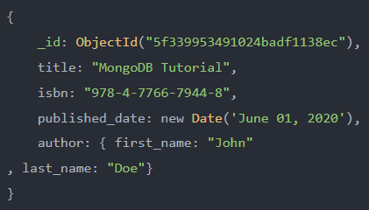
Documents
MongoDB stores data records as BSON documents, which are simply called documents.
A document is a set of field-and-value pairs with the following structure.
The field names are strings and values can be numbers, strings, objects, arrays, etc.

Slide 6
Documents
This document has the following field-and-value pairs:
_id holds an ObjectId
title holds a string.
isbn holds a string.
published_date holds a value of the Date type.
author holds an embedded document that contains two fields first_name and last_name.

Slide 7
Documents
If you are familiar with a relational database management system (RDBMS), you will find that a document is similar to a row in a table, but it is much more expressive.
Field names have the following restrictions:
MongoDB reserves the field _id and uses it to uniquely identify the document.
Field names cannot contain null characters.
Top-level field names cannot start with the dollar sign ($) character.

Slide 8
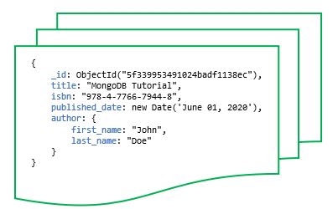
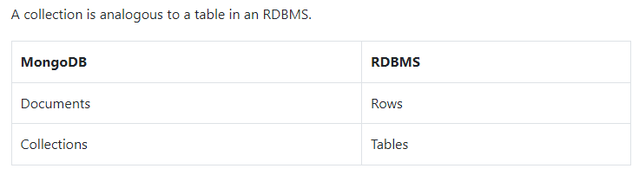
Collections
MongoDB stores documents in a collection.
A collection is a group of documents.

Slide 9
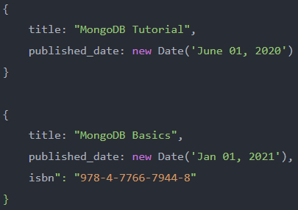
Collections
Unlike a table that has a fixed schema, a collection has a dynamic schema.
It means that a collection may contain documents that have any number of different “shapes”.
Note that the second document has one more field than the first one. In theory, you can have completely different fields for every document.
A collection has a name e.g., books.
The collection name cannot:
contain the dollar sign ($)
contain the null character (\0).
be an empty string.
begin with the system because MongoDB reserves system* for internal collection names.

Slide 10
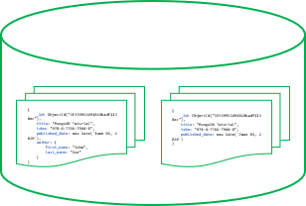
Databases
MongoDB stores collections into a database.
A single instance of MongoDB can host multiple databases.
A database can be referenced by a name for example bookdb.
The database names cannot:
Be an empty string ("").
Contain any of these characters: /, \, ., “, *, <, >, :, |, ?, $, (a single space), or \0 (the null character).
Exceed the maximum size which is 64 bytes.
MongoDB also has some reserved database names such as admin, local, and config that you cannot use to create new databases.

Slide 11
Namespace
A namespace is a concatenation of the database name with a collection in that database.
Namespaces allow you to fully qualify collections.
For example, if the collection name is books and database name is bookdb, the namespace of the books collection would be bookdb.books.

