Slide 1
MongoDB Shell
mongosh

Slide 2
MongoDB Shell
The mongo shell is an interactive JavaScript interface to MongoDB.
The mongo shell allows you to manage data in MongoDB as well as carry out administrative tasks.
Before using the mongo shell, you need to download and install it.
To start the mongo shell, you open the Terminal on macOS and Linux or a Command Prompt on Windows and use the following command mongosh.
You can use the mongo shell as a full-featured JavaScript interpreter and as a MongoDB client.

Slide 3
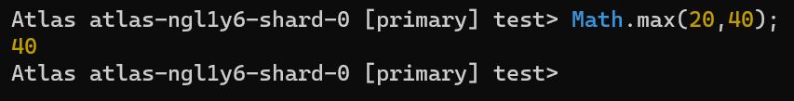
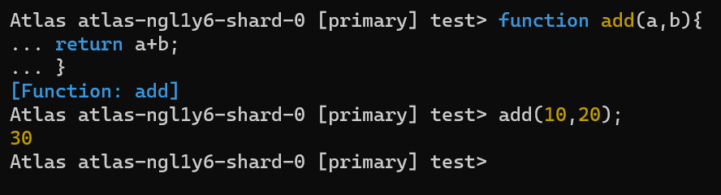
JavaScript interpreter
The mongo shell is a full-featured JavaScript interpreter so that you can execute any JavaScript code like this:
The mongo shell allows you to enter multiline commands. It will detect if the JavaScript statement is complete when you press enter.
If the statement is not complete, the mongo shell will allow you to type on the next line after the three dots (...).

Slide 4
MongoDB client
The mongo shell is a MongoDB client.
By default, the mongo shell connects to the test database on the MongoDB server and assigns the database connection to the global variable called db.
The db variable allows you to see the current database

Slide 5
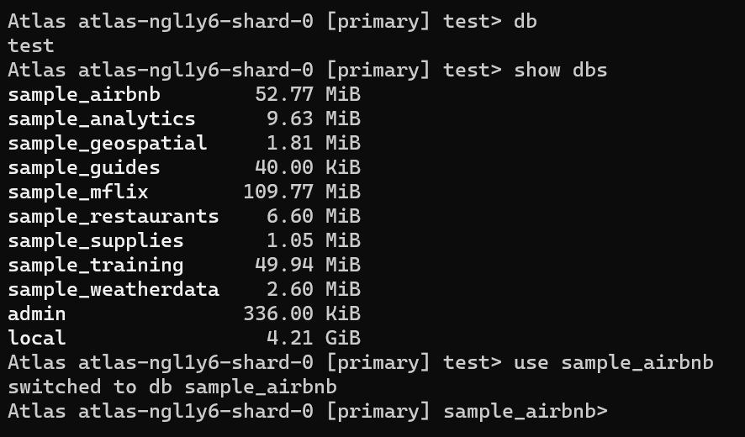
MongoDB client
To display the database you are using, use command db
To list the databases available to the user, use the command show dbs.
To switch databases, you use the use <database> command.
Note that you can switch to a database that does not exist.
In this case, MongoDB will automatically create that database when you first save the data in it.

Slide 6
Terminate a Running Command
To terminate a running command or query in mongosh, press Ctrl + C.
When you enter Ctrl + C, mongosh:
interrupts the active command,
tries to terminate the ongoing, server-side operation, and
returns a command prompt.
Pressing Ctrl + C once will not exit mongosh, press Ctrl + C twice to exit mongosh.

Slide 7
Clear the mongosh Console
The cls command clears the console. You can also clear the console with Ctrl + L and console.clear().

