Slide 1
MongoDB Data Types

Slide 2
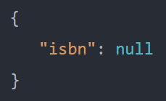
Null
The null type is used to represent a null and a field that does not exist.

Slide 3
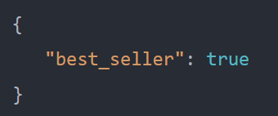
Boolean
The boolean type has two values true and false.

Slide 4
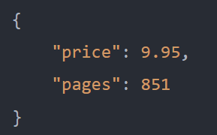
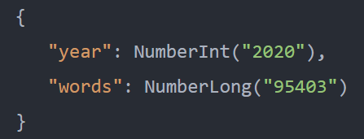
Number
By default, the mongo shell uses the 64-bit floating-point numbers.
The NumberInt and NumberLong classes represent 4-byte and 8-byte integers respectively.

Slide 5
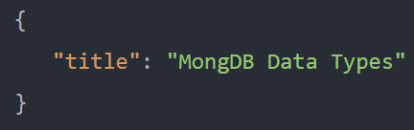
String
The string type represents any string of UTF-8 characters.

Slide 6
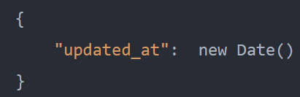
Date
The date type stores dates as 64-bit integers that represents milliseconds since the Unix epoch (January 1, 1970). It does not store the time zone.
In JavaScript, the Date class is used to represent the date type in MongoDB.
Note that you should always call the new Date(), not just Date() when you create a new Date object because the Date() returns a string representation of the date, not the Date object.
The mongo shell displays dates using local time zone settings. However, MongoDB does not store date with the time zone.

Slide 7
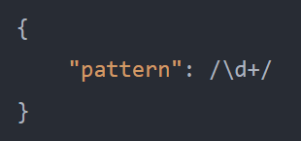
Regular Expression
MongoDB allows you to store JavaScript regular expressions.

Slide 8
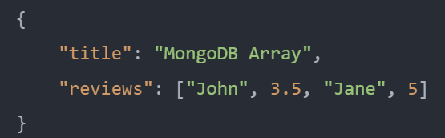
Array
The array type allows you to store a list of values of any type.
The values do not have to be in the same type.
The good thing about arrays in the document is that MongoDB understands their structures and allows you to carry operations on their elements.

Slide 9
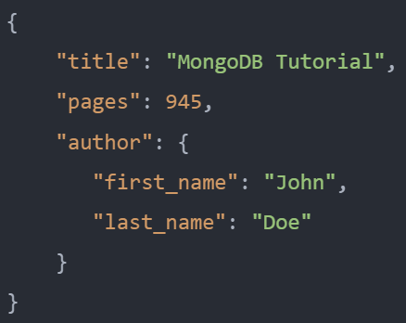
Embedded Document
A value of a document can be another document that is often referred to as an embedded document.
The following example shows a book document that contains the author document as an embedded document

Slide 10
Object ID
In MongoDB, every document has an "_id" key.
The value of the "_id" key can be any type.
However, it defaults to an ObjectId.
The value of the "_id" key must be unique within a collection so that MongoDB can identify every document in the collection.
The ObjectId class is the default type for "_id". It is used to generate unique values globally across servers.
Since MongoDB is designed to be distributed, it is important to ensure the identifiers are unique in the shared environment.

Slide 11
Object ID
The ObjectId uses 12 bytes for storage, where each byte represents 2 hexadecimal digits. In total, an ObjectId is 24 hexadecimal digits.
The 12-byte ObjectId value consists of:
A 4-byte timestamp value that represents the ObjectId‘s generated time measured in seconds since the Unix epoch.
A 5-byte random value.
A 3-byte increment counter, initialized to a random value.
These first 9 bytes of an ObjectId guarantee its uniqueness across servers and processes for a single second. The last 3 bytes guarantee uniqueness within a second in a single process.
As a result, these 12-bytes allow for up to 2563 (16,777,216) unique ObjectIds values to be generated per process in a single second.

Slide 12
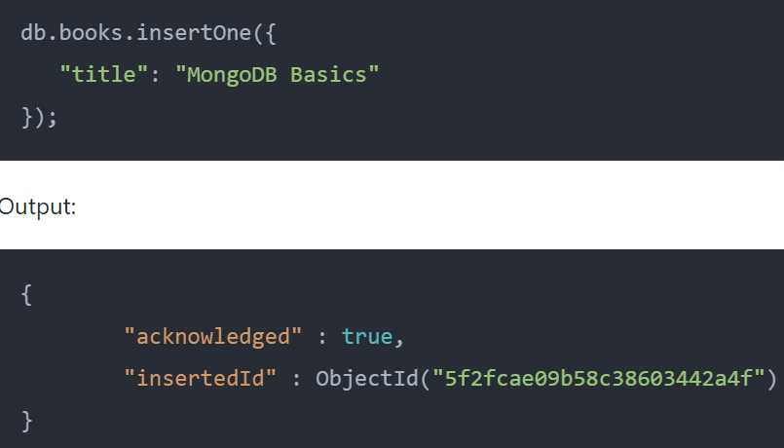
Object ID
When you insert a document without specifying a value for the "_id" key, MongoDB automatically generates a unique id for the document.

