Slide 1
CRUD Operations
Adding new documents to a collection
Selecting documents
Updating existing documents
Removing documents from a collection

Slide 2

Connect to a Deployment

Slide 3
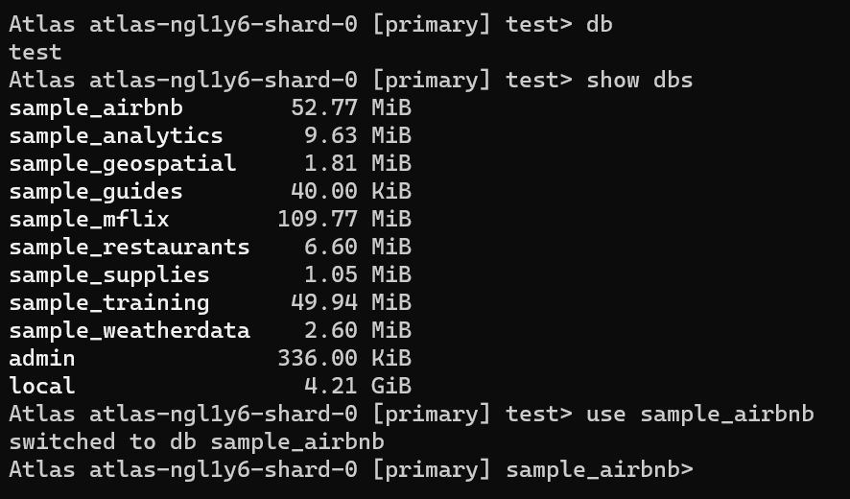
Switch Databases
To display the database you are using, type db
To list the databases available to the user, use the command show dbs.
To switch databases, issue the use <db> command

Slide 4
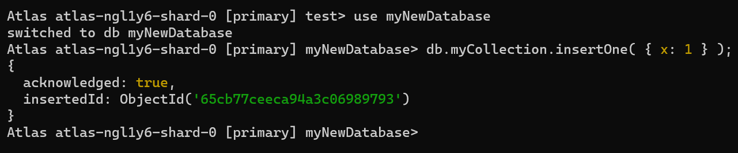
Create a New Database and Collection
To create a new database, issue the use <db> command with the database that you would like to create.
The mongo shell now assigns the database to the db variable
For example, the following commands create both the database myNewDatabase and the collection myCollection using the insertOne() operation:
If a collection does not exist, MongoDB creates the collection when you first store data for that collection.

Slide 5
Adding New Documents To A Collection

Slide 6
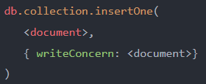
MongoDB insertOne() method
The insertOne() method allows you to insert a single document into a collection.
The insertOne() method accepts two arguments:
document is a document that you want to insert into the collection. The document argument is required.
writeConcern is an optional argument that describes the level of acknowledgment requested from MongoDB for insert operation to a standalone MongoDB server or to shared clusters.

Slide 7
MongoDB insertOne() method
The insertOne() method returns a document that contains the following fields:
acknowledged is a boolean value. It is set to true if the insert executed with write concern or false if the write concern was disabled.
insertedId stores the value of _id field of the inserted document.
Note that if the collection does not exist, the insertOne() method will also create the collection and insert the document into it.
If you don’t specify the _id field in the document, MongoDB will add the _id field and generate a unique ObjectId for it before insert.
If you explicitly specify a value for the _id field, you need to ensure that it is unique in the collection. Otherwise, you will get a duplicate key error.
To insert multiple documents into a collection, you use the insertMany() method.

Slide 8
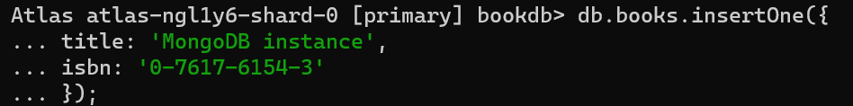
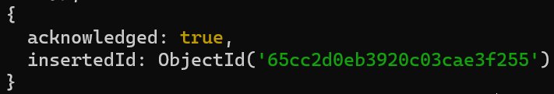
Insert a document without an _id field

Slide 9
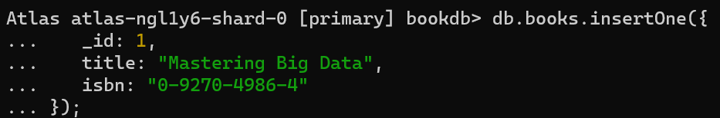
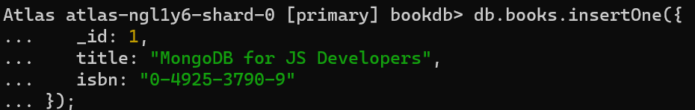
Insert a document with an _id field

Slide 10
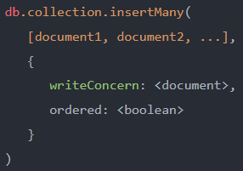
MongoDB insertMany() method
The insertMany() allows you to insert multiple documents into a collection.
The first argument is an array of documents that you want to insert into the collection.
The second argument is a document that contains two optional field-and-value pairs
The writeConcern specifies the write concern. If you omit it, the insertMany() method will use the default write concern.
The ordered is a boolean value that determines whether MongoDB should perform an ordered or unordered insert.
When the ordered is set to true, the insertMany() method inserts documents in order. This is also the default option.
If the ordered is set to false, MongoDB may reorder the documents before inserts to increase performance.

Slide 11
MongoDB insertMany() method
The insertMany() method returns a document that contains
The acknowledged key sets to true if operation executed with a write concern or false if the write concern was disabled.
An array of _id values of successfully inserted documents.

Slide 12
MongoDB insertMany() method
Collection creation
If the collection doesn’t exist, the insertMany() method will create the collection and insert the documents. And it only creates the collection when the insert operation is successful.
_id field
If you don’t specify the _id field for the document, the MongoDB generates a unique ObjectId value, assigns it to the _id field, and adds the _id field to the document before insert.
If you specify the _id fields for the document, it must be unique within the collection or you’ll get a duplicate key error.
Error handling
The insertMany() throws a BulkWriteError exception in case of an error.
If an error occurs, the ordered insert will stop while the unordered insert will continue to process for the remaining documents in the queue.

Slide 13
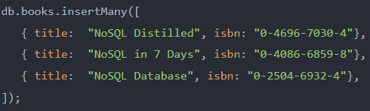
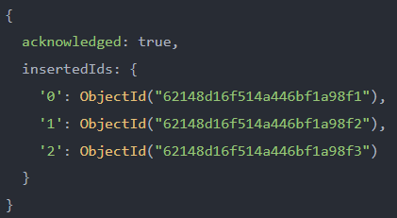
insertMany() - without specifying _id fields

Slide 14
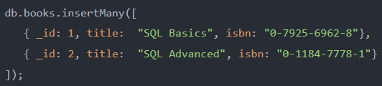
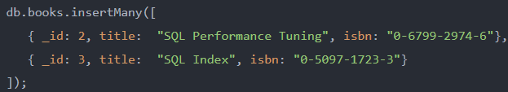
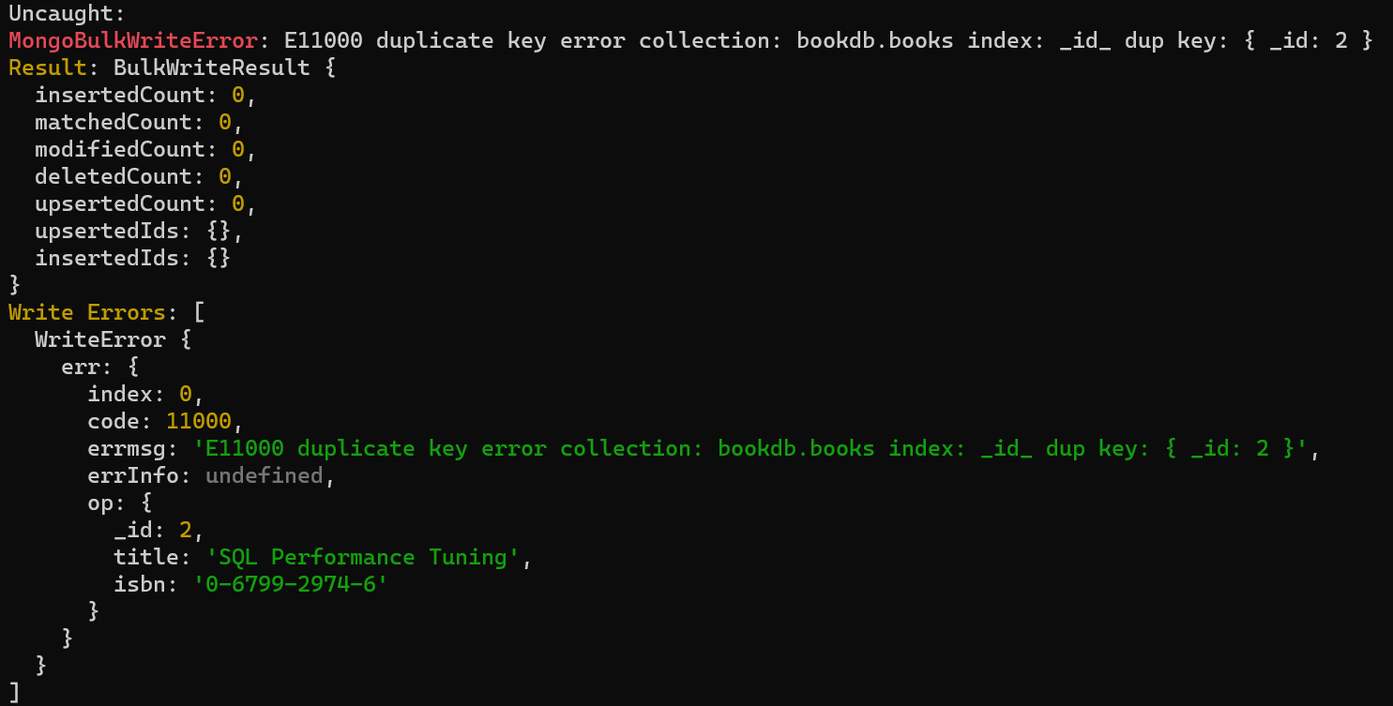
insertMany() - with _id fields

Slide 15
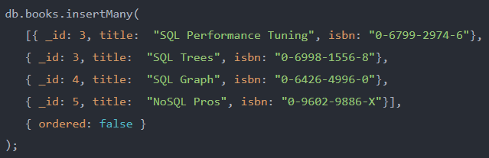
Unordered insert example
In this example, the _id: 3 is duplicated, MongoDB threw an error.
Since this example used the unordered insert, the operation continued to insert the documents with _id 4 and 5 into the books collection.

