Slide 1
Selecting Documents

Slide 2
MongoDB findOne() method
The findOne() returns a single document from a collection that satisfies the specified condition.
The findOne() accepts two optional arguments: query and projection.
The query is a document that specifies the selection criteria.
The projection is a document that specifies the fields in the matching document that you want to return.

Slide 3

MongoDB findOne() method
If you omit the query, the findOne() returns the first document in the collection according to the natural order which is the order of documents on the disk.
If you don’t pass the projection argument, then findOne() will include all fields in the matching documents.
To specify whether a field should be included in the returned document, you use the following format:
If the value is true or 1, MongoDB will include the field in the returned document. In case the value is false or 0, MongoDB won’t include it.
By default, MongoDB always includes the _id field in the returned documents. To suppress it, you need to explicitly specify _id: 0 in the projection argument.
If multiple documents satisfy the query, the findOne() method returns the first document based on the order of documents stored on the data storage.

Slide 4
findOne() method examples (sample data)
db.products.insertMany([
{ "_id" : 1, "name" : "xPhone", "price" : 799, "releaseDate": ISODate("2011-05-14"), "spec" : { "ram" : 4, "screen" : 6.5, "cpu" : 2.66 },"color":["white","black"],"storage":[64,128,256]},
{ "_id" : 2, "name" : "xTablet", "price" : 899, "releaseDate": ISODate("2011-09-01") , "spec" : { "ram" : 16, "screen" : 9.5, "cpu" : 3.66 },"color":["white","black","purple"],"storage":[128,256,512]},
{ "_id" : 3, "name" : "SmartTablet", "price" : 899, "releaseDate": ISODate("2015-01-14"), "spec" : { "ram" : 12, "screen" : 9.7, "cpu" : 3.66 },"color":["blue"],"storage":[16,64,128]},
{ "_id" : 4, "name" : "SmartPad", "price" : 699, "releaseDate": ISODate("2020-05-14"),"spec" : { "ram" : 8, "screen" : 9.7, "cpu" : 1.66 },"color":["white","orange","gold","gray"],"storage":[128,256,1024]},
{ "_id" : 5, "name" : "SmartPhone", "price" : 599,"releaseDate": ISODate("2022-09-14"), "spec" : { "ram" : 4, "screen" : 5.7, "cpu" : 1.66 },"color":["white","orange","gold","gray"],"storage":[128,256]}
])

Slide 5
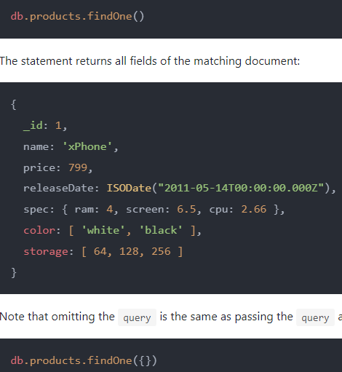
findOne() method with zero argument

Slide 6

DB findOne() method with a filter
The following statement uses the findOne() method to find the document whose _id is 2.

Slide 7
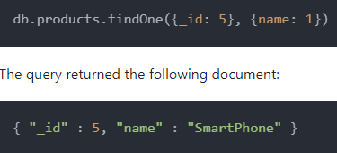
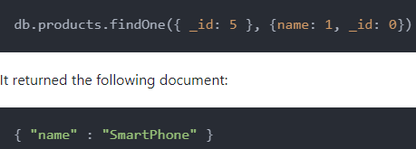
findOne() method to select some fields
The following example uses the findOne() method to find the document with _id 5. And it returns only the _id and name fields of the matching document:

Slide 8
MongoDB find() method
The find() method finds the documents that satisfy a specified condition and returns a cursor to the matching documents.
Similar to the findOne() method, the find() method accepts two optional arguments.
query : The query is a document that specifies the criteria for selecting documents from the collection. If you omit the query or pass an empty document({}), the find() returns a cursor that returns all documents in the collection.
projection : The projection is a document that specifies the fields in the matching documents to return. If you omit the projection argument, the find() method returns all fields in the matching documents.
By default, the find() method includes the _id field in the matching documents unless you explicitly specify _id: false in the projection document.
Since the mongo shell automatically iterates the cursor returned by the find() method, you don’t need to do any extra steps to get the document from the cursor.
By default, the mongo shell shows up the first 20 documents. To continue iteration, you type the it command in the shell.

Slide 9

find() method to retrieve all documents
The following example uses the find() method with no parameters to return all documents from the books collection:
In the mongo shell, the statement returns the first 20 documents with all available fields in the matching documents.
If you type it command and press enter, you’ll see the next 20 documents.

Slide 10
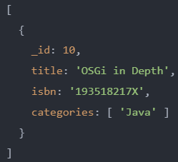
find() method to search for a specific document
The following example uses the find() method to search for the document with id 10
The statement returns the document whose _id is 10. Since it doesn’t have the projection argument, the returned document includes all available fields

Slide 11
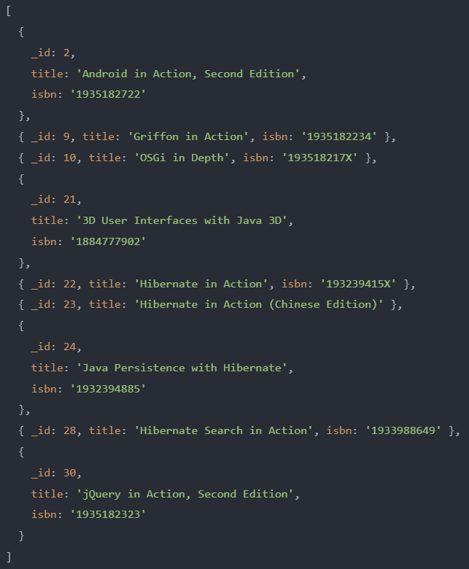
find() method to return selected fields
To remove the _id field from the matching documents, you need to explicitly specify _id: 0 in the projection argument like this
To remove the _id field from the matching documents, you need to explicitly specify _id: 0 in the projection argument like this

Slide 12
MongoDB Projection
In MongoDB, projection simply means selecting fields to return from a query.
By default, the find() and findOne() methods return all fields in matching documents.
Most of the time you don’t need data from all the fields.
To select fields to return from a query, you can specify them in a document and pass the document to the find() and findOne() methods.
This document is called a projection document.

Slide 13

MongoDB Projection
To determine if a field is included in the returned documents, you use the following syntax.
If the value is 1 or true, the <field> is included in the matching documents. In case the value is 0 or false, it is suppressed from the returned documents.
If the projection document is empty {}, all the available fields will be included in the returned documents.
To specify a field in an embedded document, you use the following dot notation
To include a <field> from an embedded document located in an array, you use the following dot notation syntax

Slide 14

Returning all fields in matching documents
If you don’t specify the projection document, the find() method will include all fields in the matching documents.
For example, the following query returns all fields from all documents in the products collection where the price is 899

Slide 15
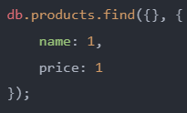
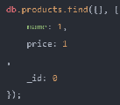
Returning specified fields including the _id field
If you specify the fields in the projection document, the find() method will return only these fields including the _id field by default.
The following example returns all documents from the products collection.
However, its result includes only the name, price, and _id field in the matching documents
To suppress the _id field, you need to explicitly specify it in the projection document like this

Slide 16
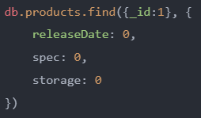
Returning all fields except for some fields
If the number of fields to return is many, you can use the projection document to exclude other fields instead.
The following example returns all fields of the document _id 1 except for releaseDate, spec, and storage fields

Slide 17
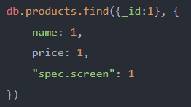
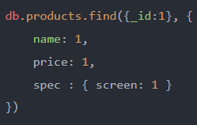
Returning fields in embedded documents
The following example returns the name, price, and _id fields of document _id 1.
It also returns the screen field on the spec embedded document
MongoDB 4.4 and later allows you to specify embedded fields using the nested form like this

Slide 18
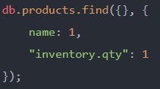
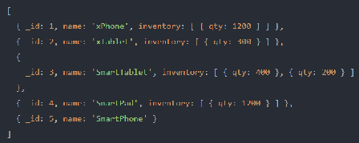
Projecting fields on embedded documents in an array
The following example specifies a projection that returns:
the _id field (by default)
The name field
And qty field in the documents embedded in the inventory array

