Slide 1
Updating Documents

Slide 2
MongoDB updateOne() method
The updateOne() method allows you to update a single document that satisfies a condition.
In this syntax:
The filter is a document that specifies the criteria for the update. If the filter matches multiple documents, then the updateOne() method updates only the first document. If you pass an empty document {} into the method, it will update the first document returned in the collection.
The update is a document that specifies the change to apply.
The updateOne() method returns a document that contains some fields. The notable ones are:
The matchedCount returns the number of matched documents.
The modifiedCount returns the number of updated documents. In the case of the updateOne() method, it can be either 0 or 1.

Slide 3
$set operator
The $set operator allows you to replace the value of a field with a specified value.
If the field doesn’t exist, the $set operator will add the new field with the specified value to the document as long as the new field doesn’t violate a type constraint.
If you specify the field with the dot notation e.g., embededDoc.field and the field does not exist, the $set will create the embedded document (embedded).

Slide 4
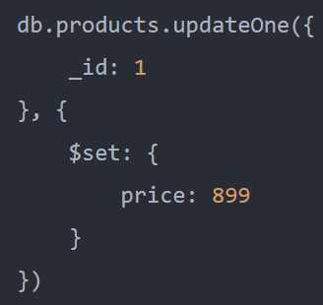
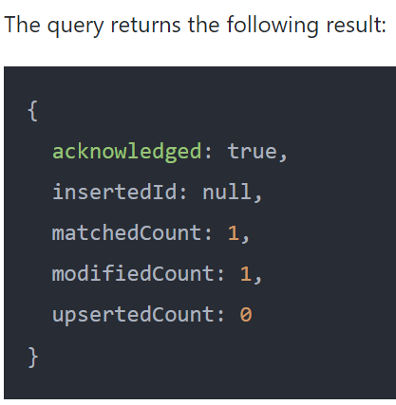
updateOne() method - Examples
The { _id : 1 } is the filter argument that matches the documents to update. In this example, it matches the document whose _id is 1.
The { $set: { price: 899 } } specifies the change to apply. It uses the $set operator to set the value of the price field to 899

Slide 5
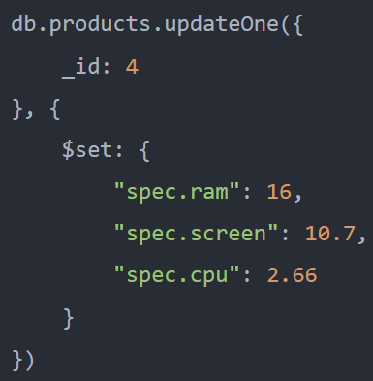
updateOne() method to update embedded documents
The following example uses the updateOne() method to update the values of the ram, screen, and cpu fields in the spec embedded document of the document _id: 4

Slide 6
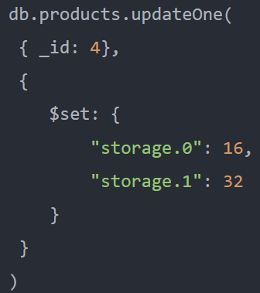
updateOne() method to update array elements
The following example uses the updateOne() method to update the first and second elements of the storage array in the document with _id 4

Slide 7
MongoDB updateMany() method
The updateMany() method allows you to update all documents that satisfy a condition.
In this syntax:
The filter is a document that specifies the condition to select the document for update. If you pass an empty document ({}) into the method, it’ll update all the documents the collection.
The update is a document that specifies the updates to apply.
The options argument provides some options for updates
The updateMany() method returns a document that contains multiple fields.
The matchedCount stores the number of matched documents.
The modifiedCount stores the number of modified documents

Slide 8
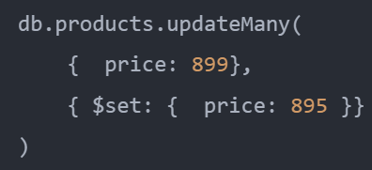
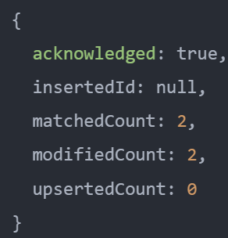
updateMany() method examples
updateMany() method to update multiple documents
The { price : 899 } is the filter argument that specified the documents to update.
The { $set: { price: 895} } specifies the update to apply, which uses the $set operator to set the value of the price field to 895

Slide 9
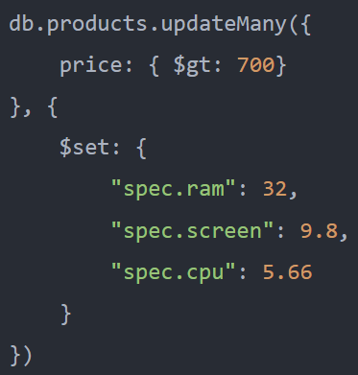
updateMany() method to update embedded documents

Slide 10
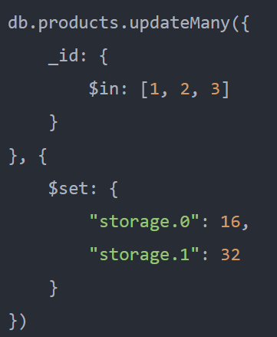
updateMany() method to update array elements

Slide 11
MongoDB $inc operator
Sometimes, you need to increment the value of one or more fields by a specified value. In this case, you can use the update() method with the $inc operator.
In this syntax, the amount can be positive or negative.
When it’s a positive value, the $inc increases the field by amount.
If the amount is a negative value, then the $inc decreases the field by the absolute value of the amount.
If the field doesn’t exist, the $inc creates the field and sets the field to the specified amount

Slide 12
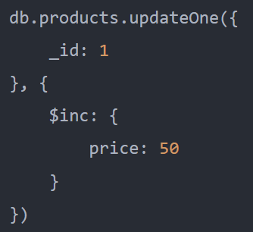
$inc operator to increase the value of a field

Slide 13
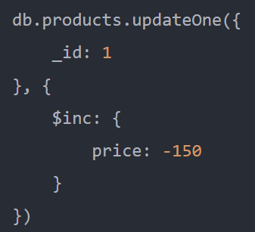
$inc operator to decrease the value of a field

Slide 14
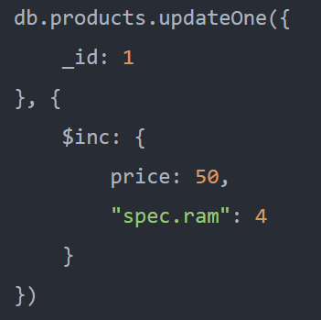
$inc operator to update values of multiple fields

Slide 15

MongoDB $min operator
The $min operator is a field update operator that allows you to update the value of a field to a specified value if the specified value is less than (<) the current value of the field.
If the current value of a field is greater than or equal to the value that you want to update, the $min operator won’t update the value.
If the field doesn’t exist, the $min operator creates the field and sets its value to the specified value

Slide 16
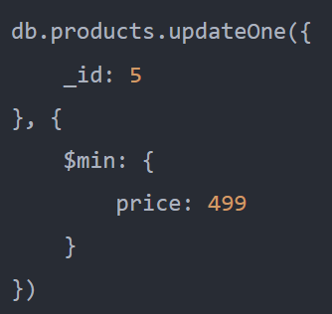
$min operator - Example

Slide 17

MongoDB $max operator
he $max is a field update operator that allows you to update the value of a field to a specified value if the specified value is greater than (>) the current value of the field.
If the current value of a field is less than or equal to the value that you want to update, the $max operator won’t update the value.
If the field doesn’t exist, the $max operator creates the field and sets its value to the specified value.

Slide 18
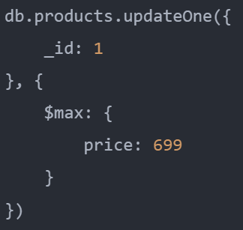
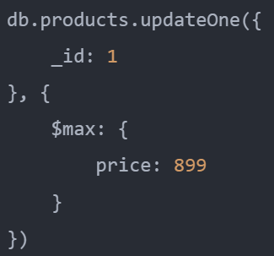
$max operator - Example
The query found one matching document but it didn’t update any document.
The reason is that the new value that we want to update is 699 which is less than the current value of the price field 799

Slide 19
MongoDB $mul operator
The $mul is a field update operator that allows you to multiply the value of a field by a specified number.
The <field> that you want to update must contain a numeric value.
To specify a field in an embedded document or in an array, you use the dot notation e.g., <embedded_doc>.<field> or <array>.<index>
If the field doesn’t exist in the document, the $mul operator creates the field and sets its value to zero.

Slide 20
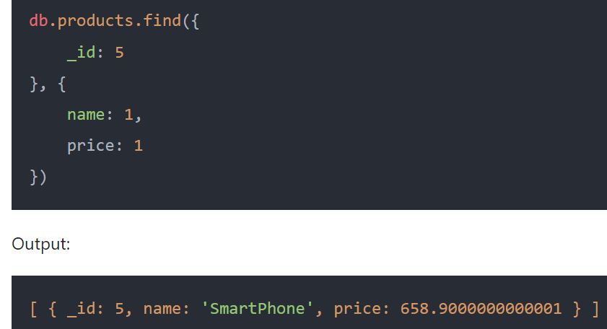
$mul to multiply the value of a field
The following example uses the $mul operator to multiply the price of the document _id 5 by 10%

Slide 21
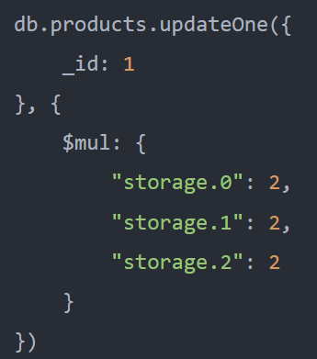
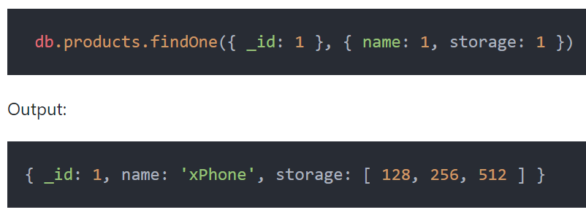
$mul to multiply the values of array elements
The following query uses the $mul operator to double the values of the first, second, and third array elements in the storage array of the document _id 1

Slide 22
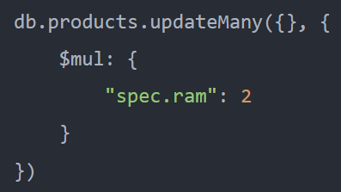
$mul operator to multiply the values of a field in embedded documents
This example uses the $mul operator to double the values of the ram field in the spec embedded documents of all documents from the products collection

Slide 23

MongoDB $unset operator
Sometimes, you may want to remove one or more fields from a document. In order to do it, you can use the $unset operator.
The $unset is a field update operator that completely removes a particular field from a document.
In this syntax, you specify the field that you want to remove and its value.
The field value isn’t important and doesn’t impact the operation.
You can specify any value, the $unset will remove the field completely.
If the <field> doesn’t exist in the document, then $unset operator will do nothing.
It also won’t issue any warnings or errors.

Slide 24
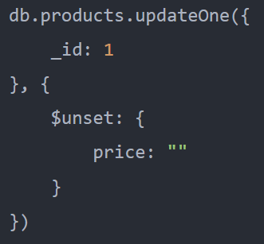
$unset operator to remove a field from a document

Slide 25
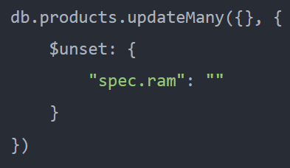
$unset operator to remove a field in an embedded document

Slide 26
$unset operator to set array elements to null

Slide 27
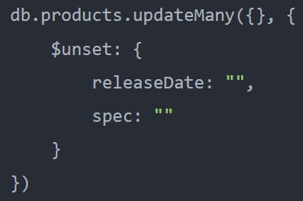
$unset operator to remove multiple fields from a document

Slide 28
MongoDB $rename operator
Sometimes, you want to rename a field in a document e.g., when it is misspelled or not descriptive enough. In this case, you can use the $rename operator.
The $rename is a field update operator that allows you to rename a field in a document to the new one.
In this syntax, the <new_field_name> must be different from the <field_name>.
If the document has a field with the same name as the <new_field_name>, the $rename operator removes that field and renames the specified <field_name> to <new_field_name>.
In case the <field_name> doesn’t exist in the document, the $rename operator does nothing. It also won’t issue any warnings or errors.
The $rename operator can rename fields in embedded documents. In addition, it can move these fields in and out of the embedded documents.

Slide 29
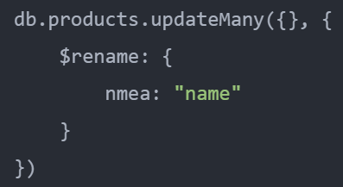
$rename to rename a field in a document
The following example uses the $rename operator to rename the misspelled field nmea to name

Slide 30
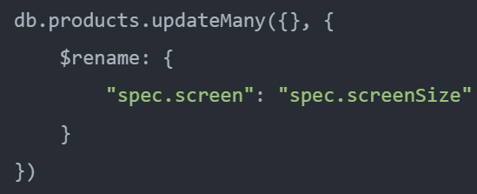
$rename operator to rename fields in embedded documents

Slide 31
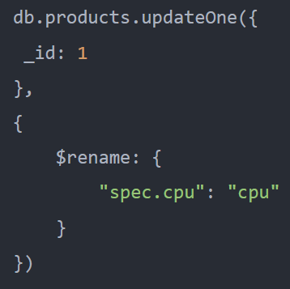
$rename to move field out of the embedded document

Slide 32
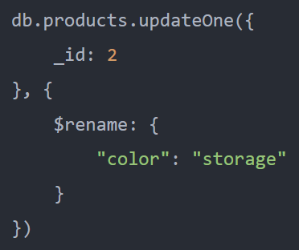
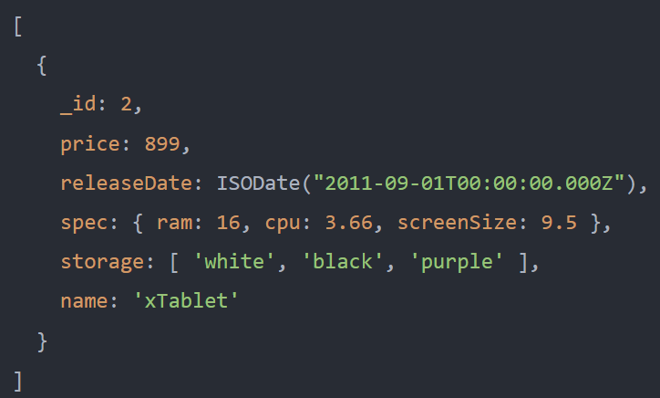
$rename to rename a field to an existing field
The following example uses the $rename operator to rename the field color to storage in the document with _id 2.
However, the storage field already exists. Therefore, the $rename operator removes the storage field and renames the field color to storage:

