Slide 1
Amazon Relational Database Service
Amazon RDS

Slide 2

What Is Amazon Relational Database Service (Amazon RDS)?
Amazon Relational Database Service (Amazon RDS) is a web service that makes it easier to set up, operate, and scale a relational database in the AWS Cloud.
It provides cost-efficient, resizable capacity for an industry-standard relational database and manages common database administration tasks.

Slide 3
What Is Amazon Relational Database Service (Amazon RDS)?
RDS automates expensive and time consuming tasks such as managing backups, software patching, automatic failure detection, and recovery.
You can help control who can access your RDS databases by using AWS Identity and Access Management (IAM) to define users and permissions.
RDS is available on several database instance types. Instance types comprise varying combinations of CPU, memory, storage, and networking capacity and give you the flexibility to choose the appropriate mix of resources for your database.
  Examples of instance types include T3, T2, M6g, M5, etc...
RDS is free to try and you will be charged based on how much computational power you use per month (pay-as-you-go).

Slide 4
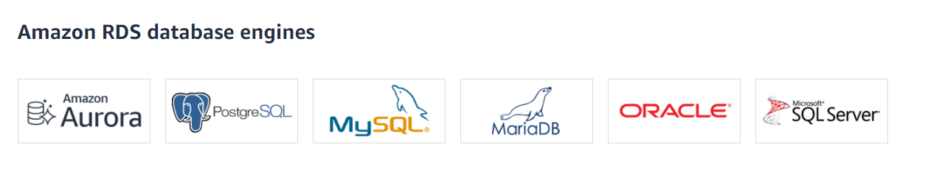
Amazon RDS database engines
RDS provides you with six familiar database engines to choose from, including Amazon Aurora, PostgreSQL, MySQL, MariaDB, Oracle Database, and SQL Server.

Slide 5
Why Use RDS?
It's important to distinguish AWS RDS from other database solutions offered through AWS.
AWS offers 15 database engines including relational, key-value, document,
in-memory, graph, time series, and ledger databases.
With RDS, you don’t need to worry about database management tasks such as server provisioning, patching, setup, configuration, backups, or recovery. The RDS manages this for you.
RDS is a relational database service, therefore it organizes data within tables in rows and columns. Compare this to non-relational or NoSQL databases which use different mechanisms to store and retrieve data through key-value pairs, document models, etc.

Slide 6
Security
A security group controls the access to a DB instance.
It does so by allowing access to IP address ranges or Amazon EC2 instances that you specify.
You can set security groups when configuring your RDS instance.

Slide 7
Using AWS RDS vs. Installing a database on an AWS EC2 Instance
DB services (like RDS) are managed services, meaning that you have limited control over the actual database. (i.e. you can't install particular software you may need).
EC2 (Elastic Cloud Compute), on the other hand, gives you maximum control over the software stack, database, and operating system.
EC2 allows you compute capacity and SUPER privileges, increasing flexibility.
RDS is more cost-effective and is automated but limits your control over the database.
RDS takes care of your database from end-to-end by managing, maintaining, and securing it, eliminating overhead costs and the role of a DBA (Database Administrator).

