Slide 1
Spring Boot Devtools and Actuator

Slide 2
Spring Boot Devtools
If you have worked on latest UI development frameworks e.g. Node, angular, gulp etc. then you must have appreciated the auto-reload of UI in browser whenever there is change in some code.
Its pretty useful and saves a lot of time.
Well, same feature can be utilized in spring boot applications using spring-boot-devtools dependency provided features.

Slide 3
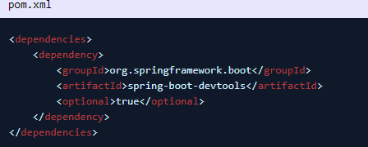
Enabling Dev Tools Module
To enable dev tools in spring boot application is very easy.
Just add the spring-boot-devtools dependency in your build file

Slide 4
Static Resource Caching
To improve the performance, dev tools cache the static content/template files to serve them faster to browser/client.
This is very good feature in production where every milli-second performance improvement matters.
But in development environment, it can be a problem and cause stale cache problem and you may not see your changes immediately in browser
By default, this feature is disabled. You can enable it to use in production environment by setting a property.
There are many such UI template libraries that support this feature. e.g. thymeleaf, freemarker, groovy, mustache etc.

Slide 5
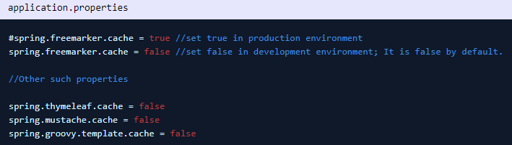
Static Resource Caching

Slide 6
Automatic server restart
Auto-restart means reloading the java classes and configuration at server side.
After the server side changes are re-deployed dynamically, server restart happen and load the modified code and configuration.
We can disable the auto-restart of a server by using the property spring.devtools.restart.enabled to false.

Slide 7

Spring Boot Actuator
Spring boot’s module Actuator allows you to monitor and manage application usages in production environment, without coding and configuration for any of them.
These monitoring and management information is exposed via REST like endpoint URLs.

Slide 8
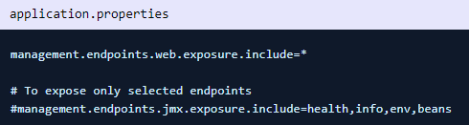
Important Actuator Endpoints
Most applications exposes endpoints via HTTP, where the ID of the endpoint along with a prefix of /actuator is mapped to a URL.
For example, by default, the health endpoint is mapped to /actuator/health.
By default, only /health and /info are exposed via Web APIs.
Rest are exposed via JMX.
Use management.endpoints.web.exposure.include=* to expose all endpoints through the Web API

Slide 9
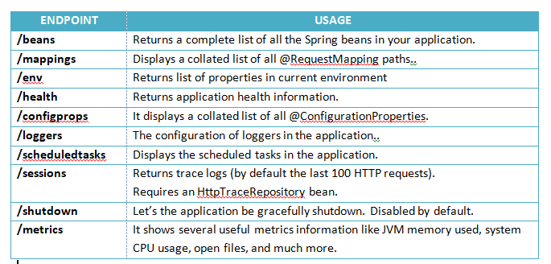
Important Actuator Endpoints

