Slide 1
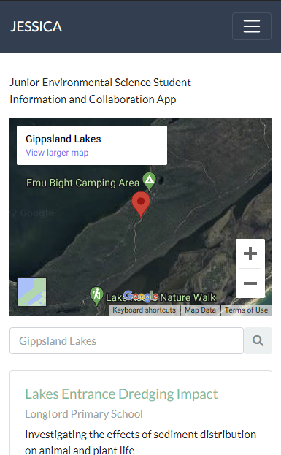
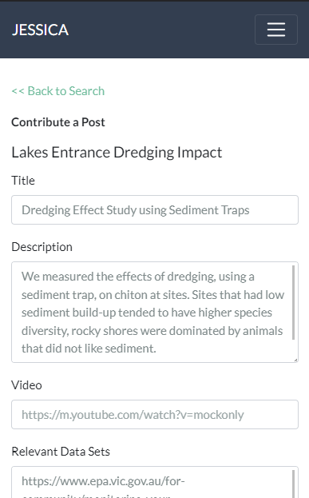
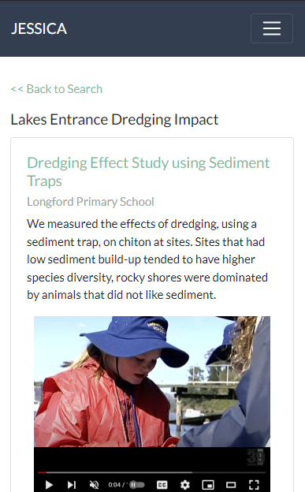
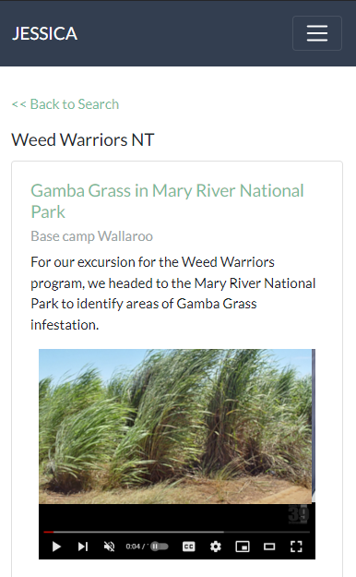
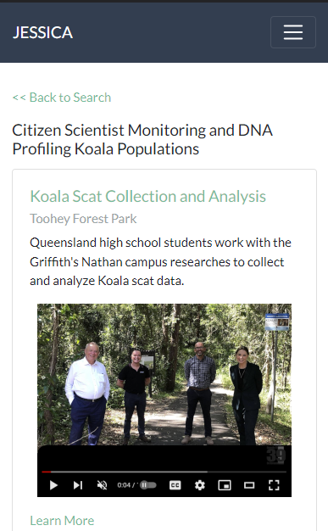
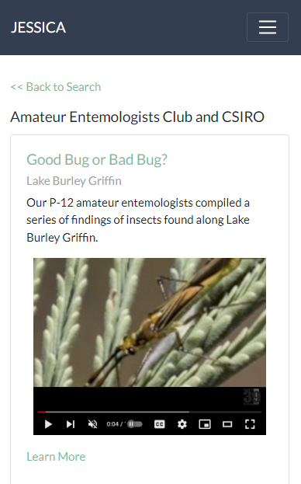
Activity Data Fields
Junior Environmental Science Student Information & Collaboration App
Local Program (conducted by schools, camps, or environmental organizations)
Geo Location
Author (student)
Description or Overview
Findings
Video Links, Images, and Document Downloads
Linked Geo Data Sources

Slide 2
JESSICA System Diagram
NT Weed Location Data
VIC Water Quality Report
JESSICA Activity Data
JESSICA Geo Data Index
ACT Threatened Fauna Habitat
Moreton Bay Koala Monitoring The Mill
JESSICA Web API Gateway
Other Environmental Science Data
JESSICA Web App
Students
Schools
Excursion /
Camp Partners
Environmental / Conservation Orgs

