Slide 1
Large Scale Data Streaming in Limavady

Slide 2
How I Bled All Over Onyx

Slide 3


Works here….
Wrote this….
Tweets here: @jasonbelldata

Slide 4
Tweet heckling is perfectly allowed as are questions as I go along.

Slide 5
The Question
“We want to stream in 12TB of data a day….. Can you do that?”

Slide 6

The Answer
Yeah we’re gonna rock like Cameo ‘86

Slide 7
Then it went quiet…..
For nearly six months.

Slide 8
Then an email….
Can we talk to you about that Onyx/Kafka thing you mentioned?

Slide 9
Oi Jase, what’s Kafka?
Apache Kafka is an open-source message broker project developed by the Apache Software Foundation written in Scala. The project aims to provide a unified, high-throughput, low-latency platform for handling real-time data feeds.
http://kafka.apache.org/
Also look at Kinesis Streams on AWS but you will be paying for it.

Slide 10
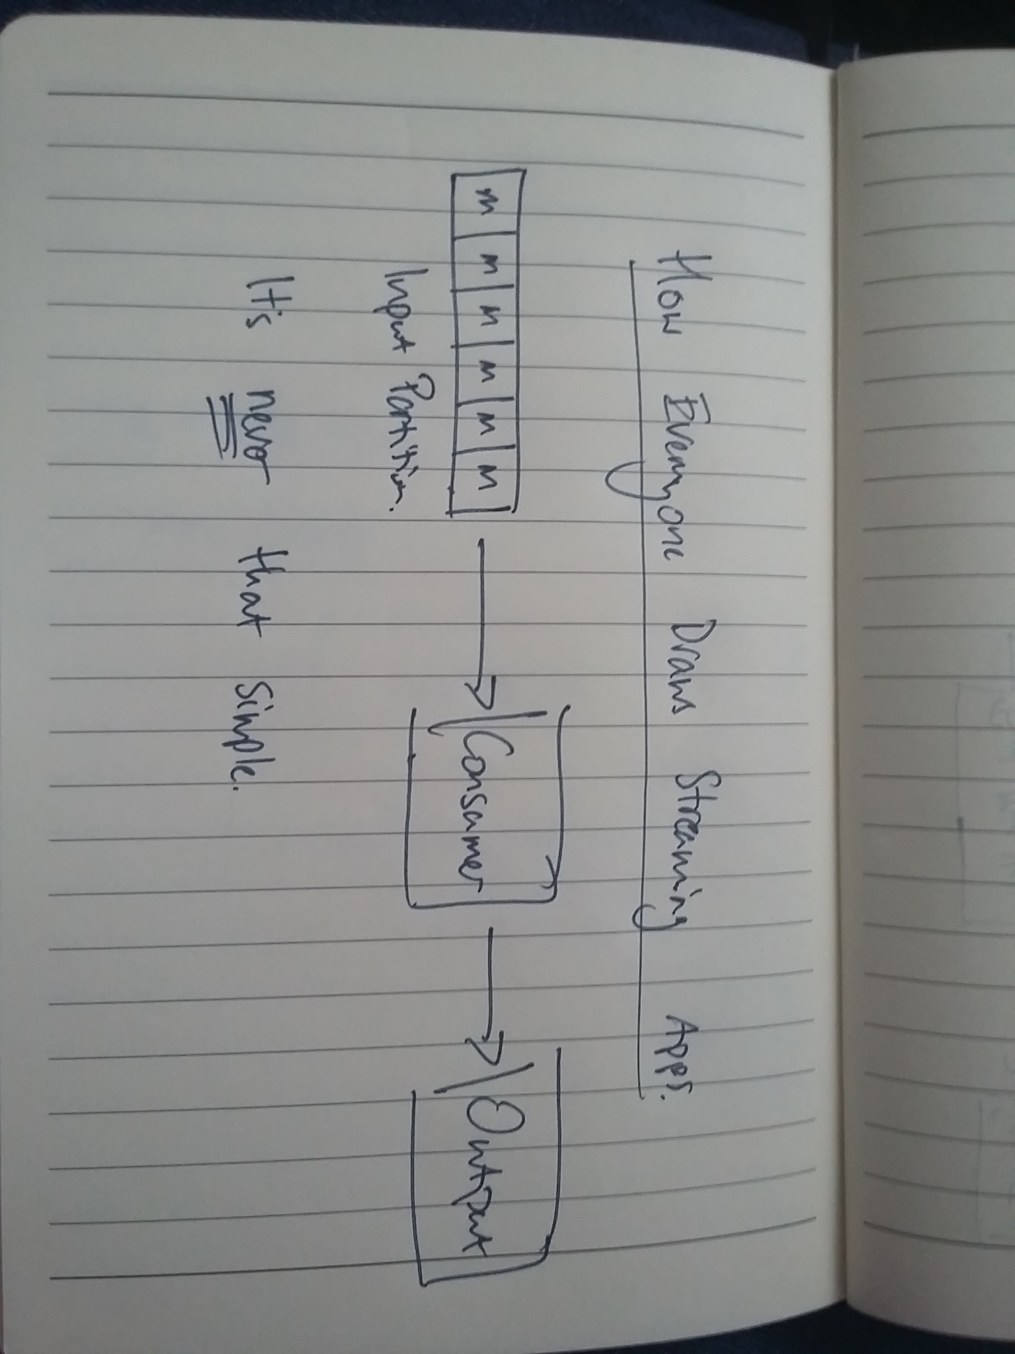
A Kafka Streaming Application

Slide 11

We design and we smile! It’s easy!

Slide 12
What is Onyx?
Distributed Computation Platform
Written 100% in Clojure
Great plugin architecture (inputs and outputs)
Uses graph Direct Acyclic Graph workflow
It’s very good….

Slide 13
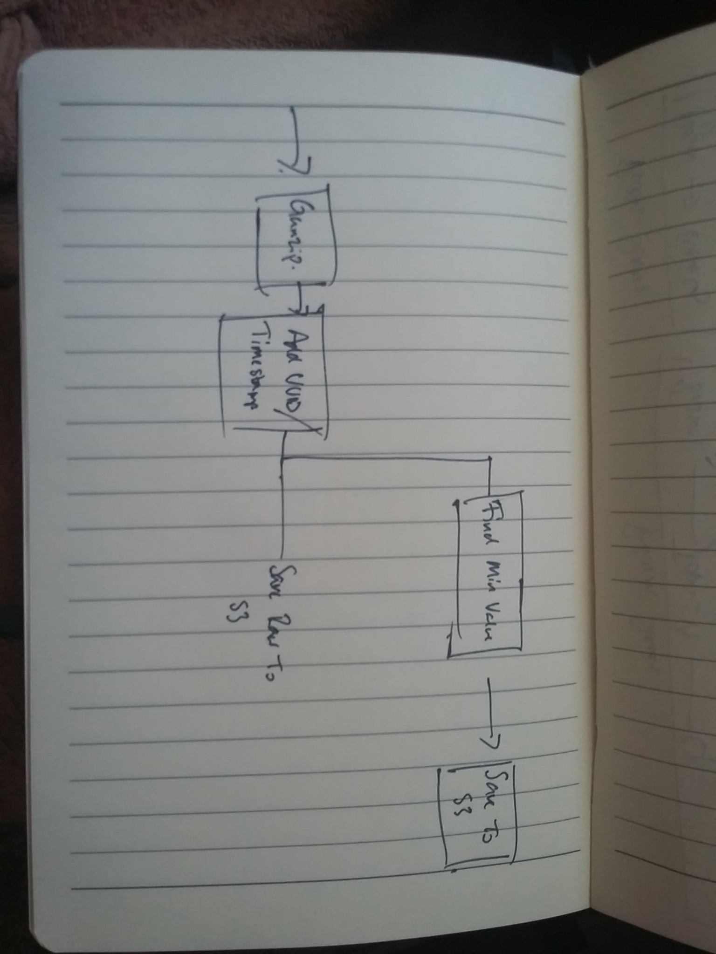

Slide 14
Onyx: Workflows as maps.
[[:in :add-fields]
[:add-fields :dump-raw]
[:add-fields :find-min]
[:find-min :dump-min]]

Slide 15
Onyx: Basic Peer Design
8 Peers
Per Kafka Partition (3)
Input task (deserialization) (1)
Assign Date + UUID (1)
Write raw to S3 (1)
Find min value row (1)
Write min value to S3 (1)

Slide 16
Terraform/Marathon/Mesos Deployment
3 Masters (m4.large)
3 Public Slaves (t2.medium)
3 Private Slaves (m4.xlarge)
4TB Volumes
We’d see how it goes from there, at worst d2 instances will do.

Slide 17
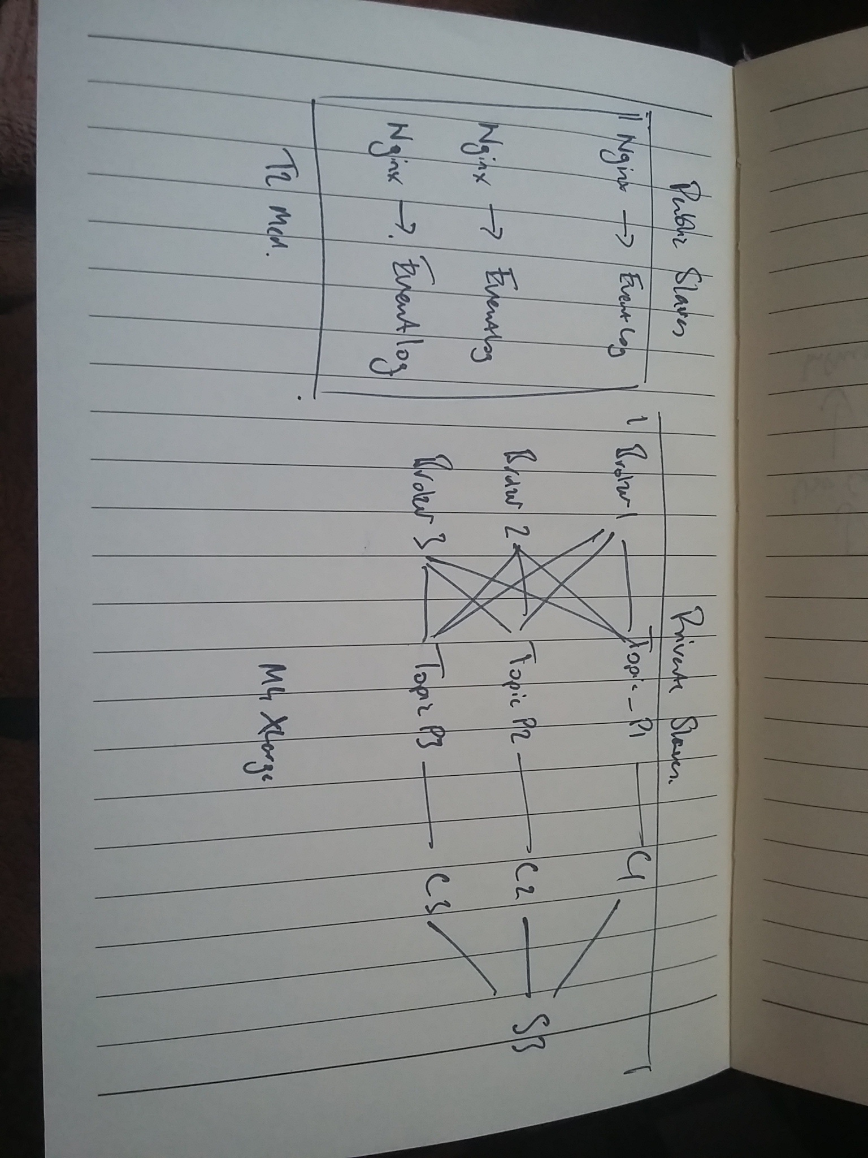

Slide 18

Great! Let’s Build!

Slide 19
Phase 1 – Testing at 1% Volume
It’s working!
Stuff’s going to S3!
Tell the client the good news!

Slide 20
Phase 2 – Testing at 2% Volume
It’s working!
Stuff’s going to S3!
Tell the client the good news!

Slide 21

Phase 3 – Testing at 5% Volume

Slide 22
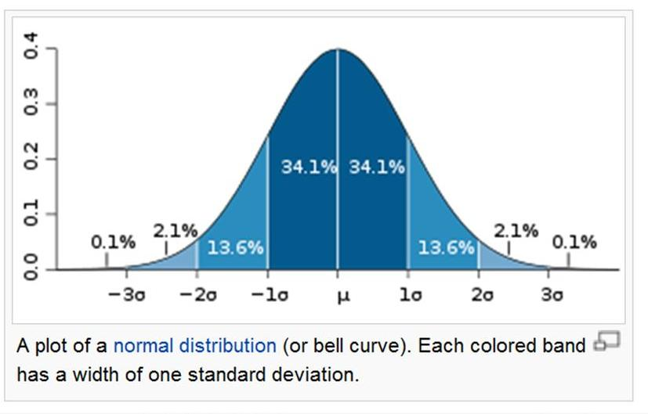
Lesson 1: Nothing means nothing until it’s on production.

Slide 23

This is new territory and I’m scared.

Slide 24
I just pushed Onyx 4sd to the mean.

Slide 25
Lesson 2: Docker containers.
--shm-size ended up being 10GB
OOM killers were frequent
Java logging is helpful but still hard to deal with.
CGROUPS_MEM=$(cat /sys/fs/cgroup/memory/memory.limit_in_bytes) MEMINFO_MEM=$(($(awk '/MemTotal/ {print $2}' /proc/meminfo)*1024)) MEM=$(($MEMINFO_MEM>$CGROUPS_MEM?$CGROUPS_MEM:$MEMINFO_MEM)) JVM_PEER_HEAP_RATIO=${JVM_PEER_HEAP_RATIO:-0.6} XMX=$(awk '{printf("%d",$1*$2/1024^2)}' <<< " ${MEM} ${JVM_PEER_HEAP_RATIO} ") # Use the container memory limit to set max heap size so that the GC # knows to collect before it's hard-stopped by the container environment, # causing OOM exception.

Slide 26
Lesson 2: Know Thy Framework Gotchas
Aeron buffer size = 3 x (batch-size x segment size x connections)
(1 x 512k x 8) x 3 = 4mb
Aeron default buffer is 16mb but then the twist
Onyx segment size = aeron.term.buffer.size / 8
Max message size of 4mb

Slide 27
Lesson 2: Know Thy Framework Gotchas
Each peer has it’s own lifecycle
Heartbeat at 10 seconds
:onyx.peer/subscriber-liveness-timeout-ms
Moved it to 30 seconds
If one peer dies the then the whole peer structure can’t process data, simple.

Slide 28

One Friday evening…

Slide 29
…two things happened…

Slide 30

1. Watched “12 Days of Christine” and cried.

Slide 31
2. I did a rewrite in Kafka Streams.
Moved the pure Clojure functions into the streams architecture.
Used Amazonica to write to AWS S3.

Slide 32
Kafka Streams rewrite…
Took 2 hours to write and deploy.

Slide 33
Kafka Streams rewrite…
Took 2 hours to write and deploy.
And, by this stage, was slightly tipsy.

Slide 34
Kafka Streams rewrite…
In deployment Kafka Streams didn’t touch more than 2% of the CPU/Memory load on the instance.
Max memory was 790Mb compared to 8Gb Onyx jobs.

Slide 35
Monday Morning…
No restarts, still processing data from the partitions!

Slide 36

Monday Morning…
Now might be a good time to tell my CTO. ;)

Slide 37
So why did Onyx bleed so bad?
Unzipping messages introduces unknowns across the peers. Very hard to monitor and predict.
Onyx isn’t designed for large messages (kb not mb)

Slide 38
Key Takeaways
Design on paper first.
Think about every function the message will visit.
Think about the fail safes on each function (size, timeouts, rogue messages).

Slide 39
Key Takeaways
Know the key Kafka topic settings.
https://dataissexy.wordpress.com/2017/03/10/kafka-diaries-topic-level-settings-you-cant-ignore-part-1-data-streaming/

Slide 40
Key Takeaways
Every latency blockage adds up over the duration of the message.
Work out your TTL backstop on Kafka (default 168 hours).
Think the Streaming Rule of 72

Slide 41
Key Takeaways
Reduce disk write i/o on Kafka, throw as much RAM at the brokers as you can.
On Kinesis you don’t get the luxury of tuning and is about 70% slower on throughput.

Slide 42
Key Takeaways
If your customer is not on a 24/7 SLA then work out how much data is going to pass through on the down days, then plan storage accordingly. Kafka will log while consumers are dead.

Slide 43
Key Takeaways
Think the Streaming Rule of 72

Slide 44
The Streaming Rule of 72
Work out % gain (130 msg/sec – 100 msg/sec)/100 = 30%
72/30 = 2.4
You will double the message throughput every 2.4 seconds.

Slide 45
Thank you.
Ask me questions anytime via Twitter, Linkedin, email and so on.
If I can help I will help.

