Slide 1
Teaching a model to write Jac
Synthetic Python → Jac data and a small finetune probe
Ayush Madhav Kumar
University of Michigan • Jaseci
Synthetic Python → Jac • MLX LoRA on Apple Silicon • Qwen3 Coder & Gemma 4

Slide 2
No real Jac corpus exists
• Models trained on Python have weak priors on Jac's data spatial idioms: walkers, nodes and edges instead of functions and classes.
• Stock 30B and 26B Gemma 4 and Qwen3 Coder produce 0% runnable Jac. They have never seen the language.
# a graph walk written as a loop
def traverse(graph, start):
stack = [start]
seen = set()
while stack:
n = stack.pop()
seen.add(n)
stack += graph[n]
return seen
# the graph walks itself
walker Traverse {
can step with Item entry {
here.seen = True;
visit [-->];
}
}
node Item { has seen: bool = False; }

Slide 3
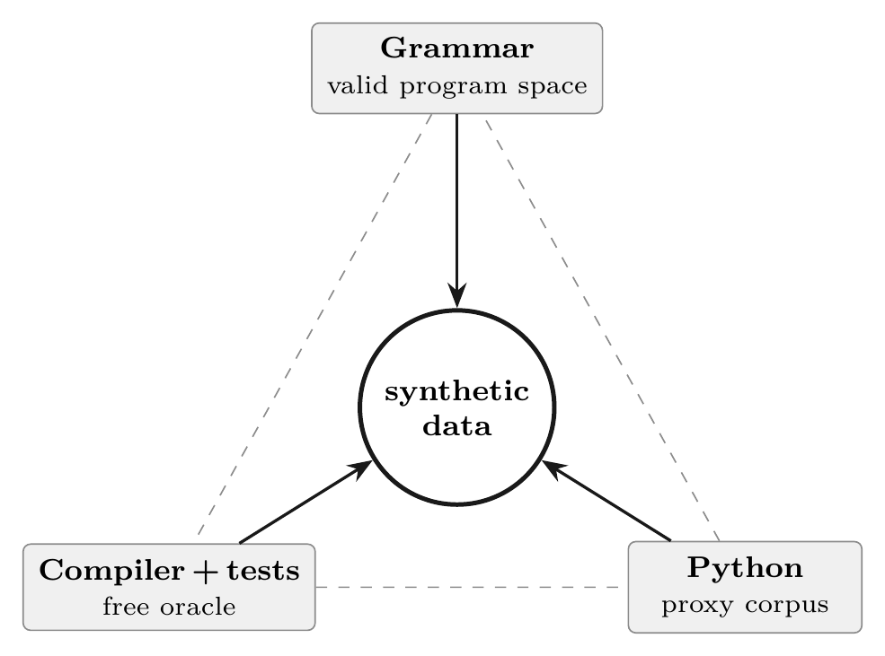
Three anchors for 100% synthetic data
1. Grammar is the distribution anchor. The Jac grammar defines the space of valid programs, and every sample is shaped to fit it.
2. Compiler and tests are a free oracle. Labelling is unlimited and costs nothing: reject anything that does not compile, run, or match its tests.
3. Python is the proxy distribution. Translate validated Python into Jac to borrow a large, correct source.
The quality gate is jac run: compile it, run it, and the output has to match. Not the type checker, which rejects plenty of code that runs.
the multi PLT method

Slide 4
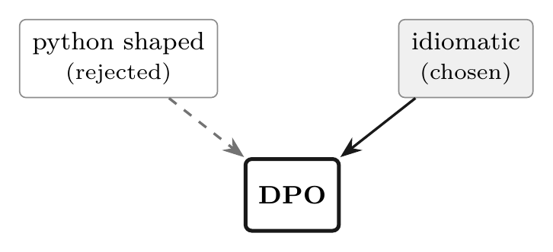
Data tiers, part 1: the three sources
1. Idiomatic core [147]. Jac written by hand or with an agent (Claude Code plus the Jac MCP): walkers, nodes, edges. 31 of these are graph shaped.
2. Transpile volume [1500]. Python auto transpiled with jac py2jac and gated on behavior. Correct, but Python shaped. This is the cheap volume.
3. DPO pairs [147]. chosen is idiomatic, rejected is the transpile. This teaches the model what is right versus what is wrong.
a DPO pair is one task with two answers (chosen ≻ rejected)
1647 SFT examples (147 idiom, 1500 transpile) • 147 DPO pairs • gate is jac run

Slide 5
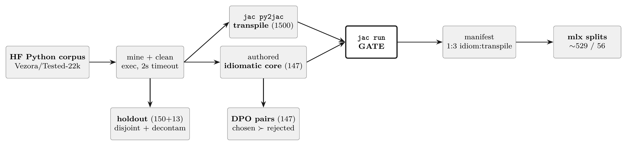
Data tiers, part 2: how the tiers are built
jac run gated • manifest 1:3 idiom:transpile • holdout decontaminated (disjoint offsets, 14 token shingles)

Slide 6
The data, tier by tier: real examples (1 of 2)
Tier 1 • Idiomatic core
task: product_of_tree, multiply values over a tree (walker / node / edge)
Tier 2 • Transpile volume
task: is_even, mechanical, Python shaped (jac py2jac, gated)
node TNode { has val: int; }
walker Product {
has result: int = 1;
can mul with TNode entry {
self.result *= here.val;
visit [-->]; # the walk IS the program
}
}
with entry {
a = TNode(val=2); b = TNode(val=3);
root ++> a; a ++> b; a ++> c;
print((a spawn Product()).result);
}
def is_even(num: Any) -> object {
return ((num % 2) == 0);
}
with entry {
print(is_even(5));
print(is_even(10));
}
Correct and runnable, but it is just Python with braces: Any and object types, no walker. The transpile gives cheap scale. The idiomatic core gives the shape.

Slide 7
The data, tier by tier: a real DPO pair (2 of 2)
task: count_children(graph, node), count a node's direct children
chosen (idiomatic, reward up)
rejected (transpile, Python shaped, reward down)
node GNode { has name: str; }
walker CountChildren {
has count: int = 0;
can chk with GNode entry {
self.count = len([-->]);
disengage;
}
}
"""Return the number of direct
children of node."""
def count_children(graph: dict,
`node: str) -> int {
return len(graph.get(`node, []));
}
Same task, two correct answers. DPO trains chosen ≻ rejected, pushing generation off graph.get(...) and toward len([-->]).

Slide 8
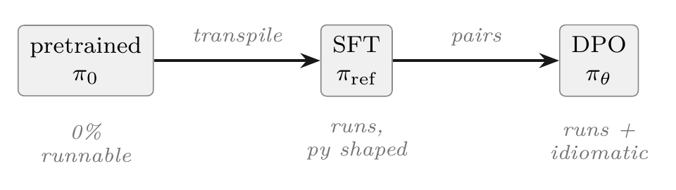
What is SFT and DPO
• SFT is supervised finetuning. Imitate gold outputs, which teaches the model to produce runnable Jac.
• DPO is direct preference optimization. Learn from chosen ≻ rejected pairs, which sharpens the model toward idiom without a reward model.
Here, SFT teaches it to run, and DPO pushes it from runs to idiomatic.

Slide 9
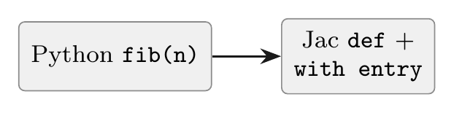
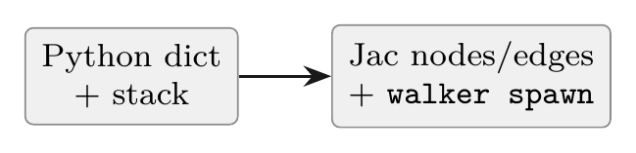
Function vs graph tasks
Function task
standalone pure function → Jac def
Graph task
dict and stack traversal → nodes / edges / walker
• idiomatic ≈ transpile → sim 0.97
• no idiom headroom: a pure function legitimately needs no walker
• oracle: recorded test cases (150 holdout)
• idiomatic diverges hard → sim 0.26, ~8 constructs
• real idiom headroom: this is where DPO can move the model
• one dict argument keeps the same eval harness (13 holdout)
The idiom axis only exists on graph tasks. On functions, "Python shaped" already is idiomatic, which is why DPO does nothing there and works here.

Slide 10
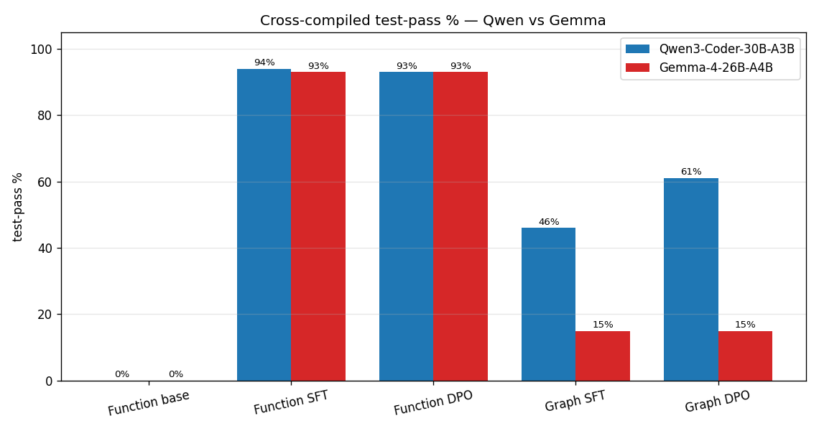
Graphs and stats: behavioral test pass
• Base eval from cold start (quantized Q4/Q8, run normally).
• Base is 0%: neither model knew Jac before this.
• Functions: both reach ~94%. SFT and DPO tie, outputs stay Python shaped, and DPO does not move them.
• Graph: Qwen pulls ahead (46/61%) while Gemma stalls (15%).

Slide 11
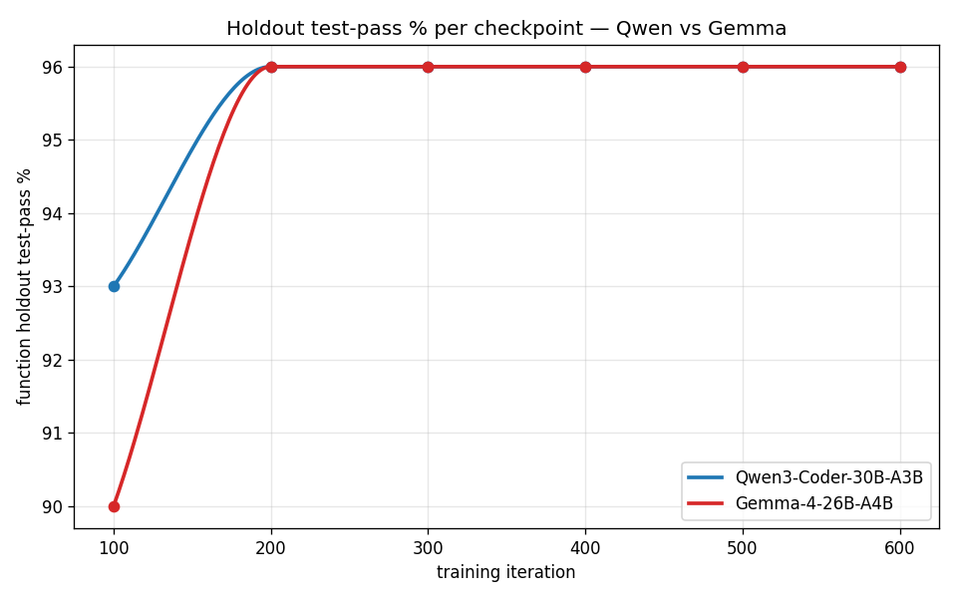
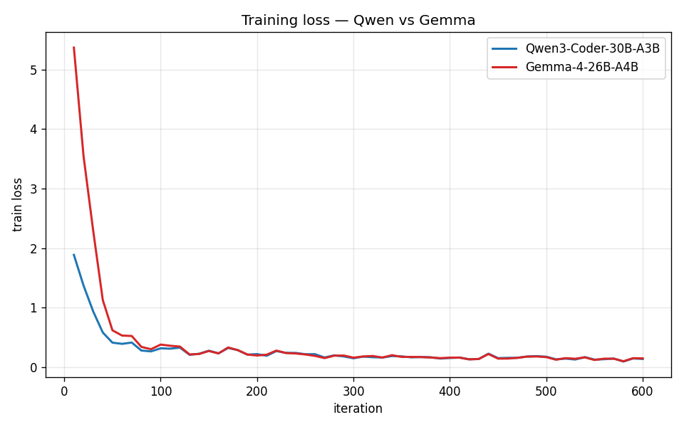
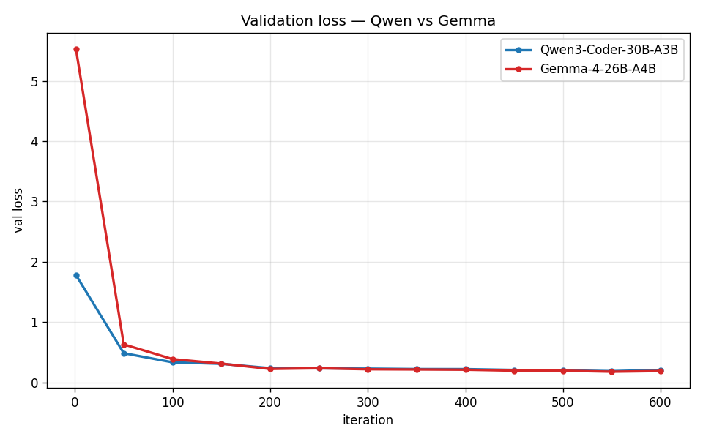
Graphs and stats, part 2: training curves
Validation loss, training loss, and the holdout learning curve are nearly identical for Qwen and Gemma. Same data, same config (LoRA r16, 600 iters, lr 2e-5).
The separation is not in loss. It is in idiom on graph tasks, which is the next slide.

Slide 12
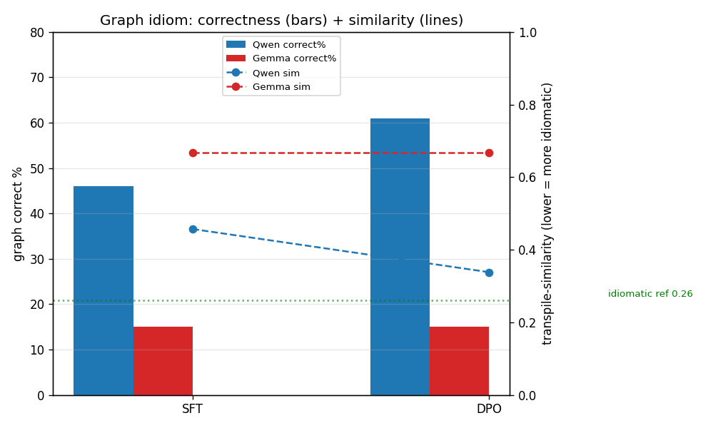
Graph tier: where idiom has room to move
• On graph tasks idiomatic Jac diverges from Python, so the idiom axis is alive.
• SFT teaches the model to run. DPO pushes it the rest of the way to idiomatic.
• Qwen: SFT 46% → DPO 61% correct; idiomatic share of correct 83% → 100%; similarity 0.457 → 0.338 (ref 0.26).
• Gemma: graph SFT only 15% (~2/13, 0 constructs), so DPO has nothing to move. Idiom acquisition depends on the model.

Slide 13
What we proved
1. Synthetic, compiler validated data teaches correct Jac. 0% → 94% behavioral test pass on a decontaminated holdout.
2. Idiom headroom plus DPO teaches idiomatic Jac. On graph tasks Qwen3 Coder reaches 100% idiomatic of correct outputs, up from 83% at SFT.
3. The result is a basic Jac coding agent. Roughly what Claude Code is, but for Jac instead of Python.
100% synthetic data • a free compiler oracle • two MoE models that fit in 48 GB

Slide 14
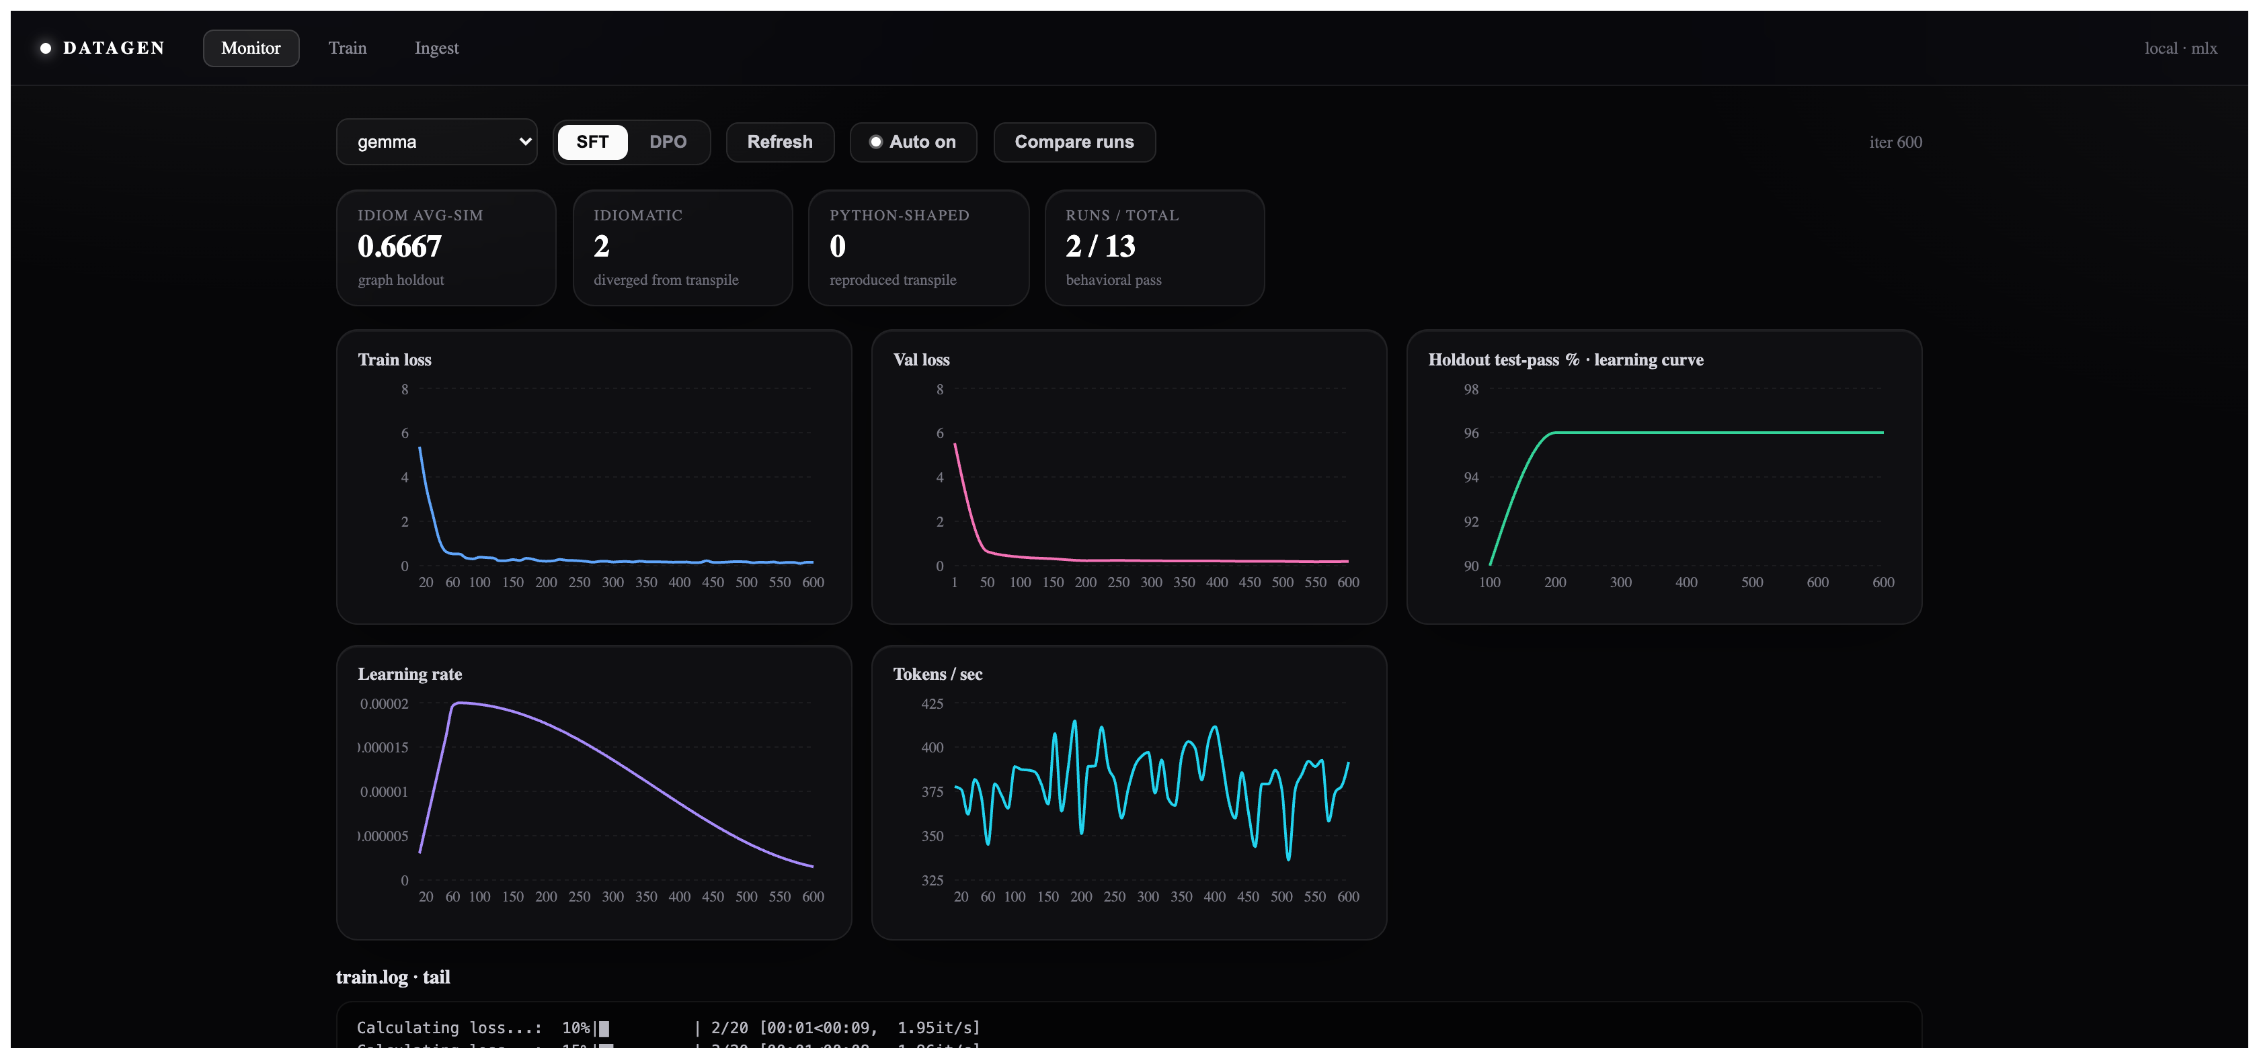
Next up
• Mine a single codebase into an RL loop: how far is the resulting codebase from what you asked for?
• Is it unreasonable to train a model on one codebase?
• What eval fits that setting?
Shipped since: a live training dashboard (Monitor, Train, Ingest) that streams SFT and DPO runs in real time. It is the item that was "next" last time.
live Monitor: run picker, idiom cards, train and val loss, learning curve, tok/s

