Slide 1


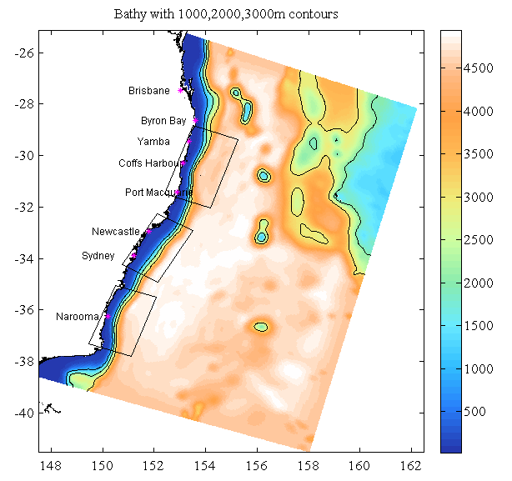

ROMS EAC Model domain and 3 nested domains
(Coffs Harbour, Hawkesbury and Narooma)
Carter et. al., 2012
Notes:
In solving this state-estimation problem, we compute the dynamical covariance between the observations and the model that allows us to directly compute the impact of each observation on the circulation estimate.

Slide 2
Summary of models
EAC Model (2.5-6km resolution, 30 vertical s-levels)
10-year free run
- 2006-2016
- BRAN3p5 bry and ini
- NCEP atmos frc
2-year reanalysis
- 2012-2013
- BRAN3p5 bry and ini
- ACCESS 12km atmos frc
- Assimilates all available observations
- Blended product created
22-year free run
- 1994-2016
- BRAN3p5 bry and ini
- NCEP atmos frc
- Improved warm bias from other free runs
Background error covariances for reanalysis
Provides physics for Carlos’ BGC modelling
Parent model for Hawkesbury model (Nina, 750m resolution)
Parent model for Coffs ONR work (2-year reanalysis and forecast, 750-900m resolution)
“Forecasting from the Deep Ocean to the Coast: Predictability of shelf circulation impacted by a Western Boundary Current”
Provides physics for Carlos’ BGC modelling
Provided bry conditions for AECOM (Merim. outfall)
Parent model for Narooma 22-year run, U. Maq. (750-1000m resolution)
Parent model for Coffs 6-year run (to estimate error covariances for Coffs 4D-Var configuration), 2010-2015, uses BARRA atmos frc

Slide 3
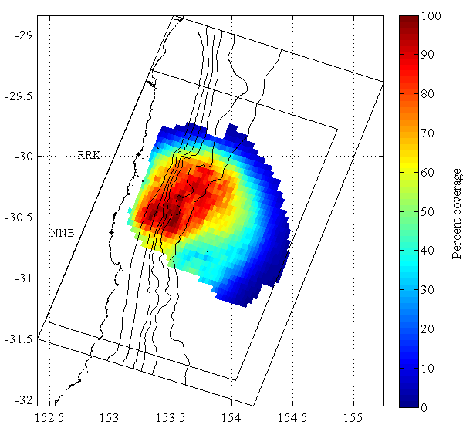
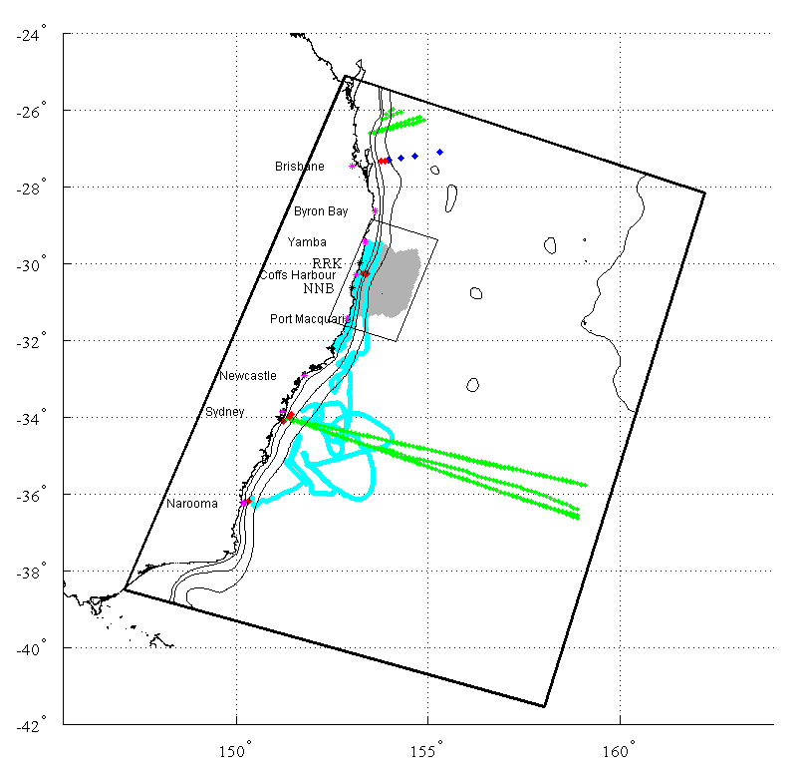
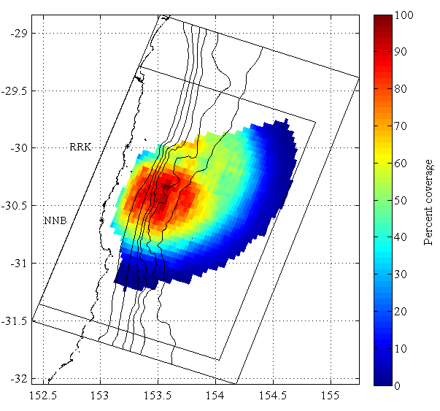
Observations assimilated into EAC reanalysis (left plot), and Coffs model domain showing HF radar coverage (right plots)

