Slide 1
Instructions for use
This resource aligns to the learning in Stage 2 Year B Unit 32 and revisits content from earlier sample units..
Classroom teachers are encouraged to add and adapt slides as required to meet the needs of their students.
Save a copy of the file to make changes to the slide deck. Go to File > Download a Copy (this downloads a copy to the computer to edit in the PowerPoint app).
To convert the PowerPoint to Google Slides:
  Upload the file into Google Drive and open it.
  Go to File > Save as Google Slides.
  (Note – conversion may cause formatting changes in the slides.)

Slide 2
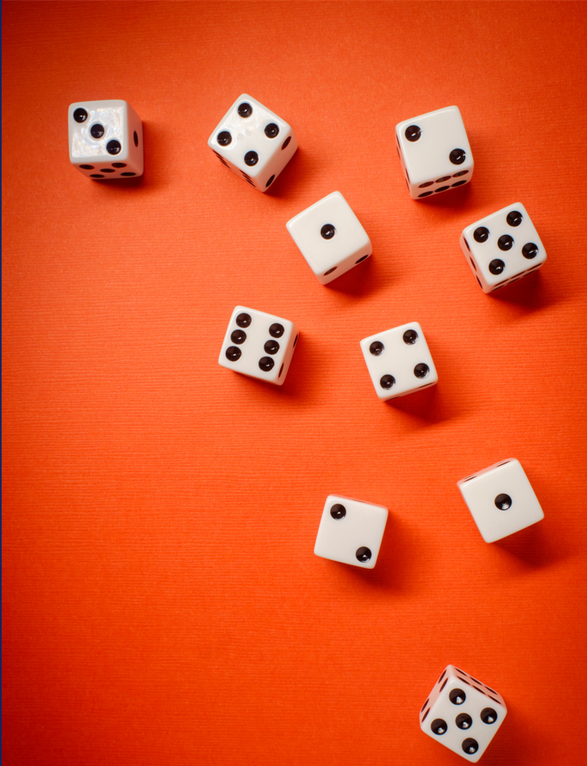
Review of Learning
Mathematics Stage 2 – Unit 32
Notes:
Reviews may include a combination of question types, requiring students to recall facts and key ideas, as well as apply their knowledge to solve problems and answer questions. To support active engagement, a mix of techniques should be employed.” (AERO, 2024).
This Review of Learning slide deck revisits key concepts from the following units:
Stage 2 Year B Unit 32
Stage 2 Year B Unit 31
Stage 2 Year B Unit 30
It also includes opportunities to review prior learning in non-number content, supporting consolidation across focus areas.
The review of learning resources include three key task types that support the development of mathematical proficiency through retrieval, spaced practice, and active participation. These practices complement the review phase (activating prior knowledge) embedded within the beginning of each lesson.
1.
Multiple-choice questions/True or false: Designed to promote active retrieval of key concepts and identify common misconceptions in number, supporting consolidation, understanding and fluency.
These questions:
support spaced and interleaved practice
help identify and address common misconceptions
support active recall and immediate feedback
support whole class participation
identify areas requiring reteach
2.
Short-response question sets: Carefully grouped questions that encourage spaced and interleaved practice across multiple focus areas, helping students revisit and apply knowledge from different points in time.
These questions:
have a combination of question types
address a range of focus areas
build automaticity and fluency
support active recall
allow for immediate feedback
identify content requiring reteach
3.
Developing number sense activities: A variety of practical, purposeful tasks that reinforce current learning and build on prior knowledge. These activities promote reasoning, problem-solving and conceptual understanding.
The review of learning resources are designed to work support teaching and learning in mathematics. For the most effective implementation, use the resources flexibly, adapting to meet student learning needs and individual classroom contexts.

Slide 3
Lessons
1
Review of learning 1
5
Review of learning 5
2
Review of learning 2
6
Review of learning 6
3
Review of learning 3
7
Review of learning 7
4
Review of learning 4
8
Review of learning 8
Notes:
Teacher notes:
Click lesson titles to go to specific lessons
Interactive features can be viewed in slide show

Slide 4
Review of learning 1

Slide 5

Multiple choice (1)
Which matches the array?
A
B
C
D
2 x 12 = 12 x 2
4 x 6 = 6 x 4
2 x 6 = 6 x 2
4 x 12 = 12 x 4
Notes:
This question connects to the content in the developing number sense activity (Activity 1)
Syllabus focus area:
Multiplicative relations B

Slide 6

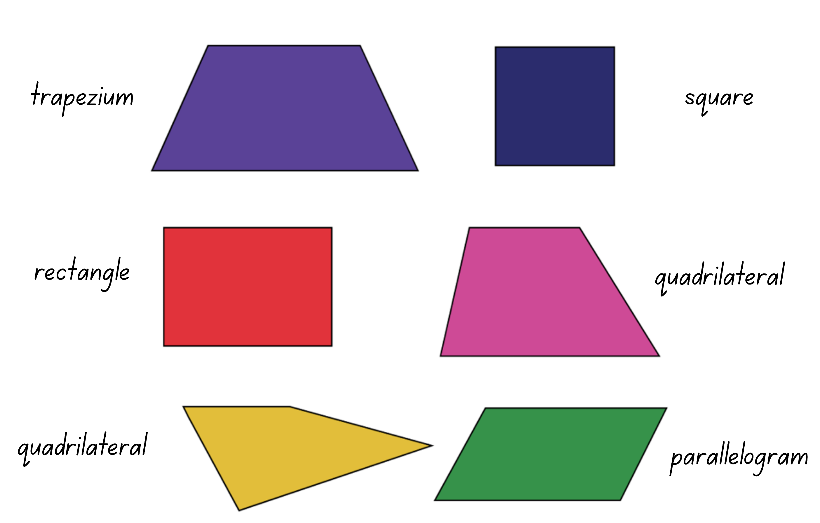
Short response (1)
Group the quadrilaterals based on the number of parallel sides.
Notes:
Short response questions provide brisk paced questions focussing on review of current and previous content to support spaced and interleaved practice.
Syllabus focus area:
Two-dimensional spatial structure A

Slide 7
Short response (2)
Record the largest and smallest number you can make by rearranging these 6 digits:
3
6
1
8
4
0
Notes:
Short response questions provide brisk paced questions focussing on review of current and previous content to support spaced and interleaved practice.
Syllabus focus area:
Representing numbers using place value B

Slide 8

Short response (3)
Use the green right-angle tester to work out if the angle of this pizza slice is:
smaller than a right angle,
equal to a right angle or
larger than a right angle.
Notes:
Short response questions provide brisk paced questions focussing on review of current and previous content to support spaced and interleaved practice.
Syllabus focus area:
Geometric measure B

Slide 9


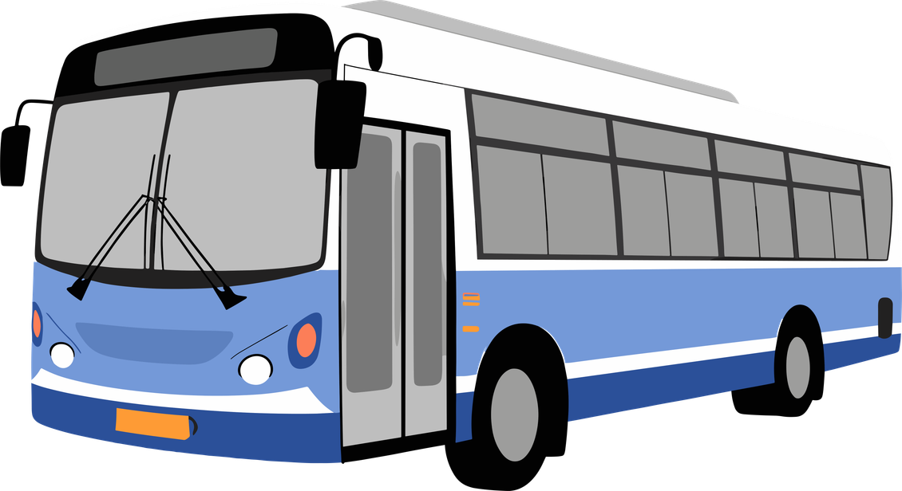
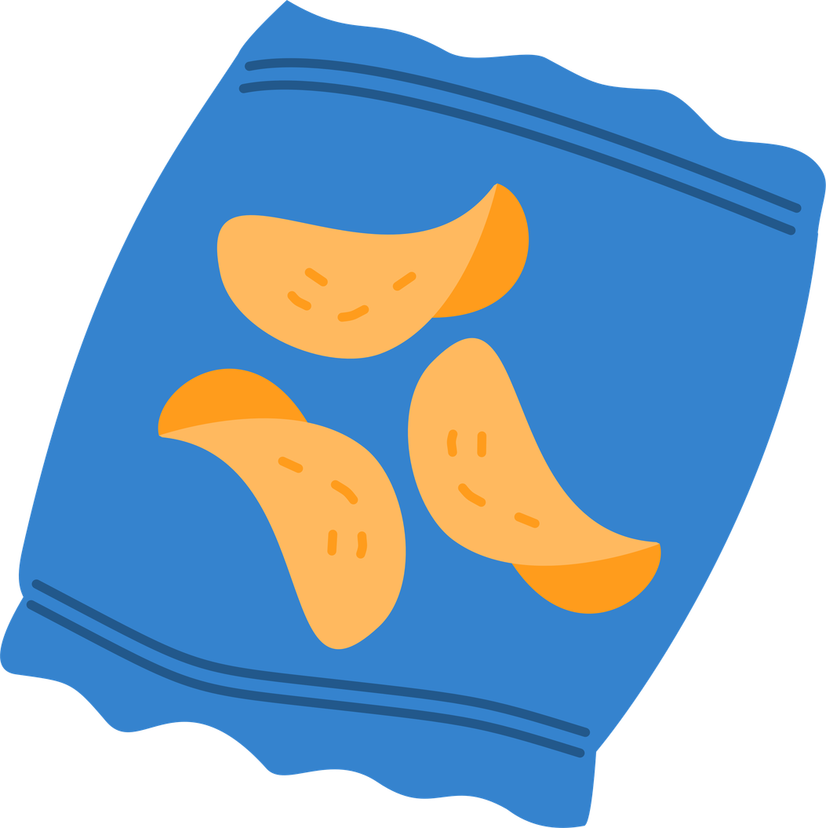
Short response (4)
Which of these objects are best measured in grams?
pencil
water bottle
bus
book
chips
Communicate your reasoning.
Notes:
Short response questions provide brisk paced questions focussing on review of current and previous content to support spaced and interleaved practice.
Syllabus focus area:
Non-spatial measure B

Slide 10

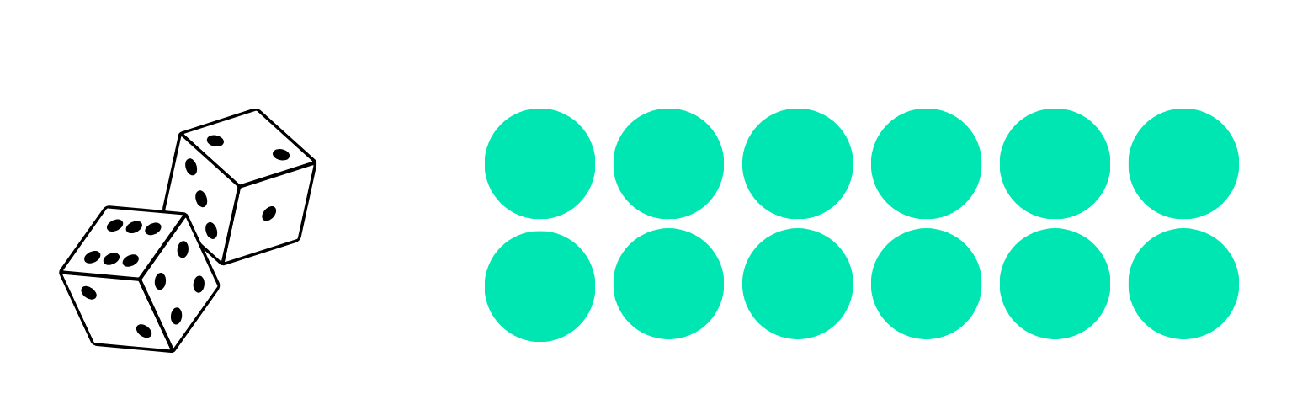
Activity 1 – commutative property
Can you make an array using the numbers rolled from 2 ten-sided dice?
Notes:
This is a developing number sense activity.
Number sense refers to a deep understanding of numbers, including their magnitude, relationships, and the effects of operations on them. It supports fluency and understanding, estimation, flexible thinking, and efficient problem-solving. Number sense activities 1–4 ‘activate’ prior number knowledge and support the learning of new content in the unit. Number sense activities 5–8 ‘loop’ back and provide opportunity for spaced practice with concepts and procedures covered in previous units.
Syllabus focus area:
Multiplicative relations B
Commutative property
In pairs, students roll two 10-sided dice. Partner A rolls the dice and uses the numbers rolled to make an array with counters or draw the array on grid paper. For example, a student rolls a 2 and a 6 and makes an array of 2 sixes.
Partner B uses the commutative property to make the matching array for the numbers rolled. For example, 6 twos.
Pairs label their array with the corresponding multiplication sentences to show the commutative property. For example, 6 × 2 = 2 × 6.
Students repeat the process using different numbers by rolling the dice.

Slide 11
Review of learning 2

Slide 12
True or false (1)
The related multiplication and division facts for the array are:
6 x 4 = 24
4 x 6 = 24
24 ÷ 6 = 4
24 ÷ 4 = 6
True | False
Notes:
The question on this slide connects to the content being explored in the developing number sense activity (Activity 2)
Syllabus focus area:
Multiplicative relations B

Slide 13

Short response (5)
Record one similarity and one difference between these shapes.
kite
trapezium
Notes:
Short response questions provide brisk paced questions focussing on review of current and previous content to support spaced and interleaved practice.
Syllabus focus area:
Two-dimensional spatial structure A

Slide 14
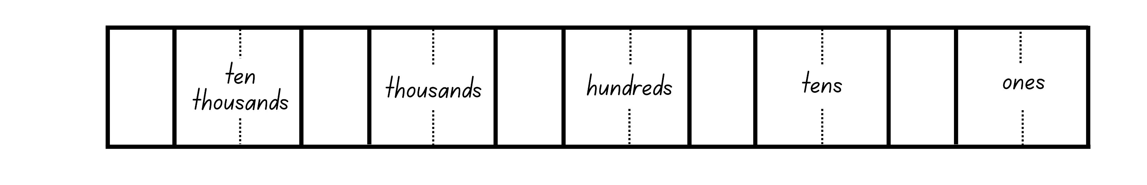
Short response (6)
Record this number in expanded notation:
24 502
Notes:
Short response questions provide brisk paced questions focussing on review of current and previous content to support spaced and interleaved practice.
Syllabus focus area:
Representing numbers using place value B

Slide 15
Short response (7)
Describe this angle as:
less than a right angle
about the same as a right angle or
more than a right angle.
Communicate your reasoning.
Notes:
Short response questions provide brisk paced questions focussing on review of current and previous content to support spaced and interleaved practice.
Syllabus focus area:
Geometric measure B

Slide 16
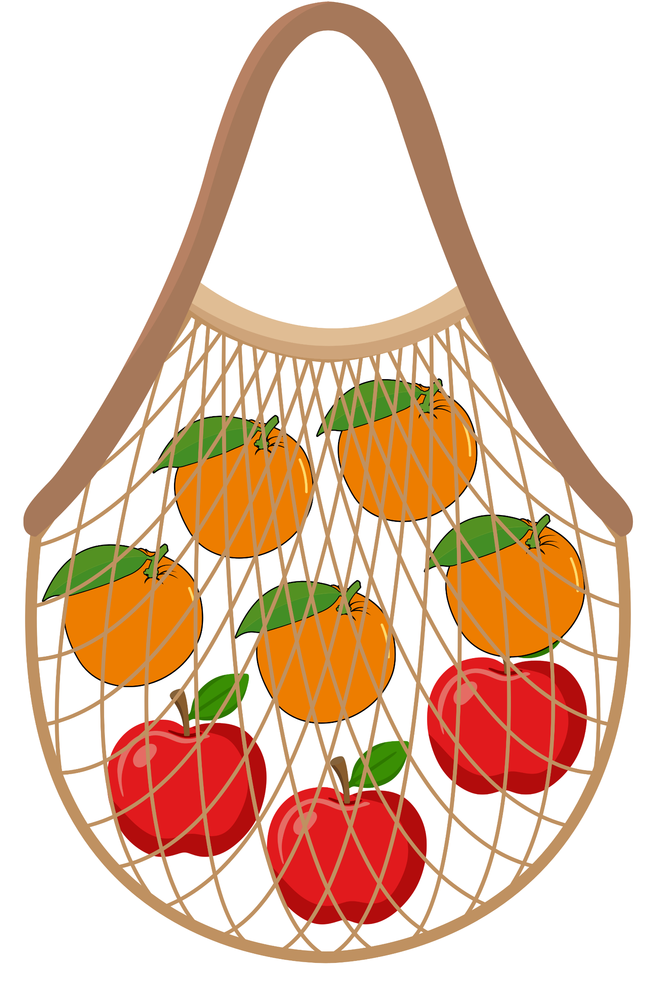
Short response (8)
If you remove an apple from the bag, does the chance of picking an orange next time become:
A more likely
B less likely
C the same.
Communicate your reasoning.
Notes:
Short response questions provide brisk paced questions focussing on review of current and previous content to support spaced and interleaved practice.
Syllabus focus area:
Chance B

Slide 17
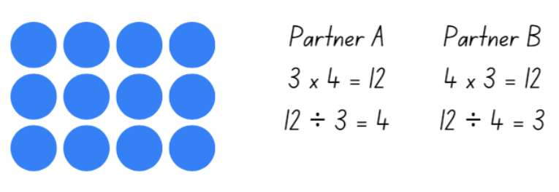
Activity 2 – multiplication fact families
Can you make an array using the numbers rolled from two ten-sided dice?
In pairs, show related multiplication and division facts.
Notes:
This is a developing number sense activity.
Number sense refers to a deep understanding of numbers, including their magnitude, relationships, and the effects of operations on them. It supports fluency and understanding, estimation, flexible thinking, and efficient problem-solving. Number sense activities 1–4 ‘activate’ prior number knowledge and support the learning of new content in the unit. Number sense activities 5–8 ‘loop’ back and provide opportunity for spaced practice with concepts and procedures covered in previous units.
Syllabus focus area:
Multiplicative relations B
Multiplication fact families
In pairs, students roll two 10-sided dice and use the dice rolls to make an array with counters or draw the array on grid paper. For example, students roll a 3 and a 4 and make an array of 3 fours.
Pairs label their array to show related multiplication and division facts. Students each write a multiplication and division number sentence. For example, Partner A writes 3 × 4 = 12, 12 ÷ 3 = 4 and Partner B writes 4 × 3 = 12, 12 ÷ 4 = 3 (see Figure 12).
Students repeat the process using different numbers by rolling the dice.

Slide 18
Review of learning 3

Slide 19
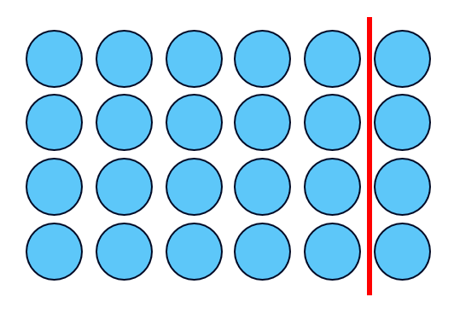
Multiple choice (2)
Which number sentence matches the partitioned array?
A
B
C
D
4 x 6 is
4 x 4 and 4 x 1
4 x 6 is
4 x 5 and 4 x 1
4 x 6 is
4 x 6 and 4 x 0
4 x 6 is
6 x 3 and 6 x 1
Notes:
This question connects to the content in the developing number sense activity (Activity 3)
Syllabus focus area:
Multiplicative relations B

Slide 20
Short response (9)
2 shapes have been combined. Record the:
name of the new shape
key features of the new shape.
Notes:
Short response questions provide brisk paced questions focussing on review of current and previous content to support spaced and interleaved practice.
Syllabus focus area:
Two-dimensional spatial structure B

Slide 21
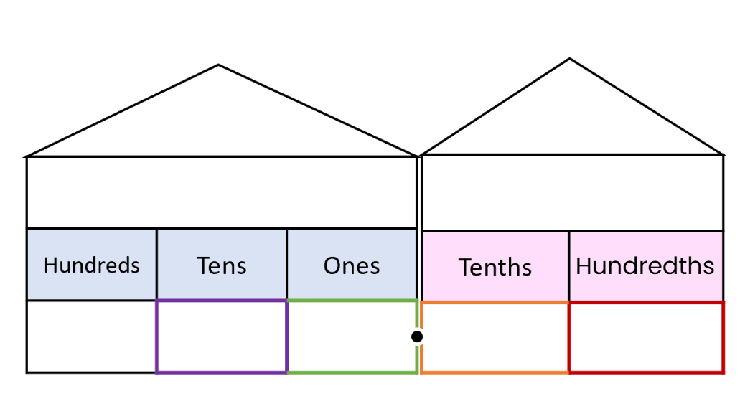
Short response (10)
Record the following as decimal numbers:
3 tenths and 6 hundredths
1 tenth and 8 hundredths
4 hundredths
Notes:
Short response questions provide brisk paced questions focussing on review of current and previous content to support spaced and interleaved practice.
Syllabus focus area:
Representing numbers using place value B

Slide 22

Short response (11)
Describe this angle as acute or obtuse
Describe this angle in comparison to a quarter-turn.
Notes:
Short response questions provide brisk paced questions focussing on review of current and previous content to support spaced and interleaved practice.
Syllabus focus area:
Geometric measure B

Slide 23
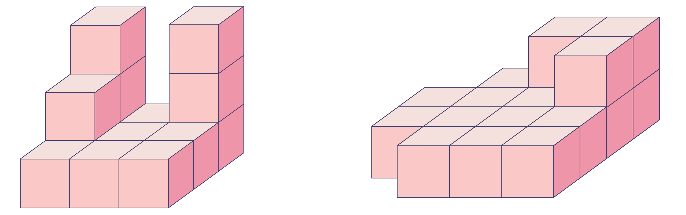
Short response (12)
Record the volume of each object by counting the cubic centimetre blocks.
A
B
Notes:
Short response questions provide brisk paced questions focussing on review of current and previous content to support spaced and interleaved practice.
Syllabus focus area:
Three-dimensional spatial structure A

Slide 24
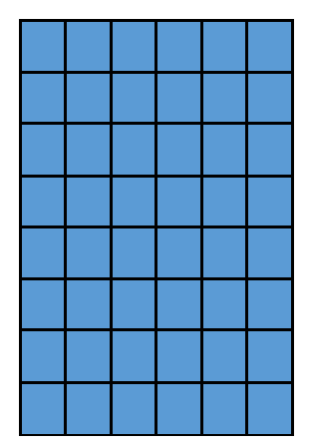
Activity 3 – flexible partitioning within multiplication 1
Can you:
name a difficult multiplication fact
construct the array
partition the array to make the multiplication fact easier to recall.
Notes:
This is a developing number sense activity.
Number sense refers to a deep understanding of numbers, including their magnitude, relationships, and the effects of operations on them. It supports fluency and understanding, estimation, flexible thinking, and efficient problem-solving. Number sense activities 1–4 ‘activate’ prior number knowledge and support the learning of new content in the unit. Number sense activities 5–8 ‘loop’ back and provide opportunity for spaced practice with concepts and procedures covered in previous units.
Syllabus focus area:
Multiplicative relations B
Flexible partitioning within multiplication 1
This resource corresponds to Resource 16 – 7 sixes in Stage 2 Year B Unit 32.
Using grid paper, model different ways of partitioning. Encourage students to use known facts to make finding a multiplication fact easier. For example, 7 × 6 can be solved by adding 6 × 6 to one more 6, or finding 7 × 5 and adding one more 7 (see Figure 13).
In pairs, students take turns to nominate a multiplication fact hard to recall. Provide students with grid paper to construct the array and record how partitioning can make recall easier. Some students may require concrete materials such as counters.

Slide 25
Review of learning 4

Slide 26
True or false (2)
The number sentence 8 x 6 can be partitioned as:
8 x 5 and 8 x 1
True | False
Communicate your reasoning.
Notes:
The question on this slide connects to the content being explored in the developing number sense activity (Activity 4)
Syllabus focus area:
Multiplicative relations B

Slide 27

Short response (13)
Identify which is an example of tessellation.
B
Communicate your reasoning using the terms reflecting, translating and rotating.
Notes:
Short response questions provide brisk paced questions focussing on review of current and previous content to support spaced and interleaved practice.
Syllabus focus area:
Two-dimensional spatial structure A

Slide 28
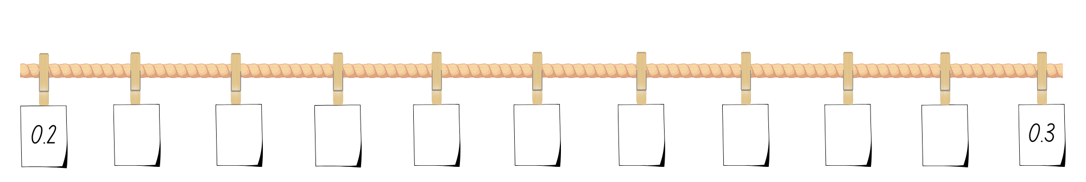
Short response (14)
Record the decimals between 0.2 and 0.3 to 2 decimal places.
Notes:
Short response questions provide brisk paced questions focussing on review of current and previous content to support spaced and interleaved practice.
Syllabus focus area:
Representing numbers using place value B

Slide 29
Short response (15)
At 3 o’clock, the hour hand and minute hand form a quarter turn and have made a right angle.
At 6 o’clock, what type of angle would be made by the hands?
How many quarter turns is equivalent to?
Notes:
Short response questions provide brisk paced questions focussing on review of current and previous content to support spaced and interleaved practice.
Syllabus focus area:
Geometric measure B

Slide 30
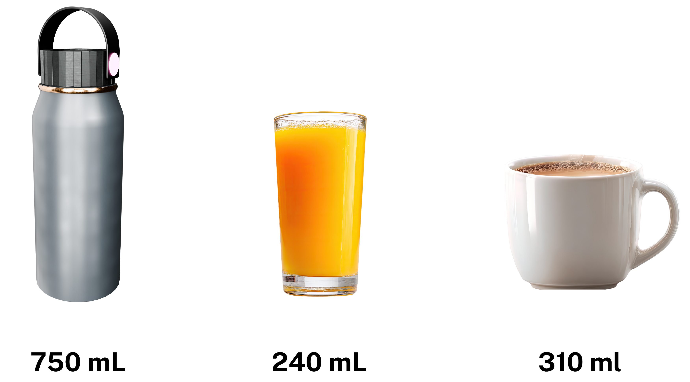
Short response (16)
Order the capacity of these containers in millimetres.
Notes:
Short response questions provide brisk paced questions focussing on review of current and previous content to support spaced and interleaved practice.
Syllabus focus area:
Three-dimensional spatial structure B

Slide 31
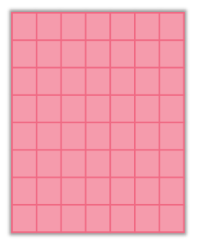
Activity 4 – flexible partitioning with multiplication 2
Can you partition the array using multiplication facts?
Notes:
This is a developing number sense activity.
Number sense refers to a deep understanding of numbers, including their magnitude, relationships, and the effects of operations on them. It supports fluency and understanding, estimation, flexible thinking, and efficient problem-solving. Number sense activities 1–4 ‘activate’ prior number knowledge and support the learning of new content in the unit. Number sense activities 5–8 ‘loop’ back and provide opportunity for spaced practice with concepts and procedures covered in previous units.
Syllabus focus area:
Multiplicative relations B
Flexible partitioning with multiplication 2
Display an array on the board, with grid paper, or with counters, for example, an array for 8 × 7.
Explain that the array can be partitioned using known multiplication facts.
Demonstrate using flexible partitioning using known multiplication facts to solve the number sentence. For example, (8 rows of 5) + (8 rows of 2) or (7 rows of 4) + (7 row of 4).
Ask:
- Which known multiplication facts helped to solve the number sentence?
- How did partitioning help to find the answer?
In pairs, students write a multiplication fact, for example, 6 × 9, and build the array on grid paper or using counters. Students partition the array into smaller, known multiplication facts, recording the number sentence to match. for example, (5 rows of 9) + (1 row of 9).
Students combine with another pair to share and reflect. Ask:
- What multiplication fact did you choose?
- How did you partition it to make it easier?
- Why was your way helpful?

Slide 32
Review of learning 5

Slide 33
Multiple choice (3)
Thomas buys a packet of chips for $2.50 and a drink for $3.75. He pays with a $10 note.
How much change does he get?
A
B
C
D
$3.75
$4.25
$5.75
$6.25
Communicate your reasoning.
Notes:
This question connects to the content in the developing number sense activity (Activity 5)
Syllabus focus area:
Additive relations B

Slide 34
Short response (17)
Maddy believes there is only 1 line of symmetry in the tile design.
Do you agree or disagree?
Communicate your reasoning.
Notes:
Short response questions provide brisk paced questions focussing on review of current and previous content to support spaced and interleaved practice.
Syllabus focus area:
Two-dimensional spatial structure A

Slide 35
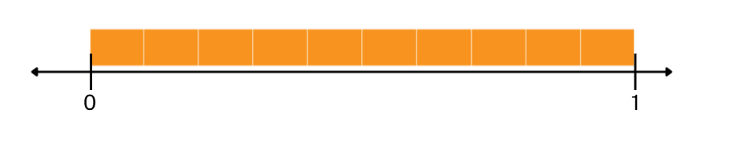
Short response (18)
Which decimal is larger, 0.7 or 0.37?
Communicate your reasoning using a number line.
Notes:
Short response questions provide brisk paced questions focussing on review of current and previous content to support spaced and interleaved practice.
Syllabus focus area:
Representing numbers using place value B

Slide 36
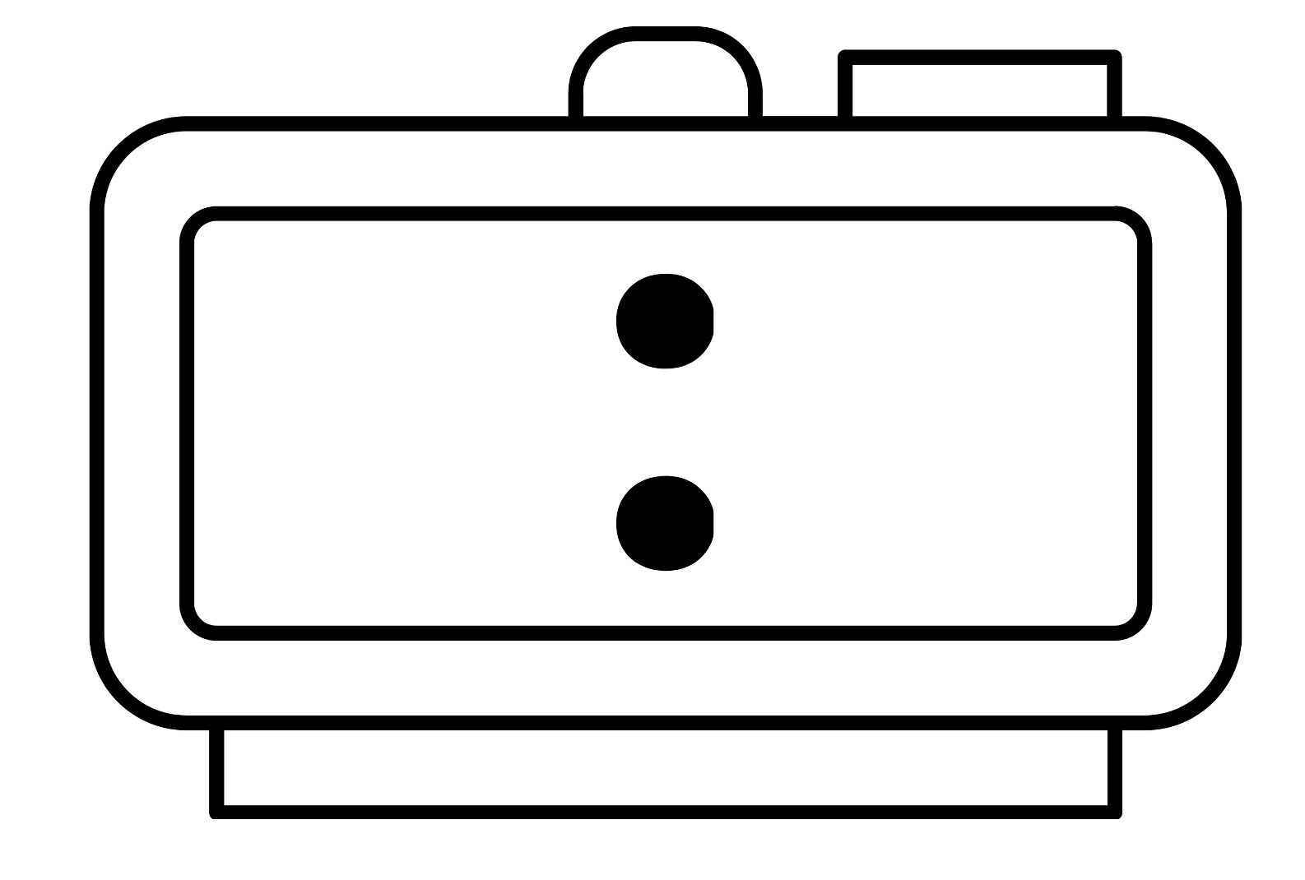
Short response (19)
Record the analog times in digital form.
A
B
C
Notes:
Short response questions provide brisk paced questions focussing on review of current and previous content to support spaced and interleaved practice.
Syllabus focus area:
Non-spatial measure B

Slide 37
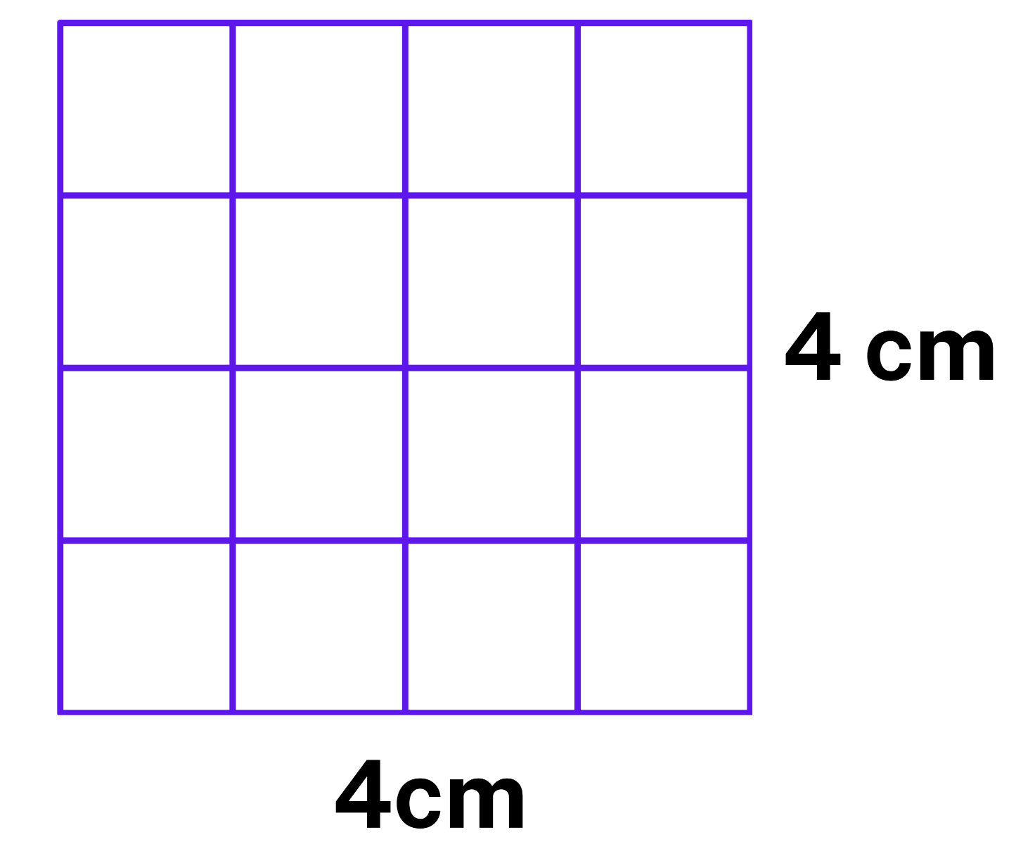
Short response (20)
Record the area in square centimetres using numerals and words.
Notes:
Short response questions provide brisk paced questions focussing on review of current and previous content to support spaced and interleaved practice.
Syllabus focus area:
Two-dimensional spatial structure A

Slide 38
Activity 5 – problem solving with money 1
What coins do we use in Australia?
Amir has one of each coin. He wants to buy a pair of shorts that costs $9.50.
- How much money does Amir have?
- How much more does he need to buy the shorts?
- What strategy can you use to calculate this?
Notes:
This is a developing number sense activity.
Number sense refers to a deep understanding of numbers, including their magnitude, relationships, and the effects of operations on them. It supports fluency and understanding, estimation, flexible thinking, and efficient problem-solving. Number sense activities 1–4 ‘activate’ prior number knowledge and support the learning of new content in the unit. Number sense activities 5–8 ‘loop’ back and provide opportunity for spaced practice with concepts and procedures covered in previous units.
Syllabus focus area:
Additive relations B
Problem solving with money 1
Brainstorm with students what coins there are in Australian currency. Show examples.
Pose the following problem: Amir has one of each coin. He wants to buy a pair of shorts that costs $9.50. Ask students:
- How much money does Amir have?
- How much more does he need to buy the shorts?
- What strategy can you use to calculate this?
Students turn and talk and record their thinking and strategies used.
Discuss the strategies used. Explain that addition and subtraction can be used to calculate the difference in money. Amir can subtract $3.85 from $9.50 or start at $3.85 and count up to $9.50 to find the difference.
Pose the following problem to students: The shorts are now on sale for $5.60. Ask students:
- What strategy can be used to work out how much more money Amir needs?
- How much more money does Amir need now?
- How can addition or subtraction be used to solve this problem?
- Is your chosen strategy effective?
Students share their ideas with a partner and reflect on whether their strategy is effective and whether it can be improved.

Slide 39
Review of learning 6

Slide 40
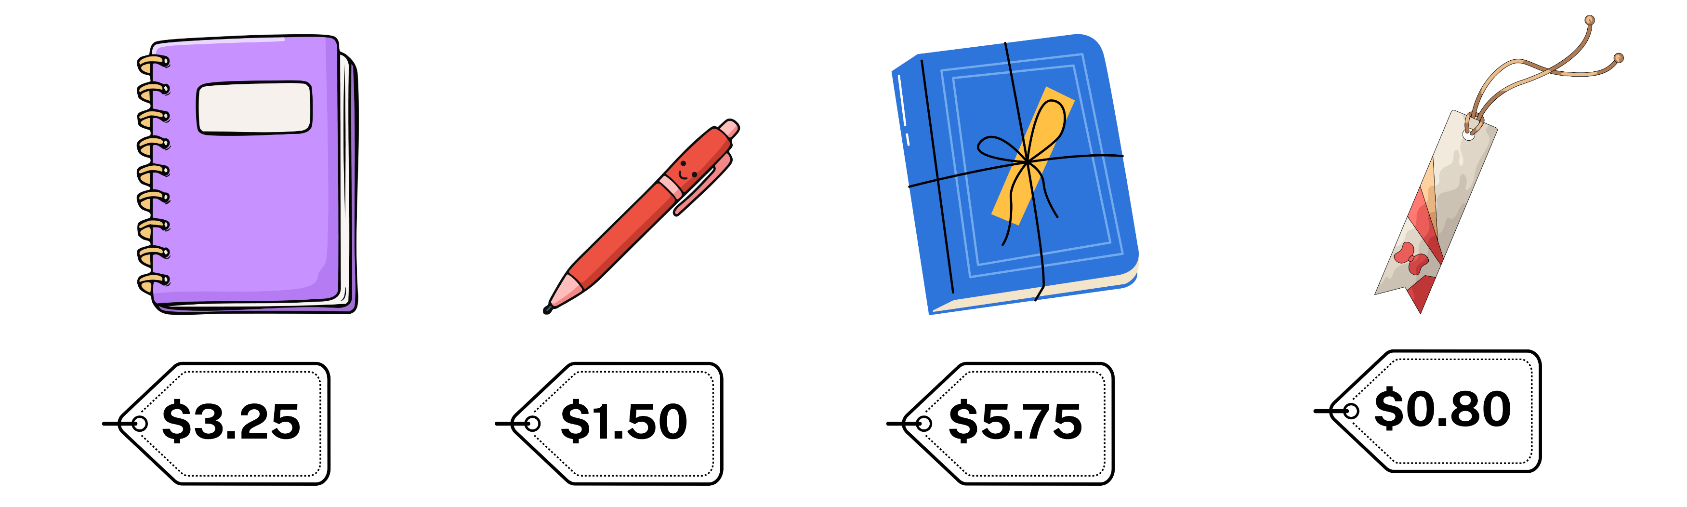
True or false (3)
A customer has a $20 note.
How much change will the customer receive from $20 after buying these items?
You will use addition (+) only to solve this problem.
True | False
Communicate your reasoning.
Notes:
The question on this slide connects to the content being explored in the developing number sense activity (Activity 6)
Syllabus focus area:
Additive relations B

Slide 41
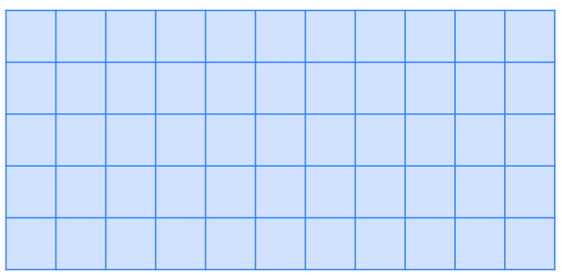
Short response (21)
Record the area of the rectangle in square centimetres using the array.
Notes:
Short response questions provide brisk paced questions focussing on review of current and previous content to support spaced and interleaved practice.
Syllabus focus area:
Two-dimensional spatial structure A

Slide 42
Short response (22)
Use the commutative property of multiplication (rearrange the order of numbers)
to solve the number sentence.
6 × 3 × 5
Notes:
Short response questions provide brisk paced questions focussing on review of current and previous content to support spaced and interleaved practice.
Syllabus focus area:
Multiplicative relations B

Slide 43
Short response (23)
Record how many minutes in:
a half-hour
one hour.
Notes:
Short response questions provide brisk paced questions focussing on review of current and previous content to support spaced and interleaved practice.
Syllabus focus area:
Non-spatial measure A

Slide 44
Short response (24)
Record the shapes that have parallel sides and/or right angles.
rectangle
triangle
circle
trapezium
Notes:
Short response questions provide brisk paced questions focussing on review of current and previous content to support spaced and interleaved practice.
Syllabus focus area:
Two-dimensional spatial structure A

Slide 45
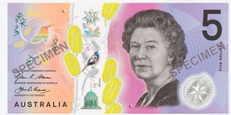



Activity 6 – problem solving with money 2
Samira has one of each note of Australian currency ($100, $50, $20, $10, and $5), six $2 coins and nine 50c coins. She wants to buy a skateboard that costs $225. Ask students:
- How much money does Samira have?
- How can she work out how much more money she needs?
- Will she use subtraction, addition, or a combination of both?
Notes:
This is a developing number sense activity.
Number sense refers to a deep understanding of numbers, including their magnitude, relationships, and the effects of operations on them. It supports fluency and understanding, estimation, flexible thinking, and efficient problem-solving. Number sense activities 1–4 ‘activate’ prior number knowledge and support the learning of new content in the unit. Number sense activities 5–8 ‘loop’ back and provide opportunity for spaced practice with concepts and procedures covered in previous units.
Syllabus focus area:
Additive relations B
Problem solving with money 2
Samira has one of each note of Australian currency ($100, $50, $20, $10, and $5), six $2 coins and nine 50c coins. She wants to buy a skateboard that costs $225. Ask students:
- How much money does Samira have?
- How can she work out how much more money she needs?
- Will she use subtraction, addition, or a combination of both?
In pairs students turn and talk to find a solution.
Share solutions and ask which strategy is most effective and why.
Samira’s aunty pays her $8 for doing some gardening and then Samira finds another 50c coin in her pocket. Ask students:
- How much money does Samira need now to buy the skateboard?
- Is the same strategy still the most effective? Why or why not?

Slide 46
Review of learning 7

Slide 47
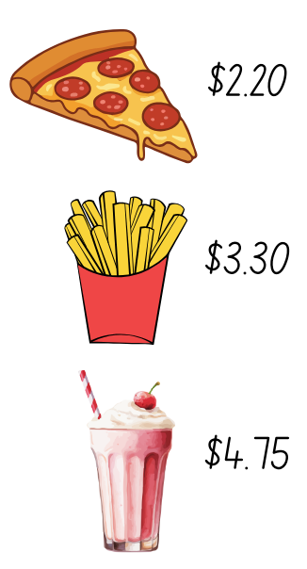
Multiple choice (4)
Which shows effective rounding to estimate the cost of the items?
A
Pizza: $2, Fries: $3, Milkshake: $4
B
Pizza: $3, Fries: $4, Milkshake: $5
C
Pizza: $3, Fries: $3, Milkshake: $5
D
Pizza: $2, Fries: $3, Milkshake: $5
Notes:
This question connects to the content in the developing number sense activity (Activity 3)
Syllabus focus area:
Additive relations B

Slide 48
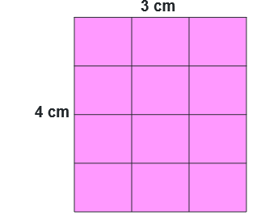
Short response (25)
Use the terms rows and columns to describe this array.
Describe another array with the same area.
Notes:
Short response questions provide brisk paced questions focussing on review of current and previous content to support spaced and interleaved practice.
Syllabus focus area:
Two-dimensional spatial structure B

Slide 49
Short response (26)
This array represents 6 x 8.
Record another way that 6 x 8 could be distributed using flexible partitioning.
Notes:
Short response questions provide brisk paced questions focussing on review of current and previous content to support spaced and interleaved practice.
Syllabus focus area:
Multiplicative relations B

Slide 50
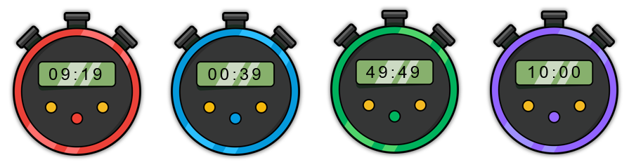
Short response (27)
Match the following digital times to the durations:
1
2
3
4
a
49 minutes and
49 seconds
b
0 minutes and 39 seconds
c
10 minutes and
0 seconds
d
9 minutes and 19 seconds
Notes:
Short response questions provide brisk paced questions focussing on review of current and previous content to support spaced and interleaved practice.
Syllabus focus area:
Non-spatial measure B

Slide 51
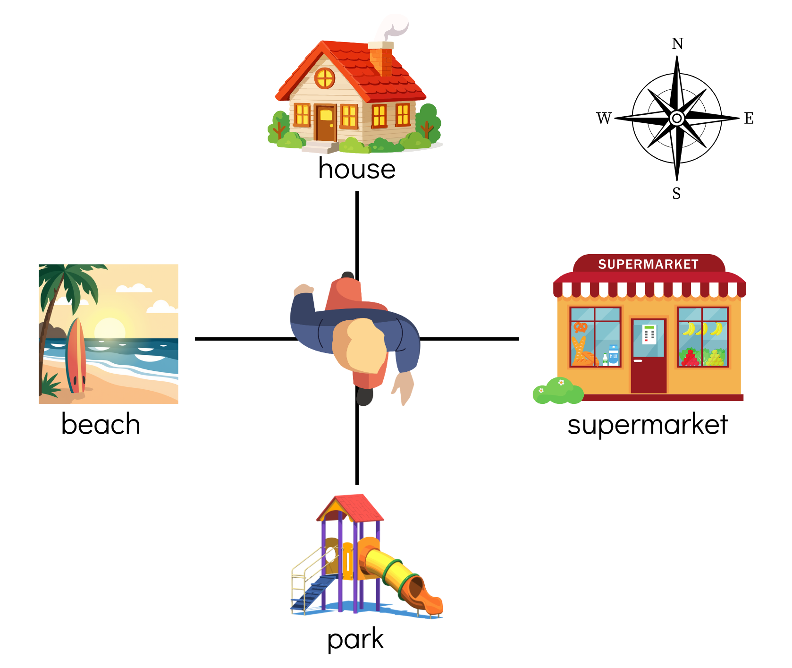
Short response (51)
Describe the amount of turn to face
the house
the beach.
Notes:
Short response questions provide brisk paced questions focussing on review of current and previous content to support spaced and interleaved practice.
Syllabus focus area:
Geometric measure B

Slide 52
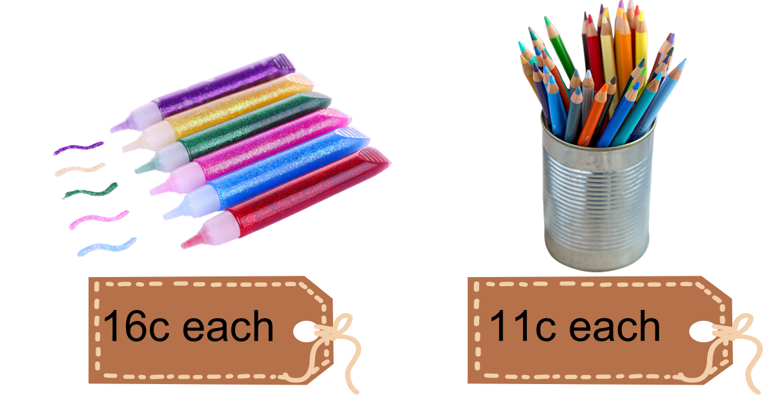
Activity 7 – using estimation for addition and subtraction involving money 1
Lisa’s mum has given her $5 to buy prizes for her stall at the school fair. Lisa and her mum only have a few minutes to shop for the prizes, so they will need to estimate the cost of their purchases quickly.
Lisa needs to buy a minimum of 40 prizes and she wants more than one type of prize. She finds glitter pens for 16c each, and coloured pencils for 11c each. Lisa has to decide whether she can buy at least 40 prizes with the money available.
Notes:
This is a developing number sense activity.
Number sense refers to a deep understanding of numbers, including their magnitude, relationships, and the effects of operations on them. It supports fluency and understanding, estimation, flexible thinking, and efficient problem-solving. Number sense activities 1–4 ‘activate’ prior number knowledge and support the learning of new content in the unit. Number sense activities 5–8 ‘loop’ back and provide opportunity for spaced practice with concepts and procedures covered in previous units.
Syllabus focus area:
Additive relations B
Using estimation for addition and subtraction involving money 1
This resource corresponds to Resource 17 – prize problem in Stage 2 Year B Unit 32.
Discuss the key information with students: $5, 40 prizes, pens for 16c and pencils for 11c.
Explain that Lisa must decide whether she can buy at least 40 prizes with the money available.
Ask students how they can use rounding and estimation to think quickly. Students turn and talk, recording their thinking on individual whiteboards. Some examples of student thinking might include:
- 16c is close to 15c, I can double that to get 30c and double again to get 60c. That gives me 4 pens and another 30c makes 6 pens for about 90c.
- 11c is about 10c so I could buy about 10 for a dollar.
- I can get about 6 pens for $1 and about 40 pencils for $4.
- I can get about 40 pencils for $4 so I know I can buy the minimum number needed. Then I can buy a few pens with the last dollar.
Discuss whether Lisa can buy a minimum of 40 prizes with the $5. Share the strategies used and which are most effective.

Slide 53
Review of learning 8

Slide 54
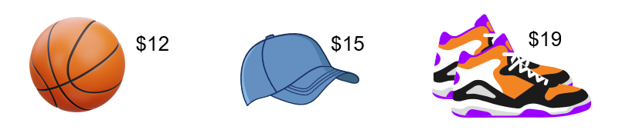
True or false (4)
$50 is a reasonable estimate for the items below.
True | False
Communicate your reasoning.
Notes:
The question on this slide connects to the content being explored in the developing number sense activity (Activity 8)
Syllabus focus area:
Additive relations B

Slide 55
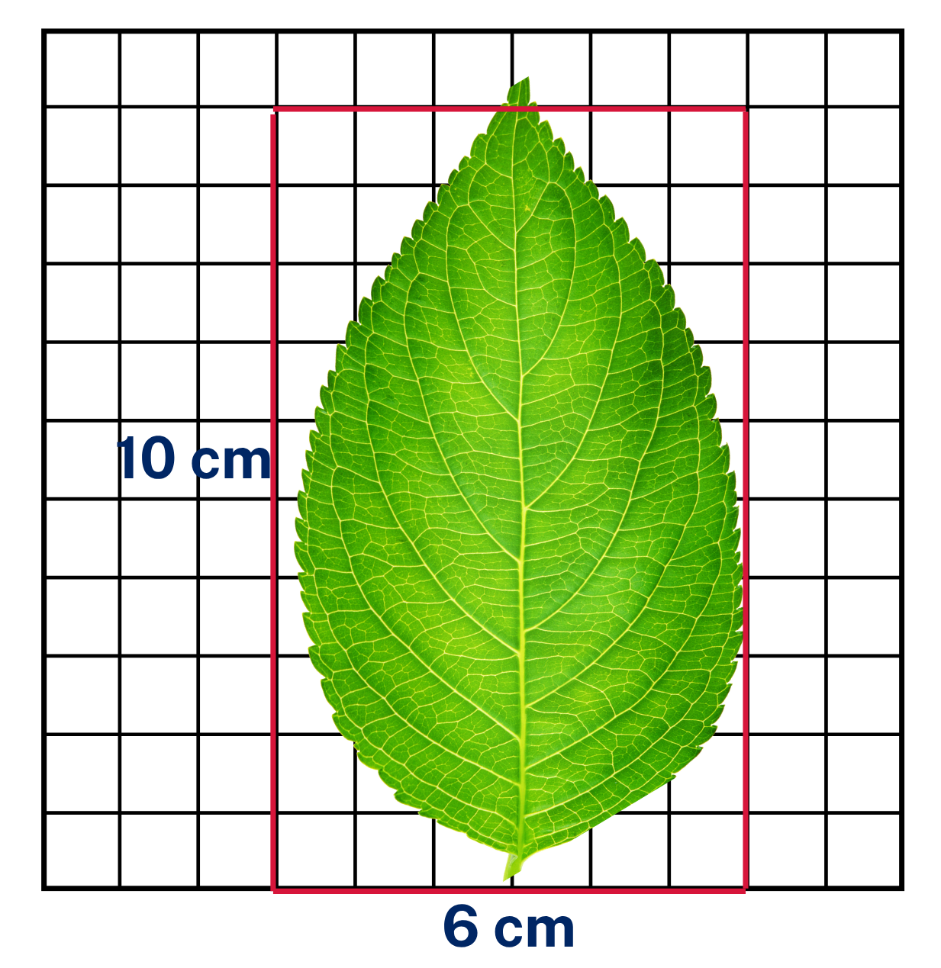
Short response (29)
Estimate the area of the leaf using the square centimetre grid overlay.
Notes:
Short response questions provide brisk paced questions focussing on review of current and previous content to support spaced and interleaved practice.
Syllabus focus area:
Two-dimensional spatial structure A

Slide 56
Short response (30)
Use multiples of 10 to partition the array to solve the number sentence.
4 x 16
Notes:
Short response questions provide brisk paced questions focussing on review of current and previous content to support spaced and interleaved practice.
Syllabus focus area:
Multiplicative relations B

Slide 57
Short response 55
Record the times in digital notation using am or pm:
20 past 10 in the morning
quarter-to 5 in the afternoon
10 minutes to 7 in the evening
Notes:
Short response questions provide brisk paced questions focussing on review of current and previous content to support spaced and interleaved practice.
Syllabus focus area:
Non-spatial measure B

Slide 58
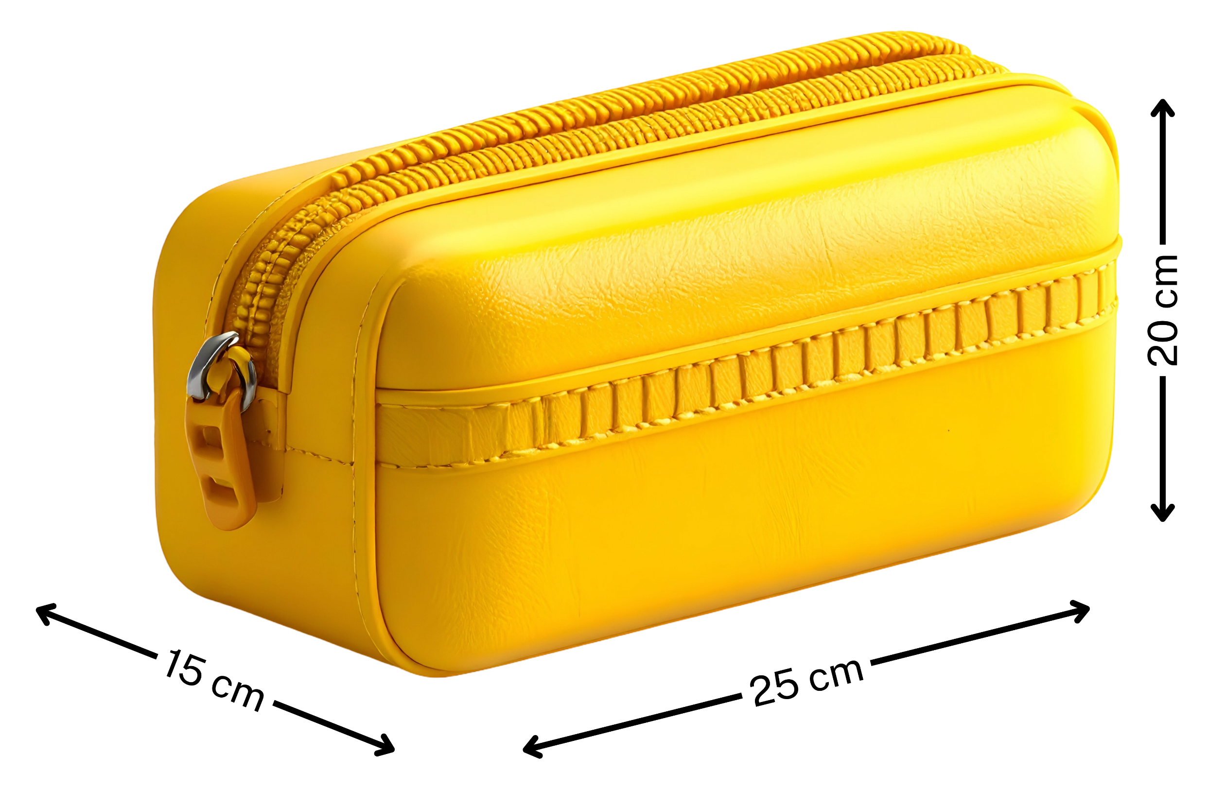
Short response (32)
Identify and record which measurements on the pencil case refer to the:
length
width
height
Notes:
Short response questions provide brisk paced questions focussing on review of current and previous content to support spaced and interleaved practice.
Syllabus focus area:
Geometric measure B

Slide 59
Activity 8 – using estimation for addition and subtraction involving money 2
I bought a sandwich for $3.80, a drink for $2.20, and a snack for $1.95. I estimate the total to be $20.00.
Without calculating exactly, is $20 a ‘good estimate’?
How could we estimate to check?
Notes:
This is a developing number sense activity.
Number sense refers to a deep understanding of numbers, including their magnitude, relationships, and the effects of operations on them. It supports fluency and understanding, estimation, flexible thinking, and efficient problem-solving. Number sense activities 1–4 ‘activate’ prior number knowledge and support the learning of new content in the unit. Number sense activities 5–8 ‘loop’ back and provide opportunity for spaced practice with concepts and procedures covered in previous units.
Syllabus focus area:
Additive relations B
Using estimation for addition and subtraction involving money 2
Pose the problem: I bought a sandwich for $3.80, a drink for $2.20, and a snack for $1.95. I estimate the total to be $20.00.
Discuss how estimation helps to quickly check the validity of solutions and to see if an estimated answer is reasonable.
Ask:
- Without calculating exactly, is $20 a ‘good estimate’?
- How could we estimate to check?
Demonstrate recording the estimates for the items bought and decide if this was a ‘good estimate’. For example:
- sandwich is $3.80, so round to $4.00
- drink is $2.20, so round to $2.00
- snack is $1.95, so round to $2.00
- estimated total = $8.00, therefore $20.00 is not a ‘good estimate’.
Pose a range of addition and subtraction problems involving money.
In pairs, students decide on a total that represents a ‘good estimate’ using rounding. Students swap with another pair to check and decide if the estimate was a ‘good estimate’.
Prompt students to record and discuss the rounded total, the estimated answer and to explain if the estimate was a ‘good estimate’ or not.

Slide 60
Double Venn diagram
Object 1
Object 2
Features similar to both objects
Features of object 1
Features of object 2

Slide 61
Frayer
Definition
Facts/Characteristics
Word, term, concept
Examples
Non-examples

Slide 62
Spider map
Idea
Subject

Slide 63
Cline
Concept 1
Concept 2
Word
Word
Word
Word
Word
Word
Word
Word
Word
Word
Word

Slide 64
Compare and contrast

Slide 65
Multiple choice (5)
A
B
C
D

Slide 66
Multiple choice
A
B
C
D
Notes:
This question connects to the content in the developing number sense activity (Activity 3)
Syllabus focus area:
[Focus area A/B]

Slide 67
References
This presentation contains NSW Curriculum and syllabus content. The NSW Curriculum is developed by the NSW Education Standards Authority. This content is prepared by NESA for and on behalf of the Crown in the right of the State of New South Wales. The material is protected by Crown copyright.
Please refer to the NESA Copyright Disclaimer for more information https://educationstandards.nsw.edu.au/wps/portal/nesa/mini-footer/copyright.
NESA holds the only official and up-to-date versions of the NSW Curriculum and syllabus documents. Please visit the NSW Education Standards Authority (NESA) website https://educationstandards.nsw.edu.au/wps/portal/nesa/home and the NSW Curriculum website https://curriculum.nsw.edu.au.
Mathematics K–10 Syllabus © NSW Education Standards Authority (NESA) for and on behalf of the Crown in right of the State of New South Wales, 2022.
National Numeracy Learning Progression © Australian Curriculum, Assessment and Reporting Authority (ACARA) 2010 to present, unless otherwise indicated. This material was downloaded from the Australian Curriculum website (National Numeracy Learning Progression) (accessed 1 April 2026) and was not modified.
Boaler J, Munson J, Williams C (2017) Mindset Mathematics: Visualizing and Investigating Big Ideas, Grade 3, Jossey-Bass: San Francisco.
——(2017) Mindset Mathematics: Visualizing and Investigating Big Ideas, Grade 4, Jossey-Bass: San Francisco.
Siemon D, Warren E, Beswick K, Faragher R, Miller J, Horne M, Jazby D, Breed M, Clark J and Brady K (2020) Teaching Mathematics: Foundations to Middle Years, 3rd edn, Oxford University Press Australia and New Zealand.
Van de Walle J, Karp K, Bay-Williams J M, Brass A, Bentley B, Ferguson S, Goff W, Livy S, Marshman M, Martin D, Pearn C, Prodromou T, Symons D and Wilkie K (2019) Primary and Middle Years Mathematics: Teaching Developmentally, 1st Australian edn, Pearson Education Australia, Melbourne.

Slide 68
Copyright
© State of New South Wales (Department of Education), 2025
The copyright material published in this resource is subject to the Copyright Act 1968 (Cth) and is owned by the NSW Department of Education or, where indicated, by a party other than the NSW Department of Education (third-party material).
Copyright material available in this resource and owned by the NSW Department of Education is licensed under a Creative Commons Attribution 4.0 International (CC BY 4.0) license.
This license allows you to share and adapt the material for any purpose, even commercially.
Attribution should be given to © State of New South Wales (Department of Education), 2025.
Material in this resource not available under a Creative Commons license:
the NSW Department of Education logo, other logos and trademark-protected material
Material owned by a third party that has been reproduced with permission. You will need to obtain permission from the third party to reuse its material.
Links to third-party material and websites
Please note that the provided (reading/viewing material/list/links/texts) are a suggestion only and implies no endorsement, by the New South Wales Department of Education, of any author, publisher, or book title. School principals and teachers are best placed to assess the suitability of resources that would complement the curriculum and reflect the needs and interests of their students.
If you use the links provided in this document to access a third party’s website, you acknowledge that the terms of use, including licence terms set out on the third-party’s website apply to the use which may be made of the materials on that third-party website or where permitted by the Copyright Act 1968 (Cth). The department accepts no responsibility for content on third-party websites.

