Slide 1
Instructions for use
This resource aligns to the learning in Stage 2 Year B Unit 33 and revisits content from earlier sample units.
Classroom teachers are encouraged to add and adapt slides as required to meet the needs of their students.
Save a copy of the file to make changes to the slide deck. Go to File > Download a Copy (this downloads a copy to the computer to edit in the PowerPoint app).
To convert the PowerPoint to Google Slides:
  Upload the file into Google Drive and open it.
  Go to File > Save as Google Slides.
  (Note – conversion may cause formatting changes in the slides.)

Slide 2

Review of Learning
Mathematics Stage 2 – Unit 33
Notes:
Reviews may include a combination of question types, requiring students to recall facts and key ideas, as well as apply their knowledge to solve problems and answer questions. To support active engagement, a mix of techniques should be employed.” (AERO, 2024).
This Review of Learning slide deck revisits key concepts from the following units:
Stage 2 Year B Unit 33
Stage 2 Year B Unit 32
Stage 2 Year B Unit 31
It also includes opportunities to review prior learning in non-number content, supporting consolidation across focus areas.
The review of learning resources include three key task types that support the development of mathematical proficiency through retrieval, spaced practice, and active participation. These practices complement the review phase (activating prior knowledge) embedded within the beginning of each lesson.
1.
Multiple-choice questions/True or false: Designed to promote active retrieval of key concepts and identify common misconceptions in number, supporting consolidation, understanding and fluency.
These questions:
support spaced and interleaved practice
help identify and address common misconceptions
support active recall and immediate feedback
support whole class participation
identify areas requiring reteach
2.
Short-response question sets: Carefully grouped questions that encourage spaced and interleaved practice across multiple focus areas, helping students revisit and apply knowledge from different points in time.
These questions:
have a combination of question types
address a range of focus areas
build automaticity and fluency
support active recall
allow for immediate feedback
identify content requiring reteach
3.
Developing number sense activities: A variety of practical, purposeful tasks that reinforce current learning and build on prior knowledge. These activities promote reasoning, problem-solving and conceptual understanding.
The review of learning resources are designed to work support teaching and learning in mathematics. For the most effective implementation, use the resources flexibly, adapting to meet student learning needs and individual classroom contexts.

Slide 3
Lessons
1
Review of learning 1
5
Review of learning 5
2
Review of learning 2
6
Review of learning 6
3
Review of learning 3
7
Review of learning 7
4
Review of learning 4
8
Review of learning 8
Notes:
Teacher notes:
Click lesson titles to go to specific lessons
Interactive features can be viewed in slide show

Slide 4
Review of learning 1

Slide 5

Multiple choice (1)
4 × ___ = 28
A
B
C
D
5
6
7
8
Notes:
This question connects to the content in the developing number sense activity (Activity 1)
Syllabus focus area:
Multiplicative relations B

Slide 6

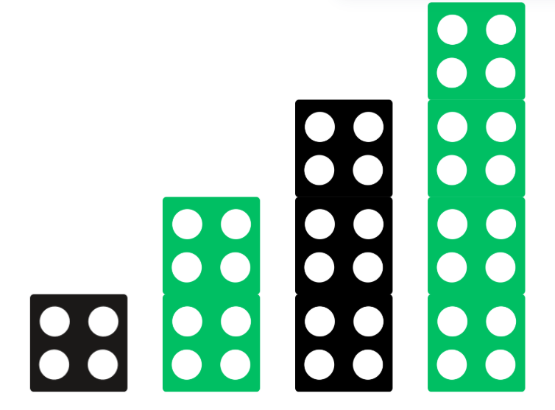
Short response (1)
Record the multiples for this pattern.
Record the next 3 multiples in the pattern.
Notes:
Short response questions provide brisk paced questions focussing on review of current and previous content to support spaced and interleaved practice.
Syllabus focus area:
Multiplicative relations A

Slide 7

Short response (2)
Is a kite a quadrilateral?
Does it have equal sides?
Does it have parallel sides?
Communicate your reasoning.
Notes:
Short response questions provide brisk paced questions focussing on review of current and previous content to support spaced and interleaved practice.
Syllabus focus area:
Two-dimensional spatial structure A

Slide 8
Short response (3)
Rearrange the digits in 45 712 to make the smallest and largest number possible.
Notes:
Short response questions provide brisk paced questions focussing on review of current and previous content to support spaced and interleaved practice.
Syllabus focus area:
Representing numbers using place value B

Slide 9
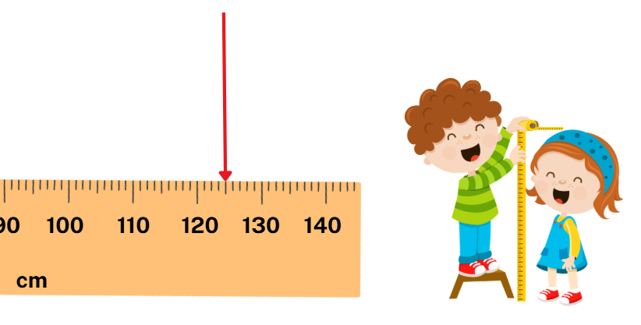
Short response (4)
Flynn measured his sister’s height.
The arrow shows her height on a tape measure.
Record the height using a combination of metres and centimetres.
Notes:
Short response questions provide brisk paced questions focussing on review of current and previous content to support spaced and interleaved practice.
Syllabus focus area:
Geometric measure A

Slide 10

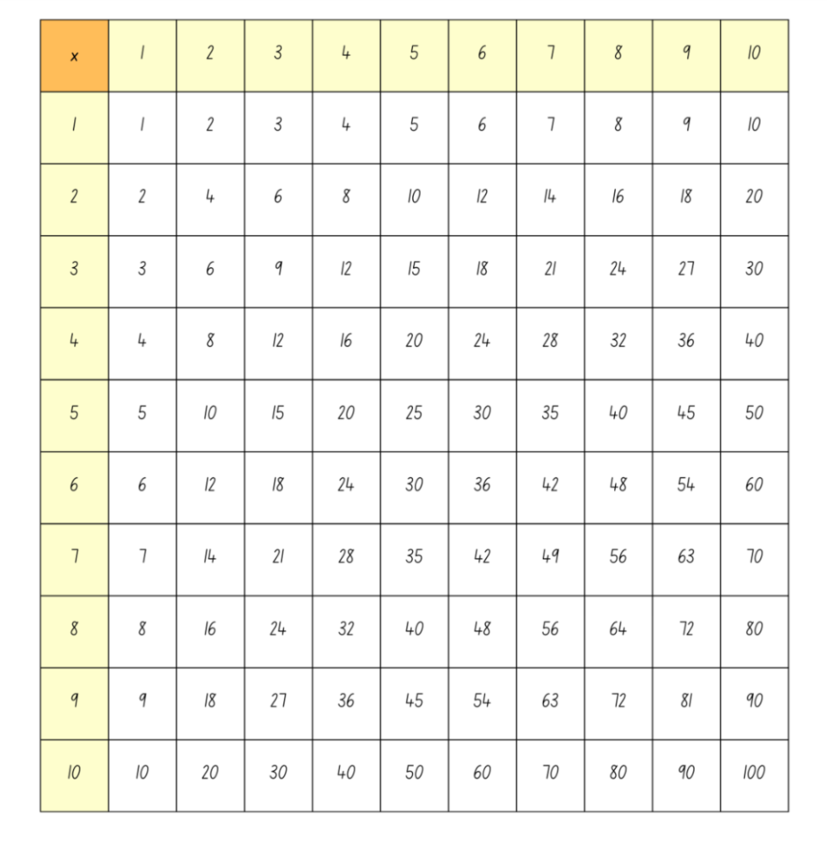
Activity 1 – multiples madness (1)
Notes:
Note: this slide is designed to be viewed in presentation mode.
This is a developing number sense activity.
Number sense refers to a deep understanding of numbers, including their magnitude, relationships, and the effects of operations on them. It supports fluency and understanding, estimation, flexible thinking, and efficient problem-solving. Number sense activities 1–4 ‘activate’ prior number knowledge and support the learning of new content in the unit. Number sense activities 5–8 ‘loop’ back and provide opportunity for spaced practice with concepts and procedures covered in previous units.
Syllabus focus area:
Multiplicative relations B
Multiples madness
This resource corresponds to Resource 16 – multiplication chart, Resource 17 – multiples madness and see Figure 3 – multiplication chart 4 and 8 in Stage 2 Year B Unit 33.
Revise that the numbers highlighted in yellow across the top and down the side represent the factors. Where a row and column meet shows the product. For example, where 3 (across the top) and 4 (down the side) intersect, the product is 12.
Call out the multiples of 4 and highlight the row and column.
Repeat with the multiples of 8 (see Figure 3).
Ask:
What patterns do you see?
What similarities and patterns do you notice between the multiples of 4 and 8?
How can knowing ×4 facts help with finding ×8 facts?
What is the product of 4 and 6, 8 and 3, 4 and 7, 8 and 7.
Select 4 or 8 to be the multiple and instruct students to fill in the gameboard with numbers accordingly. For example, if number 4 is chosen, the gameboard would be filled with 0, 4, 8, 12, 16, 20, 24, 32, 36, 40.
Players take turns to roll the dice.
They multiply the number rolled by the chosen multiple and record their number sentence on Resource 17 – multiples madness. For example, if 6 is rolled, the player would record 6 × 4 = 24.
They then place one of their counters on the number on the gameboard, claiming that place.
If the number is taken, players miss a turn.
Since players only have 3 counters, they will need to choose which counter to move once all 3 have been placed on the gameboard.
A player wins by getting 3 counters in a row (in any orientation).

Slide 11
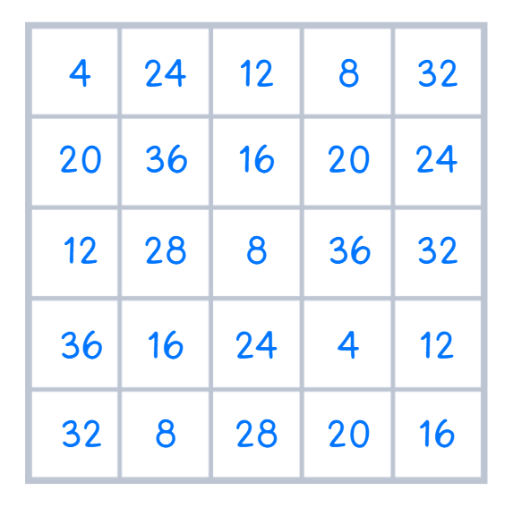
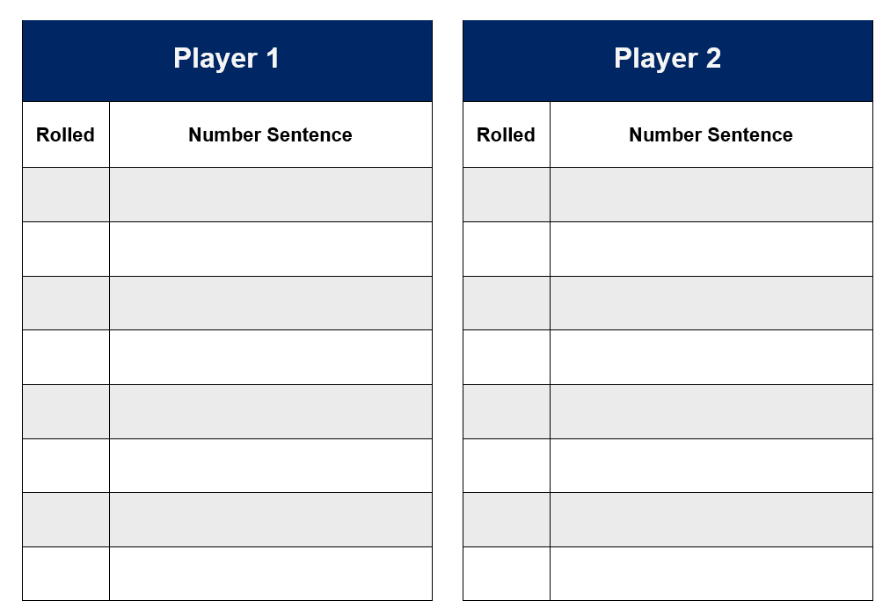
Activity 1 – multiples madness (2)
3
3 × 4 = 12
8
8 × 4 = 32
Notes:
Note: this slide is designed to be viewed in presentation mode.
This is a developing number sense activity.
Number sense refers to a deep understanding of numbers, including their magnitude, relationships, and the effects of operations on them. It supports fluency and understanding, estimation, flexible thinking, and efficient problem-solving. Number sense activities 1–4 ‘activate’ prior number knowledge and support the learning of new content in the unit. Number sense activities 5–8 ‘loop’ back and provide opportunity for spaced practice with concepts and procedures covered in previous units.
Syllabus focus area:
Multiplicative relations B
Multiples madness
This resource corresponds to Resource 17 – multiples madness in Stage 2 Year B Unit 33.
Provide students with a 9-sided dice, 3 counters in two colours and Resource 17 – multiples madness.
Select 4 or 8 to be the multiple and instruct students to fill in the gameboard with numbers accordingly. For example, if number 4 is chosen, the gameboard would be filled with 4, 8, 12, 16, 20, 24, 28, 32, 36.
Players take turns to roll the dice.
They multiply the number rolled by the chosen multiple and record their number sentence on Resource 17 – multiples madness. For example, if 6 is rolled, the player would record 6 × 4 = 24.
They then place one of their counters on the number on the gameboard, claiming that place.
If the number is taken, players miss a turn.
Since players only have 3 counters, they will need to choose which counter to move once all 3 have been placed on the gameboard.
A player wins by getting three counters in a row (in any orientation).

Slide 12
Review of learning 2

Slide 13
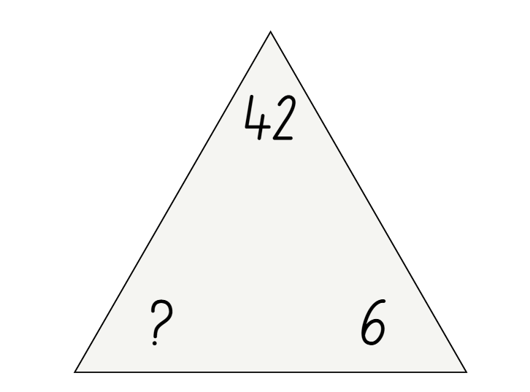
True or false (1)
The missing number in the fact family triangle is 8.
True | False
Notes:
The question on this slide connects to the content being explored in the developing number sense activity (Activity 2)
Syllabus focus area:
Multiplicative relations B

Slide 14
Short response (5)
Record the first 10 multiples when counting by twos and fours.
Circle the numbers that appear in both sequences.
Notes:
Short response questions provide brisk paced questions focussing on review of current and previous content to support spaced and interleaved practice.
Syllabus focus area:
Multiplicative relations A

Slide 15

Short response (6)
This shape has been created by combining other shapes.
What is the name of the new 2D shape?
Which shapes have been combined?
Notes:
Short response questions provide brisk paced questions focussing on review of current and previous content to support spaced and interleaved practice.
Syllabus focus area:
Two-dimensional spatial structure B

Slide 16
Short response (7)
Record the number 89 507
in expanded notation.
Notes:
Short response questions provide brisk paced questions focussing on review of current and previous content to support spaced and interleaved practice.
Syllabus focus area:
Representing numbers using place value B

Slide 17
Short response (8)
Order these lengths from shortest to longest.
5 m 65 cm
6m 56 cm
65 m 5 cm
56 m 65 cm
Notes:
Short response questions provide brisk paced questions focussing on review of current and previous content to support spaced and interleaved practice.
Syllabus focus area:
Geometric measure A

Slide 18
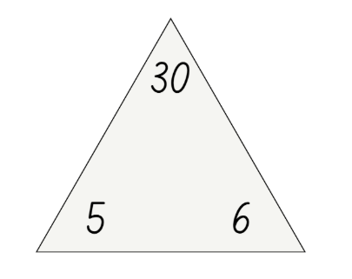
Activity 2 – fact family triangles (1)
Notes:
This is a developing number sense activity.
Number sense refers to a deep understanding of numbers, including their magnitude, relationships, and the effects of operations on them. It supports fluency and understanding, estimation, flexible thinking, and efficient problem-solving. Number sense activities 1–4 ‘activate’ prior number knowledge and support the learning of new content in the unit. Number sense activities 5–8 ‘loop’ back and provide opportunity for spaced practice with concepts and procedures covered in previous units.
Syllabus focus area:
Multiplicative relations B
Fact family triangles
This figure corresponds to Figure 4 – fact family triangle in Stage 2 Year B Unit 33.
Revise that the two factors (5 and 6) are at the bottom of the triangle and the product (30) is at the top.
Revise the relationships between the numbers in the triangle and how these relate to multiplication and division facts and number sentences.
Select students to provide the number sentences for the fact family triangle and record them on the board. Ensure students recognise the inverse relationship between the multiplication and division number sentences.
Provide students with Resource 18 – fact family triangles.
Instruct them to complete each triangle by filling in the missing factor or product. They then record all 4 related multiplication and division number sentences underneath.

Slide 19
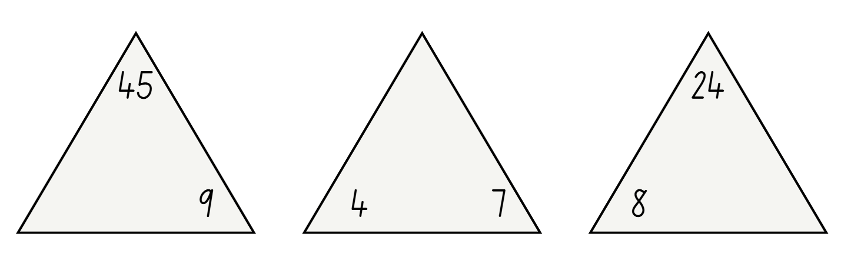
Activity 2 – fact family triangles (2)
Notes:
This is a developing number sense activity.
Number sense refers to a deep understanding of numbers, including their magnitude, relationships, and the effects of operations on them. It supports fluency and understanding, estimation, flexible thinking, and efficient problem-solving. Number sense activities 1–4 ‘activate’ prior number knowledge and support the learning of new content in the unit. Number sense activities 5–8 ‘loop’ back and provide opportunity for spaced practice with concepts and procedures covered in previous units.
Syllabus focus area:
Multiplicative relations B
Fact family triangles
This resource corresponds to Resource 18 – fact family triangles in Stage 2 Year B Unit 33.
Provide students with Resource 18 – fact family triangles.
Instruct them to complete each triangle by filling in the missing factor or product. They then record all four related multiplication and division number sentences underneath.

Slide 20
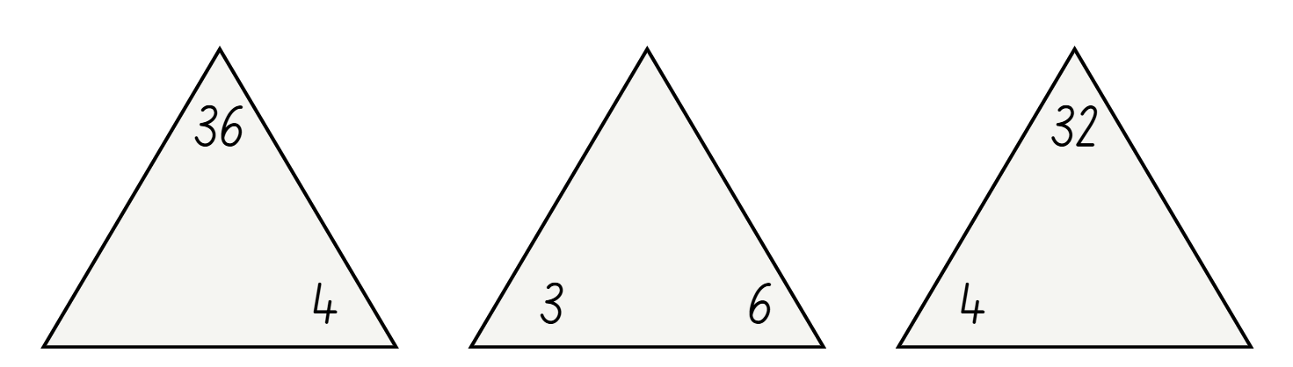
Activity 2 – fact family triangles (3)
Notes:
This is a developing number sense activity.
Number sense refers to a deep understanding of numbers, including their magnitude, relationships, and the effects of operations on them. It supports fluency and understanding, estimation, flexible thinking, and efficient problem-solving. Number sense activities 1–4 ‘activate’ prior number knowledge and support the learning of new content in the unit. Number sense activities 5–8 ‘loop’ back and provide opportunity for spaced practice with concepts and procedures covered in previous units.
Syllabus focus area:
Multiplicative relations B
Fact family triangles
This resource corresponds to Resource 18 – fact family triangles in Stage 2 Year B Unit 33.
Provide students with Resource 18 – fact family triangles.
Instruct them to complete each triangle by filling in the missing factor or product. They then record all four related multiplication and division number sentences underneath.

Slide 21
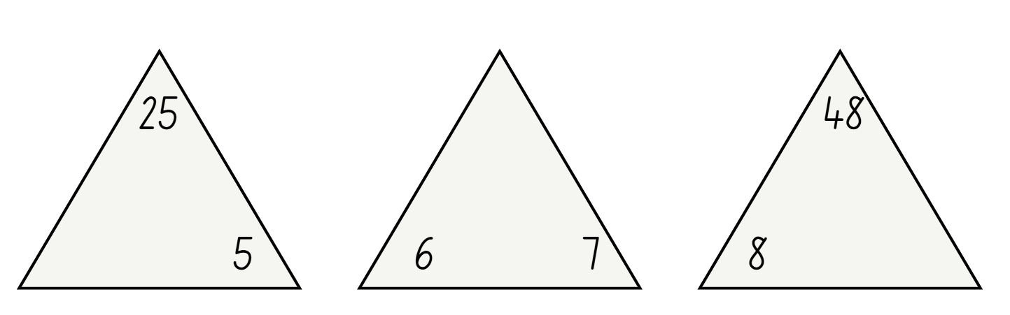
Activity 2 – fact family triangles (4)
Notes:
This is a developing number sense activity.
Number sense refers to a deep understanding of numbers, including their magnitude, relationships, and the effects of operations on them. It supports fluency and understanding, estimation, flexible thinking, and efficient problem-solving. Number sense activities 1–4 ‘activate’ prior number knowledge and support the learning of new content in the unit. Number sense activities 5–8 ‘loop’ back and provide opportunity for spaced practice with concepts and procedures covered in previous units.
Syllabus focus area:
Multiplicative relations B
Fact family triangles
This resource corresponds to Resource 18 – fact family triangles in Stage 2 Year B Unit 33.
Provide students with Resource 18 – fact family triangles.
Instruct them to complete each triangle by filling in the missing factor or product. They then record all four related multiplication and division number sentences underneath.

Slide 22
Review of learning 3

Slide 23
Multiple choice (2)
36 ÷ ___ = 12
A
B
C
D
2
3
4
6
Notes:
This question connects to the content in the developing number sense activity (Activity 3)
Syllabus focus area:
Multiplicative relations B

Slide 24
Short response (9)
Use the distributive property to solve 6 × 7.
Notes:
Short response questions provide brisk paced questions focussing on review of current and previous content to support spaced and interleaved practice.
Syllabus focus area:
Multiplicative relations B

Slide 25

Short response (10)
Create a tessellating design by reflecting, translating or rotating the triangle 3 times.
Describe your transformations.
Notes:
Short response questions provide brisk paced questions focussing on review of current and previous content to support spaced and interleaved practice.
Syllabus focus area:
Two-dimensional spatial structure A

Slide 26
Short response (11)
Does 0.70 have the same value as 0.7?
What is the role of the zero in 0.70?
Notes:
Short response questions provide brisk paced questions focussing on review of current and previous content to support spaced and interleaved practice.
Syllabus focus area:
Representing numbers using place value B

Slide 27
Short response (12)
Match the item to the most appropriate tool to measure its length.
1. school hall
2. eraser
3. balance beam
A. 30 cm ruler
B. metre ruler
C. trundle wheel
Notes:
Short response questions provide brisk paced questions focussing on review of current and previous content to support spaced and interleaved practice.
Syllabus focus area:
Geometric measure B

Slide 28
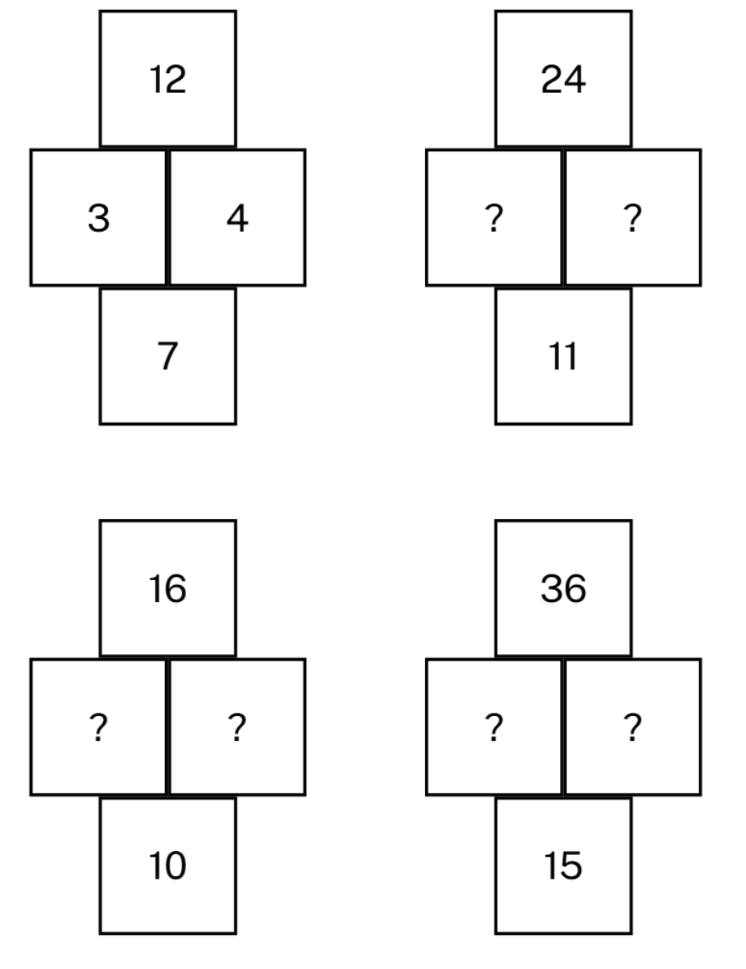
Activity 3 – factor puzzle 1
Notes:
This is a developing number sense activity.
Number sense refers to a deep understanding of numbers, including their magnitude, relationships, and the effects of operations on them. It supports fluency and understanding, estimation, flexible thinking, and efficient problem-solving. Number sense activities 1–4 ‘activate’ prior number knowledge and support the learning of new content in the unit. Number sense activities 5–8 ‘loop’ back and provide opportunity for spaced practice with concepts and procedures covered in previous units.
Syllabus focus area:
Multiplicative relations B
Factor puzzle 1
This activity is an adaptation of ‘Factor puzzles’ from Maths is FigureOutAble! by Pam Harris.
This resource corresponds to Resource 19 – factor puzzle 1 in Stage 2 Year B Unit 33.
Ask:
Can you see any relationships between the numbers in the puzzle? (the middle numbers are factors of the number at the top. The number at the bottom is the sum of the factors).
Could other factors of 12, for example 6 and 2, replace the 3 and 4? Why or Why not? (6 + 2 = 8, so it does not fit the structure of the puzzle).
Provide students with Resource 19 – factor puzzle 1. Students turn and talk to determine the missing numbers in one or all of the puzzles.
Regroup and select students to share their solutions. Encourage them to communicate their thinking using multiplicative vocabulary.

Slide 29
Review of learning 4

Slide 30
True or false (2)
1, 2, 3, 4, 6, 9, 12, 13, 36
are factors of 36.
True | False
Communicate your reasoning.
Notes:
The question on this slide connects to the content being explored in the developing number sense activity (Activity 4)
Syllabus focus area:
Multiplicative relations B

Slide 31
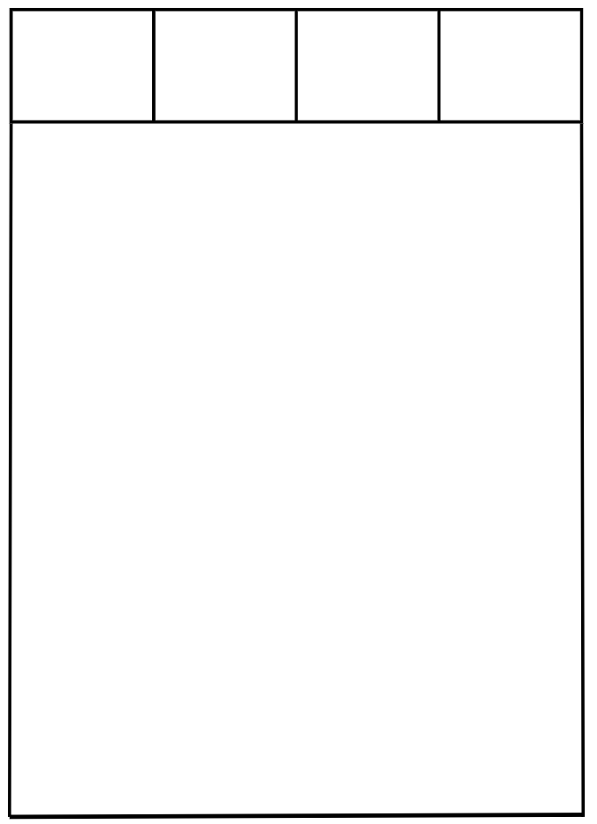
Short response (13)
Only the top row of 4 squares is visible on this rectangular grid.
The total number of squares on this grid is 28.
Record how many rows there must be.
Notes:
Short response questions provide brisk paced questions focussing on review of current and previous content to support spaced and interleaved practice.
Syllabus focus area:
Multiplicative relations B

Slide 32

Short response (14)
How many lines of symmetry can you identify on this tile?
Notes:
Short response questions provide brisk paced questions focussing on review of current and previous content to support spaced and interleaved practice.
Syllabus focus area:
Two-dimensional spatial structure A

Slide 33
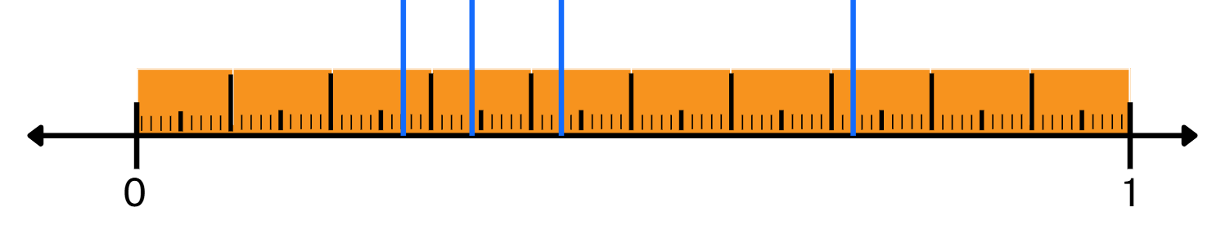
Short response (15)
Record the decimals at A, B, C, D on the number line.
A
B
C
D
Communicate your reasoning.
Notes:
Short response questions provide brisk paced questions focussing on review of current and previous content to support spaced and interleaved practice.
Syllabus focus area:
Representing numbers using place value B

Slide 34
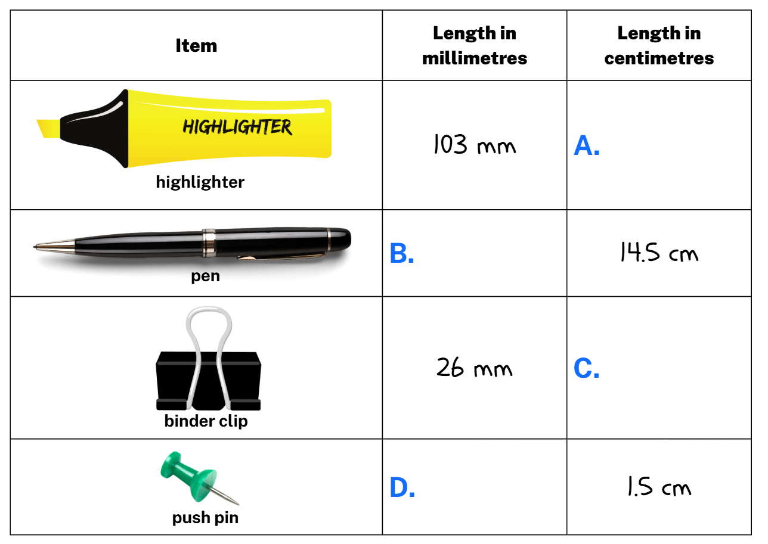
Short response (16)
Record the lengths at A, B, C, D by converting them into either millimetres or centimetres.
Notes:
Short response questions provide brisk paced questions focussing on review of current and previous content to support spaced and interleaved practice.
Syllabus focus area:
Geometric measure B

Slide 35
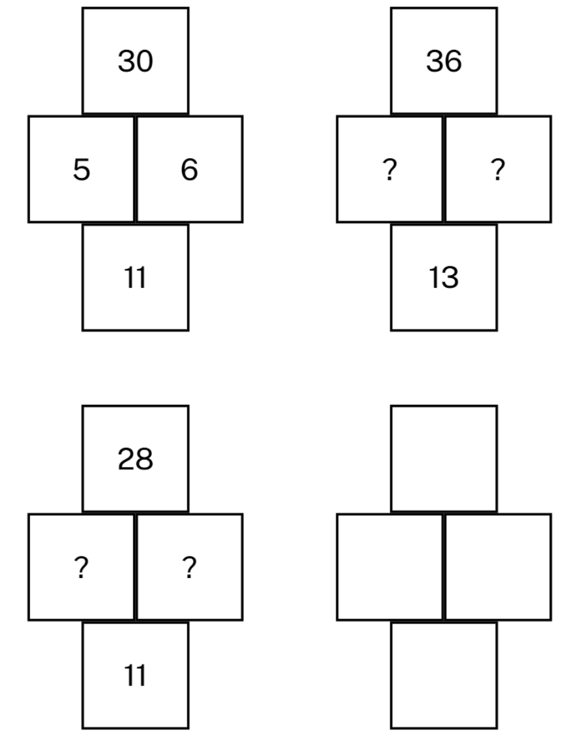
Activity 4 – factor puzzle 2
Notes:
This is a developing number sense activity.
Number sense refers to a deep understanding of numbers, including their magnitude, relationships, and the effects of operations on them. It supports fluency and understanding, estimation, flexible thinking, and efficient problem-solving. Number sense activities 1–4 ‘activate’ prior number knowledge and support the learning of new content in the unit. Number sense activities 5–8 ‘loop’ back and provide opportunity for spaced practice with concepts and procedures covered in previous units.
Syllabus focus area:
Multiplicative relations B
Factor puzzle 2
This activity is an adaptation of ‘Factor puzzles’ from Maths is FigureOutAble! by Pam Harris.
This resource corresponds to Resource 20 – factor puzzle 2 in Stage 2 Year B Unit 33.
Revise the structure of the puzzles from Activity 3.
Ask:
Can you see any relationships between the numbers in the puzzle? (the middle numbers are factors of the number at the top. The number at the bottom is the sum of the factors).
Could other factors of 30, for example 3 and 10, replace the 5 and 6? Why or Why not? (3 + 10 = 13, so it does not fit the structure of the puzzle).
Provide students with Resource 20 – factor puzzle 2. Students turn and talk to determine the missing numbers one or all of the puzzles.
Regroup and select students to share their solutions. Encourage them to communicate their thinking using multiplicative vocabulary.
Prompt students to create their own factor puzzle by filling in the blank puzzle on Resource 20 – factor puzzle 2.
Students swap with a partner, solve each other’s puzzles, and then check and discuss their answers together.

Slide 36
Review of learning 5

Slide 37
Multiple choice (3)
68 − __ = 15
A
B
C
D
63
43
54
53
Notes:
This question connects to the content in the developing number sense activity (Activity 5)
Syllabus focus area:
Additive relations B

Slide 38
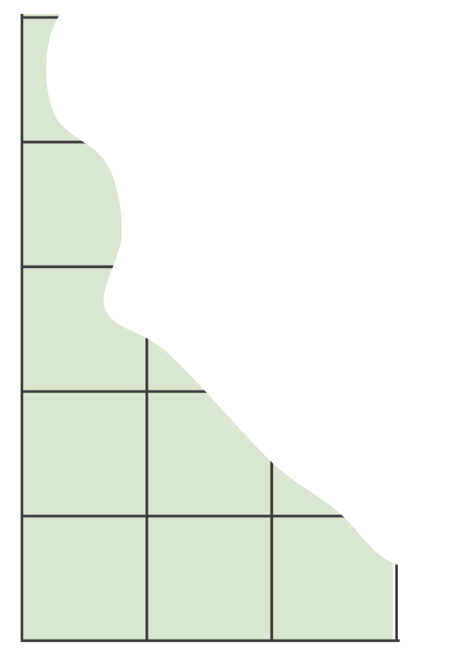
Short response (17)
This area model has been torn.
The number of rows and columns are still visible.
Describe the rows × columns.
Record the multiplication sentence.
Notes:
Short response questions provide brisk paced questions focussing on review of current and previous content to support spaced and interleaved practice.
Syllabus focus area:
Multiplicative relations B

Slide 39
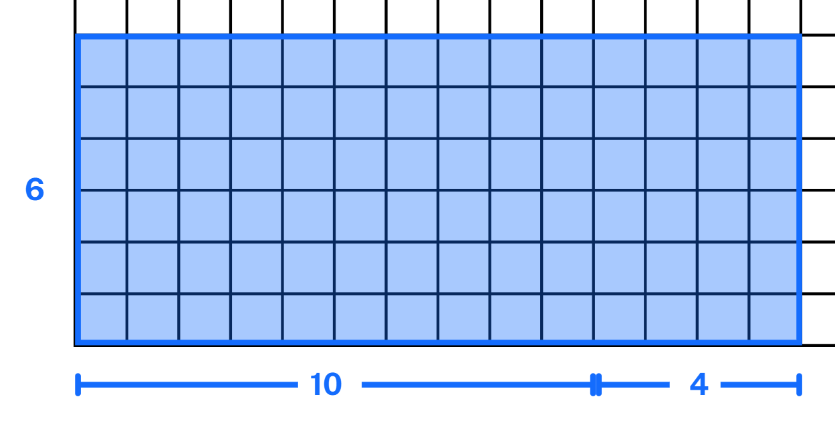
Short response (18)
Record the area of this rectangle in square centimetres.
Communicate your reasoning.
Notes:
Short response questions provide brisk paced questions focussing on review of current and previous content to support spaced and interleaved practice.
Syllabus focus area:
Two-dimensional spatial structure A

Slide 40
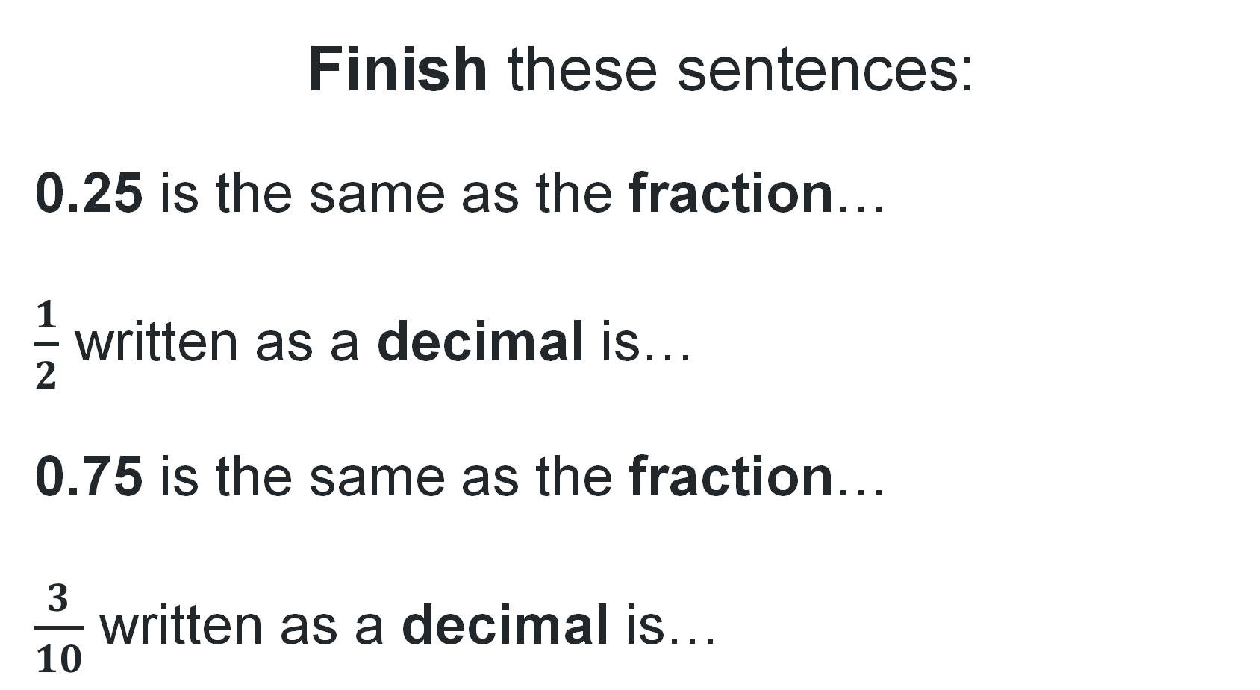
Short response (19)
Finish these sentences:
0.25 is the same as the fraction…
$\frac{1}{2}$ written as a decimal is…
0.75 is the same as the fraction…
$\frac{3}{10}$ written as a decimal is…
a)
b)
c)
d)
Notes:
Short response questions provide brisk paced questions focussing on review of current and previous content to support spaced and interleaved practice.
Syllabus focus area:
Representing numbers using place value B

Slide 41
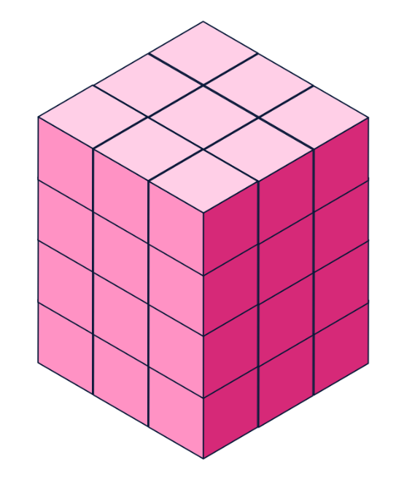
Short response (20)
For this prism:
How many layers does it have?
How many cubes in each layer?
What is the volume?
Notes:
Short response questions provide brisk paced questions focussing on review of current and previous content to support spaced and interleaved practice.
Syllabus focus area:
Three-dimensional spatial structure A

Slide 42
Activity 5 – completing subtraction sentences
3
9
Notes:
This is a developing number sense activity.
Number sense refers to a deep understanding of numbers, including their magnitude, relationships, and the effects of operations on them. It supports fluency and understanding, estimation, flexible thinking, and efficient problem-solving. Number sense activities 1–4 ‘activate’ prior number knowledge and support the learning of new content in the unit. Number sense activities 5–8 ‘loop’ back and provide opportunity for spaced practice with concepts and procedures covered in previous units.
Syllabus focus area:
Additive relations B
Completing subtraction sentences
This activity is an adaptation of ‘Subtraction with Regrouping 2’ by Ignaciuk from Open Middle.
This figure corresponds to Figure 5 – subtraction sentence in Stage 2 Year B Unit 33.
In pairs, students use digits 1 to 9 (only once each), placing a digit in each box to make the number sentence correct. For example, 56 − 17.
As a class, share and compare solutions. Ask students to identify the strategies they used and justify their choices.

Slide 43
Review of learning 6

Slide 44
True or false (3)
22 + 8 + 13 = 50 - 7
True | False
Communicate your reasoning.
Notes:
The question on this slide connects to the content being explored in the developing number sense activity (Activity 6)
Syllabus focus area:
Additive relations B

Slide 45
Short response (21)
Use the associative property to regroup the factors into multiples of 10 and record the totals.
6 × 40 = becomes 6 × (__ × __)
3 × 80 = becomes 3 × (__ × __)
5 × 70 = becomes 5 × (__ × __)
Notes:
Short response questions provide brisk paced questions focussing on review of current and previous content to support spaced and interleaved practice.
Syllabus focus area:
Multiplicative relations B

Slide 46
Short response (22)
Can rectangles with different side lengths have the same area?
Communicate your reasoning.
Notes:
Short response questions provide brisk paced questions focussing on review of current and previous content to support spaced and interleaved practice.
Syllabus focus area:
Two-dimensional spatial structure B

Slide 47
Short response (23)
Use the associative and commutative properties to solve:
12 × 25
Communicate how you used these properties to make the calculation easier.
Notes:
Short response questions provide brisk paced questions focussing on review of current and previous content to support spaced and interleaved practice.
Syllabus focus area:
Multiplicative relations B

Slide 48
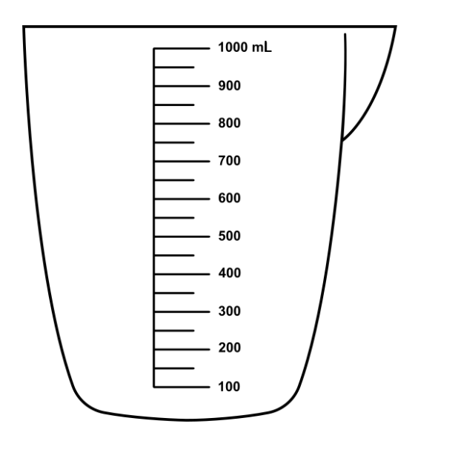
Short response (24)
Finish this sentence:
1000 mL is the same as…
Notes:
Short response questions provide brisk paced questions focussing on review of current and previous content to support spaced and interleaved practice.
Syllabus focus area:
Three-dimensional spatial structure B

Slide 49
Activity 6 – completing equivalent number sentences
Notes:
This is a developing number sense activity.
Number sense refers to a deep understanding of numbers, including their magnitude, relationships, and the effects of operations on them. It supports fluency and understanding, estimation, flexible thinking, and efficient problem-solving. Number sense activities 1–4 ‘activate’ prior number knowledge and support the learning of new content in the unit. Number sense activities 5–8 ‘loop’ back and provide opportunity for spaced practice with concepts and procedures covered in previous units.
Syllabus focus area:
Additive relations B
Completing equivalent number sentences
This activity is an adaptation of ‘Adding and Subtracting Two-Digit Whole Numbers’ by Errey from Open Middle.
This figure corresponds to Figure 6 – equivalent number sentence in Stage 2 Year B Unit 33.
In pairs, students use digits 0–9 (only once each), placing a digit in each box to make a correct number sentence. For example, 78 − 40 = 15 + 23.
As a class, share and compare solutions. Ask students to identify the strategies they used and justify their choices.

Slide 50
Review of learning 7

Slide 51
Multiple choice (4)
Which word problem matches this number sentence?
__ + 27 = 34
A
Noah had 34 books. He gave 27 away. How many books does he have left?
B
Noah had 34 books. He got 27 more books. How many books does he have now?
C
Noah had some books. He got 27 more and now has 34. How many did he start with?
D
Noah has 27 books and his friend has 34. Who has more?
Notes:
This question connects to the content in the developing number sense activity (Activity 3)
Syllabus focus area:
Additive relations B

Slide 52
Short response (25)
Complete the number sentences:
24 ÷ ___ = 4
___ × 7 = 49
___ ÷ 5 = 5
5 × ____ = 35
Notes:
Short response questions provide brisk paced questions focussing on review of current and previous content to support spaced and interleaved practice.
Syllabus focus area:
Multiplicative relations B

Slide 53
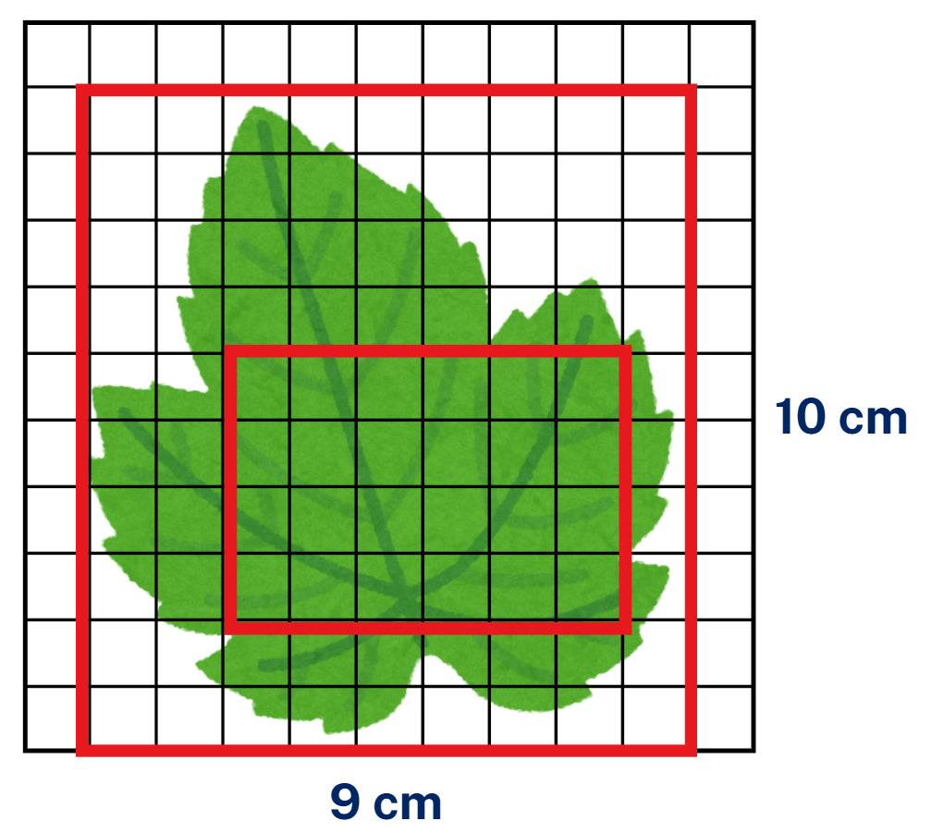
Short response (26)
Record the missing numerals and words The area of the leaf is:
a) more than _________
b) less than __________
c) I estimate the area of the leaf to be __________
Notes:
Short response questions provide brisk paced questions focussing on review of current and previous content to support spaced and interleaved practice.
Syllabus focus area:
Two-dimensional spatial structure A

Slide 54
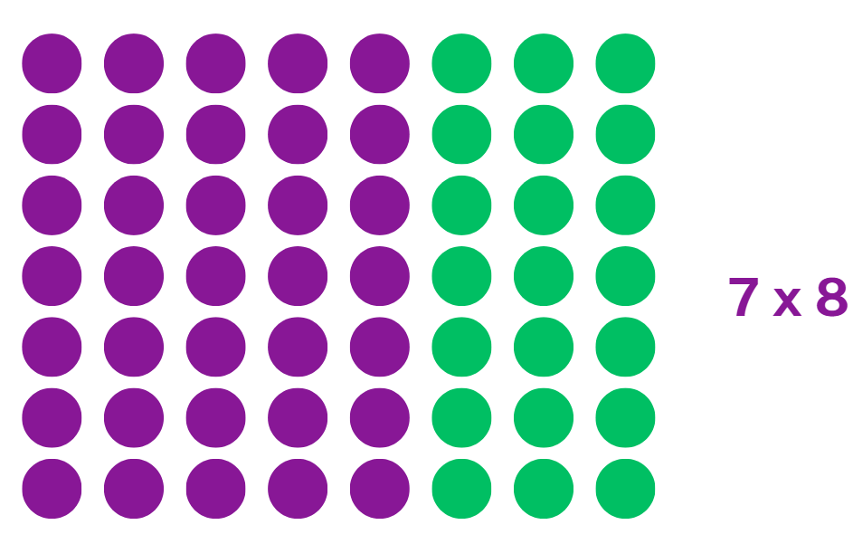
Short response (27)
Use the distributive property to solve:
Record a number sentence showing flexible partitioning.
Notes:
Short response questions provide brisk paced questions focussing on review of current and previous content to support spaced and interleaved practice.
Syllabus focus area:
Multiplicative relations B

Slide 55
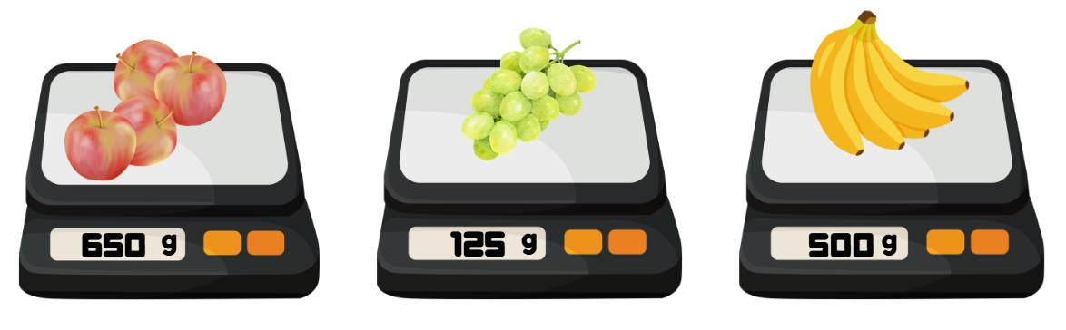
Short response (28)
Record each fruit’s mass.
A
B
C
Notes:
Short response questions provide brisk paced questions focussing on review of current and previous content to support spaced and interleaved practice.
Syllabus focus area:
Non-spatial measure B

Slide 56
Activity 7 – creating addition word problems (1)
15 + __ = 38
Farmer Kai collected 15 eggs from his chickens in week one, but he forgot to count how many eggs he collected in week 2. He collected 38 eggs altogether.
How many eggs did Farmer Kai collect in week 2?
Notes:
Note: this slide is designed to be viewed in presentation mode.
This is a developing number sense activity.
Number sense refers to a deep understanding of numbers, including their magnitude, relationships, and the effects of operations on them. It supports fluency and understanding, estimation, flexible thinking, and efficient problem-solving. Number sense activities 1–4 ‘activate’ prior number knowledge and support the learning of new content in the unit. Number sense activities 5–8 ‘loop’ back and provide opportunity for spaced practice with concepts and procedures covered in previous units.
Syllabus focus area:
Additive relations B
Creating addition word problems
Model writing a word problem to match the addition number sentence. For example, Farmer Kai collected 15 eggs from his chickens in week one, but he forgot to count how many eggs he collected in week 2. He collected 38 eggs altogether; how many eggs did Farmer Kai collect in week 2?
NEXT SLIDE
23 + _ = 41
99 + _ = 112
178 + _ = 256.
Instruct students to choose one and write a word problem to match.
In pairs, students share their word problems, ensuring that the number sentence is correct.

Slide 57
Activity 7 – creating addition word problems (2)
23 + ___ = 41
99 + ___ = 112
178 + ___ = 256
Notes:
Note: this slide is designed to be viewed in presentation mode.
This is a developing number sense activity.
Number sense refers to a deep understanding of numbers, including their magnitude, relationships, and the effects of operations on them. It supports fluency and understanding, estimation, flexible thinking, and efficient problem-solving. Number sense activities 1–4 ‘activate’ prior number knowledge and support the learning of new content in the unit. Number sense activities 5–8 ‘loop’ back and provide opportunity for spaced practice with concepts and procedures covered in previous units.
Syllabus focus area:
Additive relations B
Creating addition word problems
Instruct students to choose one and write a word problem to match.
In pairs, students share their word problems, ensuring that the number sentence is correct.

Slide 58
Review of learning 8

Slide 59
True or false (4)
The word problem matches the number sentence.
68 − 34 = ?
Ben had 68 marbles. He got 34 more marbles. Now he has 102 marbles.
True | False
Notes:
The question on this slide connects to the content being explored in the developing number sense activity (Activity 8)
Syllabus focus area:
Additive relations B

Slide 60
Short response (29)
Record the number sentence for this problem and solve it:
There are 42 apples packed into bags of 6. How many bags are needed?
Notes:
Short response questions provide brisk paced questions focussing on review of current and previous content to support spaced and interleaved practice.
Syllabus focus area:
Multiplicative relations B

Slide 61
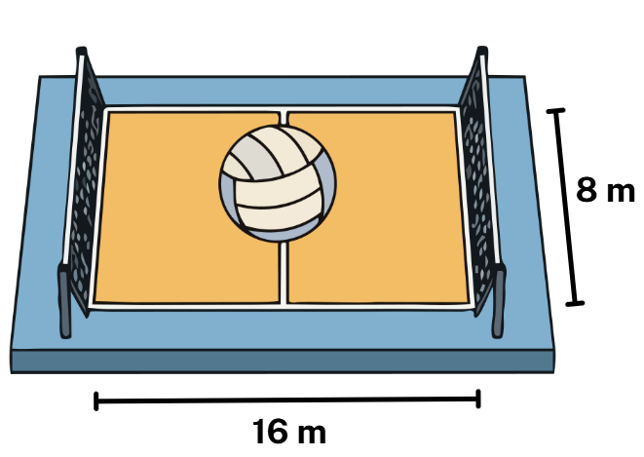
Short response (30)
Record the area of the beach volleyball court in square metres.
Notes:
Short response questions provide brisk paced questions focussing on review of current and previous content to support spaced and interleaved practice.
Syllabus focus area:
Two-dimensional spatial structure A

Slide 62

Short response (31)
16 × 4 has been partitioned using knowledge of place value to multiply by a multiple of 10 .
Record a number sentence showing this flexible partitioning.
Notes:
Short response questions provide brisk paced questions focussing on review of current and previous content to support spaced and interleaved practice.
Syllabus focus area:
Multiplicative relations B

Slide 63
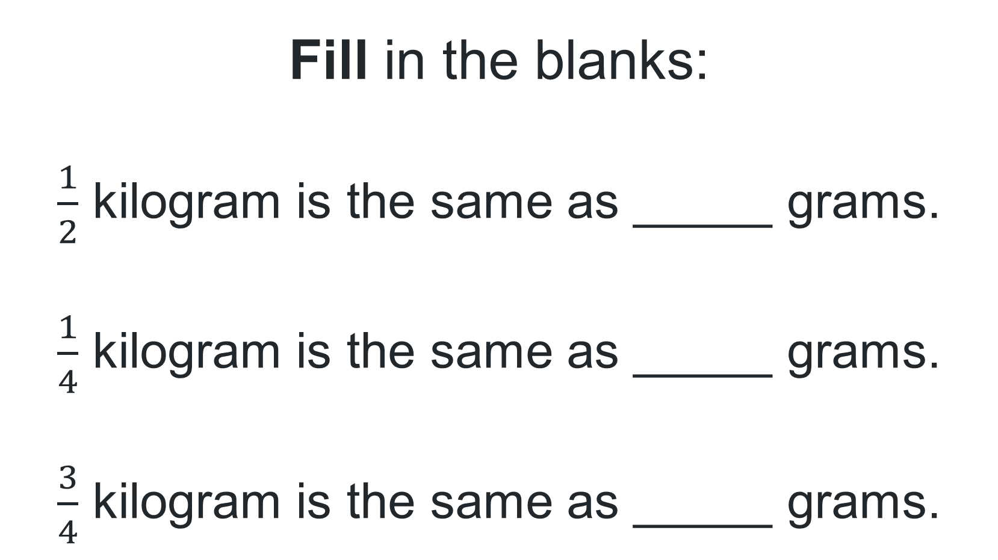
Short response (32)
Fill in the blanks:
$\frac{1}{2}$ kilogram is the same as _____ grams.
$\frac{1}{4}$ kilogram is the same as _____ grams.
$\frac{3}{4}$ kilogram is the same as _____ grams.
a)
b)
c)
Notes:
Short response questions provide brisk paced questions focussing on review of current and previous content to support spaced and interleaved practice.
Syllabus focus area:
Non-spatial measure B

Slide 64
Activity 8 – creating subtraction word problems (1)
24 − __ = 13
Dawn placed 24 fish in her new pond. When she checked on her fish the next day, Dawn could only find 13 fish.
How many fish were missing from the pond?
Notes:
Note: this slide is designed to be viewed in presentation mode.
This is a developing number sense activity.
Number sense refers to a deep understanding of numbers, including their magnitude, relationships, and the effects of operations on them. It supports fluency and understanding, estimation, flexible thinking, and efficient problem-solving. Number sense activities 1–4 ‘activate’ prior number knowledge and support the learning of new content in the unit. Number sense activities 5–8 ‘loop’ back and provide opportunity for spaced practice with concepts and procedures covered in previous units.
Syllabus focus area:
Additive relations B
Creating subtraction word problems
Model writing a word problem to match the subtraction number sentence. For example, Dawn placed 24 fish in her new pond. When she checked on her fish the next day, Dawn could only find 13 fish. How many fish were missing from the pond?
NEXT SLIDE
42 − _ = 19
156 − _ = 94
456 − _ = 289.
Instruct students to choose one and write a word problem to match.
In pairs, students share their word problems, ensuring that the number sentence is correct.

Slide 65
Activity 8 – creating subtraction word problems (2)
42 − __ = 19
156 − __ = 94
456 − __ = 289
Notes:
Note: this slide is designed to be viewed in presentation mode.
This is a developing number sense activity.
Number sense refers to a deep understanding of numbers, including their magnitude, relationships, and the effects of operations on them. It supports fluency and understanding, estimation, flexible thinking, and efficient problem-solving. Number sense activities 1–4 ‘activate’ prior number knowledge and support the learning of new content in the unit. Number sense activities 5–8 ‘loop’ back and provide opportunity for spaced practice with concepts and procedures covered in previous units.
Syllabus focus area:
Additive relations B
Creating subtraction word problems
Instruct students to choose one and write a word problem to match.
In pairs, students share their word problems, ensuring that the number sentence is correct.

Slide 66
Double Venn diagram
Object 1
Object 2
Features similar to both objects
Features of object 1
Features of object 2

Slide 67
Frayer
Definition
Facts/Characteristics
Word, term, concept
Examples
Non-examples

Slide 68
Spider map
Idea
Subject

Slide 69
Cline
Concept 1
Concept 2
Word
Word
Word
Word
Word
Word
Word
Word
Word
Word
Word

Slide 70
Compare and contrast

Slide 71
Multiple choice (5)
A
B
C
D

Slide 72
Multiple choice
A
B
C
D
Notes:
This question connects to the content in the developing number sense activity (Activity 3)
Syllabus focus area:
[Focus area A/B]

Slide 73
References
This presentation contains NSW Curriculum and syllabus content. The NSW Curriculum is developed by the NSW Education Standards Authority. This content is prepared by NESA for and on behalf of the Crown in the right of the State of New South Wales. The material is protected by Crown copyright.
Please refer to the NESA Copyright Disclaimer for more information https://educationstandards.nsw.edu.au/wps/portal/nesa/mini-footer/copyright.
NESA holds the only official and up-to-date versions of the NSW Curriculum and syllabus documents. Please visit the NSW Education Standards Authority (NESA) website https://educationstandards.nsw.edu.au/wps/portal/nesa/home and the NSW Curriculum website https://curriculum.nsw.edu.au.
Mathematics K–10 Syllabus © NSW Education Standards Authority (NESA) for and on behalf of the Crown in right of the State of New South Wales, 2022.
National Numeracy Learning Progression © Australian Curriculum, Assessment and Reporting Authority (ACARA) 2010 to present, unless otherwise indicated. This material was downloaded from the Australian Curriculum website (National Numeracy Learning Progression) (accessed 8 April 2026) and was not modified.
APSMO (2026) Australasian Problem Solving Mathematical Olympiads (APSMO) (2008–2015), APSMO website, accessed 22 April 2026.
Errey B (n.d) Adding and Subtracting Two-Digit Whole Numbers, Open Middle website, accessed 22 April 2026.
Harris P (n.d.) Factor puzzles, Math is FigureOutAble website, accessed 10 April 2026.
Ignaciuk C (n.d) Subtraction with Regrouping 2, Open Middle website, accessed 22 April 2026.
Mathematics Hub (2026) Multiplication: 2 digit by 2 digit numbers: Video and teaching guide, Mathematics Hub website, accessed 22 April 2026.
University of Cambridge (2026) Thunder and Lightning, NRICH website, accessed 22 April 2026.

Slide 74
Copyright
© State of New South Wales (Department of Education), 2025
The copyright material published in this resource is subject to the Copyright Act 1968 (Cth) and is owned by the NSW Department of Education or, where indicated, by a party other than the NSW Department of Education (third-party material).
Copyright material available in this resource and owned by the NSW Department of Education is licensed under a Creative Commons Attribution 4.0 International (CC BY 4.0) license.
This license allows you to share and adapt the material for any purpose, even commercially.
Attribution should be given to © State of New South Wales (Department of Education), 2025.
Material in this resource not available under a Creative Commons license:
the NSW Department of Education logo, other logos and trademark-protected material
Material owned by a third party that has been reproduced with permission. You will need to obtain permission from the third party to reuse its material.
Links to third-party material and websites
Please note that the provided (reading/viewing material/list/links/texts) are a suggestion only and implies no endorsement, by the New South Wales Department of Education, of any author, publisher, or book title. School principals and teachers are best placed to assess the suitability of resources that would complement the curriculum and reflect the needs and interests of their students.
If you use the links provided in this document to access a third party’s website, you acknowledge that the terms of use, including licence terms set out on the third-party’s website apply to the use which may be made of the materials on that third-party website or where permitted by the Copyright Act 1968 (Cth). The department accepts no responsibility for content on third-party websites.

