Slide 1
Instructions for use
This resource aligns to the learning in Stage 2 Year B Unit 34 and revisits content from earlier sample units.
Classroom teachers are encouraged to add and adapt slides as required to meet the needs of their students.
Save a copy of the file to make changes to the slide deck. Go to File > Download a Copy (this downloads a copy to the computer to edit in the PowerPoint app).
To convert the PowerPoint to Google Slides:
  Upload the file into Google Drive and open it.
  Go to File > Save as Google Slides.
  (Note – conversion may cause formatting changes in the slides.)

Slide 2

Review of Learning
Mathematics Stage 2 – Unit 34
Notes:
Reviews may include a combination of question types, requiring students to recall facts and key ideas, as well as apply their knowledge to solve problems and answer questions. To support active engagement, a mix of techniques should be employed.” (AERO, 2024).
This Review of Learning slide deck revisits key concepts from the following units:
Stage 2 Year B Unit 34
Stage 2 Year B Unit 33
Stage 2 Year B Unit 32
It also includes opportunities to review prior learning in non-number content, supporting consolidation across focus areas.
The review of learning resources include three key task types that support the development of mathematical proficiency through retrieval, spaced practice, and active participation. These practices complement the review phase (activating prior knowledge) embedded within the beginning of each lesson.
1.
Multiple-choice questions/True or false: Designed to promote active retrieval of key concepts and identify common misconceptions in number, supporting consolidation, understanding and fluency.
These questions:
support spaced and interleaved practice
help identify and address common misconceptions
support active recall and immediate feedback
support whole class participation
identify areas requiring reteach
2.
Short-response question sets: Carefully grouped questions that encourage spaced and interleaved practice across multiple focus areas, helping students revisit and apply knowledge from different points in time.
These questions:
have a combination of question types
address a range of focus areas
build automaticity and fluency
support active recall
allow for immediate feedback
identify content requiring reteach
3.
Developing number sense activities: A variety of practical, purposeful tasks that reinforce current learning and build on prior knowledge. These activities promote reasoning, problem-solving and conceptual understanding.
The review of learning resources are designed to work support teaching and learning in mathematics. For the most effective implementation, use the resources flexibly, adapting to meet student learning needs and individual classroom contexts.

Slide 3
Lessons
1
Review of learning 1
5
Review of learning 5
2
Review of learning 2
6
Review of learning 6
3
Review of learning 3
7
Review of learning 7
4
Review of learning 4
8
Review of learning 8
Notes:
Teacher notes:
Click lesson titles to go to specific lessons
Interactive features can be viewed in slide show

Slide 4
Review of learning 1

Slide 5

Multiple choice (1)
0.64 can be expressed as:
A
6 tenths and 4 hundredths
B
64 tenths
C
4 tenths and 6 hundredths
D
6 hundredths and 4 tenths
Notes:
This question connects to the content in the developing number sense activity (Activity 1)
Syllabus focus area:
Representing numbers using place value B

Slide 6

Short response (5)
Why is it important to use formal units like grams or kilograms to measure the mass of objects?
Notes:
Short response questions provide brisk paced questions focussing on review of current and previous content to support spaced and interleaved practice.
Syllabus focus area:
Non-spatial measure A

Slide 7
Short response (2)
Record the first 10 multiples formed by counting by 4.
Notes:
Short response questions provide brisk paced questions focussing on review of current and previous content to support spaced and interleaved practice.
Syllabus focus area:
Multiplicative relations A

Slide 8
Short response (3)
Describe a rectangle by recording:
How many parallel sides does a rectangle have?
How many right angles does a rectangle have?
Does a rectangle have equal sides?
Notes:
Short response questions provide brisk paced questions focussing on review of current and previous content to support spaced and interleaved practice.
Syllabus focus area:
Two-dimensional spatial structure A

Slide 9
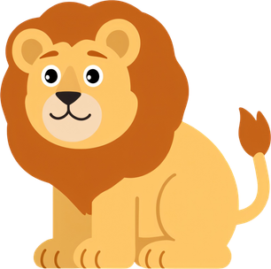
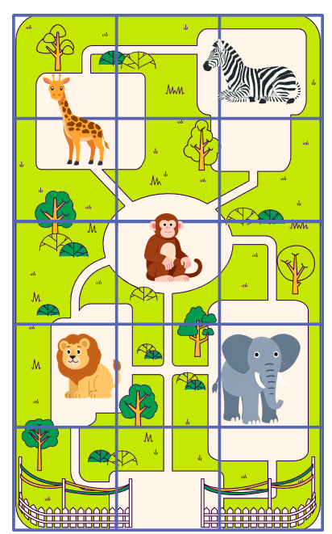
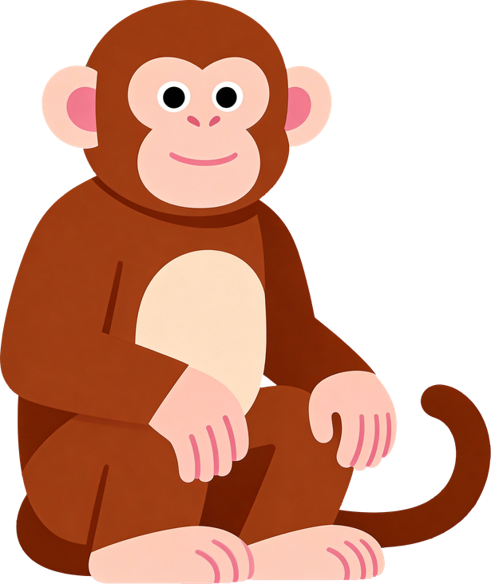
Short response (4)
The lion is located in the first column and the second row from the bottom.
Record the position of the:
monkey
Notes:
Short response questions provide brisk paced questions focussing on review of current and previous content to support spaced and interleaved practice.
Syllabus focus area:
Geometric measure A

Slide 10

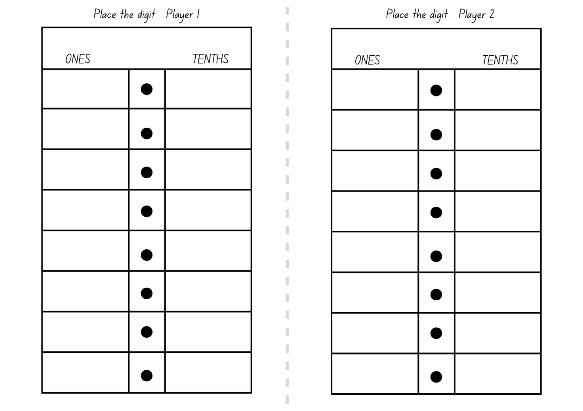
Activity 1 – making decimal numbers
Notes:
This is a developing number sense activity.
Number sense refers to a deep understanding of numbers, including their magnitude, relationships, and the effects of operations on them. It supports fluency and understanding, estimation, flexible thinking, and efficient problem-solving. Number sense activities 1–4 ‘activate’ prior number knowledge and support the learning of new content in the unit. Number sense activities 5–8 ‘loop’ back and provide opportunity for spaced practice with concepts and procedures covered in previous units.
Syllabus focus area:
Representing numbers using place value B
Making decimal numbers
This resource corresponds to Resource 11 – place the digits 1 in Stage 2 Year B Unit 34.
This activity is an adaptation of ‘Place the Digits’ from Tāhūrangi - New Zealand Curriculum by the New Zealand Ministry of Education.
- Provide pairs of students with Resource 11 – place the digits 1 and a 6-sided dice.
- The objective of the game is to make the largest decimal number after 2 rolls. Players take turns to roll the dice, deciding in which column, ones or tenths, they will place the digit. After 2 rolls, players must have a number in each column. The player with the largest decimal number in each round is awarded one point.
- After each round, explain that each player must say their decimal number aloud. For example, 2.4 is read aloud as ‘two and four-tenths’.
Note: to support place value conceptual understanding, 6.1 would be read as ‘six and one-tenth’. The word ‘and’ connects the decimal fraction with the whole number and makes a link with common fractions. The primary purpose of the decimal point is to show where the whole number ‘ones’ column is.
- After a few rounds, explain that there is an adjustment to the rules of the game. Once players have filled both columns, they can choose to trade one of the digits from either the ones or the tenths column and roll a third time, trying to make an even larger decimal number.
- After a few rounds, students play the game to make the smallest decimal number possible after 2 rolls.
Note: to allow for Resource 11 – place the digits 1 to be used multiple times, place the gameboard in a plastic sleeve and provide students with non-permanent markers and erasers.

Slide 11
Review of learning 2

Slide 12
True or false (1)
8.63 is the largest decimal number that can be made from the cards.
3
6
8
True | False
Communicate your reasoning.​
Notes:
The question on this slide connects to the content being explored in the developing number sense activity (Activity 2)
Syllabus focus area:
Representing numbers using place value B

Slide 13
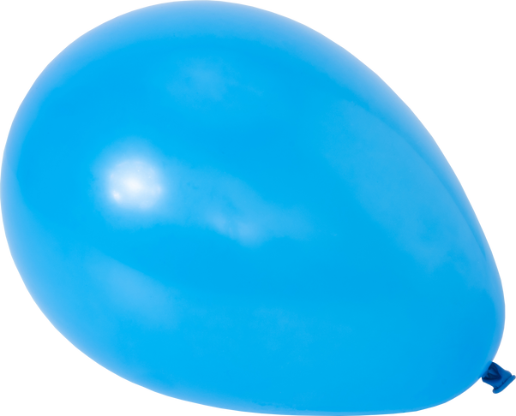
Short response (5)
Record the objects that have a mass of about one kilogram.
A
B
C
D
E
Notes:
Short response questions provide brisk paced questions focussing on review of current and previous content to support spaced and interleaved practice.
Syllabus focus area:
Non-spatial measure A

Slide 14
Short response (6)
Identify and record the missing numbers to complete the multiplication fact family.
6 × 4 = 24
4 × 6 = ?
24 ÷ 4 = ?
24 ÷ ? = 4
?
6
4
Notes:
Short response questions provide brisk paced questions focussing on review of current and previous content to support spaced and interleaved practice.
Syllabus focus area:
Multiplicative relations B

Slide 15
Short response (7)
Which two-dimensional shapes can be used to form a trapezium?
Notes:
Short response questions provide brisk paced questions focussing on review of current and previous content to support spaced and interleaved practice.
Syllabus focus area:
Two-dimensional spatial structure B

Slide 16
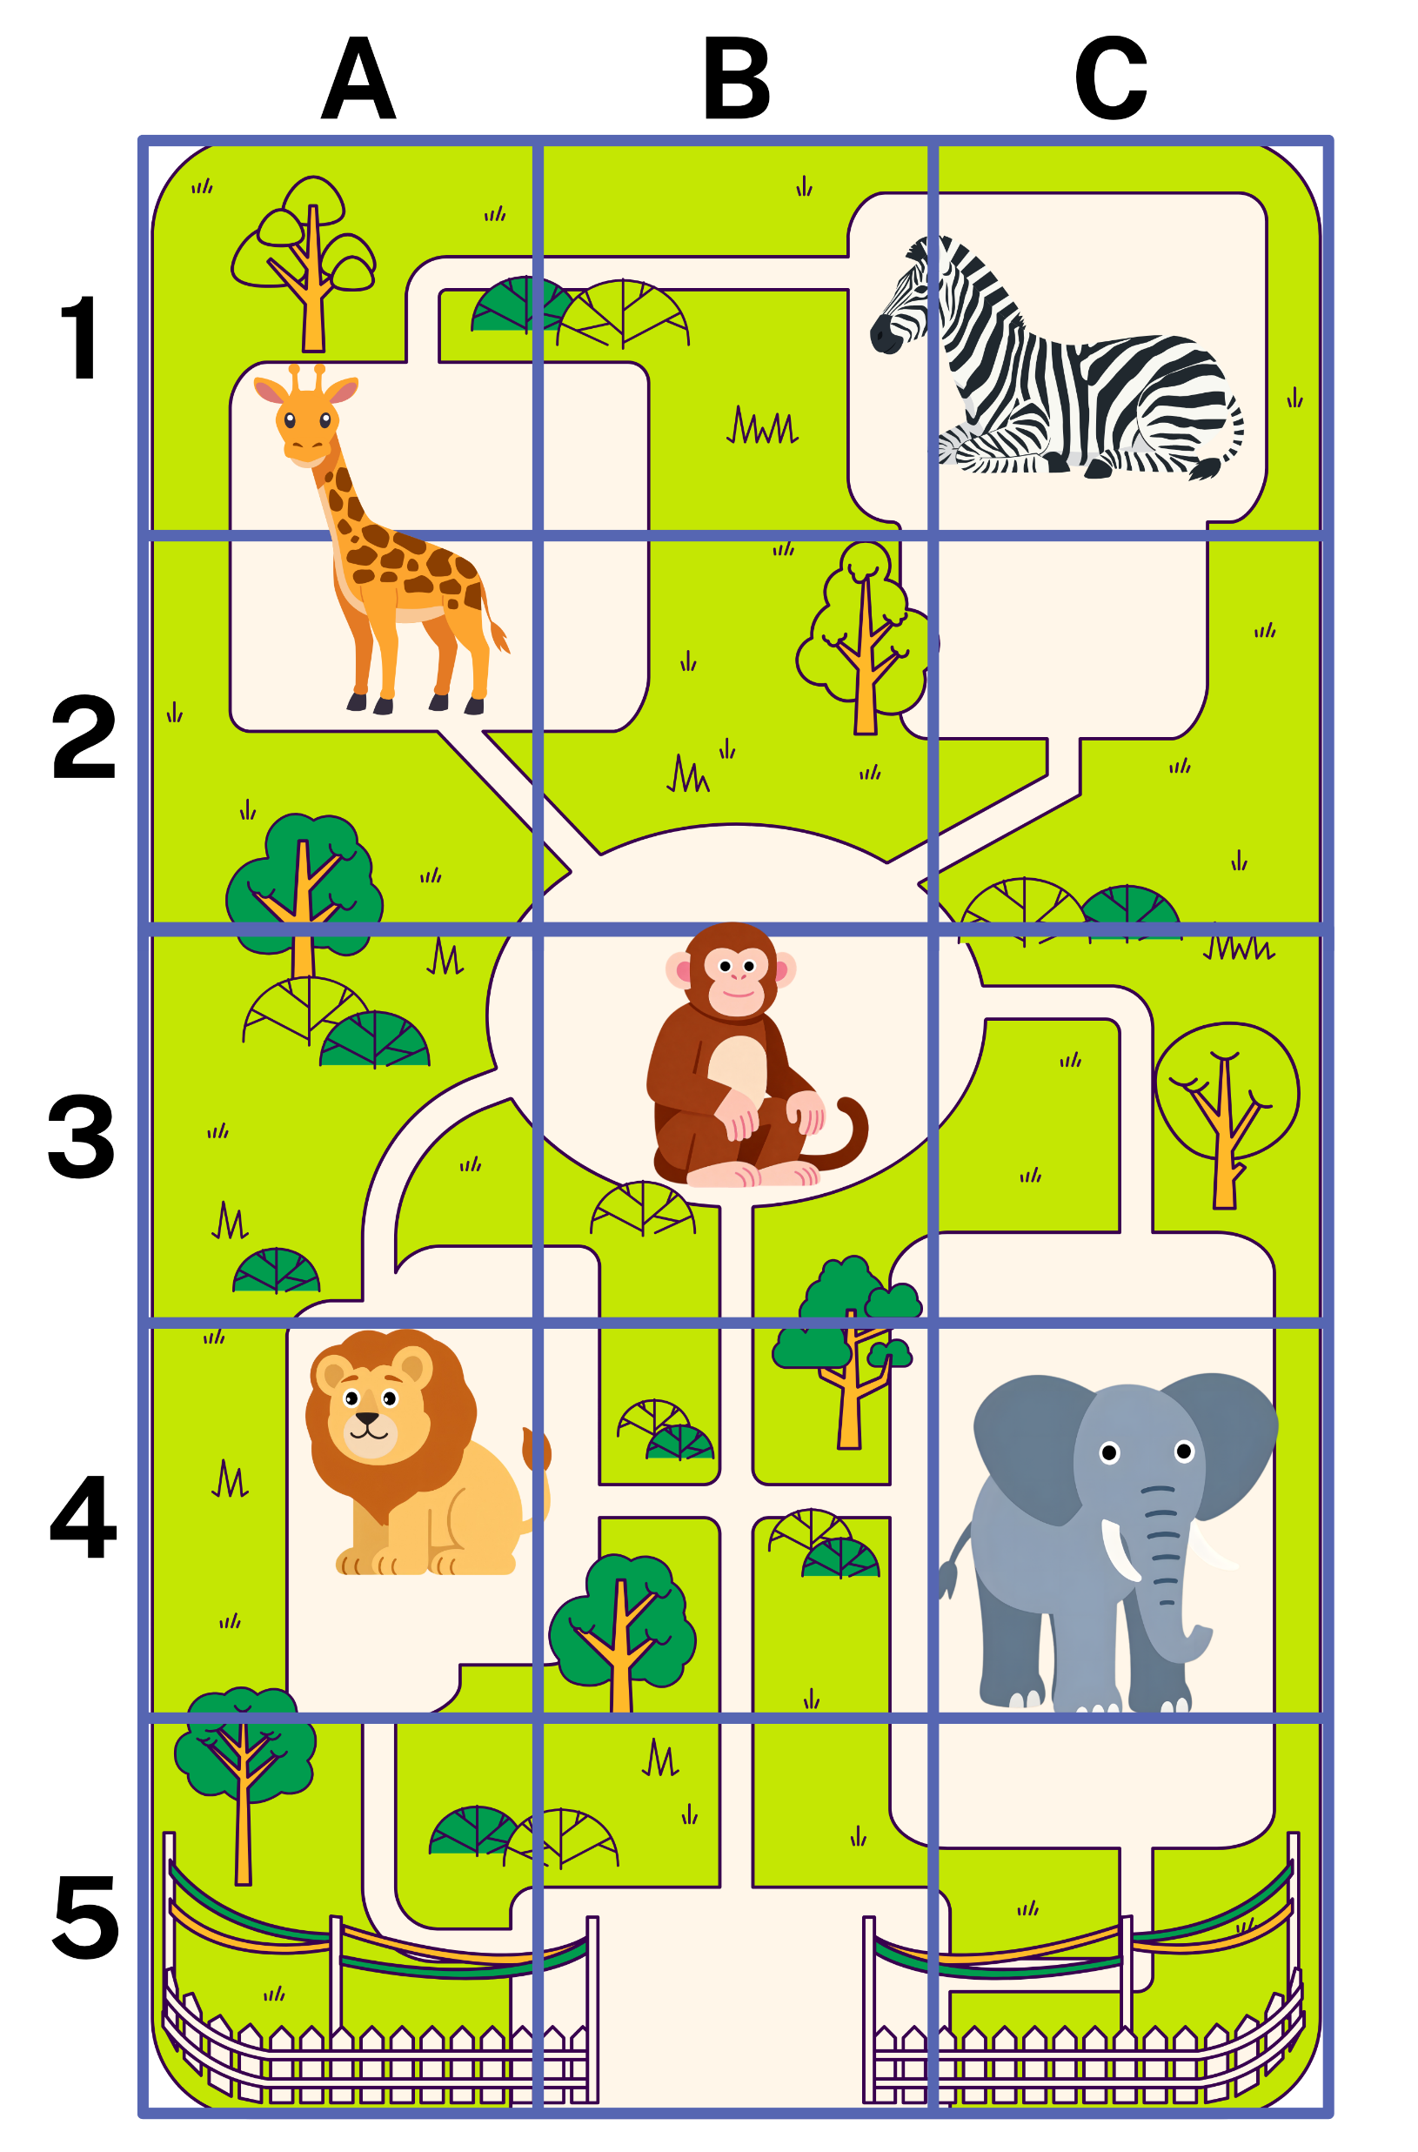

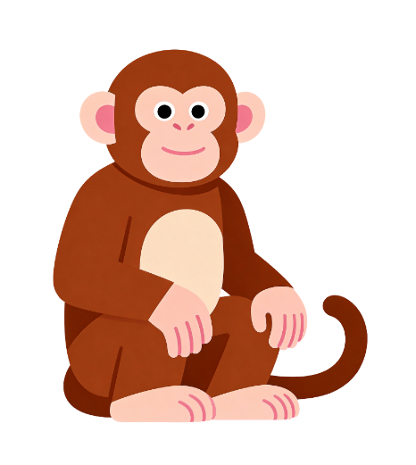
Short response (8)
Record the letter-number grid reference of the:
elephant
zebra
monkey.
Notes:
Short response questions provide brisk paced questions focussing on review of current and previous content to support spaced and interleaved practice.
Syllabus focus area:
Geometric measure A

Slide 17
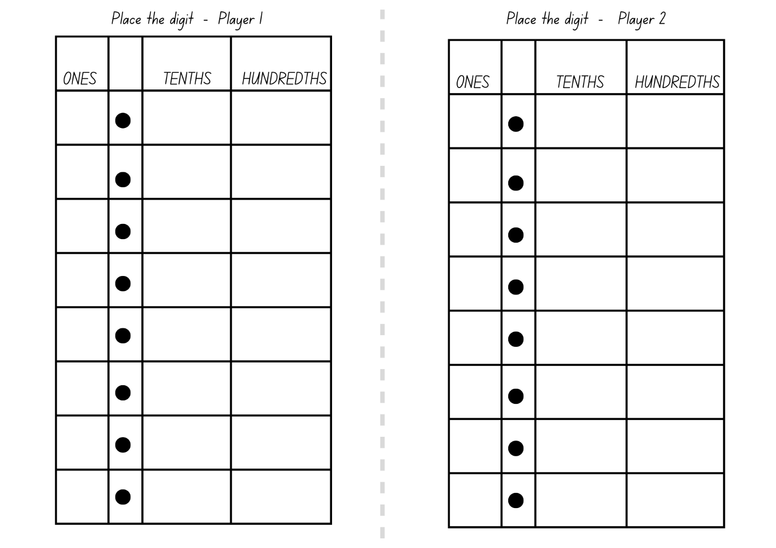
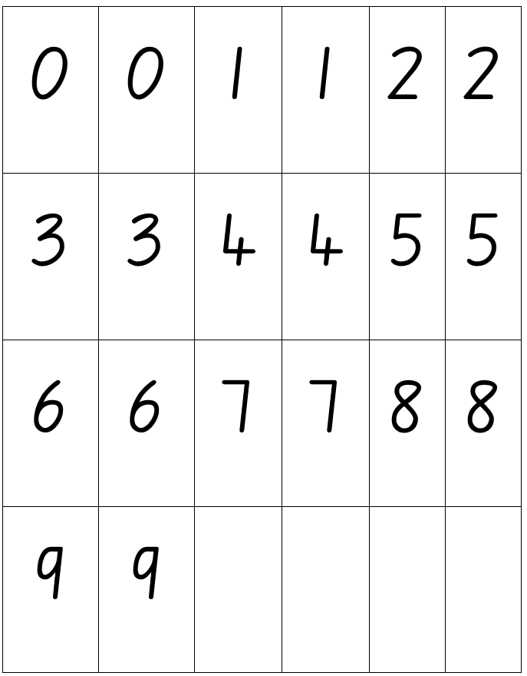
Activity 2 – making decimal numbers using tenths and hundredths
Notes:
This is a developing number sense activity.
Number sense refers to a deep understanding of numbers, including their magnitude, relationships, and the effects of operations on them. It supports fluency and understanding, estimation, flexible thinking, and efficient problem-solving. Number sense activities 1–4 ‘activate’ prior number knowledge and support the learning of new content in the unit. Number sense activities 5–8 ‘loop’ back and provide opportunity for spaced practice with concepts and procedures covered in previous units.
Syllabus focus area:
Representing numbers using place value B
Making decimal numbers using tenths and hundredths
This resource corresponds to Resource 12 – place the digits 2 and Resource 13 – number cards in Stage 2 Year B Unit 34.
This activity is an adaptation of ‘Place the Digits’ from Tāhūrangi - New Zealand Curriculum by the New Zealand Ministry of Education.
Provide pairs of students with Resource 12 – place the digits 2 and Resource 13 – number cards.
Explain the rules to the game ‘Place the digits’:
- The objective of the game is to make the largest decimal number after drawing 3 cards.
- Player 1 draws a card from the deck and records the digit in the ones, tenths or hundredths column on Resource 12 – place the digits 2.
- The player returns the drawn card to the bottom of the deck before the next player draws a card and records their digit.
- Repeat until each player has drawn 3 cards.
Note: revisit the impact zero has on a number when it is in different place value positions. The placement of the zero in these examples changes how we say, write and understand decimals. For example, 0.78, 7.08 or 7.80.
After each round, each player must say their decimal number aloud. For example, 2.45 is read aloud as ‘two and forty-five hundredths’. The winner gets one point for winning the round.
After a few rounds, explain that there is an adjustment to the rules of the game. Once players have filled all 3 columns, players can choose to trade one of the digits from either the ones, tenths or hundredths column and can draw a new card, trying to make an even larger decimal number.
After a few rounds, students play the game to make the smallest decimal number possible after drawing 3 cards.
Note: to allow for Resource 12 – place the digits 2 to be used multiple times, place the gameboard in a plastic sleeve and provide students with non-permanent markers and erasers.

Slide 18
Review of learning 3

Slide 19
Multiple choice (2)
Which decimal numbers have been placed in ascending order?
A
3.92, 3.95, 3.99, 3.09
B
2.39, 9.23, 3.92, 9.32
C
4.03, 4.35, 4.4, 4.41
D
1.11, 1.01, 1.12, 1.02
Notes:
This question connects to the content in the developing number sense activity (Activity 3)
Syllabus focus area:
Representing numbers using place value B

Slide 20
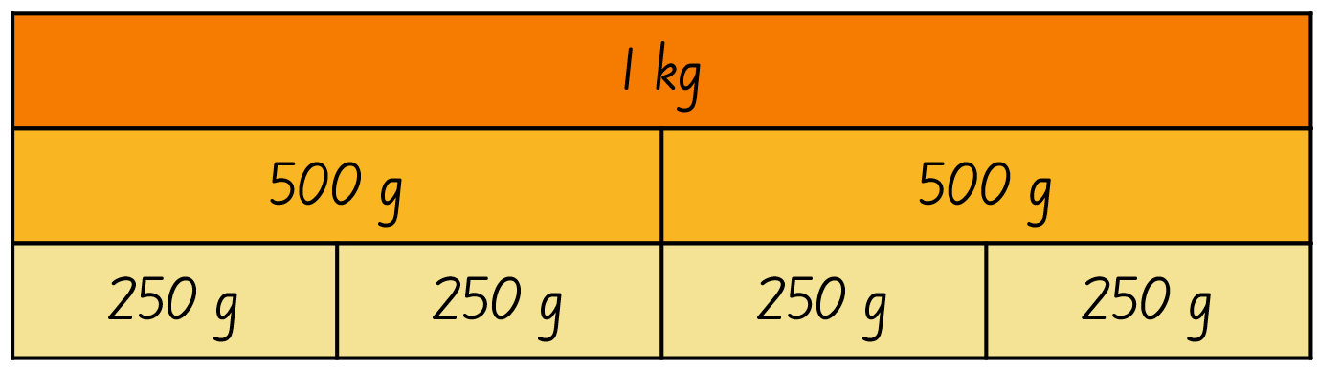
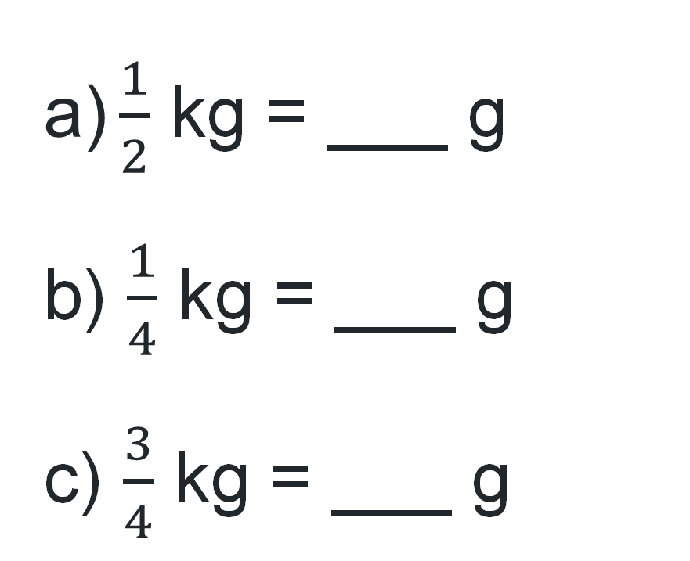
Short response (9)
Complete these numbers sentences:
$\text{a}\text{)}\frac{1}{2}$ kg = ___ g
b) $\frac{1}{4}$ kg = ___ g
c) $\frac{3}{4}$ kg = ___ g
Notes:
Short response questions provide brisk paced questions focussing on review of current and previous content to support spaced and interleaved practice.
Syllabus focus area:
Non-spatial measure B

Slide 21
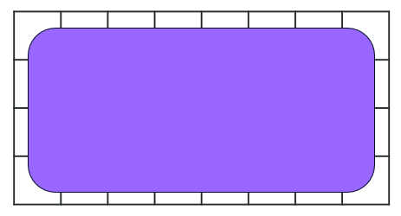
Short response (10)
Record the total number of squares in the array without counting.
__ rows of __
__ is repeated __ times
__ × __ = __
Notes:
Short response questions provide brisk paced questions focussing on review of current and previous content to support spaced and interleaved practice.
Syllabus focus area:
Multiplicative relations B

Slide 22
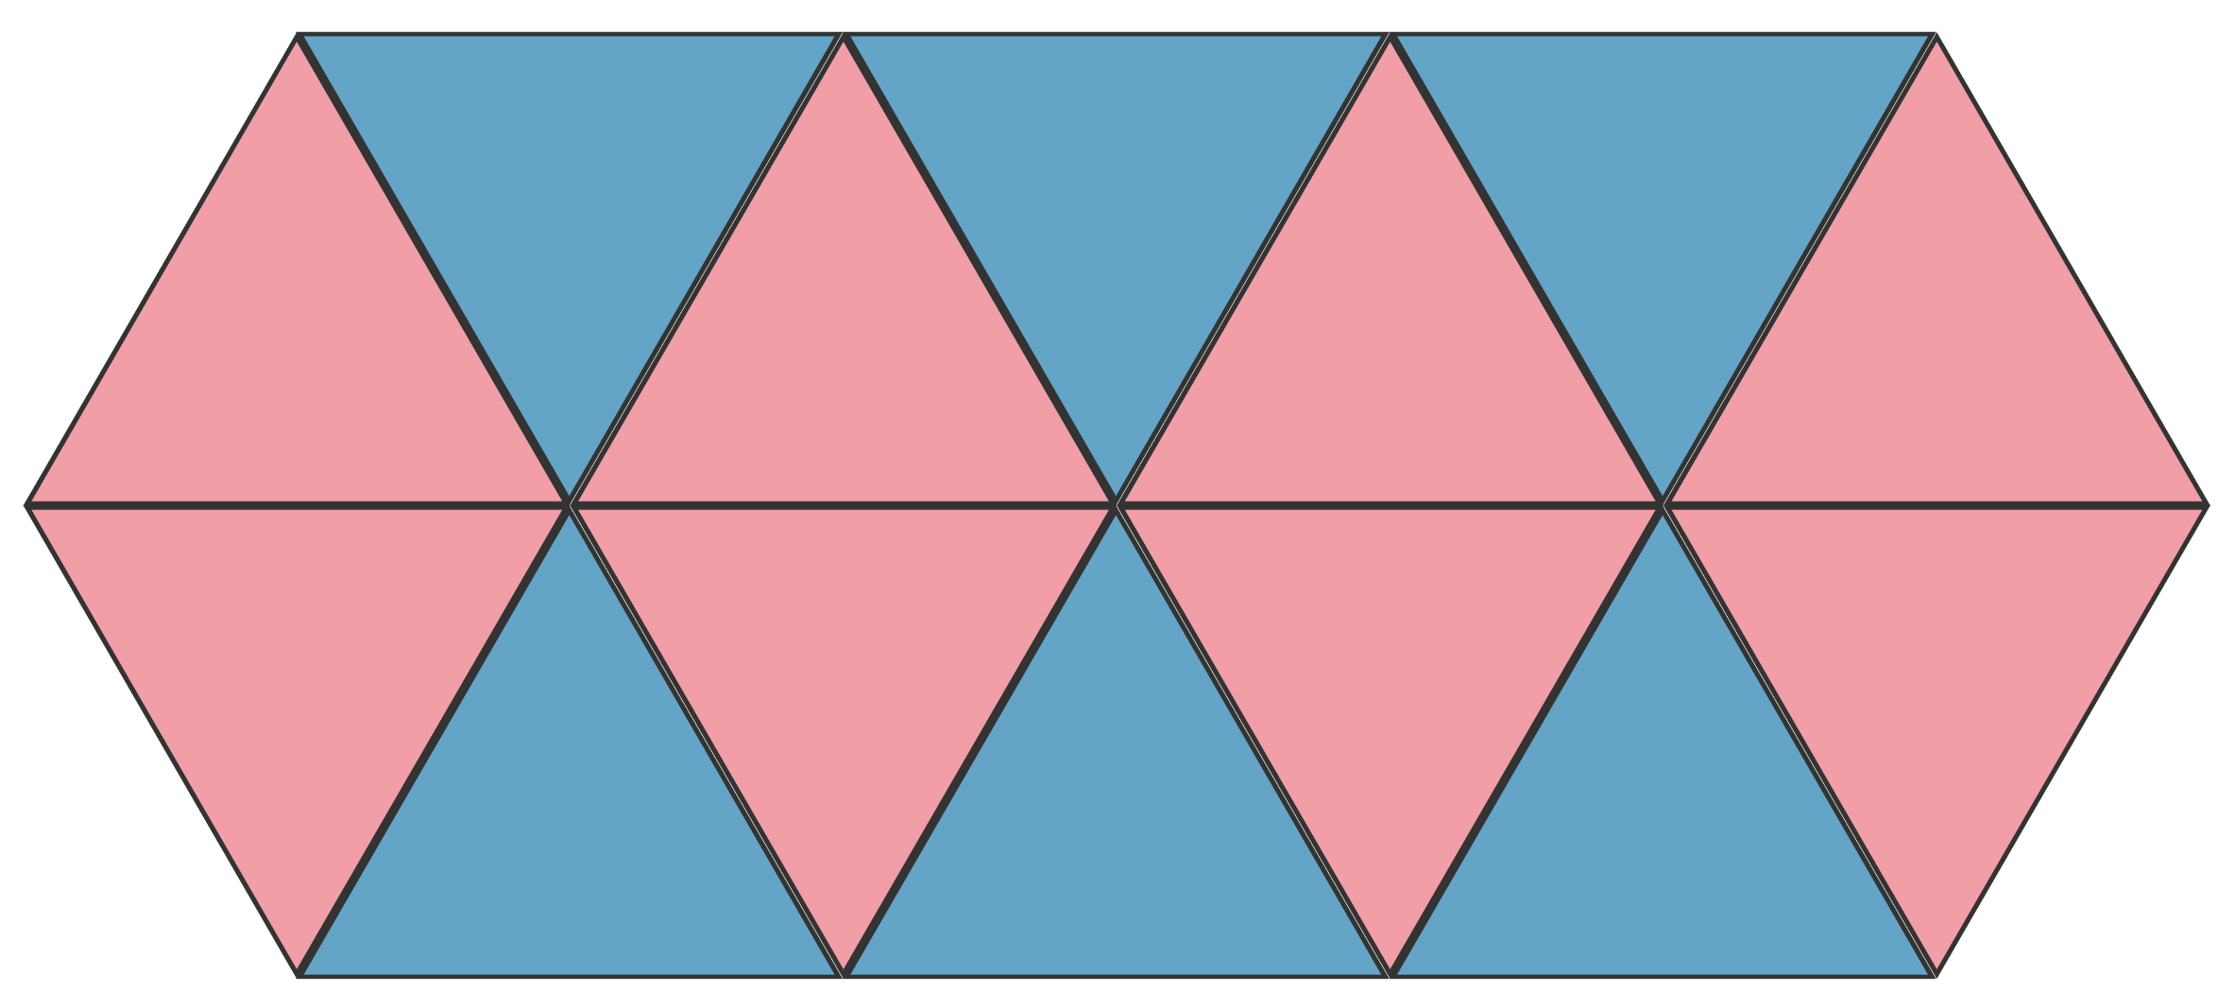
Short response (11)
Describe this tessellating design.
Have the shapes have been reflected, translated or rotated?
Notes:
Short response questions provide brisk paced questions focussing on review of current and previous content to support spaced and interleaved practice.
Syllabus focus area:
Two-dimensional spatial structure A

Slide 23
Short response (12)
Sketch a rectangular prism showing depth. Think about the 2D shapes that can be seen.
Notes:
Short response questions provide brisk paced questions focussing on review of current and previous content to support spaced and interleaved practice.
Syllabus focus area:
Three-dimensional spatial structure B

Slide 24
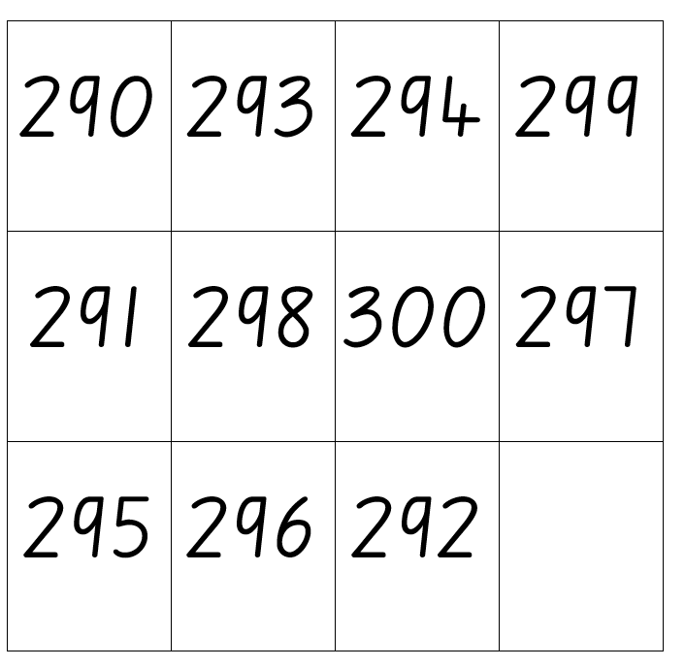
Activity 3 – tenths and hundredths on a number line
Notes:
This is a developing number sense activity.
Number sense refers to a deep understanding of numbers, including their magnitude, relationships, and the effects of operations on them. It supports fluency and understanding, estimation, flexible thinking, and efficient problem-solving. Number sense activities 1–4 ‘activate’ prior number knowledge and support the learning of new content in the unit. Number sense activities 5–8 ‘loop’ back and provide opportunity for spaced practice with concepts and procedures covered in previous units.
Syllabus focus area:
Representing numbers using place value B
Tenths and hundredths on a number line
This resource corresponds to Resource 14 – mixed up decimals in Stage 2 Year B Unit 34.
Explain that the decimal point is missing from the decimal numbers and that the decimals need to be placed in ascending order on a number line.
Provide students with Resource 14 – mixed up decimals and whiteboards, asking:
- How many possibilities are there for where the decimal point can go in each of the numbers?
- How can you convince me?
- How do you think they are going to be arranged on a number line?
As a class, discuss the possible strategies and solutions to arrange the decimals on a number line.
Prompt students to justify their reasoning by explaining how the markers are equally spaced on the number line, the decimal point is consistently placed to show the place value for each digit and the decimals are recorded in ascending order.
Select students to name the decimal numbers in order along the number line and identify the place value of each digit. For example, 29.3 is 2 tens, 9 ones and 3 tenths or 29 and 3 tenths or 2.93 is 2 and 9 tenths and 3 hundredths or 2 and 93 hundredths (see Figure 4 – examples of solutions in Stage 2 Year B Unit 34).

Slide 25
Review of learning 4

Slide 26
True or false (2)
0.608 is equal to 0.6080
True | False
Communicate your reasoning.​
Notes:
The question on this slide connects to the content being explored in the developing number sense activity (Activity 4)
Syllabus focus area:
Representing numbers using place value B

Slide 27
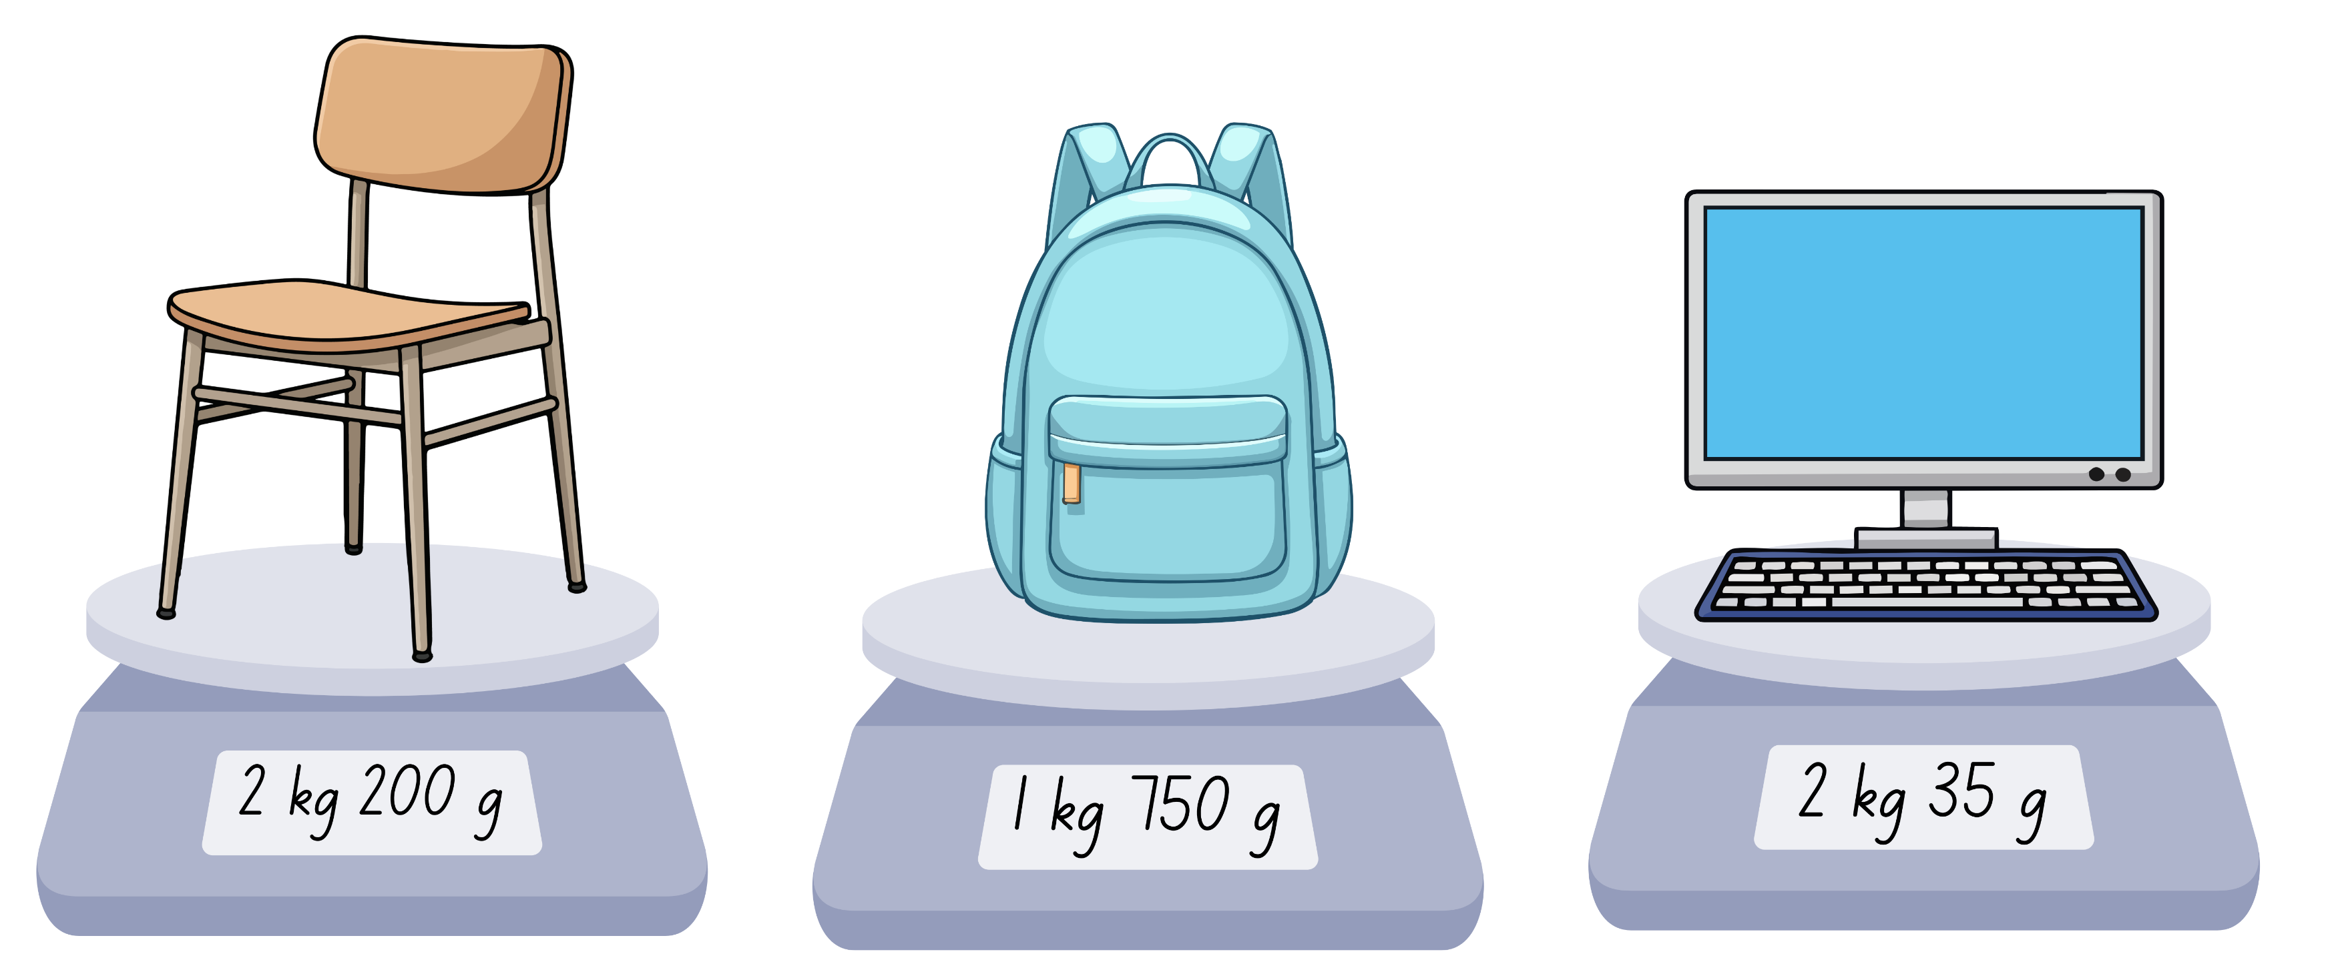
Short response (13)
Record the mass of the objects in grams.
Notes:
Short response questions provide brisk paced questions focussing on review of current and previous content to support spaced and interleaved practice.
Syllabus focus area:
Non-spatial measure B

Slide 28
Short response (14)
Area model
Total = 16, left column = 4
determine the hidden rows and columns
record the multiplication sentence.
Notes:
Short response questions provide brisk paced questions focussing on review of current and previous content to support spaced and interleaved practice.
Syllabus focus area:
Multiplicative relations B

Slide 29
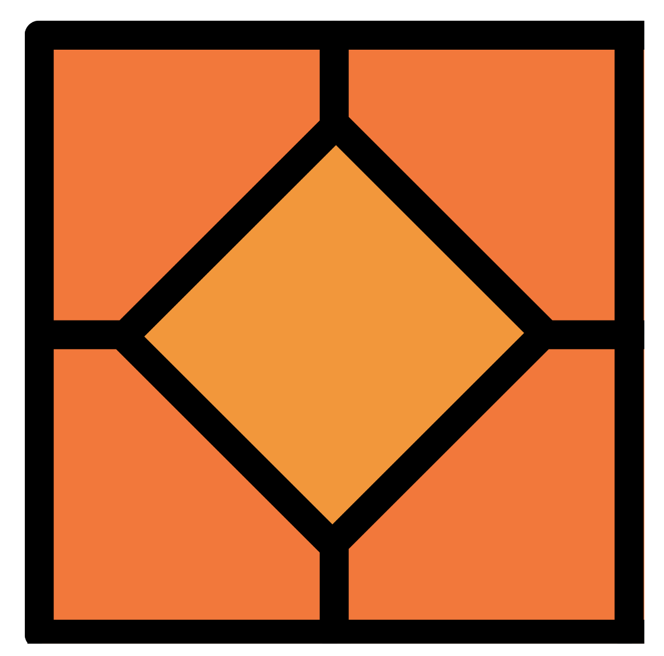
Short response (15)
Does this square have only these 2 lines of symmetry?
Communicate your reasoning.
Notes:
Short response questions provide brisk paced questions focussing on review of current and previous content to support spaced and interleaved practice.
Syllabus focus area:
Two-dimensional spatial structure A

Slide 30
Short response (16)
Which jug is filled to show one litre?
Communicate your reasoning.
A
B
C
D
Notes:
Short response questions provide brisk paced questions focussing on review of current and previous content to support spaced and interleaved practice.
Syllabus focus area:
Three-dimensional spatial structure B

Slide 31
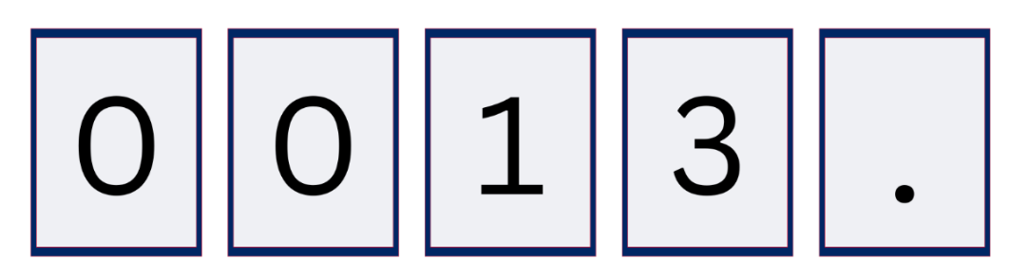
Activity 4 – the role of zero in decimal notation
Record as many numbers as you can using all 4 digits and the decimal point?
Notes:
This is a developing number sense activity.
Number sense refers to a deep understanding of numbers, including their magnitude, relationships, and the effects of operations on them. It supports fluency and understanding, estimation, flexible thinking, and efficient problem-solving. Number sense activities 1–4 ‘activate’ prior number knowledge and support the learning of new content in the unit. Number sense activities 5–8 ‘loop’ back and provide opportunity for spaced practice with concepts and procedures covered in previous units.
Syllabus focus area:
Representing numbers using place value B
The role of zero in decimal notation
This image corresponds to Figure 5 – number cards in Stage 2 Year B Unit 34.
This activity is an adaptation of ‘Funny Numbers’ from Mathematics Developmental Continuum P-10 by the Department of Education and Training, Victoria State Government.
Display 5 cards on the board, including 2 zero cards, 2 random number cards and a card labelled with a decimal point.
In pairs, ask students to write down as many numbers as they can using all 4 digits and the decimal point.
Students record their numbers in their workbook.
Students combine with another pair and compare their numbers.
Groups arrange their numbers from smallest to largest.
Ask:
- Is 1300. = 1300?
- Is 00.13 = 0.130?
- Is .3100 = 0.310?

Slide 32
Review of learning 5

Slide 33
Multiple choice (3)
Which array represents the fact family of:
2 × 4 = 8 4 × 2 = 8 8 ÷ 4 = 2 8 ÷ 2 = 4
A
B
C
D
Notes:
This question connects to the content in the developing number sense activity (Activity 5)
Syllabus focus area:
Multiplicative relations A

Slide 34
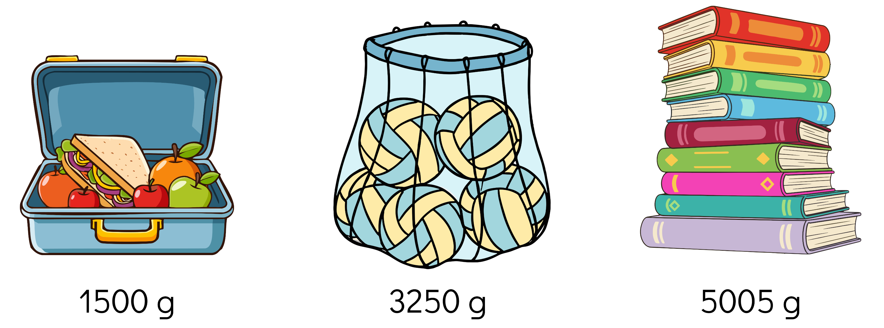
Short response (17)
Record the mass of these objects using kilograms and grams.
Notes:
Short response questions provide brisk paced questions focussing on review of current and previous content to support spaced and interleaved practice.
Syllabus focus area:
Non-spatial measure B

Slide 35
Short response (18)
Amal multiplied a one-digit number by a multiple of 10.
4 × 20 = 8 tens = 80
Record a solution to 6 × 40 using multiples of 10.
Notes:
Short response questions provide brisk paced questions focussing on review of current and previous content to support spaced and interleaved practice.
Syllabus focus area:
Multiplicative relations B

Slide 36
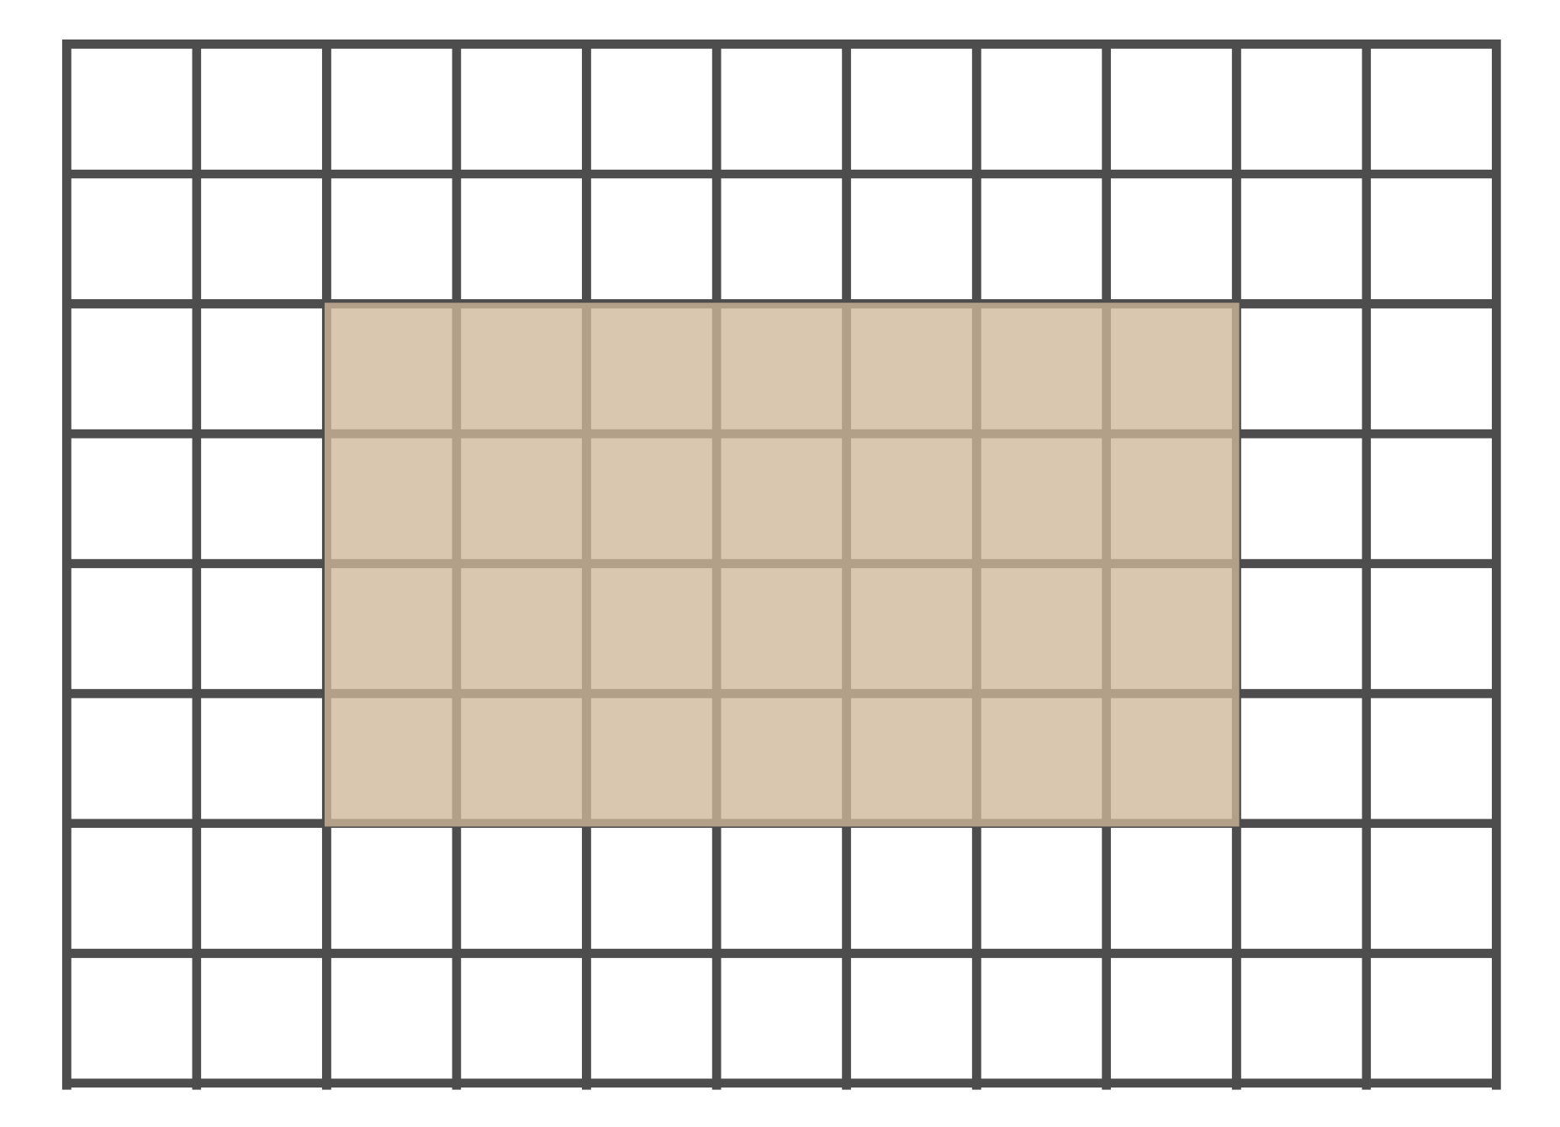
Short response (19)
Record the area of the rectangle in square centimetres.
= 1 square centimetre
Notes:
Short response questions provide brisk paced questions focussing on review of current and previous content to support spaced and interleaved practice.
Syllabus focus area:
Two-dimensional spatial structure A

Slide 37
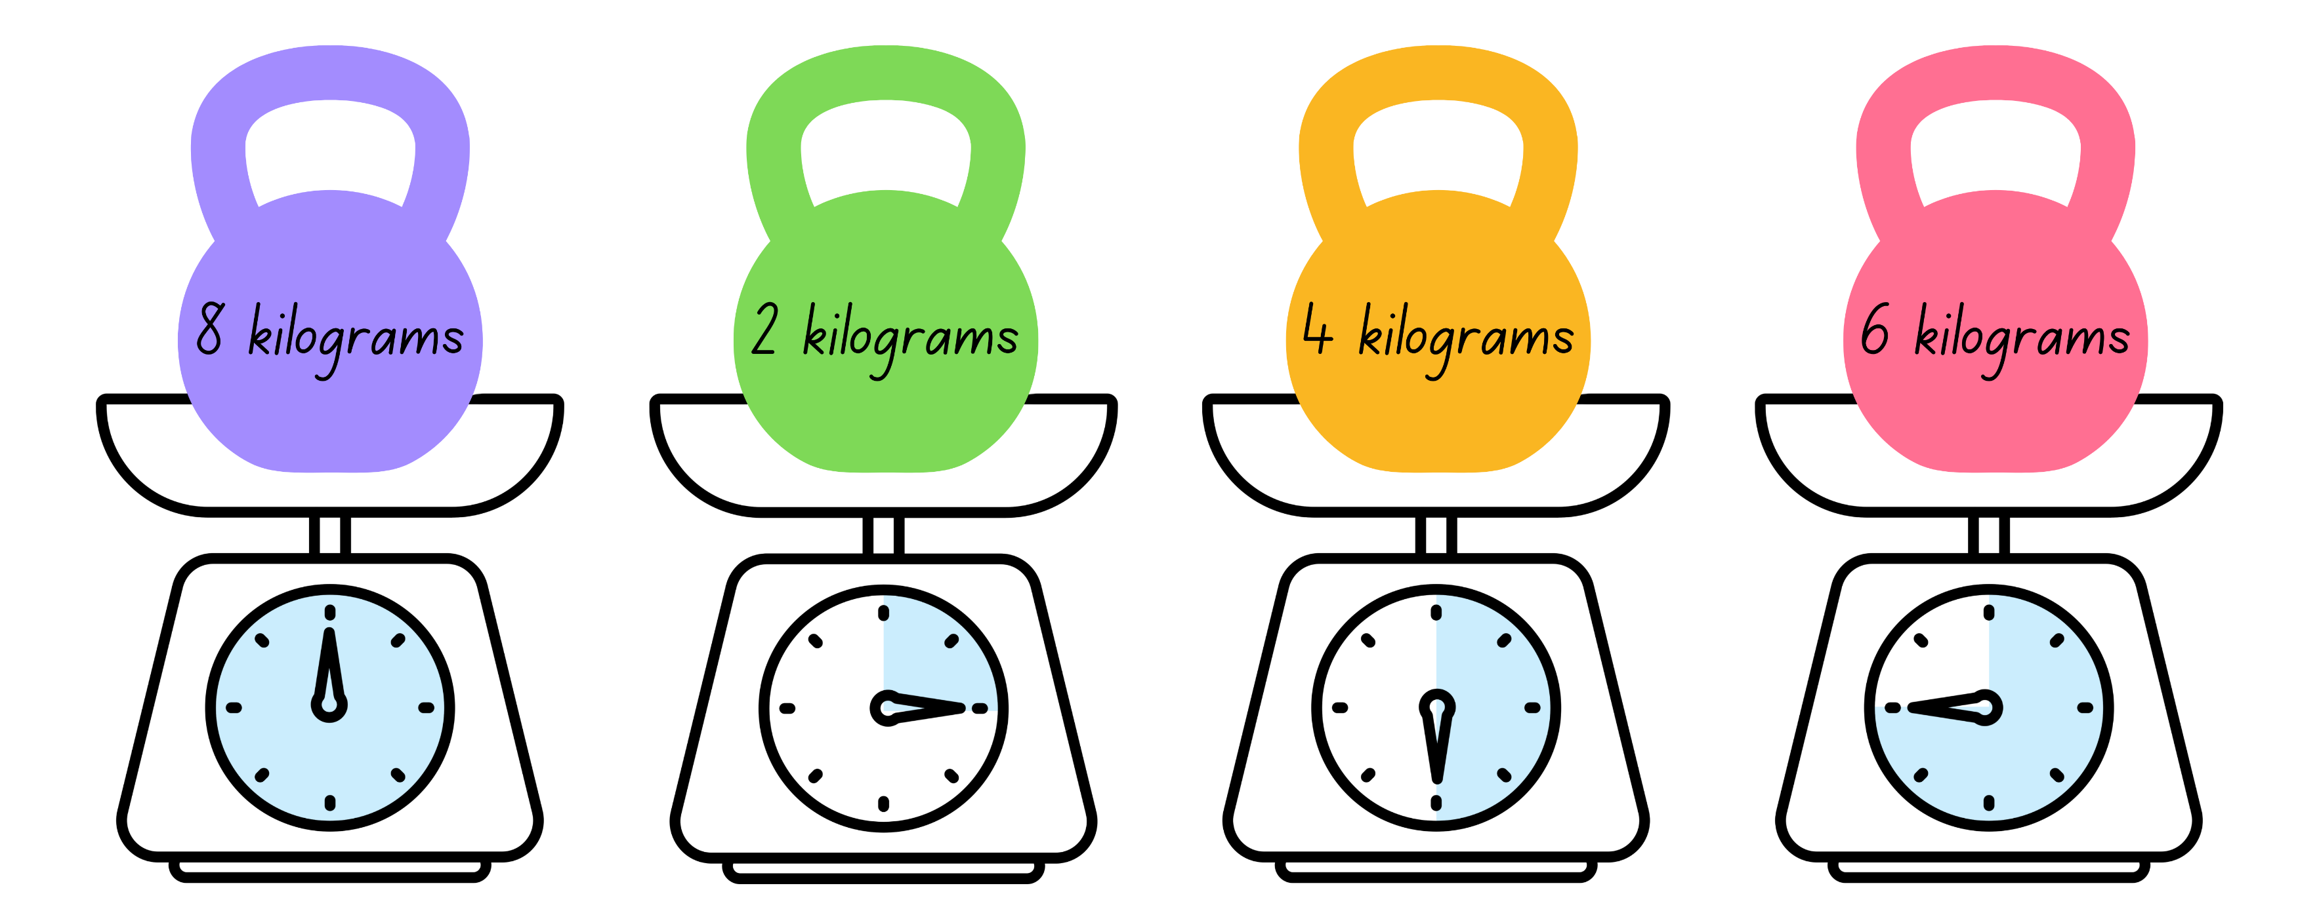
Short response (20)
Record the mass of each weight using the abbreviation for kilogram.
A
B
C
D
Notes:
Short response questions provide brisk paced questions focussing on review of current and previous content to support spaced and interleaved practice.
Syllabus focus area:
Non-spatial measure A

Slide 38
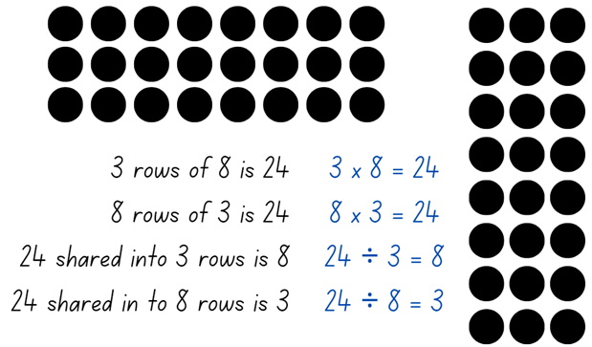
Activity 5 – fact families using arrays
Can you link multiplication and division using arrays?
Notes:
This is a developing number sense activity.
Number sense refers to a deep understanding of numbers, including their magnitude, relationships, and the effects of operations on them. It supports fluency and understanding, estimation, flexible thinking, and efficient problem-solving. Number sense activities 1–4 ‘activate’ prior number knowledge and support the learning of new content in the unit. Number sense activities 5–8 ‘loop’ back and provide opportunity for spaced practice with concepts and procedures covered in previous units.
Syllabus focus area:
Multiplicative relations A
Fact families using arrays
Demonstrate how to link multiplication and division using arrays by rolling 2 10-sided dice and using the numbers rolled to form an array with counters.
From the array, record 2 multiplication and 2 division number sentences as a fact family on the board (see Figure 6 – array number sentence from Stage 2 Year B unit 34).
Highlight:
- the link between multiplication and division
- the commutative property of multiplication.
Provide students with two 10-sided dice and their workbooks. Students record the fact families in their workbook.
Note: provide counters to students that need to support their multiplicative thinking by making the array.
Select students to share and explain their arrays and number sentences.

Slide 39
Review of learning 6

Slide 40
True or false (3)
The fact families for 20, 5 and 4 are:
5 × 4 = 20
4 × 5 = 20
20 ÷ 5 = 4
20 ÷ 4 = 5
20
5
4
True | False
Notes:
The question on this slide connects to the content being explored in the developing number sense activity (Activity 6)
Syllabus focus area:
Multiplicative relations A

Slide 41
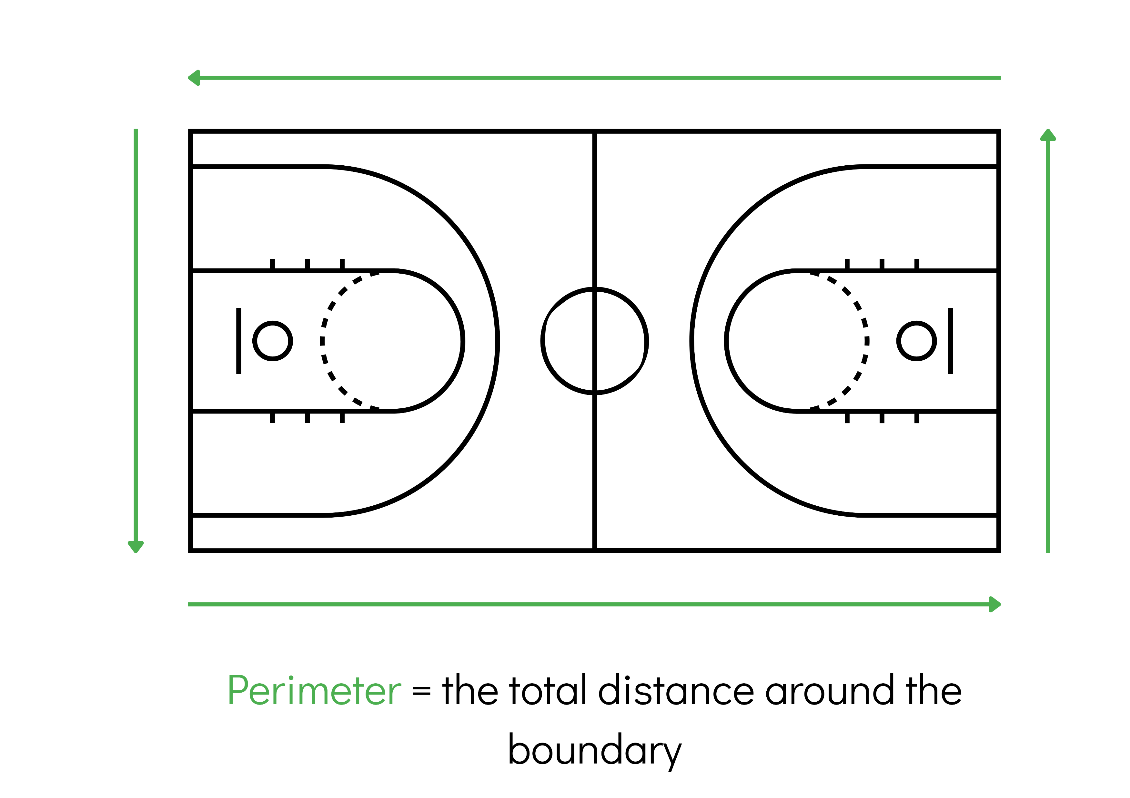
Short response (21)
Estimate then calculate the perimeter of the basketball court.
15 m
28 m
Notes:
Short response questions provide brisk paced questions focussing on review of current and previous content to support spaced and interleaved practice.
Syllabus focus area:
Geometric measure B

Slide 42
Short response (22)
Complete these multiplication (×) and division (÷) sentences by recording the missing numbers.
A
B
? × 6 = 42
42 ÷ ? = 6
Notes:
Short response questions provide brisk paced questions focussing on review of current and previous content to support spaced and interleaved practice.
Syllabus focus area:
Multiplicative relations B

Slide 43
Short response (23)
Record the side lengths and area of each rectangle.
A
B
= 1 square centimetre
Can rectangles with different side lengths have the same area?
Notes:
Short response questions provide brisk paced questions focussing on review of current and previous content to support spaced and interleaved practice.
Syllabus focus area:
Two-dimensional spatial structure B

Slide 44


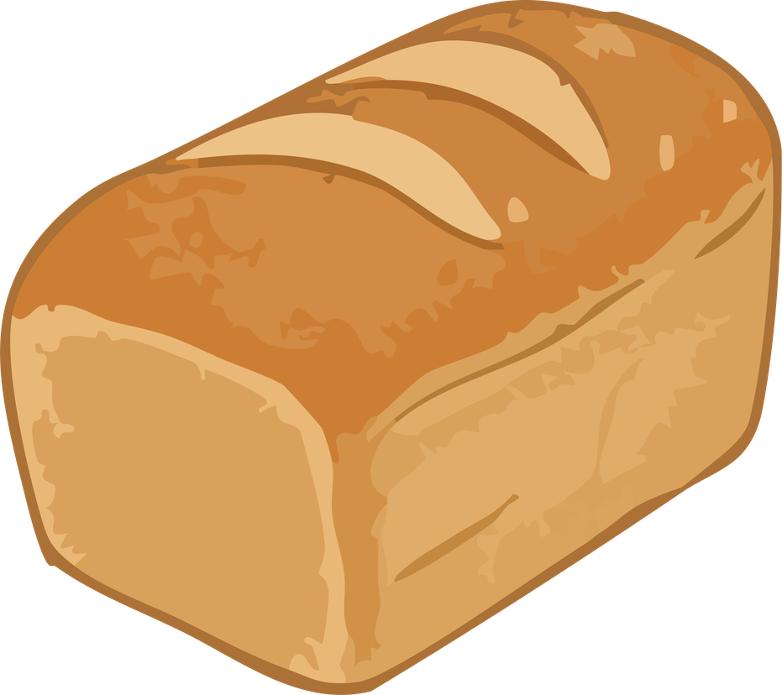
Short response (24)
Which of these familiar objects has a mass of about one kilogram? You may select more than one answer.
A
B
C
D
E
F
Communicate your reasoning.​
Notes:
Short response questions provide brisk paced questions focussing on review of current and previous content to support spaced and interleaved practice.
Syllabus focus area:
Non-spatial measure A

Slide 45
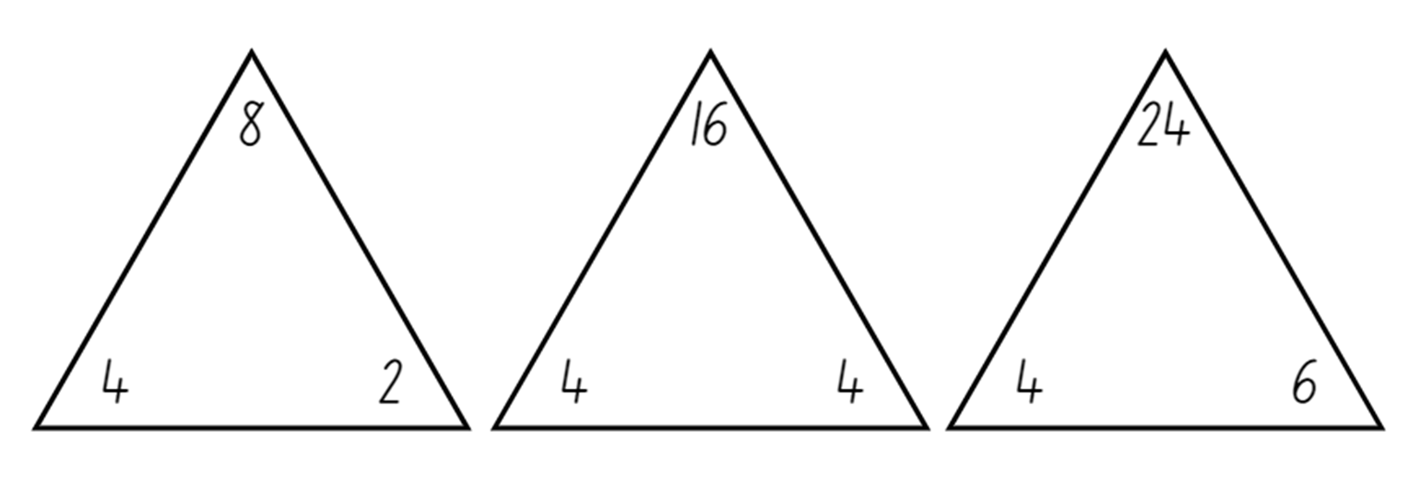
Activity 6 – multiplication and division using fact families
Notes:
This is a developing number sense activity.
Number sense refers to a deep understanding of numbers, including their magnitude, relationships, and the effects of operations on them. It supports fluency and understanding, estimation, flexible thinking, and efficient problem-solving. Number sense activities 1–4 ‘activate’ prior number knowledge and support the learning of new content in the unit. Number sense activities 5–8 ‘loop’ back and provide opportunity for spaced practice with concepts and procedures covered in previous units.
Syllabus focus area:
Multiplicative relations A
Multiplication and division using fact families
This resource corresponds to Resource 15 – making fact families in Stage 2 Year B Unit 34.
Explain that 8 is a multiple of 2 and of 4. Write the skip counting pattern of 2 and then of 4 to confirm that 8 is in both patterns. Explain that 2 and 4 are factors of 8.
Record the terms ‘multiple’ and ‘factor’ on an anchor chart or word wall.
Multiple: products formed using the same base number multiplied by different whole numbers, for example, 3, 6, 9, 12 …
Factor: a number which divides another number without a remainder. For example, 1, 2, 3 and 6 are factors of 6, but 4 and 5 are not.
Select one fact family from Resource 15 – making fact families to model:
- how to write multiplication and division sentences using fact families
- using arrays to prove the commutative property of multiplication.
Note: highlight to students that the number at the top of the triangle is the product of the 2 factors at the bottom of the triangle. For division, ensure students understand that the product of the fact family must be at the start of the sentence. Division is not commutative, so 2 ÷ 4 = 8 is not correct.
Record the term ‘product’ on the anchor chart or word wall.
Product: the result of multiplying 2 or more numbers together, for example, 12 is the product of 4 × 3.
Provide students with Resource 15 – making fact families. Students identify the fact families for the remaining triangles and record the number sentences.
Note: some students may need concrete materials, such as counters, to manipulate while completing the activity. This activity can be differentiated by having students find other factors of the product and writing out the fact families.
Select students to share and explain their work. Record student responses for the class to see.

Slide 46
Review of learning 7

Slide 47
Multiple choice (4)
You have 8 packs of stickers. Each pack has 4 stickers.
If you share all the stickers equally with 4 friends, how many stickers does each friend get?
A
B
C
D
8 + 4 = 12
12 ÷ 4 = 3
Answer: 3 stickers
8 × 4 = 32
32 ÷ 4 = 8
Answer: 8 stickers
4 × 4 = 16
16 ÷ 4 = 4
Answer: 4 stickers
8 × 4 = 32
32 ÷ 2 = 16
Answer: 16 stickers
Notes:
This question connects to the content in the developing number sense activity (Activity 7)
Syllabus focus area:
Multiplicative relations A

Slide 48
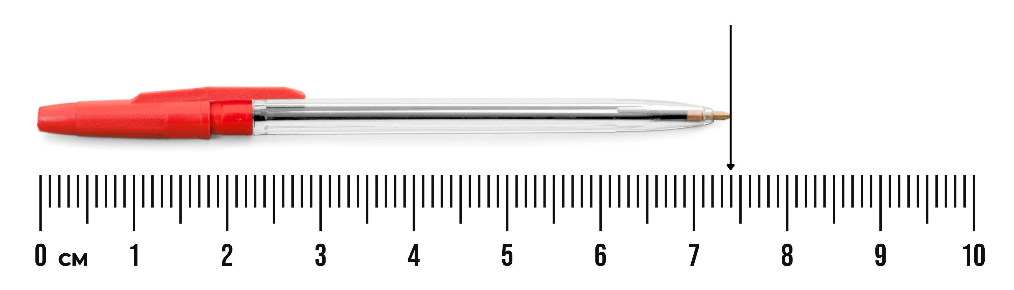
Short response (25)
Record the length of the pen using decimal notation to 2 decimal places.
Notes:
Short response questions provide brisk paced questions focussing on review of current and previous content to support spaced and interleaved practice.
Syllabus focus area:
Geometric measure B

Slide 49
Short response (26)
Record the solution using a number sentence.
There are 40 basketballs packed into bags of 8.
How many bags are needed?
Notes:
Short response questions provide brisk paced questions focussing on review of current and previous content to support spaced and interleaved practice.
Syllabus focus area:
Multiplicative relations B

Slide 50
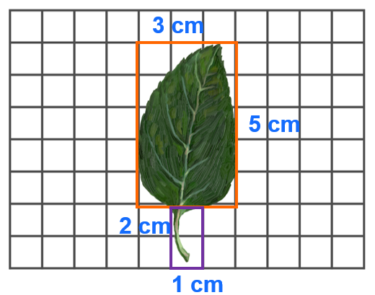
Short response (27)
Record the approximate area of this leaf in square centimetres using numerals and words.
Notes:
Short response questions provide brisk paced questions focussing on review of current and previous content to support spaced and interleaved practice.
Syllabus focus area:
Two-dimensional spatial structure A

Slide 51
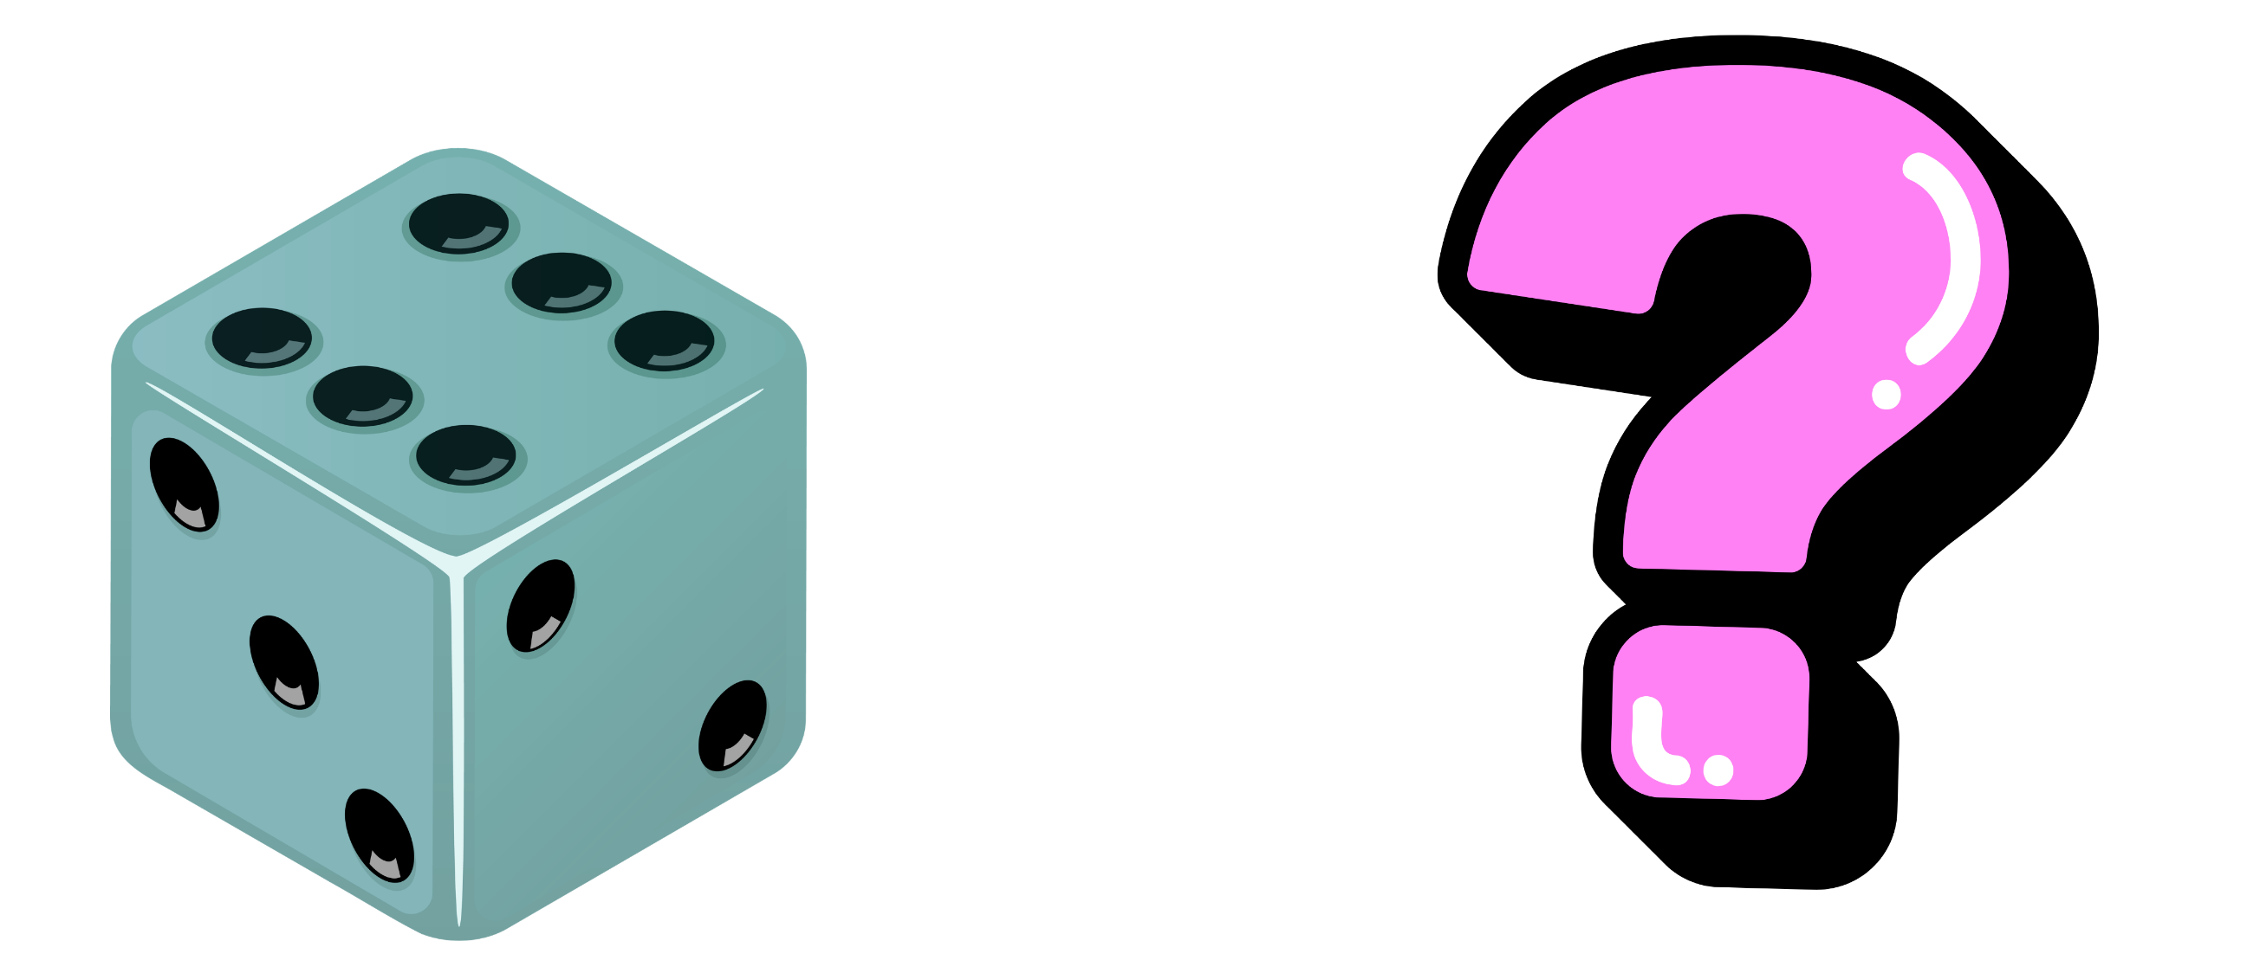
Short response (28)
Thomas rolls a dice and it lands on 6.
He believes that rolling a 6 once will double his chances of rolling a 6 again.
Is Thomas correct?
Communicate your reasoning.
Notes:
Short response questions provide brisk paced questions focussing on review of current and previous content to support spaced and interleaved practice.
Syllabus focus area:
Chance B

Slide 52
Activity 7 – solving problems with fact families
Lots of buttons
The tailor received a delivery of buttons. In the box there are 6 packets of buttons. In each packet there are 10 buttons. How many buttons are there altogether? If the tailor is using the new buttons to sew onto 12 shirts, how many buttons will she use on each shirt?
Notes:
This is a developing number sense activity.
Number sense refers to a deep understanding of numbers, including their magnitude, relationships, and the effects of operations on them. It supports fluency and understanding, estimation, flexible thinking, and efficient problem-solving. Number sense activities 1–4 ‘activate’ prior number knowledge and support the learning of new content in the unit. Number sense activities 5–8 ‘loop’ back and provide opportunity for spaced practice with concepts and procedures covered in previous units.
Syllabus focus area:
Multiplicative relations A
Solving problems with fact families
This resource corresponds to Resource 16 – solving word problems in Stage 2 Year B Unit 34.
Explain that students will work in pairs to solve the problem. Ask:
- What is the problem asking you to find out?
- Where will you start to solve the problem?
- How many different parts are there to the problem? Can you use the same strategy to solve each part?
- Which strategy do you think will work best to find a solution for this problem? Why?
- How can you record the solution?
After students have had the opportunity to work on the solution, ask:
- How do you know the strategy you are using is working?
- How can you check that the answer is correct?

Slide 53
Review of learning 8

Slide 54
True or false (4)
The divided by symbol is
÷
True | False
Notes:
The question on this slide connects to the content being explored in the developing number sense activity (Activity 8)
Syllabus focus area:
Multiplicative relations A

Slide 55
Short response (29)
Convert:
3 metres 67 cm to metres
52.6 m to cm
Notes:
Short response questions provide brisk paced questions focussing on review of current and previous content to support spaced and interleaved practice.
Syllabus focus area:
Geometric measure B

Slide 56
Short response (30)
Record one multiplication (×) and one division (÷) number sentence to match:
There are 32 desks arranged into 4 equal rows.
Notes:
Short response questions provide brisk paced questions focussing on review of current and previous content to support spaced and interleaved practice.
Syllabus focus area:
Multiplicative relations B

Slide 57
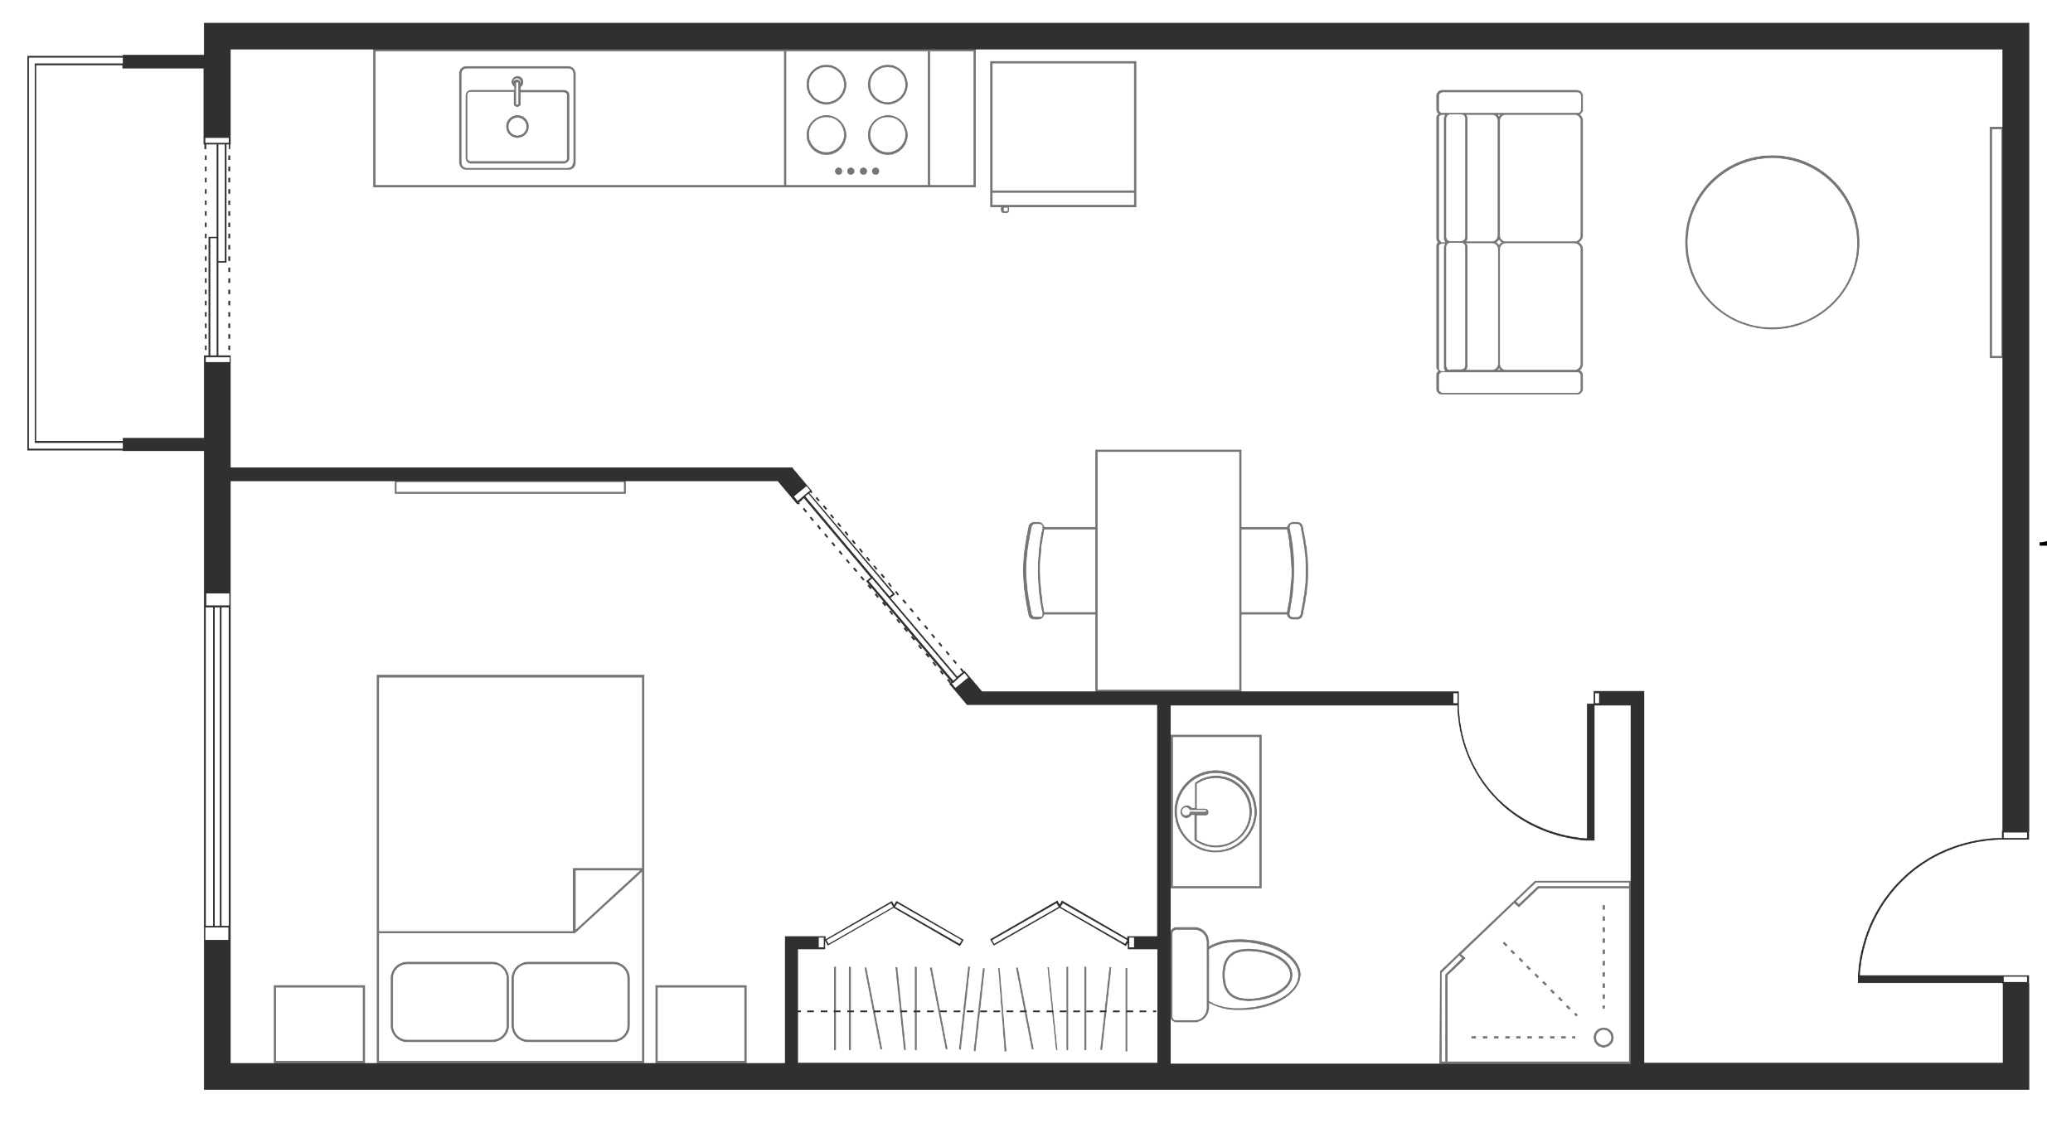
Short response (31)
Record the area of the house in square metres using numerals and words.
= 1 square metre
Notes:
Short response questions provide brisk paced questions focussing on review of current and previous content to support spaced and interleaved practice.
Syllabus focus area:
Two-dimensional spatial structure A

Slide 58
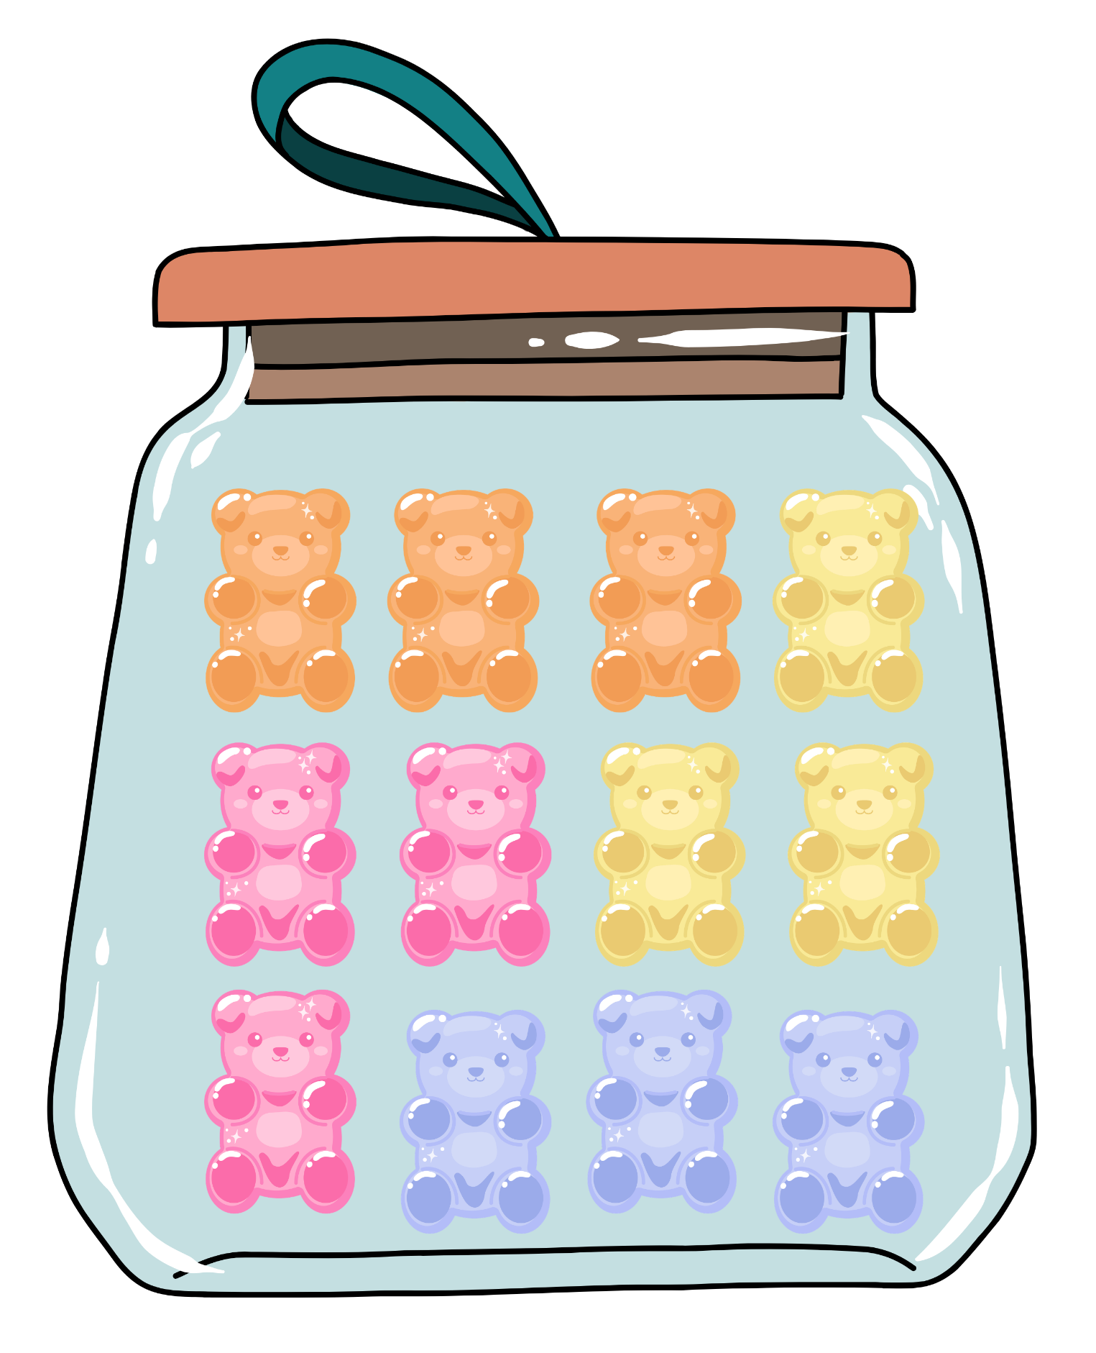
Short response (32)
Harry has a jar with 12 gummy bears.
He pulls out random gummy bears one at a time to eat them. Harry pulls out and eats one orange gummy bear.
How does taking out the first orange gummy bear affect the chance of picking another orange gummy bear?
Notes:
Short response questions provide brisk paced questions focussing on review of current and previous content to support spaced and interleaved practice.
Syllabus focus area:
Chance B

Slide 59
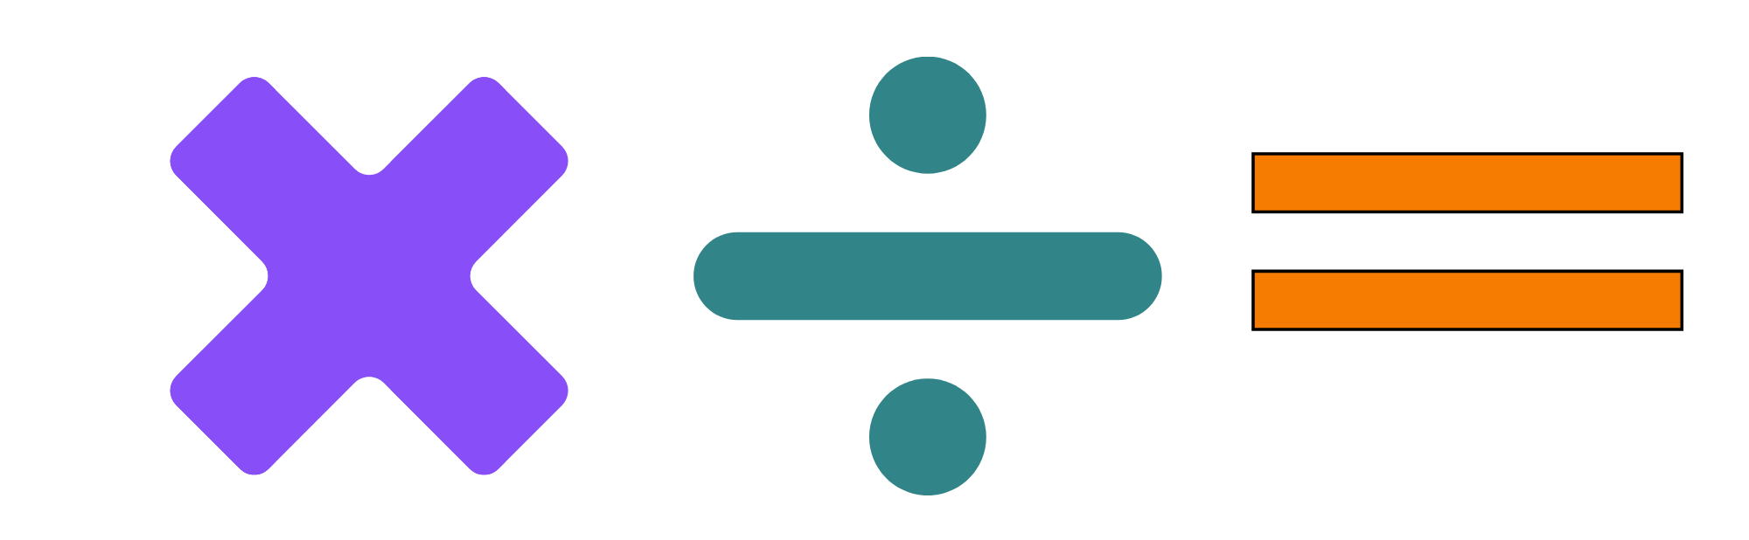
Activity 8 – generating fact families (1)
3 ____ 2 ____ 6
10 ____ 2 ____ 5
20 ____ 4 ____ 5
10 ____ 5 ____ 2
Notes:
This is a developing number sense activity.
Number sense refers to a deep understanding of numbers, including their magnitude, relationships, and the effects of operations on them. It supports fluency and understanding, estimation, flexible thinking, and efficient problem-solving. Number sense activities 1–4 ‘activate’ prior number knowledge and support the learning of new content in the unit. Number sense activities 5–8 ‘loop’ back and provide opportunity for spaced practice with concepts and procedures covered in previous units.
Syllabus focus area:
Multiplicative relations A
Generating fact families
Ask: Can you place the correct symbols into the blank spaces to make these number sentences make sense?
Students discuss their solutions, explaining their mathematical reasoning.
Revise that a fact family is a group of related number sentences using the same numbers, for example, 2, 4 and 8:
- 2 × 4 = 8
- 4 × 2 = 8
- 8 ÷ 2 = 4
- 8 ÷ 4 = 2.
(Next slide) Display a set of 3 numbers on the board, for example, 2, 10 and 20. In pairs, students record 4 related number sentences, creating the fact family.

Slide 60
Activity 8 – generating fact families (2)
2
10
20
Notes:
This is a developing number sense activity.
Number sense refers to a deep understanding of numbers, including their magnitude, relationships, and the effects of operations on them. It supports fluency and understanding, estimation, flexible thinking, and efficient problem-solving. Number sense activities 1–4 ‘activate’ prior number knowledge and support the learning of new content in the unit. Number sense activities 5–8 ‘loop’ back and provide opportunity for spaced practice with concepts and procedures covered in previous units.
Syllabus focus area:
Multiplicative relations A
Generating fact families
In pairs, students record 4 related number sentences, creating the fact family.

Slide 61
Double Venn diagram
Object 1
Object 2
Features similar to both objects
Features of object 1
Features of object 2

Slide 62
Frayer
Definition
Facts/Characteristics
Word, term, concept
Examples
Non-examples

Slide 63
Spider map
Idea
Subject

Slide 64
Cline
Concept 1
Concept 2
Word
Word
Word
Word
Word
Word
Word
Word
Word
Word
Word

Slide 65
Compare and contrast

Slide 66
Multiple choice (5)
A
B
C
D

Slide 67
Multiple choice
A
B
C
D
Notes:
This question connects to the content in the developing number sense activity (Activity 3)
Syllabus focus area:
[Focus area A/B]

Slide 68
References
This presentation contains NSW Curriculum and syllabus content. The NSW Curriculum is developed by the NSW Education Standards Authority. This content is prepared by NESA for and on behalf of the Crown in the right of the State of New South Wales. The material is protected by Crown copyright.
Please refer to the NESA Copyright Disclaimer for more information https://educationstandards.nsw.edu.au/wps/portal/nesa/mini-footer/copyright.
NESA holds the only official and up-to-date versions of the NSW Curriculum and syllabus documents. Please visit the NSW Education Standards Authority (NESA) website https://educationstandards.nsw.edu.au/wps/portal/nesa/home and the NSW Curriculum website https://curriculum.nsw.edu.au.
Mathematics K–10 Syllabus © NSW Education Standards Authority (NESA) for and on behalf of the Crown in right of the State of New South Wales, 2022.
National Numeracy Learning Progression © Australian Curriculum, Assessment and Reporting Authority (ACARA) 2010 to present, unless otherwise indicated. This material was downloaded from the Australian Curriculum website (National Numeracy Learning Progression) (accessed 20 February 2026) and was not modified.
Department of Education and Training (2009) ‘Funny Numbers’, Mathematics Developmental Continuum P-10, Victoria State Government, accessed 20 February 2026.
New Zealand Ministry of Education (n.d.) ‘Place the Digits’, Mathematics and Statistics Resources, Tāhūrangi - New Zealand Curriculum website, accessed 20 February 2026.
State of New South Wales (Department of Education) (2022) Stage 2 – mass, NSW Department of Education website, accessed 20 February 2026.
——(2022) ‘Activity 4 – "Mass-ive" Model’, Stage 2 – mass, NSW Department of Education website, accessed 20 February 2026.

Slide 69
Copyright
© State of New South Wales (Department of Education), 2025
The copyright material published in this resource is subject to the Copyright Act 1968 (Cth) and is owned by the NSW Department of Education or, where indicated, by a party other than the NSW Department of Education (third-party material).
Copyright material available in this resource and owned by the NSW Department of Education is licensed under a Creative Commons Attribution 4.0 International (CC BY 4.0) license.
This license allows you to share and adapt the material for any purpose, even commercially.
Attribution should be given to © State of New South Wales (Department of Education), 2025.
Material in this resource not available under a Creative Commons license:
the NSW Department of Education logo, other logos and trademark-protected material
Material owned by a third party that has been reproduced with permission. You will need to obtain permission from the third party to reuse its material.
Links to third-party material and websites
Please note that the provided (reading/viewing material/list/links/texts) are a suggestion only and implies no endorsement, by the New South Wales Department of Education, of any author, publisher, or book title. School principals and teachers are best placed to assess the suitability of resources that would complement the curriculum and reflect the needs and interests of their students.
If you use the links provided in this document to access a third party’s website, you acknowledge that the terms of use, including licence terms set out on the third-party’s website apply to the use which may be made of the materials on that third-party website or where permitted by the Copyright Act 1968 (Cth). The department accepts no responsibility for content on third-party websites.

