Slide 1
Instructions for use
This resource aligns to the learning in Stage 3 Year A Unit 10 and revisits content from earlier sample units.
Classroom teachers are encouraged to add and adapt slides as required to meet the needs of their students.
Save a copy of the file to make changes to the slide deck. Go to File > Download a Copy (this downloads a copy to the computer to edit in the PowerPoint app).
To convert the PowerPoint to Google Slides:
  Upload the file into Google Drive and open it.
  Go to File > Save as Google Slides.
  (Note – conversion may cause formatting changes in the slides.)

Slide 2

Review of Learning
Mathematics Stage 3 – Unit 10
Notes:
Reviews may include a combination of question types, requiring students to recall facts and key ideas, as well as apply their knowledge to solve problems and answer questions. To support active engagement, a mix of techniques should be employed.” (AERO, 2024).
This Review of Learning slide deck revisits key concepts from the following units:
Stage 3 Year A Unit 10
Stage 3 Year A Unit 9
Stage 3 Year A Unit 8
It also includes opportunities to review prior learning in non-number content, supporting consolidation across focus areas.
The review of learning resources include three key task types that support the development of mathematical proficiency through retrieval, spaced practice, and active participation. These practices complement the review phase (activating prior knowledge) embedded within the beginning of each lesson.
1.
Multiple-choice questions/True or false: Designed to promote active retrieval of key concepts and identify common misconceptions in number, supporting consolidation, understanding and fluency.
These questions:
support spaced and interleaved practice
help identify and address common misconceptions
support active recall and immediate feedback
support whole class participation
identify areas requiring reteach
2.
Short-response question sets: Carefully grouped questions that encourage spaced and interleaved practice across multiple focus areas, helping students revisit and apply knowledge from different points in time.
These questions:
have a combination of question types
address a range of focus areas
build automaticity and fluency
support active recall
allow for immediate feedback
identify content requiring reteach
3.
Developing number sense activities: A variety of practical, purposeful tasks that reinforce current learning and build on prior knowledge. These activities promote reasoning, problem-solving and conceptual understanding.
The review of learning resources are designed to work support teaching and learning in mathematics. For the most effective implementation, use the resources flexibly, adapting to meet student learning needs and individual classroom contexts.

Slide 3
Lessons
1
Review of learning 1
5
Review of learning 5
2
Review of learning 2
6
Review of learning 6
3
Review of learning 3
7
Review of learning 7
4
Review of learning 4
8
Review of learning 8
Notes:
Teacher notes:
Click lesson titles to go to specific lessons
Interactive features can be viewed in slide show

Slide 4
Review of learning 1

Slide 5


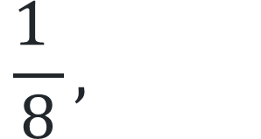
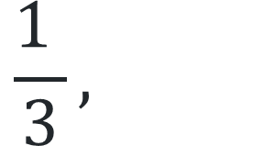
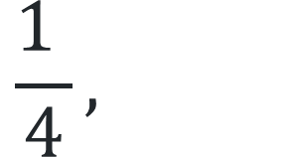
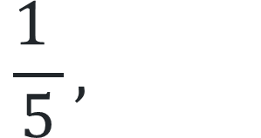
Multiple choice (1)
Which unit fraction is closest to $\frac{1 }{2}$?
A
$$\frac{1 }{5},$$
B
$$\frac{1 }{4},$$
C
$$\frac{1 }{3},$$
D
$$\frac{1 }{8},$$
Notes:
This question connects to the content in the developing number sense activity (Activity 1)
Syllabus focus area:
Representing quantity fractions A

Slide 6

Short response (1)
Name the angle that can be described as less than a quarter turn.
Notes:
Short response questions provide brisk paced questions focussing on review of current and previous content to support spaced and interleaved practice.
Syllabus focus area:
Geometric measure B: Angles (Note: Stage 2 content reviewed)

Slide 7
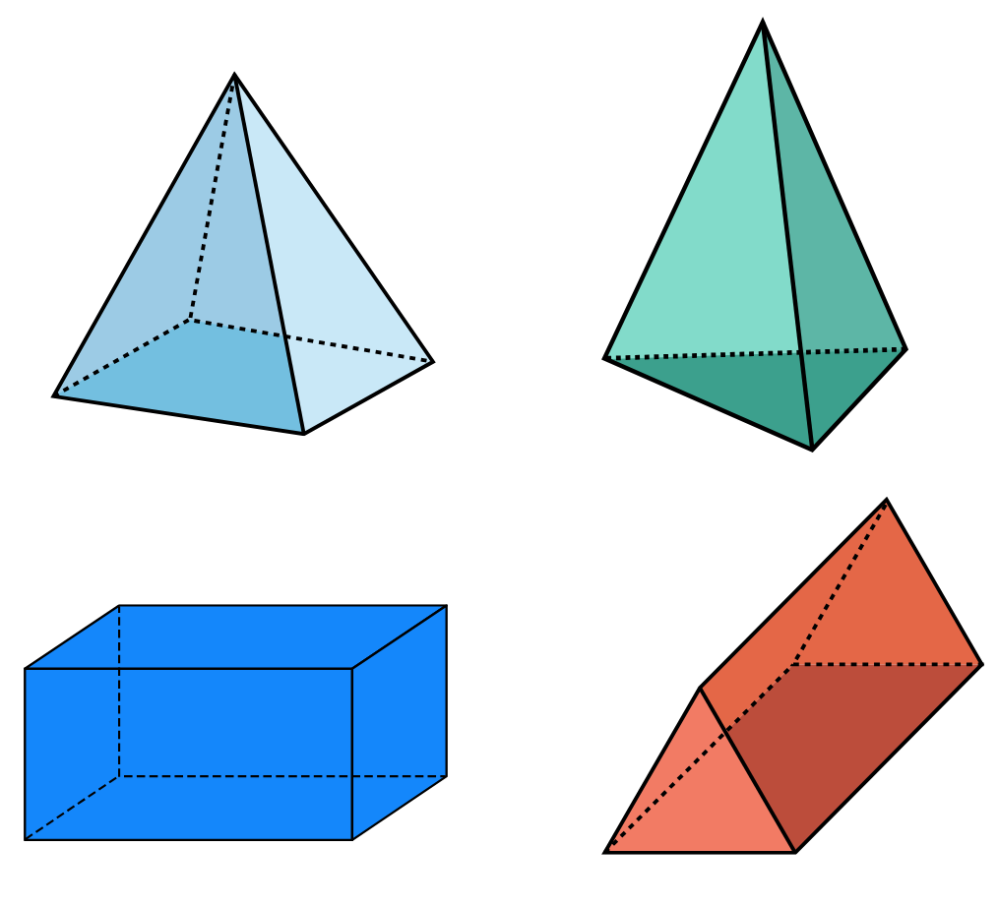
Short response (2)
A.
B.
A.
B.
Use the base of each
object to name the
pyramids and
prisms.
C.
D.
C.
D.
Notes:
Short response questions provide brisk paced questions focussing on review of current and previous content to support spaced and interleaved practice.
Syllabus focus area:
Three-dimensional spatial structure A: 3D Objects

Slide 8
Short response (3)
Record the missing part of these sentences:
The grid-map reference system gives an ____location.
The Cartesian plane gives a _______ location.
area | specific point
Notes:
Short response questions provide brisk paced questions focussing on review of current and previous content to support spaced and interleaved practice.
Syllabus focus area:
Geometric measure A: Position

Slide 9
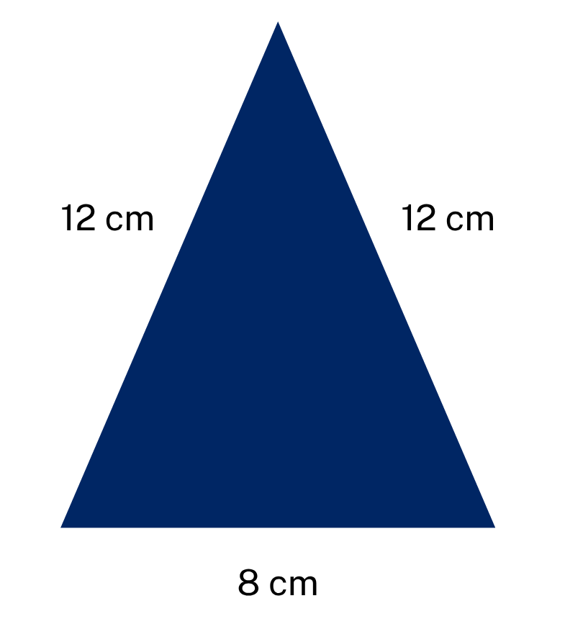
Short response (4)
Calculate the perimeter of this shape.
Notes:
Short response questions provide brisk paced questions focussing on review of current and previous content to support spaced and interleaved practice.
Syllabus focus area:
Geometric measure A: Length

Slide 10
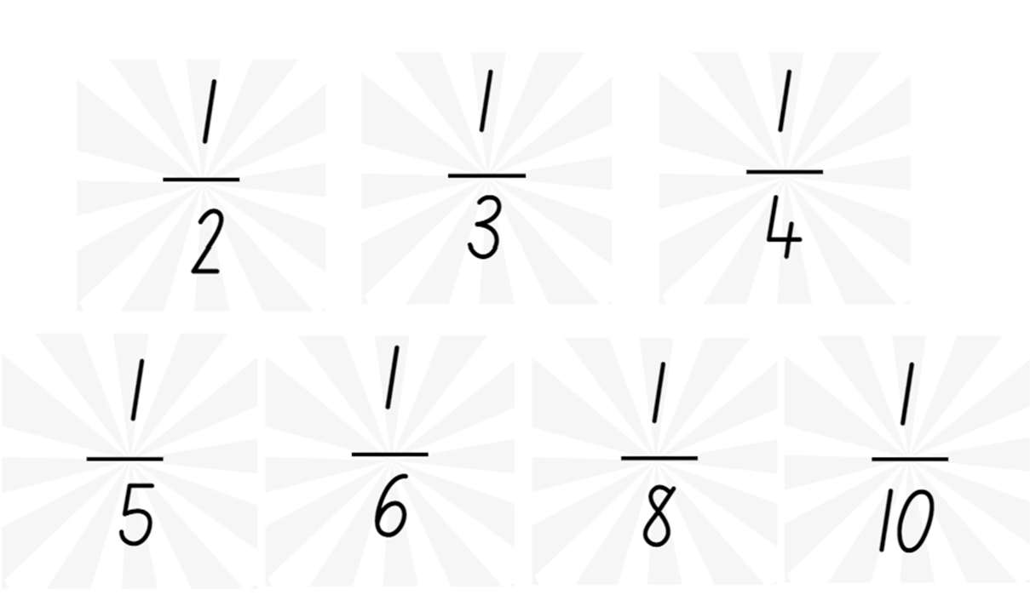

Activity 1 – comparing unit fractions to benchmark fractions
Notes:
This is a developing number sense activity.
Number sense refers to a deep understanding of numbers, including their magnitude, relationships, and the effects of operations on them. It supports fluency and understanding, estimation, flexible thinking, and efficient problem-solving. Number sense activities 1–4 ‘activate’ prior number knowledge and support the learning of new content in the unit. Number sense activities 5–8 ‘loop’ back and provide opportunity for spaced practice with concepts and procedures covered in previous units.
Syllabus focus area:
Representing quantity fractions A
Comparing unit fractions to benchmark fractions
This resource corresponds to Resource 20 – using benchmark fractions in Stage 3 Year A Unit 10.
Display Resource 20 – using benchmark fractions. Explain that students are going to use a number line to order these fractions from smallest to largest.
Ask: Which fraction cards might you place first? Explain your thinking. What are the challenges of placing them all on the same number line?
Provide small groups with Resource 20 – using benchmark fractions, pegs and string. Students place their fractions on the number line. Observe student strategies, supporting students to use benchmark fractions to guide their placements.
Regroup and ask:
Which fractions were the easiest to place and which were more challenging? Why?
Did you group any fractions to make them easier to place? For example, halves, quarters and eighths.

Slide 11
Review of learning 2

Slide 12
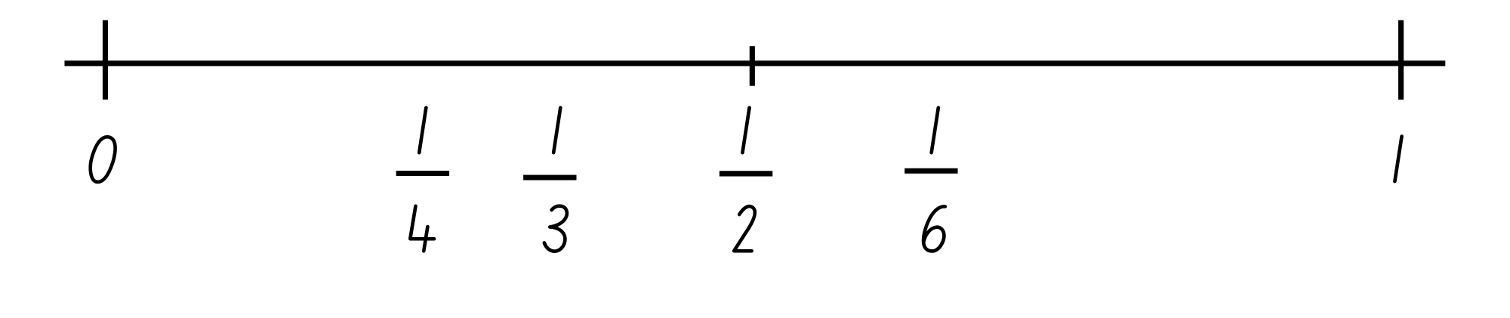
True or false (1)
These fractions are correctly ordered on the number line.
True | False
Notes:
The question on this slide connects to the content being explored in the developing number sense activity (Activity 2)
Syllabus focus area:
Representing quantity fractions A

Slide 13
Short response (5)
Estella faced the front of the classroom, then made a half turn to the right.
Mark the vertex and draw the invisible arms of the angle she made.
Notes:
Short response questions provide brisk paced questions focussing on review of current and previous content to support spaced and interleaved practice.
Syllabus focus area:
Geometric measure A: Angles

Slide 14
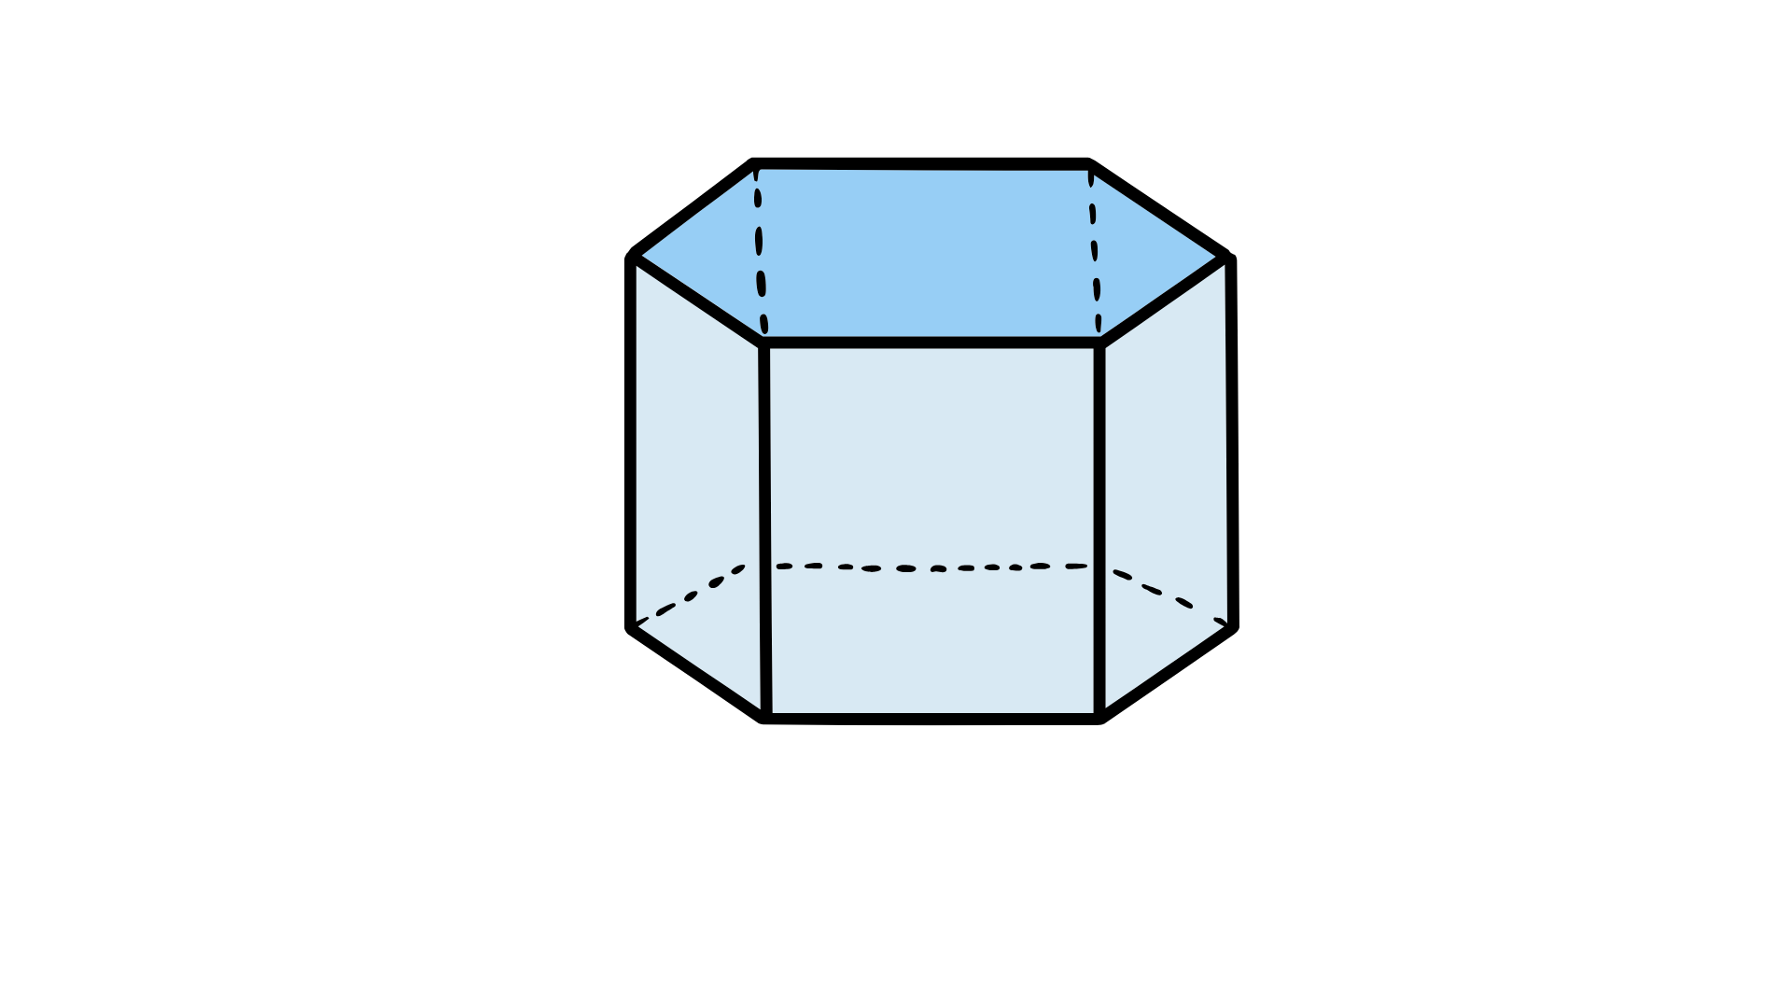
Short response (6)
Sketch the 3D object
from the top view.
Notes:
Short response questions provide brisk paced questions focussing on review of current and previous content to support spaced and interleaved practice.
Syllabus focus area:
Three-dimensional spatial structure A

Slide 15
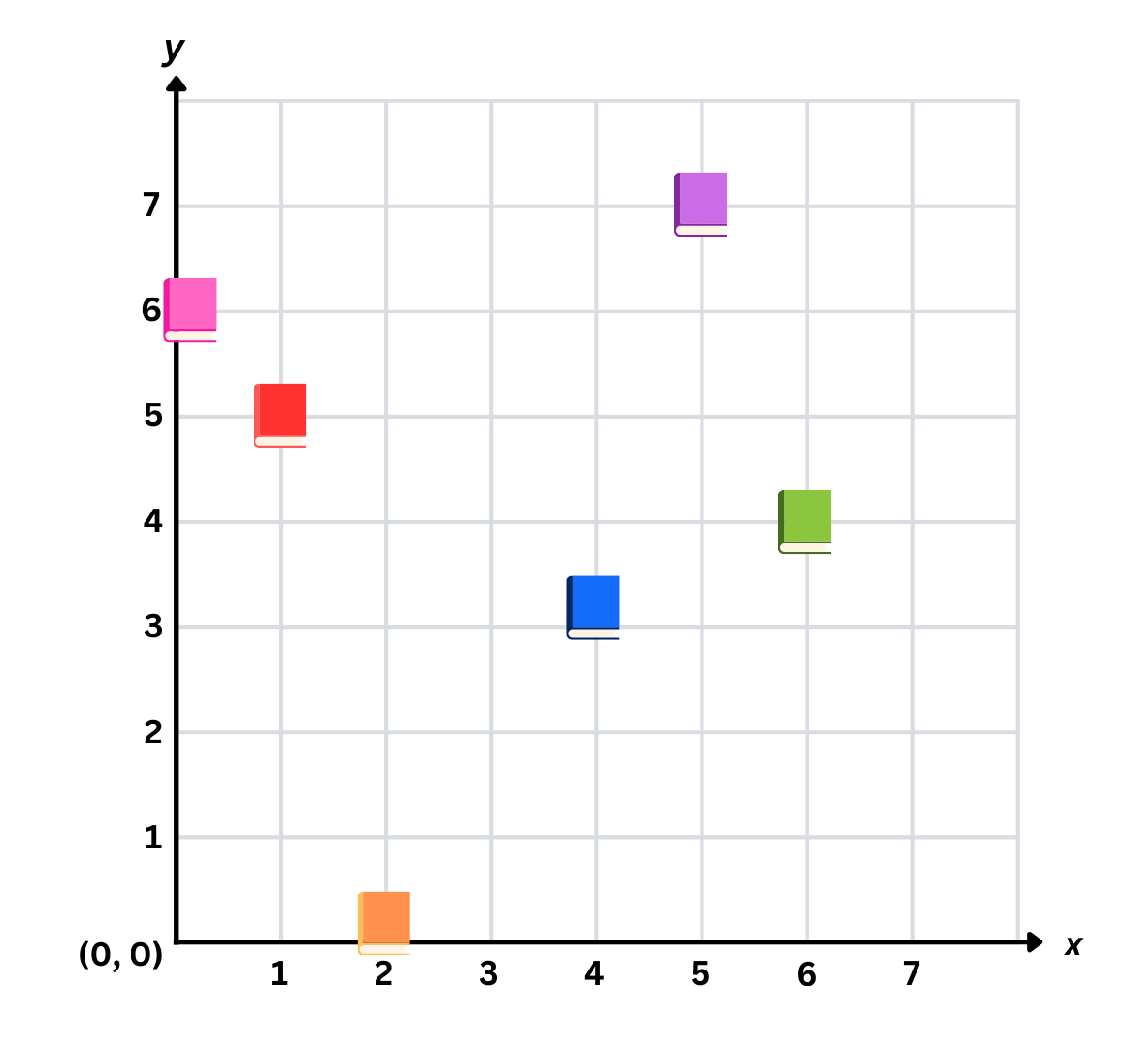
Short response (7)
Identify and record the coordinates for the:
pink book
orange book
green book
Notes:
Short response questions provide brisk paced questions focussing on review of current and previous content to support spaced and interleaved practice.
Syllabus focus area:
Geometric measure A: Position

Slide 16
Short response (8)
Two rectangles have the same perimeter of 20 cm but different dimensions (length and width).
Draw both rectangles to show how this is possible.
Communicate your reasoning.
Notes:
Short response questions provide brisk paced questions focussing on review of current and previous content to support spaced and interleaved practice.
Syllabus focus area:
Geometric measure A: Length

Slide 17
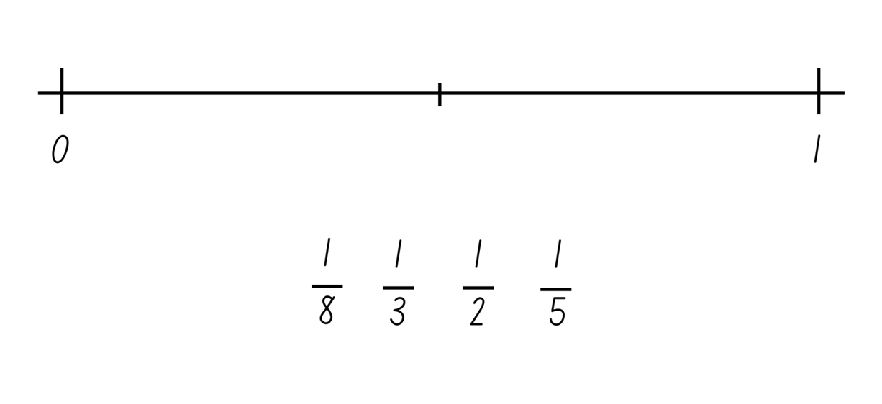
Activity 2 – ordering unit fractions 1
Notes:
This is a developing number sense activity.
Number sense refers to a deep understanding of numbers, including their magnitude, relationships, and the effects of operations on them. It supports fluency and understanding, estimation, flexible thinking, and efficient problem-solving. Number sense activities 1–4 ‘activate’ prior number knowledge and support the learning of new content in the unit. Number sense activities 5–8 ‘loop’ back and provide opportunity for spaced practice with concepts and procedures covered in previous units.
Syllabus focus area:
Representing quantity fractions A
Ordering unit fractions 1
This resource corresponds to Resource 21 – ordering unit fractions 1 in Stage 3 Year A Unit 10.
Provide students with Resource 21 – ordering unit fractions 1. Students place the fractions in the correct place on the number line.
Students then add any other common fractions to the number line that they know. For example, one-sixth students to share and explain the placement of the fractions.

Slide 18
Review of learning 3

Slide 19
Multiple choice (2)
Which statement about these fractions is correct?
You may select more than one answer.
A
$\frac{1 }{3}$ is smaller than $\frac{1 }{2}.$
$\frac{1 }{3}$ and $\frac{1 }{6}$ are both larger than $\frac{1 }{2}.$
B
$\frac{1 }{8}$ and $\frac{1 }{5}$ are both smaller than $\frac{1 }{2}.$
C
D
$\frac{1 }{6}$ and $\frac{1 }{8}$ are both larger than $\frac{1 }{2}.$
Notes:
This question connects to the content in the developing number sense activity (Activity 3)
Syllabus focus area:
Representing quantity fractions A

Slide 20
Short response (9)
Record the words missing from these sentences:
An angle that is 90° is a __________ angle.
An angle that is 180° is a __________ angle.
An angle that is 360° is an angle of _________.
Notes:
Short response questions provide brisk paced questions focussing on review of current and previous content to support spaced and interleaved practice.
Syllabus focus area:
Geometric measure A

Slide 21
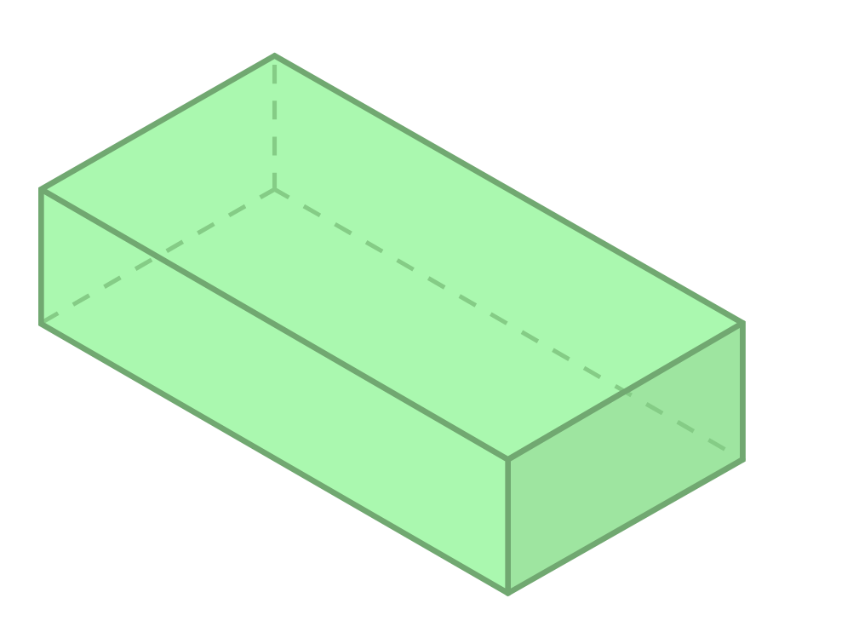
Short response (10)
Sketch the net of this prism.
Notes:
Short response questions provide brisk paced questions focussing on review of current and previous content to support spaced and interleaved practice.
Syllabus focus area:
Three-dimensional spatial structure A: 3D objects

Slide 22
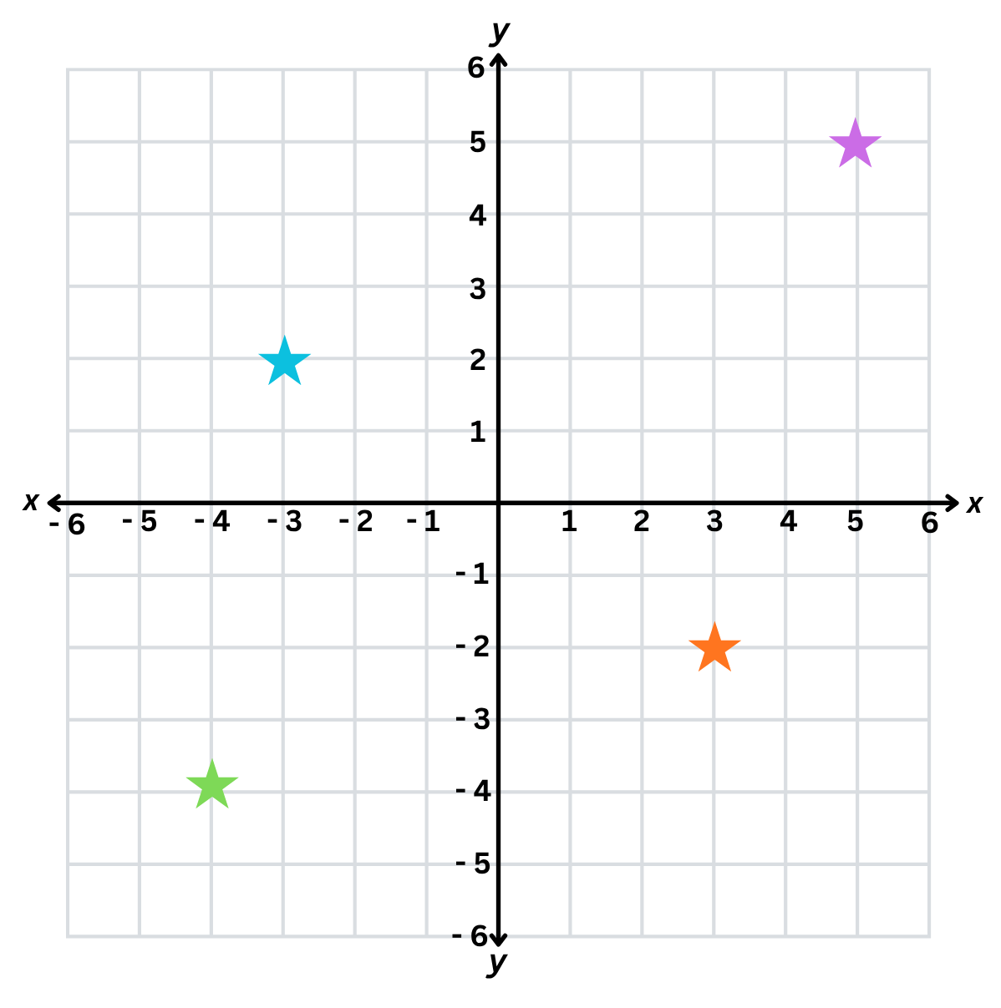
Short response (11)
Identify and record the coordinates for each star.
Notes:
Short response questions provide brisk paced questions focussing on review of current and previous content to support spaced and interleaved practice.
Syllabus focus area:
Geometric measure B: Position

Slide 23
Short response (12)
The distance from Riverdale to Pine Hill is
12 kilometres.
Record the distance using the correct abbreviation.
Notes:
Short response questions provide brisk paced questions focussing on review of current and previous content to support spaced and interleaved practice.
Syllabus focus area:
Geometric measure A: Length

Slide 24
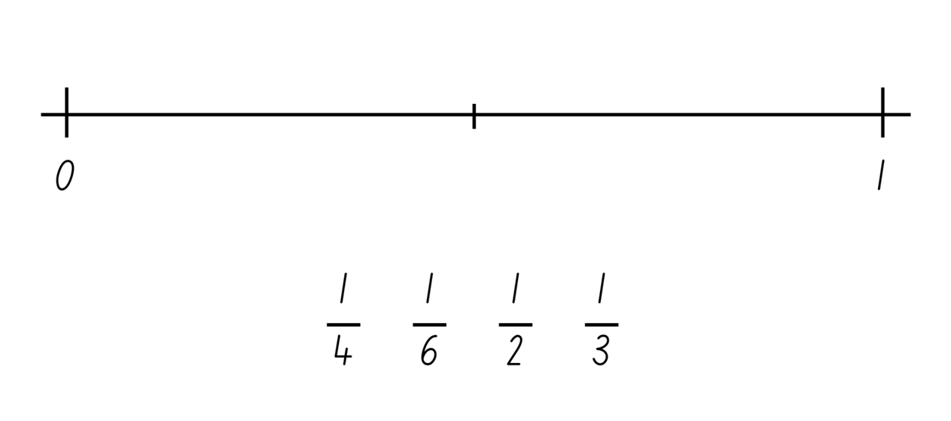
Activity 3 – ordering unit fractions 2
Notes:
This is a developing number sense activity.
Number sense refers to a deep understanding of numbers, including their magnitude, relationships, and the effects of operations on them. It supports fluency and understanding, estimation, flexible thinking, and efficient problem-solving. Number sense activities 1–4 ‘activate’ prior number knowledge and support the learning of new content in the unit. Number sense activities 5–8 ‘loop’ back and provide opportunity for spaced practice with concepts and procedures covered in previous units.
Syllabus focus area:
Representing quantity fractions A
Ordering unit fractions 2
This resource corresponds to Resource 22 – ordering unit fractions 2 in Stage 3 Year A Unit 10.
Provide students with Resource 22 – ordering unit fractions 2. Students place the fractions in the correct place on the number line.
Students then add any other common fractions to the number line that they know. For example, one eighth.
Select students to share and explain the placement of the fractions.

Slide 25
Review of learning 4

Slide 26
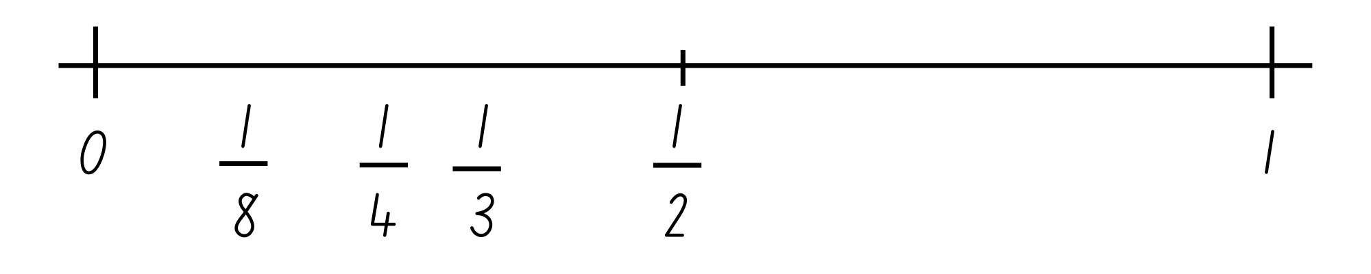
True or false (2)
These fractions have been ordered incorrectly on the number line.
True | False
Notes:
The question on this slide connects to the content being explored in the developing number sense activity (Activity 4)
Syllabus focus area:
Representing quantity fractions A

Slide 27
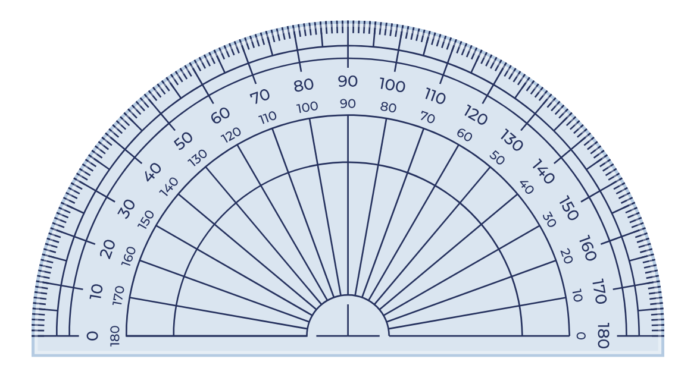
Short response (13)
Record the words missing from this sentence:
When measuring an angle using a protractor, you need to make sure to place the _______ point of the protractor on the _______ of the angle.
Notes:
Short response questions provide brisk paced questions focussing on review of current and previous content to support spaced and interleaved practice.
Syllabus focus area:
Geometric measure A: Angles

Slide 28
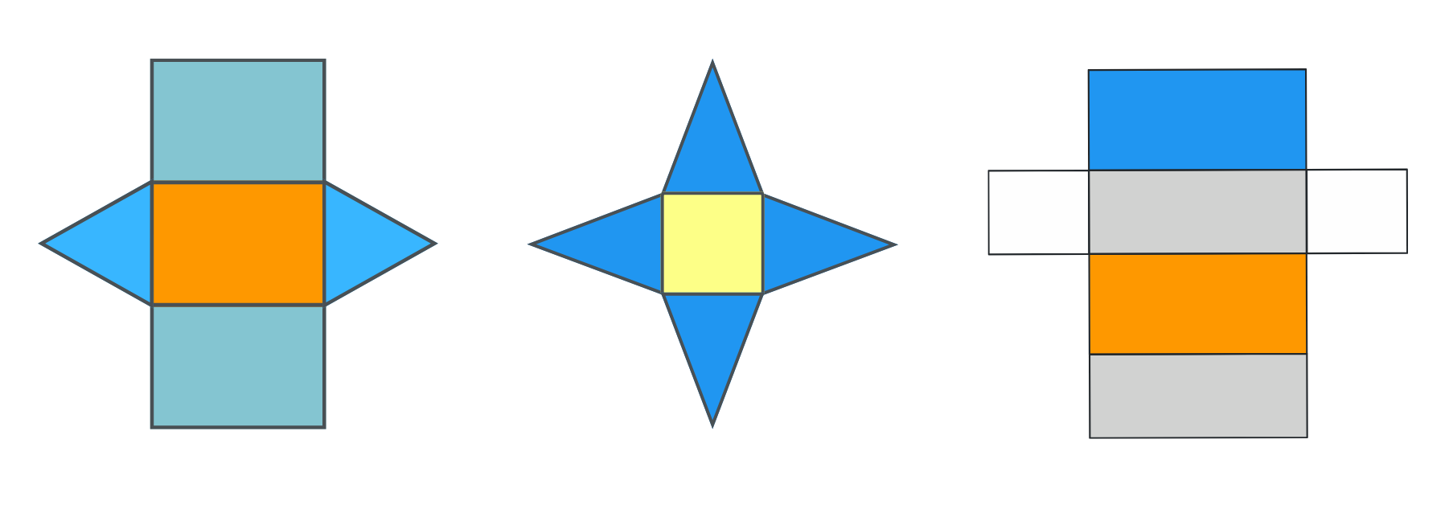
Short response (14)
Visualise folding these nets. Name the 3D objects they form.
Notes:
Short response questions provide brisk paced questions focussing on review of current and previous content to support spaced and interleaved practice.
Syllabus focus area:
Three-dimensional spatial structure A: 3D objects

Slide 29
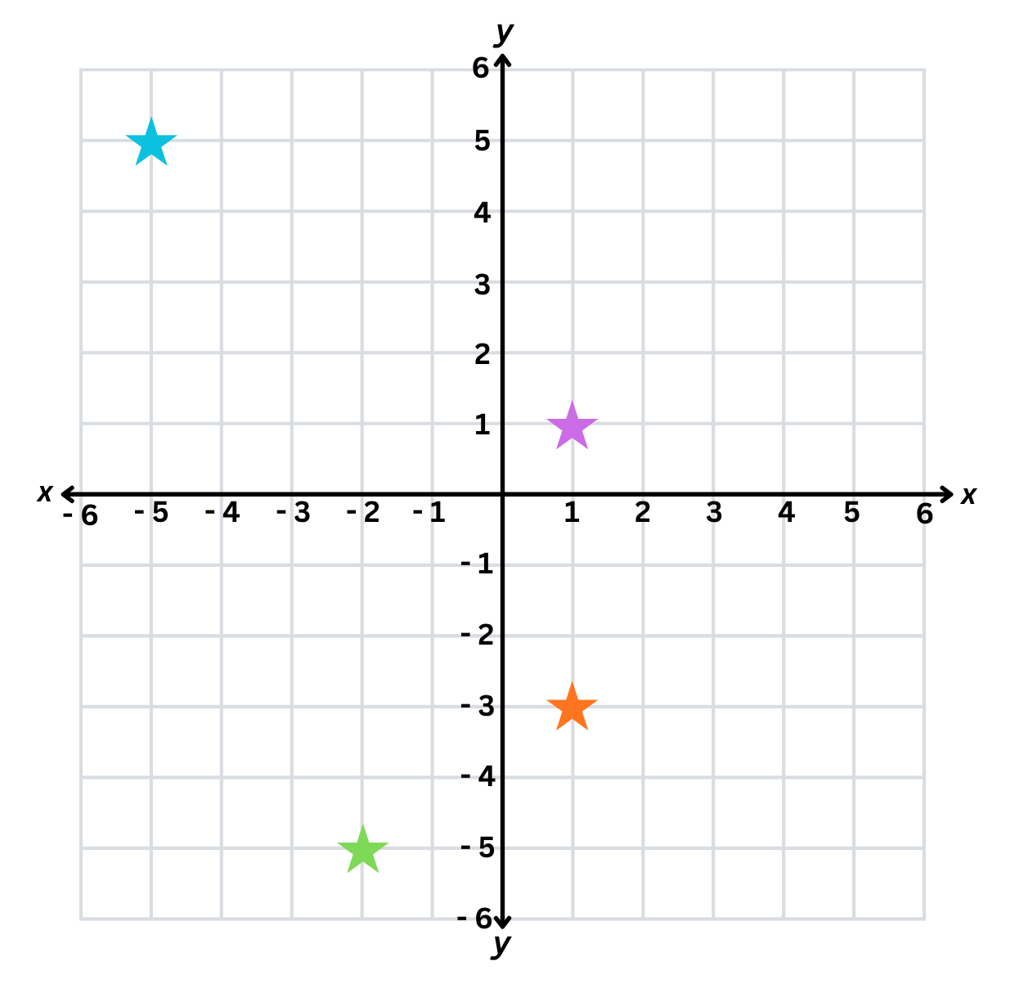
Short response (15)
Identify and record the coordinates for each star.
Notes:
Short response questions provide brisk paced questions focussing on review of current and previous content to support spaced and interleaved practice.
Syllabus focus area:
Geometric measure B: Position

Slide 30
Short response (16)
Convert and record the following to kms:
3800 m
1200 m
7400 m
Notes:
Short response questions provide brisk paced questions focussing on review of current and previous content to support spaced and interleaved practice.
Syllabus focus area:
Geometric measure B: Length

Slide 31

Activity 4 – fraction number line
Numerator: the top number is the ‘numerator’ which identifies the number of parts.
Fraction bar: The line separating the numerator and denominator is called the ‘fraction bar’. It is also sometimes referred to as the ‘vinculum’.
Denominator: the bottom number is called the ‘denominator’ and it is the total number of equal parts the whole is broken into.
$\frac{1}{5}$.
Notes:
This is a developing number sense activity.
Number sense refers to a deep understanding of numbers, including their magnitude, relationships, and the effects of operations on them. It supports fluency and understanding, estimation, flexible thinking, and efficient problem-solving. Number sense activities 1–4 ‘activate’ prior number knowledge and support the learning of new content in the unit. Number sense activities 5–8 ‘loop’ back and provide opportunity for spaced practice with concepts and procedures covered in previous units.
Syllabus focus area:
Representing quantity fractions A
Fraction number line
1. Provide students with a 10-sided dice and a whiteboard. Students draw a number line from 0–1.
2. Revise the meaning of the ‘denominator’, ‘numerator’ and ‘fraction line’.
Numerator: the top number is the ‘numerator’ which identifies the number of parts. The line separating them is called the ‘fraction bar’. It is also sometimes referred to as the ‘vinculum’.
Denominator: the bottom number is called the ‘denominator’ and it is the total number of equal parts the whole is broken into.
3. Students roll the dice and use the number rolled as the denominator with the numerator always being one. For example, if students roll a 5, the fraction will be one fifth. Students then place the fraction on the number line in the correct location.
4. Select students to share and explain the placement of the fractions.
3.
3

Slide 32
Review of learning 5

Slide 33
Multiple choice (3)
5187 - 402 - 218 =
A
4567
B
5979
C
4568
D
5807
Notes:
This question connects to the content in the developing number sense activity (Activity 5)
Syllabus focus area:
Additive relations A

Slide 34
Short response (17)
Kelly faced the front of the classroom, then made a three-quarter turn to the right.
Mark the vertex and draw the invisible arms of the angle she made.
Notes:
Short response questions provide brisk paced questions focussing on review of current and previous content to support spaced and interleaved practice.
Syllabus focus area:
Geometric measure A: Position

Slide 35
Short response (18)
Convert and record these capacities:
4215 mL​ to litres
62 mL​ to litres
6.5 L​ to millilitres
7.006 L​ to millilitres
Notes:
Short response questions provide brisk paced questions focussing on review of current and previous content to support spaced and interleaved practice.
Syllabus focus area:
Three-dimensional spatial structure A: Volume

Slide 36
Short response (19)
Complete the sentence:
The term ‘probability’ is used to describe...
Notes:
Short response questions provide brisk paced questions focussing on review of current and previous content to support spaced and interleaved practice.
Syllabus focus area:
Chance A

Slide 37
Short response (20)
Record which distance is longer:
3 km or 2500 m?
Communicate your reasoning.
Notes:
Short response questions provide brisk paced questions focussing on review of current and previous content to support spaced and interleaved practice.
Syllabus focus area:
Geometric measure B: Length

Slide 38
Activity 5 – closest to zero
Roll a 9-sided dice to make:
5-digit number 4-digit number 3-digit number
56 843 − 4713 – 245 =
Use these numbers to record and solve a subtraction sentence.
Notes:
This is a developing number sense activity.
Number sense refers to a deep understanding of numbers, including their magnitude, relationships, and the effects of operations on them. It supports fluency and understanding, estimation, flexible thinking, and efficient problem-solving. Number sense activities 1–4 ‘activate’ prior number knowledge and support the learning of new content in the unit. Number sense activities 5–8 ‘loop’ back and provide opportunity for spaced practice with concepts and procedures covered in previous units.
Syllabus focus area:
Additive relations A
Closest to zero
This activity is an adaptation of ‘Dicey Operations in Line’ from NRICH by the University of Cambridge.
Provide pairs of students with 9-sided dice and whiteboards.
Student 1 rolls the dice to make one 5-digit number, one 4-digit number and one 3-digit number. Students can create their multi-digit numbers from the numbers rolled. For example, if 6, 4 and 3 are rolled, students can choose to record 643, 346 or 463 and so on.
Student 1 uses these numbers to form a subtraction sentence and records it on their whiteboard. For example, 56 843 − 4713 – 245 = _.
Student 1 solves the number sentence using a mental or written strategy.
Student 2 repeats the process.
The winner is the student that gets the closest to zero.
Students play multiple rounds.

Slide 39
Review of learning 6

Slide 40
True or false (3)
Zara said that the sum of 24 000, 456 and 3090 is 27 546.
True | False
Notes:
The question on this slide connects to the content being explored in the developing number sense activity (Activity 6)
Syllabus focus area:
Additive relations A

Slide 41
Short response (21)
Convert and record these as 24-hour time:
1:45 am
8:38 am
1:30 pm
10:47 pm
Notes:
Short response questions provide brisk paced questions focussing on review of current and previous content to support spaced and interleaved practice.
Syllabus focus area:
Non-spatial measure A: Time

Slide 42
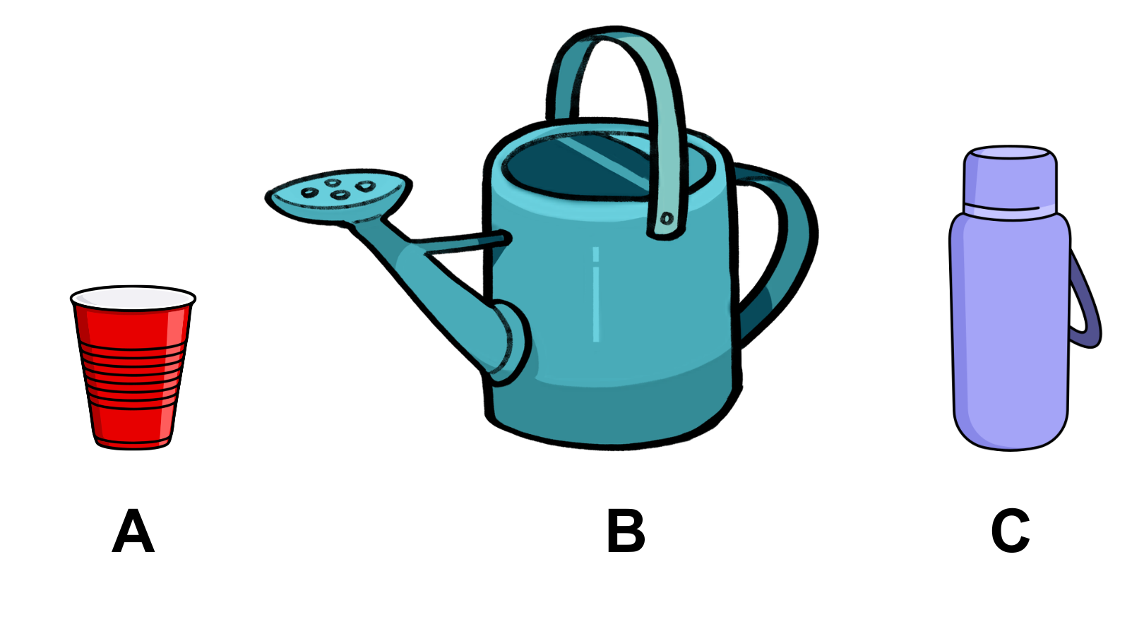
Short response (22)
Record the unit of measure most suitable to measure the capacity of each container?
Notes:
Short response questions provide brisk paced questions focussing on review of current and previous content to support spaced and interleaved practice.
Syllabus focus area:
Three-dimensional spatial structure A: Volume

Slide 43
Short response (23)
A 6-sided die is rolled.
Record all possible outcomes.
Notes:
Short response questions provide brisk paced questions focussing on review of current and previous content to support spaced and interleaved practice.
Syllabus focus area:
Chance A

Slide 44
Short response (24)
Calculate and record the total length of 3 items measuring
6 mm, 30 cm and 1.2 m.
Notes:
Short response questions provide brisk paced questions focussing on review of current and previous content to support spaced and interleaved practice.
Syllabus focus area:
Geometric measure B: Length

Slide 45
Activity 6 – Hit the target number
Decide on a target number.
Roll a 9-sided dice to make a:
5-digit number 4-digit number 3-digit number
41 873 + 5125 + 792 =
Use these numbers to record and solve an addition sentence.
Closest to the target wins.
Notes:
This is a developing number sense activity.
Number sense refers to a deep understanding of numbers, including their magnitude, relationships, and the effects of operations on them. It supports fluency and understanding, estimation, flexible thinking, and efficient problem-solving. Number sense activities 1–4 ‘activate’ prior number knowledge and support the learning of new content in the unit. Number sense activities 5–8 ‘loop’ back and provide opportunity for spaced practice with concepts and procedures covered in previous units.
Syllabus focus area:
Additive relations A
Hit the target number
This activity is an adaptation of ‘Dicey Operations in Line’ from NRICH by the University of Cambridge.
Provide pairs of students with 9-sided dice and whiteboards.
Students agree on a target number, for example 50 000.
Student 1 rolls the dice to make one 5-digit number, one 4-digit number and one 3-digit number. Students can create their multi-digit numbers from the numbers rolled. For example, if 6, 4 and 3 are rolled, students can choose to record 643, 346 or 463 and so on.
Student 1 uses these numbers to form an addition sentence and records it on their whiteboard. For example, 41 873 + 5125 + 792 = _.
Student 1 solves the number sentence using a mental or written strategy.
Student 2 repeats the process.
The winner is the student that gets the closest to the target number
Students play multiple rounds.

Slide 46
Review of learning 7

Slide 47
Multiple choice (4)
Maria picked 468 apples and 327 oranges from her garden. She sold 254 pieces of fruit at the market. Which number sentence matches the problem?
A
468 + 327 + 254
B
468 + 327 - 254
C
468 - 327 + 254
D
327 + 468 + 254
Notes:
This question connects to the content in the developing number sense activity (Activity 7)
Syllabus focus area:
Additive relations A

Slide 48
Short response (25)
Convert and record these as 12-hour time using am or pm notation:
14:45
06:38
21:47
11:15
Notes:
Short response questions provide brisk paced questions focussing on review of current and previous content to support spaced and interleaved practice.
Syllabus focus area:
Non-spatial measure A: Time

Slide 49
Short response (26)
Order and record these capacities from
smallest to largest:
7.05 L​
7071 mL​
2.62 L​
2999 mL​
Notes:
Short response questions provide brisk paced questions focussing on review of current and previous content to support spaced and interleaved practice.
Syllabus focus area:
Three-dimensional spatial structure A: Volume

Slide 50
Short response (27)
Complete the sentence:
The term ‘frequency’ is used to describe...
Notes:
Short response questions provide brisk paced questions focussing on review of current and previous content to support spaced and interleaved practice.
Syllabus focus area:
Chance B

Slide 51
Short response (28)
Suzie wants to display data to show the height of a plant’s growth over time.
Record the name of a suitable data display she could use.
Notes:
Short response questions provide brisk paced questions focussing on review of current and previous content to support spaced and interleaved practice.
Syllabus focus area:
Data A

Slide 52
Activity 7 – multistep problems
Anwar has 375 stalks of corn and 598 cabbages. The crows destroy 153 of his crops. How many crops are left undestroyed in his garden?
Which parts of the problem are important pieces of information?
What operations will be used in solving this problem? How do you know?
What strategies would be efficient for solving this problem?
Notes:
This is a developing number sense activity.
Number sense refers to a deep understanding of numbers, including their magnitude, relationships, and the effects of operations on them. It supports fluency and understanding, estimation, flexible thinking, and efficient problem-solving. Number sense activities 1–4 ‘activate’ prior number knowledge and support the learning of new content in the unit. Number sense activities 5–8 ‘loop’ back and provide opportunity for spaced practice with concepts and procedures covered in previous units.
Syllabus focus area:
Additive relations A
Multistep problems
1. Write the following problem on the board: Anwar has 375 stalks of corn and 598 cabbages. The crows destroy 153 of his crops. How many crops are left undestroyed in his garden?
2. Ask students:
Which parts of the problem are important pieces of information?
What operations will be used in solving this problem? How do you know?
What strategies would be efficient for solving this problem?
3. Students turn and talk to discuss their strategies and the information required to solve the problem.
4. Select a range of student responses to share with the class.
5. Write another problem on the board and repeat the process. For example: Farmer Josie has 9638 kilograms of grain. She feeds 3725 kilograms to her pigs and 2948 kilograms to her cows. How much grain does she have left?
5. Alternatively, pairs of students may wish to write their own multistep problems and solve them.

Slide 53
Review of learning 8

Slide 54
True or false (4)
The levelling strategy is an efficient strategy to solve 4988 + 955.
True | False
Notes:
The question on this slide connects to the content being explored in the developing number sense activity (Activity 8)
Syllabus focus area:
Additive relations A

Slide 55
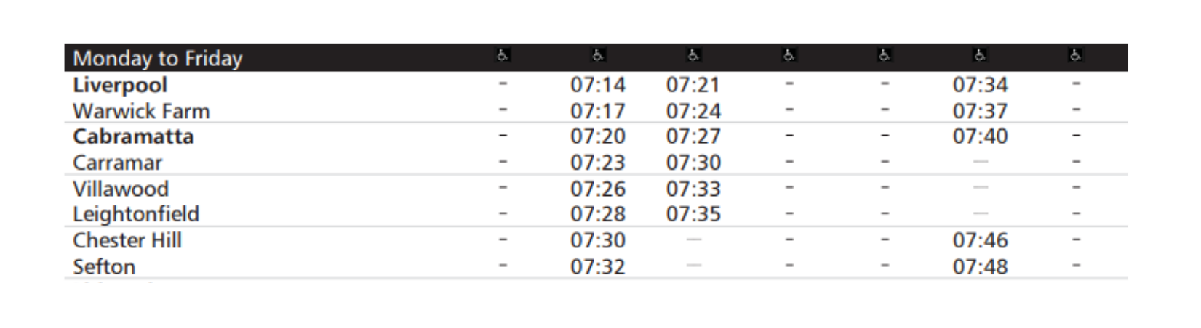
Short response (29)
Sally missed the 07:14 train from Liverpool to Sefton.
What time is the next train from Liverpool to Sefton?
Notes:
Short response questions provide brisk paced questions focussing on review of current and previous content to support spaced and interleaved practice.
Syllabus focus area:
Non-spatial measure A: Time

Slide 56
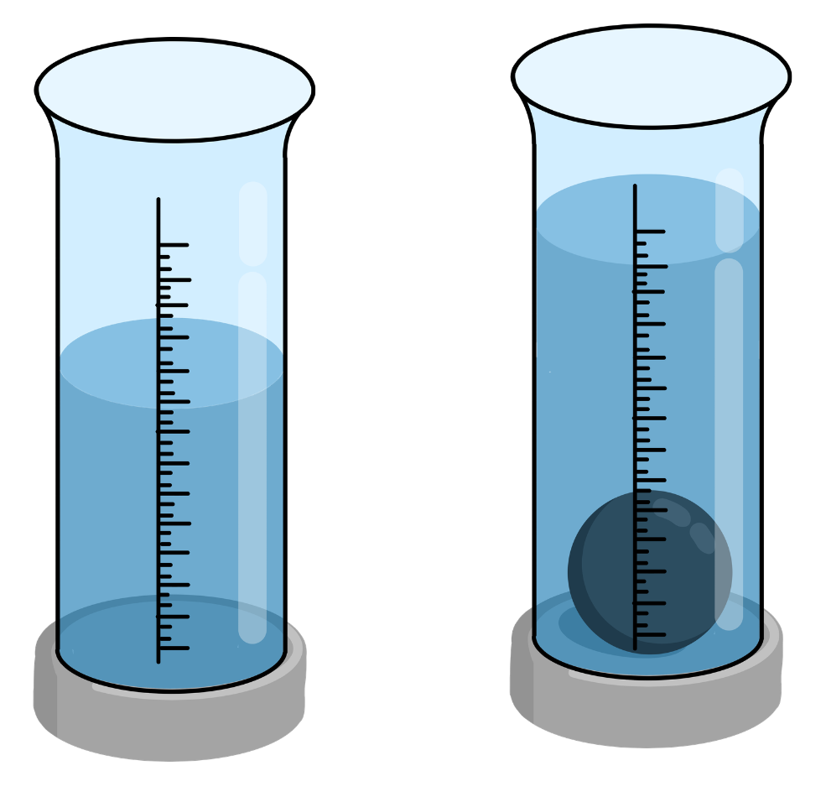
Short response (30)
The water level without
the metal ball is 90mL. The water level
with the metal ball is 130mL.
Record the change in water level to show
the objects volume in mL.
Notes:
Short response questions provide brisk paced questions focussing on review of current and previous content to support spaced and interleaved practice.
Syllabus focus area:
Three-dimensional spatial structure A: Volume

Slide 57
Short response (31)
A jar contains 5 different flavoured lollies: strawberry, lemon, apple, grape and orange.
1 lolly is picked at random.
Record all possible outcomes.
Notes:
Short response questions provide brisk paced questions focussing on review of current and previous content to support spaced and interleaved practice.
Syllabus focus area:
Chance A

Slide 58
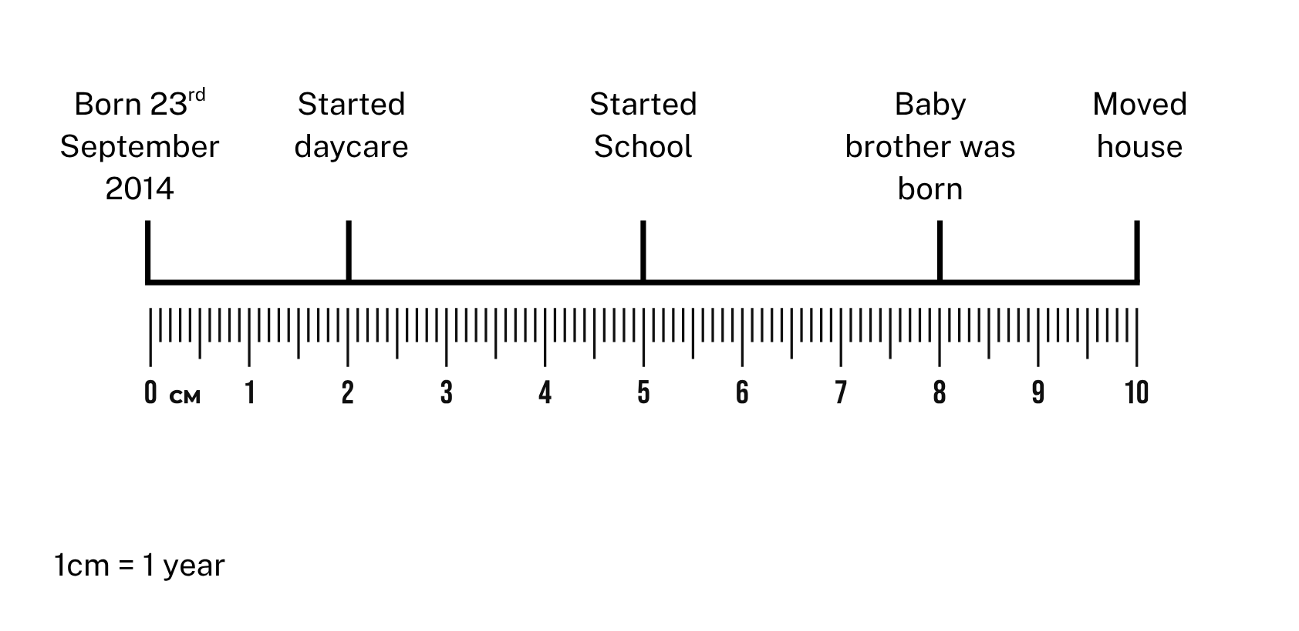
Short response (32)
Billy made a timeline. Use the scale to determine and record
the year Billy’s baby brother was born.
Notes:
Short response questions provide brisk paced questions focussing on review of current and previous content to support spaced and interleaved practice.
Syllabus focus area:
Data B

Slide 59
Activity 8 – applying strategies
3985 + 956 = _?
What strategy could you use to solve this problem?
What other strategies could be used to solve this problem?
Which strategy is the most efficient?
Notes:
This is a developing number sense activity.
Number sense refers to a deep understanding of numbers, including their magnitude, relationships, and the effects of operations on them. It supports fluency and understanding, estimation, flexible thinking, and efficient problem-solving. Number sense activities 1–4 ‘activate’ prior number knowledge and support the learning of new content in the unit. Number sense activities 5–8 ‘loop’ back and provide opportunity for spaced practice with concepts and procedures covered in previous units.
Syllabus focus area:
Additive relations A
Applying strategies
1. Write the following problem on the board: 3985 + 956 = _?
2. Ask students:
What strategy could you use to solve this problem?
What other strategies could be used to solve this problem?
Which strategy is the most efficient?
3. Students turn and talk to discuss their strategies.
4. Select a range of student responses to share with the class. Highlight the use of strategies such as levelling (3985 + 956 → 3990 + 951 → 4000 + 941) and bridging (3985 + 956 = 3985 plus 5 plus 10 plus 941).
5. Repeat the process with another problem, for example, 8002 – 2998 = _?
6. When discussing subtraction problems, highlight the use of addition for subtraction (8002 − 2998 add 2 is 3000 plus 5002) or using constant difference (8002 – 2998 → 8004 − 3000).

Slide 60
Double Venn diagram
Object 1
Object 2
Features similar to both objects
Features of object 1
Features of object 2

Slide 61
Frayer
Definition
Facts/Characteristics
Word, term, concept
Examples
Non-examples

Slide 62
Spider map
Idea
Subject

Slide 63
Cline
Concept 1
Concept 2
Word
Word
Word
Word
Word
Word
Word
Word
Word
Word
Word

Slide 64

Compare and contrast

Slide 65
Multiple choice (5)
A
B
C
D

Slide 66
Multiple choice
A
B
C
D
Notes:
This question connects to the content in the developing number sense activity (Activity 3)
Syllabus focus area:
[Focus area A/B]

Slide 67
References
This presentation contains NSW Curriculum and syllabus content. The NSW Curriculum is developed by the NSW Education Standards Authority. This content is prepared by NESA for and on behalf of the Crown in the right of the State of New South Wales. The material is protected by Crown copyright.
Please refer to the NESA Copyright Disclaimer for more information https://educationstandards.nsw.edu.au/wps/portal/nesa/mini-footer/copyright.
NESA holds the only official and up-to-date versions of the NSW Curriculum and syllabus documents. Please visit the NSW Education Standards Authority (NESA) website https://educationstandards.nsw.edu.au/wps/portal/nesa/home and the NSW Curriculum website https://curriculum.nsw.edu.au.
[Mathematics K–10 Syllabus © NSW Education Standards Authority (NESA) for and on behalf of the Crown in right of the State of New South Wales, 2022.
National Numeracy Learning Progression © Australian Curriculum, Assessment and Reporting Authority (ACARA) 2010 to present, unless otherwise indicated. This material was downloaded from the Australian Curriculum website (National Numeracy Learning Progression) (accessed 4 November 2025) and was not modified.
Education Services Australia Ltd (2016) Time tools, Scootle website, accessed 4 August 2023.
Pierce R (2021) Angles, Maths is Fun website, accessed 4 August 2023.
McMaster H and Mitchelmore M (2005) ‘The rewards and difficulties of Working Mathematically’ [conference presentation], AAMT Conference Proceedings, Sydney.
University of Cambridge (n.d.) 5 on the Clock, NRICH website, accessed 3 August 2023.
University of Cambridge (n.d.) Dicey Operations in Line, NRICH website, accessed 3 August 2023.

Slide 68
Copyright
© State of New South Wales (Department of Education), 2025
The copyright material published in this resource is subject to the Copyright Act 1968 (Cth) and is owned by the NSW Department of Education or, where indicated, by a party other than the NSW Department of Education (third-party material).
Copyright material available in this resource and owned by the NSW Department of Education is licensed under a Creative Commons Attribution 4.0 International (CC BY 4.0) license.
This license allows you to share and adapt the material for any purpose, even commercially.
Attribution should be given to © State of New South Wales (Department of Education), 2025.
Material in this resource not available under a Creative Commons license:
the NSW Department of Education logo, other logos and trademark-protected material
Material owned by a third party that has been reproduced with permission. You will need to obtain permission from the third party to reuse its material.
Links to third-party material and websites
Please note that the provided (reading/viewing material/list/links/texts) are a suggestion only and implies no endorsement, by the New South Wales Department of Education, of any author, publisher, or book title. School principals and teachers are best placed to assess the suitability of resources that would complement the curriculum and reflect the needs and interests of their students.
If you use the links provided in this document to access a third party’s website, you acknowledge that the terms of use, including licence terms set out on the third-party’s website apply to the use which may be made of the materials on that third-party website or where permitted by the Copyright Act 1968 (Cth). The department accepts no responsibility for content on third-party websites.

