Slide 1
Instructions for use
This resource aligns to the learning in Stage 3 Year A Unit 11 and revisits content from earlier sample units.
Classroom teachers are encouraged to add and adapt slides as required to meet the needs of their students.
Save a copy of the file to make changes to the slide deck. Go to File > Download a Copy (this downloads a copy to the computer to edit in the PowerPoint app).
To convert the PowerPoint to Google Slides:
  Upload the file into Google Drive and open it.
  Go to File > Save as Google Slides.
  (Note – conversion may cause formatting changes in the slides.)

Slide 2

Review of Learning
Mathematics Stage 3 – Unit 11
Notes:
Reviews may include a combination of question types, requiring students to recall facts and key ideas, as well as apply their knowledge to solve problems and answer questions. To support active engagement, a mix of techniques should be employed.” (AERO, 2024).
This Review of Learning slide deck revisits key concepts from the following units:
Stage 3 Year A Unit 11
Stage 3 Year A Unit 10
Stage 3 Year A Unit 9
It also includes opportunities to review prior learning in non-number content, supporting consolidation across focus areas.
The review of learning resources include three key task types that support the development of mathematical proficiency through retrieval, spaced practice, and active participation. These practices complement the review phase (activating prior knowledge) embedded within the beginning of each lesson.
1.
Multiple-choice questions/True or false: Designed to promote active retrieval of key concepts and identify common misconceptions in number, supporting consolidation, understanding and fluency.
These questions:
support spaced and interleaved practice
help identify and address common misconceptions
support active recall and immediate feedback
support whole class participation
identify areas requiring reteach
2.
Short-response question sets: Carefully grouped questions that encourage spaced and interleaved practice across multiple focus areas, helping students revisit and apply knowledge from different points in time.
These questions:
have a combination of question types
address a range of focus areas
build automaticity and fluency
support active recall
allow for immediate feedback
identify content requiring reteach
3.
Developing number sense activities: A variety of practical, purposeful tasks that reinforce current learning and build on prior knowledge. These activities promote reasoning, problem-solving and conceptual understanding.
The review of learning resources are designed to work support teaching and learning in mathematics. For the most effective implementation, use the resources flexibly, adapting to meet student learning needs and individual classroom contexts.

Slide 3
Lessons
1
Review of learning 1
5
Review of learning 5
2
Review of learning 2
6
Review of learning 6
3
Review of learning 3
7
Review of learning 7
4
Review of learning 4
8
Review of learning 8
Notes:
Teacher notes:
Click lesson titles to go to specific lessons
Interactive features can be viewed in slide show

Slide 4
Review of learning 1

Slide 5

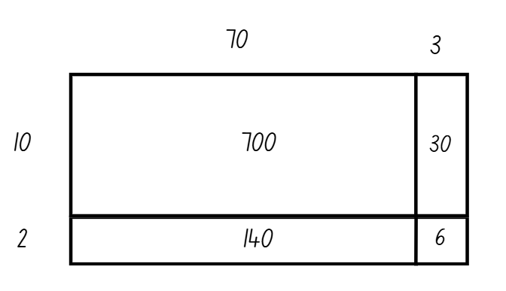
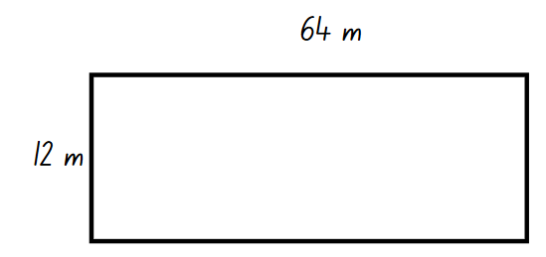
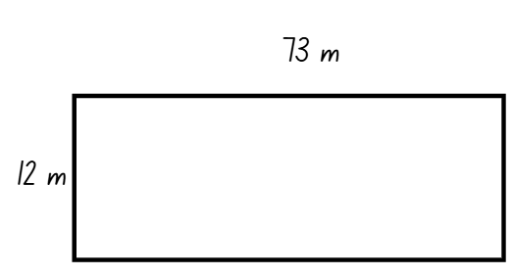
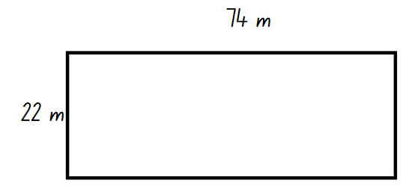
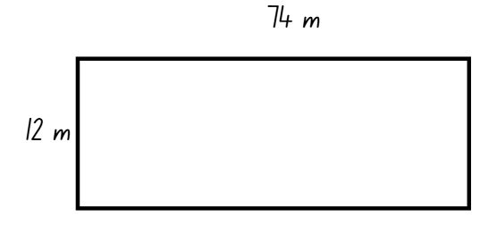
Multiple choice (1)
Which rectangle’s perimeter can be found using this area model?
A
B
C
D
Notes:
This question connects to the content in the developing number sense activity (Activity 1)
Syllabus focus area:
Multiplicative relations A

Slide 6

Short response (1)
Arrange these numbers in ascending order:
7 258 369
8 258 258
8 963 789
8 963 798
7 258 147
Notes:
Short response questions provide brisk paced questions focussing on review of current and previous content to support spaced and interleaved practice.
Syllabus focus area:
Represents numbers A: Whole numbers

Slide 7
Short response (2)
Sally faces the front of the classroom and makes a quarter-turn to her right.
Draw the vertex and arms of the angle she forms.
Notes:
Short response questions provide brisk paced questions focussing on review of current and previous content to support spaced and interleaved practice.
Syllabus focus area:
Geometric Measure A: Angles

Slide 8
Short response (3)
Record the name of a prism that has a rectangle as its base.
Notes:
Short response questions provide brisk paced questions focussing on review of current and previous content to support spaced and interleaved practice.
Syllabus focus area:
Three-dimensional spatial structure A: 3D objects

Slide 9
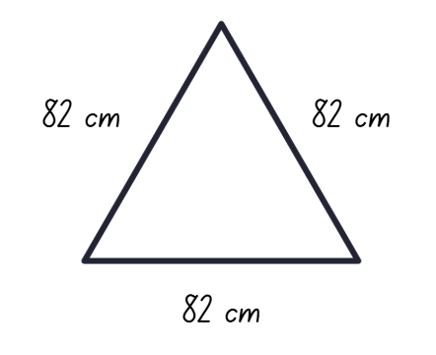
Short response (4)
Calculate and record the perimeter of this triangle.
Notes:
Short response questions provide brisk paced questions focussing on review of current and previous content to support spaced and interleaved practice.
Syllabus focus area:
Geometric measure A: Length

Slide 10

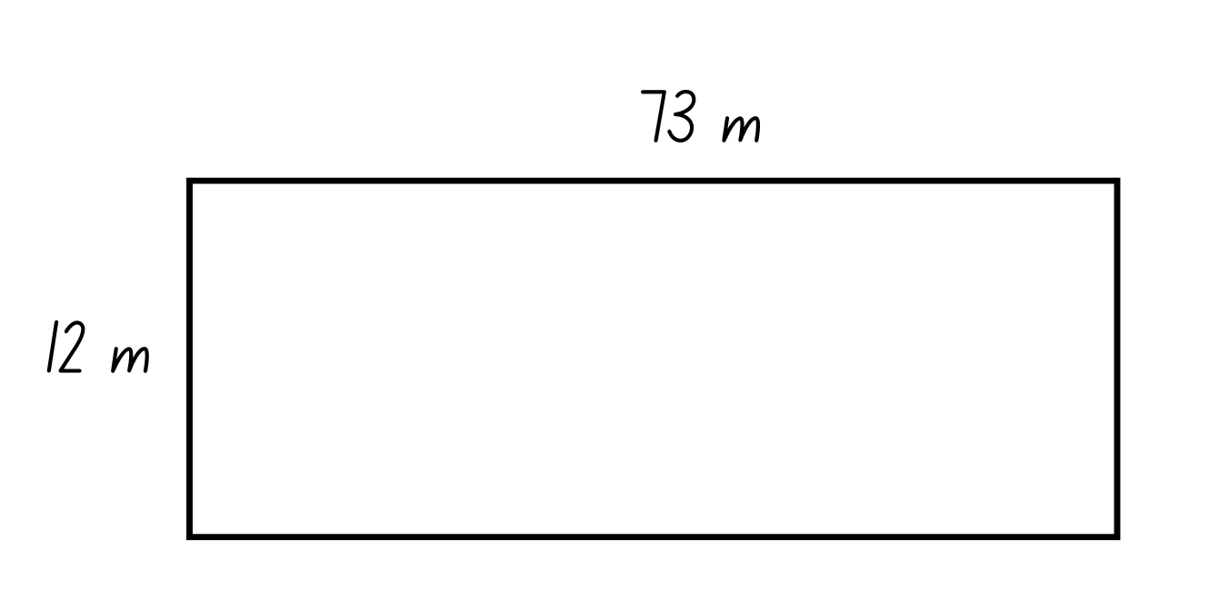
Activity 1 – find the area
A section of the school playground is 73 m by 12 m.
How could you find the area of the playground?
Notes:
This is a developing number sense activity.
Number sense refers to a deep understanding of numbers, including their magnitude, relationships, and the effects of operations on them. It supports fluency and understanding, estimation, flexible thinking, and efficient problem-solving. Number sense activities 1–4 ‘activate’ prior number knowledge and support the learning of new content in the unit. Number sense activities 5–8 ‘loop’ back and provide opportunity for spaced practice with concepts and procedures covered in previous units.
Syllabus focus area:
Multiplicative relations A
Find the area
Pose the problem: A section of the school playground is 73 m by 12 m in size.
Ask students how they could find the area of the playground.
Students think-pair-share how they would find the area of the playground and record their answers on their whiteboards.
Highlight the use of the area model to represent students’ thinking (see Figure 24).
State that 73 × 12 is represented in 2 ways. One area model shows 73 partitioned into its place value. The second example shows 73 and 12 partitioned into their place values.
Pose the problem: A different area of the playground is 54 m by 15 m.
Prompt students to use the area model to find the area of the playground.

Slide 11
Review of learning 2

Slide 12
True or false (1)
24 x 50 = 6 x (4 x 50)
which we can then think about as
6 x 200 = 1200
True | False
Notes:
The question on this slide connects to the content being explored in the developing number sense activity (Activity 2)
Syllabus focus area:
Multiplicative relations A

Slide 13
Short response (5)
Round 8 963 258 to the nearest:
thousand
ten thousand
hundred thousand
million
Notes:
Short response questions provide brisk paced questions focussing on review of current and previous content to support spaced and interleaved practice.
Syllabus focus area:
Represents numbers A: Whole numbers

Slide 14
Short response (6)
Use the symbol for degrees to record the size of the following angles:
right angle
angle of revolution
straight angle.
Notes:
Short response questions provide brisk paced questions focussing on review of current and previous content to support spaced and interleaved practice.
Syllabus focus area:
Geometric measure A: Angles

Slide 15
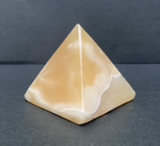
Short response (7)
Visualise and sketch this three-dimensional object from its top view.
Notes:
Short response questions provide brisk paced questions focussing on review of current and previous content to support spaced and interleaved practice.
Syllabus focus area:
Three-dimensional spatial structure A: 3D objects.

Slide 16
Short response (8)
Draw and label 2 rectangles with the same perimeter but different dimensions.
Notes:
Short response questions provide brisk paced questions focussing on review of current and previous content to support spaced and interleaved practice.
Syllabus focus area:
Geometric measure A: Length

Slide 17
Activity 2 – factorising numbers
A minibus can carry 25 passengers.
How many people can 32 minibuses carry?
Notes:
This is a developing number sense activity.
Number sense refers to a deep understanding of numbers, including their magnitude, relationships, and the effects of operations on them. It supports fluency and understanding, estimation, flexible thinking, and efficient problem-solving. Number sense activities 1–4 ‘activate’ prior number knowledge and support the learning of new content in the unit. Number sense activities 5–8 ‘loop’ back and provide opportunity for spaced practice with concepts and procedures covered in previous units.
Syllabus focus area:
Multiplicative relations A
Factorising numbers
Give students time to determine the answer and record their thinking on a whiteboard.
Select students to share a variety of strategies with the class.
On the board, write 32 × 25 = 8 × 4 × 25 = 8 × 100 = 800. Model: If I used the factors of 32, 4 and 8, then the associative property can be used.
Display 24 × 50 and 35 × 12.
Students use their whiteboards to record how the numbers can be factorised and the associative property can be used to solve the problems (see Figure 25).

Slide 18
Review of learning 3

Slide 19
Multiple choice (2)
A bus company owns 34 buses. Each bus has 28 seats.
If 50% of the seats are filled, how many passengers are there?
A
B
C
D
476
474
976
952
Notes:
This question connects to the content in the developing number sense activity (Activity 3)
Syllabus focus area:
Multiplicative relations A

Slide 20
Short response (9)
Order these decimals in descending order:
1.369
1.258
1.896
1.895
Notes:
Short response questions provide brisk paced questions focussing on review of current and previous content to support spaced and interleaved practice.
Syllabus focus area:
Represents numbers A: Decimals and percentages

Slide 21
Short response (10)
Record one thing you need to remember to do when using a protractor to measure an angle.
Notes:
Short response questions provide brisk paced questions focussing on review of current and previous content to support spaced and interleaved practice.
Syllabus focus area:
Geometric measure A: Angles

Slide 22
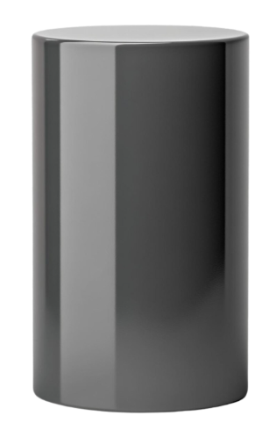
Short response (11)
Visualise and sketch the net for this cylinder.
Notes:
Short response questions provide brisk paced questions focussing on review of current and previous content to support spaced and interleaved practice.
Syllabus focus area:
Three-dimensional spatial structure A: 3D objects

Slide 23
Short response (12)
Tobi ran 1 kilometre and 700 metres.
Record this distance using the abbreviation for kilometres.
Notes:
Short response questions provide brisk paced questions focussing on review of current and previous content to support spaced and interleaved practice.
Syllabus focus area:
Geometric measure A: Length

Slide 24
Activity 3 – multiplication problems
A bus company owns 27 buses. Each bus has 54 seats.
If 50% of the seats are filled, how many passengers are there?
Notes:
This is a developing number sense activity.
Number sense refers to a deep understanding of numbers, including their magnitude, relationships, and the effects of operations on them. It supports fluency and understanding, estimation, flexible thinking, and efficient problem-solving. Number sense activities 1–4 ‘activate’ prior number knowledge and support the learning of new content in the unit. Number sense activities 5–8 ‘loop’ back and provide opportunity for spaced practice with concepts and procedures covered in previous units.
Syllabus focus area:
Multiplicative relations A
Multiplication problems
Pose the following problem: A bus company owns 27 buses. Each bus has 54 seats. If 50% of the seats are filled, how many passengers are there?
Students record 2 different strategies for solving this problem on a whiteboard.
Students share their strategies and solutions.
Ask:
Were there strategies that your partner used that you hadn’t thought of?
Which strategy was the most efficient to solve this problem?

Slide 25
Review of learning 4

Slide 26
True or false (2)
A baker has an order for 224 cupcakes. Each tray holds 24 cupcakes.
He will need to make 11 trays of cupcakes to complete this order.
True | False
Notes:
The question on this slide connects to the content being explored in the developing number sense activity (Activity 4)
Syllabus focus area:
Multiplicative relations A

Slide 27
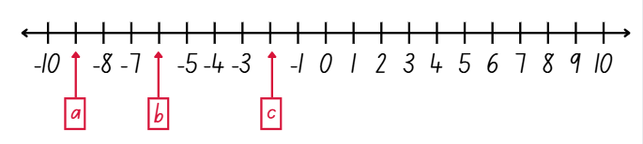
Short response (13)
Record the missing integers:
Notes:
Short response questions provide brisk paced questions focussing on review of current and previous content to support spaced and interleaved practice.
Syllabus focus area:
Represents numbers A: Whole numbers

Slide 28
Short response (14)
Zacharia faced the front of the classroom and made a three-quarter turn to his left.
Draw the vertex and arms of the angle he formed.
Notes:
Short response questions provide brisk paced questions focussing on review of current and previous content to support spaced and interleaved practice.
Syllabus focus area:
Geometric measure A: Angles

Slide 29
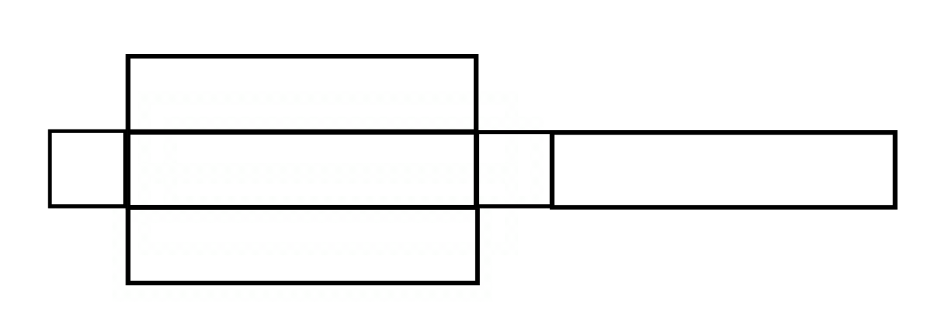
Short response (15)
Identify and record the name of the three-dimensional object from its net.
Notes:
Short response questions provide brisk paced questions focussing on review of current and previous content to support spaced and interleaved practice.
Syllabus focus area:
Three-dimensional spatial structure A: 3D objects

Slide 30
Short response (16)
Leon swam 3670 m.
Record this distance in kilometres.
Notes:
Short response questions provide brisk paced questions focussing on review of current and previous content to support spaced and interleaved practice.
Syllabus focus area:
Geometric measure A: Length

Slide 31
Activity 4 – multiplication strategies
A baker makes 135 trays of cupcakes. Each tray holds 34 cupcakes.
He sells the cupcakes in packs of 6.
How many packs can he make?
Notes:
This is a developing number sense activity.
Number sense refers to a deep understanding of numbers, including their magnitude, relationships, and the effects of operations on them. It supports fluency and understanding, estimation, flexible thinking, and efficient problem-solving. Number sense activities 1–4 ‘activate’ prior number knowledge and support the learning of new content in the unit. Number sense activities 5–8 ‘loop’ back and provide opportunity for spaced practice with concepts and procedures covered in previous units.
Syllabus focus area:
Multiplicative relations A
Multiplication strategies
Pose the following problem: A baker makes 135 trays of cupcakes. Each tray holds 34 cupcakes. He sells the cupcakes in packs of 6. How many packs can he make?
Students record 2 different strategies for solving the problem on a whiteboard.
Students share their strategies and solutions.
Ask:
Were there strategies that your partner used that you hadn’t thought of?
Which strategy was the most efficient for this problem?

Slide 32
Review of learning 5

Slide 33
Multiple choice (3)
What is the missing value in this equation:
4 × 40 =
_ × 20
A
B
C
D
9
10
7
8
Notes:
This question connects to the content in the developing number sense activity (Activity 5)
Syllabus focus area:
Multiplicative relations A

Slide 34
Short response (17)
Create a factor tree for 42.
Notes:
Short response questions provide brisk paced questions focussing on review of current and previous content to support spaced and interleaved practice.
Syllabus focus area:
Multiplicative relations A

Slide 35
Short response (18)
Arlo’s mum told him that art classes start at 18:15.
Record the time art classes start in 12-hour time using am or pm notation.
Notes:
Short response questions provide brisk paced questions focussing on review of current and previous content to support spaced and interleaved practice.
Syllabus focus area:
Non-spatial measure A: Time

Slide 36
Short response (19)
Convert the following:
3000 mL = ___ L
300 mL = ___ L
30 mL = ___ L
3 mL = ___ L
Notes:
Short response questions provide brisk paced questions focussing on review of current and previous content to support spaced and interleaved practice.
Syllabus focus area:
Three-dimensional spatial structure A: Volume

Slide 37
Short response (20)
Chandra walked 27 m on Monday, 94 m on Tuesday and 2400 cm on Wednesday.
How many metres did he walk that week?
Notes:
Short response questions provide brisk paced questions focussing on review of current and previous content to support spaced and interleaved practice.
Syllabus focus area:
Geometric measure B: Length

Slide 38
Activity 5 – multiplying multiples
× 0 = × 0
Notes:
This is a developing number sense activity.
Number sense refers to a deep understanding of numbers, including their magnitude, relationships, and the effects of operations on them. It supports fluency and understanding, estimation, flexible thinking, and efficient problem-solving. Number sense activities 1–4 ‘activate’ prior number knowledge and support the learning of new content in the unit. Number sense activities 5–8 ‘loop’ back and provide opportunity for spaced practice with concepts and procedures covered in previous units.
Syllabus focus area:
Multiplicative relations A
Multiplying multiples
This activity is an adaptation of ‘Multiply Multiples 1’ from NRICH by University of Cambridge.
Display an equation where each square represents a missing digit (see Figure 26).
State that each square represents a missing digit. Students are to find different ways to balance the equation.
Show that one possible solution is 4 × 40 = 8 × 20.
Students work in pairs to record possible solutions. Remind them that the equals sign represents balance or equivalence. Both sides of the equation must be balanced.
Students explore strategies such as place value partitioning, factorising and halving.
Share some examples of strategies used.
Ask:
Which strategy is the most efficient? Why?
Do certain strategies work better for different equations? Why?

Slide 39
Review of learning 6

Slide 40
True or false (3)
Ivy rode her bike 27 km a day for a total of 5 days.
She rode 135 km in total.
True | False
Notes:
The question on this slide connects to the content being explored in the developing number sense activity (Activity 6)
Syllabus focus area:
Multiplicative relations A

Slide 41
Short response (21)
Use the area model to solve:
387 x 8
Notes:
Short response questions provide brisk paced questions focussing on review of current and previous content to support spaced and interleaved practice.
Syllabus focus area:
Multiplicative relations A

Slide 42
Short response (22)
Luka’s grandad told him that Taekwondo finishes at 6:45pm.
Record the time Taekwondo finishes in
24-hour time.
Notes:
Short response questions provide brisk paced questions focussing on review of current and previous content to support spaced and interleaved practice.
Syllabus focus area:
Non-spatial measure A: Time

Slide 43
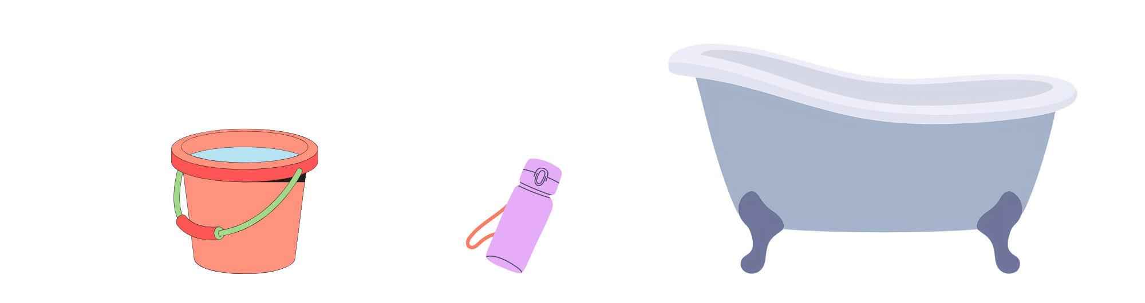
Short response (23)
Record the appropriate unit to measure the capacities of these containers.
A
B
C
Notes:
Short response questions provide brisk paced questions focussing on review of current and previous content to support spaced and interleaved practice.
Syllabus focus area:
Three-dimensional spatial structure A: Volume

Slide 44
Short response (24)
Find the total length in cm of these
3 items measuring 10 mm, 30 cm and 8.4 m.
Notes:
Short response questions provide brisk paced questions focussing on review of current and previous content to support spaced and interleaved practice.
Syllabus focus area:
Geometric measure B: Length

Slide 45
Activity 6 – multiplication problems
Oscar rides his bike 38 km a day for a total of 5 days.
How many kilometres did he ride in total?
Notes:
This is a developing number sense activity.
Number sense refers to a deep understanding of numbers, including their magnitude, relationships, and the effects of operations on them. It supports fluency and understanding, estimation, flexible thinking, and efficient problem-solving. Number sense activities 1–4 ‘activate’ prior number knowledge and support the learning of new content in the unit. Number sense activities 5–8 ‘loop’ back and provide opportunity for spaced practice with concepts and procedures covered in previous units.
Syllabus focus area:
Multiplicative relations A
Multiplication problems
Pose the following question: Oscar rides his bike 38 km a day for a total of 5 days. How many kilometres did he ride in total?
On whiteboards, students record 2 different strategies for solving this problem.
Students share their strategies and solutions with the class. Possible strategies may include:
rounding the 38 up to 40 and multiplying that by 5, then subtracting 2 fives, for example, 38 × 5 = (40 × 5) − (2 × 5) = 190
students using their knowledge of multiplying one-digit numbers with multiples of ten to double the 5 and halve the 38 – this would make 10 × 19 = 190.
As different strategies arise, ask students to explain why they chose to solve the problem in that way.

Slide 46
Review of learning 7

Slide 47
Multiple choice (4)
8 x 238 =
A
(8 x 300) + (8 x 8)
B
(2 x 800) + (8 x 30) + (8 x 8)
C
(8 x 200) + (8 x 30) + (8x8)
D
(8 x 200) + (8 x 80) + (8 x 3)
Notes:
This question connects to the content in the developing number sense activity (Activity 3)
Syllabus focus area:
Multiplicative relations A

Slide 48
Short response (25)
Solve using a formal algorithm:
896 ÷ 2
Notes:
Short response questions provide brisk paced questions focussing on review of current and previous content to support spaced and interleaved practice.
Syllabus focus area:
Multiplicative relations A

Slide 49
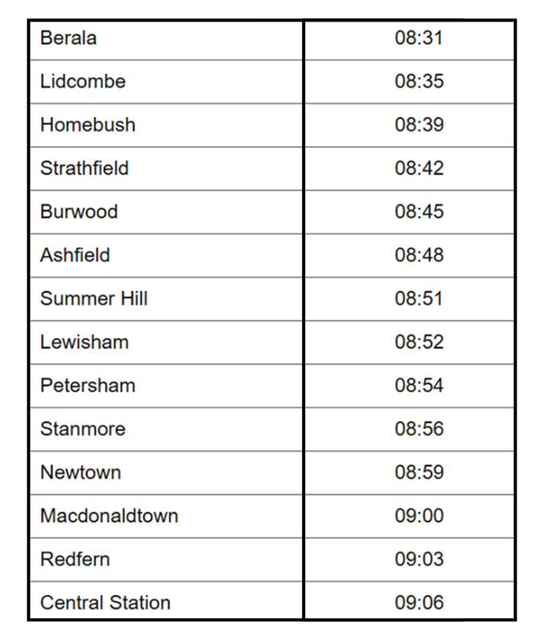
Short response (26)
A train arrives at Redfern at 09:03.
Record the time it leaves Ashfield.
Notes:
Short response questions provide brisk paced questions focussing on review of current and previous content to support spaced and interleaved practice.
Syllabus focus area:
Non-spatial measure A: Time

Slide 50
Short response (27)
Order the following capacities from largest to smallest:
6.23 L
6.023 L
6324 mL
Notes:
Short response questions provide brisk paced questions focussing on review of current and previous content to support spaced and interleaved practice.
Syllabus focus area:
Three-dimensional spatial structure A: Volume

Slide 51
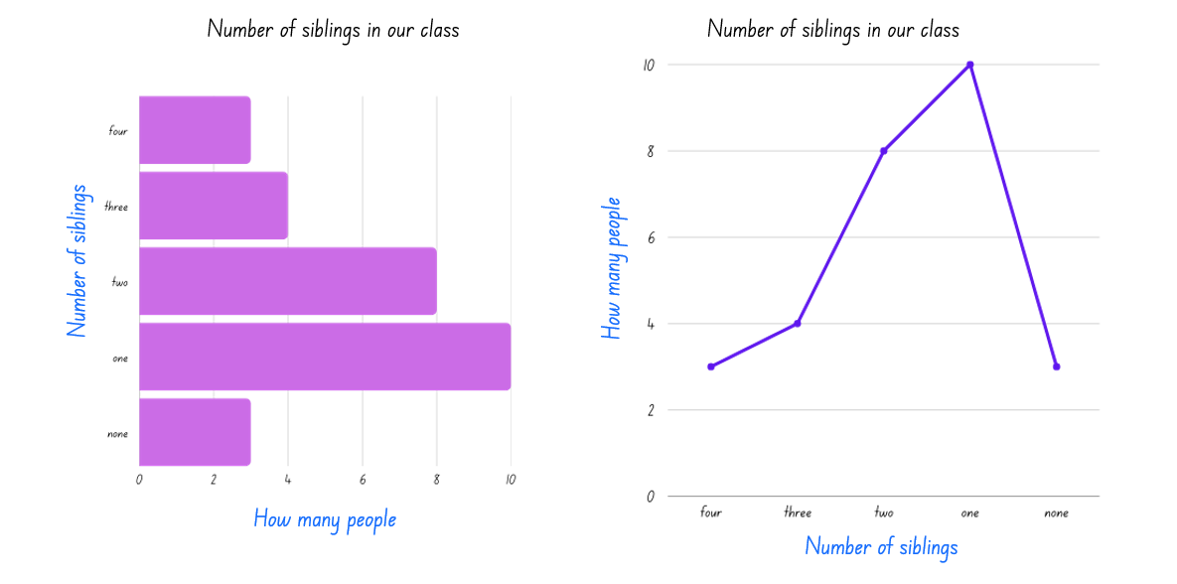
Short response (28)
Which graph best represents the number of siblings in this class?
Communicate your reasoning.
Notes:
Short response questions provide brisk paced questions focussing on review of current and previous content to support spaced and interleaved practice.
Syllabus focus area:
Data A

Slide 52
Activity 7 – place value partitioning
Charlie has saved $235 to buy herself a new scooter, but she needs 6 times this amount to buy it.
How much does she need to save altogether?
Notes:
This is a developing number sense activity.
Number sense refers to a deep understanding of numbers, including their magnitude, relationships, and the effects of operations on them. It supports fluency and understanding, estimation, flexible thinking, and efficient problem-solving. Number sense activities 1–4 ‘activate’ prior number knowledge and support the learning of new content in the unit. Number sense activities 5–8 ‘loop’ back and provide opportunity for spaced practice with concepts and procedures covered in previous units.
Syllabus focus area:
Multiplicative relations A
Place value partitioning
Pose the following problem: Charlie has saved $235 to buy herself a new scooter, but she needs 6 times this amount to buy it. How much does she need to save altogether?
Use the following questions to prompt students:
How can you use your knowledge of place value partitioning to solve this problem?
Why is this strategy useful for this problem?
In pairs, students solve the problem using their knowledge of place value partitioning in multiplication (see Figure 27).
Ask students to share their answer and explain their thinking.
Pose the following problems to students:
An armchair costs $425. How much would 4 armchairs cost?
An orchard produces enough apples each season to fill 743 crates. How many crates would be filled in 3 years?
Students solve the word problems, justifying their thinking.

Slide 53
Review of learning 8

Slide 54
True or false (4)
A bag has 9 soccer shirts. A club buys 344 bags.
The distributive property is being used to calculate the total:
9 x 344 = (9 x 300) + (9 x 40) + (9 x 4)
= 2700 + 360 + 36
= 3096
True | False
Notes:
The question on this slide connects to the content being explored in the developing number sense activity (Activity 8)
Syllabus focus area:
Multiplicative relations A

Slide 55
Short response (29)
Use the area model to calculate your answer and record the remainder for:
48 ÷ 5
Notes:
Short response questions provide brisk paced questions focussing on review of current and previous content to support spaced and interleaved practice.
Syllabus focus area:
Multiplicative relations A

Slide 56
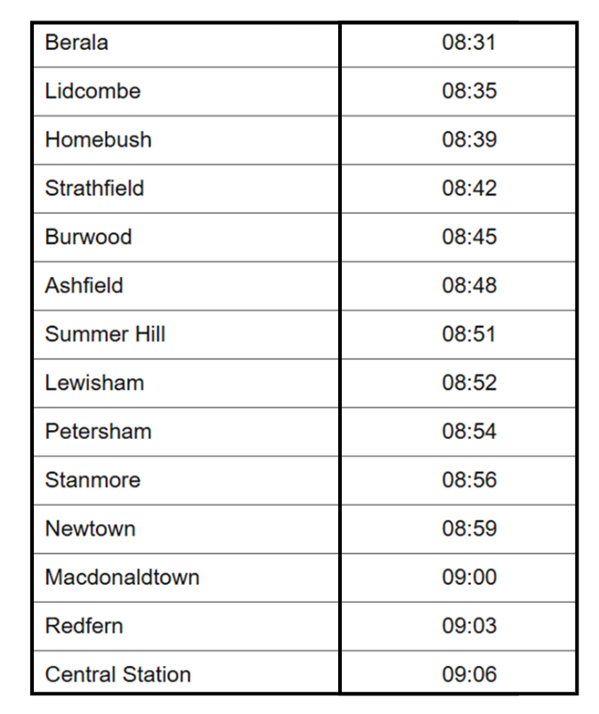
Short response (30)
Record the time the 08:35 train from Lidcombe arrives at Summer Hill.
Notes:
Short response questions provide brisk paced questions focussing on review of current and previous content to support spaced and interleaved practice.
Syllabus focus area:
Non-spatial measure A: Time

Slide 57
Short response (31)
Identify and record which of the following capacities is the smallest:
8.13 L
8314 L
8323 L
Notes:
Short response questions provide brisk paced questions focussing on review of current and previous content to support spaced and interleaved practice.
Syllabus focus area:
Three-dimensional spatial structure A: Volume

Slide 58
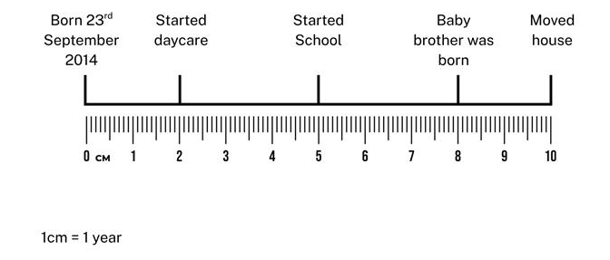
Short response (32)
How many years were there between starting school and moving house?
Notes:
Short response questions provide brisk paced questions focussing on review of current and previous content to support spaced and interleaved practice.
Syllabus focus area:
Data B

Slide 59
Activity 8 – distributive property of multiplication
A shop sells 277 boxes of chocolate. Each box has 18 chocolates.
How many chocolates are there altogether?
Notes:
This is a developing number sense activity.
Number sense refers to a deep understanding of numbers, including their magnitude, relationships, and the effects of operations on them. It supports fluency and understanding, estimation, flexible thinking, and efficient problem-solving. Number sense activities 1–4 ‘activate’ prior number knowledge and support the learning of new content in the unit. Number sense activities 5–8 ‘loop’ back and provide opportunity for spaced practice with concepts and procedures covered in previous units.
Syllabus focus area:
Multiplicative relations A
Distributive property of multiplication
Pose the problem: A shop sells 277 boxes of chocolate. Each box has 18 chocolates.
Ask students to use the distributive property to find out how many chocolates there are, recording their thinking on whiteboards.
Ask students to share their answer and explain their thinking to a partner.
Ask:
Was the distributive property strategy the best strategy to use to obtain the answer?
What could have been a more effective strategy and why?

Slide 60
Double Venn diagram
Object 1
Object 2
Features similar to both objects
Features of object 1
Features of object 2

Slide 61
Multiple choice (5)
A
B
C
D
Notes:
This question connects to the content in the developing number sense activity (Activity 3)
Syllabus focus area:
[Focus area A/B]

Slide 62
Frayer
Definition
Facts/Characteristics
Word, term, concept
Examples
Non-examples

Slide 63
Spider map
Idea
Subject

Slide 64
Cline
Concept 1
Concept 2
Word
Word
Word
Word
Word
Word
Word
Word
Word
Word
Word

Slide 65
Compare and contrast

Slide 66
Multiple choice (6)
A
B
C
D

Slide 67
Multiple choice (7)
A
B
C
D
Notes:
This question connects to the content in the developing number sense activity (Activity 3)
Syllabus focus area:
[Focus area A/B]

Slide 68
References
This presentation contains NSW Curriculum and syllabus content. The NSW Curriculum is developed by the NSW Education Standards Authority. This content is prepared by NESA for and on behalf of the Crown in the right of the State of New South Wales. The material is protected by Crown copyright.
Please refer to the NESA Copyright Disclaimer for more information https://educationstandards.nsw.edu.au/wps/portal/nesa/mini-footer/copyright.
NESA holds the only official and up-to-date versions of the NSW Curriculum and syllabus documents. Please visit the NSW Education Standards Authority (NESA) website https://educationstandards.nsw.edu.au/wps/portal/nesa/home and the NSW Curriculum website https://curriculum.nsw.edu.au.
Mathematics K–10 Syllabus © NSW Education Standards Authority (NESA) for and on behalf of the Crown in right of the State of New South Wales, 2022.
National Numeracy Learning Progression © Australian Curriculum, Assessment and Reporting Authority (ACARA) 2010 to present, unless otherwise indicated. This material was downloaded from the Australian Curriculum website (National Numeracy Learning Progression) (accessed 17 December 2025) and was not modified.
State of New South Wales (Department of Education) (2023) ‘Hit it (3-digit numbers)’, Thinking mathematically resources, NSW Department of Education website, accessed 11 August 2023.
——(2023) ‘Number visuals’, Thinking mathematically resources, NSW Department of Education website, accessed 11 August 2023.
——(2023) ‘Place value game’, Thinking mathematically resources, NSW Department of Education website, accessed 11 August 2023.
University of Cambridge (n.d.) Multiply Multiples 1, NRICH website, accessed 11 August 2023.
University of Colorado (2024) Area Model Algebra, Physics Education Technology (PhET) website, accessed 11 August 2023.

Slide 69
Copyright
© State of New South Wales (Department of Education), 2025
The copyright material published in this resource is subject to the Copyright Act 1968 (Cth) and is owned by the NSW Department of Education or, where indicated, by a party other than the NSW Department of Education (third-party material).
Copyright material available in this resource and owned by the NSW Department of Education is licensed under a Creative Commons Attribution 4.0 International (CC BY 4.0) license.
This license allows you to share and adapt the material for any purpose, even commercially.
Attribution should be given to © State of New South Wales (Department of Education), 2025.
Material in this resource not available under a Creative Commons license:
the NSW Department of Education logo, other logos and trademark-protected material
Material owned by a third party that has been reproduced with permission. You will need to obtain permission from the third party to reuse its material.
Links to third-party material and websites
Please note that the provided (reading/viewing material/list/links/texts) are a suggestion only and implies no endorsement, by the New South Wales Department of Education, of any author, publisher, or book title. School principals and teachers are best placed to assess the suitability of resources that would complement the curriculum and reflect the needs and interests of their students.
If you use the links provided in this document to access a third party’s website, you acknowledge that the terms of use, including licence terms set out on the third-party’s website apply to the use which may be made of the materials on that third-party website or where permitted by the Copyright Act 1968 (Cth). The department accepts no responsibility for content on third-party websites.

