Slide 1
Instructions for use
This resource is not a teaching and learning program. This resource aligns to the learning in Stage 3 Year A Unit 12 and revisits content from earlier sample units.
Classroom teachers are encouraged to add and adapt slides as required to meet the needs of their students.
Save a copy of the file to make changes to the slide deck. Go to File > Download a Copy (this downloads a copy to the computer to edit in the PowerPoint app).
To convert the PowerPoint to Google Slides:
  Upload the file into Google Drive and open it.
  Go to File > Save as Google Slides.
  (Note – conversion may cause formatting changes in the slides.)

Slide 2

Review of Learning
Mathematics Stage 3 – Unit 12
Notes:
Reviews may include a combination of question types, requiring students to recall facts and key ideas, as well as apply their knowledge to solve problems and answer questions. To support active engagement, a mix of techniques should be employed.” (AERO, 2024).
This Review of Learning slide deck revisits key concepts from the following units:
Stage 3 Year A Unit 12
Stage 3 Year A Unit 11
Stage 3 Year A Unit 10
It also includes opportunities to review prior learning in non-number content, supporting consolidation across focus areas.
The review of learning resources include three key task types that support the development of mathematical proficiency through retrieval, spaced practice, and active participation. These practices complement the review phase (activating prior knowledge) embedded within the beginning of each lesson.
1.
Multiple-choice questions/True or false: Designed to promote active retrieval of key concepts and identify common misconceptions in number, supporting consolidation, understanding and fluency.
These questions:
support spaced and interleaved practice
help identify and address common misconceptions
support active recall and immediate feedback
support whole class participation
identify areas requiring reteach
2.
Short-response question sets: Carefully grouped questions that encourage spaced and interleaved practice across multiple focus areas, helping students revisit and apply knowledge from different points in time.
These questions:
have a combination of question types
address a range of focus areas
build automaticity and fluency
support active recall
allow for immediate feedback
identify content requiring reteach
3.
Developing number sense activities: A variety of practical, purposeful tasks that reinforce current learning and build on prior knowledge. These activities promote reasoning, problem-solving and conceptual understanding.
The review of learning resources are designed to work support teaching and learning in mathematics. For the most effective implementation, use the resources flexibly, adapting to meet student learning needs and individual classroom contexts.

Slide 3
Lessons
1
Review of learning 1
5
Review of learning 5
2
Review of learning 2
6
Review of learning 6
3
Review of learning 3
7
Review of learning 7
4
Review of learning 4
8
Review of learning 8
Notes:
Teacher notes:
Click lesson titles to go to specific lessons
Interactive features can be viewed in slide show

Slide 4
Review of learning 1

Slide 5

Multiple choice (1)
Which number has been regrouped using place value?
5 000 000 + 600 000 + 30 000 + 2 000 + 800 + 70 + 9
A
5 362 879
B
5 623 789
C
5 632 879
D
5 632 798
Notes:
This question connects to the content in the developing number sense activity (Activity 3)
Syllabus focus area:
Represents numbers A

Slide 6

Short response (1)
Match the letter to the correct number of lines of symmetry:
P
D
X
one line of symmetry
2 or more lines of symmetry
zero lines of symmetry
Notes:
Short response questions provide brisk paced questions focussing on review of current and previous content to support spaced and interleaved practice.
Syllabus focus area:
Two-dimensional spatial structure A: 2D shapes

Slide 7
Short response (2)
Round the following numbers to the nearest hundred thousand:
312 000
650 000
281 000
829 000
Notes:
Short response questions provide brisk paced questions focussing on review of current and previous content to support spaced and interleaved practice.
Syllabus focus area:
Represents numbers A

Slide 8

Short response (3)
Peter faces north. He makes a quarter-turn to the right.
Complete the following statements:
Peter has formed a _____ angle with this rotation.
One arm of the angle is directed _____ and the other arm is directed _____.
Notes:
Short response questions provide brisk paced questions focussing on review of current and previous content to support spaced and interleaved practice.
Syllabus focus area:
Geometric measure A: Position

Slide 9
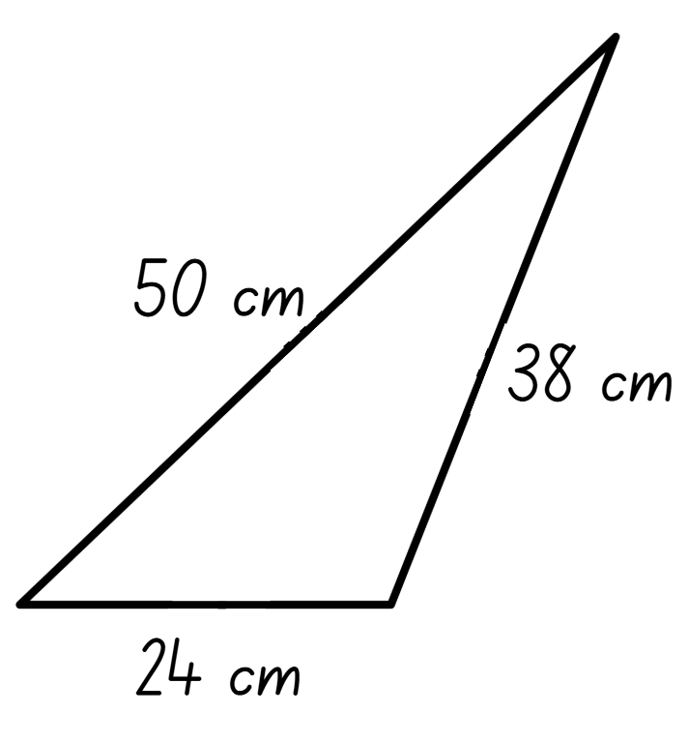
Short response (4)
Calculate the perimeter of the triangle.
Notes:
Short response questions provide brisk paced questions focussing on review of current and previous content to support spaced and interleaved practice.
Syllabus focus area:
Geometric measure A: Length

Slide 10

Activity 1 – regrouping numbers 1 (1)
The total number of students enrolled at our school is:
Notes:
This is a developing number sense activity.
Number sense refers to a deep understanding of numbers, including their magnitude, relationships, and the effects of operations on them. It supports fluency and understanding, estimation, flexible thinking, and efficient problem-solving. Number sense activities 1–4 ‘activate’ prior number knowledge and support the learning of new content in the unit. Number sense activities 5–8 ‘loop’ back and provide opportunity for spaced practice with concepts and procedures covered in previous units.
Syllabus focus area:
Represents numbers A
Regrouping numbers 1
This resource corresponds to Figure 8 – recording numbers in different forms in Stage 3 Year A Unit 12
1. Students use standard partitioning to record the total number of students enrolled at their school on an individual whiteboard. For example, 252 students can be recorded as 2 hundreds, 5 tens and 2 ones or written as 200 + 50 + 2.
2. (next slide) Introduce students to the National, state and territory population latest release website to find the total population for New South Wales.
3. Write the total population for New South Wales on the board and ask students to partition the number before recording the number in as many different forms as possible (see Figure 8 – recording numbers in different forms in Stage 3 Year A Unit 12).
4. Repeat the activity for another state or territory.

Slide 11

Activity 1 – regrouping numbers 1 (2)
National, state and territory population latest release
https://www.abs.gov.au/statistics/people/population/national-state-and-territory-population/latest-release
Notes:
This is a developing number sense activity.
Number sense refers to a deep understanding of numbers, including their magnitude, relationships, and the effects of operations on them. It supports fluency and understanding, estimation, flexible thinking, and efficient problem-solving. Number sense activities 1–4 ‘activate’ prior number knowledge and support the learning of new content in the unit. Number sense activities 5–8 ‘loop’ back and provide opportunity for spaced practice with concepts and procedures covered in previous units.
Syllabus focus area:
Represents numbers A
Regrouping numbers 1
This resource corresponds to Figure 8 – recording numbers in different forms in Stage 3 Year A Unit 12
1. Students use standard partitioning to record the total number of students enrolled at their school on an individual whiteboard. For example, 252 students can be recorded as 2 hundreds, 5 tens and 2 ones or written as 200 + 50 + 2.
2. Introduce students to the National, state and territory population latest release website to find the total population for New South Wales.
3. Write the total population for New South Wales on the board and ask students to partition the number before recording the number in as many different forms as possible (see Figure 8)
4. Repeat the activity for another state or territory.

Slide 12
Review of learning 2

Slide 13
True or false (1)
386 570 924 can be regrouped as
386 millions, 57 thousands and 924 ones.
True | False
Communicate your reasoning.
Notes:
The question on this slide connects to the content being explored in the developing number sense activity (Activity 2)
Syllabus focus area:
Represents numbers A

Slide 14
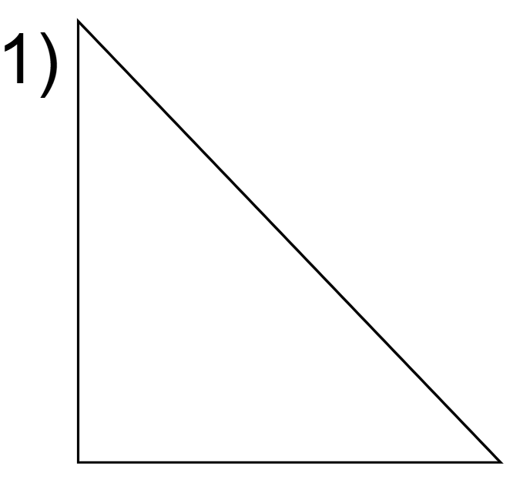
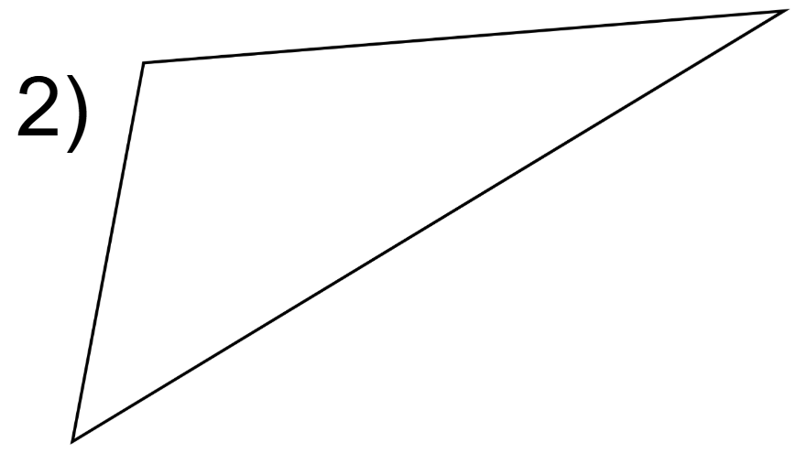
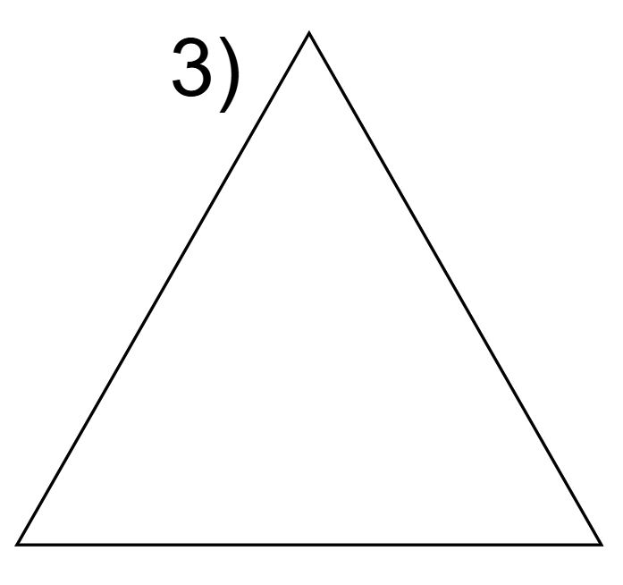
Short response (5)
Match the triangle name to its representation:
equilateral triangle
isosceles triangle
scalene triangle
Notes:
Short response questions provide brisk paced questions focussing on review of current and previous content to support spaced and interleaved practice.
Syllabus focus area:
Two-dimensional spatial structure A: 2D shapes

Slide 15
Short response (6)
Order the following decimal numbers in ascending order:
1.375
1.107
1.256
1.190
Notes:
Short response questions provide brisk paced questions focussing on review of current and previous content to support spaced and interleaved practice.
Syllabus focus area:
Represents numbers A

Slide 16
Short response (7)
Match each angle name to its correct measurement:
right angle
straight angle
angle of revolution
360°
90°
180°
Notes:
Short response questions provide brisk paced questions focussing on review of current and previous content to support spaced and interleaved practice.
Syllabus focus area:
Geometric measure A: Angles

Slide 17
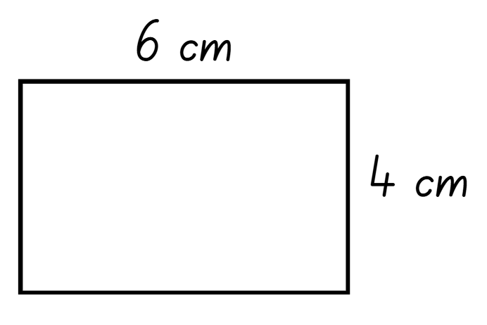
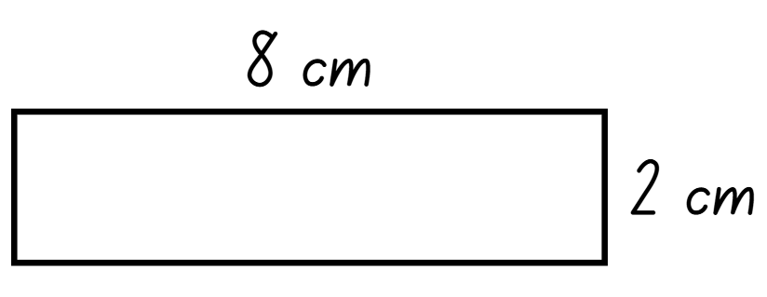
Short response (8)
Frankie states that these rectangles have different side lengths so they cannot have the same perimeter. Is Frankie correct?
Communicate your reasoning.
Notes:
Short response questions provide brisk paced questions focussing on review of current and previous content to support spaced and interleaved practice.
Syllabus focus area:
Geometric measure A: Length

Slide 18
Activity 2 – regrouping numbers 2
406 728 319
Notes:
This is a developing number sense activity.
Number sense refers to a deep understanding of numbers, including their magnitude, relationships, and the effects of operations on them. It supports fluency and understanding, estimation, flexible thinking, and efficient problem-solving. Number sense activities 1–4 ‘activate’ prior number knowledge and support the learning of new content in the unit. Number sense activities 5–8 ‘loop’ back and provide opportunity for spaced practice with concepts and procedures covered in previous units.
Syllabus focus area:
Represents numbers A
Regrouping numbers 2
2. Challenge students to represent the number in at least 3 different ways. For example:
expanded form: 400 000 000 + 6 000 000 + 700 000 + 20 000 + 8000 + 300 + 10 + 9
partitioned in 2 large sums: 406 000 000 + 728 319
as millions, thousands and ones: 406 millions, 728 thousands 319 ones.
3. Students turn and talk to discuss reasoning. Ask:
Why might we regroup numbers like this?
How does changing the grouping help us calculate or understand the size of the number?
4. Challenge students to create their own large number (up to one billion) and write down 3 different representations.

Slide 19
Review of learning 3

Slide 20
Multiple choice (2)
Which number has been partitioned in a non-standard form:
482 000 000 + 7 654 321
A
482 765 432
B
482 654 321
C
489 654 321
D
487 654 321
Notes:
This question connects to the content in the developing number sense activity (Activity 3)
Syllabus focus area:
Represents numbers A

Slide 21
Short response (9)
Match the triangle description to its classification:
A closed shape with 3 sides of different lengths and 3 angles of different sizes.
A closed shape with 3 straight sides all equal in length and 3 angles equal in size.
A closed shape with 3 straight sides, 2 of them equal in length and 2 of the angles are equal in size.
equilateral triangle
isosceles triangle
scalene triangle
Notes:
Short response questions provide brisk paced questions focussing on review of current and previous content to support spaced and interleaved practice.
Syllabus focus area:
Two-dimensional spatial structure A: 2D shapes

Slide 22
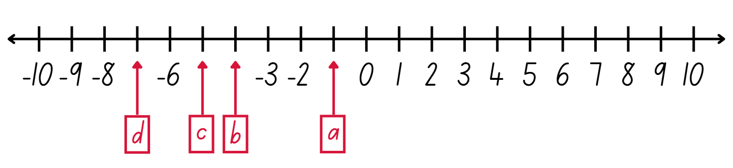
Short response (10)
Record the missing negative whole numbers:
Notes:
Short response questions provide brisk paced questions focussing on review of current and previous content to support spaced and interleaved practice.
Syllabus focus area:
Represents numbers A

Slide 23
Short response (11)
Your friend wants to measure an angle using a protractor.
Explain one important step they must follow to measure the angle correctly.
Notes:
Short response questions provide brisk paced questions focussing on review of current and previous content to support spaced and interleaved practice.
Syllabus focus area:
Geometric measure A: Angles

Slide 24
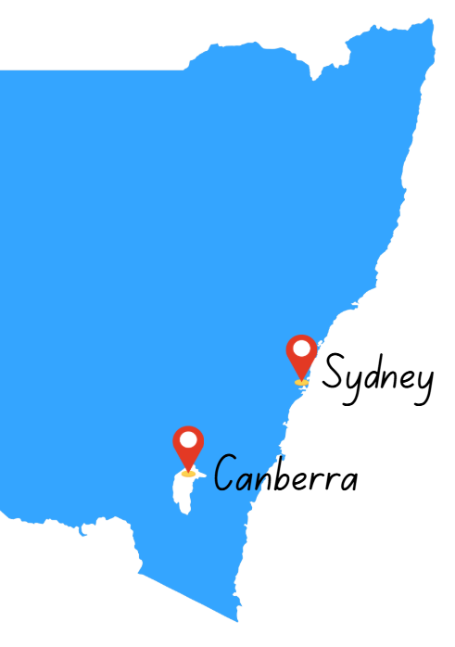
Short response (12)
The distance between Sydney and Canberra is 287 kilometres.
Record this distance using the abbreviation for kilometres.
Explain why kilometres are a more suitable unit than metres for this distance.
Notes:
Short response questions provide brisk paced questions focussing on review of current and previous content to support spaced and interleaved practice.
Syllabus focus area:
Geometric measure A: Length

Slide 25
Activity 3 – partitioning numbers 1 (1)
349 035 494
Notes:
This is a developing number sense activity.
Number sense refers to a deep understanding of numbers, including their magnitude, relationships, and the effects of operations on them. It supports fluency and understanding, estimation, flexible thinking, and efficient problem-solving. Number sense activities 1–4 ‘activate’ prior number knowledge and support the learning of new content in the unit. Number sense activities 5–8 ‘loop’ back and provide opportunity for spaced practice with concepts and procedures covered in previous units.
Syllabus focus area:
Represents numbers A
Partitioning numbers 1
1. Review understanding of regrouping numbers from Activity 1 and Activity 2.
2. Explain that place value can be applied to numbers using standard and non-standard forms.
3. Use the population of the United States of America (USA) as an example to demonstrate standard partitioning of a number up to 1 billion. For example, 349 035 494 can be partitioned as 349 millions, 35 thousands, 4 hundreds, 9 tens and 4 ones.
Note: according to Countries in the world by population (2026), it is reported that in March 2026 the population of the USA was 349 035 494.
4. Ask:
Can this number be partitioned without using the word thousands?
How can you work this out?
How can this number be partitioned in non-standard forms?
5. Demonstrate regrouping thousands into hundreds. By regrouping 349 035 494, the population of the USA can be partitioned into 349 millions, 354 hundreds, 9 tens and 4 ones.
6. Demonstrate partitioning 349 035 494 in non-standard forms. For example, 345 000 000 + 4 035 494
7. (next slide) Access Countries in the world by population (2026) to retrieve current population data for Australia and Japan. Write the populations for Australia and Japan on the board.
8. Students represent each number in standard and non-standard partitioning on individual whiteboards. Have students share their solutions and discuss their reasoning.
9. Ask students to:
name 1 million in a different way. For example, 1 million is the same as 1000 thousand.
rename 1 billion in a different way. For example, 1 billion is the same as 1000 million.

Slide 26
Activity 3 – partitioning numbers 1 (2)
Countries in the world by population (2026)
https://www.worldometers.info/world-population/population-by-country/
Notes:
This is a developing number sense activity.
Number sense refers to a deep understanding of numbers, including their magnitude, relationships, and the effects of operations on them. It supports fluency and understanding, estimation, flexible thinking, and efficient problem-solving. Number sense activities 1–4 ‘activate’ prior number knowledge and support the learning of new content in the unit. Number sense activities 5–8 ‘loop’ back and provide opportunity for spaced practice with concepts and procedures covered in previous units.
Syllabus focus area:
Represents numbers A
Partitioning numbers 1
7. Access Countries in the world by population (2026) to retrieve current population data for Australia and Japan. Write the populations for Australia and Japan on the board.
8. Students represent each number in standard and non-standard partitioning on individual whiteboards. Have students share their solutions and discuss their reasoning.
9. Ask students to:
name 1 million in a different way. For example, 1 million is the same as 1000 thousand
rename 1 billion in a different way. For example, 1 billion is the same as 1000 million.

Slide 27
Review of learning 4

Slide 28
True or false (2)
1000 thousands is 1 million and
1000 millions is 1 billion.
True | False
Notes:
The question on this slide connects to the content being explored in the developing number sense activity (Activity 4)
Syllabus focus area:
Represents numbers A

Slide 29
Short response (13)
I am a two-dimensional shape. I have:
4 sides
2 pairs of parallel sides
4 right angles
What 2 quadrilaterals could I be?
Communicate your reasoning.
Notes:
Short response questions provide brisk paced questions focussing on review of current and previous content to support spaced and interleaved practice.
Syllabus focus area:
Two-dimensional spatial structure A: Angles

Slide 30
Short response (14)
Record all the factors of
12.
Notes:
Short response questions provide brisk paced questions focussing on review of current and previous content to support spaced and interleaved practice.
Syllabus focus area:
Multiplicative relations A

Slide 31

Short response (15)
Peter faces east. He makes a half-turn to the left.
Complete the following statements:
Peter has formed a _____ angle with this rotation.
One arm of the angle is directed _____ and the other arm is directed _____.
Notes:
Short response questions provide brisk paced questions focussing on review of current and previous content to support spaced and interleaved practice.
Syllabus focus area:
Geometric measure A: Position

Slide 32
Short response (16)
Convert the following distances:
7250 m = _____ km
3.8 km = _____ m
9750 m = _____ km
Notes:
Short response questions provide brisk paced questions focussing on review of current and previous content to support spaced and interleaved practice.
Syllabus focus area:
Geometric measure B: Length

Slide 33
Activity 4 – partitioning numbers 2
874 516 302
Notes:
This is a developing number sense activity.
Number sense refers to a deep understanding of numbers, including their magnitude, relationships, and the effects of operations on them. It supports fluency and understanding, estimation, flexible thinking, and efficient problem-solving. Number sense activities 1–4 ‘activate’ prior number knowledge and support the learning of new content in the unit. Number sense activities 5–8 ‘loop’ back and provide opportunity for spaced practice with concepts and procedures covered in previous units.
Syllabus focus area:
Represents numbers A
Partitioning numbers 2
1. Write a 9-digit number on the board.
2. Ask students to record 2 different ways the number can be renamed. Select students to share ideas.
3. Revise 1000 thousands is 1 million and 1000 millions is 1 billion.
4. Provide pairs of students with a 10-sided dice. Pairs roll the dice 9 times to generate a 9-digit number and record.
5. Challenge students to rename their number in as many ways as possible using standard and non-standard partitioning.
6. Repeat the process by rolling another 9-digit number.

Slide 34
Review of learning 5

Slide 35
Multiple choice (3)
Use estimation to determine the nearest total:
248 762 + 251 498
A
B
C
D
550 000
500 000
450 000
400 000
Communicate your reasoning.
Notes:
This question connects to the content in the developing number sense activity (Activity 5)
Syllabus focus area:
Additive relations A

Slide 36
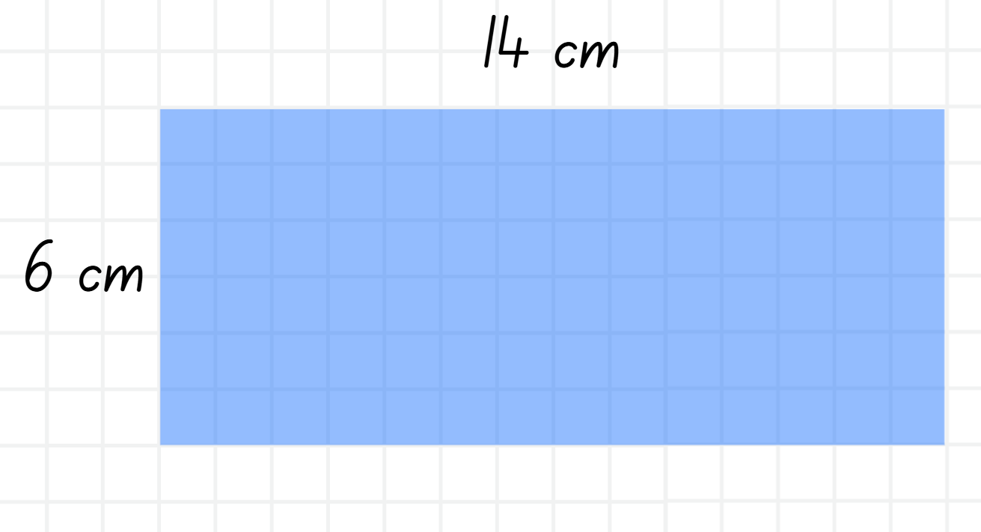
Short response (17)
Use the area model to determine
the area of the rectangle:
Notes:
Short response questions provide brisk paced questions focussing on review of current and previous content to support spaced and interleaved practice.
Syllabus focus area:
Multiplicative relations A

Slide 37
Short response (18)
Use the distributive property and the area model to solve:
378 × 5
Notes:
Short response questions provide brisk paced questions focussing on review of current and previous content to support spaced and interleaved practice.
Syllabus focus area:
Multiplicative relations A

Slide 38
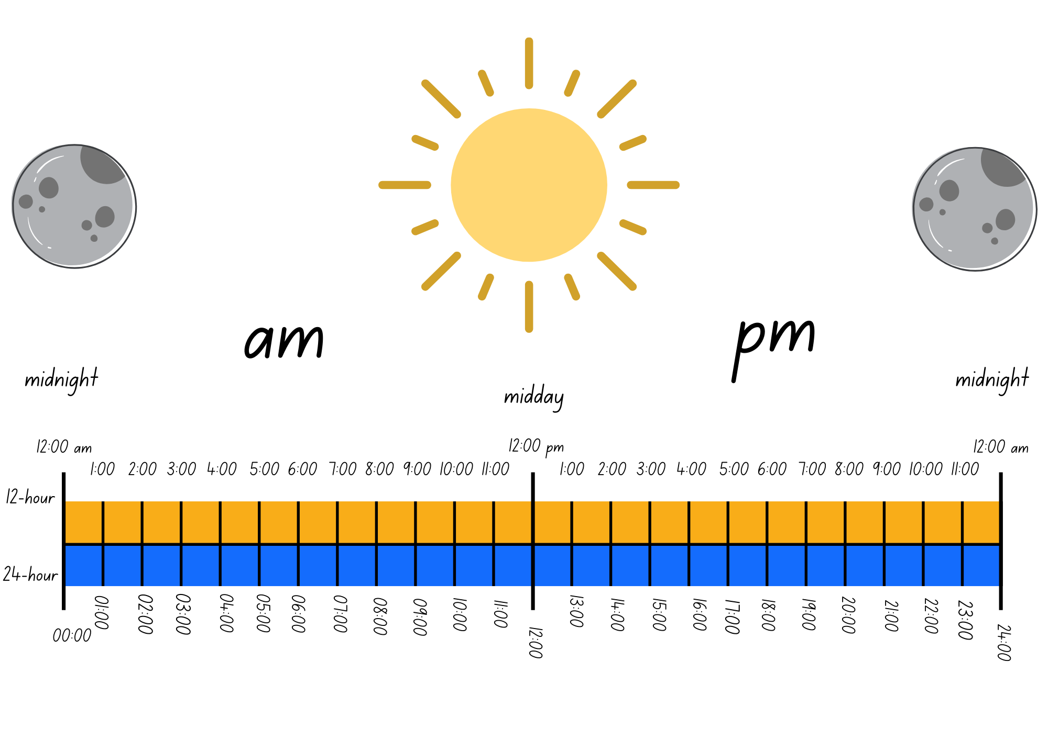
Short response (19)
Write these times as 12-hour time with am or pm:
19:12
02:47
01:45
Notes:
Short response questions provide brisk paced questions focussing on review of current and previous content to support spaced and interleaved practice.
Syllabus focus area:
Non-spatial measure A: Time

Slide 39
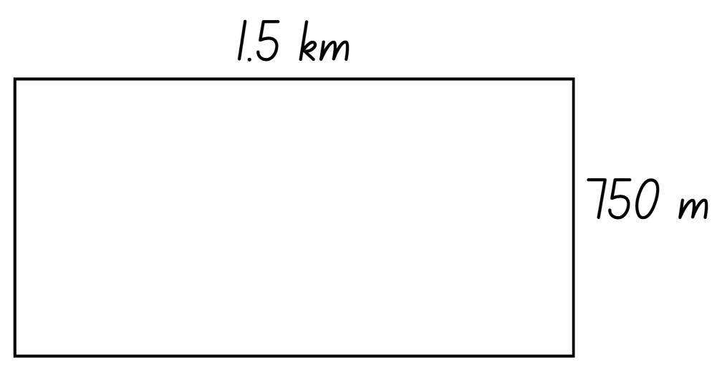
Short response (20)
Convert the side lengths to the same unit of measurement.
Calculate and record the perimeter of the rectangle.
Notes:
Short response questions provide brisk paced questions focussing on review of current and previous content to support spaced and interleaved practice.
Syllabus focus area:
Geometric measure B: Length

Slide 40
Activity 5 – using estimation
Is 37 + 75 over or under 100?
Is 712 − 458 over or under 300?
Is 579 + 1600 over or under 2000?
Is 45 900 − 21 999 over or under 20 000?
Is 987 000 − 50 000 over or under 950 000?
Notes:
This is a developing number sense activity.
Number sense refers to a deep understanding of numbers, including their magnitude, relationships, and the effects of operations on them. It supports fluency and understanding, estimation, flexible thinking, and efficient problem-solving. Number sense activities 1–4 ‘activate’ prior number knowledge and support the learning of new content in the unit. Number sense activities 5–8 ‘loop’ back and provide opportunity for spaced practice with concepts and procedures covered in previous units.
Syllabus focus area:
Additive relations A
Using estimation
This activity is an adaptation of Over or under? from Primary and Middle Years Mathematics 2nd Edition by Van de Walle, Karp, Bay-Williams, Brass and Livy (2024).
1. Explain that estimation is a helpful tool when approximating how many are in a collection. Before estimating it is necessary to round the numbers first.
2. Students round the numbers and choose whether the answer is over or under.
3. Discuss answers, giving feedback where necessary.

Slide 41
Review of learning 6

Slide 42
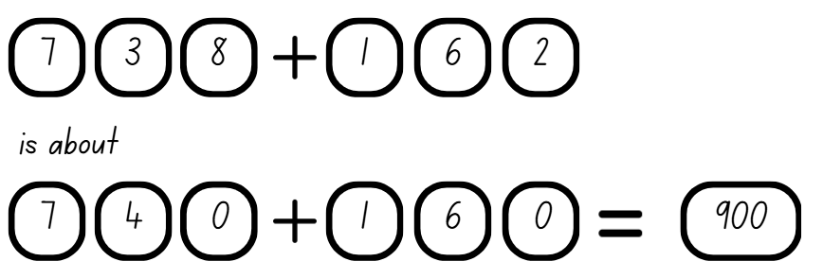
True or false (3)
True | False
Communicate your reasoning.
Notes:
The question on this slide connects to the content being explored in the developing number sense activity (Activity 6)
Syllabus focus area:
Additive relations A

Slide 43
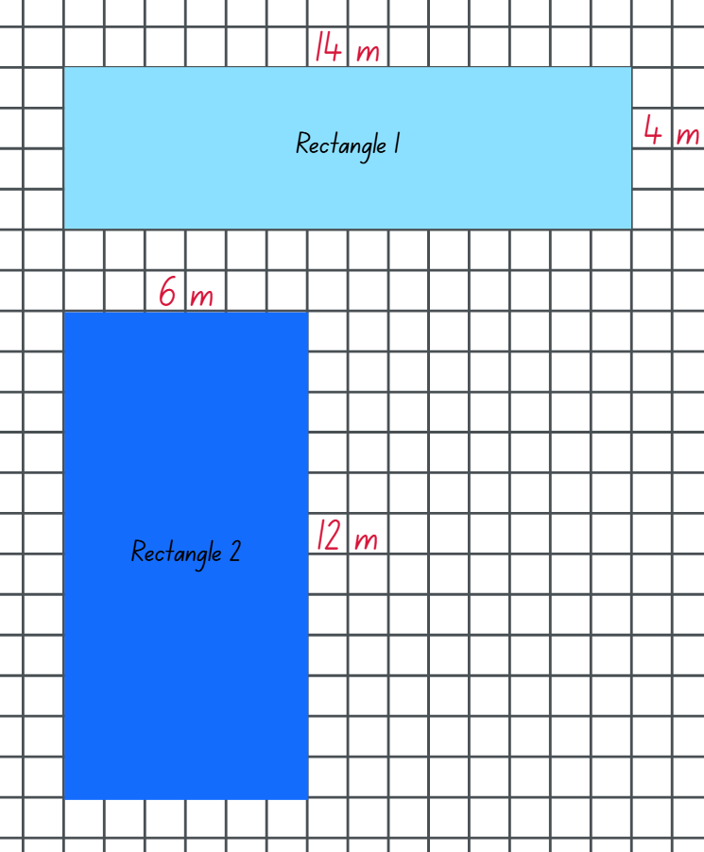
Short response (21)
Both these rectangles have a perimeter of 36 m.
Calculate the area of each rectangle.
Explain why both rectangles can have the same perimeter but different areas.
Notes:
Short response questions provide brisk paced questions focussing on review of current and previous content to support spaced and interleaved practice.
Syllabus focus area:
Two-dimensional spatial structure A: Area

Slide 44
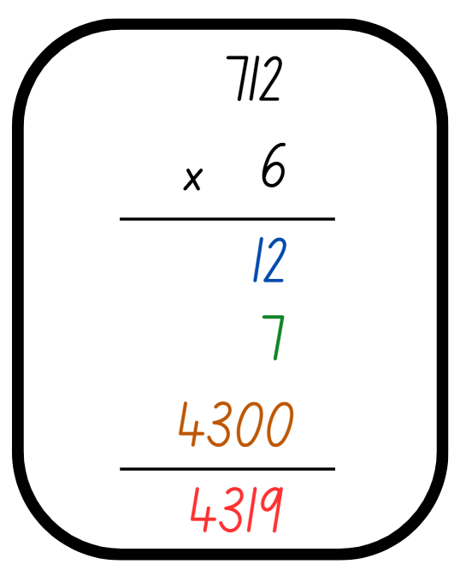
Short response (22)
Identify the errors in this formal algorithm and correct them to solve 712 × 6.
Notes:
Short response questions provide brisk paced questions focussing on review of current and previous content to support spaced and interleaved practice.
Syllabus focus area:
Multiplicative relations A

Slide 45
Short response (23)
Write these times using 24-hour notation:
11:09 pm
1:52 pm
1:26 am
Notes:
Short response questions provide brisk paced questions focussing on review of current and previous content to support spaced and interleaved practice.
Syllabus focus area:
Non-spatial measure A: Time

Slide 46
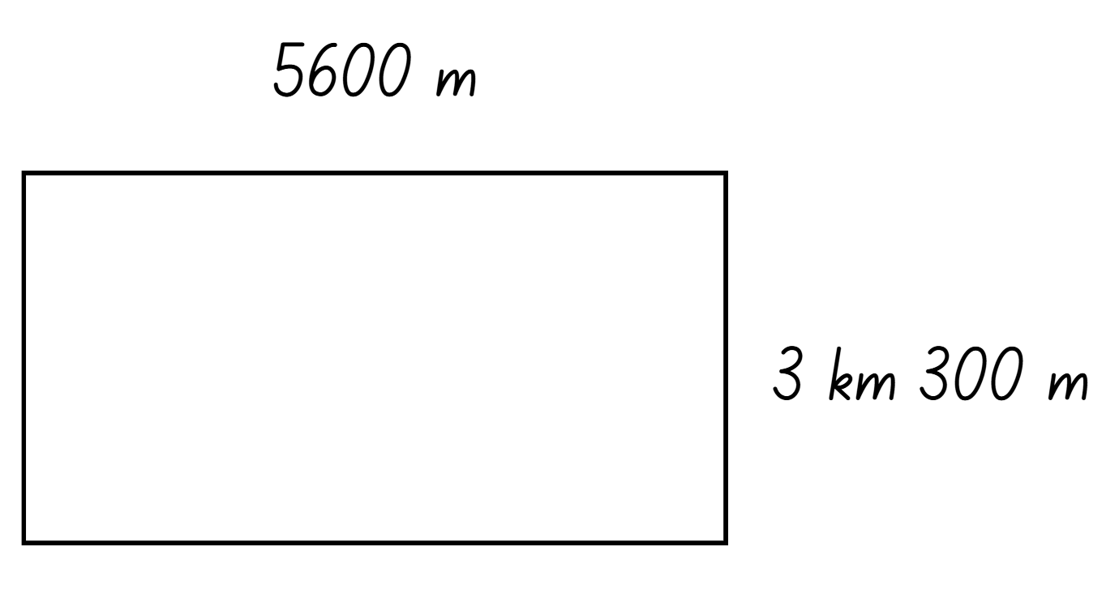
Short response (24)
Determine the perimeter of the rectangle.
Remember to convert the side lengths to the same unit of measurement before calculating.
Notes:
Short response questions provide brisk paced questions focussing on review of current and previous content to support spaced and interleaved practice.
Syllabus focus area:
Geometric measure B: Length

Slide 47
Activity 6 – using place value understanding
569 + 429
Notes:
This is a developing number sense activity.
Number sense refers to a deep understanding of numbers, including their magnitude, relationships, and the effects of operations on them. It supports fluency and understanding, estimation, flexible thinking, and efficient problem-solving. Number sense activities 1–4 ‘activate’ prior number knowledge and support the learning of new content in the unit. Number sense activities 5–8 ‘loop’ back and provide opportunity for spaced practice with concepts and procedures covered in previous units.
Syllabus focus area:
Additive relations A
Using place value understanding
1. Write an addition number sentence on the board. For example, 569 + 429.
2. Ask students how rounding the numbers can help estimate the answer to the number sentence provided. Students turn and talk.
3. Select a variety of student ideas to share with the class.
4. Record a number sentence that reflects how the numbers can be rounded. Ask students to solve the rounded number sentence to determine an appropriate estimate (see Figure 9 – rounding to support estimation in Stage 3 Year A Unit 12).
5. Provide pairs of students with a 10-sided die and individual whiteboards.
6. Students roll the dice 6 times to generate and record a number sentence. Students record the rounded number sentence and estimate on their whiteboards.
7. Students repeat the process.
Note: the number of dice rolls may vary for students to provide appropriate differentiation opportunities.

Slide 48
Review of learning 7

Slide 49
Multiple choice (4)
What is the most reasonable estimate for the sum of:
1204 + 1204 + 1204
A
B
C
D
2800
3600
4000
3000
Notes:
This question connects to the content in the developing number sense activity (Activity 7)
Syllabus focus area:
Additive relations A

Slide 50
Short response (25)
A rectangular playground is
23 m in length and 7 m in width.
Calculate the area of the playground in square metres (m²).
Notes:
Short response questions provide brisk paced questions focussing on review of current and previous content to support spaced and interleaved practice.
Syllabus focus area:
Two-dimensional spatial structure A: Length

Slide 51
Short response (26)
19 ÷ 4 = ____ remainder (r) ____
Notes:
Short response questions provide brisk paced questions focussing on review of current and previous content to support spaced and interleaved practice.
Syllabus focus area:
Multiplicative relations A

Slide 52
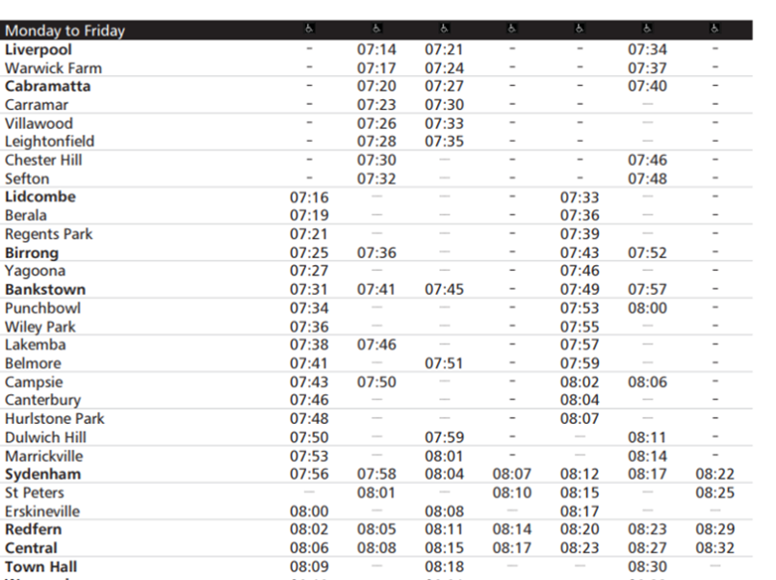
Short response (27)
A train arrives at Bankstown at 07:57. What time does it leave Warwick Farm?
What time does the 07:34 from Liverpool arrive at Marrickville?
Notes:
Short response questions provide brisk paced questions focussing on review of current and previous content to support spaced and interleaved practice.
Syllabus focus area:
Non-spatial measure A: Time

Slide 53
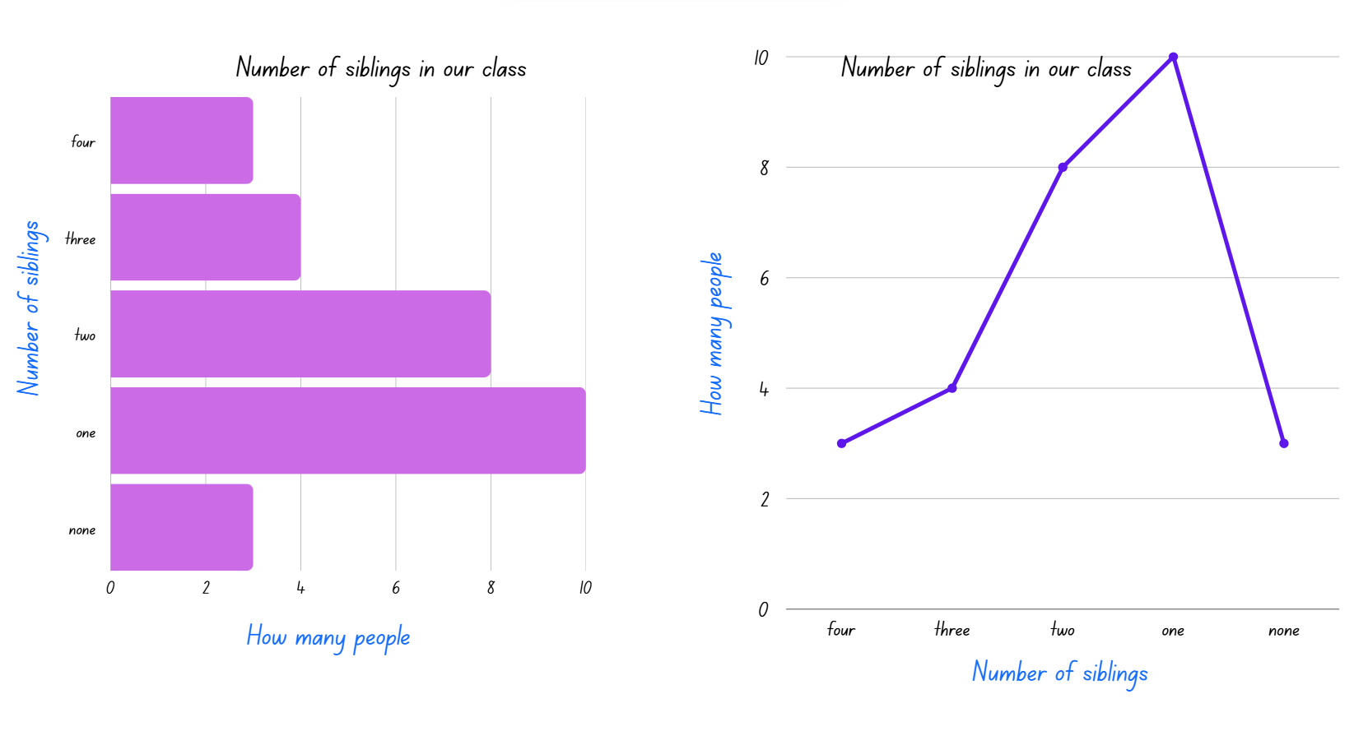
Short response (28)
Is the data in these graphs categorical or continuous?
Which data display is more appropriate to display this data? Why?
Notes:
Short response questions provide brisk paced questions focussing on review of current and previous content to support spaced and interleaved practice.
Syllabus focus area:
Data A

Slide 54
Activity 7 – determining reasonableness of solutions (1)
204 + 204 + 204 = 702
Notes:
This is a developing number sense activity.
Number sense refers to a deep understanding of numbers, including their magnitude, relationships, and the effects of operations on them. It supports fluency and understanding, estimation, flexible thinking, and efficient problem-solving. Number sense activities 1–4 ‘activate’ prior number knowledge and support the learning of new content in the unit. Number sense activities 5–8 ‘loop’ back and provide opportunity for spaced practice with concepts and procedures covered in previous units.
Syllabus focus area:
Additive relations A
Determining reasonableness of solutions
1. Students turn and talk to discuss the following:
Is the answer reasonable? Why or why not?
What error has this person made when calculating?
What would be a reasonable estimate? Why?
2. (next slide) Ask students if the answer is reasonable.
3. Students turn and talk and repeat the discussion from before.

Slide 55
Activity 7 – determining reasonableness of solutions (2)
2005 + 2005 + 2005 = 6105
Notes:
This is a developing number sense activity.
Number sense refers to a deep understanding of numbers, including their magnitude, relationships, and the effects of operations on them. It supports fluency and understanding, estimation, flexible thinking, and efficient problem-solving. Number sense activities 1–4 ‘activate’ prior number knowledge and support the learning of new content in the unit. Number sense activities 5–8 ‘loop’ back and provide opportunity for spaced practice with concepts and procedures covered in previous units.
Syllabus focus area:
Additive relations A
Determining reasonableness of solutions
2. Ask students if the answer is reasonable.
3. Students turn and talk and repeat the discussion from before.
Is the answer reasonable? Why or why not?
What error has this person made when calculating?
What would be a reasonable estimate? Why?

Slide 56
Review of learning 8

Slide 57
True or false (4)
This is a reasonable estimate:
276 + 489 = 800
True | False
Communicate your reasoning.
Notes:
The question on this slide connects to the content being explored in the developing number sense activity (Activity 8)
Syllabus focus area:
Additive relations A

Slide 58
Short response (29)
Choose either hectares (ha) or square kilometres (km²) as the most appropriate unit to measure the area of:
a large farm
a country
a sports field.
Communicate your reasoning.
Notes:
Short response questions provide brisk paced questions focussing on review of current and previous content to support spaced and interleaved practice.
Syllabus focus area:
Two-dimensional spatial structure A: Area

Slide 59
Short response (30)
Use knowledge of multiples to
partition and solve
624 ÷ 4
Notes:
Short response questions provide brisk paced questions focussing on review of current and previous content to support spaced and interleaved practice.
Syllabus focus area:
Multiplicative relations A

Slide 60
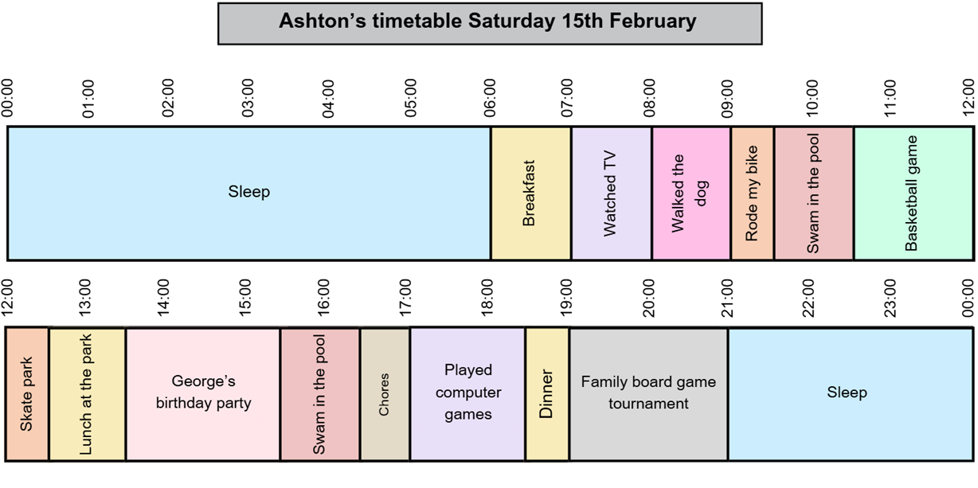
Short response (31)
Between which times was Ashton playing in the family board game tournament?
What was Ashton doing at 4:00 pm?
Notes:
Short response questions provide brisk paced questions focussing on review of current and previous content to support spaced and interleaved practice.
Syllabus focus area:
Non-spatial measure A: Time

Slide 61
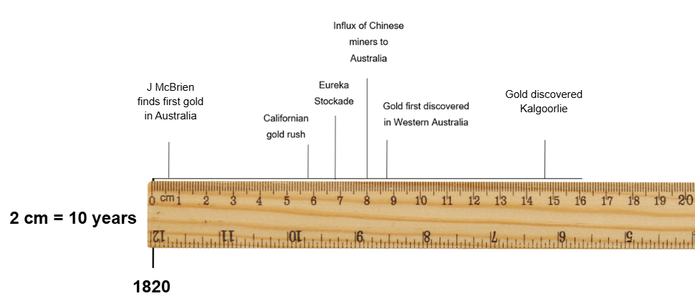
Short response (32)
Use the timeline, scale and ruler to answer:
Which year was there an influx of Chinese miners to Australia?
Notes:
Short response questions provide brisk paced questions focussing on review of current and previous content to support spaced and interleaved practice.
Syllabus focus area:
Data B

Slide 62
Activity 8 – estimating reasonableness of solutions (1)
1438 + 129 = 1567
Notes:
This is a developing number sense activity.
Number sense refers to a deep understanding of numbers, including their magnitude, relationships, and the effects of operations on them. It supports fluency and understanding, estimation, flexible thinking, and efficient problem-solving. Number sense activities 1–4 ‘activate’ prior number knowledge and support the learning of new content in the unit. Number sense activities 5–8 ‘loop’ back and provide opportunity for spaced practice with concepts and procedures covered in previous units.
Syllabus focus area:
Additive relations A
Estimating reasonableness of solutions
1. Ask:
Is the answer reasonable? How do you know?
What would be an unreasonable answer? Why?
2. (next slide) Ask:
Is the answer reasonable? How do you know?
What would be a reasonable answer? Why?
3. In pairs, students write an equation and repeat the process.

Slide 63
Activity 8 – estimating reasonableness of solutions (2)
1895 − 1125 = 1029
Notes:
This is a developing number sense activity.
Number sense refers to a deep understanding of numbers, including their magnitude, relationships, and the effects of operations on them. It supports fluency and understanding, estimation, flexible thinking, and efficient problem-solving. Number sense activities 1–4 ‘activate’ prior number knowledge and support the learning of new content in the unit. Number sense activities 5–8 ‘loop’ back and provide opportunity for spaced practice with concepts and procedures covered in previous units.
Syllabus focus area:
Additive relations A
Estimating reasonableness of solutions
2. Ask:
Is the answer reasonable? How do you know?
What would be a reasonable answer? Why?
3. In pairs, students write an equation and repeat the process.

Slide 64
Double Venn diagram
Object 1
Object 2
Features similar to both objects
Features of object 1
Features of object 2

Slide 65
Frayer
Definition
Facts/Characteristics
Word, term, concept
Examples
Non-examples

Slide 66
Spider map
Idea
Subject

Slide 67
Cline
Concept 1
Concept 2
Word
Word
Word
Word
Word
Word
Word
Word
Word
Word
Word

Slide 68
Compare and contrast

Slide 69
Multiple choice (5)
A
B
C
D

Slide 70
Multiple choice
A
B
C
D
Notes:
This question connects to the content in the developing number sense activity (Activity 3)
Syllabus focus area:
[Focus area A/B]

Slide 71
References (1)
This presentation contains NSW Curriculum and syllabus content. The NSW Curriculum is developed by the NSW Education Standards Authority. This content is prepared by NESA for and on behalf of the Crown in the right of the State of New South Wales. The material is protected by Crown copyright.
Please refer to the NESA Copyright Disclaimer for more information https://educationstandards.nsw.edu.au/wps/portal/nesa/mini-footer/copyright.
NESA holds the only official and up-to-date versions of the NSW Curriculum and syllabus documents. Please visit the NSW Education Standards Authority (NESA) website https://educationstandards.nsw.edu.au/wps/portal/nesa/home and the NSW Curriculum website https://curriculum.nsw.edu.au.
Mathematics K–10 Syllabus © NSW Education Standards Authority (NESA) for and on behalf of the Crown in right of the State of New South Wales, 2022.
National Numeracy Learning Progression © Australian Curriculum, Assessment and Reporting Authority (ACARA) 2010 to present, unless otherwise indicated. This material was downloaded from the Australian Curriculum website (National Numeracy Learning Progression) (accessed 3 March 2026) and was not modified.
Amplify Education (2025) Polygons - Basic, Polypad website, accessed 3 March 2026.
ABS (Australian Bureau of Statistics) (2025) National, state and territory population – latest release, ABS website, accessed 3 March 2026.
Commonwealth of Australia (Geoscience Australia) (2021) Area of Australia - States and Territories, Australian Government Geoscience Australia website, accessed 3 March 2026.
The Council of the City of Sydney (n.d.) Areas of service, City of Sydney website, accessed 3 March 2026.
Google Earth (2025) Google Earth [software], Google Earth website, accessed 3 March 2026.

Slide 72
References (2)
This presentation contains NSW Curriculum and syllabus content. The NSW Curriculum is developed by the NSW Education Standards Authority. This content is prepared by NESA for and on behalf of the Crown in the right of the State of New South Wales. The material is protected by Crown copyright.
Please refer to the NESA Copyright Disclaimer for more information https://educationstandards.nsw.edu.au/wps/portal/nesa/mini-footer/copyright.
NESA holds the only official and up-to-date versions of the NSW Curriculum and syllabus documents. Please visit the NSW Education Standards Authority (NESA) website https://educationstandards.nsw.edu.au/wps/portal/nesa/home and the NSW Curriculum website https://curriculum.nsw.edu.au.
NASA (National Aeronautics and Space Administration) (n.d.) Earth Observatory: Uluru, Central Australia, NASA website, accessed 3 march 2026.
NSW Government, Department of Climate Change, Energy, the Environment and Water (2025) ‘All parks and reserves in New South Wales – 28 October 2025 (National Parks and Wildlife Service)’ [PDF 525 KB], accessed 8 April 2026.
Toy Theater (2026) Geoboard, Toy Theater website, accessed 3 March 2026.
University of Cambridge (n.d.) Can They Be Equal?, NRICH website, accessed 3 March 2026.
Van de Walle J, Karp K, Bay-Williams JM, Brass A, Bentley B, Ferguson S, Goff W, Livy S, Marshman M, Martin D, Pearn C, Prodromou T, Symons D and Wilkie K (2019) Primary and Middle Years Mathematics: Teaching Developmentally, 1st Australian edn, Pearson Education Australia, Melbourne.
WaterNSW (2025) Regional NSW dams: Menindee Lakes, WaterNSW website, accessed 3 March 2026.
Worldometers.info (n.d.) Countries in the world by population (2026), Worldometer website, accessed 3 March 2026.

Slide 73
Copyright
© State of New South Wales (Department of Education), 2025
The copyright material published in this resource is subject to the Copyright Act 1968 (Cth) and is owned by the NSW Department of Education or, where indicated, by a party other than the NSW Department of Education (third-party material).
Copyright material available in this resource and owned by the NSW Department of Education is licensed under a Creative Commons Attribution 4.0 International (CC BY 4.0) license.
This license allows you to share and adapt the material for any purpose, even commercially.
Attribution should be given to © State of New South Wales (Department of Education), 2025.
Material in this resource not available under a Creative Commons license:
the NSW Department of Education logo, other logos and trademark-protected material
Material owned by a third party that has been reproduced with permission. You will need to obtain permission from the third party to reuse its material.
Links to third-party material and websites
Please note that the provided (reading/viewing material/list/links/texts) are a suggestion only and implies no endorsement, by the New South Wales Department of Education, of any author, publisher, or book title. School principals and teachers are best placed to assess the suitability of resources that would complement the curriculum and reflect the needs and interests of their students.
If you use the links provided in this document to access a third party’s website, you acknowledge that the terms of use, including licence terms set out on the third-party’s website apply to the use which may be made of the materials on that third-party website or where permitted by the Copyright Act 1968 (Cth). The department accepts no responsibility for content on third-party websites.

