Slide 1
Instructions for use
This resource is not a teaching and learning program. It should be used in conjunction with Stage 3 Year A Unit 9.
Classroom teachers are encouraged to add and adapt slides as required to meet the needs of their students.
Save a copy of the file to make changes to the slide deck. Go to File > Download a Copy (this downloads a copy to the computer to edit in the PowerPoint app).
To convert the PowerPoint to Google Slides:
  Upload the file into Google Drive and open it.
  Go to File > Save as Google Slides.
  (Note – conversion may cause formatting changes in the slides.)

Slide 2

Review of Learning
Mathematics Stage 3 – Unit 9
Notes:
Reviews may include a combination of question types, requiring students to recall facts and key ideas, as well as apply their knowledge to solve problems and answer questions. To support active engagement, a mix of techniques should be employed.” (AERO, 2024).
This Review of Learning slide deck revisits key concepts from the following units:
Stage 3 Year A Unit 9
Stage 3 Year A Unit 8
Stage 3 Year A Unit 7
It also includes opportunities to review prior learning in non-number content, supporting consolidation across focus areas.
The review of learning resources include three key task types that support the development of mathematical proficiency through retrieval, spaced practice, and active participation. These practices complement the review phase (activating prior knowledge) embedded within the beginning of each lesson.
1.
Multiple-choice questions/True or false: Designed to promote active retrieval of key concepts and identify common misconceptions in number, supporting consolidation, understanding and fluency.
These questions:
support spaced and interleaved practice
help identify and address common misconceptions
support active recall and immediate feedback
support whole class participation
identify areas requiring reteach
2.
Short-response question sets: Carefully grouped questions that encourage spaced and interleaved practice across multiple focus areas, helping students revisit and apply knowledge from different points in time.
These questions:
have a combination of question types
address a range of focus areas
build automaticity and fluency
support active recall
allow for immediate feedback
identify content requiring reteach
3.
Developing number sense activities: A variety of practical, purposeful tasks that reinforce current learning and build on prior knowledge. These activities promote reasoning, problem-solving and conceptual understanding.
The review of learning resources are designed to work support teaching and learning in mathematics. For the most effective implementation, use the resources flexibly, adapting to meet student learning needs and individual classroom contexts.

Slide 3
Lessons
1
Review of learning 1
5
Review of learning 5
2
Review of learning 2
6
Review of learning 6
3
Review of learning 3
7
Review of learning 7
4
Review of learning 4
8
Review of learning 8
Notes:
Teacher notes:
Click lesson titles to go to specific lessons
Interactive features can be viewed in slide show

Slide 4
Review of learning 1

Slide 5

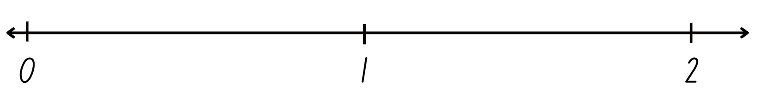
Multiple choice (1)
The decimal 1.429 would be placed on the number line at:
A
B
C
D
A
B
C
D
Notes:
This question connects to the content in the developing number sense activity (Activity 1)
Syllabus focus area:
Represents numbers A

Slide 6

Short response (1)
Sketch a rectangular prism and a rectangular pyramid.
Notes:
Short response questions provide brisk paced questions focussing on review of current and previous content to support spaced and interleaved practice.
Syllabus focus area:
Three-dimensional spatial structure B (stage 2 content)

Slide 7
Short response (2)
Which of these identifies a specific point:
grid-map reference system
or
Cartesian plane coordinate system?
Communicate your reasoning.
Notes:
Short response questions provide brisk paced questions focussing on review of current and previous content to support spaced and interleaved practice.
Syllabus focus area:
Geometric measure A

Slide 8
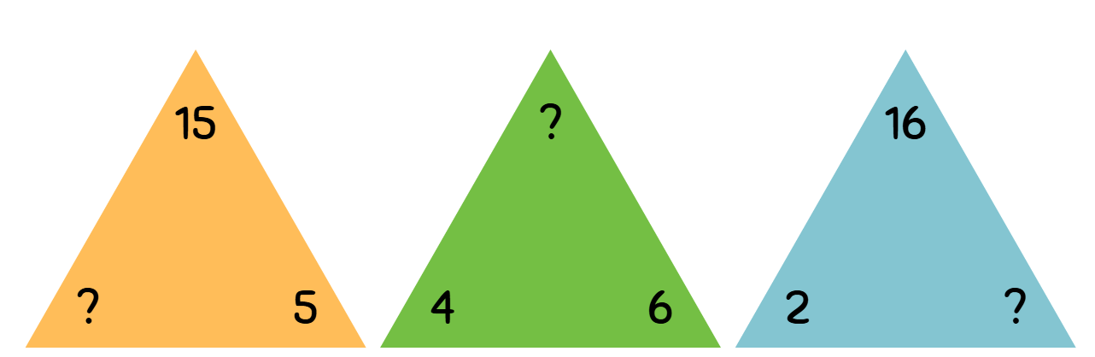
Short response (3)
Write the missing number from each fact family triangle.
Notes:
Short response questions provide brisk paced questions focussing on review of current and previous content to support spaced and interleaved practice.
Syllabus focus area:
Multiplicative relations B (Stage 2 content)

Slide 9
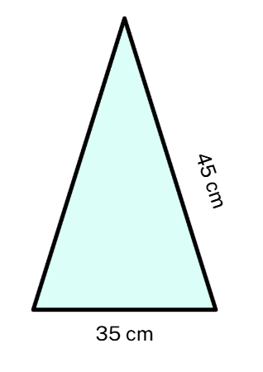
Short response (4)
Calculate the perimeter of the isosceles triangle.
Communicate your reasoning.
Notes:
Short response questions provide brisk paced questions focussing on review of current and previous content to support spaced and interleaved practice.
Syllabus focus area:
Geometric measure A

Slide 10

Activity 1 – decimals on a number line
Say the number aloud and then place the number on the number line.
0
1
2
1.50
1.20
1.99
1.10
0.80
1.80
1.25
0.20
1.494
0.75
1.60
0.125
0.50
0.20
1.55
0.70
0.089
1.70
0.02
0.170
1.075
0.25
0.60
0.909
0.375
1.40
0.025
1.429
1.125
1.75
0.10
1.90
0.90
1.804
1.30
Notes:
This is a developing number sense activity.
Number sense refers to a deep understanding of numbers, including their magnitude, relationships, and the effects of operations on them. It supports fluency and understanding, estimation, flexible thinking, and efficient problem-solving. Number sense activities 1–4 ‘activate’ prior number knowledge and support the learning of new content in the unit. Number sense activities 5–8 ‘loop’ back and provide opportunity for spaced practice with concepts and procedures covered in previous units.
Syllabus focus area:
Represents numbers A
Decimals on a number line
This resource corresponds to Resource 20 – decimal cards in Stage 3 Year A Unit 9.
Note: pre-cut Resource 20 – decimal cards before the start of the lesson. To support place value conceptual understanding, 1.429 would be read as one and four hundred and twenty-nine thousandths. The language connects the decimal fraction with the whole number and makes a connection with common fractions.
Give each student a card from Resource 20 – decimal cards.
Students read their decimal number aloud and then place it on the number line
Students explain their reasoning for placing the card in that position.
Prompt students to use the existing whole numbers and decimals on the number line to help determine where their card should be placed.
Once students have placed numbers, ask:
Are there any numbers that need to have their position adjusted? If yes, explain why.
Which decimals are closest to the whole numbers?
Are there any numbers you have seen represented in more than one way? For example, 0.50 and 0.5
If I have a card with the number 2.25, where would I place it?

Slide 11
Review of learning 2

Slide 12
True or false (1)
A zero can be a placeholder in a decimal number.
True | False
Communicate your reasoning.
Notes:
The question on this slide connects to the content being explored in the developing number sense activity (Activity 2)
Syllabus focus area:
Represents numbers A

Slide 13
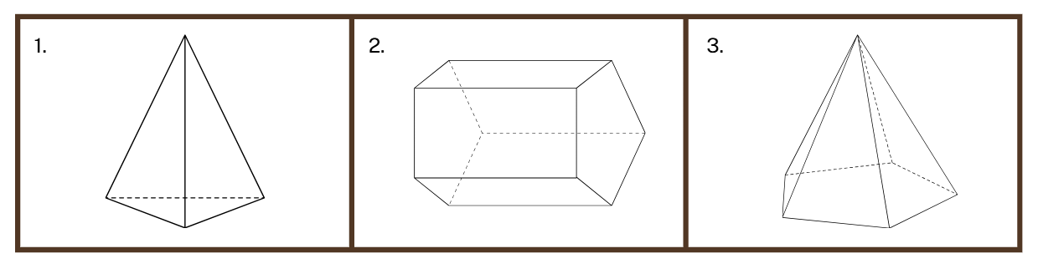
Short response (5)
Name the prisms and pyramids.
Notes:
Short response questions provide brisk paced questions focussing on review of current and previous content to support spaced and interleaved practice.
Syllabus focus area:
Three-dimensional spatial structure A

Slide 14
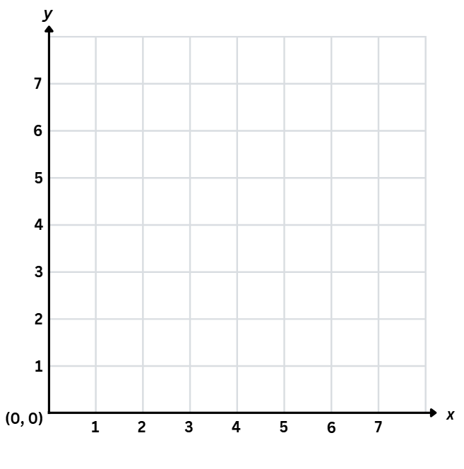






Short response (6)
Record the coordinates of the books plotted on the Cartesian plane.
green
purple
blue
Notes:
Short response questions provide brisk paced questions focussing on review of current and previous content to support spaced and interleaved practice.
Syllabus focus area:
Geometric measure A

Slide 15
Short response (7)
Categorise the following numbers into prime, composite or neither.
0
12
23
3
11
16
1
17
25
Communicate your reasoning.
Notes:
Short response questions provide brisk paced questions focussing on review of current and previous content to support spaced and interleaved practice.
Syllabus focus area:
Multiplicative relations A

Slide 16
Short response (8)
Convert these measurements from metres to kilometres
2600 m
367 m
1008 m
6050 m
Notes:
Short response questions provide brisk paced questions focussing on review of current and previous content to support spaced and interleaved practice.
Syllabus focus area:
Geometric measure B

Slide 17
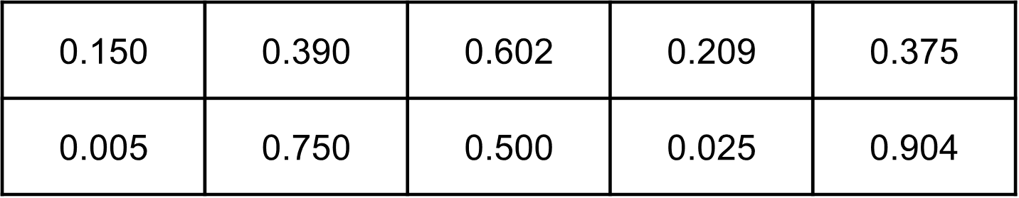
Activity 2 – approximating decimals
Remember we must write a zero in the ones place if the decimal is smaller than 1.
Cut up take turns to select a card, read the decimal aloud and sort the cards from smallest to largest, justifying your decision.
Then decide which zeros matter. For example, the zeros in 0.025 are important, but the zero in 1.590 does not affect the place value if removed
Notes:
This is a developing number sense activity.
Number sense refers to a deep understanding of numbers, including their magnitude, relationships, and the effects of operations on them. It supports fluency and understanding, estimation, flexible thinking, and efficient problem-solving. Number sense activities 1–4 ‘activate’ prior number knowledge and support the learning of new content in the unit. Number sense activities 5–8 ‘loop’ back and provide opportunity for spaced practice with concepts and procedures covered in previous units.
Syllabus focus area:
Represents number A
Approximating decimals
This resource corresponds to Resource 21 – decimals with zeros in Stage 3 Year A Unit 9.
Note: the Stage 3 teaching advice states that the role of zero as a place holder assists in understanding how we say and write decimals. Zero is written in the ones place in a decimal to reduce the risk of misreading the decimal as a whole number. The number 0.2 has the same value as 0.20 and the number 2 has the same value as 2.0. In measurement, zeros at the end of a decimal have a different meaning as they are used to record precision. A measurement recorded as 0.2 seconds is measured in tenths of a second. A measurement recorded as 0.20 seconds is measured in hundredths of a second.
Revise with students the role of zero as a placeholder to support saying and writing decimals. Revise how we must write a zero in the ones place if the decimal is smaller than 1.
Small groups of students cut up Resource 24 – decimals with zeros.
Students take turns to select a card, read the decimal aloud and sort the cards from smallest to largest, justifying decisions. Students decide which zeros matter. For example, the zeros in 0.025 are important, but the zero in 1.590 does not affect the place value if removed.
Note: when reading aloud, the normal convention is to ignore the end zeros. For example, 0.500 is interpreted as 0.5 and read as 5 tenths.
As groups are working, monitor any misconceptions about the role of zeros in decimals.
Once groups have ordered the cards, they compare their card order to another group.
Ask:
Were there any groups that had any cards in a different position? Why do you think that is?
Did your group face any challenges while deciding on the order of cards?
Are all zeros in decimal numbers important? Why or why not?

Slide 18
Review of learning 3

Slide 19
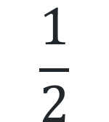
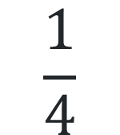
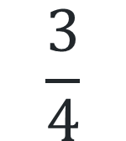
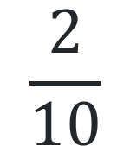
Multiple choice (2)
What is the closest benchmark fraction
to 0.254?
A
B
C
D
$$\frac{1}{2}$$
$$\frac{2}{10}$$
$$\frac{3}{4}$$
$$\frac{1}{4}$$
Notes:
This question connects to the content in the developing number sense activity (Activity 3)
Syllabus focus area:
Represents numbers A

Slide 20
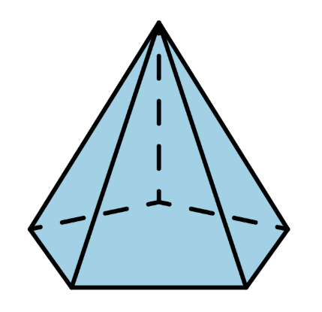
Short response (9)
Sketch the 3D object from the top, front and side views.
Notes:
Short response questions provide brisk paced questions focussing on review of current and previous content to support spaced and interleaved practice.
Syllabus focus area:
Three-dimensional spatial structure A

Slide 21
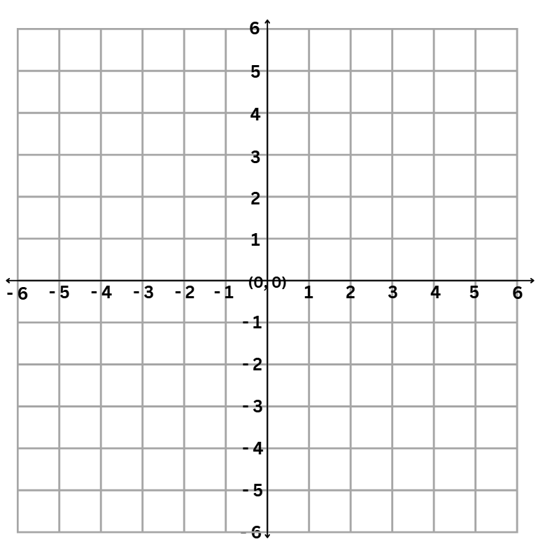
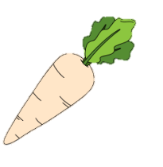
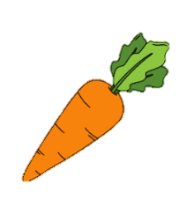
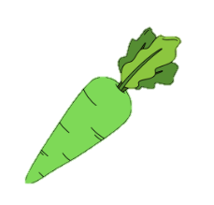
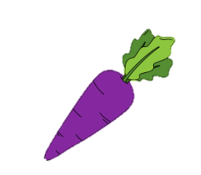
Short response (10)
Record the coordinates of the carrots plotted on the 4 quadrants of the Cartesian plane.
Notes:
Short response questions provide brisk paced questions focussing on review of current and previous content to support spaced and interleaved practice.
Syllabus focus area:
Geometric measure B

Slide 22
Short response (11)
Use place value understanding and mental strategies to multiply by 10 to solve:
7 × 74
Notes:
Short response questions provide brisk paced questions focussing on review of current and previous content to support spaced and interleaved practice.
Syllabus focus area:
Multiplicative relations A

Slide 23
Short response (12)
Convert these measurements from kilometres to metres
2.3 km
0.045 km
10.07 km
Notes:
Short response questions provide brisk paced questions focussing on review of current and previous content to support spaced and interleaved practice.
Syllabus focus area:
Geometric measure B

Slide 24
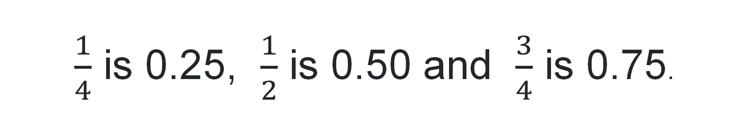
Activity 3 – approximating decimals
$\frac{1}{4}$ is 0.25, $\frac{1}{2}$ is 0.50 and $\frac{3}{4}$ is 0.75.
0.790
0.254
0.551
0.189
What is the closest benchmark fraction?
Notes:
Note: this slide is designed to be viewed in presentation mode.
This is a developing number sense activity.
Number sense refers to a deep understanding of numbers, including their magnitude, relationships, and the effects of operations on them. It supports fluency and understanding, estimation, flexible thinking, and efficient problem-solving. Number sense activities 1–4 ‘activate’ prior number knowledge and support the learning of new content in the unit. Number sense activities 5–8 ‘loop’ back and provide opportunity for spaced practice with concepts and procedures covered in previous units.
Syllabus focus area:
Represents numbers A
Approximating decimals
This resource corresponds to Resource 22 – decimal flash cards in Stage 3 Year A Unit 9.
Approximate: an estimate of a number or an amount to a particular accuracy. For example, to 2 decimal places 1.254 is 1.25.
Revise benchmark fractions as decimal numbers. For example, , $\frac{1}{4}$ is 0.25, $\frac{1}{2}$ is 0.50 and $\frac{3}{4}$ is 0.75.
Explain to students that they will be approximating decimals to the nearest benchmark fraction. 0.254 is approximated to 2 decimal places as 0.25 or $\frac{1}{4}$
Display a decimal card from Resource 22 – decimal flash cards. Ask students what the closest benchmark is. For example, 0.254 is closest to $\frac{1}{4}$ or 0.25.
Provide small groups of students with Resource 22 – decimal flash cards. Students sort cards into 3 groups: close to one-quarter, one-half and three-quarters.
As groups are sorting, monitor and correct any misconceptions about the place value of decimals.

Slide 25
Review of learning 4

Slide 26
True or false (2)
These decimal cards have been ordered from smallest to largest.
0.189
0.198
1.222
0.033
True | False
Notes:
The question on this slide connects to the content being explored in the developing number sense activity (Activity 4)
Syllabus focus area:
Represents numbers A

Slide 27
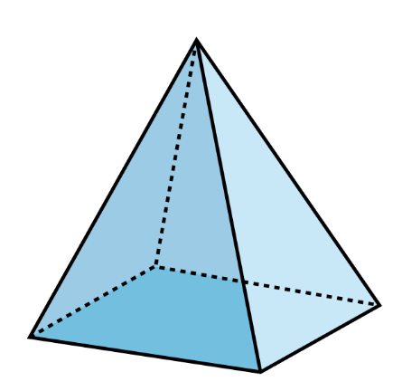
Short response (13)
Sketch the net of the square pyramid.
Notes:
Short response questions provide brisk paced questions focussing on review of current and previous content to support spaced and interleaved practice.
Syllabus focus area:
Three-dimensional spatial structure A

Slide 28
Short response (14)
Record the following coordinates of the point:
marked in the first quadrant.
if it was reflected across the y-axis to create a mirror image in the second quadrant.
if it was reflected across the x-axis into the fourth quadrant.
Notes:
Short response questions provide brisk paced questions focussing on review of current and previous content to support spaced and interleaved practice.
Syllabus focus area:
Geometric measure B

Slide 29
Short response (15)
Use an area model to solve:
56 × 8
Notes:
Short response questions provide brisk paced questions focussing on review of current and previous content to support spaced and interleaved practice.
Syllabus focus area:
Multiplicative relations A

Slide 30
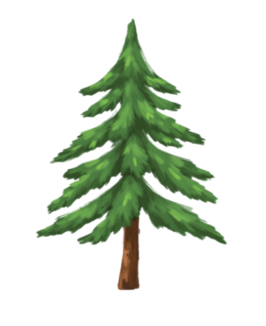

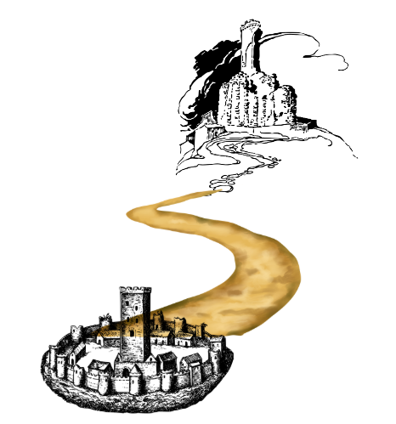
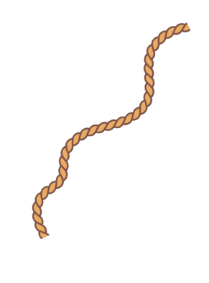
Short response (16)
Use decimal notation to record the lengths in:
metres
c) centimetres
168 mm
375 cm
b) metres
d) kilometres
12 600 m
245 cm
Notes:
Short response questions provide brisk paced questions focussing on review of current and previous content to support spaced and interleaved practice.
Syllabus focus area:
Geometric measure B

Slide 31
Activity 4 – comparing and ordering decimals
Take turns to
select a card
read the decimal aloud
sort the cards from smallest to largest.
0.189
0.254
0.551
0.790
Notes:
This is a developing number sense activity.
Number sense refers to a deep understanding of numbers, including their magnitude, relationships, and the effects of operations on them. It supports fluency and understanding, estimation, flexible thinking, and efficient problem-solving. Number sense activities 1–4 ‘activate’ prior number knowledge and support the learning of new content in the unit. Number sense activities 5–8 ‘loop’ back and provide opportunity for spaced practice with concepts and procedures covered in previous units.
Syllabus focus area:
Represents numbers A
Comparing and ordering decimals
This resource corresponds to Resource 22 – decimal flash cards in Stage 3 Year A Unit 9.
Provide small groups of students with Resource 22 – decimal flash cards.
Students take turns to select a card, read the decimal aloud and sort the cards from smallest to largest.
As groups are ordering, monitor and correct any misconceptions about the place value of decimals.
Once groups have ordered the cards, they compare their card order to another group.
Ask:
— How did you decide which number was the largest and/or smallest?
— How is ordering decimals similar to ordering whole numbers?
— Which digit was most important when comparing these numbers?
— When did you need to compare the digit in the hundredths or thousandths place?
— Were any cards challenging to compare? Why?

Slide 32
Review of learning 5

Slide 33
Multiple choice (3)
5 + 0.4 + 0.02 + 0.009 =
A
B
C
D
5 .429
5 .492
5 .942
5 .924
Notes:
This question connects to the content in the developing number sense activity (Activity 5)
Syllabus focus area:
Represents numbers A

Slide 34
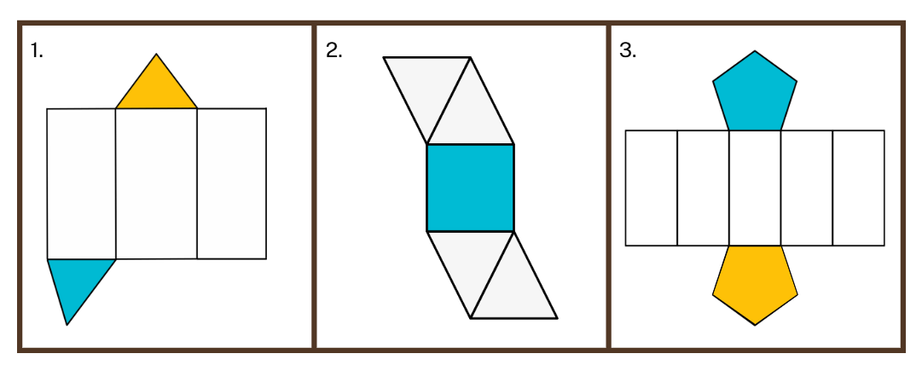
Short response (17)
Visualise folding these nets.
Name the 3D objects they would make.
Notes:
Short response questions provide brisk paced questions focussing on review of current and previous content to support spaced and interleaved practice.
Syllabus focus area:
Three-dimensional spatial structure A

Slide 35
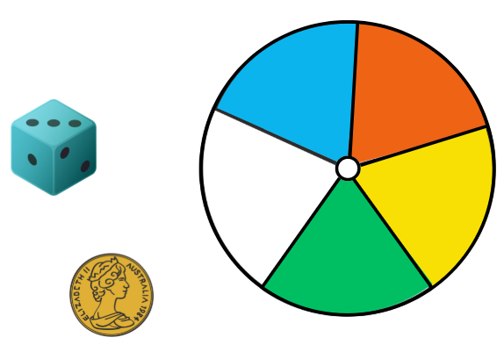
Short response (18)
Using numerical values, record the probability of:
tossing heads
rolling a 3
spinning orange.
Notes:
Short response questions provide brisk paced questions focussing on review of current and previous content to support spaced and interleaved practice.
Syllabus focus area:
Chance A

Slide 36
Short response (19)
Partition the dividend (72) into smaller multiples of the divisor (4) and then use an area model to solve:
72 ÷ 4
Notes:
Short response questions provide brisk paced questions focussing on review of current and previous content to support spaced and interleaved practice.
Syllabus focus area:
Multiplicative relations A

Slide 37
Short response (20)
Read the following 24-hour times aloud:
1800 hours
1630 hours
0630 hours
Notes:
Short response questions provide brisk paced questions focussing on review of current and previous content to support spaced and interleaved practice.
Syllabus focus area:
Non-spatial measure A

Slide 38
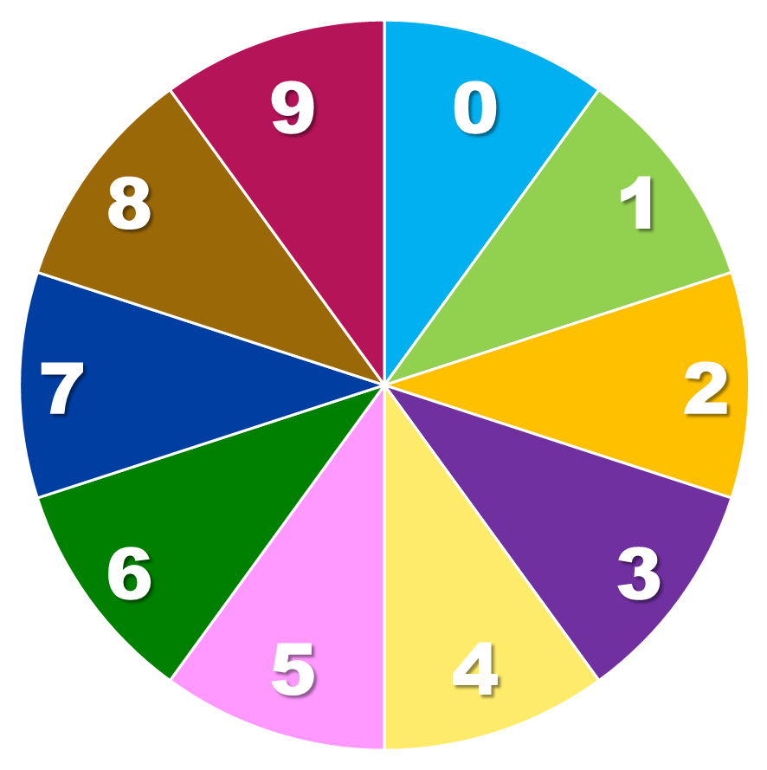
Activity 5 – thousandths as decimals
Spin!
ones
tenths
hundredths
thousandths
.
Notes:
Note: This slide is designed to be viewed in presentation mode.​ Click on the ‘Spin’ button to make the spinner spin. Click again on the ‘Spin’ button to make it stop.
This is a developing number sense activity.
Number sense refers to a deep understanding of numbers, including their magnitude, relationships, and the effects of operations on them. It supports fluency and understanding, estimation, flexible thinking, and efficient problem-solving. Number sense activities 1–4 ‘activate’ prior number knowledge and support the learning of new content in the unit. Number sense activities 5–8 ‘loop’ back and provide opportunity for spaced practice with concepts and procedures covered in previous units.
Syllabus focus area:
Represents numbers A
Thousandths as decimals
This figure corresponds to Figure 11 – whiteboard recording and Figure 12 – student non-standard partitioning sample in Stage 3 Year A Unit 9.
On the whiteboard, draw a place value chart, showing the decimal point and 3 decimal places (see Figure 11).
Spin a 0–9 spinner (or roll a 9-sided dice) 4 times and record a decimal on the board (see Figure 11).
Identify the place value parts and read the decimal number aloud to demonstrate place value understanding. For example, 5.429 is 5 ones, 4 tenths, 2 hundredths and 9 thousandths. However, it is read as 5 and 429 thousandths (see Figure 11).
Provide pairs with a 0–9 spinner (or 9-sided dice). Students take turns to repeat Steps 1–3 on whiteboards. Partners provide feedback on whether the decimal has been read correctly according to its place value.
As a class, spin (or roll) another number. Challenge students to consider non-standard place value partitioning:
If you cannot have a whole number, how many thousandths would you have? For example, 7.264 could be recorded in a non-standard place value form as 7264 thousandths.
If you cannot have tenths, how could you say this number? 7 wholes, 26 hundredths and 4 thousandths.
If you cannot have hundredths, how could you say this number? 7 wholes, 2 tenths and 64 thousandths.
Students take turns to repeat Step 5 on whiteboards. Partners state the whole number or decimal place that cannot be used.
Students record the non-standard partitioning. (see Figure 12)

Slide 39
Review of learning 6

Slide 40
True or false (3)
One and five hundred and sixty-one thousandths written as a decimal is 1.561.
True | False
Notes:
The question on this slide connects to the content being explored in the developing number sense activity (Activity 6)
Syllabus focus area:
Represents numbers A

Slide 41
Short response (21)
Convert the millilitres to litres and the litres to millilitres:
125 mL
2.03L
6 mL
Notes:
Short response questions provide brisk paced questions focussing on review of current and previous content to support spaced and interleaved practice.
Syllabus focus area:
Three-dimensional spatial structure A

Slide 42
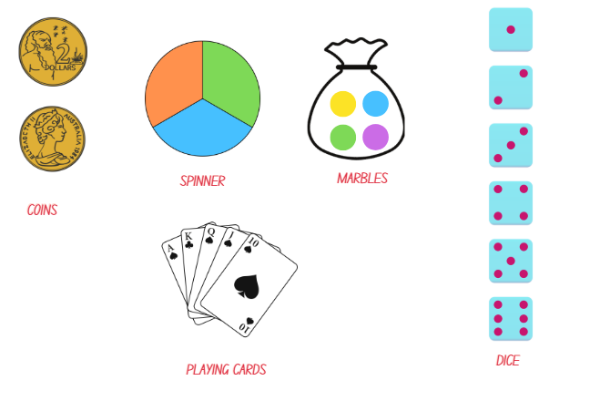
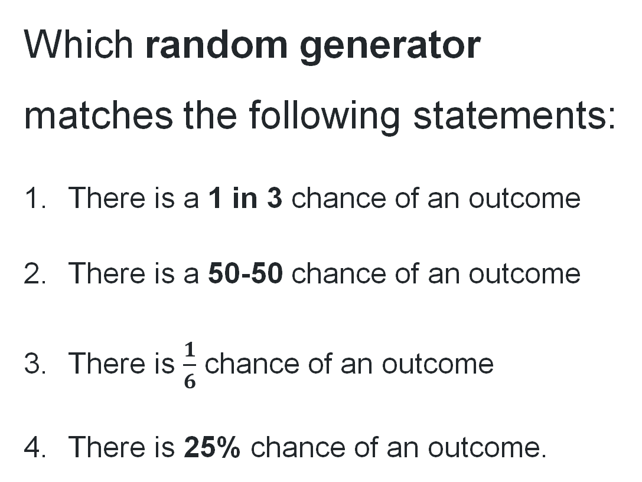
Short response (22)
Which random generator matches the following statements:
There is a 1 in 3 chance of an outcome
There is a 50-50 chance of an outcome
There is $\frac{1}{6}$ chance of an outcome
There is 25% chance of an outcome.
Notes:
Short response questions provide brisk paced questions focussing on review of current and previous content to support spaced and interleaved practice.
Syllabus focus area:
Chance A

Slide 43
Short response (23)
Use the distributive property to solve:
382 x 3
Notes:
Short response questions provide brisk paced questions focussing on review of current and previous content to support spaced and interleaved practice.
Syllabus focus area:
Multiplicative relations A

Slide 44
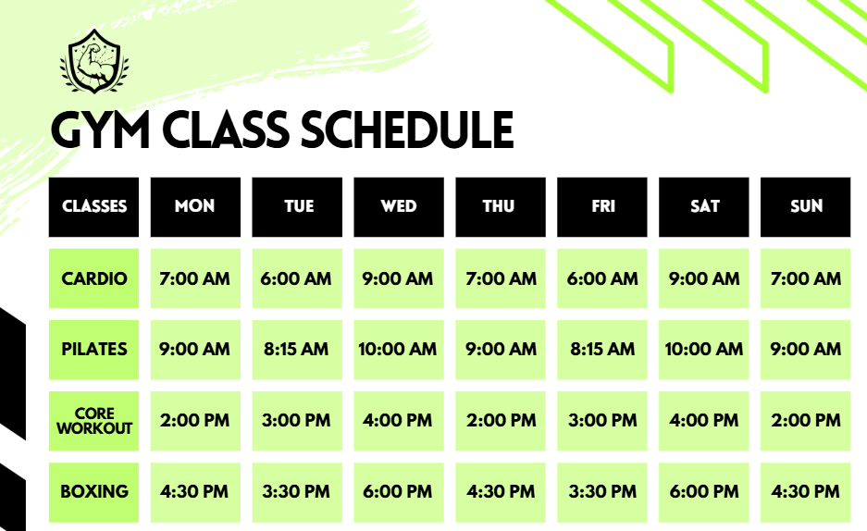
Short response (24)
Which class is scheduled on Monday, Thursday and Sunday at 7:00 am?
What time is boxing on Wednesdays?
What time do you think the gym closes on Wednesdays and Saturdays? Explain why.
Notes:
Short response questions provide brisk paced questions focussing on review of current and previous content to support spaced and interleaved practice.
Syllabus focus area:
Non-spatial measure A

Slide 45
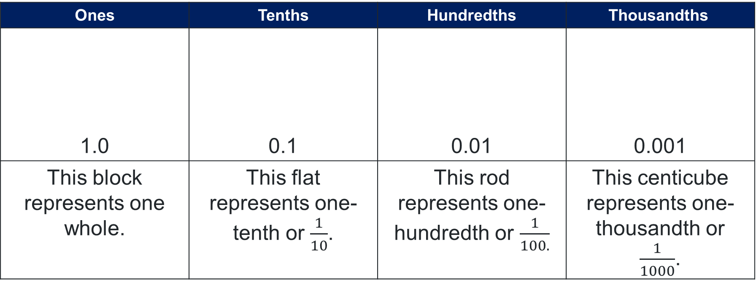
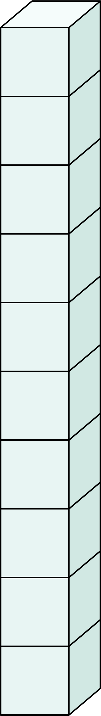
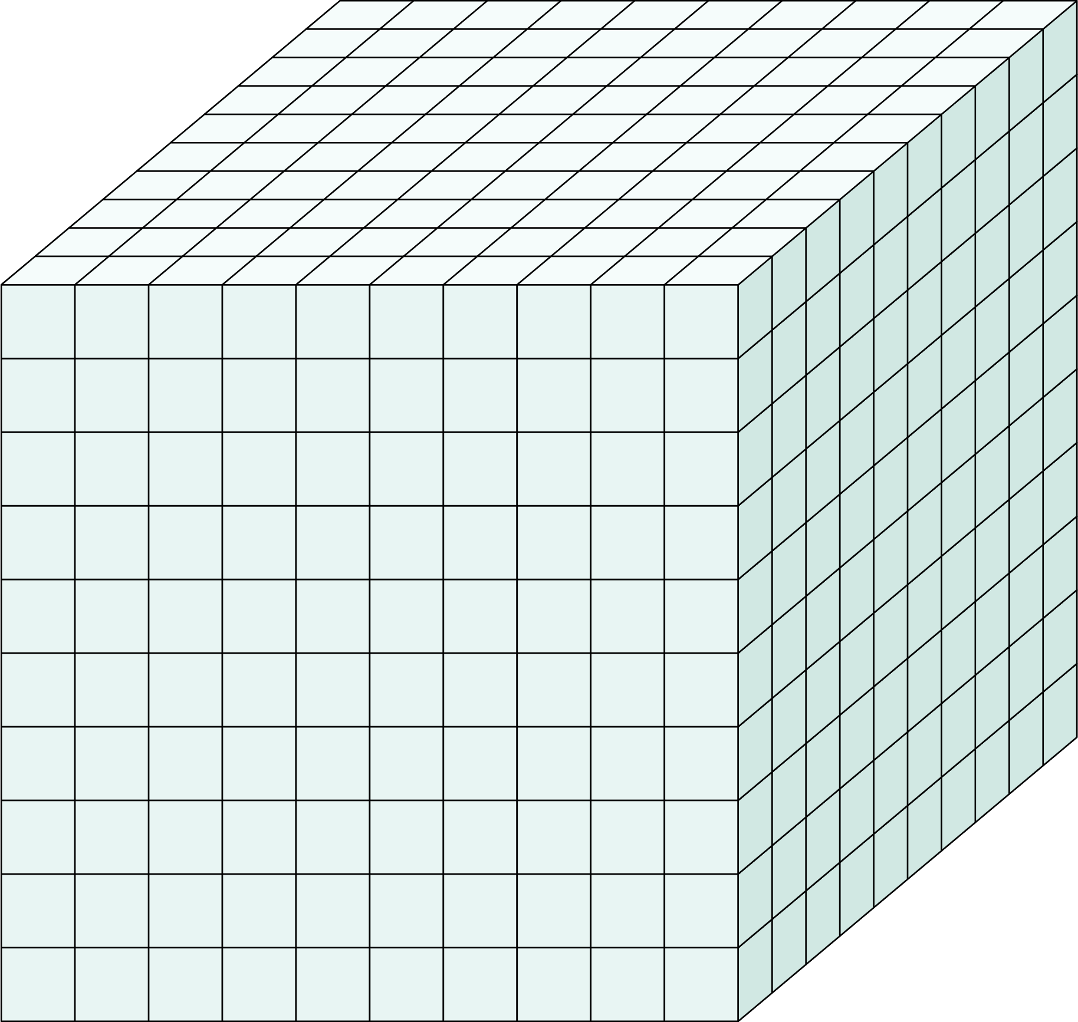
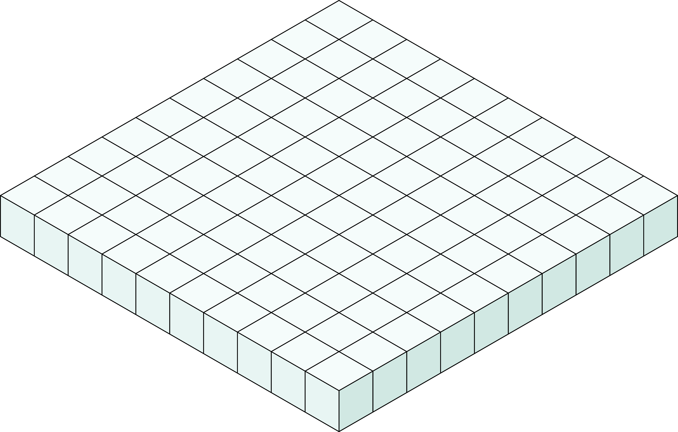
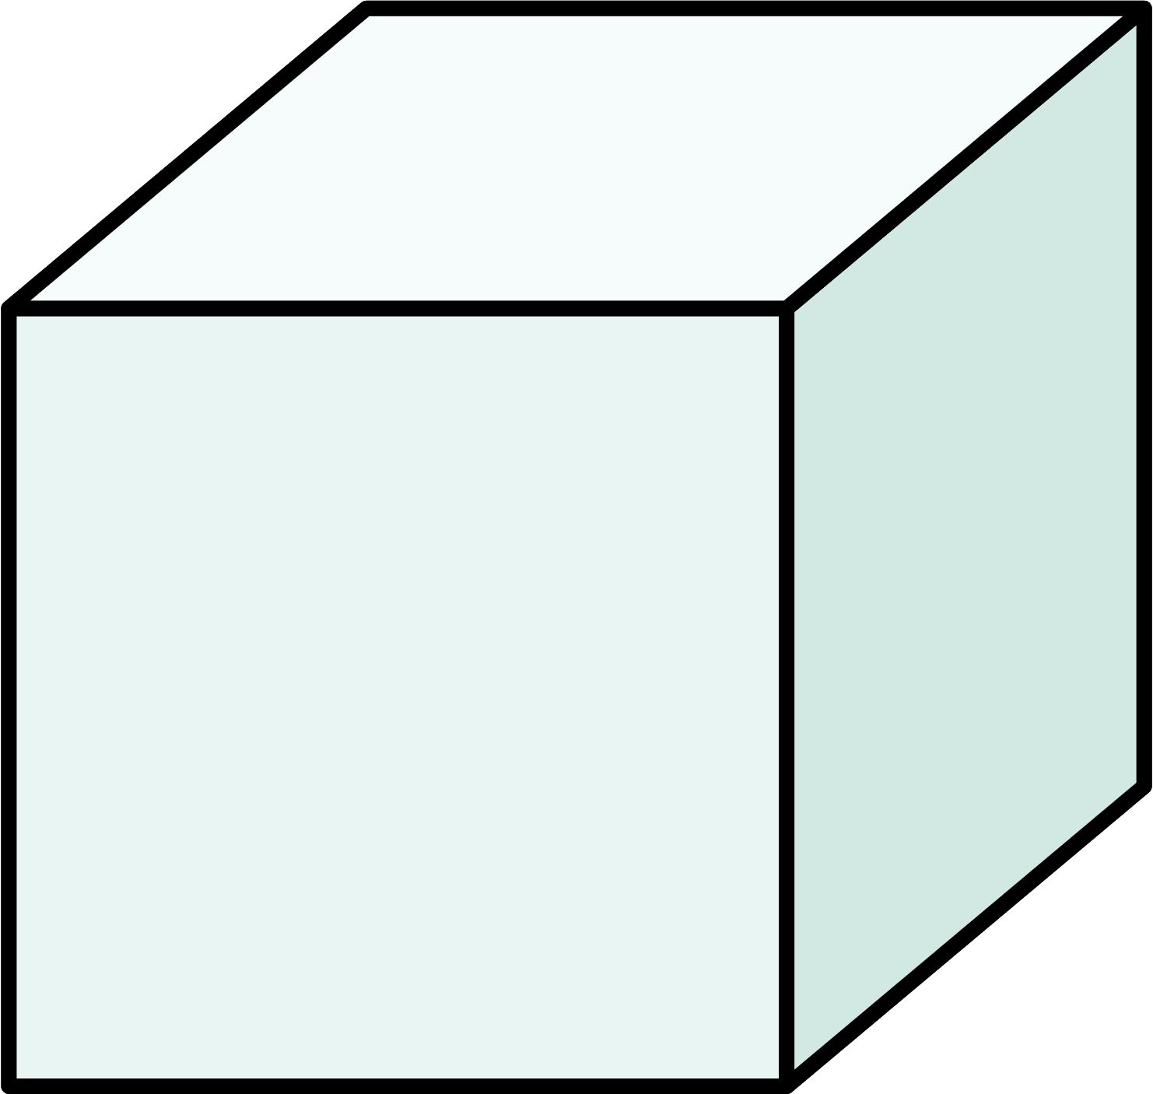
Activity 6 – decimals with MAB materials
Notes:
This is a developing number sense activity.
Number sense refers to a deep understanding of numbers, including their magnitude, relationships, and the effects of operations on them. It supports fluency and understanding, estimation, flexible thinking, and efficient problem-solving. Number sense activities 1–4 ‘activate’ prior number knowledge and support the learning of new content in the unit. Number sense activities 5–8 ‘loop’ back and provide opportunity for spaced practice with concepts and procedures covered in previous units.
Syllabus focus area:
Represents numbers A
Decimals with MAB materials
This figure corresponds to Figure 13 – MAB representing decimals in Stage 3 Year A Unit 9.
This activity is an adaptation of ‘Identifies, represents and compares decimals’ from the Universal Resources Hub.
Show students a collection of MAB materials and explain that, as per Figure 13:
— the block represents one whole
— the flat represents one tenth
— the long represents one hundredth
— the one represents one thousandth.
Note: students who have previously only used MAB materials for whole numbers may require support to adjust their thinking.
Write the following decimal numbers on the board and instruct students to represent them using MAB materials:
— 1.594
— 2.637
— 0.186
— 3.045
— 2.108
— 1.770.
Ask:
— How many whole numbers are there?
— How many tenths?
— How many hundredths?
— How many thousandths?
— What was the role of zero?

Slide 46
Activity 8 – decimals with MAB materials (2) (2)
Read the number aloud and represent it using MAB materials
1.594
Notes:
Note: This slide is designed to be interactive. Drag the MAB blocks to make the decimal.
Ask:
— How many whole numbers are there?
— How many tenths?
— How many hundredths?
— How many thousandths?
— What was the role of zero?

Slide 47
Activity 8 – decimals with MAB materials (3) (3)
Read the number aloud and represent it using MAB materials
2.637
Notes:
Note: This slide is designed to be interactive. Drag the MAB blocks to make the decimal.
Ask:
— How many whole numbers are there?
— How many tenths?
— How many hundredths?
— How many thousandths?
— What was the role of zero?

Slide 48
Activity 8 – decimals with MAB materials (4) (4)
Read the number aloud and represent it using MAB materials
0.186
Notes:
Note: This slide is designed to be interactive. Drag the MAB blocks to make the decimal.
Ask:
— How many whole numbers are there?
— How many tenths?
— How many hundredths?
— How many thousandths?
— What was the role of zero?

Slide 49
Activity 8 – decimals with MAB materials (5)(5)
Read the number aloud and represent it using MAB materials
3.045
Notes:
Note: This slide is designed to be interactive. Drag the MAB blocks to make the decimal.
Ask:
— How many whole numbers are there?
— How many tenths?
— How many hundredths?
— How many thousandths?
— What was the role of zero?

Slide 50
Activity 8 – decimals with MAB materials (6) (6)
2.108
Read the number aloud and represent it using MAB materials
Notes:
Note: This slide is designed to be interactive. Drag the MAB blocks to make the decimal.
Ask:
— How many whole numbers are there?
— How many tenths?
— How many hundredths?
— How many thousandths?
— What was the role of zero?

Slide 51
Activity 8 – decimals with MAB materials (7)(7)
1.770
Read the number aloud and represent it using MAB materials
Notes:
Note: This slide is designed to be interactive. Drag the MAB blocks to make the decimal.
Ask:
— How many whole numbers are there?
— How many tenths?
— How many hundredths?
— How many thousandths?
— What was the role of zero?

Slide 52
Review of learning 7

Slide 53
Multiple choice (4)
1600 mm converted to metres is:
A
B
C
D
16 m
1.6 m
160 m
0.16 m
Notes:
This question connects to the content in the developing number sense activity (Activity 7)
Syllabus focus area:
Represents numbers A

Slide 54
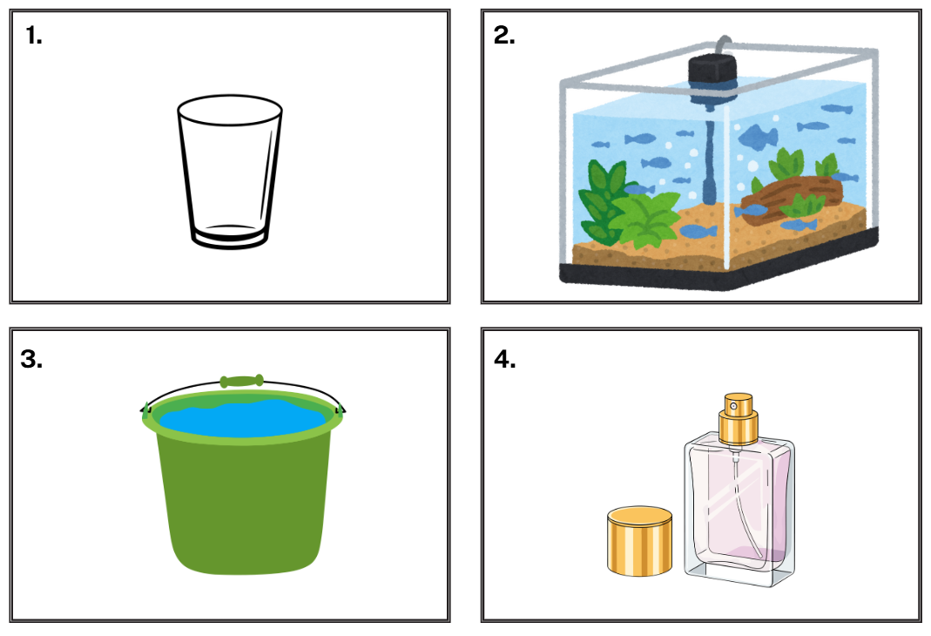
Short response (25)
Which formal unit of measurement would be appropriate to measure the capacity of these containers?
Notes:
Short response questions provide brisk paced questions focussing on review of current and previous content to support spaced and interleaved practice.
Syllabus focus area:
Three-dimensional spatial structure A

Slide 55
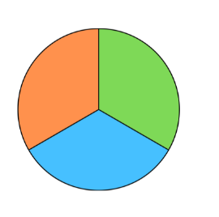
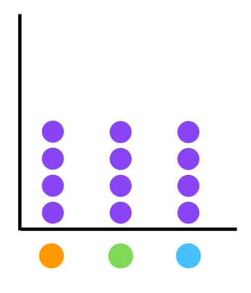
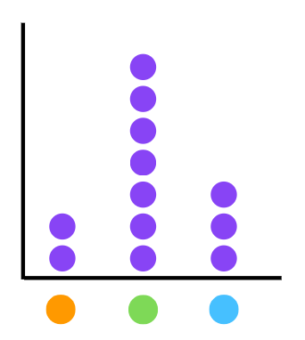
Short response (26)
This dot plot that shows the expected frequency of this spinner if there were 12 trials.
This dot plot shows the observed frequency graph. Explain why the observed frequency is different to the expected frequency.
Notes:
Note: this slide is designed to be viewed in presentation mode.
Short response questions provide brisk paced questions focussing on review of current and previous content to support spaced and interleaved practice.
Syllabus focus area:
Chance B

Slide 56
Short response (27)
Solve:
746 x
5
Communicate your strategy.
Notes:
Short response questions provide brisk paced questions focussing on review of current and previous content to support spaced and interleaved practice.
Syllabus focus area:
Multiplicative relations A

Slide 57
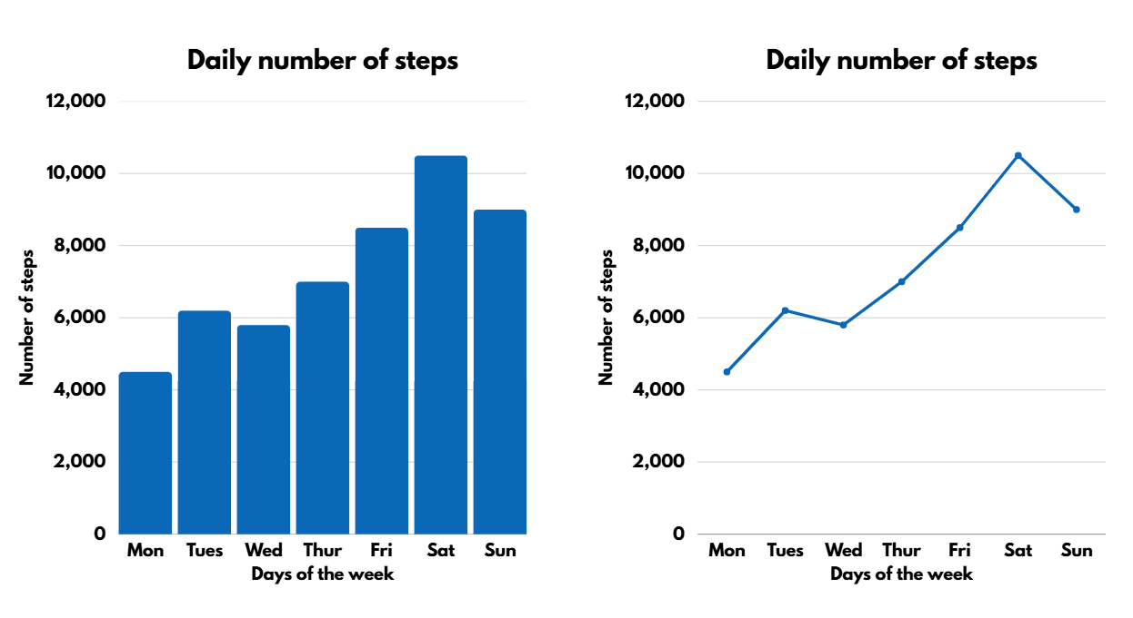
Short response (28)
Which graph is more appropriate to display this type of data?
Communicate your reasoning.
Notes:
Short response questions provide brisk paced questions focussing on review of current and previous content to support spaced and interleaved practice.
Syllabus focus area:
Data A

Slide 58
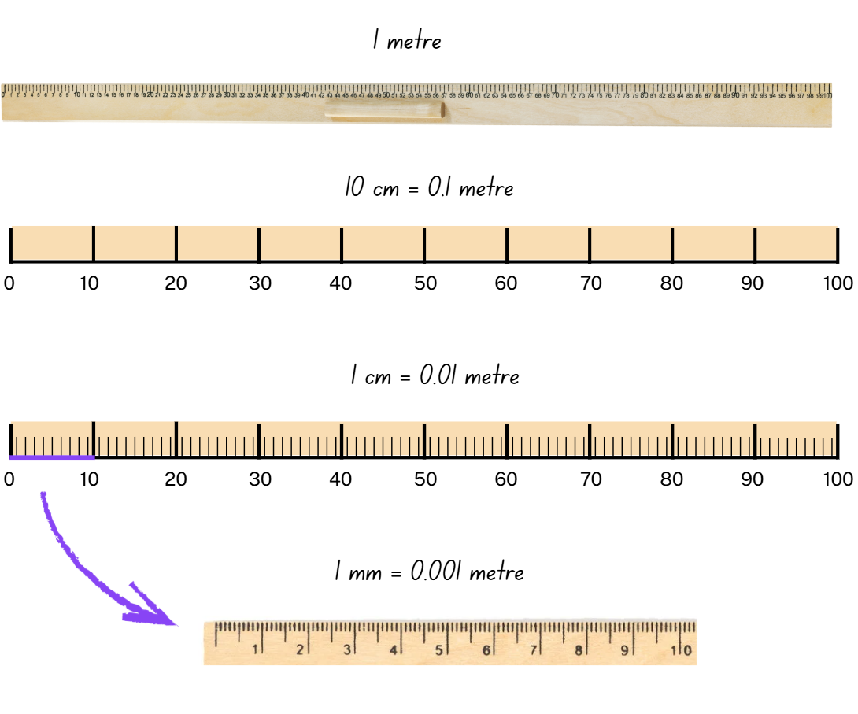
Activity 7 – decimal notation in measurement (1)
Notes:
This is a developing number sense activity.
Number sense refers to a deep understanding of numbers, including their magnitude, relationships, and the effects of operations on them. It supports fluency and understanding, estimation, flexible thinking, and efficient problem-solving. Number sense activities 1–4 ‘activate’ prior number knowledge and support the learning of new content in the unit. Number sense activities 5–8 ‘loop’ back and provide opportunity for spaced practice with concepts and procedures covered in previous units.
Syllabus focus area:
Represents numbers A
Activity title
This resource corresponds to Resource 23 – metre ruler in Stage 3 Year A Unit 9.
Display a metre ruler and Resource 23 – metre ruler. Highlight the millimetre markings on the metre ruler.
Revise with students that there are 10 mm in one centimetre and 1000 millimetres in one metre. Explain that 1 mm is equal to 0.001 m, 10 mm is equal to 0.01 m (one centimetre) and 100 mm is equal to 0.1 m (10 centimetres).
Write 301 mm on the board.
Revise with students that because there are 1000 millimetres in one metre 301 mm is equivalent to 0.301 m. Explain that we read 0.301 m as 301 thousandths of a metre.
Note: some students may benefit from the use of a number slider to convert between millimetres and metres.
Give students writing materials and a ruler. Students measure items around the room and record the millimetre measurement. Then they record the equivalent measurement in metres (see next slide).
Ask:
— How does your knowledge of decimal place value help you convert millimetres to metres?
— What patterns do you notice when converting millimetres to metres?
— What were the smallest and largest decimal notations you recorded? What were the items?

Slide 59
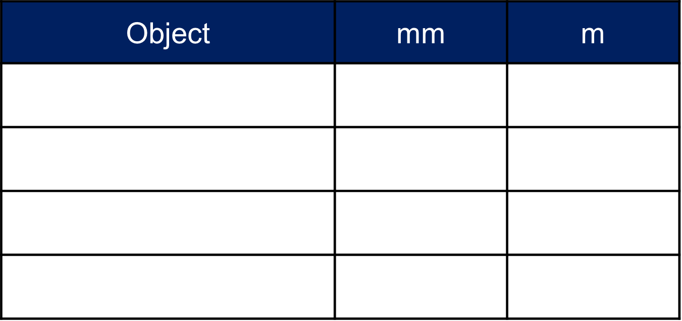
Activity 7 – decimal notation in measurement (2)
Use your ruler to measure items around the room and record the millimetre measurement. Then the equivalent measurement in metres.
Notes:
This is a developing number sense activity.
Number sense refers to a deep understanding of numbers, including their magnitude, relationships, and the effects of operations on them. It supports fluency and understanding, estimation, flexible thinking, and efficient problem-solving. Number sense activities 1–4 ‘activate’ prior number knowledge and support the learning of new content in the unit. Number sense activities 5–8 ‘loop’ back and provide opportunity for spaced practice with concepts and procedures covered in previous units.
Syllabus focus area:
Represents numbers A
Activity title
This table corresponds to Table 2 – student recording in Stage 3 Year A Unit 9.
Display a metre ruler and Resource 23 – metre ruler. Highlight the millimetre markings on the metre ruler.
Revise with students that there are 10 mm in one centimetre and 1000 millimetres in one metre. Explain that 1 mm is equal to 0.001 m, 10 mm is equal to 0.01 m (one centimetre) and 100 mm is equal to 0.1 m (10 centimetres).
Write 301 mm on the board.
Revise with students that because there are 1000 millimetres in one metre 301 mm is equivalent to 0.301 m. Explain that we read 0.301 m as 301 thousandths of a metre.
Note: some students may benefit from the use of a number slider to convert between millimetres and metres.
Give students writing materials and a ruler. Students measure items around the room and record the millimetre measurement. Then they record the equivalent measurement in metres.
Ask:
— How does your knowledge of decimal place value help you convert millimetres to metres?
— What patterns do you notice when converting millimetres to metres?
— What were the smallest and largest decimal notations you recorded? What were the items?

Slide 60
Review of learning 8

Slide 61
True or false (4)
0.506 is greater than 0.56.
True | False
Communicate your reasoning.
Notes:
The question on this slide connects to the content being explored in the developing number sense activity (Activity 8)
Syllabus focus area:
Represents numbers A

Slide 62
Short response (29)
Order these capacities from smallest to largest.
3.05 L
3075 mL
3.2 L
2990 mL
3.125 L
Notes:
Short response questions provide brisk paced questions focussing on review of current and previous content to support spaced and interleaved practice.
Syllabus focus area:
Three-dimensional spatial structure A

Slide 63
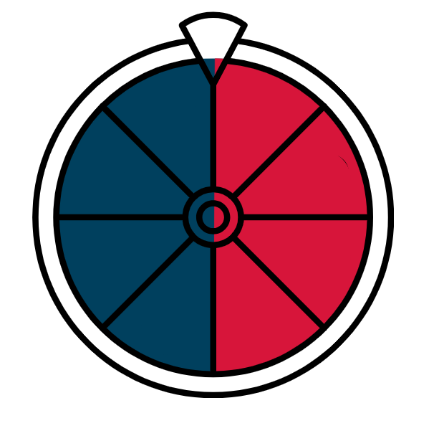
Short response (30)
How would you change this spinner so that there is a 1 in 4 chance of landing on red?
Notes:
Short response questions provide brisk paced questions focussing on review of current and previous content to support spaced and interleaved practice.
Syllabus focus area:
Chance A

Slide 64
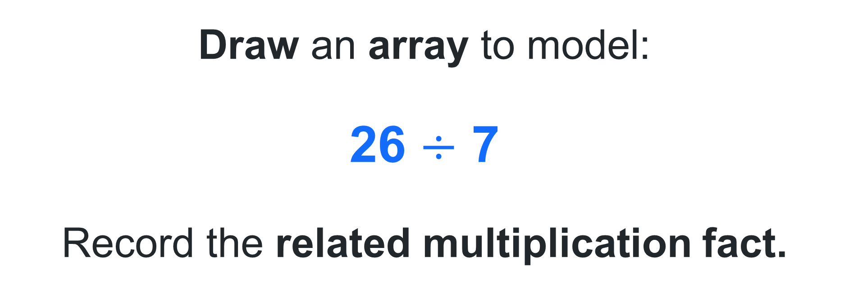
Short response (31)
Draw an array to model:
26 $÷$ 7
Record the related multiplication fact.
Notes:
Short response questions provide brisk paced questions focussing on review of current and previous content to support spaced and interleaved practice.
Syllabus focus area:
Multiplicative relations A

Slide 65
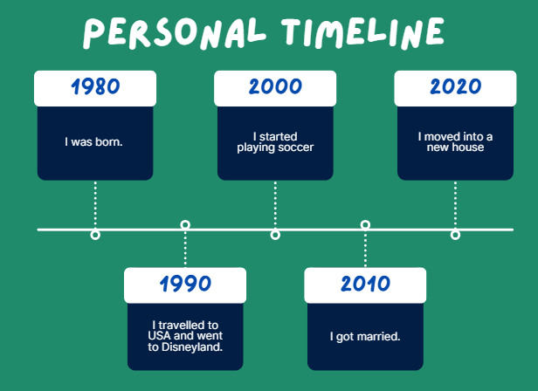
Short response (32)
How many years are between the intervals on the timeline?
What year did I start playing soccer? How old was I?
What year would be next on the timeline?
Notes:
Short response questions provide brisk paced questions focussing on review of current and previous content to support spaced and interleaved practice.
Syllabus focus area:
Data B

Slide 66
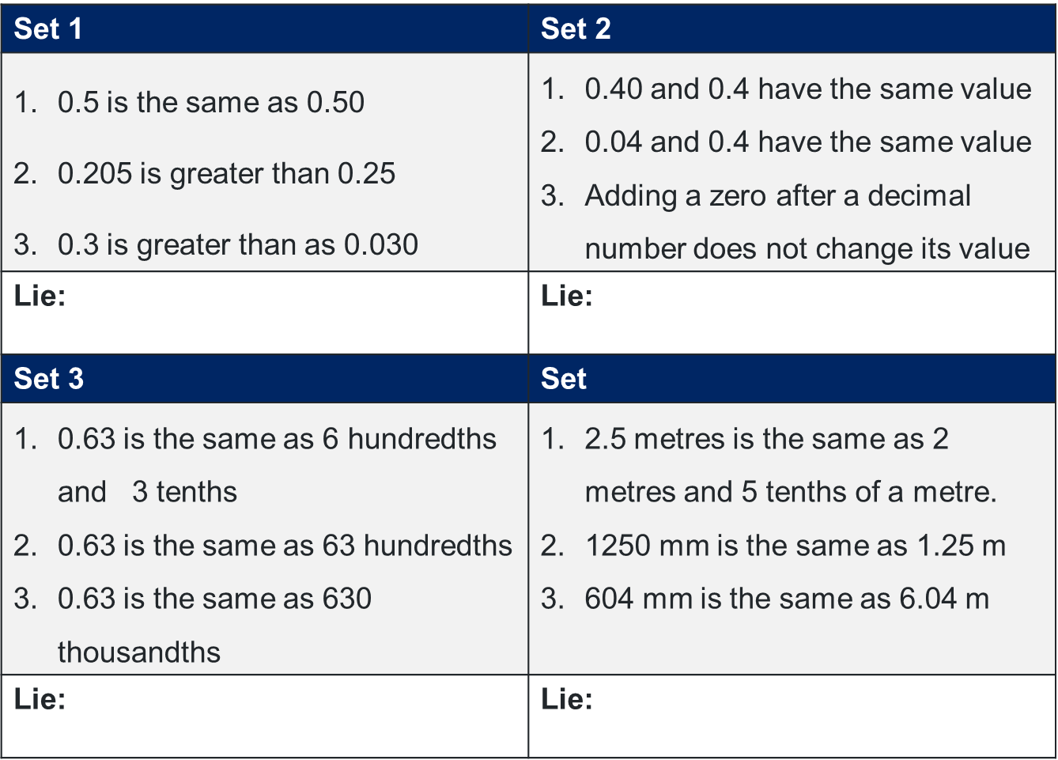
Activity 8 – decimals in the place value system
Notes:
This is a developing number sense activity.
Number sense refers to a deep understanding of numbers, including their magnitude, relationships, and the effects of operations on them. It supports fluency and understanding, estimation, flexible thinking, and efficient problem-solving. Number sense activities 1–4 ‘activate’ prior number knowledge and support the learning of new content in the unit. Number sense activities 5–8 ‘loop’ back and provide opportunity for spaced practice with concepts and procedures covered in previous units.
Syllabus focus area:
Represents numbers A
Decimals in the place value system
This resource corresponds to Resource 24 – 2 truths 1 lie in Stage 3 Year A Unit 9.
This activity is an adaptation of ‘2 truths 1 lie’ from Thinking mathematically resources by the State of New South Wales (Department of Education).
Display and provide students with Resource 24 – 2 truths 1 lie.
Instruct students to work in pairs to determine whether statements are true or false.
Students select and record the lie in the table on Resource 24 – 2 truths 1 lie, justifying their decisions by providing reasons for their choice.
Select pairs to share their ideas and justification with the class.

Slide 67
Double Venn diagram
Object 1
Object 2
Features similar to both objects
Features of object 1
Features of object 2

Slide 68
Frayer
Definition
Facts/Characteristics
Word, term, concept
Examples
Non-examples

Slide 69
Spider map
Idea
Subject

Slide 70
Cline
Concept 1
Concept 2
Word
Word
Word
Word
Word
Word
Word
Word
Word
Word
Word

Slide 71

Compare and contrast

Slide 72
Multiple choice (5)
A
B
C
D

Slide 73
Multiple choice
A
B
C
D
Notes:
This question connects to the content in the developing number sense activity (Activity 3)
Syllabus focus area:
[Focus area A/B]

Slide 74
References
This presentation contains NSW Curriculum and syllabus content. The NSW Curriculum is developed by the NSW Education Standards Authority. This content is prepared by NESA for and on behalf of the Crown in the right of the State of New South Wales. The material is protected by Crown copyright.
Please refer to the NESA Copyright Disclaimer for more information https://educationstandards.nsw.edu.au/wps/portal/nesa/mini-footer/copyright.
NESA holds the only official and up-to-date versions of the NSW Curriculum and syllabus documents. Please visit the NSW Education Standards Authority (NESA) website https://educationstandards.nsw.edu.au/wps/portal/nesa/home and the NSW Curriculum website https://curriculum.nsw.edu.au.
[Subject] [Year–Year] © Syllabus NSW Education Standards Authority (NESA) for and on behalf of the Crown in right of the State of New South Wales, [Year of publication].
[Insert references consulted to produce the presentation being developed.]
[Include any other full attributions here.]

Slide 75
Copyright
© State of New South Wales (Department of Education), 2025
The copyright material published in this resource is subject to the Copyright Act 1968 (Cth) and is owned by the NSW Department of Education or, where indicated, by a party other than the NSW Department of Education (third-party material).
Copyright material available in this resource and owned by the NSW Department of Education is licensed under a Creative Commons Attribution 4.0 International (CC BY 4.0) license.
This license allows you to share and adapt the material for any purpose, even commercially.
Attribution should be given to © State of New South Wales (Department of Education), 2025.
Material in this resource not available under a Creative Commons license:
the NSW Department of Education logo, other logos and trademark-protected material
Material owned by a third party that has been reproduced with permission. You will need to obtain permission from the third party to reuse its material.
Links to third-party material and websites
Please note that the provided (reading/viewing material/list/links/texts) are a suggestion only and implies no endorsement, by the New South Wales Department of Education, of any author, publisher, or book title. School principals and teachers are best placed to assess the suitability of resources that would complement the curriculum and reflect the needs and interests of their students.
If you use the links provided in this document to access a third party’s website, you acknowledge that the terms of use, including licence terms set out on the third-party’s website apply to the use which may be made of the materials on that third-party website or where permitted by the Copyright Act 1968 (Cth). The department accepts no responsibility for content on third-party websites.

