Slide 1
Instructions for use
This resource aligns to the learning in Stage 3 Year B Unit 13 and revisits content from earlier sample units.
Classroom teachers are encouraged to add and adapt slides as required to meet the needs of their students.
Save a copy of the file to make changes to the slide deck. Go to File > Download a Copy (this downloads a copy to the computer to edit in the PowerPoint app).
To convert the PowerPoint to Google Slides:
  Upload the file into Google Drive and open it.
  Go to File > Save as Google Slides.
  (Note – conversion may cause formatting changes in the slides.)

Slide 2

Review of Learning
Mathematics Stage 3 – Unit 13
Notes:
Reviews may include a combination of question types, requiring students to recall facts and key ideas, as well as apply their knowledge to solve problems and answer questions. To support active engagement, a mix of techniques should be employed.” (AERO, 2024).
This Review of Learning slide deck revisits key concepts from the following units:
Stage 3 Year A Unit 13
Stage 3 Year A Unit 12
Stage 3 Year A Unit 11
It also includes opportunities to review prior learning in non-number content, supporting consolidation across focus areas.
The review of learning resources include three key task types that support the development of mathematical proficiency through retrieval, spaced practice, and active participation. These practices complement the review phase (activating prior knowledge) embedded within the beginning of each lesson.
1.
Multiple-choice questions/True or false: Designed to promote active retrieval of key concepts and identify common misconceptions in number, supporting consolidation, understanding and fluency.
These questions:
support spaced and interleaved practice
help identify and address common misconceptions
support active recall and immediate feedback
support whole class participation
identify areas requiring reteach
2.
Short-response question sets: Carefully grouped questions that encourage spaced and interleaved practice across multiple focus areas, helping students revisit and apply knowledge from different points in time.
These questions:
have a combination of question types
address a range of focus areas
build automaticity and fluency
support active recall
allow for immediate feedback
identify content requiring reteach
3.
Developing number sense activities: A variety of practical, purposeful tasks that reinforce current learning and build on prior knowledge. These activities promote reasoning, problem-solving and conceptual understanding.
The review of learning resources are designed to work support teaching and learning in mathematics. For the most effective implementation, use the resources flexibly, adapting to meet student learning needs and individual classroom contexts.

Slide 3
Lessons
1
Review of learning 1
5
Review of learning 5
2
Review of learning 2
6
Review of learning 6
3
Review of learning 3
7
Review of learning 7
4
Review of learning 4
8
Review of learning 8
Notes:
Teacher notes:
Click lesson titles to go to specific lessons
Interactive features can be viewed in slide show

Slide 4
Review of learning 1

Slide 5

Multiple choice (1)
The factors for 12 are
1, 2, 4, 6, 12 and…
A
B
C
D
5
3
8
10
Notes:
This question connects to the content in the developing number sense activity (Activity 1)
Syllabus focus area:
Multiplicative relations A

Slide 6



Short response (1)
Demonstrate another way to model 12.
Notes:
Short response questions provide brisk paced questions focussing on review of current and previous content to support spaced and interleaved practice.
Syllabus focus area:
Multiplicative relations A

Slide 7



Short response (2)
Match the triangles to their classification.
1.
A. equilateral
B. isosceles
C. scalene
2.
3.
Notes:
Short response questions provide brisk paced questions focussing on review of current and previous content to support spaced and interleaved practice.
Syllabus focus area:
Two-dimensional spatial structure A

Slide 8
Short response (3)
Round 4 681 222 to the nearest:
thousand
ten thousand
hundred thousand
million
Notes:
Short response questions provide brisk paced questions focussing on review of current and previous content to support spaced and interleaved practice.
Syllabus focus area:
Represents numbers A

Slide 9
Short response (4)
You have been asked to fill a mystery bag with counters, some are red and some are blue.
You need to ensure that it is twice as likely to pick a red counter than a blue counter.
Record how many red and blue counters you would put in the bag to make this happen?
Notes:
Short response questions provide brisk paced questions focussing on review of current and previous content to support spaced and interleaved practice.
Syllabus focus area:
Chance B

Slide 10

Activity 1 – mystery factors (1)
18
24
48
Notes:
This is a developing number sense activity.
Number sense refers to a deep understanding of numbers, including their magnitude, relationships, and the effects of operations on them. It supports fluency and understanding, estimation, flexible thinking, and efficient problem-solving. Number sense activities 1–4 ‘activate’ prior number knowledge and support the learning of new content in the unit. Number sense activities 5–8 ‘loop’ back and provide opportunity for spaced practice with concepts and procedures covered in previous units.
Syllabus focus area:
Multiplicative relations A
Mystery factors
This activity is an adaptation of ‘Mystery Matrix’ from NRICH by University of Cambridge.
This resource corresponds to Resource 16 – mystery factors in Stage 3 Year A Unit 13.
Prompt students to turn and talk to determine all the factors for the number 18.
Select students to share and record the factors on the boards.
Repeat with 24 and 48. (Next slide).
Display Resource 16 – mystery factors.
Explain that all the factors on the multiplication grid are missing from the headings. Highlight that some of the products inside the grid have been filled in, and these can be used as clues to help determine the missing factors.
Ask:
- Can you work out which factor goes in each row and column heading?
- Where might you start? Why?
- Can you see a relationship between the products?
Prompt students to work in pairs to determine the factors and to complete the multiplication grid.
Encourage students to use trial and error in situations where there are several possible factors.

Slide 11
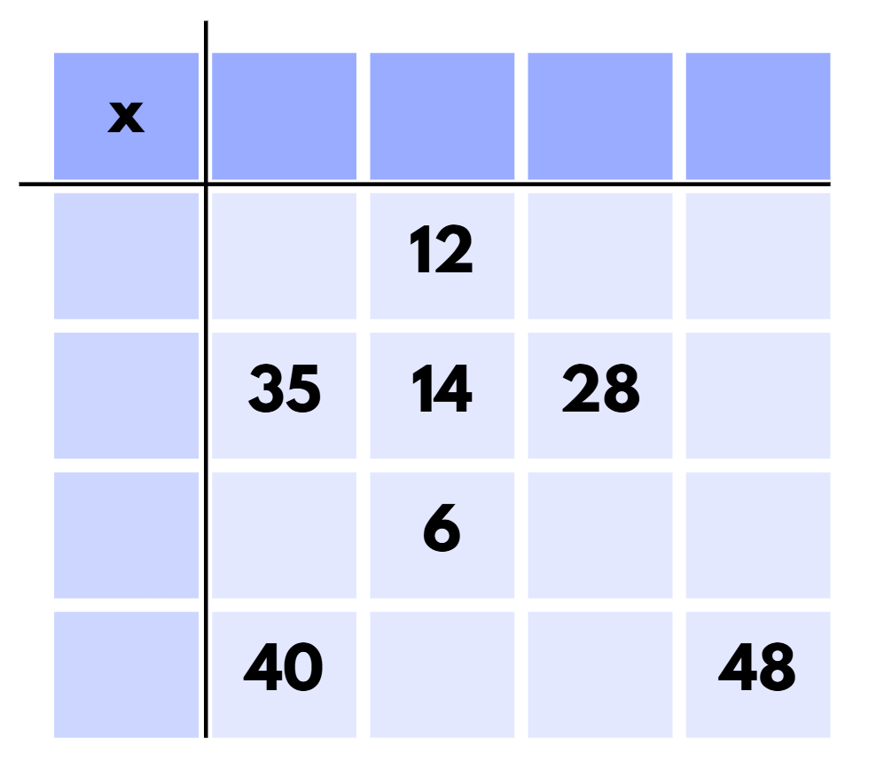
Activity 1 – mystery factors (2)
Notes:
This is a developing number sense activity.
Number sense refers to a deep understanding of numbers, including their magnitude, relationships, and the effects of operations on them. It supports fluency and understanding, estimation, flexible thinking, and efficient problem-solving. Number sense activities 1–4 ‘activate’ prior number knowledge and support the learning of new content in the unit. Number sense activities 5–8 ‘loop’ back and provide opportunity for spaced practice with concepts and procedures covered in previous units.
Syllabus focus area:
Multiplicative relations A
Mystery factors
This activity is an adaptation of ‘Mystery Matrix’ from NRICH by University of Cambridge.
This resource corresponds to Resource 16 – mystery factors in Stage 3 Year A Unit 13.
Explain that all the factors on the multiplication grid are missing from the headings. Highlight that some of the products inside the grid have been filled in, and these can be used as clues to help determine the missing factors.
Ask:
- Can you work out which factor goes in each row and column heading?
- Where might you start? Why?
- Can you see a relationship between the products?
Prompt students to work in pairs to determine the factors and to complete the multiplication grid.
Encourage students to use trial and error in situations where there are several possible factors.

Slide 12
Review of learning 2

Slide 13
True or false (1)
4 is a factor of 32.
True | False
Notes:
The question on this slide connects to the content being explored in the developing number sense activity (Activity 2)
Syllabus focus area:
Multiplicative relations A

Slide 14
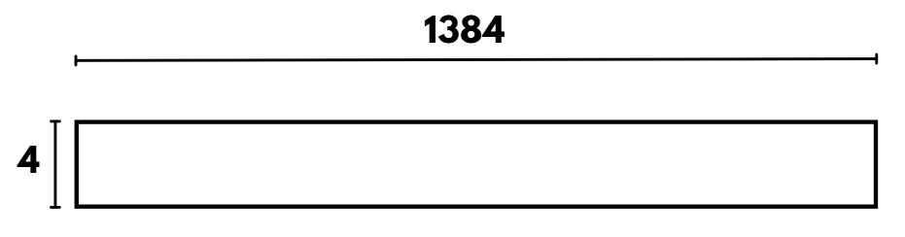
Short response (5)
Use an area model to solve
1384 ÷ 4
Notes:
Short response questions provide brisk paced questions focussing on review of current and previous content to support spaced and interleaved practice.
Syllabus focus area:
Multiplicative relations A

Slide 15
Short response (6)
Name a quadrilateral that does not have a line of symmetry.
Name a quadrilateral that has a diagonal line of symmetry.
Name a quadrilateral that has rotational symmetry.
Notes:
Short response questions provide brisk paced questions focussing on review of current and previous content to support spaced and interleaved practice.
Syllabus focus area:
Two-dimensional spatial structure A

Slide 16
Short response (7)
Order these decimals in ascending order:
0.26
0.126
1.26
0.62
Notes:
Short response questions provide brisk paced questions focussing on review of current and previous content to support spaced and interleaved practice.
Syllabus focus area:
Represent numbers A

Slide 17
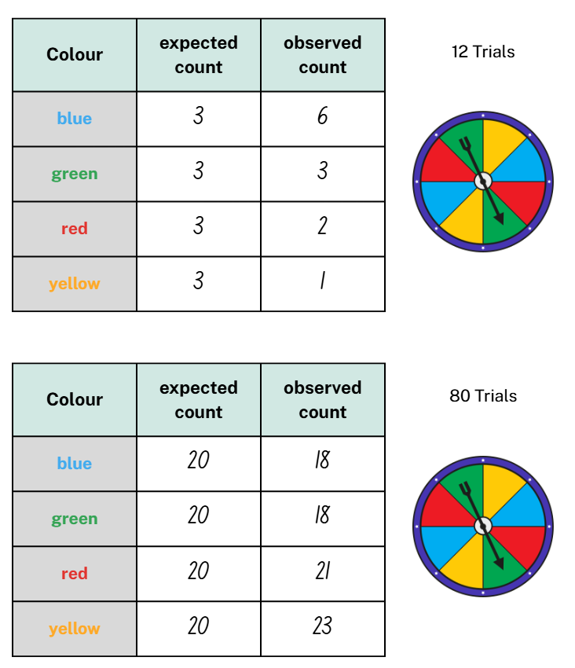
Short response (8)
Discuss the differences between the expected probabilities and the observed probabilities of the 2 spinner trials.
Notes:
Short response questions provide brisk paced questions focussing on review of current and previous content to support spaced and interleaved practice.
Syllabus focus area:
Chance B

Slide 18
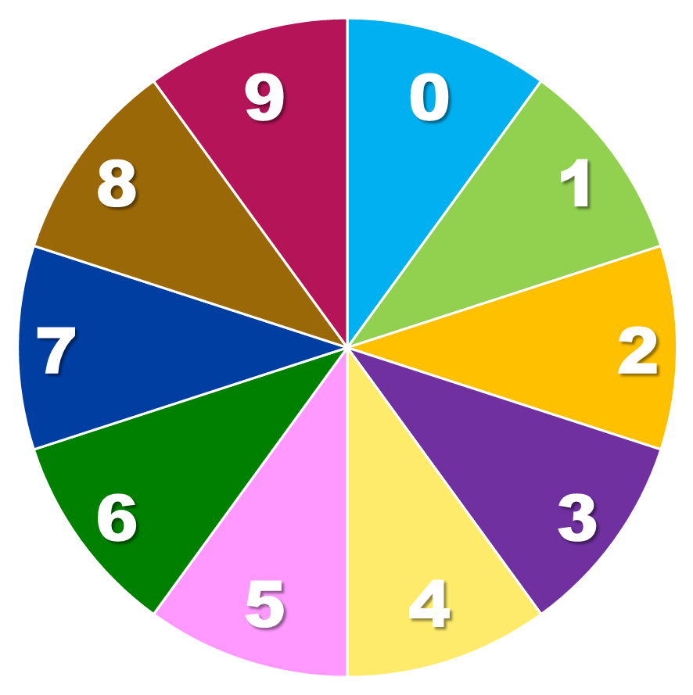
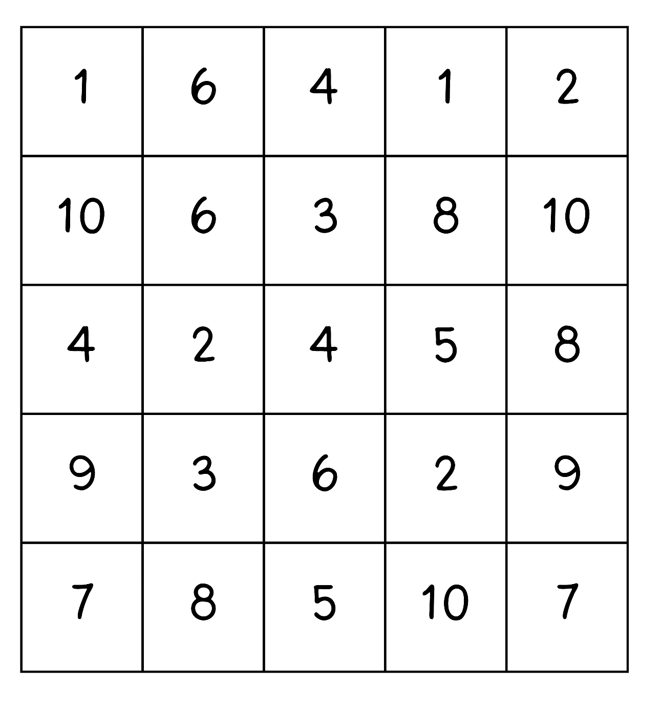
Activity 2 – factors fun - fours
32
4
24
36
Spin!
8
16
20
40
12
28
Notes:
This is a developing number sense activity.
Number sense refers to a deep understanding of numbers, including their magnitude, relationships, and the effects of operations on them. It supports fluency and understanding, estimation, flexible thinking, and efficient problem-solving. Number sense activities 1–4 ‘activate’ prior number knowledge and support the learning of new content in the unit. Number sense activities 5–8 ‘loop’ back and provide opportunity for spaced practice with concepts and procedures covered in previous units.
Syllabus focus area:
Multiplicative relations A
Factors fun - fours
This activity is an adaptation of ‘Factors fun’ from Thinking mathematically by NSW Department of Education.
This resource corresponds to Resource 17 – factors fun in Stage 3 Year A Unit 13.
Demonstrate how to play the game.
a. Spin the spinner with a pencil and paper clip to determine the product (for example, 32).
b. Identify the factor that multiplies with 4 to make the product.
c. Place one counter on the matching number on the gameboard, claiming that place.
d. If the number is taken, miss a turn.
e. If there are no new counters that can be added to the gameboard, move an existing counter to a new place.
f. Players win by getting four counters in a row (in any orientation, including a square).
Provide pairs of students with the gameboard on Resource 17 – factors fun, 12 counters (6 counters in each colour), a paper clip, a pencil and spinner – fours.
Students play the game until one of the players wins by getting 4 of their coloured counters in a row.

Slide 19
Review of learning 3

Slide 20
Multiple choice (2)
The factors for 30 are
1, 2, 3, 5, 6, 10, 30 and…
A
B
C
D
4
12
15
20
Notes:
This question connects to the content in the developing number sense activity (Activity 3)
Syllabus focus area:
Multiplicative relations A

Slide 21
Short response (9)
Solve 5329 × 6 using the distributive property.
Notes:
Short response questions provide brisk paced questions focussing on review of current and previous content to support spaced and interleaved practice.
Syllabus focus area:
Multiplicative relations A

Slide 22

Short response (10)
Match the 2D shapes to their classification.
1.
A. regular triangle
B. irregular quadrilateral
C. irregular triangle
D: regular quadrilateral
2.
3.
4.
Notes:
Short response questions provide brisk paced questions focussing on review of current and previous content to support spaced and interleaved practice.
Syllabus focus area:
Two-dimensional spatial structure A

Slide 23
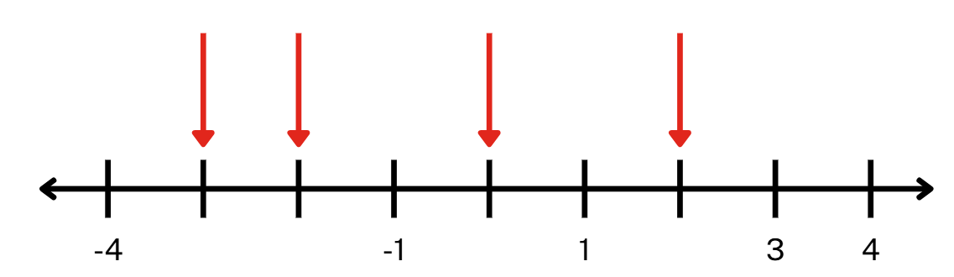
Short response (11)
Record the integers at A, B, C and D on the number line.
A
B
C
D
Notes:
Short response questions provide brisk paced questions focussing on review of current and previous content to support spaced and interleaved practice.
Syllabus focus area:
Represents numbers A

Slide 24
Short response (12)
Convert and record as 24-hour time:
6.25 am
8:45 pm
11:58 pm
Notes:
Short response questions provide brisk paced questions focussing on review of current and previous content to support spaced and interleaved practice.
Syllabus focus area:
Non-spatial measure A

Slide 25
Activity 3 – factors fun - sixes
42
6
56
30
Spin!
24
18
60
36
48
12
Notes:
This is a developing number sense activity.
Number sense refers to a deep understanding of numbers, including their magnitude, relationships, and the effects of operations on them. It supports fluency and understanding, estimation, flexible thinking, and efficient problem-solving. Number sense activities 1–4 ‘activate’ prior number knowledge and support the learning of new content in the unit. Number sense activities 5–8 ‘loop’ back and provide opportunity for spaced practice with concepts and procedures covered in previous units.
Syllabus focus area:
Multiplication relations A
Factors fun – sixes
This activity is an adaptation of ‘Factors fun’ from Thinking mathematically by NSW Department of Education.
This resource corresponds to Resource 17 – factors fun in Stage 3 Year A Unit 13.
Demonstrate how to play the game.
a. Spin the spinner with a pencil and paper clip to determine the product (for example, 48).
b. Identify the factor that multiplies with 4 to make the product.
c. Place one counter on the matching number on the gameboard, claiming that place.
d. If the number is taken, miss a turn.
e. If there are no new counters that can be added to the gameboard, move an existing counter to a new place.
f. Players win by getting four counters in a row (in any orientation, including a square).
Provide pairs of students with the gameboard on Resource 17 – factors fun, 12 counters (6 counters in each colour), a paper clip, a pencil and spinner – sixes.
Students play the game until one of the players wins by getting 4 of their coloured counters in a row.

Slide 26
Review of learning 4

Slide 27
True or false (2)
3 is a factor of 20.
True | False
Notes:
The question on this slide connects to the content being explored in the developing number sense activity (Activity 4)
Syllabus focus area:
Multiplicative relations A

Slide 28
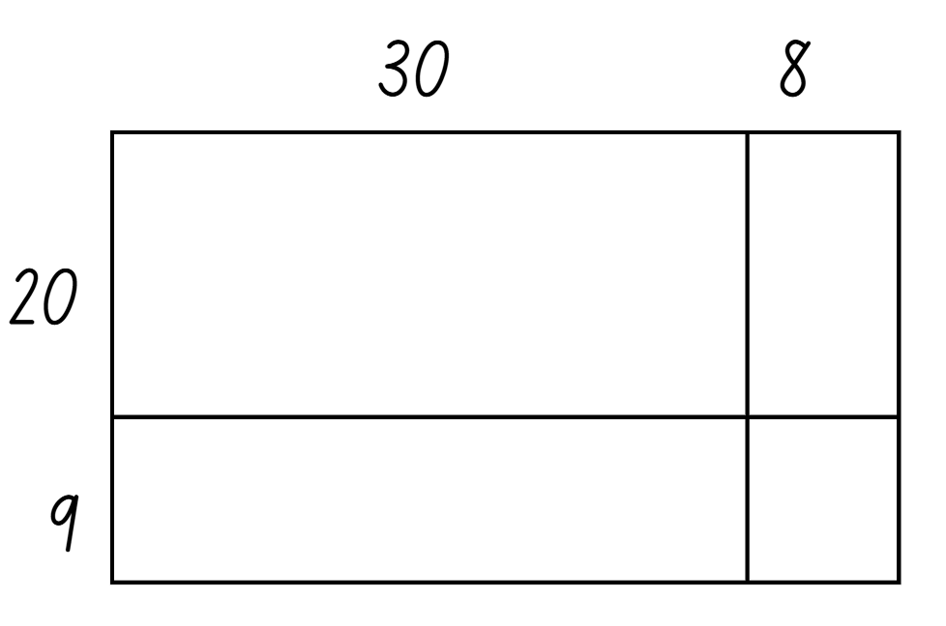
Short response (13)
Use the area model to solve:
29 × 38
Notes:
Short response questions provide brisk paced questions focussing on review of current and previous content to support spaced and interleaved practice.
Syllabus focus area:
Multiplicative relations A

Slide 29
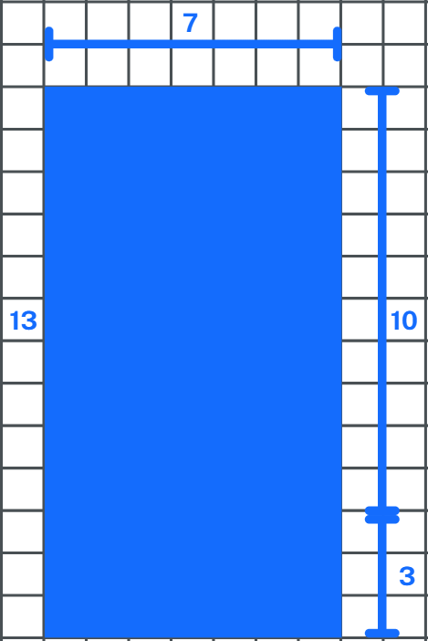
Short response (14)
Use the area model to calculate and record the area of the rectangle in square centimetres.
Notes:
Short response questions provide brisk paced questions focussing on review of current and previous content to support spaced and interleaved practice.
Syllabus focus area:
Multiplicative relations A

Slide 30
Short response (15)
Record the factors of 36.
Notes:
Short response questions provide brisk paced questions focussing on review of current and previous content to support spaced and interleaved practice.
Syllabus focus area:
Multiplicative relations A

Slide 31
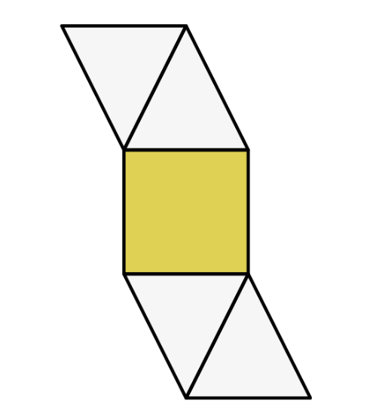
Short response (16)
Is this the net of a 3D object?
Communicate your reasoning.
Notes:
Short response questions provide brisk paced questions focussing on review of current and previous content to support spaced and interleaved practice.
Syllabus focus area:
Three-dimensional spatial structure A

Slide 32
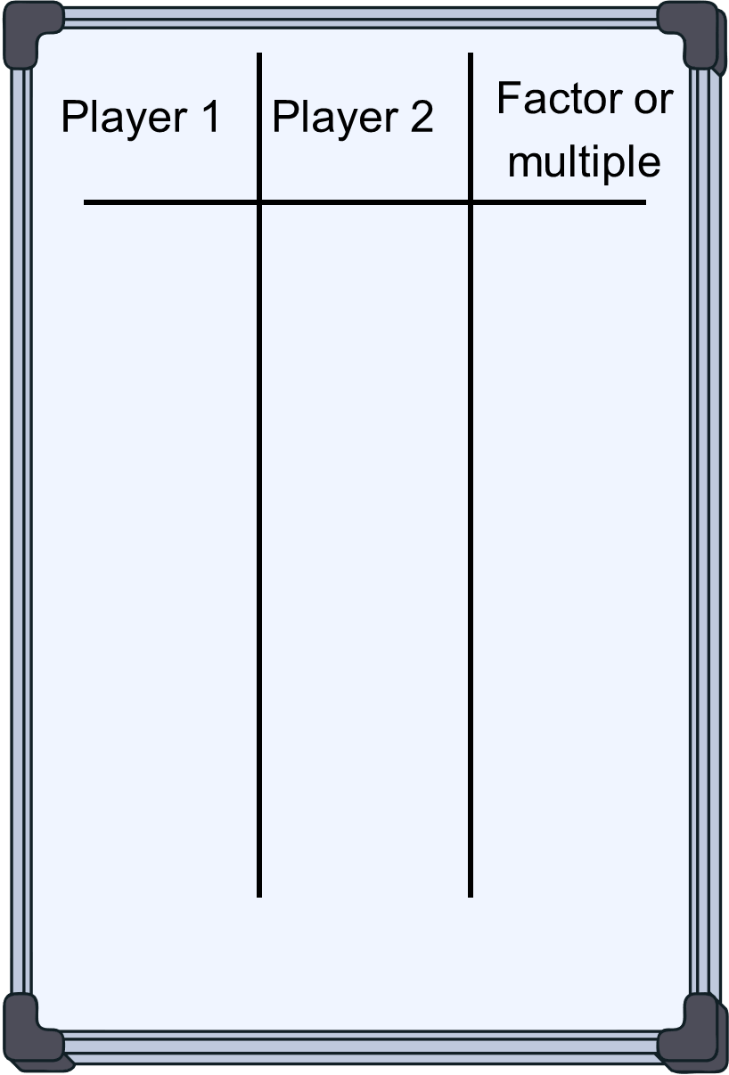
Activity 4 – factors and multiples
20
40
M
8
F
4
F
16
M
16
M
Notes:
Note: this slide is designed to be view in presentation mode.
This is a developing number sense activity.
Number sense refers to a deep understanding of numbers, including their magnitude, relationships, and the effects of operations on them. It supports fluency and understanding, estimation, flexible thinking, and efficient problem-solving. Number sense activities 1–4 ‘activate’ prior number knowledge and support the learning of new content in the unit. Number sense activities 5–8 ‘loop’ back and provide opportunity for spaced practice with concepts and procedures covered in previous units.
Syllabus focus area:
Multiplicative relations A
Factors and multiples
This activity is an adaptation of ‘Factors and Multiples Game’ from NRICH by University of Cambridge. An interactive version can also be found on the website. This activity was introduced in Stage 3 Unit 1.
This resource corresponds to Resource 18 – number chart and Figure 26 – number chart in Stage 3 Year A Unit 13.
Demonstrate with 2 different coloured pens how to play the game.
Explain:
a. The first player chooses an even number less than 50 and crosses it out.
The second player must then choose another number that is either a factor or a multiple of the previously crossed-out number. Each number may only be crossed out once.
After each move, the player records their number on a whiteboard or piece of paper, noting whether it is a factor or multiple of the previous number (see Figure 26).
Players take turns, crossing out numbers and recording each move according to the factor-or-multiple rules.
The game continues until a player cannot make a valid move.
The winner is the player who crossed out the last number.
After completing one round, students play again, switching which player goes first.

Slide 33
Review of learning 5

Slide 34
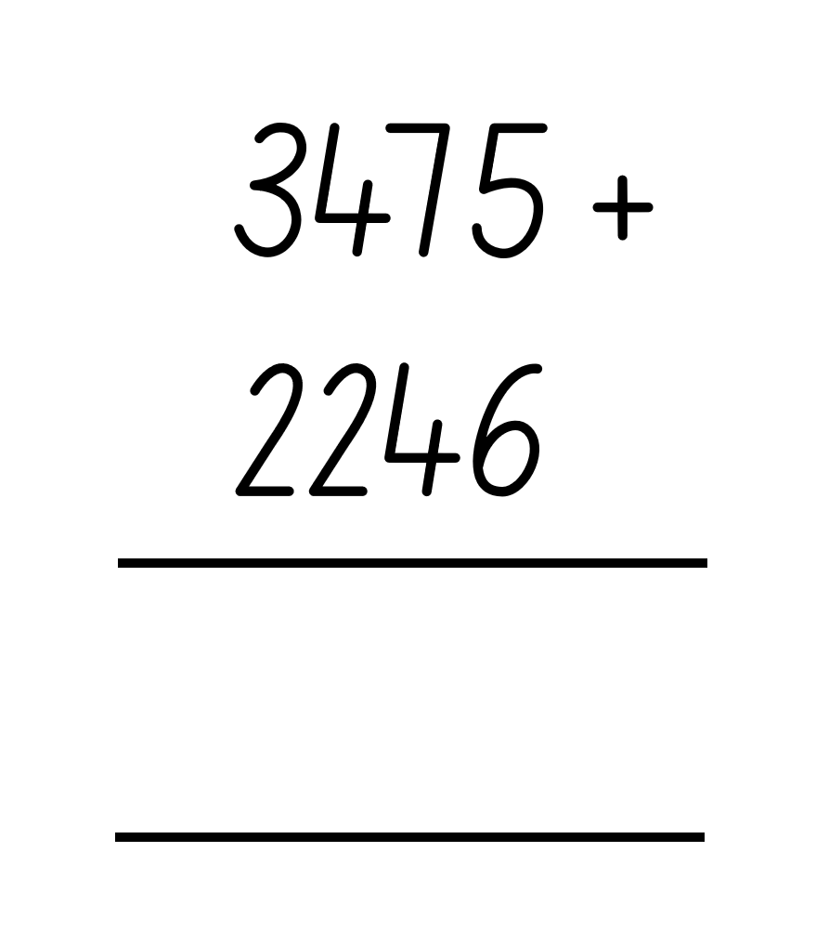
Multiple choice (3)
What is the answer to this equation?
A
5611
B
5711
C
56 111
D
5721
Notes:
This question connects to the content in the developing number sense activity (Activity 5)
Syllabus focus area:
Additive relations A

Slide 35
Short response (17)
When solving 289 × 36 using a multiplication algorithm, which statement is correct?
Multiply 289 by 6 and then 289 by 3.
Multiply 289 by 6 and then 289 by 30.
Communicate your reasoning.
Notes:
Short response questions provide brisk paced questions focussing on review of current and previous content to support spaced and interleaved practice.
Syllabus focus area:
Multiplicative relations A

Slide 36
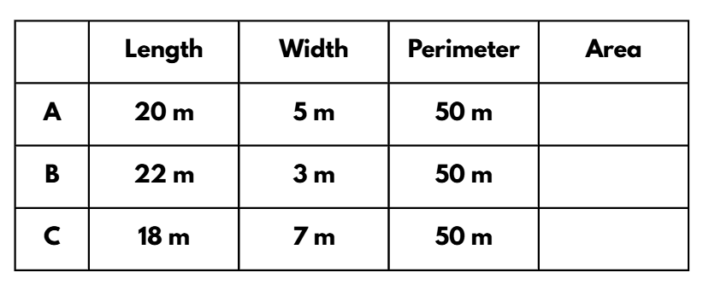
Short response (18)
This table shows the dimensions of 3 rectangles with the same perimeter.
Calculate the area for each rectangle.
Identify which rectangle has the largest and smallest area.
Notes:
Short response questions provide brisk paced questions focussing on review of current and previous content to support spaced and interleaved practice.
Syllabus focus area:
Two-dimensional spatial structure A

Slide 37
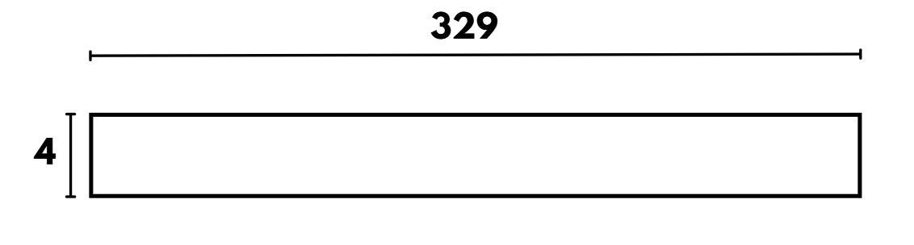
Short response (19)
Partition 329 into place value parts and solve 329 × 4 using the area model.
Notes:
Short response questions provide brisk paced questions focussing on review of current and previous content to support spaced and interleaved practice.
Syllabus focus area:
Multiplicative relations A

Slide 38
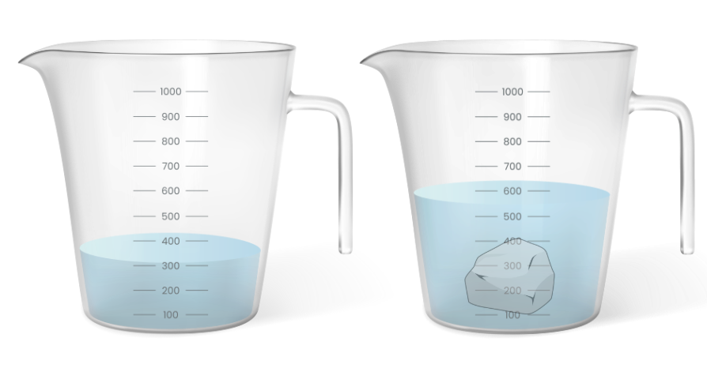
Short response (20)
The water level without
the rock is 300 mL. The water level with the rock is 550 mL.
Why does the water level increase when the rock is placed in the jug?
Notes:
Short response questions provide brisk paced questions focussing on review of current and previous content to support spaced and interleaved practice.
Syllabus focus area:
Three-dimensional spatial structure A

Slide 39
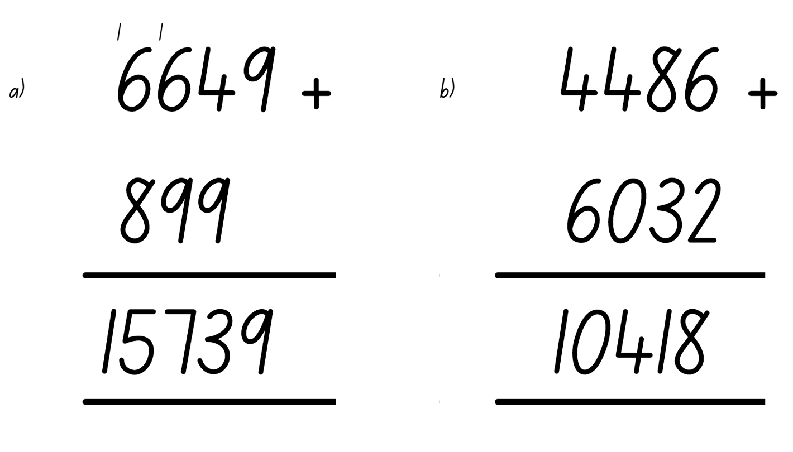
Activity 5 – checking addition algorithms
Notes:
This is a developing number sense activity.
Number sense refers to a deep understanding of numbers, including their magnitude, relationships, and the effects of operations on them. It supports fluency and understanding, estimation, flexible thinking, and efficient problem-solving. Number sense activities 1–4 ‘activate’ prior number knowledge and support the learning of new content in the unit. Number sense activities 5–8 ‘loop’ back and provide opportunity for spaced practice with concepts and procedures covered in previous units.
Syllabus focus area:
Additive relations A
Checking addition algorithms
This resource corresponds to Resource 19 – addition algorithms errors in Stage 3 Year A Unit 13.
Explain that a student has made some errors with their calculations.
Ask:
— What errors has the student made in the first algorithm?
— What advice would you give so the error does not happen again?
— What error has the student made in the second algorithm?
— What advice would you give so the error does not happen again?
Students record the correct working out for both algorithms on individual whiteboards.
Students share their working out with a partner and communicate the correct process for the vertical algorithm.

Slide 40
Review of learning 6

Slide 41
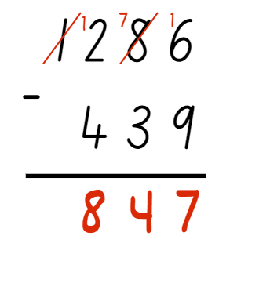
True or false (3)
This equation has been solved correctly.
True | False
Notes:
The question on this slide connects to the content being explored in the developing number sense activity (Activity 6)
Syllabus focus area:
Additive relations A

Slide 42
Short response (21)
Choose the most appropriate multiplicative strategy to solve:
6412 × 59
Communicate your reasoning.
Notes:
Short response questions provide brisk paced questions focussing on review of current and previous content to support spaced and interleaved practice.
Syllabus focus area:
Multiplicative relations A

Slide 43
Short response (22)
Farmer Jessie wants to turn one of her paddocks into a space for alpacas. Which paddock has the larger area for the alpacas?
Length: 35 m Width: 5 m
Length: 29 m Width: 9 m
Notes:
Short response questions provide brisk paced questions focussing on review of current and previous content to support spaced and interleaved practice.
Syllabus focus area:
Two-dimensional spatial structure A

Slide 44
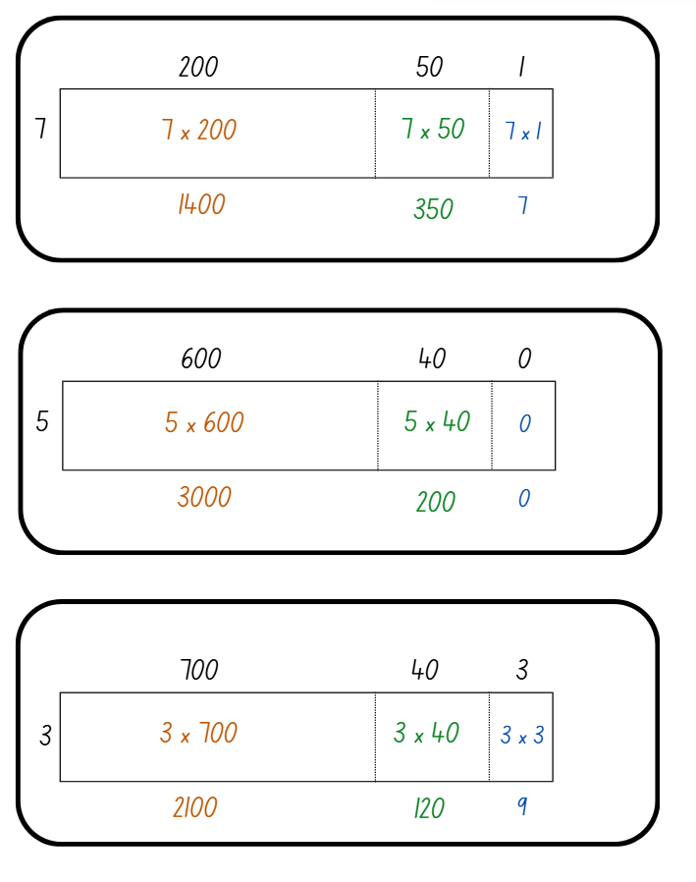
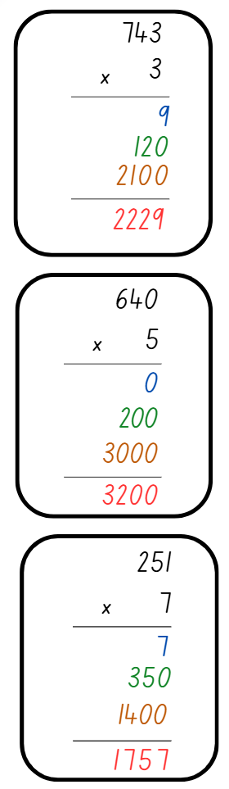
Short response (23)
Match the area model to the corresponding algorithm.
1.
A.
2.
B.
3.
C.
Notes:
Short response questions provide brisk paced questions focussing on review of current and previous content to support spaced and interleaved practice.
Syllabus focus area:
Multiplicative relations A

Slide 45
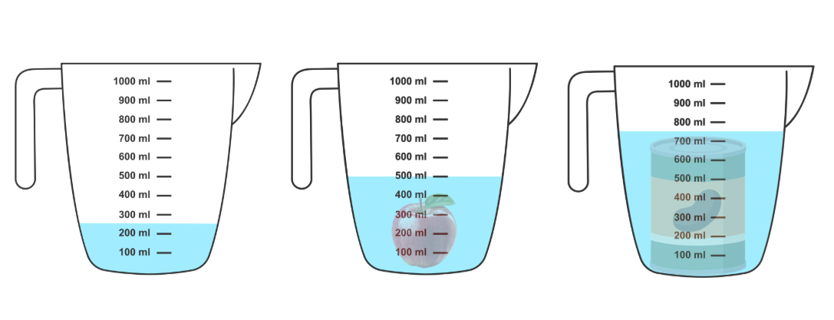
Short response (24)
This measuring jug contains 250 mL of water.
Use the change in water level to compare the volumes of the apple and the can of beans when each is submerged in the jug.
apple
can of beans
Notes:
Short response questions provide brisk paced questions focussing on review of current and previous content to support spaced and interleaved practice.
Syllabus focus area:
Three-dimensional spatial structure A

Slide 46
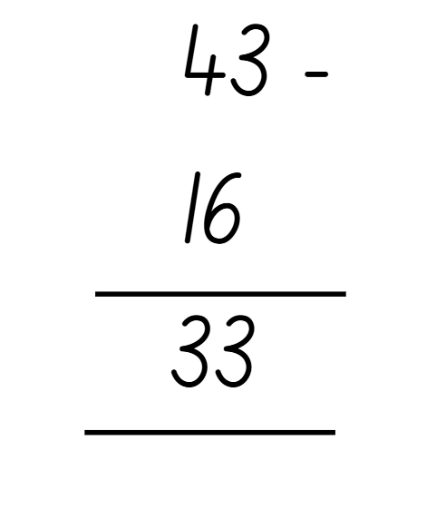
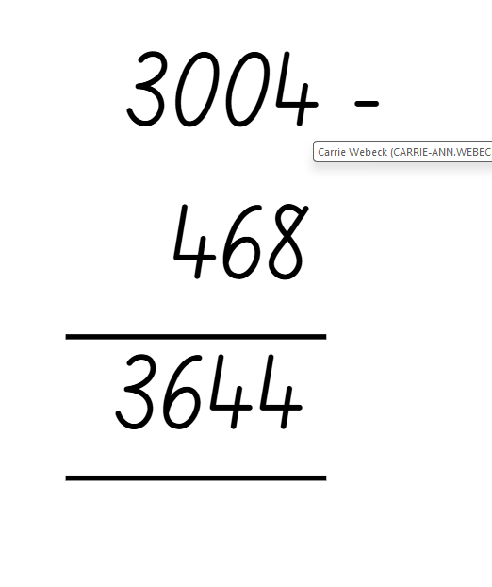
Activity 6 – checking subtraction algorithms
Notes:
This is a developing number sense activity.
Number sense refers to a deep understanding of numbers, including their magnitude, relationships, and the effects of operations on them. It supports fluency and understanding, estimation, flexible thinking, and efficient problem-solving. Number sense activities 1–4 ‘activate’ prior number knowledge and support the learning of new content in the unit. Number sense activities 5–8 ‘loop’ back and provide opportunity for spaced practice with concepts and procedures covered in previous units.
Syllabus focus area:
Additive relations A
Checking subtraction algorithms
Note: this slide was designed to be used in presentation mode.
Prompt students to estimate the answer and then ask:
- Is this answer reasonable? Why or why not?
What error has been made in this algorithm?
Why might this error have been made?
What advice would you give so this error does not happen again?
Students turn and talk to discuss their thinking.
Students record the correct working out for the algorithm on individual whiteboards.
Students share their algorithm with a partner and communicate the process used to solve it.
Repeat steps 1–4 with the vertical algorithm 3004 − 468 = 3644.

Slide 47
Review of learning 7

Slide 48
Multiple choice (4)
Which is the best strategy to make a reasonable estimate for 62 134 − 289?
A
62 000 − 300 = 61 700
B
62 100 − 200 = 61 900
C
63 000 − 300 = 62 700
D
62 000 − 200 = 61 800
Notes:
This question connects to the content in the developing number sense activity (Activity 7)
Syllabus focus area:
Additive relations A

Slide 49
Short response (25)
17 ÷ 4 =
Draw an array to model the equation.
Record the division number sentence.
Record an inverse multiplication number sentence.
Notes:
Short response questions provide brisk paced questions focussing on review of current and previous content to support spaced and interleaved practice.
Syllabus focus area:
Multiplicative relations A

Slide 50
Short response (26)
Record an example of a location that would be measured in:
hectares
square kilometres
Notes:
Short response questions provide brisk paced questions focussing on review of current and previous content to support spaced and interleaved practice.
Syllabus focus area:
Two-dimensional spatial structure A

Slide 51
Short response (27)
23 ÷ 3 =
Notes:
Short response questions provide brisk paced questions focussing on review of current and previous content to support spaced and interleaved practice.
Syllabus focus area:
Multiplicative relations A

Slide 52
Short response (28)
Julia swam 1.2 km on Monday, 800 m on Tuesday and 2400 m on Wednesday.
How many kilometres did Julia swim that week?
Notes:
Short response questions provide brisk paced questions focussing on review of current and previous content to support spaced and interleaved practice.
Syllabus focus area:
Geometric measure B

Slide 53
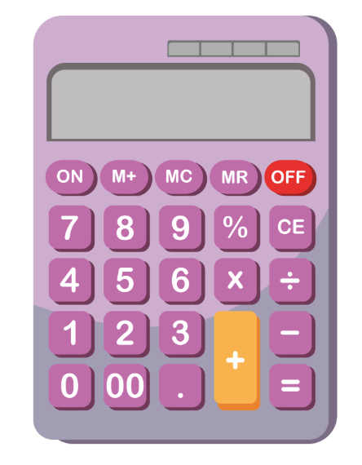
Activity 7 – checking addition using estimation
Finn adds 45 678 and 589 on his calculator and gets 45 089.
45 678 + 589 = 45 089
Notes:
This is a developing number sense activity.
Number sense refers to a deep understanding of numbers, including their magnitude, relationships, and the effects of operations on them. It supports fluency and understanding, estimation, flexible thinking, and efficient problem-solving. Number sense activities 1–4 ‘activate’ prior number knowledge and support the learning of new content in the unit. Number sense activities 5–8 ‘loop’ back and provide opportunity for spaced practice with concepts and procedures covered in previous units.
Syllabus focus area:
Additive relations A
Checking addition using estimation
This activity is an adaptation of ‘Checking Addition and Subtraction by Estimation’ from NZ Maths by the New Zealand Ministry of Education.
Ask:
- Is this a reasonable answer? Why or why not? (No. The answer must be larger than 45 678 because he is adding.)
- What do you think Finn did wrong when calculating? (He pressed the subtraction button rather than the addition button.)
- Can adjusting numbers help you to estimate an answer? How?
- What is a reasonable estimation for the solution of 45 678 + 589?
Students share their thinking. For example, by adjusting to the nearest hundred, we can say 678 + 589 is about 1300 because 700 + 600 = 1300, so the answer must be near 46 300.
Students use the vertical algorithm to solve the problem on individual whiteboards.
Students share their algorithm with a partner and communicate the process used to solve it.

Slide 54
Review of learning 8

Slide 55
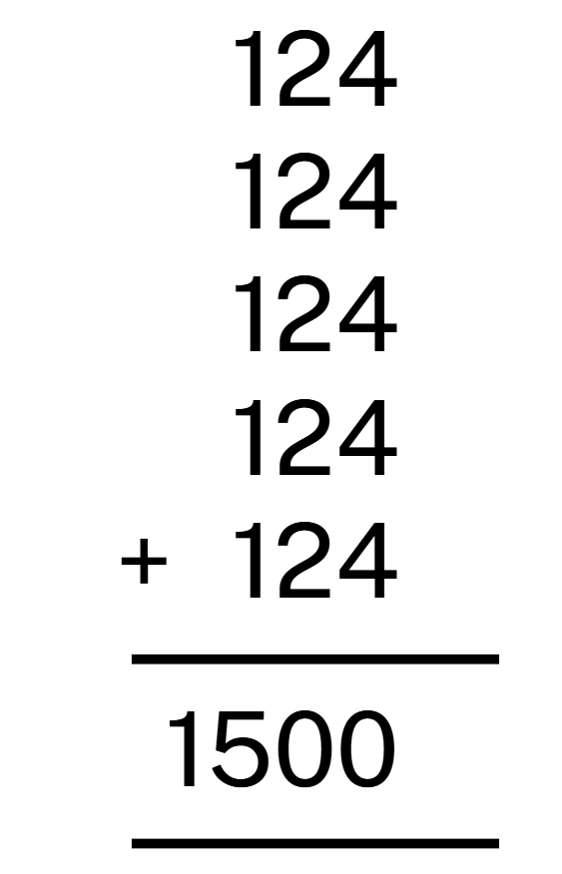
True or false (4)
Using place value to check, the answer to this algorithm is correct.
True | False
Notes:
The question on this slide connects to the content being explored in the developing number sense activity (Activity 8)
Syllabus focus area:
Additive relations A

Slide 56
Short response (29)
Partition 7248 into multiples of 6
to solve:
7248 ÷ 6 =
Notes:
Short response questions provide brisk paced questions focussing on review of current and previous content to support spaced and interleaved practice.
Syllabus focus area:
Multiplicative relations A

Slide 57
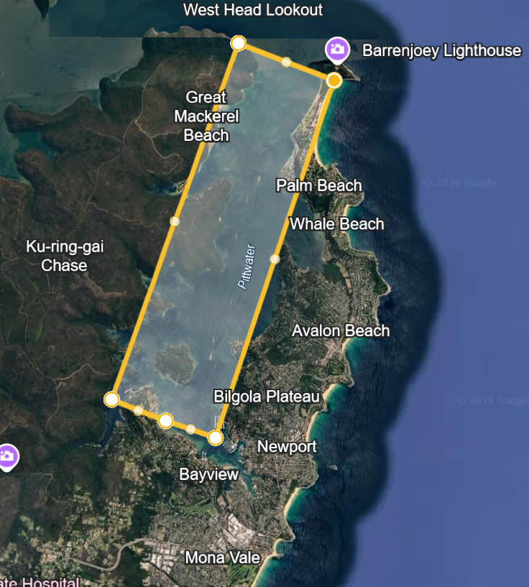
Short response (30)
Round the length 7945 m and width 2808 m to the nearest kilometre.
Record the approximate area of Pittwater in square kilometres (km²)
Notes:
Short response questions provide brisk paced questions focussing on review of current and previous content to support spaced and interleaved practice.
Syllabus focus area:
Two-dimensional spatial structure A

Slide 58
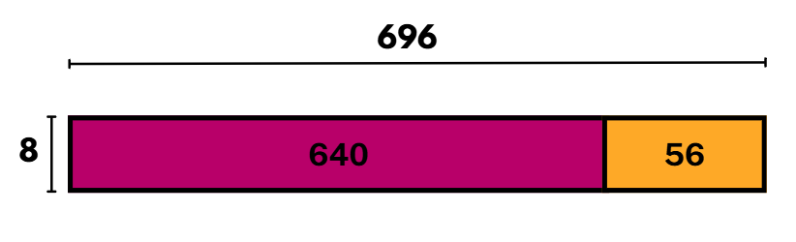
Short response (31)
Miss Green is organising the school athletics carnival. She has 696 students to put into 50 m metre sprint races.
If it is an 8-lane track, how many races will there be?
Identify in the partial quotients on this area model to solve the problem.
Notes:
Note: this slide is designed to be viewed in presentation mode.
Short response questions provide brisk paced questions focussing on review of current and previous content to support spaced and interleaved practice.
Syllabus focus area:
Multiplicative relations A

Slide 59
Short response (32)
Use decimal notation to record these lengths in kilometres (km):
2356 m
65 777 m
129 m
Notes:
Short response questions provide brisk paced questions focussing on review of current and previous content to support spaced and interleaved practice.
Syllabus focus area:
Geometric measure B

Slide 60
Activity 8 – four strikes (1)
+
=
0 1 2 3 4 5 6 7 8 9
Notes:
This is a developing number sense activity.
Number sense refers to a deep understanding of numbers, including their magnitude, relationships, and the effects of operations on them. It supports fluency and understanding, estimation, flexible thinking, and efficient problem-solving. Number sense activities 1–4 ‘activate’ prior number knowledge and support the learning of new content in the unit. Number sense activities 5–8 ‘loop’ back and provide opportunity for spaced practice with concepts and procedures covered in previous units.
Syllabus focus area:
Additive relations A
Four strikes
This activity is an adaptation of ‘Additive strategies: Four strikes and you're out! (Task 7)’ from Stage 3 numbers and algebra by State of New South Wales (Department of Education). This activity was introduced in Stage 3 Year A Unit 2.
This figure corresponds to Figure 27 – four strikes in Stage 3 Year A Unit 13.
Conceal the equation 4627 + 1358 = 5985.
Explain that students will take turns guessing a number between zero and 9. If the number is within the problem, it will be written in the corresponding space on Figure 27. If the number is not in the problem, it will be a ‘strike’. To win, students need to determine all the numbers before they get 4 strikes.
Note: encourage students to think about place value when making their guesses. For example, if presented with 3_ + _ _ = 7 _, it would be reasonable to estimate that there could be a 4 in the tens place of the second number.
(Next slide) Change the plus symbol in Figure 27 to a minus symbol and repeat the game with the equation 9758 − 4321 = 5437.

Slide 61
Activity 8 – four strikes (2)
-
=
0 1 2 3 4 5 6 7 8 9
Notes:
This is a developing number sense activity.
Number sense refers to a deep understanding of numbers, including their magnitude, relationships, and the effects of operations on them. It supports fluency and understanding, estimation, flexible thinking, and efficient problem-solving. Number sense activities 1–4 ‘activate’ prior number knowledge and support the learning of new content in the unit. Number sense activities 5–8 ‘loop’ back and provide opportunity for spaced practice with concepts and procedures covered in previous units.
Syllabus focus area:
Additive relations A
Four strikes
This activity is an adaptation of ‘Additive strategies: Four strikes and you're out! (Task 7)’ from Stage 3 numbers and algebra by State of New South Wales (Department of Education). This activity was introduced in Stage 3 Year A Unit 2.
This figure corresponds to Figure 27 – four strikes in Stage 3 Year A Unit 13.
Change the plus symbol in Figure 27 to a minus symbol and repeat the game with the equation 9758 − 4321 = 5437.

Slide 62
Double Venn diagram
Object 1
Object 2
Features similar to both objects
Features of object 1
Features of object 2

Slide 63
Frayer
Definition
Facts/Characteristics
Word, term, concept
Examples
Non-examples

Slide 64
Spider map
Idea
Subject

Slide 65
Cline
Concept 1
Concept 2
Word
Word
Word
Word
Word
Word
Word
Word
Word
Word
Word

Slide 66
Compare and contrast

Slide 67
Multiple choice (5)
A
B
C
D

Slide 68
Multiple choice
A
B
C
D
Notes:
This question connects to the content in the developing number sense activity (Activity 3)
Syllabus focus area:
[Focus area A/B]

Slide 69
References (1)
This presentation contains NSW Curriculum and syllabus content. The NSW Curriculum is developed by the NSW Education Standards Authority. This content is prepared by NESA for and on behalf of the Crown in the right of the State of New South Wales. The material is protected by Crown copyright.
Please refer to the NESA Copyright Disclaimer for more information https://educationstandards.nsw.edu.au/wps/portal/nesa/mini-footer/copyright.
NESA holds the only official and up-to-date versions of the NSW Curriculum and syllabus documents. Please visit the NSW Education Standards Authority (NESA) website https://educationstandards.nsw.edu.au/wps/portal/nesa/home and the NSW Curriculum website https://curriculum.nsw.edu.au.
Mathematics K–10 Syllabus © NSW Education Standards Authority (NESA) for and on behalf of the Crown in right of the State of New South Wales, 2022.
National Numeracy Learning Progression © Australian Curriculum, Assessment and Reporting Authority (ACARA) 2010 to present, unless otherwise indicated. This material was downloaded from the Australian Curriculum website (National Numeracy Learning Progression) (accessed March 2026) and was not modified.
ABC Education (2023) Game: Goat Busters (Area model for multiplication), ABC Education, accessed 1 July 2025.
Amplify Education (2024) Polypad: Number Frames, Amplify Polypad website, accessed 21 February 2024.
New Zealand Ministry of Education (n.d.) Checking Addition and Subtraction by Estimation, Meaningful Maths website, accessed 1 July 2025.

Slide 70
References (2)
This presentation contains NSW Curriculum and syllabus content. The NSW Curriculum is developed by the NSW Education Standards Authority. This content is prepared by NESA for and on behalf of the Crown in the right of the State of New South Wales. The material is protected by Crown copyright.
Please refer to the NESA Copyright Disclaimer for more information https://educationstandards.nsw.edu.au/wps/portal/nesa/mini-footer/copyright.
NESA holds the only official and up-to-date versions of the NSW Curriculum and syllabus documents. Please visit the NSW Education Standards Authority (NESA) website https://educationstandards.nsw.edu.au/wps/portal/nesa/home and the NSW Curriculum website https://curriculum.nsw.edu.au.
State of New South Wales (Department of Education) (2023) ‘Factors fun’, Thinking mathematically resources, NSW Department of Education website, accessed 3 April 2024.
——(2025) ‘Additive strategies: Four strikes and you’re out! (Task 7)’, Stage 3 numbers and algebra, NSW Department of Education website, accessed 29 August 2025.
University of Cambridge (n.d.) Mystery Matrix, NRICH website, accessed 11 August 2025.
——(n.d.) Factors and Multiples Game, NRICH website, accessed 4 April 2024.

Slide 71
Copyright
© State of New South Wales (Department of Education), 2025
The copyright material published in this resource is subject to the Copyright Act 1968 (Cth) and is owned by the NSW Department of Education or, where indicated, by a party other than the NSW Department of Education (third-party material).
Copyright material available in this resource and owned by the NSW Department of Education is licensed under a Creative Commons Attribution 4.0 International (CC BY 4.0) license.
This license allows you to share and adapt the material for any purpose, even commercially.
Attribution should be given to © State of New South Wales (Department of Education), 2025.
Material in this resource not available under a Creative Commons license:
the NSW Department of Education logo, other logos and trademark-protected material
Material owned by a third party that has been reproduced with permission. You will need to obtain permission from the third party to reuse its material.
Links to third-party material and websites
Please note that the provided (reading/viewing material/list/links/texts) are a suggestion only and implies no endorsement, by the New South Wales Department of Education, of any author, publisher, or book title. School principals and teachers are best placed to assess the suitability of resources that would complement the curriculum and reflect the needs and interests of their students.
If you use the links provided in this document to access a third party’s website, you acknowledge that the terms of use, including licence terms set out on the third-party’s website apply to the use which may be made of the materials on that third-party website or where permitted by the Copyright Act 1968 (Cth). The department accepts no responsibility for content on third-party websites.

