Slide 1
Instructions for use
This resource aligns to the learning in Stage 3 Year A Unit 14 and revisits content from earlier sample units.
Classroom teachers are encouraged to add and adapt slides as required to meet the needs of their students.
Save a copy of the file to make changes to the slide deck. Go to File > Download a Copy (this downloads a copy to the computer to edit in the PowerPoint app).
To convert the PowerPoint to Google Slides:
  Upload the file into Google Drive and open it.
  Go to File > Save as Google Slides.
  (Note – conversion may cause formatting changes in the slides.)

Slide 2

Review of Learning
Mathematics Stage 3 – Unit 14
Notes:
Reviews may include a combination of question types, requiring students to recall facts and key ideas, as well as apply their knowledge to solve problems and answer questions. To support active engagement, a mix of techniques should be employed.” (AERO, 2024).
This Review of Learning slide deck revisits key concepts from the following units:
Stage 3 Year A Unit 14
Stage 3 Year A Unit 13
Stage 3 Year A Unit 12
It also includes opportunities to review prior learning in non-number content, supporting consolidation across focus areas.
The review of learning resources include three key task types that support the development of mathematical proficiency through retrieval, spaced practice, and active participation. These practices complement the review phase (activating prior knowledge) embedded within the beginning of each lesson.
1.
Multiple-choice questions/True or false: Designed to promote active retrieval of key concepts and identify common misconceptions in number, supporting consolidation, understanding and fluency.
These questions:
support spaced and interleaved practice
help identify and address common misconceptions
support active recall and immediate feedback
support whole class participation
identify areas requiring reteach
2.
Short-response question sets: Carefully grouped questions that encourage spaced and interleaved practice across multiple focus areas, helping students revisit and apply knowledge from different points in time.
These questions:
have a combination of question types
address a range of focus areas
build automaticity and fluency
support active recall
allow for immediate feedback
identify content requiring reteach
3.
Developing number sense activities: A variety of practical, purposeful tasks that reinforce current learning and build on prior knowledge. These activities promote reasoning, problem-solving and conceptual understanding.
The review of learning resources are designed to work support teaching and learning in mathematics. For the most effective implementation, use the resources flexibly, adapting to meet student learning needs and individual classroom contexts.

Slide 3
Lessons
1
Review of learning 1
5
Review of learning 5
2
Review of learning 2
6
Review of learning 6
3
Review of learning 3
7
Review of learning 7
4
Review of learning 4
8
Review of learning 8
Notes:
Teacher notes:
Click lesson titles to go to specific lessons
Interactive features can be viewed in slide show

Slide 4
Review of learning 1

Slide 5

Multiple choice (1)
The value of the 7 in the decimal number 2.379 is…
A
B
C
D
7
7 tenths
7 hundredths
7 thousandths
Notes:
This question connects to the content in the developing number sense activity (Activity 1)
Syllabus focus area:
Represents numbers A

Slide 6

Short response (1)
5.125 m
What does the 5 represent in this number?
What does the 125 represent in this number?
How can 5.125 m be renamed to an equivalent length?
Notes:
Short response questions provide brisk paced questions focussing on review of current and previous content to support spaced and interleaved practice.
Syllabus focus area:
Geometric measure B

Slide 7
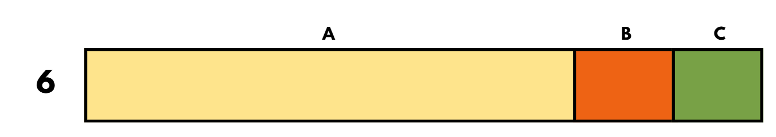
Short response (2)
248 × 6
Partition 248 into its place value parts to help solve this equation.
Notes:
Short response questions provide brisk paced questions focussing on review of current and previous content to support spaced and interleaved practice.
Syllabus focus area:
Multiplicative relations A

Slide 8



Short response (3)
1.
Identify which triangle is:
equilateral
isosceles
scalene
2.
3.
Notes:
Short response questions provide brisk paced questions focussing on review of current and previous content to support spaced and interleaved practice.
Syllabus focus area:
Two-dimensional spatial structure A

Slide 9
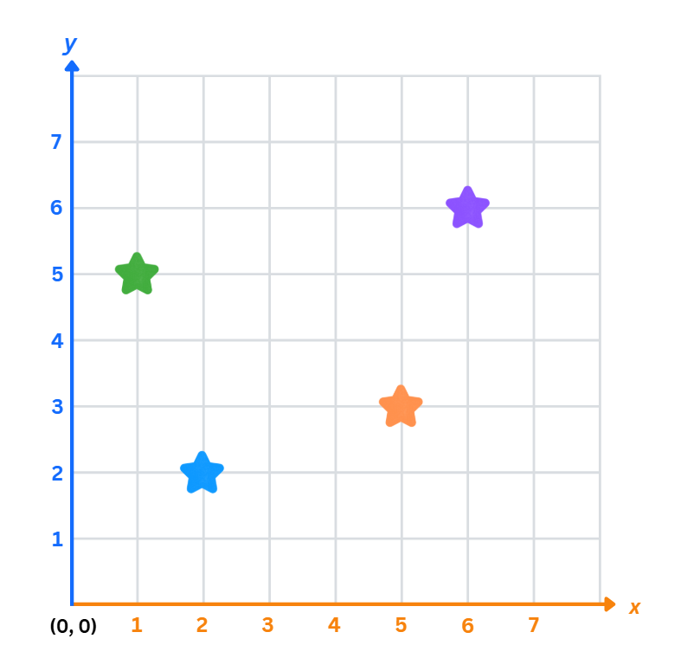
Short response (4)
Record the coordinates of each star on the first quadrant of the Cartesian plane.
Notes:
Short response questions provide brisk paced questions focussing on review of current and previous content to support spaced and interleaved practice.
Syllabus focus area:
Geometric measure A

Slide 10

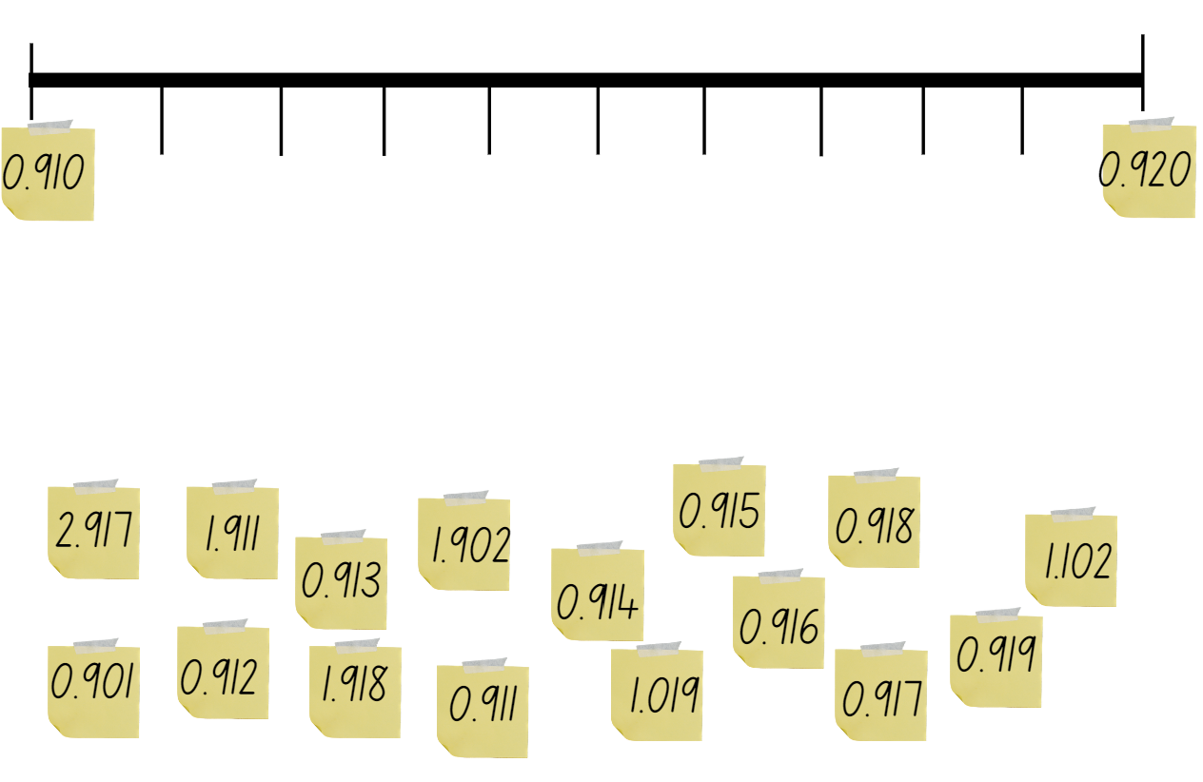
Activity 1 – decimal numbers
Notes:
This is a developing number sense activity.
Number sense refers to a deep understanding of numbers, including their magnitude, relationships, and the effects of operations on them. It supports fluency and understanding, estimation, flexible thinking, and efficient problem-solving. Number sense activities 1–4 ‘activate’ prior number knowledge and support the learning of new content in the unit. Number sense activities 5–8 ‘loop’ back and provide opportunity for spaced practice with concepts and procedures covered in previous units.
Syllabus focus area:
Represents numbers A
Decimal numbers
This resource corresponds to Resource 18 – missing decimal numbers in Stage 3 Year A Unit 14.
Ask:
What do you see?
What are you wondering?
Explain that the labelled sticky notes fell off the number line and need to be placed back on in ascending order.
Provide students with Resource 18 – missing decimal numbers and writing materials. Instruct students to read the decimal aloud as it is placed on the number line. Remind students that the decimal 0.918 is read as ‘918 thousandths’, not ‘zero point nine one eight’.
Students turn and talk with a partner and share strategies and their solution. Ask:
What would be the closest whole number?
Can you explain the place value for each of the digits in a decimal number, for example 0.901?
How can you check that you have placed the decimal numbers in the correct order along the number line?
Did you place all the sticky notes? Why or why not?
What was a useful strategy? Explain.

Slide 11
Review of learning 2

Slide 12
True or false (1)
4.725
The value of 2 in this number is
2 hundredths.
True | False
Notes:
The question on this slide connects to the content being explored in the developing number sense activity (Activity 2)
Syllabus focus area:
Represents numbers A

Slide 13
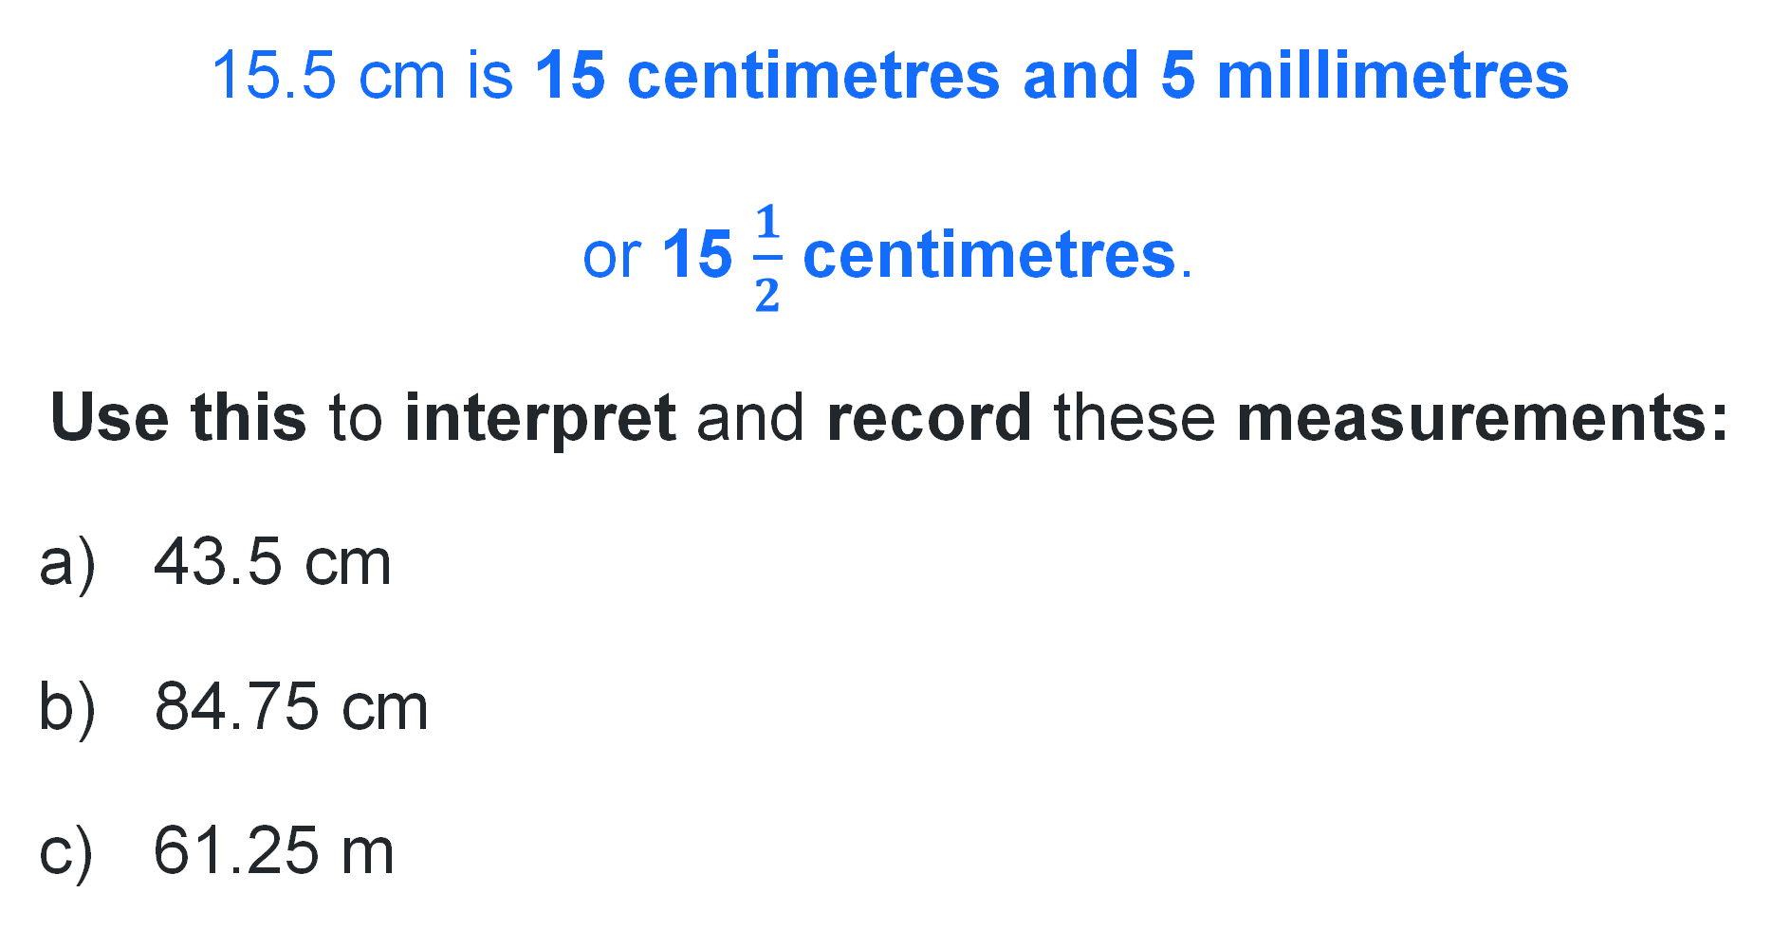
Short response (5)
15.5 cm is 15 centimetres and 5 millimetres
or 15 $\frac{1}{2}$ centimetres.
Use this to interpret and record these measurements:
43.5 cm
84.75 cm
61.25 m
Notes:
Short response questions provide brisk paced questions focussing on review of current and previous content to support spaced and interleaved practice.
Syllabus focus area:
Geometric measure B

Slide 14
Short response (6)
2564 × 3
Use the distributive property with partial products to solve this problem.
Notes:
Short response questions provide brisk paced questions focussing on review of current and previous content to support spaced and interleaved practice.
Syllabus focus area:
Multiplicative relations A

Slide 15
Short response (7)
Match the triangle with its classification.
A. no equal sides and no equal angles
equilateral
isosceles
scalene
B. 3 equal sides and 3 equal angles
C. 2 equal sides and 2 equal angles
Notes:
Short response questions provide brisk paced questions focussing on review of current and previous content to support spaced and interleaved practice.
Syllabus focus area:
Two-dimensional spatial structure A

Slide 16
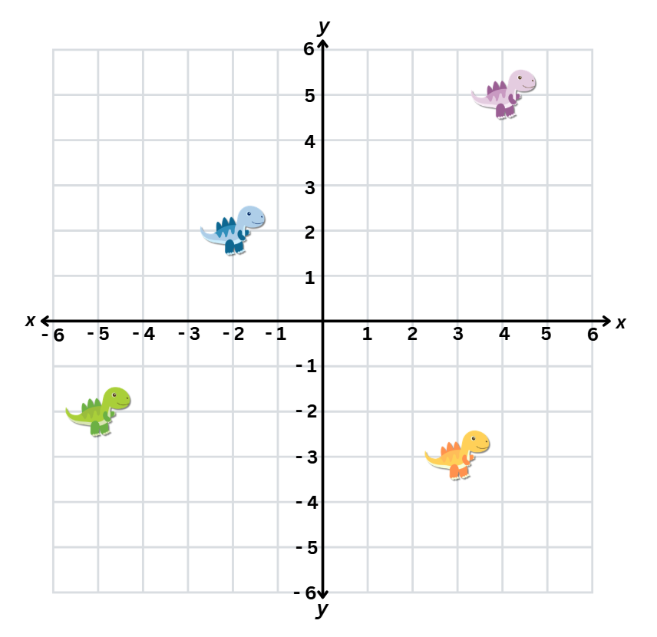

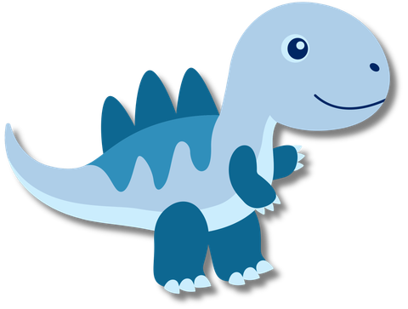
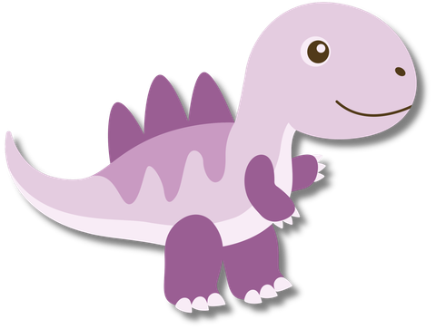
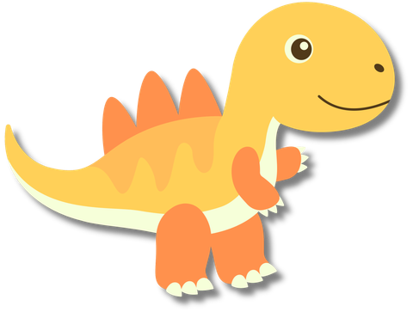
Short response (8)
Record the coordinates of each dinosaur on the Cartesian plane.​
Notes:
Short response questions provide brisk paced questions focussing on review of current and previous content to support spaced and interleaved practice.
Syllabus focus area:
Geometric measure B

Slide 17
Activity 2 – before and after decimals numbers
Before | Decimal number | After
 | 0.125
 | 2.065
 | 1.988
 | 6.107
 | 0.002
 | 0.999
Notes:
This is a developing number sense activity.
Number sense refers to a deep understanding of numbers, including their magnitude, relationships, and the effects of operations on them. It supports fluency and understanding, estimation, flexible thinking, and efficient problem-solving. Number sense activities 1–4 ‘activate’ prior number knowledge and support the learning of new content in the unit. Number sense activities 5–8 ‘loop’ back and provide opportunity for spaced practice with concepts and procedures covered in previous units.
Syllabus focus area:
Represents numbers A
Before and after decimal numbers
This resource corresponds to Resource 19 – before and after in Stage 3 Year A Unit 14.
Provide students with Resource 19 – before and after and writing materials.
Students record the decimal number that comes before and after each displayed decimal number.
Select students to say a chosen decimal number aloud and identify the ones, tenths, hundredths and thousandths.
Ask the following questions:
Which decimal is the largest? How do you know?
Which decimal is the smallest? How do you know?
Which decimal is closest to a whole number? Explain how you know.

Slide 18
Review of learning 3

Slide 19
Multiple choice (2)
6, 4, 5, 7
The largest decimal that can be made by arranging these numbers is:
A
B
C
D
4.567
6.574
7.654
7.645
Notes:
This question connects to the content in the developing number sense activity (Activity 3)
Syllabus focus area:
Represents numbers A

Slide 20
Short response (9)
Sofia ran 2600 m.
How many kilometres did she run?
Notes:
Short response questions provide brisk paced questions focussing on review of current and previous content to support spaced and interleaved practice.
Syllabus focus area:
Geometric measure B

Slide 21
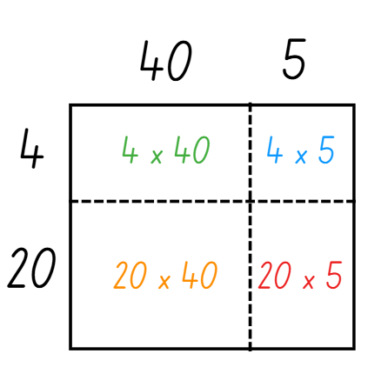
Short response (10)
Use the area model to solve:
24 × 45 =
Notes:
Short response questions provide brisk paced questions focussing on review of current and previous content to support spaced and interleaved practice.
Syllabus focus area:
Multiplicative relations A

Slide 22
Short response (11)
Match the quadrilateral with its classification.
square
rectangle
parallelogram
rhombus
A. 2 pairs of equal sides and 2 pairs of equal angles
B. 4 equal sides and 4 equal angles
C. 2 pairs of equal sides and 4 equal angles
D. 4 equal sides and 2 pairs of equal angles
Notes:
Short response questions provide brisk paced questions focussing on review of current and previous content to support spaced and interleaved practice.
Syllabus focus area:
Two-dimensional spatial structure A

Slide 23
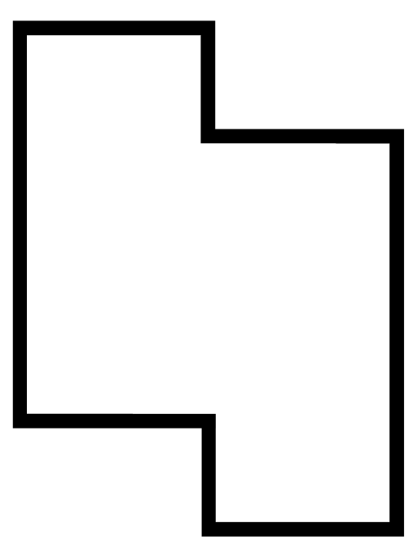
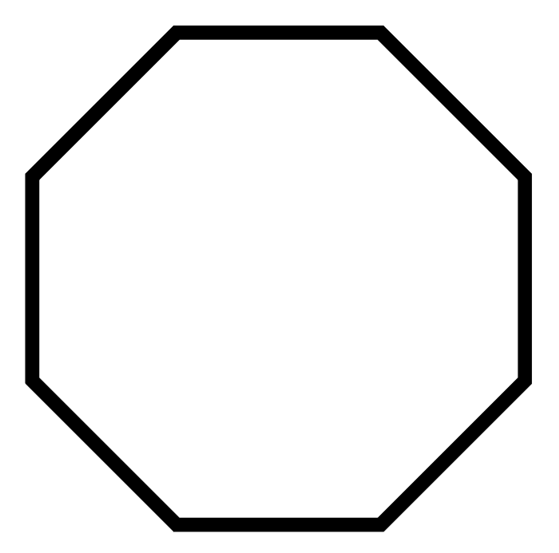
Short response (12)
Identify the
regular polygon
irregular polygon
1.
2.
Communicate your reasoning.
Notes:
Short response questions provide brisk paced questions focussing on review of current and previous content to support spaced and interleaved practice.
Syllabus focus area:
Two-dimensional spatial structure A

Slide 24
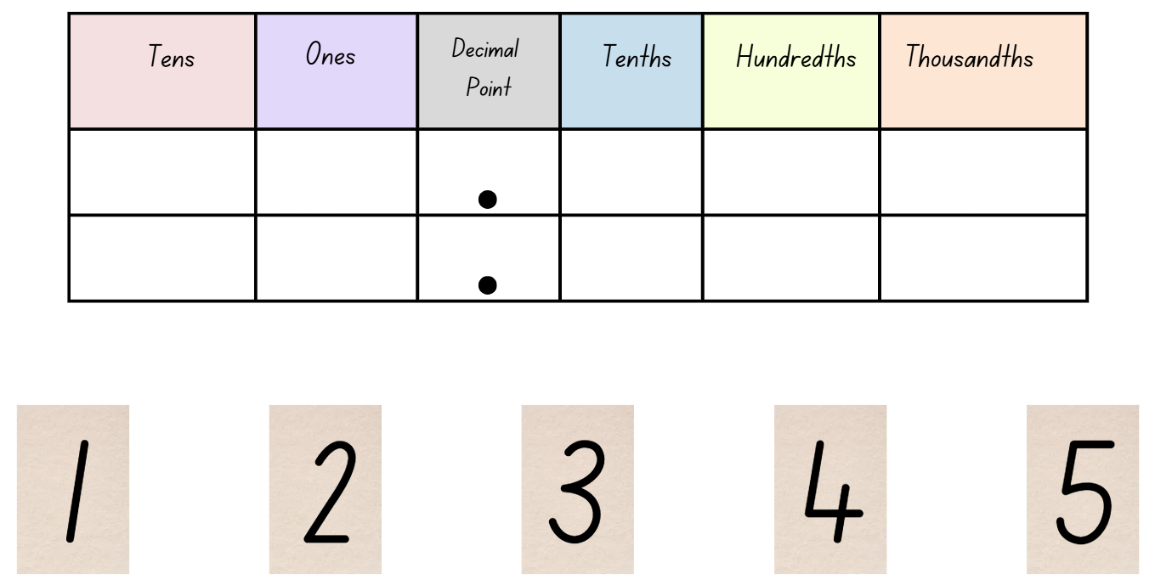
Activity 3 – making thousandths
Notes:
This is a developing number sense activity.
Number sense refers to a deep understanding of numbers, including their magnitude, relationships, and the effects of operations on them. It supports fluency and understanding, estimation, flexible thinking, and efficient problem-solving. Number sense activities 1–4 ‘activate’ prior number knowledge and support the learning of new content in the unit. Number sense activities 5–8 ‘loop’ back and provide opportunity for spaced practice with concepts and procedures covered in previous units.
Syllabus focus area:
Represents numbers A
Making thousandths
This resource corresponds to Resource 20 – making thousandths in Stage 3 Year A Unit 14.
Provide students with Resource 20 – making thousandths.
Instruct students to record the largest and the smallest decimal number that can be made using 4 of the digits. For example, the smallest decimal is 1.234 and the largest decimal is 5.432.
Select students to share and explain solutions. Ask:
How do you know your numbers are the largest and the smallest possible decimal numbers?
If you could repeat a digit, which one would it be and why?
What strategy is most helpful?
How did you check your solutions?
For an additional challenge, offer students to either repeat one digit or use a zero. Select students to explain which one they would select and why.

Slide 25
Review of learning 4

Slide 26
True or false (2)
0.725 is greater than 0.072
True | False
Communicate your reasoning.
Notes:
The question on this slide connects to the content being explored in the developing number sense activity (Activity 4)
Syllabus focus area:
Represents numbers A

Slide 27
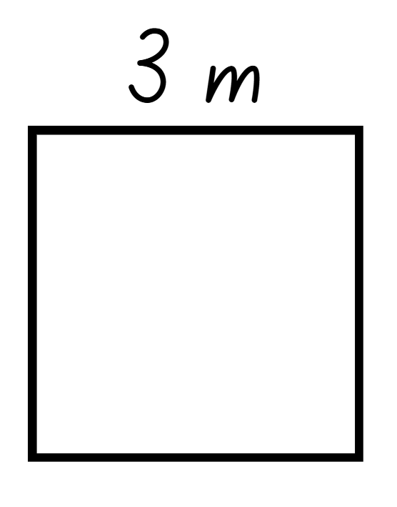
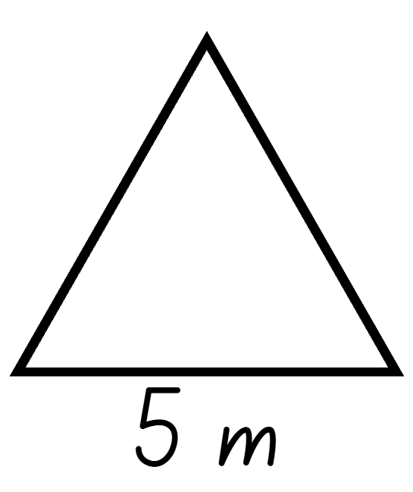
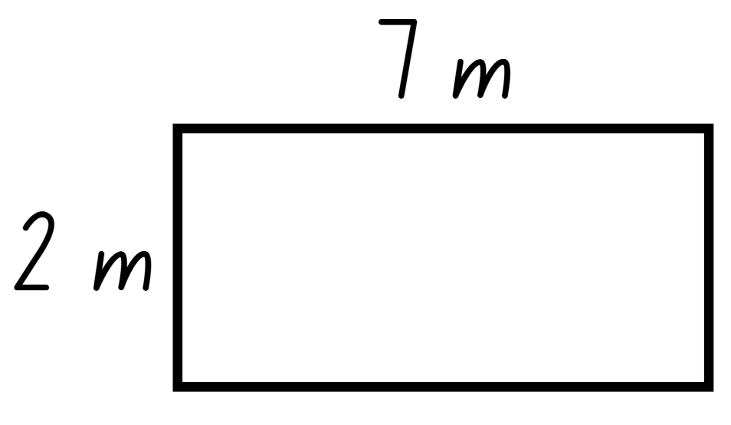
Short response (13)
What is the perimeter of each shape?
A
B
C
Notes:
Short response questions provide brisk paced questions focussing on review of current and previous content to support spaced and interleaved practice.
Syllabus focus area:
Geometric measure A

Slide 28
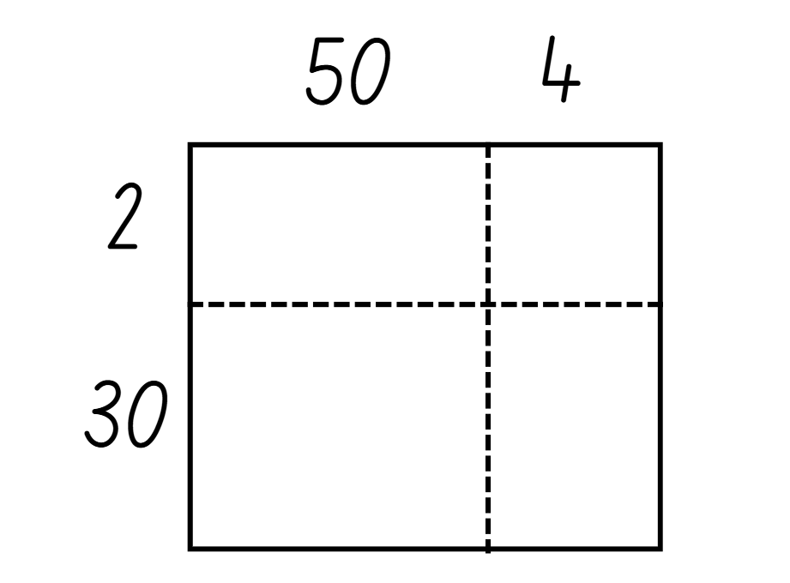
Short response (14)
Use the area model to solve:
32 × 54
Notes:
Short response questions provide brisk paced questions focussing on review of current and previous content to support spaced and interleaved practice.
Syllabus focus area:
Multiplicative relations A

Slide 29
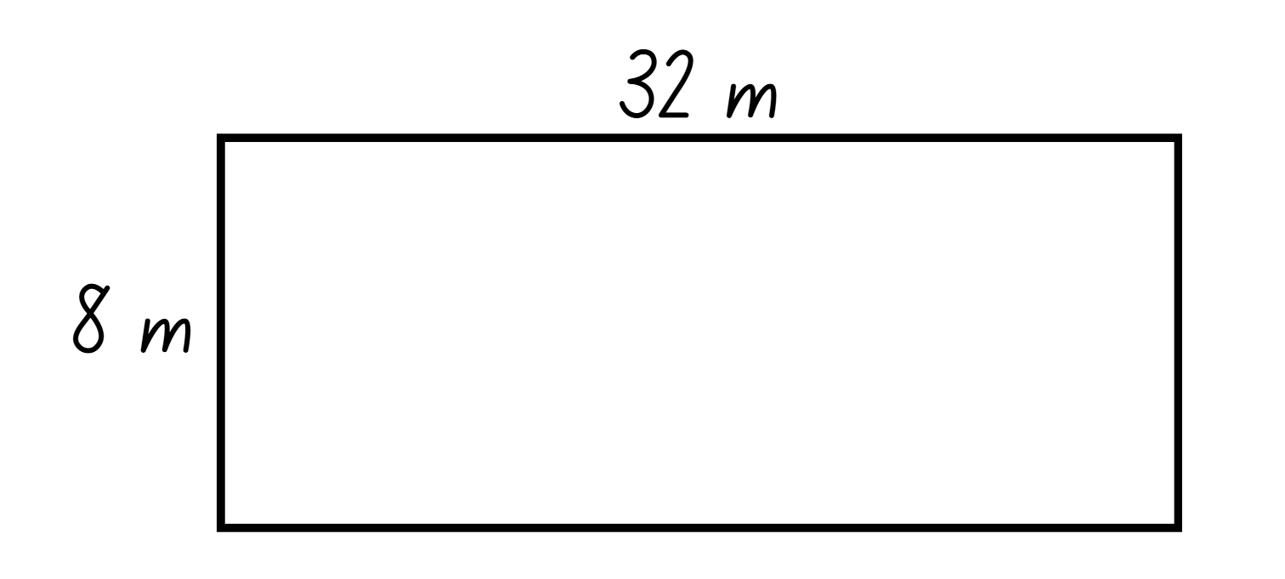
Short response (15)
Use the area model to calculate the area of this rectangle:
Notes:
Short response questions provide brisk paced questions focussing on review of current and previous content to support spaced and interleaved practice.
Syllabus focus area:
Multiplicative relations A

Slide 30
Short response (16)
Draw the net for this three-dimensional shape.
Notes:
Short response questions provide brisk paced questions focussing on review of current and previous content to support spaced and interleaved practice.
Syllabus focus area:
Three-dimensional spatial structure A

Slide 31
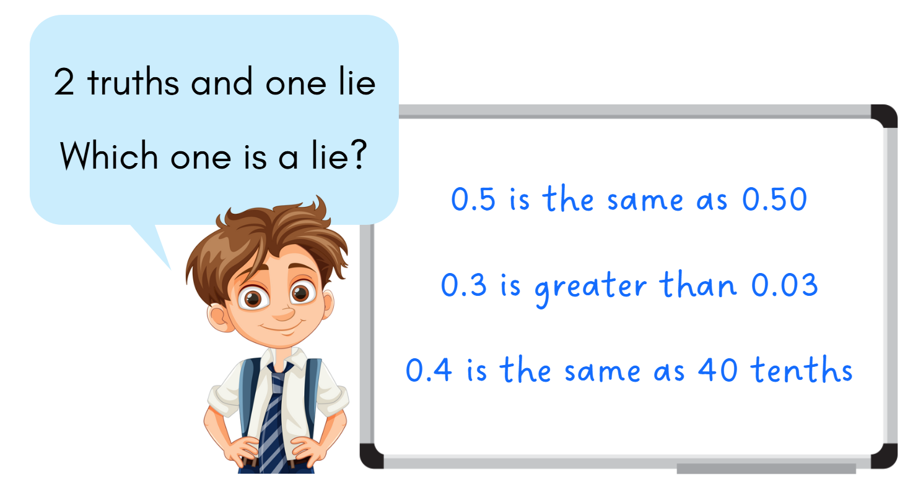
Activity 4 – decimals in the place value system
Notes:
This is a developing number sense activity.
Number sense refers to a deep understanding of numbers, including their magnitude, relationships, and the effects of operations on them. It supports fluency and understanding, estimation, flexible thinking, and efficient problem-solving. Number sense activities 1–4 ‘activate’ prior number knowledge and support the learning of new content in the unit. Number sense activities 5–8 ‘loop’ back and provide opportunity for spaced practice with concepts and procedures covered in previous units.
Syllabus focus area:
Represents numbers A
Decimals in the place value system
This activity is an adaptation of ‘2 truths 1 lie’ from Thinking mathematically resources by the State of New South Wales (Department of Education).
In pairs, students play ‘2 truths 1 lie’ by recording on their individual whiteboard 2 facts involving decimals and one lie. For example, a student could record 0.5 is the same as 0.50, 0.3 is greater than 0.03 and 0.4 is the same as 40 tenths.
Students swap whiteboards and identify which statements are true and which is the lie, justifying their reasoning.
Repeat with new statements.

Slide 32
Review of learning 5

Slide 33
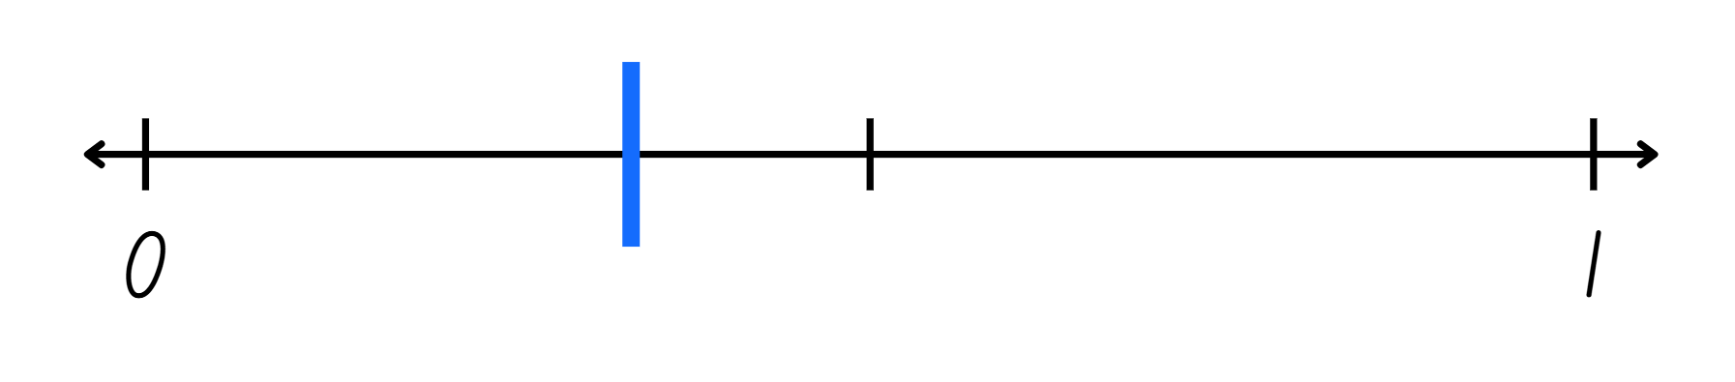
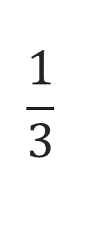
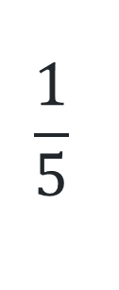
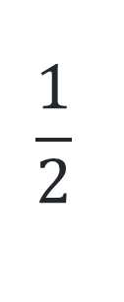
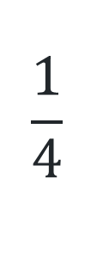
Multiple choice (3)
Which fraction would be located at the blue line?
A
B
C
D
$$\frac{1}{4}$$
$$\frac{1}{2}$$
$$\frac{1}{5}$$
$$\frac{1}{3}$$
Notes:
This question connects to the content in the developing number sense activity (Activity 5)
Syllabus focus area:
Representing quantity fractions A

Slide 34
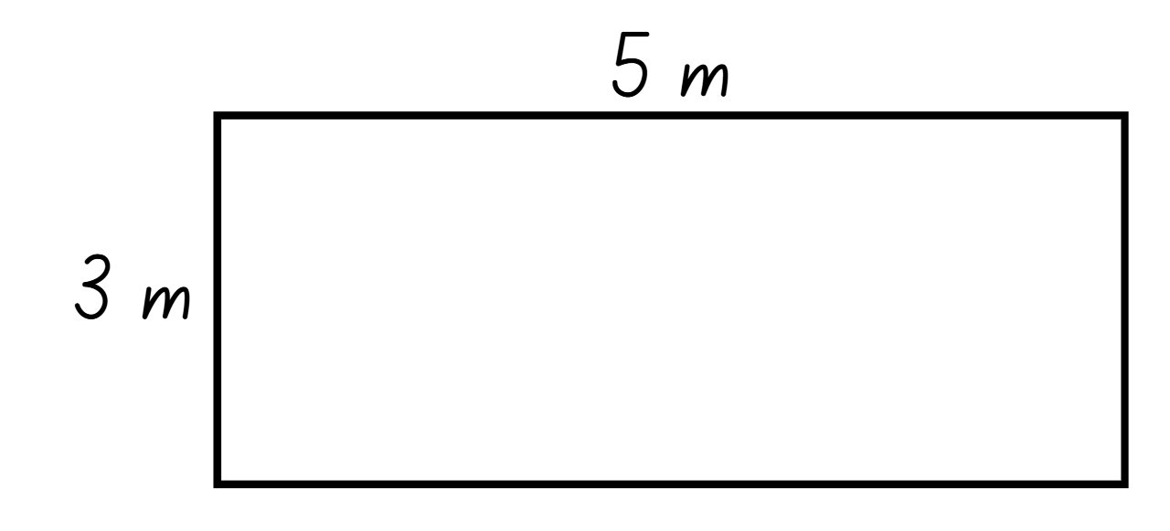
Short response (17)
This rectangle has a perimeter of 16 metres.
Draw and label a rectangle with the same perimeter but different side lengths.
Notes:
Short response questions provide brisk paced questions focussing on review of current and previous content to support spaced and interleaved practice.
Syllabus focus area:
Geometric measure A

Slide 35
Short response (18)
Choose the most appropriate multiplicative strategy to solve:
732 × 45
Communicate your reasoning.
Notes:
Short response questions provide brisk paced questions focussing on review of current and previous content to support spaced and interleaved practice.
Syllabus focus area:
Multiplicative relations A

Slide 36
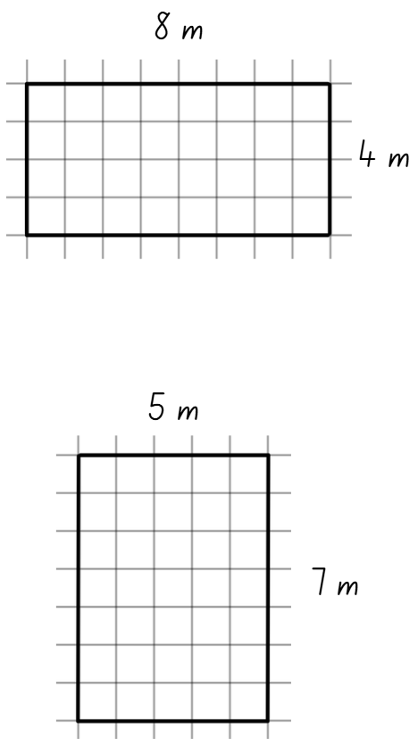
Short response (19)
Both rectangles have a perimeter of 24 metres.
Do they have the same area?
Communicate your reasoning.
Notes:
Short response questions provide brisk paced questions focussing on review of current and previous content to support spaced and interleaved practice.
Syllabus focus area:
Two-dimensional spatial structure A

Slide 37
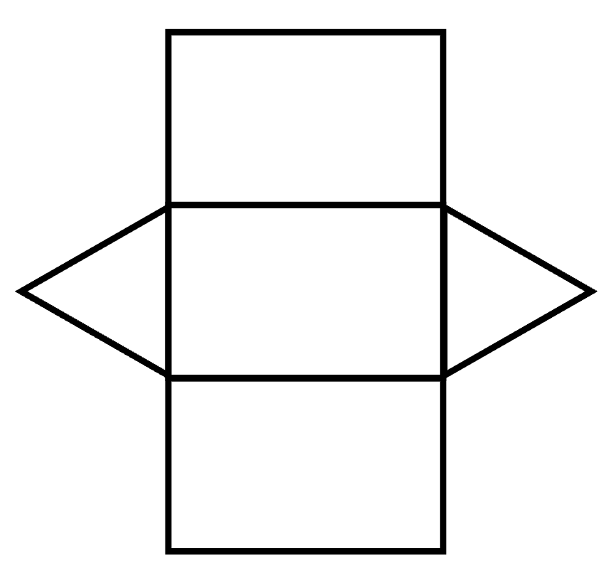
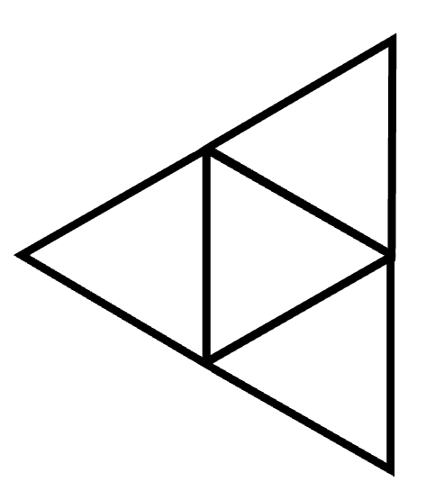
Short response (20)
A
Identify the
three-dimensional shapes from
these nets.
B
Notes:
Short response questions provide brisk paced questions focussing on review of current and previous content to support spaced and interleaved practice.
Syllabus focus area:
Three-dimensional spatial structure A

Slide 38
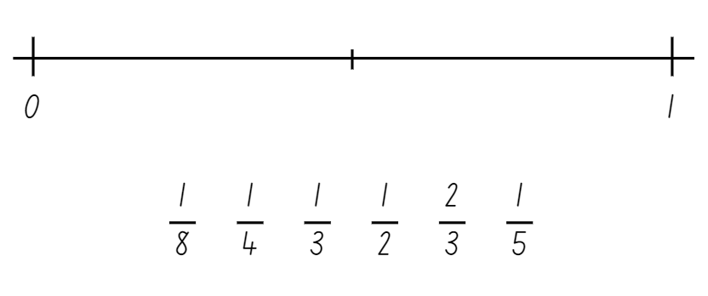
Activity 5 – order fractions
Notes:
This is a developing number sense activity.
Number sense refers to a deep understanding of numbers, including their magnitude, relationships, and the effects of operations on them. It supports fluency and understanding, estimation, flexible thinking, and efficient problem-solving. Number sense activities 1–4 ‘activate’ prior number knowledge and support the learning of new content in the unit. Number sense activities 5–8 ‘loop’ back and provide opportunity for spaced practice with concepts and procedures covered in previous units.
Syllabus focus area:
Representing quantity fractions A
Order fractions
This resource corresponds to Resource 21 – fractions in Stage 3 Year A Unit 14.
Provide students with Resource 21 – fractions. Students place the fractions in the correct place on the number line.
Students then add any other common fractions to the number line that they know. For example, one sixth.
Select students to share and explain the placement of the fractions.

Slide 39
Review of learning 6

Slide 40
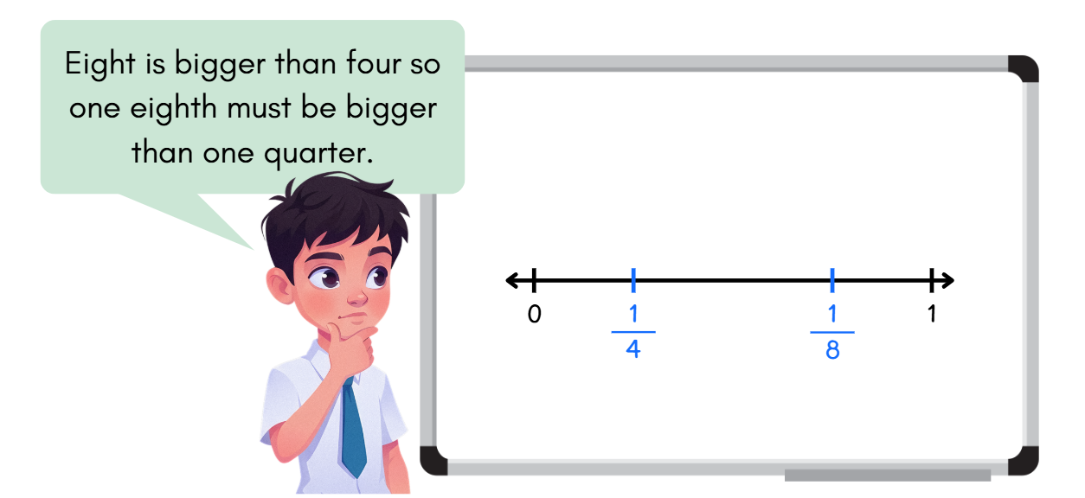
True or false (3)
True | False
Notes:
The question on this slide connects to the content being explored in the developing number sense activity (Activity 6)
Syllabus focus area:
Representing quantity fractions A

Slide 41
Short response (21)
Record these measurements using kilograms and grams:
3.06 kg
53.25 kg
7.308 kg
Notes:
Short response questions provide brisk paced questions focussing on review of current and previous content to support spaced and interleaved practice.
Syllabus focus area:
Non-spatial measure A

Slide 42
Short response (22)
38 ÷ 6
a) Draw an array to model the equation.
b) Record the inverse multiplication number sentence.
Notes:
Short response questions provide brisk paced questions focussing on review of current and previous content to support spaced and interleaved practice.
Syllabus focus area:
Multiplicative relations A

Slide 43
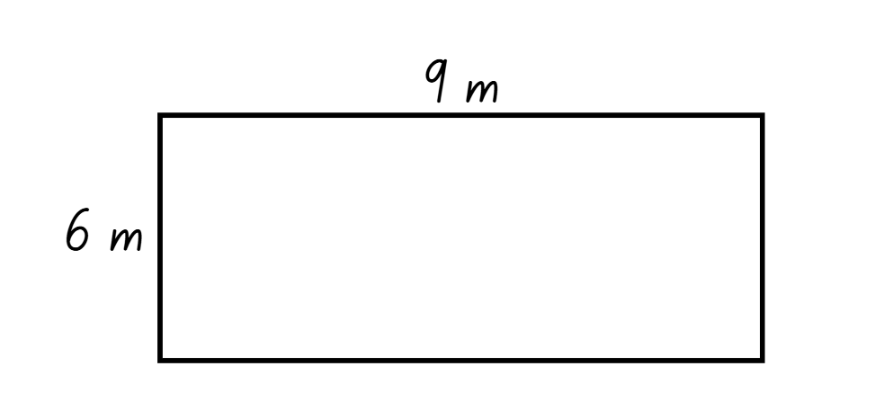
Short response (23)
Calculate the area of this rectangle:
Notes:
Short response questions provide brisk paced questions focussing on review of current and previous content to support spaced and interleaved practice.
Syllabus focus area:
Two-dimensional spatial structure A

Slide 44
Short response (24)
1800 hours is read as eighteen-hundred hours.
Using 24-hour time language, write how we would read:
1400 hours
1630 hours
0630 hours.
Notes:
Short response questions provide brisk paced questions focussing on review of current and previous content to support spaced and interleaved practice.
Syllabus focus area:
Non-spatial measure A

Slide 45
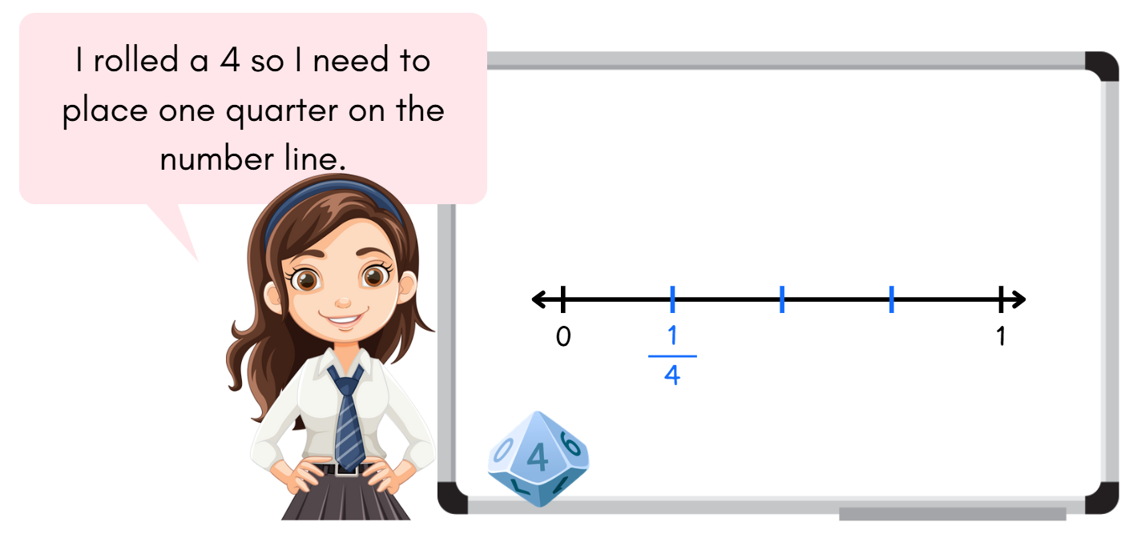
Activity 6 – fractions on a number line
Notes:
This is a developing number sense activity.
Number sense refers to a deep understanding of numbers, including their magnitude, relationships, and the effects of operations on them. It supports fluency and understanding, estimation, flexible thinking, and efficient problem-solving. Number sense activities 1–4 ‘activate’ prior number knowledge and support the learning of new content in the unit. Number sense activities 5–8 ‘loop’ back and provide opportunity for spaced practice with concepts and procedures covered in previous units.
Syllabus focus area:
Representing quantity fractions A
Fractions on a number line
Numerator: the top number is the numerator, which identifies the number of parts. The line separating the top number from the bottom number is called the fraction bar; it is also sometimes referred to as the ‘vinculum’.
Denominator: the bottom number is called the denominator and is the total number of equal parts the whole is broken into.
Unit fraction: a unit fraction can be defined as a fraction whose numerator is 1.
Provide each student with a 10-sided dice and an individual whiteboard. Students draw a number line from 0–1.
Revise the meaning of the denominator, numerator and fraction line.
Students roll the dice and use the number rolled as the denominator with the numerator always being one. For example, if students roll a 5 the fractions will be one fifth.
Students place the fraction on the number line in the correct location.
Select students to share and explain the placement of the fractions.

Slide 46
Review of learning 7

Slide 47
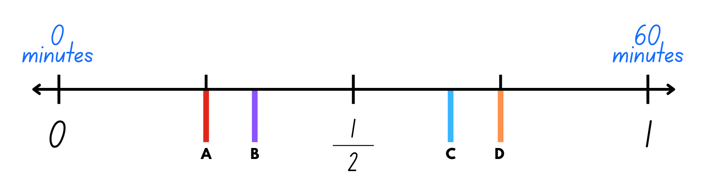
Multiple choice (4)
This number line shows 0 to 60 minutes.
Which letter would represent 40 minutes?
Notes:
This question connects to the content in the developing number sense activity (Activity 7)
Syllabus focus area:
Representing quantity fractions A

Slide 48
Short response (25)
Convert these measurements from grams to kilograms:
306 g
2305 g
9338 g
Notes:
Short response questions provide brisk paced questions focussing on review of current and previous content to support spaced and interleaved practice.
Syllabus focus area:
Non-spatial measure B

Slide 49
Short response (26)
Use your knowledge of multiples to partition and divide:
1628 ÷ 4
Notes:
Short response questions provide brisk paced questions focussing on review of current and previous content to support spaced and interleaved practice.
Syllabus focus area:
Multiplicative relations A

Slide 50
Short response (27)
Which area would be calculated using square kilometres?
swimming pool
local park
Communicate your reasoning.
Notes:
Short response questions provide brisk paced questions focussing on review of current and previous content to support spaced and interleaved practice.
Syllabus focus area:
Two-dimensional spatial structure A

Slide 51
Short response (28)
Convert to 12-hour time using am or pm notation:
2330 hours
1745 hours
0815 hours.
Notes:
Short response questions provide brisk paced questions focussing on review of current and previous content to support spaced and interleaved practice.
Syllabus focus area:
Non-spatial measure A

Slide 52
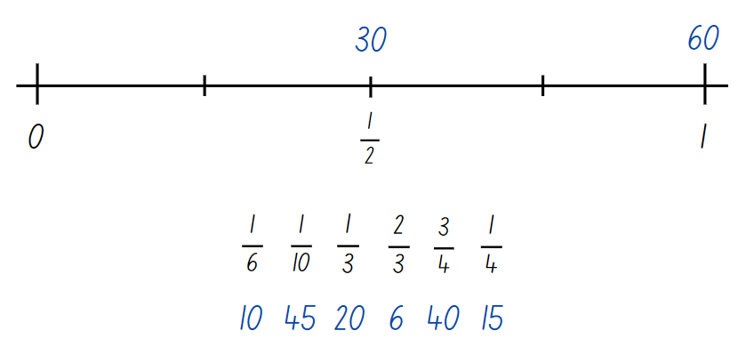
Activity 7 – fraction of time
Notes:
This is a developing number sense activity.
Number sense refers to a deep understanding of numbers, including their magnitude, relationships, and the effects of operations on them. It supports fluency and understanding, estimation, flexible thinking, and efficient problem-solving. Number sense activities 1–4 ‘activate’ prior number knowledge and support the learning of new content in the unit. Number sense activities 5–8 ‘loop’ back and provide opportunity for spaced practice with concepts and procedures covered in previous units.
Syllabus focus area:
Representing quantity fractions A
Fraction of time
This resource corresponds to Resource 22 – fraction line in Stage 3 Year A Unit 14.
Ask in what situation one whole equals 60 of something.
Note: provide time for students to make the connection between one hour and 60 minutes, or prompt them if needed.
Explain that on Resource 22 – fraction line students need to place the fractions in the correct place on the number line and then record the equivalent minutes above the line (see Figure 6).
Select students to share and explain their placement of the fractions and the equivalent minutes.

Slide 53
Review of learning 8

Slide 54
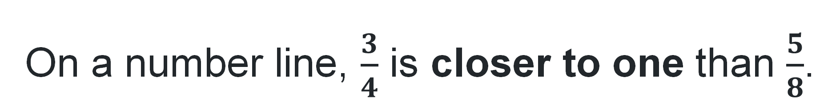
True or false (4)
On a number line, $\frac{3}{4}$ is closer to one than $\frac{5}{8}$.
True | False
Notes:
The question on this slide connects to the content being explored in the developing number sense activity (Activity 8)
Syllabus focus area:
Representing quantity fractions A

Slide 55
Short response (29)
Convert these measurements from kilograms to tonnes:
3650 kg
6605 kg
8002 kg
Notes:
Short response questions provide brisk paced questions focussing on review of current and previous content to support spaced and interleaved practice.
Syllabus focus area:
Non-spatial measure B

Slide 56
Short response (30)
Use repeated halving to solve:
4 identical bicycles cost $5408, what is the cost of one bicycle?
Notes:
Short response questions provide brisk paced questions focussing on review of current and previous content to support spaced and interleaved practice.
Syllabus focus area:
Multiplicative relations A

Slide 57
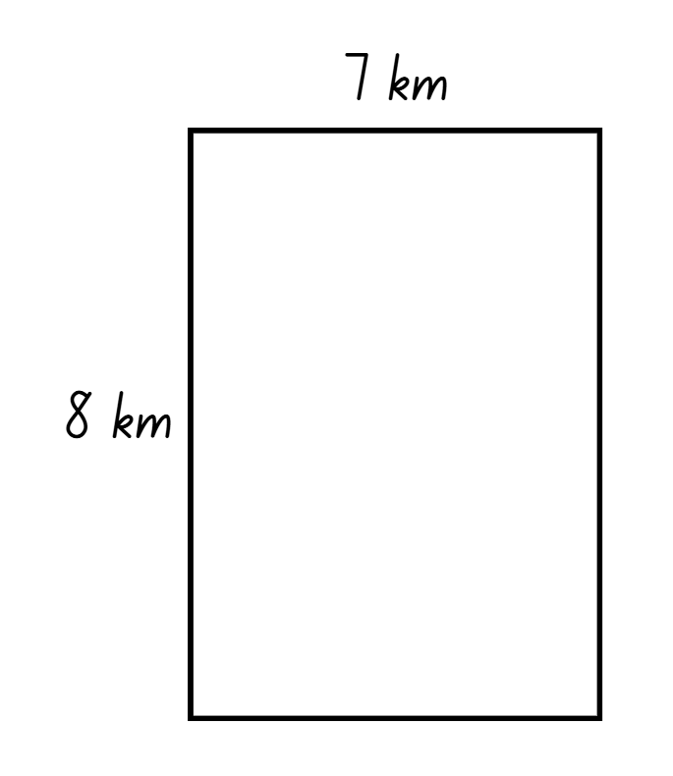
Short response (31)
Calculate the area of this rectangle.
Notes:
Short response questions provide brisk paced questions focussing on review of current and previous content to support spaced and interleaved practice.
Syllabus focus area:
Two-dimensional spatial structure A

Slide 58
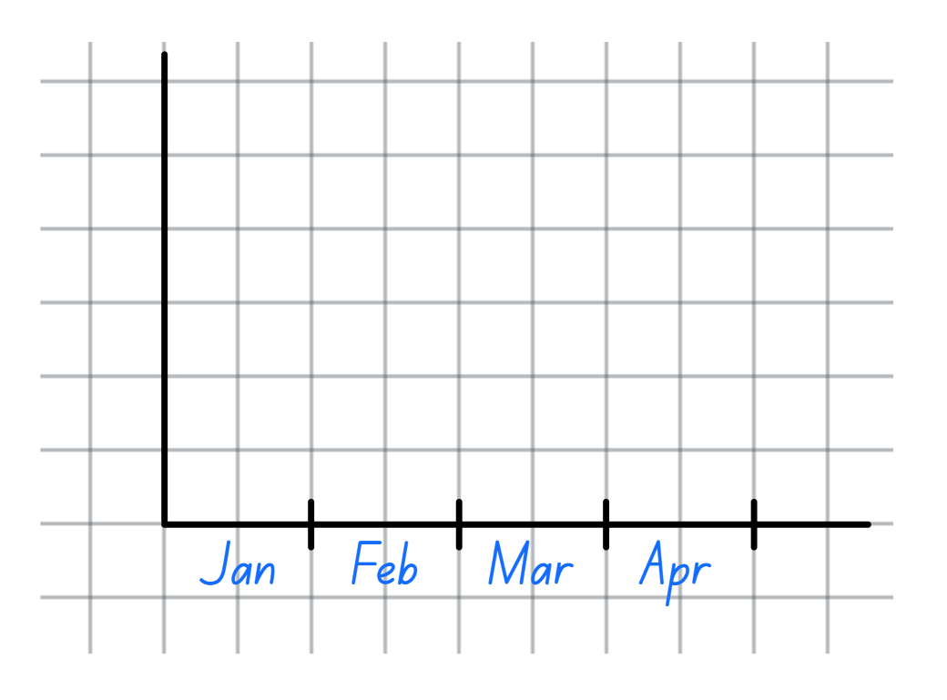
Short response (32)
Seb needs to choose an appropriate vertical scale for this graph to represent the following number of books read each month.
Jan: 2
Feb: 5
Mar: 9
Apr: 12
What would be an appropriate vertical scale?
Notes:
Short response questions provide brisk paced questions focussing on review of current and previous content to support spaced and interleaved practice.
Syllabus focus area:
Data A

Slide 59
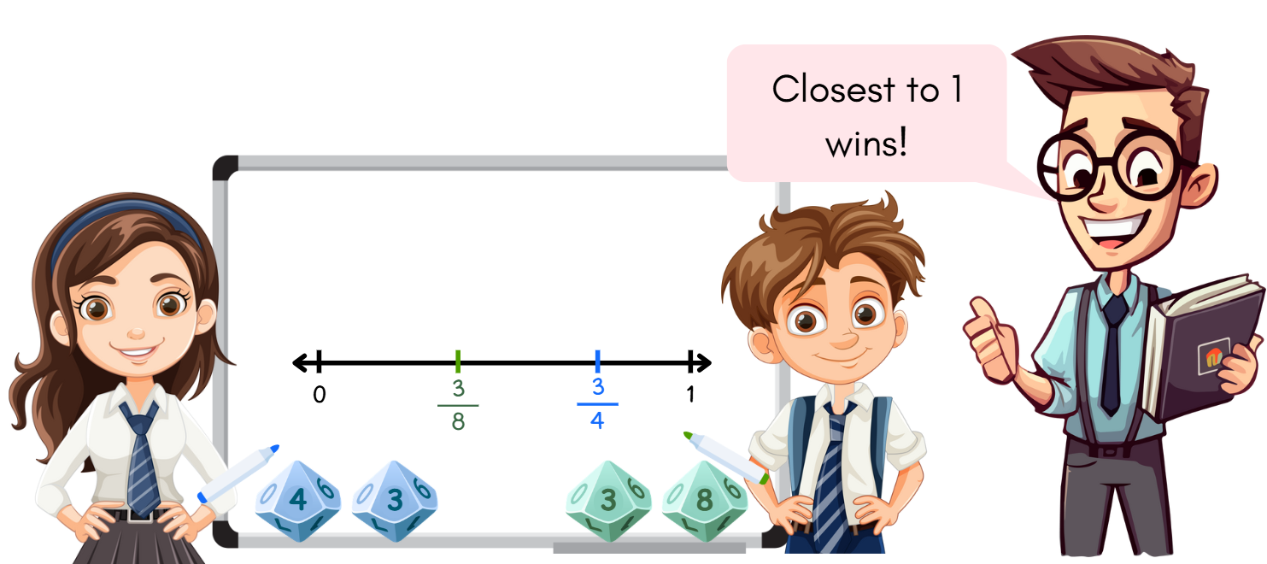
Activity 8 – compare and order fractions
Notes:
This is a developing number sense activity.
Number sense refers to a deep understanding of numbers, including their magnitude, relationships, and the effects of operations on them. It supports fluency and understanding, estimation, flexible thinking, and efficient problem-solving. Number sense activities 1–4 ‘activate’ prior number knowledge and support the learning of new content in the unit. Number sense activities 5–8 ‘loop’ back and provide opportunity for spaced practice with concepts and procedures covered in previous units.
Syllabus focus area:
Representing quantity fractions A
Compare and order fractions
In pairs, provide students with two 10-sided dice and an individual whiteboard. Students draw a number line from 0–1.
Students roll the dice and use the numbers rolled to make a fraction (no greater than 1). For example, if students rolled a 5 and an 8, the fraction would be five eighths. Students then write the fraction on the number line in the correct location.
Once both students have created a fraction and placed it on the number line, the teacher announces the winning location such as closest to one, closest to zero, closest to 0.5, and so on.

Slide 60
Double Venn diagram
Object 1
Object 2
Features similar to both objects
Features of object 1
Features of object 2

Slide 61
Frayer
Definition
Facts/Characteristics
Word, term, concept
Examples
Non-examples

Slide 62
Spider map
Idea
Subject

Slide 63
Cline
Concept 1
Concept 2
Word
Word
Word
Word
Word
Word
Word
Word
Word
Word
Word

Slide 64
Compare and contrast

Slide 65
Multiple choice (5)
A
B
C
D

Slide 66
Multiple choice
A
B
C
D
Notes:
This question connects to the content in the developing number sense activity (Activity 3)
Syllabus focus area:
[Focus area A/B]

Slide 67
References (1)
This presentation contains NSW Curriculum and syllabus content. The NSW Curriculum is developed by the NSW Education Standards Authority. This content is prepared by NESA for and on behalf of the Crown in the right of the State of New South Wales. The material is protected by Crown copyright.
Please refer to the NESA Copyright Disclaimer for more information https://educationstandards.nsw.edu.au/wps/portal/nesa/mini-footer/copyright.
NESA holds the only official and up-to-date versions of the NSW Curriculum and syllabus documents. Please visit the NSW Education Standards Authority (NESA) website https://educationstandards.nsw.edu.au/wps/portal/nesa/home and the NSW Curriculum website https://curriculum.nsw.edu.au.
Mathematics K–10 Syllabus © NSW Education Standards Authority (NESA) for and on behalf of the Crown in right of the State of New South Wales, 2022.
National Numeracy Learning Progression © Australian Curriculum, Assessment and Reporting Authority (ACARA) 2010 to present, unless otherwise indicated. This material was downloaded from the Australian Curriculum website (National Numeracy Learning Progression) (accessed 25 February 2026) and was not modified.
Australian Academy of Science (2020) ‘Measurement: Jump!’, Classic sequences for AC V8.4, reSolve website, accessed 25 February 2026.
Grant J, Lewis E and Woods A (2007) Cambridge Maths in-a-Box 3, Cambridge University Press, Australia.
Lenchner G (2022) Creative Problem Solving in School Mathematics, Australasian Problem Solving Mathematical Olympiad (APSMO), Australia.
New Zealand Ministry of Education (n.d.) ‘Weighty Problems’, Resource, NZ Maths website, accessed 25 February 2026.

Slide 68
References (2)
This presentation contains NSW Curriculum and syllabus content. The NSW Curriculum is developed by the NSW Education Standards Authority. This content is prepared by NESA for and on behalf of the Crown in the right of the State of New South Wales. The material is protected by Crown copyright.
Please refer to the NESA Copyright Disclaimer for more information https://educationstandards.nsw.edu.au/wps/portal/nesa/mini-footer/copyright.
NESA holds the only official and up-to-date versions of the NSW Curriculum and syllabus documents. Please visit the NSW Education Standards Authority (NESA) website https://educationstandards.nsw.edu.au/wps/portal/nesa/home and the NSW Curriculum website https://curriculum.nsw.edu.au.
State of New South Wales (Department of Education) (2023) ‘Stage 3 Mass’, Universal Resources Hub, NSW Department of Education website, accessed 25 February 2026.
——(2024) ‘2 truths 1 lie (whole numbers)’, Thinking mathematically resources, NSW Department of Education website, accessed 9 April 2026.
Sullivan P (2017) Challenging Mathematical Tasks: Unlocking the Potential of All Students, Oxford University Press ANZ, Great Britain.
Sullivan P and Lilburn P (2017) Open-ended Maths Activities: Using ‘Good’ Questions to Enhance Learning in Mathematics, Revised edn, Oxford University Press ANZ, Great Britain.

Slide 69
Copyright
© State of New South Wales (Department of Education), 2025
The copyright material published in this resource is subject to the Copyright Act 1968 (Cth) and is owned by the NSW Department of Education or, where indicated, by a party other than the NSW Department of Education (third-party material).
Copyright material available in this resource and owned by the NSW Department of Education is licensed under a Creative Commons Attribution 4.0 International (CC BY 4.0) license.
This license allows you to share and adapt the material for any purpose, even commercially.
Attribution should be given to © State of New South Wales (Department of Education), 2025.
Material in this resource not available under a Creative Commons license:
the NSW Department of Education logo, other logos and trademark-protected material
Material owned by a third party that has been reproduced with permission. You will need to obtain permission from the third party to reuse its material.
Links to third-party material and websites
Please note that the provided (reading/viewing material/list/links/texts) are a suggestion only and implies no endorsement, by the New South Wales Department of Education, of any author, publisher, or book title. School principals and teachers are best placed to assess the suitability of resources that would complement the curriculum and reflect the needs and interests of their students.
If you use the links provided in this document to access a third party’s website, you acknowledge that the terms of use, including licence terms set out on the third-party’s website apply to the use which may be made of the materials on that third-party website or where permitted by the Copyright Act 1968 (Cth). The department accepts no responsibility for content on third-party websites.

