Slide 1
Instructions for use
This resource aligns to the learning in Stage 3 Year A Unit 15 and revisits content from earlier sample units.
Classroom teachers are encouraged to add and adapt slides as required to meet the needs of their students.
Save a copy of the file to make changes to the slide deck. Go to File > Download a Copy (this downloads a copy to the computer to edit in the PowerPoint app).
To convert the PowerPoint to Google Slides:
  Upload the file into Google Drive and open it.
  Go to File > Save as Google Slides.
  (Note – conversion may cause formatting changes in the slides.)

Slide 2

Review of Learning
Mathematics Stage 3 – Unit 15
Notes:
Reviews may include a combination of question types, requiring students to recall facts and key ideas, as well as apply their knowledge to solve problems and answer questions. To support active engagement, a mix of techniques should be employed.” (AERO, 2024).
This Review of Learning slide deck revisits key concepts from the following units:
Stage 3 Year A Unit 15
Stage 3 Year A Unit 14
Stage 3 Year A Unit 13
It also includes opportunities to review prior learning in non-number content, supporting consolidation across focus areas.
The review of learning resources include three key task types that support the development of mathematical proficiency through retrieval, spaced practice, and active participation. These practices complement the review phase (activating prior knowledge) embedded within the beginning of each lesson.
1.
Multiple-choice questions/True or false: Designed to promote active retrieval of key concepts and identify common misconceptions in number, supporting consolidation, understanding and fluency.
These questions:
support spaced and interleaved practice
help identify and address common misconceptions
support active recall and immediate feedback
support whole class participation
identify areas requiring reteach
2.
Short-response question sets: Carefully grouped questions that encourage spaced and interleaved practice across multiple focus areas, helping students revisit and apply knowledge from different points in time.
These questions:
have a combination of question types
address a range of focus areas
build automaticity and fluency
support active recall
allow for immediate feedback
identify content requiring reteach
3.
Developing number sense activities: A variety of practical, purposeful tasks that reinforce current learning and build on prior knowledge. These activities promote reasoning, problem-solving and conceptual understanding.
The review of learning resources are designed to work support teaching and learning in mathematics. For the most effective implementation, use the resources flexibly, adapting to meet student learning needs and individual classroom contexts.

Slide 3
Lessons
1
Review of learning 1
5
Review of learning 5
2
Review of learning 2
6
Review of learning 6
3
Review of learning 3
7
Review of learning 7
4
Review of learning 4
8
Review of learning 8
Notes:
Teacher notes:
Click lesson titles to go to specific lessons
Interactive features can be viewed in slide show

Slide 4
Review of learning 1

Slide 5

Multiple choice (1)
Choose the most efficient strategy to round each number to the nearest 100 when estimating the total for 6754 + 7892
A
6700 + 7800
B
6750 + 7890
C
6800 + 7900
D
6800 + 7800
Notes:
This question connects to the content in the developing number sense activity (Activity 1)
Syllabus focus area:
Additive relations A

Slide 6

Short response (1)
Match these decimals to the positions on the number line.
A
B
C
D
0
1
2
1.45
0.45
0.80
1.05
Notes:
Short response questions provide brisk paced questions focussing on review of current and previous content to support spaced and interleaved practice.
Syllabus focus area:
Represents numbers A

Slide 7
Short response (2)
8.85 m is:
______ m and _____ cm.
Notes:
Short response questions provide brisk paced questions focussing on review of current and previous content to support spaced and interleaved practice.
Syllabus focus area:
Geometric measure B

Slide 8
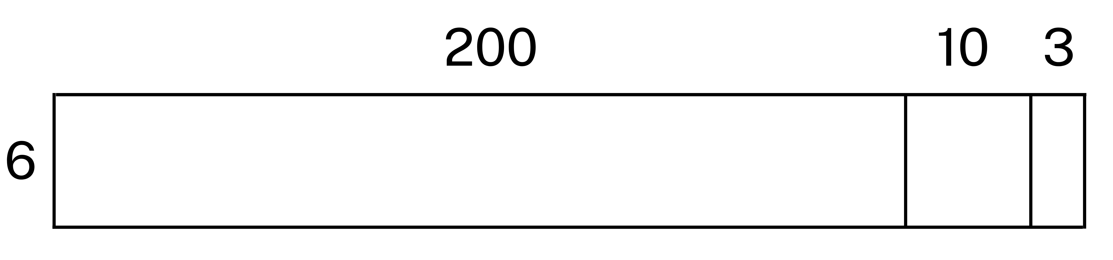
Short response (3)
Estimate the total for 213 x 6, then use the area model to solve.
Notes:
Short response questions provide brisk paced questions focussing on review of current and previous content to support spaced and interleaved practice.
Syllabus focus area:
Multiplicative relations A

Slide 9
Short response (4)
Why might the expected frequency differ to the observed frequency of an outcome in a chance experiment?
Notes:
Short response questions provide brisk paced questions focussing on review of current and previous content to support spaced and interleaved practice.
Syllabus focus area:
Chance B

Slide 10

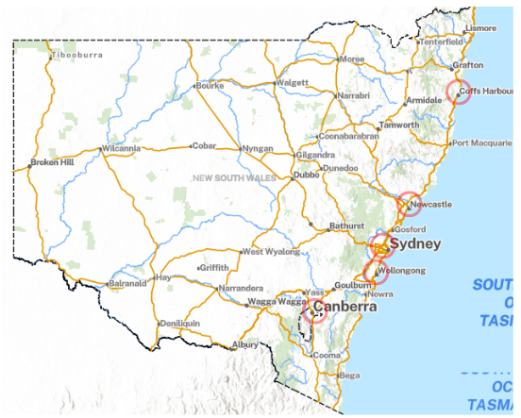
Activity 1 – distance across NSW
Notes:
This is a developing number sense activity.
Number sense refers to a deep understanding of numbers, including their magnitude, relationships, and the effects of operations on them. It supports fluency and understanding, estimation, flexible thinking, and efficient problem-solving. Number sense activities 1–4 ‘activate’ prior number knowledge and support the learning of new content in the unit. Number sense activities 5–8 ‘loop’ back and provide opportunity for spaced practice with concepts and procedures covered in previous units.
Syllabus focus area:
Additive relations A
Distance across NSW
This resource corresponds to Resource 23 – NSW map in Stage 3 Year A Unit 15.
Discuss Resource 23 – NSW map.
Explain the following scenario: Imagine your family is planning a road trip in New South Wales and the Australian Capital Territory. You have the following distances to consider:
- Sydney City (Gadigal Country) to Newcastle (Awabakal Country): 117 kilometres
- Sydney to Wollongong (Dharawal Country): 68 kilometres
- Wollongong to Coffs Harbour (Gumbaynggirr Country): 504 kilometres
- Coffs Harbour to Sydney: 623 kilometres
- Sydney to Canberra (Ngunnawal Country): 286 kilometres
- Canberra to Wollongong: 235 kilometres.
Explain that students need to choose 4 destinations, then estimate the total distance to travel between them.
Explain that when making an estimate, it is not necessary to calculate the actual distance. Instead, each distance can be rounded to the nearest 10 or 100 kilometres so that it is easier to estimate the total distance.
Students estimate the total distance they would travel for their road trip visiting at least 4 of the destinations.
Regroup and ask questions such as:
- What is your estimated total distance?
- What strategies did you use to help you find the estimate for your road trip?
- If your car uses one litre of petrol for every 10 kilometres, how much petrol will you need for your journey?

Slide 11
Review of learning 2

Slide 12
True or false (1)
2357 + 6106 = 8463
Using estimation, this answer is reasonable.
True | False
Notes:
The question on this slide connects to the content being explored in the developing number sense activity (Activity 2)
Syllabus focus area:
Additive relations A

Slide 13
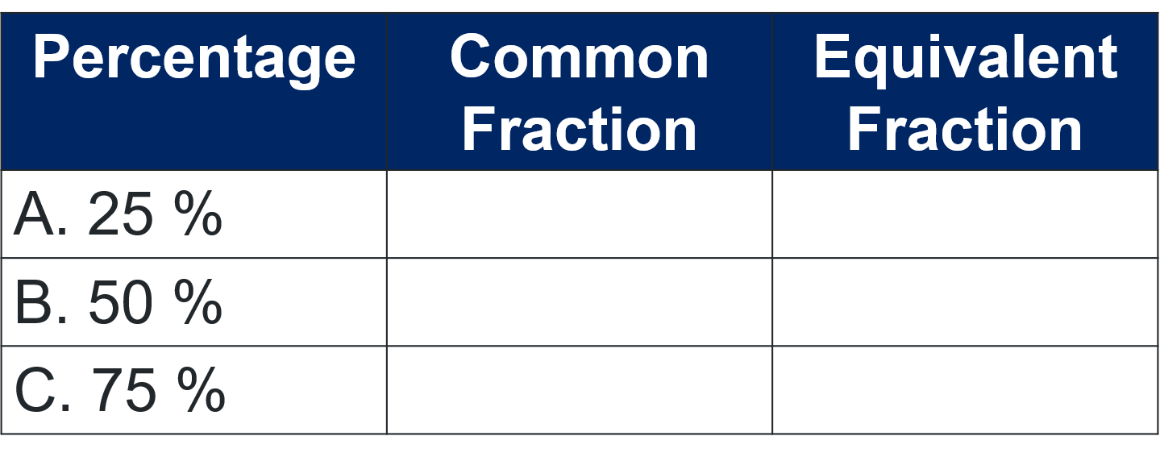
Short response (5)
Represent each percentage as a common fraction and a related equivalent fraction.
Notes:
Short response questions provide brisk paced questions focussing on review of current and previous content to support spaced and interleaved practice.
Syllabus focus area:
Represents number B

Slide 14
Short response (6)
Convert:
a) 3650 m to km
b) 8 kilometres 250 metres to m
Notes:
Short response questions provide brisk paced questions focussing on review of current and previous content to support spaced and interleaved practice.
Syllabus focus area:
Geometric measure B

Slide 15
Short response (7)
Use the distributive property with partial products to solve:
4568 x 8
Notes:
Short response questions provide brisk paced questions focussing on review of current and previous content to support spaced and interleaved practice.
Syllabus focus area:
Multiplicative relations A

Slide 16

Short response (8)
Is the coin flip game ‘heads or tails’ fair?
Is the game random?
Communicate your reasoning.
Notes:
Short response questions provide brisk paced questions focussing on review of current and previous content to support spaced and interleaved practice.
Syllabus focus area:
Chance B

Slide 17
Activity 2 – estimation
Justify if the answers are reasonable or unreasonable:
812 + 514 = 1514
923 + 346 = 1200
2357 + 6106 = 8460
4216 + 3942 = 8000
43 892 + 92 106 = 135 900
628 − 413 = 215
781 − 234 = 550
7842 − 5209 = 2600
8456 − 4234 = 6120
73 812 – 28 492 = 40 320
Notes:
This is a developing number sense activity.
Number sense refers to a deep understanding of numbers, including their magnitude, relationships, and the effects of operations on them. It supports fluency and understanding, estimation, flexible thinking, and efficient problem-solving. Number sense activities 1–4 ‘activate’ prior number knowledge and support the learning of new content in the unit. Number sense activities 5–8 ‘loop’ back and provide opportunity for spaced practice with concepts and procedures covered in previous units.
Syllabus focus area:
Additive relations A
Estimation
Revise the purpose of estimating. Emphasise that students should not calculate an answer.
Using their whiteboard, students estimate the total of some of the following equations. Students need to justify if the answers are reasonable or unreasonable:
812 + 514 = 1514
923 + 346 = 1200
2357 + 6106 = 8460
4216 + 3942 = 8000
43 892 + 92 106 = 135 900
628 − 413 = 215
781 − 234 = 550
7842 − 5209 = 2600
8456 − 4234 = 6120
73 812 – 28 492 = 40 320.
Select students to share their thinking.

Slide 18
Review of learning 3

Slide 19
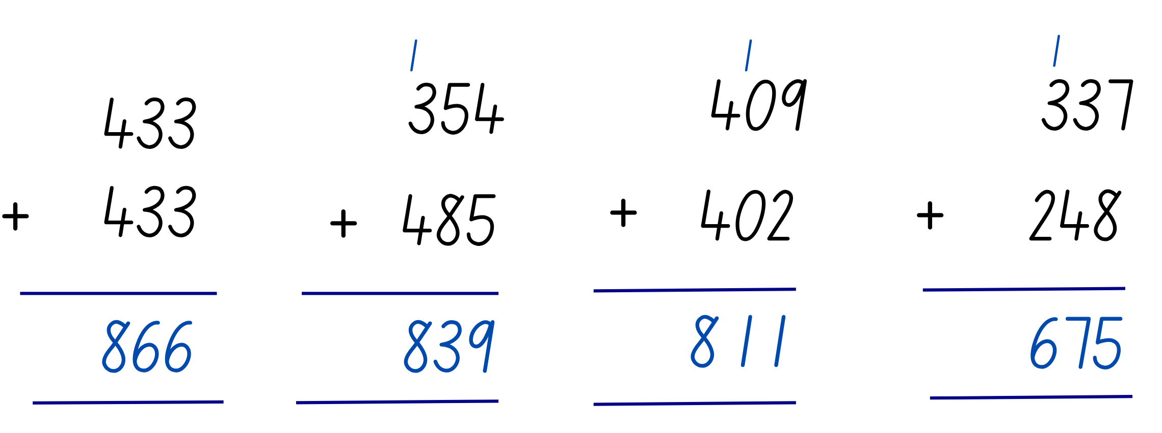
Multiple choice (2)
Which algorithm has a place value error?
A
B
C
D
Notes:
This question connects to the content in the developing number sense activity (Activity 3)
Syllabus focus area:
Additive relations A

Slide 20
Short response (9)
Complete the sentences:
To find 10% the total amount is divided by _____.
To find 25% or one quarter, the total amount is divided by _____.
To find 50% the total amount is divided by _____.
Notes:
Short response questions provide brisk paced questions focussing on review of current and previous content to support spaced and interleaved practice.
Syllabus focus area:
Represents number B

Slide 21
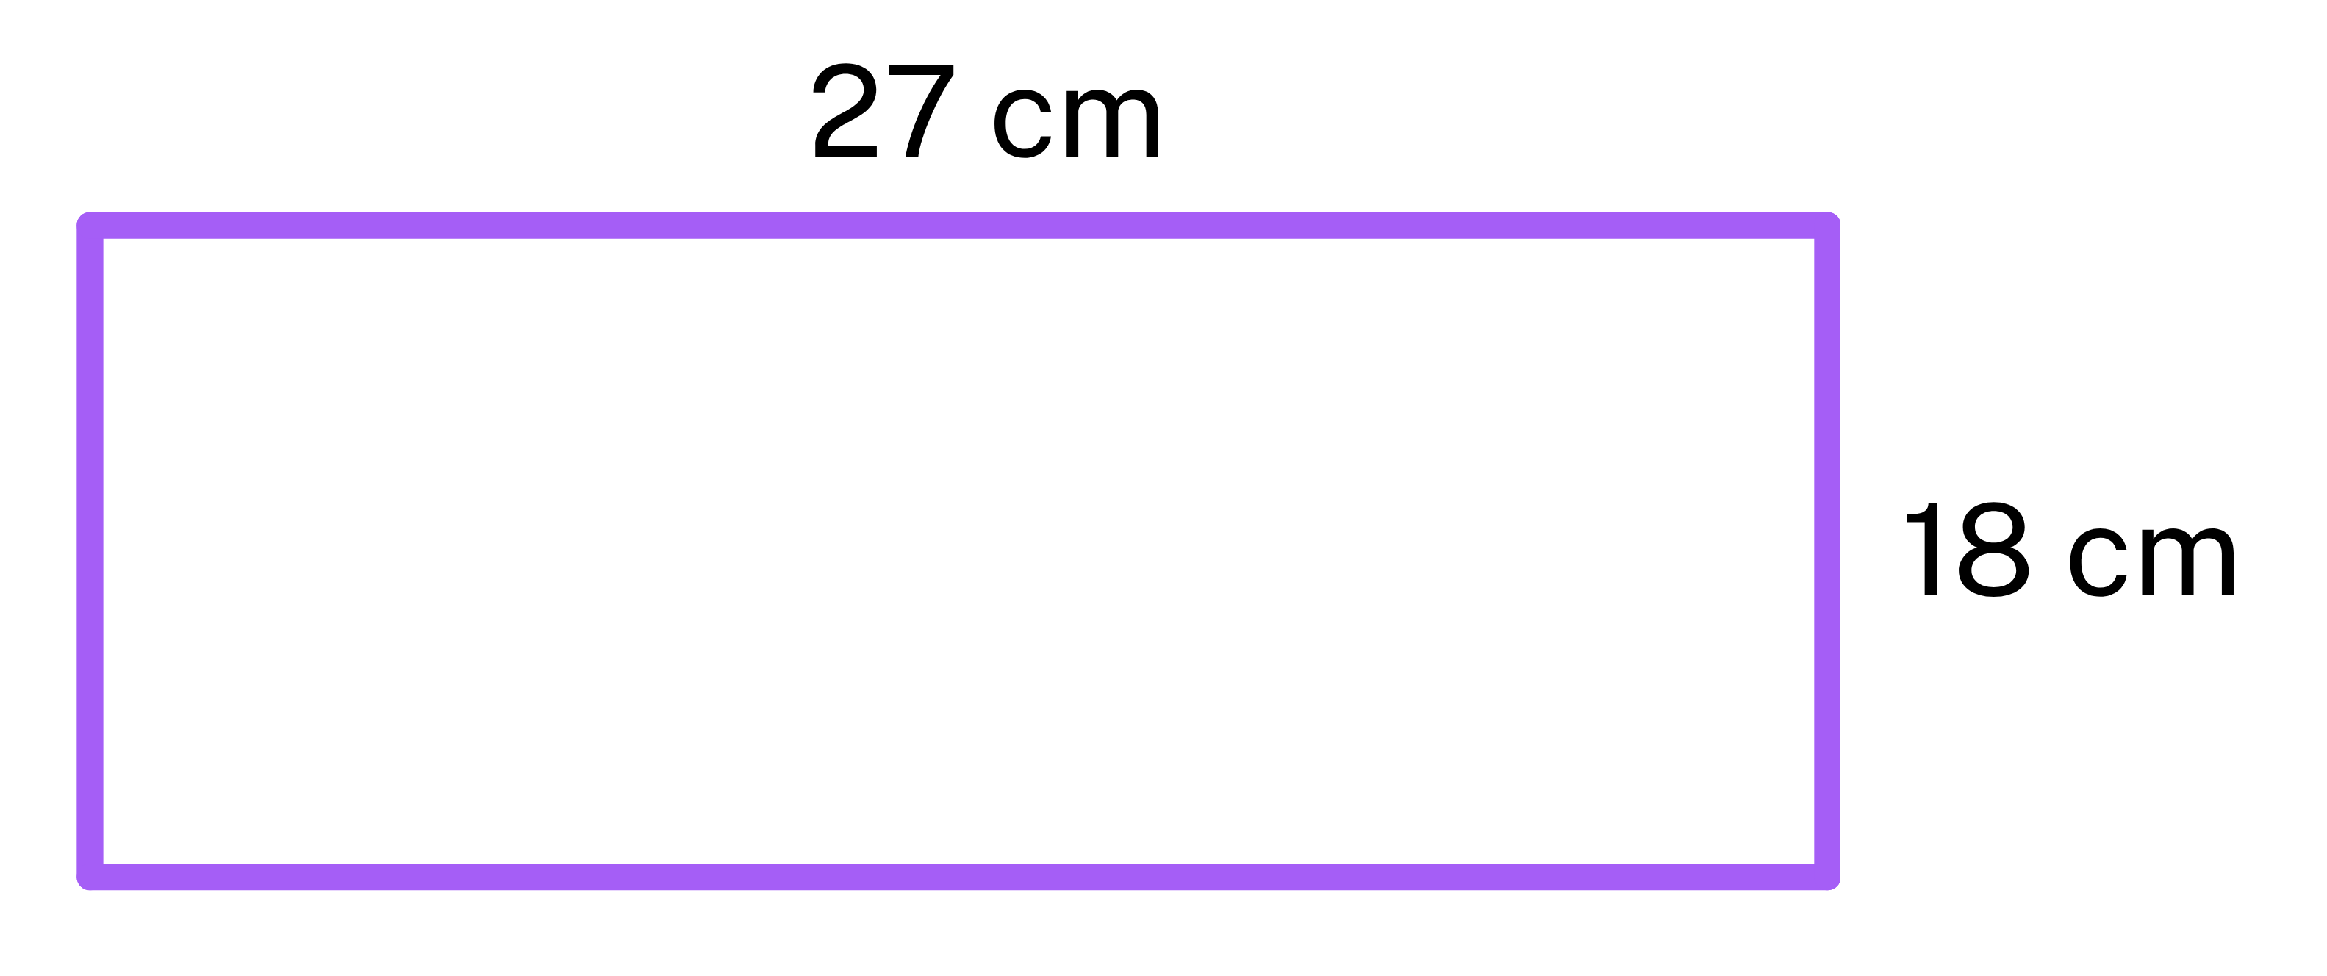
Short response (10)
Calculate the perimeter of the rectangle.
Notes:
Short response questions provide brisk paced questions focussing on review of current and previous content to support spaced and interleaved practice.
Syllabus focus area:
Geometric measure A

Slide 22
Short response (11)
Use the area model to represent and solve:
76 x 42
Notes:
Short response questions provide brisk paced questions focussing on review of current and previous content to support spaced and interleaved practice.
Syllabus focus area:
Multiplicative relations A

Slide 23
Short response (12)
Select square kilometres or hectares to identify which unit is used to measure the area of:
Communicate your reasoning.
A
B
a farm
Australia
Notes:
Short response questions provide brisk paced questions focussing on review of current and previous content to support spaced and interleaved practice.
Syllabus focus area:
Two-dimensional spatial structure A

Slide 24
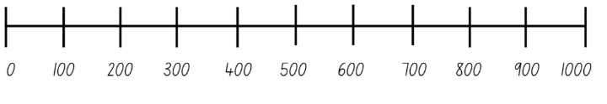
Activity 3 – rounding on a number line
Notes:
This is a developing number sense activity.
Number sense refers to a deep understanding of numbers, including their magnitude, relationships, and the effects of operations on them. It supports fluency and understanding, estimation, flexible thinking, and efficient problem-solving. Number sense activities 1–4 ‘activate’ prior number knowledge and support the learning of new content in the unit. Number sense activities 5–8 ‘loop’ back and provide opportunity for spaced practice with concepts and procedures covered in previous units.
Syllabus focus area:
Additive relations A
Rounding on a number line
Explain that students are going to play a game in pairs. The aim is to get 4 numbers in a row.
Provide pairs with three 0–9 dice and whiteboards. They draw one number line with interval marks of 100 (see Figure 11).
Students take turns rolling the dice to form a 3-digit number. They write each number on the number line.
The first player to get 4 numbers in a row without being blocked, wins the game (see Figure 12).
Note: as students form their own numbers to position on the number line, they need to consider whether to block their partner's progress. The blue player in Figure 12 could have blocked the red player by choosing 503 or 530 instead of 305.
Once students get 4 in a row, they round and add 2 of their numbers and provide an approximate answer, for example 426 + 478 = 900.
They check the reasonableness of their rounding by using place value understanding to form a vertical algorithm of the original numbers. This is used to find the actual total.

Slide 25
Review of learning 4

Slide 26
True or false (2)
8800 is a reasonable estimation for 7659 + 1345
True | False
Notes:
The question on this slide connects to the content being explored in the developing number sense activity (Activity 4)
Syllabus focus area:
Additive relations A

Slide 27
Short response (13)
Use place value to solve:
2134 + 56 + 210
Communicate your reasoning.
Notes:
Short response questions provide brisk paced questions focussing on review of current and previous content to support spaced and interleaved practice.
Syllabus focus area:
Additive relations A

Slide 28
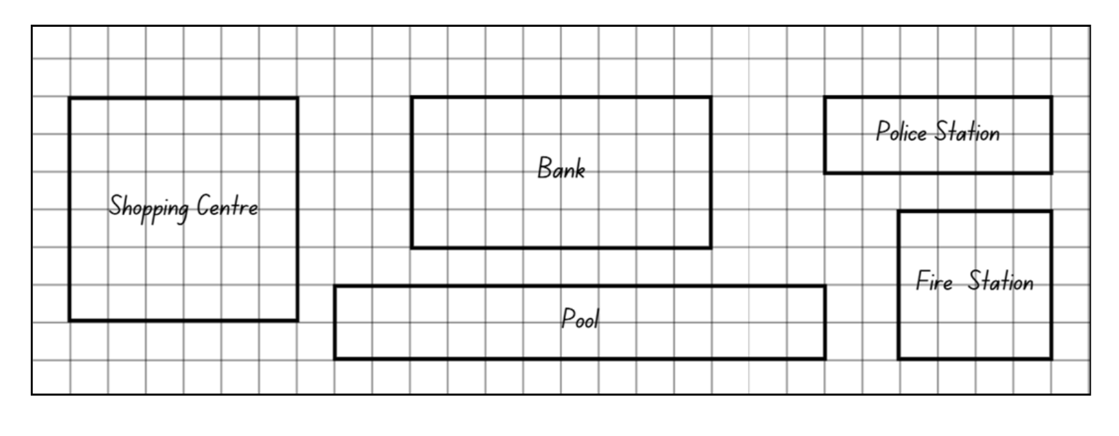
Short response (14)
Find 2 buildings with the same perimeter.
Explain your reasoning
Notes:
Short response questions provide brisk paced questions focussing on review of current and previous content to support spaced and interleaved practice.
Syllabus focus area:
Geometric measure A

Slide 29
Short response (15)
Choose the most appropriate multiplicative strategy to solve:
278 x 29
Notes:
Short response questions provide brisk paced questions focussing on review of current and previous content to support spaced and interleaved practice.
Syllabus focus area:
Multiplicative relations A

Slide 30
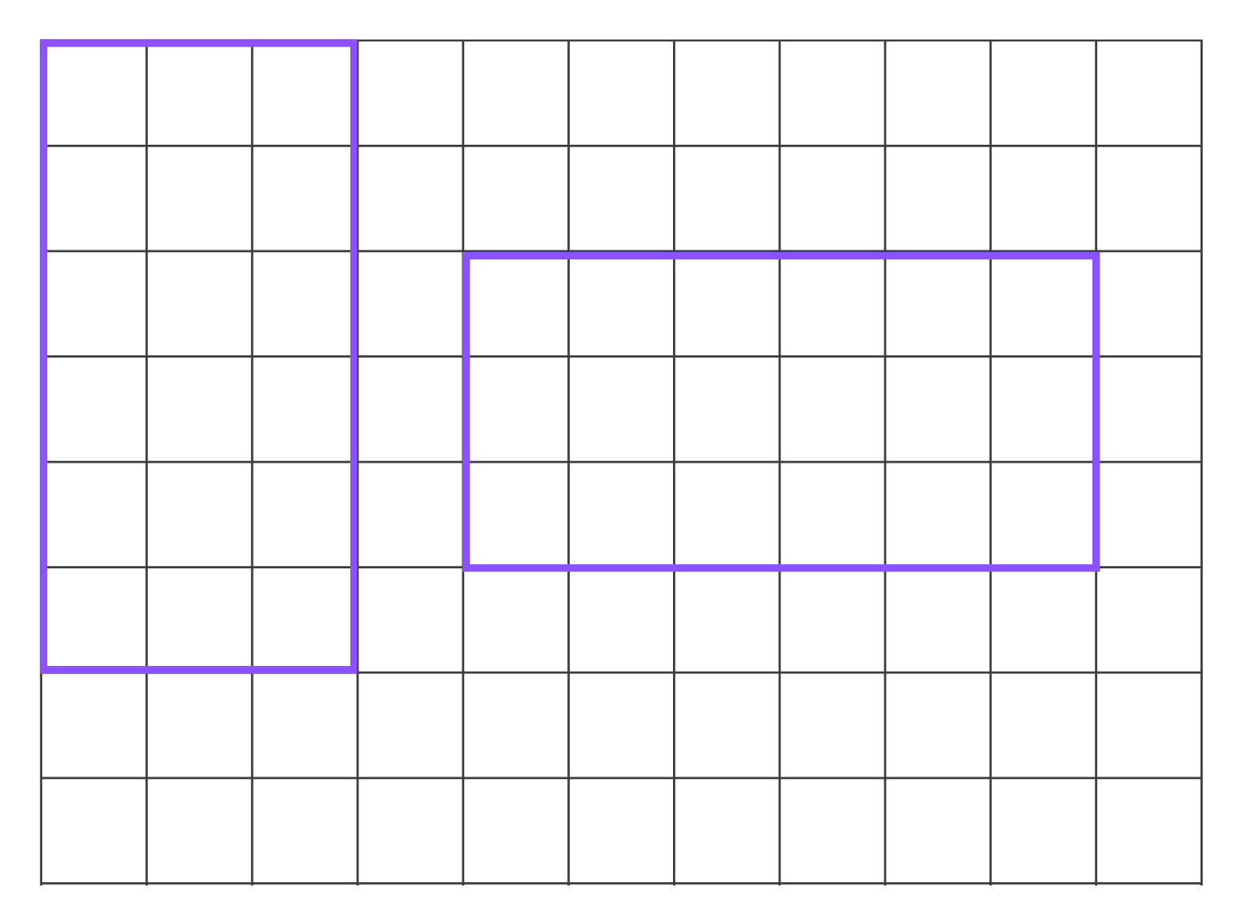
Short response (16)
Do these rectangles have the same area?
Communicate your reasoning.
Notes:
Short response questions provide brisk paced questions focussing on review of current and previous content to support spaced and interleaved practice.
Syllabus focus area:
Two-dimensional spatial structure A

Slide 31
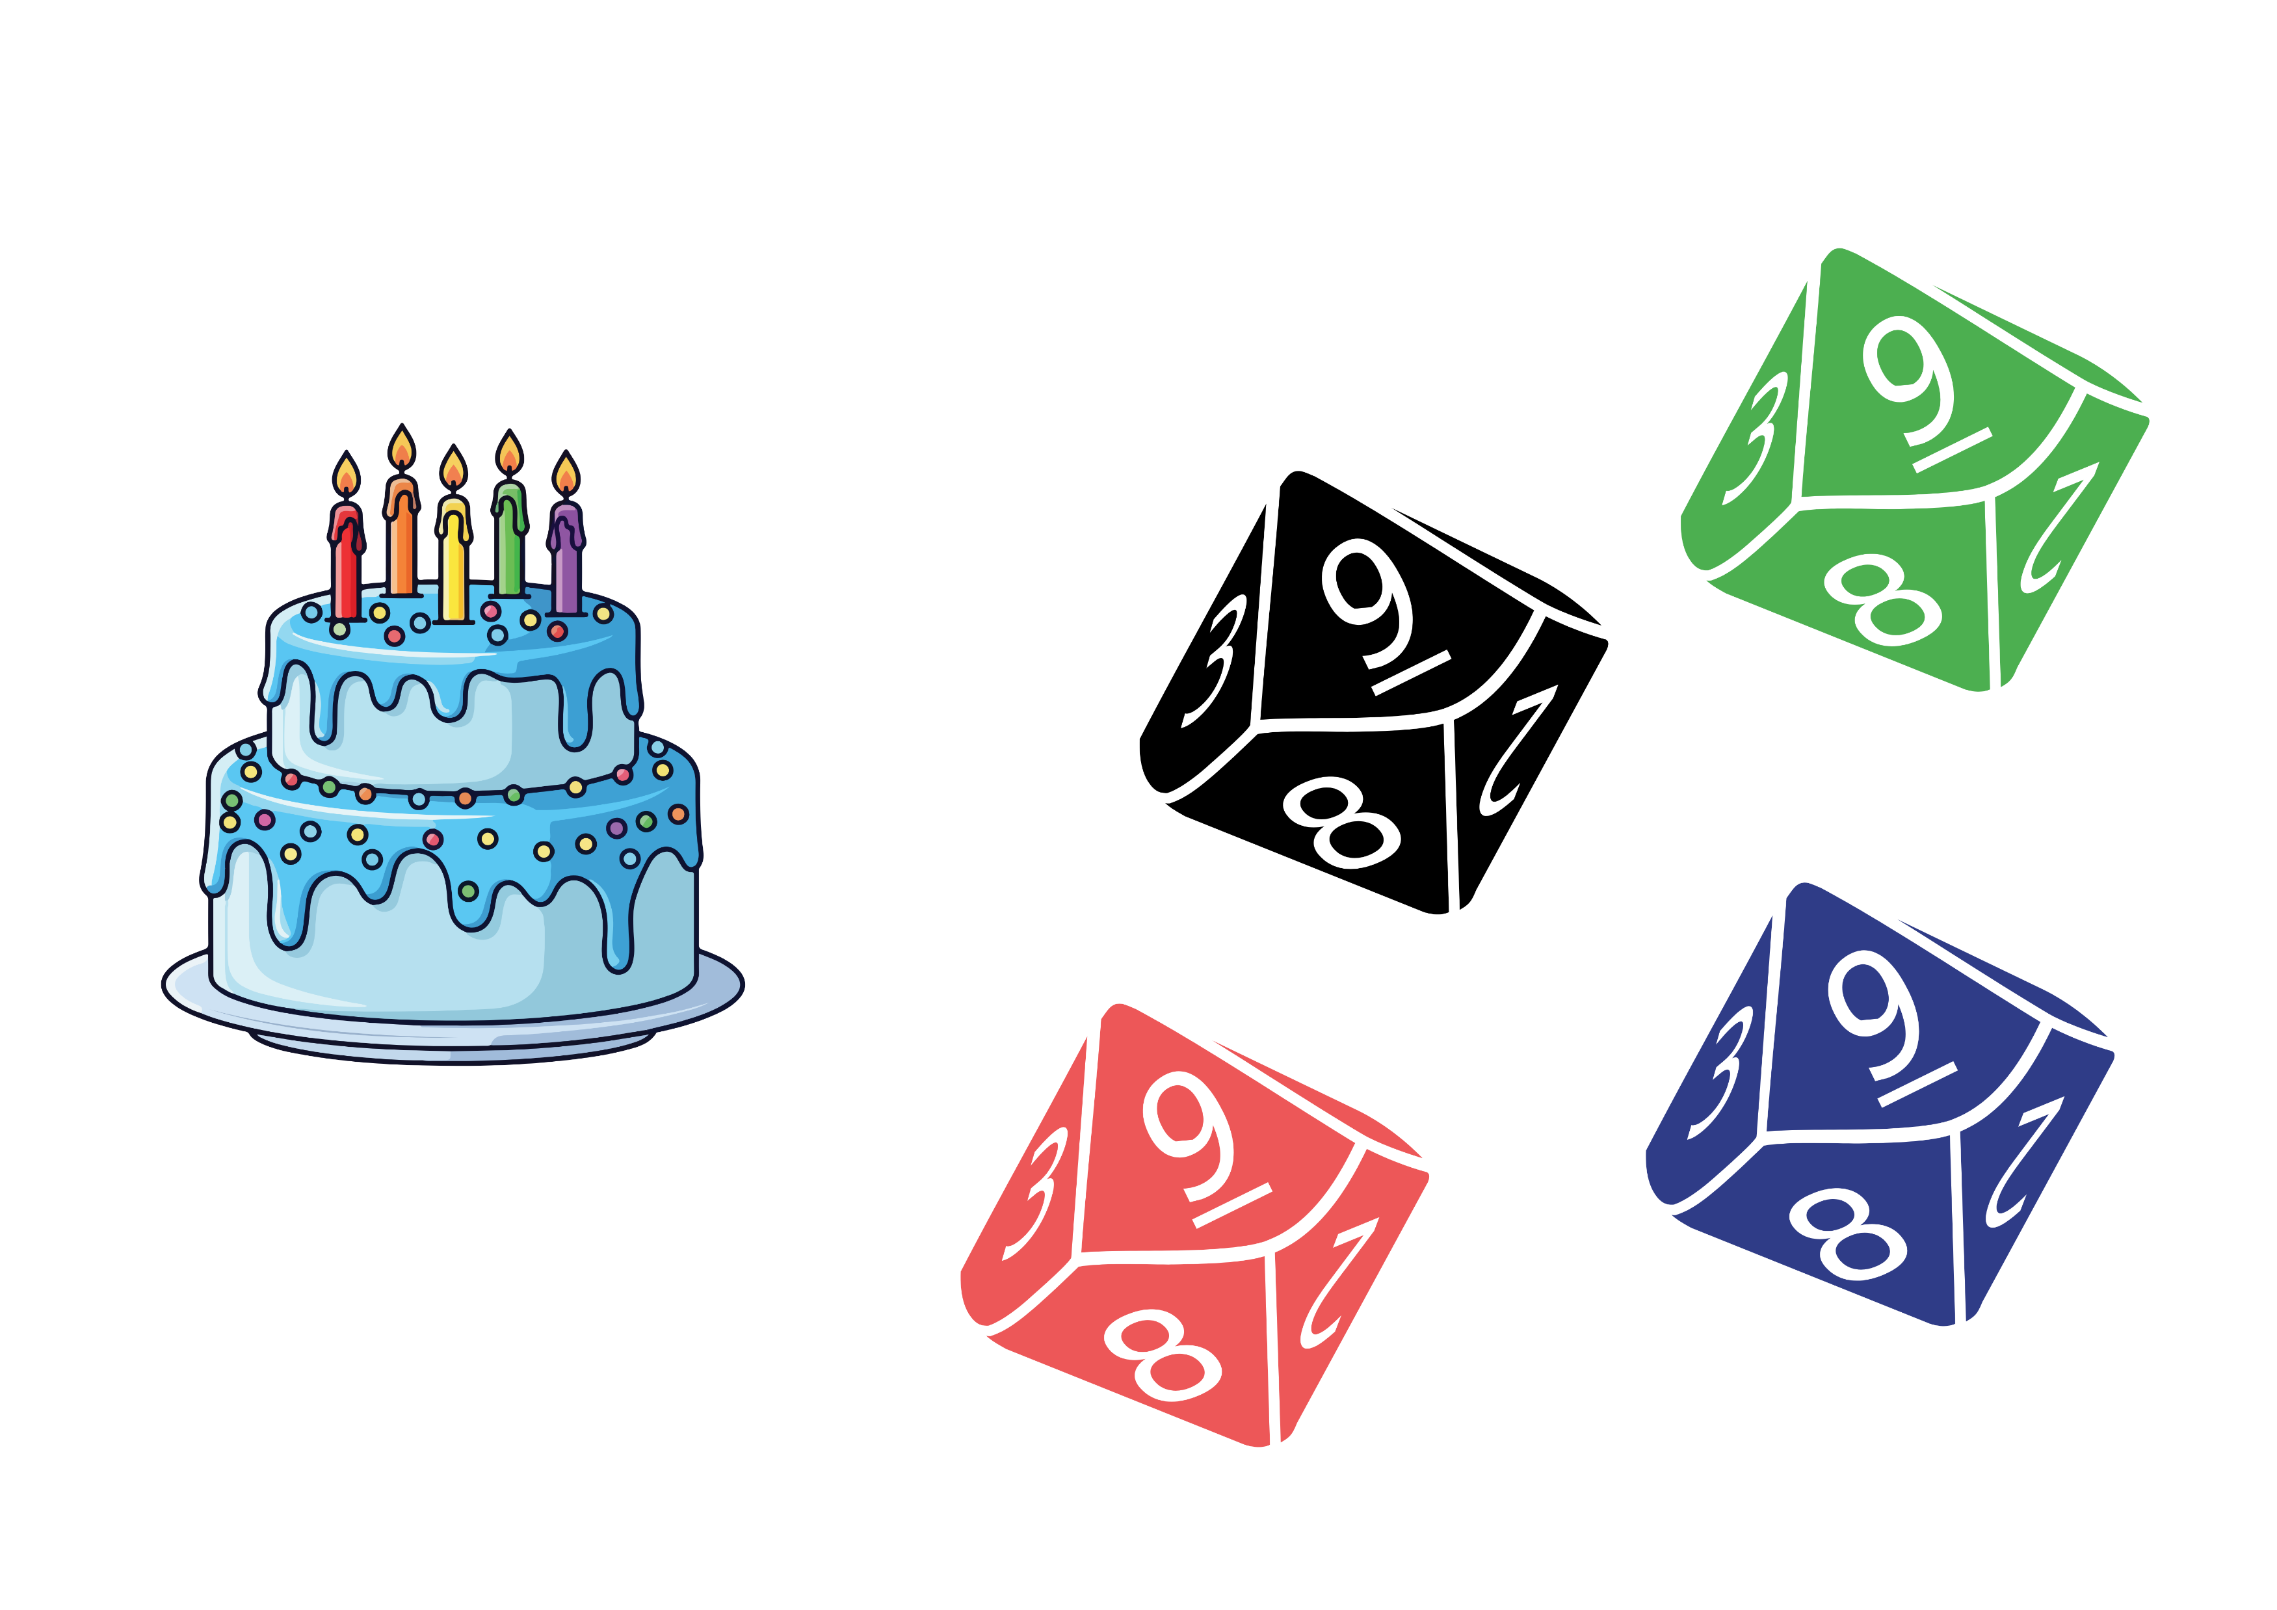
Activity 4 – reasonable estimations
Can you create a two 4-digit numbers to find the total sum?
Remember to:
Decide on a reasonable estimate.
Solve the problem using a selected strategy.
Discuss with your partner if your answer was accurate.
Notes:
This is a developing number sense activity.
Number sense refers to a deep understanding of numbers, including their magnitude, relationships, and the effects of operations on them. It supports fluency and understanding, estimation, flexible thinking, and efficient problem-solving. Number sense activities 1–4 ‘activate’ prior number knowledge and support the learning of new content in the unit. Number sense activities 5–8 ‘loop’ back and provide opportunity for spaced practice with concepts and procedures covered in previous units.
Syllabus focus area:
Additive relations A
Reasonable estimations
Place students in pairs, providing each with four 10-sided dice.
Explain the rules of the game to the students:
- Student 1 rolls four 10-sided dice to create a 4-digit number. They repeat this to create two 4-digit numbers and record the sum on a whiteboard. For example, 7214 + 9087.
- They make a reasonable estimate of what they believe the answer could be, discussing with student 2.
- Student 2 states if they agree or disagree and state why or why not.
- Student 1 solves the problem using a selected strategy.
- Pairs discuss if the actual answer was close to the estimation.
- Students swap roles and play the game again.

Slide 32
Review of learning 5

Slide 33
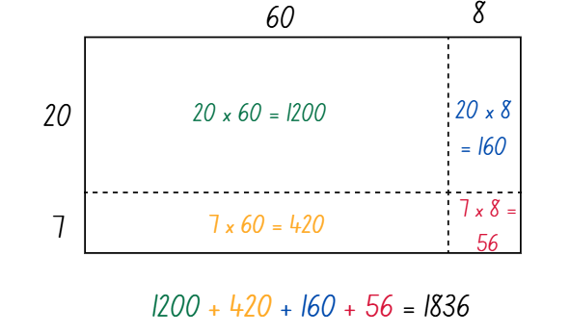
Multiple choice (3)
Which 2-digit by 2-digit multiplication problem matches the area model?
A
B
C
D
80 x 15
27 x 86
68 x 20
27 x 68
Notes:
This question connects to the content in the developing number sense activity (Activity 5)
Syllabus focus area:
Multiplicative relations A

Slide 34
Short response (17)
4988 + 955 = 4990 + 953 = 5000 + 943
Which strategy has been used to calculate the answer? Constant difference, bridging, levelling or addition for subtraction?
Communicate your reasoning.
Notes:
Short response questions provide brisk paced questions focussing on review of current and previous content to support spaced and interleaved practice.
Syllabus focus area:
Additive relations A

Slide 35
Short response (18)
3.75kg is the same as
____ kilograms and ____ grams.
Notes:
Short response questions provide brisk paced questions focussing on review of current and previous content to support spaced and interleaved practice.
Syllabus focus area:
Non-spatial measure A

Slide 36
Short response (19)
Use a formal algorithm to solve:
53 x 29
Notes:
Short response questions provide brisk paced questions focussing on review of current and previous content to support spaced and interleaved practice.
Syllabus focus area:
Multiplicative relations A

Slide 37
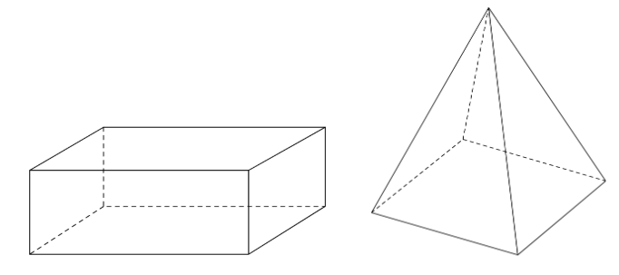
Short response (20)
Compare the properties of these
three-dimensional objects.
Notes:
Short response questions provide brisk paced questions focussing on review of current and previous content to support spaced and interleaved practice.
Syllabus focus area:
Three-dimensional spatial structure A

Slide 38
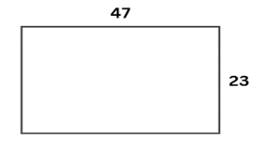
Activity 5 – find the area
A new section of artificial turf is being added to the local soccer club’s field. The area is 47 metres long and 23 metres wide. How much turf will the club need to order?
Notes:
This is a developing number sense activity.
Number sense refers to a deep understanding of numbers, including their magnitude, relationships, and the effects of operations on them. It supports fluency and understanding, estimation, flexible thinking, and efficient problem-solving. Number sense activities 1–4 ‘activate’ prior number knowledge and support the learning of new content in the unit. Number sense activities 5–8 ‘loop’ back and provide opportunity for spaced practice with concepts and procedures covered in previous units.
Syllabus focus area:
Multiplicative relations A
Find the area
Students Think-Pair-Share and use whiteboards to find the area of the field. Ask:
- What strategies did you use to solve this problem?
- How could partitioning be used to solve this problem?
- How could partitioning be represented using the area model?
- Is there more than one way that the area model could be used?
If turf cost $9 per square metre, estimate the total cost to the nearest thousand dollars. Explain your thinking.
Select students to share a variety of strategies with the class.
Highlight the use of the area model to represent students’ thinking (see Figure 14)
Explain that 47 × 23 is represented in 2 ways with the area model where one example shows 47 partitioned into its place value and the second example shows 47 and 23 partitioned into its place value.
Optional problem: A different area of the club’s soccer field is also getting an upgrade. It is 94 metres long and 46 metres wide. Ask students:
- What is the area of this field?
- How much larger is this field than the first one? Why? (4 times larger, it is the same as ‘double, double’).
- If turf is only sold in rolls of 50 m long by 5 m wide, what is the smallest number of rolls the club needs to order?
Students turn and talk to discuss their strategies with a partner. They record their ideas on whiteboards.

Slide 39
Review of learning 6

Slide 40
True or false (3)
To solve 4 x 18 mentally, you can factorise 18 into 2 x 9.
True | False
Communicate your reasoning.
Notes:
The question on this slide connects to the content being explored in the developing number sense activity (Activity 6)
Syllabus focus area:
Multiplicative relations A

Slide 41
Short response (21)
Record a formal algorithm to solve:
5367 + 880 + 14
Notes:
Short response questions provide brisk paced questions focussing on review of current and previous content to support spaced and interleaved practice.
Syllabus focus area:
Additive relations A

Slide 42
Short response (22)
Convert:
7.5 kg into grams
375 g into kilograms
Notes:
Short response questions provide brisk paced questions focussing on review of current and previous content to support spaced and interleaved practice.
Syllabus focus area:
Non-spatial measure B

Slide 43
Short response (23)
Model your answer using a diagram:
34 ÷ 8 =
Notes:
Short response questions provide brisk paced questions focussing on review of current and previous content to support spaced and interleaved practice.
Syllabus focus area:
Multiplicative relations A

Slide 44
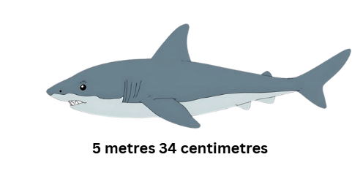
Short response (24)
Record the length of the shark using decimal notation.
Notes:
Short response questions provide brisk paced questions focussing on review of current and previous content to support spaced and interleaved practice.
Syllabus focus area:
Three-dimensional spatial structure A

Slide 45
Activity 6 – solve it
14 x 7 = ___
(14 × 7) + (14 × 3) + (23 × 10) + (13 × 10)
Notes:
This is a developing number sense activity.
Number sense refers to a deep understanding of numbers, including their magnitude, relationships, and the effects of operations on them. It supports fluency and understanding, estimation, flexible thinking, and efficient problem-solving. Number sense activities 1–4 ‘activate’ prior number knowledge and support the learning of new content in the unit. Number sense activities 5–8 ‘loop’ back and provide opportunity for spaced practice with concepts and procedures covered in previous units.
Syllabus focus area:
Multiplicative relations A
Solve it
Display 14 × 7 = and ask:
- What are the factors of 14?
How could you use the factors of 14 to make this number sentence easier to solve?
Display the following equation on the board: (14 × 7) + (14 × 3) + (23 × 10) + (13 × 10).
Discuss what the grouping symbols mean. Ask students:
- Are there any patterns or relationships between the numbers?
- Can you rearrange the order of the numbers in the grouping symbols to make it easier to calculate? (Yes, you can).
- What property allows you to do that? (The commutative property of multiplication).
- Can you break any of the numbers into factors to make it easier to calculate?
Regroup as a class and ask students to share their strategies.
Use some of the following question prompts to support the class discussion:
- What was your first step in solving this equation? Why did you choose that operation first?
- What do you notice about the operations in this equation?
- What are the commutative, distributive and associative properties of multiplication? How can they be applied to this equation?
- Is it possible to solve this only using mental strategies?
Discuss the efficiency and accuracy of the various strategies used by students.

Slide 46
Review of learning 7

Slide 47
Multiple choice (4)
Jane set up 23 rows of chairs. Each row has 14 chairs. How many chairs are there altogether?
A
345
B
324
C
322
D
233
Notes:
This question connects to the content in the developing number sense activity (Activity 7)
Syllabus focus area:
Multiplicative relations A

Slide 48

Short response (25)
Mia said bridging is the most efficient strategy to solve
74 357 + 6869
Is she correct?
Communicate your reasoning.
Notes:
Short response questions provide brisk paced questions focussing on review of current and previous content to support spaced and interleaved practice.
Syllabus focus area:
Additive relations A

Slide 49
Short response (26)
Convert:
2250 kilograms to tonnes
9.5 tonnes to kilograms
Communicate your reasoning.
Notes:
Short response questions provide brisk paced questions focussing on review of current and previous content to support spaced and interleaved practice.
Syllabus focus area:
Non-spatial measure B

Slide 50
Short response (27)
Use your knowledge of multiples to partition and divide:
954 ÷ 6
Notes:
Short response questions provide brisk paced questions focussing on review of current and previous content to support spaced and interleaved practice.
Syllabus focus area:
Multiplicative relations A

Slide 51
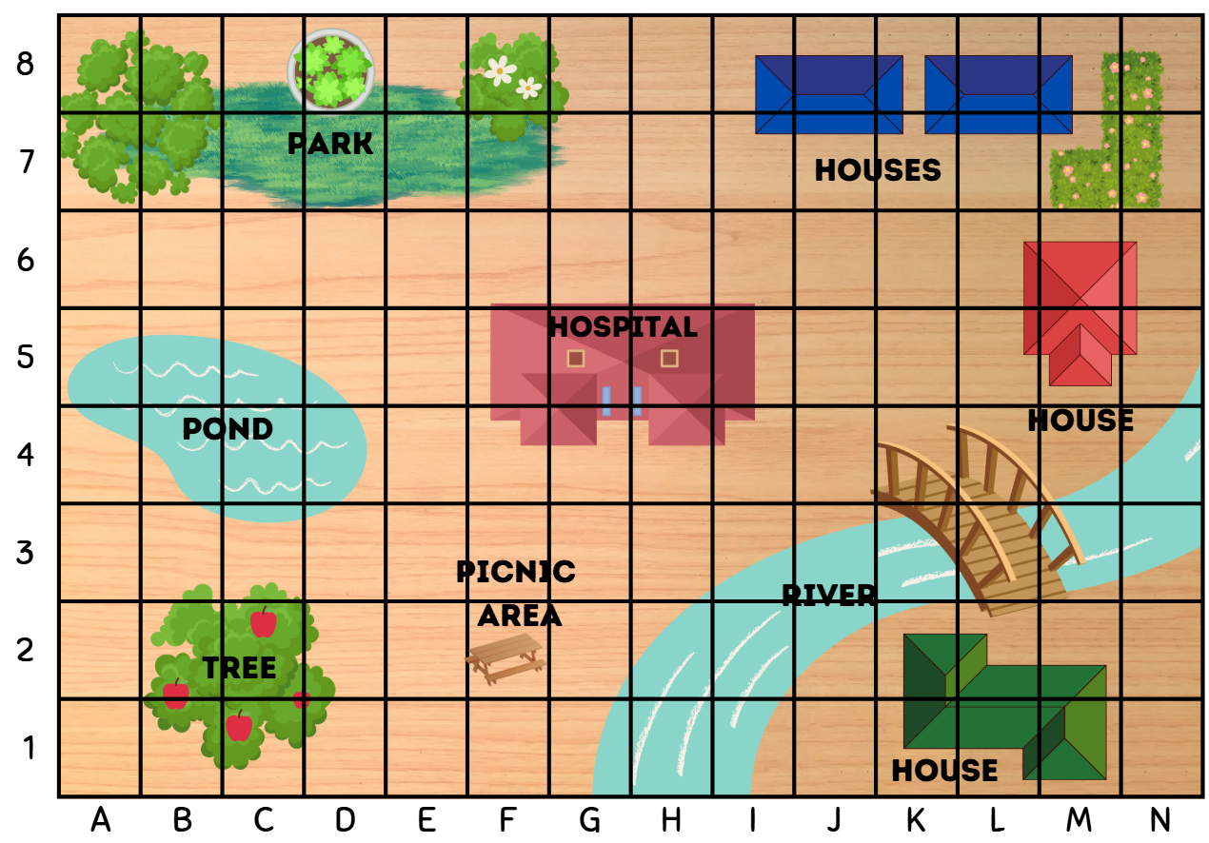
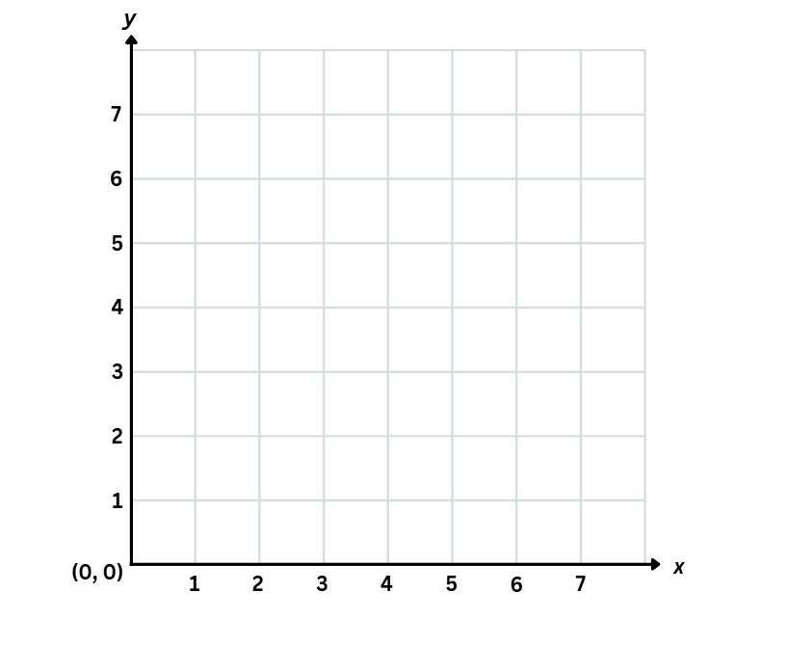
Short response (28))
Complete the sentences.
The grid-map reference is used to _______ .
The number plane is used to _______ .
Notes:
Short response questions provide brisk paced questions focussing on review of current and previous content to support spaced and interleaved practice.
Syllabus focus area:
Geometric measure A

Slide 52
Activity 7 – age maths puzzle
Solve the following questions relating to your next birthday:
How old will you be on your next birthday?
How could you provide your answer in months?
How could you provide your answer in weeks?
How could you provide your answer in minutes?
How could you provide your answer in seconds?
Notes:
This is a developing number sense activity.
Number sense refers to a deep understanding of numbers, including their magnitude, relationships, and the effects of operations on them. It supports fluency and understanding, estimation, flexible thinking, and efficient problem-solving. Number sense activities 1–4 ‘activate’ prior number knowledge and support the learning of new content in the unit. Number sense activities 5–8 ‘loop’ back and provide opportunity for spaced practice with concepts and procedures covered in previous units.
Syllabus focus area:
Multiplicative relations A
Age maths puzzle
Ask students to solve the following questions related to their next birthday:
- How old will you be on your next birthday?
- How could you provide your answer in months?
- How could you provide your answer in weeks?
- How could you provide your answer in minutes?
- How could you provide your answer in seconds?
Share students results as a class and ask the following questions:
- How did you approach calculating your age in months, days and other time units?
- Did you notice any specific multiplication patterns when figuring out your age in different time units?
- Can you share any multiplication strategies that made these calculations easier or more efficient for you?

Slide 53
Review of learning 8

Slide 54
True or false (4)
A school orders 43 packs of pencils. Each pack contains 29 pencils.
1247 pencils have been ordered.
True | False
Notes:
The question on this slide connects to the content being explored in the developing number sense activity (Activity 8)
Syllabus focus area:
Multiplicative relations A

Slide 55
Short response (29)
Use a bar model or empty number line to solve:
4.21 – 2.43
Communicate your reasoning.
Notes:
Short response questions provide brisk paced questions focussing on review of current and previous content to support spaced and interleaved practice.
Syllabus focus area:
Additive relations B

Slide 56
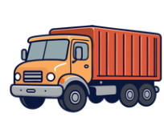
Short response (30)
A truck weighs 6.7 tonnes.
It is loaded with 760 kilograms of fruit.
It delivers 345 kilograms to the first fruit shop.
How much does the truck weigh now?
Notes:
Short response questions provide brisk paced questions focussing on review of current and previous content to support spaced and interleaved practice.
Syllabus focus area:
Non-spatial measure B

Slide 57
Short response (31)
A factory produces 6240 litres of juice. Each bottle holds 24 litres.
How many full bottles can be filled?
Notes:
Short response questions provide brisk paced questions focussing on review of current and previous content to support spaced and interleaved practice.
Syllabus focus area:
Multiplicative relations A

Slide 58

Short response (32)
How can Erolyn refine her question to be able to obtain numerical data?
Notes:
Short response questions provide brisk paced questions focussing on review of current and previous content to support spaced and interleaved practice.
Syllabus focus area:
Data A

Slide 59
Activity 8 – multiplication word problem
Question 1: A farmer plants 125 trees in each field. He has 24 fields.
How many trees does he plant altogether?
Question 2: A school orders 48 packs of pencils. Each pack contains 25 pencils.
How many pencils are ordered?
Question 3: A theatre has 324 rows with 36 seats in each row.
How many seats are there altogether?
Notes:
This is a developing number sense activity.
Number sense refers to a deep understanding of numbers, including their magnitude, relationships, and the effects of operations on them. It supports fluency and understanding, estimation, flexible thinking, and efficient problem-solving. Number sense activities 1–4 ‘activate’ prior number knowledge and support the learning of new content in the unit. Number sense activities 5–8 ‘loop’ back and provide opportunity for spaced practice with concepts and procedures covered in previous units.
Syllabus focus area:
Multiplicative relations A
Multiplication word problem
This resource corresponds to Resource 24 – multiplication word problems in Stage 3 Year A Unit 15.
In pairs, students work choose a problem to word on and identify the key information.
Pairs decide the most efficient multiplicative strategy to use to solve the problem, representing their thinking on their whiteboard.
Students share their responses with another pair and discuss answers obtained.

Slide 60
Double Venn diagram
Object 1
Object 2
Features similar to both objects
Features of object 1
Features of object 2

Slide 61
Frayer
Definition
Facts/Characteristics
Word, term, concept
Examples
Non-examples

Slide 62
Spider map
Idea
Subject

Slide 63
Cline
Concept 1
Concept 2
Word
Word
Word
Word
Word
Word
Word
Word
Word
Word
Word

Slide 64
Compare and contrast

Slide 65
Multiple choice (5)
A
B
C
D

Slide 66
Multiple choice
A
B
C
D
Notes:
This question connects to the content in the developing number sense activity (Activity 3)
Syllabus focus area:
[Focus area A/B]

Slide 67
References
This presentation contains NSW Curriculum and syllabus content. The NSW Curriculum is developed by the NSW Education Standards Authority. This content is prepared by NESA for and on behalf of the Crown in the right of the State of New South Wales. The material is protected by Crown copyright.
Please refer to the NESA Copyright Disclaimer for more information https://educationstandards.nsw.edu.au/wps/portal/nesa/mini-footer/copyright.
NESA holds the only official and up-to-date versions of the NSW Curriculum and syllabus documents. Please visit the NSW Education Standards Authority (NESA) website https://educationstandards.nsw.edu.au/wps/portal/nesa/home and the NSW Curriculum website https://curriculum.nsw.edu.au.
[Mathematics K–10 Syllabus © NSW Education Standards Authority (NESA) for and on behalf of the Crown in right of the State of New South Wales, 2022.
National Numeracy Learning Progression © Australian Curriculum, Assessment and Reporting Authority (ACARA) 2010 to present, unless otherwise indicated. This material was downloaded from the Australian Curriculum website (National Numeracy Learning Progression) (accessed (accessed 18 January 2024) and was not modified.
Classroom Secrets (2023) Add and Subtract Decimals Discussion Problems, Classroom secrets website, accessed 12 October 2025.
Education Services Australia (2016) Playground Percentages, Education Services Australia website, accessed 12 October 2025.
NCTM (National Council of Teachers of Mathematics) (n.d.) Fraction models, NCTM website, accessed 21 April 2026.
State of New South Wales (Department of Education) (2023) Proportional thinking: Fractions, decimals and percentages, NSW Department of Education website, accessed 10 March 2026.

Slide 68
References 2
This presentation contains NSW Curriculum and syllabus content. The NSW Curriculum is developed by the NSW Education Standards Authority. This content is prepared by NESA for and on behalf of the Crown in the right of the State of New South Wales. The material is protected by Crown copyright.
Please refer to the NESA Copyright Disclaimer for more information https://educationstandards.nsw.edu.au/wps/portal/nesa/mini-footer/copyright.
NESA holds the only official and up-to-date versions of the NSW Curriculum and syllabus documents. Please visit the NSW Education Standards Authority (NESA) website https://educationstandards.nsw.edu.au/wps/portal/nesa/home and the NSW Curriculum website https://curriculum.nsw.edu.au.
Toy Theater (2001–2026) Calculator, Toy Theater website, accessed 21 March 2026.
Visnos (n.d) Percentage, Fraction & Decimal Grid Explorer, Visnos website, accessed 21 April 2026.

Slide 69
Copyright
© State of New South Wales (Department of Education), 2025
The copyright material published in this resource is subject to the Copyright Act 1968 (Cth) and is owned by the NSW Department of Education or, where indicated, by a party other than the NSW Department of Education (third-party material).
Copyright material available in this resource and owned by the NSW Department of Education is licensed under a Creative Commons Attribution 4.0 International (CC BY 4.0) license.
This license allows you to share and adapt the material for any purpose, even commercially.
Attribution should be given to © State of New South Wales (Department of Education), 2025.
Material in this resource not available under a Creative Commons license:
the NSW Department of Education logo, other logos and trademark-protected material
Material owned by a third party that has been reproduced with permission. You will need to obtain permission from the third party to reuse its material.
Links to third-party material and websites
Please note that the provided (reading/viewing material/list/links/texts) are a suggestion only and implies no endorsement, by the New South Wales Department of Education, of any author, publisher, or book title. School principals and teachers are best placed to assess the suitability of resources that would complement the curriculum and reflect the needs and interests of their students.
If you use the links provided in this document to access a third party’s website, you acknowledge that the terms of use, including licence terms set out on the third-party’s website apply to the use which may be made of the materials on that third-party website or where permitted by the Copyright Act 1968 (Cth). The department accepts no responsibility for content on third-party websites.

