Slide 1
Instructions for use
This resource aligns to the learning in Stage 3 Year B Unit 36 and revisits content from earlier sample units.
Classroom teachers are encouraged to add, edit and adapt to meet the needs of their students.
Save a copy of the file to make changes to the slide deck. Go to File > Download a Copy (this downloads a copy to the computer to edit in the PowerPoint app).
To convert the PowerPoint to Google Slides:
  Upload the file into Google Drive and open it.
  Go to File > Save as Google Slides.
  (Note – conversion may cause formatting changes in the slides.)

Slide 2

Review of Learning
Mathematics Stage 3 – Unit 36
Notes:
Reviews may include a combination of question types, requiring students to recall facts and key ideas, as well as apply their knowledge to solve problems and answer questions. To support active engagement, a mix of techniques should be employed.” (AERO, 2024).
This Review of Learning slide deck revisits key concepts from the following units:
Stage 3 Year B Unit 36
Stage 3 Year B Unit 35
Stage 3 Year B Unit 34
It also includes opportunities to review prior learning in non-number content, supporting consolidation across focus areas.
The review of learning resources include three key task types that support the development of mathematical proficiency through retrieval, spaced practice, and active participation. These practices complement the review phase (activating prior knowledge) embedded within the beginning of each lesson.
1.
Multiple-choice questions/True or false: Designed to promote active retrieval of key concepts and identify common misconceptions in number, supporting consolidation, understanding and fluency.
These questions:
support spaced and interleaved practice
help identify and address common misconceptions
support active recall and immediate feedback
support whole class participation
identify areas requiring reteach
2.
Short-response question sets: Carefully grouped questions that encourage spaced and interleaved practice across multiple focus areas, helping students revisit and apply knowledge from different points in time.
These questions:
have a combination of question types
address a range of focus areas
build automaticity and fluency
support active recall
allow for immediate feedback
identify content requiring reteach
3.
Developing number sense activities: A variety of practical, purposeful tasks that reinforce current learning and build on prior knowledge. These activities promote reasoning, problem-solving and conceptual understanding.
The review of learning resources are designed to work support teaching and learning in mathematics. For the most effective implementation, use the resources flexibly, adapting to meet student learning needs and individual classroom contexts.

Slide 3
Lessons
1
Review of learning 1
5
Review of learning 5
2
Review of learning 2
6
Review of learning 6
3
Review of learning 3
7
Review of learning 7
4
Review of learning 4
8
Review of learning 8
Notes:
Teacher notes:
Click lesson numbers to go to specific lessons
Interactive features can be viewed in slide show

Slide 4
Review of learning 1

Slide 5

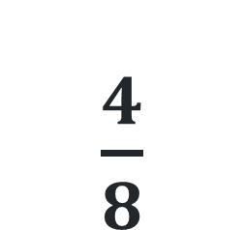
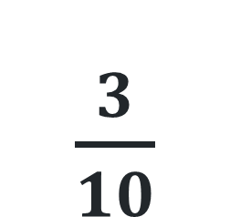
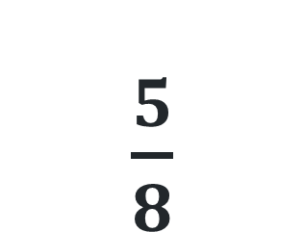
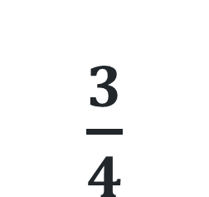
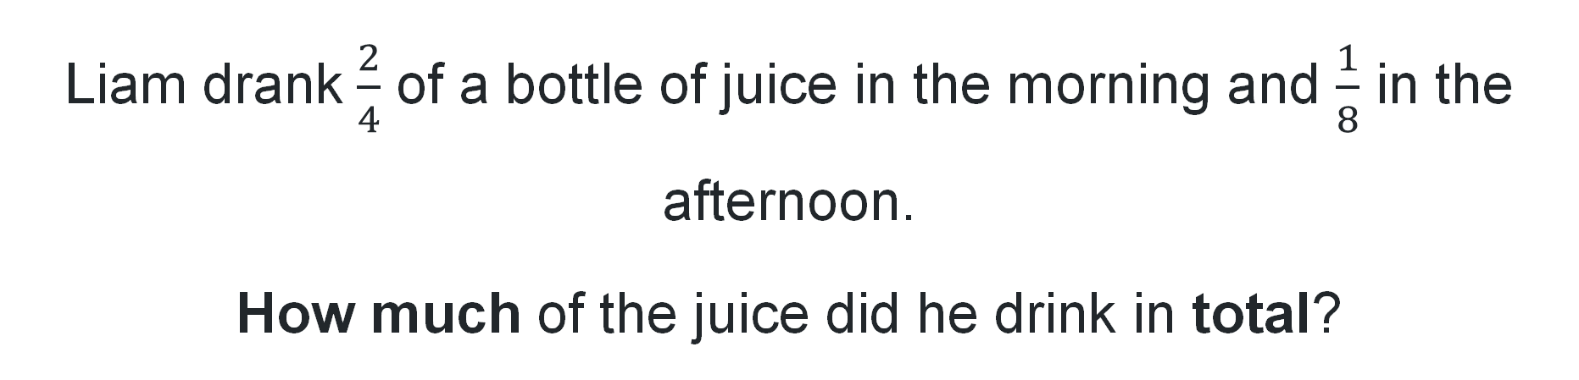
Multiple choice (1)
Liam drank$\frac{2}{4}$ of a bottle of juice in the morning and $\frac{1}{8}$ ​in the afternoon.
How much of the juice did he drink in total?
A
B
C
D
$\frac{3}{4}$
$\frac{5}{8}$
$\frac{3}{10}$
$\frac{4}{8}$
Notes:
This question connects to the content in the developing number sense activity (Activity 1)
Syllabus focus area:
Representing quantity fractions B

Slide 6

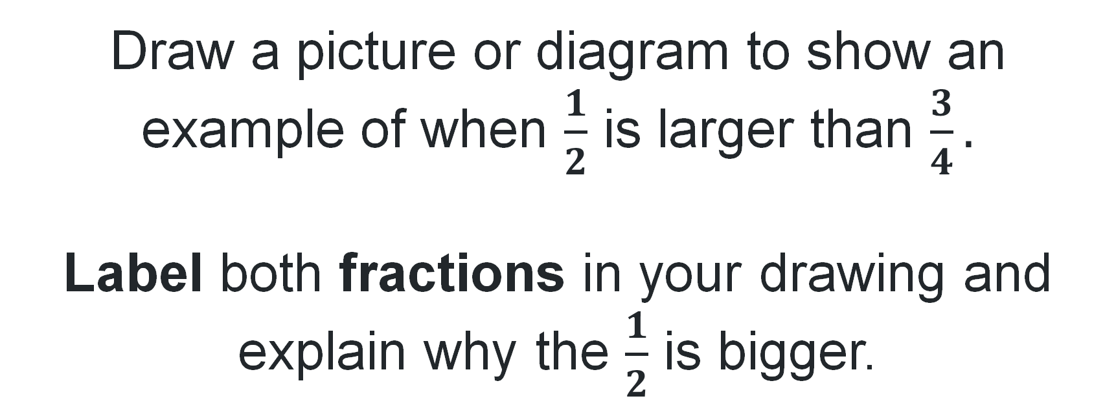
Short response (1)
Draw a picture or diagram to show an example of when $\frac{1}{2}$ is larger than $\frac{3}{4}.$
Label both fractions in your drawing and explain why the $\frac{1}{2}$ is bigger.
Notes:
Short response questions provide brisk paced questions focussing on review of current and previous content to support spaced and interleaved practice.
Syllabus focus area:
Representing quantity fractions A

Slide 7
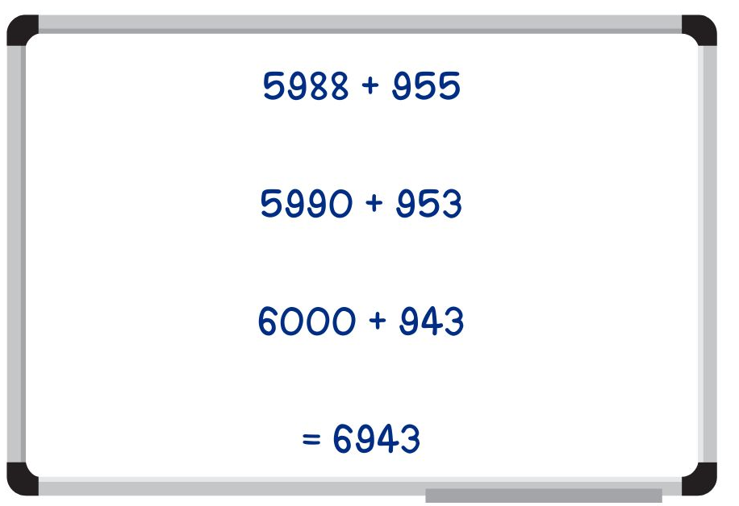
Short response (2)
Remy needed to solve 5988 + 955.
Here is how she worked it out.
What strategy did she use?
Was it the most efficient strategy?
Explain your reasoning.
Notes:
Short response questions provide brisk paced questions focussing on review of current and previous content to support spaced and interleaved practice.
Syllabus focus area:
Additive relations B

Slide 8
Short response (4)
Nana Julie has a playdough recipe that requires 1276 g of flour. How many kilograms of flour is in the playdough?
Notes:
Short response questions provide brisk paced questions focussing on review of current and previous content to support spaced and interleaved practice.
Syllabus focus area:
Non spatial measure B: Mass

Slide 9
Short response (5)
Emma started reading her book at
3:17 pm and finished at 4:12 pm.
How much time did she spend reading?
Notes:
Short response questions provide brisk paced questions focussing on review of current and previous content to support spaced and interleaved practice.
Syllabus focus area:
Non spatial measure B: Time

Slide 10

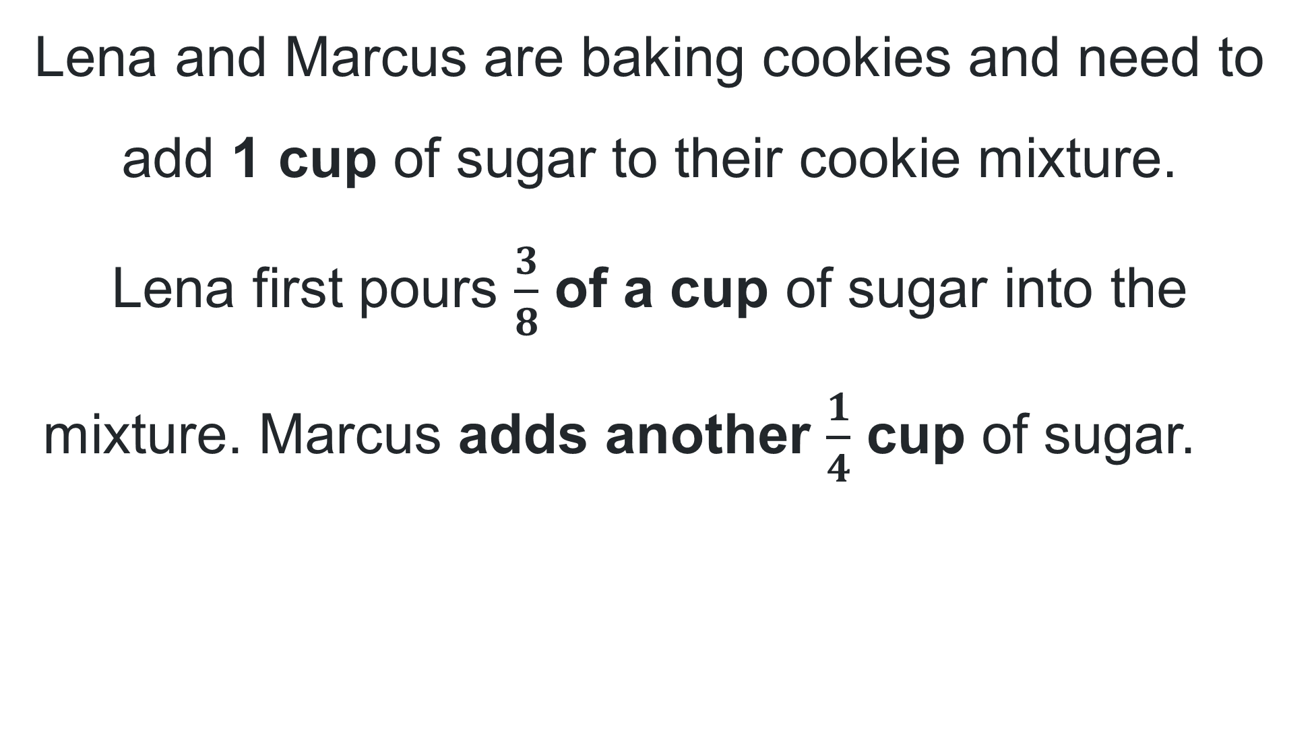
Activity 1 – fraction word problems 1
Lena and Marcus are baking cookies and need to add 1 cup of sugar to their cookie mixture. Lena first pours $\frac{3}{8}$ of a cup of sugar into the mixture. Marcus adds another $\frac{1}{4}$ cup of sugar.
Notes:
This is a developing number sense activity.
Number sense refers to a deep understanding of numbers, including their magnitude, relationships, and the effects of operations on them. It supports fluency and understanding, estimation, flexible thinking, and efficient problem-solving. Number sense activities 1–4 ‘activate’ prior number knowledge and support the learning of new content in the unit. Number sense activities 5–8 ‘loop’ back and provide opportunity for spaced practice with concepts and procedures covered in previous units.
Syllabus focus area:
Representing quantity fractions B
Fraction word problems 1
Lena and Marcus are baking cookies and need to add 1 cup of sugar to their cookie mixture. Lena first pours 3/8 cup of sugar into the mixture. Marcus adds another 1/4 cup of sugar.
How much sugar have Lena and Marcus added so far?
If Lena and Marcus need to add 1 cup of sugar in total, what fraction of sugar still needs to be added?
Prompt students to draw bar models on individual whiteboards to solve the problem

Slide 11
Review of learning 2

Slide 12
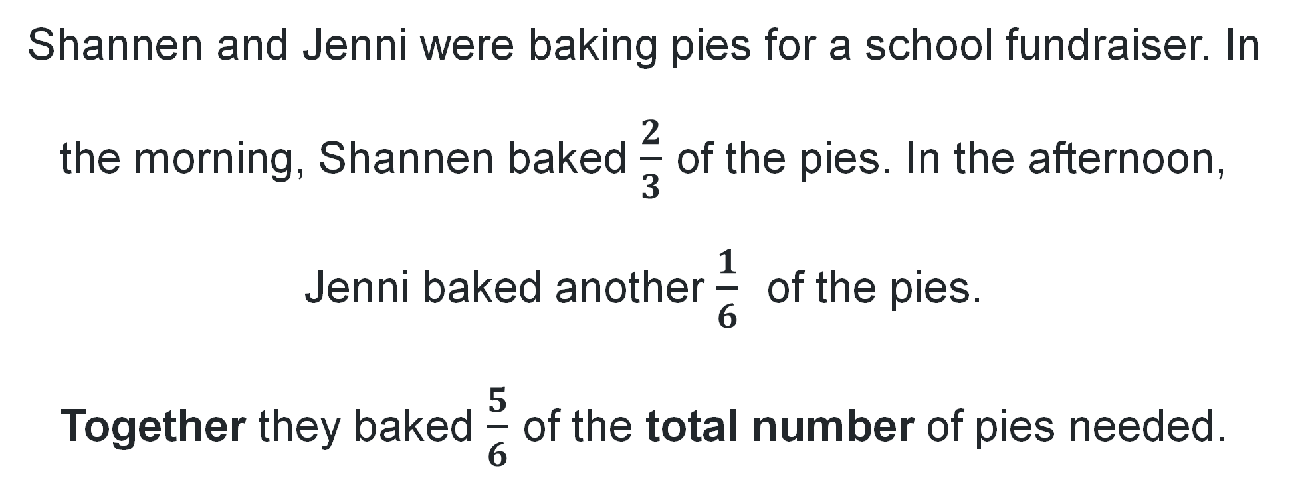
True or false (1)
Shannen and Jenni were baking pies for a school fundraiser. In the morning, Shannen baked $\frac{2}{3}$ of the pies. In the afternoon, Jenni baked another $\frac{1}{6}$ of the pies.
Together they baked $\frac{5}{6}$ of the total number of pies needed.
True | False
Notes:
The question on this slide connects to the content being explored in the developing number sense activity (Activity 2)
Syllabus focus area:
Representing quantity fractions B

Slide 13
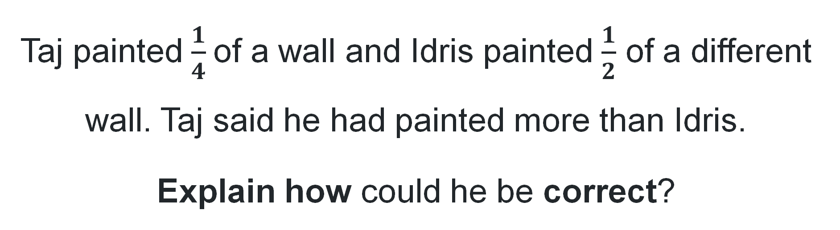
Short response (31)
Taj painted $\frac{1}{4}$of a wall and Idris painted $\frac{1}{2}$ of a different wall. Taj said he had painted more than Idris.
Explain how could he be correct?
Notes:
Short response questions provide brisk paced questions focussing on review of current and previous content to support spaced and interleaved practice.
Syllabus focus area:
Representing quantity fractions A

Slide 14
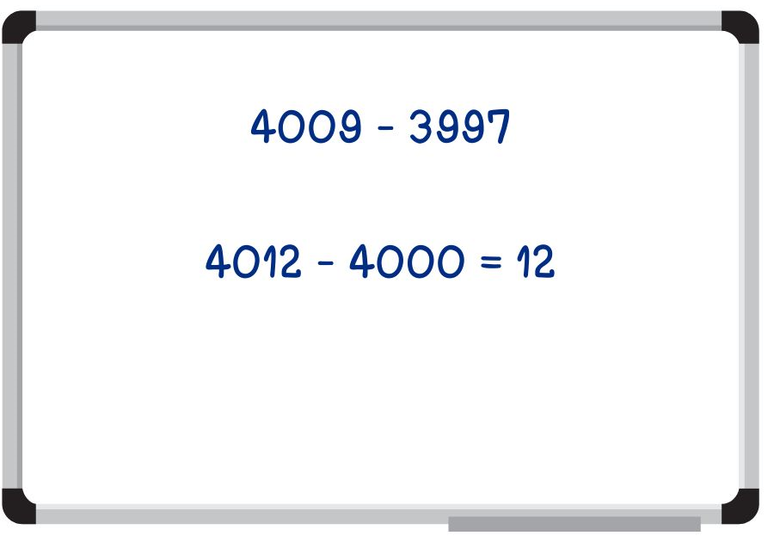
Short response (32)
Remy needed to solve 4009 – 3997
Here is how she worked it out.
What strategy did she use?
Was it the most efficient strategy?
Explain your reasoning.
Notes:
Short response questions provide brisk paced questions focussing on review of current and previous content to support spaced and interleaved practice.
Syllabus focus area:
Additive relations B

Slide 15
Short response (33)
Rubbish produced per person | Grams (g) | Kilograms (kg) | Tonnes (t)
Per week | 10 000 g
Per year |  | 520 kg
Draw the table and fill in the missing grams, kilograms and tonnes.
Notes:
Short response questions provide brisk paced questions focussing on review of current and previous content to support spaced and interleaved practice.
Syllabus focus area:
Non spatial measure B: Mass

Slide 16

Short response (6)
height:
36 cm
base: 44 cm
What is the area of this parallelogram?
Record your solution.
Notes:
Short response questions provide brisk paced questions focussing on review of current and previous content to support spaced and interleaved practice.
Syllabus focus area:
Two-dimensional spatial structure B: Area

Slide 17
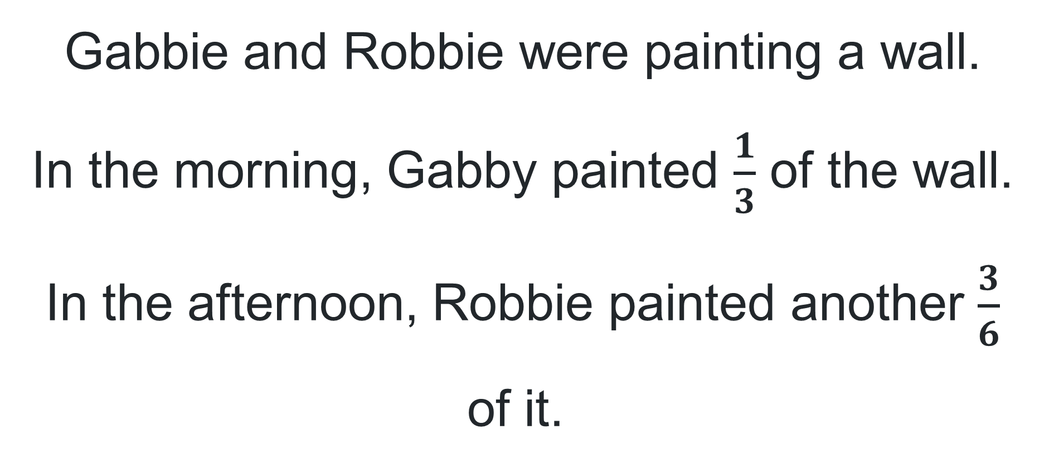
Activity 2 – fraction word problems 2
Gabbie and Robbie were painting a wall.
In the morning, Gabby painted $\frac{1}{3}$ of the wall. In the afternoon, Robbie painted another $\frac{3}{6}$ of it.
Notes:
This is a developing number sense activity.
Number sense refers to a deep understanding of numbers, including their magnitude, relationships, and the effects of operations on them. It supports fluency and understanding, estimation, flexible thinking, and efficient problem-solving. Number sense activities 1–4 ‘activate’ prior number knowledge and support the learning of new content in the unit. Number sense activities 5–8 ‘loop’ back and provide opportunity for spaced practice with concepts and procedures covered in previous units.
Syllabus focus area:
Representing quantity fractions B
Fraction word problems 2
Gabbie and Robbie were painting a wall. In the morning, Gabby painted 1/3 of the wall. In the afternoon, Robbie painted another 3/6 of it.
What fraction of the wall did Gabbie and Robbie paint in total?
What fraction of the wall is still left to be painted? How do you know?
Prompt students use bar models on individual whiteboards to solve the problem

Slide 18
Review of learning 3

Slide 19
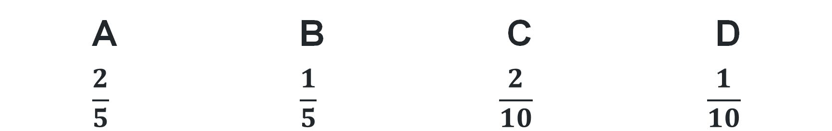

Multiple choice (2)
How much more is $\frac{2}{5}$ than $\frac{3}{10}$?
A | B | C | D
$$\frac{2}{5}$$ | $$\frac{1}{5}$$ | $$\frac{2}{10}$$ | $$\frac{1}{10}$$
Notes:
This question connects to the content in the developing number sense activity (Activity 3)
Syllabus focus area:
Representing quantity fractions B

Slide 20
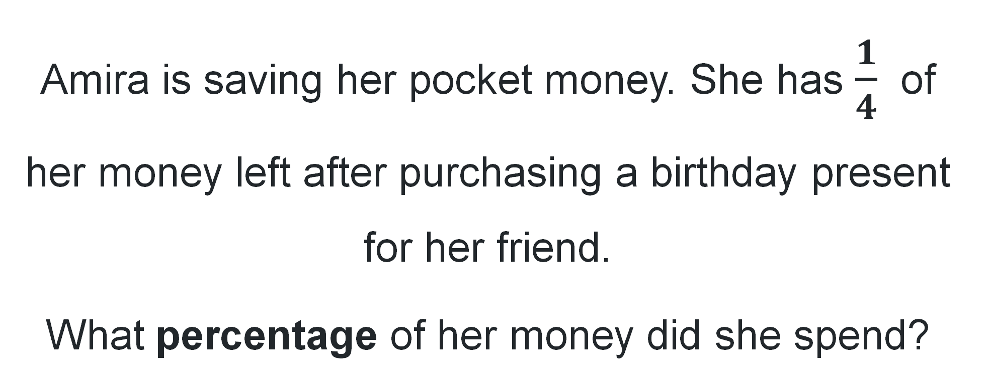
Short response (7)
Amira is saving her pocket money. She has $\frac{1}{4}$ of her money left after purchasing a birthday present for her friend.
What percentage of her money did she spend?
Notes:
Short response questions provide brisk paced questions focussing on review of current and previous content to support spaced and interleaved practice.
Syllabus focus area:
Represents number B

Slide 21
Short response (8)
Use addition for subtraction on an empty number line to solve:
4009 – 2997
Notes:
Short response questions provide brisk paced questions focussing on review of current and previous content to support spaced and interleaved practice.
Syllabus focus area:
Additive relations B

Slide 22
Short response (9)
Darvin buys 4 kg of red lollies, a box of chocolate weighing 3.75 kg, a 1.25 kg box of cupcakes and a 1.5 kg container of ice cream. How much mass is this altogether?
Record your answer in grams and kilograms.
Notes:
Short response questions provide brisk paced questions focussing on review of current and previous content to support spaced and interleaved practice.
Syllabus focus area:
Non spatial measure B: Mass

Slide 23
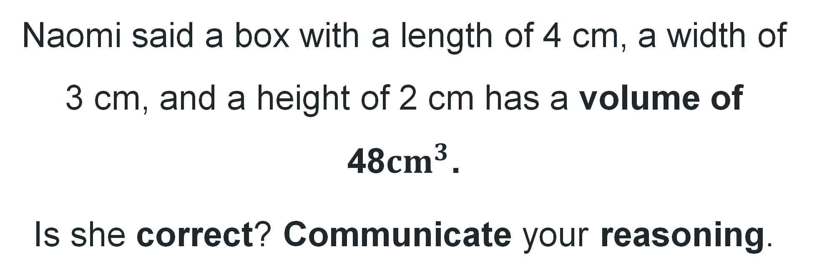
Short response (10)
Naomi said a box with a length of 4 cm, a width of 3 cm, and a height of 2 cm has a volume of 48${cm}^{3}$.
Is she correct? Communicate your reasoning.
Notes:
Short response questions provide brisk paced questions focussing on review of current and previous content to support spaced and interleaved practice.
Syllabus focus area:
Three-dimensional spatial structure B: Volume

Slide 24
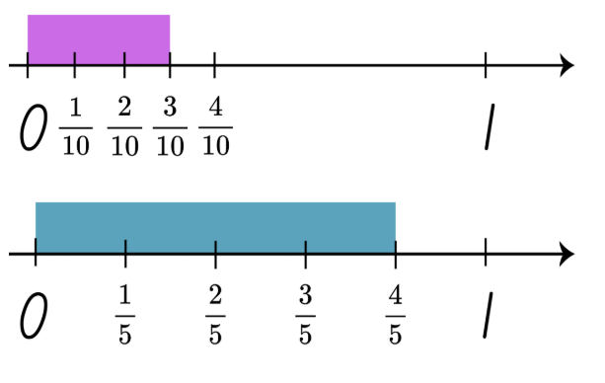
Activity 3 – comparing fractional quantities 1
Notes:
This is a developing number sense activity.
Number sense refers to a deep understanding of numbers, including their magnitude, relationships, and the effects of operations on them. It supports fluency and understanding, estimation, flexible thinking, and efficient problem-solving. Number sense activities 1–4 ‘activate’ prior number knowledge and support the learning of new content in the unit. Number sense activities 5–8 ‘loop’ back and provide opportunity for spaced practice with concepts and procedures covered in previous units.
Syllabus focus area:
Representing quantity fractions B
Comparing fractional quantities 1
Display and provide students with Resource 23 – comparing fractional quantities 1 (this resource corresponds to Resource 23 – comparing fractional quantities 1 in Stage 3, Year B Unit 36).
Students use the fraction strip and number line representations to work out how much more four-fifths is than three-tenths.
Students turn and talk with a partner to work on their answer. Ask:
What strategy did you use to find the difference?
What did you notice about the denominators in this question? (They are related denominators.)
Are the related denominators helpful?
If 4/5 is 5/10 more than 3/10, how many more tenths are needed to make one whole? 5/10 + 3/10 + 2/10 = one whole.
How else could one whole be made adding fifths and tenths? For example, 4/5 + 2/10= one whole.

Slide 25
Review of learning 4

Slide 26

True or false (2)
The difference between $\frac{2}{3}$ and $\frac{3}{6}$ is $\frac{1}{6}$ .
True | False
Notes:
The question on this slide connects to the content being explored in the developing number sense activity (Activity 4)
Syllabus focus area:
Representing quantity fractions B

Slide 27
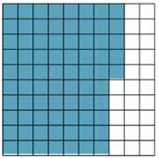
Short response (11)
Record the fraction, decimal and percentage for the shaded area.
Notes:
Short response questions provide brisk paced questions focussing on review of current and previous content to support spaced and interleaved practice.
Syllabus focus area:
Represents number B

Slide 28

Short response (12)
Matthew worked out this decimal equation:
What error did Matthew make?
Correct the equation.
4.25 – 2.5 = 4.10
Notes:
Short response questions provide brisk paced questions focussing on review of current and previous content to support spaced and interleaved practice.
Syllabus focus area:
Additive relations B

Slide 29
Short response (13)
Weight | Grams (g) | Kilograms (kg)
A | 10 000 g
B | 1687 g
C | 12 876 g
Convert the weight of these crocodiles to kilograms. Which crocodile is the heaviest?
Notes:
Short response questions provide brisk paced questions focussing on review of current and previous content to support spaced and interleaved practice.
Syllabus focus area:
Non spatial measure B: Mass

Slide 30
Short response (14)
You have a square on a piece of paper.
If you reflect the square over a line, where will the new square be? Then, if you rotate the original square 90 degrees, how will it look?
Describe what happens to the square with each transformation.
Notes:
Short response questions provide brisk paced questions focussing on review of current and previous content to support spaced and interleaved practice.
Syllabus focus area:
Two-dimensional spatial structure B: 2DS Shape

Slide 31
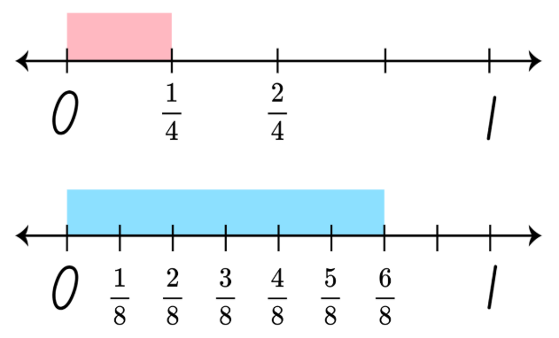
Activity 4 – comparing fractional quantities 2
Notes:
This is a developing number sense activity.
Number sense refers to a deep understanding of numbers, including their magnitude, relationships, and the effects of operations on them. It supports fluency and understanding, estimation, flexible thinking, and efficient problem-solving. Number sense activities 1–4 ‘activate’ prior number knowledge and support the learning of new content in the unit. Number sense activities 5–8 ‘loop’ back and provide opportunity for spaced practice with concepts and procedures covered in previous units.
Syllabus focus area:
Representing quantity fractions B
Comparing fractional quantities 2
Display Resource 24- comparing fractional quantities 2 in Stage 3, Year B Unit 36.
Students use the fraction strip and number line to find the difference between 6 eighths and one-quarter.
Students turn and talk with a partner to share their reasoning. Ask:
What strategy did you use to find the difference?
Was the strategy different to the one you used for the problem in Lesson 3? If yes, why?
Is there more than one answer to this problem using the related denominators of 4 and 8
Can you explain why there can be 2 answers to this problem using the related denominators or 4 and 8? 2/4
and 4/8 are equivalent fractions.

Slide 32
Review of learning 5

Slide 33
Multiple choice (3)
What values are missing from the table?
Number of squares | 1 | 2 | 3 | 4 | 5 | 6 | 7
Number of sides | 4 | 8 | 12
A | B | C | D
18, 22, 26, 32 | 16, 24, 28, 32 | 16, 20, 24, 28 | 16, 22, 26, 30
Notes:
This question connects to the content in the developing number sense activity (Activity 5)
Syllabus focus area:
Multiplicative relations B

Slide 34
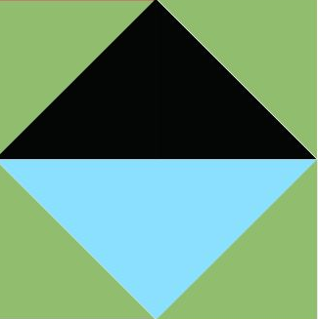
Short response (15)
What fraction of the shape is black?
Record any equivalent fractions.
Notes:
Short response questions provide brisk paced questions focussing on review of current and previous content to support spaced and interleaved practice.
Syllabus focus area:
Represent quantity fractions B

Slide 35
Short response (16)
Use partitioning to solve:
193.628 + 3207.84
Notes:
Short response questions provide brisk paced questions focussing on review of current and previous content to support spaced and interleaved practice.
Syllabus focus area:
Additive relations B

Slide 36
Short response (17)
Robbie ran 5.2 kilometres in one lap and 3.75 kilometres in another lap.
Calculate the total distance he travelled in metres.
Notes:
Short response questions provide brisk paced questions focussing on review of current and previous content to support spaced and interleaved practice.
Syllabus focus area:
Geometric measure B: Length

Slide 37
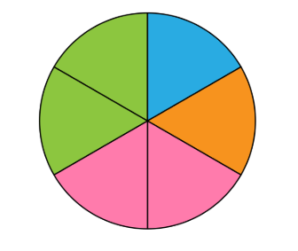
Short response (18)
Using words, describe the chance of spinning green or pink.
Notes:
Short response questions provide brisk paced questions focussing on review of current and previous content to support spaced and interleaved practice.
Syllabus focus area:
Chance B

Slide 38
Activity 5 – table of values 1
Number of shapes | 1 | 2 | 3 | 4 | 5 | 6 | 7 | 8 | 9 | 10
Number of sides
Notes:
This is a developing number sense activity.
Number sense refers to a deep understanding of numbers, including their magnitude, relationships, and the effects of operations on them. It supports fluency and understanding, estimation, flexible thinking, and efficient problem-solving. Number sense activities 1–4 ‘activate’ prior number knowledge and support the learning of new content in the unit. Number sense activities 5–8 ‘loop’ back and provide opportunity for spaced practice with concepts and procedures covered in previous units.
Syllabus focus area: Multiplicative relations B
Table of values 1
Ask:
1. How many sides are there? Record the number 6 below the diagram, in the first box of the table.
2. Draw another hexagon next to the first one and pose the question: I have drawn another hexagon, how many sides have I drawn altogether? Record the number 12 below the second diagram and in the second box of the table.
3. Students continue the sequence to the tenth term and record it in a table.
4. Discuss the pattern using the prompts:
How many ways can you describe the pattern? [The numbers in the pattern are increasing by 6; The pattern is made up of numbers that are multiples of 6. The third number in the pattern is 3 × 6. The fourth number in the pattern is 4 × 6 and it continues].
How does the table help determine the relationship between the number of shapes and the number of sides? [The table helps me see that I do not need to add 6 to continue the pattern. I can see that if I take the number of shapes and multiply it by 6 it will give me the number of sides; For every new hexagon, the sides increase by 6. I can say for every 1 hexagon, there are 6 more sides].
Can you create a rule using multiplication to determine the number of sides for any given number of hexagons? [The rule is: number of shapes × 6 = number of sides. (Highlight that the number of hexagons multiplied by 6 always determines the number of sides.)].

Slide 39
Review of learning 6

Slide 40
True or false (3)
Keely has accurately completed the table.
Number of hexagons | 4 | 5 | 6 | 7 | 8 | 9 | 10
Number of sides | 24 | 30 | 36 | 42 | 48 | 54 | 60
True | False
Communicate your reasoning.
Notes:
The question on this slide connects to the content being explored in the developing number sense activity (Activity 6)
Syllabus focus area:
Multiplicative relations B

Slide 41
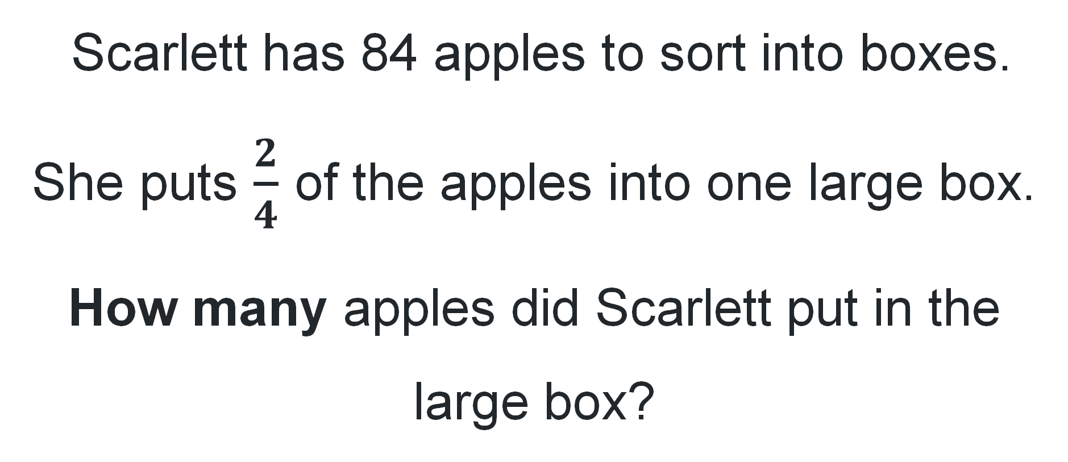
Short response (19)
Scarlett has 84 apples to sort into boxes. She puts $\frac{2}{4}$ of the apples into one large box.
How many apples did Scarlett put in the large box?
Notes:
Short response questions provide brisk paced questions focussing on review of current and previous content to support spaced and interleaved practice.
Syllabus focus area:
Represent quantity fractions B

Slide 42
Short response (20)
Student | School | Height
Joesphine | Happy Valley PS | 1.61 m
Yin Lee | Happy Valley PS | 1.51 m
Zoran | Mountain Top PS | 1.47 m
Mitchell | Galaxy PS | 1.55 m
Carolina | Galaxy PS | 1.59 m
Zeinab | Mountain Top PS | 1.54 m
Use an efficient strategy to determine the total combined high jump height for each school?
Notes:
Short response questions provide brisk paced questions focussing on review of current and previous content to support spaced and interleaved practice.
Syllabus focus area:
Additive relations B

Slide 43
Short response (21)
Jamie has a piece of string that is 2.4 metres long. She cuts off a piece that is 1.3 metres long for a project.
How long is the remaining piece of string?
If Jamie needs a total length of 2.5 metres for another project, does she have enough string left?
Notes:
Short response questions provide brisk paced questions focussing on review of current and previous content to support spaced and interleaved practice.
Syllabus focus area:
Geometric measure B: Length

Slide 44
Short response (22)
Draw the front, side and top view for a triangular prism.
Notes:
Short response questions provide brisk paced questions focussing on review of current and previous content to support spaced and interleaved practice.
Syllabus focus area:
Three-dimensional spatial structure B: 3DS Objects

Slide 45
Activity 6 – table of values 2
Number of shapes | 1 | 2 | 3 | 4 | 5 | 6 | 7 | 8 | 9 | 10
Number of sides
Notes:
This is a developing number sense activity.
Number sense refers to a deep understanding of numbers, including their magnitude, relationships, and the effects of operations on them. It supports fluency and understanding, estimation, flexible thinking, and efficient problem-solving. Number sense activities 1–4 ‘activate’ prior number knowledge and support the learning of new content in the unit. Number sense activities 5–8 ‘loop’ back and provide opportunity for spaced practice with concepts and procedures covered in previous units.
Syllabus focus area: Multiplicative relations B
Table of values 2
Ask:
How many sides are there? Record the number 8 below the diagram, in the first box of the table.
Draw another octagon next to the first one and pose the question: I have drawn another octagon, how many sides have I drawn altogether? Record the number 16 below the second diagram and in the second box of the table.
Students continue the sequence to the tenth term and record it in a table.
Discuss the pattern using the prompts below.
How many ways can you describe the pattern? [The numbers in the pattern are increasing by 8; The pattern is made up of numbers that are multiples of 8. The third number in the pattern is 3 × 8. The fourth number in the pattern is 4 × 8 and it continues].
How does the table help determine the relationship between the number of shapes and the number of sides? [The table helps me see that I do not need to add 8 to continue the pattern. I can see that if I take the number of shapes and multiply it by 8 it will give me the number of sides; For every new shape, the sides increase by 8. I can say for every one shape, there are 8 more sides].
Can you create a rule using multiplication to determine the number of sides for any given number of octagons? [The rule is: number of octagons × 8 = number of sides. (Highlight that the number of octagons multiplied by 8 always determines the number of sides.)].

Slide 46
Review of learning 7

Slide 47
Multiple choice (4)
Which value did Sierra incorrectly record in this table of values?
Number of clocks | 4 | 5 | 6 | 7 | 8
Total batteries needed | 16 | 20 | 24 | 30 | 32
A | B | C | D
20 | 16 | 32 | 30
Notes:
This question connects to the content in the developing number sense activity (Activity 7)
Syllabus focus area:
Multiplicative relations B

Slide 48
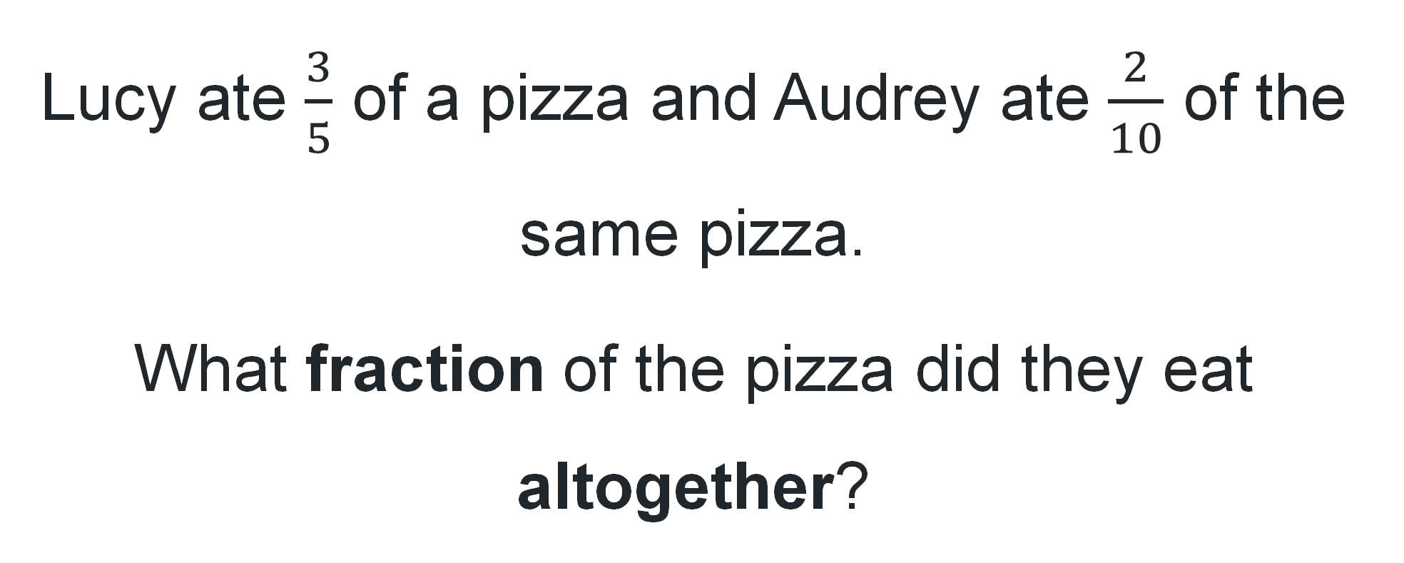
Short response (23)
Lucy ate $\frac{3}{5}$ of a pizza and Audrey ate $\frac{2}{10}$ of the same pizza.
What fraction of the pizza did they eat altogether?
Notes:
Short response questions provide brisk paced questions focussing on review of current and previous content to support spaced and interleaved practice.
Syllabus focus area:
Represent quantity fractions B

Slide 49
Short response (24)
Class 5D are going on a zoo excursion. There are 25 students and 3 adults attending. Find the total cost for zoo entry.
Zoo entry | Cost
Adults | $25
Students/Concession | $18
Children (3 – 14 years) | $14
Family (2 adults/2 chn) | $65
Notes:
Short response questions provide brisk paced questions focussing on review of current and previous content to support spaced and interleaved practice.
Syllabus focus area:
Additive relations B

Slide 50
Short response (25)
Mehan has 2 pieces of wood. One is 150 centimetres long, and the other is 1.2 metres long.
Which piece is longer, and by how much? Convert the measurements to the same unit to compare the lengths accurately.
Notes:
Short response questions provide brisk paced questions focussing on review of current and previous content to support spaced and interleaved practice.
Syllabus focus area:
Geometric measure B: Length

Slide 51
Short response (26)
Draw and describe an adjacent angle.
Notes:
Short response questions provide brisk paced questions focussing on review of current and previous content to support spaced and interleaved practice.
Syllabus focus area:
Geometric measure B: Angles

Slide 52
Activity 7– describing a pattern
Torches | 1 | 3 | 7 | 2 | 4
Total batteries needed | 3 | 8 | 21 | 6 | 12
Notes:
This is a developing number sense activity.
Number sense refers to a deep understanding of numbers, including their magnitude, relationships, and the effects of operations on them. It supports fluency and understanding, estimation, flexible thinking, and efficient problem-solving. Number sense activities 1–4 ‘activate’ prior number knowledge and support the learning of new content in the unit. Number sense activities 5–8 ‘loop’ back and provide opportunity for spaced practice with concepts and procedures covered in previous units.
Syllabus focus area: Multiplicative relations B
Describing a pattern
Explain that the table is not in numerical order. There is also an error in the table of values. Students turn and talk to identify the error.
Select students to share their ideas with the class.
Ask:
What value is incorrect in the table?
How did you determine the error?
What is the multiplicative rule describing the relationship between the bottom number and the top number?
Did the order make a difference?
Students record the table of values in their workbook with the error corrected. They describe the pattern formed by the multiples in the table.
Students create their own table of values with an error. They swap with a partner to solve.

Slide 53
Review of learning 8

Slide 54
True or false (4)
Silas is buying packs of markers. He multiplied each pack by 6 to determine the total number of markers.
Number of packs | 4 | 6 | 7 | 9 | 11
Total number of markers | 28 | 42 | 49 | 63 | 77
True | False
Notes:
The question on this slide connects to the content being explored in the developing number sense activity (Activity 8)
Syllabus focus area:
Multiplicative relations B

Slide 55
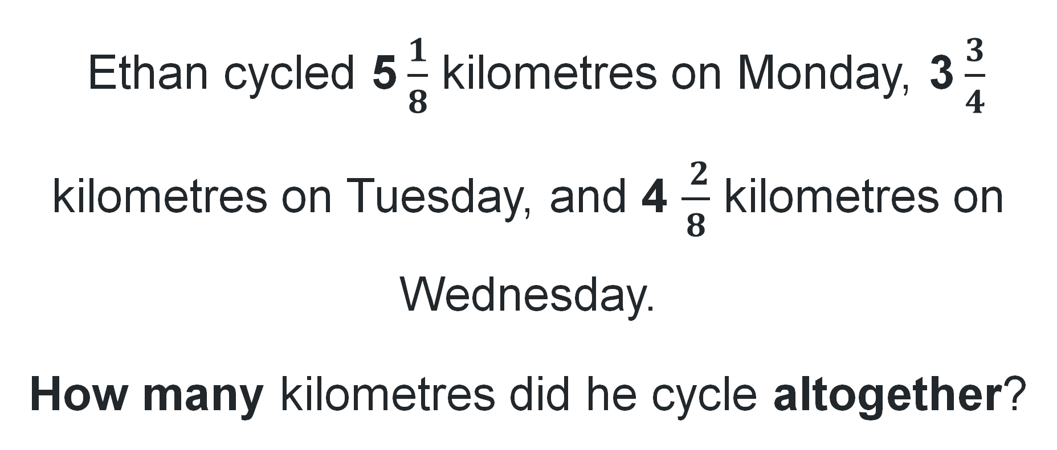
Short response (27)
Ethan cycled 5 $\frac{1}{8}$ kilometres on Monday, 3 $\frac{3}{4}$ kilometres on Tuesday, and 4 $\frac{ 2}{8}$ kilometres on Wednesday.
How many kilometres did he cycle altogether?
Notes:
Short response questions provide brisk paced questions focussing on review of current and previous content to support spaced and interleaved practice.
Syllabus focus area:
Represent quantity fractions B

Slide 56
Short response (28)
Solve 9001 - 589.
Communicate and compare your solution with a partner.
Notes:
Short response questions provide brisk paced questions focussing on review of current and previous content to support spaced and interleaved practice.
Syllabus focus area:
Additive relations B

Slide 57
Short response (29)
A garden is 3.2 metres long and 1.6 metres wide. You have fence sections that are 0.8 metres long.
How many sections of fencing will you need to go around the entire garden?
Notes:
Short response questions provide brisk paced questions focussing on review of current and previous content to support spaced and interleaved practice.
Syllabus focus area:
Geometric measure B: Length

Slide 58
Short response (30)
Ella walked the dog at 3:55 pm. If she walked for 2 hours and 35 minutes, what time did she get home?
Notes:
Short response questions provide brisk paced questions focussing on review of current and previous content to support spaced and interleaved practice.
Syllabus focus area:
Non spatial measure B: Time

Slide 59
Activity 8 – determining a rule
A deer farmer wants to fence a paddock to keep the deer safe. The farmer knows they will need a post for every 3 metres of fencing. They will also need one at each end.
Length of fencing (metres) | 3 | 6 | 9 | 12 | 15 | 27
Number of posts | 2 | 3 | 4 | 5 | 6
Notes:
This is a developing number sense activity.
Number sense refers to a deep understanding of numbers, including their magnitude, relationships, and the effects of operations on them. It supports fluency and understanding, estimation, flexible thinking, and efficient problem-solving. Number sense activities 1–4 ‘activate’ prior number knowledge and support the learning of new content in the unit. Number sense activities 5–8 ‘loop’ back and provide opportunity for spaced practice with concepts and procedures covered in previous units.
Syllabus focus area: Multiplicative relations B
Determining a rule
Presenter note: table and questions will appear on click.
Ask students to identify the rule describing the relationship between the length of fencing and number of posts. If not identified, explain that in this example, the number of posts required is determined by:
the total length of fencing ÷ 3 posts + 1 starting post
−1 starting post × 3 posts.
Students calculate the number of posts needed for 27 metres of fence. They complete the table in their workbooks.
Select students to share and explain their solution.
Students then calculate and record the number of posts of length of fence needed for the following:
90 metres of fencing (31 posts)
240 metres of fencing (81 posts)
72 posts (25 posts).
5. Regroup as a class and select students to share and justify their calculations.

Slide 60
Double Venn diagram
Object 1
Object 2
Features similar to both objects
Features of object 1
Features of object 2

Slide 61
Frayer
Definition
Facts/Characteristics
Word, term, concept
Examples
Non-examples

Slide 62
Spider map
Idea
Subject

Slide 63
Cline
Concept 1
Concept 2
Word
Word
Word
Word
Word
Word
Word
Word
Word
Word
Word

Slide 64

Compare and contrast
Notes:
Use the arrows to navigate between related activities.
Hyperlink each arrow to compare between related slides.

Slide 65
Multiple choice (1)
A
B
C
D
Notes:
This question connects to the content in the developing number sense activity (Activity 1)
This question can:
support spaced and interleaved practice
help identify and address common misconceptions
support active recall and immediate feedback
support whole class participation
identify areas requiring reteach
Teachers are encouraged to adapt and contextualise for their contexts.

Slide 66
Multiple choice (2)
A
B
C
D
Notes:
This question connects to the content in the developing number sense activity (Activity 1)
Syllabus focus area:
Multiplicative relations A
This question can:
support spaced and interleaved practice
help identify and address common misconceptions
support active recall and immediate feedback
support whole class participation
identify areas requiring reteach
Teachers are encouraged to adapt and contextualise for their contexts.

Slide 67
References (1)
This presentation contains NSW Curriculum and syllabus content. The NSW Curriculum is developed by the NSW Education Standards Authority. This content is prepared by NESA for and on behalf of the Crown in the right of the State of New South Wales. The material is protected by Crown copyright.
Please refer to the NESA Copyright Disclaimer for more information https://educationstandards.nsw.edu.au/wps/portal/nesa/mini-footer/copyright.
NESA holds the only official and up-to-date versions of the NSW Curriculum and syllabus documents. Please visit the NSW Education Standards Authority (NESA) website https://educationstandards.nsw.edu.au/wps/portal/nesa/home and the NSW Curriculum website https://curriculum.nsw.edu.au.
Mathematics K–10 Syllabus © NSW Education Standards Authority (NESA) for and on behalf of the Crown in right of the State of New South Wales, 2022.
National Numeracy Learning Progression © Australian Curriculum, Assessment and Reporting Authority (ACARA) 2010 to present, unless otherwise indicated. This material was downloaded from the Australian Curriculum website (National Numeracy Learning Progression) (accessed 29 February 2024) and was not modified.
ACARA (2023a) NAPLAN 2014 Final test, Numeracy, Year 3 test papers and answers [PDF 4.48 MB], NAPLAN, accessed 29 February 2024.
ACARA (2023b) NAPLAN 2015 Final test, Numeracy, Year 3 test papers and answers [PDF 2.89 MB], NAPLAN, accessed 29 February 2024.
Amplify Education (n.d.) Virtual manipulatives, Amplify Polypad website, accessed 29 February 2024.
Clarke D and Roche A (2014) ‘Colour in fractions’ in Clarke D and Roche A (eds) Engaging Maths: 25 favourite lessons, 2nd edn, Mathematics Teaching and Learning Centre, Australia.

Slide 68
References (2)
This presentation contains NSW Curriculum and syllabus content. The NSW Curriculum is developed by the NSW Education Standards Authority. This content is prepared by NESA for and on behalf of the Crown in the right of the State of New South Wales. The material is protected by Crown copyright.
Please refer to the NESA Copyright Disclaimer for more information https://educationstandards.nsw.edu.au/wps/portal/nesa/mini-footer/copyright.
NESA holds the only official and up-to-date versions of the NSW Curriculum and syllabus documents. Please visit the NSW Education Standards Authority (NESA) website https://educationstandards.nsw.edu.au/wps/portal/nesa/home and the NSW Curriculum website https://curriculum.nsw.edu.au.
Didax, Inc (2023) ‘Fraction number line’, Virtual Manipulatives, Didax website, accessed 29 February 2024.
ESA (Education Services Australia Ltd) and AAMT (The Australian Association of Mathematics Teachers) (n.d.) ‘Fraction wall game’, Fractions, Top Drawer Teachers: Resources for Teachers of Mathematics website, accessed 29 February 2024.
Siemon D, Warren E, Beswick K, Faragher R, Miller J, Horne M, Jazby D, Breed M, Clark J and Brady K (2022) Teaching Mathematics: Foundations to Middle Years, 3rd edn, Oxford University Press, Australia.
Valentine J (2024) ‘Fractions on a Number Line - Beyond One Whole’, Unit 9: Fractions, BetterLesson website, accessed 29 February 2024.

Slide 69
Copyright
© State of New South Wales (Department of Education), 2025
The copyright material published in this resource is subject to the Copyright Act 1968 (Cth) and is owned by the NSW Department of Education or, where indicated, by a party other than the NSW Department of Education (third-party material).
Copyright material available in this resource and owned by the NSW Department of Education is licensed under a Creative Commons Attribution 4.0 International (CC BY 4.0) license.
This license allows you to share and adapt the material for any purpose, even commercially.
Attribution should be given to © State of New South Wales (Department of Education), 2025.
Material in this resource not available under a Creative Commons license:
the NSW Department of Education logo, other logos and trademark-protected material
Material owned by a third party that has been reproduced with permission. You will need to obtain permission from the third party to reuse its material.
Links to third-party material and websites
Please note that the provided (reading/viewing material/list/links/texts) are a suggestion only and implies no endorsement, by the New South Wales Department of Education, of any author, publisher, or book title. School principals and teachers are best placed to assess the suitability of resources that would complement the curriculum and reflect the needs and interests of their students.
If you use the links provided in this document to access a third party’s website, you acknowledge that the terms of use, including licence terms set out on the third-party’s website apply to the use which may be made of the materials on that third-party website or where permitted by the Copyright Act 1968 (Cth). The department accepts no responsibility for content on third-party websites.

