Slide 1
Instructions for use
This resource aligns to the learning in Stage 3 Year B Unit 37 and revisits content from earlier sample units.
Classroom teachers are encouraged to add, edit and adapt to meet the needs of their students.
Save a copy of the file to make changes to the slide deck. Go to File > Download a Copy (this downloads a copy to the computer to edit in the PowerPoint app).
To convert the PowerPoint to Google Slides:
  Upload the file into Google Drive and open it.
  Go to File > Save as Google Slides.
  (Note – conversion may cause formatting changes in the slides.)

Slide 2

Review of Learning
Mathematics Stage 3 – Unit 37
Notes:
Reviews may include a combination of question types, requiring students to recall facts and key ideas, as well as apply their knowledge to solve problems and answer questions. To support active engagement, a mix of techniques should be employed.” (AERO, 2024).
This Review of Learning slide deck revisits key concepts from the following units:
Stage 3 Year B Unit 37
Stage 3 Year B Unit 36
Stage 3 Year B Unit 35
It also includes opportunities to review prior learning in non-number content, supporting consolidation across focus areas.
The review of learning resources include three key task types that support the development of mathematical proficiency through retrieval, spaced practice, and active participation. These practices complement the review phase (activating prior knowledge) embedded within the beginning of each lesson.
1.
Multiple-choice questions/True or false: Designed to promote active retrieval of key concepts and identify common misconceptions in number, supporting consolidation, understanding and fluency.
These questions:
support spaced and interleaved practice
help identify and address common misconceptions
support active recall and immediate feedback
support whole class participation
identify areas requiring reteach
2.
Short-response question sets: Carefully grouped questions that encourage spaced and interleaved practice across multiple focus areas, helping students revisit and apply knowledge from different points in time.
These questions:
have a combination of question types
address a range of focus areas
build automaticity and fluency
support active recall
allow for immediate feedback
identify content requiring reteach
3.
Developing number sense activities: A variety of practical, purposeful tasks that reinforce current learning and build on prior knowledge. These activities promote reasoning, problem-solving and conceptual understanding.
The review of learning resources are designed to work support teaching and learning in mathematics. For the most effective implementation, use the resources flexibly, adapting to meet student learning needs and individual classroom contexts.

Slide 3
Lessons
1
Review of learning 1
5
Review of learning 5
2
Review of learning 2
6
Review of learning 6
3
Review of learning 3
7
Review of learning 7
4
Review of learning 4
8
Review of learning 8
Notes:
Teacher notes:
Click lesson numbers to go to specific lessons
Interactive features can be viewed in slide show

Slide 4
Review of learning 1

Slide 5

Multiple choice (1)
Nathan needs to multiply 497 x 87. He estimates by multiplying 500 x 90.
Which answer is an accurate estimate?
A | B | C | D
14000 | 4500 | 1400 | 45000
Notes:
This question connects to the content in the developing number sense activity (Activity 1).
Syllabus focus area:
Multiplication relations B

Slide 6

Short response (1)
List the factors of 36.
Notes:
Short response questions provide brisk paced questions focussing on review of current and previous content to support spaced and interleaved practice.
Syllabus focus area:
Multiplicative relations A

Slide 7
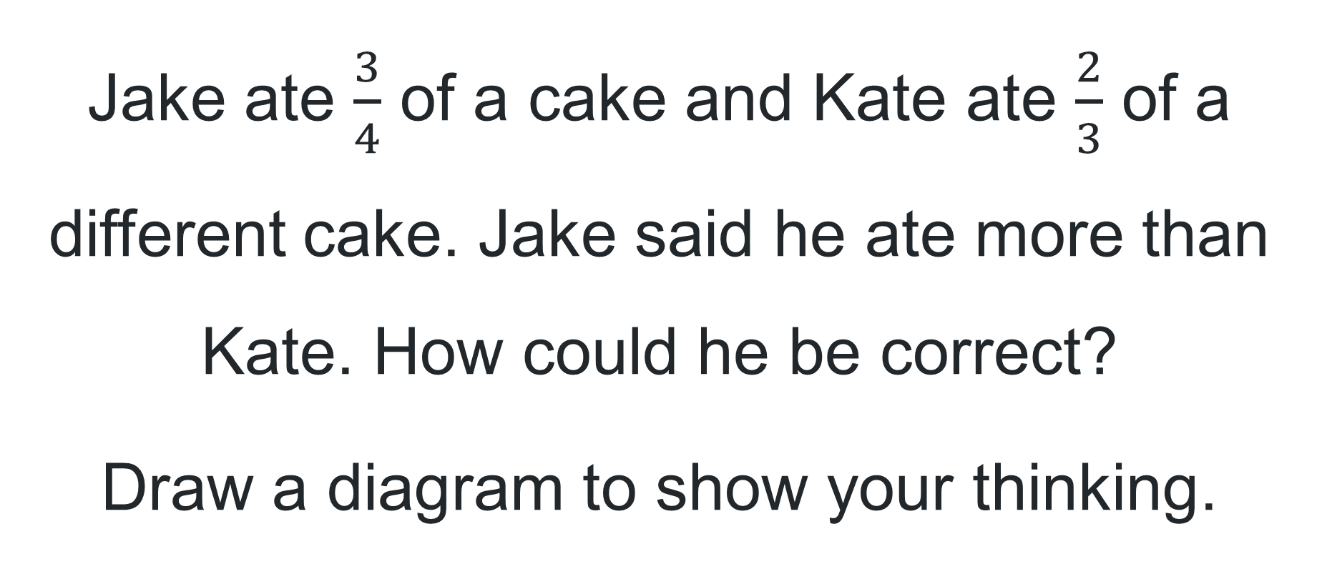
Short response (2)
Jake ate $\frac{3}{4}$ of a cake and Kate ate $\frac{2}{3}$ of a different cake. Jake said he ate more than Kate. How could he be correct?
Draw a diagram to show your thinking.
Notes:
Short response questions provide brisk paced questions focussing on review of current and previous content to support spaced and interleaved practice.
Syllabus focus area:
Representing quantity fractions A

Slide 8
Short response (4)
18 cards are shared between 2 people. One person gets 4 more than the other. How many cards does each person get?
Communicate your reasoning on a number line, tape diagram or bar model.
Notes:
Short response questions provide brisk paced questions focussing on review of current and previous content to support spaced and interleaved practice.
Syllabus focus area:
Additive relations B

Slide 9
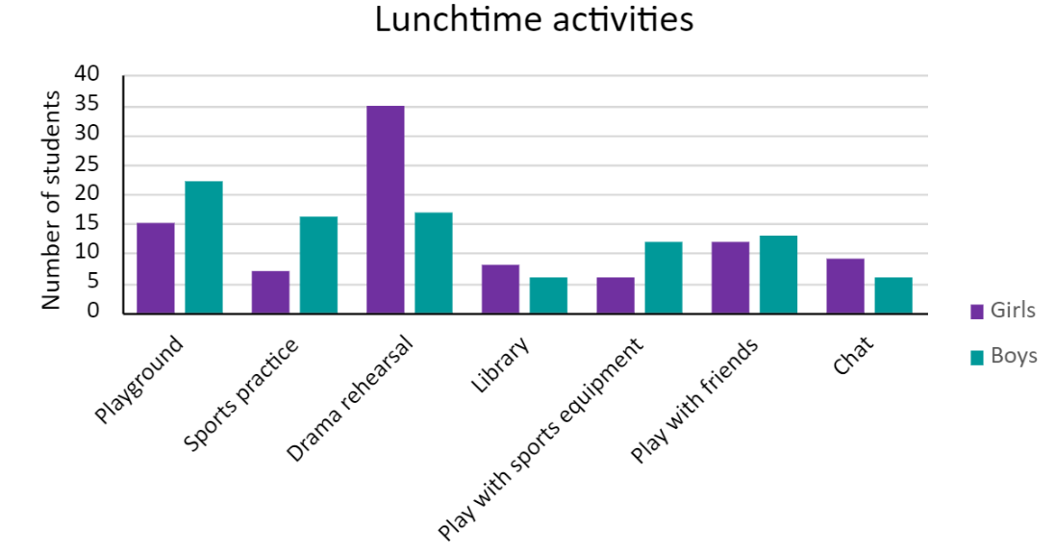
Short response (4)
Which activity had the least difference between the number of girls and boys in it?
How many more girls chose drama rehearsal than boys?
Notes:
Short response questions provide brisk paced questions focussing on review of current and previous content to support spaced and interleaved practice.
Syllabus focus area:
Data B

Slide 10

Activity 1 – mental or written?
Record your ideas on individual whiteboards.
5 × 10 001 =
237 × 4 =
326 × 11=
95 x 20 =
Notes:
This is a developing number sense activity.
Number sense refers to a deep understanding of numbers, including their magnitude, relationships, and the effects of operations on them. It supports fluency and understanding, estimation, flexible thinking, and efficient problem-solving. Number sense activities 1–4 ‘activate’ prior number knowledge and support the learning of new content in the unit. Number sense activities 5–8 ‘loop’ back and provide opportunity for spaced practice with concepts and procedures covered in previous units.
Syllabus focus area:
Multiplicative relations B
Mental or written?
Students work in pairs with whiteboards to solve problems. One student solves the problem using mental strategies, the other will only use written strategies. Display problems one at a time. After each question ask:
Which strategy was more efficient, the mental strategy or the written strategy? Why?
How did you solve the multiplication problem? Explain your thinking and reasoning.

Slide 11
Review of learning 2

Slide 12
True or false (1)
The numbers 6, 5, 4 and 0 in a number sentence _ _ _ × _ can make an answer of zero.
True | False
Notes:
The question on this slide connects to the content being explored in the developing number sense activity (Activity 2).
Syllabus focus area:
Multiplication relations B

Slide 13
Short response (1)
What is the product of 12 x 18?
Notes:
Short response questions provide brisk paced questions focussing on review of current and previous content to support spaced and interleaved practice.
Syllabus focus area:
Multiplicative relations A

Slide 14
Short response (2)
What fraction is needed to complete the whole?
Notes:
Short response questions provide brisk paced questions focussing on review of current and previous content to support spaced and interleaved practice.
Syllabus focus area:
Representing quantity fractions A

Slide 15
Short response (3)
The camp bus costs $200 to hire plus $750 for each trip it takes. The school hires the bus for 2 trips. The school also gets a $50 discount off the total price. What is the total cost?
Communicate your reasoning on a number line.
Notes:
Short response questions provide brisk paced questions focussing on review of current and previous content to support spaced and interleaved practice.
Syllabus focus area:
Additive relations B

Slide 16
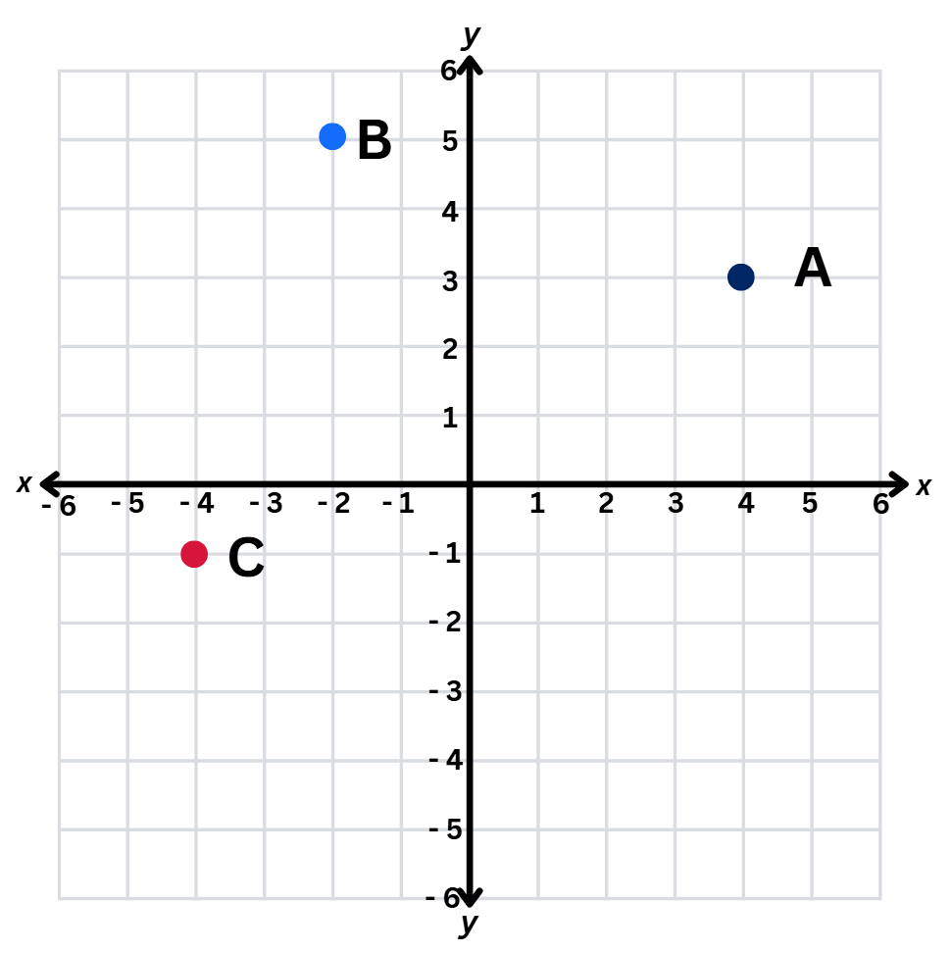
Short response (4)
Record the coordinates for these points on the Cartesian plane?
A =
B =
C =
Notes:
Short response questions provide brisk paced questions focussing on review of current and previous content to support spaced and interleaved practice.
Syllabus focus area:
Geometric measure B: Position

Slide 17
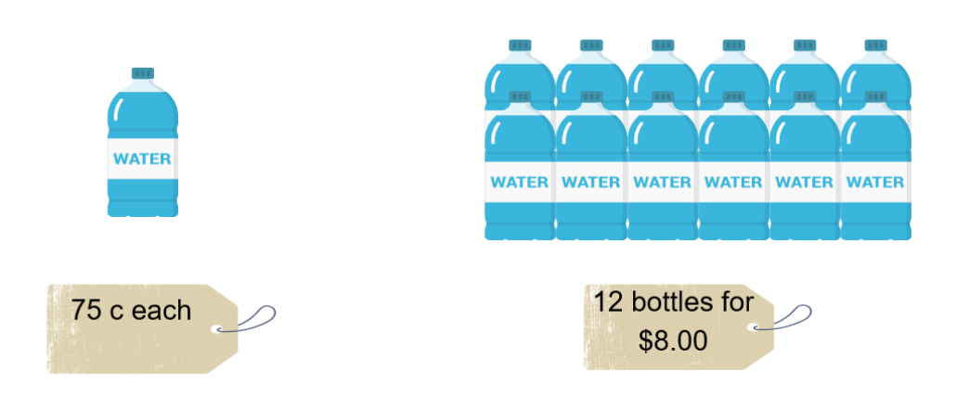
Activity 2 – better deal
12 bottles of water costs $8.00 and single bottles cost $0.75.
If I want to buy 12 bottles of water, which is the better deal?
Notes:
This is a developing number sense activity.
Number sense refers to a deep understanding of numbers, including their magnitude, relationships, and the effects of operations on them. It supports fluency and understanding, estimation, flexible thinking, and efficient problem-solving. Number sense activities 1–4 ‘activate’ prior number knowledge and support the learning of new content in the unit. Number sense activities 5–8 ‘loop’ back and provide opportunity for spaced practice with concepts and procedures covered in previous units.
Syllabus focus area:
Multiplicative relations B
Determining factors
Note: this activity is an adaptation of ‘Best Value’ from Open-Ended Maths Activities by Sullivan and Lilburn.
Display Resource 20 – better deal.
Explain that 12 bottles of water costs $8.00 and single bottles cost $0.75.
Ask:
If I need 12 bottles of water, which is the better deal?
How can this problem be presented visually and numerically?
Select a range of student strategies and representations to share with the class. Include a variety of equations and visual representations.

Slide 18
Review of learning 3

Slide 19
Multiple choice (1)
32 x 12 = __
A | B | C | D
362 | 384 | 303 | 329
Notes:
This question connects to the content in the developing number sense activity (Activity 3).
Syllabus focus area:
Multiplicative relations B

Slide 20
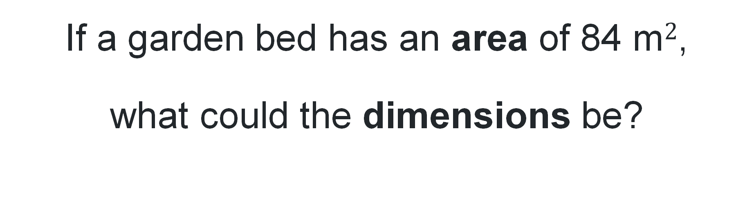
Short response (1)
If a garden bed has an area of 84 m$2$,
what could the dimensions be?
Notes:
Short response questions provide brisk paced questions focussing on review of current and previous content to support spaced and interleaved practice.
Syllabus focus area:
Two-dimensional spatial structure A: Area

Slide 21


Short response (2)
Record the missing equivalent benchmark fractions, decimals and percentages.
Fraction | Decimal | Percentage
 | 0.25
 |  | 50%
 | 0.75
 |  | 100%
$\frac{1}{4}$
$\frac{3}{4}$
Notes:
Short response questions provide brisk paced questions focussing on review of current and previous content to support spaced and interleaved practice.
Syllabus focus area:
Represents numbers B

Slide 22
Short response (3)
Kobi bought secondhand games for $20, $37 and $19. He also bought 2 controllers at $39 each. How much did he spend?
Use a number line to communicate your reasoning.
Notes:
Short response questions provide brisk paced questions focussing on review of current and previous content to support spaced and interleaved practice.
Syllabus focus area:
Additive relations B

Slide 23
Short response (4)
Has this irregular hexagon been
translated, reflected or rotated?
Communicate your reasoning.
Notes:
Short response questions provide brisk paced questions focussing on review of current and previous content to support spaced and interleaved practice.
Syllabus focus area:
Two-dimensional spatial structure B: 2D shapes

Slide 24
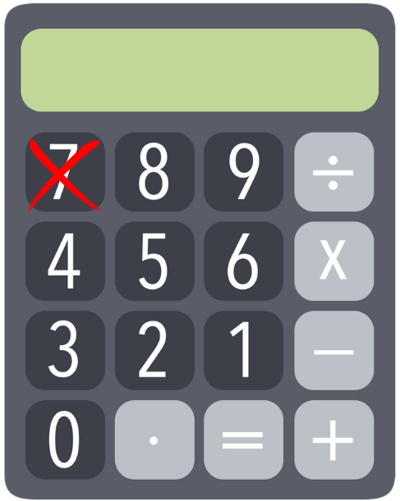
Activity 3 – solving problems using a calculator
How could you calculate 17 × 26 if the number 7 button on your calculator is broken?
Notes:
This is a developing number sense activity.
Number sense refers to a deep understanding of numbers, including their magnitude, relationships, and the effects of operations on them. It supports fluency and understanding, estimation, flexible thinking, and efficient problem-solving. Number sense activities 1–4 ‘activate’ prior number knowledge and support the learning of new content in the unit. Number sense activities 5–8 ‘loop’ back and provide opportunity for spaced practice with concepts and procedures covered in previous units.
Syllabus focus area:
Multiplicative relations B
Solving problems using a calculator
Note: this lesson is an adaptation of a task from Open-Ended Maths Activities by Sullivan and Lilburn.
Image source: CANVA’© Media Element via Canva.com
Pose the problem: How could you calculate 17 × 26 if the number 7 button on your calculator is broken?
Ask: How would you approach this task?
Explain to students they don’t need to find the answer at this stage. Their task is to plan a strategy.
Select a variety of students’ strategies to share with the class. For example:
17 partitioned in ways other than 10 and 7, for example 8 and 9 or 5 and 12
multiply 26 by another number and then add or subtract 26. For example, 18 × 26 − 26.
Pose this problem: How could you calculate 16 × 35 if the number 6 button on your calculator is broken?
Students record their strategy to solve this problem.
Regroup and ask:
What strategies did you use with the new multiplication?
Did factorising the numbers help you solve this problem mentally?
Is it more efficient to use a calculator, or to use a mental or written strategy to solve this problem?
Provide calculators for students to test their strategies and compare their solutions.

Slide 25
Review of learning 4

Slide 26
True or false (1)
Mark multiplied 245 x 20 and got an answer of 4900. Mark's answer is incorrect.
True | False
Notes:
The question on this slide connects to the content being explored in the developing number sense activity (Activity 4).
Syllabus focus area:
Multiplicative relations B

Slide 27
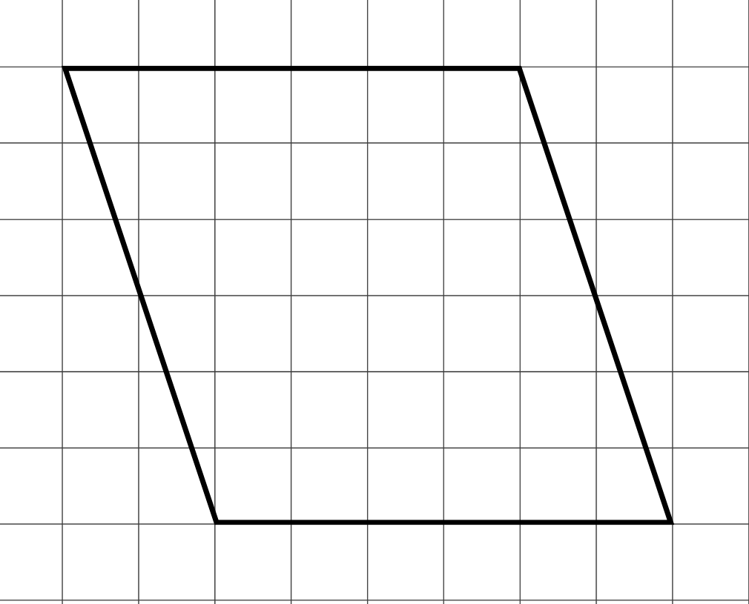
Short response (1)
Transform the shape to calculate the area.
Notes:
Short response questions provide brisk paced questions focussing on review of current and previous content to support spaced and interleaved practice.
Syllabus focus area:
Two-dimensional spatial structure B: Area

Slide 28
Short response (2)
The school gets a discount for hiring the local swimming pool. They only pay 40 % of $550. How much will it cost now?
Notes:
Short response questions provide brisk paced questions focussing on review of current and previous content to support spaced and interleaved practice.
Syllabus focus area:
Represents numbers B

Slide 29
Short response (3)
Frankie is solving 1504 – 896.
What mental strategy could she use to solve it efficiently?
Notes:
Short response questions provide brisk paced questions focussing on review of current and previous content to support spaced and interleaved practice.
Syllabus focus area:
Additive relations B

Slide 30

Short response (4)
The rectangular prism has a volume of 32 cubic-centimetre blocks. The base layer has 4 rows of 2 blocks. How many layers of blocks are there?
Notes:
Short response questions provide brisk paced questions focussing on review of current and previous content to support spaced and interleaved practice.
Syllabus focus area:
Three-dimensional spatial structure B: 3D objects

Slide 31

Activity 4 – factors of 4-digit products
Can you identify number sentences using 2 or more factors that make a product of 8640?
8640
Notes:
This is a developing number sense activity.
Number sense refers to a deep understanding of numbers, including their magnitude, relationships, and the effects of operations on them. It supports fluency and understanding, estimation, flexible thinking, and efficient problem-solving. Number sense activities 1–4 ‘activate’ prior number knowledge and support the learning of new content in the unit. Number sense activities 5–8 ‘loop’ back and provide opportunity for spaced practice with concepts and procedures covered in previous units.
Syllabus focus area:
Multiplicative relations B
Factors of 4-digit products
Write the number 8640 on the board.
Students identify pairs of factors that make a product of 8640. For example,
864 x 10 = 8640
432 x 20 = 8640
108 x 80 = 8640
144 x 60 = 8640
90 x 96 = 8640

Slide 32
Review of learning 5

Slide 33
Multiple choice (1)
Which gives you the most money?
A | B | C | D
50% of $30 | 25% of $100 | 50% of $10 | 10% of $50
Notes:
This question connects to the content in the developing number sense activity (Activity 5).
Syllabus focus area:
Represents numbers B: Make connections between benchmark fractions, decimals and percentages

Slide 34
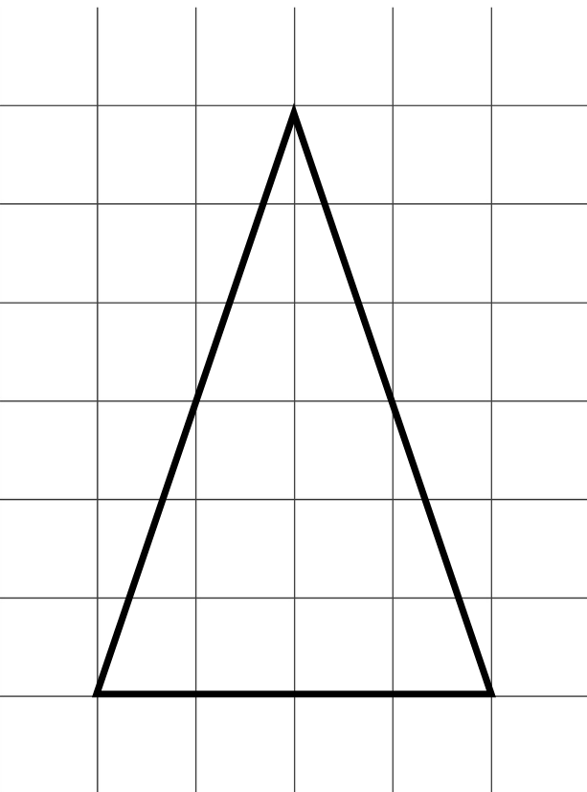
Short response (1)
Calculate the area of the triangle.
Notes:
Short response questions provide brisk paced questions focussing on review of current and previous content to support spaced and interleaved practice.
Syllabus focus area:
Two-dimensional spatial structure B: Area

Slide 35
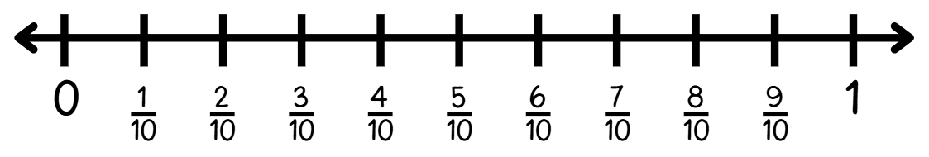





Short response (2)
Write equivalent fractions from the number line for:
= = = = =
$\frac{1}{5}$
$\frac{2}{5}$
$\frac{3}{5}$
$\frac{4}{5}$
$\frac{5}{5}$
Notes:
Short response questions provide brisk paced questions focussing on review of current and previous content to support spaced and interleaved practice.
Syllabus focus area:
Representing quantity fractions B

Slide 36
Short response (3)
Taylor is a carpenter and needs to calculate 5009 − 3997 while working on a house.
How can she use addition to solve this?
What is the solution?
Notes:
Short response questions provide brisk paced questions focussing on review of current and previous content to support spaced and interleaved practice.
Syllabus focus area:
Additive relations B

Slide 37
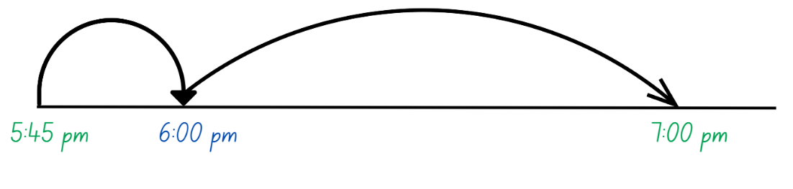
Short response (4)
How many minutes have elapsed on the number line?
Notes:
Short response questions provide brisk paced questions focussing on review of current and previous content to support spaced and interleaved practice.
Syllabus focus area:
Non-spatial measure B: Time

Slide 38


Activity 5 – solving problems involving percentages
Sophie was given a 10% discount on the price of a tennis racquet. If the original price was $20, how much would Sophie save with a 10% discount?
$20
Notes:
This is a developing number sense activity.
Number sense refers to a deep understanding of numbers, including their magnitude, relationships, and the effects of operations on them. It supports fluency and understanding, estimation, flexible thinking, and efficient problem-solving. Number sense activities 1–4 ‘activate’ prior number knowledge and support the learning of new content in the unit. Number sense activities 5–8 ‘loop’ back and provide opportunity for spaced practice with concepts and procedures covered in previous units.
Syllabus focus area:
Represent numbers B: Decimals and percentages
Solving problems involving percentages
Pose the problem: Sophie was given a 10% discount on the price of a tennis racquet. If the original price was $20, how much would Sophie save with a 10% discount?
Select a range of student responses to share with the class. Ask:
What strategy did you use to calculate 10% of the price?
If Sophie was given a 20% discount, how might your strategy for calculating the discount change? 50% discount? 25% discount?

Slide 39
Review of learning 6

Slide 40
True or false (1)
75% of $120 is greater than 50% of $200, because 75% is a larger percentage.
True | False
Communicate your reasoning.
Notes:
The question on this slide connects to the content being explored in the developing number sense activity (Activity 6).
Syllabus focus area:
Represents numbers B

Slide 41
Short response (1)
Give 3 examples of when you would measure volume in cubic metres.
Notes:
Short response questions provide brisk paced questions focussing on review of current and previous content to support spaced and interleaved practice.
Syllabus focus area:
Three-dimensional spatial structure B: Volume

Slide 42

Short response (2)
Lucas has 8 books, which is 2-fifths ( ) the number of books Ayesha has. How many books does Ayesha have?
$\frac{2}{5}$
Ayesha
Lucas
Notes:
Short response questions provide brisk paced questions focussing on review of current and previous content to support spaced and interleaved practice.
Syllabus focus area:
Representing quantity fractions B

Slide 43



Short response (3)
The scales were faulty. Take 2 kg off each parcel and calculate the total weight.
47.41 kg
4.003 kg
32.213 kg
Notes:
Short response questions provide brisk paced questions focussing on review of current and previous content to support spaced and interleaved practice.
Syllabus focus area:
Additive relations B

Slide 44
Short response (4)
In 15 minutes Sofia ran 1 758 m and Chanel ran 1.8 km. Record Sofia’s distance using decimal notation.
Who was the fastest runner?
Communicate your reasoning.
Notes:
Short response questions provide brisk paced questions focussing on review of current and previous content to support spaced and interleaved practice.
Syllabus focus area:
Two-dimensional spatial structure B: Length

Slide 45
Activity 6 – finding percentages of a quantity
Which of the following has the greatest value?
50% of 10
40% of 20
30 % of 30
20% of 40
10% of 50
Notes:
This is a developing number sense activity.
Number sense refers to a deep understanding of numbers, including their magnitude, relationships, and the effects of operations on them. It supports fluency and understanding, estimation, flexible thinking, and efficient problem-solving. Number sense activities 1–4 ‘activate’ prior number knowledge and support the learning of new content in the unit. Number sense activities 5–8 ‘loop’ back and provide opportunity for spaced practice with concepts and procedures covered in previous units.
Syllabus focus area:
Represent numbers B: Decimals and percentages
Finding percentages of a quantity
Display Resource 21 – valuable percentages.
Students record their solutions on individual whiteboards.
Discuss students’ findings.
Ask the following questions:
How can calculating 10% help calculate other percentages?
What strategies did you use to calculate the different percentages?
What connections do you notice?
Note: students may notice the commutative property of percentages from this activity. For example, 50% of 10 is the same as 10% of 50. This property may be something to explore further with students if time permits.

Slide 46
Review of learning 7

Slide 47
Multiple choice (1)
Which percentage gives you the least amount?
10% of 400
A
B
20% of 300
C
30% of 200
D
50% of 100
Notes:
This question connects to the content in the developing number sense activity (Activity 7).
Syllabus focus area:
Represents numbers B

Slide 48
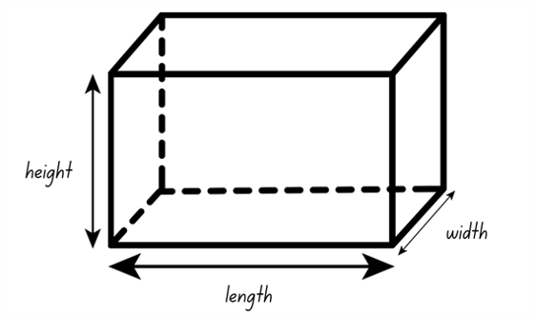
Short response (1)
A rectangular prism has a volume of 100 cubic centimetres. What dimensions could it have?
Notes:
Short response questions provide brisk paced questions focussing on review of current and previous content to support spaced and interleaved practice.
Syllabus focus area:
Three-dimensional spatial structure B: Volume

Slide 49
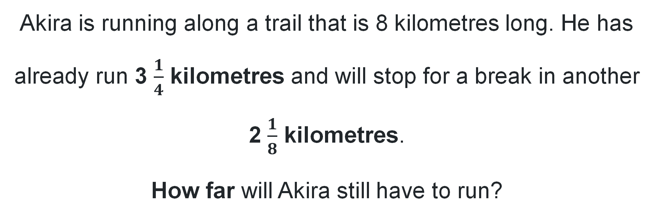
Short response (2)
Akira is running along a trail that is 8 kilometres long. He has already run 3 $\frac{1}{4}$ kilometres and will stop for a break in another 2 $\frac{1}{8}$ kilometres.
How far will Akira still have to run?
Notes:
Short response questions provide brisk paced questions focussing on review of current and previous content to support spaced and interleaved practice.
Syllabus focus area:
Representing quantity fractions B

Slide 50
Short response (3)
1087 – 645 – 422
Communicate how you use place value understanding to solve this problem.
Notes:
Short response questions provide brisk paced questions focussing on review of current and previous content to support spaced and interleaved practice.
Syllabus focus area:
Additive relations B

Slide 51
Short response (4)
Tanvir closed his eyes and chose a handball from the box.
What is the probability of selecting a blue handball?
Notes:
Short response questions provide brisk paced questions focussing on review of current and previous content to support spaced and interleaved practice.
Syllabus focus area:
Chance B

Slide 52
Activity 7 – 10% off the price)
At the end of year sale, every item in the store was reduced by 10%. Every employee at the store is entitled to a staff discount of 10%.
Is an employee entitled to a 20% discount on a dress that originally cost $150? Explain your reasoning.
Notes:
This is a developing number sense activity.
Number sense refers to a deep understanding of numbers, including their magnitude, relationships, and the effects of operations on them. It supports fluency and understanding, estimation, flexible thinking, and efficient problem-solving. Number sense activities 1–4 ‘activate’ prior number knowledge and support the learning of new content in the unit. Number sense activities 5–8 ‘loop’ back and provide opportunity for spaced practice with concepts and procedures covered in previous units.
Syllabus focus area:
Represent numbers B: Decimals and percentages
10% off the price
This lesson is an adaptation of ‘Percentage Challenge 2’ from Enrich-e-matics! A graded maths enrichment programme – Book F by Joshua.
Read the problem as a class and discuss student strategies.
Ask:
What did you discover?
Why might the employee think they were entitled to a 20% discount?
What is the difference between 20% of the original cost and 10% of the reduced cost?

Slide 53
Review of learning 8

Slide 54
True or false (1)
Hamza said that 20% off the regular price of a $550 mountain bike is better value than an extra 5% off the sale price of $500.
True | False
Notes:
The question on this slide connects to the content being explored in the developing number sense activity (Activity 8).
Syllabus focus area:
Represents numbers B

Slide 55
Short response (1)
A teacher needs to stack chairs in a storage room.
The volume of the room is 1200 cubic metres.
What dimensions could it have?
Notes:
Short response questions provide brisk paced questions focussing on review of current and previous content to support spaced and interleaved practice.
Syllabus focus area:
Three-dimensional spatial structure B: Volume

Slide 56
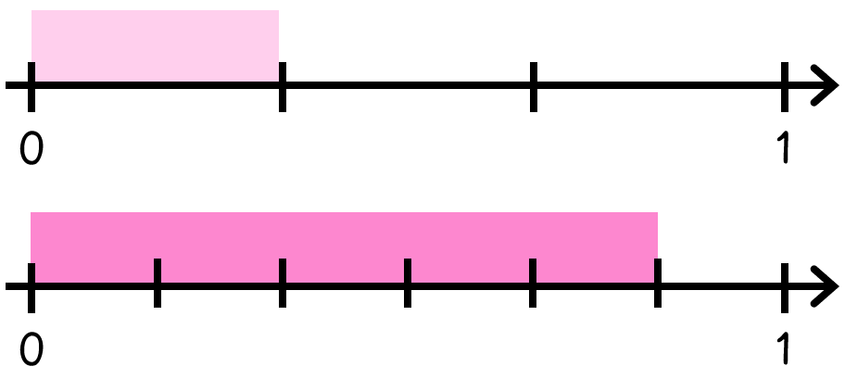
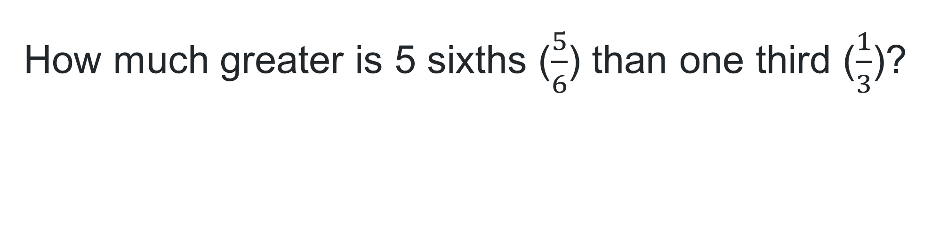
Short response (2)
How much greater is 5 sixths ($\frac{5}{6}$) than one third ($\frac{1}{3}$)?
Notes:
Short response questions provide brisk paced questions focussing on review of current and previous content to support spaced and interleaved practice.
Syllabus focus area:
Representing quantity fractions B

Slide 57
Short response (3)
Solve
12 300 – 4 293 + 210
Notes:
Short response questions provide brisk paced questions focussing on review of current and previous content to support spaced and interleaved practice.
Syllabus focus area:
Additive relations B

Slide 58
Short response (4)
Draw how the irregular hexagon would appear if it was rotated 90°
Shape B
Notes:
Short response questions provide brisk paced questions focussing on review of current and previous content to support spaced and interleaved practice.
Syllabus focus area:
Two-dimensional spatial structure B: 2D Shapes

Slide 59

Activity 8 – 10% sales tax (2)
You must pay 10% sales tax on every item you purchase.
In a sale, a 20% discount is offered on all items.
Which would you prefer to have calculated first - the discount or tax?
$100
Notes:
This is a developing number sense activity.
Number sense refers to a deep understanding of numbers, including their magnitude, relationships, and the effects of operations on them. It supports fluency and understanding, estimation, flexible thinking, and efficient problem-solving. Number sense activities 1–4 ‘activate’ prior number knowledge and support the learning of new content in the unit. Number sense activities 5–8 ‘loop’ back and provide opportunity for spaced practice with concepts and procedures covered in previous units.
Syllabus focus area:
Represent numbers B: Decimals and percentages
10% sales tax
Give students time to solve the problem and record their solutions.
Ask:
Is it better to calculate the discount or tax first?
What strategies did you use to solve the problem?
Select students to communicate their reasoning and justification.

Slide 60
Double Venn diagram
Object 1
Object 2
Features similar to both objects
Features of object 1
Features of object 2

Slide 61
Frayer
Definition
Facts/Characteristics
Word, term, concept
Examples
Non-examples

Slide 62
Spider map
Idea
Subject

Slide 63
Cline
Concept 1
Concept 2
Word
Word
Word
Word
Word
Word
Word
Word
Word
Word
Word

Slide 64

Compare and contrast
Notes:
Use the arrows to navigate between related activities.
Hyperlink each arrow to compare between related slides.

Slide 65
Multiple choice (1)
A
B
C
D
Notes:
This question connects to the content in the developing number sense activity (Activity 1)
This question can:
support spaced and interleaved practice
help identify and address common misconceptions
support active recall and immediate feedback
support whole class participation
identify areas requiring reteach
Teachers are encouraged to adapt and contextualise for their contexts.

Slide 66
Multiple choice (2)
A
B
C
D
Notes:
This question connects to the content in the developing number sense activity (Activity 1)
Syllabus focus area:
Multiplicative relations A
This question can:
support spaced and interleaved practice
help identify and address common misconceptions
support active recall and immediate feedback
support whole class participation
identify areas requiring reteach
Teachers are encouraged to adapt and contextualise for their contexts.

Slide 67
References
This presentation contains NSW Curriculum and syllabus content. The NSW Curriculum is developed by the NSW Education Standards Authority. This content is prepared by NESA for and on behalf of the Crown in the right of the State of New South Wales. The material is protected by Crown copyright.
Please refer to the NESA Copyright Disclaimer for more information https://educationstandards.nsw.edu.au/wps/portal/nesa/mini-footer/copyright.
NESA holds the only official and up-to-date versions of the NSW Curriculum and syllabus documents. Please visit the NSW Education Standards Authority (NESA) website https://educationstandards.nsw.edu.au/wps/portal/nesa/home and the NSW Curriculum website https://curriculum.nsw.edu.au.
Mathematics K–10 Syllabus © NSW Education Standards Authority (NESA) for and on behalf of the Crown in right of the State of New South Wales, 2022.
Amplify Education (2024) Polypad, Polypad website, accessed 26 May 2025.
Joshua A (1997) Enrich-e-matics! A graded maths enrichment programme – Book F, Addison Wesley Longman Australia, Melbourne.
Sullivan P and Lilburn P (2017) Open-Ended Maths Activities, Oxford University Press Australia and New Zealand, Great Britain.

Slide 68
Copyright
© State of New South Wales (Department of Education), 2025
The copyright material published in this resource is subject to the Copyright Act 1968 (Cth) and is owned by the NSW Department of Education or, where indicated, by a party other than the NSW Department of Education (third-party material).
Copyright material available in this resource and owned by the NSW Department of Education is licensed under a Creative Commons Attribution 4.0 International (CC BY 4.0) license.
This license allows you to share and adapt the material for any purpose, even commercially.
Attribution should be given to © State of New South Wales (Department of Education), 2025.
Material in this resource not available under a Creative Commons license:
the NSW Department of Education logo, other logos and trademark-protected material
Material owned by a third party that has been reproduced with permission. You will need to obtain permission from the third party to reuse its material.
Links to third-party material and websites
Please note that the provided (reading/viewing material/list/links/texts) are a suggestion only and implies no endorsement, by the New South Wales Department of Education, of any author, publisher, or book title. School principals and teachers are best placed to assess the suitability of resources that would complement the curriculum and reflect the needs and interests of their students.
If you use the links provided in this document to access a third party’s website, you acknowledge that the terms of use, including licence terms set out on the third-party’s website apply to the use which may be made of the materials on that third-party website or where permitted by the Copyright Act 1968 (Cth). The department accepts no responsibility for content on third-party websites.

