Slide 1
Instructions for use
This resource is not a teaching and learning program. It should be used in conjunction with Stage 3 Year A Unit 38.
Classroom teachers are encouraged to add and adapt slides as required to meet the needs of their students.
Save a copy of the file to make changes to the slide deck. Go to File > Download a Copy (this downloads a copy to the computer to edit in the PowerPoint app).
To convert the PowerPoint to Google Slides:
  Upload the file into Google Drive and open it.
  Go to File > Save as Google Slides.
  (Note – conversion may cause formatting changes in the slides.)

Slide 2

Review of Learning
Mathematics Stage 3 – Unit 38
Notes:
Reviews may include a combination of question types, requiring students to recall facts and key ideas, as well as apply their knowledge to solve problems and answer questions. To support active engagement, a mix of techniques should be employed.” (AERO, 2024).
This Review of Learning slide deck revisits key concepts from the following units:
Stage 3 Year B Unit 38
Stage 3 Year B Unit 37
Stage 3 Year B Unit 36
It also includes opportunities to review prior learning in non-number content, supporting consolidation across focus areas.
The review of learning resources include three key task types that support the development of mathematical proficiency through retrieval, spaced practice, and active participation. These practices complement the review phase (activating prior knowledge) embedded within the beginning of each lesson.
1.
Multiple-choice questions/True or false: Designed to promote active retrieval of key concepts and identify common misconceptions in number, supporting consolidation, understanding and fluency.
These questions:
support spaced and interleaved practice
help identify and address common misconceptions
support active recall and immediate feedback
support whole class participation
identify areas requiring reteach
2.
Short-response question sets: Carefully grouped questions that encourage spaced and interleaved practice across multiple focus areas, helping students revisit and apply knowledge from different points in time.
These questions:
have a combination of question types
address a range of focus areas
build automaticity and fluency
support active recall
allow for immediate feedback
identify content requiring reteach
3.
Developing number sense activities: A variety of practical, purposeful tasks that reinforce current learning and build on prior knowledge. These activities promote reasoning, problem-solving and conceptual understanding.
The review of learning resources are designed to work support teaching and learning in mathematics. For the most effective implementation, use the resources flexibly, adapting to meet student learning needs and individual classroom contexts.

Slide 3
Lessons
1
Review of learning 1
5
Review of learning 5
2
Review of learning 2
6
Review of learning 6
3
Review of learning 3
7
Review of learning 7
4
Review of learning 4
8
Review of learning 8
Notes:
Teacher notes:
Click lesson numbers to go to specific lessons
Interactive features can be viewed in slide show

Slide 4
Review of learning 1

Slide 5


Multiple choice (1)
$\frac{1}{5}$ of 40 is:
A
6
B
7
C
8
D
9
Notes:
This question connects to the content in the developing number sense activity (Activity 1)
Syllabus focus area:
Representing quantity fractions B

Slide 6

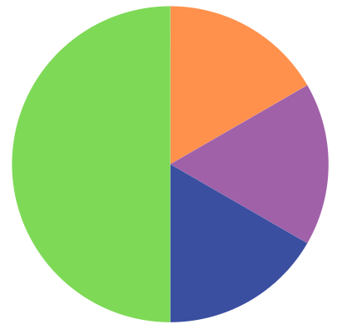
Short response (1)
Record the chance of landing on a purple segment as a fraction.
Notes:
Short response questions provide brisk paced questions focussing on review of current and previous content to support spaced and interleaved practice.
Syllabus focus area:
Chance B

Slide 7
Short response (2)
Explain why a number is prime, composite or neither.
Notes:
Short response questions provide brisk paced questions focussing on review of current and previous content to support spaced and interleaved practice.
Syllabus focus area:
Multiplicative relations A

Slide 8
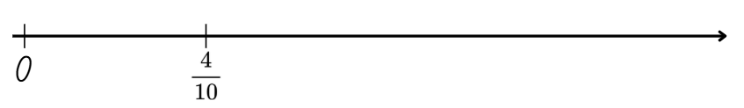
Short response (3)
Record where one would be on the number line to represent the whole:
Notes:
Short response questions provide brisk paced questions focussing on review of current and previous content to support spaced and interleaved practice.
Syllabus focus area:
Representing quantity fractions A

Slide 9
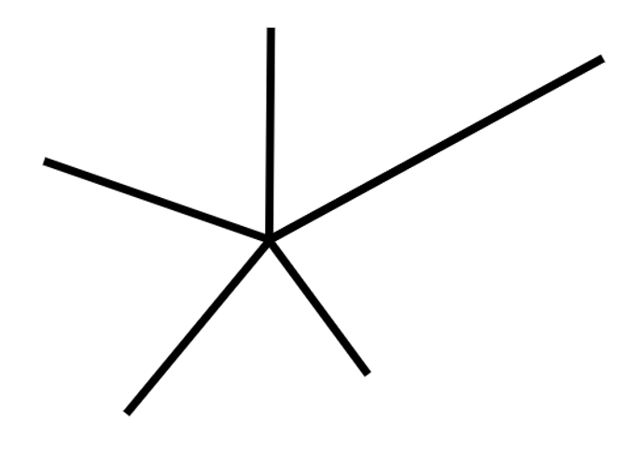
Short response (4)
Identify 2 angle types displayed below:
Notes:
Short response questions provide brisk paced questions focussing on review of current and previous content to support spaced and interleaved practice.
Syllabus focus area:
Geometric measure B: Angles

Slide 10

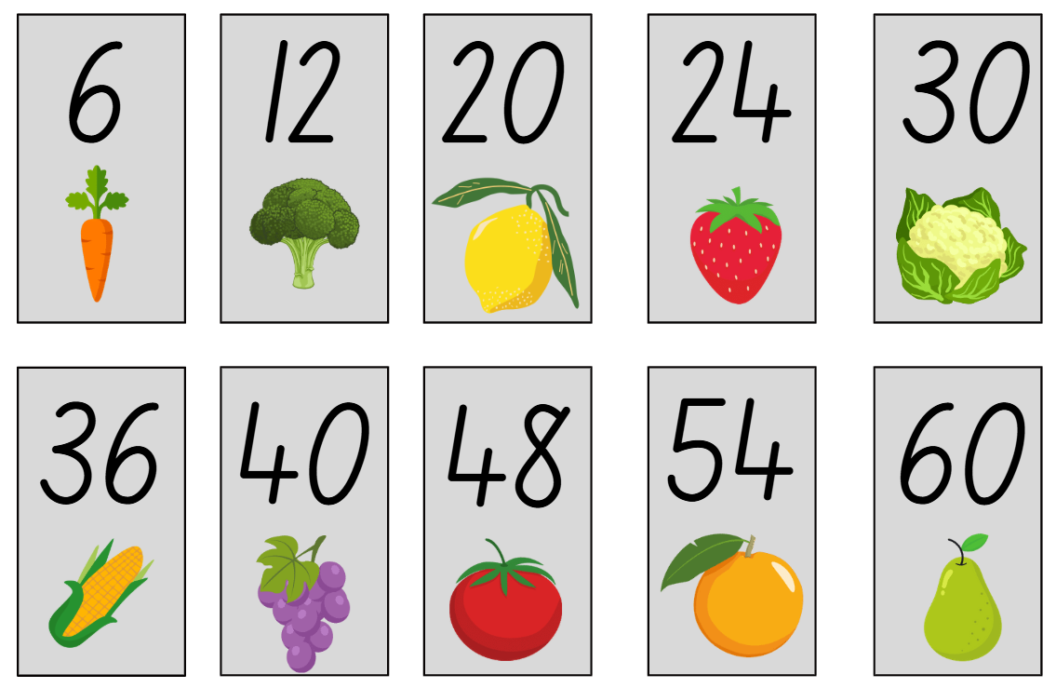
Activity 1 – farmer’s market
Notes:
This is a developing number sense activity.
Number sense refers to a deep understanding of numbers, including their magnitude, relationships, and the effects of operations on them. It supports fluency and understanding, estimation, flexible thinking, and efficient problem-solving. Number sense activities 1–4 ‘activate’ prior number knowledge and support the learning of new content in the unit. Number sense activities 5–8 ‘loop’ back and provide opportunity for spaced practice with concepts and procedures covered in previous units.
Syllabus focus area:
Representing quantity fractions B
Farmer’s market
This resource corresponds to Resource 25 – farmer’s market cards in Stage 3 Year B Unit 38.
Provide students with Resource 25 – farmer’s market cards (this resource corresponds to Resource 25 – farmer’s market cards in Stage 3 Year B Unit 38), a 6-sided die and an individual whiteboard. Remind students how to play Farmer’s Market as introduced in Stage 3 Unit 24.
- Have all the cards face up.
- Player 1 rolls the die. This will be the denominator for the unit fraction. For example, if a 5 is rolled, the fraction would be $\frac{1}{5}$. If a 1 is rolled, roll again.
- Choose a produce card.
- Calculate the fraction of the produce you have picked. For example, if the card is 20 lemons, calculate $\frac{1}{5}$ of 20 = 4.
- Draw a tape diagram to record the fractional thinking.
Note: a tape diagram is a type of bar model used in previous units.
- Once a produce card has been used, flip it over. It can no longer be used in this round.
- Player 2 repeats the same steps.
- If a player rolls a denominator that cannot be used on the cards without a remainder, they miss their turn.
- Continue until all the cards have been used.
- The winner is the player with the largest collection of produce items.

Slide 11
Review of learning 2

Slide 12

True or false (1)
$\frac{1}{10}$of 72 is
7.2
True | False
Notes:
The question on this slide connects to the content being explored in the developing number sense activity (Activity 2)
Syllabus focus area:
Representing quantity fractions B

Slide 13
Short response (5)
Design a random generator that displays the chance of an outcome using a fraction with a denominator of 5.
Notes:
Short response questions provide brisk paced questions focussing on review of current and previous content to support spaced and interleaved practice.
Syllabus focus area:
Chance B

Slide 14
Short response (6)
Record the factors for the following numbers:
32
65
48
Notes:
Short response questions provide brisk paced questions focussing on review of current and previous content to support spaced and interleaved practice.
Syllabus focus area:
Multiplicative relations A

Slide 15
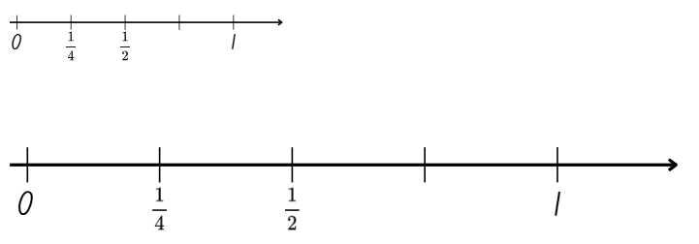
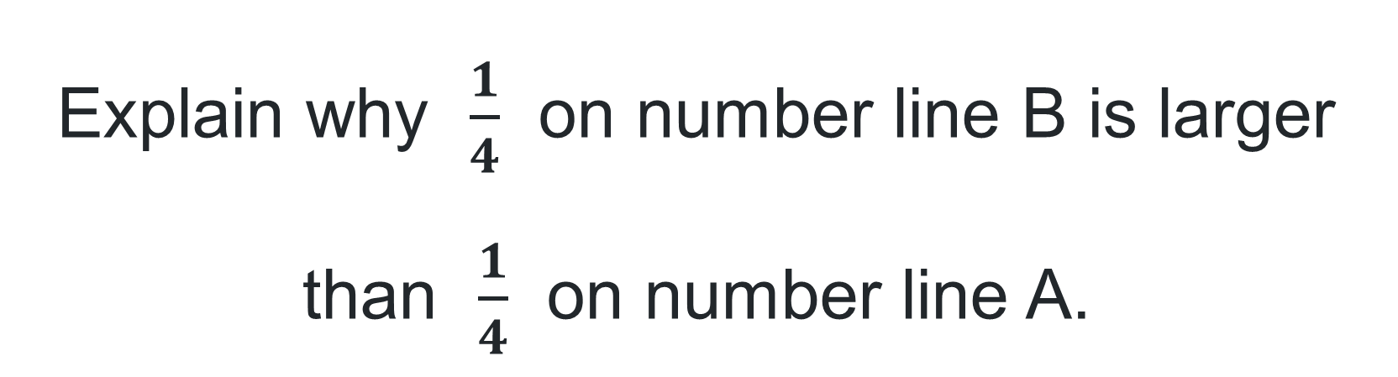
Short response (7)
Explain why $\frac{1}{4}$ on number line B is larger than $\frac{1}{4}$ on number line A.
A
B
Notes:
Short response questions provide brisk paced questions focussing on review of current and previous content to support spaced and interleaved practice.
Syllabus focus area:
Representing quantity fractions A

Slide 16
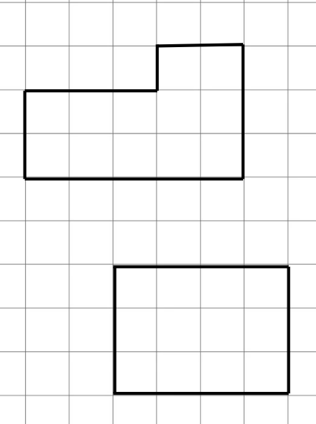
Short response (8)
These polygons have the same area.
Are the perimeters the same?
What strategies did you use to find out?
Notes:
Short response questions provide brisk paced questions focussing on review of current and previous content to support spaced and interleaved practice.
Syllabus focus area:
Geometric measure B: Length

Slide 17








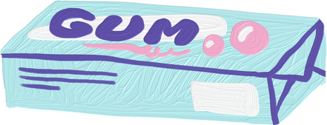
Activity 2 – lolly shop
72
35
30
60
42
80
120
64
Notes:
This is a developing number sense activity.
Number sense refers to a deep understanding of numbers, including their magnitude, relationships, and the effects of operations on them. It supports fluency and understanding, estimation, flexible thinking, and efficient problem-solving. Number sense activities 1–4 ‘activate’ prior number knowledge and support the learning of new content in the unit. Number sense activities 5–8 ‘loop’ back and provide opportunity for spaced practice with concepts and procedures covered in previous units.
Syllabus focus area:
Representing quantity fractions B
Lolly shop
Note: this activity is similar to the farmer’s market in Lesson 1, building on quarters and fifths.
1. Provide students with Resource 26 – lolly shop cards (this resource corresponds to Resource 26 – lolly shop cards in Stage 3 Year B Unit 38), and a deck of cards with 3, 6, 7, 8, 9 and picture cards removed.
Place lolly shop cards in one pile and place playing cards into a separate pile.
Player 1 flips over a card. This will be the denominator for the unit fraction. For example, a 10 is flipped, so the fraction would be $\frac{1}{10}$.
Player 1 then flips over a lolly shop card and calculates the fraction by drawing a bar model or a tape diagram to record the fractional thinking.
Player 2 repeats the same steps.
If a player picks a denominator that cannot be used on the lolly shop cards without a remainder, they miss their turn.
2. Play continues until all the cards have been used. The winner is the player with the most lollies after all the cards have been played.

Slide 18
Review of learning 3

Slide 19

Multiple choice (2)
$\frac{1}{4}$ of a dozen eggs is:
A
3
B
4
C
6
D
8
Notes:
This question connects to the content in the developing number sense activity (Activity 3)
Syllabus focus area:
Representing quantity fractions B

Slide 20
Short response (9)
Out of 10 spins, 40% landed on green, 10% landed on black, 30% landed on blue and 20% landed on purple. If there were 10 more spins, would the results be the same?
Communicate your thinking.
Notes:
Short response questions provide brisk paced questions focussing on review of current and previous content to support spaced and interleaved practice.
Syllabus focus area:
Chance B

Slide 21
Short response (10)
Yaya needs to fence her vegetable garden. The area to be fenced is 48 m². What could the length and width measure?
What would be the perimeter?
Notes:
Short response questions provide brisk paced questions focussing on review of current and previous content to support spaced and interleaved practice.
Syllabus focus area:
Two-dimensional spatial structure A: Area

Slide 22
Short response (11)
Draw different bar models to show 25%, 50%, 75% and 100%.
Above the percentages, record the equivalent fraction.
Notes:
Short response questions provide brisk paced questions focussing on review of current and previous content to support spaced and interleaved practice.
Syllabus focus area:
Represents numbers B: Decimals and percentages

Slide 23
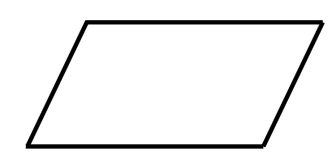
Short response (12)
Translate, rotate a quarter turn and reflect a parallelogram.
Notes:
Short response questions provide brisk paced questions focussing on review of current and previous content to support spaced and interleaved practice.
Syllabus focus area:
Two-dimensional spatial structure B: 2D Shapes

Slide 24
Activity 3 – fractions of chocolates
I have a box of chocolates with 4 flavours.
A quarter of my chocolates are caramel, and one-fifth of my chocolates are Turkish delight.
  How many caramel chocolates are there?
  How many Turkish delights are there?
Notes:
This is a developing number sense activity.
Number sense refers to a deep understanding of numbers, including their magnitude, relationships, and the effects of operations on them. It supports fluency and understanding, estimation, flexible thinking, and efficient problem-solving. Number sense activities 1–4 ‘activate’ prior number knowledge and support the learning of new content in the unit. Number sense activities 5–8 ‘loop’ back and provide opportunity for spaced practice with concepts and procedures covered in previous units.
Syllabus focus area:
Representing quantity fractions B
Fractions of chocolates
Display Resource 27 – box of chocolates (this resource corresponds to Resource 27 – box of chocolates in Stage 3 Year B Unit 38). Students work on a solution, recording their ideas on an individual whiteboard.
Discuss the task. Ask the following questions:
- How many caramel chocolates are there?
- How many Turkish delight chocolates are there?
State that a bar model or tape diagram may help with this task.
Regroup and ask:
- What was the most effective you used to determine the answer? Why was it the most effective?

Slide 25
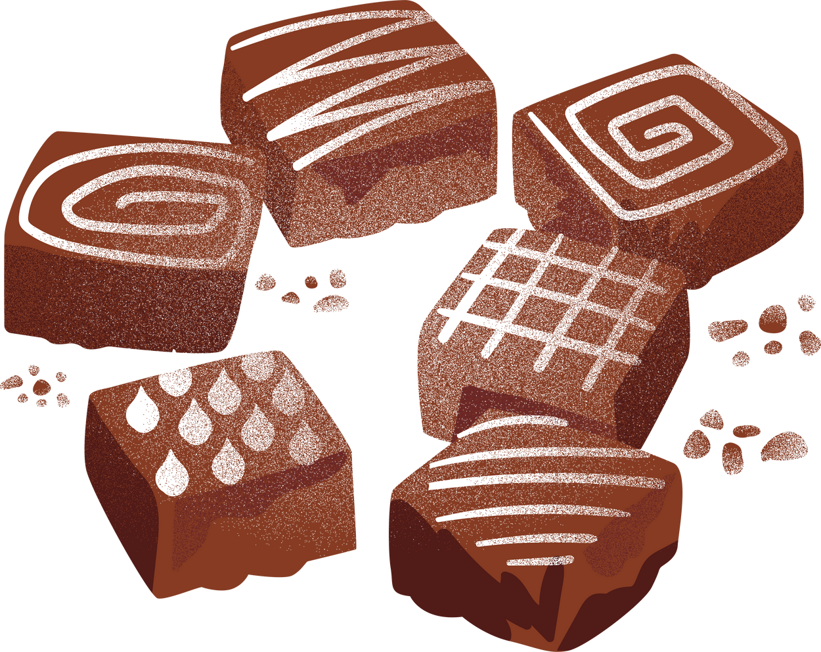
Activity 3 – fractions of chocolates (1)
Notes:
This is a developing number sense activity.
Number sense refers to a deep understanding of numbers, including their magnitude, relationships, and the effects of operations on them. It supports fluency and understanding, estimation, flexible thinking, and efficient problem-solving. Number sense activities 1–4 ‘activate’ prior number knowledge and support the learning of new content in the unit. Number sense activities 5–8 ‘loop’ back and provide opportunity for spaced practice with concepts and procedures covered in previous units.
Syllabus focus area:
Representing quantity fractions B
Fractions of chocolates
Display Resource 27 – box of chocolates (this resource corresponds to Resource 27 – box of chocolates in Stage 3 Year B Unit 38). Students work on a solution, recording their ideas on an individual whiteboard.
Discuss the task. Ask the following questions:
- How many caramel chocolates are there?
- How many Turkish delight chocolates are there?
State that a bar model or tape diagram may help with this task.
Regroup and ask:
- What was the most effective you used to determine the answer? Why was it the most effective?

Slide 26
Review of learning 4

Slide 27
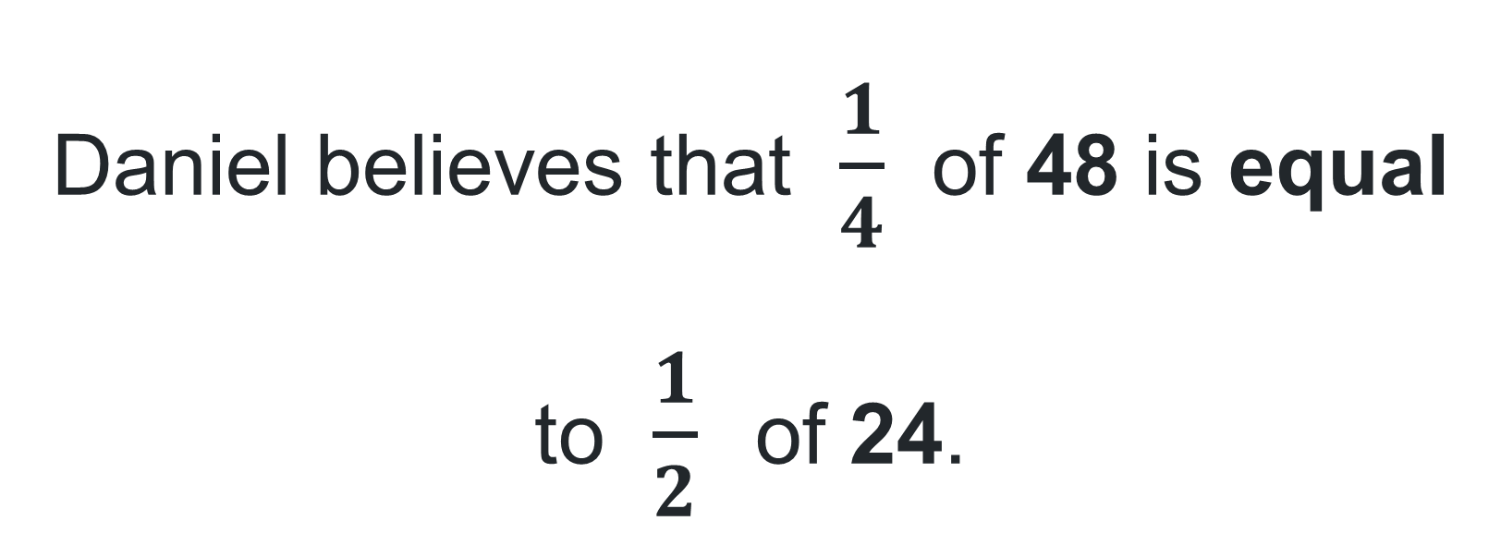
True or false (2)
Daniel believes that $\frac{1}{4}$ of 48 is equal to $\frac{1}{2}$ of 24.
True | False
Communicate your thinking.
Notes:
The question on this slide connects to the content being explored in the developing number sense activity (Activity 4)
Syllabus focus area:
Representing quantity fractions B

Slide 28
Short response (13)
The expected results of rolling a six-sided dice 60 times should be that each number appears approximately 10 times. 6W conducted the experiment, the results were:
Die number | Times rolled
1 | 10
2 | 8
3 | 12
4 | 15
5 | 7
6 | 8
Compare the observed frequencies with the expected frequencies. Explain why only one number rolled the expected frequency.
Notes:
Short response questions provide brisk paced questions focussing on review of current and previous content to support spaced and interleaved practice.
Syllabus focus area:
Chance B

Slide 29
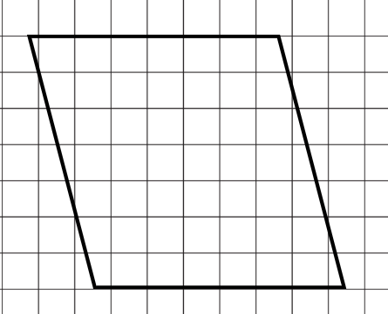
Short response (14)
Model how you would find the area of a parallelogram.
Notes:
Short response questions provide brisk paced questions focussing on review of current and previous content to support spaced and interleaved practice.
Syllabus focus area:
Two-dimensional spatial structure B: Area

Slide 30
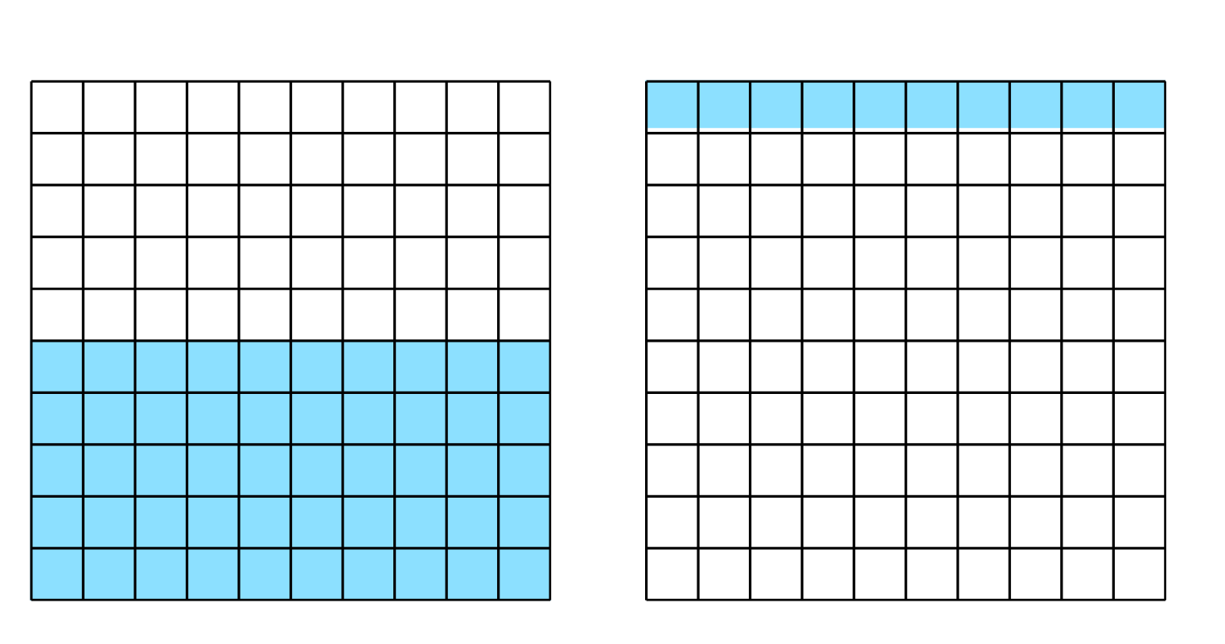
Short response (15)
Record the percentage, fraction and decimal for each grid.
Notes:
Short response questions provide brisk paced questions focussing on review of current and previous content to support spaced and interleaved practice.
Syllabus focus area:
Represents numbers B: Decimals and percentages

Slide 31
Short response (16)
Daisy slept from 20:30 last night until 6:45 am.
How long did Daisy sleep for?
Notes:
Short response questions provide brisk paced questions focussing on review of current and previous content to support spaced and interleaved practice.
Syllabus focus area:
Non-spatial measure B: Time

Slide 32
Activity 4 – fraction chocolate box
I have a box of chocolates with 4 flavours.
A quarter of my chocolates are caramel, and one-fifth of my chocolates are Turkish delight.
  Two of my chocolates are peppermint. What fraction of the box would contain peppermint chocolates?
  How many white raspberry chocolates make up the box?
Notes:
This is a developing number sense activity.
Number sense refers to a deep understanding of numbers, including their magnitude, relationships, and the effects of operations on them. It supports fluency and understanding, estimation, flexible thinking, and efficient problem-solving. Number sense activities 1–4 ‘activate’ prior number knowledge and support the learning of new content in the unit. Number sense activities 5–8 ‘loop’ back and provide opportunity for spaced practice with concepts and procedures covered in previous units.
Syllabus focus area:
Representing quantity fractions B
Fraction chocolate box
Display Resource 28 – box of chocolates 2 (this resource corresponds to Resource 28 – box of chocolates 2 in Stage 3 Year B Unit 38). Students work on a solution, recording their ideas on an individual whiteboard.
Discuss the task. Ask the following questions:
- Two of my chocolates are peppermint. What fraction of the box would contain peppermint chocolates?
- How many white raspberry chocolates make up the box?
State that a bar model or tape diagram may help with this task.
Students work in pairs to complete the task.
Regroup and ask students to share:
- How did you calculate the fraction of peppermint chocolates?

Slide 33
Activity 4 – fraction chocolate box (1)
Notes:
This is a developing number sense activity.
Number sense refers to a deep understanding of numbers, including their magnitude, relationships, and the effects of operations on them. It supports fluency and understanding, estimation, flexible thinking, and efficient problem-solving. Number sense activities 1–4 ‘activate’ prior number knowledge and support the learning of new content in the unit. Number sense activities 5–8 ‘loop’ back and provide opportunity for spaced practice with concepts and procedures covered in previous units.
Syllabus focus area:
Representing quantity fractions B
Fraction chocolate box
Display Resource 28 – box of chocolates 2 (this resource corresponds to Resource 28 – box of chocolates 2 in Stage 3 Year B Unit 38). Students work on a solution, recording their ideas on an individual whiteboard.
Discuss the task. Ask the following questions:
- Two of my chocolates are peppermint. What fraction of the box would contain peppermint chocolates?
- How many white raspberry chocolates make up the box?
State that a bar model or tape diagram may help with this task.
Students work in pairs to complete the task.
Regroup and ask students to share:
- How did you calculate the fraction of peppermint chocolates?

Slide 34
Review of learning 5

Slide 35
Multiple choice (3)
25% of 60 is:
A
B
C
D
12
18
15
16
Notes:
This question connects to the content in the developing number sense activity (Activity 5)
Syllabus focus area:
Representing numbers B: Decimals and percentages

Slide 36
Short response (17)
A bag contains 30 marbles: 10 red, 10 blue and 10 green. Pria randomly selects a marble from the bag 30 times and records the results.
Colour of the marble | Number of times randomly selected
Red | 12
Blue | 8
Green | 10
What is the expected frequency for each colour of marble if the selection is fair?
Notes:
Short response questions provide brisk paced questions focussing on review of current and previous content to support spaced and interleaved practice.
Syllabus focus area:
Chance B

Slide 37
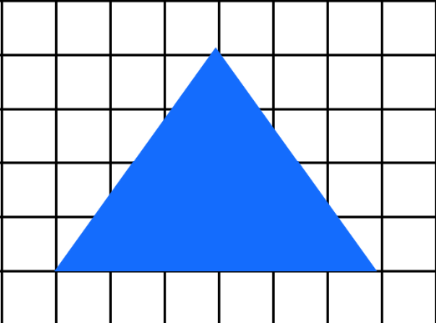
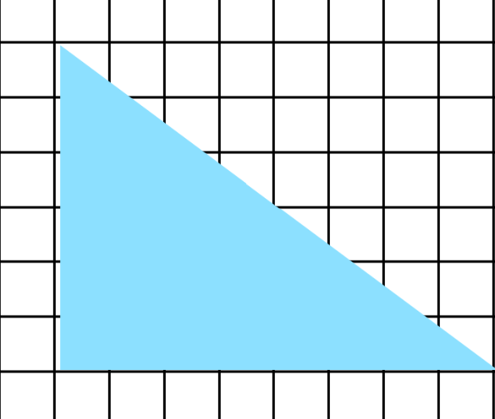
Short response (18)
Find the areas of these triangles:
Base – 6 cm
Height – 6 cm
Height – 4 cm
Base – 8 cm
Notes:
Short response questions provide brisk paced questions focussing on review of current and previous content to support spaced and interleaved practice.
Syllabus focus area:
Two-dimensional spatial structure B: Area

Slide 38
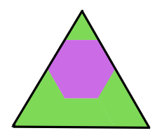
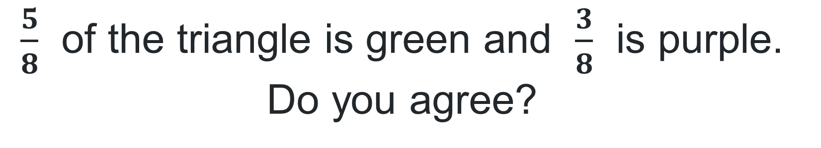
Short response (19)
$\frac{5}{8}$ of the triangle is green and $\frac{3}{8}$ is purple. Do you agree?
Explain your thinking.
Notes:
Short response questions provide brisk paced questions focussing on review of current and previous content to support spaced and interleaved practice.
Syllabus focus area:
Representing quantity fractions B

Slide 39
Short response (20)
Riccardo made a pizza base using 512 g of flour, 15 g of salt, 4 g of instant yeast and 480 g of lukewarm water. What is the total mass of Riccardo’s ingredients. Answer in grams and kilograms.
Notes:
Short response questions provide brisk paced questions focussing on review of current and previous content to support spaced and interleaved practice.
Syllabus focus area:
Non-spatial measure B: Mass

Slide 40
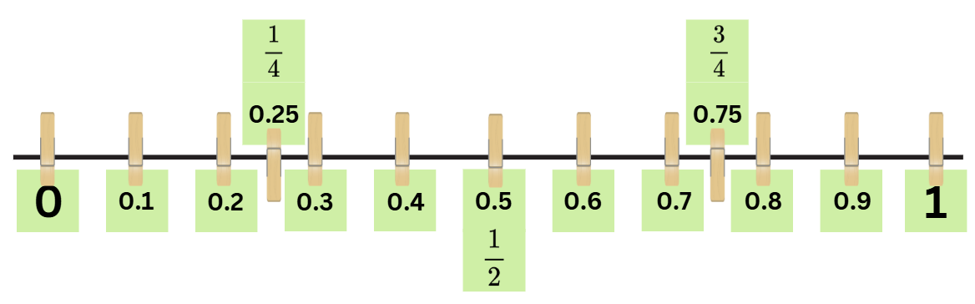
Activity 5 – determining percentages
Notes:
This is a developing number sense activity.
Number sense refers to a deep understanding of numbers, including their magnitude, relationships, and the effects of operations on them. It supports fluency and understanding, estimation, flexible thinking, and efficient problem-solving. Number sense activities 1–4 ‘activate’ prior number knowledge and support the learning of new content in the unit. Number sense activities 5–8 ‘loop’ back and provide opportunity for spaced practice with concepts and procedures covered in previous units.
Syllabus focus area:
Represents numbers B
Determining percentages
Provide small groups with sticky notes, pegs and one metre of string.
Groups construct a number line from zero to one, showing known decimals and percentages. See Figure 7 (this resource corresponds to Figure 7 – number line in Stage 3 Year B Unit 38).
Remind students that percentage relies on an understanding of fractions and decimals.
Note: a percentage is a fraction out of 100 and can be expressed as a decimal with hundredths. Students can make connections easily when both fractions and decimals are illustrated as hundredths, for example $\frac{75}{100}$, equals 0.75, which is equivalent to 75%. When 0.75 is read as 75 hundredths, students can more easily connect it with $\frac{75}{100}$, it is appropriate to focus on known benchmarks such as 50%, 25% and 10%. The link between hundredths and percent can be made using a hundredths diagram (Siemon et al. 2022).
Write 10%, 25% and 50% on the board. Highlight the connection to known decimals and fractions, for example 10% = $\frac{1}{10}$ or 0.1.
Revisit how our base-10 number system makes it easy to find 10% of a quantity. For example, 10% of 150 is 15, because 150 is 10 lots of 15. Therefore, 20% of 150 is 2 lots of 15, 30% is 3 lots of 15 and so on.
Explain that 10% is equivalent to dividing the total amount by 10, 25% is dividing by 4, 50% is dividing by 2 and 75% is dividing by 4 to determine 25% and then multiplying by 3.
Students represent these percentages on their number line using a different coloured sticky note , see Figure 8 (this resource corresponds to Figure 8 – number line with percentages in Stage 3 Year B Unit 38).
Groups share and discuss their number lines.

Slide 41
Review of learning 6

Slide 42
True or false (3)
In the half-yearly sales, Tim will get a 25% discount on the drum kit he wants. The original price is $400. The discount is $25.
True | False
Notes:
The question on this slide connects to the content being explored in the developing number sense activity (Activity 6)
Syllabus focus area:
Representing numbers B: Decimals and percentages

Slide 43
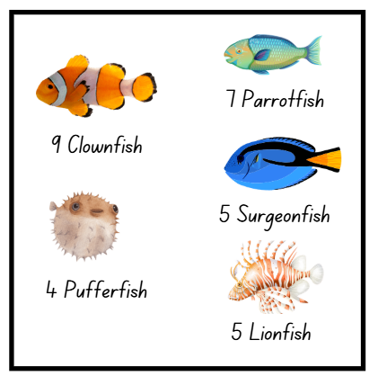
Short response (21)
6W saw an abundance of fish on their aquarium excursion. Choose and create an appropriate table to display the data about the fish they saw.
Notes:
Short response questions provide brisk paced questions focussing on review of current and previous content to support spaced and interleaved practice.
Syllabus focus area:
Data A

Slide 44
Short response (22)
A rectangular prism has 6 layers of 5 cubes. Record the volume using the abbreviation for cubic centimetres.
Notes:
Short response questions provide brisk paced questions focussing on review of current and previous content to support spaced and interleaved practice.
Syllabus focus area:
Three-dimensional spatial structure B: Volume

Slide 45
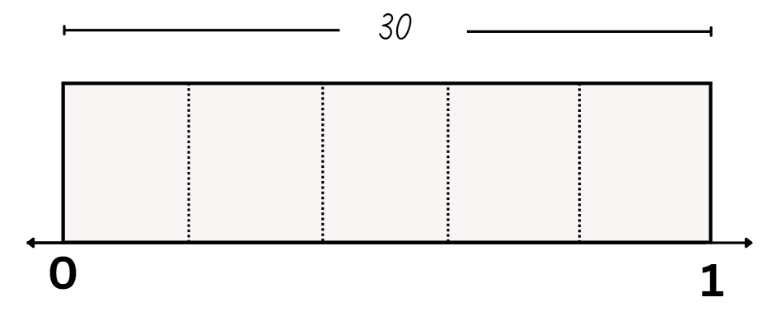
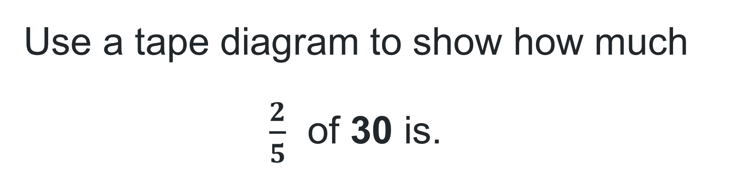
Short response (23)
Use a tape diagram to show how much $\frac{2}{5}$ of 30 is.
Notes:
Short response questions provide brisk paced questions focussing on review of current and previous content to support spaced and interleaved practice.
Syllabus focus area:
Representing quantity fractions B

Slide 46
Short response (24)
Draw a model of a building using a rectangular prism and a triangular prism.
Notes:
Short response questions provide brisk paced questions focussing on review of current and previous content to support spaced and interleaved practice.
Syllabus focus area:
Three-dimensional spatial structure B: 3D Objects

Slide 47
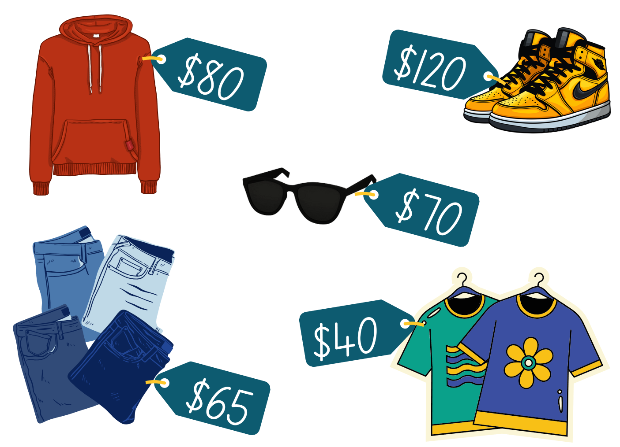
Activity 6 – estimating discounts
Notes:
This is a developing number sense activity.
Number sense refers to a deep understanding of numbers, including their magnitude, relationships, and the effects of operations on them. It supports fluency and understanding, estimation, flexible thinking, and efficient problem-solving. Number sense activities 1–4 ‘activate’ prior number knowledge and support the learning of new content in the unit. Number sense activities 5–8 ‘loop’ back and provide opportunity for spaced practice with concepts and procedures covered in previous units.
Syllabus focus area: Represents numbers B
Estimating discounts
Display Resource 29 – clothes shop (this resource corresponds to Resource 29 – clothes shop in Stage 3 Year B Unit 38). Explain that students will use mental strategies to calculate the discount for each piece of clothing.
Students choose an item and calculate a percentage discount amount of either 10%, 25% or 50%. All items must have a discount applied to them. All 3 discount percentages should be calculated at least once during the task.
Note: in this task, students are only required to calculate the discount amount, not the price of the item after the discount has been applied.
Students turn and talk, discussing their strategies and solutions.
Select students to share and explain their strategies and answers, recording their responses on the board. When all items of clothing are discussed, reveal the discounts. For example, 10% of the jumper is $8, 25% is $20 and 50% is $40.

Slide 48
Review of learning 7

Slide 49
Multiple choice (4)
A smart watch is $360 with a discount of 25%. The sale price is:
A
B
C
D
$460
$320
$260
$270
Notes:
This question connects to the content in the developing number sense activity (Activity 7)
Syllabus focus area:
Representing numbers B

Slide 50
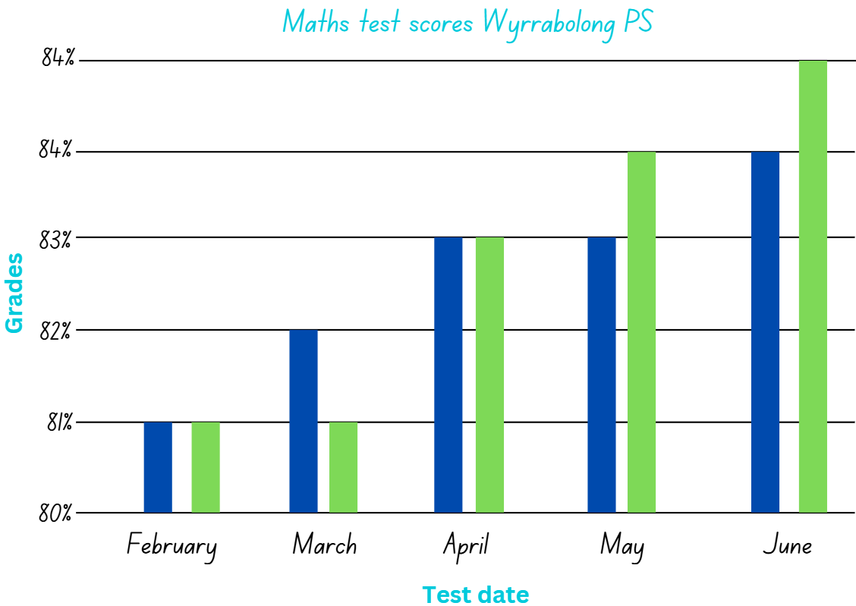
Short response (25)
The River Gazette, published a story on student maths scores improving since the start of the year. Identify the misleading data in this graph.
Notes:
Short response questions provide brisk paced questions focussing on review of current and previous content to support spaced and interleaved practice.
Syllabus focus area:
Data B

Slide 51
Short response (26)
Yaya needs to put fresh soil on her vegetable garden. The layer of soil will be 10 cm thick. The width of her garden is 6 metres and the length is 8 metres. In cubic metres, what is the volume of soil needed for Yaya’s vegetable garden?
Notes:
Short response questions provide brisk paced questions focussing on review of current and previous content to support spaced and interleaved practice.
Syllabus focus area:
Three-dimensional spatial structure B: Volume

Slide 52
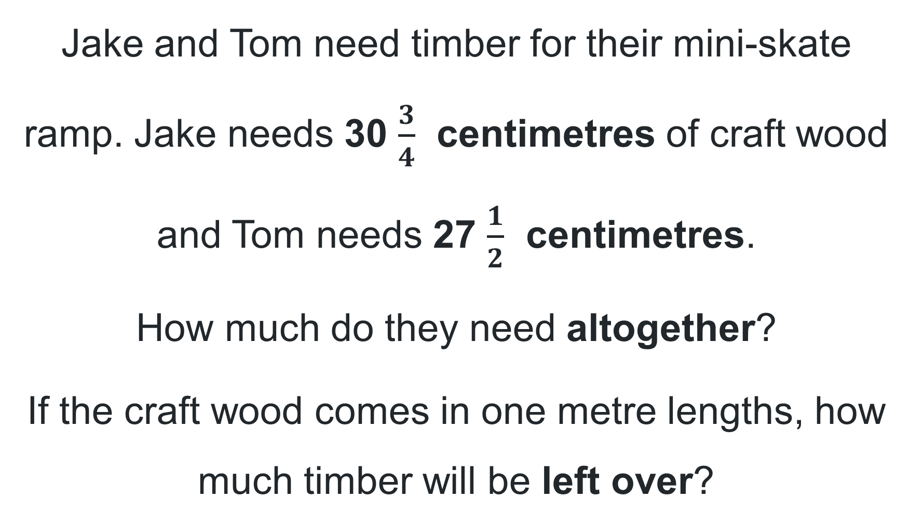
Short response (27)
Jake and Tom need timber for their mini-skate ramp. Jake needs 30 $\frac{3}{4}$ centimetres of craft wood and Tom needs 27 $\frac{1}{2}$ centimetres.
How much do they need altogether?
If the craft wood comes in one metre lengths, how much timber will be left over?
Notes:
Short response questions provide brisk paced questions focussing on review of current and previous content to support spaced and interleaved practice.
Syllabus focus area:
Representing quantity fractions B

Slide 53
Short response (28)
What is the equivalent length for the following:
245 cm
3.25 m
8.7 km
Notes:
Short response questions provide brisk paced questions focussing on review of current and previous content to support spaced and interleaved practice.
Syllabus focus area:
Geometric measure B: Length

Slide 54
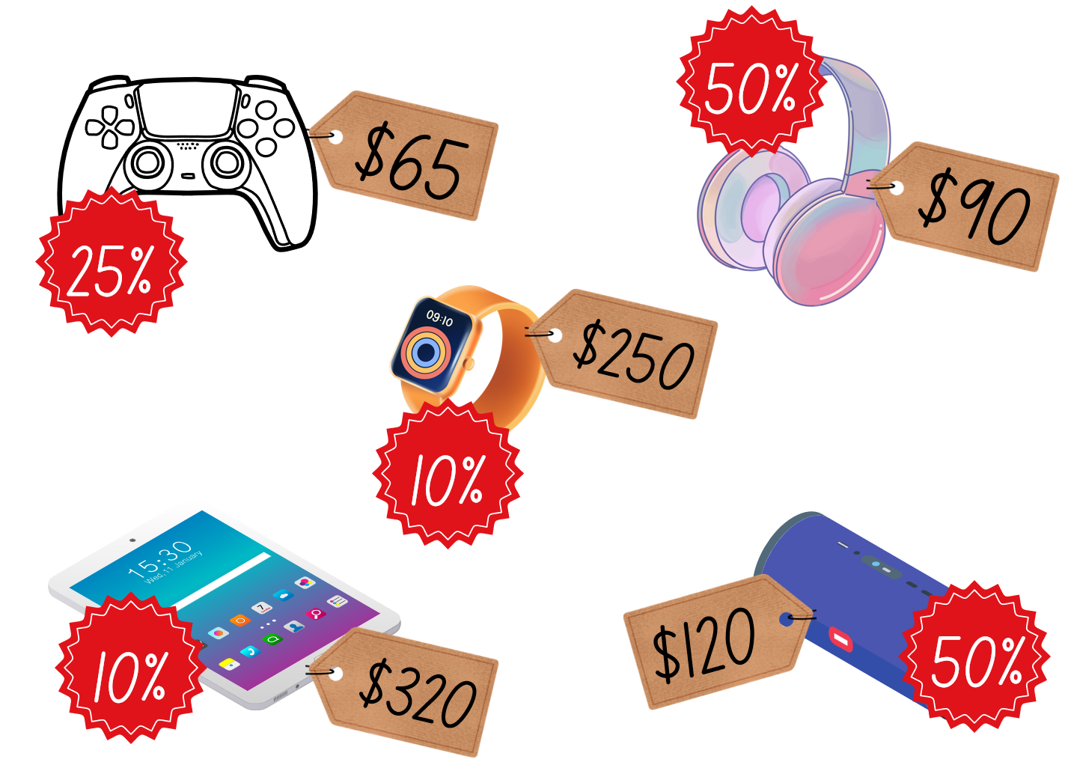
Activity 7 – sales price
Notes:
This is a developing number sense activity.
Number sense refers to a deep understanding of numbers, including their magnitude, relationships, and the effects of operations on them. It supports fluency and understanding, estimation, flexible thinking, and efficient problem-solving. Number sense activities 1–4 ‘activate’ prior number knowledge and support the learning of new content in the unit. Number sense activities 5–8 ‘loop’ back and provide opportunity for spaced practice with concepts and procedures covered in previous units.
Syllabus focus area:
Represents numbers B
Sales price
Revise student understanding of calculating discounts. For example, that 10% is dividing by 10, 25% is dividing by 4 and 50% is dividing by 2.
Display Resource 30 – sale items (this resource corresponds to Resource 30 – sale items in Stage 3 Year B Unit 38). Explain that students will calculate the sale price after the discount that is in the red sale sticker has been applied. For example, the headphones are $90 and have a discount of 50%, so the sale price would be $45.
Students record the sale price after the discount for each item in their workbook.
Once students have completed recording the sale price, select students to share and explain their working.

Slide 55
Review of learning 8

Slide 56
True or false (4)
Joley is looking for the best deal on a smart watch. She finds one for 10% off $180 and another for 50% off $360. The 10% off is the better deal.
True | False
Notes:
The question on this slide connects to the content being explored in the developing number sense activity (Activity 8)
Syllabus focus area:
Representing numbers B

Slide 57
Short response (29)
What is the difference between the number of girls and boys who like swimming?
Are there any similarities and difference between the answers?
Record one other thing you notice in the data.
Notes:
Short response questions provide brisk paced questions focussing on review of current and previous content to support spaced and interleaved practice.
Syllabus focus area:
Data B

Slide 58
Short response (30)
The post office has a parcel bag with a volume of 40 cm³. The dimensions of Liza’s parcel is 10 cm x 2 cm x 6 cm. Is the volume of the parcel bag enough?
Explain your thinking.
Notes:
Short response questions provide brisk paced questions focussing on review of current and previous content to support spaced and interleaved practice.
Syllabus focus area:
Three-dimensional spatial structure B: Volume

Slide 59
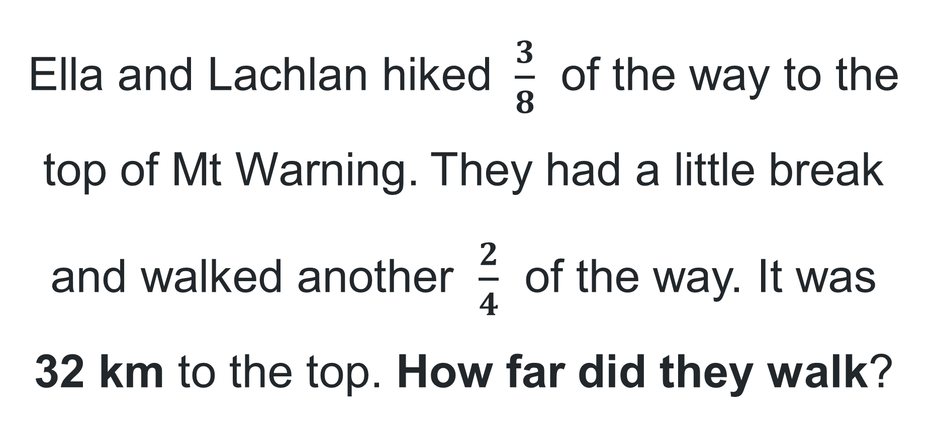
Short response (31)
Ella and Lachlan hiked $\frac{3}{8}$ of the way to the top of Mt Warning. They had a little break and walked another $\frac{2}{4}$ of the way. It was 32 km to the top. How far did they walk?
Notes:
Short response questions provide brisk paced questions focussing on review of current and previous content to support spaced and interleaved practice.
Syllabus focus area:
Representing quantity fractions B

Slide 60
Short response (32)
Logan and her friends want to go to the movies. The movie starts at 3:30 pm and goes for 1 hour and 45 minutes. If they are getting picked up at 18:30, do they have enough time for some shopping?
Notes:
Short response questions provide brisk paced questions focussing on review of current and previous content to support spaced and interleaved practice.
Syllabus focus area:
Non-spatial measure B: Time

Slide 61




Activity 8 – the best deal(1)
$190
10%
$200
25%
Electric deal Electronics
Bargain Electronics
$350
50%
Number one deals
Notes:
This is a developing number sense activity.
Number sense refers to a deep understanding of numbers, including their magnitude, relationships, and the effects of operations on them. It supports fluency and understanding, estimation, flexible thinking, and efficient problem-solving. Number sense activities 1–4 ‘activate’ prior number knowledge and support the learning of new content in the unit. Number sense activities 5–8 ‘loop’ back and provide opportunity for spaced practice with concepts and procedures covered in previous units.
Syllabus focus area:
Represents numbers B
The best deal
Display Resource 33 – Gabby’s problem (this resource corresponds to Resource 33 – Gabby’s problem in Stage 3 Year B Unit 38).
Explain that Gabby was shopping online and wanted to buy herself a new set of headphones. The ones she had been looking at were on sale at different shops.
Using Resource 33 – Gabby’s problem, students determine which deal provides the best discount on the headphones.
Students record their thinking on a whiteboard.
Regroup and discuss which store would give Gabby the best discount. (Answer: Bargain Electronics – saving $50. Total price of the headphones is $150)

Slide 62
Double Venn diagram
Object 1
Object 2
Features similar to both objects
Features of object 1
Features of object 2

Slide 63
Frayer
Definition
Facts/Characteristics
Word, term, concept
Examples
Non-examples

Slide 64
Spider map
Idea
Subject

Slide 65
Cline
Concept 1
Concept 2
Word
Word
Word
Word
Word
Word
Word
Word
Word
Word
Word

Slide 66

Compare and contrast

Slide 67
Multiple choice (5)
A
B
C
D

Slide 68
Multiple choice (6)
A
B
C
D

Slide 69
References (1)
This presentation contains NSW Curriculum and syllabus content. The NSW Curriculum is developed by the NSW Education Standards Authority. This content is prepared by NESA for and on behalf of the Crown in the right of the State of New South Wales. The material is protected by Crown copyright.
Please refer to the NESA Copyright Disclaimer for more information https://educationstandards.nsw.edu.au/wps/portal/nesa/mini-footer/copyright.
NESA holds the only official and up-to-date versions of the NSW Curriculum and syllabus documents. Please visit the NSW Education Standards Authority (NESA) website https://educationstandards.nsw.edu.au/wps/portal/nesa/home and the NSW Curriculum website https://curriculum.nsw.edu.au.
Mathematics K–10 Syllabus © NSW Education Standards Authority (NESA) for and on behalf of the Crown in right of the State of New South Wales, 2022.
National Numeracy Learning Progression © Australian Curriculum, Assessment and Reporting Authority (ACARA) 2010 to present, unless otherwise indicated. This material was downloaded from the Australian Curriculum website (National Numeracy Learning Progression) (accessed 4 April 2024 and was not modified.)
ABC (Australian Broadcasting Corporation) (19 January 2022) 'Catalyst: How to win at rock-paper-scissors' [video], Catalyst, ABC Education website, accessed 9 April 2024.
AIMS (Australian Institute of Marine Science) (n.d.) ‘Reef monitoring sampling methods’, Monitoring the Great Barrier Reef, AIMS website, accessed 9 April 2024.
Downton A, Knight R, Clarke D and Lewis G (2015) Mathematics Assessment for Learning: Rich Tasks & Work Samples, 3rd edn, Australian Catholic University and Catholic Education Office, Melbourne.

Slide 70
References (2)
This presentation contains NSW Curriculum and syllabus content. The NSW Curriculum is developed by the NSW Education Standards Authority. This content is prepared by NESA for and on behalf of the Crown in the right of the State of New South Wales. The material is protected by Crown copyright.
Please refer to the NESA Copyright Disclaimer for more information https://educationstandards.nsw.edu.au/wps/portal/nesa/mini-footer/copyright.
NESA holds the only official and up-to-date versions of the NSW Curriculum and syllabus documents. Please visit the NSW Education Standards Authority (NESA) website https://educationstandards.nsw.edu.au/wps/portal/nesa/home and the NSW Curriculum website https://curriculum.nsw.edu.au.
Great Barrier Reef Foundation (7 March 2024) ‘What is coral bleaching?’, News, Great Barrier Reef Foundation website, accessed 19 July 2024.
NESA (NSW Education Standards Authority) (2022) ‘Stage 3: Teaching advice for Chance B’, Mathematics K–10 Syllabus, NESA website, accessed 10 July 2024.
NESA (2022) ‘Stage 3: Teaching advice for Data B’, Mathematics K–10 Syllabus, NESA website, accessed 10 July 2024.
Siemon D, Warren E, Beswick K, Faragher R, Miller J, Horne M, Jazby D, Breed M, Clark J and Brady K (2020) Teaching Mathematics: Foundation to Middle Years, 3rd edn, Oxford University Press Australia and New Zealand
Travel + Leisure (6 December 2019) 'How Scientists Are Restoring The Great Barrier Reef | Travel + Leisure' [video], Travel + Leisure, YouTube, accessed 9 April 2024.

Slide 71
References (3)
This presentation contains NSW Curriculum and syllabus content. The NSW Curriculum is developed by the NSW Education Standards Authority. This content is prepared by NESA for and on behalf of the Crown in the right of the State of New South Wales. The material is protected by Crown copyright.
Please refer to the NESA Copyright Disclaimer for more information https://educationstandards.nsw.edu.au/wps/portal/nesa/mini-footer/copyright.
NESA holds the only official and up-to-date versions of the NSW Curriculum and syllabus documents. Please visit the NSW Education Standards Authority (NESA) website https://educationstandards.nsw.edu.au/wps/portal/nesa/home and the NSW Curriculum website https://curriculum.nsw.edu.au.
Van de Walle J, Karp K, Bay-Williams JM, Brass A, Bentley B, Ferguson S, Goff W, Livy S, Marshman M, Martin D, Pearn C, Prodromou T, Symons D and Wilkie K (2019) Primary and Middle Years Mathematics: Teaching Developmentally, 1st Australian edn, Pearson Education Australia, Melbourne.

Slide 72
Copyright
© State of New South Wales (Department of Education), 2025
The copyright material published in this resource is subject to the Copyright Act 1968 (Cth) and is owned by the NSW Department of Education or, where indicated, by a party other than the NSW Department of Education (third-party material).
Copyright material available in this resource and owned by the NSW Department of Education is licensed under a Creative Commons Attribution 4.0 International (CC BY 4.0) license.
This license allows you to share and adapt the material for any purpose, even commercially.
Attribution should be given to © State of New South Wales (Department of Education), 2025.
Material in this resource not available under a Creative Commons license:
the NSW Department of Education logo, other logos and trademark-protected material
Material owned by a third party that has been reproduced with permission. You will need to obtain permission from the third party to reuse its material.
Links to third-party material and websites
Please note that the provided (reading/viewing material/list/links/texts) are a suggestion only and implies no endorsement, by the New South Wales Department of Education, of any author, publisher, or book title. School principals and teachers are best placed to assess the suitability of resources that would complement the curriculum and reflect the needs and interests of their students.
If you use the links provided in this document to access a third party’s website, you acknowledge that the terms of use, including licence terms set out on the third-party’s website apply to the use which may be made of the materials on that third-party website or where permitted by the Copyright Act 1968 (Cth). The department accepts no responsibility for content on third-party websites.

