Slide 1
Instructions for use
This resource aligns to the learning in Stage 3 Year B Unit 39 and revisits content from earlier sample units.
Classroom teachers are encouraged to add, edit and adapt to meet the needs of their students.
Save a copy of the file to make changes to the slide deck. Go to File > Download a Copy (this downloads a copy to the computer to edit in the PowerPoint app).
To convert the PowerPoint to Google Slides:
  Upload the file into Google Drive and open it.
  Go to File > Save as Google Slides.
  (Note – conversion may cause formatting changes in the slides.)

Slide 2

Review of Learning
Mathematics Stage 3 – Unit 39
Notes:
Reviews may include a combination of question types, requiring students to recall facts and key ideas, as well as apply their knowledge to solve problems and answer questions. To support active engagement, a mix of techniques should be employed.” (AERO, 2024).
This Review of Learning slide deck revisits key concepts from the following units:
Stage 3 Year B Unit 39
Stage 3 Year B Unit 38
Stage 3 Year B Unit 37
It also includes opportunities to review prior learning in non-number content, supporting consolidation across focus areas.
The review of learning resources include three key task types that support the development of mathematical proficiency through retrieval, spaced practice, and active participation. These practices complement the review phase (activating prior knowledge) embedded within the beginning of each lesson.
1.
Multiple-choice questions/True or false: Designed to promote active retrieval of key concepts and identify common misconceptions in number, supporting consolidation, understanding and fluency.
These questions:
support spaced and interleaved practice
help identify and address common misconceptions
support active recall and immediate feedback
support whole class participation
identify areas requiring reteach
2.
Short-response question sets: Carefully grouped questions that encourage spaced and interleaved practice across multiple focus areas, helping students revisit and apply knowledge from different points in time.
These questions:
have a combination of question types
address a range of focus areas
build automaticity and fluency
support active recall
allow for immediate feedback
identify content requiring reteach
3.
Developing number sense activities: A variety of practical, purposeful tasks that reinforce current learning and build on prior knowledge. These activities promote reasoning, problem-solving and conceptual understanding.
The review of learning resources are designed to work support teaching and learning in mathematics. For the most effective implementation, use the resources flexibly, adapting to meet student learning needs and individual classroom contexts.

Slide 3
Lessons
1
Review of learning 1
5
Review of learning 5
2
Review of learning 2
6
Review of learning 6
3
Review of learning 3
7
Review of learning 7
4
Review of learning 4
8
Review of learning 8
Notes:
Teacher notes:
Click lesson numbers to go to specific lessons
Interactive features can be viewed in slide show

Slide 4
Review of learning 1

Slide 5

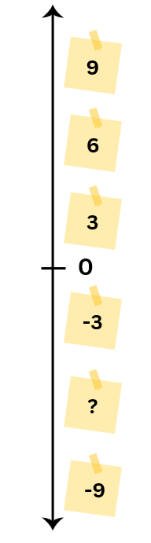
Multiple choice (1)
Which of the following completes the number line?
A
6
B
12
C
- 6
D
-12
Notes:
This question connects to the content in the developing number sense activity (Activity 1)
Syllabus focus area:
Represents numbers B: Whole numbers

Slide 6

Short response (1)
Isla started her swimming lesson at 4:05pm. When she finished, the clock read 17:50.
How long was Isla’s swimming lesson?
Communicate your reasoning.
Notes:
Short response questions provide brisk paced questions focussing on review of current and previous content to support spaced and interleaved practice.
Syllabus focus area:
Non-spatial measure B: Time

Slide 7


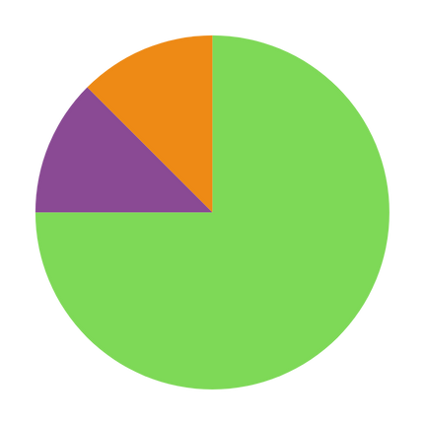
Short response (2)
Abir is creating a spinner so that one of the colours has a 75% chance of being landed on. Which spinner should she create?
2.
3.
1.
Communicate your reasoning.
Notes:
Short response questions provide brisk paced questions focussing on review of current and previous content to support spaced and interleaved practice.
Syllabus focus area:
Chance B

Slide 8
Short response (3)
List the factors for the following numbers:
24
100
56
49
Notes:
Short response questions provide brisk paced questions focussing on review of current and previous content to support spaced and interleaved practice.
Syllabus focus area:
Multiplicative relations A

Slide 9
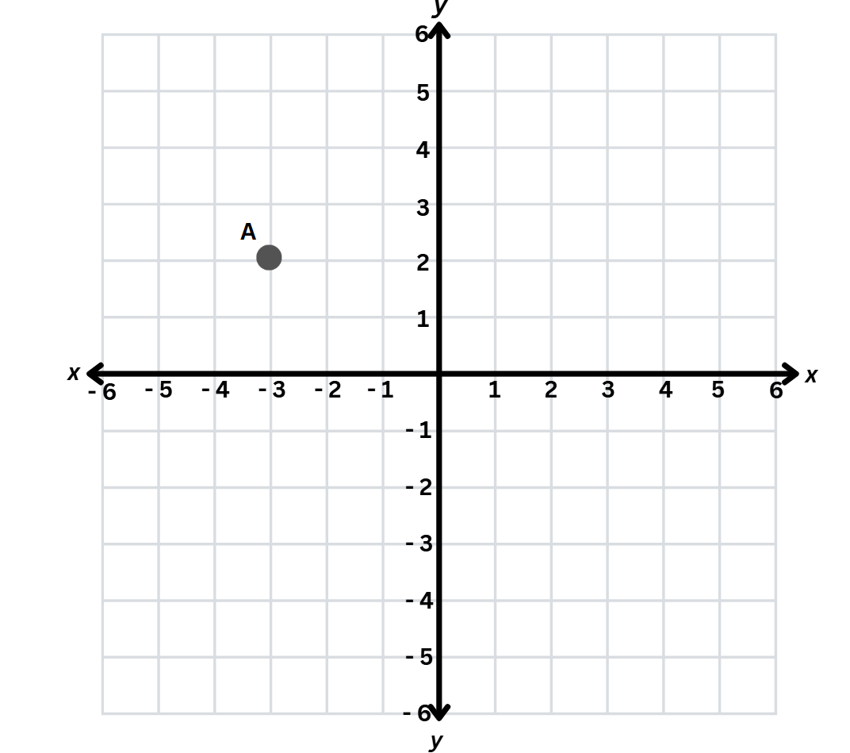
Short response (4)
Point A is located at (–3, 2) on the Cartesian plane.
It is then reflected across the x-axis. What are the coordinates of the new point?
Now reflect the new point across the y-axis.
What are its coordinates now?
Describe the changes to the coordinates.
Notes:
Short response questions provide brisk paced questions focussing on review of current and previous content to support spaced and interleaved practice.
Syllabus focus area:
Geometric measure B: Position

Slide 10

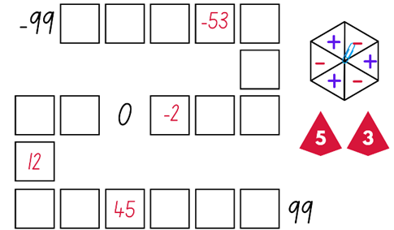
Activity 1 – integer place value game (2)
Aim of the game
To fill in the final place on the pathway, or fill more numbers on the board than your opponent
Rules:
Roll two 9-sided dice and create a 2-digit integer.
Spin your spinner to decide if the number is positive or negative.
Record your integer in the most appropriate position between –99 and 99.
Notes:
This is a developing number sense activity.
Number sense refers to a deep understanding of numbers, including their magnitude, relationships, and the effects of operations on them. It supports fluency and understanding, estimation, flexible thinking, and efficient problem-solving. Number sense activities 1–4 ‘activate’ prior number knowledge and support the learning of new content in the unit. Number sense activities 5–8 ‘loop’ back and provide opportunity for spaced practice with concepts and procedures covered in previous units.
Syllabus focus area:
Represents numbers B
This resource corresponds to Resource 23 - integer gameboard in Stage 3 Year B Unit 39.
Note: This slide is designed to be used in presentation mode. It can be used interactively to demonstrate the game. Click spin to start and top the spinner.
1. Revise the definition of integers and negative numbers.
2. Provide student pairs with two 9-sided dice, a paperclip and Resource 1 – integer place value gameboard.
3. Students roll the dice and create a 2-digit integer. For example, if 5 and 3 are rolled, they could make 53 or 35. Students then spin the spinner to determine if their integer is positive or negative. Players record their integer in the most appropriate position between −99 and 99
This activity is an adaptation of The place value game from Mathematics K-6 resources by State of New South Wales (Department of Education).

Slide 11
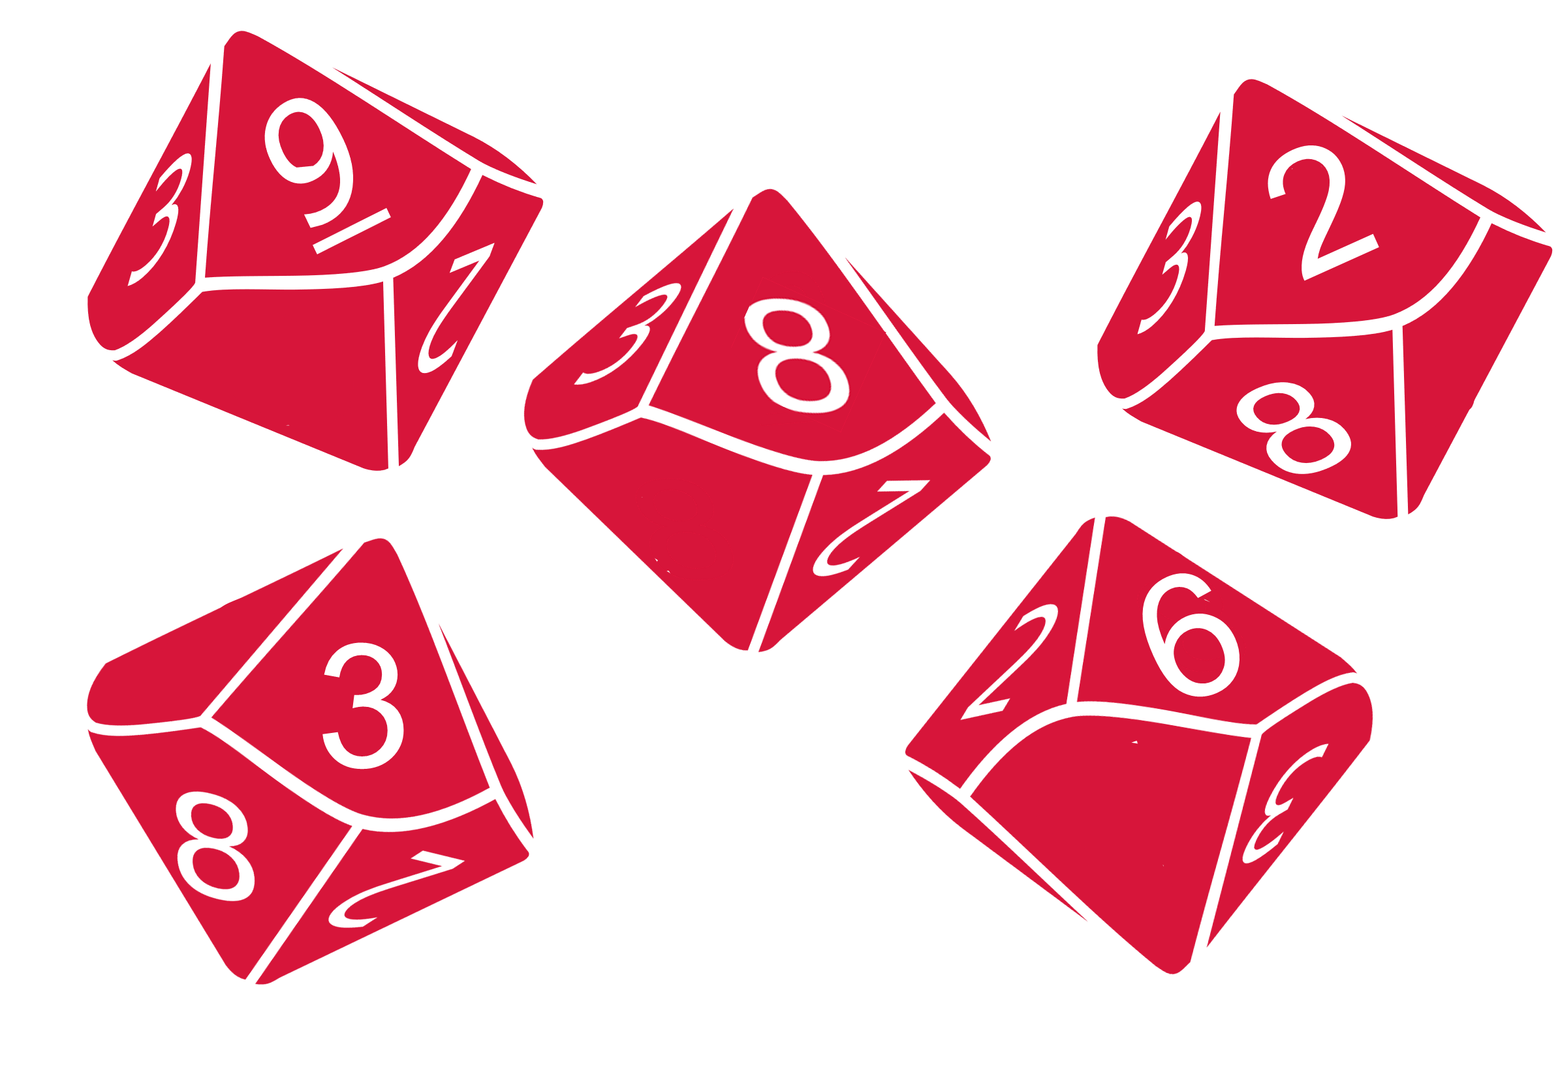
Activity 1 – integer place value game (1)
-99
Spin!
0
99
Notes:
This game can be played with the interactive spinner in presentation mod as a whole class activity.
This is a developing number sense activity.
Number sense refers to a deep understanding of numbers, including their magnitude, relationships, and the effects of operations on them. It supports fluency and understanding, estimation, flexible thinking, and efficient problem-solving. Number sense activities 1–4 ‘activate’ prior number knowledge and support the learning of new content in the unit. Number sense activities 5–8 ‘loop’ back and provide opportunity for spaced practice with concepts and procedures covered in previous units.
Syllabus focus area:
Represents numbers B
This resource corresponds to Resource 23 - integer gameboard in Stage 3 Year B Unit 39.
Revise the definition of integers and negative numbers.
Provide student pairs with two 9-sided dice, a paperclip and Resource 23 - integer gameboard. Students roll the dice and create a 2-digit integer. For example, if 5 and 3 are rolled, they could make 53 or 35. Students then spin the spinner to determine if their integer is positive or negative. Players record their integer in the most appropriate position between −99 and 99 (see Figure 17).
If the integer cannot be placed on the gameboard, students miss their turn. Play continues until all boxes are filled.

Slide 12
Review of learning 2

Slide 13
True or false (1)
– 8 is closer to 0 than – 10 is
on a number line?
True | False
Notes:
The question on this slide connects to the content being explored in the developing number sense activity (Activity 2)
Syllabus focus area:
Represents numbers B: Whole numbers

Slide 14
Short response (5)
Calculate the elapsed time between 6:25 pm and 8:10 pm.
Explain the strategy you used.
Notes:
Short response questions provide brisk paced questions focussing on review of current and previous content to support spaced and interleaved practice.
Syllabus focus area:
Non-spatial measure B: Time

Slide 15
Short response (6)
There are 10 marbles in the jar.
4 blue, 2 pink, 3 green and 1 yellow.
Use fractions to assign probabilities to the outcomes for a chance experiment.
Notes:
Short response questions provide brisk paced questions focussing on review of current and previous content to support spaced and interleaved practice.
Syllabus focus area:
Chance B

Slide 16
Short response (7)
Prove that 13 is a prime number.
Communicate your reasoning.
Notes:
Short response questions provide brisk paced questions focussing on review of current and previous content to support spaced and interleaved practice.
Syllabus focus area:
Multiplicative relations A

Slide 17
Short response (8)
Represent 13 centimetres and 5 millimetres as:
a fraction
a decimal
Notes:
Short response questions provide brisk paced questions focussing on review of current and previous content to support spaced and interleaved practice.
Syllabus focus area:
Geometric measure B: Length

Slide 18
Activity 2 – integer number line 1
C
A
B
C
C
D
C
F
A
A
A
B
B
B
C
D
E
C
E
0
D
E
E
-20
0
0
F
F
5
Notes:
This is a developing number sense activity.
Number sense refers to a deep understanding of numbers, including their magnitude, relationships, and the effects of operations on them. It supports fluency and understanding, estimation, flexible thinking, and efficient problem-solving. Number sense activities 1–4 ‘activate’ prior number knowledge and support the learning of new content in the unit. Number sense activities 5–8 ‘loop’ back and provide opportunity for spaced practice with concepts and procedures covered in previous units.
Syllabus focus area:
Represents numbers B
This activity is an adaptation of Finding numbers on a number line from Mathematics K-6 resources by State of New South Wales (Department of Education).
Note: This slide is designed to be used in presentation mode. Click through the slides while asking the following questions.
Number line 1
Ask students to identify what integers could be placed on the number line at each point.
Students record their answers on individual whiteboards.
Number line 2 (zero added to number line between point C and D)
Ask students what they notice about the number line now and if some of the integers at each point need to change.
Students record their responses on individual whiteboards then turn and talk and compare responses.
Is there more than one way to complete the number line? What is another way you could complete it? Explain your reasoning.
If I moved the points so that they were no longer evenly spaced on the number line, would that change the integers at the points? How?
Will the integers change if I move the zero between E and F? Why?
Number line 3 (Point F is 5 and point D is –20)
Ask students to describe what happens if you start at 5 and end at −20.

Slide 19
Review of learning 3

Slide 20
Multiple choice (2)
Which of these numbers is the
furthest from 0 on a number line?
A | B | C | D
– 8 | 7 | – 6 | 0.5
Notes:
This question connects to the content in the developing number sense activity (Activity 3)
Syllabus focus area:
Represents numbers B: Whole numbers

Slide 21
Short response (9)
Represent the following as decimal 2 hours and 15 minutes.
Notes:
Short response questions provide brisk paced questions focussing on review of current and previous content to support spaced and interleaved practice.
Syllabus focus area:
Non-spatial measure B: Time

Slide 22
Short response (10)
Assign probabilities for this spinner using fractions, decimals and percentages.
Notes:
Short response questions provide brisk paced questions focussing on review of current and previous content to support spaced and interleaved practice.
Syllabus focus area:
Chance B

Slide 23
Short response (11)
A rectangular vegetable garden has an area of 60 square metres.
What are the possible dimensions and the perimeter?
How many answers can you create?
Notes:
Short response questions provide brisk paced questions focussing on review of current and previous content to support spaced and interleaved practice.
Syllabus focus area:
Two-dimensional spatial structure A: Area

Slide 24
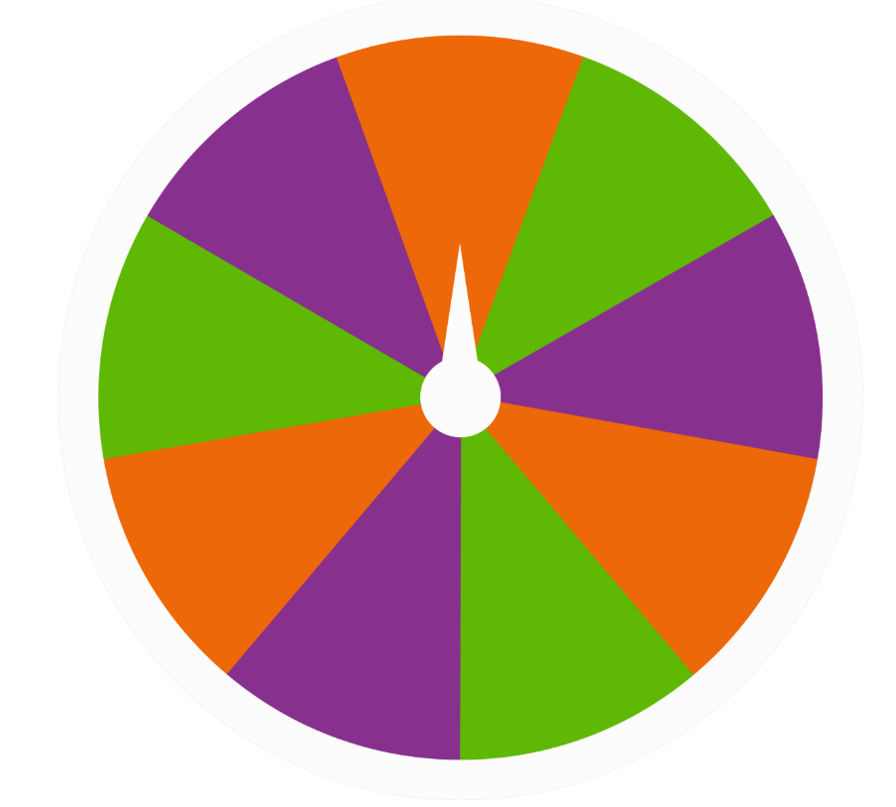
Short response (12)
Mia, Leo and Zara play a game using this spinner. Mia chooses orange, Leo chooses purple and Zara chooses green.
They spin it 30 times.
Whoever’s colour it lands on gets a point.
The person with the most points wins.
Is this game fair? Why or why not?
Can the results still be different for each player? Explain.
Notes:
Short response questions provide brisk paced questions focussing on review of current and previous content to support spaced and interleaved practice.
Syllabus focus area:
Chance B

Slide 25

Activity 3 – integer number line 2
0
-50
-25
25
10
-24
-5
50
Notes:
This is a developing number sense activity.
Number sense refers to a deep understanding of numbers, including their magnitude, relationships, and the effects of operations on them. It supports fluency and understanding, estimation, flexible thinking, and efficient problem-solving. Number sense activities 1–4 ‘activate’ prior number knowledge and support the learning of new content in the unit. Number sense activities 5–8 ‘loop’ back and provide opportunity for spaced practice with concepts and procedures covered in previous units.
Syllabus focus area:
Represents numbers B: Whole numbers
This activity is an adaptation of ‘What’s in the box?’ from Learning to Think Mathematically with the Number Line by Frykholm.
Use a number line on the board or create a large-scale number line on the floor of the classroom or in an outdoor space.
Take a sticky note with the integer −25 and ask students where this sticky note should be positioned on the number line.
Prompt students to place it halfway between 0 and −50
Repeat Step 3 with the integers: 10, −24, −5, 50.
Place 3 blank sticky notes at random places on the number line
In pairs, students choose integers that could be written on the blank sticky notes, justifying their thinking.
Regroup as a class. Select students to share their reasoning and ideas.

Slide 26
Review of learning 4

Slide 27
True or false (2)
Nadia entered 36 on her calculator. If she repeatedly subtracts 6, her calculator will eventually show – 12.
True | False
Notes:
The question on this slide connects to the content being explored in the developing number sense activity (Activity 4)
Syllabus focus area:
Represents numbers B: Whole numbers

Slide 28
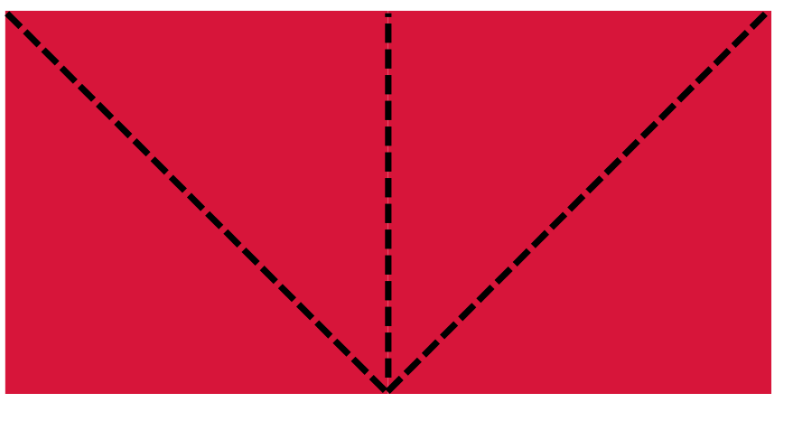
Short response (13)
Emilia has dissected this rectangle into 4 triangles.
Record another way she could dissect this rectangle into smaller shapes.
Notes:
Short response questions provide brisk paced questions focussing on review of current and previous content to support spaced and interleaved practice.
Syllabus focus area:
Two-dimensional spatial structure B: 2D shapes

Slide 29
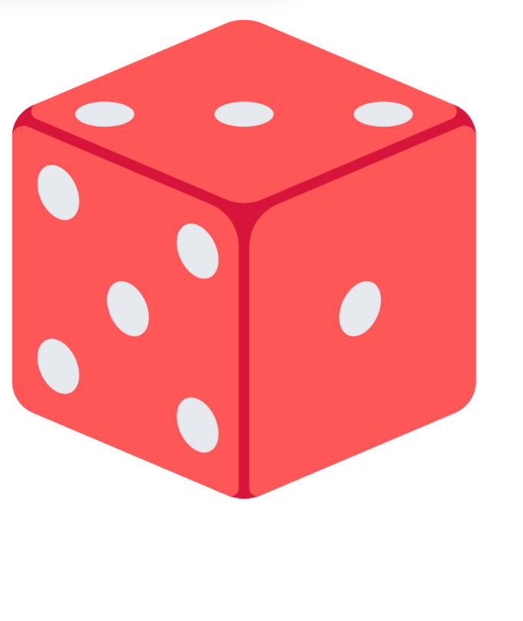
Short response (14)
What is the expected frequency of landing on an even number if I roll a standard dice 18 times?
Notes:
Short response questions provide brisk paced questions focussing on review of current and previous content to support spaced and interleaved practice.
Syllabus focus area:
Chance B

Slide 30
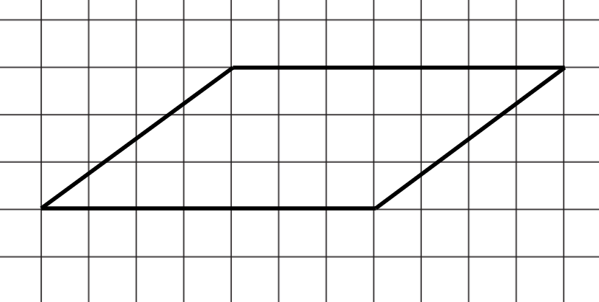
Short response (15)
What is the area of this parallelogram?
Explain your method.
Notes:
Short response questions provide brisk paced questions focussing on review of current and previous content to support spaced and interleaved practice.
Syllabus focus area:
Two-dimensional spatial structure B: Area

Slide 31
Short response (16)
James is packing for a school camping trip.
He packs a sleeping bag that weighs 800 g, a torch that weighs 150 g, and a tent that weighs 1.5 kg.
What is the combined mass of all the
items in kilograms?
Notes:
Short response questions provide brisk paced questions focussing on review of current and previous content to support spaced and interleaved practice.
Syllabus focus area:
Non-spatial measure B: Mass

Slide 32
Activity 4 – negative whole numbers
25 - 7
Target number -3
41 - 7
Target number -8
19 - 4
Target number -9
62 - 8
Target number -18
Notes:
This is a developing number sense activity.
Number sense refers to a deep understanding of numbers, including their magnitude, relationships, and the effects of operations on them. It supports fluency and understanding, estimation, flexible thinking, and efficient problem-solving. Number sense activities 1–4 ‘activate’ prior number knowledge and support the learning of new content in the unit. Number sense activities 5–8 ‘loop’ back and provide opportunity for spaced practice with concepts and procedures covered in previous units.
Syllabus focus area:
Represents numbers B
Note: This slide is designed to be used in presentation mode.
The activity is an adaptation from Engaging Maths: 25 Favourite Lessons by Clark and Roche.
Students place a calculator on a flat surface in front of them.
Explain that they will be given 2 numbers to type and a target number. They will then be putting their finger on the equals key, closing their eyes and pushing equals. Students keep track of the number sequence in their head and only open their eyes when they are confident that the calculator is showing the target number.
To start, ask students to type 25 - 7 and close their eyes and push the equals sign repeatedly. When they think they have reached the targeted number of -3, they are to stop and check their answer. Students share their results.
Repeat the task for the following equations:
41 - 7 = target number -8
19 - 4 = target number -9
62 - 8 = target number -18
5. Regroup and ask students:
How did you feel about completing calculations with your eyes closed and using mental calculations?
What strategies did you use to keep track of the number sequence in your head?
How did you know when to stop your calculation and open your eyes for negative number calculations?
Did you need to adjust your mental strategies when dealing with negative numbers compared to positive numbers?
What was challenging about this task? What do you think might be helpful?

