Slide 1
Instructions for use
This resource is not a teaching and learning program. It should be used in conjunction with Stage 3 Year B Unit 40.
Classroom teachers are encouraged to add and adapt slides as required to meet the needs of their students.
Save a copy of the file to make changes to the slide deck. Go to File > Download a Copy (this downloads a copy to the computer to edit in the PowerPoint app).
To convert the PowerPoint to Google Slides:
  Upload the file into Google Drive and open it.
  Go to File > Save as Google Slides.
  (Note – conversion may cause formatting changes in the slides.)

Slide 2

Review of Learning
Mathematics Stage 3 – Unit 40
Notes:
Reviews may include a combination of question types, requiring students to recall facts and key ideas, as well as apply their knowledge to solve problems and answer questions. To support active engagement, a mix of techniques should be employed.” (AERO, 2024).
This Review of Learning slide deck revisits key concepts from the following units:
Stage 3 Year B Unit 40
Stage 3 Year B Unit 39
Stage 3 Year B Unit 38
It also includes opportunities to review prior learning in non-number content, supporting consolidation across focus areas.
The review of learning resources include three key task types that support the development of mathematical proficiency through retrieval, spaced practice, and active participation. These practices complement the review phase (activating prior knowledge) embedded within the beginning of each lesson.
1.
Multiple-choice questions/True or false: Designed to promote active retrieval of key concepts and identify common misconceptions in number, supporting consolidation, understanding and fluency.
These questions:
support spaced and interleaved practice
help identify and address common misconceptions
support active recall and immediate feedback
support whole class participation
identify areas requiring reteach
2.
Short-response question sets: Carefully grouped questions that encourage spaced and interleaved practice across multiple focus areas, helping students revisit and apply knowledge from different points in time.
These questions:
have a combination of question types
address a range of focus areas
build automaticity and fluency
support active recall
allow for immediate feedback
identify content requiring reteach
3.
Developing number sense activities: A variety of practical, purposeful tasks that reinforce current learning and build on prior knowledge. These activities promote reasoning, problem-solving and conceptual understanding.
The review of learning resources are designed to work support teaching and learning in mathematics. For the most effective implementation, use the resources flexibly, adapting to meet student learning needs and individual classroom contexts.

Slide 3
Lessons
1
Review of learning 1
5
Review of learning 5
2
Review of learning 2
6
Review of learning 6
3
Review of learning 3
7
Review of learning 7
4
Review of learning 4
8
Review of learning 8
Notes:
Teacher notes:
Click lesson numbers to go to specific lessons
Interactive features can be viewed in slide show

Slide 4
Review of learning 1

Slide 5


Multiple choice (1)
$1099.99
Estimate 50% of this price.
$50
$250
$100
$500
A
B
C
D
Notes:
This question connects to the content in the developing number sense activity (Activity 1)
Syllabus focus area:
Represents numbers B

Slide 6

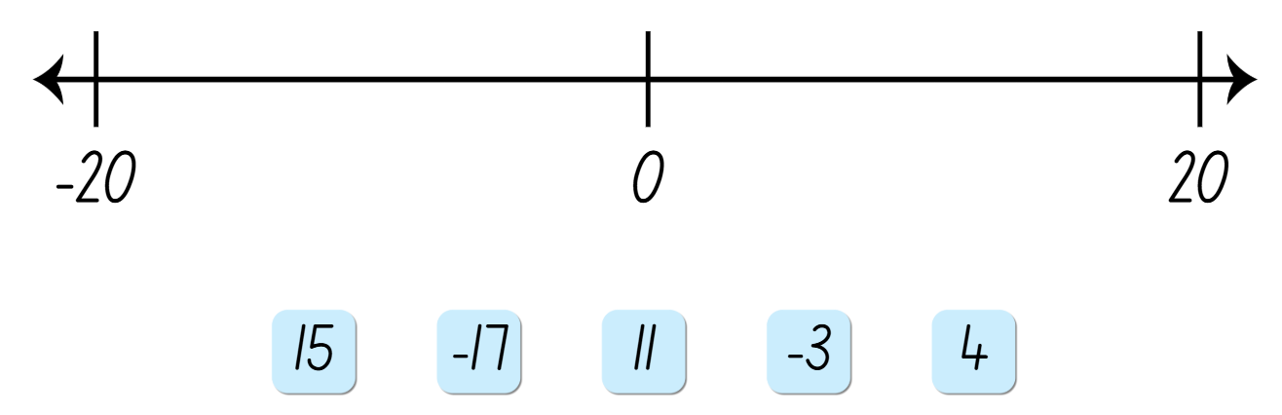
Short response (1)
Place the integers along the number line.
Communicate your reasoning.
Notes:
Short response questions provide brisk paced questions focussing on review of current and previous content to support spaced and interleaved practice.
Syllabus focus area:
Represents numbers B

Slide 7

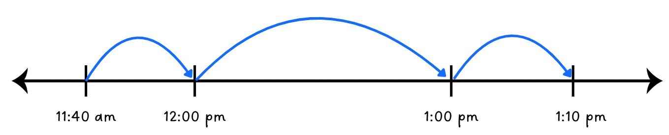
Short response (2)
Does the number line accurately show calculating the elapsed time? Explain your answer.
What was the total elapsed time?
Notes:
Short response questions provide brisk paced questions focussing on review of current and previous content to support spaced and interleaved practice.
Syllabus focus area:
Non-spatial measure B

Slide 8

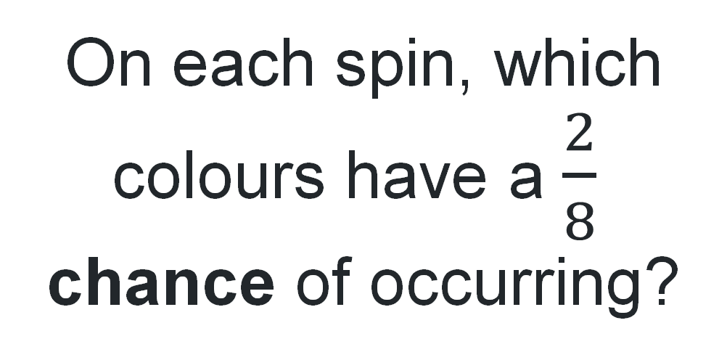
Short response (3)
On each spin, which colours have a $\frac{2}{8}$ chance of occurring?
Communicate your reasoning.
Notes:
Short response questions provide brisk paced questions focussing on review of current and previous content to support spaced and interleaved practice.
Syllabus focus area:
Chance B

Slide 9
Short response (4)
Represent 2 hours 15 minutes as a fraction and a decimal.
Notes:
Short response questions provide brisk paced questions focussing on review of current and previous content to support spaced and interleaved practice.
Syllabus focus area:
Non-spatial measure B: Time

Slide 10

Activity 1 – strategies to estimate discounts
Which is more?
First estimate using mental strategies, without any formal calculations.
10% of $200 or 50% of $40?
10% of $500 or 25% of $200?
10% of 50 or 50% of 10?
Notes:
This is a developing number sense activity.
Number sense refers to a deep understanding of numbers, including their magnitude, relationships, and the effects of operations on them. It supports fluency and understanding, estimation, flexible thinking, and efficient problem-solving. Number sense activities 1–4 ‘activate’ prior number knowledge and support the learning of new content in the unit. Number sense activities 5–8 ‘loop’ back and provide opportunity for spaced practice with concepts and procedures covered in previous units.
Syllabus focus area:
Represents numbers B
Strategies to estimate discounts
This activity is an adaptation of ‘Calculating percentages’ from the Universal Resources Hub by the State of New South Wales (Department of Education).
Using a think-aloud, model using mental strategies to estimate discounts of 10% of $80. For example, ‘I know that 10% means one-tenth of something. To find 10% of $80, I can divide $80 by 10. That equals $8’.
Connect to prior learning that the percentage of 10% is equivalent to the fraction one-tenth, 25% is equivalent to the fraction one-quarter and 50% is equivalent to the fraction one-half.
Ask:
How could I estimate the discount of 25% of $80?
How could I estimate the discount of 50% of $80?
In pairs, students use mental strategies to estimate the discounts.
Check for understanding by having students share their thinking with the class.
Pose the following ‘Which is more?’ questions:
10% of $200 or 50% of $40?
10% of $500 or 25% of $200?
10% of 50 or 50% of 10?
Students first estimate using mental strategies, without any formal calculations.
Students turn and talk to decide on their answers.
Select students to share the strategies used to estimate the answer.
Pose another set of ‘Which is more?’ questions:
10% of $200 or 50% of $38.95?
10% of $495.95 or 25% of $185.95?
Discuss how the rounding of numbers can support estimating with benchmark percentages.
Repeat with other percentage pairs for benchmark percentages.

Slide 11
Review of learning 2

Slide 12
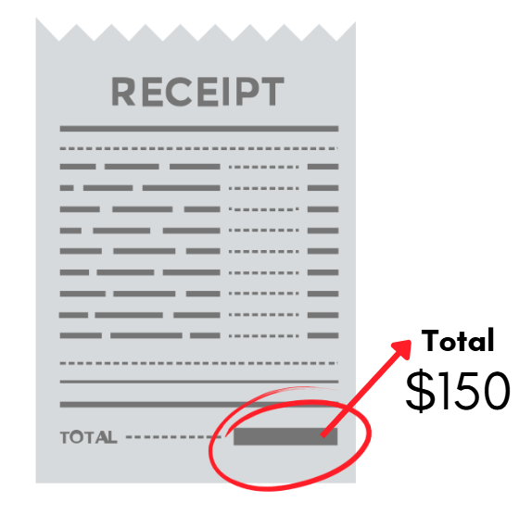
True or false (1)
‘Take $10 off your total shop’
saves you more than
‘25% off your total shop’.
True | False
Notes:
The question on this slide connects to the content being explored in the developing number sense activity (Activity 2)
Syllabus focus area:
Represents numbers B

Slide 13
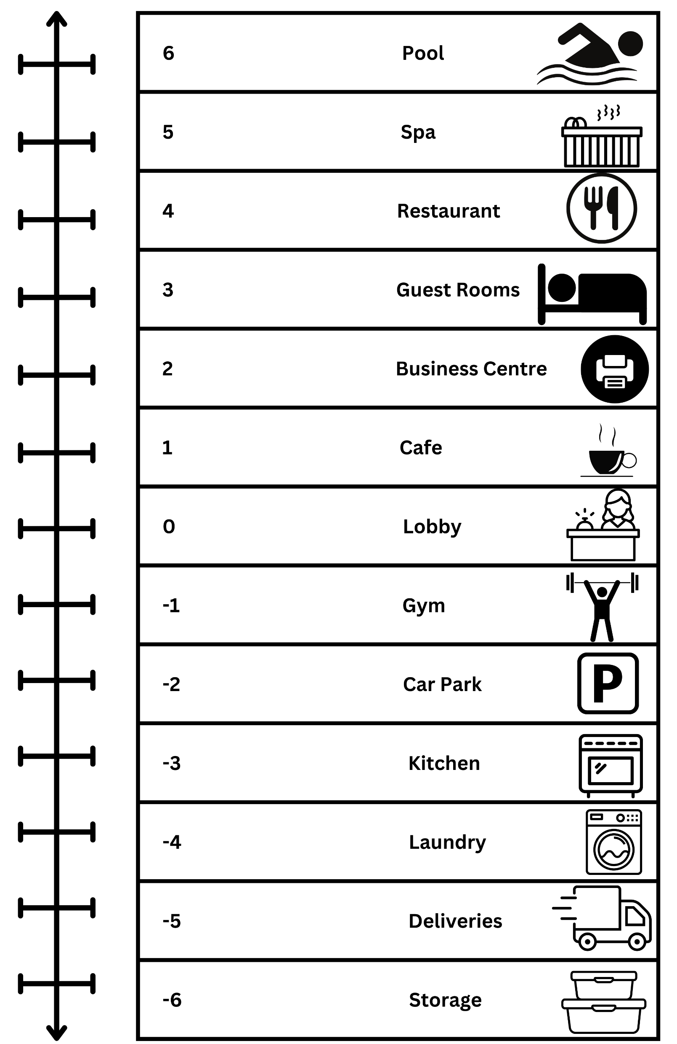
Short response (5)
Phil rolled a die and moved from the Café to Deliveries.
Record this movement on a number line.
What number did he roll?
Notes:
Short response questions provide brisk paced questions focussing on review of current and previous content to support spaced and interleaved practice.
Syllabus focus area:
Represents numbers B

Slide 14
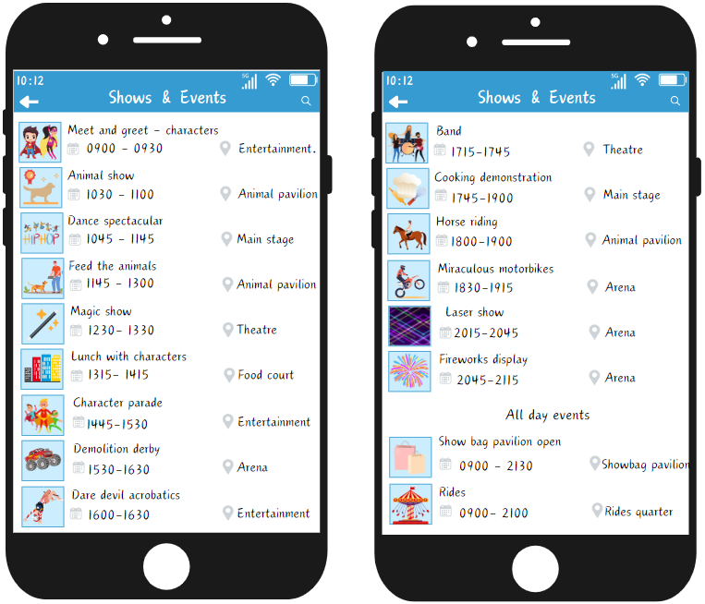
Short response (6)
List events that are 30 mins in duration.
Notes:
Short response questions provide brisk paced questions focussing on review of current and previous content to support spaced and interleaved practice.
Syllabus focus area:
Non-spatial measure B: Time

Slide 15

Short response (7)
Express the probability of the arrow landing on each colour as a fraction.
Notes:
Short response questions provide brisk paced questions focussing on review of current and previous content to support spaced and interleaved practice.
Syllabus focus area:
Chance B

Slide 16
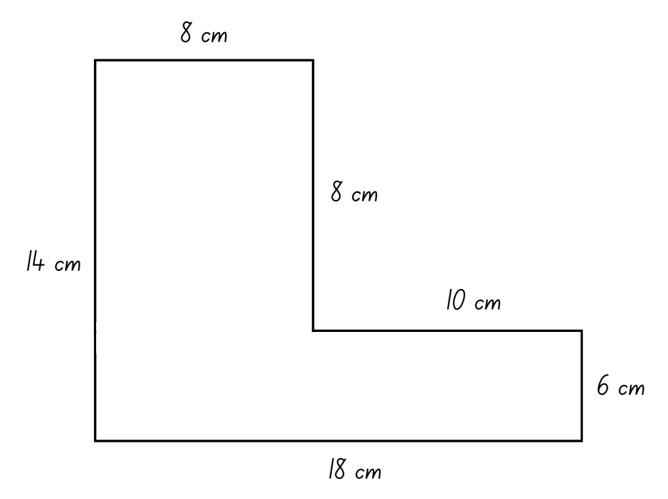
Short response (8)
Find the area of the composite shape.
Notes:
Short response questions provide brisk paced questions focussing on review of current and previous content to support spaced and interleaved practice.
Syllabus focus area:
Two-dimensional spatial structure B: Area

Slide 17
Activity 2 – percentage discounts
Lila has a membership card for her local grocery store. As part of the December promotions, the owner gave selected shoppers an option to ‘take $10 off your total shop’ or ‘25% off your total shop’. Lila finished her Christmas shopping with a total bill of $250.
Which discount voucher should Lila use?
Notes:
This is a developing number sense activity.
Number sense refers to a deep understanding of numbers, including their magnitude, relationships, and the effects of operations on them. It supports fluency and understanding, estimation, flexible thinking, and efficient problem-solving. Number sense activities 1–4 ‘activate’ prior number knowledge and support the learning of new content in the unit. Number sense activities 5–8 ‘loop’ back and provide opportunity for spaced practice with concepts and procedures covered in previous units.
Syllabus focus area:
Represents numbers B
Percentage discounts
Connect to prior learning that to find 10% of a number, we divide by 10, 25% or finding a quarter, we divide by 4, and 50% or finding half, we divide by 2.
Share the story: Lila has a membership card for her local grocery store. As part of the December promotions, the owner gave selected shoppers an option to ‘take $10 off your total shop’ or ‘25% off your total shop’. Lila finished her Christmas shopping with a total bill of $250. Which discount voucher should Lila use?
In pairs, students determine the better promotion for Lila.
Ask:
Is it possible to determine the best option with just an estimate?
How much would Lila have to pay if she took $10 off her total shop of $250?
How much is 25% of $250?
How much would Lila have to pay if she took a 25% discount off her total shop?
When would $10 off be a better choice than a 25% discount?
When would both deals be worth the same?
Students share and discuss their solutions with the class.

Slide 18
Review of learning 3

Slide 19
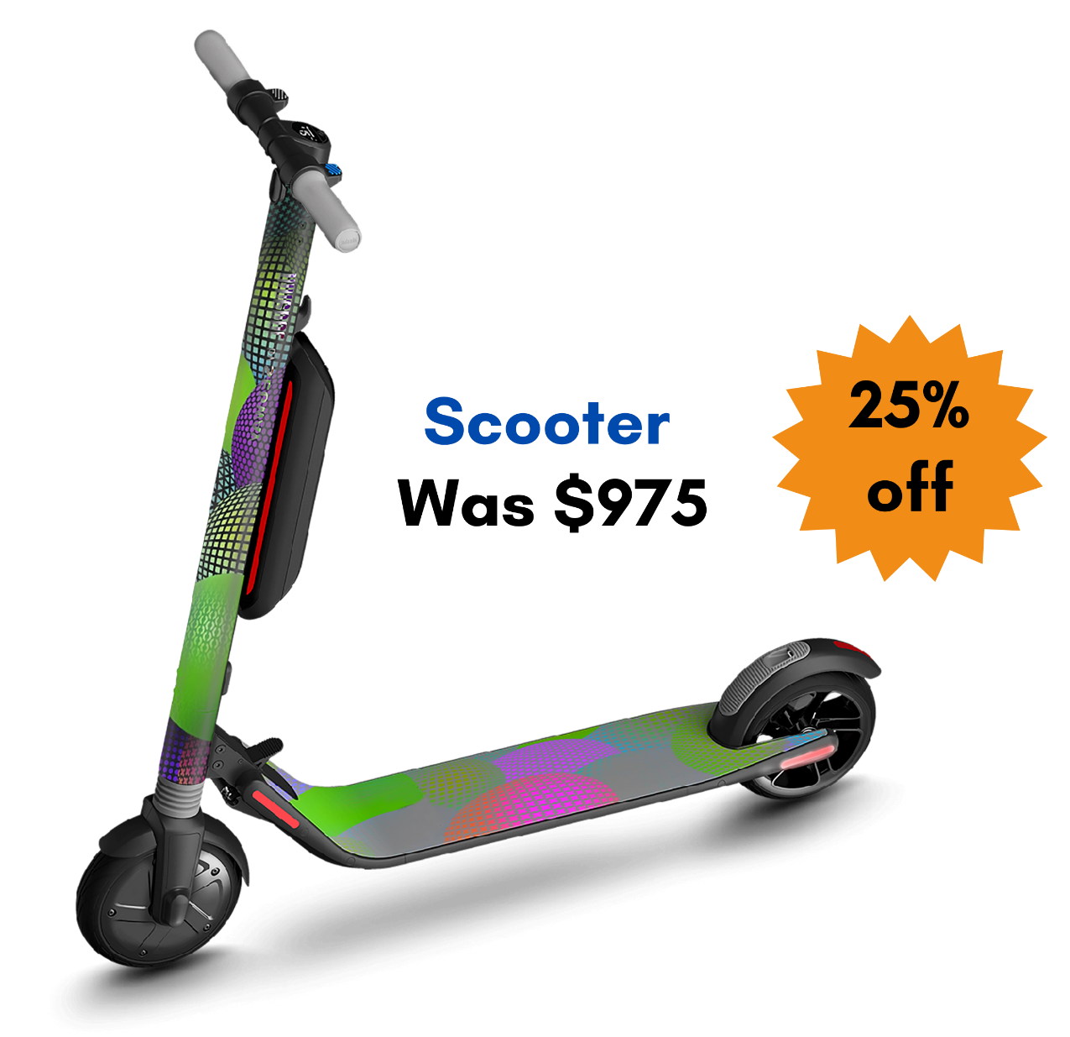
Multiple choice (2)
Estimate the price of this scooter.
$250
$800
$750
$500
A
B
C
D
Notes:
This question connects to the content in the developing number sense activity (Activity 3)
Syllabus focus area:
Represents numbers B

Slide 20
Short response (9)
Which decimal is larger?
7.5
7.361
Communicate your reasoning.
Notes:
Short response questions provide brisk paced questions focussing on review of current and previous content to support spaced and interleaved practice.
Syllabus focus area:
Represents numbers A

Slide 21
Short response (10)
Draw a diagram to show how to translate, rotate and reflect this triangle.
Notes:
Short response questions provide brisk paced questions focussing on review of current and previous content to support spaced and interleaved practice.
Syllabus focus area:
Two-dimensional spatial structure B: 2D shapes

Slide 22

Short response (11)
John tossed a coin 10 times. It landed on heads 7 times and on tails 3 times. The next time he tosses a coin, John is sure it will land on heads.
Is this possible?
Communicate your reasoning.
Notes:
Short response questions provide brisk paced questions focussing on review of current and previous content to support spaced and interleaved practice.
Syllabus focus area:
Chance B

Slide 23
Short response (12)
Explain why there is a need for a formal unit larger than the cubic centimetre to measure volume.
Notes:
Short response questions provide brisk paced questions focussing on review of current and previous content to support spaced and interleaved practice.
Syllabus focus area:
Three-dimensional spatial structure B: Volume

Slide 24

Activity 3 – strategies to estimate discounts
Notes:
This is a developing number sense activity.
Number sense refers to a deep understanding of numbers, including their magnitude, relationships, and the effects of operations on them. It supports fluency and understanding, estimation, flexible thinking, and efficient problem-solving. Number sense activities 1–4 ‘activate’ prior number knowledge and support the learning of new content in the unit. Number sense activities 5–8 ‘loop’ back and provide opportunity for spaced practice with concepts and procedures covered in previous units.
Syllabus focus area:
Represents numbers B
Strategies to estimate discounts
This resource corresponds to Resource 12 – seasonal sales in Stage 3 Year B Unit 40.
Provide students with individual copies of Resource 12 – seasonal sales.
Explain that the orange label indicates the discount that should be applied to that item.
Students turn and talk to estimate the discounts for each of the items.
Regroup as a class and select students to share their estimations. Ask:
What strategy did you use to estimate the discount of each item?
How did rounding help you make an estimate?
In pairs, students:
determine the sale price of each item after the discount
use calculators to check their answers.
Regroup as a class and ask:
What strategy did you use to determine the percentage discount?
How did your knowledge of fractions and percentages help you determine the discount?
What other mathematical concepts did you use to solve these problems?

Slide 25
Review of learning 4

Slide 26


True or false (2)
The sticky notes are placed in the correct positions on the number line.
-50
0
50
-25
5
True | False
Communicate your reasoning.
Notes:
The question on this slide connects to the content being explored in the developing number sense activity (Activity 4)
Syllabus focus area:
Represents numbers B

Slide 27
Short response (13)
Sam bought 3.75 kg of grapes and 2.5 kg of watermelon for afternoon snacks. He worked out he had 5.4 kg in total.
Was he correct?
What is the correct total?
Notes:
Short response questions provide brisk paced questions focussing on review of current and previous content to support spaced and interleaved practice.
Syllabus focus area:
Additive relations B

Slide 28
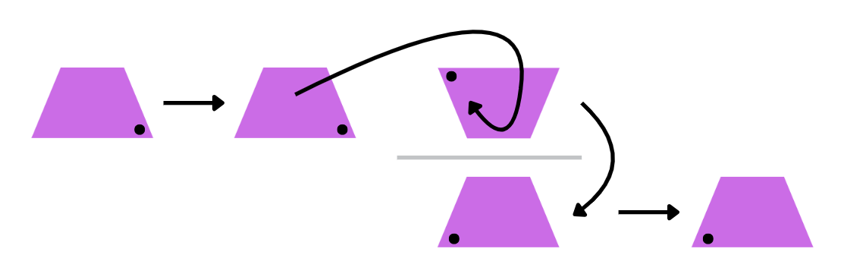
Short response (14)
Describe the path of the trapezium using the word translate, rotate and reflect.
Notes:
Short response questions provide brisk paced questions focussing on review of current and previous content to support spaced and interleaved practice.
Syllabus focus area:
Two-dimensional spatial structure B: 2D shapes

Slide 29

Short response (15)
During a game of ‘Scissor, Paper, Rock’ Ayesha has won every round using ‘Scissors’. She is sure she will win the next round using ‘Scissors’ again.
Is this possible?
Explain your reasoning.
Notes:
Short response questions provide brisk paced questions focussing on review of current and previous content to support spaced and interleaved practice.
Syllabus focus area:
Chance B

Slide 30
Short response (16)
What does not change when translating, reflecting or rotating a shape?
position orientation size
Notes:
Short response questions provide brisk paced questions focussing on review of current and previous content to support spaced and interleaved practice.
Syllabus focus area:
Two-dimensional spatial structure B: 2DS Shapes

Slide 31
Activity 4 – negative number line
Number line
-50
0
50
Notes:
This is a developing number sense activity.
Number sense refers to a deep understanding of numbers, including their magnitude, relationships, and the effects of operations on them. It supports fluency and understanding, estimation, flexible thinking, and efficient problem-solving. Number sense activities 1–4 ‘activate’ prior number knowledge and support the learning of new content in the unit. Number sense activities 5–8 ‘loop’ back and provide opportunity for spaced practice with concepts and procedures covered in previous units.
Syllabus focus area:
Represents numbers B
Negative number line
Revise the terms ‘integer’, ‘positive numbers’, ‘negative numbers’ and ‘whole numbers’.
Draw and display a number line, labelled −50 to +50. To check for understanding, ask:
What does the word integer mean? (a whole number, positive, negative or zero)
What do we call the numbers to the left of the zero on this number line? (negative numbers)
How do we read −5? (negative 5).
Explain that students will play a game in pairs or groups of 3. The aim of the game is to figure out where to place the mystery numbers on the −50 to +50 number line.
Students draw a blank number line on their individual whiteboards marking −50, 0 and +50.
Provide students with 5 mystery numbers. For example, 10, −10, 35, −47, 45.
Students write the mystery numbers on the number line where they think they should be placed.
Once each student in the pair or group has placed their numbers, they take turns to explain their reasoning behind the placement and what strategies they used to make their determination.
The process can be repeated using a different set of mystery numbers.
Check for understanding by viewing student’s whiteboards. Provide feedback and correct misconceptions as needed.

Slide 32
Review of learning 5

Slide 33
Multiple choice (3)
21 | 28 | 35 | 42 | 49 | 56 | 63 | 70 | 77
What number would come next?
90
85
84
83
A
B
C
D
Notes:
This question connects to the content in the developing number sense activity (Activity 5)
Syllabus focus area:
Multiplicative relations B

Slide 34
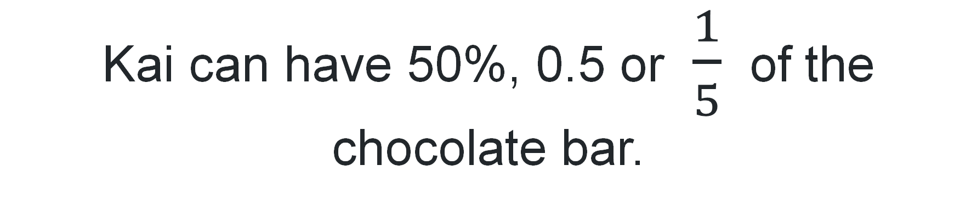
Short response (17)
Kai can have 50%, 0.5 or $\frac{1}{5}$ of the chocolate bar.
Which choice gives him the most chocolate?
Notes:
Short response questions provide brisk paced questions focussing on review of current and previous content to support spaced and interleaved practice.
Syllabus focus area:
Represents numbers B

Slide 35
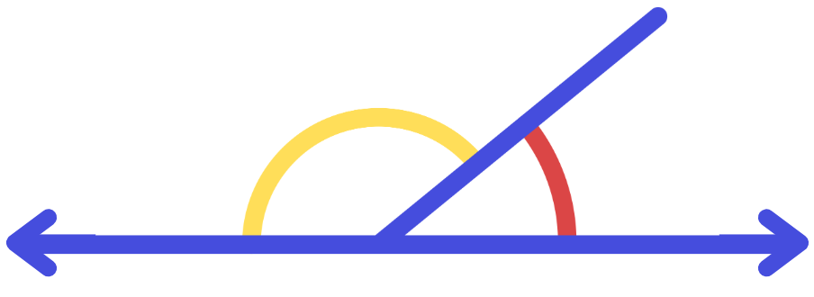
Short response (18)
Name the types of angles found on this straight line.
Notes:
Short response questions provide brisk paced questions focussing on review of current and previous content to support spaced and interleaved practice.
Syllabus focus area:
Geometric measure B

Slide 36






Short response (19)
Draw a table and record the number of each coloured ball using tally marks.
Notes:
Short response questions provide brisk paced questions focussing on review of current and previous content to support spaced and interleaved practice.
Syllabus focus area:
Data A

Slide 37

Short response (20)
Express the probability of drawing each colour ball from the bag as a fraction.
Notes:
Short response questions provide brisk paced questions focussing on review of current and previous content to support spaced and interleaved practice.
Syllabus focus area:
Chance B

Slide 38
Activity 5 – number patterns
 | 1 | 2 | 3 | 4 | 5 | 6 | 7 | 8 | 9 | 10
 | 7 | 14 | 21 | 28 | 35 | 42 | 49 | 56 | 63 | 70
Notes:
This is a developing number sense activity.
Number sense refers to a deep understanding of numbers, including their magnitude, relationships, and the effects of operations on them. It supports fluency and understanding, estimation, flexible thinking, and efficient problem-solving. Number sense activities 1–4 ‘activate’ prior number knowledge and support the learning of new content in the unit. Number sense activities 5–8 ‘loop’ back and provide opportunity for spaced practice with concepts and procedures covered in previous units.
Syllabus focus area:
Multiplicative relations B
Number patterns
Explain that a pattern formed by multiples can be described using multiplication rather than addition. For example, there are 3 times as many sides as there are triangles, the rule would be to multiply the number of triangles by 3 to find the total number of sides.
Draw the table from slide on the board, leaving out the title and row headings (see slide image).
Select students to identify and share a rule. They apply it to a value not displayed in the table. For example, if the number in the first row is 12, the number in the second row will be 84.
Students suggest headings for the rows and justify their suggestions. Possible headings include number of weeks and number of days, number of heptagons and number of sides, number and number multiplied by 7, teams and players for rugby sevens or water polo.
Ask:
What would the number in the second row be if 240 was in the top row? How did you work out the answer?
If 308 was the bottom number, what would the top number be? How did you work out your answer?
How does the table help determine the relationship between the top and bottom rows?
Have students create their own tables to describe patterns they identify in daily life, omitting headings and some of the values.
Students swap with a peer who can suggest headings and missing values to complete the table.

Slide 39
Review of learning 6

Slide 40
True or false (3)
74 ÷ 6 = 12 remainder 2
True | False
Notes:
The question on this slide connects to the content being explored in the developing number sense activity (Activity 6)
Syllabus focus area:
Multiplicative relations B

Slide 41
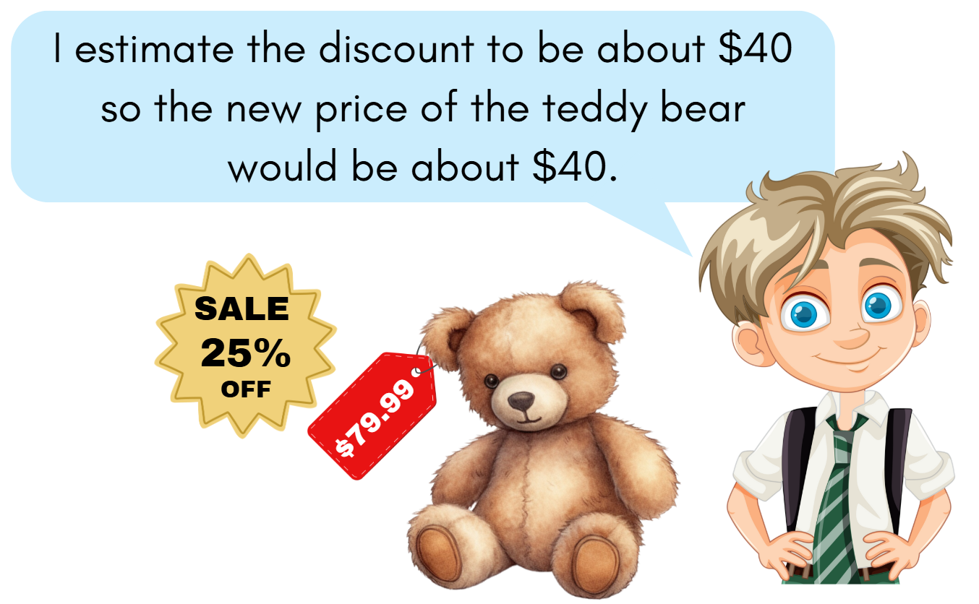
Short response (21)
Is he correct?
Communicate your reasoning.
Notes:
Short response questions provide brisk paced questions focussing on review of current and previous content to support spaced and interleaved practice.
Syllabus focus area:
Represents numbers B

Slide 42


Short response (22)
Name the angles.
1. | 2. | 3.
How many degrees are in each angle?
Notes:
Short response questions provide brisk paced questions focussing on review of current and previous content to support spaced and interleaved practice.
Syllabus focus area:
Geometric measure A: Angles

Slide 43
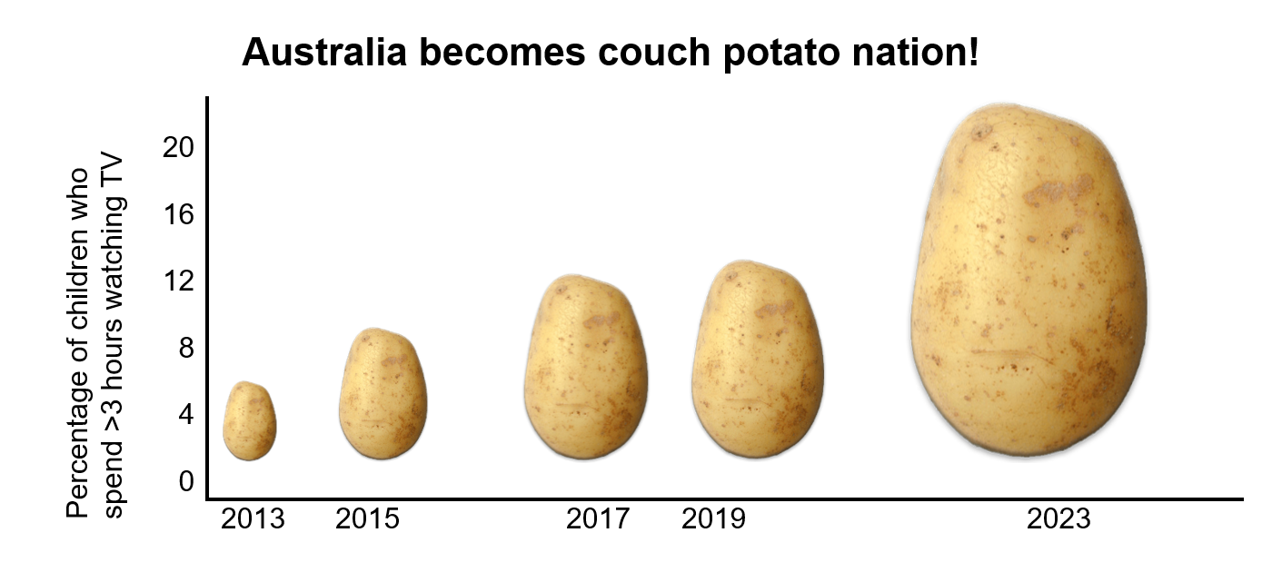
Short response (23)
Explain why this graph could be considered misleading.
Notes:
Short response questions provide brisk paced questions focussing on review of current and previous content to support spaced and interleaved practice.
Syllabus focus area:
Data B

Slide 44
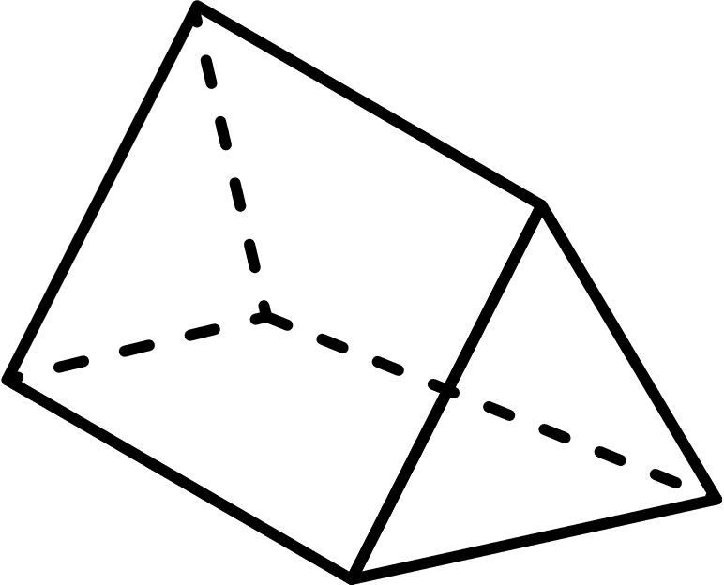
Short response (24)
Is this shape a prism or a pyramid?
Communicate your reasoning.
Notes:
Short response questions provide brisk paced questions focussing on review of current and previous content to support spaced and interleaved practice.
Syllabus focus area:
Three-dimensional spatial structure B: 3DS Objects

Slide 45
Activity 6 – multiplication to solve division problems
Division equation | Score | No remainder bonus (+10) | Total so far
65 ÷ 5 = 13 | 13 | 10 | 23
Notes:
This is a developing number sense activity.
Number sense refers to a deep understanding of numbers, including their magnitude, relationships, and the effects of operations on them. It supports fluency and understanding, estimation, flexible thinking, and efficient problem-solving. Number sense activities 1–4 ‘activate’ prior number knowledge and support the learning of new content in the unit. Number sense activities 5–8 ‘loop’ back and provide opportunity for spaced practice with concepts and procedures covered in previous units.
Syllabus focus area:
Multiplicative relations A
Activity title
This resource corresponds to Resource 13 – ‘Dice division’ instructions and Resource 14 – ‘Dice division’ gameboard. in Stage X Year A/B Unit X.
This lesson is an adaptation from ‘Damult Dice Division’ from Maths for Love by Finkel and Cook and ‘Remainders’ from NRICH by the University of Cambridge.
Present a division problem such as 48 ÷ 5.
Ask students which multiplication fact they might use to help solve it. Identify the quotient and the remainder.
Display and read Resource 13 – ‘Dice division’ instructions.
Provide students with 3 dice and a copy of Resource 14 – ‘Dice division’ gameboard.
Students play the game and record each calculation and score.

Slide 46
Review of learning 7

Slide 47
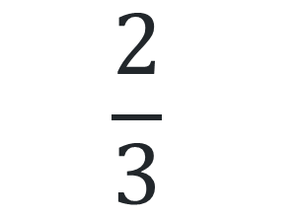
Multiple choice (4)
Which of these are integers?
$$\frac{2}{3}$$
3.5
0
- 63
A
B
C
D
Notes:
This question connects to the content in the developing number sense activity (Activity 7)
Syllabus focus area:
Represents numbers B

Slide 48
Short response (25)
36 × 0.4 = 14.4
Use the number sentence to help solve:
36 × 0.04
3.6 × 4
Communicate your reasoning.
Notes:
Short response questions provide brisk paced questions focussing on review of current and previous content to support spaced and interleaved practice.
Syllabus focus area:
Multiplicative relations B

Slide 49
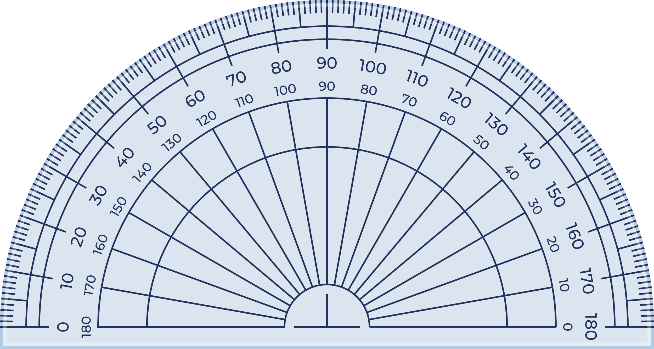
Short response (26)
How many degrees in the highlighted angle?
How many degrees in the adjacent angle?
Notes:
Short response questions provide brisk paced questions focussing on review of current and previous content to support spaced and interleaved practice.
Syllabus focus area:
Geometric measure A: Angles

Slide 50
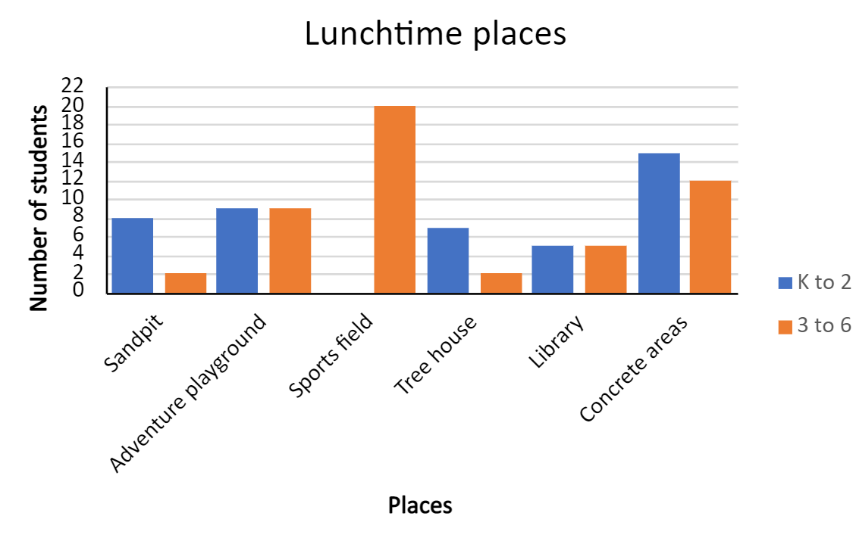
Short response (27)
Describe the differences in play choices between K–2 and 3–6 students.
Notes:
Short response questions provide brisk paced questions focussing on review of current and previous content to support spaced and interleaved practice.
Syllabus focus area:
Data B

Slide 51

Short response (28)
Angles at a point are called?
What is the total of these angles?
Notes:
Short response questions provide brisk paced questions focussing on review of current and previous content to support spaced and interleaved practice.
Syllabus focus area:
Geometric measure B: Angles

Slide 52
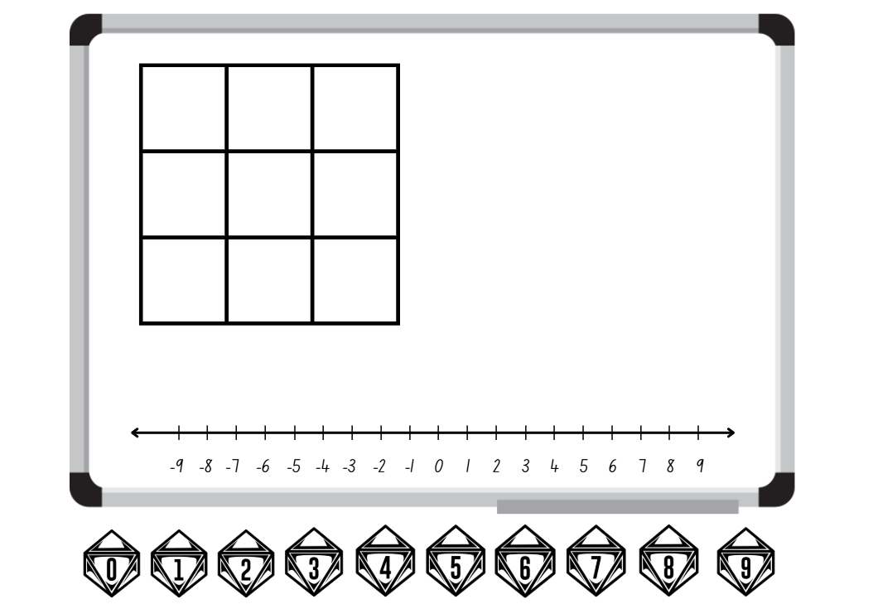
Activity 7 – integers to describe numbers(1)
Notes:
This is a developing number sense activity.
Number sense refers to a deep understanding of numbers, including their magnitude, relationships, and the effects of operations on them. It supports fluency and understanding, estimation, flexible thinking, and efficient problem-solving. Number sense activities 1–4 ‘activate’ prior number knowledge and support the learning of new content in the unit. Number sense activities 5–8 ‘loop’ back and provide opportunity for spaced practice with concepts and procedures covered in previous units.
Syllabus focus area:
Represents numbers B
Integers to describe numbers
Revise that integers are a set of numbers that include all the positive whole numbers, negative whole numbers, and zero. They do not include fractions or decimals.
Examples of positive integers: 1, 2, 3, 4, 5, ...
Examples of negative integers: −1, −2, −3, −4, −5, ...
Zero is also an integer: 0
Explain that negative whole numbers can result from subtraction. Model subtracting a larger number from a smaller number showing the result as a negative number. For example, 4 − 7 = −3.
In pairs, students play a game of ‘Integer subtraction bingo’.
Explain the rules:
Each student draws a 3 × 3 gameboard grid and records a number between −9 and 9 in each square.
At least 6 of the numbers recorded must be negative numbers.
Students take turns to roll two 10-sided dice (0–9) and create a subtraction number sentence.
The dice can be arranged in any order. For example, if a 1 and 8 are rolled, 1 − 8 or 8 − 1 could be recorded.
Students use a −9 to 9 number line as a representation to solve the subtraction.
The number sentence is recorded on each student's whiteboard and the answer is crossed out if it appears on their gameboard.
The winner is the first student to cross out every integer on their gameboard.
Provide pairs with two 10-sided dice (0–9), individual whiteboards and markers.
Students play the game multiple times, changing the numbers on their gameboard each round.

Slide 53
Review of learning 8

Slide 54
True or false (4)
3478 × 19
When solving this equation, estimating by rounding to 3500 × 20 helps check if the exact answer is reasonable.
True | False
Notes:
The question on this slide connects to the content being explored in the developing number sense activity (Activity 8)
Syllabus focus area:
Multiplicative relations B

Slide 55
Short response (29)
1 8 4 7
Using these numbers, demonstrate the effect grouping symbols can have on the answer.
Notes:
Short response questions provide brisk paced questions focussing on review of current and previous content to support spaced and interleaved practice.
Syllabus focus area:
Multiplicative relations B

Slide 56

Short response (30)
All these angles are the same size.
What can you tell about the size of these angles?
Notes:
Short response questions provide brisk paced questions focussing on review of current and previous content to support spaced and interleaved practice.
Syllabus focus area:
Geometric measure B: Angles

Slide 57
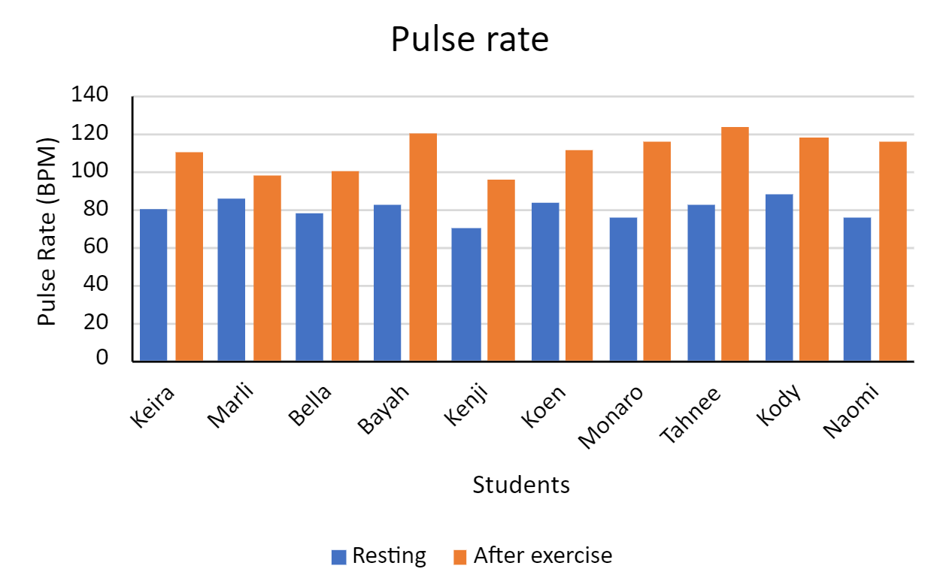
Short response (31)
Explain what the distribution of data shows about pulse rates.
Notes:
Short response questions provide brisk paced questions focussing on review of current and previous content to support spaced and interleaved practice.
Syllabus focus area:
Data B

Slide 58
Short response (32)
How much time has elapsed between 3:45 and 6:00?
Notes:
Short response questions provide brisk paced questions focussing on review of current and previous content to support spaced and interleaved practice.
Syllabus focus area:
Non-spatial measure B: Time

Slide 59
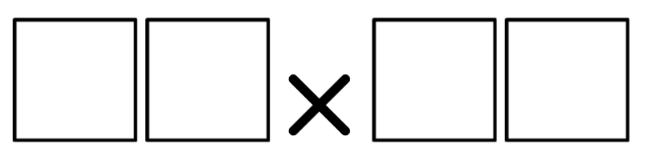
Activity 8 – strategies to multiply
Notes:
This is a developing number sense activity.
Number sense refers to a deep understanding of numbers, including their magnitude, relationships, and the effects of operations on them. It supports fluency and understanding, estimation, flexible thinking, and efficient problem-solving. Number sense activities 1–4 ‘activate’ prior number knowledge and support the learning of new content in the unit. Number sense activities 5–8 ‘loop’ back and provide opportunity for spaced practice with concepts and procedures covered in previous units.
Syllabus focus area:
Multiplicative relations B
Strategies to multiply
Draw 2 boxes multiplied by 2 boxes on the board.
Explain that students will be placing the digits 1–9 in each box to find the closest product to 500. Once a digit has been used, it cannot be used again.
Provide some thinking time. Students think-pair-share their digits for the boxes and explain their strategy and reasoning.
Variation: students draw 4 empty boxes multiplied by 2 empty boxes. Explain that the target product is now 50 000. Students report back on their closest product and discuss their reasoning. If not elicited, draw students’ attention to using powers of 10 to simplify their placement of digits.

Slide 60
Double Venn diagram
Object 1
Object 2
Features similar to both objects
Features of object 1
Features of object 2

Slide 61
Frayer
Definition
Facts/Characteristics
Word, term, concept
Examples
Non-examples

Slide 62
Spider map
Idea
Subject

Slide 63
Cline
Concept 1
Concept 2
Word
Word
Word
Word
Word
Word
Word
Word
Word
Word
Word

Slide 64

Compare and contrast

Slide 65
Multiple choice (5)
A
B
C
D

Slide 66
Multiple choice (6)
A
B
C
D

Slide 67
References
This presentation contains NSW Curriculum and syllabus content. The NSW Curriculum is developed by the NSW Education Standards Authority. This content is prepared by NESA for and on behalf of the Crown in the right of the State of New South Wales. The material is protected by Crown copyright.
Please refer to the NESA Copyright Disclaimer for more information https://educationstandards.nsw.edu.au/wps/portal/nesa/mini-footer/copyright.
NESA holds the only official and up-to-date versions of the NSW Curriculum and syllabus documents. Please visit the NSW Education Standards Authority (NESA) website https://educationstandards.nsw.edu.au/wps/portal/nesa/home and the NSW Curriculum website https://curriculum.nsw.edu.au.
Mathematics K–10 Syllabus © NSW Education Standards Authority (NESA) for and on behalf of the Crown in right of the State of New South Wales, 2022.
National Numeracy Learning Progression © Australian Curriculum, Assessment and Reporting Authority (ACARA) 2010 to present, unless otherwise indicated. This material was downloaded from the Australian Curriculum website (National Numeracy Learning Progression) (accessed 29 February 2024) and was not modified.
ACARA (2023a) NAPLAN 2014 Final test, Numeracy, Year 3 test papers and answers [PDF 4.48 MB], NAPLAN, accessed 29 February 2024.
ACARA (2023b) NAPLAN 2015 Final test, Numeracy, Year 3 test papers and answers [PDF 2.89 MB], NAPLAN, accessed 29 February 2024.
Amplify Education (n.d.) Virtual manipulatives, Amplify Polypad website, accessed 29 February 2024.
Clarke D and Roche A (2014) ‘Colour in fractions’ in Clarke D and Roche A (eds) Engaging Maths: 25 favourite lessons, 2nd edn, Mathematics Teaching and Learning Centre, Australia.

Slide 68
References (2) (1)
This presentation contains NSW Curriculum and syllabus content. The NSW Curriculum is developed by the NSW Education Standards Authority. This content is prepared by NESA for and on behalf of the Crown in the right of the State of New South Wales. The material is protected by Crown copyright.
Please refer to the NESA Copyright Disclaimer for more information https://educationstandards.nsw.edu.au/wps/portal/nesa/mini-footer/copyright.
NESA holds the only official and up-to-date versions of the NSW Curriculum and syllabus documents. Please visit the NSW Education Standards Authority (NESA) website https://educationstandards.nsw.edu.au/wps/portal/nesa/home and the NSW Curriculum website https://curriculum.nsw.edu.au.
Didax, Inc (2023) ‘Fraction number line’, Virtual Manipulatives, Didax website, accessed 29 February 2024.
ESA (Education Services Australia Ltd) and AAMT (The Australian Association of Mathematics Teachers) (n.d.) ‘Fraction wall game’, Fractions, Top Drawer Teachers: Resources for Teachers of Mathematics website, accessed 29 February 2024.
Siemon D, Warren E, Beswick K, Faragher R, Miller J, Horne M, Jazby D, Breed M, Clark J and Brady K (2022) Teaching Mathematics: Foundations to Middle Years, 3rd edn, Oxford University Press, Australia.
Valentine J (2024) ‘Fractions on a Number Line - Beyond One Whole’, Unit 9: Fractions, BetterLesson website, accessed 29 February 2024.

Slide 69
Copyright
© State of New South Wales (Department of Education), 2025
The copyright material published in this resource is subject to the Copyright Act 1968 (Cth) and is owned by the NSW Department of Education or, where indicated, by a party other than the NSW Department of Education (third-party material).
Copyright material available in this resource and owned by the NSW Department of Education is licensed under a Creative Commons Attribution 4.0 International (CC BY 4.0) license.
This license allows you to share and adapt the material for any purpose, even commercially.
Attribution should be given to © State of New South Wales (Department of Education), 2025.
Material in this resource not available under a Creative Commons license:
the NSW Department of Education logo, other logos and trademark-protected material
Material owned by a third party that has been reproduced with permission. You will need to obtain permission from the third party to reuse its material.
Links to third-party material and websites
Please note that the provided (reading/viewing material/list/links/texts) are a suggestion only and implies no endorsement, by the New South Wales Department of Education, of any author, publisher, or book title. School principals and teachers are best placed to assess the suitability of resources that would complement the curriculum and reflect the needs and interests of their students.
If you use the links provided in this document to access a third party’s website, you acknowledge that the terms of use, including licence terms set out on the third-party’s website apply to the use which may be made of the materials on that third-party website or where permitted by the Copyright Act 1968 (Cth). The department accepts no responsibility for content on third-party websites.

