Slide 1
Instructions for use
This resource is not a teaching and learning program. It should be used in conjunction with Stage 2 Year B Unit 21.
Classroom teachers are encouraged to add and adapt slides as required to meet the needs of their students.
Save a copy of the file to make changes to the slide deck. Go to File > Download a Copy (this downloads a copy to the computer to edit in the PowerPoint app).
To convert the PowerPoint to Google Slides:
  Upload the file into Google Drive and open it.
  Go to File > Save as Google Slides.
  (Note – conversion may cause formatting changes in the slides.)

Slide 2

Review of Learning
Mathematics Stage 2 – Unit 21
Notes:
Reviews may include a combination of question types, requiring students to recall facts and key ideas, as well as apply their knowledge to solve problems and answer questions. To support active engagement, a mix of techniques should be employed.” (AERO, 2024).
This Review of Learning slide deck revisits key concepts from the following units:
Stage 2 Year B Unit 21
Stage 2 Year A Unit 20
Stage 2 Year A Unit 19
It also includes opportunities to review prior learning in non-number content, supporting consolidation across focus areas.
The review of learning resources include three key task types that support the development of mathematical proficiency through retrieval, spaced practice, and active participation. These practices complement the review phase (activating prior knowledge) embedded within the beginning of each lesson.
1.
Multiple-choice questions/True or false: Designed to promote active retrieval of key concepts and identify common misconceptions in number, supporting consolidation, understanding and fluency.
These questions:
support spaced and interleaved practice
help identify and address common misconceptions
support active recall and immediate feedback
support whole class participation
identify areas requiring reteach
2.
Short-response question sets: Carefully grouped questions that encourage spaced and interleaved practice across multiple focus areas, helping students revisit and apply knowledge from different points in time.
These questions:
have a combination of question types
address a range of focus areas
build automaticity and fluency
support active recall
allow for immediate feedback
identify content requiring reteach
3.
Developing number sense activities: A variety of practical, purposeful tasks that reinforce current learning and build on prior knowledge. These activities promote reasoning, problem-solving and conceptual understanding.
The review of learning resources are designed to work support teaching and learning in mathematics. For the most effective implementation, use the resources flexibly, adapting to meet student learning needs and individual classroom contexts.

Slide 3
Lessons
1
Review of learning 1
5
Review of learning 5
2
Review of learning 2
6
Review of learning 6
3
Review of learning 3
7
Review of learning 7
4
Review of learning 4
8
Review of learning 8
Notes:
Teacher notes:
Click lesson numbers to go to specific lessons
Interactive features can be viewed in slide show

Slide 4
Review of learning 1

Slide 5

Multiple choice (1)
Which number is the smallest?
A
7054
B
7405
C
7450
D
7504
Notes:
This question connects to the content in the developing number sense activity (Activity 1)
Syllabus focus area:
Representing numbers using place value A

Slide 6

Short response (1)
Count forwards by tens starting from 100 up to 250.
Count backwards by tens from 320 to 110.
Notes:
Short response questions provide brisk paced questions focussing on review of current and previous content to support spaced and interleaved practice.
Syllabus focus area:
Representing numbers using place value A: Whole numbers

Slide 7
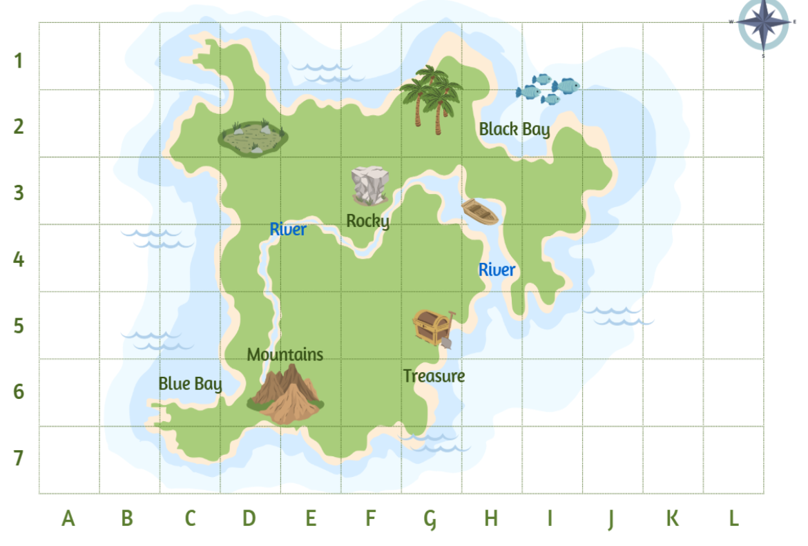
Short response (2)
Identify the grid reference for these landmark images:
rocky
treasure
boat
Notes:
Short response questions provide brisk paced questions focussing on review of current and previous content to support spaced and interleaved practice.
Syllabus focus area:
Geometric measure A: Position

Slide 8

Short response (3)
Name the quadrilaterals with parallel sides.
Name and describe these polygons.
Notes:
Short response questions provide brisk paced questions focussing on review of current and previous content to support spaced and interleaved practice.
Syllabus focus area:
Two-dimensional spatial structure A: 2D shapes

Slide 9
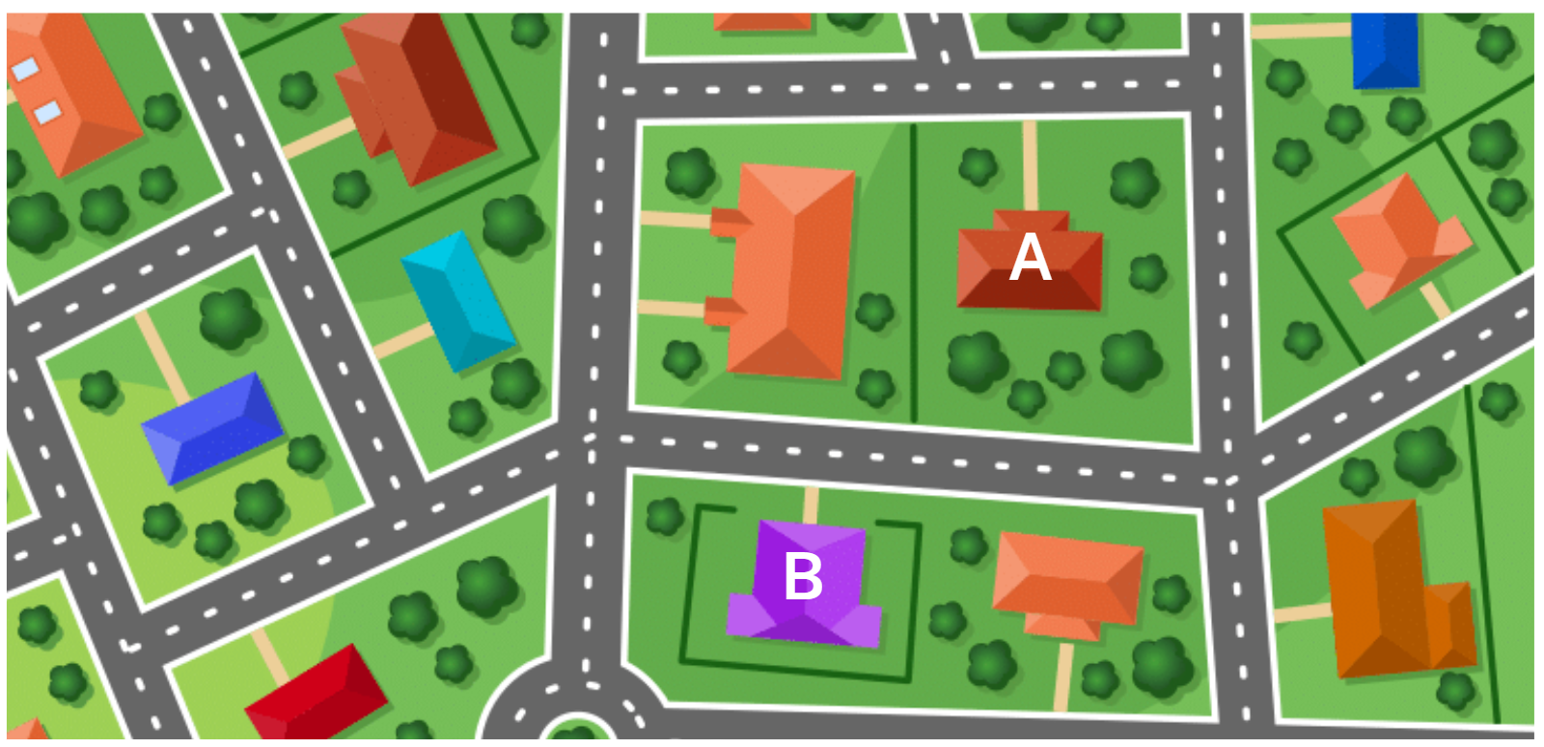
Short response (4)
Describe how to get from A to B.
Notes:
Short response questions provide brisk paced questions focussing on review of current and previous content to support spaced and interleaved practice.
Syllabus focus area:
Geometric measure A: Position

Slide 10

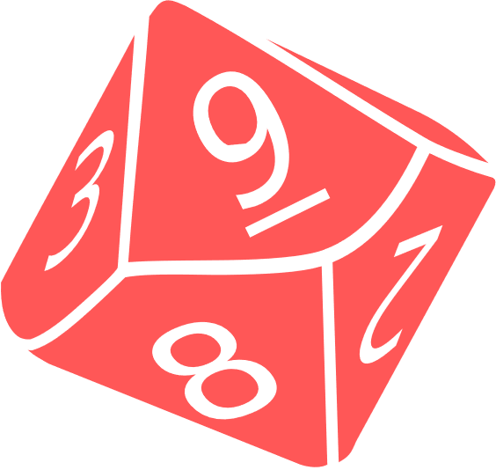


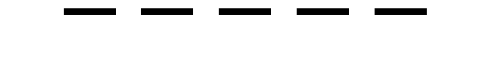
Activity 1 – 4-digit numbers
Player 1
Player 2
TTh Th H T O
99 999
TTh Th H T O
9 6 3 5 2
8 6 5 5 0
1 pt
Notes:
Note: This slide is designed to be used in presentation mode.
This is a developing number sense activity.
Number sense refers to a deep understanding of numbers, including their magnitude, relationships, and the effects of operations on them. It supports fluency and understanding, estimation, flexible thinking, and efficient problem-solving. Number sense activities 1–4 ‘activate’ prior number knowledge and support the learning of new content in the unit. Number sense activities 5–8 ‘loop’ back and provide opportunity for spaced practice with concepts and procedures covered in previous units.
Syllabus focus area:
Representing numbers using place value A
Activity title
This resource corresponds Stage 2 Year B Unit 21.
Provide pairs with markers, a whiteboard and a 9-sided die.
Students draw a gameboard on their whiteboard with 4 place value labels and 4 lines to represent the 4 digits
The aim of the game is to make numbers as close to 5000 as possible without going over, with the highest number winning a point. The player with the most points after 5 rounds is declared the winner.
Students take turns to roll the die. After each roll, write the number on one of the lines. Once the 4 blank lines are full, players read their number and identify which number is the closest to 5000. This player wins a point.
Note: a variation to this task is to select a target number that is a multiple of thousands between 1000 and 9000.
This activity is an adaptation of Hit it (3-digit numbers) from Mathematics K–6 resources by State of New South Wales (Department of Education).

Slide 11
Review of learning 2

Slide 12
True or false (1)
If you rearrange the digits in 4562 to make 6542, the number becomes smaller.
True | False
Notes:
The question on this slide connects to the content being explored in the developing number sense activity (Activity 2)
Syllabus focus area:
Representing numbers using place value B: Whole numbers

Slide 13
Short response (5)
Make the following numbers 10 times larger:
78
321
1208
Notes:
Short response questions provide brisk paced questions focussing on review of current and previous content to support spaced and interleaved practice.
Syllabus focus area:
Representing numbers using place value B: Whole numbers

Slide 14
Short response (6)
On a grid map:
What direction does the horizontal axis show?
What directions does the vertical axis show?
Notes:
Short response questions provide brisk paced questions focussing on review of current and previous content to support spaced and interleaved practice.
Syllabus focus area:
Geometric measure A: Position

Slide 15

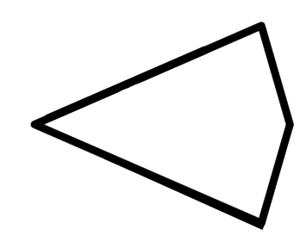


Short response (7)
Which of these quadrilaterals have all sides equal in length?
Explain your thinking.
Notes:
Short response questions provide brisk paced questions focussing on review of current and previous content to support spaced and interleaved practice.
Syllabus focus area:
Two-dimensional spatial structure A: 2D shapes

Slide 16
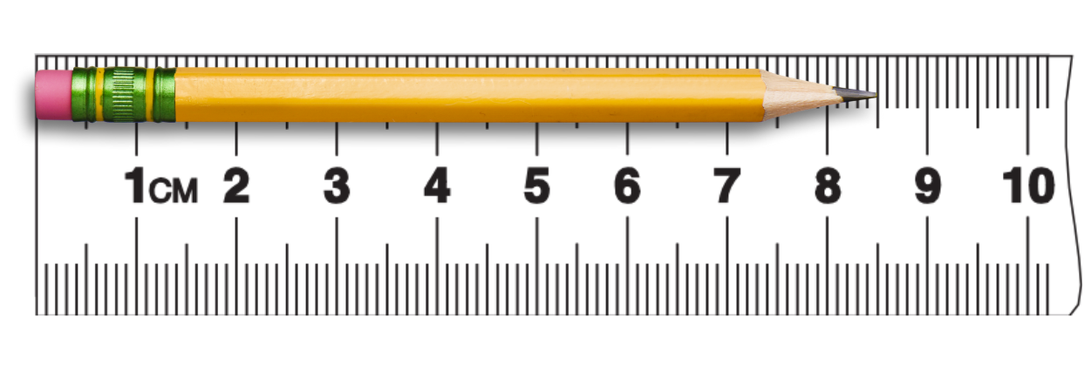
Short response (8)
Record the length of this pencil in millimetres.
Notes:
Short response questions provide brisk paced questions focussing on review of current and previous content to support spaced and interleaved practice.
Syllabus focus area:
Geometric measure A: Length

Slide 17
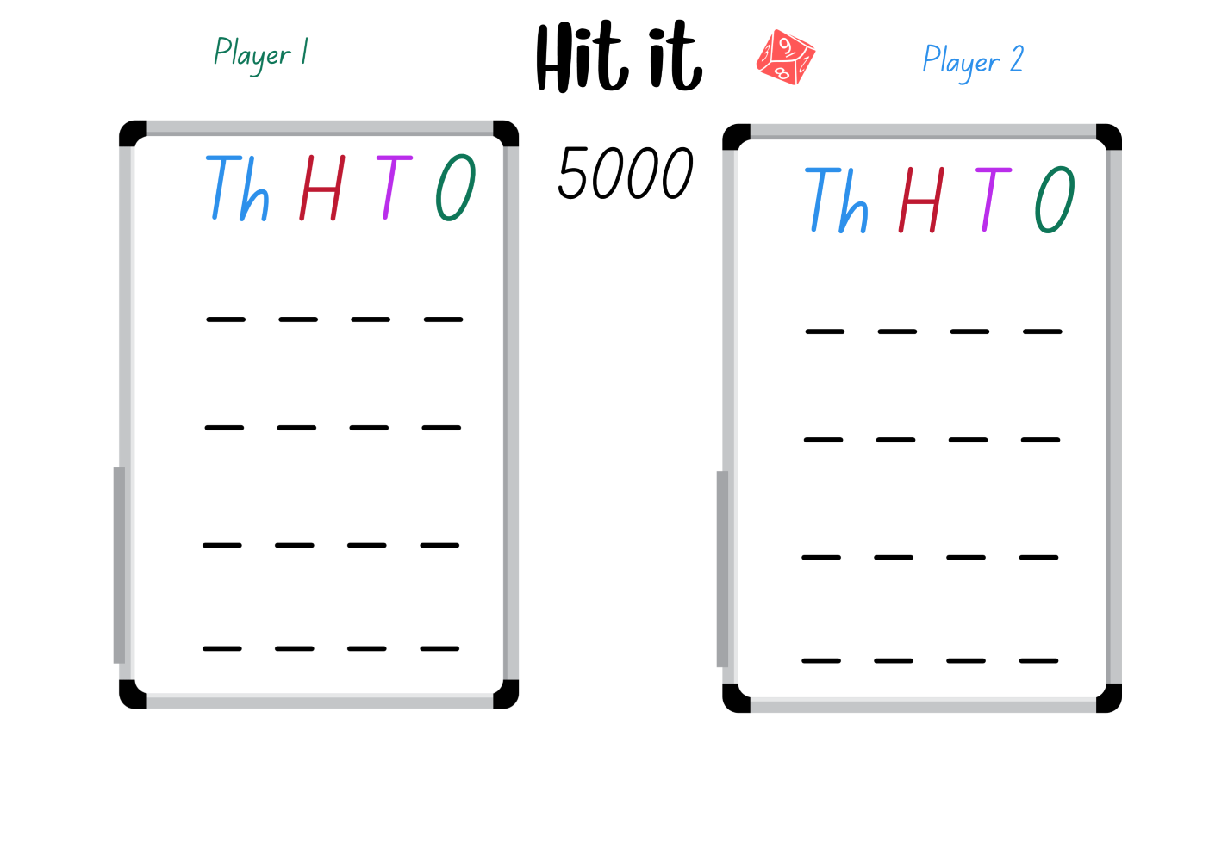
Activity 2 – 5-digit numbers
4 8 7 1
3 3 5 1
1 pt
0 pt
2 9 6 8
4 9 1 8
0 pt
1 pt
3 9 8 9
3 8 7 9
1 pt
0 pt
Notes:
Note: This slide is designed to be used in presentation mode.
This is a developing number sense activity.
Number sense refers to a deep understanding of numbers, including their magnitude, relationships, and the effects of operations on them. It supports fluency and understanding, estimation, flexible thinking, and efficient problem-solving. Number sense activities 1–4 ‘activate’ prior number knowledge and support the learning of new content in the unit. Number sense activities 5–8 ‘loop’ back and provide opportunity for spaced practice with concepts and procedures covered in previous units.
Syllabus focus area:
Representing numbers using place value B: Whole numbers
Activity title
This resource corresponds to Stage 2 Year B Unit 21.
Provide pairs with markers, a whiteboard and a 9-sided die.
Students draw a gameboard on their whiteboard with 5 lines to represent the 5-digits.
The aim of the game is to make numbers as close to 99 999 as possible, with the closest number winning a point. The player with the most points after 5 rounds is declared the winner.
This activity is an adaptation of Hit it (3-digit numbers) from Mathematics K–6 resources by State of New South Wales (Department of Education).

Slide 18
Review of learning 3

Slide 19
Multiple choice (2)
Which is the correct expanded form
of 305 482?
A
300 000 + 500 + 400 + 80 + 2
B
300 000 + 5 000 + 40 + 80 + 2
C
300 000 + 5 000 + 400 + 80 + 2
D
300 000 + 5 000 + 400 + 8 + 2
Notes:
This question connects to the content in the developing number sense activity (Activity 3)
Syllabus focus area:
Representing numbers using place value B: Whole numbers

Slide 20
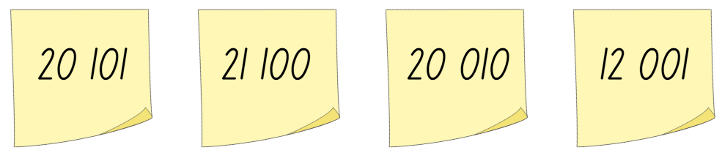
Short response (9)
Kate arranged these numbers in descending order. Is she correct?
Why or Why not?
Explain your reasoning.
Notes:
Short response questions provide brisk paced questions focussing on review of current and previous content to support spaced and interleaved practice.
Syllabus focus area:
Representing numbers using place value B: Whole numbers

Slide 21
Short response (10) (9)
You have $1.30 made up of 4 coins.
What different combinations of coins could you have?
Communicate your reasoning.
Notes:
Short response questions provide brisk paced questions focussing on review of current and previous content to support spaced and interleaved practice.
Syllabus focus area:
Additive relations A

Slide 22
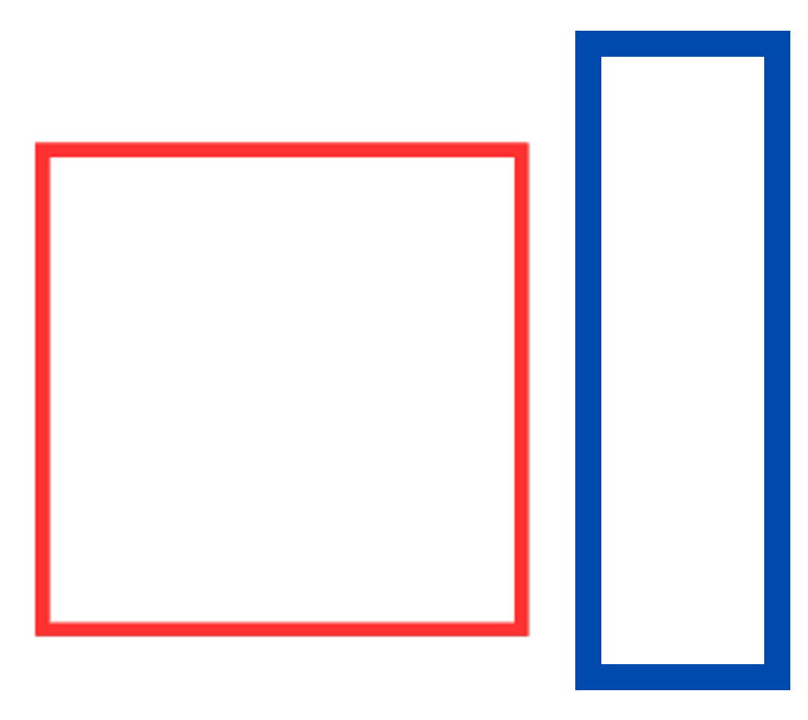

Short response (11)
These quadrilaterals have been grouped using one attribute. Describe how they have been grouped.
Notes:
Short response questions provide brisk paced questions focussing on review of current and previous content to support spaced and interleaved practice.
Syllabus focus area:
Two-dimensional spatial structure A: 2D shapes

Slide 23
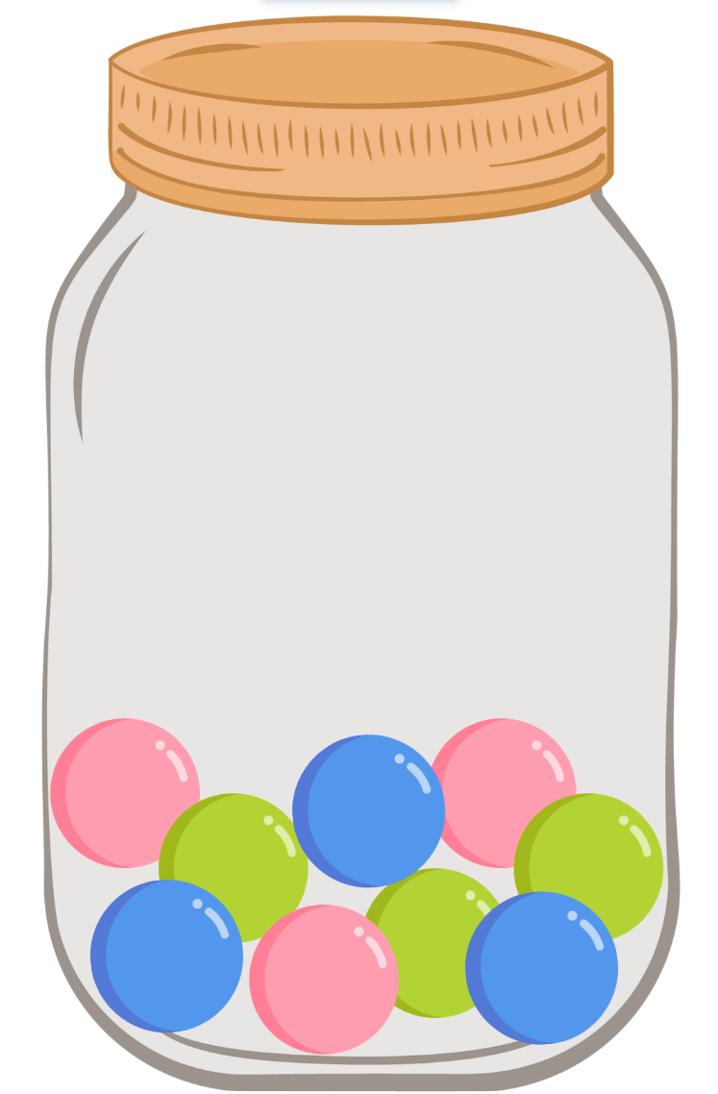
Short response (12)
In this jar is 3 blue, 3 pink and 3 green marbles.
What different colour combinations are possible if 3 marbles are randomly selected?
Notes:
Short response questions provide brisk paced questions focussing on review of current and previous content to support spaced and interleaved practice.
Syllabus focus area:
Chance A

Slide 24
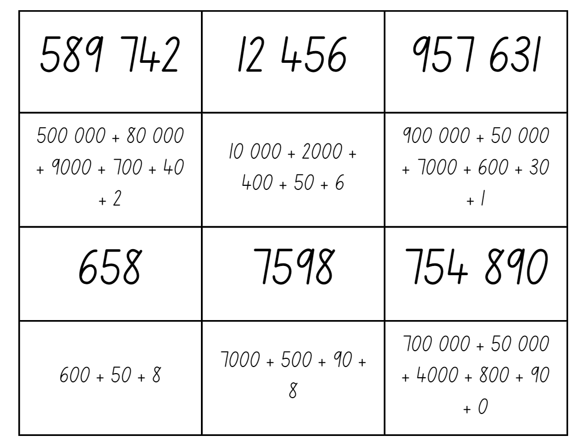
Activity 3 – expanded notation memory
Notes:
This is a developing number sense activity.
Number sense refers to a deep understanding of numbers, including their magnitude, relationships, and the effects of operations on them. It supports fluency and understanding, estimation, flexible thinking, and efficient problem-solving. Number sense activities 1–4 ‘activate’ prior number knowledge and support the learning of new content in the unit. Number sense activities 5–8 ‘loop’ back and provide opportunity for spaced practice with concepts and procedures covered in previous units.
Syllabus focus area:
Representing numbers using place value B: Whole numbers
Activity title
This resource corresponds to Resource 21 – expanded notation memory in Stage 2 Year B Unit 21.
Provide student pairs copies of Resource 21 – expanded notation memory. Students cut out the cards, shuffle the cards and place them face down.
Player 1 selects one card and then selects another card. If the cards match, the student keeps the 2 cards and has another turn. If there is no match the student returns the cards face down and Player 2 takes a turn.
Play continues until there are no cards left. The player with the greatest number of cards at the end of the game wins.

Slide 25
Review of learning 4

Slide 26

True or false (2)
This array can be described as 3 fours are 12.
True | False
Notes:
The question on this slide connects to the content being explored in the developing number sense activity (Activity 4)
Syllabus focus area:
Multiplicative relations A

Slide 27
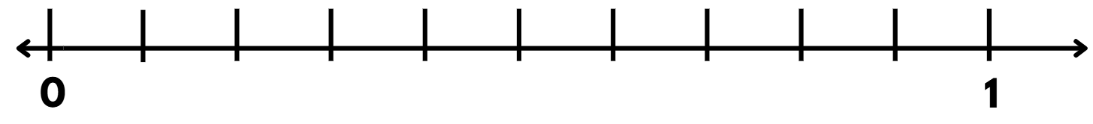
Short response (13)
Draw the number line and label the tenths using decimal notation.
Notes:
Short response questions provide brisk paced questions focussing on review of current and previous content to support spaced and interleaved practice.
Syllabus focus area:
Representing numbers using place value B: Decimals

Slide 28
Short response (14)
Record the number 3256 using non standard place value partitioning.
Communicate your reasoning.
Notes:
Short response questions provide brisk paced questions focussing on review of current and previous content to support spaced and interleaved practice.
Syllabus focus area:
Representing numbers using place value A: Whole numbers:

Slide 29
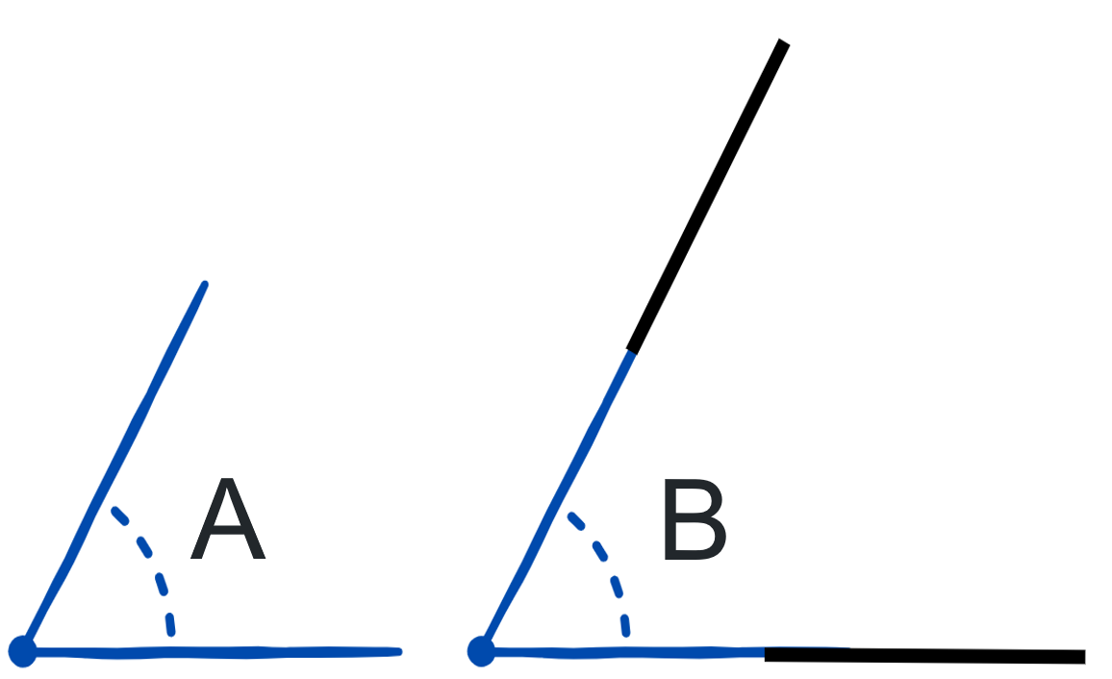
Short response (15)
Matt drew angle A. He wanted to make the angle bigger, so he made the arms longer to make angle B. Did Matt
make a bigger angle?
Why? Why not?
Notes:
Short response questions provide brisk paced questions focussing on review of current and previous content to support spaced and interleaved practice.
Syllabus focus area:
Geometric measure A: Angles

Slide 30
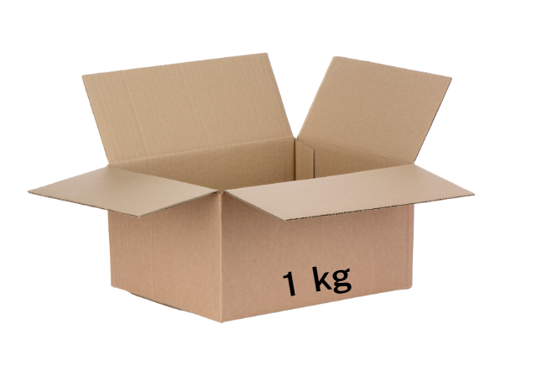
Short response (16)
What might be in this box weighing 1 kg?
Communicate your reasoning.
Notes:
Short response questions provide brisk paced questions focussing on review of current and previous content to support spaced and interleaved practice.
Syllabus focus area:
Non-spatial measure A: Mass

Slide 31
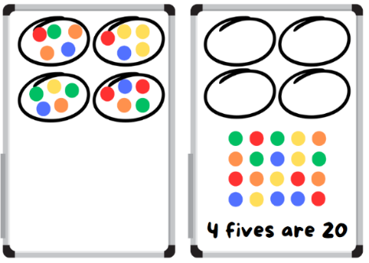
Activity 4 – groups to arrays
Notes:
This is a developing number sense activity.
Number sense refers to a deep understanding of numbers, including their magnitude, relationships, and the effects of operations on them. It supports fluency and understanding, estimation, flexible thinking, and efficient problem-solving. Number sense activities 1–4 ‘activate’ prior number knowledge and support the learning of new content in the unit. Number sense activities 5–8 ‘loop’ back and provide opportunity for spaced practice with concepts and procedures covered in previous units.
Syllabus focus area:
Multiplicative relations A
Activity title
This resource corresponds to Stage 2 Year B Unit 21.
Note: when students are describing an array, encourage them to read an array like a book from left to right to determine how many in each row. For example, 5 rows (groups) of 3 becomes 5 threes with the ‘rows of’ or ‘groups of’ implied. This then leads to one three is 3, 2 threes are 6, 3 threes are nine, and so on.
The aim is to obtain the highest product at the end of each round
Give pairs of students a 6-sided die, counters and individual whiteboards.
Player 1 rolls a 6-sided die and draws the resulting number of loops on their whiteboard.
Player 1 rolls again and places that number of counters in each loop.
Player 1 rearranges the counters into an array and labels the array, for example 4 fives are 20 (see ).
Player 2 repeats the process.
At the end of the round, the player with the highest product wins and scores a point. The player who scores the most points by the end of the game is the winner.
This activity is an adaptation of Loops and Groups from Math Learning Center.

Slide 32
Review of learning 5

Slide 33
Multiple choice
Which number is closest to 700 on a number line?
500
650
790
800
A
B
C
D
Notes:
This question connects to the content in the developing number sense activity (Activity 5)
Syllabus focus area:
Representing numbers using place value A: Whole numbers

Slide 34
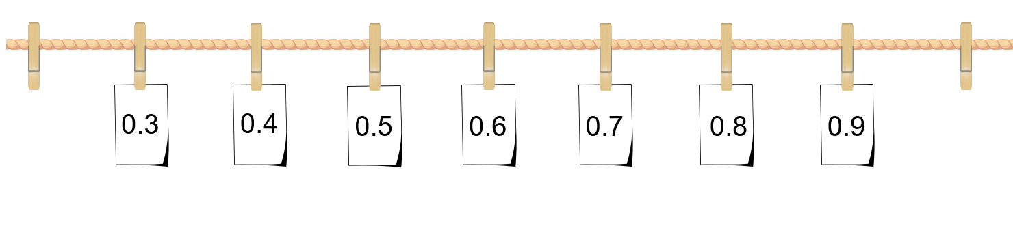
Short response (17)
Record the missing decimal numbers.
?
?
Notes:
Short response questions provide brisk paced questions focussing on review of current and previous content to support spaced and interleaved practice.
Syllabus focus area:
Representing numbers using place value B: Decimals

Slide 35
Short response (18)
Use the compensation strategy to calculate:
28 + 35
260 – 29
125 – 78
Notes:
Short response questions provide brisk paced questions focussing on review of current and previous content to support spaced and interleaved practice.
Syllabus focus area:
Additive relations A

Slide 36
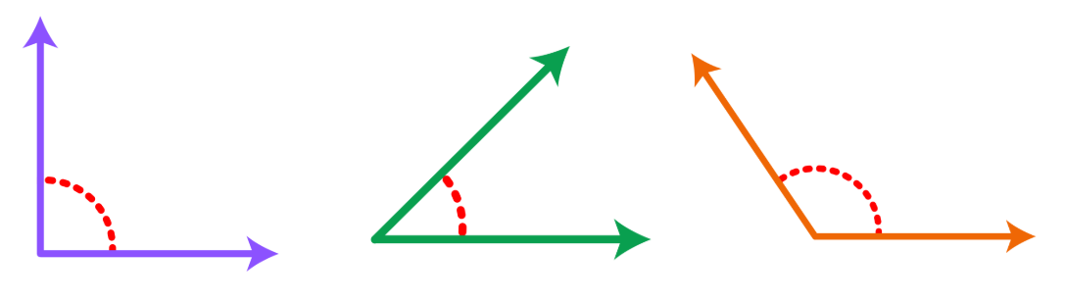
Short response (19)
Draw this angle and label the arms and vertex.
Notes:
Short response questions provide brisk paced questions focussing on review of current and previous content to support spaced and interleaved practice.
Syllabus focus area:
Geometric measure A: Angles

Slide 37
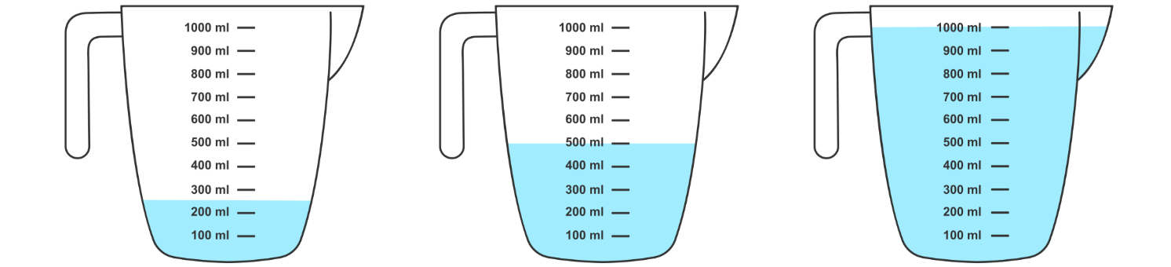
Short response (20)
Craig’s jug has a litre of water in it. Dina has half a litre in hers. Which jug is Craig’s, and which is Dina’s?
A B C
Explain how you know.
Notes:
Short response questions provide brisk paced questions focussing on review of current and previous content to support spaced and interleaved practice.
Syllabus focus area:
Three-dimensional spatial structure B: Volume

Slide 38

Activity 5 – number lines
17
50
30
100
Notes:
This is a developing number sense activity.
Number sense refers to a deep understanding of numbers, including their magnitude, relationships, and the effects of operations on them. It supports fluency and understanding, estimation, flexible thinking, and efficient problem-solving. Number sense activities 1–4 ‘activate’ prior number knowledge and support the learning of new content in the unit. Number sense activities 5–8 ‘loop’ back and provide opportunity for spaced practice with concepts and procedures covered in previous units.
Syllabus focus area:
Representing numbers using place value A
Activity title
This resource corresponds to Stage 2 Year B Unit 21.
Using sticky notes write the number 17 and place it near the start of the number line
Take a blank sticky note and ask students where this sticky note could be positioned on the number line. Have students explain their reasoning. Encourage students to think about the fact that the empty sticky note can go anywhere on the line as the number line is open, and the card could represent any number on the line. Place the card on the number line
Next, take a sticky note with the number 50 on it and place it on the number line to the right of the blank note
Ask students if they would like to change their thinking about what the blank sticky note number could now be. Have some students share their thinking.
Move the sticky note with the number 50 right next to the blank sticky note
In pairs, have students discuss the following:
Do we have to change the number we selected for our blank sticky note? Why or why not?
What is a better number to put in there? Explain your thinking.
What if we changed the first sticky note with the number 17 to a 30? Would the blank sticky note have to change?
What if we changed the 50 to 100? Would the blank sticky note change?
As a class, select some of the students to share their reasoning and ideas.
This activity is an adaptation of ‘What’s in the box?’ from Learning to Think Mathematically with the Number Line [PDF 1.1 KB] by Frykholm.

Slide 39
Review of learning 6

Slide 40
True or false (3)
These numbers are arranged in ascending order:
30 248, 30 428, 30 284, 32 804
True | False
Notes:
The question on this slide connects to the content being explored in the developing number sense activity (Activity 6)
Syllabus focus area:
Representing numbers using place value B: Whole numbers

Slide 41
Short response (21)
Explain why 2.0 is not the same as 0.2.
Notes:
Short response questions provide brisk paced questions focussing on review of current and previous content to support spaced and interleaved practice.
Syllabus focus area:
Representing numbers using place value B: Decimals and percentages

Slide 42
Short response (22)
Group these numbers to make multiples of 10 and solve:
26 + 19 + 4 + 1
Notes:
Short response questions provide brisk paced questions focussing on review of current and previous content to support spaced and interleaved practice.
Syllabus focus area:
Additive relations A

Slide 43
Short response (23)
Draw:
an angle that is less than a right angle
an angle that is equal to a right angle
an angle that is greater than a right angle.
Notes:
Short response questions provide brisk paced questions focussing on review of current and previous content to support spaced and interleaved practice.
Syllabus focus area:
Geometric measure B: Angles

Slide 44
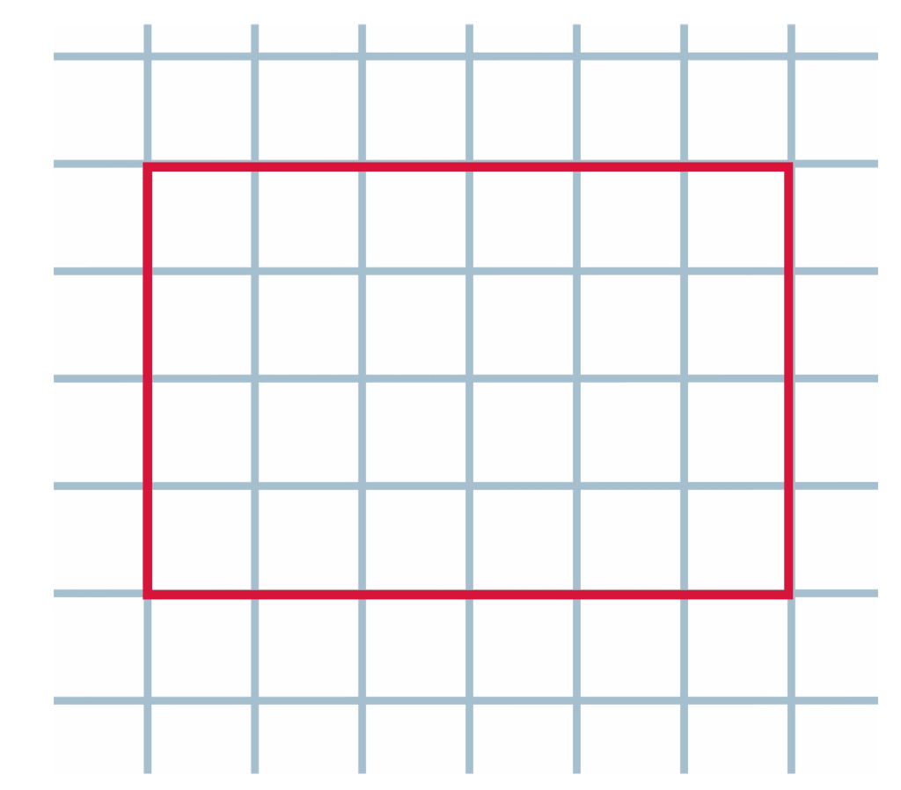
Short response (24)
Use the structure of rows and columns to find the area of his rectangle.
Notes:
Short response questions provide brisk paced questions focussing on review of current and previous content to support spaced and interleaved practice.
Syllabus focus area:
Two-dimensional spatial structure A: Area

Slide 45
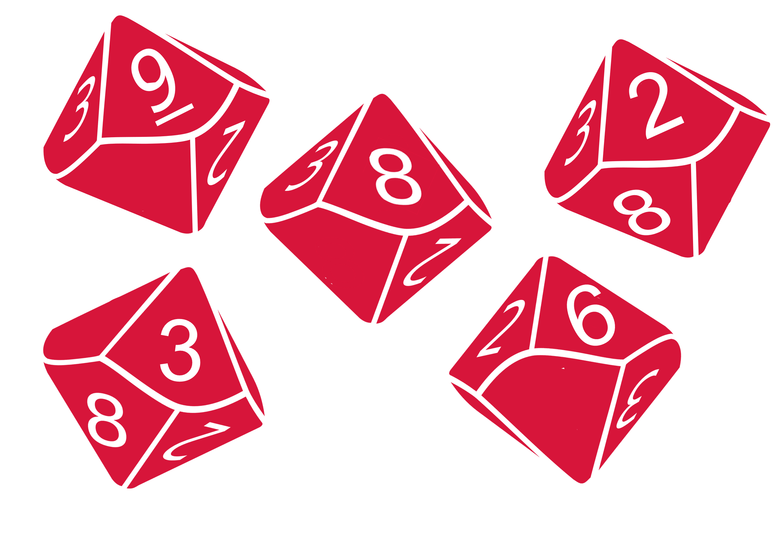
Activity 6 – digit ascending order
29 863
10 000
62 389
98 632
100 000
Notes:
Note: This slide is designed to be used in presentation mode.
This is a developing number sense activity.
Number sense refers to a deep understanding of numbers, including their magnitude, relationships, and the effects of operations on them. It supports fluency and understanding, estimation, flexible thinking, and efficient problem-solving. Number sense activities 1–4 ‘activate’ prior number knowledge and support the learning of new content in the unit. Number sense activities 5–8 ‘loop’ back and provide opportunity for spaced practice with concepts and procedures covered in previous units.
Syllabus focus area:
Representing numbers using place value A
Activity title
This resource corresponds to Resource 22 – 5-digit numbers gameboard in Stage 2 Year B Unit 21.
Explain that the aim of the game is to order 5-digit numbers in an ascending sequence on a gameboard.
Provide pairs with five 9-sided dice and a copy of Resource 22 – 5-digit numbers gameboard for each player.
Students roll the dice and create a 5-digit number. For example, 6, 2, 8, 3 and 9 could be recorded as 62 389, 36 892, 29 863, 38 269, 93 628 or 39 286. Players record their chosen number in the most appropriate position between 10 000 and 100 000 (see Figure 26).
This activity is an adaptation of The place value game from Mathematics K–6 resources by State of New South Wales (Department of Education).

Slide 46
Review of learning 7

Slide 47
Multiple choice (4)
What is the largest number that can be made by rearranging the digits 4, 7, 2, 5 and 9?
A
74 259
B
97 542
C
95 274
D
97 245
Notes:
This question connects to the content in the developing number sense activity (Activity 7)
Syllabus focus area:
Representing numbers using place value B: Whole numbers

Slide 48
Short response (25)
Are multiples of even numbers always even numbers?
Explain how you know.
Notes:
Short response questions provide brisk paced questions focussing on review of current and previous content to support spaced and interleaved practice.
Syllabus focus area:
Multiplicative relations B

Slide 49
Short response (26)
Sam solved 249 + 58 by changing it to 250 + 57 to make it easier to calculate.
Does his thinking work?
Explain why or why not.
Notes:
Short response questions provide brisk paced questions focussing on review of current and previous content to support spaced and interleaved practice.
Syllabus focus area:
Additive relations A:

Slide 50
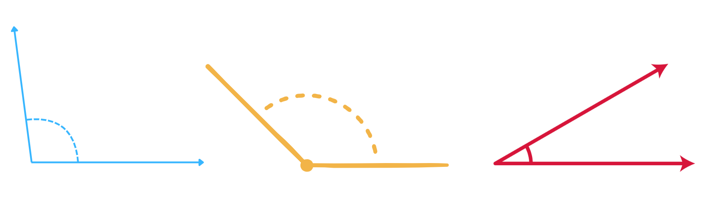
Short response (27)
Describe these angles using the terms:
less than a right angle
about the same as a right angle
greater than a right angle
A
B
C
Notes:
Short response questions provide brisk paced questions focussing on review of current and previous content to support spaced and interleaved practice.
Syllabus focus area:
Geometric Measure B: Angles

Slide 51

Short response (28)
On an analog clock, the number 3 shows two different values.
What are the two values?
Explain how you know.
Notes:
Short response questions provide brisk paced questions focussing on review of current and previous content to support spaced and interleaved practice.
Syllabus focus area:
Non-spatial measure A: Time

Slide 52
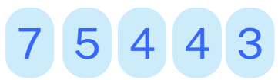
Activity 7– arranging digits place value
Notes:
This is a developing number sense activity.
Number sense refers to a deep understanding of numbers, including their magnitude, relationships, and the effects of operations on them. It supports fluency and understanding, estimation, flexible thinking, and efficient problem-solving. Number sense activities 1–4 ‘activate’ prior number knowledge and support the learning of new content in the unit. Number sense activities 5–8 ‘loop’ back and provide opportunity for spaced practice with concepts and procedures covered in previous units.
Syllabus focus area:
Representing numbers using place value B
Activity title
This resource corresponds to Resource X – ?? in Stage X Year A/B Unit X.
Divide students into small groups of 3 or 4 and provide a deck of number cards (0-9), a whiteboard and markers.
Shuffle the deck of number cards and place them face down in the centre of the group.
Set a timer for 10 minutes for the entire activity.
Each player takes turns drawing a card from the deck and placing it face up in front of them.
After drawing a card, the player must decide where to place the digit in a number they are creating, with the goal of making the highest possible number up to tens of thousands.
Players can place a digit in one of the following positions: ten-thousands, thousands, hundreds, tens, or ones. Once placed, it cannot be moved.
If a player draws a zero, they must strategically decide where to place it, considering its role in the number.
Continue drawing and placing cards until each player has filled all five positions of their number.
Once all positions are filled, players reveal their numbers to the group.
The player with the highest number wins that round.

Slide 53
Review of learning 8

Slide 54

True or false (4)
This array shows 2 sixes, which is the same as 6 twos.
True | False
Notes:
The question on this slide connects to the content being explored in the developing number sense activity (Activity 8)
Syllabus focus area:
Multiplicative Relations A

Slide 55

Short response (29)
What is the commutative law?
How many facts can you record about this array using your knowledge of commutativity?
Notes:
Short response questions provide brisk paced questions focussing on review of current and previous content to support spaced and interleaved practice.
Syllabus focus area:
Multiplicative relations A

Slide 56
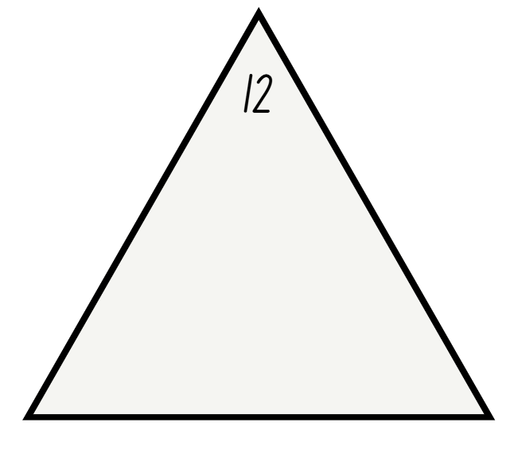
Short response (30)
Complete the fact family triangle and record number sentences to match.
Notes:
Short response questions provide brisk paced questions focussing on review of current and previous content to support spaced and interleaved practice.
Syllabus focus area:
Multiplicative relations A

Slide 57
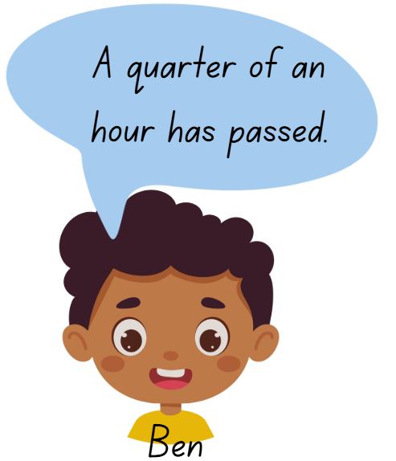
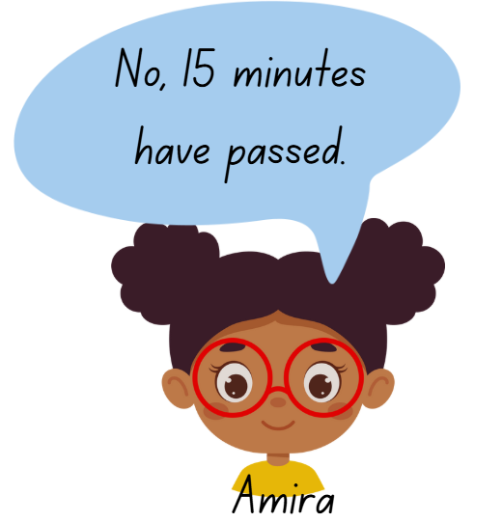
Short response (31)
Explain why both Amira and Ben are correct.
Notes:
Short response questions provide brisk paced questions focussing on review of current and previous content to support spaced and interleaved practice.
Syllabus focus area:
Non-spatial measure A: Time

Slide 58
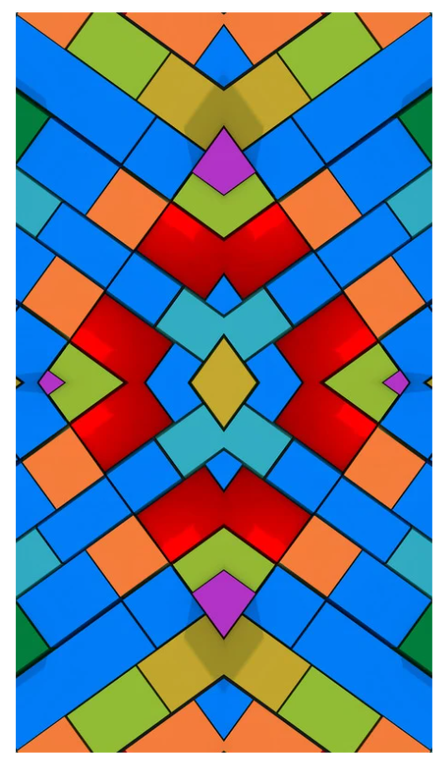
Short response (32)
Look carefully at this design.
Describe the lines of symmetry you can see.
Explain how you know.
Notes:
Short response questions provide brisk paced questions focussing on review of current and previous content to support spaced and interleaved practice.
Syllabus focus area:
Two-dimensional spatial structure A: 2D shape

Slide 59
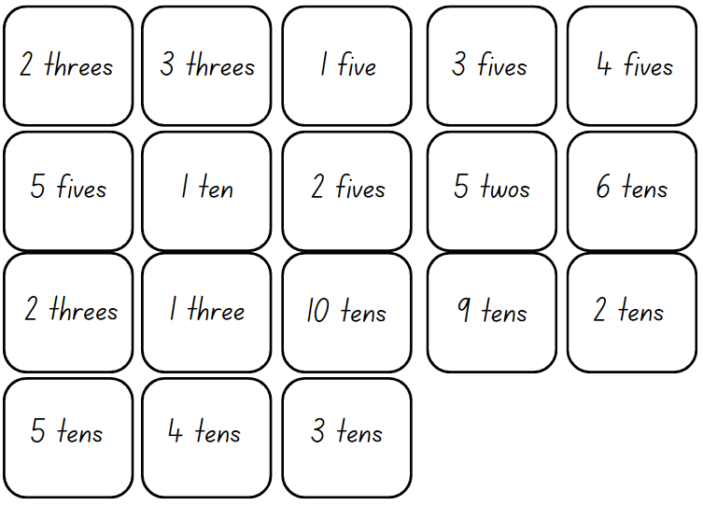
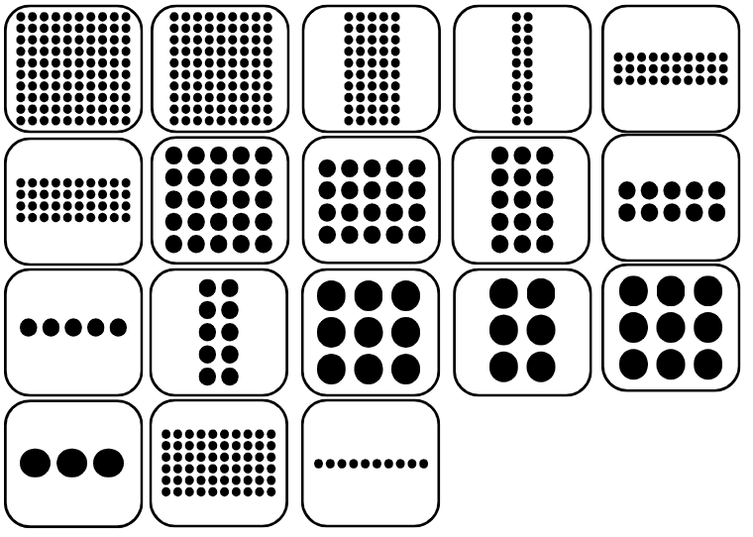
Activity 8 – array bingo
Notes:
This is a developing number sense activity.
Number sense refers to a deep understanding of numbers, including their magnitude, relationships, and the effects of operations on them. It supports fluency and understanding, estimation, flexible thinking, and efficient problem-solving. Number sense activities 1–4 ‘activate’ prior number knowledge and support the learning of new content in the unit. Number sense activities 5–8 ‘loop’ back and provide opportunity for spaced practice with concepts and procedures covered in previous units.
Syllabus focus area:
Multiplicative Relations A
Activity title
This resource corresponds to Resource 23 – array bingo cards and Resource 24 – array descriptor cards in Stage 2 Year B Unit 21.
Give pairs of students Resource 23 – array bingo cards and Resource 24 – array descriptor cards.
Each player creates a gameboard using 6 dotted array cards, setting aside any remaining array cards.
Students place the descriptor cards in a pile facing down.
Players take turns to pick up a descriptor card and check if they have the matching array card. If they do, they can turn the array card face down. If both players have the matching array card, they can both turn their matching array card face down.
Students can use the commutative property to rotate and rename the arrays. For example, 3 twos can be rotated to show 2 threes.
If neither player has the matching array card, turn over the next descriptor card in the pile.
The winner is the first player to turn all their array cards face down and say ‘Bingo!’

Slide 60
Double Venn diagram
Object 1
Object 2
Features similar to both objects
Features of object 1
Features of object 2

Slide 61
Frayer
Definition
Facts/Characteristics
Word, term, concept
Examples
Non-examples

Slide 62
Spider map
Idea
Subject

Slide 63
Cline
Concept 1
Concept 2
Word
Word
Word
Word
Word
Word
Word
Word
Word
Word
Word

Slide 64

Compare and contrast
Notes:
Use the arrows to navigate between related activities.
Hyperlink each arrow to compare between related slides.

Slide 65
Multiple choice
A
B
C
D
Notes:
This question connects to the content in the developing number sense activity (Activity 1)
This question can:
support spaced and interleaved practice
help identify and address common misconceptions
support active recall and immediate feedback
support whole class participation
identify areas requiring reteach
Teachers are encouraged to adapt and contextualise for their contexts.

Slide 66
Multiple choice
A
B
C
D
Notes:
This question connects to the content in the developing number sense activity (Activity 1)
Syllabus focus area:
Multiplicative relations A
This question can:
support spaced and interleaved practice
help identify and address common misconceptions
support active recall and immediate feedback
support whole class participation
identify areas requiring reteach
Teachers are encouraged to adapt and contextualise for their contexts.

Slide 67
References 2
This presentation contains NSW Curriculum and syllabus content. The NSW Curriculum is developed by the NSW Education Standards Authority. This content is prepared by NESA for and on behalf of the Crown in the right of the State of New South Wales. The material is protected by Crown copyright.
Please refer to the NESA Copyright Disclaimer for more information https://educationstandards.nsw.edu.au/wps/portal/nesa/mini-footer/copyright.
NESA holds the only official and up-to-date versions of the NSW Curriculum and syllabus documents. Please visit the NSW Education Standards Authority (NESA) website https://educationstandards.nsw.edu.au/wps/portal/nesa/home and the NSW Curriculum website https://curriculum.nsw.edu.au.
Mathematics K-10 Syllabus © Syllabus NSW Education Standards Authority (NESA) for and on behalf of the Crown in right of the State of New South Wales, 2022.
Boaler J, Munson J and Williams C (2017) Mindset Mathematics: Visualizing and Investigating Big Ideas, Grade 4, Jossey-Bass, San Francisco.
Burkhart J (2015–2023) Deep Math Projects, 5280 MATH website, accessed 9 August 2024.
Frykholm J (2010) Learning to Think Mathematically with the Number Line: A Resource for Teachers, A Tool for Young Children [PDF 1.07MB], The Math Learning Center, accessed 9 August 2024.
New Zealand Ministry of Education (n.d.) ‘Missing Number Bingo’, Resource Finder, NZ Maths, accessed 9 August 2024.
State of New South Wales (Department of Education) (2023) ‘Hit it (3-digit numbers)’, Mathematics K-6 resources, NSW Department of Education website, accessed July 2024.

Slide 68
References 3
This presentation contains NSW Curriculum and syllabus content. The NSW Curriculum is developed by the NSW Education Standards Authority. This content is prepared by NESA for and on behalf of the Crown in the right of the State of New South Wales. The material is protected by Crown copyright.
Please refer to the NESA Copyright Disclaimer for more information https://educationstandards.nsw.edu.au/wps/portal/nesa/mini-footer/copyright.
NESA holds the only official and up-to-date versions of the NSW Curriculum and syllabus documents. Please visit the NSW Education Standards Authority (NESA) website https://educationstandards.nsw.edu.au/wps/portal/nesa/home and the NSW Curriculum website https://curriculum.nsw.edu.au.
State of New South Wales (Department of Education) (2023) ‘Place value game’, Mathematics K-6 resources, NSW Department of Education website, accessed July 2024.
State of New South Wales (Department of Education) (2023) 'Array bingo’, Mathematics K-6 resources, NSW Department of Education website, accessed July 2024.
The Maths Learning Centre (2026), 'CenterLoops and Groups', Maths learning center website, accessed 20 June 2025.
University of Cambridge (Faculty of Mathematics) (n.d.) Multiply Multiples 3, NRICH website, accessed 9 August 2024.

Slide 69
Copyright
© State of New South Wales (Department of Education), 2025
The copyright material published in this resource is subject to the Copyright Act 1968 (Cth) and is owned by the NSW Department of Education or, where indicated, by a party other than the NSW Department of Education (third-party material).
Copyright material available in this resource and owned by the NSW Department of Education is licensed under a Creative Commons Attribution 4.0 International (CC BY 4.0) license.
This license allows you to share and adapt the material for any purpose, even commercially.
Attribution should be given to © State of New South Wales (Department of Education), 2025.
Material in this resource not available under a Creative Commons license:
the NSW Department of Education logo, other logos and trademark-protected material
Material owned by a third party that has been reproduced with permission. You will need to obtain permission from the third party to reuse its material.
Links to third-party material and websites
Please note that the provided (reading/viewing material/list/links/texts) are a suggestion only and implies no endorsement, by the New South Wales Department of Education, of any author, publisher, or book title. School principals and teachers are best placed to assess the suitability of resources that would complement the curriculum and reflect the needs and interests of their students.
If you use the links provided in this document to access a third party’s website, you acknowledge that the terms of use, including licence terms set out on the third-party’s website apply to the use which may be made of the materials on that third-party website or where permitted by the Copyright Act 1968 (Cth). The department accepts no responsibility for content on third-party websites.

