Slide 1
Instructions for use
This resource is not a teaching and learning program. It should be used in conjunction with Stage 2 Year B Unit 22.
Classroom teachers are encouraged to add and adapt slides as required to meet the needs of their students.
Save a copy of the file to make changes to the slide deck. Go to File > Download a Copy (this downloads a copy to the computer to edit in the PowerPoint app).
To convert the PowerPoint to Google Slides:
  Upload the file into Google Drive and open it.
  Go to File > Save as Google Slides.
  (Note – conversion may cause formatting changes in the slides.)

Slide 2

Review of Learning
Mathematics Stage 2 – Unit 22
Notes:
Reviews may include a combination of question types, requiring students to recall facts and key ideas, as well as apply their knowledge to solve problems and answer questions. To support active engagement, a mix of techniques should be employed.” (AERO, 2024).
This Review of Learning slide deck revisits key concepts from the following units:
Stage 2 Year B Unit 22
Stage 2 Year B Unit 21
Stage 2 Year A Unit 20
It also includes opportunities to review prior learning in non-number content, supporting consolidation across focus areas.
The review of learning resources include three key task types that support the development of mathematical proficiency through retrieval, spaced practice, and active participation. These practices complement the review phase (activating prior knowledge) embedded within the beginning of each lesson.
1.
Multiple-choice questions/True or false: Designed to promote active retrieval of key concepts and identify common misconceptions in number, supporting consolidation, understanding and fluency.
These questions:
support spaced and interleaved practice
help identify and address common misconceptions
support active recall and immediate feedback
support whole class participation
identify areas requiring reteach
2.
Short-response question sets: Carefully grouped questions that encourage spaced and interleaved practice across multiple focus areas, helping students revisit and apply knowledge from different points in time.
These questions:
have a combination of question types
address a range of focus areas
build automaticity and fluency
support active recall
allow for immediate feedback
identify content requiring reteach
3.
Developing number sense activities: A variety of practical, purposeful tasks that reinforce current learning and build on prior knowledge. These activities promote reasoning, problem-solving and conceptual understanding.
The review of learning resources are designed to work support teaching and learning in mathematics. For the most effective implementation, use the resources flexibly, adapting to meet student learning needs and individual classroom contexts.

Slide 3
Lessons
1
Review of learning 1
5
Review of learning 5
2
Review of learning 2
6
Review of learning 6
3
Review of learning 3
7
Review of learning 7
4
Review of learning 4
8
Review of learning 8
Notes:
Teacher notes:
Click lesson numbers to go to specific lessons
Interactive features can be viewed in slide show

Slide 4
Review of learning 1

Slide 5

Multiple choice (1)
Complete the number sentence.
+ 26 = 16 + 23
A
12
B
16
C
13
D
10
Notes:
This question connects to the content in the developing number sense activity (Activity 1)
Syllabus focus area:
Additive relations A

Slide 6

Short response (1)
Record the quantity value of each digit in 543.
Notes:
Short response questions provide brisk paced questions focussing on review of current and previous content to support spaced and interleaved practice.
Syllabus focus area:
Additive relations B

Slide 7
Short response (2)
Order these numbers from smallest to largest.
3847 2091 3487 2901 1078
Notes:
Short response questions provide brisk paced questions focussing on review of current and previous content to support spaced and interleaved practice.
Syllabus focus area:
Representing numbers using place value A: Whole numbers

Slide 8
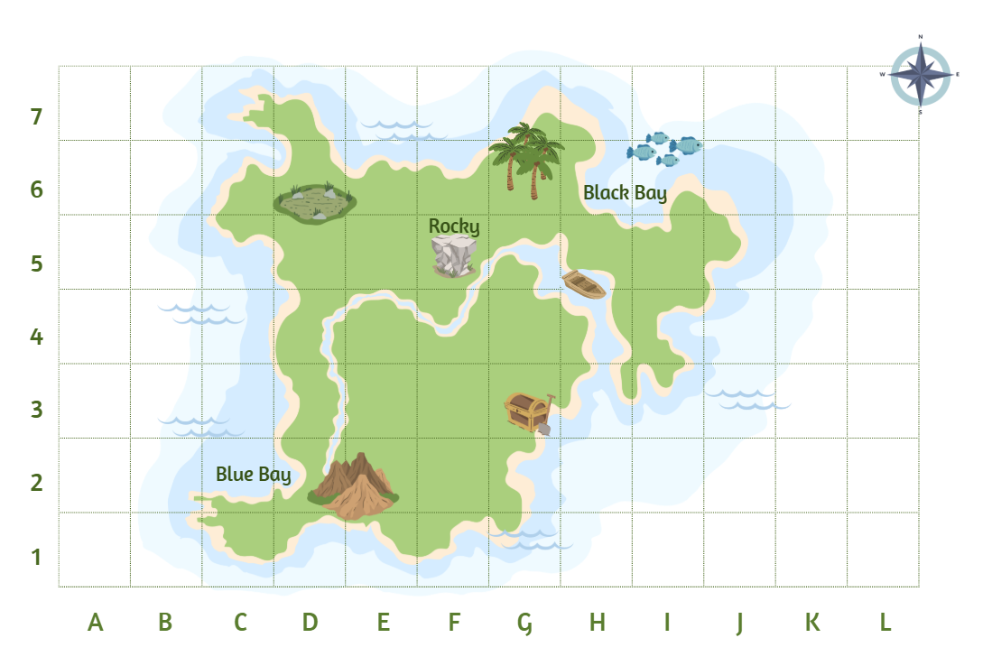
Short response (3)
Record the coordinates for the location of the treasure icon.
Notes:
Short response questions provide brisk paced questions focussing on review of current and previous content to support spaced and interleaved practice.
Syllabus focus area:
Geometric measure A: Position

Slide 9
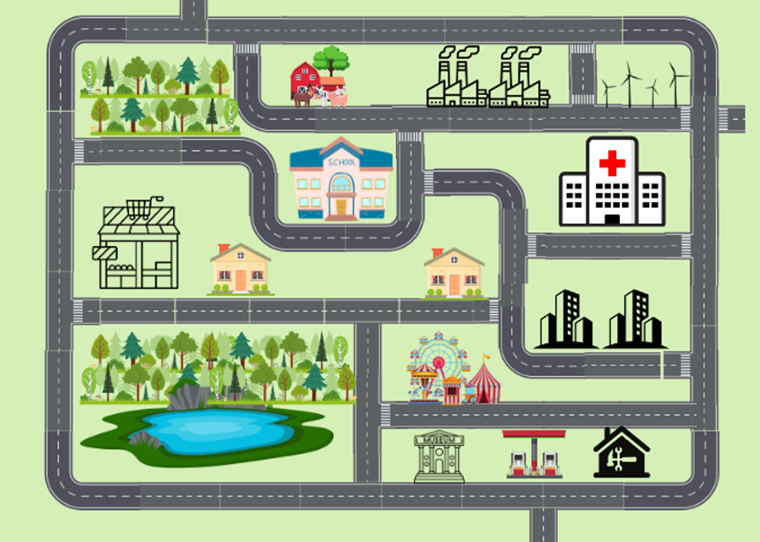
Short response (4)
Record the directions to get from the ferris wheel to the hospital.
Notes:
Short response questions provide brisk paced questions focussing on review of current and previous content to support spaced and interleaved practice.
Syllabus focus area:
Geometric measure A: Position

Slide 10

Activity 1 – equality (1)
24 + 11 = 23 + 12
Notes:
This is a developing number sense activity.
Number sense refers to a deep understanding of numbers, including their magnitude, relationships, and the effects of operations on them. It supports fluency and understanding, estimation, flexible thinking, and efficient problem-solving. Number sense activities 1–4 ‘activate’ prior number knowledge and support the learning of new content in the unit. Number sense activities 5–8 ‘loop’ back and provide opportunity for spaced practice with concepts and procedures covered in previous units.
Syllabus focus area:
Additive relations A
Activity 1 – Equality
Display the number sentence 24 + 11 = 23 + 12 and ask the students if the statement is correct and have them explain their thinking.
Display Resource 15 – solve it cards. Students individually solve the cards in their workbooks.
In pairs, students share their answers and justify their responses.
Regroup and ask students how they would explain the concept of equality to someone who is just beginning to learn about number sentences and the equals sign.

Slide 11
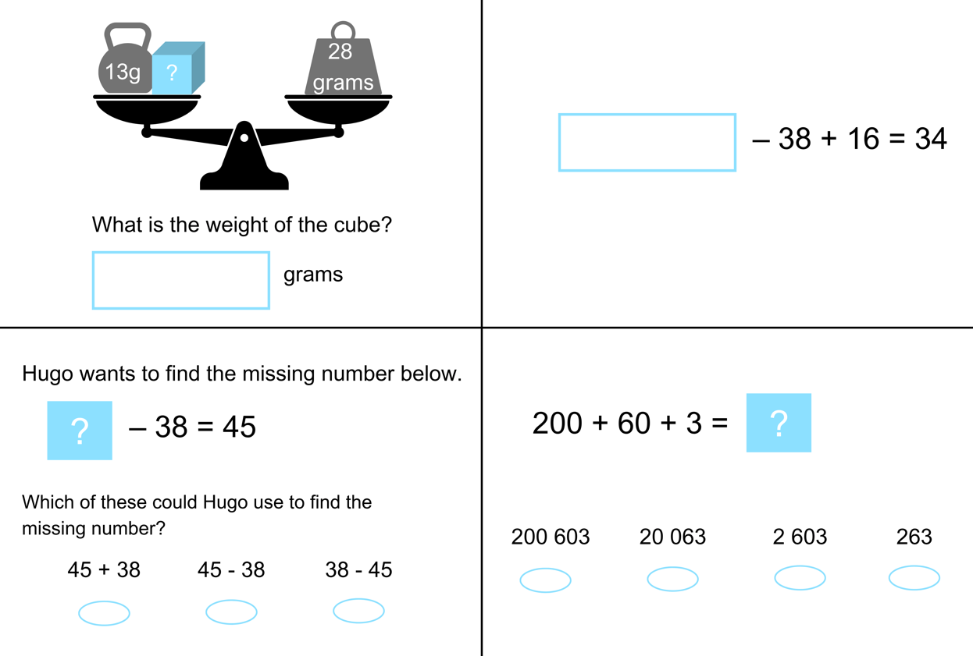
Activity 1 – equality (2)(1)
Notes:
Activity 1–equality continued
This resource corresponds to Resource 15 – solve it cards in Stage 2 Year B Unit 22.

Slide 12
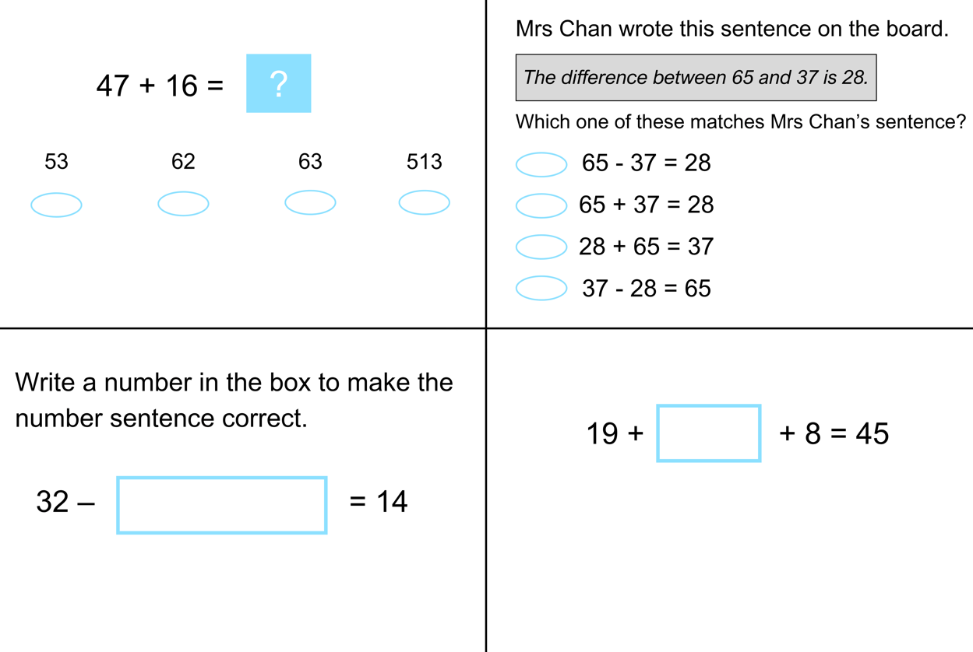
Activity 1 – equality (3)(2)
Notes:
Activity 1–equality continued
This resource corresponds to Resource 15 – solve it cards in Stage 2 Year B Unit 22.

Slide 13
Review of learning 2

Slide 14
True or false (1)
32 + 18 = 35 + 14
True | False
Notes:
The question on this slide connects to the content being explored in the developing number sense activity (Activity 2)
Syllabus focus area:
Additive relations A

Slide 15
Short response (5)
Use regrouping to solve 473 + 37.
Communicate your thinking.
Notes:
Short response questions provide brisk paced questions focussing on review of current and previous content to support spaced and interleaved practice.
Syllabus focus area:
Additive relations B

Slide 16
Short response (6)
Complete these sentences.
Ascending order means ….
Descending order means ….
Notes:
Short response questions provide brisk paced questions focussing on review of current and previous content to support spaced and interleaved practice.
Syllabus focus area:
Representing numbers using place value B: Whole numbers

Slide 17
Short response (7)
What is located at G6 and F5?
Notes:
Short response questions provide brisk paced questions focussing on review of current and previous content to support spaced and interleaved practice.
Syllabus focus area:
Geometric measure A: Position

Slide 18
Short response (8)
Record the numbers that complete the sentences.
There are _____ millimetres in 1 centimetre.
There are _____ millimetres in 2 centimetres.
There are _____ millimetres in 6 centimetres.
Notes:
Short response questions provide brisk paced questions focussing on review of current and previous content to support spaced and interleaved practice.
Syllabus focus area:
Geometric Measure A: Length

Slide 19
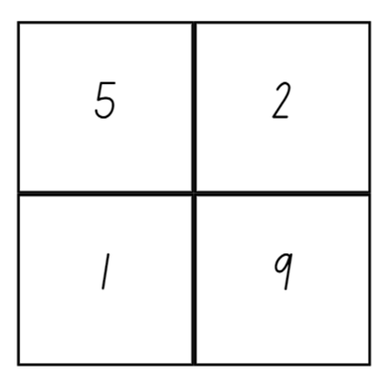
Activity 2 – equivalence
This gives four 2-digit numbers:
52 (reading along the 1st row)
19 (reading along the 2nd row)
51 (reading down the left hand column)
29 (reading down the right hand column)
In this case their sum is 151.
Notes:
This is a developing number sense activity.
Number sense refers to a deep understanding of numbers, including their magnitude, relationships, and the effects of operations on them. It supports fluency and understanding, estimation, flexible thinking, and efficient problem-solving. Number sense activities 1–4 ‘activate’ prior number knowledge and support the learning of new content in the unit. Number sense activities 5–8 ‘loop’ back and provide opportunity for spaced practice with concepts and procedures covered in previous units.
Syllabus focus area:
Additive relations A
Activity 2 – equivalence
This activity is an adaptation of Reach 100 from NRICH by University of Cambridge (Faculty of Mathematics).
Students draw a square and divide it into quarters. They choose 4 different digits from one to 9 and put them in each box. The aim is to find 4 different digits that give four 2-digit numbers which add or balance to a total of 100.
Explain that using associative property of addition to form multiples of 10 is a useful strategy. For example, 52 + 19 + 51 + 29 = 51 + 19 + 52 + 29. Explain that using place value understanding flexibly makes it is easier to solve 51 +19 = 70 and then add on 52 + 29.
Associative law: when more than 2 numbers are added or multiplied, the result is unchanged regardless of how they are grouped or associated. For example, 22 + 13 + 8 = 22 + 8 + 13 = 30 + 13 = 43.
In pairs, students try to solve the challenge and record all the solutions they can find on a whiteboard.
Regroup as a class and discuss the different strategies students used to find balancing equations to 100.

Slide 20
Review of learning 3

Slide 21
Multiple choice (2)
32 + 7 and 22 + 17
are both equivalent to…
A
39
B
46
C
37
D
49
Notes:
This question connects to the content in the developing number sense activity (Activity 3)
Syllabus focus area:
Additive relations A

Slide 22
Short response (9)
Use regrouping to solve 284 - 76.
Communicate your thinking.
Notes:
Short response questions provide brisk paced questions focussing on review of current and previous content to support spaced and interleaved practice.
Syllabus focus area:
Additive relations B

Slide 23
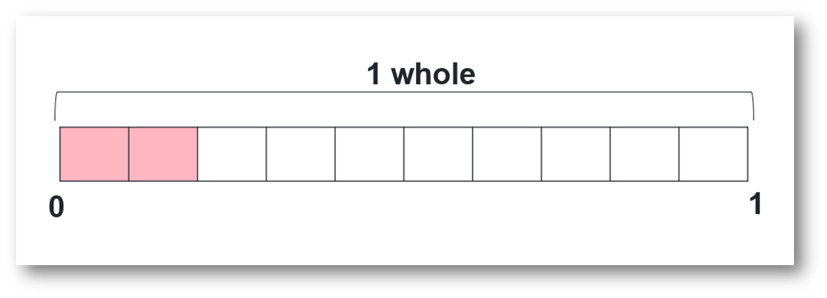
Short response (10)
How many tenths have been shaded pink?
Record using decimal notation.
Notes:
Short response questions provide brisk paced questions focussing on review of current and previous content to support spaced and interleaved practice.
Syllabus focus area:
Representing numbers using place value B: Decimals

Slide 24
Short response (11)
Record 3 different ways $4 can be made using a combination of gold and silver coins.
Notes:
Short response questions provide brisk paced questions focussing on review of current and previous content to support spaced and interleaved practice.
Syllabus focus area:
Additive relations A

Slide 25
Short response (12)
A jar contains different coloured jellybeans red, blue, orange, green and yellow.
Clara randomly picks 1 jellybean.
Record all possible outcomes.
Notes:
Short response questions provide brisk paced questions focussing on review of current and previous content to support spaced and interleaved practice.
Syllabus focus area:
Chance A

Slide 26
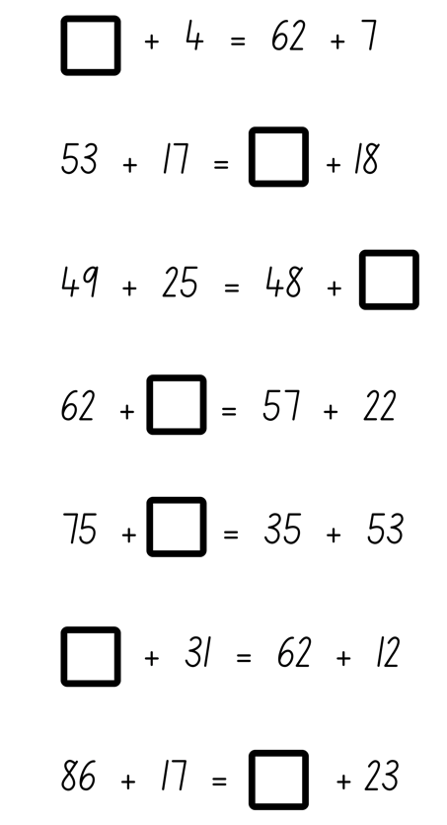
Activity 3 – finding the missing numbers addition
Notes:
This is a developing number sense activity.
Number sense refers to a deep understanding of numbers, including their magnitude, relationships, and the effects of operations on them. It supports fluency and understanding, estimation, flexible thinking, and efficient problem-solving. Number sense activities 1–4 ‘activate’ prior number knowledge and support the learning of new content in the unit. Number sense activities 5–8 ‘loop’ back and provide opportunity for spaced practice with concepts and procedures covered in previous units.
Syllabus focus area:
Additive relations A
Activity 3 – finding the missing numbers addition
This resource corresponds to Resource 16 – finding the missing numbers addition in Stage 2 Year B Unit 22.
Display Resource 16 – finding the missing numbers addition.
Explain to students they will be finding the missing numbers in each problem.
In pairs students solve and record the addition number sentences on whiteboards.
Regroup as a class and ask:
What does it mean for the differences to be equal?
What strategies did you use to solve the problems?
Did you use subtraction to help solve any of the number sentences?

Slide 27
Review of learning 4

Slide 28
True or false (2)
20 - 13 = 17 - 10
True | False
Notes:
The question on this slide connects to the content being explored in the developing number sense activity (Activity 4)
Syllabus focus area:
Additive relations A

Slide 29
Short response (13)
Use partitioning and regrouping strategies to determine 2 numbers that combine to make 784.
Communicate your thinking.
Notes:
Short response questions provide brisk paced questions focussing on review of current and previous content to support spaced and interleaved practice.
Syllabus focus area:
Additive relations B

Slide 30
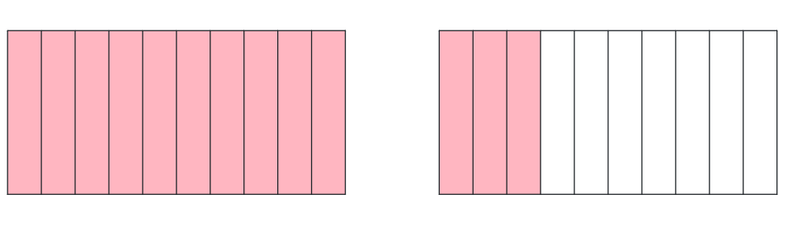
Short response (14)
Use decimal notation to record the decimal represented in the tenths mats.
Notes:
Short response questions provide brisk paced questions focussing on review of current and previous content to support spaced and interleaved practice.
Syllabus focus area:
Representing numbers using place value B: Decimals

Slide 31
Short response (15)
Complete the sentence.
6792 can be partitioned in non-standard form as…
Notes:
Short response questions provide brisk paced questions focussing on review of current and previous content to support spaced and interleaved practice.
Syllabus focus area:
Representing numbers using place value A: Whole numbers

Slide 32
Short response (16)
Record 3 different items that each have a mass of about 1 kilogram.
Notes:
Short response questions provide brisk paced questions focussing on review of current and previous content to support spaced and interleaved practice.
Syllabus focus area:
Non-spatial measure A: Mass

Slide 33
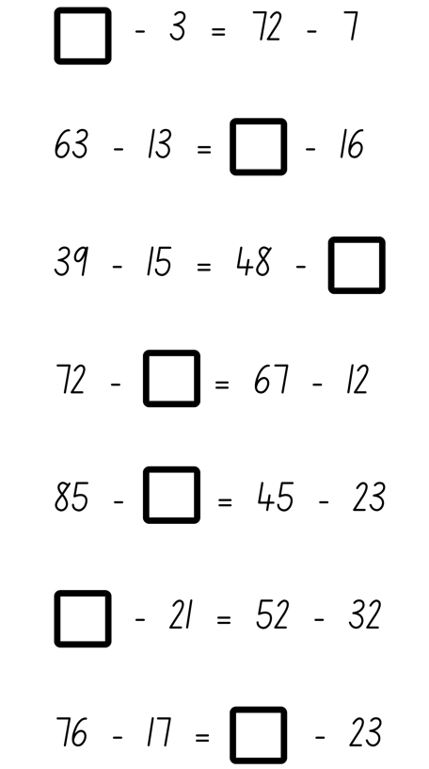
Activity 4 – finding the missing number subtraction
Notes:
This is a developing number sense activity.
Number sense refers to a deep understanding of numbers, including their magnitude, relationships, and the effects of operations on them. It supports fluency and understanding, estimation, flexible thinking, and efficient problem-solving. Number sense activities 1–4 ‘activate’ prior number knowledge and support the learning of new content in the unit. Number sense activities 5–8 ‘loop’ back and provide opportunity for spaced practice with concepts and procedures covered in previous units.
Syllabus focus area:
Additive relations A
Activity 4 – finding the missing number subtraction
This resource corresponds to Resource 17 – finding the missing numbers subtraction in Stage 2 Year A Unit 22.
Display Resource 17 – finding the missing numbers subtraction.
Explain to students they will be finding the missing numbers in each problem.
In pairs students solve and record the subtraction number sentences on whiteboards.
Regroup as a class and ask:
What strategies did you use to solve the problems?
Did you use addition to help solve any of the number sentences?

Slide 34
Review of learning 5

Slide 35
Multiple choice (3)
1652 can be renamed as…
A
1000 + 600 + 500 + 20
B
160 + 50 + 2
C
1000 + 6000 + 50 + 2
D
1000 + 600 + 50 +2
Notes:
This question connects to the content in the developing number sense activity (Activity 5)
Syllabus focus area:
Representing numbers using place value A: Whole numbers

Slide 36
Short response (17)
The school library has 562. If 337 were borrowed, how many books were left in the library?
Record your thinking using a bar model.
Notes:
Short response questions provide brisk paced questions focussing on review of current and previous content to support spaced and interleaved practice.
Syllabus focus area:
Additive relations A

Slide 37
Short response (18)
Conrad said that 0.6 and 0.60
represent different values.
Is Conrad correct?
Communicate your reasoning.
Notes:
Short response questions provide brisk paced questions focussing on review of current and previous content to support spaced and interleaved practice.
Syllabus focus area:
Representing numbers using place value B: Decimals

Slide 38
Short response (19)
Which strategy would be most efficient to use when solving
146 – 88?
Communicate your reasoning.
Notes:
Short response questions provide brisk paced questions focussing on review of current and previous content to support spaced and interleaved practice.
Syllabus focus area:
Additive relations A

Slide 39
Short response (20)
Record the following in litres and millilitres.
1500 mL
2700 mL
1450 mL
Notes:
Short response questions provide brisk paced questions focussing on review of current and previous content to support spaced and interleaved practice.
Syllabus focus area:
Three-dimensional spatial structure B: Volume

Slide 40
Activity 5 – how many way?
How many ways can you rename this number?
1265
Notes:
This is a developing number sense activity.
Number sense refers to a deep understanding of numbers, including their magnitude, relationships, and the effects of operations on them. It supports fluency and understanding, estimation, flexible thinking, and efficient problem-solving. Number sense activities 1–4 ‘activate’ prior number knowledge and support the learning of new content in the unit. Number sense activities 5–8 ‘loop’ back and provide opportunity for spaced practice with concepts and procedures covered in previous units.
Syllabus focus area:
Representing numbers using place value A
Activity 5 – how many way?
This activity is an adaptation of ‘Place value tasks’ from Open-ended maths activities by Sullivan and Lilburn.
Provide students with an whiteboard and ask how many ways they can rename 1265.
Students record responses using thousands, hundreds, tens and ones, for example, 1000 + 200 + 60 + 5, 1000 + 100 + 150 + 15 and so on.
After giving students time to respond, provide students with MAB materials to test out the conjectures and swap the MAB materials to make the number.
Regroup as a class and ask:
What strategies did you use to answer the question, and how effective were they?
How does understanding standard form assist in performing mathematical operations?

Slide 41
Review of learning 6

Slide 42
True or false (3)
145 can be renamed as
13 tens and 15 ones
True | False
Notes:
The question on this slide connects to the content being explored in the developing number sense activity (Activity 6)
Syllabus focus area:
Representing numbers using place value A: Whole numbers

Slide 43
Short response (21)
Selina used a vertical algorithm to solve 247 + 328. Her teacher asked her to explain what the
1 meant in her recording.
What could Selina say?
Communicate your reasoning.
2 4 7
+ 3 2 8
5 7 8
1
Notes:
Short response questions provide brisk paced questions focussing on review of current and previous content to support spaced and interleaved practice.
Syllabus focus area:
Additive relations B

Slide 44
Short response (22)
Which decimal does not belong?
0.70 7.0 0.7
Communicate your reasoning.
Notes:
Short response questions provide brisk paced questions focussing on review of current and previous content to support spaced and interleaved practice.
Syllabus focus area:
Representing numbers using place value B: Decimals

Slide 45
Short response (23)
Use the associative property to form multiples of 10 to solve this addition equation:
23 + 12 + 7 =
Notes:
Short response questions provide brisk paced questions focussing on review of current and previous content to support spaced and interleaved practice.
Syllabus focus area:
Additive relations A

Slide 46

Short response (24)
Estimate the area of a regular-sized sticky note using square centimetres.
Communicate your reasoning.
Notes:
Short response questions provide brisk paced questions focussing on review of current and previous content to support spaced and interleaved practice.
Syllabus focus area:
Two-dimensional spatial structure A: Area

Slide 47
Activity 6 – two truths and a lie (1)
Read each statement and then test using MAB materials
to identify which are the truths and which is the lie.
The number…
a. 32 can be represented with 5 MAB materials.
b. 68 can be represented with 41 MAB materials.
c.145 can be represented with 25 MAB materials.
Notes:
This is a developing number sense activity.
Number sense refers to a deep understanding of numbers, including their magnitude, relationships, and the effects of operations on them. It supports fluency and understanding, estimation, flexible thinking, and efficient problem-solving. Number sense activities 1–4 ‘activate’ prior number knowledge and support the learning of new content in the unit. Number sense activities 5–8 ‘loop’ back and provide opportunity for spaced practice with concepts and procedures covered in previous units.
Syllabus focus area:
Representing numbers using place value A
Activity 6 – two truths and a lie
This resource corresponds to Resource 18 and resource 19 in Stage 2 Year B Unit 22.
Display the following statements that are 2 truths and a lie.
Display Resource 18 – what is my number? 1.
32 can be represented with 5 MAB materials.
68 can be represented with 41 MAB materials.
145 can be represented with 25 MAB materials.
Students read each statement and then test using MAB materials to identify which are the truths or the lie.
Provide small groups of students with one copy of Resource 19 – what is my number? 2 and MAB materials. Students test each statement and record the representation of MAB materials on Resource 19 – what is my number? 2
Students work together to identify which statement is the lie by proving the accuracy of all 3 statements.
Regroup as a class and ask:
How did you decide which MAB materials to choose for each statement?
Were there any statements that were particularly challenging to determine as truth or lie? Why?
Did you rely on any specific strategies to make your choices?

Slide 48
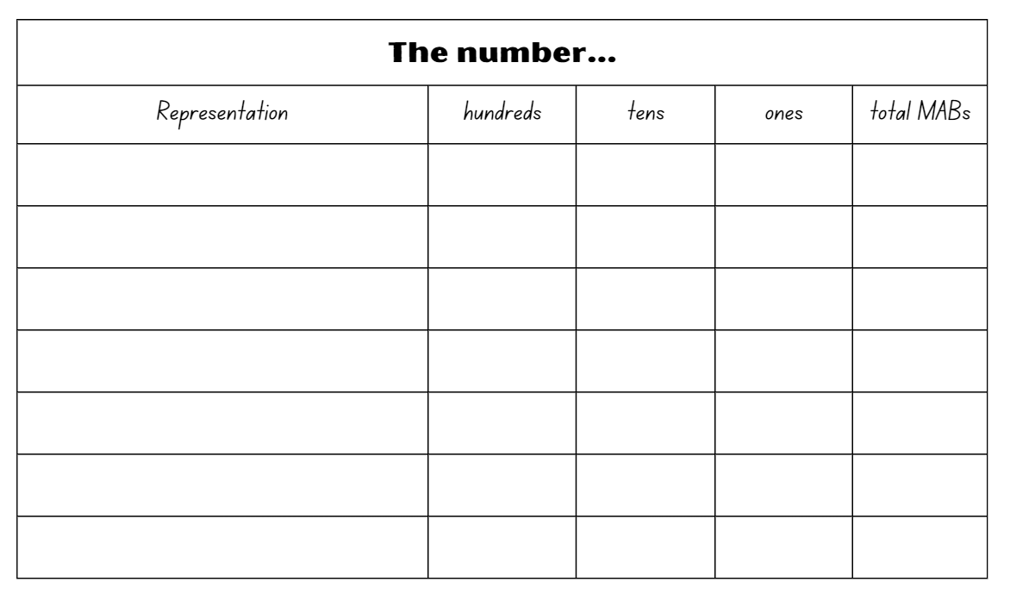
Activity 6 – two truths and a lie (2)
Notes:
Activity 6 – two truths and a lie continued
This resource corresponds to Resource – 19 in Stage 2 Year B Unit 22.

Slide 49
Review of learning 7

Slide 50
Multiple choice (4)
2000 + 400 + 20 + 6
and
24 hundred + 26 ones
are both representations of ….
A
2426
B
2406
C
2026
D
246
Notes:
This question connects to the content in the developing number sense activity (Activity 7)
Syllabus focus area:
Representing numbers using place value A: Whole numbers

Slide 51
Short response (25)
Evie used a vertical algorithm to solve 699 – 96.
Is this the most efficient strategy she could have used?
Communicate your reasoning.
6 9 9
- 9 6
6 0 3
Notes:
Short response questions provide brisk paced questions focussing on review of current and previous content to support spaced and interleaved practice.
Syllabus focus area:
Additive relations B

Slide 52
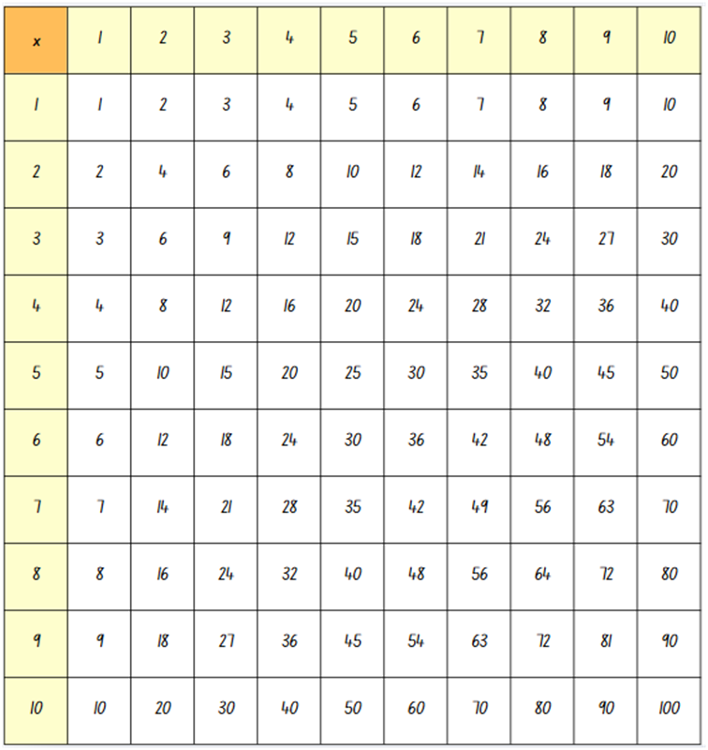
Short response (26)
Multiples of 2, 4, and 8 are highlighted in pink on the multiplication chart. Describe the relationship between these multiples.
Notes:
Short response questions provide brisk paced questions focussing on review of current and previous content to support spaced and interleaved practice.
Syllabus focus area:
Multiplicative relations B

Slide 53
Short response (27)
Solve 72 – 59 using the most efficient strategy.
Communicate your reasoning.
Notes:
Short response questions provide brisk paced questions focussing on review of current and previous content to support spaced and interleaved practice.
Syllabus focus area:
Additive relations A

Slide 54
Short response (28)
Complete the sentences.
A quarter-hour is equal to ____ minutes.
A half-hour is equal to ____ minutes.
An hour is equal to ____ minutes.
Notes:
Short response questions provide brisk paced questions focussing on review of current and previous content to support spaced and interleaved practice.
Syllabus focus area:
Non-spatial measure A: Time

Slide 55
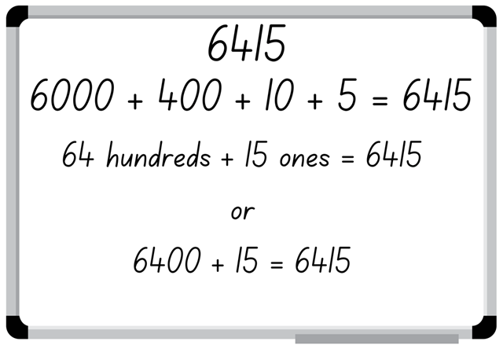
Activity 7 – partitioning
Notes:
This is a developing number sense activity.
Number sense refers to a deep understanding of numbers, including their magnitude, relationships, and the effects of operations on them. It supports fluency and understanding, estimation, flexible thinking, and efficient problem-solving. Number sense activities 1–4 ‘activate’ prior number knowledge and support the learning of new content in the unit. Number sense activities 5–8 ‘loop’ back and provide opportunity for spaced practice with concepts and procedures covered in previous units.
Syllabus focus area:
Representing numbers using place value A
Activity 7 – partitioning
In pairs students shuffle game cards numbered zero to 9 and place them face down in a stack.
Each player takes turns drawing 4 cards from the stack to form a 4-digit number.
Each player records the 4-digit number formed on their whiteboard, the standard place value form and a non-standard place value representation.
Each player swaps their whiteboard and checks their peer’s standard and non-standard representations.
If the representation is correct, the student gets a point.
Player 2 selects 4 cards to form a new 4-digit number and repeats the process.
Repeat the process for 5 rounds.
Regroup and ask students to identify the strategies they used and to justify their answers when identifying the place value in non-standard form.
Note: number expanders can assist students to understand place value and renaming numbers into non-standard forms.

Slide 56
Review of learning 8

Slide 57
True or false (4)
39 tens is ten less than 400.
True | False
Notes:
The question on this slide connects to the content being explored in the developing number sense activity (Activity 8)
Syllabus focus area:
Representing numbers using place value A: Whole numbers

Slide 58
Short response (29)
Evie solved 436 – 53 using a vertical algorithm. Use the table below to represent her thinking by drawing MAB materials.
4 3 6
- 5 3
3 8 3
 | H | T | 0
436
53
=
3
1
Notes:
Short response questions provide brisk paced questions focussing on review of current and previous content to support spaced and interleaved practice.
Syllabus focus area:
Additive relations B

Slide 59
Short response (30)
Draw an array that shows 4 x 5.
Record ways to describe your array.
Notes:
Short response questions provide brisk paced questions focussing on review of current and previous content to support spaced and interleaved practice.
Syllabus focus area:
Multiplicative relations A

Slide 60
Short response (31)
Record all multiplication and division facts from this array.
Notes:
Short response questions provide brisk paced questions focussing on review of current and previous content to support spaced and interleaved practice.
Syllabus focus area:
Multiplicative relations A

Slide 61
Short response (32)
List quadrilaterals that have all sides equal in length.
Notes:
Short response questions provide brisk paced questions focussing on review of current and previous content to support spaced and interleaved practice.
Syllabus focus area:
Two-dimensional spatial structure A: 2D shape

Slide 62
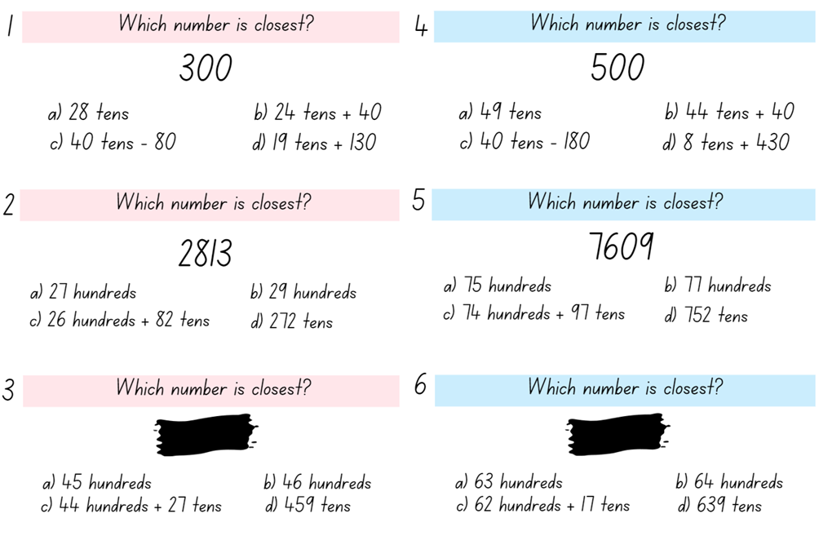
Activity 8 – which number is closest?
Notes:
This is a developing number sense activity.
Number sense refers to a deep understanding of numbers, including their magnitude, relationships, and the effects of operations on them. It supports fluency and understanding, estimation, flexible thinking, and efficient problem-solving. Number sense activities 1–4 ‘activate’ prior number knowledge and support the learning of new content in the unit. Number sense activities 5–8 ‘loop’ back and provide opportunity for spaced practice with concepts and procedures covered in previous units.
Syllabus focus area:
Representing numbers using place value A
Activity 8 – which number is closest?
This resource corresponds to Resource 20 – which number is closest? in Stage 2 Year B Unit 22.
This activity is an adaptation of As Close As It Gets from Maths is Figure-Out-Able! by Harris. Key ideas for Stage 2 place value are outlined in the syllabus teaching advice and in the professional learning module The role of place value from My Professional Learning by the NSW Department of Education.
Display Resource 20 – which number is closest?
Provide students with an individual whiteboard and ask which representation is the closest to 300 on card 1.
Students test using MAB materials to identify which non-standard form is closest to 300.
Students work together to identify which non-standard forms are closest to the target number on cards 2, 4 and 5.
Explain that for cards 3 and 6 they will need to find a suitable number to match the non-standard forms.
Regroup as a class and ask:
What strategies did you use to answer the questions, and how effective were they?
How does understanding non-standard form assist in performing mathematical operations?
For cards 3 and 6 how did you justify your answers when identifying the place value in non-standard form?

Slide 63
Double Venn diagram
Object 1
Object 2
Features similar to both objects
Features of object 1
Features of object 2

Slide 64
Frayer
Definition
Facts/Characteristics
Word, term, concept
Examples
Non-examples

Slide 65
Spider map
Idea
Subject

Slide 66
Cline
Concept 1
Concept 2
Word
Word
Word
Word
Word
Word
Word
Word
Word
Word
Word

Slide 67

Compare and contrast

Slide 68
Multiple choice (5)
A
B
C
D

Slide 69
Multiple choice (6)
A
B
C
D

Slide 70
References (1)
This presentation contains NSW Curriculum and syllabus content. The NSW Curriculum is developed by the NSW Education Standards Authority. This content is prepared by NESA for and on behalf of the Crown in the right of the State of New South Wales. The material is protected by Crown copyright.
Please refer to the NESA Copyright Disclaimer for more information https://educationstandards.nsw.edu.au/wps/portal/nesa/mini-footer/copyright.
NESA holds the only official and up-to-date versions of the NSW Curriculum and syllabus documents. Please visit the NSW Education Standards Authority (NESA) website https://educationstandards.nsw.edu.au/wps/portal/nesa/home and the NSW Curriculum website https://curriculum.nsw.edu.au.
[Mathematics K–10 Syllabus © NSW Education Standards Authority (NESA) for and on behalf of the Crown in right of the State of New South Wales, 2022.
National Numeracy Learning Progression © Australian Curriculum, Assessment and Reporting Authority (ACARA) 2010 to present, unless otherwise indicated. This material was downloaded from the Australian Curriculum website (National Numeracy Learning Progression) (accessed 28 August 2023) and was not modified.
ABC iview (2021) ‘Mini Lessons: Maths – Series 1 Episode 15 Years 3-4: Partitioning Numbers Using Efficient Strategies’, ABC iview, accessed 26 June 2023.
Australasian Problem-Solving Mathematical Olympiads (APSMO) (2022) Maths games [PDF 529 KB], APSMO website, accessed 26 June 2023.
Australasian Problem-Solving Mathematical Olympiads (APSMO) (2022) Maths explorer [PDF 530 KB], APSMO website, accessed 26 June 2023.
New Zealand Ministry of Education (n.d) Create 5000 [PDF 352 KB], NZ Maths website, accessed 26 June 2023.

Slide 71
References (2)
This presentation contains NSW Curriculum and syllabus content. The NSW Curriculum is developed by the NSW Education Standards Authority. This content is prepared by NESA for and on behalf of the Crown in the right of the State of New South Wales. The material is protected by Crown copyright.
Please refer to the NESA Copyright Disclaimer for more information https://educationstandards.nsw.edu.au/wps/portal/nesa/mini-footer/copyright.
NESA holds the only official and up-to-date versions of the NSW Curriculum and syllabus documents. Please visit the NSW Education Standards Authority (NESA) website https://educationstandards.nsw.edu.au/wps/portal/nesa/home and the NSW Curriculum website https://curriculum.nsw.edu.au.
New Zealand Ministry of Education (n.d) Problems to solve, NZ Maths website, accessed 26 June 2023.
State of New South Wales (Department of Education) (2023) Equivalent number sentences, Universal Resource Hub website, accessed 26 June 2023.
Sullivan P (2018) Challenging Mathematical Tasks: Unlocking the potential of all students, Oxford University Press, Australia and New Zealand.
Sullivan P and Lilburn P (2017) Open-Ended Maths Activities, 2nd edn, Oxford University Press, Australia and New Zealand.
University of Cambridge (Faculty of Mathematics) (2023) Reach 100, NRICH website, accessed 26 June 2023.

Slide 72
Copyright
© State of New South Wales (Department of Education), 2025
The copyright material published in this resource is subject to the Copyright Act 1968 (Cth) and is owned by the NSW Department of Education or, where indicated, by a party other than the NSW Department of Education (third-party material).
Copyright material available in this resource and owned by the NSW Department of Education is licensed under a Creative Commons Attribution 4.0 International (CC BY 4.0) license.
This license allows you to share and adapt the material for any purpose, even commercially.
Attribution should be given to © State of New South Wales (Department of Education), 2025.
Material in this resource not available under a Creative Commons license:
the NSW Department of Education logo, other logos and trademark-protected material
Material owned by a third party that has been reproduced with permission. You will need to obtain permission from the third party to reuse its material.
Links to third-party material and websites
Please note that the provided (reading/viewing material/list/links/texts) are a suggestion only and implies no endorsement, by the New South Wales Department of Education, of any author, publisher, or book title. School principals and teachers are best placed to assess the suitability of resources that would complement the curriculum and reflect the needs and interests of their students.
If you use the links provided in this document to access a third party’s website, you acknowledge that the terms of use, including licence terms set out on the third-party’s website apply to the use which may be made of the materials on that third-party website or where permitted by the Copyright Act 1968 (Cth). The department accepts no responsibility for content on third-party websites.

