Slide 1
Instructions for use
This resource is not a teaching and learning program. It should be used in conjunction with Stage 2 Year B Unit 23.
Classroom teachers are encouraged to add and adapt slides as required to meet the needs of their students.
Save a copy of the file to make changes to the slide deck. Go to File > Download a Copy (this downloads a copy to the computer to edit in the PowerPoint app).
To convert the PowerPoint to Google Slides:
  Upload the file into Google Drive and open it.
  Go to File > Save as Google Slides.
  (Note – conversion may cause formatting changes in the slides.)

Slide 2

Review of Learning
Mathematics Stage 2 – Unit 23
Notes:
Reviews may include a combination of question types, requiring students to recall facts and key ideas, as well as apply their knowledge to solve problems and answer questions. To support active engagement, a mix of techniques should be employed.” (AERO, 2024).
This Review of Learning slide deck revisits key concepts from the following units:
Stage 2 Year B Unit 23
Stage 2 Year B Unit 22
Stage 2 Year B Unit 21
It also includes opportunities to review prior learning in non-number content, supporting consolidation across focus areas.
The review of learning resources include three key task types that support the development of mathematical proficiency through retrieval, spaced practice, and active participation. These practices complement the review phase (activating prior knowledge) embedded within the beginning of each lesson.
1.
Multiple-choice questions/True or false: Designed to promote active retrieval of key concepts and identify common misconceptions in number, supporting consolidation, understanding and fluency.
These questions:
support spaced and interleaved practice
help identify and address common misconceptions
support active recall and immediate feedback
support whole class participation
identify areas requiring reteach
2.
Short-response question sets: Carefully grouped questions that encourage spaced and interleaved practice across multiple focus areas, helping students revisit and apply knowledge from different points in time.
These questions:
have a combination of question types
address a range of focus areas
build automaticity and fluency
support active recall
allow for immediate feedback
identify content requiring reteach
3.
Developing number sense activities: A variety of practical, purposeful tasks that reinforce current learning and build on prior knowledge. These activities promote reasoning, problem-solving and conceptual understanding.
The review of learning resources are designed to work support teaching and learning in mathematics. For the most effective implementation, use the resources flexibly, adapting to meet student learning needs and individual classroom contexts.

Slide 3
Lessons
1
Review of learning 1
5
Review of learning 5
2
Review of learning 2
6
Review of learning 6
3
Review of learning 3
7
Review of learning 7
4
Review of learning 4
8
Review of learning 8
Notes:
Teacher notes:
Click lesson numbers to go to specific lessons
Interactive features can be viewed in slide show

Slide 4
Review of learning 1

Slide 5

Multiple choice (1)
Which number is 10 times larger than 49?
A
4.9
B
49
C
490
D
4900
Notes:
This question connects to the content in the developing number sense activity (Activity 1)
Syllabus focus area:
Representing numbers using place value B

Slide 6

Short response (1)
What is an appropriate
tool to measure the
length of a pencil?
Communicate your reasoning.
Notes:
Short response questions provide brisk paced questions focussing on review of current and previous content to support spaced and interleaved practice.
Syllabus focus area:
Geometric measure A: Length

Slide 7
Short response (2)
Hunter has 158 bonsai trees for his market stall. He would like to have 320 bonsai trees.
Use a number line to show how many more bonsai trees Hunter needs for his stall.
Notes:
Short response questions provide brisk paced questions focussing on review of current and previous content to support spaced and interleaved practice.
Syllabus focus area:
Additive relations A

Slide 8
Short response (3)
Regroup
674
in two different ways.
Notes:
Short response questions provide brisk paced questions focussing on review of current and previous content to support spaced and interleaved practice.
Syllabus focus area:
Representing numbers using place value A: Whole numbers

Slide 9
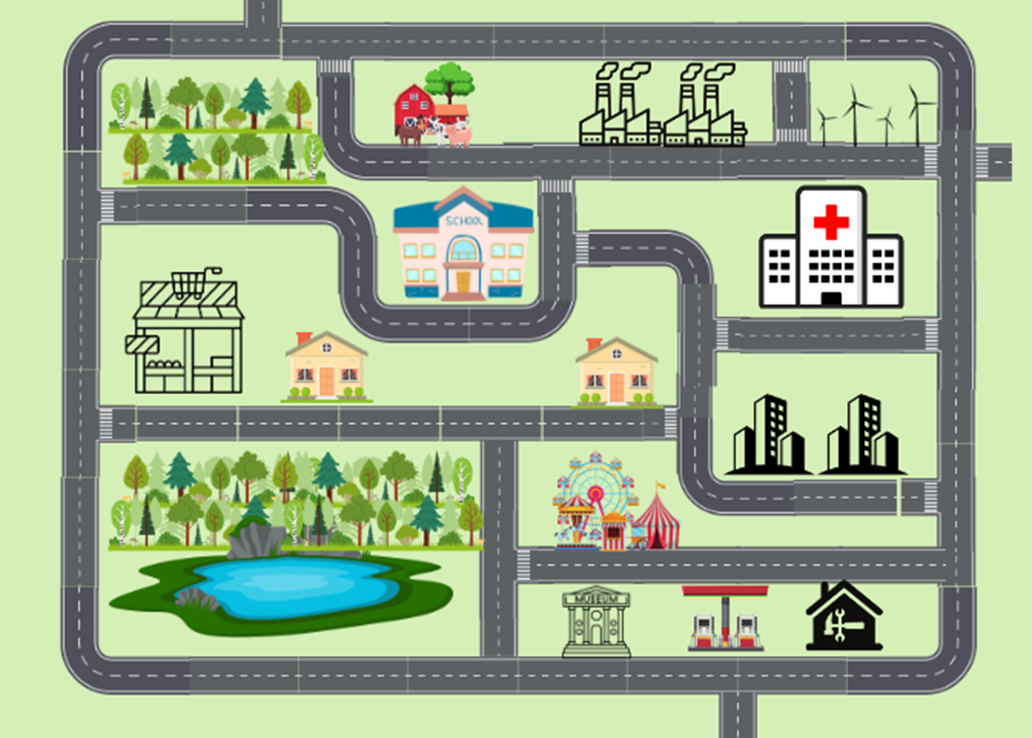
Short response (4)
Record the directions from the school to the hospital.
Notes:
Short response questions provide brisk paced questions focussing on review of current and previous content to support spaced and interleaved practice.
Syllabus focus area:
Geometric measure A: Position

Slide 10

Activity 1 – 10, 100 and 1000 larger
 | x 1 | x 10 | x 100 | x 1000
Example | 3 | 30 | 300 | 3000
First roll
Second roll
Third roll
Fourth roll
Fifth roll
Notes:
This is a developing number sense activity.
Number sense refers to a deep understanding of numbers, including their magnitude, relationships, and the effects of operations on them. It supports fluency and understanding, estimation, flexible thinking, and efficient problem-solving. Number sense activities 1–4 ‘activate’ prior number knowledge and support the learning of new content in the unit. Number sense activities 5–8 ‘loop’ back and provide opportunity for spaced practice with concepts and procedures covered in previous units.
Syllabus focus area:
Representing numbers using place value B
10, 100 and 1000 larger
This resource corresponds to Resource 21 – tens, hundreds, and thousands in Stage 2 Year B Unit 23.
Provide students with Resource 21 – tens, hundreds, and thousands and a 9-sided die.
Students roll the dice and record the number rolled. Students then record the numbers that are 10, 100 and 1000 times larger than the number rolled.
Students repeat 4 more times and identify the number of tens, hundreds or thousands in the number.
Students record in their workbooks how making the number 10, 100 or 1000 times as large changes the place value of the digits.

Slide 11
Review of learning 2

Slide 12
True or false (1)
In the number 9 567 there are 95 hundreds.
True | False
Communicate your reasoning.
Notes:
The question on this slide connects to the content being explored in the developing number sense activity (Activity 2)
Syllabus focus area:
Representing numbers using place value B

Slide 13
Short response (5)
What unit of measure for length would you use for the following?
          a laptop
          a skateboard
          a long jump pit
          a grain of rice
Notes:
Short response questions provide brisk paced questions focussing on review of current and previous content to support spaced and interleaved practice.
Syllabus focus area:
Geometric measure A: Length

Slide 14
Short response (6)
Use regrouping to solve:
381 + 409 =
Communicate your thinking.
Notes:
Short response questions provide brisk paced questions focussing on review of current and previous content to support spaced and interleaved practice.
Syllabus focus area:
Additive relations B

Slide 15
Short response (7)
Write the number
6 704
in words.
Notes:
Short response questions provide brisk paced questions focussing on review of current and previous content to support spaced and interleaved practice.
Syllabus focus area:
Representing numbers using place value A: Whole numbers

Slide 16
Short response (8)
Order the lengths in ascending order:
1.2 metres
123 centimetres
1210 millimetres
Notes:
Short response questions provide brisk paced questions focussing on review of current and previous content to support spaced and interleaved practice.
Syllabus focus area:
Geometric Measure A: Length

Slide 17
Activity 2 – 10, 100 and 1000 larger 2
 | x 1 | x 10 | x 100 | x 1000
Example | 3 | 30 | 300 | 3000
First roll
Second roll
Third roll
Fourth roll
Fifth roll
Notes:
This is a developing number sense activity.
Number sense refers to a deep understanding of numbers, including their magnitude, relationships, and the effects of operations on them. It supports fluency and understanding, estimation, flexible thinking, and efficient problem-solving. Number sense activities 1–4 ‘activate’ prior number knowledge and support the learning of new content in the unit. Number sense activities 5–8 ‘loop’ back and provide opportunity for spaced practice with concepts and procedures covered in previous units.
Syllabus focus area:
Representing numbers using place value B
10, 100 and 1000 larger 2
This resource corresponds to Resource 21 – 10s, 100s, and 1000s in Stage 2 Year B Unit 23.
Provide students with Resource 21 – 10s, 100s and 1000s and a 20-sided die.
Students roll the dice and record the number rolled. Students then record the numbers that are 10, 100 and 1000 times larger than the number rolled.
Students repeat 4 more times and identify the number of tens, hundreds or thousands in the number.
Students record in their workbooks how making the number 10, 100 or 1000 times as large changes the place value of the digits.

Slide 18
Review of learning 3

Slide 19
Multiple choice (2)
When 548 is made 10 times as large, the 5 in the hundreds place becomes a 5 in the:
A
tens place
B
ones place
C
hundreds place
D
thousands place
Notes:
This question connects to the content in the developing number sense activity (Activity 3)
Syllabus focus area:
Representing numbers using place value B

Slide 20
Short response (9)
Convert:
158 mm into cm
74 cm into mm
Notes:
Short response questions provide brisk paced questions focussing on review of current and previous content to support spaced and interleaved practice.
Syllabus focus area:
Geometric measure B: Length

Slide 21
Short response (10)
Use non-standard partitioning and regrouping to solve
543 – 337 =
Communicate your reasoning.
Notes:
Short response questions provide brisk paced questions focussing on review of current and previous content to support spaced and interleaved practice.
Syllabus focus area:
Additive relations B

Slide 22
Short response (11)
What are the missing numbers in the sequence?
2423, 2323, ____, 2123, ____, ____
Notes:
Short response questions provide brisk paced questions focussing on review of current and previous content to support spaced and interleaved practice.
Syllabus focus area:
Representing numbers using place value B: Whole numbers

Slide 23
Short response (12)
A bag contains 4 different coloured counters - red, blue, green and purple.
Violet randomly picks 2 counters.
Record all possible outcomes.
Notes:
Short response questions provide brisk paced questions focussing on review of current and previous content to support spaced and interleaved practice.
Syllabus focus area:
Chance A

Slide 24
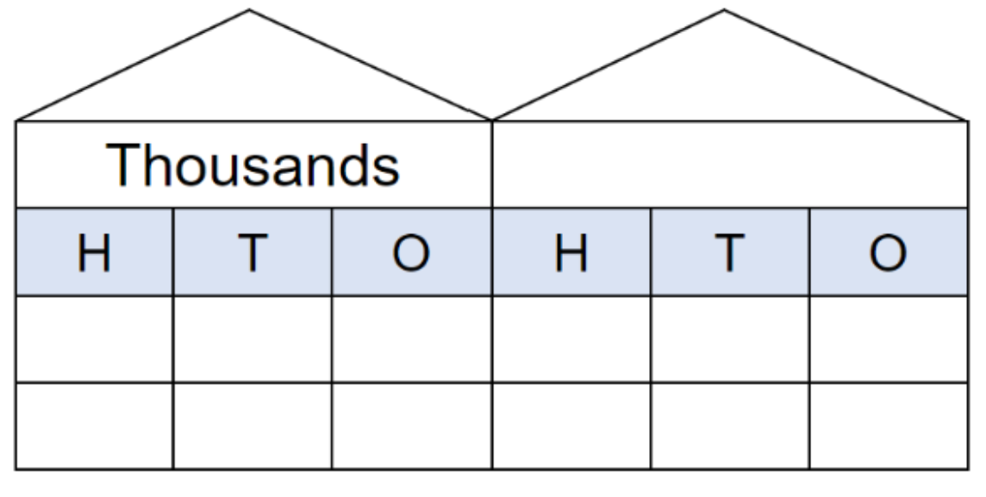
Activity 3 – the effect of making a number 10, 100 or 1000 times larger
Notes:
This is a developing number sense activity.
Number sense refers to a deep understanding of numbers, including their magnitude, relationships, and the effects of operations on them. It supports fluency and understanding, estimation, flexible thinking, and efficient problem-solving. Number sense activities 1–4 ‘activate’ prior number knowledge and support the learning of new content in the unit. Number sense activities 5–8 ‘loop’ back and provide opportunity for spaced practice with concepts and procedures covered in previous units.
Syllabus focus area:
Representing numbers using place value B
The effect of making a number 10, 100 or 1000 times larger
Draw a large place value house on the whiteboard, making it large enough for students to stand in front of each column (see Figure 9).
Ask 6 students to represent numbers by standing or squatting in front of the place value house. Students stand to represent the number one and squat to represent zero.
Select a student to provide a number that is made of ones or zeros. For example, 11.
Note: initial numbers must be limited to a maximum of 111 to ensure the larger number will fit inside the place value house.
To represent 11, the students in front of the 10 and ones column remain standing. All others must squat.
Ask the students to represent a number 100 times larger. To represent the number 1100, only the thousand and hundred students remain standing. All others squat. Ask students to explain how making a number 10, 100 or 1000 times larger changes the place value of the digits.
Rotate students regularly to ensure all are involved.
Continue making numbers with ones and zeros and numbers that are 10, 100 and 1000 times larger.
Note: an alternative is to form teams of 6 students. Students must allocate themselves to a column and the teams compete to create their number representations.

Slide 25
Review of learning 4

Slide 26
True or false (2)
When 648 is made 100 times larger, the 6 in the hundreds place becomes a 6 in the thousands place, the 4 in the tens place becomes a 4 in the hundreds place and the 8 in the ones place becomes an 8 in the tens place.
True | False
Notes:
The question on this slide connects to the content being explored in the developing number sense activity (Activity 4)
Syllabus focus area:
Representing numbers using place value B

Slide 27
Short response (13)
If 1 cm is 10 times larger than 1 mm, convert the following:
mm | cm
165 mm
15 mm
25 mm
Notes:
Short response questions provide brisk paced questions focussing on review of current and previous content to support spaced and interleaved practice.
Syllabus focus area:
Geometric measure B: Length

Slide 28
Short response (14)
Charni worked at the netball canteen selling drinks and sandwiches. She sold 483 items in total. 291 of the items were drinks.
How many sandwiches did Charni sell?
Communicate the strategy you used to solve the problem.
Notes:
Short response questions provide brisk paced questions focussing on review of current and previous content to support spaced and interleaved practice.
Syllabus focus area:
Additive relations B

Slide 29
Short response (15)
Create a number line from 0 to 3 and record the following decimals:
0.8
2.45
3.0
Notes:
Short response questions provide brisk paced questions focussing on review of current and previous content to support spaced and interleaved practice.
Syllabus focus area:
Representing numbers using place value B: Decimals

Slide 30
Short response (16)
Record items that have an estimated mass of:
more than one kilogram
less than one kilogram
about the same as one kilogram.
Notes:
Short response questions provide brisk paced questions focussing on review of current and previous content to support spaced and interleaved practice.
Syllabus focus area:
Non-spatial measure A: Mass

Slide 31
Activity 4 – number of tens, hundreds or thousands in a number
Notes:
This is a developing number sense activity.
Number sense refers to a deep understanding of numbers, including their magnitude, relationships, and the effects of operations on them. It supports fluency and understanding, estimation, flexible thinking, and efficient problem-solving. Number sense activities 1–4 ‘activate’ prior number knowledge and support the learning of new content in the unit. Number sense activities 5–8 ‘loop’ back and provide opportunity for spaced practice with concepts and procedures covered in previous units.
Syllabus focus area:
Representing numbers using place value B
Number of tens, hundreds or thousands in a number
Provide each pair of students three 9-sided dice and a mini-whiteboard.
Ask students to draw a place value house on their whiteboard.
Students roll the dice and arrange the dice to form the smallest number possible. For example, if a student rolls a 5, 1 and 9, the dice could be arranged to form the number 159.
Students record the number that is 10 times larger.
On the second dice roll, students form the largest number possible and record the number that is 100 times larger.
On the third dice roll, students form any number and record the number that is 1000 times larger.
Repeat this 3 times so that students can practice numbers 10, 100 and 1000 times larger.
Vary the task by asking students to select specific numbers, such as those that have an even hundreds digit, or an odd unit, or a number with even thousands and tens digits.

Slide 32
Review of learning 5

Slide 33
Multiple choice (3)
In ascending order, the correct position of 4365 is:
A
6534, 5634, X, 3465
B
5634, 3465, 6534, X
C
3465, 6534, X, 5634
D
3465, X, 5634, 6534
Notes:
This question connects to the content in the developing number sense activity (Activity 5)
Syllabus focus area:
Representing numbers using place value B

Slide 34
Short response (17)
Ethan measured a desk for his gaming set. The length of the desk was 163 cm. Record this length using decimal notation to 2 decimal places.
Notes:
Short response questions provide brisk paced questions focussing on review of current and previous content to support spaced and interleaved practice.
Syllabus focus area:
Geometric measure B: Length

Slide 35
Short response (18)
Use an addition algorithm to solve:
396 + 527 =
Notes:
Short response questions provide brisk paced questions focussing on review of current and previous content to support spaced and interleaved practice.
Syllabus focus area:
Additive relations B

Slide 36
Short response (19)
Record the role of zero in each of the following decimals:
0.5
5.0
0.05
Notes:
Short response questions provide brisk paced questions focussing on review of current and previous content to support spaced and interleaved practice.
Syllabus focus area:
Representing numbers using place value B: Decimals

Slide 37
Short response (20)
Record everyday containers that have a capacity of:
250 mL
1000 mL
2000 mL
Notes:
Short response questions provide brisk paced questions focussing on review of current and previous content to support spaced and interleaved practice.
Syllabus focus area:
Three-dimensional spatial structure B: Volume

Slide 38

Activity 5 – ordering 4-digit numbers
8562
2861
Notes:
This is a developing number sense activity.
Number sense refers to a deep understanding of numbers, including their magnitude, relationships, and the effects of operations on them. It supports fluency and understanding, estimation, flexible thinking, and efficient problem-solving. Number sense activities 1–4 ‘activate’ prior number knowledge and support the learning of new content in the unit. Number sense activities 5–8 ‘loop’ back and provide opportunity for spaced practice with concepts and procedures covered in previous units.
Syllabus focus area:
Representing numbers using place value B
Ordering 4-digit numbers
Explain the aim of the game is to position 4-digit numbers in sequence on the ladder rungs.
Roll a 9-sided dice 4 times to form a 4-digit number and record on one of the ladder rungs.
Select a student to roll the dice again and form another 4-digit number to place on a rung of the ladder. Ask the student to explain and justify which rung they have nominated to place the number on before recording it on the ladder.
Continue the game until a player is unable to place their number on the ladder, then the game is over. Discuss if there were any other possible combinations that could have helped a player win.
The game can be adapted by adding more rungs to the ladder to order more numbers.
Note: the game can be played as whole class or in pairs. Use dice that have a zero as it is important to understand that the zero is a placeholder and does not have a value.

Slide 39
Review of learning 6

Slide 40
True or false (3)
The following numbers are in descending order:
8574, 8374, 8754, 8453
True | False
Notes:
The question on this slide connects to the content being explored in the developing number sense activity (Activity 6)
Syllabus focus area:
Representing numbers using place value B

Slide 41
Short response (21)
Jordan was trying to explain to Jesse the mathematical term for the boundary around the football field. Explain the term Jordan is thinking of and draw an example.
Notes:
Short response questions provide brisk paced questions focussing on review of current and previous content to support spaced and interleaved practice.
Syllabus focus area:
Geometric measure B: Length

Slide 42
Short response (22)
Use a subtraction algorithm to solve:
428 – 33 =
Notes:
Short response questions provide brisk paced questions focussing on review of current and previous content to support spaced and interleaved practice.
Syllabus focus area:
Additive relations B

Slide 43
Short response (23)
James records 0.6 cm and his friend Clara tells him that is the same as 6 cm.
Is Clara right?
Explain your thinking.
Notes:
Short response questions provide brisk paced questions focussing on review of current and previous content to support spaced and interleaved practice.
Syllabus focus area:
Representing numbers using place value B: Decimals

Slide 44

Short response (24)
Record the area of the rectangle using square centimetres.
Notes:
Short response questions provide brisk paced questions focussing on review of current and previous content to support spaced and interleaved practice.
Syllabus focus area:
Two-dimensional spatial structure A: Area

Slide 45

Activity 6 – arrange 4-digit numbers in ascending order
2861
5528
8562
9431
Notes:
This is a developing number sense activity.
Number sense refers to a deep understanding of numbers, including their magnitude, relationships, and the effects of operations on them. It supports fluency and understanding, estimation, flexible thinking, and efficient problem-solving. Number sense activities 1–4 ‘activate’ prior number knowledge and support the learning of new content in the unit. Number sense activities 5–8 ‘loop’ back and provide opportunity for spaced practice with concepts and procedures covered in previous units.
Syllabus focus area:
Representing numbers using place value B
Arrange 4-digit numbers in ascending order
Organise students into small groups and provide each group with four 10-sided dice.
Students take turn rolling the dice to create a 4-digit number. Students record the number on a sticky note and, one by one, place themselves in order from smallest to largest.
When each group has all members in order, combine 2 groups. Group members need to adjust their order to ensure they are still in order from smallest to largest.
Continue to combine groups and adjust placements until the whole class is in order.

Slide 46
Review of learning 7

Slide 47
Multiple choice (4)
The next number in ascending order is
1457, 1563, 1637, ?
A
1756
B
172
C
1794
D
777
Notes:
This question connects to the content in the developing number sense activity (Activity 7)
Syllabus focus area:
Representing numbers using place value B

Slide 48
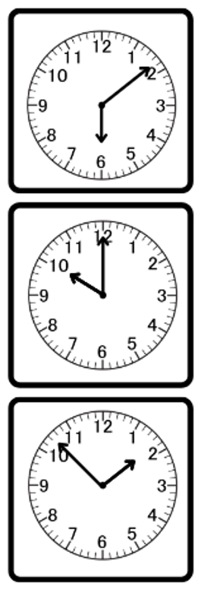
Short response (25)
A
Record these analog times as:
a digital display
in words.
B
Notes:
Short response questions provide brisk paced questions focussing on review of current and previous content to support spaced and interleaved practice.
Syllabus focus area:
Non-spatial measure B: Time

Slide 49
Short response (26)
Lily has 460 chocolates to sell. She has sold 243. How many more chocolates does Lily need to sell?
Communicate the strategy used to solve the problem.
Notes:
Short response questions provide brisk paced questions focussing on review of current and previous content to support spaced and interleaved practice.
Syllabus focus area:
Additive relations B

Slide 50
Short response (27)
Record the missing numbers in the pattern and explain your thinking.
6, 12, 18, __, __, 36, __, 42
Notes:
Short response questions provide brisk paced questions focussing on review of current and previous content to support spaced and interleaved practice.
Syllabus focus area:
Multiplicative relations B

Slide 51
Short response (28)
Record the time half an hour after the following times:
10:30 am
seven o’clock
a quarter past eight
Notes:
Short response questions provide brisk paced questions focussing on review of current and previous content to support spaced and interleaved practice.
Syllabus focus area:
Non-spatial measure A: Time

Slide 52
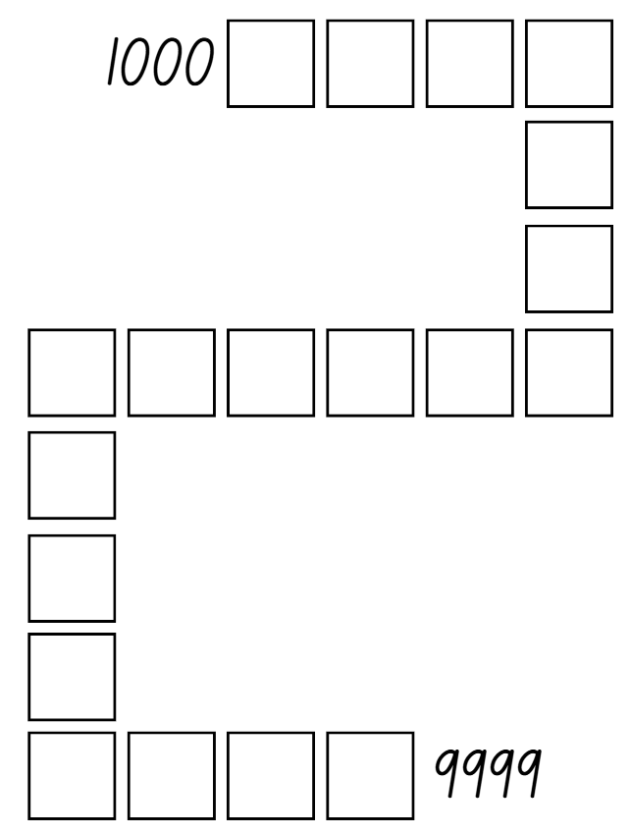
Activity 7 – rearranging digits changes the size of a number
Notes:
This is a developing number sense activity.
Number sense refers to a deep understanding of numbers, including their magnitude, relationships, and the effects of operations on them. It supports fluency and understanding, estimation, flexible thinking, and efficient problem-solving. Number sense activities 1–4 ‘activate’ prior number knowledge and support the learning of new content in the unit. Number sense activities 5–8 ‘loop’ back and provide opportunity for spaced practice with concepts and procedures covered in previous units.
Syllabus focus area:
Representing numbers using place value B
Rearranging digits changes the size of a number
This resource corresponds to Resource 22 – ordering gameboard in Stage 2 Year B Unit 23.
Explain the aim of the game is to position 4-digit numbers in sequence on the gameboard. Provide pairs with four 10-sided dice and Resource 22 – ordering gameboard to each player.
Students roll the dice and create a 4-digit number. For example, 4, 6, 9 and zero could be recorded as 4609, 6490 or 9604. Players record their chosen number in the most appropriate position between 100 and 9999.
If numbers cannot be placed, students miss their turn. Play continues until all boxes are filled.
Note: the game can also be played as whole class. Use dice that have a zero as it is important to understand that the zero is a placeholder and does not have a value. Using a reusable sleeve for the gameboard will allow students to play multiple games.

Slide 53
Review of learning 8

Slide 54
True or false (4)
These numbers are in the ascending order:
2640, 2604, 4040, 4004
True | False
Communicate your reasoning.
Notes:
The question on this slide connects to the content being explored in the developing number sense activity (Activity 8)
Syllabus focus area:
Representing numbers using place value B

Slide 55
Short response (29)
The time on a digital clock reads
7:34 pm
How many minutes are there until the next hour?
Notes:
Short response questions provide brisk paced questions focussing on review of current and previous content to support spaced and interleaved practice.
Syllabus focus area:
Non-spatial measure B: Time

Slide 56
Short response (30)
Ruby plans to walk 287 kilometres across the month to raise money for charity. She has already walked 48 kilometres.
How many kilometres does Ruby have left to walk?
Communicate your strategy.
Notes:
Short response questions provide brisk paced questions focussing on review of current and previous content to support spaced and interleaved practice.
Syllabus focus area:
Additive relations B

Slide 57

Short response (31)
Record all multiplication and division facts from this array.
Notes:
Short response questions provide brisk paced questions focussing on review of current and previous content to support spaced and interleaved practice.
Syllabus focus area:
Multiplicative relations A

Slide 58
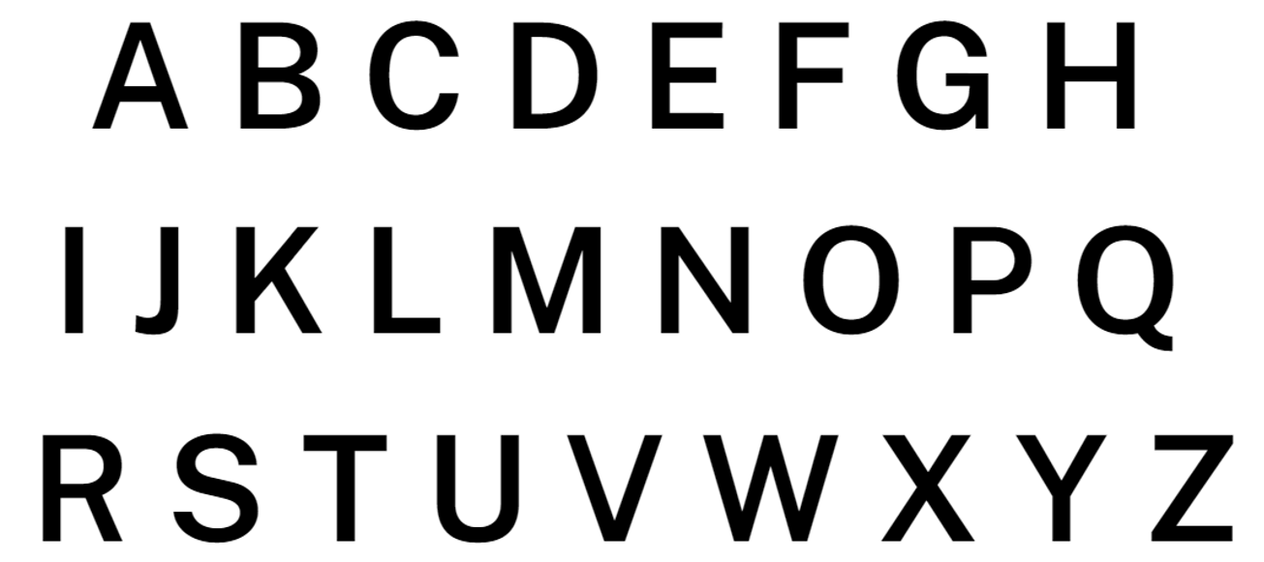
Short response (32)
Which capital letters of the alphabet have one line of symmetry?
Notes:
Short response questions provide brisk paced questions focussing on review of current and previous content to support spaced and interleaved practice.
Syllabus focus area:
Two-dimensional spatial structure A: 2D shape

Slide 59
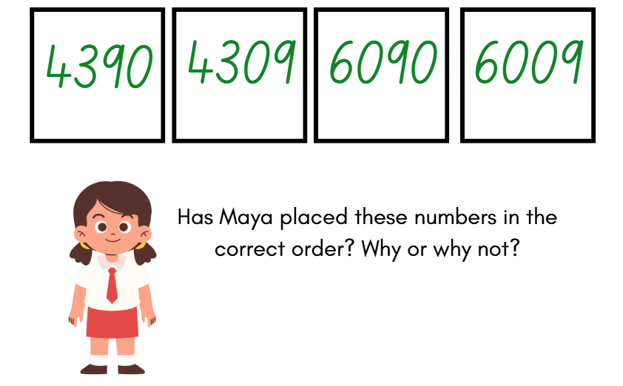
Activity 8 – ascending order misconception
Notes:
This is a developing number sense activity.
Number sense refers to a deep understanding of numbers, including their magnitude, relationships, and the effects of operations on them. It supports fluency and understanding, estimation, flexible thinking, and efficient problem-solving. Number sense activities 1–4 ‘activate’ prior number knowledge and support the learning of new content in the unit. Number sense activities 5–8 ‘loop’ back and provide opportunity for spaced practice with concepts and procedures covered in previous units.
Syllabus focus area:
Representing numbers using place value B
Ascending order misconception
This resource corresponds to Resource 23 – ascending order misconception in Stage 2 Year B Unit 23.
Explain to students that Maya has been given five numbers to order. She was asked to place them in ascending order.
Ask students:
Has Maya placed the numbers in the correct order? Why or why not?
What misconceptions has Maya made?
Students correctly place the numbers in ascending order and explain their thinking.
Discuss: What was similar or different to your order, compared to Maya’s order?

Slide 60
Double Venn diagram
Object 1
Object 2
Features similar to both objects
Features of object 1
Features of object 2

Slide 61
Frayer
Definition
Facts/Characteristics
Word, term, concept
Examples
Non-examples

Slide 62
Spider map
Idea
Subject

Slide 63
Cline
Concept 1
Concept 2
Word
Word
Word
Word
Word
Word
Word
Word
Word
Word
Word

Slide 64

Compare and contrast

Slide 65
Multiple choice (5)
A
B
C
D

Slide 66
Multiple choice (6)
A
B
C
D

Slide 67
References
This presentation contains NSW Curriculum and syllabus content. The NSW Curriculum is developed by the NSW Education Standards Authority. This content is prepared by NESA for and on behalf of the Crown in the right of the State of New South Wales. The material is protected by Crown copyright.
Please refer to the NESA Copyright Disclaimer for more information https://educationstandards.nsw.edu.au/wps/portal/nesa/mini-footer/copyright.
NESA holds the only official and up-to-date versions of the NSW Curriculum and syllabus documents. Please visit the NSW Education Standards Authority (NESA) website https://educationstandards.nsw.edu.au/wps/portal/nesa/home and the NSW Curriculum website https://curriculum.nsw.edu.au.
Mathematics K–10 Syllabus © NSW Education Standards Authority (NESA) for and on behalf of the Crown in right of the State of New South Wales, 2022.
National Numeracy Learning Progression © Australian Curriculum, Assessment and Reporting Authority (ACARA) 2010 to present, unless otherwise indicated. This material was downloaded from the Australian Curriculum website (National Numeracy Learning Progression) (accessed 22 July 2025) and was not modified.
Sullivan P (2018) Challenging Mathematical tasks: Unlocking the potential of all students, Oxford University Press Australia and New Zealand.
Toy Theater (2001-2023) Analog clock, Toy Theater website, accessed 27 June 2023.
Toy Theater (2001-2023) Dice, Toy Theater website, accessed 27 June 2023.
Toy Theater (2001-2023) Pattern blocks, Toy Theater website, accessed 27 June 2023.

Slide 68
Copyright
© State of New South Wales (Department of Education), 2025
The copyright material published in this resource is subject to the Copyright Act 1968 (Cth) and is owned by the NSW Department of Education or, where indicated, by a party other than the NSW Department of Education (third-party material).
Copyright material available in this resource and owned by the NSW Department of Education is licensed under a Creative Commons Attribution 4.0 International (CC BY 4.0) license.
This license allows you to share and adapt the material for any purpose, even commercially.
Attribution should be given to © State of New South Wales (Department of Education), 2025.
Material in this resource not available under a Creative Commons license:
the NSW Department of Education logo, other logos and trademark-protected material
Material owned by a third party that has been reproduced with permission. You will need to obtain permission from the third party to reuse its material.
Links to third-party material and websites
Please note that the provided (reading/viewing material/list/links/texts) are a suggestion only and implies no endorsement, by the New South Wales Department of Education, of any author, publisher, or book title. School principals and teachers are best placed to assess the suitability of resources that would complement the curriculum and reflect the needs and interests of their students.
If you use the links provided in this document to access a third party’s website, you acknowledge that the terms of use, including licence terms set out on the third-party’s website apply to the use which may be made of the materials on that third-party website or where permitted by the Copyright Act 1968 (Cth). The department accepts no responsibility for content on third-party websites.

