Slide 1
Instructions for use
This resource is not a teaching and learning program. It should be used in conjunction with Stage 2 Year B Unit 24.
Classroom teachers are encouraged to add and adapt slides as required to meet the needs of their students.
Save a copy of the file to make changes to the slide deck. Go to File > Download a Copy (this downloads a copy to the computer to edit in the PowerPoint app).
To convert the PowerPoint to Google Slides:
  Upload the file into Google Drive and open it.
  Go to File > Save as Google Slides.
  (Note – conversion may cause formatting changes in the slides.)

Slide 2

Review of Learning
Mathematics Stage 2 – Unit 24
Notes:
Reviews may include a combination of question types, requiring students to recall facts and key ideas, as well as apply their knowledge to solve problems and answer questions. To support active engagement, a mix of techniques should be employed.” (AERO, 2024).
This Review of Learning slide deck revisits key concepts from the following units:
Stage 2 Year B Unit 24
Stage 2 Year B Unit 23
Stage 2 Year B Unit 22
It also includes opportunities to review prior learning in non-number content, supporting consolidation across focus areas.
The review of learning resources include three key task types that support the development of mathematical proficiency through retrieval, spaced practice, and active participation. These practices complement the review phase (activating prior knowledge) embedded within the beginning of each lesson.
1.
Multiple-choice questions/True or false: Designed to promote active retrieval of key concepts and identify common misconceptions in number, supporting consolidation, understanding and fluency.
These questions:
support spaced and interleaved practice
help identify and address common misconceptions
support active recall and immediate feedback
support whole class participation
identify areas requiring reteach
2.
Short-response question sets: Carefully grouped questions that encourage spaced and interleaved practice across multiple focus areas, helping students revisit and apply knowledge from different points in time.
These questions:
have a combination of question types
address a range of focus areas
build automaticity and fluency
support active recall
allow for immediate feedback
identify content requiring reteach
3.
Developing number sense activities: A variety of practical, purposeful tasks that reinforce current learning and build on prior knowledge. These activities promote reasoning, problem-solving and conceptual understanding.
The review of learning resources are designed to work support teaching and learning in mathematics. For the most effective implementation, use the resources flexibly, adapting to meet student learning needs and individual classroom contexts.

Slide 3
Lessons
1
Review of learning 1
5
Review of learning 4
2
Review of learning 2
6
Review of learning 5
3
Review of learning 3
7
Review of learning 6
4
Review of learning 4
8
Review of learning 7
Notes:
Teacher notes:
Click lesson numbers to go to specific lessons
Interactive features can be viewed in slide show

Slide 4
Review of learning 1

Slide 5

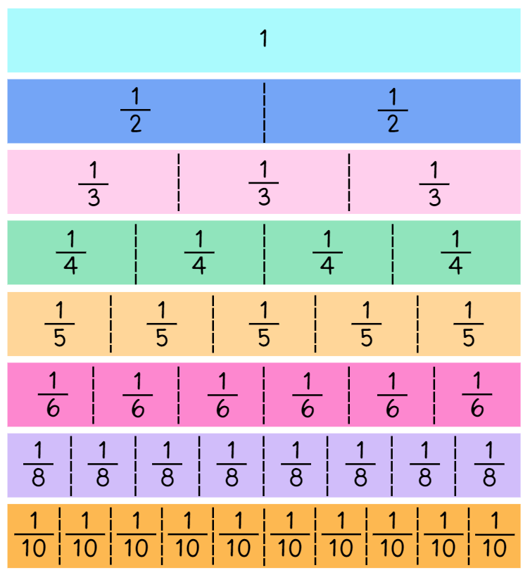
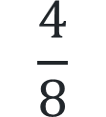
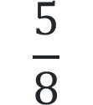
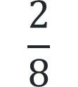
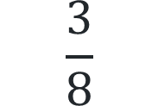
Multiple choice (1)
Which of these is equivalent to one half?
A
B
C
D
$$\frac{3}{8}$$
$$\frac{2}{8}$$
$$\frac{4}{8}$$
$$\frac{5}{8}$$
Notes:
This question connects to the content in the developing number sense activity (Activity 1)
Syllabus focus area:
Partitioned fractions B

Slide 6

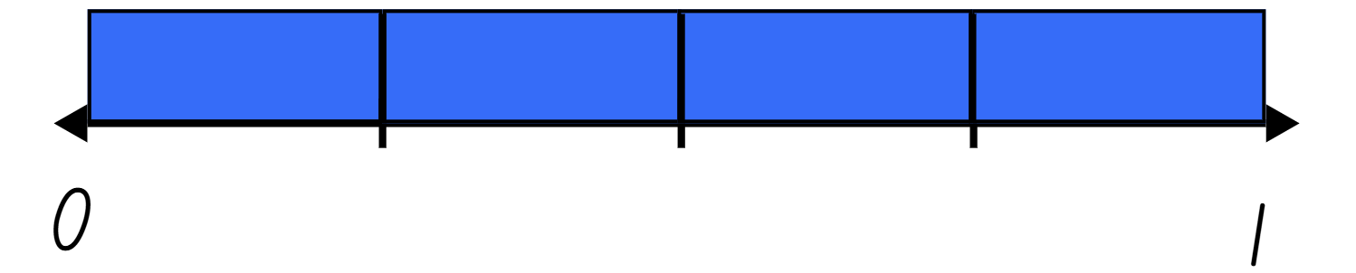
Short response (1)
Pippa folded her paper strip into
equal parts like this.
Draw Linda’s paper strip and label the fractions.
Notes:
Short response questions provide brisk paced questions focussing on review of current and previous content to support spaced and interleaved practice.
Syllabus focus area:
Partitioned fractions A

Slide 7
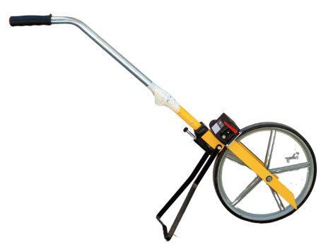
Short response (2)
Name something you would measure with:
a 30cm ruler
a metre ruler
trundle wheel
Communicate your reasoning.
Notes:
Short response questions provide brisk paced questions focussing on review of current and previous content to support spaced and interleaved practice.
Syllabus focus area:
Geometric measure A

Slide 8
Short response (3)
Use the compensation strategy to solve
373 - 47
Communicate your thinking.
Notes:
Short response questions provide brisk paced questions focussing on review of current and previous content to support spaced and interleaved practice.
Syllabus focus area:
Additive relations A

Slide 9
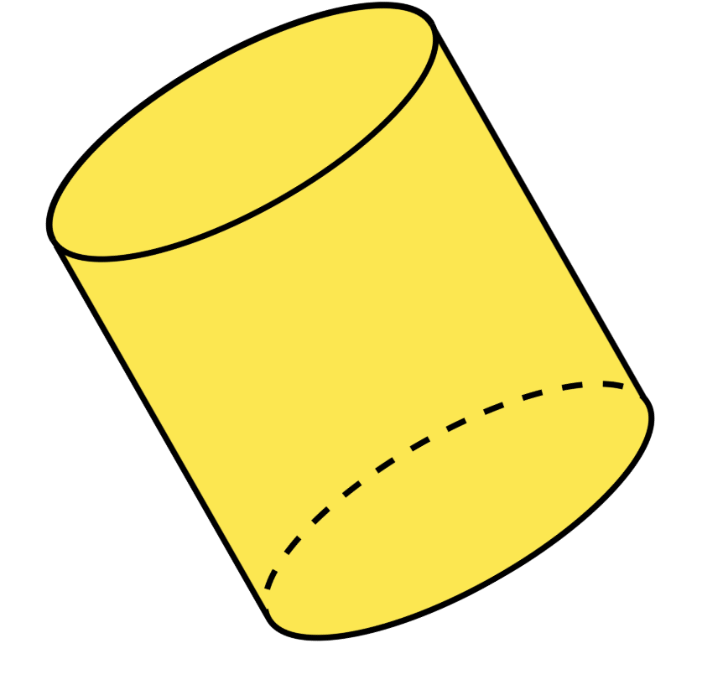
Short response (4)
Describe the features of this cylinder.
Notes:
Short response questions provide brisk paced questions focussing on review of current and previous content to support spaced and interleaved practice.
Syllabus focus area:
Three-dimensional spatial structure A: 3D objects

Slide 10

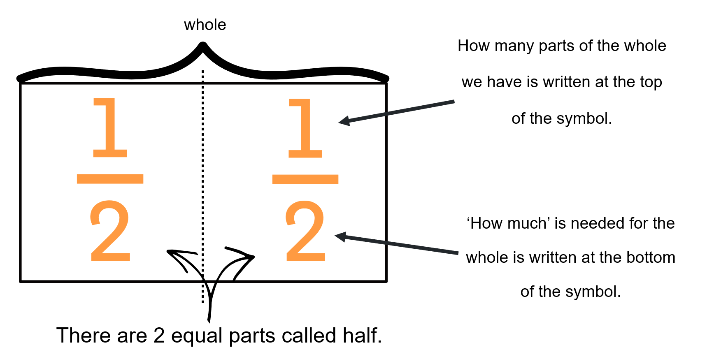
Activity 1 – equivalent to half
Notes:
This is a developing number sense activity.
Number sense refers to a deep understanding of numbers, including their magnitude, relationships, and the effects of operations on them. It supports fluency and understanding, estimation, flexible thinking, and efficient problem-solving. Number sense activities 1–4 ‘activate’ prior number knowledge and support the learning of new content in the unit. Number sense activities 5–8 ‘loop’ back and provide opportunity for spaced practice with concepts and procedures covered in previous units.
Syllabus focus area:
Partitioned fractions B
Activity title
This resource corresponds to Resource 1 – fraction wall in Stage 2 Year AB Unit 24.
Revise that when a whole length is divided into 2 equal parts, each of those parts is named one-half.
Ask students to recall the name of the parts when a whole length is partitioned into 3, 4 and 8 equal parts.
Revise that when writing one half with fraction notation, the 2 shows how much the whole is (2 parts) and the 1 shows how many equal parts of the whole are selected (1 part) (see Figure 15).
Note: use language that will assist students to develop early fraction ideas. For example, rather than saying ‘1 over 2’, ‘1 of 2’ or ‘1 on 2’ (describing the symbol only) say ‘one half of the whole strip’. The teaching advice states that the terms numerator and denominator are used in Stage 3.
Discuss the relationship between the numerals in the fraction representing one-half. Guide students to understand that, if the fraction is equal to half, the number of parts we have (numerator) is always half the number representing how much is needed for the whole (denominator).
Explain that this set of fractions which represent the same value, such as all fractions equal to one-half, are called equivalent fractions.
Provide students with individual whiteboards.
Ask students to find fractions equivalent to one-half and record the fractional notation on their whiteboards.
Ask students to think of examples which are equivalent to one-half that are not shown on the fraction wall. Students record their ideas using fraction notation, concrete materials, diagrams or number lines.
Students share and explain their reasoning.
Explain that these fractions have a multiplicative relationship to each other as the number of parts we have is always exactly half of the number of parts that make the whole. For example, a student may reason that ten twentieths is equivalent to one-half because if 20 parts are divided into 2 equal groups, each group will have 10 parts.

Slide 11
Review of learning 2

Slide 12
True or false (1)
2-quarters is equivalent to one half?
True | False
Notes:
The question on this slide connects to the content being explored in the developing number sense activity (Activity 2)
Syllabus focus area:
Partitioned fractions B

Slide 13
Short response (5)
Write a fraction that is smaller than one half but bigger than one quarter.
Notes:
Short response questions provide brisk paced questions focussing on review of current and previous content to support spaced and interleaved practice.
Syllabus focus area:
Partitioned fractions A

Slide 14
Short response (6)
If your desk is about 120cm long, estimate the height of your classroom door.
Communicate your thinking.
Notes:
Short response questions provide brisk paced questions focussing on review of current and previous content to support spaced and interleaved practice.
Syllabus focus area:
Geometric measure B

Slide 15
Short response (7)
Use regrouping to solve
373 + 47
Communicate your thinking.
Notes:
Short response questions provide brisk paced questions focussing on review of current and previous content to support spaced and interleaved practice.
Syllabus focus area:
Additive relations B

Slide 16
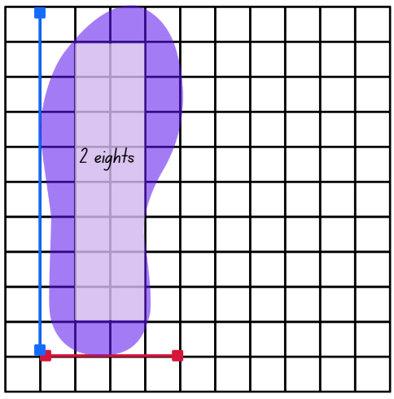
Short response (8)
Clara drew around her shoe onto centimetre grid paper. She used an array to estimate the area.
Which numbers complete the sentence?
The area of Clara’s shoe must be more than _______and less than ______ square centimetres.
Notes:
Short response questions provide brisk paced questions focussing on review of current and previous content to support spaced and interleaved practice.
Syllabus focus area:
Two-dimensional spatial structure A: Area

Slide 17
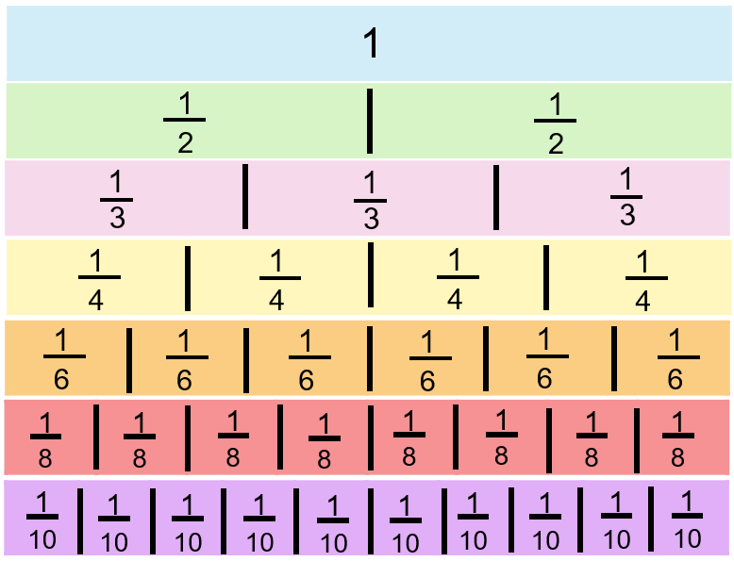
Activity 2 – equivalent fractions
Notes:
This is a developing number sense activity.
Number sense refers to a deep understanding of numbers, including their magnitude, relationships, and the effects of operations on them. It supports fluency and understanding, estimation, flexible thinking, and efficient problem-solving. Number sense activities 1–4 ‘activate’ prior number knowledge and support the learning of new content in the unit. Number sense activities 5–8 ‘loop’ back and provide opportunity for spaced practice with concepts and procedures covered in previous units.
Syllabus focus area:
Partitioned fractions B
Equivalent fractions
This resource corresponds to Resource 1 – fraction wall in Stage 2 Year B Unit 24.
Provide students with individual whiteboards.
Ask students to identify and record any fractions equivalent to one half, one third, one quarter and one fifth on an individual whiteboard.
Ask students what they notice about these groups of fractions. Highlight the multiplicative relationship between the equivalent fractions. For example, a student may reason that one fifth is equivalent to two tenths because if 10 parts are divided into 5 equal groups, each group will have 2 parts.
Provide students with strips of paper to fold, model and label the fractions they identify as equivalent.
Have students use the fraction wall to identify any other equivalent fractions and record these.

Slide 18
Review of learning 3

Slide 19
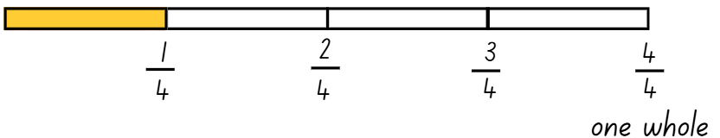
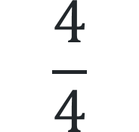
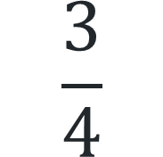
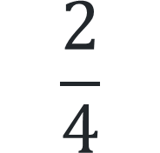
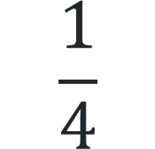
Multiple choice (2)
What fraction needs to be shaded to complete one whole?
A
B
C
D
$$\frac{1}{4}$$
$$\frac{2}{4}$$
$$\frac{3}{4}$$
$$\frac{4}{4}$$
Notes:
This question connects to the content in the developing number sense activity (Activity 3)
Syllabus focus area:
Partitioned fractions A

Slide 20
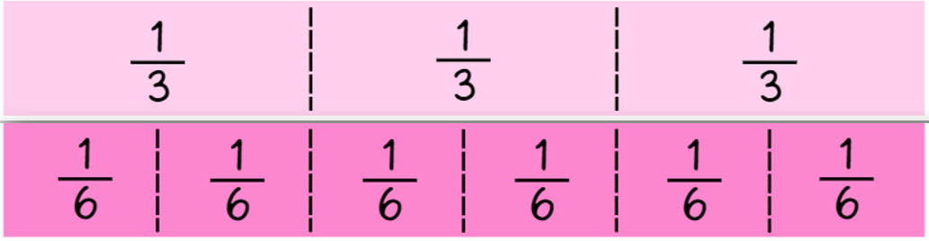

Short response (9)
Which is larger $\frac{2}{3} or \frac{2}{6} ?$
Notes:
Short response questions provide brisk paced questions focussing on review of current and previous content to support spaced and interleaved practice.
Syllabus focus area:
Partitioned fractions B

Slide 21
Short response (10)
Convert :
175 millimetres into centimetres
40 centimetres into millimetres
Notes:
Short response questions provide brisk paced questions focussing on review of current and previous content to support spaced and interleaved practice.
Syllabus focus area:
Geometric measure B

Slide 22
Short response (11)
Use regrouping to solve
284 - 76
Communicate your thinking.
Notes:
Short response questions provide brisk paced questions focussing on review of current and previous content to support spaced and interleaved practice.
Syllabus focus area:
Additive relations B

Slide 23
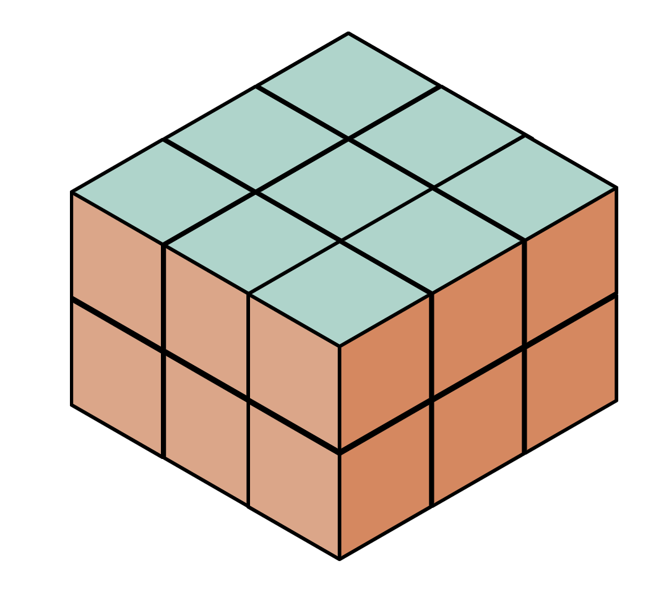
Short response (12)
Ryder made this prism using blocks.
What is the volume of this prism?
Communicate your thinking.
Notes:
Short response questions provide brisk paced questions focussing on review of current and previous content to support spaced and interleaved practice.
Syllabus focus area:
Three-dimensional spatial structure A: 3D objects

Slide 24
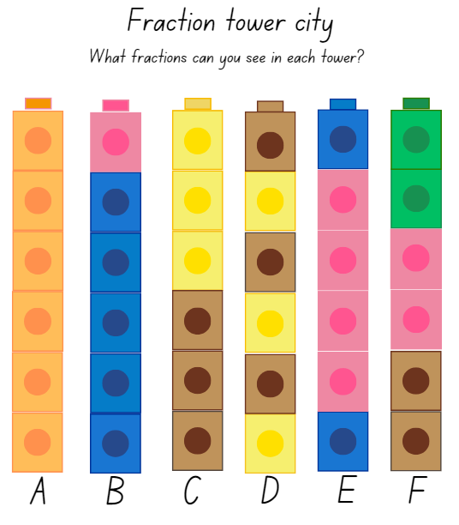
Activity 3 – complementary fractions
Notes:
This is a developing number sense activity.
Number sense refers to a deep understanding of numbers, including their magnitude, relationships, and the effects of operations on them. It supports fluency and understanding, estimation, flexible thinking, and efficient problem-solving. Number sense activities 1–4 ‘activate’ prior number knowledge and support the learning of new content in the unit. Number sense activities 5–8 ‘loop’ back and provide opportunity for spaced practice with concepts and procedures covered in previous units.
Syllabus focus area:
Partitioned fractions A
Complementary fractions
This resource corresponds to Resource 21- tower fractions in Stage 2 Year B Unit 24.
Ask students to record the fractions they can see in each tower.
Explain that there are no complementary fractions in Tower A, however there are complementary fractions in Towers B–E. Ask students to consider why this is the case.
Select a student to record the fraction notation for Tower B as one sixth and 5 sixths. State that these fractions are complementary as they represent 2 fractional parts needed to complete one whole.
For Tower D, present the following statements:
one student represented the fractions as one sixth, one sixth, one sixth, one sixth, one sixth and one sixth.
a second student represented the fractions as 3 sixths and 3 sixths.
a third student represented the fractions as one half and one half.
Ask students to provide reasoning as to which statement is correct and why.
Students share the fraction notation they used to record the remaining towers and discuss complementary fractions and equivalence.

Slide 25
Review of learning 4

Slide 26
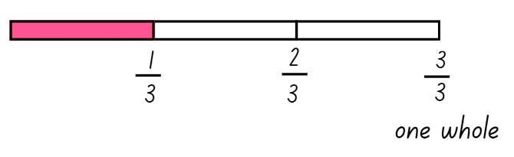
True or false (2)
Two thirds are needed to complete one whole.
True | False
Notes:
The question on this slide connects to the content being explored in the developing number sense activity (Activity 4)
Syllabus focus area:
Partitioned fractions A

Slide 27

Short response (13)
Which is larger $\frac{3}{4} or \frac{5}{8} ?$
Notes:
Short response questions provide brisk paced questions focussing on review of current and previous content to support spaced and interleaved practice.
Syllabus focus area:
Partitioned fractions B

Slide 28
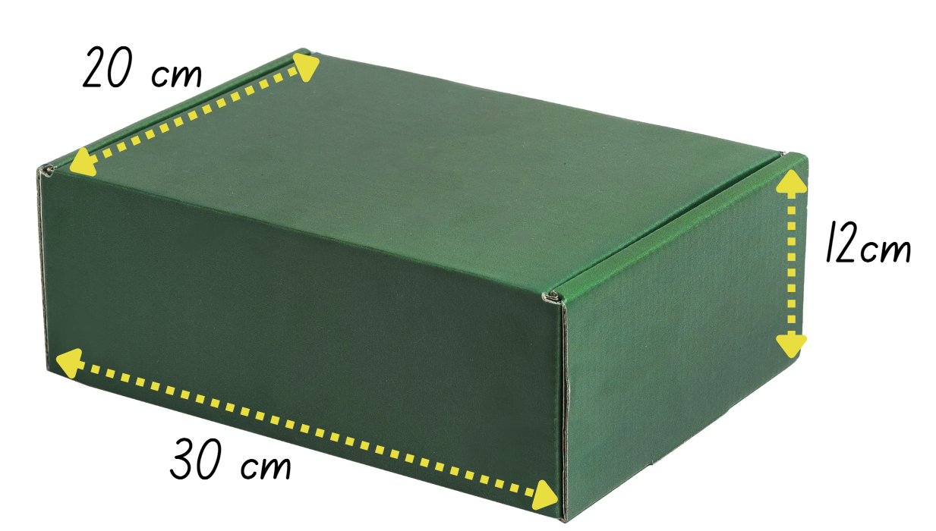
Short response (14)
Describe this box using the words length, width and height.
Notes:
Short response questions provide brisk paced questions focussing on review of current and previous content to support spaced and interleaved practice.
Syllabus focus area:
Geometric measure B

Slide 29
Short response (15)
Use partitioning and regrouping strategies to determine 2 numbers that combine to make 573.
Communicate your thinking.
Notes:
Short response questions provide brisk paced questions focussing on review of current and previous content to support spaced and interleaved practice.
Syllabus focus area:
Additive relations B

Slide 30
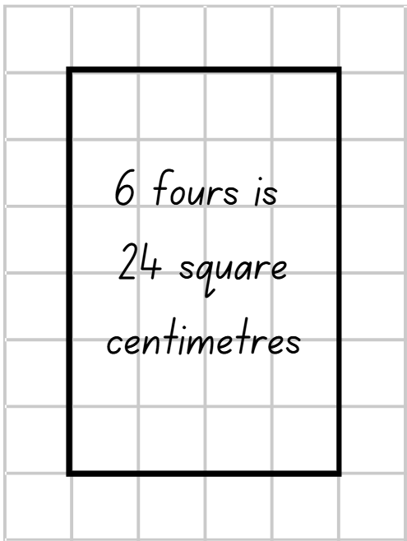
Short response (16)
This shows one array of 6 fours. What other arrays can be made for 24?
Have you recorded all possible arrays?
How do you know?
Notes:
Short response questions provide brisk paced questions focussing on review of current and previous content to support spaced and interleaved practice.
Syllabus focus area:
Two-dimensional spatial structure A: Area

Slide 31
Activity 4 – additional complementary fractions
Notes:
This is a developing number sense activity.
Number sense refers to a deep understanding of numbers, including their magnitude, relationships, and the effects of operations on them. It supports fluency and understanding, estimation, flexible thinking, and efficient problem-solving. Number sense activities 1–4 ‘activate’ prior number knowledge and support the learning of new content in the unit. Number sense activities 5–8 ‘loop’ back and provide opportunity for spaced practice with concepts and procedures covered in previous units.
Syllabus focus area:
Partitioned fractions A
Additional complementary fractions
This resource corresponds to Resource 21 – tower fractions in Stage 2 Year B Unit 24.
Discuss the complementary fractions evident and not evident.
In pairs, students build 3 towers of 6 interconnecting cubes using different colours. Students record the complementary fraction notation for each of their towers. For example, one sixth and 5 sixths.
In pairs, students compare their sets of towers and the labelling of complementary fractions.
Students provide reasoning as to why they labelled the fractional components as they did show complementary fractions. For example, these fractions are complementary as they represent 2 fractional parts needed to complete one whole.
Students compare any similarities or differences in the towers they made.

Slide 32
Review of learning 5

Slide 33
Multiple choice (3)
35 243 in expanded notation is
A
3 000 + 50 000 + 200 + 40 + 3
B
35 000 + 200 + 400 + 3
C
30 000 + 5000 + 200 + 40 + 3
D
30 000 + 500 + 2 000 + 40 + 3
Notes:
This question connects to the content in the developing number sense activity (Activity 5)
Syllabus focus area:
Representing numbers using place value B

Slide 34

Short response (17)
Why is a quarter of this length of string more than a quarter of this length of ribbon.
Notes:
Short response questions provide brisk paced questions focussing on review of current and previous content to support spaced and interleaved practice.
Syllabus focus area:
Partitioned fractions B

Slide 35
Short response (18)
What does perimeter mean?
Notes:
Short response questions provide brisk paced questions focussing on review of current and previous content to support spaced and interleaved practice.
Syllabus focus area:
Geometric measure B

Slide 36
Short response (19)
Use partitioning and regrouping strategies to solve:
583 + 67
Notes:
Short response questions provide brisk paced questions focussing on review of current and previous content to support spaced and interleaved practice.
Syllabus focus area:
Additive relations B

Slide 37
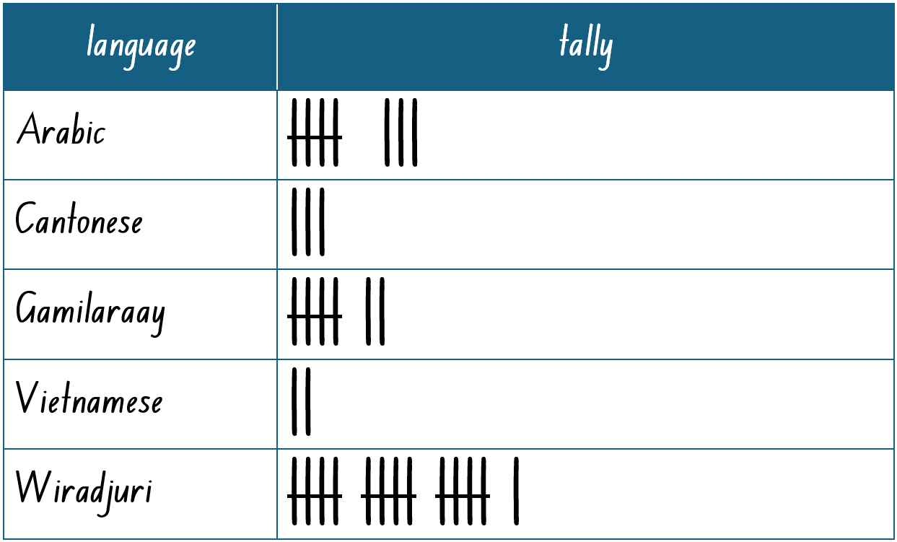
Short response (20)
Mrs Matthews made this tally table of the languages spoken by the students in her class.
Complete these sentences about the data:
More students speak …
Fewer students speak …
Notes:
Short response questions provide brisk paced questions focussing on review of current and previous content to support spaced and interleaved practice.
Syllabus focus area:
Data A – tally tables

Slide 38
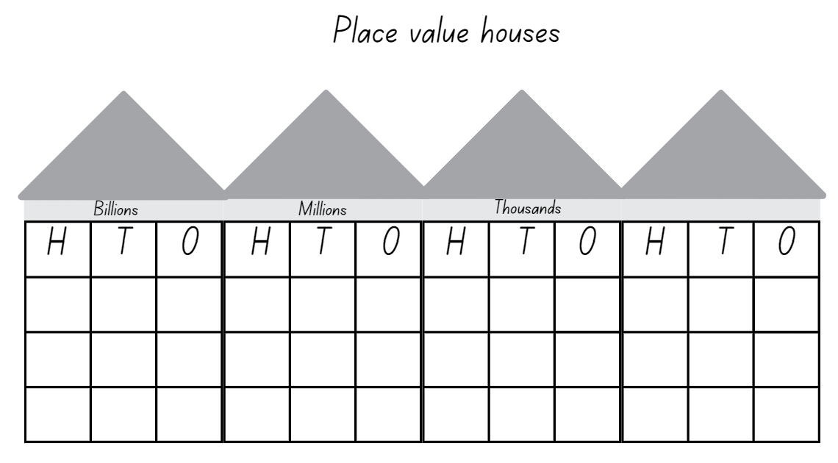
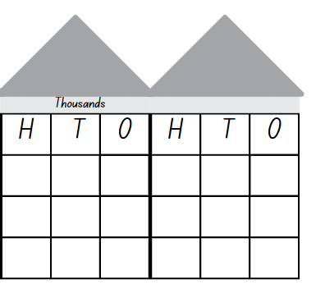
Activity 5 – place value grouping
Aim of the game
To make the closest possible number to 500 000, without going over.
Rules:
each player rolls a 9-sided dice 6 times
after each roll, choose where to place the digit
once a digit is placed, it cannot be moved
after 6 throws, read your number to a partner and record the number using expanded notation
as a class, determine who has made the number closest to 500 000.
38
Notes:
This is a developing number sense activity.
Number sense refers to a deep understanding of numbers, including their magnitude, relationships, and the effects of operations on them. It supports fluency and understanding, estimation, flexible thinking, and efficient problem-solving. Number sense activities 1–4 ‘activate’ prior number knowledge and support the learning of new content in the unit. Number sense activities 5–8 ‘loop’ back and provide opportunity for spaced practice with concepts and procedures covered in previous units.
Syllabus focus area:
Representing numbers using place value B
Place value grouping
This resource corresponds to Resource 22 – place value houses in Stage 2 Year B Unit 24.
Explain that students will get 6 dice rolls with a 9-sided die to make the closest possible number to 500 000, without going over.
Provide each student with Resource 22 – place value houses and a 9-sided die. After each roll, students need to decide where to place that digit. Once a digit is placed, it cannot be moved.
After 5 throws, students decide which number they would most like to be the last dice roll.
After 6 throws, each student reads out their number to the person next to them. For example, four hundred and ninety-two thousand, five hundred and eighty-one. Students then use expanded notation to record their number, emphasising the thousands, tens and ones. For example, 400 000 + 90 000 + 2000 + 500 + 80 + 1.
As a class, determine who has made the number closest to 500 000.
Repeat the process in small groups.
Ask students to consider whether changing the rules of the game to allow going over 500 000 could help them to get closer to the target number. For example, 512 367 is closer than 481 975.

Slide 39
Review of learning 6

Slide 40
True or false (3)
The number 507 218 can be read as fifty-seven thousand, two hundred and eighteen.
True | False
Notes:
The question on this slide connects to the content being explored in the developing number sense activity (Activity 6)
Syllabus focus area:
Representing numbers using place value B

Slide 41
Short response (21)
Record the answers:
How many fifths are equal to one whole?
How many thirds make one whole?
How many wholes do 6-sixths make?
Notes:
Short response questions provide brisk paced questions focussing on review of current and previous content to support spaced and interleaved practice.
Syllabus focus area:
Partitioned fractions B

Slide 42
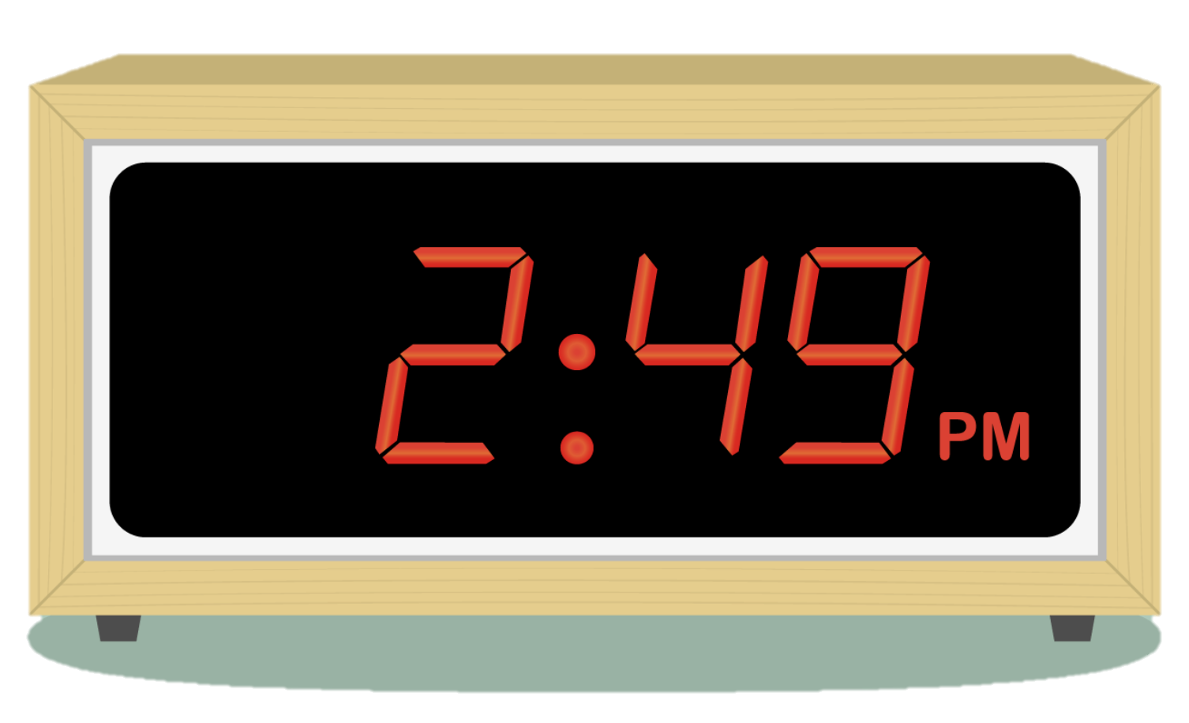
Short response (22)
What is the time to the minute?
Record your answer in words.
Notes:
Short response questions provide brisk paced questions focussing on review of current and previous content to support spaced and interleaved practice.
Syllabus focus area:
Non-spatial measure B

Slide 43
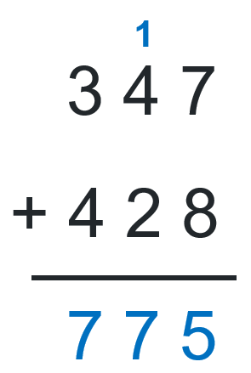
Short response (23)
Avery used a vertical algorithm to solve 347 + 428. Her teacher asked her to explain what the
1 meant in her recording.
What could Avery say?
Communicate your reasoning.
Notes:
Short response questions provide brisk paced questions focussing on review of current and previous content to support spaced and interleaved practice.
Syllabus focus area:
Additive relations B

Slide 44
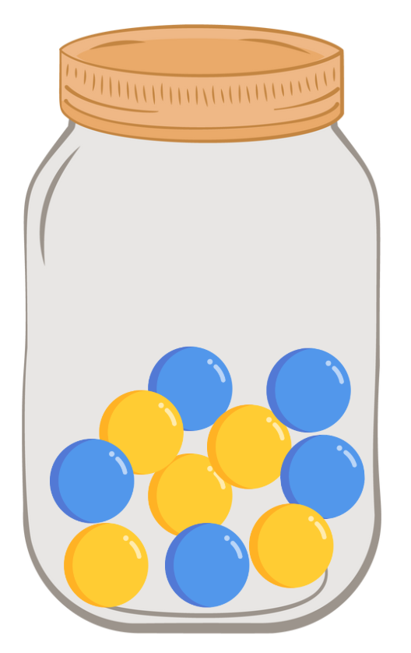
Short response (24)
This jar has equal numbers of yellow and blue marbles.
List the outcomes when 3 marbles are randomly selected from this jar.
Notes:
Short response questions provide brisk paced questions focussing on review of current and previous content to support spaced and interleaved practice.
Syllabus focus area:
Chance A

Slide 45
Activity 6 – place value comparisons
Aim of the game
To make the closest possible number to 500 000, without going over.
Rules:
each player rolls a 9-sided dice 6 times
after each roll, choose where to place the digit
once a digit is placed, it cannot be moved
after 6 throws, you may swap 2 of your digits with each other
read your number to a partner and record the number using expanded notation
as a class, determine who has made the number closest to 500 000.
Notes:
This is a developing number sense activity.
Number sense refers to a deep understanding of numbers, including their magnitude, relationships, and the effects of operations on them. It supports fluency and understanding, estimation, flexible thinking, and efficient problem-solving. Number sense activities 1–4 ‘activate’ prior number knowledge and support the learning of new content in the unit. Number sense activities 5–8 ‘loop’ back and provide opportunity for spaced practice with concepts and procedures covered in previous units.
Syllabus focus area:
Representing numbers using place value B
Place value comparisons
This resource corresponds to Resource 22 – place value houses in Stage 2 Year B Unit 24.
Repeat the game ‘Make 500 000’ from Activity 5 using Resource 22 – place value houses. This time, after the last dice roll, students can swap 2 of their digits with each other. For example, if students have recorded 549 662, they could swap the 5 and the 4 to make 459 662 as this would be closer to 500 000.
Repeat the game, but this time the digit swap must be after the fifth dice roll, and no change can be made again after the last dice roll.

Slide 46
Review of learning 7

Slide 47
Multiple choice (4)
600 000 + 90 000 + 3000 + 400 + 1 is expanded notation for
A
693 401
B
690 341
C
693 041
D
694 301
Notes:
This question connects to the content in the developing number sense activity (Activity 7)
Syllabus focus area:
Representing numbers using place value B

Slide 48
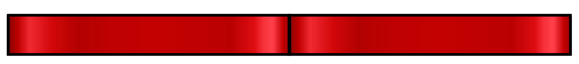
Short response (25)
This ribbon has been split into 2 parts.
Draw this ribbon and label the halves.
Next draw and label 3 halves.
Notes:
Short response questions provide brisk paced questions focussing on review of current and previous content to support spaced and interleaved practice.
Syllabus focus area:
Partitioned fractions B

Slide 49
Short response (26)
How long until 3:00pm?
Notes:
Short response questions provide brisk paced questions focussing on review of current and previous content to support spaced and interleaved practice.
Syllabus focus area:
Non-spatial measure B

Slide 50
Short response (27)
Corey used a vertical algorithm to solve 798 – 93.
Is this the most efficient strategy he could have used?
Communicate your reasoning.
7 9 8
- 9 3
7 0 5
Notes:
Short response questions provide brisk paced questions focussing on review of current and previous content to support spaced and interleaved practice.
Syllabus focus area:
Additive relations B

Slide 51
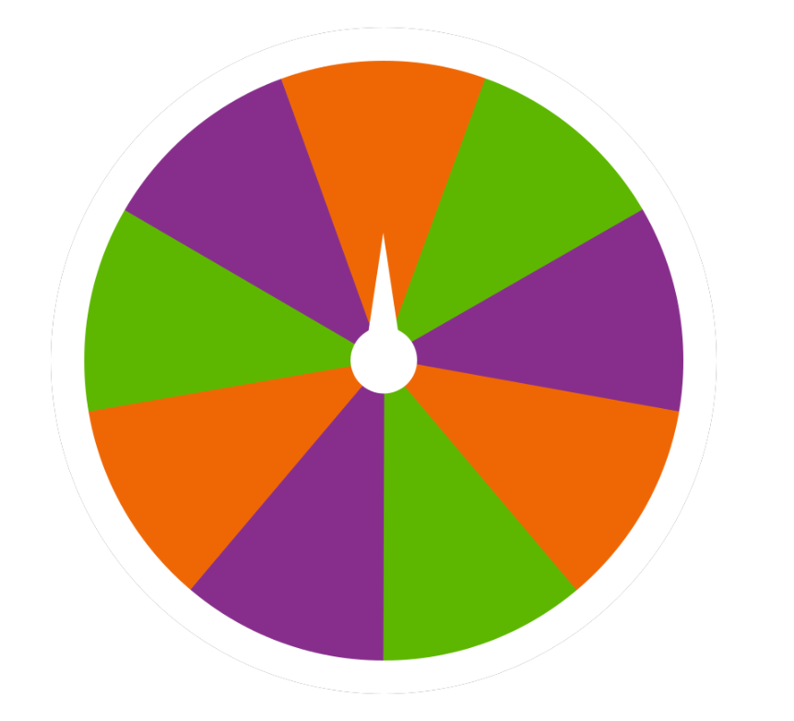
Short response (28)
Ravi is going to spin this spinner 12 times. Predict how many times the spinner will land on purple.
Notes:
Short response questions provide brisk paced questions focussing on review of current and previous content to support spaced and interleaved practice.
Syllabus focus area:
Chance A

Slide 52
Activity 7 – expanding number notation (1)
six and
ninety one
thousand and
hundred four
three
Notes:
This is a developing number sense activity.
Number sense refers to a deep understanding of numbers, including their magnitude, relationships, and the effects of operations on them. It supports fluency and understanding, estimation, flexible thinking, and efficient problem-solving. Number sense activities 1–4 ‘activate’ prior number knowledge and support the learning of new content in the unit. Number sense activities 5–8 ‘loop’ back and provide opportunity for spaced practice with concepts and procedures covered in previous units.
Syllabus focus area:
Representing numbers using place value B
Expanding number notation
This resource corresponds to Resource 23 in Stage 2 Year B Unit 24.
Students use all words from the list to make one number. They can add one hyphen to join 2 numbers together, for example, ninety-three. Students write their solution using words and expanded notation. If they find one solution, ask if that is the only solution possible.
Example solutions are:
- six hundred and ninety-three thousand, four hundred and one = 600 000 + 90 000 + 3000 + 400 + 1
- four hundred and ninety-six thousand, one hundred and four = 400 000 + 90 000 + 6000 + 100 + 4
one hundred and four thousand, six hundred and ninety-three = 100 000 + 4000 + 600 + 90 + 3
Students repeat the process, choosing one option from Resource 23 – What’s the number? (following slide)
Note: Some of these include zero as a challenge.

Slide 53
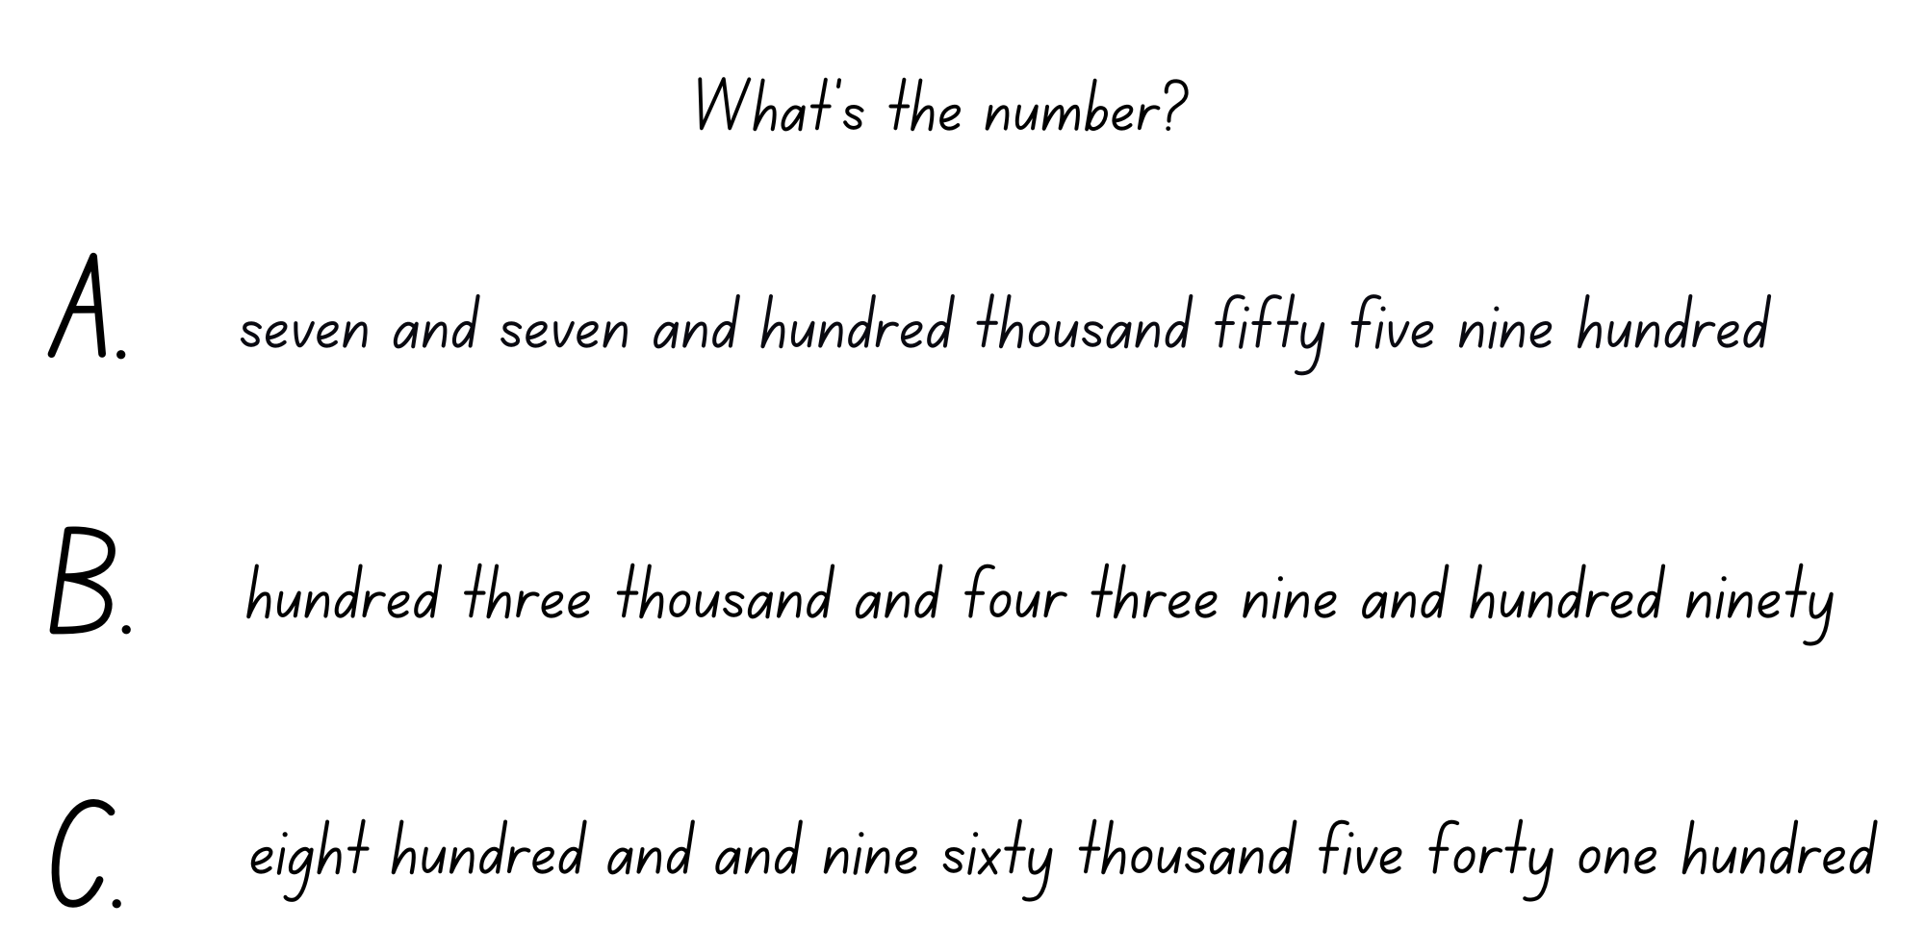
Activity 7 – expanding number notation (2)
Notes:
This is a developing number sense activity.
Number sense refers to a deep understanding of numbers, including their magnitude, relationships, and the effects of operations on them. It supports fluency and understanding, estimation, flexible thinking, and efficient problem-solving. Number sense activities 1–4 ‘activate’ prior number knowledge and support the learning of new content in the unit. Number sense activities 5–8 ‘loop’ back and provide opportunity for spaced practice with concepts and procedures covered in previous units.
Syllabus focus area:
Representing numbers using place value B
Expanding number notation
Students repeat the process, choosing one option from Resource 23 – What’s the number?
Note: Some of these include zero as a challenge.

Slide 54
Review of learning 8

Slide 55
True or false (4)
605 124 = 600 000 + 50 000 + 100 + 20 + 4
True | False
Notes:
The question on this slide connects to the content being explored in the developing number sense activity (Activity 8)
Syllabus focus area:
Representing numbers using place value B

Slide 56
Short response (29)
Record your answers:
How many wholes can you make with 7 halves?
How many halves will be left over?
How can we represent 7 halves as wholes and fractions?
Notes:
Short response questions provide brisk paced questions focussing on review of current and previous content to support spaced and interleaved practice.
Syllabus focus area:
Partitioned fractions B

Slide 57
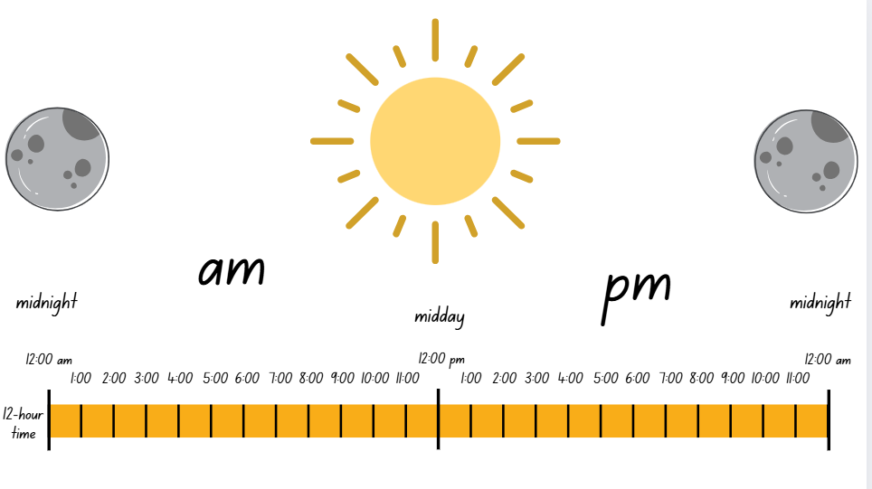
Short response (30)
List 3 things you might do
between 9:00am and 3:00 pm.
Notes:
Short response questions provide brisk paced questions focussing on review of current and previous content to support spaced and interleaved practice.
Syllabus focus area:
Non-spatial measure B

Slide 58
Short response (31)
Stevie solved 628 – 53 using a vertical algorithm. Use the table below to represent her thinking by drawing MAB materials.
6 2 8
- 5 3
7 7 5
5
1
 | H | T | 0
628
- 53
=
Notes:
Short response questions provide brisk paced questions focussing on review of current and previous content to support spaced and interleaved practice.
Syllabus focus area:
Additive relations B

Slide 59
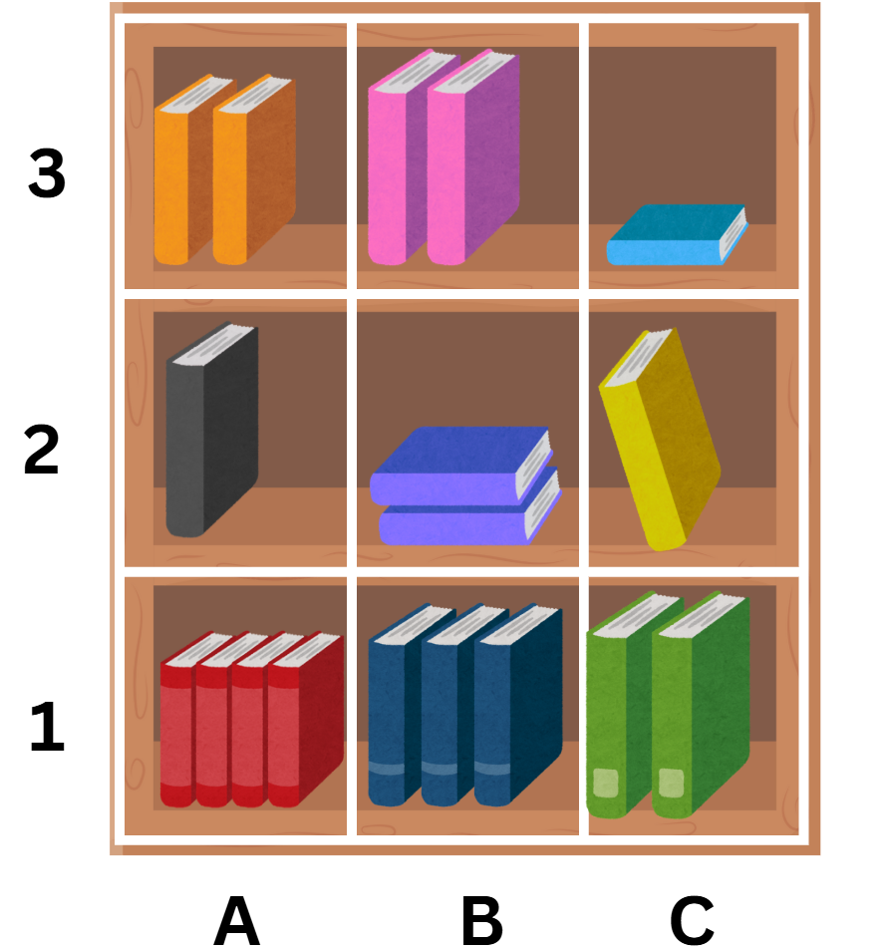
Short response (32)
Use the grid reference to write the location of the following items:
the orange books
the green books
the red books.
Notes:
Short response questions provide brisk paced questions focussing on review of current and previous content to support spaced and interleaved practice.
Syllabus focus area:
Geometric measure A: Position

Slide 60
Activity 8 – place value expanded number notation
472 691
693 543
184 397
Notes:
This is a developing number sense activity.
Number sense refers to a deep understanding of numbers, including their magnitude, relationships, and the effects of operations on them. It supports fluency and understanding, estimation, flexible thinking, and efficient problem-solving. Number sense activities 1–4 ‘activate’ prior number knowledge and support the learning of new content in the unit. Number sense activities 5–8 ‘loop’ back and provide opportunity for spaced practice with concepts and procedures covered in previous units.
Syllabus focus area:
Representing numbers using place value B
Place value expanded number notation
Discuss how these can be rewritten with words and expanded numbers. Students write each of the numbers using words and expanded notation.
In pairs students write a 6-digit number and their partner records the number using words and expanded notation. Students take turns repeating the process.

Slide 61
Double Venn diagram
Object 1
Object 2
Features similar to both objects
Features of object 1
Features of object 2

Slide 62
Frayer
Definition
Facts/Characteristics
Word, term, concept
Examples
Non-examples

Slide 63
Spider map
Idea
Subject

Slide 64
Cline
Concept 1
Concept 2
Word
Word
Word
Word
Word
Word
Word
Word
Word
Word
Word

Slide 65

Compare and contrast

Slide 66
Multiple choice (5)
A
B
C
D

Slide 67
Multiple choice (6)
A
B
C
D

Slide 68
References
This presentation contains NSW Curriculum and syllabus content. The NSW Curriculum is developed by the NSW Education Standards Authority. This content is prepared by NESA for and on behalf of the Crown in the right of the State of New South Wales. The material is protected by Crown copyright.
Please refer to the NESA Copyright Disclaimer for more information https://educationstandards.nsw.edu.au/wps/portal/nesa/mini-footer/copyright.
NESA holds the only official and up-to-date versions of the NSW Curriculum and syllabus documents. Please visit the NSW Education Standards Authority (NESA) website https://educationstandards.nsw.edu.au/wps/portal/nesa/home and the NSW Curriculum website https://curriculum.nsw.edu.au.
Mathematics K–10 Syllabus © NSW Education Standards Authority (NESA) for and on behalf of the Crown in right of the State of New South Wales, 2022.​
National Numeracy Learning Progression © Australian Curriculum, Assessment and Reporting Authority (ACARA) 2010 to present, unless otherwise indicated. This material was downloaded from the Australian Curriculum website (National Numeracy Learning Progression) (accessed 14 November 2025) and was not modified.
NSW Education Standards Authority (NESA) (2022) ‘Teaching advice for Partitioned fractions B’, Stage 2, NSW Curriculum website, accessed 14 November 2025.

Slide 69
Copyright
© State of New South Wales (Department of Education), 2025
The copyright material published in this resource is subject to the Copyright Act 1968 (Cth) and is owned by the NSW Department of Education or, where indicated, by a party other than the NSW Department of Education (third-party material).
Copyright material available in this resource and owned by the NSW Department of Education is licensed under a Creative Commons Attribution 4.0 International (CC BY 4.0) license.
This license allows you to share and adapt the material for any purpose, even commercially.
Attribution should be given to © State of New South Wales (Department of Education), 2025.
Material in this resource not available under a Creative Commons license:
the NSW Department of Education logo, other logos and trademark-protected material
Material owned by a third party that has been reproduced with permission. You will need to obtain permission from the third party to reuse its material.
Links to third-party material and websites
Please note that the provided (reading/viewing material/list/links/texts) are a suggestion only and implies no endorsement, by the New South Wales Department of Education, of any author, publisher, or book title. School principals and teachers are best placed to assess the suitability of resources that would complement the curriculum and reflect the needs and interests of their students.
If you use the links provided in this document to access a third party’s website, you acknowledge that the terms of use, including licence terms set out on the third-party’s website apply to the use which may be made of the materials on that third-party website or where permitted by the Copyright Act 1968 (Cth). The department accepts no responsibility for content on third-party websites.

