Slide 1
Instructions for use
This resource is not a teaching and learning program. It should be used in conjunction with Stage 2 Year B Unit 25.
Classroom teachers are encouraged to add and adapt slides as required to meet the needs of their students.
Save a copy of the file to make changes to the slide deck. Go to File > Download a Copy (this downloads a copy to the computer to edit in the PowerPoint app).
To convert the PowerPoint to Google Slides:
  Upload the file into Google Drive and open it.
  Go to File > Save as Google Slides.
  (Note – conversion may cause formatting changes in the slides.)

Slide 2

Review of Learning
Mathematics Stage 2 – Unit 25
Notes:
Reviews may include a combination of question types, requiring students to recall facts and key ideas, as well as apply their knowledge to solve problems and answer questions. To support active engagement, a mix of techniques should be employed.” (AERO, 2024).
This Review of Learning slide deck revisits key concepts from the following units:
Stage 2 Year B Unit 25
Stage 2 Year B Unit 24
Stage 2 Year B Unit 23
It also includes opportunities to review prior learning in non-number content, supporting consolidation across focus areas.
The review of learning resources include three key task types that support the development of mathematical proficiency through retrieval, spaced practice, and active participation. These practices complement the review phase (activating prior knowledge) embedded within the beginning of each lesson.
1.
Multiple-choice questions/True or false: Designed to promote active retrieval of key concepts and identify common misconceptions in number, supporting consolidation, understanding and fluency.
These questions:
support spaced and interleaved practice
help identify and address common misconceptions
support active recall and immediate feedback
support whole class participation
identify areas requiring reteach
2.
Short-response question sets: Carefully grouped questions that encourage spaced and interleaved practice across multiple focus areas, helping students revisit and apply knowledge from different points in time.
These questions:
have a combination of question types
address a range of focus areas
build automaticity and fluency
support active recall
allow for immediate feedback
identify content requiring reteach
3.
Developing number sense activities: A variety of practical, purposeful tasks that reinforce current learning and build on prior knowledge. These activities promote reasoning, problem-solving and conceptual understanding.
The review of learning resources are designed to work support teaching and learning in mathematics. For the most effective implementation, use the resources flexibly, adapting to meet student learning needs and individual classroom contexts.

Slide 3
Lessons
1
Review of learning 1
5
Review of learning 5
2
Review of learning 2
6
Review of learning 6
3
Review of learning 3
7
Review of learning 7
4
Review of learning 4
8
Review of learning 8
Notes:
Teacher notes:
Click lesson numbers to go to specific lessons
Interactive features can be viewed in slide show

Slide 4
Review of learning 1

Slide 5

Multiple choice (1)
60 x 3 is the same as:
A
60 groups of 10, 3 tens and 180
B
6 groups of 3 tens, 18 tens and 180
C
6 groups of 3 tens, 120 tens and 180
D
6 groups of 100, 18 tens and 180
Notes:
This question connects to the content in the developing number sense activity (Activity 1)
Syllabus focus area:
Multiplicative relations B

Slide 6

Short response (1)
Write a definition for the term 'statistical question'.
Notes:
Short response questions provide brisk paced questions focussing on review of current and previous content to support spaced and interleaved practice.
Syllabus focus area:
Data B

Slide 7
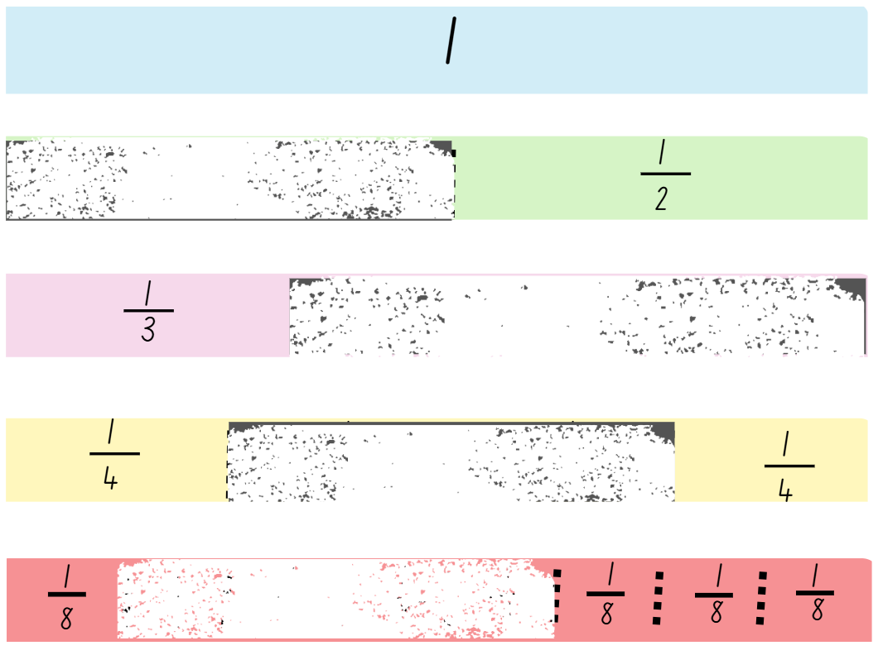
Short response (2)
Record the missing fraction parts.
Notes:
Short response questions provide brisk paced questions focussing on review of current and previous content to support spaced and interleaved practice.
Syllabus focus area:
Partitioned fractions A

Slide 8
Short response (3)
Which scaled instrument would be the most appropriate to use to measure the length of the following?
          a laptop
          a desk
          a swimming pool
Communicate your reasoning.
Notes:
Short response questions provide brisk paced questions focussing on review of current and previous content to support spaced and interleaved practice.
Syllabus focus area:
Geometric measure B

Slide 9
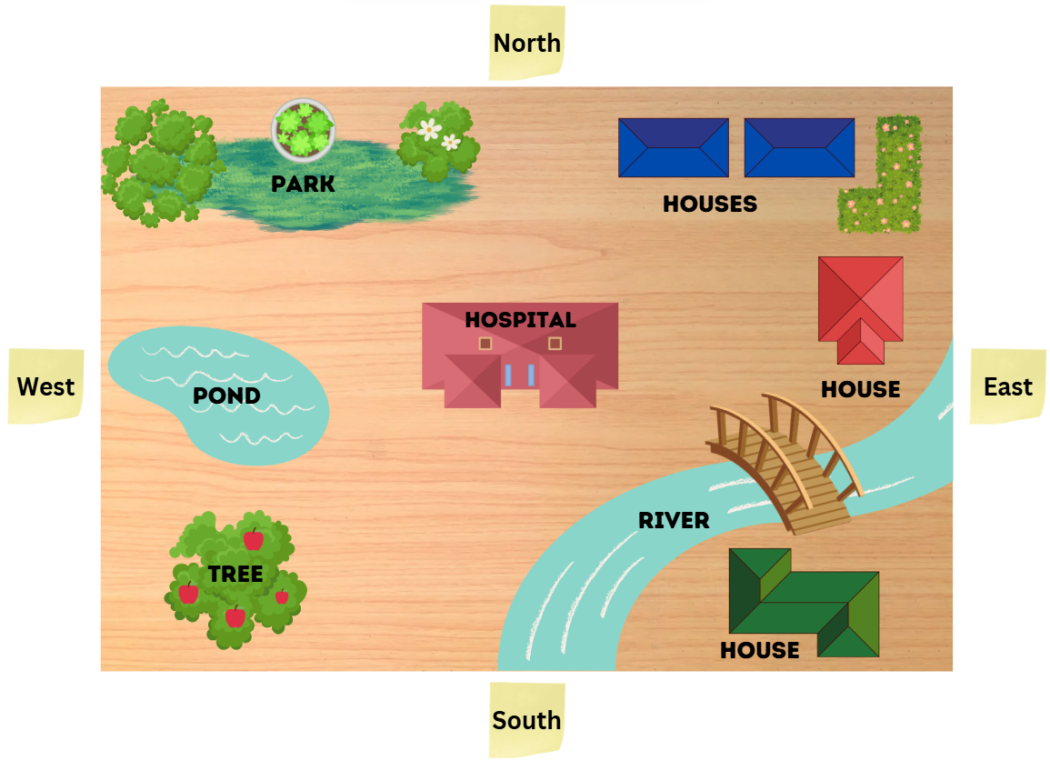
Short response (4)
Describe the route from the blue houses to the pond.
Notes:
Short response questions provide brisk paced questions focussing on review of current and previous content to support spaced and interleaved practice.
Syllabus focus area:
Geometric measure A

Slide 10

Activity 1 – counting by tens
Target number – 180
10, 20
30, 40, 50
60, 70, 80
90, 100
110, 120
130, 140
150
160, 170, 180
Madi
Ruby
Notes:
This is a developing number sense activity.
Number sense refers to a deep understanding of numbers, including their magnitude, relationships, and the effects of operations on them. It supports fluency and understanding, estimation, flexible thinking, and efficient problem-solving. Number sense activities 1–4 ‘activate’ prior number knowledge and support the learning of new content in the unit. Number sense activities 5–8 ‘loop’ back and provide opportunity for spaced practice with concepts and procedures covered in previous units.
Syllabus focus area:
Multiplicative Relations B
Activity 1 – Counting by tens
This activity is an adaptation of the ‘Counting game (by multiples of 10)’ from Thinking mathematically resources by State of New South Wales (Department of Education).
Aim of the game
Be the player to say the target number in the counting by tens sequence to score a point.
Rules:
roll the die/spin the spinner four times. Multiply each number by 10, then add them together to find the target number
start at zero and take turns counting on by saying the next 1, 2, or 3 numbers in the tens sequence
keep track of the target number and the numbers said during each turn
the player who says the target number scores a point. Choose a new target number and play again.
1. The game may be varied by:
starting at the target number and counting backwards to zero
rolling the die or spinning the spinner once and multiplying by a multiple of 10, for example, if a player rolls a 5, it becomes 50.
2. Reflect on the activity, asking questions such as:
Did you prefer going first or second? Why?
What strategy did you use? How successful was it and why?
Looking back on the games that you played, can you see any ways that one player could change their moves to win?
How could you make the game easier or harder?

Slide 11
Review of learning 2

Slide 12
True or false (1)
7 x 10 = 700
True | False
Notes:
The question on this slide connects to the content being explored in the developing number sense activity (Activity 2)
Syllabus focus area:
Multiplicative relations B

Slide 13
Short response (5)
Data was collected from students in class KD about their favourite sports.
Represent this data in a dot plot.
Football | 8
AFL | 7
Netball | 4
Tennis | 2
Notes:
Short response questions provide brisk paced questions focussing on review of current and previous content to support spaced and interleaved practice.
Syllabus focus area:
Data A

Slide 14
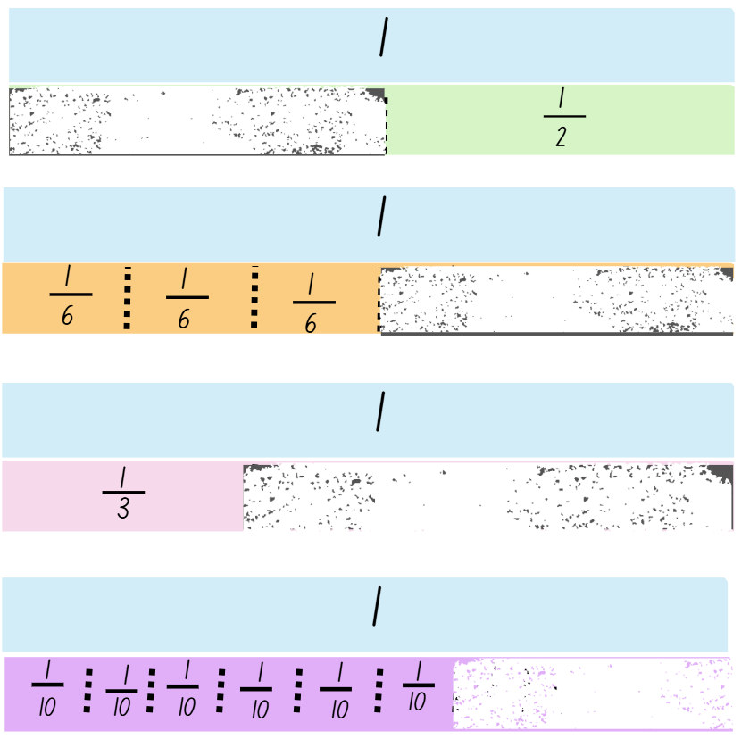
Short response (6)
Record the missing fraction parts.
Notes:
Short response questions provide brisk paced questions focussing on review of current and previous content to support spaced and interleaved practice.
Syllabus focus area:
Partitioned fractions A

Slide 15
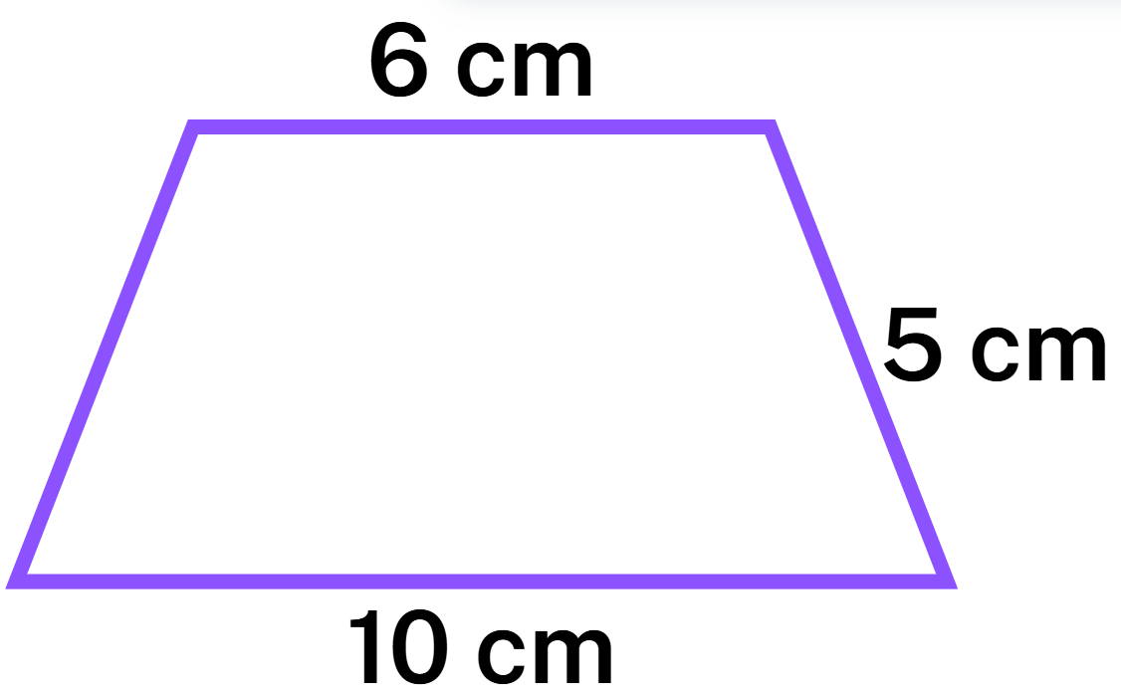
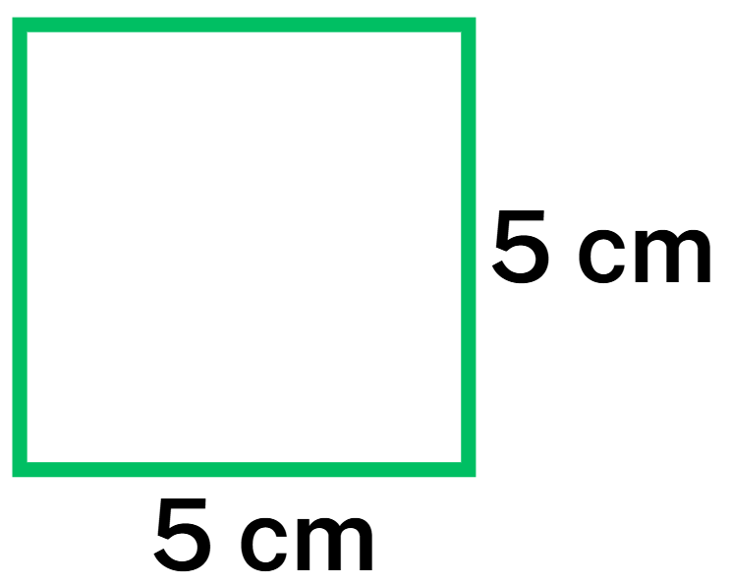
Short response (7)
Which quadrilateral has the greater perimeter?
Notes:
Short response questions provide brisk paced questions focussing on review of current and previous content to support spaced and interleaved practice.
Syllabus focus area:
Geometric measure B

Slide 16

Short response (8)
Name the shapes below that have right angles.
Notes:
Short response questions provide brisk paced questions focussing on review of current and previous content to support spaced and interleaved practice.
Syllabus focus area:
Two-dimensional spatial structure A

Slide 17
Activity 2 – multiply by 10 (1)
0 | 10 | 40 | 80 | 60
30 | 70 | 20 | 50 | 30
50 | 20 | 0 | 40 | 60
90 | 10 | 70 | 80 | 50
40 | 60 | 30 | 90 | 20
Player 1 counters
Player 2 counters
Notes:
This is a developing number sense activity. ​
​
Number sense refers to a deep understanding of numbers, including their magnitude, relationships, and the effects of operations on them. It supports fluency and understanding, estimation, flexible thinking, and efficient problem-solving. Number sense activities 1–4 ‘activate’ prior number knowledge and support the learning of new content in the unit. Number sense activities 5–8 ‘loop’ back and provide opportunity for spaced practice with concepts and procedures covered in previous units. ​
​
Syllabus focus area:​
Multiplicative relations B
​
Activity 2 – Multiply by 10
This activity is an adaptation of ‘Multiples madness (fives)’ from ‘Thinking mathematically resources’ by State of New South Wales (Department of Education).
This resource corresponds to Resource 22 – multiples madness gameboard and Resource 23– multiples madness scoreboard in Stage 2 Year B Unit 25.
Aim of the game
Be the first player to get 3 counters in a row on the gameboard by multiplying numbers by 10.
Rules:
ning the spinner. Multiply the number by 10 and explain your thinking to your partner
place a counter on the matching number on the gameboard. If the number is already taken, you miss a turn
once all 3 of your counters are on the board, you’ll need to move one of them to a new number to try for 3 in a row.
Reflect on the activity, asking questions such as:
Did you prefer going first or second? Why?
What strategy did you use? How successful was it and why?
How might the game change if you multiplied by 20?
Would it be easier if you had more counters? Why?
Note: The counters can be moved in normal view. The spinner (next slide) functions in the presentation mode. Click on the ‘Spin’ button to make the spinner spin. Click again on the ‘Spin’ button to make it stop. The spinner does not work in the same mode as the pile of infinite counters.

Slide 18
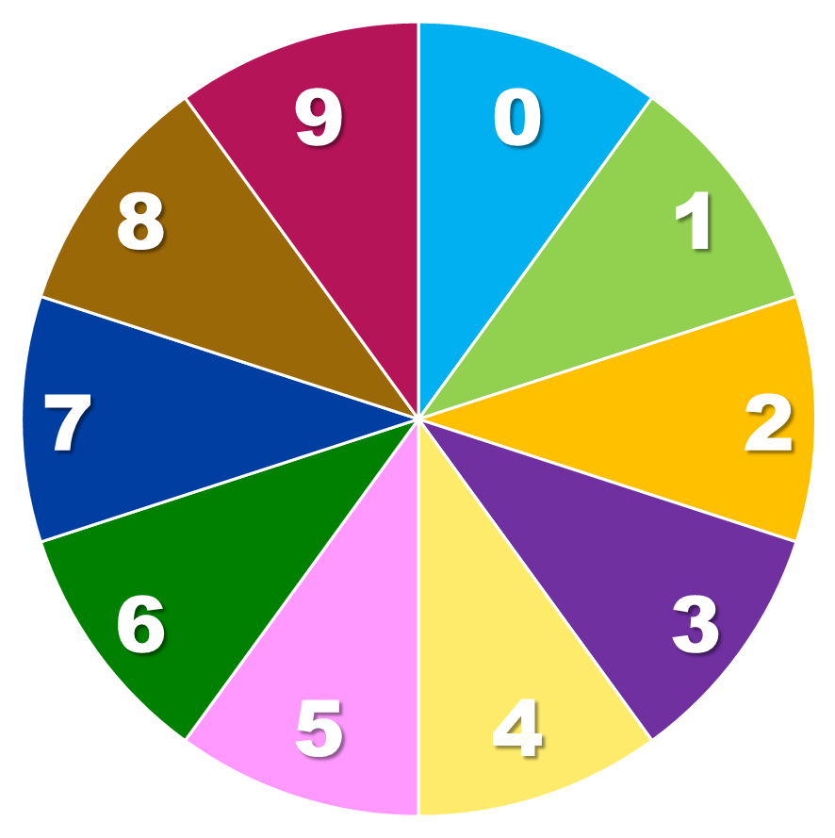
Activity 2 – multiply by 10 (2)
Spin!
Notes:
Note: The spinner functions in the presentation mode. Click on the ‘Spin’ button to make the spinner spin. Click again on the ‘Spin’ button to make it stop. The spinner does not work in the same mode as the pile of infinite counters.

Slide 19
Review of learning 3

Slide 20
Multiple choice (2)
9 x 60 =
A
480
B
460
C
540
D
54
Notes:
This question connects to the content in the developing number sense activity (Activity 3)
Syllabus focus area:
Multiplicative relations B

Slide 21
Short response (9)
Create a statistical question to ask a group of students about their favourite food.
Notes:
Short response questions provide brisk paced questions focussing on review of current and previous content to support spaced and interleaved practice.
Syllabus focus area:
Data B

Slide 22
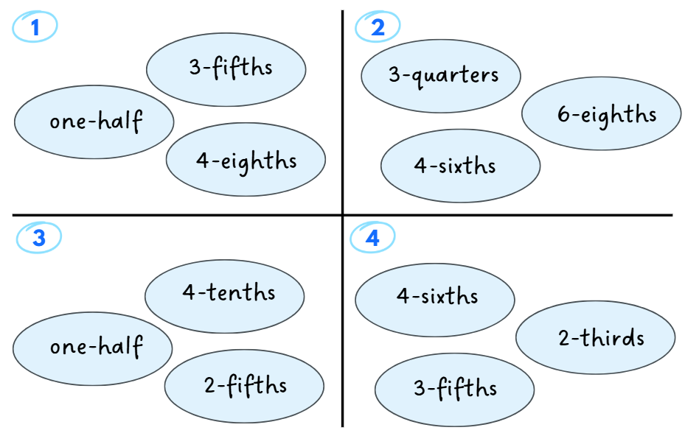
Short response (10)
Which one does not belong?
Notes:
Short response questions provide brisk paced questions focussing on review of current and previous content to support spaced and interleaved practice.
Syllabus focus area:
Partitioned fractions B

Slide 23
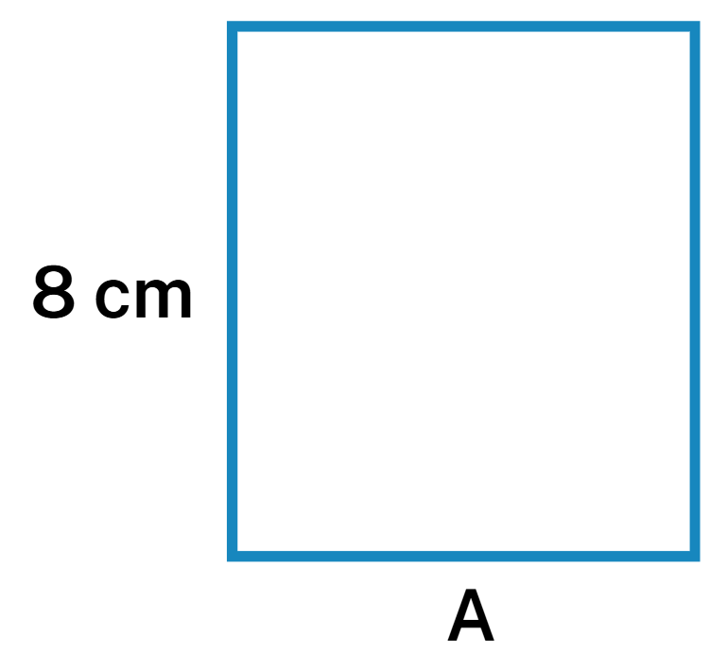
Short response (11)
The perimeter of this rectangle is 30 cm.
One side is 8 cm.
What is the length of side A?
Notes:
Short response questions provide brisk paced questions focussing on review of current and previous content to support spaced and interleaved practice.
Syllabus focus area:
Geometric measure B

Slide 24

Short response (12)
If this arrow moves one quarter turn clockwise, draw what it would look like.
Notes:
Short response questions provide brisk paced questions focussing on review of current and previous content to support spaced and interleaved practice.
Syllabus focus area:
Two-dimensional spatial structure A

Slide 25
Activity 3 – multiplying by multiples
Order | Roll 1 | Roll 2 | Number sentence | Actual order
1
2
3
4
5
Spin!
Notes:
This is a developing number sense activity.
Number sense refers to a deep understanding of numbers, including their magnitude, relationships, and the effects of operations on them. It supports fluency and understanding, estimation, flexible thinking, and efficient problem-solving. Number sense activities 1–4 ‘activate’ prior number knowledge and support the learning of new content in the unit. Number sense activities 5–8 ‘loop’ back and provide opportunity for spaced practice with concepts and procedures covered in previous units.
Syllabus focus area:
Multiplicative Relations B
Activity 3 – Multiplying by multiples
This resource corresponds to Resource 24 – multiplying multiples in Stage 2 Year B Unit 25.
Aim of the game
Be the player with the most points by correctly placing your multiplication products in ascending order.
Rules:
in pairs, take turns spinning the spinner twice per turn
the first number is the multiplier. The second number becomes a multiple of 10
multiply the two numbers and record your thinking in one row of the game sheet. Choose a row that keeps your results in ascending order
after 5 turns, check the ‘Actual Order’ column to see how many of your products were correctly placed. Score 1 point for each correct placement.
Reflect on the game, asking questions such as:
What strategy did you use to multiply?
How did you decide where to place each answer?
Did you change your strategy in the next round? Why or why not?
What modifications could you suggest for the game?
Note: The spinner functions in the presentation mode. Click on the ‘Spin’ button to make the spinner spin. Click again on the ‘Spin’ button to make it stop. The spinner does not work in the same mode as the pile of infinite counters.

Slide 26
Review of learning 4

Slide 27
True or false (2)
30 x 4 = 3 x 10 x 4 = 12 x 10 =120
True | False
Notes:
The question on this slide connects to the content being explored in the developing number sense activity (Activity 4)
Syllabus focus area:
Multiplicative relations B

Slide 28
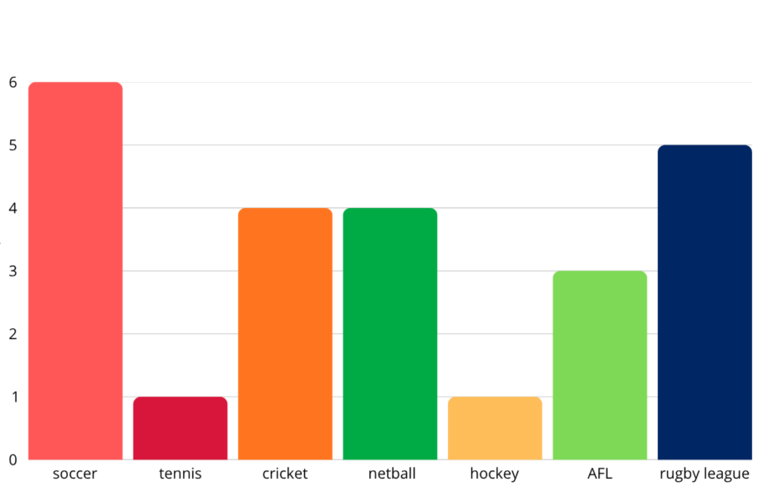
Short response (13)
Label each axes of the column graph.
Create a title for the column graph.
Notes:
Short response questions provide brisk paced questions focussing on review of current and previous content to support spaced and interleaved practice.
Syllabus focus area:
Data B

Slide 29
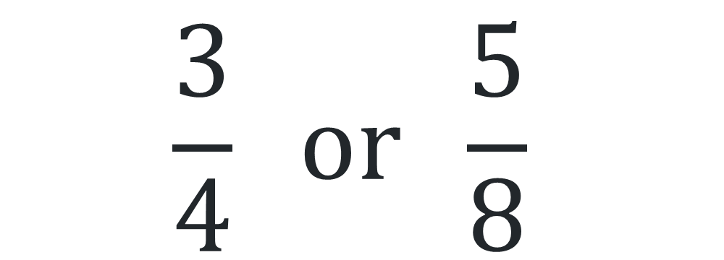
Short response (14)
Draw fraction strips to show which is bigger.
$$\frac{3}{4} or \frac{5}{8}$$
Notes:
Short response questions provide brisk paced questions focussing on review of current and previous content to support spaced and interleaved practice.
Syllabus focus area:
Partitioned fractions B

Slide 30
Short response (15)
Convert:
105 millimetres into centimetres
27 centimetres into millimetres
Notes:
Short response questions provide brisk paced questions focussing on review of current and previous content to support spaced and interleaved practice.
Syllabus focus area:
Geometric measure B

Slide 31
Short response (16)
Which of the following items is about a kilogram?
banana
glue stick
laptop
a bucket of water
pencil case
you
Notes:
Short response questions provide brisk paced questions focussing on review of current and previous content to support spaced and interleaved practice.
Syllabus focus area:
Non-spatial measure A

Slide 32
Activity 4 – multiplying multiples reflection
Reflection questions:
What strategy did you use to multiply?
How did you decide where to place each answer?
Did you change your strategy in the next round? Why or why not?
What modifications could you suggest for the game?
Notes:
This is a developing number sense activity.
Number sense refers to a deep understanding of numbers, including their magnitude, relationships, and the effects of operations on them. It supports fluency and understanding, estimation, flexible thinking, and efficient problem-solving. Number sense activities 1–4 ‘activate’ prior number knowledge and support the learning of new content in the unit. Number sense activities 5–8 ‘loop’ back and provide opportunity for spaced practice with concepts and procedures covered in previous units.
Syllabus focus area:
Multiplicative Relations B
Activity 4 – multiplying multiples reflection
Revisit the responses from Resource 24 – multiplying multiples, completed during Activity 3.
Reflect on the game, asking questions such as:
What strategy did you use to multiply?
How did you decide where to place each answer?
Did you change your strategy in the next round? Why or why not?
What modifications could you suggest for the game?

Slide 33
Review of learning 5

Slide 34
Multiple choice (3)
146, 155, 164, 173
This pattern increases…
A
by 8
B
by 9
C
by 7
D
by 10
Notes:
This question connects to the content in the developing number sense activity (Activity 5)
Syllabus focus area:
Multiplicative relations A

Slide 35
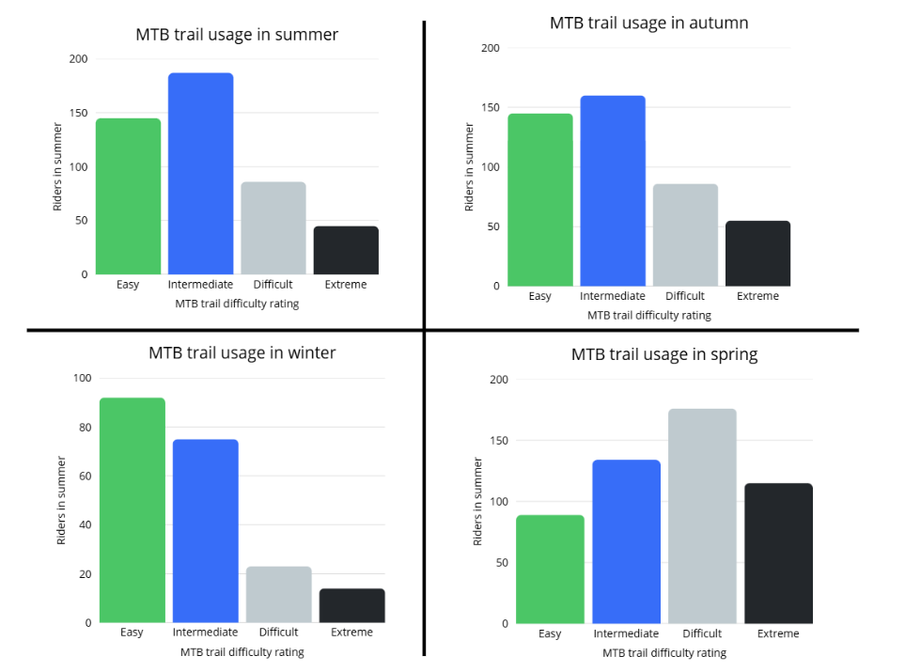
Short response (17)
Which season had the most bike riders use the extreme trail?
Which season had the most bike riders use the intermediate trail?
Which season had the least bike riders use the easy trail?
Notes:
Short response questions provide brisk paced questions focussing on review of current and previous content to support spaced and interleaved practice.
Syllabus focus area:
Data B

Slide 36
Short response (18)
Draw fraction strips to show how these fractions are equivalent:
2-quarters
1-half
Notes:
Short response questions provide brisk paced questions focussing on review of current and previous content to support spaced and interleaved practice.
Syllabus focus area:
Partitioned fractions B

Slide 37
Short response (19)
Record if the following activities would be measured in minutes or seconds:
Reading a short story
Taking a shower
Counting to 20
Eating lunch.
Notes:
Short response questions provide brisk paced questions focussing on review of current and previous content to support spaced and interleaved practice.
Syllabus focus area:
Non-spatial measure B

Slide 38
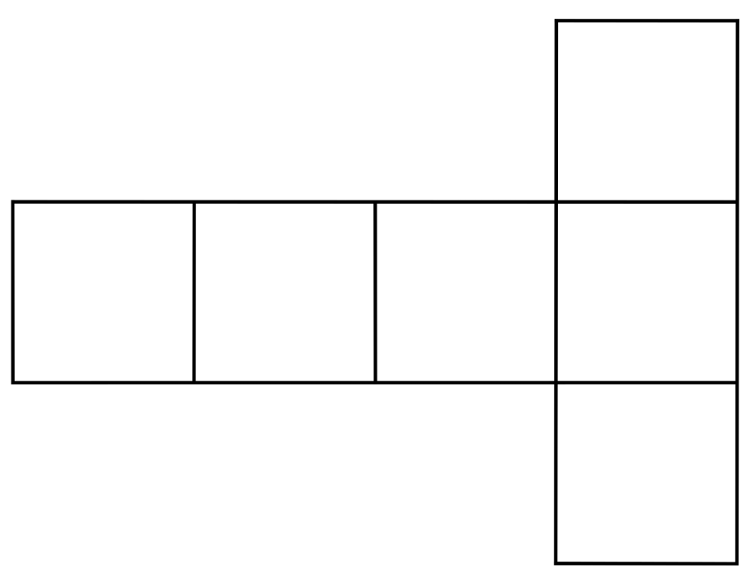
Short response (20)
This net can be folded to make a three-dimensional object. What object will it make when folded?
Describe the faces, edges and vertices of the object.
Notes:
Short response questions provide brisk paced questions focussing on review of current and previous content to support spaced and interleaved practice.
Syllabus focus area:
Three-dimensional spatial structure A: 3D objects

Slide 39
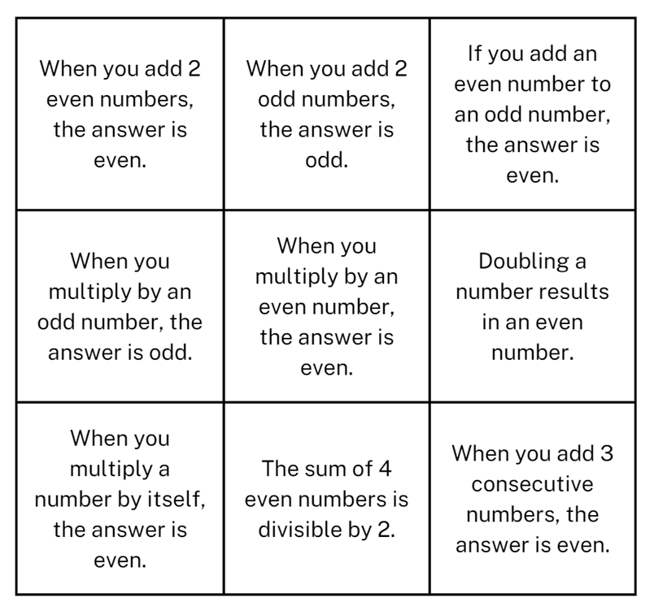
Activity 5 – odds and evens
Notes:
This is a developing number sense activity.
Number sense refers to a deep understanding of numbers, including their magnitude, relationships, and the effects of operations on them. It supports fluency and understanding, estimation, flexible thinking, and efficient problem-solving. Number sense activities 1–4 ‘activate’ prior number knowledge and support the learning of new content in the unit. Number sense activities 5–8 ‘loop’ back and provide opportunity for spaced practice with concepts and procedures covered in previous units.
Syllabus focus area:
Multiplicative Relations A
Activity 5 – Odds and Evens
This activity is an adaptation of ‘Always, sometimes or never?’ from NRICH by University of Cambridge.
This resource corresponds to Resource 25 – always, sometimes, never? in Stage 2 Year B Unit 25.
Display a variety of odd and even one-, 2- and 3-digit numbers and ask students to identify if they are odd or even.
Ask students to explain how they know if a number is odd or even.
Demonstrate the link between even numbers and the multiplication facts for 2. Explain the significance of the final digit of a whole number.
Note: one result that follows from the place value system is that any whole number can be written as a multiple of 10 plus a single digit. For example, 153 is 150 plus 3. Since a multiple of 10 is always even because every group of 10 is 2 rows of 5, then whether a number is odd or even can be determined by its final digit.
Direct students to this display
Students work in pairs or small groups to explore and then record if each statement is always true, sometimes true or never true. Advise students to check each statement with at least 3 different sets of numbers of varying size.
Select students to share their thinking and discuss, asking questions such as:
Can you explain your thinking?
Does anyone disagree? Why?
Can you explain why this statement is always or never true?
Can you rewrite this ‘sometimes’ statement so that it changes to an ‘always’ statement?

Slide 40
Review of learning 6

Slide 41
True or false (3)
94, 104, 114, 124
This pattern increases by multiples of 10.
True | False
Notes:
The question on this slide connects to the content being explored in the developing number sense activity (Activity 6)
Syllabus focus area:
Multiplicative relations A

Slide 42
Short response (21)
Write a definition for the term 'many to one scale'.
Notes:
Short response questions provide brisk paced questions focussing on review of current and previous content to support spaced and interleaved practice.
Syllabus focus area:
Data b

Slide 43
Short response (22)
How many quarters make one and 3- quarters?
How many wholes do 12-sixths make?
Communicate your reasoning.
Notes:
Short response questions provide brisk paced questions focussing on review of current and previous content to support spaced and interleaved practice.
Syllabus focus area:
Partitioned fractions B

Slide 44

Short response (23)
Daniella sets her timer for 2 minutes.
How many seconds until the timer rings?
Notes:
Short response questions provide brisk paced questions focussing on review of current and previous content to support spaced and interleaved practice.
Syllabus focus area:
Non-spatial measure B

Slide 45
Short response (24)
How many minutes are in
two and a half hours?
Notes:
Short response questions provide brisk paced questions focussing on review of current and previous content to support spaced and interleaved practice.
Syllabus focus area:
Non-spatial measure A

Slide 46
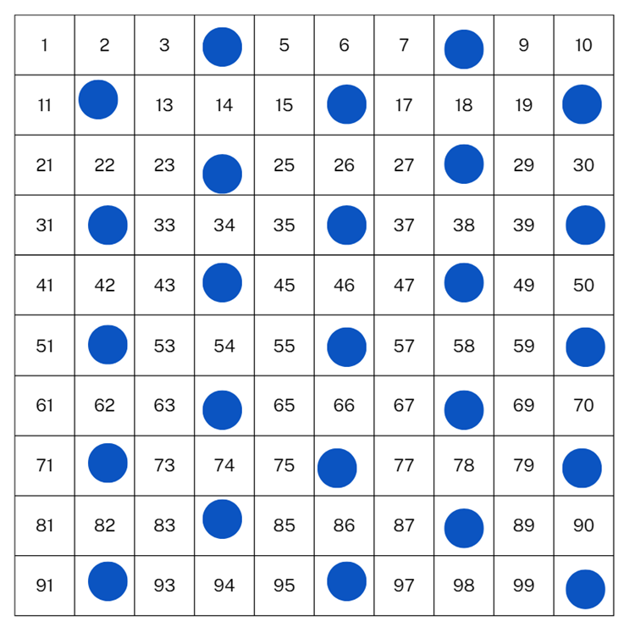
Activity 6 – number chart patterns
Notes:
This is a developing number sense activity.
Number sense refers to a deep understanding of numbers, including their magnitude, relationships, and the effects of operations on them. It supports fluency and understanding, estimation, flexible thinking, and efficient problem-solving. Number sense activities 1–4 ‘activate’ prior number knowledge and support the learning of new content in the unit. Number sense activities 5–8 ‘loop’ back and provide opportunity for spaced practice with concepts and procedures covered in previous units.
Syllabus focus area:
Multiplicative Relations A
Activity 6 – Number chart patterns
This activity is an adaptation of ‘Multiple Patterns’ from Meaningful Maths.
This resource corresponds to Resource 26 – number chart patterns and Resource 27 – number chart in Stage 2 Year B Unit 25.
Ask students:
What do you notice?
What do you wonder?
What might the pattern look like if multiples of 2 are covered?
How do we know if a number is a multiple of 2?
What might the pattern look like if multiples of 10 are covered?
How do we know if a number is a multiple of 10?
What might the pattern look like if multiples of 5 are covered?
How do we know if a number is a multiple of 5?
Provide students with a copy of Resource 27 - number chart.
Students to use coloured counters or markers to indicate multiples of 2, 5 and 10.
Ask students:
Do the patterns match your predictions?
What do you notice about the numbers that are not covered?
What might the pattern look like if multiples of 6 are covered?
What might the pattern look like if multiples of 8 are covered?

Slide 47
Review of learning 7

Slide 48
Multiple choice (4)
An example of an increasing number pattern by a constant amount is:
A
44, 55, 66, 77, 88
B
45, 76, 89, 100
C
23, 25, 27, 30
D
59, 63, 66, 67
Notes:
This question connects to the content in the developing number sense activity (Activity 7)
Syllabus focus area:
Multiplicative relations A

Slide 49
Short response (25)
She sells seashells by the seashore.
Use tally marks to create a table identifying how many times each letter appears in the sentence.
Notes:
Short response questions provide brisk paced questions focussing on review of current and previous content to support spaced and interleaved practice.
Syllabus focus area:
Data B

Slide 50
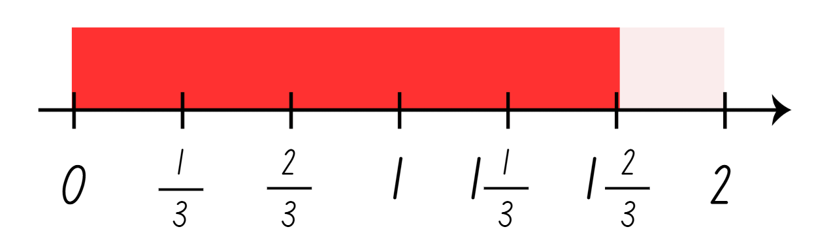
Short response (26)
How many thirds in one and 2-thirds?
Notes:
Short response questions provide brisk paced questions focussing on review of current and previous content to support spaced and interleaved practice.
Syllabus focus area:
Partitioned fractions B

Slide 51
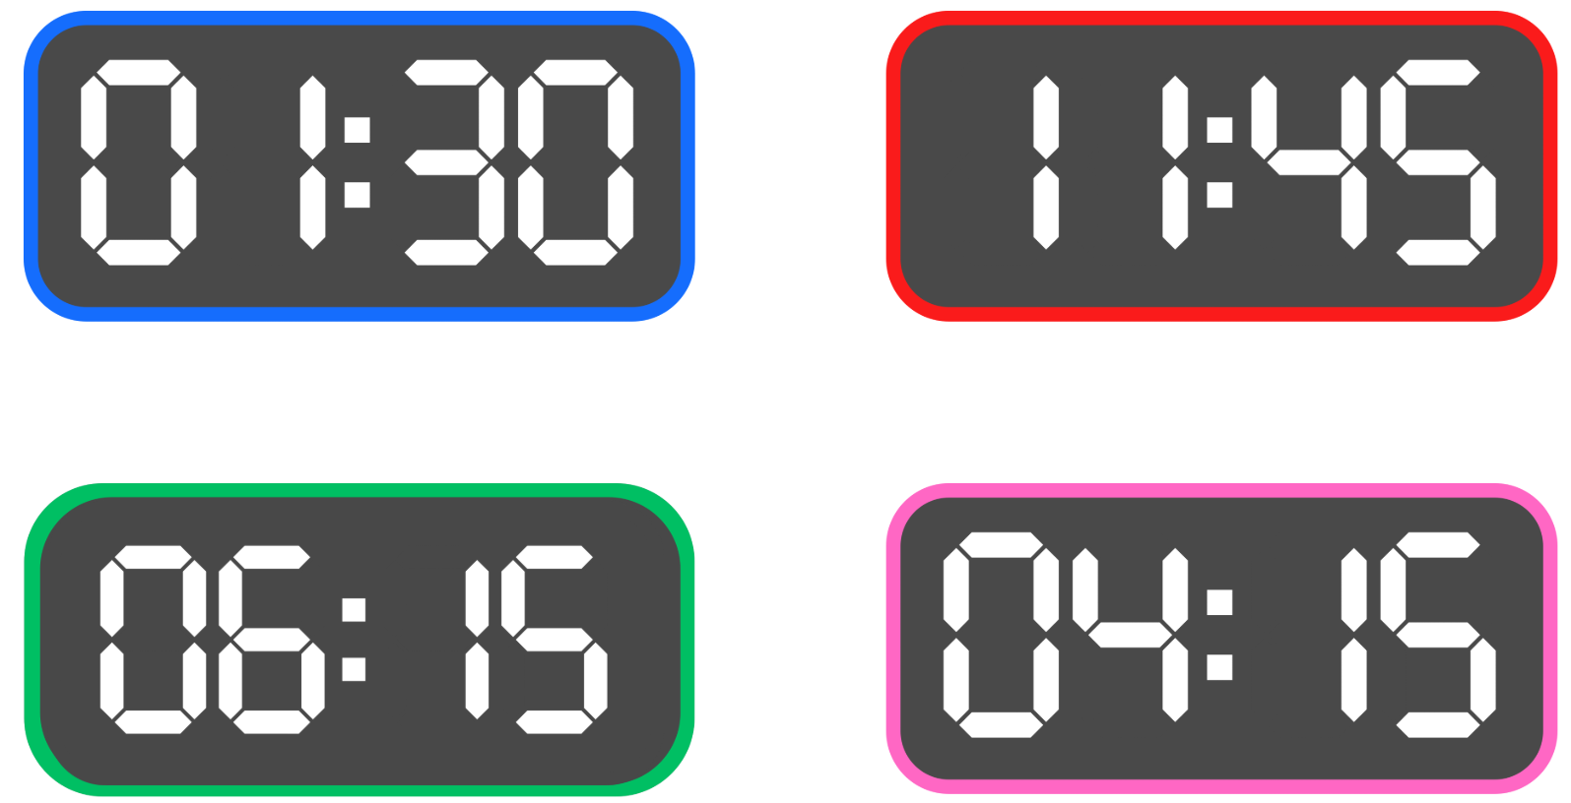
Short response (27)
Record these digital times in words.
Notes:
Short response questions provide brisk paced questions focussing on review of current and previous content to support spaced and interleaved practice.
Syllabus focus area:
Non-spatial measure B

Slide 52
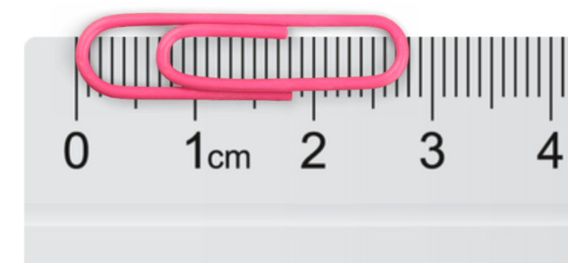
Short response (28)
Record the length of this paper clip in millimetres.
Notes:
Short response questions provide brisk paced questions focussing on review of current and previous content to support spaced and interleaved practice.
Syllabus focus area:
Geometric measure: Length

Slide 53
Activity 7 – increasing number patterns
95, 88, 81, 74, 67
90, 96, 102, 108, 114
79, 88, 97, 106, 115.
Notes:
This is a developing number sense activity.
Number sense refers to a deep understanding of numbers, including their magnitude, relationships, and the effects of operations on them. It supports fluency and understanding, estimation, flexible thinking, and efficient problem-solving. Number sense activities 1–4 ‘activate’ prior number knowledge and support the learning of new content in the unit. Number sense activities 5–8 ‘loop’ back and provide opportunity for spaced practice with concepts and procedures covered in previous units.
Syllabus focus area:
Multiplicative Relations A
Activity 7 – increasing number patterns
For each number pattern, ask students:
Can you describe the pattern?
How do you know it is a pattern?
What would the next 3 numbers be?
What would the 3 numbers be before the displayed numbers?
Students create and record their own number patterns that increase by any number under 12.
Students give their patterns to a partner and ask them to describe the pattern and record the next 3 numbers.

Slide 54
Review of learning 8

Slide 55
True or false (4)
An example of a decreasing number pattern by a constant amount is:
134, 130, 126, 122
True | False
Notes:
The question on this slide connects to the content being explored in the developing number sense activity (Activity 8)
Syllabus focus area:
Multiplicative relations A

Slide 56
Short response (29)
What makes data representations in the media effective?
Notes:
Short response questions provide brisk paced questions focussing on review of current and previous content to support spaced and interleaved practice.
Syllabus focus area:
Data B

Slide 57
Short response (30)
How many wholes can you make with 5-halves?
How many halves will be left over?
How can we represent 5-halves as wholes and fractions?
Record your thinking.
Notes:
Short response questions provide brisk paced questions focussing on review of current and previous content to support spaced and interleaved practice.
Syllabus focus area:
Partitioned fractions B

Slide 58
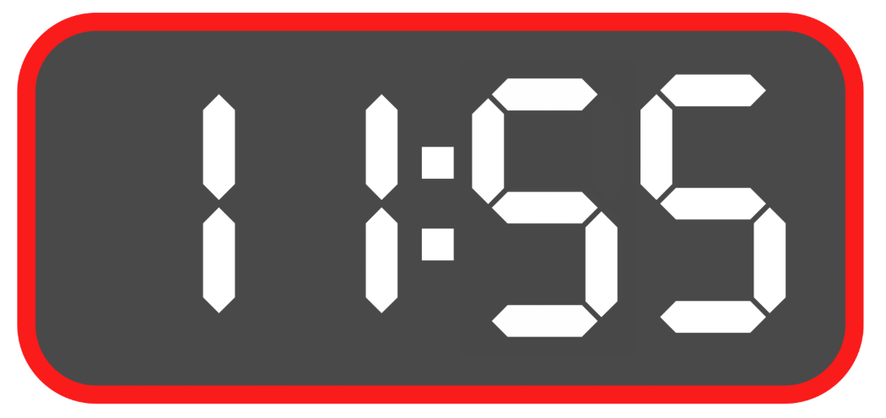
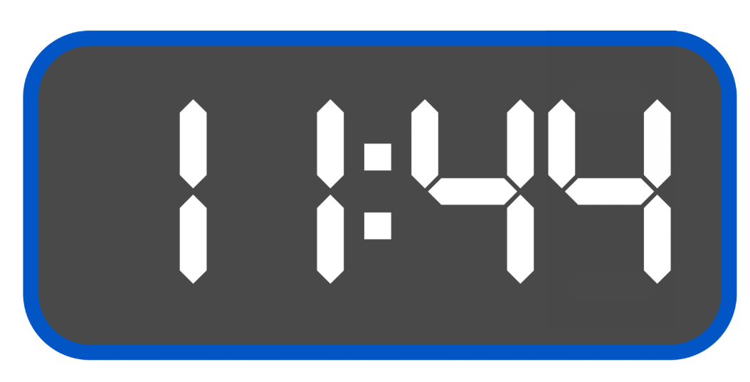
Short response (31)
How long is left until twelve o’clock for the following times?
Notes:
Short response questions provide brisk paced questions focussing on review of current and previous content to support spaced and interleaved practice.
Syllabus focus area:
Non-spatial measure B

Slide 59
Short response (32)
Record three angles found in your classroom.
Notes:
Short response questions provide brisk paced questions focussing on review of current and previous content to support spaced and interleaved practice.
Syllabus focus area:
Geometric measure: Angles

Slide 60
Activity 8 – decreasing number patterns
55, 51, 48, 45, 41
88, 84, 80, 76, 72
115, 109, 103, 97, 91
Notes:
This is a developing number sense activity.
Number sense refers to a deep understanding of numbers, including their magnitude, relationships, and the effects of operations on them. It supports fluency and understanding, estimation, flexible thinking, and efficient problem-solving. Number sense activities 1–4 ‘activate’ prior number knowledge and support the learning of new content in the unit. Number sense activities 5–8 ‘loop’ back and provide opportunity for spaced practice with concepts and procedures covered in previous units.
Syllabus focus area:
Multiplicative Relations A
Activity 8 – decreasing number patterns
For each number pattern, ask students:
Can you describe the pattern?
How do you know it is a pattern?
What would the next 3 numbers be?
What would the 3 numbers be before the displayed numbers?
Students create and record their own number patterns that decrease by any number under 12.
Students give their patterns to a partner and ask them to describe the pattern and record the next 3 numbers.

Slide 61
Double Venn diagram
Object 1
Object 2
Features similar to both objects
Features of object 1
Features of object 2

Slide 62
Frayer
Definition
Facts/Characteristics
Word, term, concept
Examples
Non-examples

Slide 63
Spider map
Idea
Subject

Slide 64
Cline
Concept 1
Concept 2
Word
Word
Word
Word
Word
Word
Word
Word
Word
Word
Word

Slide 65

Compare and contrast

Slide 66
Multiple choice (5)
A
B
C
D

Slide 67
Multiple choice (6)
A
B
C
D

Slide 68
References
This presentation contains NSW Curriculum and syllabus content. The NSW Curriculum is developed by the NSW Education Standards Authority. This content is prepared by NESA for and on behalf of the Crown in the right of the State of New South Wales. The material is protected by Crown copyright.
Please refer to the NESA Copyright Disclaimer for more information https://educationstandards.nsw.edu.au/wps/portal/nesa/mini-footer/copyright.
NESA holds the only official and up-to-date versions of the NSW Curriculum and syllabus documents. Please visit the NSW Education Standards Authority (NESA) website https://educationstandards.nsw.edu.au/wps/portal/nesa/home and the NSW Curriculum website https://curriculum.nsw.edu.au.
Mathematics K–10 Syllabus © NSW Education Standards Authority (NESA) for and on behalf of the Crown in right of the State of New South Wales, 2022.​
National Numeracy Learning Progression © Australian Curriculum, Assessment and Reporting Authority (ACARA) 2010 to present, unless otherwise indicated. This material was downloaded from the Australian Curriculum website (National Numeracy Learning Progression) (accessed 17 November 2025) and was not modified. ​
NSW Education Standards Authority (NESA) (2022) ‘Teaching advice for Data A’, Stage 2, NSW Curriculum website accessed 23 October 2025.
State of New South Wales (Department of Education) (2023) ‘Counting game (by multiples of 10)’, Thinking mathematically resources, NSW Department of Education website, accessed 23 June 2023.
——(2023) ‘Multiples madness (fives)’, Thinking mathematically resources, NSW Department of Education website, accessed 23 June 2023.
Meaningful Maths (n.d.) Multiple Patterns, Meaningful Maths website, accessed 23 June 2023.
University of Cambridge (n.d.) Always, sometimes or never?, NRICH website, accessed 23 June 2023.

Slide 69
Copyright
© State of New South Wales (Department of Education), 2025
The copyright material published in this resource is subject to the Copyright Act 1968 (Cth) and is owned by the NSW Department of Education or, where indicated, by a party other than the NSW Department of Education (third-party material).
Copyright material available in this resource and owned by the NSW Department of Education is licensed under a Creative Commons Attribution 4.0 International (CC BY 4.0) license.
This license allows you to share and adapt the material for any purpose, even commercially.
Attribution should be given to © State of New South Wales (Department of Education), 2025.
Material in this resource not available under a Creative Commons license:
the NSW Department of Education logo, other logos and trademark-protected material
Material owned by a third party that has been reproduced with permission. You will need to obtain permission from the third party to reuse its material.
Links to third-party material and websites
Please note that the provided (reading/viewing material/list/links/texts) are a suggestion only and implies no endorsement, by the New South Wales Department of Education, of any author, publisher, or book title. School principals and teachers are best placed to assess the suitability of resources that would complement the curriculum and reflect the needs and interests of their students.
If you use the links provided in this document to access a third party’s website, you acknowledge that the terms of use, including licence terms set out on the third-party’s website apply to the use which may be made of the materials on that third-party website or where permitted by the Copyright Act 1968 (Cth). The department accepts no responsibility for content on third-party websites.

