Slide 1
Instructions for use
This resource is not a teaching and learning program. It should be used in conjunction with Stage 3 Year A Unit 6.
Classroom teachers are encouraged to add and adapt slides as required to meet the needs of their students.
Save a copy of the file to make changes to the slide deck. Go to File > Download a Copy (this downloads a copy to the computer to edit in the PowerPoint app).
To convert the PowerPoint to Google Slides:
  Upload the file into Google Drive and open it.
  Go to File > Save as Google Slides.
  (Note – conversion may cause formatting changes in the slides.)

Slide 2

Review of Learning
Mathematics Stage 3 – Unit 6
Notes:
Reviews may include a combination of question types, requiring students to recall facts and key ideas, as well as apply their knowledge to solve problems and answer questions. To support active engagement, a mix of techniques should be employed.” (AERO, 2024).
This Review of Learning slide deck revisits key concepts from the following units:
Stage 3 Year A Unit 4
Stage 3 Year A Unit 5
Stage 3 Year A Unit 6
It also includes opportunities to review prior learning in non-number content, supporting consolidation across focus areas.
The review of learning resources include three key task types that support the development of mathematical proficiency through retrieval, spaced practice, and active participation. These practices complement the review phase (activating prior knowledge) embedded within the beginning of each lesson.
1.
Multiple-choice questions/True or false: Designed to promote active retrieval of key concepts and identify common misconceptions in number, supporting consolidation, understanding and fluency.
These questions:
support spaced and interleaved practice
help identify and address common misconceptions
support active recall and immediate feedback
support whole class participation
identify areas requiring reteach
2.
Short-response question sets: Carefully grouped questions that encourage spaced and interleaved practice across multiple focus areas, helping students revisit and apply knowledge from different points in time.
These questions:
have a combination of question types
address a range of focus areas
build automaticity and fluency
support active recall
allow for immediate feedback
identify content requiring reteach
3.
Developing number sense activities: A variety of practical, purposeful tasks that reinforce current learning and build on prior knowledge. These activities promote reasoning, problem-solving and conceptual understanding.
The review of learning resources are designed to work support teaching and learning in mathematics. For the most effective implementation, use the resources flexibly, adapting to meet student learning needs and individual classroom contexts.

Slide 3
Lessons
1
Review of learning 1
5
Review of learning 5
2
Review of learning 2
6
Review of learning 6
3
Review of learning 3
7
Review of learning 7
4
Review of learning 4
8
Review of learning 8
Notes:
Teacher notes:
Click lesson numbers to go to specific lessons
Interactive features can be viewed in slide show

Slide 4
Review of learning 1

Slide 5

Multiple choice (1)
125 + 89 =
A
B
C
D
224
214
216
226
Communicate your strategy.
Notes:
This question connects to the content in the developing number sense activity (Activity 1)
Syllabus focus area:
Additive relations A

Slide 6

Short response (1)
Record the following number as a numeral:
Six hundred and seventy-four thousand, eight hundred and ninety-nine.
Notes:
Short response questions provide brisk paced questions focussing on review of current and previous content to support spaced and interleaved practice.
Syllabus focus area:
Represents numbers A

Slide 7





Short response (2)
What is a survey?
Interpret data
Pose question
DATA CYCLE
Represent data
Collect data
Notes:
Short response questions provide brisk paced questions focussing on review of current and previous content to support spaced and interleaved practice.
Syllabus focus area:
Data A

Slide 8
Short response (3)
0
1
1
4
1
3
1
5
1
10
1
6
Draw a number line
Place these unit fractions on the number line.
Notes:
Short response questions provide brisk paced questions focussing on review of current and previous content to support spaced and interleaved practice.
Syllabus focus area:
Representing quantity fractions A

Slide 9
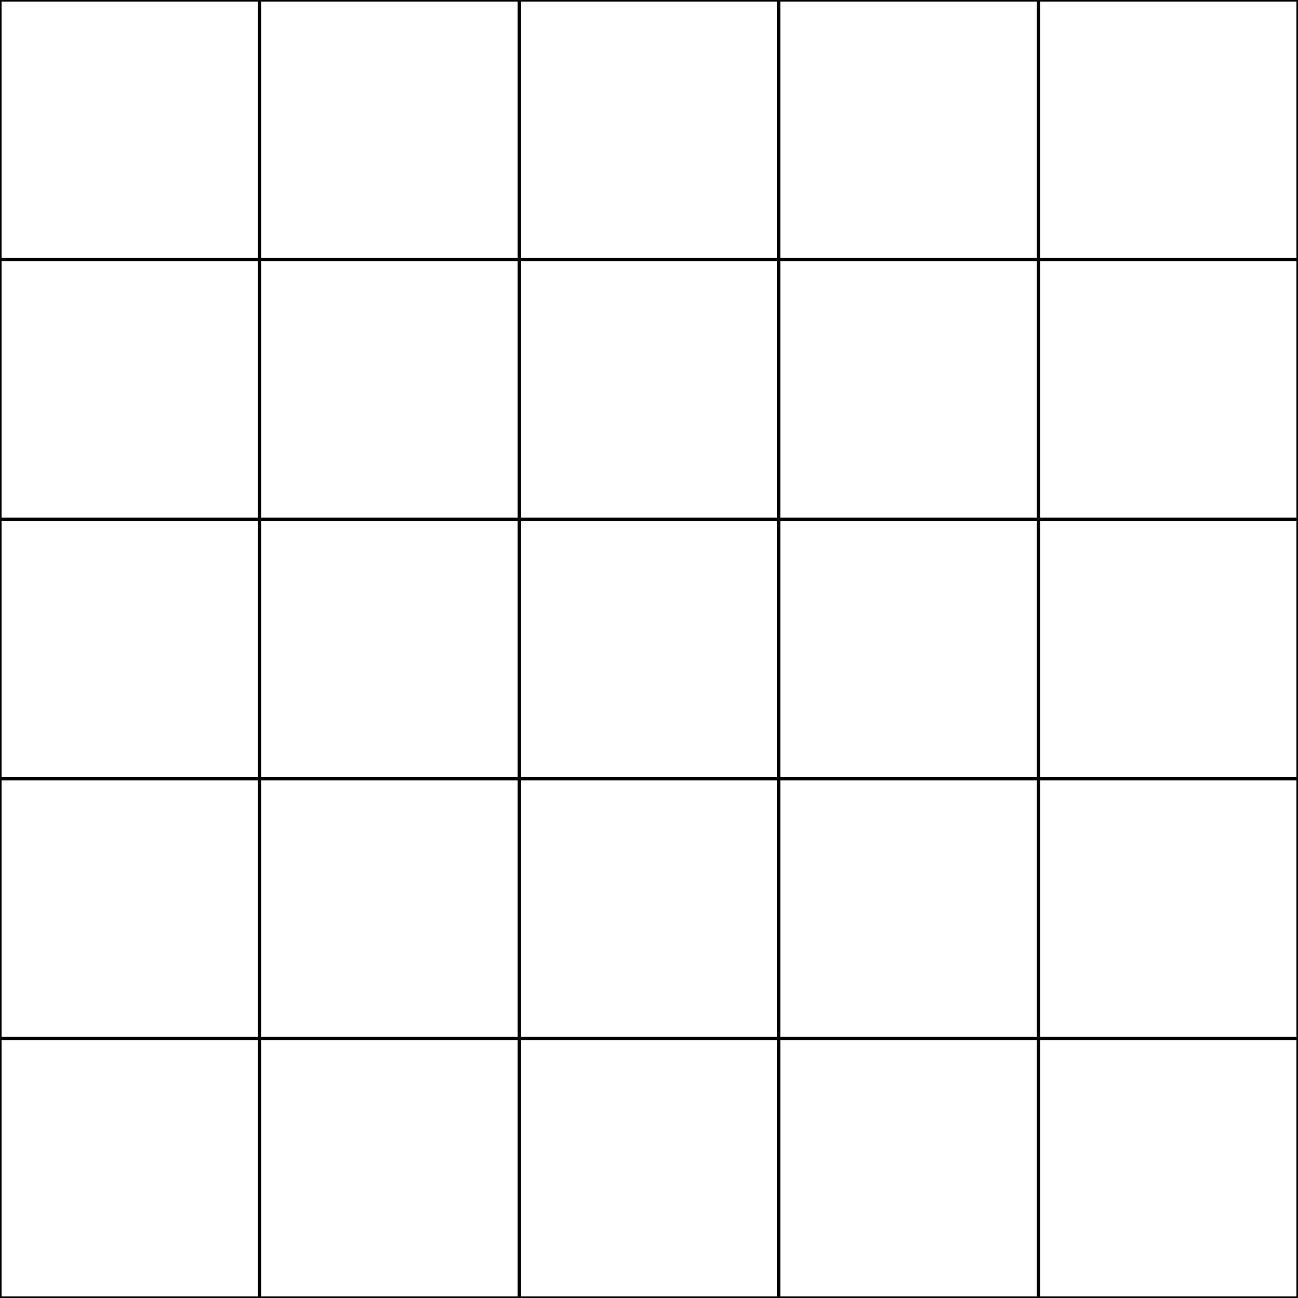



Short response (4)
Record the grid reference for the king’s crown, throne and jewel.
5
4
3
2
1
A
B
C
D
E
Notes:
Short response questions provide brisk paced questions focussing on review of current and previous content to support spaced and interleaved practice.
Syllabus focus area:
Geometric measure B: Position (Note: Stage 2 content reviewed)

Slide 10

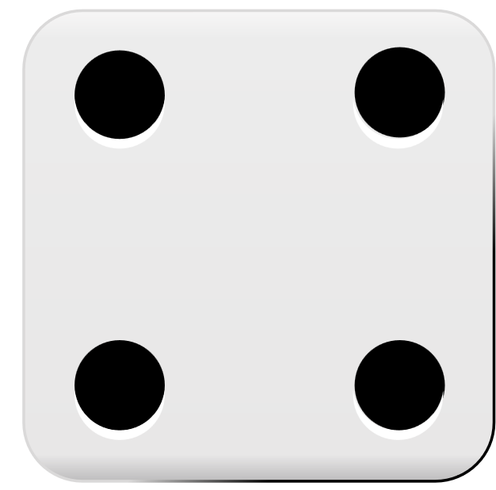
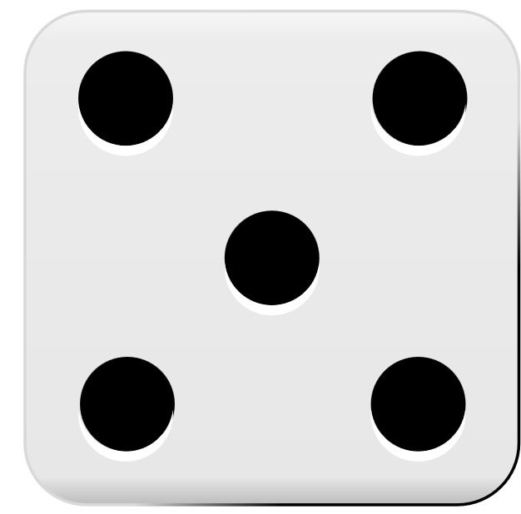
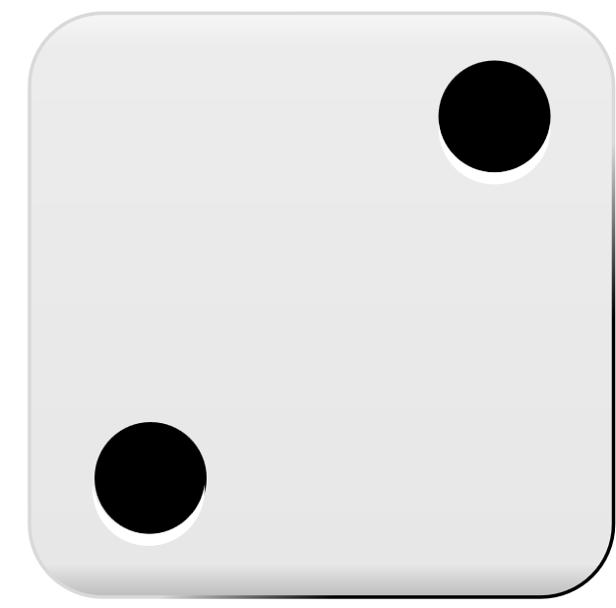
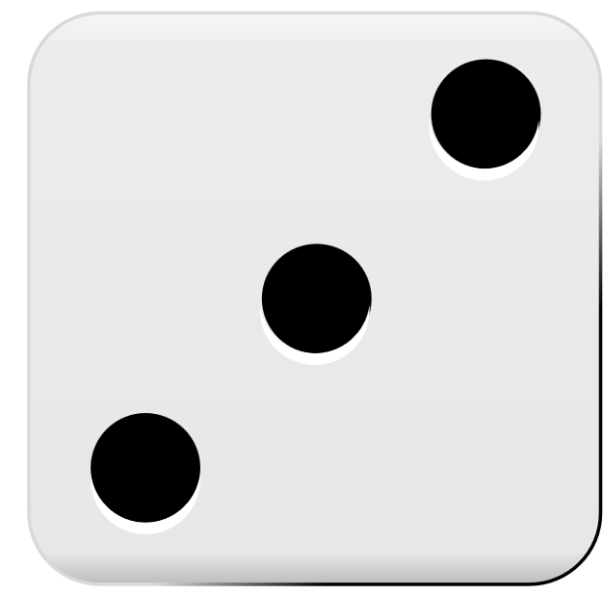

Activity 1 – tug of war – adding and subtracting
Example of game play
+11
100
125
130
136
150
-6
Student A
Plus
Student B
Minus
Notes:
Note: This slide is designed to be used in presentation mode.
This is a developing number sense activity.
Number sense refers to a deep understanding of numbers, including their magnitude, relationships, and the effects of operations on them. It supports fluency and understanding, estimation, flexible thinking, and efficient problem-solving. Number sense activities 1–4 ‘activate’ prior number knowledge and support the learning of new content in the unit. Number sense activities 5–8 ‘loop’ back and provide opportunity for spaced practice with concepts and procedures covered in previous units.
Syllabus focus area:
Additive relations A
Tug of war- adding and subtracting
This activity is an adaptation of Tug of War from NRICH by University of Cambridge (Faculty of Mathematics).
Give pairs of students a coloured counter, three 6-sided dice and a piece of paper.
Students draw a number line on the paper with the values 100, 125 and 150
One student is the ‘Plus’ and the other student is the ‘Minus’. Plus moves right and Minus moves left.
Students place the counter on the number 125 and take turns to roll the dice.
Students add the numbers on the dice and move the counter the corresponding number of places in their direction. For example, if the dice adds to 15 the ‘plus’ student will move to 140.
Students write the number they land on along the number line.
Students continue until the counter either reaches 100 or 150. If it gets to 100, ‘Minus’ wins and if it gets to 150, ‘Plus’ wins.

Slide 11
Review of learning 2

Slide 12
True or false (1)
593 + 207 = 700
True | False
Communicate your strategy.
Notes:
The question on this slide connects to the content being explored in the developing number sense activity (Activity 2)
Syllabus focus area:
Additive relations A

Slide 13
Short response (5)
Record how many millions there are in the following number:
45 812 894
Notes:
Short response questions provide brisk paced questions focussing on review of current and previous content to support spaced and interleaved practice.
Syllabus focus area:
Represents number A

Slide 14

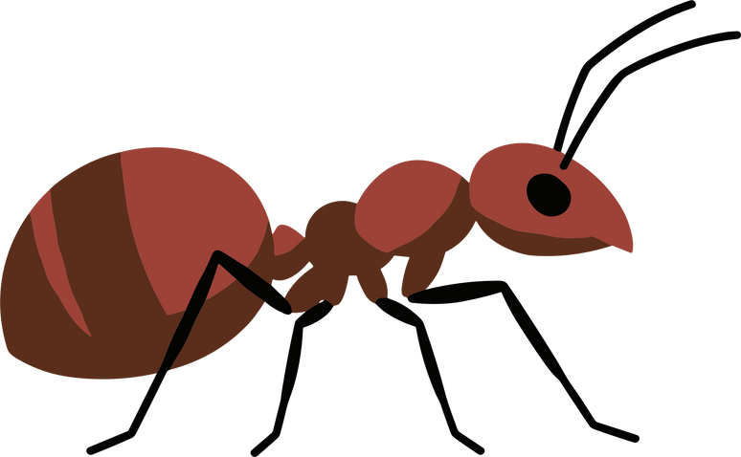
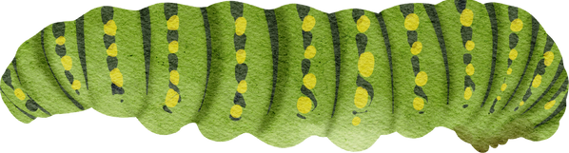

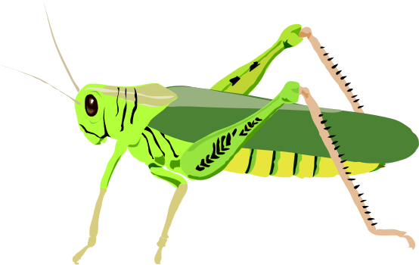
Short response (6)
This is the data collected from an observation of insects in the garden at four different times of the day.
How could you represent this data?
Notes:
Short response questions provide brisk paced questions focussing on review of current and previous content to support spaced and interleaved practice.
Syllabus focus area:
Data A

Slide 15
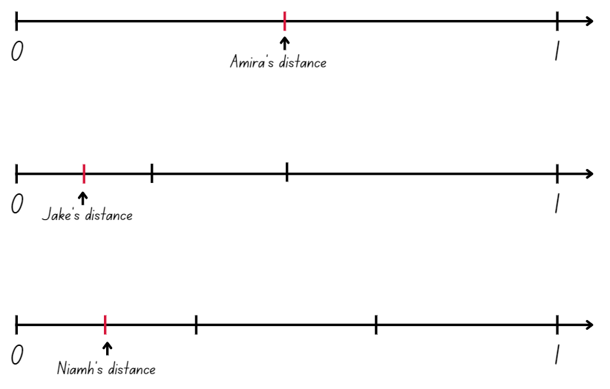
Short response (7)
If 0 is the start and 1 is the finish line…
How far has each child run in the cross-country?
Notes:
Short response questions provide brisk paced questions focussing on review of current and previous content to support spaced and interleaved practice.
Syllabus focus area:
Representing quantity fractions A

Slide 16
Short response (8)
Convert each measurement:
3 m = ___ cm
250 cm = ___ m
6 cm = ___ mm
90 mm = ___ cm
Notes:
Short response questions provide brisk paced questions focussing on review of current and previous content to support spaced and interleaved practice.
Syllabus focus area:
Geometric measure B: Length (Note: Stage 2 content reviewed)

Slide 17
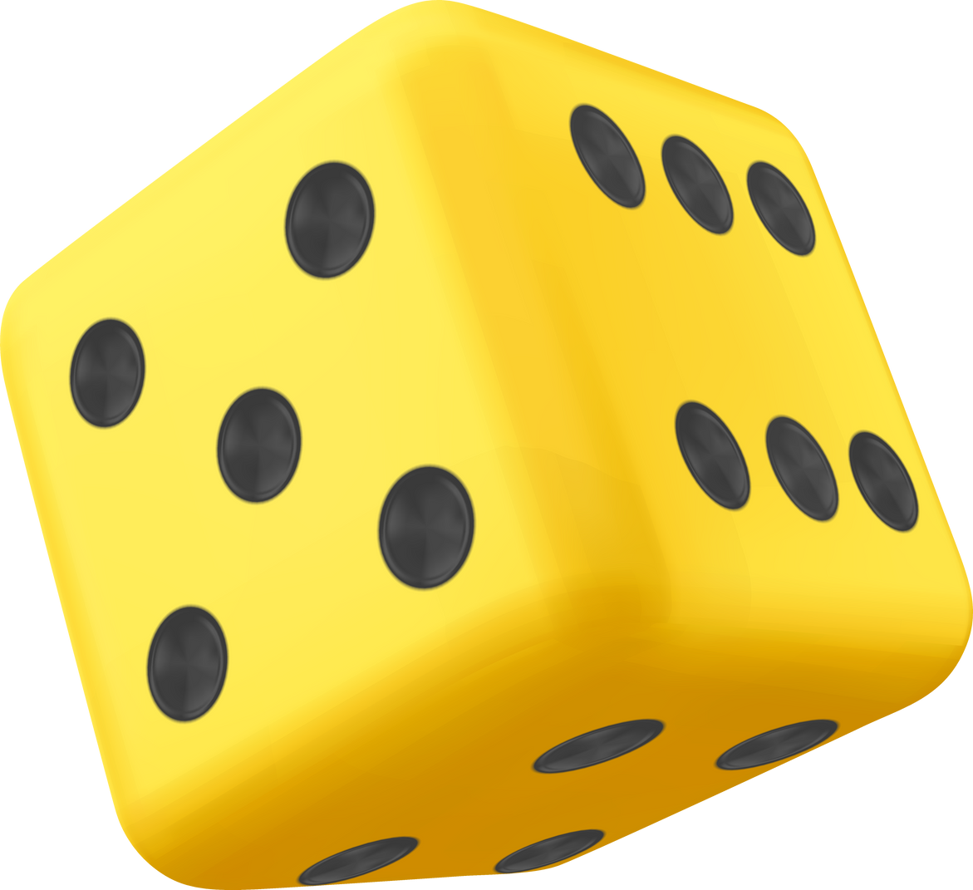

Activity 2 – adding 3-digit numbers
+
+
=
Notes:
This is a developing number sense activity.
Number sense refers to a deep understanding of numbers, including their magnitude, relationships, and the effects of operations on them. It supports fluency and understanding, estimation, flexible thinking, and efficient problem-solving. Number sense activities 1–4 ‘activate’ prior number knowledge and support the learning of new content in the unit. Number sense activities 5–8 ‘loop’ back and provide opportunity for spaced practice with concepts and procedures covered in previous units.
Syllabus focus area:
Additive Relations A
Adding 3-digit numbers
This activity is an adaptation of Dicey Operations in Line from NRICH by University of Cambridge (Faculty of Mathematics).
Students draw 9 blank number cells in their workbooks.
Students play in pairs. They take turns to roll a 6-sided die and fill a cell each time with numbers they have rolled.
Students continue until they have filled in all 9 of their cells
Students add the 3 numbers. The winner is the student that gets closest to 1000, whether the number is higher or lower than 1000.
Students can play multiple rounds. As students get more familiar with the game they can work more strategically when filling the cells in.

Slide 18
Review of learning 3

Slide 19
Multiple choice (2)
7851 – 1739 =
6128
A
6102
B
6122
C
6112
D
Communicate your strategy.
Notes:
This question connects to the content in the developing number sense activity (Activity 3)
Syllabus focus area:
Additive relations A

Slide 20
Short response (9)
How many millions is the same as one billion?
Notes:
Short response questions provide brisk paced questions focussing on review of current and previous content to support spaced and interleaved practice.
Syllabus focus area:
Represents numbers A

Slide 21
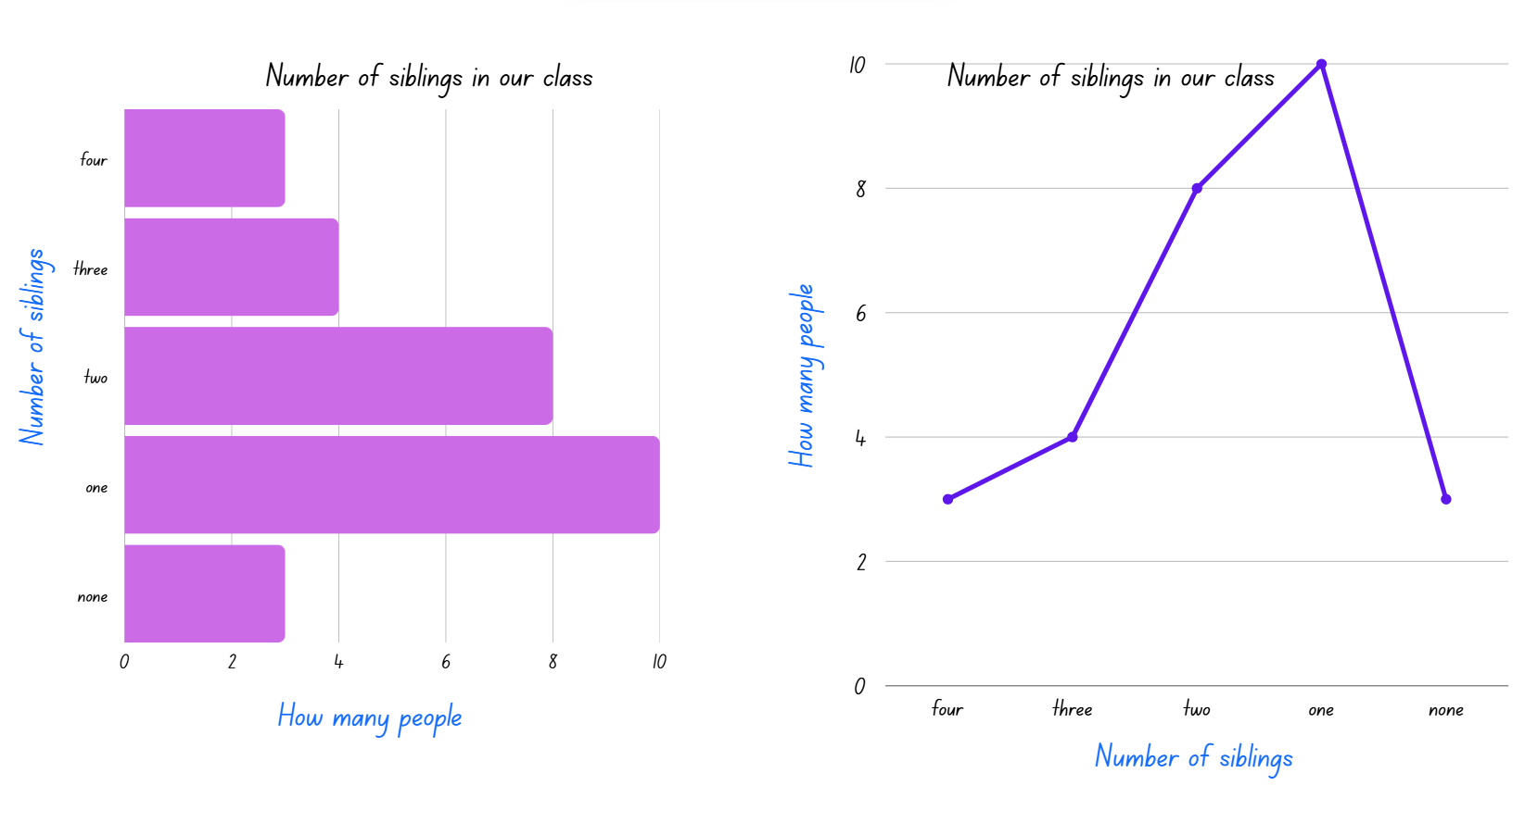
Short response (10)
Which graph is appropriate to represent this data set?
Communicate your thinking.
Notes:
Short response questions provide brisk paced questions focussing on review of current and previous content to support spaced and interleaved practice.
Syllabus focus area:
Data A

Slide 22
Short response (11)
Record a fraction that is smaller than one half.
Notes:
Short response questions provide brisk paced questions focussing on review of current and previous content to support spaced and interleaved practice.
Syllabus focus area:
Representing quantity fractions B

Slide 23
Short response (12)
A
B
C
D
Which of these shapes have a right angle?
Notes:
Short response questions provide brisk paced questions focussing on review of current and previous content to support spaced and interleaved practice.
Syllabus focus area:
Two-dimensional spatial structure: 2D shapes (Note: Stage 2 content reviewed)

Slide 24
Activity 3 – Subtracting 4-digit numbers
-
=
Notes:
This is a developing number sense activity.
Number sense refers to a deep understanding of numbers, including their magnitude, relationships, and the effects of operations on them. It supports fluency and understanding, estimation, flexible thinking, and efficient problem-solving. Number sense activities 1–4 ‘activate’ prior number knowledge and support the learning of new content in the unit. Number sense activities 5–8 ‘loop’ back and provide opportunity for spaced practice with concepts and procedures covered in previous units.
Syllabus focus area:
Additive relations A
Subtracting 4-digit numbers
This activity is an adaptation of Dicey Operations in Line from NRICH by University of Cambridge (Faculty of Mathematics).
Students draw 8 blank number cells in their workbooks.
Students play in pairs. They take turns to roll a 6-sided die 8 times and record the 8 numbers they have rolled.
Students place their largest number in the first cell, then continue to fill the rest of the cells until they have made two 4-digit numbers
Students then subtract the 2 numbers. The winner is the student that gets closest to 1000, whether the number is higher or lower than 1000.
Students can play multiple rounds. As students get more familiar with the game they can work more strategically when filling the cells in.

Slide 25
Review of learning 4

Slide 26
True or false (2)
632 – 236 = 396
True | False
Communicate your strategy.
Notes:
The question on this slide connects to the content being explored in the developing number sense activity (Activity 4)
Syllabus focus area:
Additive relations A

Slide 27
Short response (13)
Write five and one hundred and twenty-six thousandths in decimal notation.
Notes:
Short response questions provide brisk paced questions focussing on review of current and previous content to support spaced and interleaved practice.
Syllabus focus area:
Represents numbers A

Slide 28
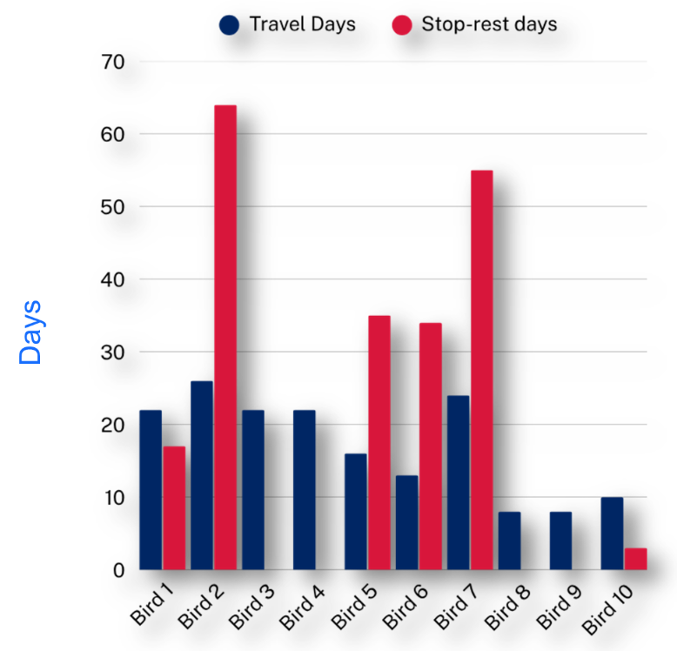
Short response (14)
Which bird travelled the least number of days?
Which bird rested the most?
Notes:
Short response questions provide brisk paced questions focussing on review of current and previous content to support spaced and interleaved practice.
Syllabus focus area:
Data B

Slide 29
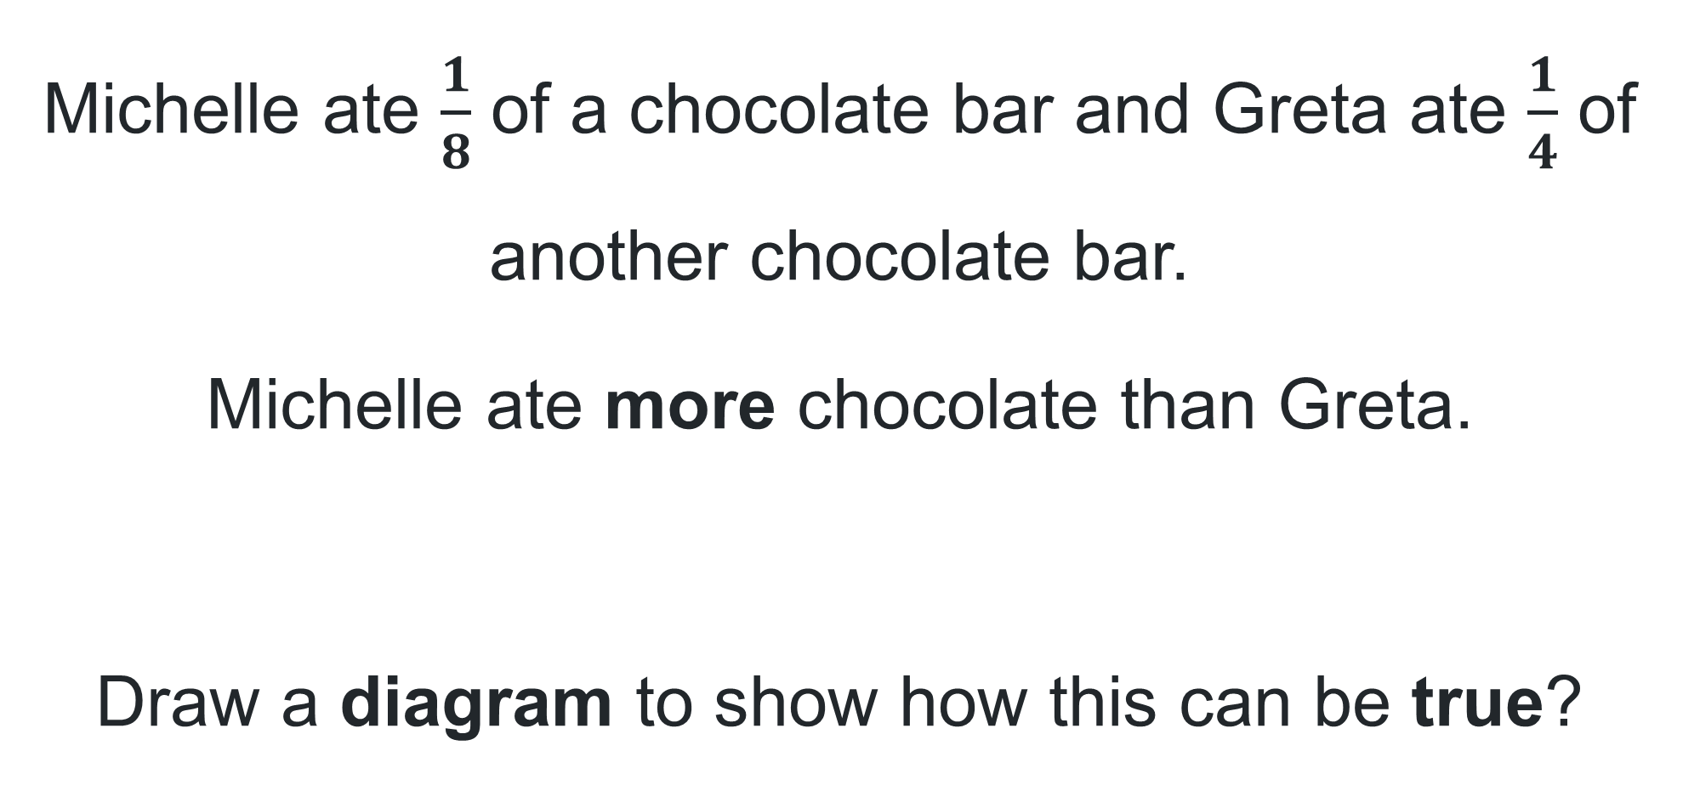
Short response (15)
Michelle ate $\frac{1}{8}$ of a chocolate bar and Greta ate $\frac{1}{4}$ of another chocolate bar.
Michelle ate more chocolate than Greta.
Draw a diagram to show how this can be true?
Notes:
Short response questions provide brisk paced questions focussing on review of current and previous content to support spaced and interleaved practice.
Syllabus focus area:
Representing quantity fractions A

Slide 30
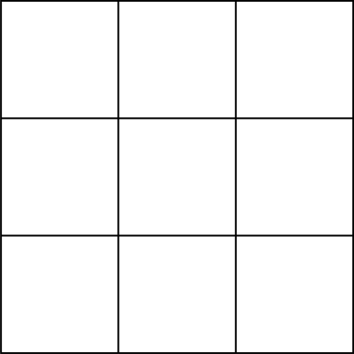
Short response (16)
This rectangle is made up of square centimetres. What is the area of the rectangle?
Communicate your reasoning.
Notes:
Short response questions provide brisk paced questions focussing on review of current and previous content to support spaced and interleaved practice.
Syllabus focus area:
Two-dimensional spatial structure B: Area (Note: Stage 2 content reviewed)

Slide 31

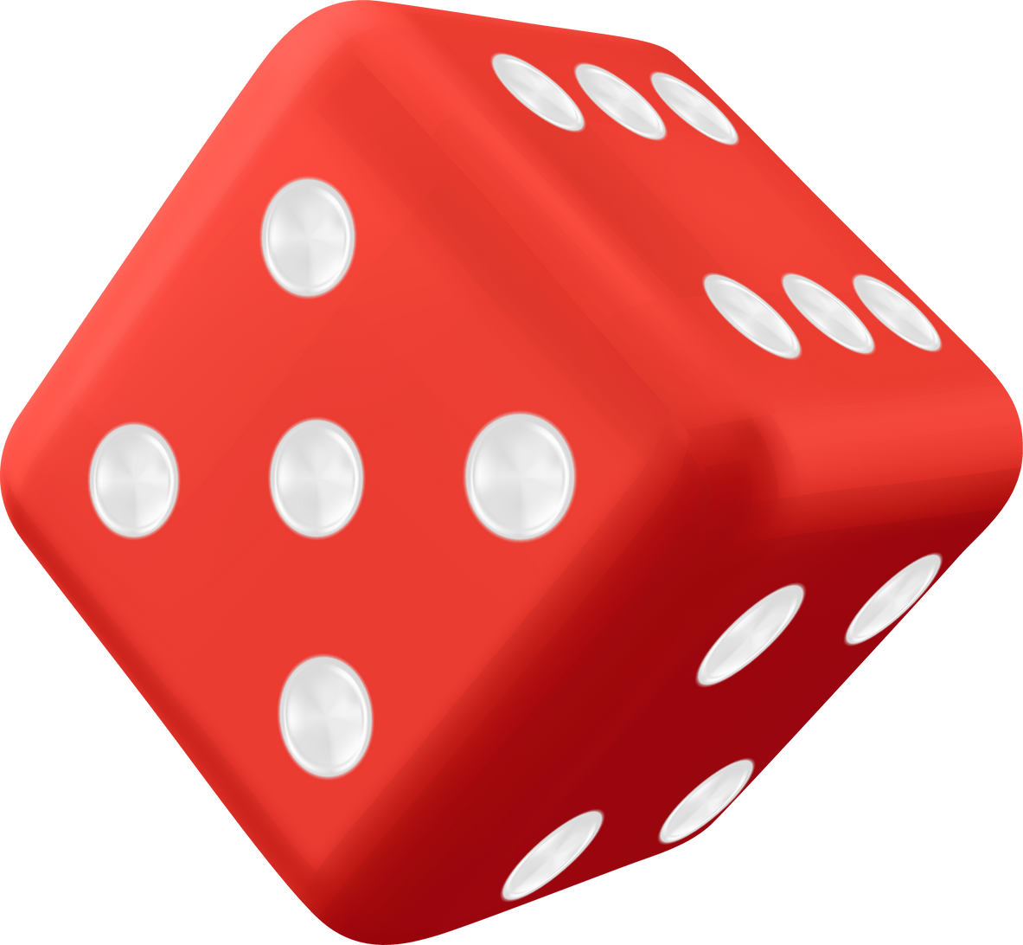

Activity 4 – applying strategies to subtract
632
236
Subtract
Roll
Reverse
632 – 236 = 396
Repeat
693 – 396 =
Notes:
This is a developing number sense activity.
Number sense refers to a deep understanding of numbers, including their magnitude, relationships, and the effects of operations on them. It supports fluency and understanding, estimation, flexible thinking, and efficient problem-solving. Number sense activities 1–4 ‘activate’ prior number knowledge and support the learning of new content in the unit. Number sense activities 5–8 ‘loop’ back and provide opportunity for spaced practice with concepts and procedures covered in previous units.
Syllabus focus area:
Additive relations A
Applying strategies to subtract
This activity is an adaptation of Subtracting reverses from Maths for Love by Finkel.
Pose the question: What happens when you take the difference of a number and its reverse?
Provide pairs of students with a 9-sided die and prompt them to roll it three times to generate and record a 3-digit number on an individual whiteboard.
Instruct students to reverse the number and then subtract the smaller from the larger number. For example, the reversal of 236 is 632. The equation is 632 ­ 236 =.
Students find the difference between the two numbers and then repeat the process. For example, 632- ­ 236 = 394 so the next reversal will be 493- ­ 394 =.
Pairs continue to generate numbers and subtract the reversals.
Ask:
Can you see a pattern emerging?
Are there any numbers that won’t come to 99?
Can you predict when the answer will be 99 on the next step?
Do you think this pattern would continue when creating a 2-digit or 4-digit number?

Slide 32
Review of learning 5

Slide 33
Multiple choice (3)
Which of these numbers are larger than 74 312 98? You may select more than one answer.
A
47 312 982
B
93 321 999
C
74 312 991
D
7 431 299
Communicate your reasoning .
Notes:
This question connects to the content in the developing number sense activity (Activity 5)
Syllabus focus area:
Represents numbers A

Slide 34
Short response (17)
Which decimal is larger?
0.578 or 0.6
Communicate your reasoning.
Notes:
Short response questions provide brisk paced questions focussing on review of current and previous content to support spaced and interleaved practice.
Syllabus focus area:
Represents numbers A

Slide 35
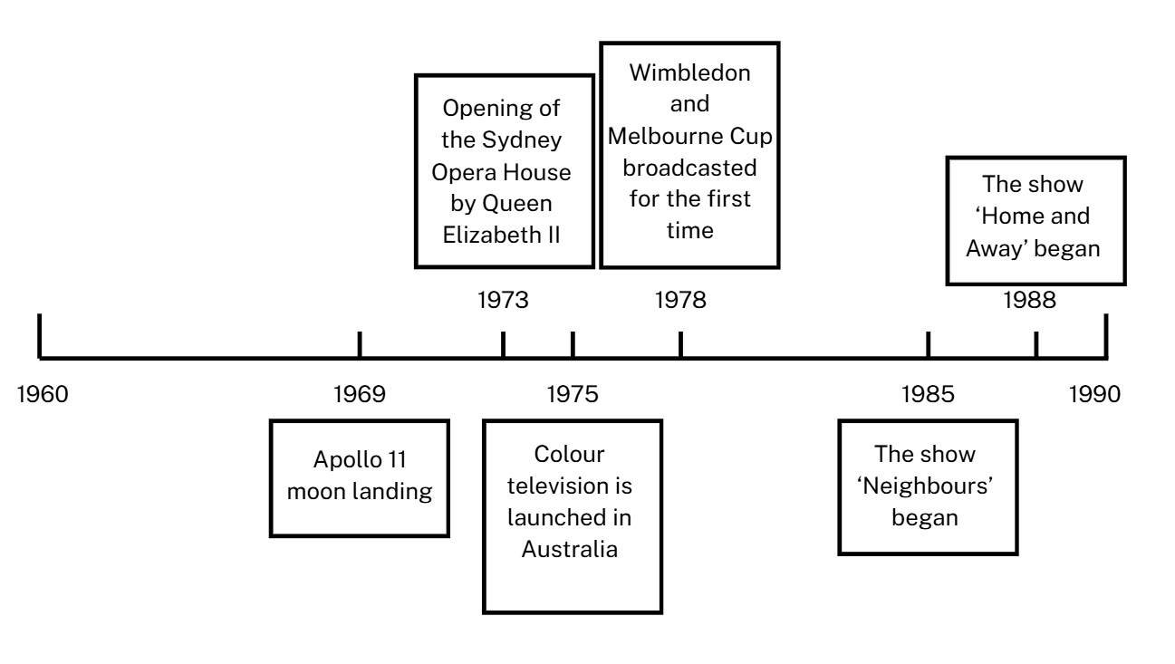
Short response (18)
Australian TV broadcasting
Phil thinks that the opening of the Opera House occurred before the Apollo moon landing and after colour television was launched.
Do you agree?
Communicate your thinking
Notes:
Short response questions provide brisk paced questions focussing on review of current and previous content to support spaced and interleaved practice.
Syllabus focus area:
Data B

Slide 36

Short response (19)
$$\frac{5}{8}+ \frac{6}{8}=$$
Record the answer in two forms.
Notes:
Short response questions provide brisk paced questions focussing on review of current and previous content to support spaced and interleaved practice.
Syllabus focus area:
Representing quantity fractions A

Slide 37
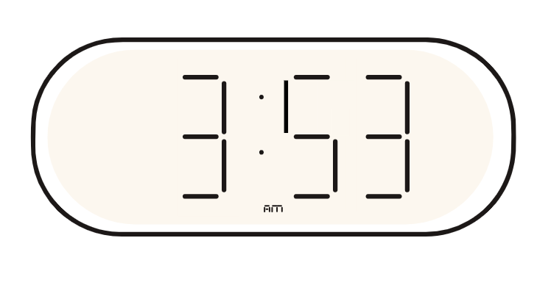
Short response (20)
How many minutes until 4 o’clock?
Notes:
Short response questions provide brisk paced questions focussing on review of current and previous content to support spaced and interleaved practice.
Syllabus focus area:
Non-spatial measure B: Time (Note: Stage 2 content reviewed)

Slide 38
Activity 5 – recognising a smaller and larger number
Read this number aloud:
62 451 286
Write a number that is larger.
Write a number that is smaller.
Notes:
This is a developing number sense activity.
Number sense refers to a deep understanding of numbers, including their magnitude, relationships, and the effects of operations on them. It supports fluency and understanding, estimation, flexible thinking, and efficient problem-solving. Number sense activities 1–4 ‘activate’ prior number knowledge and support the learning of new content in the unit. Number sense activities 5–8 ‘loop’ back and provide opportunity for spaced practice with concepts and procedures covered in previous units.
Syllabus focus area:
Represents numbers A
Recognising a smaller and larger number
This activity is an adaptation from Open-ended Maths Activities: Using ‘Good’ Questions to Enhance Learning in Mathematics by Sullivan and Lilburn.
Write an 8-digit number on the board. Have students read the number aloud.
Students write a number that is larger than this number and a number that is smaller.
Both numbers must have the same number of digits as the original number on the board.
Students turn and talk and read their numbers to a peer.
Record various students’ numbers on the board and ask the following questions:
How do you know this number is smaller than the one on the board?
How do you know this number is larger than the one on the board?

Slide 39
Review of learning 6

Slide 40
True or false (3)
The number 3 217 689 has 3 217 thousands.
True | False
Notes:
The question on this slide connects to the content being explored in the developing number sense activity (Activity 6)
Syllabus focus area:
Represents numbers A

Slide 41
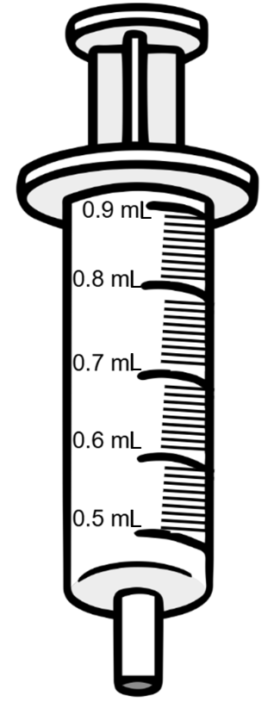
Short response (21)
Record the dose marked with a red arrow on the syringe.
Notes:
Short response questions provide brisk paced questions focussing on review of current and previous content to support spaced and interleaved practice.
Syllabus focus area:
Represents numbers A

Slide 42
Short response (22)
What is the place value of the
digit 3 in 0.243?
Notes:
Short response questions provide brisk paced questions focussing on review of current and previous content to support spaced and interleaved practice.
Syllabus focus area:
Represents numbers A

Slide 43
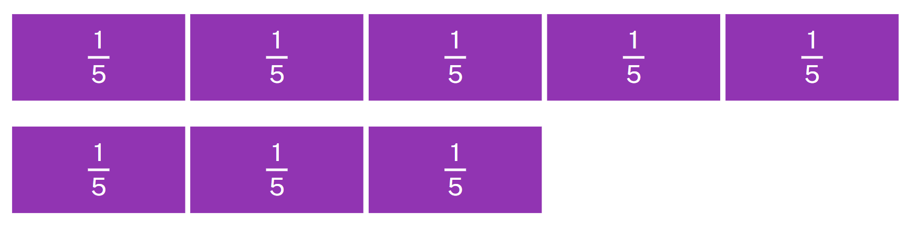
Short response (23)
Record an equation for the diagram.
Notes:
Short response questions provide brisk paced questions focussing on review of current and previous content to support spaced and interleaved practice.
Syllabus focus area:
Representing quantity fractions A

Slide 44

Short response (24)
Record the time in digital notation.
Notes:
Short response questions provide brisk paced questions focussing on review of current and previous content to support spaced and interleaved practice.
Syllabus focus area:
Non-spatial measure B: Time (Note: Stage 2 content reviewed)

Slide 45



Activity 6 – Mastermind – naming numbers in the millions
7 246 384
3 217 689
Notes:
This is a developing number sense activity.
Number sense refers to a deep understanding of numbers, including their magnitude, relationships, and the effects of operations on them. It supports fluency and understanding, estimation, flexible thinking, and efficient problem-solving. Number sense activities 1–4 ‘activate’ prior number knowledge and support the learning of new content in the unit. Number sense activities 5–8 ‘loop’ back and provide opportunity for spaced practice with concepts and procedures covered in previous units.
Syllabus focus area:
Represents numbers A
Mastermind- naming numbers in the millions
This activity is an adaptation of Mastermind from Mathematics K-6 resources by State of New South Wales (Department of Education).
In pairs, Player 1 writes down a 7-digit number without showing their partner.
Player 2 guesses their opponent’s 7-digit number. Guessed numbers should be written down, said aloud and named correctly using place value language.
After each guess, Player 1 marks, under each digit, the following symbols:
a tick for the correct digit in the correct place
a circle for a correct digit but not in the correct place
a cross for an incorrect digit
Note: in the example in Figure 13, player 1’s number is 7 246 384 and the guess is 3 217 689. There are 2 correct digits in the correct place (tens and hundred thousand), 3 correct digits in the wrong place (millions, thousands and hundreds) and 2 incorrect thousand.
Players use this information to refine their guesses.
The first player to correctly guess their opponent’s number in the least amount of turns is the winner.
The level of difficulty can be changed by using numbers with more or fewer digits.

Slide 46
Review of learning 7

Slide 47
Multiple choice (4)
The number forty-three million, six hundred and thirty-four thousand, nine hundred and fourteen is written as:
A
43 634
B
43 634 940
C
43 634 914
D
634 914 43
Notes:
This question connects to the content in the developing number sense activity (Activity 7)
Syllabus focus area:
Represents whole numbers A

Slide 48
Short response (25)
Use the addition for subtraction strategy to solve the following equation:
405 – 389 =
Explain why this strategy is efficient.
Notes:
Short response questions provide brisk paced questions focussing on review of current and previous content to support spaced and interleaved practice.
Syllabus focus area:
Additive relations A

Slide 49
Short response (26)
Record the missing integers that complete the number line.
-7
-6
?
?
-3
?
-1
0
1
2
?
4
?
6
?
Notes:
Short response questions provide brisk paced questions focussing on review of current and previous content to support spaced and interleaved practice.
Syllabus focus area:
Represents numbers B

Slide 50
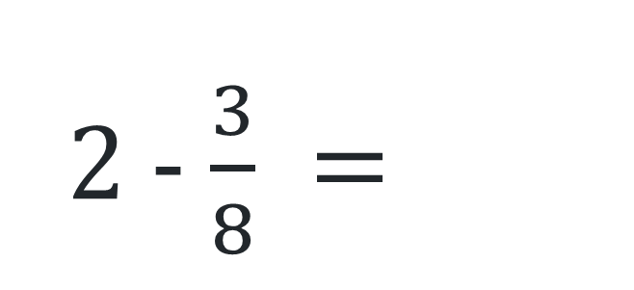
Short response (27)
2 - $\frac{3}{8} =$
Communicate your strategy.
Notes:
Short response questions provide brisk paced questions focussing on review of current and previous content to support spaced and interleaved practice.
Syllabus focus area:
Representing quantity fractions A

Slide 51
Short response (28)
Sketch a cube.
Notes:
Short response questions provide brisk paced questions focussing on review of current and previous content to support spaced and interleaved practice.
Syllabus focus area:
Three-dimensional spatial structure B: 3D objects (Note: Stage 2 content reviewed)

Slide 52

Activity 7 – reading numbers in the millions
7, 17, 317, 4317, 94 317, 194 317, 8 194 317, 28 194 317, 728 194 317
Notes:
This is a developing number sense activity.
Number sense refers to a deep understanding of numbers, including their magnitude, relationships, and the effects of operations on them. It supports fluency and understanding, estimation, flexible thinking, and efficient problem-solving. Number sense activities 1–4 ‘activate’ prior number knowledge and support the learning of new content in the unit. Number sense activities 5–8 ‘loop’ back and provide opportunity for spaced practice with concepts and procedures covered in previous units.
Syllabus focus area:
Represents numbers A
Reading numbers in the millions
This activity is an adaptation of ‘Reading large numbers’ from Teaching Mathematics Foundations to Middle Years by Siemon et al.
Write a series of numbers on the board going from right to left. As each new number is added, have students read them out. For example, 7, 17, 317, 4317, 94 317.
In pairs, students repeat the task by rolling a 9-sided die and recording the number rolled from right to left. As each number is rolled, the partner reads out the new number.
Pairs continue until a 9-digit number is recorded and then swap rolls.
Repeat the activity but this time record and say the numbers from left to right.

Slide 53
Review of learning 8

Slide 54

True or false (4)
The following numbers are in ascending order.
5 481 497
5 058 723
4 946 811
4 212 905
True | False
Notes:
The question on this slide connects to the content being explored in the developing number sense activity (Activity 8)
Syllabus focus area:
Represents number A

Slide 55
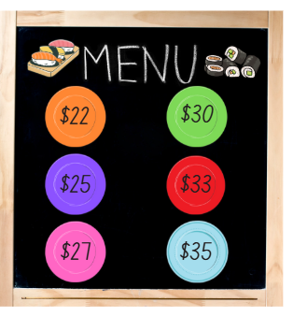
Short response (29)
Flynn ate 2 purple plates, 3 orange plates and 2 red plates.
How much change will he get from $200?
Notes:
Short response questions provide brisk paced questions focussing on review of current and previous content to support spaced and interleaved practice.
Syllabus focus area:
Additive relations A

Slide 56
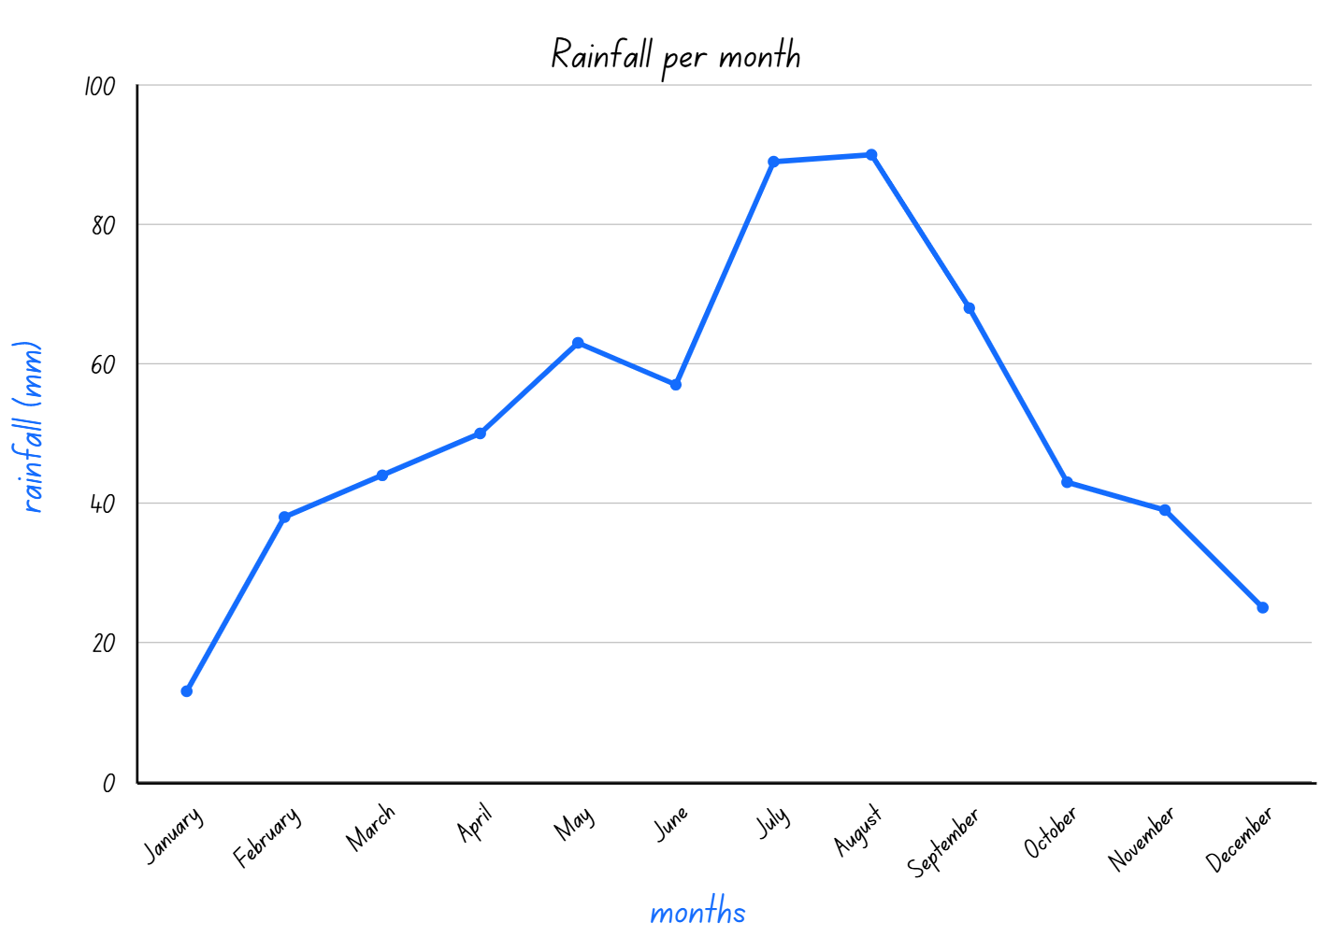
Short response (30)
Which month had the most rainfall?
Which month had the least amount of rainfall?
Notes:
Short response questions provide brisk paced questions focussing on review of current and previous content to support spaced and interleaved practice.
Syllabus focus area:
Data B

Slide 57

Short response (31)
$$\frac{5}{6}+1\frac{2}{6}=$$
Communicate your strategy.
Notes:
Short response questions provide brisk paced questions focussing on review of current and previous content to support spaced and interleaved practice.
Syllabus focus area:
Representing quantity fractions A

Slide 58



Short response (32)
How many triangles and/or rhombus’s form a hexagon?
Notes:
Short response questions provide brisk paced questions focussing on review of current and previous content to support spaced and interleaved practice.
Syllabus focus area:
Two-dimensional spatial structure B: 2D shapes (Note: Stage 2 content reviewed)

Slide 59
Activity 8 – ordering numbers in the millions
5 481 497
3 058 723
8 946 811
7 212 905
Notes:
This is a developing number sense activity.
Number sense refers to a deep understanding of numbers, including their magnitude, relationships, and the effects of operations on them. It supports fluency and understanding, estimation, flexible thinking, and efficient problem-solving. Number sense activities 1–4 ‘activate’ prior number knowledge and support the learning of new content in the unit. Number sense activities 5–8 ‘loop’ back and provide opportunity for spaced practice with concepts and procedures covered in previous units.
Syllabus focus area:
Represents numbers A
Ordering numbers in the millions
This activity is an adaptation of Order! Order! (four-digit numbers) from Mathematics K-6 resources by State of New South Wales (Department of Education).
This game may be played individually, in pairs or in small groups.
Use a 9-sided die to generate a 7-digit number. The number is recorded on a sticky note.
Repeat this process to make 4 different 7-digit numbers.
The aim of the game is to rearrange the sticky notes so the numbers are in ascending order in the fewest moves possible, moving adjacent sticky notes only and recording the number of moves required.
Repeat with 4 new numbers arranging the sticky notes so the numbers are in descending order.
Observe students and ask questions, such as:
What will your next move be? Why?
What is the largest number? How do you know?
What is the smallest number? How do you know?
How many moves have you made so far?
After the game, students turn and talk to compare how many moves they took.

Slide 60
Double Venn diagram
Object 1
Object 2
Features similar to both objects
Features of object 1
Features of object 2

Slide 61
Frayer
Definition
Facts/Characteristics
Word, term, concept
Examples
Non-examples

Slide 62
Spider map
Idea
Subject

Slide 63
Cline
Concept 1
Concept 2
Word
Word
Word
Word
Word
Word
Word
Word
Word
Word
Word

Slide 64

Compare and contrast

Slide 65
Multiple choice (5)
A
B
C
D

Slide 66
Multiple choice
A
B
C
D
Notes:
This question connects to the content in the developing number sense activity (Activity 3)
Syllabus focus area:
[Focus area A/B]

Slide 67
References (1)
This presentation contains NSW Curriculum and syllabus content. The NSW Curriculum is developed by the NSW Education Standards Authority. This content is prepared by NESA for and on behalf of the Crown in the right of the State of New South Wales. The material is protected by Crown copyright.
Please refer to the NESA Copyright Disclaimer for more information https://educationstandards.nsw.edu.au/wps/portal/nesa/mini-footer/copyright.
NESA holds the only official and up-to-date versions of the NSW Curriculum and syllabus documents. Please visit the NSW Education Standards Authority (NESA) website https://educationstandards.nsw.edu.au/wps/portal/nesa/home and the NSW Curriculum website https://curriculum.nsw.edu.au.
Mathematics K–10 Syllabus © NSW Education Standards Authority (NESA) for and on behalf of the Crown in right of the State of New South Wales, 2022.
National Numeracy Learning Progression © Australian Curriculum, Assessment and Reporting Authority (ACARA) 2010 to present, unless otherwise indicated. This material was downloaded from the Australian Curriculum website (National Numeracy Learning Progression) (accessed 11 September 2025 and was not modified.
Finkel, D (2017) ‘Subtracting Reverses’, Maths for love website, accessed 11 September 2025
Siemon D, Warren E, Beswick K, Faragher R, Miller J, Horne M, Jazby D and Breed M (2020) Teaching Mathematics: Foundations to Middle Years, 3rd edn, Oxford University Press Australia and New Zealand.
State of New South Wales (Department of Education) (2023) ‘Mastermind’, Mathematics K-6 Resources, NSW Department of Education website, accessed 11 September 2025.

Slide 68
References (2)
This presentation contains NSW Curriculum and syllabus content. The NSW Curriculum is developed by the NSW Education Standards Authority. This content is prepared by NESA for and on behalf of the Crown in the right of the State of New South Wales. The material is protected by Crown copyright.
Please refer to the NESA Copyright Disclaimer for more information https://educationstandards.nsw.edu.au/wps/portal/nesa/mini-footer/copyright.
NESA holds the only official and up-to-date versions of the NSW Curriculum and syllabus documents. Please visit the NSW Education Standards Authority (NESA) website https://educationstandards.nsw.edu.au/wps/portal/nesa/home and the NSW Curriculum website https://curriculum.nsw.edu.au.
State of New South Wales (Department of Education) (2023) ‘Order! Order! (four-digit numbers)’, Mathematics K-6 Resources, NSW Department of Education website, accessed 11 September 2025.
Sullivan P and Lilburn P (2017) Open-ended Maths Activities: Using ‘Good’ Questions to Enhance Learning in Mathematics, Revised 2nd edn, Oxford University Press, Melbourne.
University of Cambridge (Faculty of Mathematics) (1997–2023) Tug of War, NRICH website, accessed 11 September 2025.
University of Cambridge (Faculty of Mathematics) (1997–2023) Dicey Operations in Line, NRICH website, accessed 11 September 2025.
Van de Walle J, Karp K, Bay-Williams JM, Brass A, Bentley B, Ferguson S, Goff W, Livy S, Marshman M, Martin D, Pearn C, Prodromou T, Symons D and Wilkie K (2019) Primary and Middle Years Mathematics: Teaching Developmentally, 1st Australian edn, Pearson Education Australia, Melbourne

Slide 69
Copyright
© State of New South Wales (Department of Education), 2025
The copyright material published in this resource is subject to the Copyright Act 1968 (Cth) and is owned by the NSW Department of Education or, where indicated, by a party other than the NSW Department of Education (third-party material).
Copyright material available in this resource and owned by the NSW Department of Education is licensed under a Creative Commons Attribution 4.0 International (CC BY 4.0) license.
This license allows you to share and adapt the material for any purpose, even commercially.
Attribution should be given to © State of New South Wales (Department of Education), 2025.
Material in this resource not available under a Creative Commons license:
the NSW Department of Education logo, other logos and trademark-protected material
Material owned by a third party that has been reproduced with permission. You will need to obtain permission from the third party to reuse its material.
Links to third-party material and websites
Please note that the provided (reading/viewing material/list/links/texts) are a suggestion only and implies no endorsement, by the New South Wales Department of Education, of any author, publisher, or book title. School principals and teachers are best placed to assess the suitability of resources that would complement the curriculum and reflect the needs and interests of their students.
If you use the links provided in this document to access a third party’s website, you acknowledge that the terms of use, including licence terms set out on the third-party’s website apply to the use which may be made of the materials on that third-party website or where permitted by the Copyright Act 1968 (Cth). The department accepts no responsibility for content on third-party websites.

