Slide 1
Instructions for use
This resource is not a teaching and learning program. It should be used in conjunction with Stage 3 Year A Unit 7.
Classroom teachers are encouraged to add and adapt slides as required to meet the needs of their students.
Save a copy of the file to make changes to the slide deck. Go to File > Download a Copy (this downloads a copy to the computer to edit in the PowerPoint app).
To convert the PowerPoint to Google Slides:
  Upload the file into Google Drive and open it.
  Go to File > Save as Google Slides.
  (Note – conversion may cause formatting changes in the slides.)

Slide 2

Review of Learning
Mathematics Stage 3 – Unit 7
Notes:
Reviews may include a combination of question types, requiring students to recall facts and key ideas, as well as apply their knowledge to solve problems and answer questions. To support active engagement, a mix of techniques should be employed.” (AERO, 2024).
This Review of Learning slide deck revisits key concepts from the following units:
Stage 3 Year A Unit 7
Stage 3 Year A Unit 6
Stage 3 Year A Unit 5
It also includes opportunities to review prior learning in non-number content, supporting consolidation across focus areas.
The review of learning resources include three key task types that support the development of mathematical proficiency through retrieval, spaced practice, and active participation. These practices complement the review phase (activating prior knowledge) embedded within the beginning of each lesson.
1.
Multiple-choice questions/True or false: Designed to promote active retrieval of key concepts and identify common misconceptions in number, supporting consolidation, understanding and fluency.
These questions:
support spaced and interleaved practice
help identify and address common misconceptions
support active recall and immediate feedback
support whole class participation
identify areas requiring reteach
2.
Short-response question sets: Carefully grouped questions that encourage spaced and interleaved practice across multiple focus areas, helping students revisit and apply knowledge from different points in time.
These questions:
have a combination of question types
address a range of focus areas
build automaticity and fluency
support active recall
allow for immediate feedback
identify content requiring reteach
3.
Developing number sense activities: A variety of practical, purposeful tasks that reinforce current learning and build on prior knowledge. These activities promote reasoning, problem-solving and conceptual understanding.
The review of learning resources are designed to work support teaching and learning in mathematics. For the most effective implementation, use the resources flexibly, adapting to meet student learning needs and individual classroom contexts.

Slide 3
Lessons
1
Review of learning 1
5
Review of learning 5
2
Review of learning 2
6
Review of learning 6
3
Review of learning 3
7
Review of learning 7
4
Review of learning 4
8
Review of learning 8
Notes:
Teacher notes:
Click lesson numbers to go to specific lessons
Interactive features can be viewed in slide show

Slide 4
Review of learning 1

Slide 5

Multiple choice (1)
Which if these is equivalent to 804 903?
You may select more than one answer.
A
800 000 + 4900 + 3
B
500 000 + 304 000 + 903
C
80 000 + 4000 + 90 + 3
D
800 000 + 4000 + 900 + 3
Notes:
This question connects to the content in the developing number sense activity (Activity 1)
Syllabus focus area:
Represents numbers A

Slide 6

Short response (1)
Record multiplication fact families for these numbers:
4
6
10
Notes:
Short response questions provide brisk paced questions focussing on review of current and previous content to support spaced and interleaved practice.
Syllabus focus area:
Multiplicative relations B (Note: Stage 2 content reviewed)

Slide 7
Short response (2)
How many millions are there in:
10 678 794
496 065 713
78 641 099
Notes:
Short response questions provide brisk paced questions focussing on review of current and previous content to support spaced and interleaved practice.
Syllabus focus area:
Represents numbers A

Slide 8
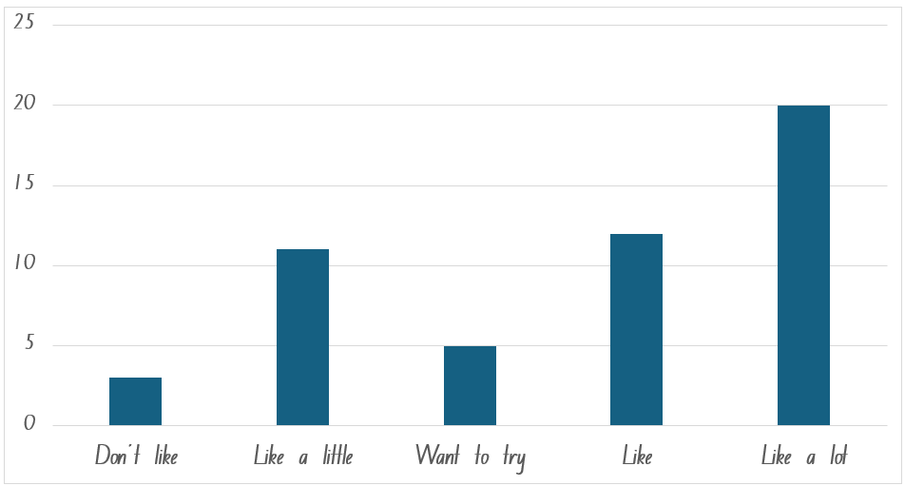
Short response (3)
Write a question that can be answered
using this data.
Notes:
Short response questions provide brisk paced questions focussing on review of current and previous content to support spaced and interleaved practice.
Syllabus focus area:
Data A

Slide 9
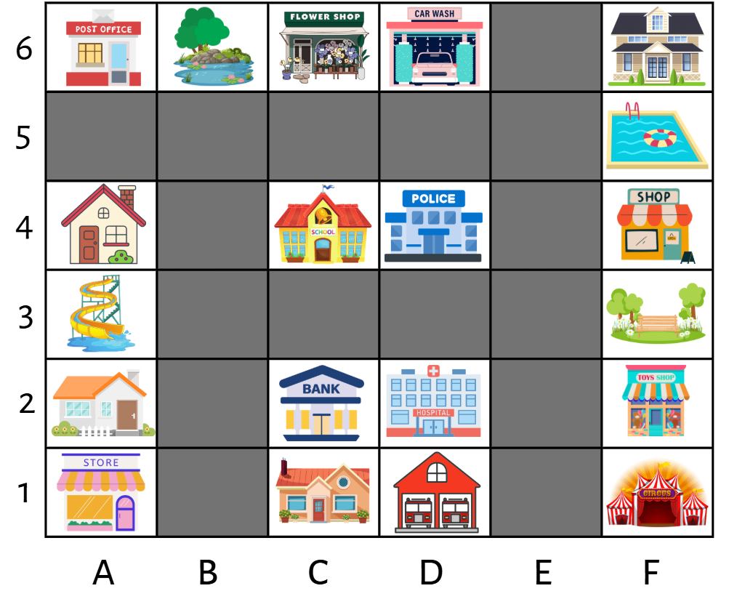

Short response (4)
Describe the route from the bank at C2 to the carwash at D6.
North
West
East
South
Notes:
Short response questions provide brisk paced questions focussing on review of current and previous content to support spaced and interleaved practice.
Syllabus focus area:
Geometric measure B: Position (Note: Stage 2 content reviewed)

Slide 10

Activity 1 – regrouping numbers in different forms (1)
What are 2 different ways we can regroup this number:
586 120
Notes:
This is a developing number sense activity.
Number sense refers to a deep understanding of numbers, including their magnitude, relationships, and the effects of operations on them. It supports fluency and understanding, estimation, flexible thinking, and efficient problem-solving. Number sense activities 1–4 ‘activate’ prior number knowledge and support the learning of new content in the unit. Number sense activities 5–8 ‘loop’ back and provide opportunity for spaced practice with concepts and procedures covered in previous units.
Syllabus focus area:
Represents numbers A
Regrouping numbers in different forms
Model recording different ways to regroup the number. For example:
500 thousands, 8 ten thousands, 6 thousands, 1 hundred and 2 tens
500 000 + 80 000 + 6000 + 100 + 20.
NEXT SLIDE
Display another 6-digit number on the board. For example, 804 903.
Ask students to record 2 different ways of regrouping the number.

Slide 11
Activity 1 – regrouping numbers in different forms (2)
What are 2 different ways we can regroup this number:
804 903
Notes:
This is a developing number sense activity.
Number sense refers to a deep understanding of numbers, including their magnitude, relationships, and the effects of operations on them. It supports fluency and understanding, estimation, flexible thinking, and efficient problem-solving. Number sense activities 1–4 ‘activate’ prior number knowledge and support the learning of new content in the unit. Number sense activities 5–8 ‘loop’ back and provide opportunity for spaced practice with concepts and procedures covered in previous units.
Syllabus focus area:
Represents numbers A
Regrouping numbers in different forms
Ask students to record 2 different ways of regrouping the number.

Slide 12
Review of learning 2

Slide 13
True or false (1)
483 160 can be partitioned as
483 000 + 6 160
True | False
Notes:
The question on this slide connects to the content being explored in the developing number sense activity (Activity 2)
Syllabus focus area:
Represents numbers A

Slide 14
Short response (5)
Categorise the following numbers as prime, composite or neither:
7
10
0
9
Notes:
Short response questions provide brisk paced questions focussing on review of current and previous content to support spaced and interleaved practice.
Syllabus focus area:
Multiplicative relations A

Slide 15
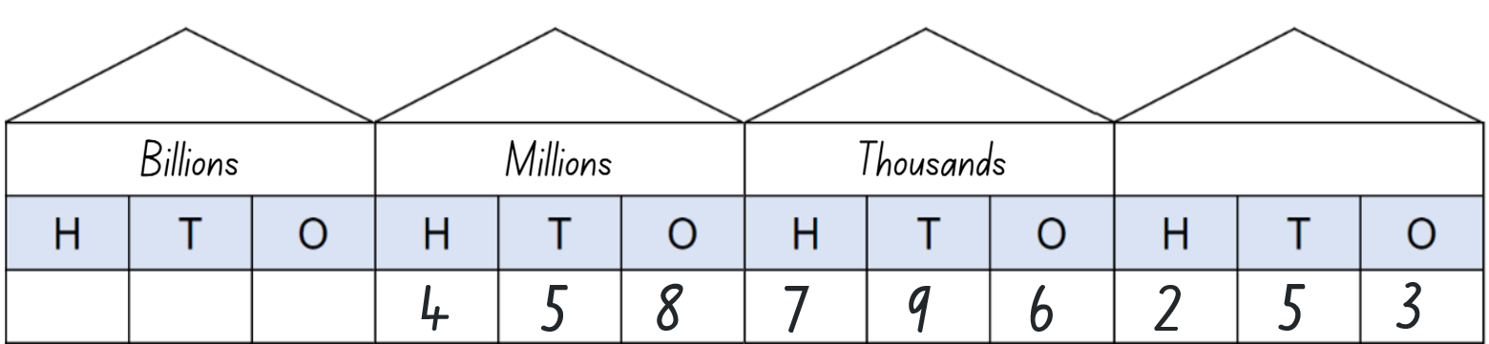
Short response (6)
Write this number in a
non-standard form
Notes:
Short response questions provide brisk paced questions focussing on review of current and previous content to support spaced and interleaved practice.
Syllabus focus area:
Represents numbers A

Slide 16
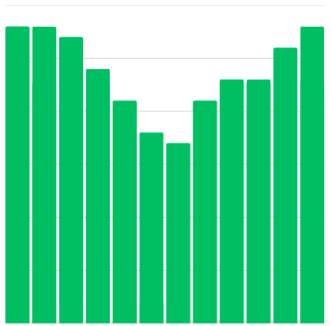
Short response (7)
Write features missing from this graph.
Notes:
Short response questions provide brisk paced questions focussing on review of current and previous content to support spaced and interleaved practice.
Syllabus focus area:
Data A

Slide 17
Short response (8)
Show a right angle with your arms.
Communicate how you know this is a right angle.
Notes:
Short response questions provide brisk paced questions focussing on review of current and previous content to support spaced and interleaved practice.
Syllabus focus area:
Geometric measure B: Angles (Note: Stage 2 content reviewed)

Slide 18
Activity 2 – partitioning in non-standard forms (1)
How can we partition:
586 120
Notes:
This is a developing number sense activity.
Number sense refers to a deep understanding of numbers, including their magnitude, relationships, and the effects of operations on them. It supports fluency and understanding, estimation, flexible thinking, and efficient problem-solving. Number sense activities 1–4 ‘activate’ prior number knowledge and support the learning of new content in the unit. Number sense activities 5–8 ‘loop’ back and provide opportunity for spaced practice with concepts and procedures covered in previous units.
Syllabus focus area:
Represents numbers A
Partitioning in non-standard forms
This resource corresponds to Resource 3 – place value house in Stage 3 Year A Unit 7.
Model recording different ways to partition the number in a non-standard forms. For example:
586 thousands and 120 ones
580 000 + 6120.
NEXT SLIDE
Ask students to partition the number in a non-standard form and record.
Students share their non-standard partitioning with a partner to compare and check for accuracy.
Repeat the process with another number.

Slide 19
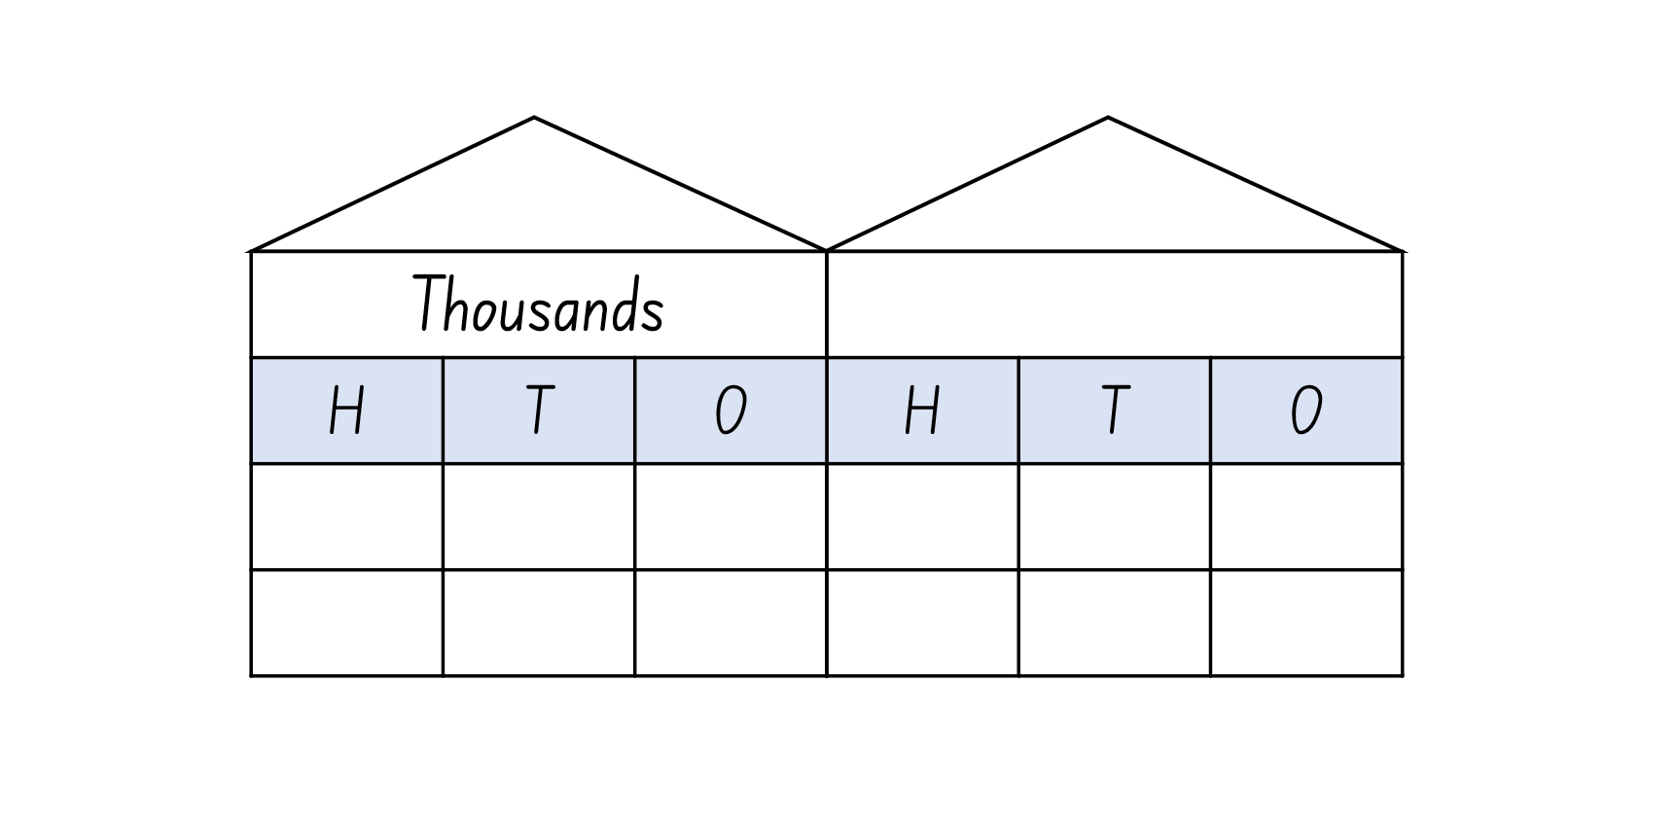
Activity 2 – partitioning in non-standard forms (2)
Record on the place value house:
273 409
How can we partition this number in a non-standard form?
Notes:
This is a developing number sense activity.
Number sense refers to a deep understanding of numbers, including their magnitude, relationships, and the effects of operations on them. It supports fluency and understanding, estimation, flexible thinking, and efficient problem-solving. Number sense activities 1–4 ‘activate’ prior number knowledge and support the learning of new content in the unit. Number sense activities 5–8 ‘loop’ back and provide opportunity for spaced practice with concepts and procedures covered in previous units.
Syllabus focus area:
Represents numbers A
Partitioning in non-standard forms
This resource corresponds to Resource 3 – place value house in Stage 3 Year A Unit 7.
Ask students to partition the number in a non-standard form and record.
Students share their non-standard partitioning with a partner to compare and check for accuracy.
Repeat the process with another number.

Slide 20
Review of learning 3

Slide 21
Multiple choice (2)
Select partitions of 427 138.
You may select more than one answer.
A
400 000 + 27 000 + 1380
B
427 thousands and 138 ones
C
420 000 + 7 000 + 100 + 30 + 8
D
400 000 + 20 000 + 7000 + 1000 + 300 + 80
Notes:
This question connects to the content in the developing number sense activity (Activity 3)
Syllabus focus area:
Represents numbers A

Slide 22
Short response (9)
Use mental strategies to find the product of:
2 x 42
6 x 157
5 x 432
Notes:
Short response questions provide brisk paced questions focussing on review of current and previous content to support spaced and interleaved practice.
Syllabus focus area:
Multiplicative relations A

Slide 23
Short response (10)
Record as decimals:
5 and 37 hundredths
3 and 24 hundredths
2 and 45 hundredths
Notes:
Short response questions provide brisk paced questions focussing on review of current and previous content to support spaced and interleaved practice.
Syllabus focus area:
Represents numbers A

Slide 24
Short response (11)
Write a survey question about students' preferences for after school activities that uses this Likert scale:
1 = don't like, 2 = like a little, 3 = don't know, 4 = like, 5 = like a lot
Notes:
Short response questions provide brisk paced questions focussing on review of current and previous content to support spaced and interleaved practice.
Syllabus focus area:
Data A

Slide 25
Short response (12)
Mia says, ‘A right angle is greater in size than all acute angles.’
Is Mia correct?
Communicate your thinking.
Notes:
Short response questions provide brisk paced questions focussing on review of current and previous content to support spaced and interleaved practice.
Syllabus focus area:
Geometric measure B: Angles (Note: Stage 2 content reviewed)

Slide 26
Activity 3 – regrouping and partitioning numbers (1)
Number | Standard or non-standard partitioning | Correct or not? | Correct partitioning
472 305 | 400 000 + 70 000 + 2000 + 300 +5
639 214 | 630 000 + 9000 + 200 +12
581 406 | 581 thousands and 406 ones
427 138 | 400 000 + 27 000 + 1380
Which standard and non-standard partition displayed are correct and which are not?
Notes:
This is a developing number sense activity.
Number sense refers to a deep understanding of numbers, including their magnitude, relationships, and the effects of operations on them. It supports fluency and understanding, estimation, flexible thinking, and efficient problem-solving. Number sense activities 1–4 ‘activate’ prior number knowledge and support the learning of new content in the unit. Number sense activities 5–8 ‘loop’ back and provide opportunity for spaced practice with concepts and procedures covered in previous units.
Syllabus focus area:
Represents numbers A
Regrouping and partitioning numbers
This resource corresponds to Resource 15 – Correct or incorrect? in Stage 3 Year A Unit 7.
Provide each student with a copy of Resource 15 – correct or incorrect?
Students determine whether each standard or non-standard partition displayed is correct or not.
For the incorrect examples given, students record a standard or non-standard partitioning example that is equal to the number displayed.

Slide 27
Activity 3 – regrouping and partitioning numbers (2)
Number | Standard or non-standard partitioning | Correct or not? | Correct partitioning
506 709 | 500 thousands, 6 thousands, 7 hundreds and 9 ones
345 672 | 340 thousands, 6 thousands and 672 ones
586 120 | 580 000 + 6120
493 208 | 400 000 + 90 000 + 23 208
Which standard and non-standard partition displayed are correct and which are not?
Notes:
This is a developing number sense activity.
Number sense refers to a deep understanding of numbers, including their magnitude, relationships, and the effects of operations on them. It supports fluency and understanding, estimation, flexible thinking, and efficient problem-solving. Number sense activities 1–4 ‘activate’ prior number knowledge and support the learning of new content in the unit. Number sense activities 5–8 ‘loop’ back and provide opportunity for spaced practice with concepts and procedures covered in previous units.
Syllabus focus area:
Represents numbers A
Regrouping and partitioning numbers
This resource corresponds to Resource 15 – Correct or incorrect? in Stage 3 Year A Unit 7.
Provide each student with a copy of Resource 15 – correct or incorrect?
Students determine whether each standard or non-standard partition displayed is correct or not.
For the incorrect examples given, students record a standard or non-standard partitioning example that is equal to the number displayed.

Slide 28
Review of learning 4

Slide 29
True or false (2)
Two hundred and sixty-three thousand four hundred and eighty can be partitioned as 200 000 + 60 000 + 3000 + 400 + 80.
True | False
Notes:
The question on this slide connects to the content being explored in the developing number sense activity (Activity 4)
Syllabus focus area:
Represents numbers A

Slide 30
Short response (13)
Use mental strategies to find the product of:
9 x 100
9 x 200
9 x 1000
Notes:
Short response questions provide brisk paced questions focussing on review of current and previous content to support spaced and interleaved practice.
Syllabus focus area:
Multiplicative relations A

Slide 31
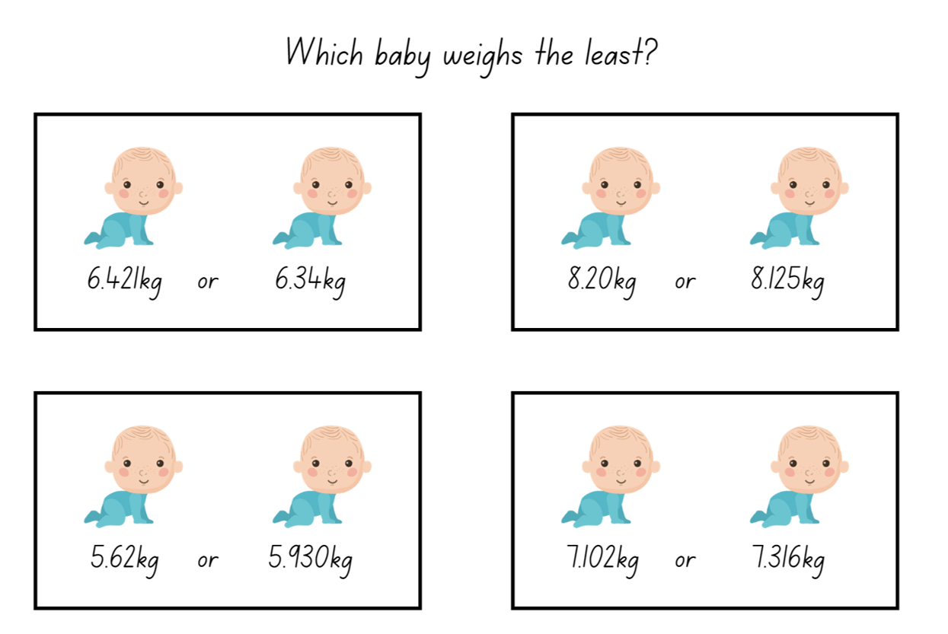
Short response (14)
Record the weight of the heaviest
baby in each set.
Set A
Set B
Set C
6.421kg or 6.34kg
7.102kg or 7.316kg
8.20kg or 8.125kg
Notes:
Short response questions provide brisk paced questions focussing on review of current and previous content to support spaced and interleaved practice.
Syllabus focus area:
Represents numbers A

Slide 32
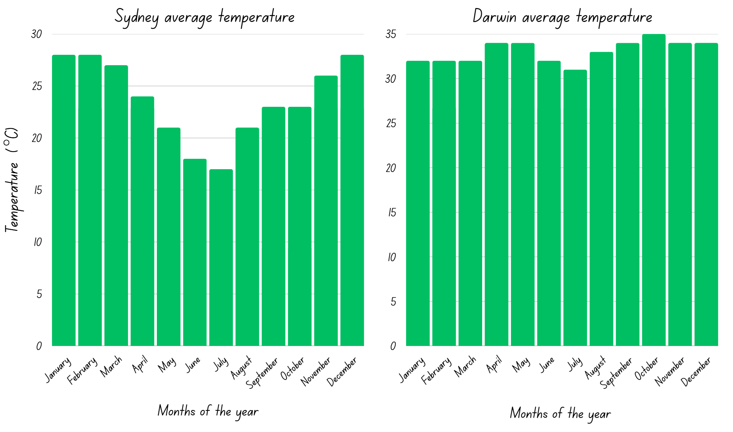
Short response (15)
Describe how the distribution of data is different in these graphs.
Notes:
Short response questions provide brisk paced questions focussing on review of current and previous content to support spaced and interleaved practice.
Syllabus focus area:
Data B

Slide 33
Short response (16)
Draw a quadrilateral.
Then record its attributes.
Notes:
Short response questions provide brisk paced questions focussing on review of current and previous content to support spaced and interleaved practice.
Syllabus focus area:
Two-dimensional structure A (Note: Stage 2 content reviewed)

Slide 34
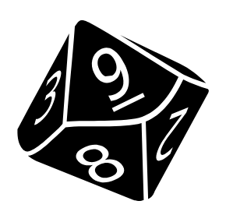

Activity 4 – standard and non-standard partitioning
I rolled a nine and decided to record this number in the hundreds place.
Roll the dice and record each number on the place value house to make a 6-digit number.
Take turns to record the 6-digit number in standard and non-standard partitioning.
Notes:
This is a developing number sense activity.
Number sense refers to a deep understanding of numbers, including their magnitude, relationships, and the effects of operations on them. It supports fluency and understanding, estimation, flexible thinking, and efficient problem-solving. Number sense activities 1–4 ‘activate’ prior number knowledge and support the learning of new content in the unit. Number sense activities 5–8 ‘loop’ back and provide opportunity for spaced practice with concepts and procedures covered in previous units.
Syllabus focus area:
Represents numbers A
Standard and non-standard partitioning
This resource corresponds to Resource 3 – place value house in Stage 3 Year A Unit 7.
Provide pairs of students with a copy of Resource 3 – place value house and a 9-sided dice.
Students roll the dice and decide where to place each number on the resource until a 6-digit number has been created.
One student in the pair records the number using standard partitioning and the other student records the number using non-standard partitioning.
Once both students have recorded their partitioned numbers, they check and discuss.
Repeat the process with students swapping roles of recording the standard or non-standard partitioning for the next 6-digit number generated.

Slide 35
Review of learning 5

Slide 36
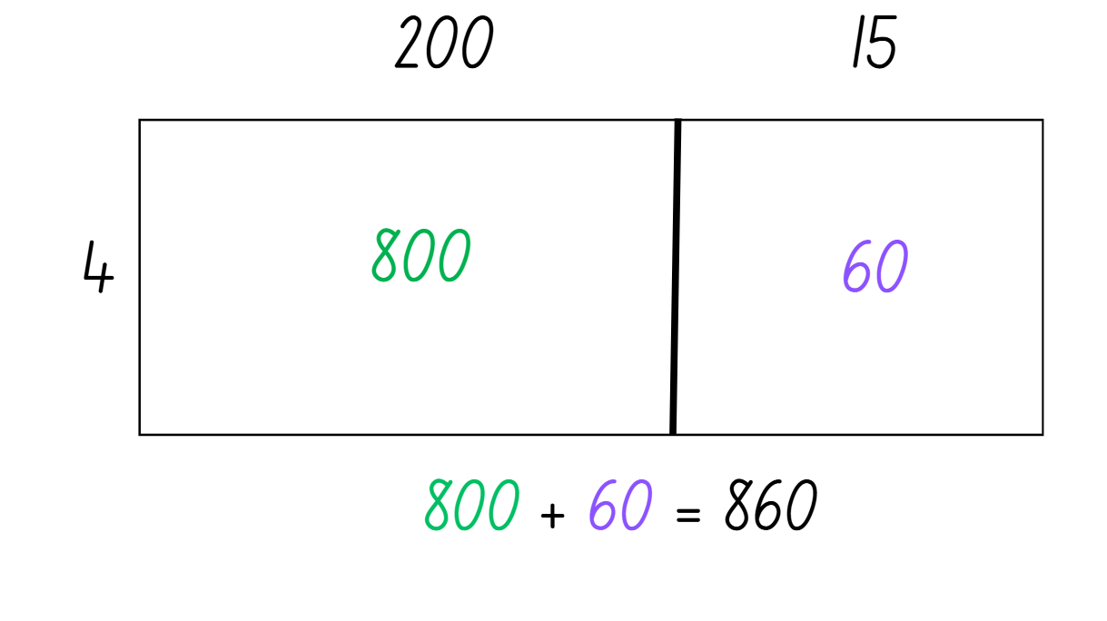
Multiple choice (3)
This area models shows…
A
B
C
D
860 x 4
204 x 15
215 x 4
4 x 860
Notes:
This question connects to the content in the developing number sense activity (Activity 5)
Syllabus focus area:
Multiplicative relations A

Slide 37
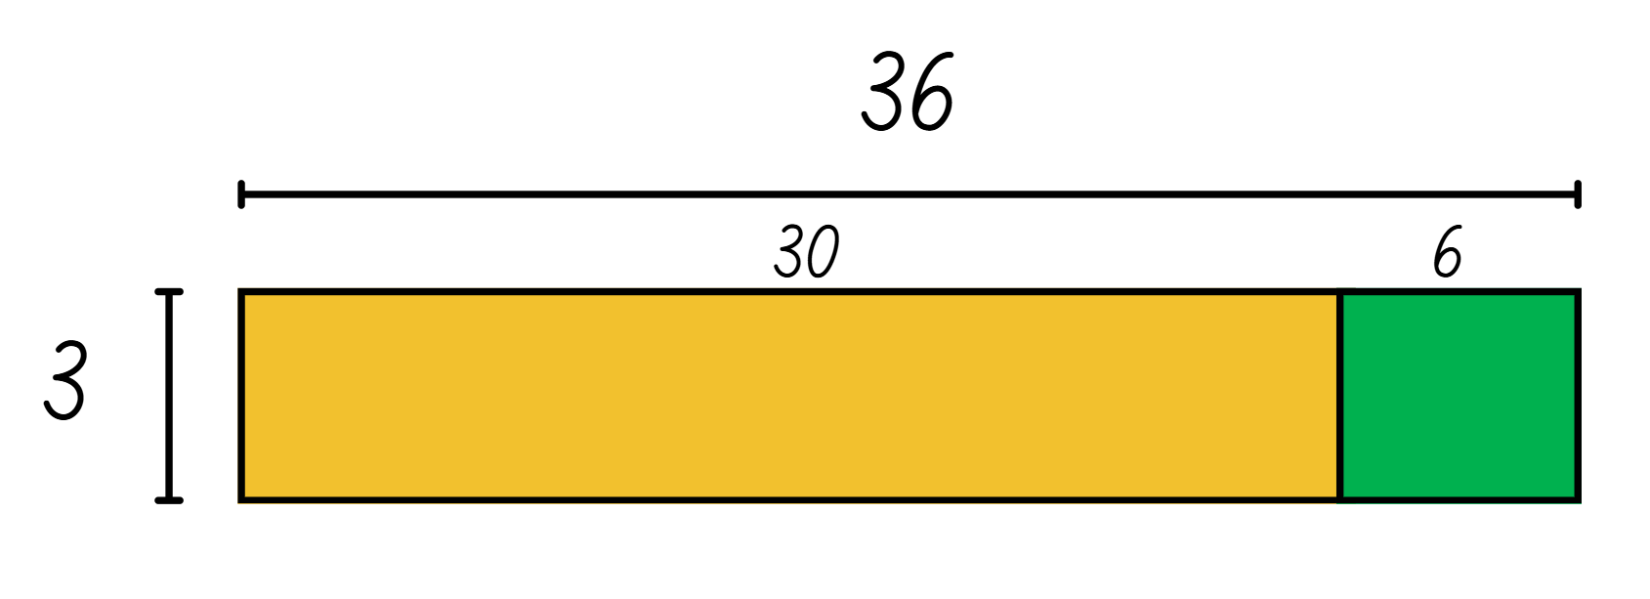
Short response (17)
Use the area model to solve 36 divided by 3.
Notes:
Short response questions provide brisk paced questions focussing on review of current and previous content to support spaced and interleaved practice.
Syllabus focus area:
Multiplicative relations A

Slide 38
Short response (18)
Order these heights from shortest to tallest:
1.8 m
1.27 m
1.82 m
1.7 m
Notes:
Short response questions provide brisk paced questions focussing on review of current and previous content to support spaced and interleaved practice.
Syllabus focus area:
Represents numbers A

Slide 39
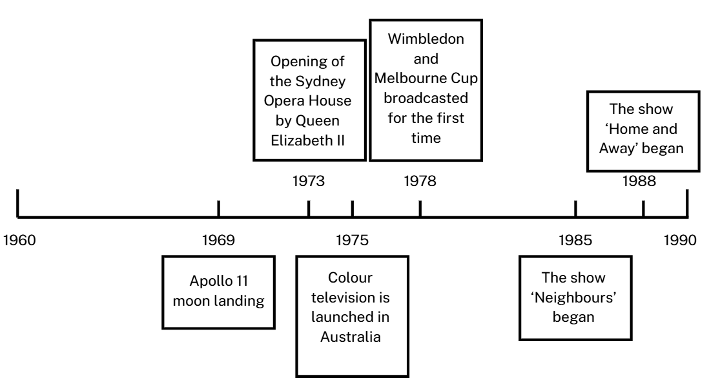
Short response (19)
Record the year the show ‘Home and Away’ began.
Notes:
Short response questions provide brisk paced questions focussing on review of current and previous content to support spaced and interleaved practice.
Syllabus focus area:
Data B

Slide 40

Short response (20)
How much time is remaining until nine o’clock.
Notes:
Short response questions provide brisk paced questions focussing on review of current and previous content to support spaced and interleaved practice.
Syllabus focus area:
Non-spatial measure B: Time (Note: Stage 2 content reviewed)

Slide 41
Activity 5 – using the area model to solve division problems (1)
Use an area model to solve:
The sports shed has 72 tennis balls. Each container holds 8 balls.
How many containers are needed?
Notes:
This is a developing number sense activity.
Number sense refers to a deep understanding of numbers, including their magnitude, relationships, and the effects of operations on them. It supports fluency and understanding, estimation, flexible thinking, and efficient problem-solving. Number sense activities 1–4 ‘activate’ prior number knowledge and support the learning of new content in the unit. Number sense activities 5–8 ‘loop’ back and provide opportunity for spaced practice with concepts and procedures covered in previous units.
Syllabus focus area:
Multiplicative relations A
Using the area model to solve division problems
This resource corresponds to Resource 16 – sports shed equipment in Stage 3 Year A Unit 7.
Ask students to use area models to solve each of the problems displayed.
Students turn and talk to discuss their solutions. Pairs of students check their answers using the inverse operation of multiplication to check their answers.

Slide 42
Activity 5 – using the area model to solve division problems (2)
Use an area model to solve:
The sports shed has 56 training cones.
They are stacked in groups of 7. How many stacks are there?
Notes:
This is a developing number sense activity.
Number sense refers to a deep understanding of numbers, including their magnitude, relationships, and the effects of operations on them. It supports fluency and understanding, estimation, flexible thinking, and efficient problem-solving. Number sense activities 1–4 ‘activate’ prior number knowledge and support the learning of new content in the unit. Number sense activities 5–8 ‘loop’ back and provide opportunity for spaced practice with concepts and procedures covered in previous units.
Syllabus focus area:
Multiplicative relations A
Using the area model to solve division problems
This resource corresponds to Resource 16 – sports shed equipment in Stage 3 Year A Unit 7.
Ask students to use area models to solve each of the problems displayed.
Students turn and talk to discuss their solutions. Pairs of students check their answers using the inverse operation of multiplication to check their answers.

Slide 43
Review of learning 6

Slide 44
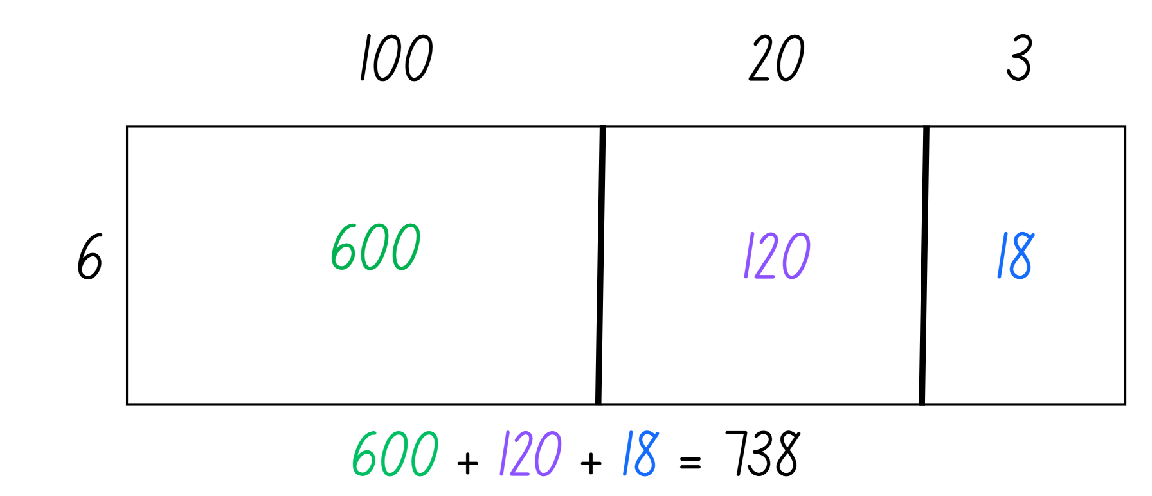
True or false (3)
This area model represents 123 x 6.
True | False
Notes:
The question on this slide connects to the content being explored in the developing number sense activity (Activity 6)
Syllabus focus area:
Multiplicative relations A

Slide 45
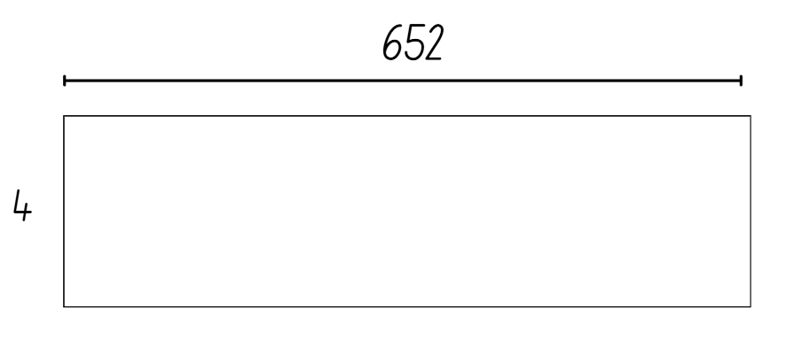
Short response (21)
Solve 652 × 4 using the area model:
Notes:
Short response questions provide brisk paced questions focussing on review of current and previous content to support spaced and interleaved practice.
Syllabus focus area:
Multiplicative relations A

Slide 46
Short response (22)
On the weekend 532 people went to see a movie. Halfway through the movie, 67 people left because they didn't like it. How many people watched the whole movie?
Communicate your strategy.
Notes:
Short response questions provide brisk paced questions focussing on review of current and previous content to support spaced and interleaved practice.
Syllabus focus area:
Additive relations A

Slide 47
Short response (23)
Order the following decimals from
smallest to largest:
0.68
0.8
0.0086
Notes:
Short response questions provide brisk paced questions focussing on review of current and previous content to support spaced and interleaved practice.
Syllabus focus area:
Represents numbers A

Slide 48
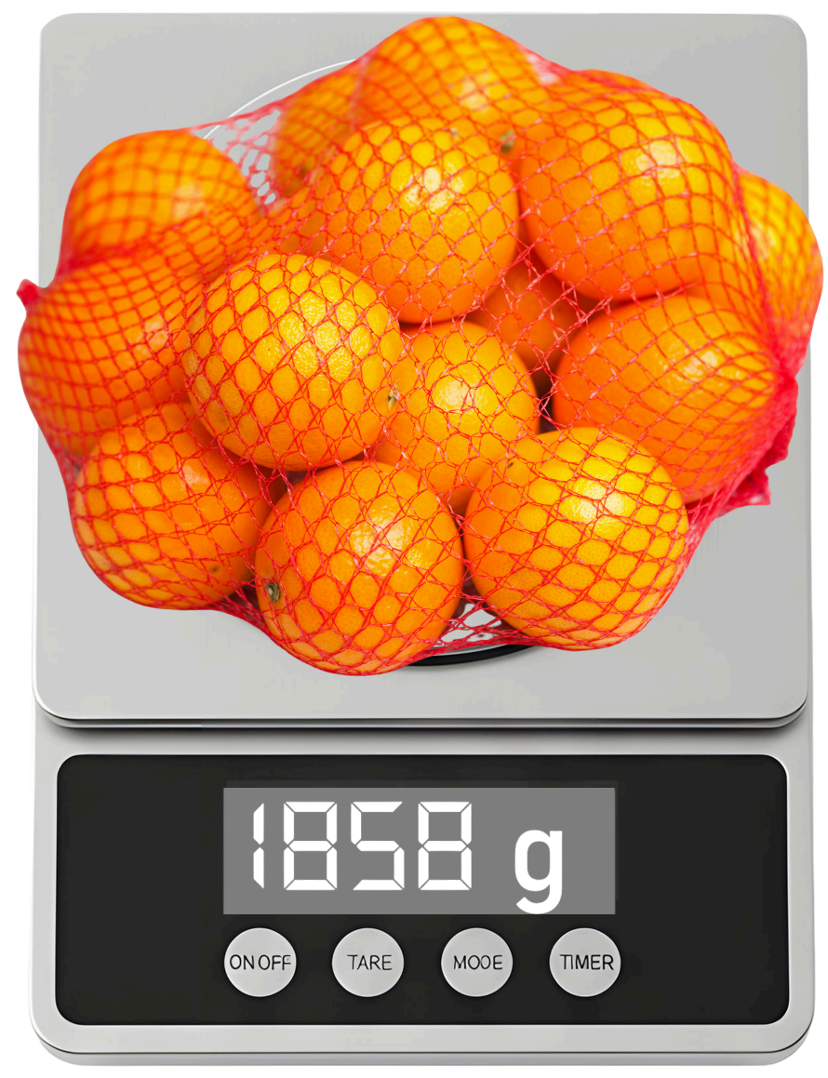
Short response (24)
Record the mass of the oranges in kilograms and grams.
Notes:
Short response questions provide brisk paced questions focussing on review of current and previous content to support spaced and interleaved practice.
Syllabus focus area:
Non-spatial measure B: Mass (Note: Stage 2 content reviewed)

Slide 49
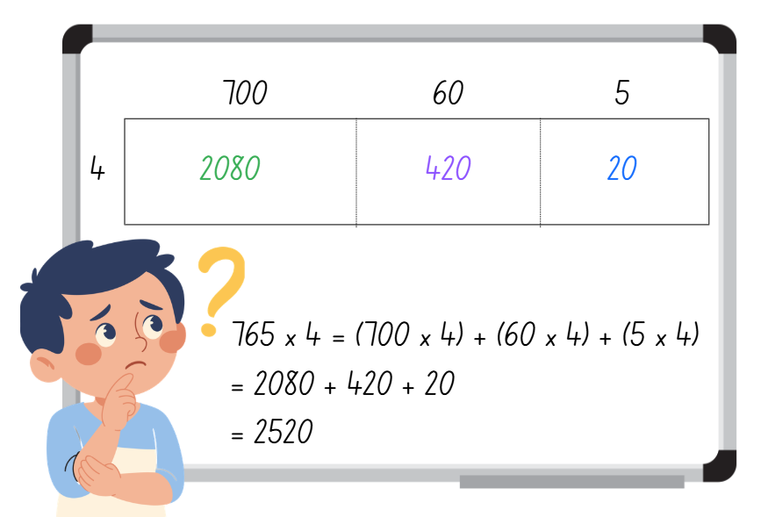
Activity 6 – investigating the area model
Use the area model to solve 765 × 4 to determine when Akram’s calculations are correct.
Notes:
This is a developing number sense activity.
Number sense refers to a deep understanding of numbers, including their magnitude, relationships, and the effects of operations on them. It supports fluency and understanding, estimation, flexible thinking, and efficient problem-solving. Number sense activities 1–4 ‘activate’ prior number knowledge and support the learning of new content in the unit. Number sense activities 5–8 ‘loop’ back and provide opportunity for spaced practice with concepts and procedures covered in previous units.
Syllabus focus area:
Multiplicative relations A
Investigating the area model
This resource corresponds to Resource 17 – Akram’s area model in Stage 3 Year A Unit 7.
Ask students to use the area model to solve 765 × 4 to determine when Akram’s calculations are accurate.
Students turn and talk to discuss their calculations and what errors Akram made in his calculations.

Slide 50
Review of learning 7

Slide 51
Multiple choice (4)
(3 x 5) x 4 =
A
B
C
D
23
60
75
15
Notes:
This question connects to the content in the developing number sense activity (Activity 7)
Syllabus focus area:
Multiplicative relations A

Slide 52
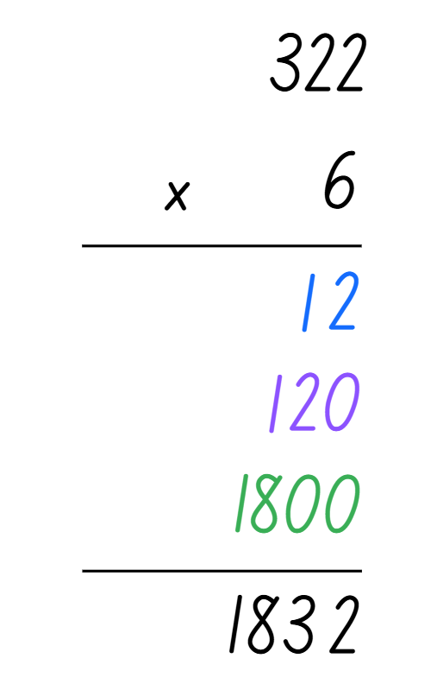
Short response (25)
Draw the area model to match:
Notes:
Short response questions provide brisk paced questions focussing on review of current and previous content to support spaced and interleaved practice.
Syllabus focus area:
Multiplicative relations A

Slide 53
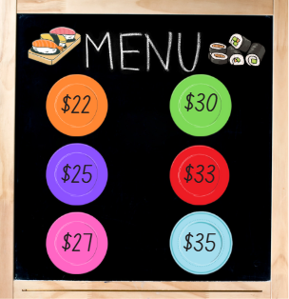
Short response (26)
Stage 3 students gathered at a local sushi restaurant.
Katrina ate 3 purple plates, 4 pink plates and 2 blue plates. She paid with a $250. How much change did she receive?
Communicate your strategy.
Notes:
Short response questions provide brisk paced questions focussing on review of current and previous content to support spaced and interleaved practice.
Syllabus focus area:
Additive relations A

Slide 54
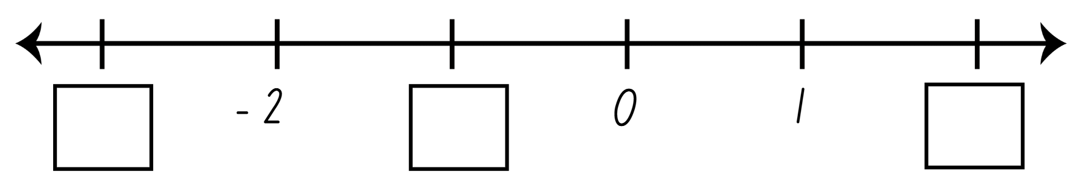
Short response (27)
Record the missing numbers:
Notes:
Short response questions provide brisk paced questions focussing on review of current and previous content to support spaced and interleaved practice.
Syllabus focus area:
Represents numbers B

Slide 55
Short response (28)
Sketch a square pyramid from the top and side views.
Notes:
Short response questions provide brisk paced questions focussing on review of current and previous content to support spaced and interleaved practice.
Syllabus focus area:
Three-dimensional spatial structure B: 3D objects (Note: Stage 2 content reviewed)

Slide 56
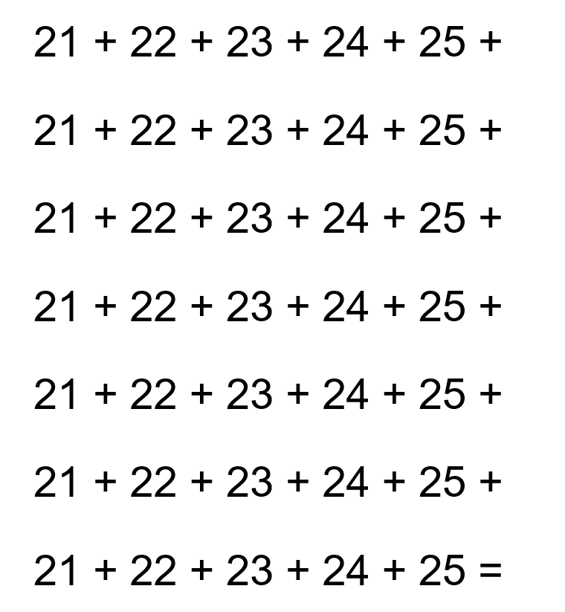
Activity 7 – using partial products
Use the distributive property with partial products to find the sum of all the numbers displayed.
Notes:
This is a developing number sense activity.
Number sense refers to a deep understanding of numbers, including their magnitude, relationships, and the effects of operations on them. It supports fluency and understanding, estimation, flexible thinking, and efficient problem-solving. Number sense activities 1–4 ‘activate’ prior number knowledge and support the learning of new content in the unit. Number sense activities 5–8 ‘loop’ back and provide opportunity for spaced practice with concepts and procedures covered in previous units.
Syllabus focus area:
Multiplicative relations A
Using partial products
This resource corresponds to Resource 18 – find the total and Figure 16 in Stage 3 Year A Unit 7.
Ask students to use the distributive property with partial products to find the sum of all the numbers displayed. If required, prompt students to identify that the numbers in each row are repeated, so if the numbers in the top row are added together first, then this total can be multiplied by the number of rows (see Figure 16).

Slide 57
Review of learning 8

Slide 58
True or false (4)
(4 x 6) x 3 = 6 x (3 x 4)
True | False
Notes:
The question on this slide connects to the content being explored in the developing number sense activity (Activity 8)
Syllabus focus area:
Multiplicative relations A

Slide 59
Short response (29)
Jai bakes 43 cookies and places them
into boxes ready to sell.
Each box must have 6 cookies.
How many boxes will Jai fill?
How many cookies remain unboxed?
Communicate your reasoning.
Notes:
Short response questions provide brisk paced questions focussing on review of current and previous content to support spaced and interleaved practice.
Syllabus focus area:
Multiplicative relations A

Slide 60
Short response (30)
Record an estimation for this worded problem. Then use a strategy to calculate.
In a school of 938 students, 324 parents visited the school for a special assembly. At the end of the assembly, 126 children went home with their parents. How many children stayed at school?
Notes:
Short response questions provide brisk paced questions focussing on review of current and previous content to support spaced and interleaved practice.
Syllabus focus area:
Additive relations A

Slide 61
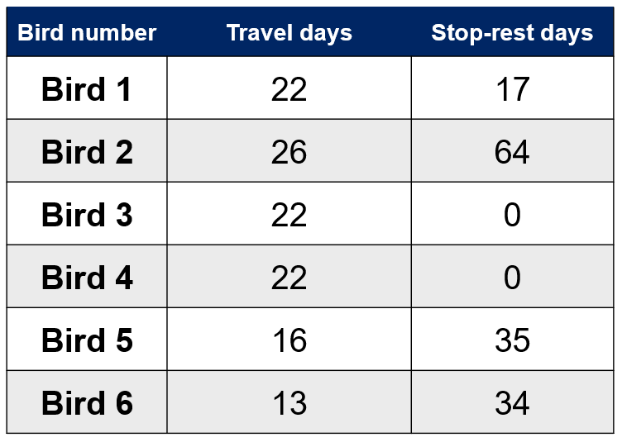
Short response (31)
What is the range in each of the categories of this dataset.
Notes:
Short response questions provide brisk paced questions focussing on review of current and previous content to support spaced and interleaved practice.
Syllabus focus area:
Data B

Slide 62
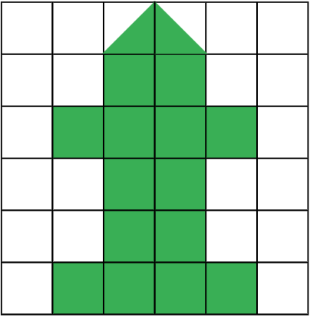
Short response (32)
Record the area of the green shape which has been drawn onto a square-centimetre grid.
Notes:
Short response questions provide brisk paced questions focussing on review of current and previous content to support spaced and interleaved practice.
Syllabus focus area:
Two-dimensional spatial structure B: Area (Note: Stage 2 content reviewed)

Slide 63
Activity 8 – using the distributive property
Roll the dice 5 times to make a 4-digit number and a one-digit number.
Record the 2 numbers as a multiplication number sentence.
Record 2 different strategies to find the solution.
What strategies did you choose? Why?
Which one was most efficient?
For example,
2847 × 9
I could solve this by using the area model or the distributive property with partial products.
Notes:
This is a developing number sense activity.
Number sense refers to a deep understanding of numbers, including their magnitude, relationships, and the effects of operations on them. It supports fluency and understanding, estimation, flexible thinking, and efficient problem-solving. Number sense activities 1–4 ‘activate’ prior number knowledge and support the learning of new content in the unit. Number sense activities 5–8 ‘loop’ back and provide opportunity for spaced practice with concepts and procedures covered in previous units.
Syllabus focus area:
Multiplicative relations A
Using the distributive property
Provide each student with a 9-sided dice.
Students roll the dice 5 times to make a 4-digit number and a one-digit number. Ask students to record their 2 numbers as a multiplication number sentence. For example, 2847 × 9.
Students record 2 different methods to find the solution. For example, the area model, the distributive property with partial products or a formal algorithm.
Ask students:
What strategies did you choose? Why?
From the 2 strategies, which one was most efficient?

Slide 64
Double Venn diagram
Object 1
Object 2
Features similar to both objects
Features of object 1
Features of object 2

Slide 65
Frayer
Definition
Facts/Characteristics
Word, term, concept
Examples
Non-examples

Slide 66
Spider map
Idea
Subject

Slide 67
Cline
Concept 1
Concept 2
Word
Word
Word
Word
Word
Word
Word
Word
Word
Word
Word

Slide 68

Compare and contrast

Slide 69
Multiple choice (5)
A
B
C
D

Slide 70
Multiple choice
A
B
C
D
Notes:
This question connects to the content in the developing number sense activity (Activity 3)
Syllabus focus area:
[Focus area A/B]

Slide 71
References (1)
This presentation contains NSW Curriculum and syllabus content. The NSW Curriculum is developed by the NSW Education Standards Authority. This content is prepared by NESA for and on behalf of the Crown in the right of the State of New South Wales. The material is protected by Crown copyright.
Please refer to the NESA Copyright Disclaimer for more information https://educationstandards.nsw.edu.au/wps/portal/nesa/mini-footer/copyright.
NESA holds the only official and up-to-date versions of the NSW Curriculum and syllabus documents. Please visit the NSW Education Standards Authority (NESA) website https://educationstandards.nsw.edu.au/wps/portal/nesa/home and the NSW Curriculum website https://curriculum.nsw.edu.au.
Mathematics K–10 Syllabus © NSW Education Standards Authority (NESA) for and on behalf of the Crown in right of the State of New South Wales, 2022.
National Numeracy Learning Progression © Australian Curriculum, Assessment and Reporting Authority (ACARA) 2010 to present, unless otherwise indicated. This material was downloaded from the Australian Curriculum website (National Numeracy Learning Progression) (accessed 29 February 2024) and was not modified.
Artwork © Kayleb Waters, Gomeroi artist and Cultural mentor 2025
Common Ground Team (2020) First Nations Symbols, Common Ground Website, accessed 1 October 2025.
Commonwealth of Australia (2024) Osprey migration data, Mathematics Hub website, accessed 13 August 2025.
NSW Education Standards Authority (NESA) (2022a) ‘Teaching advice for Data A’, Stage 3, NSW Curriculum website, accessed 14 October 2025.
NSW Education Standards Authority (NESA) (2022b) ‘Teaching advice for Data B’, Stage 3, NSW Curriculum website, accessed 14 October 2025.
.

Slide 72
References (2)
This presentation contains NSW Curriculum and syllabus content. The NSW Curriculum is developed by the NSW Education Standards Authority. This content is prepared by NESA for and on behalf of the Crown in the right of the State of New South Wales. The material is protected by Crown copyright.
Please refer to the NESA Copyright Disclaimer for more information https://educationstandards.nsw.edu.au/wps/portal/nesa/mini-footer/copyright.
NESA holds the only official and up-to-date versions of the NSW Curriculum and syllabus documents. Please visit the NSW Education Standards Authority (NESA) website https://educationstandards.nsw.edu.au/wps/portal/nesa/home and the NSW Curriculum website https://curriculum.nsw.edu.au.
NSW Education Standards Authority (NESA) (2022c) ‘Teaching advice for Represents numbers B’, Stage 3, NSW Curriculum website, accessed 14 October 2025
New Zealand Ministry of Education (n.d.) ‘Data Distortion’, Figure It Out, Tāhūrangi - New Zealand Curriculum website, accessed 18 November 2025.
University of Melbourne (2023) ‘Stellar navigation and mathematics’, Aboriginal and Torres Strait Islander School Curricula: Resources Indigenous Knowledge Institute website, accessed 26 July 2023.

Slide 73
Copyright
© State of New South Wales (Department of Education), 2025
The copyright material published in this resource is subject to the Copyright Act 1968 (Cth) and is owned by the NSW Department of Education or, where indicated, by a party other than the NSW Department of Education (third-party material).
Copyright material available in this resource and owned by the NSW Department of Education is licensed under a Creative Commons Attribution 4.0 International (CC BY 4.0) license.
This license allows you to share and adapt the material for any purpose, even commercially.
Attribution should be given to © State of New South Wales (Department of Education), 2025.
Material in this resource not available under a Creative Commons license:
the NSW Department of Education logo, other logos and trademark-protected material
Material owned by a third party that has been reproduced with permission. You will need to obtain permission from the third party to reuse its material.
Links to third-party material and websites
Please note that the provided (reading/viewing material/list/links/texts) are a suggestion only and implies no endorsement, by the New South Wales Department of Education, of any author, publisher, or book title. School principals and teachers are best placed to assess the suitability of resources that would complement the curriculum and reflect the needs and interests of their students.
If you use the links provided in this document to access a third party’s website, you acknowledge that the terms of use, including licence terms set out on the third-party’s website apply to the use which may be made of the materials on that third-party website or where permitted by the Copyright Act 1968 (Cth). The department accepts no responsibility for content on third-party websites.

