Slide 1
Instructions for use
This resource is not a teaching and learning program. It should be used in conjunction with Stage 3 Year A Unit 8.
Classroom teachers are encouraged to add and adapt slides as required to meet the needs of their students.
Save a copy of the file to make changes to the slide deck. Go to File > Download a Copy (this downloads a copy to the computer to edit in the PowerPoint app).
To convert the PowerPoint to Google Slides:
  Upload the file into Google Drive and open it.
  Go to File > Save as Google Slides.
  (Note – conversion may cause formatting changes in the slides.)

Slide 2

Review of Learning
Mathematics Stage 3 – Unit 8
Notes:
Reviews may include a combination of question types, requiring students to recall facts and key ideas, as well as apply their knowledge to solve problems and answer questions. To support active engagement, a mix of techniques should be employed.” (AERO, 2024).
This Review of Learning slide deck revisits key concepts from the following units:
Stage 3 Year A Unit 8
Stage 3 Year A Unit 7
Stage 3 Year A Unit 6
It also includes opportunities to review prior learning in non-number content, supporting consolidation across focus areas.
The review of learning resources include three key task types that support the development of mathematical proficiency through retrieval, spaced practice, and active participation. These practices complement the review phase (activating prior knowledge) embedded within the beginning of each lesson.
1.
Multiple-choice questions/True or false: Designed to promote active retrieval of key concepts and identify common misconceptions in number, supporting consolidation, understanding and fluency.
These questions:
support spaced and interleaved practice
help identify and address common misconceptions
support active recall and immediate feedback
support whole class participation
identify areas requiring reteach
2.
Short-response question sets: Carefully grouped questions that encourage spaced and interleaved practice across multiple focus areas, helping students revisit and apply knowledge from different points in time.
These questions:
have a combination of question types
address a range of focus areas
build automaticity and fluency
support active recall
allow for immediate feedback
identify content requiring reteach
3.
Developing number sense activities: A variety of practical, purposeful tasks that reinforce current learning and build on prior knowledge. These activities promote reasoning, problem-solving and conceptual understanding.
The review of learning resources are designed to work support teaching and learning in mathematics. For the most effective implementation, use the resources flexibly, adapting to meet student learning needs and individual classroom contexts.

Slide 3
Lessons
1
Review of learning 1
5
Review of learning 5
2
Review of learning 2
6
Review of learning 6
3
Review of learning 3
7
Review of learning 7
4
Review of learning 4
8
Review of learning 8
Notes:
Teacher notes:
Click lesson numbers to go to specific lessons
Interactive features can be viewed in slide show

Slide 4
Review of learning 1

Slide 5

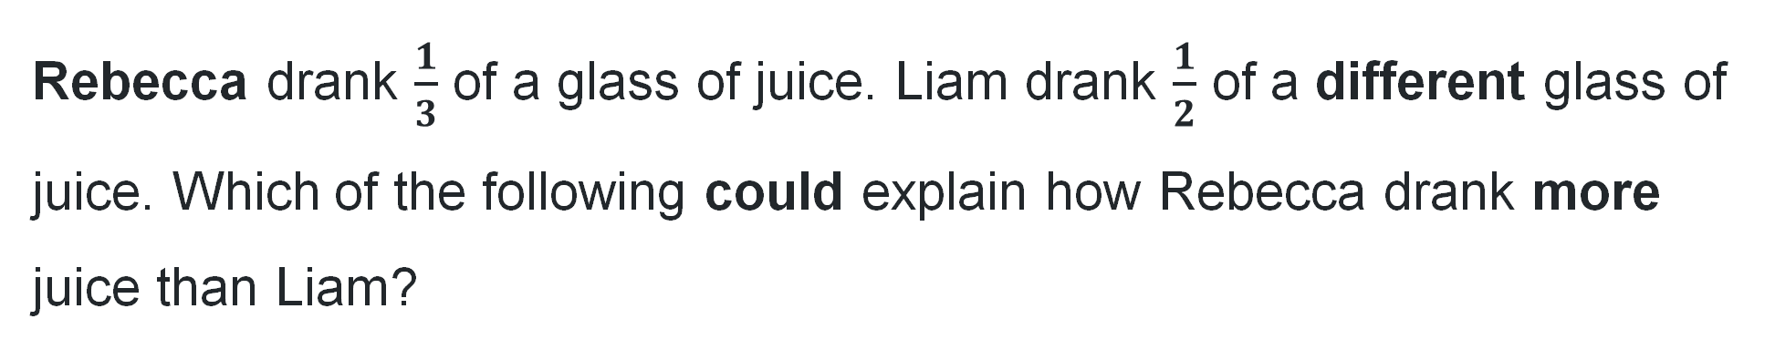
Multiple choice (1)
Rebecca drank $\frac{1}{3}$ of a glass of juice. Liam drank $\frac{1}{2}$ of a different glass of juice. Which of the following could explain how Rebecca drank more juice than Liam?
A
Rebecca’s glass was larger than Liam’s glass.
B
$\frac{1}{3}$ is always larger than $\frac{1}{2}$.
C
Liam’s glass was larger than Rebecca’s.
D
Rebecca drank orange juice and Liam drank apple juice.
Notes:
This question connects to the content in the developing number sense activity (Activity 3)
Syllabus focus area:
Representing quantity fractions A

Slide 6
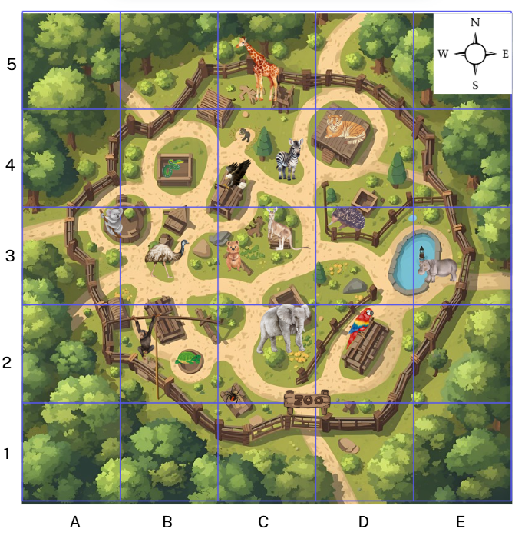

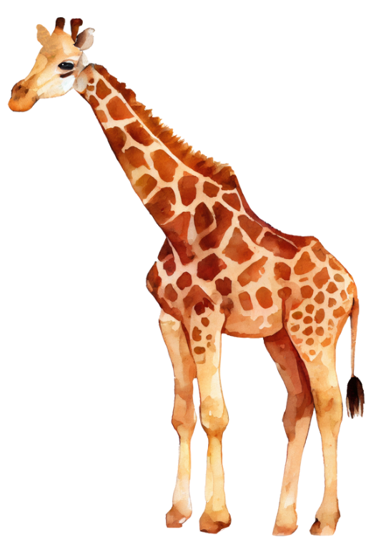
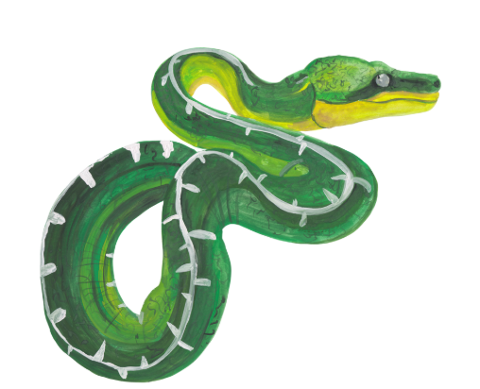
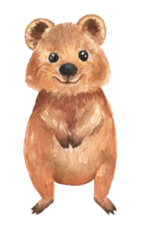
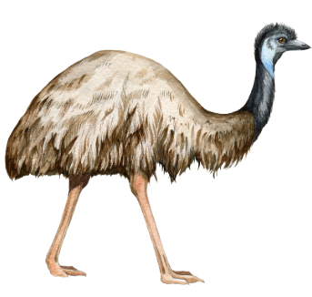
Short response (1)
Record the grid references for the:
giraffe
snake
quokka
emu
Notes:
Short response questions provide brisk paced questions focussing on review of current and previous content to support spaced and interleaved practice.
Syllabus focus area:
Geometric measure B (Stage 2 content reviewed)

Slide 7
Short response (2)
Determine whether the following numbers are either prime, composite or neither:
9
11
0
Communicate your reasoning.
Notes:
Short response questions provide brisk paced questions focussing on review of current and previous content to support spaced and interleaved practice.
Syllabus focus area:
Multiplicative relations A

Slide 8
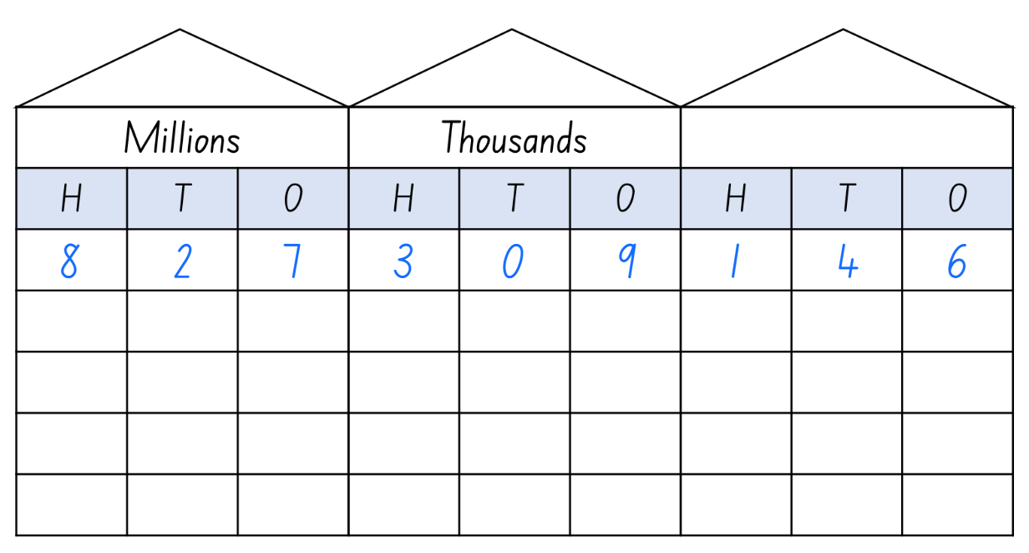
Short response (3)
What is the value of the digit in the hundreds place?
How many ten thousands are in the number?
What is the value of the digit in the hundred millions place?
Notes:
Short response questions provide brisk paced questions focussing on review of current and previous content to support spaced and interleaved practice.
Syllabus focus area:
Represents numbers A

Slide 9
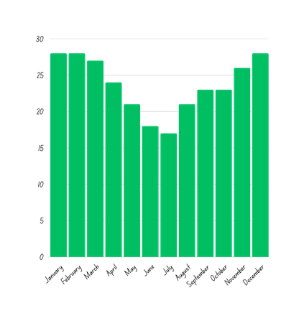
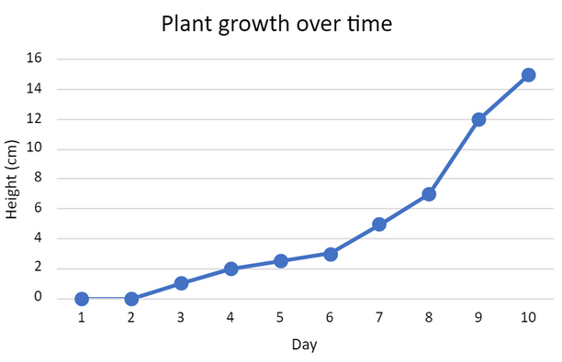
Short response (4)
Which type of data display is appropriate to represent the
average temperature in Sydney?
A. Column graph
B. Line graph
Communicate your reasoning.
Notes:
Short response questions provide brisk paced questions focussing on review of current and previous content to support spaced and interleaved practice.
Syllabus focus area:
Data A

Slide 10

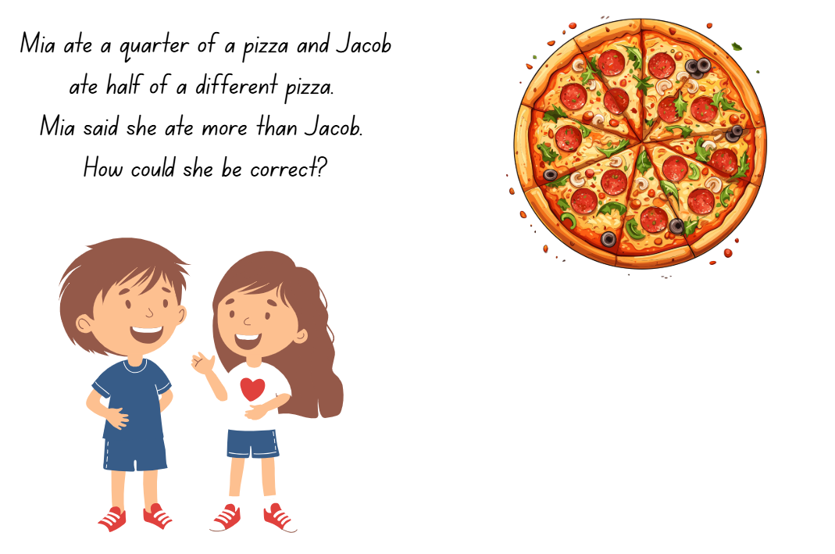
Activity 1 – comparing halves and quarters (1)
Notes:
This is a developing number sense activity.
Number sense refers to a deep understanding of numbers, including their magnitude, relationships, and the effects of operations on them. It supports fluency and understanding, estimation, flexible thinking, and efficient problem-solving. Number sense activities 1–4 ‘activate’ prior number knowledge and support the learning of new content in the unit. Number sense activities 5–8 ‘loop’ back and provide opportunity for spaced practice with concepts and procedures covered in previous units.
Syllabus focus area:
Representing quantity fractions A
Comparing halves and quarters
This resource corresponds to Resource 27 – fraction problem solving and Resource 28 – Would you rather? in Stage 3 Year A Unit 8.
Mia ate a quarter of a pizza and Jacob ate half of a different pizza. Mia said she ate more than Jacob. How could she be correct?
Guide students to consider the problem and show their working out on a whiteboard.
Students turn and talk to explain their thinking.

Slide 11
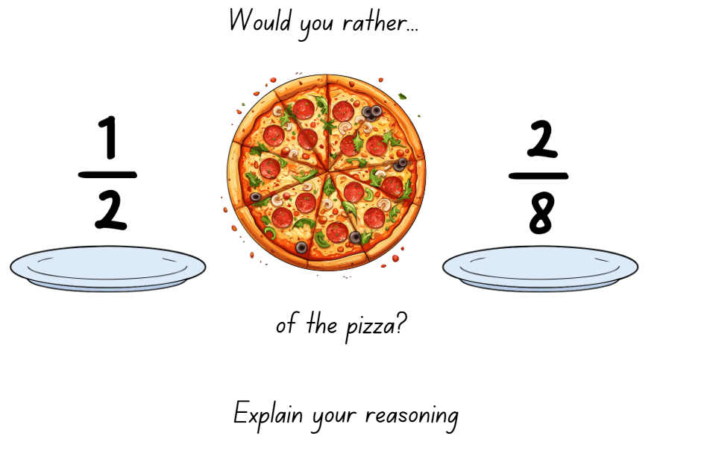
Activity 1 – comparing halves and quarters (2)
Notes:
This is a developing number sense activity.
Number sense refers to a deep understanding of numbers, including their magnitude, relationships, and the effects of operations on them. It supports fluency and understanding, estimation, flexible thinking, and efficient problem-solving. Number sense activities 1–4 ‘activate’ prior number knowledge and support the learning of new content in the unit. Number sense activities 5–8 ‘loop’ back and provide opportunity for spaced practice with concepts and procedures covered in previous units.
Syllabus focus area:
Representing quantity fractions A
Comparing halves and quarters
This resource corresponds to Resource 27 – fraction problem solving and Resource 28 – Would you rather? in Stage 3 Year A Unit 8.
Students discuss how they compared the halves and quarters of different sized pizzas, describe the part eaten and justify the need to represent the common whole.

Slide 12
Review of learning 2

Slide 13

True or false (1)
$\frac{1}{5}$ is smaller than $\frac{1}{2}$.
True | False
Communicate your reasoning.
Notes:
The question on this slide connects to the content being explored in the developing number sense activity (Activity 2)
Syllabus focus area:
Representing quantity fractions A

Slide 14
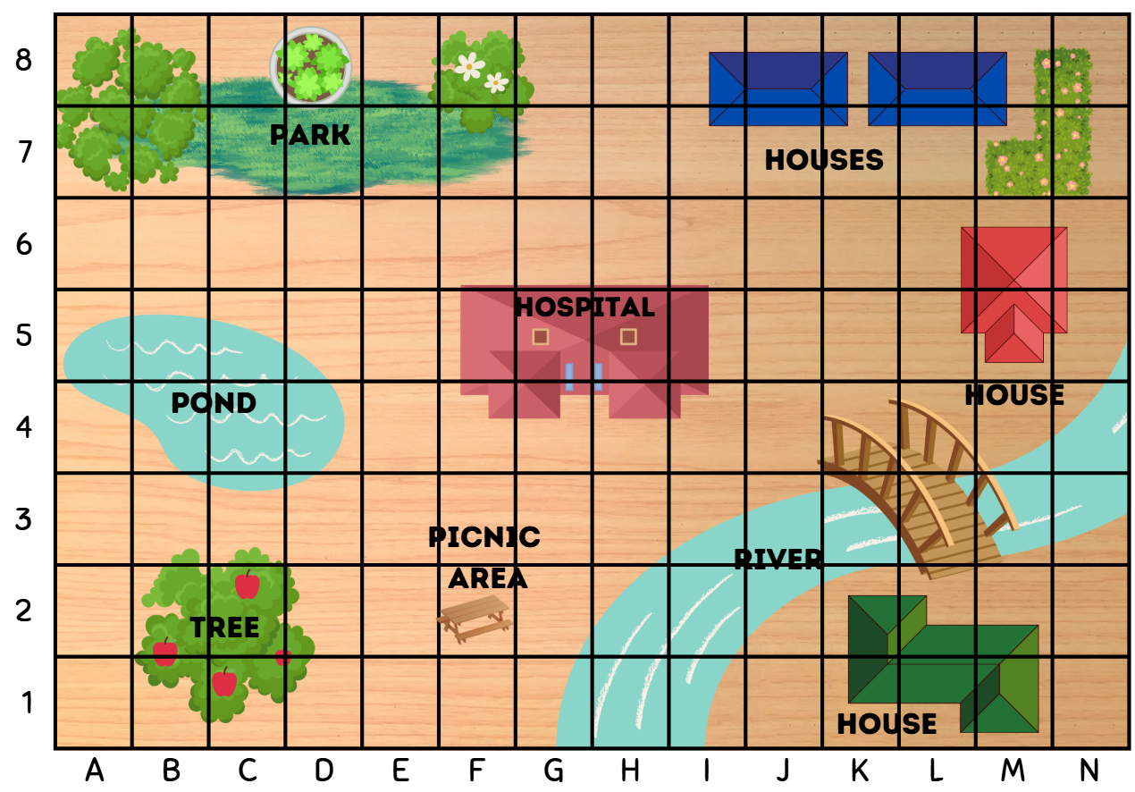
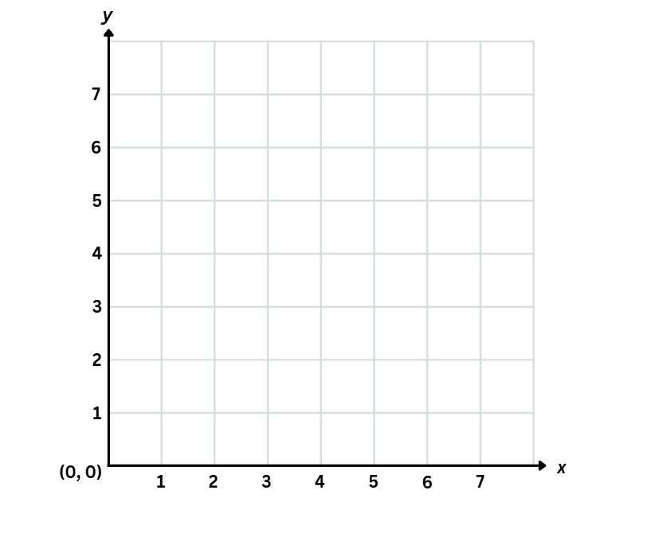
Short response (5)
Complete the sentences.
The grid-map reference is used to _____________ .
The number plane is used to ________________ .
identifies a specific point
gives the area of a location
Notes:
Short response questions provide brisk paced questions focussing on review of current and previous content to support spaced and interleaved practice.
Syllabus focus area:
Geometric measure A

Slide 15
Short response (6)
Use mental strategies to calculate the following:
7 × 70
8 × 600
9 × 2000
Notes:
Short response questions provide brisk paced questions focussing on review of current and previous content to support spaced and interleaved practice.
Syllabus focus area:
Multiplicative relations A

Slide 16
Short response (7)
Partition
827 309 146
in non-standard form.
Notes:
Short response questions provide brisk paced questions focussing on review of current and previous content to support spaced and interleaved practice.
Syllabus focus area:
Represents numbers A

Slide 17
Short response (8)
Calculate the perimeters of the following two-dimensional shapes:
325 m
415 m
280 m
Communicate your strategies.
Notes:
Short response questions provide brisk paced questions focussing on review of current and previous content to support spaced and interleaved practice.
Syllabus focus area:
Geometric measure A

Slide 18
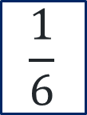
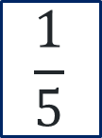
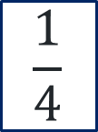
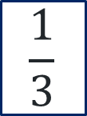
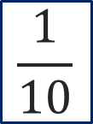
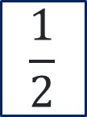
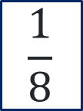
Activity 2 – ordering unit fractions on a number line
0
1
$$\frac{1}{2}$$
$$\frac{1}{3}$$
$$\frac{1}{4}$$
$$\frac{1}{5}$$
$$\frac{1}{6}$$
$$\frac{1}{8}$$
$$\frac{1}{10}$$
Notes:
This is a developing number sense activity.
Number sense refers to a deep understanding of numbers, including their magnitude, relationships, and the effects of operations on them. It supports fluency and understanding, estimation, flexible thinking, and efficient problem-solving. Number sense activities 1–4 ‘activate’ prior number knowledge and support the learning of new content in the unit. Number sense activities 5–8 ‘loop’ back and provide opportunity for spaced practice with concepts and procedures covered in previous units.
Syllabus focus area:
Representing quantity fractions A
Ordering unit fractions on a number line
This resource corresponds to Resource 29 – finding fractions and Figure 15 in Stage 3 Year A Unit 8.
Prepare Resource 29 – finding fractions.
Provide small groups of students with one of the fractions. Each group discusses where this fraction should be placed.
Model using a half and a quarter as benchmark fractions to assist in placing other fractions along the number line.
When directed, one student will place their fraction on the line, using adhesive materials.
Note: this task can be varied by using string, nine pegs and sticky notes with recorded fractions (see Figure 15). Alternatively, students can draw a line, marking zero to one, and write the given fractions on paper or individual whiteboard.

Slide 19
Review of learning 3

Slide 20
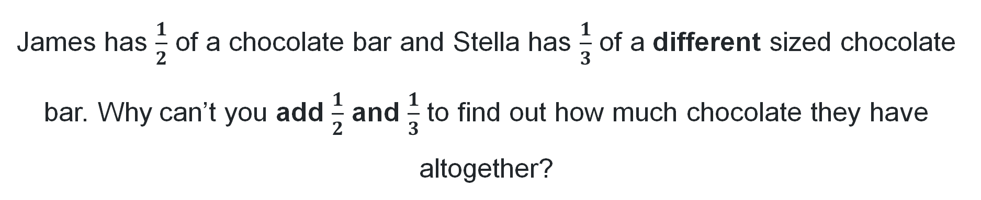
Multiple choice (2)
James has $\frac{1}{2}$ of a chocolate bar and Stella has $\frac{1}{3}$ of a different sized chocolate bar. Why can’t you add $\frac{1}{2}$ and $\frac{1}{3}$ to find out how much chocolate they have altogether?
A
The chocolate bars are different sizes, so they are fractions of different sized wholes.
B
You can, they have $\frac{2}{5}$ altogether.
C
$\frac{1}{2}$ is bigger than $\frac{1}{3}$, so you can not add fractions that are different sizes.
D
Chocolate can only be counted in whole bars.
Notes:
This question connects to the content in the developing number sense activity (Activity 3)
Syllabus focus area:
Representing quantity fractions A

Slide 21
Short response (9)
Record the coordinates of:
a.
b.
c.
d.
e.
Notes:
Short response questions provide brisk paced questions focussing on review of current and previous content to support spaced and interleaved practice.
Syllabus focus area:
Geometric measure A

Slide 22
Short response (10)
Use mental strategies to calculate the following:
50 × 7
900 × 4
8000 × 6
Notes:
Short response questions provide brisk paced questions focussing on review of current and previous content to support spaced and interleaved practice.
Syllabus focus area:
Multiplicative relations A

Slide 23
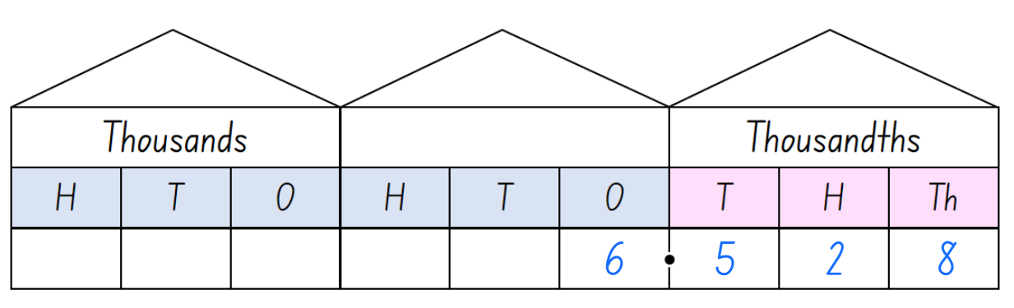
Short response (11)
What is the value of the digit in the tenths place?
What is the value of the digit in the hundredths place?
What is the value of the digit in the thousandths place?
Notes:
Short response questions provide brisk paced questions focussing on review of current and previous content to support spaced and interleaved practice.
Syllabus focus area:
Represents numbers A

Slide 24
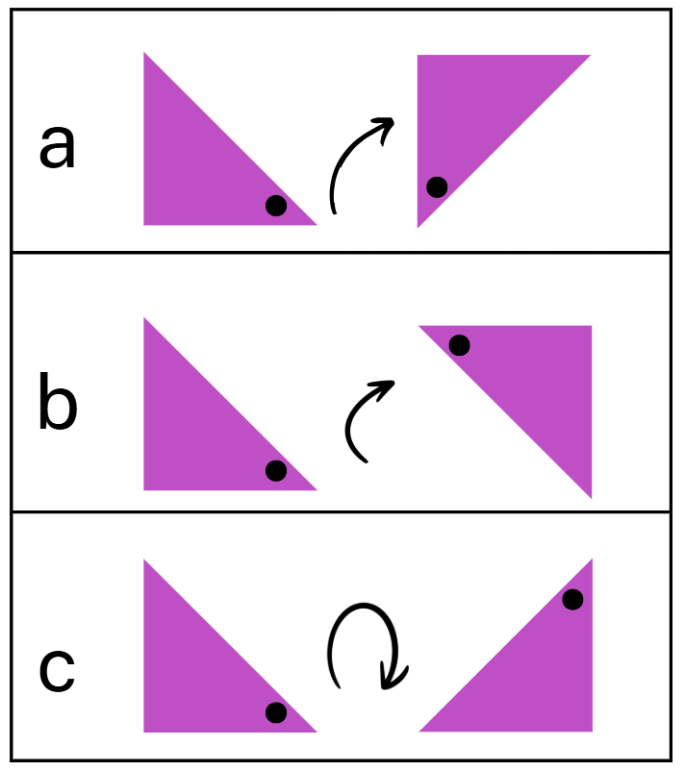
Short response (12)
Describe the amount of rotation using the terms:
quarter-turn
half-turn
three-quarter turn
Notes:
Short response questions provide brisk paced questions focussing on review of current and previous content to support spaced and interleaved practice.
Syllabus focus area:
Two-dimensional spatial structure B (Stage 2 content reviewed)

Slide 25
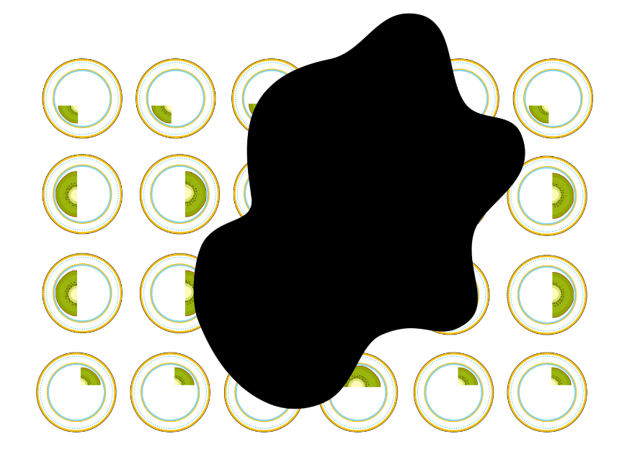
Activity 3 – applying the common whole (one) when adding fractions
Notes:
This is a developing number sense activity.
Number sense refers to a deep understanding of numbers, including their magnitude, relationships, and the effects of operations on them. It supports fluency and understanding, estimation, flexible thinking, and efficient problem-solving. Number sense activities 1–4 ‘activate’ prior number knowledge and support the learning of new content in the unit. Number sense activities 5–8 ‘loop’ back and provide opportunity for spaced practice with concepts and procedures covered in previous units.
Syllabus focus area:
Representing quantity fractions A
Applying the common whole (one) when adding fractions
This resource corresponds to Resource 30 – fruit fractions and Figure 16 in Stage 3 Year A Unit 8.
Remind students that when adding fractions, the number 1 is the common whole. For example, you cannot add a quarter to a half if the size of the wholes you are comparing are different. To add fractions, a common whole (one) is needed (see Figure 16).
Explain that these fractions displayed represent parts of whole slices that are the same size. Someone has spilt some cola over the plates.
Ask students to turn and talk to answer:
— What fraction pieces are visible? (Halves and quarters)
— How many whole slices do the visible pieces total? How did you work it out? (5 and a quarter)
— On how many plates is it unclear what fraction is on the plate? (10)
— What is the range of pieces that could be covered by the cola? (Quarter, half, three-quarters, whole, other fractions)
4. Guide students in how these kiwifruit slices are only cut into quarters, halves or three-quarters. There are no whole pieces or other fractions.
5. Ask students what the pieces covered by the cola might be if there were between 8 and 9 slices in total. Share different student responses.

Slide 26
Review of learning 4

Slide 27
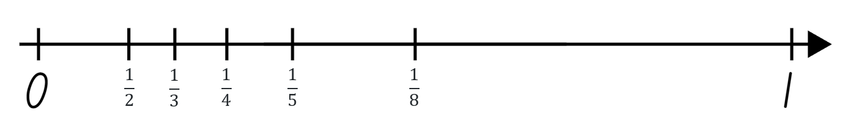
True or false (2)
All fractions have been ordered and placed correctly on the number line.
True | False
Communicate your reasoning.
Notes:
The question on this slide connects to the content being explored in the developing number sense activity (Activity 4)
Syllabus focus area:
Representing quantity fractions A

Slide 28
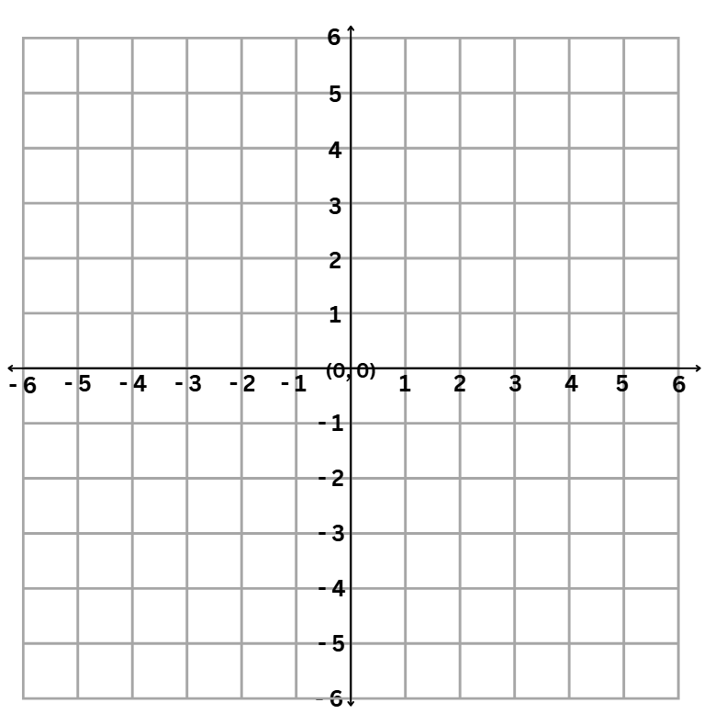
Short response (13)
Record the coordinates of:
a.
b.
c.
d.
e.
Notes:
Short response questions provide brisk paced questions focussing on review of current and previous content to support spaced and interleaved practice.
Syllabus focus area:
Geometric measure B

Slide 29
Short response (14)
Draw the area model to solve:
94 × 7
Notes:
Short response questions provide brisk paced questions focussing on review of current and previous content to support spaced and interleaved practice.
Syllabus focus area:
Multiplicative relations A

Slide 30
Short response (15)
Arrange the following decimals in
ascending order:
2.935
2.041
2.608
2.47
Communicate your reasoning.
Notes:
Short response questions provide brisk paced questions focussing on review of current and previous content to support spaced and interleaved practice.
Syllabus focus area:
Represents numbers A

Slide 31
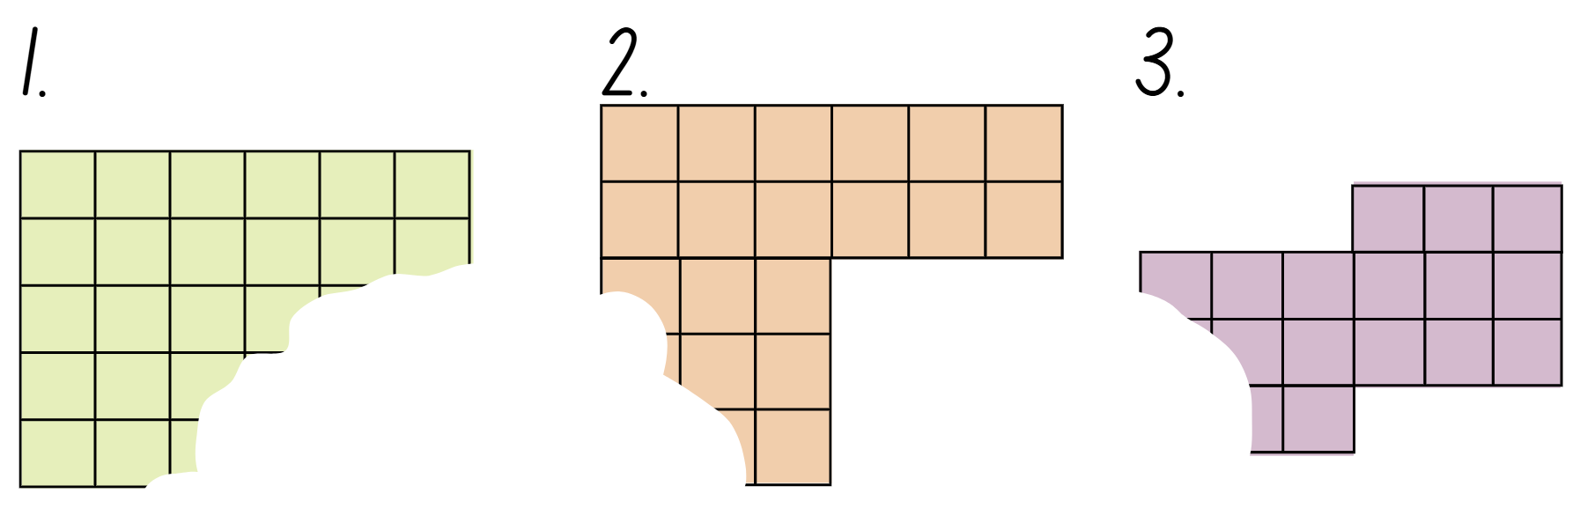
Short response (16)
These shapes with a square-centimetre grid overlay on them have been torn. Calculate the area of each of the shapes.
Notes:
Short response questions provide brisk paced questions focussing on review of current and previous content to support spaced and interleaved practice.
Syllabus focus area:
Two-dimensional spatial structure B

Slide 32
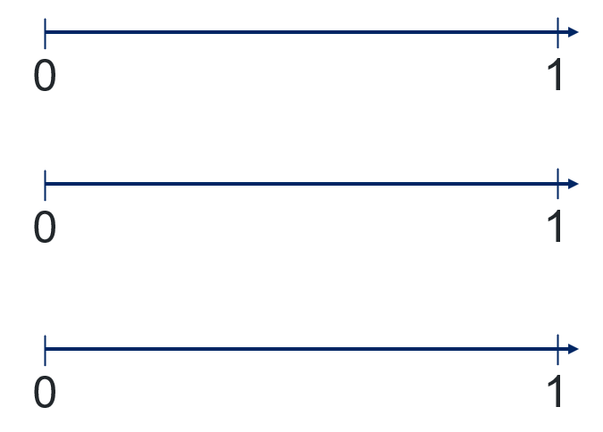
Activity 4 – comparing and ordering unit fractions on a number line
Order and write:
half, quarters and eighths on the first number line
thirds and sixths on the second number line
fifths and tenths on the third number line.
Draw and label:
Notes:
This is a developing number sense activity.
Number sense refers to a deep understanding of numbers, including their magnitude, relationships, and the effects of operations on them. It supports fluency and understanding, estimation, flexible thinking, and efficient problem-solving. Number sense activities 1–4 ‘activate’ prior number knowledge and support the learning of new content in the unit. Number sense activities 5–8 ‘loop’ back and provide opportunity for spaced practice with concepts and procedures covered in previous units.
Syllabus focus area:
Representing quantity fractions A
Comparing and ordering unit fractions on a number line
1. In pairs or small groups, students draw and label 3 number lines of approximately the same length, showing zero to one.
2. Ask students to order and write,
— half, quarters and eighths on the first number line
— thirds and sixths on the second number line
— fifths and tenths on the third number line.
3. Prompt students to consider where half would be on the second and third number line.
4. Select 3 number lines to share with the class. Discuss similarities and differences.
5. Ask students to justify any placements that differ to their peers.

Slide 33
Review of learning 5

Slide 34
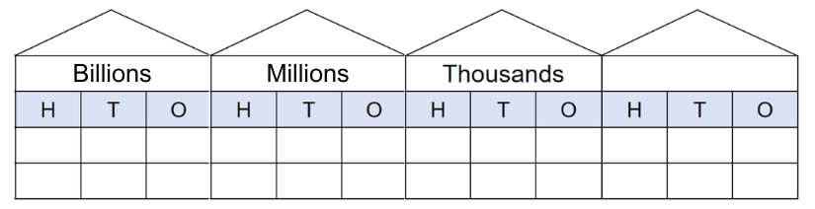
Multiple choice (3)
How many millions make one billion?
1
0
0
0
0
0
0
0
0
0
A
B
C
D
10
100
1000
10 000
Notes:
This question connects to the content in the developing number sense activity (Activity 5)
Syllabus focus area:
Represents numbers A

Slide 35
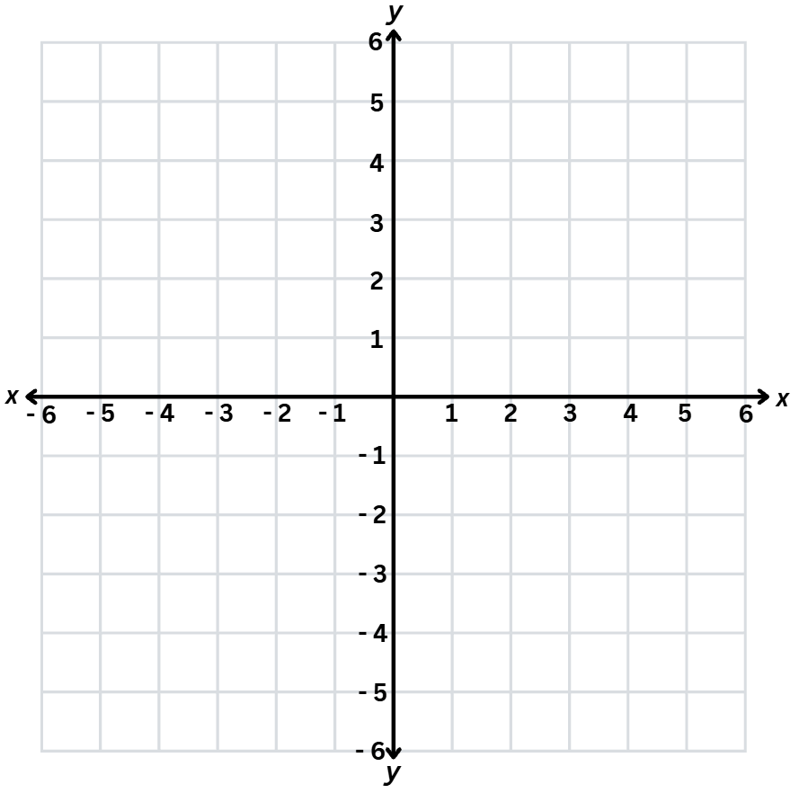
Short response (17)
If I reflected the point across the y-axis, what would the coordinates be in the second quadrant?
If I reflected the point across the x-axis, what would the coordinates be in the fourth quadrant?
Notes:
Short response questions provide brisk paced questions focussing on review of current and previous content to support spaced and interleaved practice.
Syllabus focus area:
[Geometric measure B

Slide 36
Short response (18)
Use the distributive property and the area model to solve:
8.53 × 4
Notes:
Short response questions provide brisk paced questions focussing on review of current and previous content to support spaced and interleaved practice.
Syllabus focus area:
Multiplicative relations A

Slide 37
Short response (19)
Draw an empty number line starting at 0 and ending at 1.
0
1
Mark the following decimals on the number line:
0.375
0.592
0.105
0.820
Notes:
Short response questions provide brisk paced questions focussing on review of current and previous content to support spaced and interleaved practice.
Syllabus focus area:
Represents numbers A

Slide 38

Short response (20)
Draw the top, front and side view of this rectangular prism.
Notes:
Short response questions provide brisk paced questions focussing on review of current and previous content to support spaced and interleaved practice.
Syllabus focus area:
Three-dimensional spatial structure B (Stage 2 content reviewed)

Slide 39
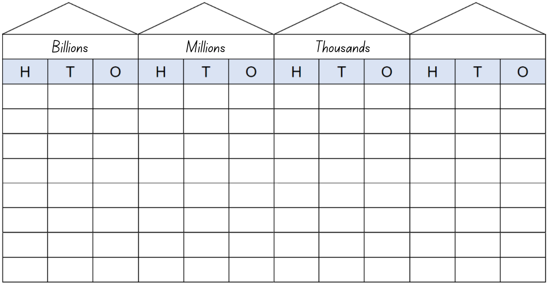
Activity 5 – applying place value with numbers to 1 billion
1. How many hundred thousands are in one million?
2. How many hundreds are there in 100 000?
3. How many thousands in one million? How do you know?
4. How can we rename 1000 millions?
Notes:
This is a developing number sense activity.
Number sense refers to a deep understanding of numbers, including their magnitude, relationships, and the effects of operations on them. It supports fluency and understanding, estimation, flexible thinking, and efficient problem-solving. Number sense activities 1–4 ‘activate’ prior number knowledge and support the learning of new content in the unit. Number sense activities 5–8 ‘loop’ back and provide opportunity for spaced practice with concepts and procedures covered in previous units.
Syllabus focus area:
Represents numbers A
Applying place value with numbers to 1 billion
This resource corresponds to Resource 31 – place value houses in Stage 3 Year A Unit 8.
1. Ask the following questions:
— How many hundred thousands are in one million?
— How many hundreds are there in 100 000?
— How many thousands in one million? How do you know?
— How can we rename 1000 millions?
2. Provide students with individual whiteboards to record their responses.
3. Regroup as a class. Students share and explain their answers.

Slide 40
Review of learning 6

Slide 41
True or false (3)
1 384 790 can be regrouped as:
1 000 000 + 30 000 + 8000 + 400 + 70 + 9.
True | False
Communicate your reasoning.
Notes:
The question on this slide connects to the content being explored in the developing number sense activity (Activity 6)
Syllabus focus area:
Represents numbers A

Slide 42
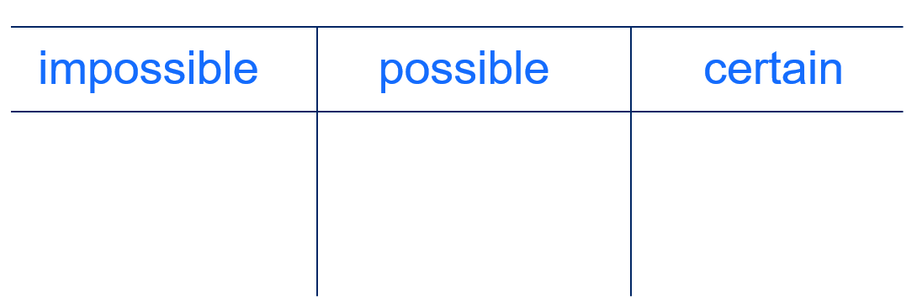

Short response (21)
Sort the numerical values into the 3 categories:
1 in 2
0-1
25%
$$\frac{1}{3}$$
0.1
Notes:
Short response questions provide brisk paced questions focussing on review of current and previous content to support spaced and interleaved practice.
Syllabus focus area:
Chance A

Slide 43
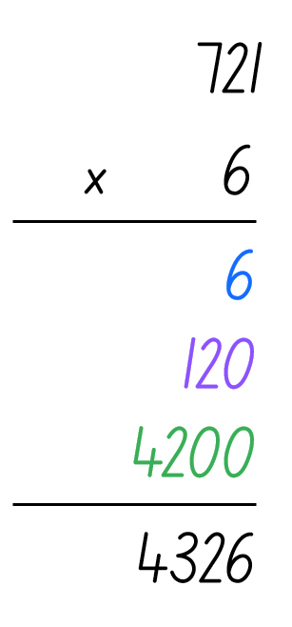
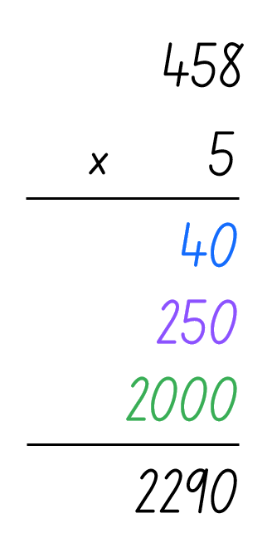
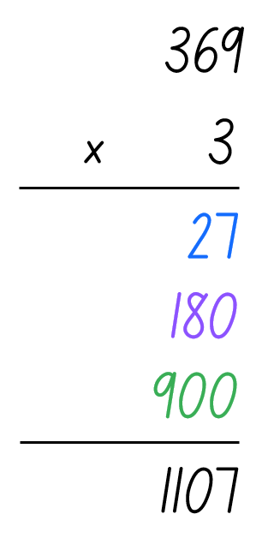
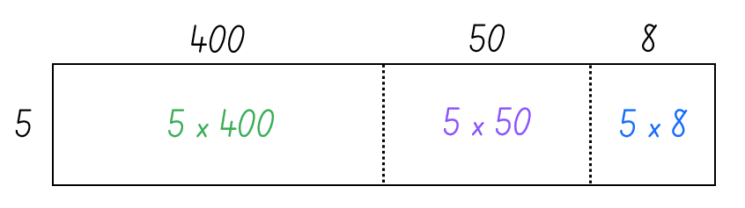
Short response (22)
Which algorithm matches this area model?
A
B.
C.
Notes:
Short response questions provide brisk paced questions focussing on review of current and previous content to support spaced and interleaved practice.
Syllabus focus area:
Multiplicative relations A

Slide 44
Short response (23)
The school canteen has 864 cartons of juice in storage. Before a delivery arrives, 529 cartons are taken out for a sports carnival. Later, the canteen manager realises that 36 cartons are past their use-by date and removes those as well.
How many cartons of juice are left in storage?
Notes:
Short response questions provide brisk paced questions focussing on review of current and previous content to support spaced and interleaved practice.
Syllabus focus area:
Additive relations A

Slide 45
Short response (24)
Convert to 24-hour time:
7:30 pm
10:00 pm
12:30 am
Notes:
Short response questions provide brisk paced questions focussing on review of current and previous content to support spaced and interleaved practice.
Syllabus focus area:
Non- spatial measure A

Slide 46
Activity 6 – applying non-standard partitioning
two
forty
hundred
seven
million
thousand
one
five
Notes:
This is a developing number sense activity.
Number sense refers to a deep understanding of numbers, including their magnitude, relationships, and the effects of operations on them. It supports fluency and understanding, estimation, flexible thinking, and efficient problem-solving. Number sense activities 1–4 ‘activate’ prior number knowledge and support the learning of new content in the unit. Number sense activities 5–8 ‘loop’ back and provide opportunity for spaced practice with concepts and procedures covered in previous units.
Syllabus focus area:
Represents numbers A
Applying non-standard partitioning
Note: some students may benefit from having the words printed on cards or sticky notes that they can move around to support their understanding.
1. In pairs, students form the largest number possible using the words provided.
2. Select students to read their chosen number aloud, listening for correct place value language.
3. Ask students to record and partition their number in various non-standard forms.
4. Regroup as a class and ask:
— Can you explain the different ways you partitioned the number you formed?
— Did you use any specific techniques or patterns for partitioning?

Slide 47
Review of learning 7

Slide 48
Multiple choice (4)
49 687 329 can be regrouped as:
You may select more than one.
A
400 000 000 + 90 000 000 + 6 000 000 + 800 000 + 70 000 + 329
B
40 000 000 + 9 000 000 + 600 000 + 80 000 + 7000 + 300 + 20 + 9
C
4 900 000 + 680 000 + 7320 + 9
D
49 000 000 + 680 000 + 7300 + 29
Notes:
This question connects to the content in the developing number sense activity (Activity 7)
Syllabus focus area:
Represents numbers A

Slide 49
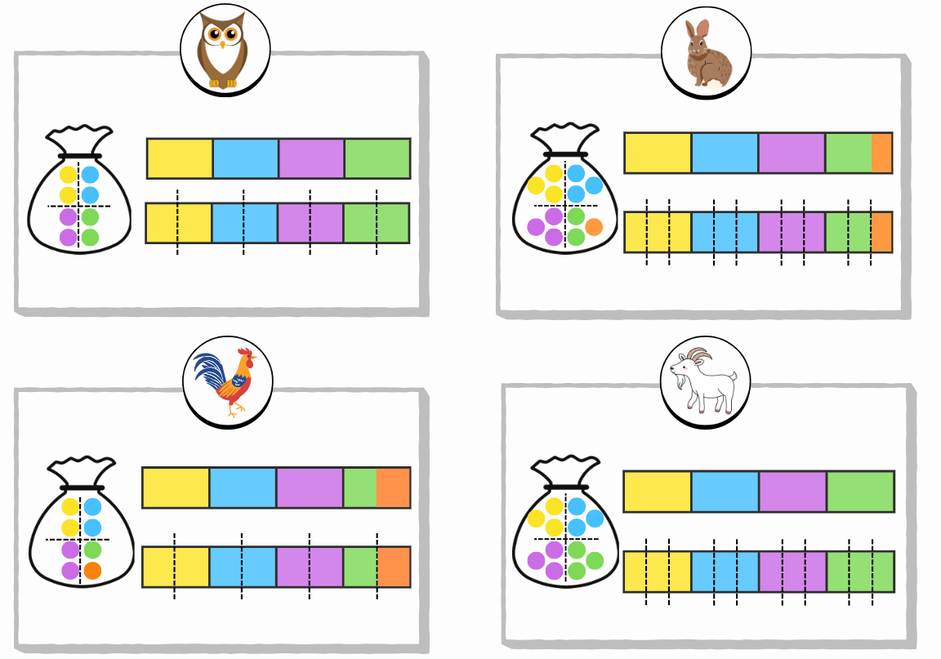
Short response (25)
Which animals represent:
Equally likely outcomes
Unequal chance
Explain your reasoning.
owl
rabbit
rooster
goat
Notes:
Short response questions provide brisk paced questions focussing on review of current and previous content to support spaced and interleaved practice.
Syllabus focus area:
Chance A

Slide 50
Short response (26)
Solve this division problem by showing the division modelled as an array and
the remainder recorded using words.
24 ÷ 5
Notes:
Short response questions provide brisk paced questions focussing on review of current and previous content to support spaced and interleaved practice.
Syllabus focus area:
Multiplicative relations A

Slide 51
Short response (27)
Teal Public School held a fun run to raise money for the school. $865 was raised from the cake stall. $1740 was raised from sponsorships. $96 was raised from the raffle. The school spent $2318 on new sports equipment.
How much money is left to spend?
Notes:
Short response questions provide brisk paced questions focussing on review of current and previous content to support spaced and interleaved practice.
Syllabus focus area:
Additive relations A

Slide 52
Short response (28)
Match each event to the correct term:
a. Rolling an even or odd number on a 6-sided die
unlikely
b. Landing on green on a spinner that has 20 equal sections and only one section is green.
likely
c. picking a blue counter from a bag containing 12 blue counters and one red counter.
equally likely
Notes:
Short response questions provide brisk paced questions focussing on review of current and previous content to support spaced and interleaved practice.
Syllabus focus area:
Chance B (Stage 2 content reviewed)

Slide 53
Activity 7 – regrouping and renaming numbers to 1 billion (1)
376 294 591
Notes:
This is a developing number sense activity.
Number sense refers to a deep understanding of numbers, including their magnitude, relationships, and the effects of operations on them. It supports fluency and understanding, estimation, flexible thinking, and efficient problem-solving. Number sense activities 1–4 ‘activate’ prior number knowledge and support the learning of new content in the unit. Number sense activities 5–8 ‘loop’ back and provide opportunity for spaced practice with concepts and procedures covered in previous units.
Syllabus focus area:
Represents numbers A
Regrouping and renaming numbers to 1 billion
1. Revise grouping the number in spoken and written forms for example:
— Spoken – 376 million, 294 thousand, 5 hundred and 91.
— Written – 300 000 000 + 70 000 000 + 6 000 000 + 200 000 + 90 000 + 4 000 + 500 + 90 + 1

Slide 54
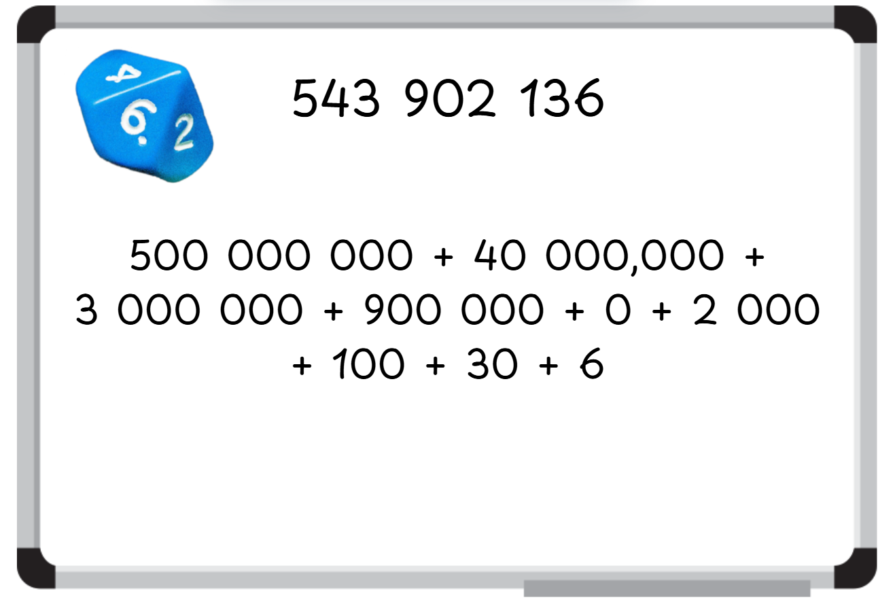
Activity 7 – regrouping and renaming numbers to 1 billion (2)
Notes:
This is a developing number sense activity.
Number sense refers to a deep understanding of numbers, including their magnitude, relationships, and the effects of operations on them. It supports fluency and understanding, estimation, flexible thinking, and efficient problem-solving. Number sense activities 1–4 ‘activate’ prior number knowledge and support the learning of new content in the unit. Number sense activities 5–8 ‘loop’ back and provide opportunity for spaced practice with concepts and procedures covered in previous units.
Syllabus focus area:
Represents numbers A
Regrouping and renaming numbers to 1 billion
This image corresponds to Figure 17 – example of student recording in Stage 3 Year A Unit 8.
1. Each student writes a 9-digit number on an individual whiteboard formed from rolling a 0-9 die, nine times.
2. Encourage students to use a zero if rolled, as a place holder.
3. Ask students to turn and talk, and:
— say the name in its spoken form in two different ways
— record the number in its expanded form
4. Repeat steps 3 to 5 (see Figure 17)
5. Prompt students to share their mathematical thinking and responses with the class.

Slide 55
Review of learning 8

Slide 56
True or false (4)
429 305 968 can be regrouped as:
429 000 000 + 30 000 + 5900 + 68.
True | False
Communicate your reasoning.
Notes:
The question on this slide connects to the content being explored in the developing number sense activity (Activity 8)
Syllabus focus area:
Represents numbers A

Slide 57
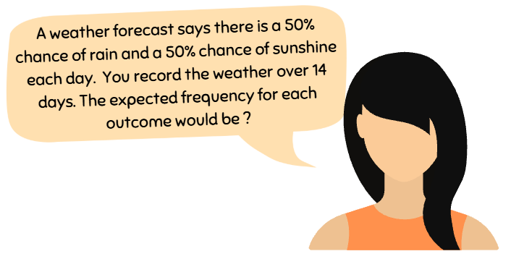
Short response (29)
Record the expected frequency for the chance scenario:
Notes:
Short response questions provide brisk paced questions focussing on review of current and previous content to support spaced and interleaved practice.
Syllabus focus area:
Chance B

Slide 58
Short response (30)
Use estimation to determine a reasonable answer for:
648 ÷ 8
Next use the area model to calculate the quotient and check the reasonableness of your estimate.
Notes:
Short response questions provide brisk paced questions focussing on review of current and previous content to support spaced and interleaved practice.
Syllabus focus area:
Multiplicative relations A

Slide 59
Short response (31)
Use estimation to roughly calculate the answer to this worded problem:
At an outdoor movie night, 846 people attended.
During the movie it started to rain, so 312 people left early. Of those who stayed, 387 were adults.
How many were children?
Notes:
Short response questions provide brisk paced questions focussing on review of current and previous content to support spaced and interleaved practice.
Syllabus focus area:
Additive relations A

Slide 60
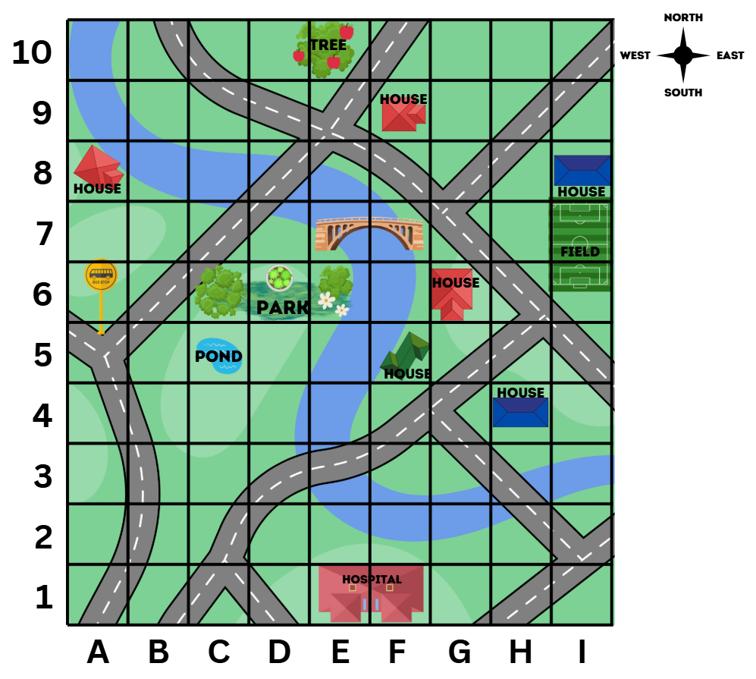
Short response (32)
Use the grid map and compass directions (N, S, E, W) to describe the following route from the park to the hospital.
Notes:
Short response questions provide brisk paced questions focussing on review of current and previous content to support spaced and interleaved practice.
Syllabus focus area:
Geometric measure B (Stage 2 content reviewed)

Slide 61
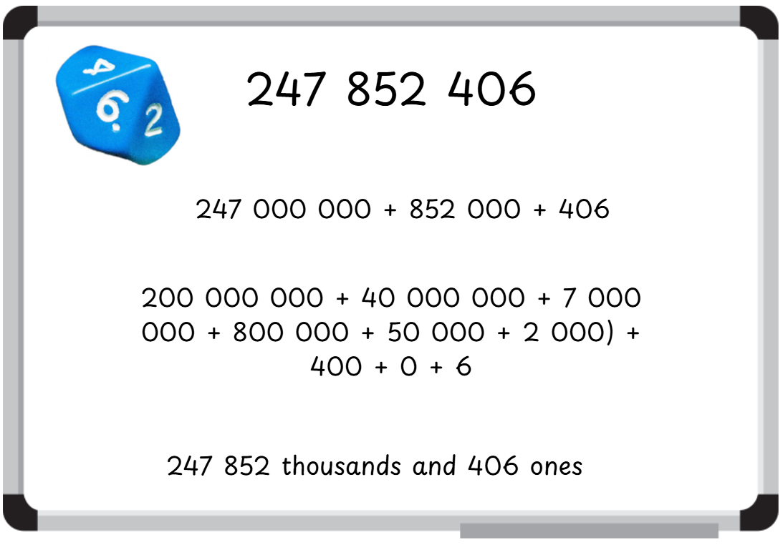
Activity 8 – partitioning and regrouping numbers in standard and non-standard form to 1 billion
Notes:
This is a developing number sense activity.
Number sense refers to a deep understanding of numbers, including their magnitude, relationships, and the effects of operations on them. It supports fluency and understanding, estimation, flexible thinking, and efficient problem-solving. Number sense activities 1–4 ‘activate’ prior number knowledge and support the learning of new content in the unit. Number sense activities 5–8 ‘loop’ back and provide opportunity for spaced practice with concepts and procedures covered in previous units.
Syllabus focus area:
Represents numbers A
Partitioning and regrouping numbers in standard and non-standard form to 1 billion
This image corresponds to Figure 18 – example of student recording in Stage 3 Year A Unit 8.
Note: this activity can be modified to student need by increasing or decreasing the value. For example, rolling the die seven times.
1. Each student writes a 9-digit number on an individual whiteboard formed from rolling a 0-9 die, nine times. For example, 247 852 406
2. Students record the number and at least two different ways to partition and regroup the number in different standard and non-standard forms.
3. Students swap their whiteboards with a partner, who regroups the partitioned number (see Figure 18).
4. Conduct a gallery walk to share students’ strategies for partitioning and regrouping the number in different standard and non-standard forms.

Slide 62
Double Venn diagram
Object 1
Object 2
Features similar to both objects
Features of object 1
Features of object 2

Slide 63
Frayer
Definition
Facts/Characteristics
Word, term, concept
Examples
Non-examples

Slide 64
Spider map
Idea
Subject

Slide 65
Cline
Concept 1
Concept 2
Word
Word
Word
Word
Word
Word
Word
Word
Word
Word
Word

Slide 66

Compare and contrast

Slide 67
Multiple choice (5)
A
B
C
D

Slide 68
Multiple choice
A
B
C
D
Notes:
This question connects to the content in the developing number sense activity (Activity 3)
Syllabus focus area:
[Focus area A/B]

Slide 69
References
This presentation contains NSW Curriculum and syllabus content. The NSW Curriculum is developed by the NSW Education Standards Authority. This content is prepared by NESA for and on behalf of the Crown in the right of the State of New South Wales. The material is protected by Crown copyright.
Please refer to the NESA Copyright Disclaimer for more information https://educationstandards.nsw.edu.au/wps/portal/nesa/mini-footer/copyright.
NESA holds the only official and up-to-date versions of the NSW Curriculum and syllabus documents. Please visit the NSW Education Standards Authority (NESA) website https://educationstandards.nsw.edu.au/wps/portal/nesa/home and the NSW Curriculum website https://curriculum.nsw.edu.au.
Mathematics K–10 Syllabus © NSW Education Standards Authority (NESA) for and on behalf of the Crown in right of the State of New South Wales, 2022.
National Numeracy Learning Progression © Australian Curriculum, Assessment and Reporting Authority (ACARA) 2010 to present, unless otherwise indicated. This material was downloaded from the Australian Curriculum website (National Literacy Learning Progression) (accessed 19 September 2025) and was not modified.

Slide 70
Copyright
© State of New South Wales (Department of Education), 2025
The copyright material published in this resource is subject to the Copyright Act 1968 (Cth) and is owned by the NSW Department of Education or, where indicated, by a party other than the NSW Department of Education (third-party material).
Copyright material available in this resource and owned by the NSW Department of Education is licensed under a Creative Commons Attribution 4.0 International (CC BY 4.0) license.
This license allows you to share and adapt the material for any purpose, even commercially.
Attribution should be given to © State of New South Wales (Department of Education), 2025.
Material in this resource not available under a Creative Commons license:
the NSW Department of Education logo, other logos and trademark-protected material
Material owned by a third party that has been reproduced with permission. You will need to obtain permission from the third party to reuse its material.
Links to third-party material and websites
Please note that the provided (reading/viewing material/list/links/texts) are a suggestion only and implies no endorsement, by the New South Wales Department of Education, of any author, publisher, or book title. School principals and teachers are best placed to assess the suitability of resources that would complement the curriculum and reflect the needs and interests of their students.
If you use the links provided in this document to access a third party’s website, you acknowledge that the terms of use, including licence terms set out on the third-party’s website apply to the use which may be made of the materials on that third-party website or where permitted by the Copyright Act 1968 (Cth). The department accepts no responsibility for content on third-party websites.

