Slide 1
Instructions for use
This resource aligns to the learning in Stage 2 Year A Unit 11 and revisits content from earlier sample units.
Classroom teachers are encouraged to add and adapt slides as required to meet the needs of their students.
Save a copy of the file to make changes to the slide deck. Go to File > Download a Copy (this downloads a copy to the computer to edit in the PowerPoint app).
To convert the PowerPoint to Google Slides:
  Upload the file into Google Drive and open it.
  Go to File > Save as Google Slides.
  (Note – conversion may cause formatting changes in the slides.)

Slide 2

Review of Learning
Mathematics Stage 2 – Unit 11
Notes:
Reviews may include a combination of question types, requiring students to recall facts and key ideas, as well as apply their knowledge to solve problems and answer questions. To support active engagement, a mix of techniques should be employed.” (AERO, 2024).
This Review of Learning slide deck revisits key concepts from the following units:
Stage 2 Year A Unit 11
Stage 2 Year A Unit 10
Stage 2 Year A Unit 9
It also includes opportunities to review prior learning in non-number content, supporting consolidation across focus areas.
The review of learning resources include three key task types that support the development of mathematical proficiency through retrieval, spaced practice, and active participation. These practices complement the review phase (activating prior knowledge) embedded within the beginning of each lesson.
1.
Multiple-choice questions/True or false: Designed to promote active retrieval of key concepts and identify common misconceptions in number, supporting consolidation, understanding and fluency.
These questions:
support spaced and interleaved practice
help identify and address common misconceptions
support active recall and immediate feedback
support whole class participation
identify areas requiring reteach
2.
Short-response question sets: Carefully grouped questions that encourage spaced and interleaved practice across multiple focus areas, helping students revisit and apply knowledge from different points in time.
These questions:
have a combination of question types
address a range of focus areas
build automaticity and fluency
support active recall
allow for immediate feedback
identify content requiring reteach
3.
Developing number sense activities: A variety of practical, purposeful tasks that reinforce current learning and build on prior knowledge. These activities promote reasoning, problem-solving and conceptual understanding.
The review of learning resources are designed to work support teaching and learning in mathematics. For the most effective implementation, use the resources flexibly, adapting to meet student learning needs and individual classroom contexts.

Slide 3
Lessons
1
Review of learning 1
5
Review of learning 5
2
Review of learning 2
6
Review of learning 6
3
Review of learning 3
7
Review of learning 7
4
Review of learning 4
8
Review of learning 8
Notes:
Teacher notes:
Click lesson titles to go to specific lessons
Interactive features can be viewed in slide show

Slide 4
Review of learning 1

Slide 5

Multiple choice (1)
A runner completes 5 laps of the oval in the morning. In the afternoon, he runs 6 times as many laps. How many laps does he run in the afternoon?
A
B
C
D
11
30
24
35
Notes:
This question connects to the content in the developing number sense activity (Activity 1)
Syllabus focus area:
Multiplicative relations A

Slide 6

Short response (1)
Order these numbers from smallest to largest.
4567
4467
4577
5467
Notes:
Short response questions provide brisk paced questions focussing on review of current and previous content to support spaced and interleaved practice.
Syllabus focus area:
Representing numbers using place value A

Slide 7
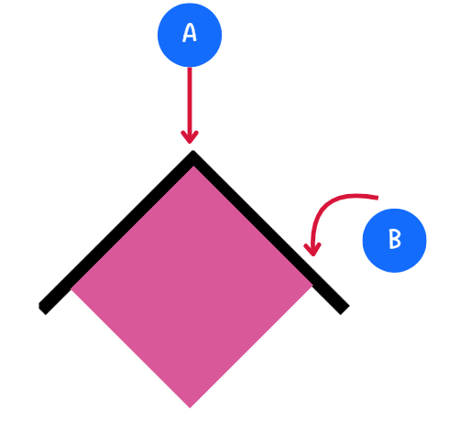
Short response (2)
Record the name of the parts of the angle labelled A and B.
Notes:
Short response questions provide brisk paced questions focussing on review of current and previous content to support spaced and interleaved practice.
Syllabus focus area:
Geometric measure A

Slide 8
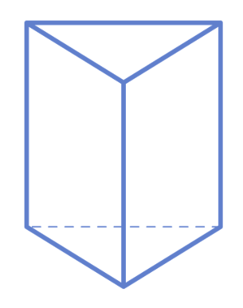
Short response (3)
Record the number of:
faces
edges
vertices
Record whether it is a prism or a pyramid.
Notes:
Short response questions provide brisk paced questions focussing on review of current and previous content to support spaced and interleaved practice.
Syllabus focus area:
Three-dimensional spatial structure B

Slide 9
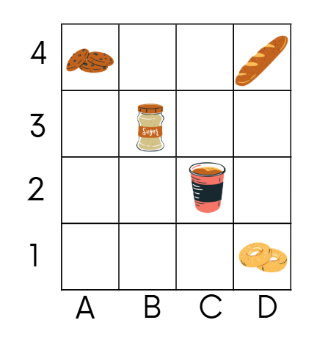
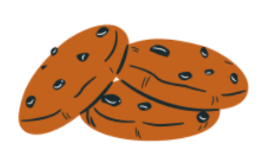
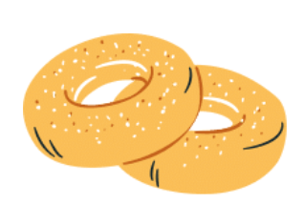

Short response (4)
Record the grid reference for the:
cookies
donuts
sugar
Notes:
Short response questions provide brisk paced questions focussing on review of current and previous content to support spaced and interleaved practice.
Syllabus focus area:
Geometric measure A

Slide 10

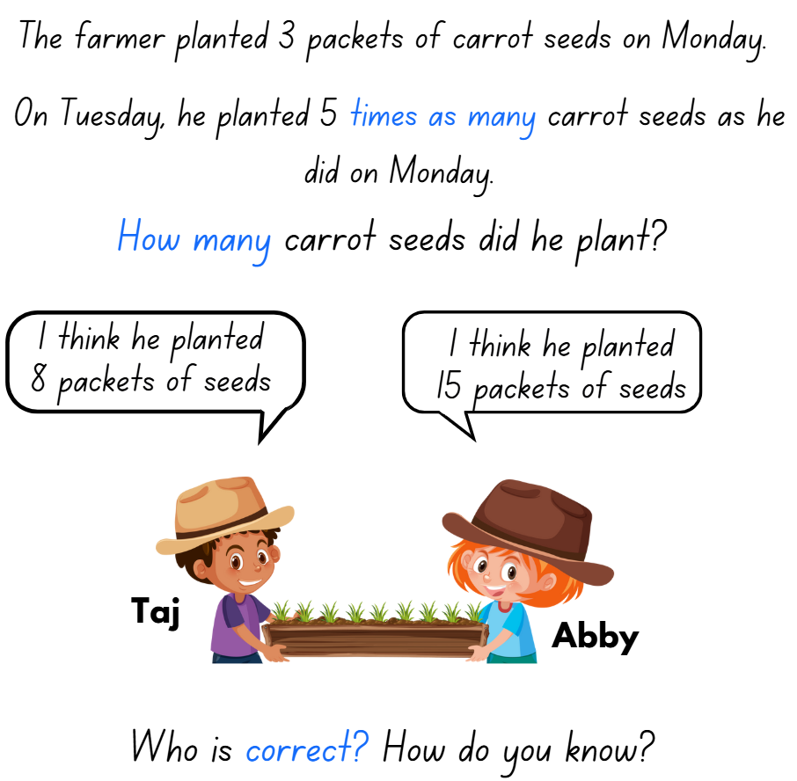
Activity 1 – 5 times as many (1)
Notes:
This is a developing number sense activity.
Number sense refers to a deep understanding of numbers, including their magnitude, relationships, and the effects of operations on them. It supports fluency and understanding, estimation, flexible thinking, and efficient problem-solving. Number sense activities 1–4 ‘activate’ prior number knowledge and support the learning of new content in the unit. Number sense activities 5–8 ‘loop’ back and provide opportunity for spaced practice with concepts and procedures covered in previous units.
Syllabus focus area:
Multiplicative relations A
5 times as many
This resource corresponds to Resource 20 – prove it! in Stage 2 Year A Unit 11.
Read the scenario to students.
Independently or in pairs, students work on individual whiteboards to determine how many seeds the farmer planted. They use this to decide which student’s statement is correct.
Students use diagrams, words or symbols to record their answer.
Ask:
How did you determine if the answer was correct?
How did you record your thinking?
Is there another way of working it out?
(Next slide) Repeat these steps for the following scenarios:
The teacher gives out 4 stickers before lunch. She gives out 5 times as many stickers after lunch. How many stickers does she hand out?
A baker bakes 10 cupcakes in the morning. He bakes 5 times as many cupcakes in the afternoon. How many cupcakes does he bake that day?

Slide 11
Activity 1 – 5 times as many (2)
The teacher gives out 4 stickers before lunch. After lunch, she gives out 5 times as many stickers. How many stickers does she hand out?
A baker bakes 10 cupcakes in the morning. In the afternoon, he bakes 5 times as many cupcakes. How many cupcakes does he bake? How many cupcakes did he bake that day?
Notes:
This is a developing number sense activity.
Number sense refers to a deep understanding of numbers, including their magnitude, relationships, and the effects of operations on them. It supports fluency and understanding, estimation, flexible thinking, and efficient problem-solving. Number sense activities 1–4 ‘activate’ prior number knowledge and support the learning of new content in the unit. Number sense activities 5–8 ‘loop’ back and provide opportunity for spaced practice with concepts and procedures covered in previous units.
Syllabus focus area:
Multiplicative relations A
5 times as many
Read the scenario to students.
The teacher gives out 4 stickers before lunch. After lunch, she gives out 5 times as many stickers. How many stickers does she hand out?
A baker bakes 10 cupcakes in the morning. In the afternoon, he bakes 5 times as many cupcakes. How many cupcakes does he bake? How many cupcakes did he bake that day?
Independently or in pairs, students work on individual whiteboards to determine how many seeds the farmer planted. They use this to decide which student’s statement is correct.
Students use diagrams, words or symbols to record their answer.
Ask:
How did you determine if the answer was correct?
How did you record your thinking?
Is there another way of working it out?

Slide 12
Review of learning 2

Slide 13

True or false (1)
The total number of counters in this partially covered array is 24?
True | False
Notes:
The question on this slide connects to the content being explored in the developing number sense activity (Activity 2)
Syllabus focus area:
Multiplicative relations A

Slide 14
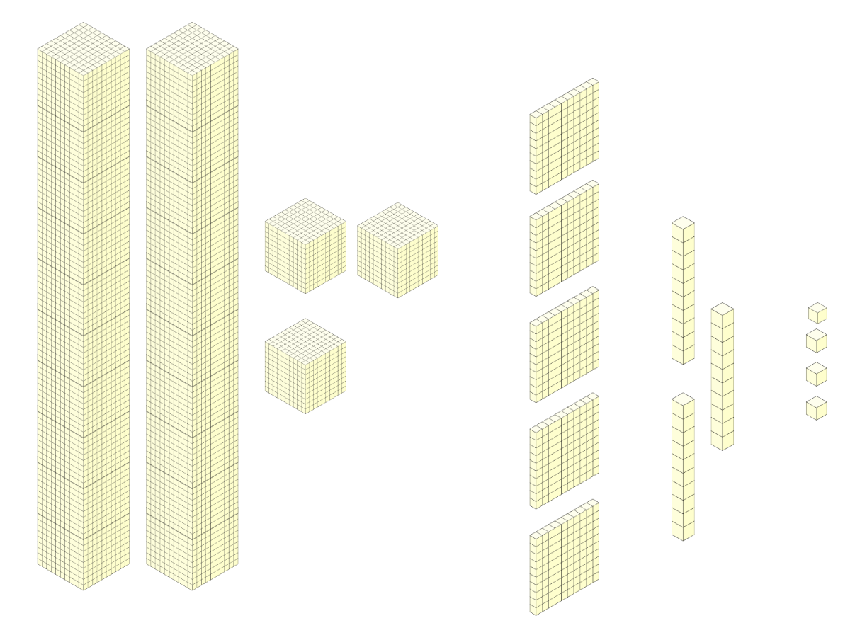
Short response (5)
Record the number represented by base-10 materials.
Notes:
Short response questions provide brisk paced questions focussing on review of current and previous content to support spaced and interleaved practice.
Syllabus focus area:
Representing numbers using place value A

Slide 15
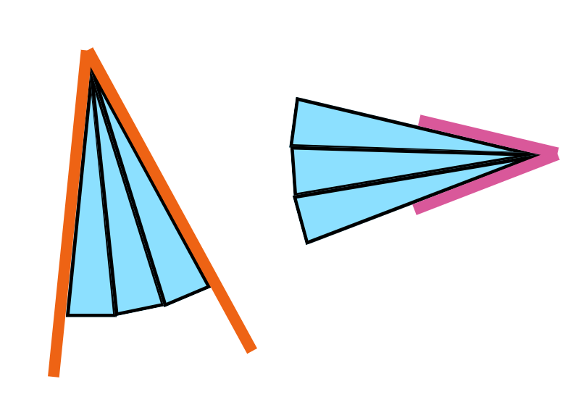
Short response (6)
Which statement is correct?
The orange angle is larger.
The pink angle is larger.
Both angles measure the same.
Communicate your reasoning.
Notes:
Short response questions provide brisk paced questions focussing on review of current and previous content to support spaced and interleaved practice.
Syllabus focus area:
Geometric measure A

Slide 16
Short response (7)
What are some differences between a pyramid, prism and cylinder?
Notes:
Short response questions provide brisk paced questions focussing on review of current and previous content to support spaced and interleaved practice.
Syllabus focus area:
Three-dimensional spatial structure A

Slide 17
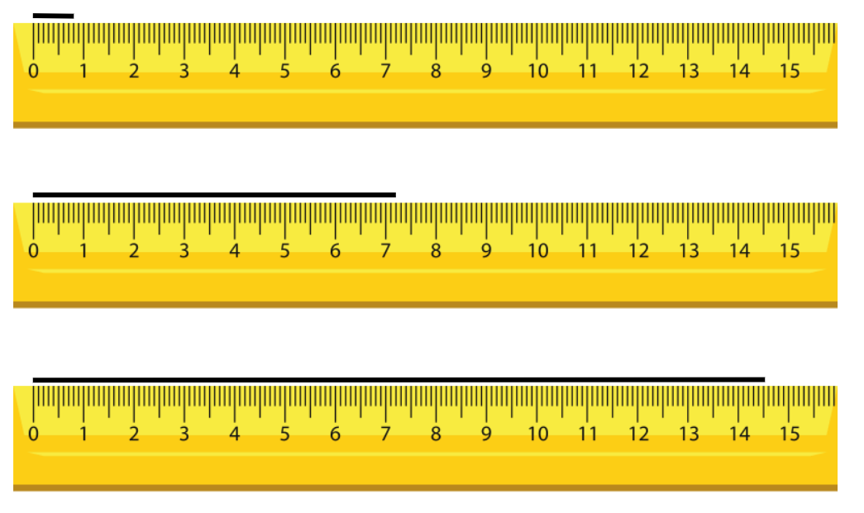
Short response (8)
Record the following lengths in millimetres:
A
B
C
Notes:
Short response questions provide brisk paced questions focussing on review of current and previous content to support spaced and interleaved practice.
Syllabus focus area:
Geometric measure A

Slide 18

Activity 2 – partially covered array
​Play in pairs.
Take turns to roll two dice and use the numbers to make an array.
Partially cover the array with the cardboard so that only the top of one row and one column can be seen.
Show your partner the partially covered array.
Your partner records a number sentence that represents the array. For example, 4 rows of 6 is 24.
Notes:
This is a developing number sense activity.
Number sense refers to a deep understanding of numbers, including their magnitude, relationships, and the effects of operations on them. It supports fluency and understanding, estimation, flexible thinking, and efficient problem-solving. Number sense activities 1–4 ‘activate’ prior number knowledge and support the learning of new content in the unit. Number sense activities 5–8 ‘loop’ back and provide opportunity for spaced practice with concepts and procedures covered in previous units.
Syllabus focus area:
Multiplicative relations A
Partially covered array
Provide each pair of students with 30 counters, two 6-sided dice and a piece of cardboard.
To set up the task, Student A rolls two 6-sided dice. The numbers rolled are used to make an array using counters, for example, 4 and 6.
They partially cover the array with the cardboard so that only part of one row and one column can be seen. Student A does this without being observed by Student B.
Student A shows the partially covered array to Student B.
Student B uses the information they can see to record the total number of counters on their whiteboard as a sentence or number sentence, for example, 4 rows of 6 is 24 or 4 × 6 = 24.
Student A uncovers the array and checks the accuracy of Student B’s answer.
Repeat the activity with students swapping roles.

Slide 19
Review of learning 3

Slide 20
Multiple choice (2)
4 x 3 = 12, so
12 ÷ 3 =
A
B
C
D
12
3
4
6
Notes:
This question connects to the content in the developing number sense activity (Activity 3)
Syllabus focus area:
Multiplicative relations A

Slide 21
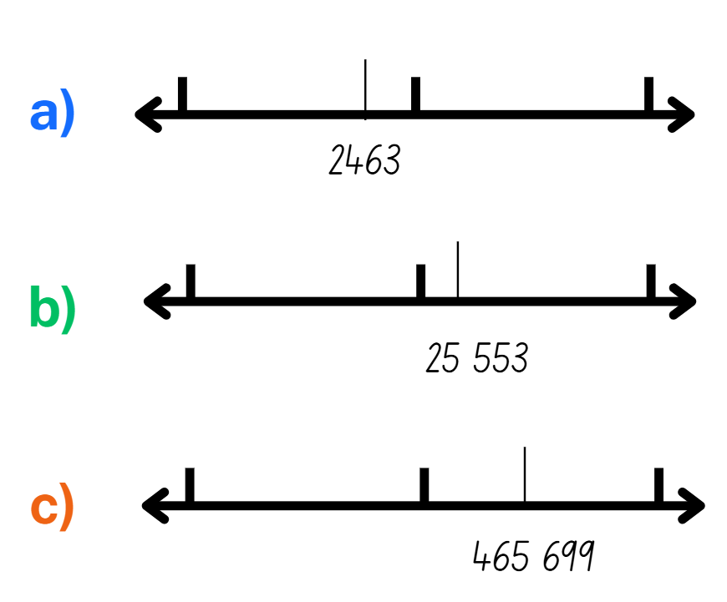
Short response (9)
For the number marked on the number line, record the nearest:
a) thousand
b) ten thousand
c) hundred thousand
Notes:
Short response questions provide brisk paced questions focussing on review of current and previous content to support spaced and interleaved practice.
Syllabus focus area:
Representing numbers using place value B

Slide 22
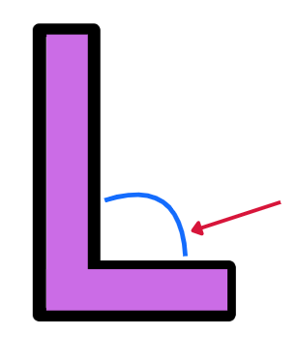
Short response (10)
The letter L is a ___________ angle.
Notes:
Short response questions provide brisk paced questions focussing on review of current and previous content to support spaced and interleaved practice.
Syllabus focus area:
Geometric measure A

Slide 23
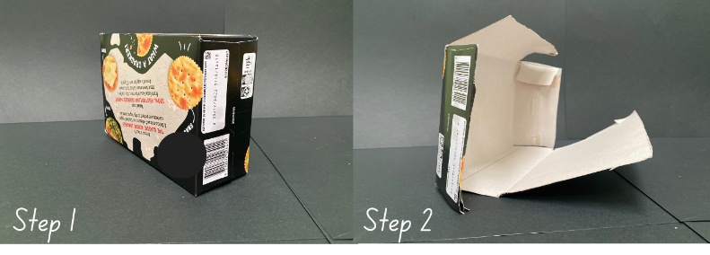
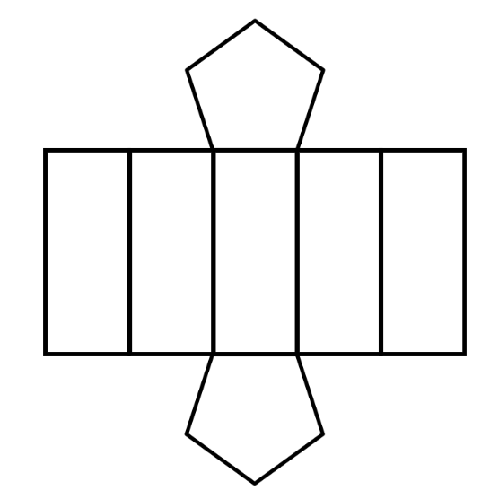
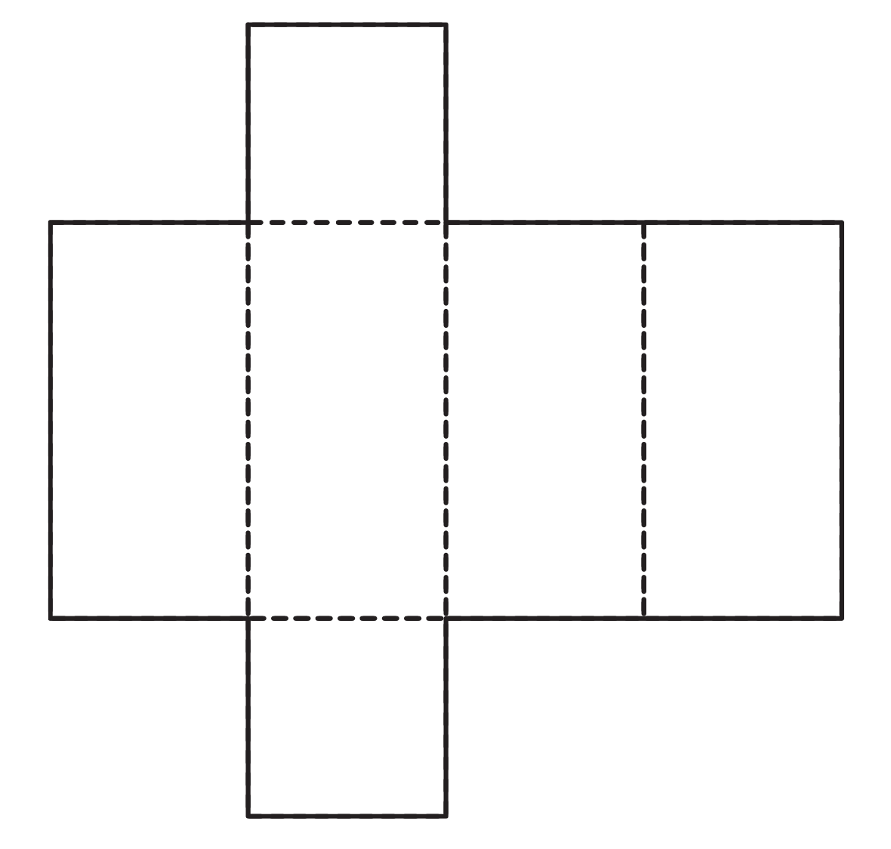
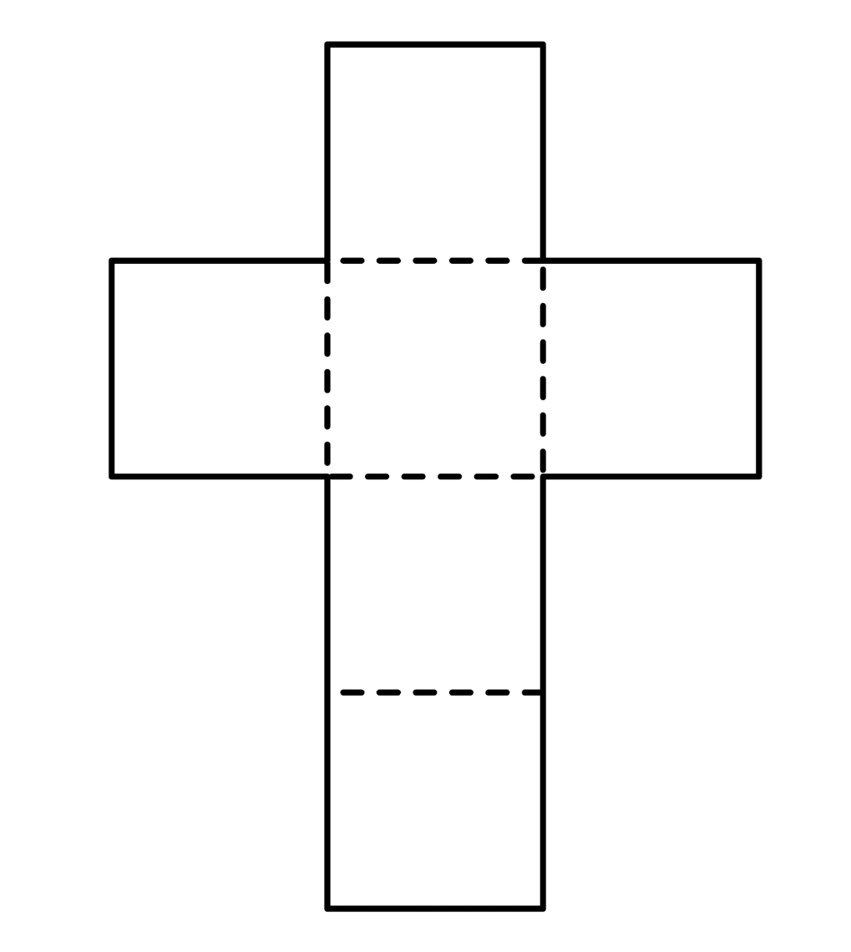
Short response (11)
The net for this deconstructed box would look like:
A
B
C
Communicate your reasoning.
Notes:
Short response questions provide brisk paced questions focussing on review of current and previous content to support spaced and interleaved practice.
Syllabus focus area:
Three-dimensional spatial structure A

Slide 24
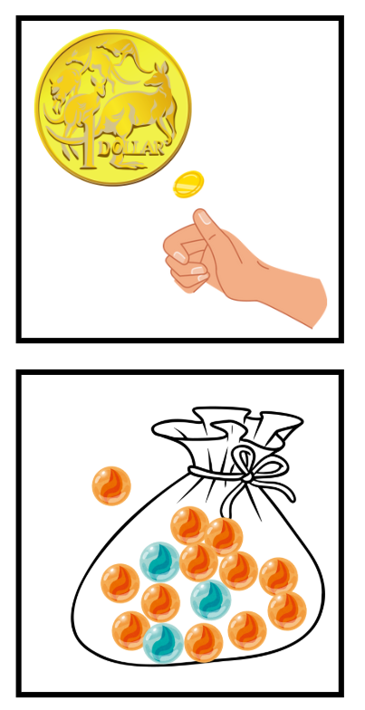
Short response (12)
Fill in the blanks with these words:
likely
equally likely
unlikely
It is _____________ I will toss tails.
It is _____________ I will draw a blue marble.
It is _____________ I will draw an orange marble.
Notes:
Short response questions provide brisk paced questions focussing on review of current and previous content to support spaced and interleaved practice.
Syllabus focus area:
Chance B

Slide 25
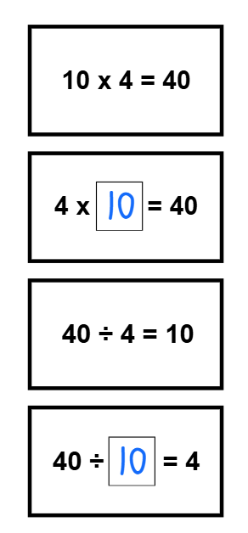
Activity 3 – inverse relationship
Fill in the missing numbers on the cards.
Group the fact family number sentences together.
Notes:
This is a developing number sense activity.
Number sense refers to a deep understanding of numbers, including their magnitude, relationships, and the effects of operations on them. It supports fluency and understanding, estimation, flexible thinking, and efficient problem-solving. Number sense activities 1–4 ‘activate’ prior number knowledge and support the learning of new content in the unit. Number sense activities 5–8 ‘loop’ back and provide opportunity for spaced practice with concepts and procedures covered in previous units.
Syllabus focus area:
Multiplicative relations A
Inverse relationship
This resource corresponds to Resource 21 – missing number cards in Stage 2 Year A Unit 11.
Provide pairs of students with Resource 21 – missing number cards.
Explain that these cards contain a variety of multiplication and division number sentences. The cards will form 6 different fact families with 2 multiplication facts and 2 related division facts for each family.
Explain that some of the cards have one number that is missing. Students are to fill in the missing spaces on the cards supported by the inverse relationship on the other multiplication and division cards.
When all the missing numbers have been filled in, students group the fact family number sentences together. Each fact family consists of 2 multiplication and 2 division cards.
Keep Resource 21 – missing number cards to be used in Activity 4.

Slide 26
Review of learning 4

Slide 27
True or false (2)
The inverse operation of 4 × 5 = 20
is 5 × 4 = 20.
True | False
Notes:
The question on this slide connects to the content being explored in the developing number sense activity (Activity 4)
Syllabus focus area:
Multiplicative relations A

Slide 28
Short response (13)
Partition
974 541
in non-standard form.
Notes:
Short response questions provide brisk paced questions focussing on review of current and previous content to support spaced and interleaved practice.
Syllabus focus area:
Representing numbers using place value B

Slide 29



Short response (14)
Match the event to its duration.
1. One half of a soccer game
2. Recess
3. 60 star jumps
One minute
45 minutes
20 minutes
Notes:
Short response questions provide brisk paced questions focussing on review of current and previous content to support spaced and interleaved practice.
Syllabus focus area:
Non-spatial measure A

Slide 30
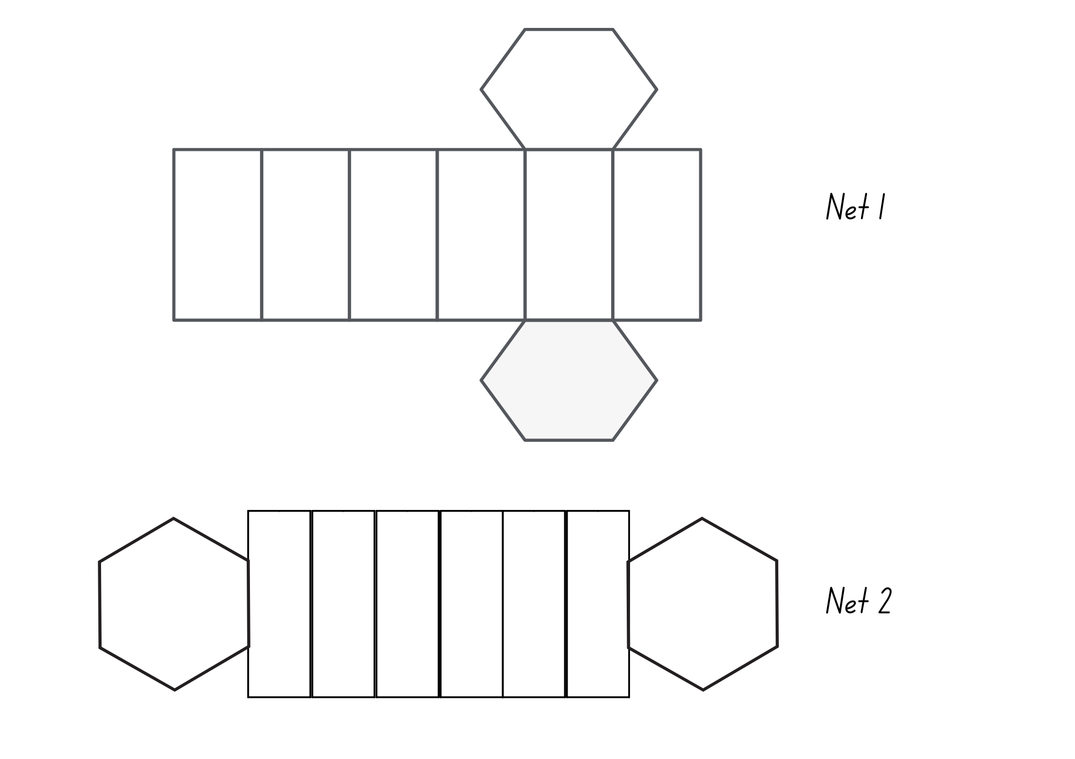
Short response (15)
Describe the 2D shapes that form this net.
What 2D shape always appears on the net of a prism?
Notes:
Short response questions provide brisk paced questions focussing on review of current and previous content to support spaced and interleaved practice.
Syllabus focus area:
Two-dimensional spatial structure A

Slide 31
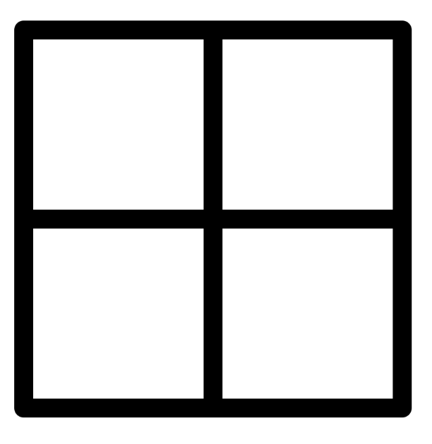
Short response (16)
Copy this 2 x 2 grid and label the grid references.
Mark:
 in B2
 in A1
 in A2
○ in B1.
Notes:
Short response questions provide brisk paced questions focussing on review of current and previous content to support spaced and interleaved practice.
Syllabus focus area:
Geometric measure B

Slide 32
Activity 4 – memory – inverse relationship
Shuffle the cards and lay them all face down.
Take turns to flip over 2 cards. Try to match a multiplication number sentence with an inverse division number sentence.
If they match, keep the cards and have another turn.
If they do not match, flip the cards back over and the next player has a turn.
Notes:
This is a developing number sense activity.
Number sense refers to a deep understanding of numbers, including their magnitude, relationships, and the effects of operations on them. It supports fluency and understanding, estimation, flexible thinking, and efficient problem-solving. Number sense activities 1–4 ‘activate’ prior number knowledge and support the learning of new content in the unit. Number sense activities 5–8 ‘loop’ back and provide opportunity for spaced practice with concepts and procedures covered in previous units.
Syllabus focus area:
Multiplicative relations A
Memory – inverse relationship
This resource corresponds to Resource 21 – missing number cards in Stage 2 Year A Unit 11.
Provide students with Resource 21 – missing number cards.
In pairs or small groups, students play memory.
Explain the game instructions:
Shuffle the cards and lay out all the cards face down in an array formation.
Players take turns flipping over 2 cards at a time, aiming to match a multiplication number sentence with an inverse division number sentence.
If they match, keep the cards and take another turn.
If they do not match, flip the cards back over and the next player has a turn.
The game continues until all number sentences have been matched.

Slide 33
Review of learning 5

Slide 34
Multiple choice (3)
3, 6, 9, 12, 15…
The next number in this number pattern is:
A
B
C
D
17
18
19
16
Notes:
This question connects to the content in the developing number sense activity (Activity 5)
Syllabus focus area:
Multiplicative relations A

Slide 35
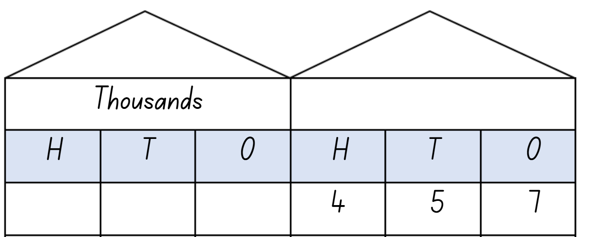
Short response (17)
Record the number 10, 100 and 1000 times larger.
Notes:
Short response questions provide brisk paced questions focussing on review of current and previous content to support spaced and interleaved practice.
Syllabus focus area:
Representing numbers using place value B

Slide 36
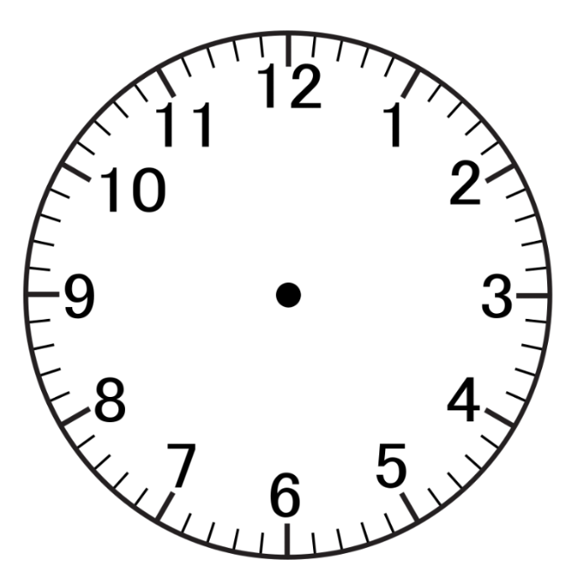
Short response (18)
Harry was wondering how long it was until the end of the school day. He asked Koa to check the time. Koa said the hands are on the 10 and the 2.
Harry knows that the numerals on an analog clock can represent 2 different values, depending on which hand is pointing to them.
Record the 2 possible times it could be.
Notes:
Short response questions provide brisk paced questions focussing on review of current and previous content to support spaced and interleaved practice.
Syllabus focus area:
Non-spatial measure A

Slide 37
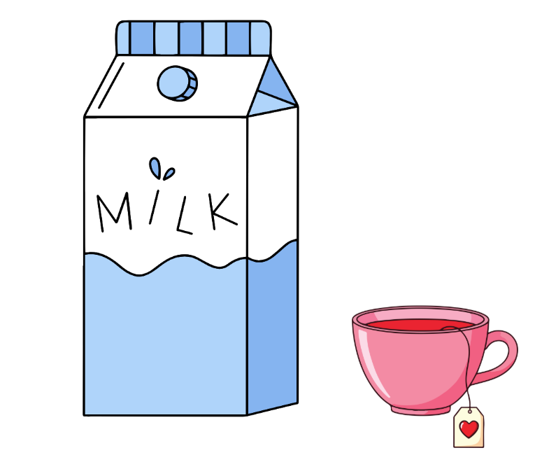
Short response (19)
Which container has a capacity of 1L?
Communicate your reasoning.
Notes:
Short response questions provide brisk paced questions focussing on review of current and previous content to support spaced and interleaved practice.
Syllabus focus area:
Three-dimensional spatial structure A

Slide 38

Short response (20)
Match the description to the 2D shape .
  1. adjacent sides equal
A. parallelogram
  2. one pair of parallel sides
B. kite
  3. 2 pairs of parallel sides
  opposite sides equal
  opposite angles equal
C. trapezium
Notes:
Short response questions provide brisk paced questions focussing on review of current and previous content to support spaced and interleaved practice.
Syllabus focus area:
Two-dimensional spatial structure A

Slide 39
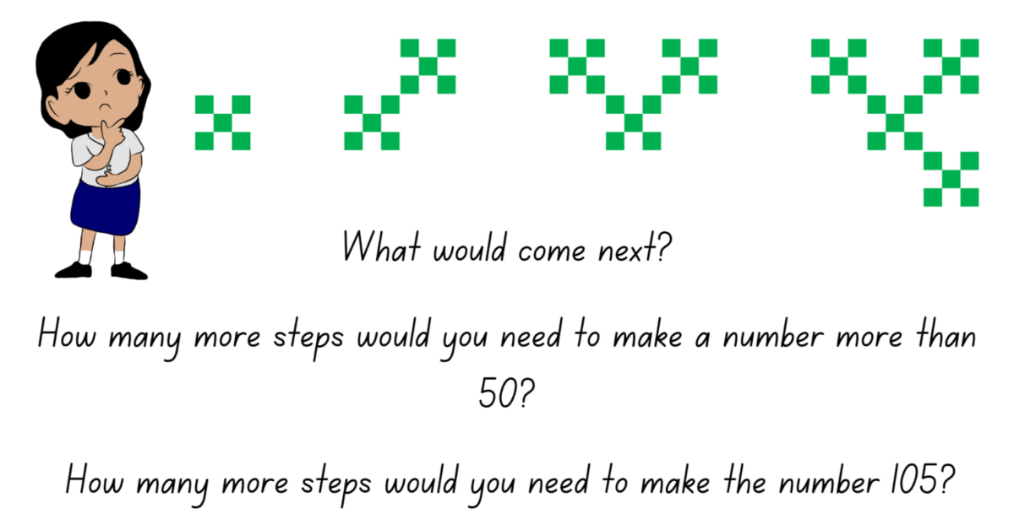
Activity 5 – continuing a pattern
Notes:
This is a developing number sense activity.
Number sense refers to a deep understanding of numbers, including their magnitude, relationships, and the effects of operations on them. It supports fluency and understanding, estimation, flexible thinking, and efficient problem-solving. Number sense activities 1–4 ‘activate’ prior number knowledge and support the learning of new content in the unit. Number sense activities 5–8 ‘loop’ back and provide opportunity for spaced practice with concepts and procedures covered in previous units.
Syllabus focus area:
Multiplicative relations A
Continuing a pattern
This resource corresponds to Resource 22 – Pattern or not? in Stage 2 Year A Unit 11.
Display Resource 22 – Pattern or not?
Students look for a pattern. They turn and talk to a partner to describe what they can see.
Ask:
- If this is a pattern, can you describe it?
- Based on what you can see, can you predict what comes next?
Students record their ideas on individual whiteboards using diagrams, numbers and symbols.
Select students to share their ideas, providing reasoning to support their response.
Challenge students:
- If we know that the first picture is step one, how many steps will it take to make a number over 50?
- How many steps will it take to make a number over 100?

Slide 40
Review of learning 6

Slide 41
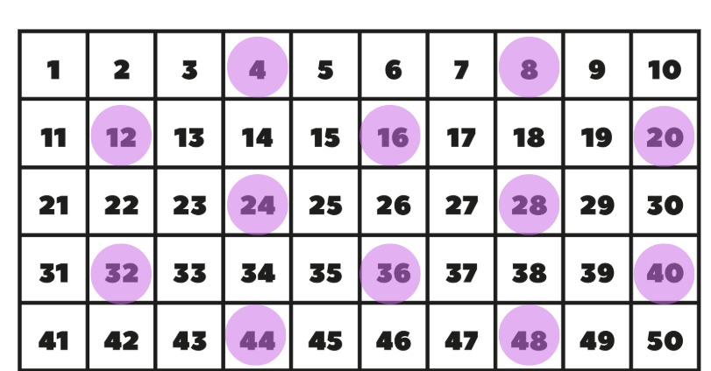
True or false (3)
The number chart shows the multiples of 4. pattern.
True | False
Notes:
The question on this slide connects to the content being explored in the developing number sense activity (Activity 6)
Syllabus focus area:
Multiplicative relations A

Slide 42
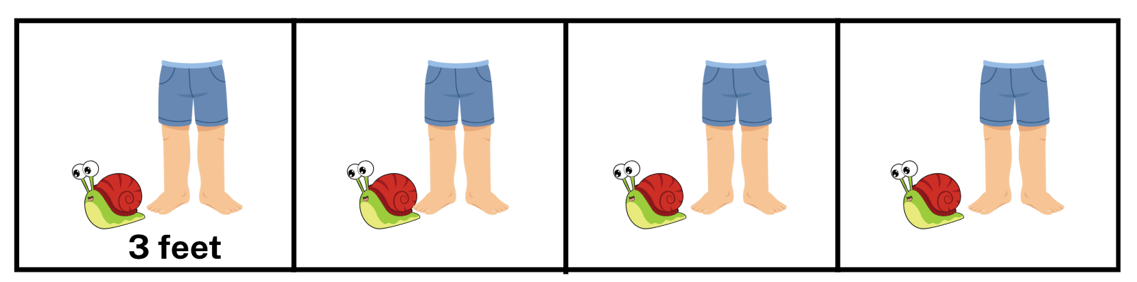
Short response (21)
Record the multiples for this pattern of feet.
Record the next 3 multiples that follow in the pattern.
Notes:
Short response questions provide brisk paced questions focussing on review of current and previous content to support spaced and interleaved practice.
Syllabus focus area:
Multiplicative relations A

Slide 43
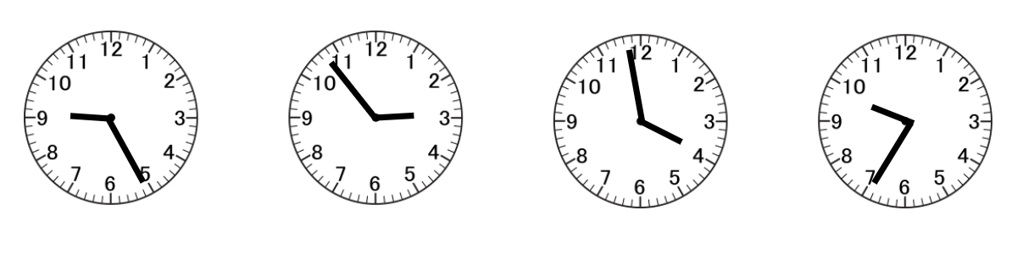
Short response (22)
What is the 5-minute benchmark time on these 4 analog clocks?
A
B
C
D
Notes:
Short response questions provide brisk paced questions focussing on review of current and previous content to support spaced and interleaved practice.
Syllabus focus area:
Non-spatial measure A

Slide 44
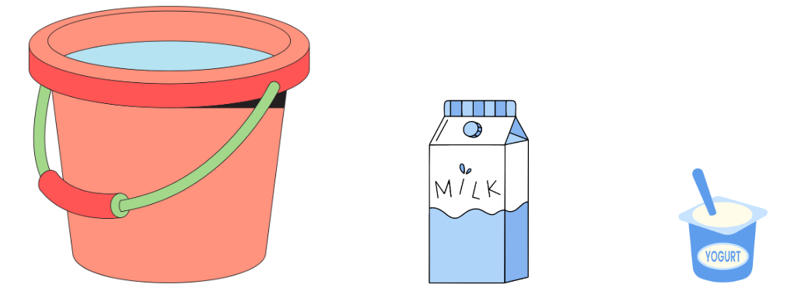
Short response (23)
If the milk carton has a capacity of 1L, do the A and B containers measure more than or less than a litre?
A
B
Notes:
Short response questions provide brisk paced questions focussing on review of current and previous content to support spaced and interleaved practice.
Syllabus focus area:
Three-dimensional spatial structure A

Slide 45
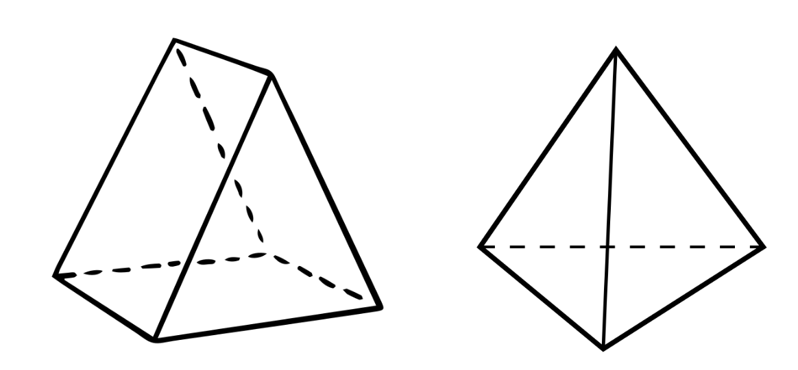
Short response (24)
Explain how a triangular prism and triangular pyramid are different.
Notes:
Short response questions provide brisk paced questions focussing on review of current and previous content to support spaced and interleaved practice.
Syllabus focus area:
Three-dimensional spatial structure A

Slide 46
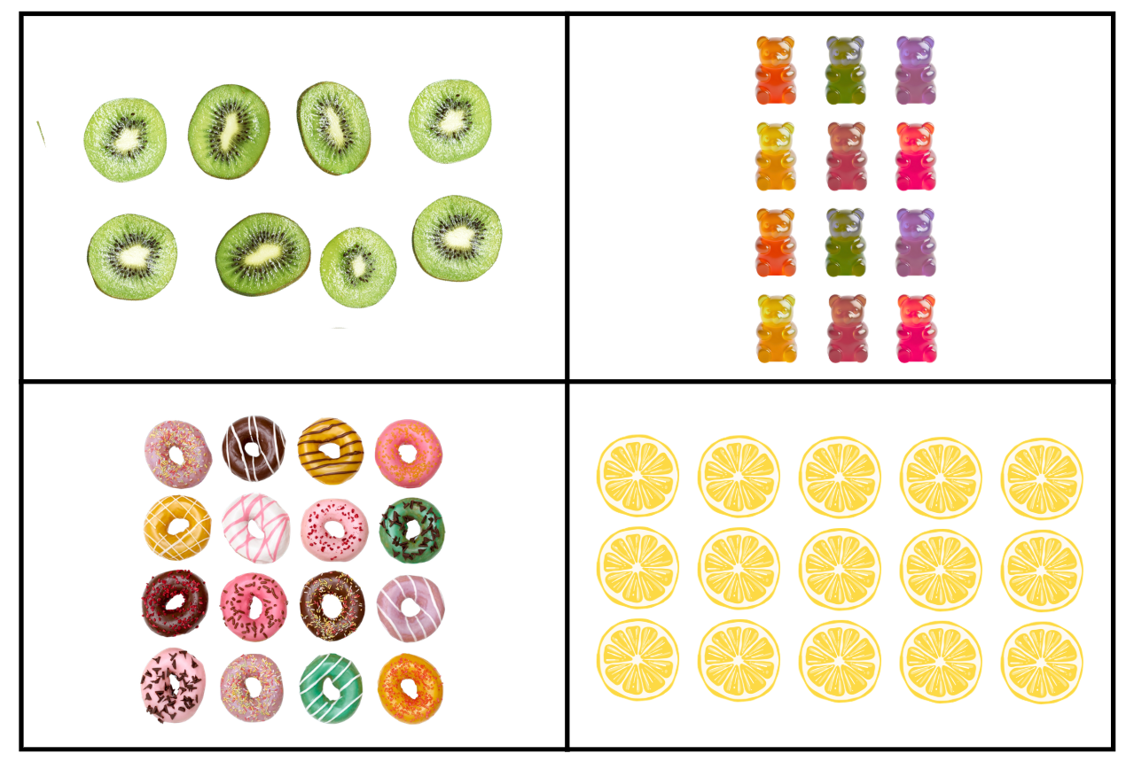
Activity 6 – odd one out of the pattern
Notes:
This is a developing number sense activity.
Number sense refers to a deep understanding of numbers, including their magnitude, relationships, and the effects of operations on them. It supports fluency and understanding, estimation, flexible thinking, and efficient problem-solving. Number sense activities 1–4 ‘activate’ prior number knowledge and support the learning of new content in the unit. Number sense activities 5–8 ‘loop’ back and provide opportunity for spaced practice with concepts and procedures covered in previous units.
Syllabus focus area:
Multiplicative relations A
Activity title
This resource corresponds to Resource 23 – odd one out in Stage 2 Year A Unit 11.
Display Resource 23 – odd one out
In pairs, students must decide which picture doesn’t belong to a pattern and why. For example, there are 15 lemon pieces. 15 is the only number that is a multiple of 5.
Select students to share their ideas with the class, describe the pattern they discovered and explain which picture they decided didn’t belong.
Students record the number pattern they described on an individual whiteboard, completing any missing numbers.

Slide 47
Review of learning 7

Slide 48
Multiple choice (4)
4, 8, 12, 16, 20…
The next number in this number pattern is:
A
B
C
D
21
22
23
24
Notes:
This question connects to the content in the developing number sense activity (Activity 5)
Syllabus focus area:
Multiplicative relations A

Slide 49

Short response (25)
Fill in the facts for the array.
___ rows of ___ is ___ in total
___ x ___ =____
___ shared into ___ rows is ___
___ ÷ ___ =____
Notes:
Short response questions provide brisk paced questions focussing on review of current and previous content to support spaced and interleaved practice.
Syllabus focus area:
Multiplicative relations A

Slide 50
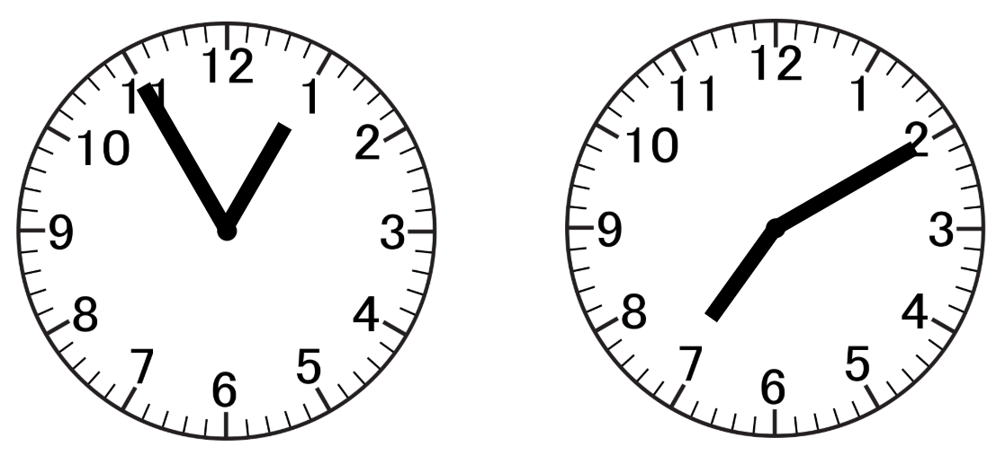
Short response (26)
Record the time shown on these analog clocks using ‘to’ or ‘past’.
A
B
Notes:
Short response questions provide brisk paced questions focussing on review of current and previous content to support spaced and interleaved practice.
Syllabus focus area:
Non-spatial measure A

Slide 51
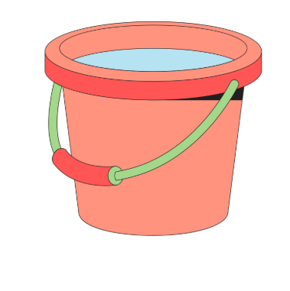
Short response (27)
A milk carton has the capacity of 1L.
Record the capacity of the bucket, if it took 4 milk cartons to fill it.
Communicate your reasoning.
Notes:
Short response questions provide brisk paced questions focussing on review of current and previous content to support spaced and interleaved practice.
Syllabus focus area:
Three-dimensional spatial structure A

Slide 52
Short response (28)
Record the following lengths using the abbreviations:
fifty-three millimetres
twenty-two millimetres
six centimetres and two millimetres
Notes:
Short response questions provide brisk paced questions focussing on review of current and previous content to support spaced and interleaved practice.
Syllabus focus area:
Geometric measure A

Slide 53
Activity 7 – describing increasing number patterns
5, 10, 15, 20, 25…
Notes:
This is a developing number sense activity.
Number sense refers to a deep understanding of numbers, including their magnitude, relationships, and the effects of operations on them. It supports fluency and understanding, estimation, flexible thinking, and efficient problem-solving. Number sense activities 1–4 ‘activate’ prior number knowledge and support the learning of new content in the unit. Number sense activities 5–8 ‘loop’ back and provide opportunity for spaced practice with concepts and procedures covered in previous units.
Syllabus focus area:
Multiplicative relations A
Describing increasing number patterns
Display the number pattern 5, 10, 15, 20, 25…
Ask:
- Can you describe this pattern?
- Which numbers come next in the pattern?

Slide 54
Activity 7 – describing increasing number patterns (2)
8, 13, 18, 23, 28…
Notes:
This is a developing number sense activity.
Number sense refers to a deep understanding of numbers, including their magnitude, relationships, and the effects of operations on them. It supports fluency and understanding, estimation, flexible thinking, and efficient problem-solving. Number sense activities 1–4 ‘activate’ prior number knowledge and support the learning of new content in the unit. Number sense activities 5–8 ‘loop’ back and provide opportunity for spaced practice with concepts and procedures covered in previous units.
Syllabus focus area:
Multiplicative relations A
Describing increasing number patterns
-Display the number pattern 8, 13, 18, 23, 28…
Ask:
Can you describe this pattern?
- Which numbers come next in the pattern?
Explain that the pattern is the same (numbers are going up by 5) but the starting number is different.

Slide 55
Activity 7 – describing increasing number patterns (3)
5, 9, 13, 17, 21…
111, 116, 121, 126, 131…
76, 86, 96, 106, 116…
17, 21, 25, 29, 33…
Notes:
This is a developing number sense activity.
Number sense refers to a deep understanding of numbers, including their magnitude, relationships, and the effects of operations on them. It supports fluency and understanding, estimation, flexible thinking, and efficient problem-solving. Number sense activities 1–4 ‘activate’ prior number knowledge and support the learning of new content in the unit. Number sense activities 5–8 ‘loop’ back and provide opportunity for spaced practice with concepts and procedures covered in previous units.
Syllabus focus area:
Multiplicative relations A
Describing increasing number patterns
Display the number patterns:
- 5, 9, 13, 17, 21…
- 111, 116, 121, 126, 131…
- 76, 86, 96, 106, 116…
- 17, 21, 25, 29, 33…
Students turn and talk to discuss each pattern. Students determine the amount by which each pattern is increasing.
Students continue the number patterns and record the next 5 values on individual whiteboards.

Slide 56
Review of learning 8

Slide 57
True or false (4)
45, 40, 35, 30, 25…
The numbers in this pattern are decreasing by 5.
True | False
Notes:
The question on this slide connects to the content being explored in the developing number sense activity (Activity 8)
Syllabus focus area:
Multiplicative relations A

Slide 58
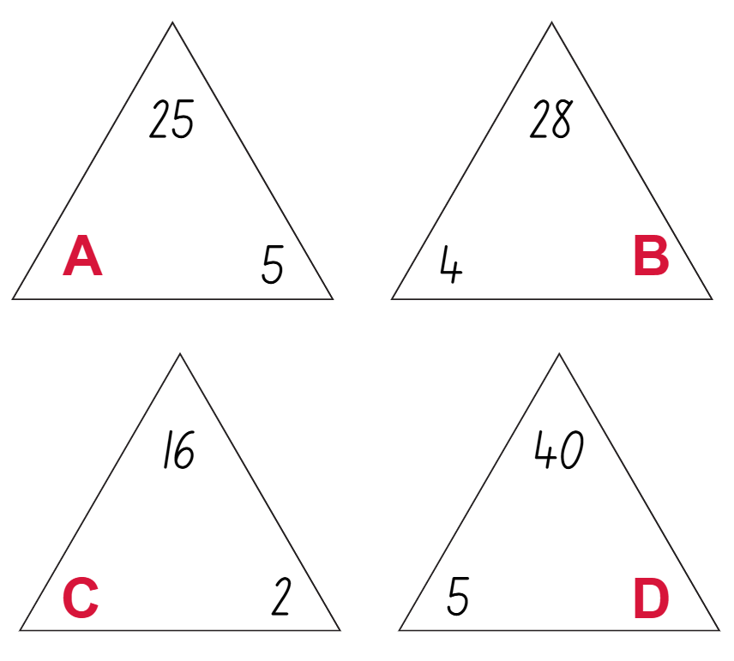
Short response (29)
Record the missing number at
A, B, C, D
to complete the fact family triangles.
Notes:
Short response questions provide brisk paced questions focussing on review of current and previous content to support spaced and interleaved practice.
Syllabus focus area:
Multiplicative relations B

Slide 59
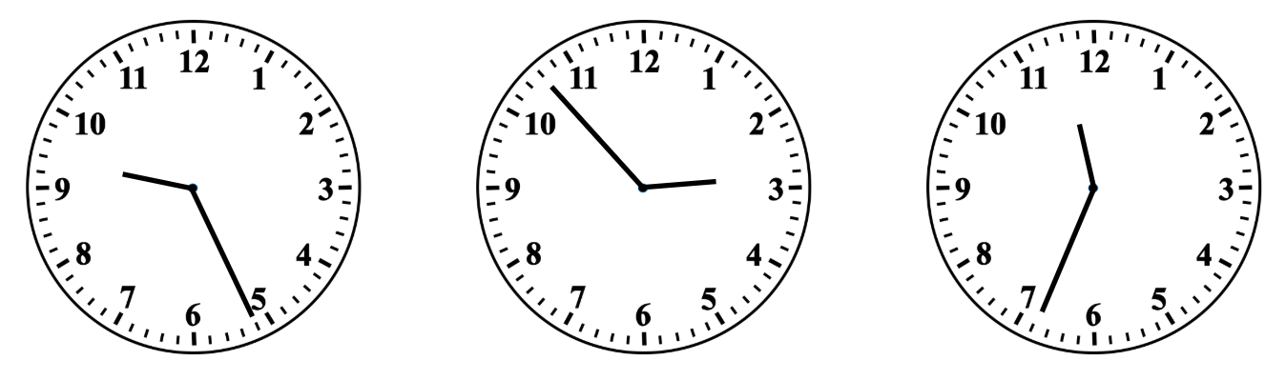
Short response (30)
Record the time shown on these analog clocks to the minute.
A
B
C
Notes:
Short response questions provide brisk paced questions focussing on review of current and previous content to support spaced and interleaved practice.
Syllabus focus area:
Non-spatial measure A

Slide 60
Short response (31)
How many 250 millilitre cups would it take to fill a one-litre jug?
Communicate your reasoning.
Notes:
Short response questions provide brisk paced questions focussing on review of current and previous content to support spaced and interleaved practice.
Syllabus focus area:
Three-dimensional spatial structure B

Slide 61
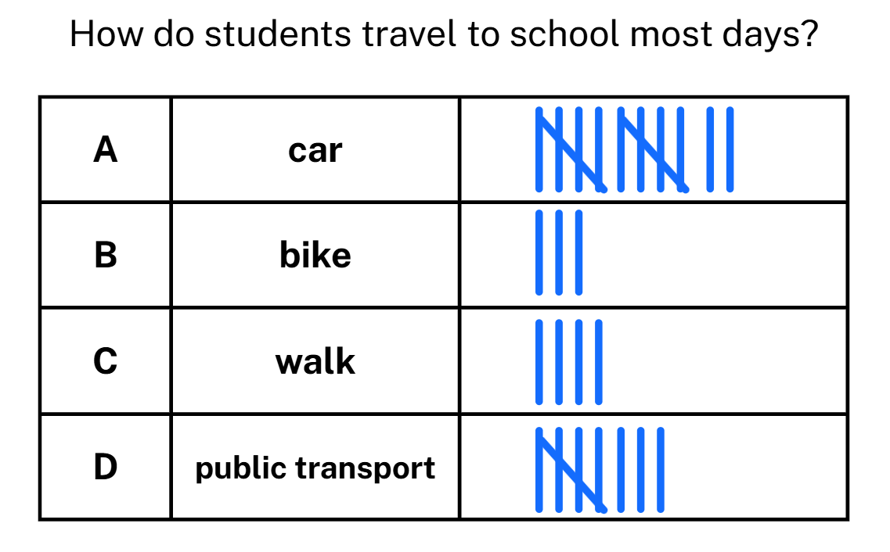
Short response (32)
Record a sentence to answer the question:
How do most students travel to school most days?
Notes:
Short response questions provide brisk paced questions focussing on review of current and previous content to support spaced and interleaved practice.
Syllabus focus area:
Data A

Slide 62
Activity 8 – describing decreasing number patterns
85, 80, 75, 70, 65…
Notes:
This is a developing number sense activity.
Number sense refers to a deep understanding of numbers, including their magnitude, relationships, and the effects of operations on them. It supports fluency and understanding, estimation, flexible thinking, and efficient problem-solving. Number sense activities 1–4 ‘activate’ prior number knowledge and support the learning of new content in the unit. Number sense activities 5–8 ‘loop’ back and provide opportunity for spaced practice with concepts and procedures covered in previous units.
Syllabus focus area:
Multiplicative relations A
Describing decreasing number patterns
Display the number pattern 85, 80, 75, 70, 65…
Ask:
- Can you describe this pattern?
- Which numbers come next in the pattern?

Slide 63
Activity 8 – describing decreasing number patterns (2)
87, 82, 77, 72, 67…
Notes:
This is a developing number sense activity.
Number sense refers to a deep understanding of numbers, including their magnitude, relationships, and the effects of operations on them. It supports fluency and understanding, estimation, flexible thinking, and efficient problem-solving. Number sense activities 1–4 ‘activate’ prior number knowledge and support the learning of new content in the unit. Number sense activities 5–8 ‘loop’ back and provide opportunity for spaced practice with concepts and procedures covered in previous units.
Syllabus focus area:
Multiplicative relations A
Describing decreasing number patterns
Display the number pattern 87, 82, 77, 72, 67…
Ask:
- Can you describe this pattern?
- Which numbers come next in the pattern?
Explain that the pattern is the same (numbers are going down by 5) but the starting number is different.

Slide 64
Activity 8 – describing decreasing number patterns (3)
38, 34, 30, 26, 22…
111, 106, 101, 96, 91…
176, 166, 156, 146, 136…
31, 27, 23, 19, 15…
Notes:
This is a developing number sense activity.
Number sense refers to a deep understanding of numbers, including their magnitude, relationships, and the effects of operations on them. It supports fluency and understanding, estimation, flexible thinking, and efficient problem-solving. Number sense activities 1–4 ‘activate’ prior number knowledge and support the learning of new content in the unit. Number sense activities 5–8 ‘loop’ back and provide opportunity for spaced practice with concepts and procedures covered in previous units.
Syllabus focus area:
Multiplicative relations A
Describing decreasing number patterns
Display the number patterns:
- 38, 34, 30, 26, 22…
- 111, 106, 101, 96, 91…
- 176, 166, 156, 146, 136…
- 31, 27, 23, 19, 15…
Students turn and talk to discuss each pattern. Students determine the amount by which each pattern is decreasing.
Students continue the number patterns and record the next 5 values on individual whiteboards.

Slide 65
Double Venn diagram
Object 1
Object 2
Features similar to both objects
Features of object 1
Features of object 2

Slide 66
Frayer
Definition
Facts/Characteristics
Word, term, concept
Examples
Non-examples

Slide 67
Spider map
Idea
Subject

Slide 68
Cline
Concept 1
Concept 2
Word
Word
Word
Word
Word
Word
Word
Word
Word
Word
Word

Slide 69
Compare and contrast

Slide 70
Multiple choice (5)
A
B
C
D

Slide 71
Multiple choice
A
B
C
D
Notes:
This question connects to the content in the developing number sense activity (Activity 3)
Syllabus focus area:
[Focus area A/B]

Slide 72
References
This presentation contains NSW Curriculum and syllabus content. The NSW Curriculum is developed by the NSW Education Standards Authority. This content is prepared by NESA for and on behalf of the Crown in the right of the State of New South Wales. The material is protected by Crown copyright.
Please refer to the NESA Copyright Disclaimer for more information https://educationstandards.nsw.edu.au/wps/portal/nesa/mini-footer/copyright.
NESA holds the only official and up-to-date versions of the NSW Curriculum and syllabus documents. Please visit the NSW Education Standards Authority (NESA) website https://educationstandards.nsw.edu.au/wps/portal/nesa/home and the NSW Curriculum website https://curriculum.nsw.edu.au.
Mathematics K–10 Syllabus © NSW Education Standards Authority (NESA) for and on behalf of the Crown in right of the State of New South Wales, 2022.
National Numeracy Learning Progression © Australian Curriculum, Assessment and Reporting Authority (ACARA) 2010 to present, unless otherwise indicated. This material was downloaded from the Australian Curriculum website (National Numeracy Learning Progression) (accessed 8 December 2025) and was not modified.
Amplify Education Inc, (2024) ‘Polypad – number tiles’, Amplify Polypad website, accessed 8 December 2025.
Sayre AP and Sayre J (2010) One Is a Snail, Ten Is a Crab: A Counting by Feet Book (Cecil R illus), Candlewick Press, United States.
Siemon D, Warren E, Beswick K, Faragher R, Miller J, Horne M, Jazby D, Breed M, Clark J and Brady K (2020) Teaching Mathematics: Foundations to Middle Years, 3rd edn, Oxford University Press Australia and New Zealand.

Slide 73
References (2)
This presentation contains NSW Curriculum and syllabus content. The NSW Curriculum is developed by the NSW Education Standards Authority. This content is prepared by NESA for and on behalf of the Crown in the right of the State of New South Wales. The material is protected by Crown copyright.
Please refer to the NESA Copyright Disclaimer for more information https://educationstandards.nsw.edu.au/wps/portal/nesa/mini-footer/copyright.
NESA holds the only official and up-to-date versions of the NSW Curriculum and syllabus documents. Please visit the NSW Education Standards Authority (NESA) website https://educationstandards.nsw.edu.au/wps/portal/nesa/home and the NSW Curriculum website https://curriculum.nsw.edu.au.
Toy Theatre (2022) ‘120 chart’, Virtual Manipulatives, Toy Theatre website, accessed 8 December 2025.
University of Cambridge (n.d) ‘Round the four dice’ NRICH website, accessed 8 December 2025.
University of Cambridge (n.d) ‘The deca tree’, NRICH website, accessed 8 December 2025.

Slide 74
Copyright
© State of New South Wales (Department of Education), 2025
The copyright material published in this resource is subject to the Copyright Act 1968 (Cth) and is owned by the NSW Department of Education or, where indicated, by a party other than the NSW Department of Education (third-party material).
Copyright material available in this resource and owned by the NSW Department of Education is licensed under a Creative Commons Attribution 4.0 International (CC BY 4.0) license.
This license allows you to share and adapt the material for any purpose, even commercially.
Attribution should be given to © State of New South Wales (Department of Education), 2025.
Material in this resource not available under a Creative Commons license:
the NSW Department of Education logo, other logos and trademark-protected material
Material owned by a third party that has been reproduced with permission. You will need to obtain permission from the third party to reuse its material.
Links to third-party material and websites
Please note that the provided (reading/viewing material/list/links/texts) are a suggestion only and implies no endorsement, by the New South Wales Department of Education, of any author, publisher, or book title. School principals and teachers are best placed to assess the suitability of resources that would complement the curriculum and reflect the needs and interests of their students.
If you use the links provided in this document to access a third party’s website, you acknowledge that the terms of use, including licence terms set out on the third-party’s website apply to the use which may be made of the materials on that third-party website or where permitted by the Copyright Act 1968 (Cth). The department accepts no responsibility for content on third-party websites.

