Slide 1
Instructions for use
This resource aligns to the learning in Stage 2 Year A Unit 12 and revisits content from earlier sample units.​
Classroom teachers are encouraged to add and adapt slides as required to meet the needs of their students.
Save a copy of the file to make changes to the slide deck. Go to File > Download a Copy (this downloads a copy to the computer to edit in the PowerPoint app).
To convert the PowerPoint to Google Slides:
  Upload the file into Google Drive and open it.
  Go to File > Save as Google Slides.
  (Note – conversion may cause formatting changes in the slides.)

Slide 2

Review of Learning
Mathematics Stage 2 – Unit 12
Notes:
Reviews may include a combination of question types, requiring students to recall facts and key ideas, as well as apply their knowledge to solve problems and answer questions. To support active engagement, a mix of techniques should be employed.” (AERO, 2024).
This Review of Learning slide deck revisits key concepts from the following units:
Stage 2 Year A Unit 12
Stage 2 Year A Unit 11
Stage 2 Year A Unit 10
It also includes opportunities to review prior learning in non-number content, supporting consolidation across focus areas.
The review of learning resources include three key task types that support the development of mathematical proficiency through retrieval, spaced practice, and active participation. These practices complement the review phase (activating prior knowledge) embedded within the beginning of each lesson.
1.
Multiple-choice questions/True or false: Designed to promote active retrieval of key concepts and identify common misconceptions in number, supporting consolidation, understanding and fluency.
These questions:
support spaced and interleaved practice
help identify and address common misconceptions
support active recall and immediate feedback
support whole class participation
identify areas requiring reteach
2.
Short-response question sets: Carefully grouped questions that encourage spaced and interleaved practice across multiple focus areas, helping students revisit and apply knowledge from different points in time.
These questions:
have a combination of question types
address a range of focus areas
build automaticity and fluency
support active recall
allow for immediate feedback
identify content requiring reteach
3.
Developing number sense activities: A variety of practical, purposeful tasks that reinforce current learning and build on prior knowledge. These activities promote reasoning, problem-solving and conceptual understanding.
The review of learning resources are designed to work support teaching and learning in mathematics. For the most effective implementation, use the resources flexibly, adapting to meet student learning needs and individual classroom contexts.

Slide 3
Lessons
1
Review of learning 1
5
Review of learning 5
2
Review of learning 2
6
Review of learning 6
3
Review of learning 3
7
Review of learning 7
4
Review of learning 4
8
Review of learning 8
Notes:
Teacher notes:
Click lesson titles to go to specific lessons
Interactive features can be viewed in slide show

Slide 4
Review of learning 1

Slide 5

Multiple choice (1)
I have a set of numbers. When I multiplied each number in the set by 4, the products were 12, 20, 28 and 36. Which set of numbers were multiplied by 4?
A
3, 5, 7, 9
B
4, 6, 8, 10
C
2, 4, 6, 8
D
8, 12, 16, 20
Notes:
This question connects to the content in the developing number sense activity (Activity 1)
Syllabus focus area:
Multiplicative relations A

Slide 6

Short response (1)
Match the description to the two-dimensional shape:
A shape with 3 straight sides.
A shape with 5 straight sides.
A shape with 6 straight sides.
hexagon
triangle
pentagon
Notes:
Short response questions provide brisk paced questions focussing on review of current and previous content to support spaced and interleaved practice.
Syllabus focus area:
Two-dimensional spatial structure A (Stage 1 content reviewed)

Slide 7
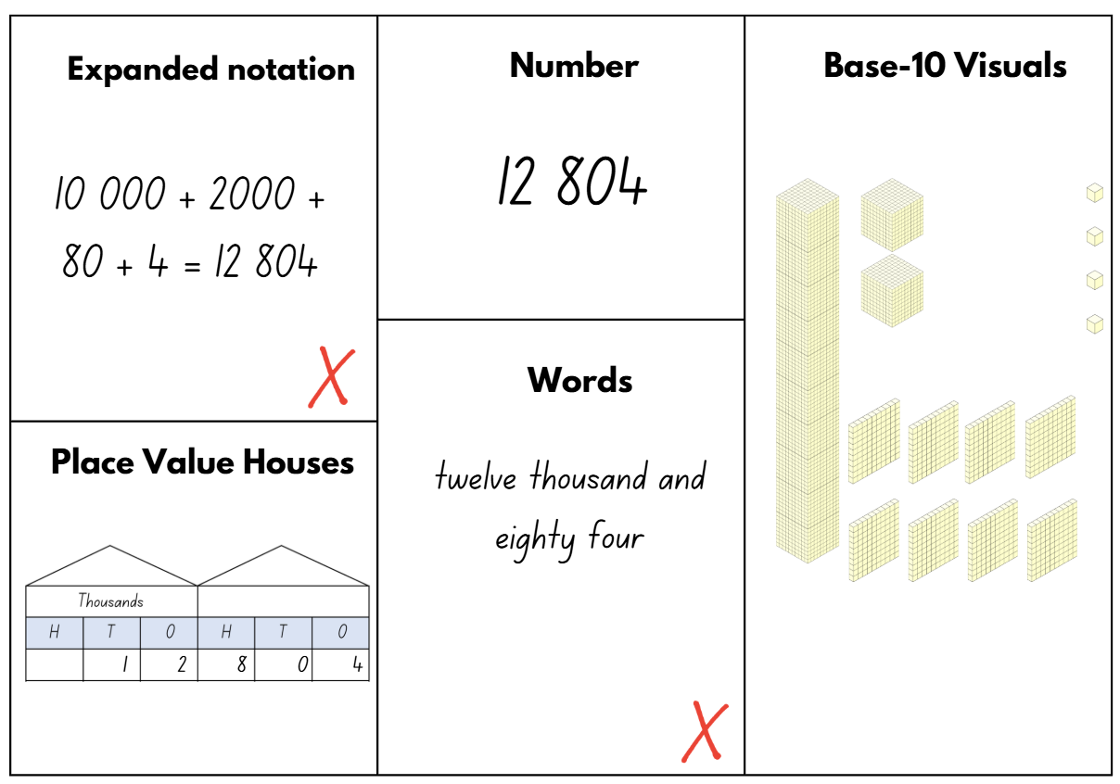
Short response (2)
Sasha made 2 mistakes. Record the correct answers for these mistakes.
Notes:
Short response questions provide brisk paced questions focussing on review of current and previous content to support spaced and interleaved practice.
Syllabus focus area:
Representing numbers using place value A

Slide 8
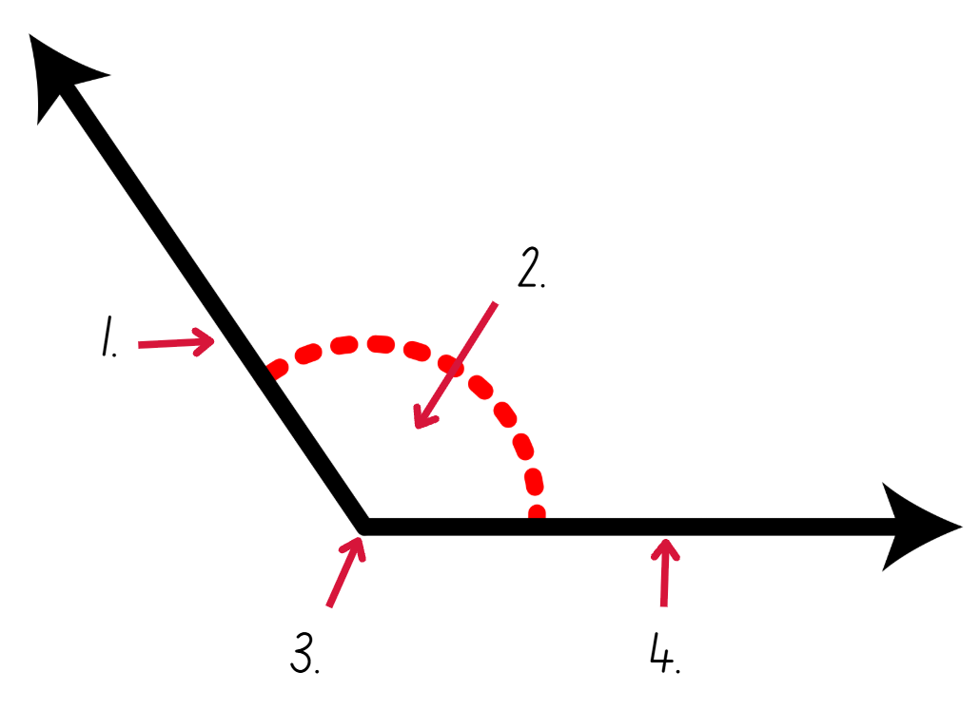
Short response (3)
Identify these parts of the angle:
arm
vertex
angle.
Notes:
Short response questions provide brisk paced questions focussing on review of current and previous content to support spaced and interleaved practice.
Syllabus focus area:
Geometric measure A

Slide 9
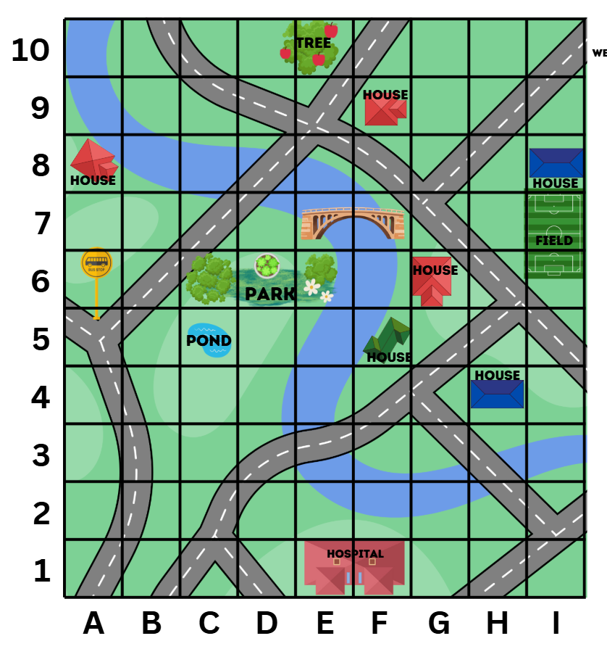

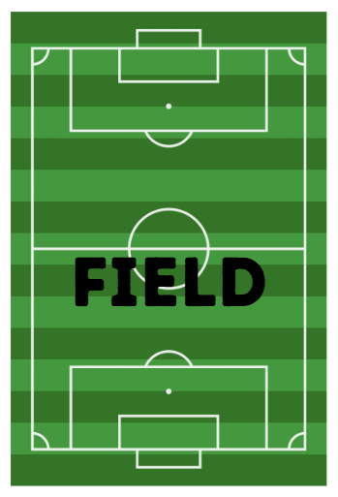


Short response (4)
Record the landmark positions. Remember that some might cover more than one grid square on the map:
Notes:
Short response questions provide brisk paced questions focussing on review of current and previous content to support spaced and interleaved practice.
Syllabus focus area:
Geometric measure A

Slide 10

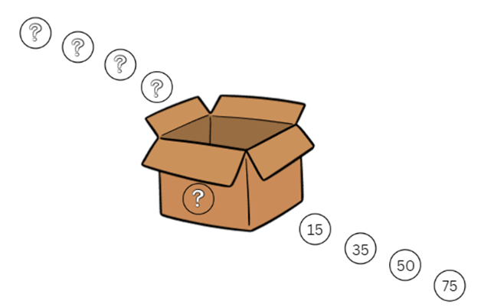
Activity 1 – exploring multiples
I placed 4 numbers into a box. This box multiplied these numbers by another number and 4 new numbers came out. The new numbers that came out were 15, 35, 50 and 75.
What 4 numbers did I place in the box to begin with?
What is the rule in the box that is multiplying all 4 numbers?
Notes:
This is a developing number sense activity.
Number sense refers to a deep understanding of numbers, including their magnitude, relationships, and the effects of operations on them. It supports fluency and understanding, estimation, flexible thinking, and efficient problem-solving. Number sense activities 1–4 ‘activate’ prior number knowledge and support the learning of new content in the unit. Number sense activities 5–8 ‘loop’ back and provide opportunity for spaced practice with concepts and procedures covered in previous units.
Syllabus focus area:
Multiplicative relations A
Exploring multiples
This image corresponds to Figure 6 – numbers in a box in Stage 2 Year A Unit 12.
This activity is an adaptation of ‘What’s in the Box?’ from NRICH by University of Cambridge.
1. Pose the following scenario: I placed 4 numbers into a box. This box multiplied these numbers by another number and 4 new numbers came out. The new numbers that came out were 15, 35, 50 and 75. What 4 numbers did I place in the box to begin with? What is the rule in the box that is multiplying all 4 numbers?
2. Students Think-Pair-Share how they would solve this problem. Ask:
What multiplication might have happened to each number inside the box to get the answers in the picture above?
Are there any other possibilities? How do you know?
Can you identify 4 more numbers to go into the box and determine what would come out?
How can you check your answer using division?
Can you generate a fact family triangle for each of the numbers?
3. In pairs, students choose their own set of 4 numbers that will be placed in the box along with a rule. Swap with another pair to solve the problem.

Slide 11
Review of learning 2

Slide 12
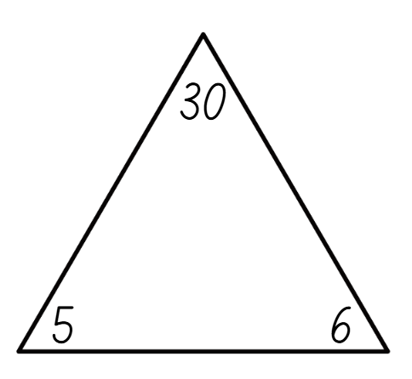
True or false (1)
The number sentence 5 ÷ 6 = 30 represents this fact family.
True | False
Communicate your reasoning.
Notes:
The question on this slide connects to the content being explored in the developing number sense activity (Activity 2)
Syllabus focus area:
Multiplicative relations A

Slide 13
Short response (5)
rectangle
trapezium
How many sides does each shape have?
How many sets of parallel sides does each shape have?
Are both shapes quadrilaterals? Explain your answer.
Notes:
Short response questions provide brisk paced questions focussing on review of current and previous content to support spaced and interleaved practice.
Syllabus focus area:
Two-dimensional spatial structure A

Slide 14
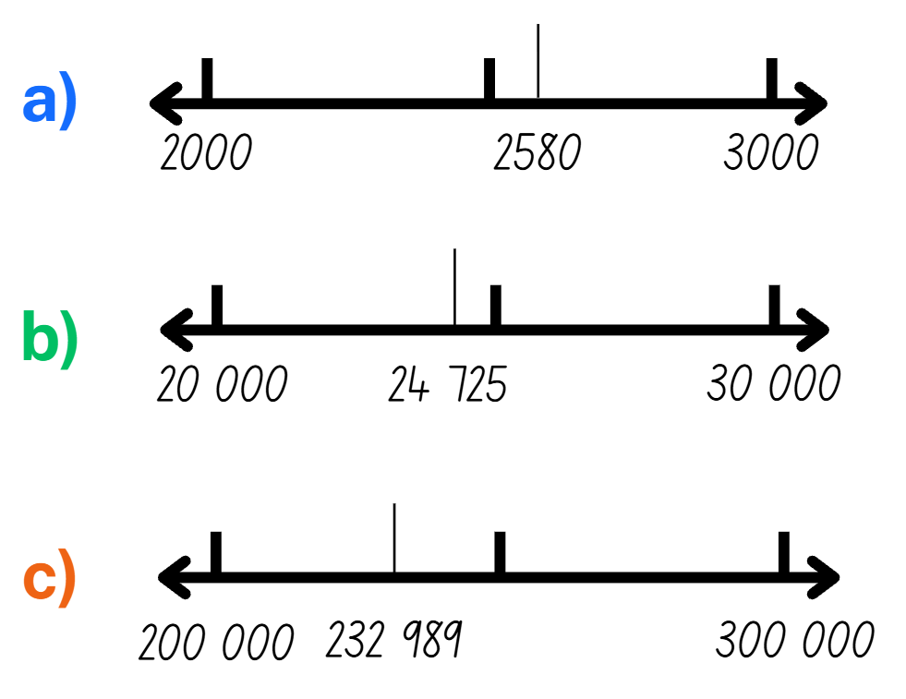
Short response (6)
For the number marked on the number line, record the nearest:
a) thousand
b) ten thousand
c) hundred thousand
Notes:
Short response questions provide brisk paced questions focussing on review of current and previous content to support spaced and interleaved practice.
Syllabus focus area:
Representing numbers using place value B

Slide 15
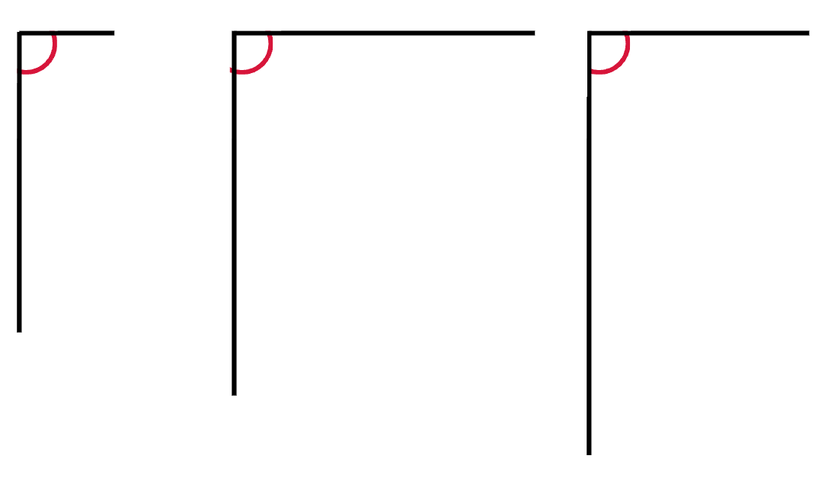
Short response (7)
Explain whether the length of the arms affects the size of the angle.
Use these angles to support your explanation.
Notes:
Short response questions provide brisk paced questions focussing on review of current and previous content to support spaced and interleaved practice.
Syllabus focus area:
Geometric measure A

Slide 16
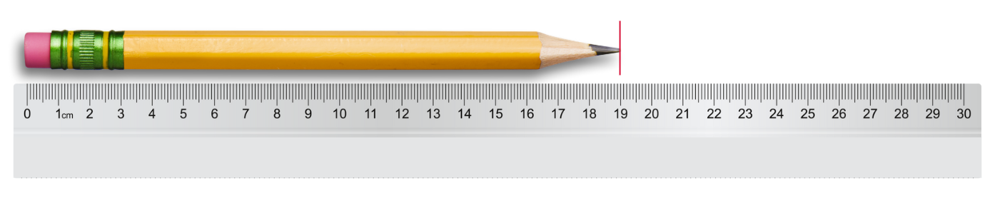
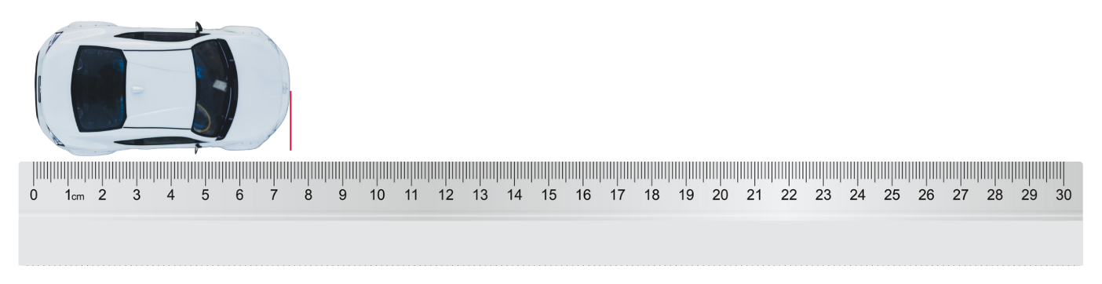
Short response (8)
These objects have been measured using a ruler.
Record the lengths of the objects using the abbreviation for millimetres.
A.
B.
Notes:
Short response questions provide brisk paced questions focussing on review of current and previous content to support spaced and interleaved practice.
Syllabus focus area:
Geometric measure A

Slide 17
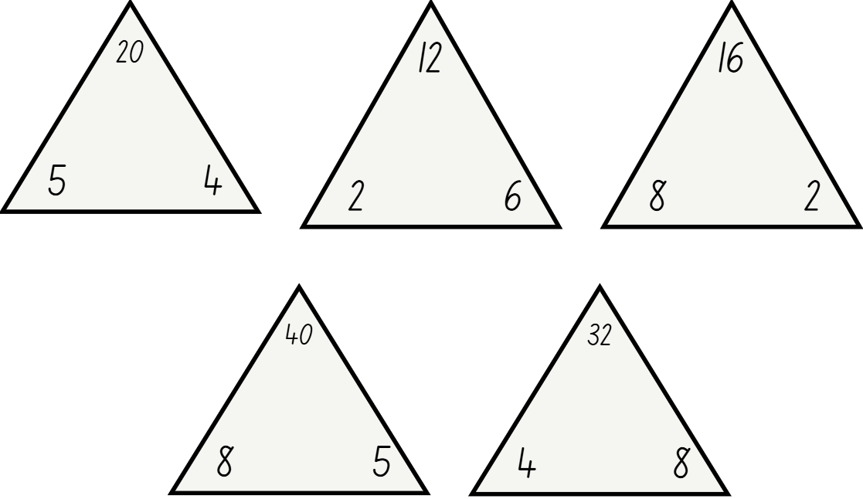
Activity 2 – fact families
Notes:
This is a developing number sense activity.
Number sense refers to a deep understanding of numbers, including their magnitude, relationships, and the effects of operations on them. It supports fluency and understanding, estimation, flexible thinking, and efficient problem-solving. Number sense activities 1–4 ‘activate’ prior number knowledge and support the learning of new content in the unit. Number sense activities 5–8 ‘loop’ back and provide opportunity for spaced practice with concepts and procedures covered in previous units.
Syllabus focus area:
Multiplicative relations A
Fact families
This resource corresponds to Resource 11 – fact families and Figure 7 – fact families in Stage 2 Year A Unit 12.
1. Revise fact family triangles. Model how to write multiplication and division sentences (see Figure 7 – fact families).
2. Use arrays to prove the commutative property of multiplication.
Note: emphasise that the number at the top of the triangle is the product of the 2 factors at the bottom of the triangle. For division, ensure students understand that the product of the fact family must be at the start of the sentence. Division is not commutative, so 2 ÷ 4 = 8 is not correct.
3. Students create the fact families for the remaining triangles.
4. Share student responses and record student ideas.

Slide 18
Review of learning 3

Slide 19
Multiple choice (2)
Which number sentence represents the the array displayed?
You may choose more than one answer.
A
B
C
D
4 × 6 = 24
24 ÷ 8 = 3
2 × 12 = 24
24 ÷ 4 = 6
Communicate your reasoning.
Notes:
This question connects to the content in the developing number sense activity (Activity 3)
Syllabus focus area:
Multiplicative relations A

Slide 20
Short response (9)
square
trapezium
rhombus
Which shapes have all sides equal?
Which shapes have opposite sides parallel?
Is a square also a parallelogram? Explain why or why not.
Notes:
Short response questions provide brisk paced questions focussing on review of current and previous content to support spaced and interleaved practice.
Syllabus focus area:
Two-dimensional spatial structure A

Slide 21
Short response (10)
Record
894 397
in non-standard form.
Notes:
Short response questions provide brisk paced questions focussing on review of current and previous content to support spaced and interleaved practice.
Syllabus focus area:
Representing numbers using place value B

Slide 22
Short response (11)
Which angle is used to describe a
quarter-turn?
Explain why this angle is used to describe a quarter-turn.
Notes:
Short response questions provide brisk paced questions focussing on review of current and previous content to support spaced and interleaved practice.
Syllabus focus area:
Geometric measure A

Slide 23

Short response (12)
Draw the angle displayed. Label the drawn angle with the terms:
arm
vertex
angle.
Notes:
Short response questions provide brisk paced questions focussing on review of current and previous content to support spaced and interleaved practice.
Syllabus focus area:
Geometric measure A

Slide 24
Activity 3 – using arrays
8
12
24
25
30
35
Notes:
This is a developing number sense activity.
Number sense refers to a deep understanding of numbers, including their magnitude, relationships, and the effects of operations on them. It supports fluency and understanding, estimation, flexible thinking, and efficient problem-solving. Number sense activities 1–4 ‘activate’ prior number knowledge and support the learning of new content in the unit. Number sense activities 5–8 ‘loop’ back and provide opportunity for spaced practice with concepts and procedures covered in previous units.
Syllabus focus area:
Multiplicative relations A
Using arrays
This resource corresponds Figure 8 – multiplication and division facts in an array in Stage 2 Year A Unit 12.
1. Direct students' attention to the following numbers 8, 12, 24, 25, 30 and 35.
2. Students make an array to represent their chosen number. For example, 12 dots could be used to make arrays of one row of 12, 12 rows of one, 2 rows of 6, 6 rows of 2, 3 rows of 4 or 4 rows of 3.
3. Students record the multiplication and division fact families. For example, 3 × 4 = 12, 4 × 3 = 12, 12 ÷ 3 = 4, 12 ÷ 4 = 3. Support students to use words rather than symbols if appropriate (see Figure 8 – multiplication and division facts).
4. Repeat the process using a different possible array for the same number of dots.
5. When all possibilities have been used, students select a new total and repeat the process.

Slide 25
Review of learning 4

Slide 26
True or false (2)
These are the related number sentences for this array.
5 × 7 = 35
7 × 5 = 35
35 ÷ 5 = 7
35 ÷ 7 = 5
True | False
Notes:
The question on this slide connects to the content being explored in the developing number sense activity (Activity 4)
Syllabus focus area:
Multiplicative relations A

Slide 27
Short response (13)
Match the number of lines of symmetry to the two-dimensional shapes shown.
1.
one line of symmetry
2 or more lines of symmetry
no lines of symmetry.
2.
3.
Notes:
Short response questions provide brisk paced questions focussing on review of current and previous content to support spaced and interleaved practice.
Syllabus focus area:
Two-dimensional spatial structure A

Slide 28
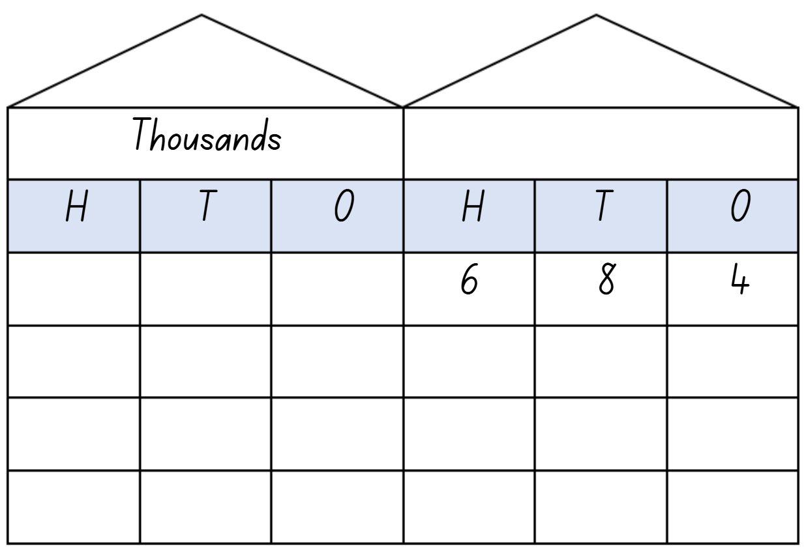
Short response (14)
Record the number 10, 100 and 1000 times larger.
Notes:
Short response questions provide brisk paced questions focussing on review of current and previous content to support spaced and interleaved practice.
Syllabus focus area:
Representing numbers using place value B

Slide 29
Short response (15)
Which of these activities have a duration of
less than 1 minute?
tying your shoelaces
packing your lunchbox into your school bag
walking from the office to the classroom.
Notes:
Short response questions provide brisk paced questions focussing on review of current and previous content to support spaced and interleaved practice.
Syllabus focus area:
Non-spatial measure A

Slide 30
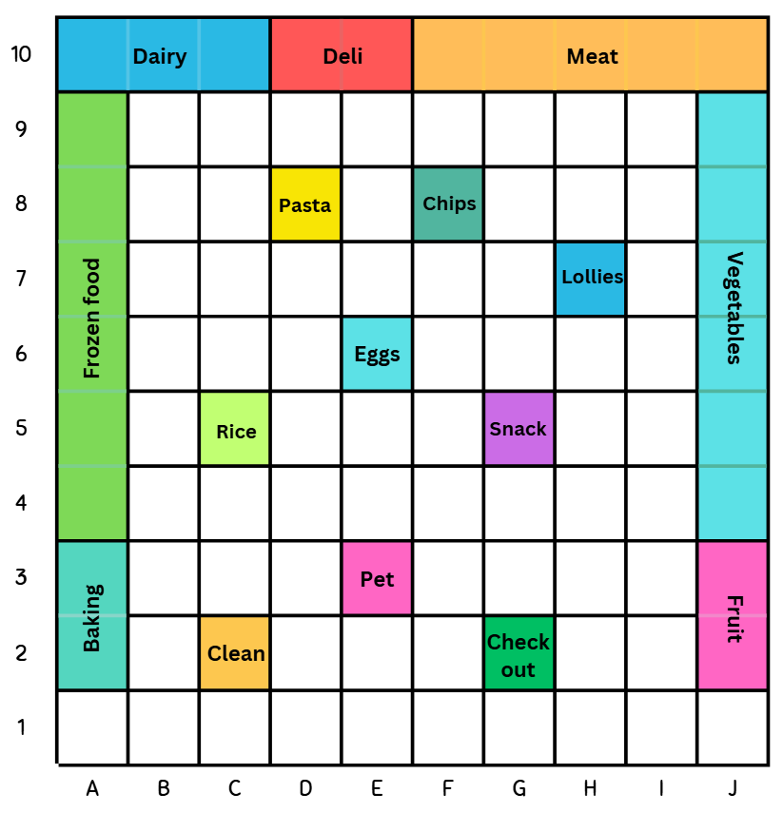



Short response (16)
Record the grid references for:
Notes:
Short response questions provide brisk paced questions focussing on review of current and previous content to support spaced and interleaved practice.
Syllabus focus area:
Geometric measure B

Slide 31
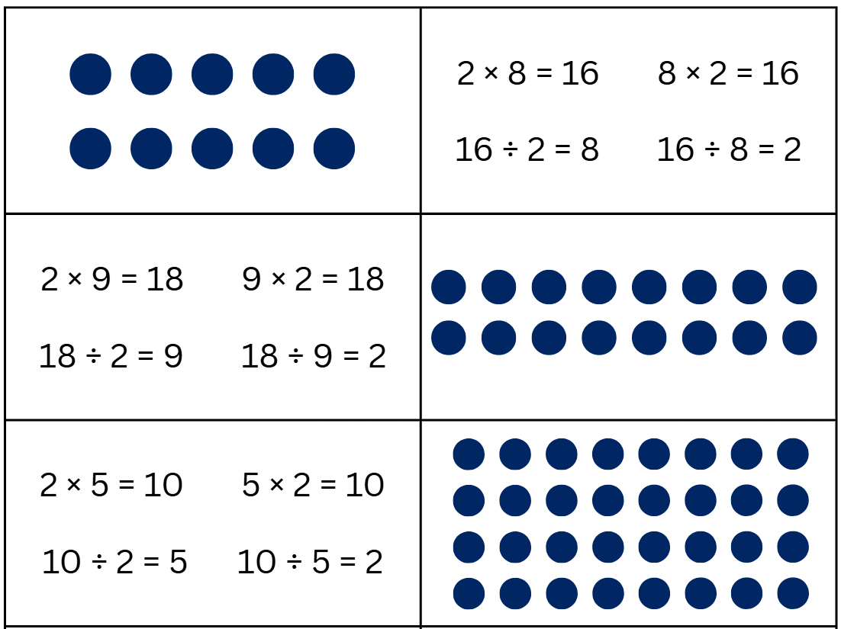
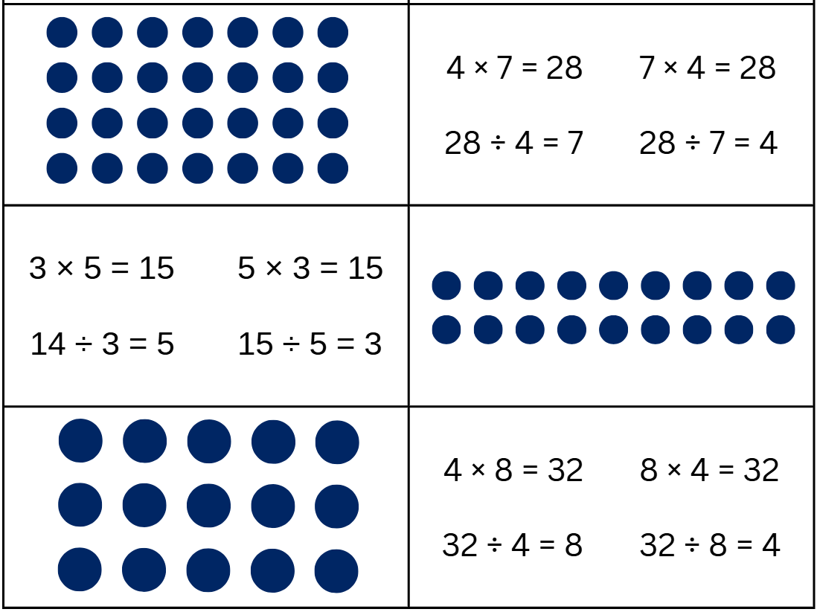
Activity 4 – fact families and arrays
Notes:
This is a developing number sense activity.
Number sense refers to a deep understanding of numbers, including their magnitude, relationships, and the effects of operations on them. It supports fluency and understanding, estimation, flexible thinking, and efficient problem-solving. Number sense activities 1–4 ‘activate’ prior number knowledge and support the learning of new content in the unit. Number sense activities 5–8 ‘loop’ back and provide opportunity for spaced practice with concepts and procedures covered in previous units.
Syllabus focus area:
Multiplicative relations A
Fact families and arrays
This resource corresponds to Resource 12 – array matching in Stage 2 Year A Unit 12.
1. Provide pairs of students with a set of cards each from Resource 12 – array matching.
2. Students shuffle the cards and place them face down in an array formation.
3. Students take turns to turn over 2 cards at a time to try and find a matching set of fact families to an array.
4. If students make a match, they get to keep the cards. If the set does not match, the cards get turned face down again.
5. Play continues until all sets have been matched.

Slide 32
Review of learning 5

Slide 33
Multiple choice (3)
Which of these shows how 472 + 38 can be partitioned?
You may choose more than one answer.
A
472 + 20 + 20
B
472 + 8 + 30
C
470 + 38
D
472 + 28 + 10
Notes:
This question connects to the content in the developing number sense activity (Activity 5)
Syllabus focus area:
Additive relations A

Slide 34

Short response (17)
Which letters shown have:
one line of symmetry
2 or more lines of symmetry
no lines of symmetry.
Notes:
Short response questions provide brisk paced questions focussing on review of current and previous content to support spaced and interleaved practice.
Syllabus focus area:
Two-dimensional spatial structure A

Slide 35
Short response (18)
3, 6, 9, 12…
What is the rule for the pattern?
Write a multiplication fact that matches what comes next in this pattern.
Draw an array to represent the multiplication fact in Question 2.
Notes:
Short response questions provide brisk paced questions focussing on review of current and previous content to support spaced and interleaved practice.
Syllabus focus area:
Multiplicative relations A

Slide 36

Short response (19)
The 6 on the analog clock can represent:
_____ hours
or ____ minutes
Notes:
Short response questions provide brisk paced questions focussing on review of current and previous content to support spaced and interleaved practice.
Syllabus focus area:
Non-spatial measure A

Slide 37
Short response (20)
Describe one similarity and one difference between a rectangle and a parallelogram.
Notes:
Short response questions provide brisk paced questions focussing on review of current and previous content to support spaced and interleaved practice.
Syllabus focus area:
Two-dimensional spatial structure A

Slide 38
Activity 5 – using partitioning to add (1)
689 + 56 =
Notes:
This is a developing number sense activity.
Number sense refers to a deep understanding of numbers, including their magnitude, relationships, and the effects of operations on them. It supports fluency and understanding, estimation, flexible thinking, and efficient problem-solving. Number sense activities 1–4 ‘activate’ prior number knowledge and support the learning of new content in the unit. Number sense activities 5–8 ‘loop’ back and provide opportunity for spaced practice with concepts and procedures covered in previous units.
Syllabus focus area:
Additive relations A
Using partitioning to add
This resource corresponds to Figure 9 – partitioning examples for 689 + 56 in Stage 2 Year A Unit 12
1. Discuss standard and non-standard partitioning strategies to add the 2 numbers.
2. In pairs, students discuss and record strategies used to find a solution on individual whiteboards.
3. Select students to share with the class. Record an example on the board of using quantity values and of bridging to the decade (see Figure 9 – partitioning examples for 689 + 56).
4. (next slide) Repeat with the equation 549 + 38 = _.
5. Ask:
Which partitioning strategy did you prefer to use? Why?
Which strategy was more efficient in solving the problem?
Are there other ways you can partition the number to solve the problem more efficiently?

Slide 39
Activity 5 – using partitioning to add (2)
549 + 38 =
Notes:
This is a developing number sense activity.
Number sense refers to a deep understanding of numbers, including their magnitude, relationships, and the effects of operations on them. It supports fluency and understanding, estimation, flexible thinking, and efficient problem-solving. Number sense activities 1–4 ‘activate’ prior number knowledge and support the learning of new content in the unit. Number sense activities 5–8 ‘loop’ back and provide opportunity for spaced practice with concepts and procedures covered in previous units.
Syllabus focus area:
Additive relations A
Using partitioning to add
This resource corresponds to Figure 9 – partitioning examples for 689 + 56 in Stage 2 Year A Unit 12
1. Discuss standard and non-standard partitioning strategies to add the 2 numbers.
2. In pairs, students discuss and record strategies used to find a solution on individual whiteboards.
3. Select students to share with the class. Record an example on the board of using quantity values and of bridging to the decade (see Figure 9 – partitioning examples for 689 + 56).
4. Ask:
Which partitioning strategy did you prefer to use? Why?
Which strategy was more efficient in solving the problem?
Are there other ways you can partition the number to solve the problem more efficiently?

Slide 40
Review of learning 6

Slide 41
True or false (3)
471 – 87 = 470 – 86
True | False
Communicate your reasoning.
Notes:
The question on this slide connects to the content being explored in the developing number sense activity (Activity 6)
Syllabus focus area:
Additive relations A

Slide 42
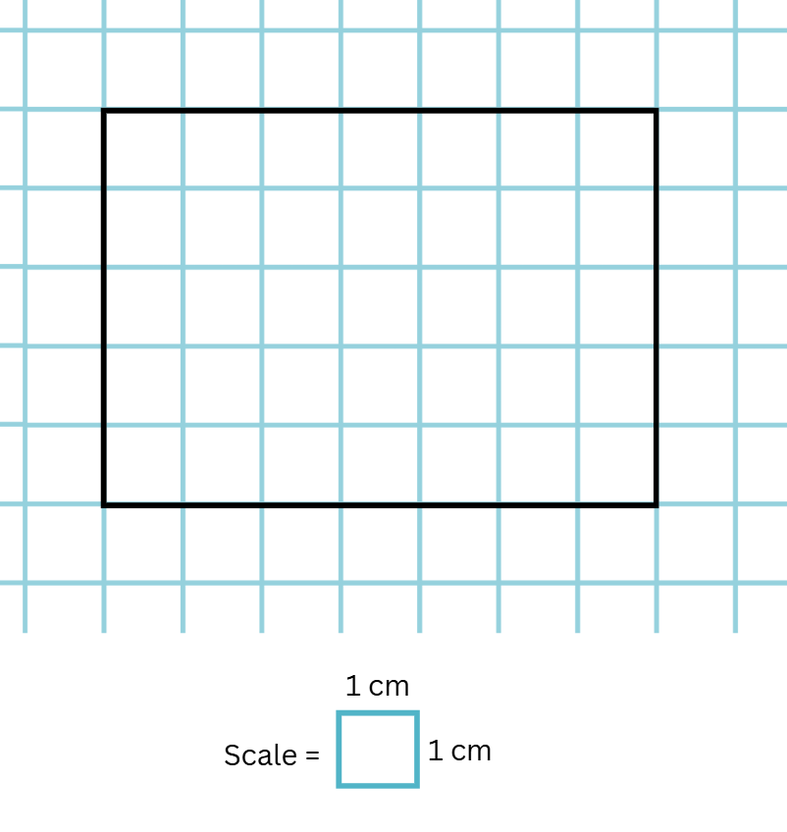
Short response (21)
• describe the area using the terms ‘rows’, ‘columns’ and ‘for each’.
• record the area in square centimetres using numerals and words.
Notes:
Short response questions provide brisk paced questions focussing on review of current and previous content to support spaced and interleaved practice.
Syllabus focus area:
Two-dimensional spatial structure A

Slide 43

Short response (22)
Record the missing numbers to complete the facts for the array.
___ rows of ___ is ____ in total.
____ shared into___ rows is___.
43
Notes:
Short response questions provide brisk paced questions focussing on review of current and previous content to support spaced and interleaved practice.
Syllabus focus area:
Multiplicative relations A

Slide 44
Short response (23)
Match the digital times to the nearest benchmark 5-minute interval:
4:19
7:43
6:51
ten-to seven
twenty-past four
quarter-to eight.
Notes:
Short response questions provide brisk paced questions focussing on review of current and previous content to support spaced and interleaved practice.
Syllabus focus area:
Non-spatial measure A

Slide 45
Short response (24)
A pyramid and a prism are both three-dimensional objects. Describe one way they are different.
pyramid
prism
Notes:
Short response questions provide brisk paced questions focussing on review of current and previous content to support spaced and interleaved practice.
Syllabus focus area:
Three-dimensional spatial structure A

Slide 46
Activity 6 – using constant difference to subtract (1)
352 – 98 =
Notes:
This is a developing number sense activity.
Number sense refers to a deep understanding of numbers, including their magnitude, relationships, and the effects of operations on them. It supports fluency and understanding, estimation, flexible thinking, and efficient problem-solving. Number sense activities 1–4 ‘activate’ prior number knowledge and support the learning of new content in the unit. Number sense activities 5–8 ‘loop’ back and provide opportunity for spaced practice with concepts and procedures covered in previous units.
Syllabus focus area:
Additive relations A
Using constant difference to subtract
This resource corresponds to Resource 13 – 119 number chart and Figure 10 – constant difference 352 − 98 = in Stage 2 Year A Unit 12.
Note: ‘Race to zero’ was played in Stage 2 Year A Unit 2. Resources for the game may already be printed.
1. Discuss how the numbers in the equation can be adjusted up or down to help solve the problem.
2. In pairs, students discuss strategies to adjust the numbers and record a solution on individual whiteboards.
3. Select students to share with the class. Record an example on the board and ensure students recognise that the constant difference strategy keeps the distance between the 2 numbers the same (see Figure 10 – constant difference 352 − 98 =).
4. (next slide) Provide students with Resource 13 – 119 number chart to play ‘Race to zero’.
5. Explain that the goal is to be the first to reach zero. The rules of the game are as follows:
Start at 119 and subtract 2-digit numbers generated by rolling a dice.
Apply constant difference to solve (for example, 119 − 23 becomes 120 − 24), use writing materials to support problem solving.
Explain your thinking to your partner. If agreed upon, move your counter toward zero.
You must land exactly on zero. If the roll goes below zero, return to 25 for the next turn.

Slide 47
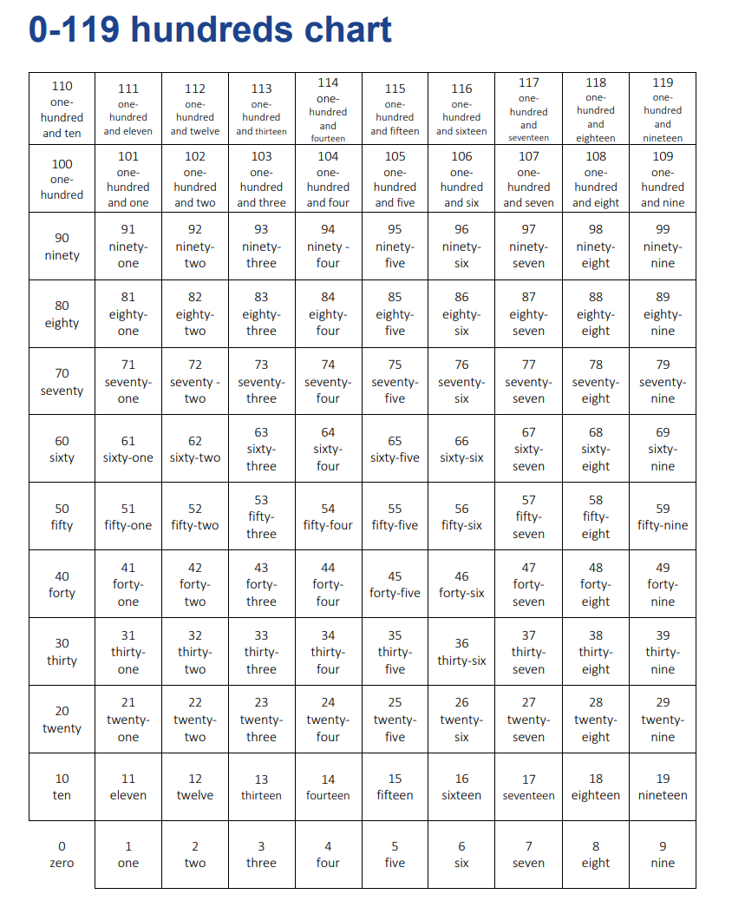
Activity 6 – using constant difference to subtract (2)
Access a high resolution copy of Resource 7 from 0–119 hundreds chart.
Notes:
This is a developing number sense activity.
Number sense refers to a deep understanding of numbers, including their magnitude, relationships, and the effects of operations on them. It supports fluency and understanding, estimation, flexible thinking, and efficient problem-solving. Number sense activities 1–4 ‘activate’ prior number knowledge and support the learning of new content in the unit. Number sense activities 5–8 ‘loop’ back and provide opportunity for spaced practice with concepts and procedures covered in previous units.
Syllabus focus area:
Additive relations A
Using constant difference to subtract
This resource corresponds to Resource 13 – 119 number chart in Stage 2 Year A Unit 12.
Note: ‘Race to zero’ was played in Stage 2 Year A Unit 2. Resources for the game may already be printed.
4. Provide students with Resource 13 – 119 number chart to play ‘Race to zero’.
5. Explain that the goal is to be the first to reach zero. The rules of the game are as follows:
Start at 119 and subtract 2-digit numbers generated by rolling a dice.
Apply constant difference to solve (for example, 119 − 23 becomes 120 − 24), use writing materials to support problem solving.
Explain your thinking to your partner. If agreed upon, move your counter toward zero.
You must land exactly on zero. If the roll goes below zero, return to 25 for the next turn.

Slide 48
Review of learning 7

Slide 49
Multiple choice (4)
Which strategy do you consider the most efficient for accurately solving 478 + 67?
A
Record and solve 478 + 67 using an algorithm
B
478 + 22 = 500, 500 + 45 = 545
C
478 + 2 = 480, 480 + 20 = 500, 500 + 40 = 540, 540 + 5 = 545
D
Estimate the answer.
Notes:
This question connects to the content in the developing number sense activity (Activity 7)
Syllabus focus area:
Additive relations A

Slide 50


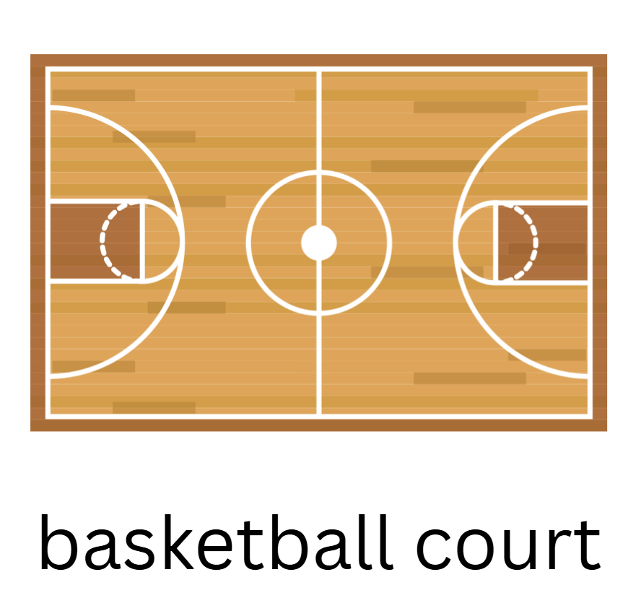
Short response (25)
For each object, record whether you would measure its area in square centimetres or square metres.
Communicate your reasoning.
Notes:
Short response questions provide brisk paced questions focussing on review of current and previous content to support spaced and interleaved practice.
Syllabus focus area:
Two-dimensional spatial structure A

Slide 51
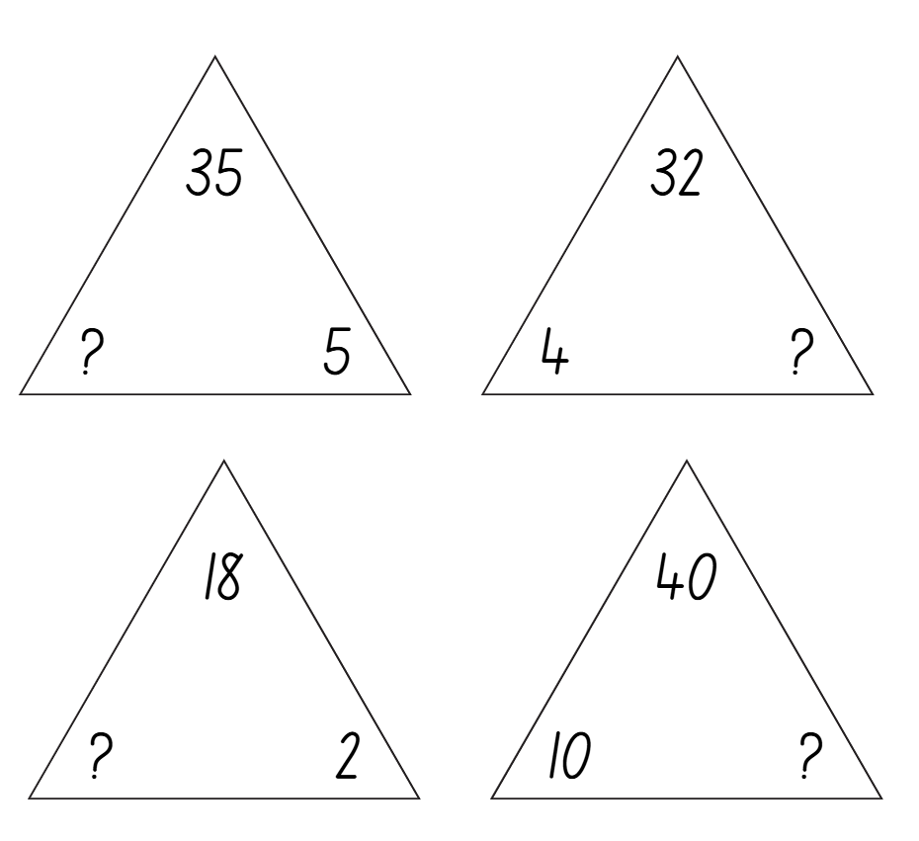
Short response (26)
Record the missing numbers in the fact family triangles.
Notes:
Short response questions provide brisk paced questions focussing on review of current and previous content to support spaced and interleaved practice.
Syllabus focus area:
Multiplicative relations B

Slide 52


Short response (27)
Record the times displayed on the analog clock using the term ‘past’ or ‘to’.
B.
A.
Notes:
Short response questions provide brisk paced questions focussing on review of current and previous content to support spaced and interleaved practice.
Syllabus focus area:
Non-spatial measure A

Slide 53
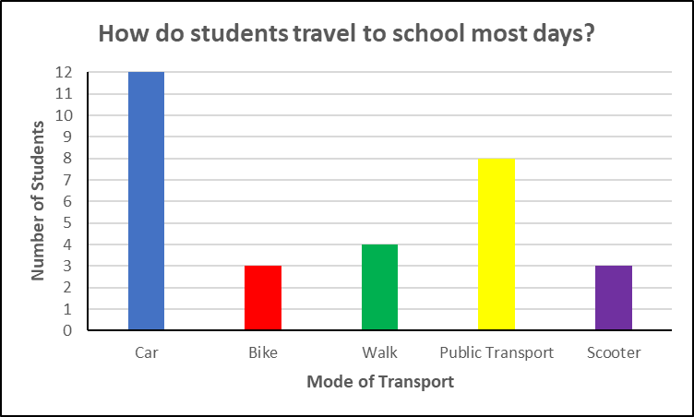
Short response (32)
Which is the most common mode of transport?
Which are the 2 least common modes of transport?
Notes:
Short response questions provide brisk paced questions focussing on review of current and previous content to support spaced and interleaved practice.
Syllabus focus area:
Data A

Slide 54
Activity 7 – comparing additive strategies (1)
314 + 96 =
Notes:
This is a developing number sense activity.
Number sense refers to a deep understanding of numbers, including their magnitude, relationships, and the effects of operations on them. It supports fluency and understanding, estimation, flexible thinking, and efficient problem-solving. Number sense activities 1–4 ‘activate’ prior number knowledge and support the learning of new content in the unit. Number sense activities 5–8 ‘loop’ back and provide opportunity for spaced practice with concepts and procedures covered in previous units.
Syllabus focus area:
Additive relations A
Comparing additive strategies
1. In small groups, students solve the equation 314 + 96 using 3 different additive strategies.
2. Select groups to share with the class. Record an example of each strategy on the board.
3. Ask:
What was the solution?
What strategy did you find most efficient? Why?
What strategy did you find least efficient? Why?
Which strategy is your personal favourite? Is it also your most efficient?
4. (next slide) Repeat steps 1–3 with the equation 987 + 32 = _.
5. Discuss that the most effective strategy may vary; learning different methods gives students the flexibility to determine which is the fastest and/or most efficient for them.

Slide 55
Activity 7 – comparing additive strategies (2)
987 + 32 =
Notes:
This is a developing number sense activity.
Number sense refers to a deep understanding of numbers, including their magnitude, relationships, and the effects of operations on them. It supports fluency and understanding, estimation, flexible thinking, and efficient problem-solving. Number sense activities 1–4 ‘activate’ prior number knowledge and support the learning of new content in the unit. Number sense activities 5–8 ‘loop’ back and provide opportunity for spaced practice with concepts and procedures covered in previous units.
Syllabus focus area:
Additive relations A
Comparing additive strategies
1. In small groups, students solve the equation 987 + 32 = _.using 3 different additive strategies.
2. Select groups to share with the class. Record an example of each strategy on the board.
3. Ask:
What was the solution?
What strategy did you find most efficient? Why?
What strategy did you find least efficient? Why?
Which strategy is your personal favourite? Is it also your most efficient?
4. Discuss that the most effective strategy may vary; learning different methods gives students the flexibility to determine which is the fastest and/or most efficient for them.

Slide 56
Review of learning 8

Slide 57
True or false (4)
The following calculation is correct:
523 – 67 = 520 – 64
True | False
Communicate your reasoning.
Notes:
The question on this slide connects to the content being explored in the developing number sense activity (Activity 8)
Syllabus focus area:
Additive relations A

Slide 58
Short response (29)
You have been asked to measure a rectangular space in the school playground using a square metre.
Record the area of the space in numerals and words.
9 metres
6 metres
Notes:
Short response questions provide brisk paced questions focussing on review of current and previous content to support spaced and interleaved practice.
Syllabus focus area:
Two-dimensional spatial structure A

Slide 59
Short response (30)
Aaron gets 5 stickers in each packet.
He buys 4 packets.
Write a number sentence to match the problem.
How many stickers does Aaron have altogether?
Notes:
Short response questions provide brisk paced questions focussing on review of current and previous content to support spaced and interleaved practice.
Syllabus focus area:
Multiplicative relations A

Slide 60
Short response (31)
How many minutes there are in an hour?
How many minutes there are in a half-hour?
How many minutes there are in a quarter-hour?
Explain the connection between the number of minutes in an hour, half-hour and quarter-hour.
Notes:
Short response questions provide brisk paced questions focussing on review of current and previous content to support spaced and interleaved practice.
Syllabus focus area:
Non-spatial measure A

Slide 61


Short response (28)
Read and record the analog times displayed, using the terms ‘past’ and ‘to’.
A.
B.
Notes:
Short response questions provide brisk paced questions focussing on review of current and previous content to support spaced and interleaved practice.
Syllabus focus area:
Non-spatial measure A

Slide 62

Activity 8 – comparing strategies for subtraction
Which strategy was the most efficient?
Where did regrouping or non-standard partitioning help?
Would the same strategy be efficient for different numbers?
Is there a strategy you have not used before, that you could use next time?
Notes:
This is a developing number sense activity.
Number sense refers to a deep understanding of numbers, including their magnitude, relationships, and the effects of operations on them. It supports fluency and understanding, estimation, flexible thinking, and efficient problem-solving. Number sense activities 1–4 ‘activate’ prior number knowledge and support the learning of new content in the unit. Number sense activities 5–8 ‘loop’ back and provide opportunity for spaced practice with concepts and procedures covered in previous units.
Syllabus focus area:
Additive relations A
Comparing strategies for subtraction
1. Provide pairs of students with a 9-sided dice. In pairs, students roll the dice to make a 3-digit and a 2-digit number.
2. Students use those 2 recorded numbers to create a subtraction number sentence.
3. Pairs solve the number sentence using 3 different additive strategies.
4. Students compare their strategies with another pair. Ask:
Which strategy was the most efficient?
Where did regrouping or non-standard partitioning help?
Would the same strategy be efficient for different numbers?
Is there a strategy you have not used before, that you could use next time?
5. Repeat the process with a new set of dice rolls.

Slide 63
Double Venn diagram
Object 1
Object 2
Features similar to both objects
Features of object 1
Features of object 2

Slide 64
Frayer
Definition
Facts/Characteristics
Word, term, concept
Examples
Non-examples

Slide 65
Spider map
Idea
Subject

Slide 66
Cline
Concept 1
Concept 2
Word
Word
Word
Word
Word
Word
Word
Word
Word
Word
Word

Slide 67
Compare and contrast

Slide 68
Multiple choice (5)
A
B
C
D

Slide 69
Multiple choice
A
B
C
D
Notes:
This question connects to the content in the developing number sense activity (Activity 3)
Syllabus focus area:
[Focus area A/B]

Slide 70
References (1)
This presentation contains NSW Curriculum and syllabus content. The NSW Curriculum is developed by the NSW Education Standards Authority. This content is prepared by NESA for and on behalf of the Crown in the right of the State of New South Wales. The material is protected by Crown copyright.
Please refer to the NESA Copyright Disclaimer for more information https://educationstandards.nsw.edu.au/wps/portal/nesa/mini-footer/copyright.
NESA holds the only official and up-to-date versions of the NSW Curriculum and syllabus documents. Please visit the NSW Education Standards Authority (NESA) website https://educationstandards.nsw.edu.au/wps/portal/nesa/home and the NSW Curriculum website https://curriculum.nsw.edu.au.
Mathematics K–10 Syllabus © NSW Education Standards Authority (NESA) for and on behalf of the Crown in right of the State of New South Wales, 2022.
National Numeracy Learning Progression © Australian Curriculum, Assessment and Reporting Authority (ACARA) 2010 to present, unless otherwise indicated. This material was downloaded from the Australian Curriculum website (National Numeracy Learning Progression) (accessed 27 February 2026) and was not modified.
Toy Theater (2001–2026) Geoboard, Toy Theater website, accessed 20 March 2026.
Siemon D, Beswick K, Brady K, Clark J, Faragher R, Warren E (2015) Teaching Mathematics – Foundations to Middle years, 2nd edn, Oxford University Press Australian and New Zealand.
State of New South Wales (Department of Education) (2017) Teaching measurement Stage 2 to Stage 3, NSW Department of Education website, accessed 20 March 2026.

Slide 71
References (2)
This presentation contains NSW Curriculum and syllabus content. The NSW Curriculum is developed by the NSW Education Standards Authority. This content is prepared by NESA for and on behalf of the Crown in the right of the State of New South Wales. The material is protected by Crown copyright.
Please refer to the NESA Copyright Disclaimer for more information https://educationstandards.nsw.edu.au/wps/portal/nesa/mini-footer/copyright.
NESA holds the only official and up-to-date versions of the NSW Curriculum and syllabus documents. Please visit the NSW Education Standards Authority (NESA) website https://educationstandards.nsw.edu.au/wps/portal/nesa/home and the NSW Curriculum website https://curriculum.nsw.edu.au.
University of Cambridge (n.d.) What’s in the Box?, NRICH website, accessed 27 February 2026.
Van de Walle J, Karp K, Bay-Williams JM, Brass A, Bentley B, Ferguson S, Goff W, Livy S, Marshman M, Martin D, Pearn C, Prodromou T, Symons D and Wilkie K (2019) Primary and Middle Years Mathematics: Teaching Developmentally, 1st Australian edn, Pearson Education Australia, Melbourne.

Slide 72
Copyright
© State of New South Wales (Department of Education), 2025
The copyright material published in this resource is subject to the Copyright Act 1968 (Cth) and is owned by the NSW Department of Education or, where indicated, by a party other than the NSW Department of Education (third-party material).
Copyright material available in this resource and owned by the NSW Department of Education is licensed under a Creative Commons Attribution 4.0 International (CC BY 4.0) license.
This license allows you to share and adapt the material for any purpose, even commercially.
Attribution should be given to © State of New South Wales (Department of Education), 2025.
Material in this resource not available under a Creative Commons license:
the NSW Department of Education logo, other logos and trademark-protected material
Material owned by a third party that has been reproduced with permission. You will need to obtain permission from the third party to reuse its material.
Links to third-party material and websites
Please note that the provided (reading/viewing material/list/links/texts) are a suggestion only and implies no endorsement, by the New South Wales Department of Education, of any author, publisher, or book title. School principals and teachers are best placed to assess the suitability of resources that would complement the curriculum and reflect the needs and interests of their students.
If you use the links provided in this document to access a third party’s website, you acknowledge that the terms of use, including licence terms set out on the third-party’s website apply to the use which may be made of the materials on that third-party website or where permitted by the Copyright Act 1968 (Cth). The department accepts no responsibility for content on third-party websites.

