Slide 1
Instructions for use
This resource aligns to the learning in Stage 2 Year A Unit 13 and revisits content from earlier sample units.
Classroom teachers are encouraged to add and adapt slides as required to meet the needs of their students.
Save a copy of the file to make changes to the slide deck. Go to File > Download a Copy (this downloads a copy to the computer to edit in the PowerPoint app).
To convert the PowerPoint to Google Slides:
  Upload the file into Google Drive and open it.
  Go to File > Save as Google Slides.
  (Note – conversion may cause formatting changes in the slides.)

Slide 2

Review of Learning
Mathematics Stage 2 – Unit 13
Notes:
Reviews may include a combination of question types, requiring students to recall facts and key ideas, as well as apply their knowledge to solve problems and answer questions. To support active engagement, a mix of techniques should be employed.” (AERO, 2024).
This Review of Learning slide deck revisits key concepts from the following units:
Stage 2 Year A Unit 13
Stage 2 Year A Unit 12
Stage 2 Year A Unit 11
It also includes opportunities to review prior learning in non-number content, supporting consolidation across focus areas.
The review of learning resources include three key task types that support the development of mathematical proficiency through retrieval, spaced practice, and active participation. These practices complement the review phase (activating prior knowledge) embedded within the beginning of each lesson.
1.
Multiple-choice questions/True or false: Designed to promote active retrieval of key concepts and identify common misconceptions in number, supporting consolidation, understanding and fluency.
These questions:
support spaced and interleaved practice
help identify and address common misconceptions
support active recall and immediate feedback
support whole class participation
identify areas requiring reteach
2.
Short-response question sets: Carefully grouped questions that encourage spaced and interleaved practice across multiple focus areas, helping students revisit and apply knowledge from different points in time.
These questions:
have a combination of question types
address a range of focus areas
build automaticity and fluency
support active recall
allow for immediate feedback
identify content requiring reteach
3.
Developing number sense activities: A variety of practical, purposeful tasks that reinforce current learning and build on prior knowledge. These activities promote reasoning, problem-solving and conceptual understanding.
The review of learning resources are designed to work support teaching and learning in mathematics. For the most effective implementation, use the resources flexibly, adapting to meet student learning needs and individual classroom contexts.

Slide 3
Lessons
1
Review of learning 1
5
Review of learning 5
2
Review of learning 2
6
Review of learning 6
3
Review of learning 3
7
Review of learning 7
4
Review of learning 4
8
Review of learning 8
Notes:
Teacher notes:
Click lesson titles to go to specific lessons
Interactive features can be viewed in slide show

Slide 4
Review of learning 1

Slide 5

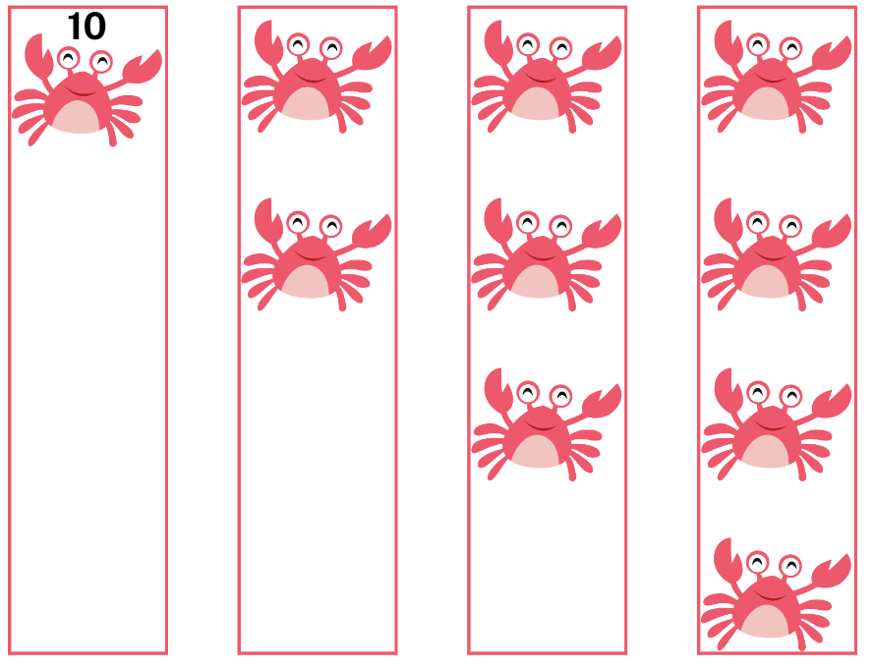
Multiple choice (1)
The pattern of multiples is…
A
10, 15, 20, 25
B
10, 100, 1000, 10 000
C
10, 20, 30, 40
D
5, 15, 25, 35
Notes:
This question connects to the content in the developing number sense activity (Activity 1)
Syllabus focus area:
Multiplicative relations A

Slide 6

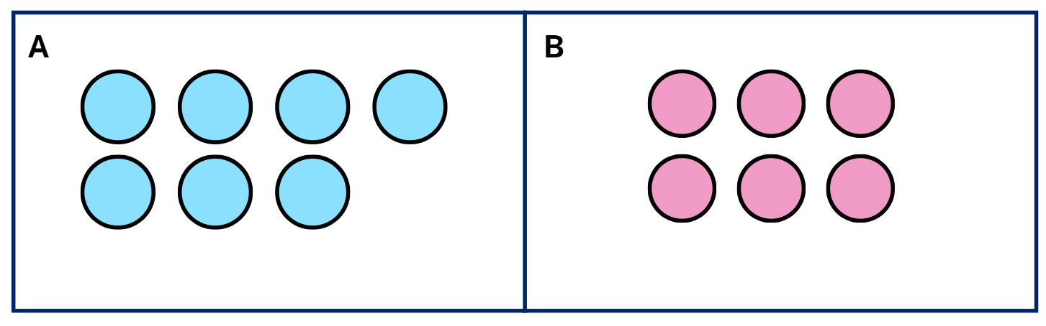
Short response (1)
Describe as odd or even.
Communicate your reasoning.
Notes:
Short response questions provide brisk paced questions focussing on review of current and previous content to support spaced and interleaved practice.
Syllabus focus area:
Representing whole numbers A (Stage 1 content)

Slide 7

Short response (2)
Would you classify this polygon as a quadrilateral?
Communicate your reasoning.
Notes:
Short response questions provide brisk paced questions focussing on review of current and previous content to support spaced and interleaved practice.
Syllabus focus area:
Two-dimensional spatial structure A

Slide 8
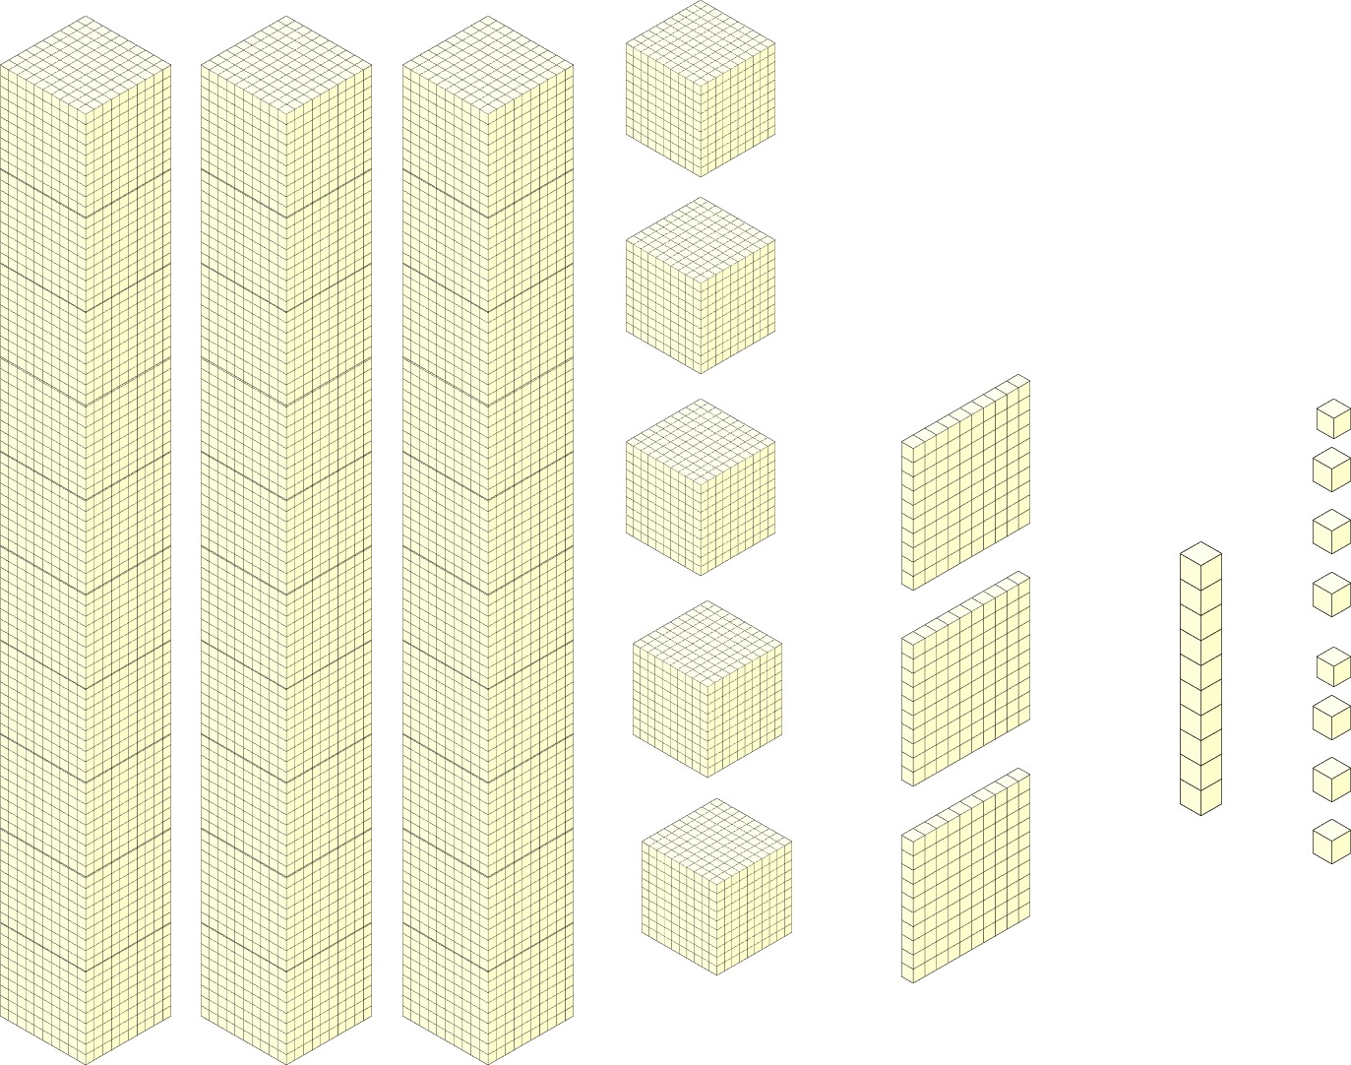
Short response (3)
Record the number represented by these base 10 materials.
Notes:
Short response questions provide brisk paced questions focussing on review of current and previous content to support spaced and interleaved practice.
Syllabus focus area:
Representing numbers using place value A

Slide 9

Short response (4)
Record the missing words:
The blue book is on the _________ shelf,
________ from the right.
Notes:
Short response questions provide brisk paced questions focussing on review of current and previous content to support spaced and interleaved practice.
Syllabus focus area:
Geometric measure A

Slide 10

Activity 1 – describing increasing and decreasing patterns (1)
4, 8, 12, 16, 20…
Notes:
This is a developing number sense activity.
Number sense refers to a deep understanding of numbers, including their magnitude, relationships, and the effects of operations on them. It supports fluency and understanding, estimation, flexible thinking, and efficient problem-solving. Number sense activities 1–4 ‘activate’ prior number knowledge and support the learning of new content in the unit. Number sense activities 5–8 ‘loop’ back and provide opportunity for spaced practice with concepts and procedures covered in previous units.
Syllabus focus area:
Multiplicative relations A
Describing increasing and decreasing patterns
Ask:
- Can you describe this pattern?
- Which numbers come next in the pattern? (next slide)
Display the number pattern 28, 24, 20, 16, 12 …
Ask the questions from step 2.
Explain that both patterns continue by a constant amount, but the first increases by 4 and the second decreases by 4. (next slide)
Display the following number patterns:
- 6, 11, 16, 21, 26 …
- 174, 164, 154, 144, 134 …
- 3, 7, 11, 15, 19, 23 …
- 67, 62, 57, 52, 47 …
Students turn and talk to discuss each pattern. Students determine the amount by which each pattern is increasing or decreasing.
Students continue the number patterns and record the next 5 values on whiteboards.

Slide 11
Activity 1 – describing increasing and decreasing patterns (2)
28, 24, 20, 16, 12…
Notes:
This is a developing number sense activity.
Number sense refers to a deep understanding of numbers, including their magnitude, relationships, and the effects of operations on them. It supports fluency and understanding, estimation, flexible thinking, and efficient problem-solving. Number sense activities 1–4 ‘activate’ prior number knowledge and support the learning of new content in the unit. Number sense activities 5–8 ‘loop’ back and provide opportunity for spaced practice with concepts and procedures covered in previous units.
Syllabus focus area:
Multiplicative relations A
Describing increasing and decreasing patterns
Ask:
- Can you describe this pattern?
- Which numbers come next in the pattern?
Explain that the pattern both patterns continue by a constant amount but the first increases by 4, and the second decreases by 4. (next slide)

Slide 12
Activity 1 – describing increasing and decreasing patterns (3)
6, 11, 16, 21, 26…
174, 164, 154, 144, 134…
3, 7, 11, 15, 19, 23…
67, 62, 57, 52, 47…
Notes:
This is a developing number sense activity.
Number sense refers to a deep understanding of numbers, including their magnitude, relationships, and the effects of operations on them. It supports fluency and understanding, estimation, flexible thinking, and efficient problem-solving. Number sense activities 1–4 ‘activate’ prior number knowledge and support the learning of new content in the unit. Number sense activities 5–8 ‘loop’ back and provide opportunity for spaced practice with concepts and procedures covered in previous units.
Syllabus focus area:
Multiplicative relations A
Describing increasing and decreasing patterns
Students turn and talk to discuss each pattern. Students determine the amount by which each pattern is increasing or decreasing.
Students continue the number patterns and record the next 5 values on individual whiteboards.

Slide 13
Review of learning 2

Slide 14
True or false (1)
The next number in this pattern is 24.
4, 8, 12, 16, 20…
True | False
Notes:
The question on this slide connects to the content being explored in the developing number sense activity (Activity 2)
Syllabus focus area:
Multiplicative relations A

Slide 15
Short response (5)
Record whether the following numbers are even (E) or odd (O):
59
276
197
Communicate your reasoning.
Notes:
Note: this slide is designed to be viewed in presentation mode.
Short response questions provide brisk paced questions focussing on review of current and previous content to support spaced and interleaved practice.
Syllabus focus area:
Multiplicative relations A

Slide 16
Short response (6)
Name a 2D shape with the following features:
a) one set of parallel sides
b) all sides equal
c) opposite sides are parallel and equal.
Notes:
Short response questions provide brisk paced questions focussing on review of current and previous content to support spaced and interleaved practice.
Syllabus focus area:
Two-dimensional spatial structure A

Slide 17
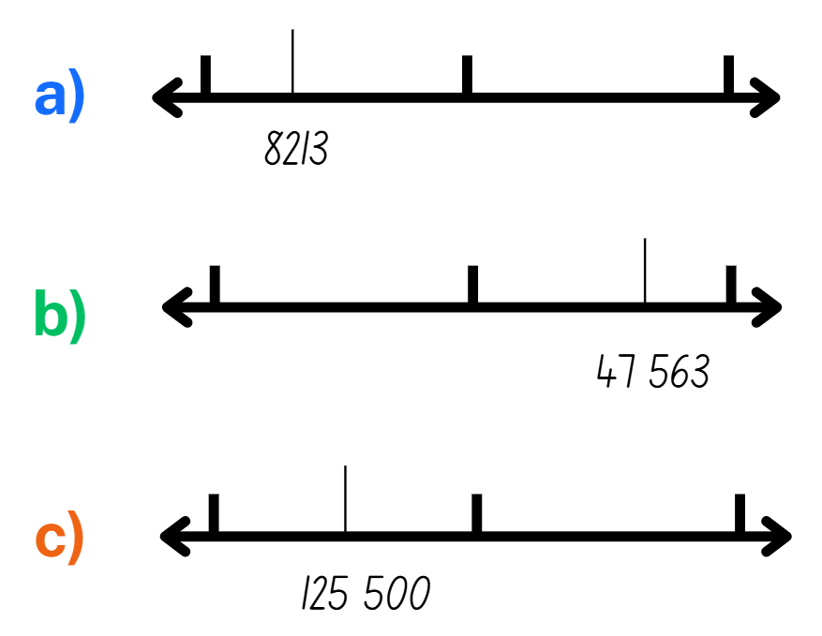
Short response (7)
Record the nearest:
a) thousand
b) ten thousand
c) hundred thousand
for the number marked on each of the number lines.
Notes:
Short response questions provide brisk paced questions focussing on review of current and previous content to support spaced and interleaved practice.
Syllabus focus area:
Representing numbers using place value B

Slide 18
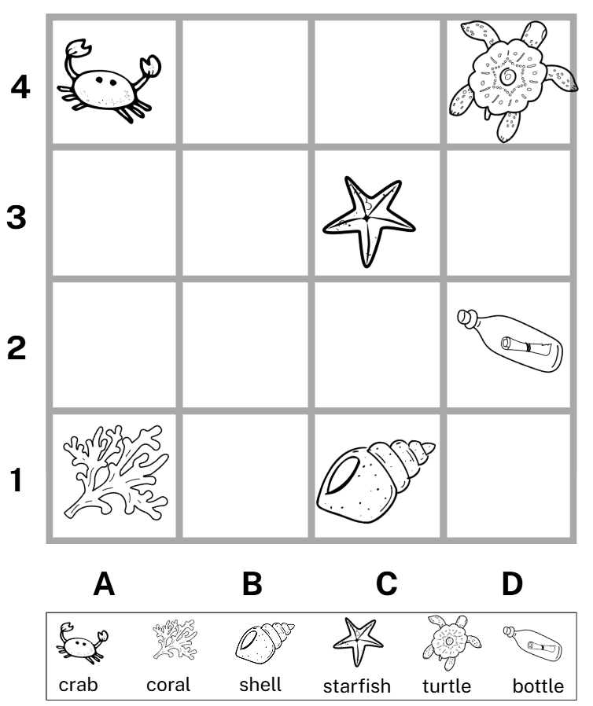
Short response (8)
Record the object at the position:
A4
C3
C1
D4
Notes:
Short response questions provide brisk paced questions focussing on review of current and previous content to support spaced and interleaved practice.
Syllabus focus area:
Geometric measure A

Slide 19
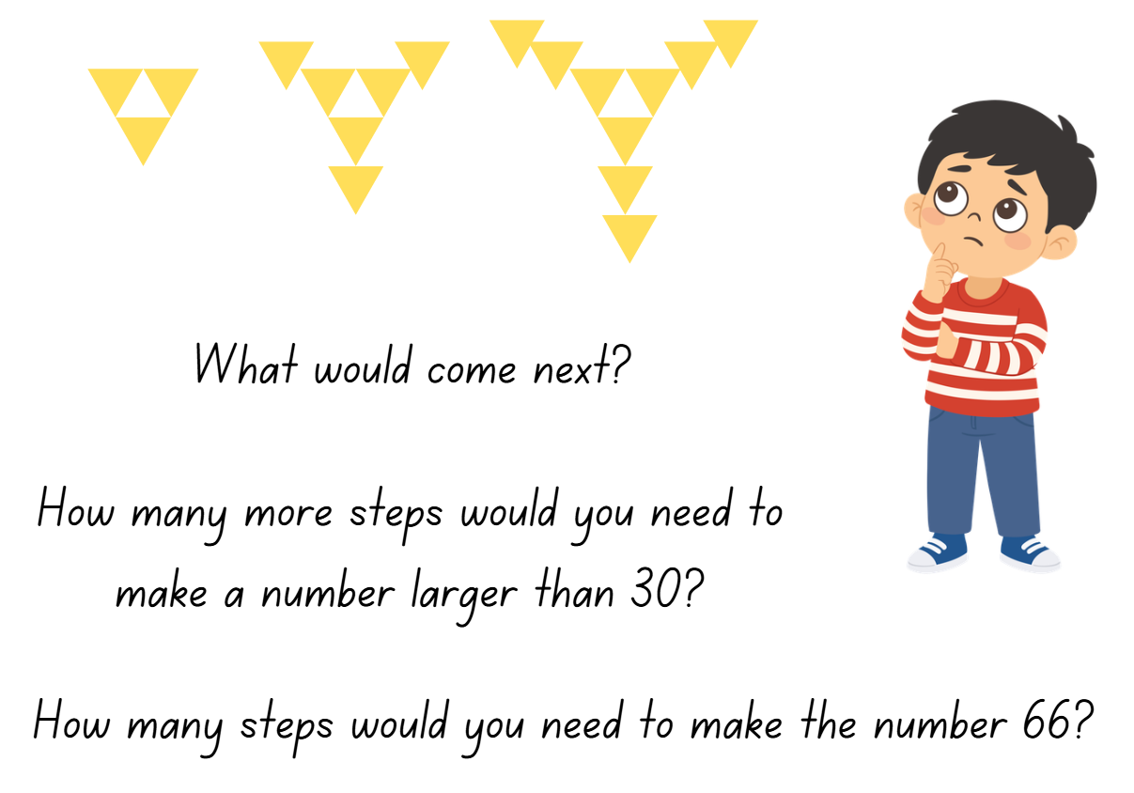
Activity 2 – continuing a pattern
Notes:
This is a developing number sense activity.
Number sense refers to a deep understanding of numbers, including their magnitude, relationships, and the effects of operations on them. It supports fluency and understanding, estimation, flexible thinking, and efficient problem-solving. Number sense activities 1–4 ‘activate’ prior number knowledge and support the learning of new content in the unit. Number sense activities 5–8 ‘loop’ back and provide opportunity for spaced practice with concepts and procedures covered in previous units.
Syllabus focus area:
Multiplicative relations A
Continuing a pattern
This resource corresponds to Resource 16 – What comes next? in Stage 2 Year A Unit 13.
Students look for a pattern. They turn and talk to a partner to describe what they can see.
Ask:
- If this is a pattern, can you describe it?
- Based on what you can see, can you predict what comes next?
Students record their ideas on individual whiteboards using diagrams, numbers and symbols.
Select students to share their ideas, providing reasoning to support their response.
Challenge students:
- If we know that the first picture is step one, how many steps will it take to make a number over 30?
- How many steps will it take to make the number 66?

Slide 20
Review of learning 3

Slide 21
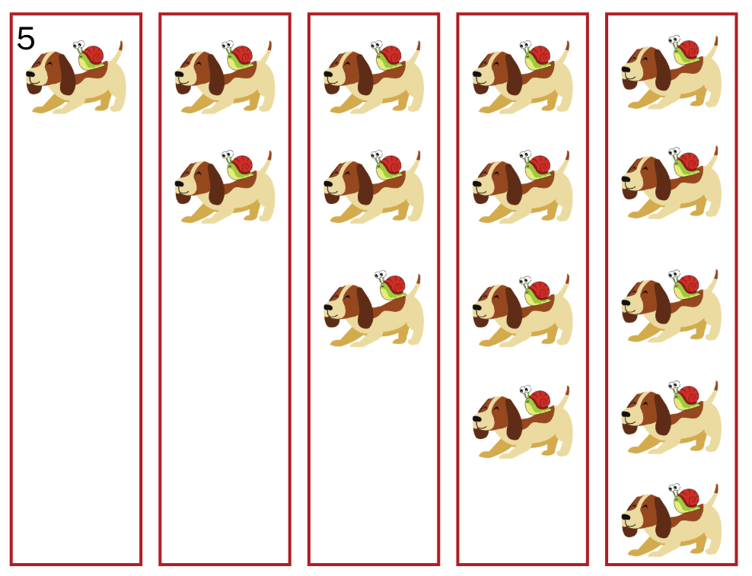
Multiple choice (2)
The pattern of multiples is…
A
5, 10, 15, 20, 25
B
5, 15, 25, 35, 45
C
5, 6, 7, 8, 9
D
1, 2, 3, 4, 5
Notes:
This question connects to the content in the developing number sense activity (Activity 3)
Syllabus focus area:
Multiplicative relations A

Slide 22
Short response (9)
Draw a 3 threes array.
Record the multiplication fact it represents.
Record the square number.
Notes:
Short response questions provide brisk paced questions focussing on review of current and previous content to support spaced and interleaved practice.
Syllabus focus area:
Multiplicative relations A

Slide 23




Short response (10)
Which of these 2D shapes do not have a line of symmetry?
A
B
C
D
Communicate your reasoning.
Notes:
Short response questions provide brisk paced questions focussing on review of current and previous content to support spaced and interleaved practice.
Syllabus focus area:
Two-dimensional spatial structure A

Slide 24
Short response (11)
Record the number
248 921
in a non-standard form.
Notes:
Short response questions provide brisk paced questions focussing on review of current and previous content to support spaced and interleaved practice.
Syllabus focus area:
Representing numbers using place value B

Slide 25
Short response (12)
Order the lengths from shortest to longest:
4 m 24 cm
1 m 92 cm
3 m 5 cm
Notes:
Short response questions provide brisk paced questions focussing on review of current and previous content to support spaced and interleaved practice.
Syllabus focus area:
Geometric measure A

Slide 26
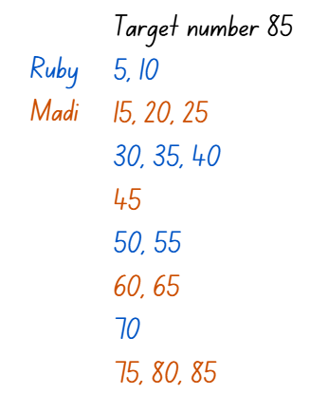
Activity 3 – target number – number patterns and multiples
Choose a target number that is a multiple of 5.
Players take turns to skip count by 5 to the next one, 2 or 3 numbers.
Record the target number and numbers counted by each player.
The player who says the target number receives a point.
Notes:
This is a developing number sense activity.
Number sense refers to a deep understanding of numbers, including their magnitude, relationships, and the effects of operations on them. It supports fluency and understanding, estimation, flexible thinking, and efficient problem-solving. Number sense activities 1–4 ‘activate’ prior number knowledge and support the learning of new content in the unit. Number sense activities 5–8 ‘loop’ back and provide opportunity for spaced practice with concepts and procedures covered in previous units.
Syllabus focus area:
Multiplicative relations A
Target number – number patterns and multiples
This activity is an adaptation of ‘Counting game (by multiples of 5)’ from Thinking mathematically resources by State of New South Wales (Department of Education).
This figure corresponds to Figure 8 – example recording of target number in Stage 2 Year A Unit 13.
In pairs, students choose a target number that is a multiple of 5.
Ask students how they know that the target number is a multiple of 5. For example, any number that ends in zero or 5 is a multiple of 5.
Explain that the object of the game is to be the person who says the target number.
Players take turns to count on by saying the next one, 2 or 3 number words in the fives sequence.
Pairs record the target number and the number words each turn. For example, see Figure 8 – example recording of target number in Stage 2 Year A Unit 13.
The player who says the target number receives a point.
Students choose a new target number and play the game again.
The game may be varied by starting at the target number and counting backwards to zero or by choosing a different multiple.
Reflect on the activity, asking questions such as:
Did you prefer going first or second? Why?
What strategy did you use? How successful was it and why?
Looking back on the games that you played, can you see any ways that one player could change their moves to win?
How could you make the game easier or harder?

Slide 27
Review of learning 4

Slide 28
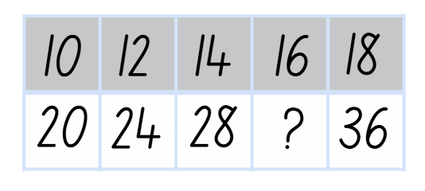
True or false (2)
The missing number in the doubles pattern is 30.
True | False
Communicate your reasoning.
Notes:
The question on this slide connects to the content being explored in the developing number sense activity (Activity 4)
Syllabus focus area:
Multiplicative relations A

Slide 29

Short response (13)
Record the rows and columns in this partially covered array?
Record the array using a number sentence.
Notes:
Short response questions provide brisk paced questions focussing on review of current and previous content to support spaced and interleaved practice.
Syllabus focus area:
Multiplicative relations A

Slide 30

Short response (14)
Which of these pictures have line/s of symmetry?
A
B
C
Communicate your reasoning.
Notes:
Short response questions provide brisk paced questions focussing on review of current and previous content to support spaced and interleaved practice.
Syllabus focus area:
Two-dimensional spatial structure A

Slide 31
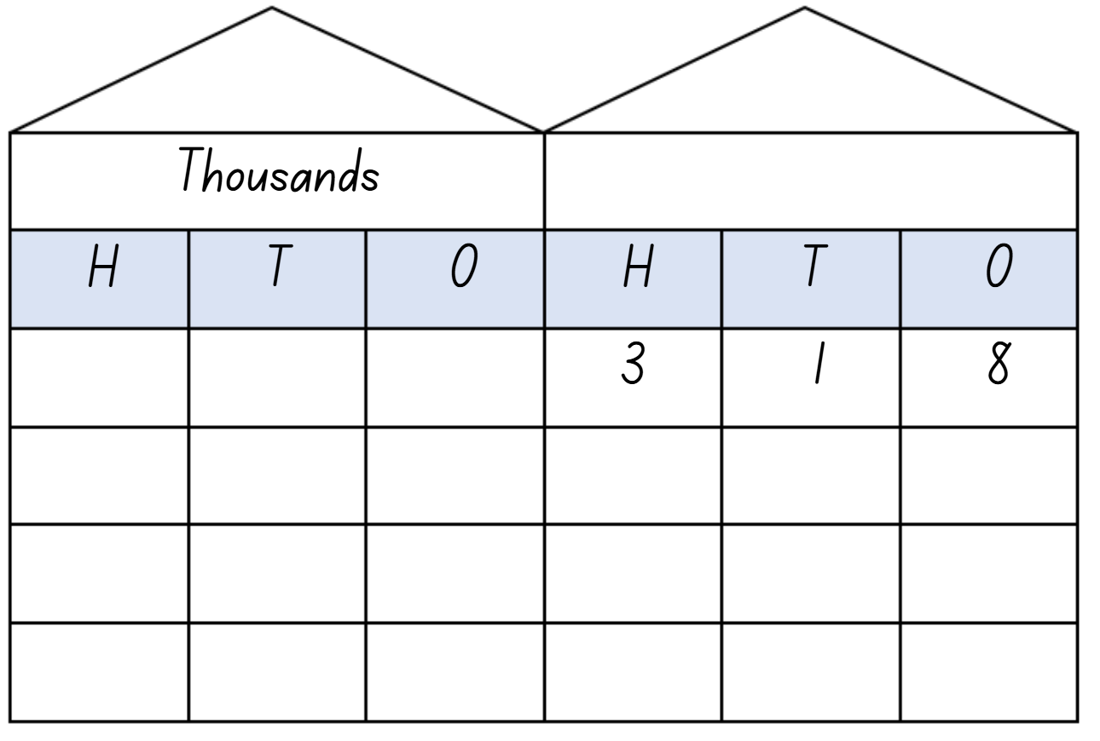
Short response (15)
Record the number 10, 100 and 1000 times larger.
Notes:
Short response questions provide brisk paced questions focussing on review of current and previous content to support spaced and interleaved practice.
Syllabus focus area:
Representing numbers using place value B

Slide 32
Short response (16)
Record how many millimetres are in 6 cm using the abbreviation for millimetres (mm).
Communicate your reasoning.
Notes:
Short response questions provide brisk paced questions focussing on review of current and previous content to support spaced and interleaved practice.
Syllabus focus area:
Geometric measure A

Slide 33
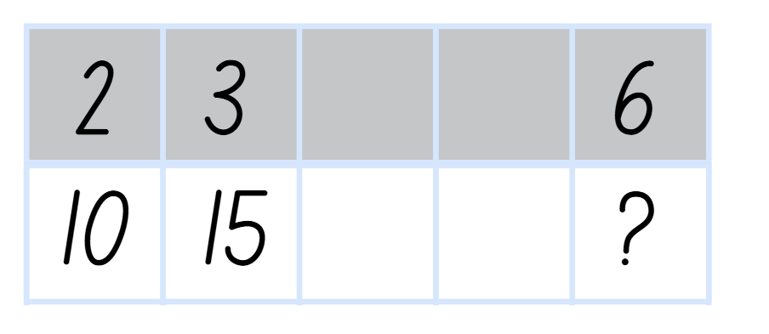
Activity 4 – patterns of multiples (1)
Notes:
This is a developing number sense activity.
Number sense refers to a deep understanding of numbers, including their magnitude, relationships, and the effects of operations on them. It supports fluency and understanding, estimation, flexible thinking, and efficient problem-solving. Number sense activities 1–4 ‘activate’ prior number knowledge and support the learning of new content in the unit. Number sense activities 5–8 ‘loop’ back and provide opportunity for spaced practice with concepts and procedures covered in previous units.
Syllabus focus area:
Multiplicative relations A
Patterns of multiples
This resource corresponds to Resource 17 – multiplicative tables in Stage 2 Year A Unit 13.
Ask:
What is the multiplicative relationship between the number pairs?
What number would be in the place of the question mark? How did you work it out?
What other number pairs belong in the table? (next slide)
Provide students with Resource 17 – multiplicative tables.
Students turn and talk to determine the multiplicative relationship between the number pairs in the remaining tables.
Students complete each table.
Regroup and share responses. Ask:
- What is the multiplicative relationship between the number pairs in the remaining tables?
- Which numbers did you add to the tables?
- What other number pairs belong to each table? Justify your response.
- Can the numbers 33, 45, 57 be added to the bottom row of the second table? Why or why not?

Slide 34
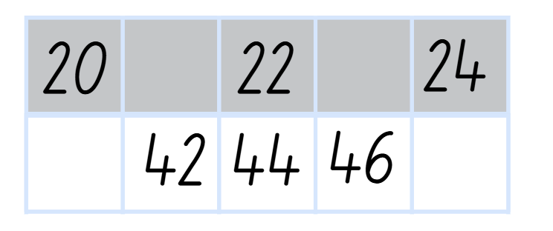
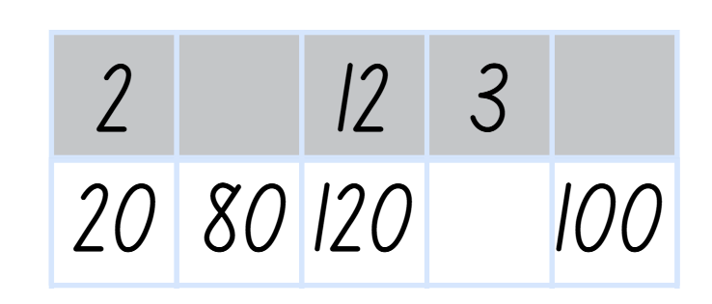
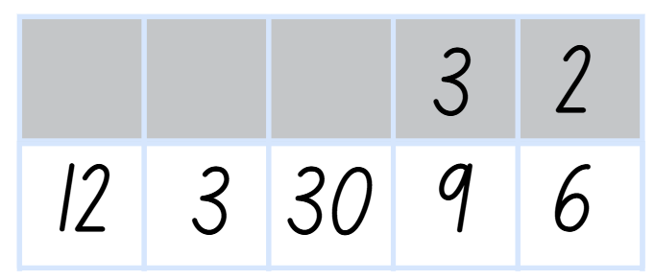
Activity 4 – patterns of multiples (2)
Notes:
This is a developing number sense activity.
Number sense refers to a deep understanding of numbers, including their magnitude, relationships, and the effects of operations on them. It supports fluency and understanding, estimation, flexible thinking, and efficient problem-solving. Number sense activities 1–4 ‘activate’ prior number knowledge and support the learning of new content in the unit. Number sense activities 5–8 ‘loop’ back and provide opportunity for spaced practice with concepts and procedures covered in previous units.
Syllabus focus area:
Multiplicative relations A
Patterns of multiples
This resource corresponds to Resource 17 – multiplicative tables in Stage 2 Year A Unit 13.
Provide students with Resource 17 – multiplicative tables.
Students turn and talk to determine the multiplicative relationship between the number pairs in the remaining tables.
Students complete each table.
Regroup and share responses. Ask:
What is the multiplicative relationship between the number pairs in the remaining tables?
Which numbers did you add to the tables?
What other number pairs belong to each table? Justify your response.

Slide 35
Review of learning 5

Slide 36
Multiple choice (3)
What is the largest number that can be made by arranging the digits 7, 3, 9 and 2?
A
B
C
D
9723
9237
9327
9732
Communicate your reasoning.
Notes:
This question connects to the content in the developing number sense activity (Activity 5)
Syllabus focus area:
Representing numbers using place value B

Slide 37
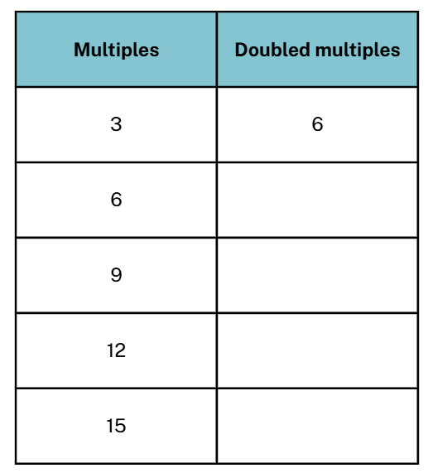
Short response (17)
Multiples of 6 are double the multiples of 3.
Record the missing multiples of 6.
?
?
?
?
Notes:
Short response questions provide brisk paced questions focussing on review of current and previous content to support spaced and interleaved practice.
Syllabus focus area:
Multiplicative relations B

Slide 38
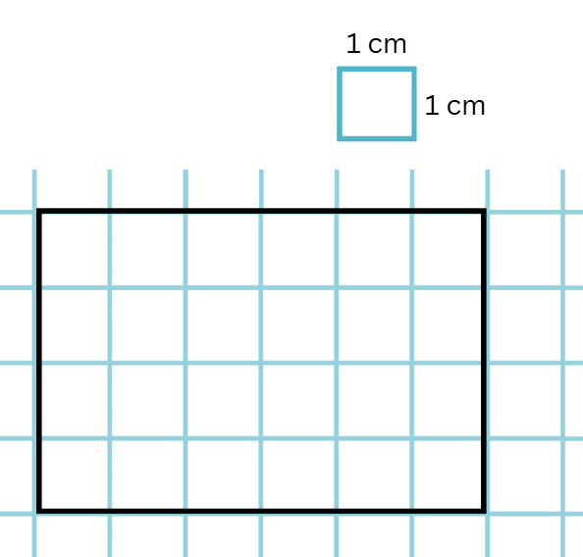
Short response (18)
Record the length and width of the rectangle in centimetres.
Record the area of the rectangle in square centimetres.
Notes:
Short response questions provide brisk paced questions focussing on review of current and previous content to support spaced and interleaved practice.
Syllabus focus area:
Two-dimensional spatial structure A

Slide 39
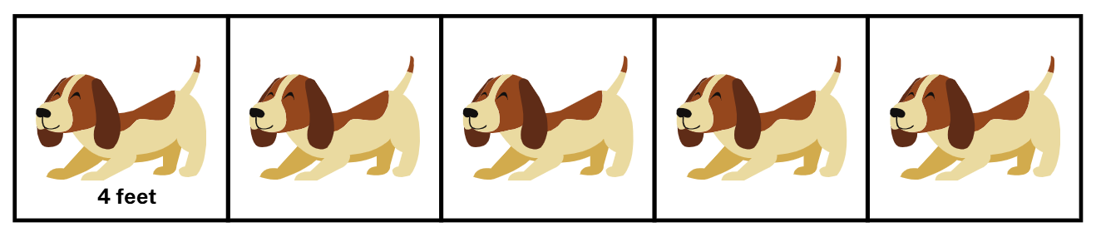
Short response (19)
Record the multiples for this pattern of feet.
Continue the pattern and record the next
3 multiples.
Notes:
Short response questions provide brisk paced questions focussing on review of current and previous content to support spaced and interleaved practice.
Syllabus focus area:
Multiplicative relations A

Slide 40
Short response (20)
Record the missing word.
The ___________ of a shape is the length around the outside, or boundary, of a shape.
Notes:
Short response questions provide brisk paced questions focussing on review of current and previous content to support spaced and interleaved practice.
Syllabus focus area:
Geometric measure B

Slide 41
Activity 5 – rearranging digits and ordering numbers
3 8 5 0
Notes:
This is a developing number sense activity.
Number sense refers to a deep understanding of numbers, including their magnitude, relationships, and the effects of operations on them. It supports fluency and understanding, estimation, flexible thinking, and efficient problem-solving. Number sense activities 1–4 ‘activate’ prior number knowledge and support the learning of new content in the unit. Number sense activities 5–8 ‘loop’ back and provide opportunity for spaced practice with concepts and procedures covered in previous units.
Syllabus focus area:
Representing numbers using place value B
Rearranging digits and ordering numbers
Prompt students to use the digits to create a 4-digit number. Students record their number on an individual whiteboard.
Select students to share their numbers and record them on the board.
Discuss how the placement of the digits changes the size of the number.
Prompt students to rearrange the digits to record the largest possible number.
Ask:
How did you decide where to place each digit?
Which digit did you place in the thousands place? Why?
What strategy helped you make the largest possible number?
Prompt students to rearrange the digits to record the smallest possible number. Repeat the questions from step 6.
Prompt students to record a number:
between 3000 and 4000
larger than 8000
smaller than 6000
with the 0 digit in the hundreds place.
Select students to share, providing feedback on whether the responses fit the relevant criteria.
Instruct students to arrange all their recorded numbers in ascending order.
Students turn and talk to justify the ordering of their numbers.

Slide 42
Review of learning 6

Slide 43
True or false (3)
These numbers are in descending order.
6890
7213
8654
True | False
Notes:
The question on this slide connects to the content being explored in the developing number sense activity (Activity 6)
Syllabus focus area:
Representing numbers using place value B

Slide 44
Short response (21)
a) 3 x 4 = 12, so 6 x 4 = ?
b) 6 x 8 = 48, so 48 ÷ 6 = ?
c) 4 x 5 = 20, so 8 x 5 = ?
d) 10 x 8 = 80, so 9 x 8 = ?
Notes:
Note: This slide has been designed to be viewed in presentation mode.
Short response questions provide brisk paced questions focussing on review of current and previous content to support spaced and interleaved practice.
Syllabus focus area:
Multiplicative relations B

Slide 45
Short response (22)
Explain why a formal unit larger than a square centimetre is needed.
Notes:
Short response questions provide brisk paced questions focussing on review of current and previous content to support spaced and interleaved practice.
Syllabus focus area:
Two-dimensional spatial structure A

Slide 46

Short response (23)
Record the related facts for these arrays.
____ × ____ =
____ × ____ =
____ ÷ ____ =
____ ÷ ____ =
Notes:
Short response questions provide brisk paced questions focussing on review of current and previous content to support spaced and interleaved practice.
Syllabus focus area:
Multiplicative relations A

Slide 47
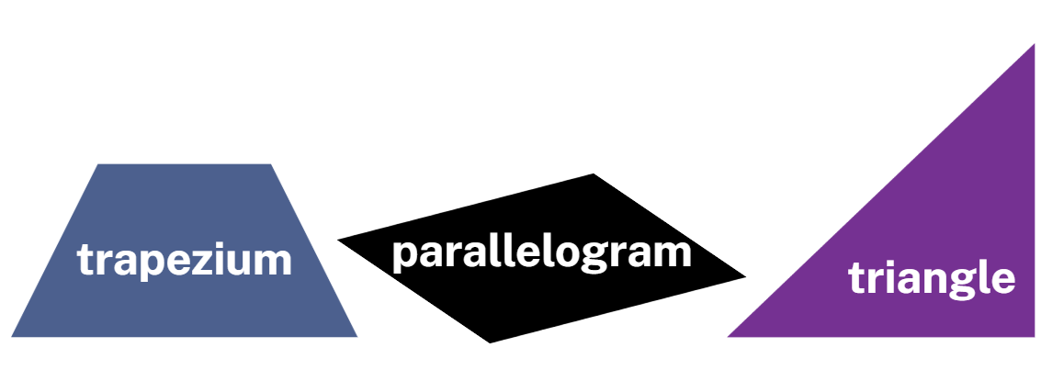
Short response (24)
Sort these 2D shapes into 2 groups:
shapes with a right angle
shapes without a right angle.
Notes:
Short response questions provide brisk paced questions focussing on review of current and previous content to support spaced and interleaved practice.
Syllabus focus area:
Two-dimensional spatial structure A

Slide 48
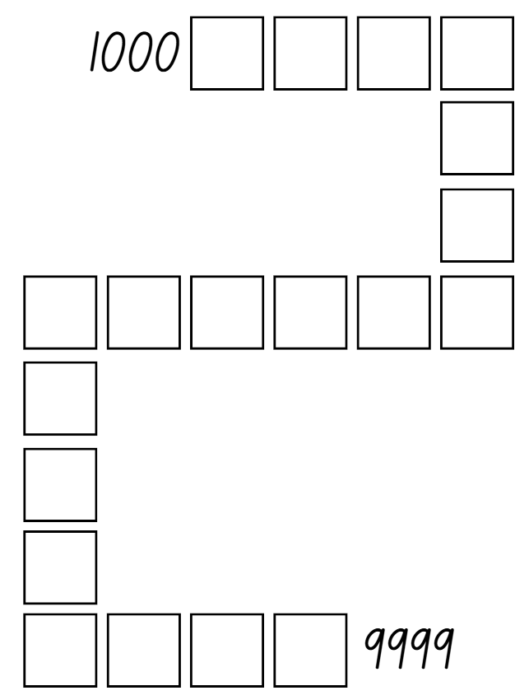
Activity 6 – place value game
Notes:
This is a developing number sense activity.
Number sense refers to a deep understanding of numbers, including their magnitude, relationships, and the effects of operations on them. It supports fluency and understanding, estimation, flexible thinking, and efficient problem-solving. Number sense activities 1–4 ‘activate’ prior number knowledge and support the learning of new content in the unit. Number sense activities 5–8 ‘loop’ back and provide opportunity for spaced practice with concepts and procedures covered in previous units.
Syllabus focus area:
Representing numbers using place value B
Place value game
This resource corresponds to Resource 18 – place value game in Stage 2 Year A Unit 13.
Explain the aim of the game is to position 4-digit numbers in sequence on the gameboard.
Provide pairs with four 10-sided dice and Resource 18 – place value game.
Students roll the dice and create a 4-digit number. For example, 4, 6, 9 and zero could be recorded as 4609, 6490 or 9604. Players record their chosen number in the most appropriate position between 100 and 9999
If numbers cannot be placed, students miss their turn. Play continues until all boxes are filled.
Note: the game can also be played as whole class. Use dice that have a zero as it is important to understand that the zero is a placeholder and does not have a value. Using a reusable sleeve for the gameboard will allow students to play multiple games.

Slide 49
Review of learning 7

Slide 50
Multiple choice (4)
Which set of numbers are in ascending order?
A
5677, 6755, 5766
B
6111, 7111, 1671
C
8888, 9888, 9999
D
2456, 5642, 4562
Notes:
This question connects to the content in the developing number sense activity (Activity 7)
Syllabus focus area:
Representing numbers using place value B

Slide 51

Short response (25)
How can you split this array to help you answer 6 × 7?
Record the number sentence to match the split array.
Notes:
Short response questions provide brisk paced questions focussing on review of current and previous content to support spaced and interleaved practice.
Syllabus focus area:
Multiplicative relations B

Slide 52
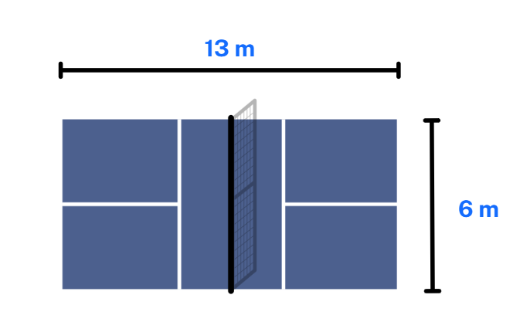
Short response (26)
Record the area of the pickleball court using numerals and words.
Notes:
Short response questions provide brisk paced questions focussing on review of current and previous content to support spaced and interleaved practice.
Syllabus focus area:
Two-dimensional spatial structure A

Slide 53
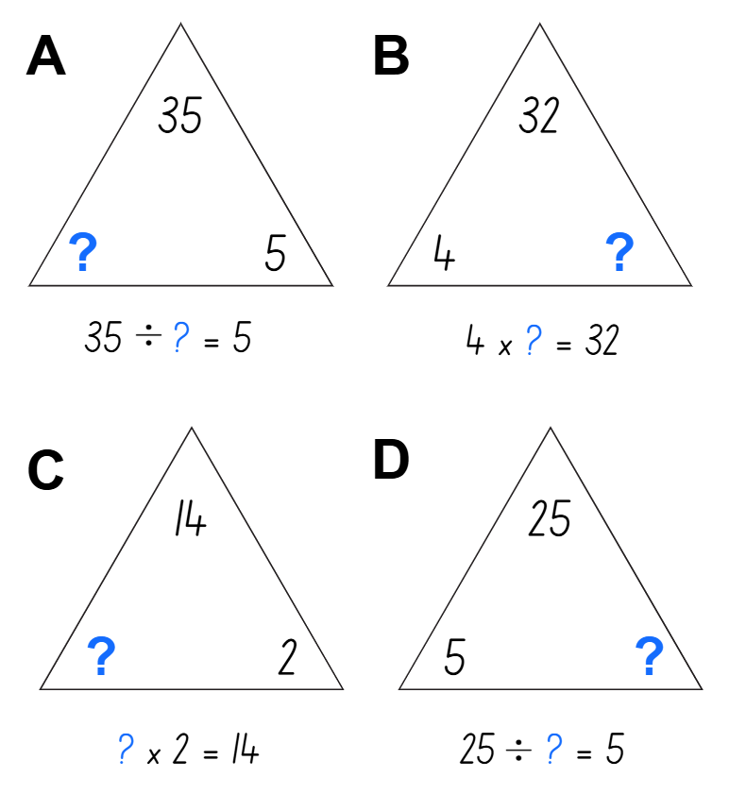
Short response (27)
Identify the missing numbers in the fact family triangles.
Complete the number sentences.
Notes:
Short response questions provide brisk paced questions focussing on review of current and previous content to support spaced and interleaved practice.
Syllabus focus area:
Multiplicative relations B

Slide 54
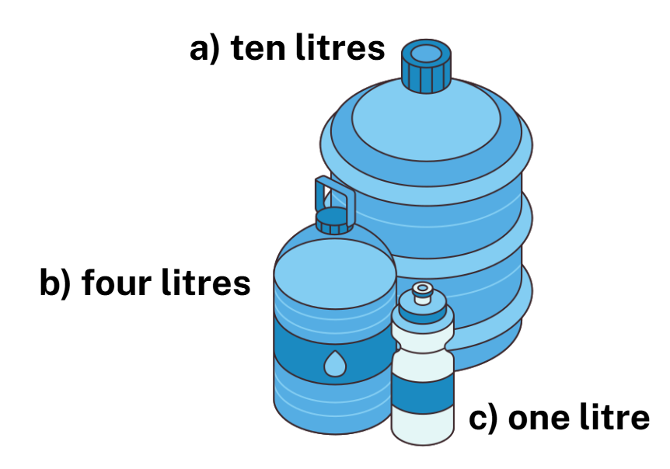
Short response (28)
Record the capacities of these containers using the abbreviation for litres.
Notes:
Short response questions provide brisk paced questions focussing on review of current and previous content to support spaced and interleaved practice.
Syllabus focus area:
Three-dimensional spatial structure A

Slide 55
Activity 7 – hat trick – arranging digits to order in the thousands
Team A
5285
8250
9134
9556
5000
6000
7000
8000
9000
10 000
5682
6497
6932
7845
Team B
Team B wins
Notes:
Note: this slide is designed to be viewed in presentation mode.
This is a developing number sense activity.
Number sense refers to a deep understanding of numbers, including their magnitude, relationships, and the effects of operations on them. It supports fluency and understanding, estimation, flexible thinking, and efficient problem-solving. Number sense activities 1–4 ‘activate’ prior number knowledge and support the learning of new content in the unit. Number sense activities 5–8 ‘loop’ back and provide opportunity for spaced practice with concepts and procedures covered in previous units.
Syllabus focus area:
Representing numbers using place value B
Hat trick – arranging digits to order in the thousands
This image corresponds to Figure 10 – hat trick example in Stage 2 Year A Unit 13.
This activity is an adaptation of ‘Double hat-trick‘ by James Russo.
Separate the class into two teams.
Draw a 5000 - 10 000 number line with thousands marked at equal intervals on the board (see Figure 10 – hat trick example in Stage 2 Year A Unit 13).
Explain that the goal of the game is for a team to place four of their numbers in a row on the number-line without the other team interrupting their sequence.
Select a representative from Team A to roll four 10-sided dice.
Team A discuss how to arrange the digits to form a 4-digit numbers. Team A place the number above the number line.
Team B repeats the above steps but places the number below the number line.
Play continue until one team gets 4 numbers in a row and wins the game.

Slide 56
Review of learning 8

Slide 57
True or false (4)
I can rearrange the digits in 7821 to make a larger number.
True | False
Communicate your reasoning.
Notes:
The question on this slide connects to the content being explored in the developing number sense activity (Activity 8)
Syllabus focus area:
Representing numbers using place value B

Slide 58
Short response (29)
Complete the number sentences by recording the missing numbers:
8 × ___ = 32
___ × 7 = 42
63 ÷ ___ = 9
Notes:
Short response questions provide brisk paced questions focussing on review of current and previous content to support spaced and interleaved practice.
Syllabus focus area:
Multiplicative relations B

Slide 59
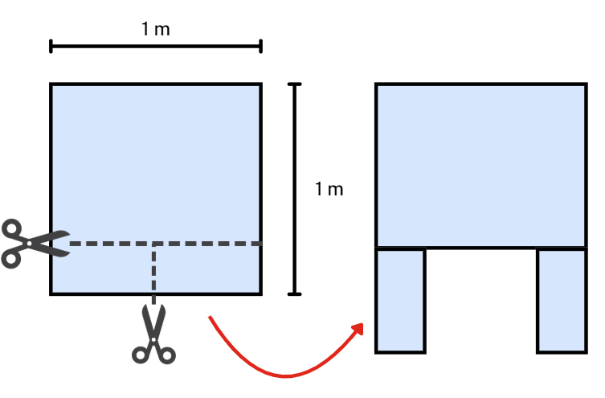
Short response (30)
Is a square metre always a square?
Does it always have side lengths of 1 metre?
Communicate your reasoning.
Notes:
Short response questions provide brisk paced questions focussing on review of current and previous content to support spaced and interleaved practice.
Syllabus focus area:
Two-dimensional spatial structure A

Slide 60
Short response (31)
Record the solutions to the multiplication and division facts.
4 x 2 =
6 x 4 =
16 ÷ 2 =
28 ÷ 4 =
Notes:
Short response questions provide brisk paced questions focussing on review of current and previous content to support spaced and interleaved practice.
Syllabus focus area:
Multiplicative relations A

Slide 61
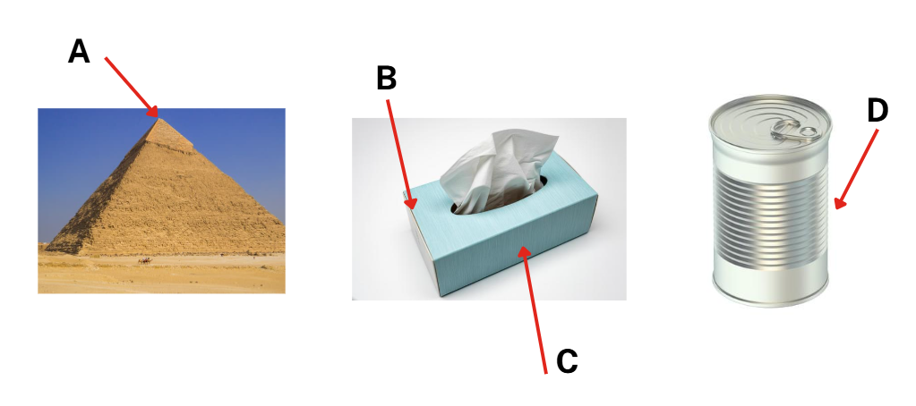
Short response (32)
Name these features of the prism, pyramid and cylinder.
Notes:
Short response questions provide brisk paced questions focussing on review of current and previous content to support spaced and interleaved practice.
Syllabus focus area:
Three-dimensional spatial structure B

Slide 62
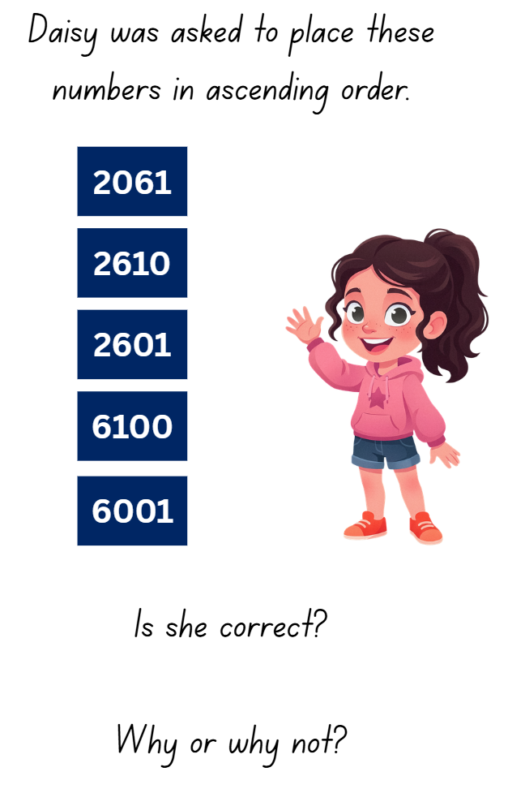
Activity 8 – ordering numbers misconception
Notes:
This is a developing number sense activity.
Number sense refers to a deep understanding of numbers, including their magnitude, relationships, and the effects of operations on them. It supports fluency and understanding, estimation, flexible thinking, and efficient problem-solving. Number sense activities 1–4 ‘activate’ prior number knowledge and support the learning of new content in the unit. Number sense activities 5–8 ‘loop’ back and provide opportunity for spaced practice with concepts and procedures covered in previous units.
Syllabus focus area:
Representing numbers using place value B
Ordering numbers misconception
This resource corresponds to Resource 19 – ordering numbers misconception in Stage 2 Year A Unit 13.
Explain to students that Daisy has been given 6 numbers to order. She was asked to place them in ascending order.
Ask students:
Has Daisy placed the numbers in the correct order? Why or why not?
What misconceptions has Daisy made?
Students correctly place the numbers in ascending order and explain their thinking.
Discuss: What was similar or different to your order, compared to Daisy’s order?

Slide 63
Double Venn diagram
Object 1
Object 2
Features similar to both objects
Features of object 1
Features of object 2

Slide 64
Frayer
Definition
Facts/Characteristics
Word, term, concept
Examples
Non-examples

Slide 65
Spider map
Idea
Subject

Slide 66
Cline
Concept 1
Concept 2
Word
Word
Word
Word
Word
Word
Word
Word
Word
Word
Word

Slide 67
Compare and contrast

Slide 68
Multiple choice (5)
A
B
C
D

Slide 69
Multiple choice
A
B
C
D
Notes:
This question connects to the content in the developing number sense activity (Activity 3)
Syllabus focus area:
[Focus area A/B]

Slide 70
References (1)
This presentation contains NSW Curriculum and syllabus content. The NSW Curriculum is developed by the NSW Education Standards Authority. This content is prepared by NESA for and on behalf of the Crown in the right of the State of New South Wales. The material is protected by Crown copyright.
Please refer to the NESA Copyright Disclaimer for more information https://educationstandards.nsw.edu.au/wps/portal/nesa/mini-footer/copyright.
NESA holds the only official and up-to-date versions of the NSW Curriculum and syllabus documents. Please visit the NSW Education Standards Authority (NESA) website https://educationstandards.nsw.edu.au/wps/portal/nesa/home and the NSW Curriculum website https://curriculum.nsw.edu.au.
Mathematics K–10 Syllabus © NSW Education Standards Authority (NESA) for and on behalf of the Crown in right of the State of New South Wales, 2022.
National Numeracy Learning Progression © Australian Curriculum, Assessment and Reporting Authority (ACARA) 2010 to present, unless otherwise indicated. This material was downloaded from the Australian Curriculum website (National Numeracy Learning Progression) (accessed 9 April 2026) and was not modified.
Kaplinsky R (n.d.) ‘Multiply and Divide Within A Hundred 1’, Grade 3, Open Middle website, accessed 9 April 2026.
Joshua A (2008) Enrich-E-Matics: Book 3, 3rd edn, Pearson, United States.
Russo J (2018) ‘Get your game on: Double hat-trick’, Prime number, 33(3):5.

Slide 71
References (2)
This presentation contains NSW Curriculum and syllabus content. The NSW Curriculum is developed by the NSW Education Standards Authority. This content is prepared by NESA for and on behalf of the Crown in the right of the State of New South Wales. The material is protected by Crown copyright.
Please refer to the NESA Copyright Disclaimer for more information https://educationstandards.nsw.edu.au/wps/portal/nesa/mini-footer/copyright.
NESA holds the only official and up-to-date versions of the NSW Curriculum and syllabus documents. Please visit the NSW Education Standards Authority (NESA) website https://educationstandards.nsw.edu.au/wps/portal/nesa/home and the NSW Curriculum website https://curriculum.nsw.edu.au.
Siemon D, Warren E, Beswick K, Faragher R, Miller J, Horne M, Jazby D, Breed M, Clark J and Brady K (2021) Teaching Mathematics: Foundations to Middle Years, 3rd edn, Oxford University Press Australia and New Zealand.
State of New South Wales (Department of Education) (2024) ‘Counting game (by multiples of 5)’, Thinking mathematically resources, NSW Department of Education website, accessed 17 April 2026.
Van de Walle J, Karp K, Bay-Williams JM, Brass A, Bentley B, Ferguson S, Goff W, Livy S, Marshman M, Martin D, Pearn C, Prodromou T, Symons D and Wilkie K (2019) Primary and Middle Years Mathematics: Teaching Developmentally, 1st Australian edn, Pearson Education Australia, Melbourne.

Slide 72
Copyright
© State of New South Wales (Department of Education), 2025
The copyright material published in this resource is subject to the Copyright Act 1968 (Cth) and is owned by the NSW Department of Education or, where indicated, by a party other than the NSW Department of Education (third-party material).
Copyright material available in this resource and owned by the NSW Department of Education is licensed under a Creative Commons Attribution 4.0 International (CC BY 4.0) license.
This license allows you to share and adapt the material for any purpose, even commercially.
Attribution should be given to © State of New South Wales (Department of Education), 2025.
Material in this resource not available under a Creative Commons license:
the NSW Department of Education logo, other logos and trademark-protected material
Material owned by a third party that has been reproduced with permission. You will need to obtain permission from the third party to reuse its material.
Links to third-party material and websites
Please note that the provided (reading/viewing material/list/links/texts) are a suggestion only and implies no endorsement, by the New South Wales Department of Education, of any author, publisher, or book title. School principals and teachers are best placed to assess the suitability of resources that would complement the curriculum and reflect the needs and interests of their students.
If you use the links provided in this document to access a third party’s website, you acknowledge that the terms of use, including licence terms set out on the third-party’s website apply to the use which may be made of the materials on that third-party website or where permitted by the Copyright Act 1968 (Cth). The department accepts no responsibility for content on third-party websites.

