Slide 1
Instructions for use
This resource aligns to the learning in Stage 2 Year A Unit 14 and revisits content from earlier sample units.
Classroom teachers are encouraged to add and adapt slides as required to meet the needs of their students.
Save a copy of the file to make changes to the slide deck. Go to File > Download a Copy (this downloads a copy to the computer to edit in the PowerPoint app).
To convert the PowerPoint to Google Slides:
  Upload the file into Google Drive and open it.
  Go to File > Save as Google Slides.
  (Note – conversion may cause formatting changes in the slides.)

Slide 2

Review of Learning
Mathematics Stage 2 – Unit 14
Notes:
Reviews may include a combination of question types, requiring students to recall facts and key ideas, as well as apply their knowledge to solve problems and answer questions. To support active engagement, a mix of techniques should be employed.” (AERO, 2024).
This Review of Learning slide deck revisits key concepts from the following units:
Stage 2 Year A Unit 14
Stage 2 Year A Unit 13
Stage 2 Year A Unit 12
It also includes opportunities to review prior learning in non-number content, supporting consolidation across focus areas.
The review of learning resources include three key task types that support the development of mathematical proficiency through retrieval, spaced practice, and active participation. These practices complement the review phase (activating prior knowledge) embedded within the beginning of each lesson.
1.
Multiple-choice questions/True or false: Designed to promote active retrieval of key concepts and identify common misconceptions in number, supporting consolidation, understanding and fluency.
These questions:
support spaced and interleaved practice
help identify and address common misconceptions
support active recall and immediate feedback
support whole class participation
identify areas requiring reteach
2.
Short-response question sets: Carefully grouped questions that encourage spaced and interleaved practice across multiple focus areas, helping students revisit and apply knowledge from different points in time.
These questions:
have a combination of question types
address a range of focus areas
build automaticity and fluency
support active recall
allow for immediate feedback
identify content requiring reteach
3.
Developing number sense activities: A variety of practical, purposeful tasks that reinforce current learning and build on prior knowledge. These activities promote reasoning, problem-solving and conceptual understanding.
The review of learning resources are designed to work support teaching and learning in mathematics. For the most effective implementation, use the resources flexibly, adapting to meet student learning needs and individual classroom contexts.

Slide 3
Lessons
1
Review of learning 1
5
Review of learning 5
2
Review of learning 2
6
Review of learning 6
3
Review of learning 3
7
Review of learning 7
4
Review of learning 4
8
Review of learning 8
Notes:
Teacher notes:
Click lesson titles to go to specific lessons
Interactive features can be viewed in slide show

Slide 4
Review of learning 1

Slide 5

Multiple choice (1)
Which number is 10 times as large as 9?
A
B
C
D
900
90
909
99
Communicate your reasoning.
Notes:
This question connects to the content in the developing number sense activity (Activity 1)
Syllabus focus area:
Representing numbers using place value B

Slide 6

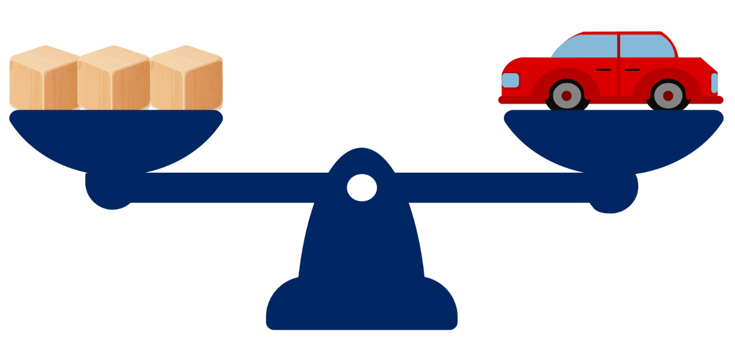
Short response (1)
A toy car balances with 3 blocks on an equal-arm balance.
How many blocks would balance 2 toy cars? Communicate your reasoning.
Notes:
Short response questions provide brisk paced questions focussing on review of current and previous content to support spaced and interleaved practice.
Syllabus focus area:
Non-spatial measure B (Stage 1)

Slide 7
Short response (2)
Is 176 an odd or even number?
Communicate your reasoning.
Notes:
Short response questions provide brisk paced questions focussing on review of current and previous content to support spaced and interleaved practice.
Syllabus focus area:
Multiplicative relations A

Slide 8

Short response (3)
Which of the following two-dimensional shapes are quadrilaterals?
A
B
C
E
D
triangle
parallelogram
pentagon
rhombus
trapezium
Notes:
Short response questions provide brisk paced questions focussing on review of current and previous content to support spaced and interleaved practice.
Syllabus focus area:
Two-dimensional spatial structure A

Slide 9
Short response (4)
The spinner is spun 3 times.
List all possible outcomes of this chance experiment.
Notes:
Short response questions provide brisk paced questions focussing on review of current and previous content to support spaced and interleaved practice.
Syllabus focus area:
Chance A

Slide 10

Activity 1 – 10 times as large
 | Number rolled | × 10 | × 100 | × 1000
Example | 6 | 60 | 600 | 6000
Roll 1
Roll 2
Roll 3
Roll 4
Roll 5
Notes:
This is a developing number sense activity.
Number sense refers to a deep understanding of numbers, including their magnitude, relationships, and the effects of operations on them. It supports fluency and understanding, estimation, flexible thinking, and efficient problem-solving. Number sense activities 1–4 ‘activate’ prior number knowledge and support the learning of new content in the unit. Number sense activities 5–8 ‘loop’ back and provide opportunity for spaced practice with concepts and procedures covered in previous units.
Syllabus focus area:
Representing numbers using place value B
10 times as large
This resource corresponds to Resource 15 – 10 times larger in Stage 2 Year A Unit 14.
1. Provide students with Resource 15 – 10 times larger and a 9-sided dice.
2. Students roll the dice and record the number rolled. Students then record the numbers that are 10, 100 and 1000 times larger than the number rolled.
3. Students repeat 4 more times and identify the number of tens, hundreds or thousands in the number.
4. Students create a reflection in their workbooks how making the number 10, 100 or 1000 times as large changes the place value of the digits.

Slide 11
Review of learning 2

Slide 12
True or false (1)
850 is 100 times as large as 85.
True | False
Communicate your reasoning.
Notes:
The question on this slide connects to the content being explored in the developing number sense activity (Activity 2)
Syllabus focus area:
Representing numbers using place value B

Slide 13

Short response (5)
Record the objects that have a mass of about 1 kg.
Communicate your reasoning.
D
A
C
B
bag of sugar
pencil
bag of flour
school chair
Notes:
Short response questions provide brisk paced questions focussing on review of current and previous content to support spaced and interleaved practice.
Syllabus focus area:
Non-spatial measure A

Slide 14
Short response (6)
Draw an array to show that 9 is a square number.
Record a number sentence to match the array.
Notes:
Short response questions provide brisk paced questions focussing on review of current and previous content to support spaced and interleaved practice.
Syllabus focus area:
Multiplicative relations A

Slide 15
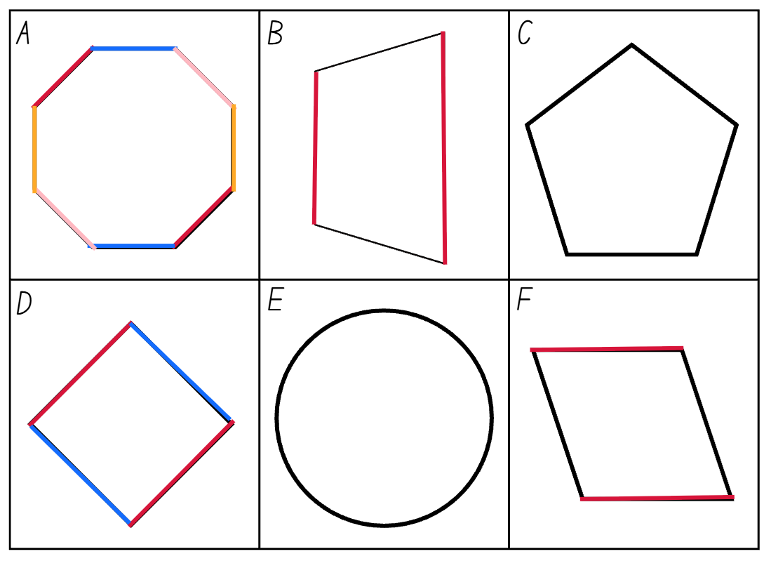
Short response (7)
Hannah was asked to identify the parallel sides of each two-dimensional shape by marking them with different colours for each set.
Which of these shapes did Hannah accurately identify all sets of parallel lines?
Communicate your reasoning.
Notes:
Short response questions provide brisk paced questions focussing on review of current and previous content to support spaced and interleaved practice.
Syllabus focus area:
Two-dimensional spatial structure A

Slide 16
Short response (8)
A six-sided dice is rolled twice.
List all possible outcomes of this chance experiment.
Notes:
Short response questions provide brisk paced questions focussing on review of current and previous content to support spaced and interleaved practice.
Syllabus focus area:
Chance A

Slide 17

Activity 2 – 100 times as large
Place value chart
https://toytheater.com/place-value-chart/
Notes:
This is a developing number sense activity.
Number sense refers to a deep understanding of numbers, including their magnitude, relationships, and the effects of operations on them. It supports fluency and understanding, estimation, flexible thinking, and efficient problem-solving. Number sense activities 1–4 ‘activate’ prior number knowledge and support the learning of new content in the unit. Number sense activities 5–8 ‘loop’ back and provide opportunity for spaced practice with concepts and procedures covered in previous units.
Syllabus focus area:
Representing numbers using place value B
100 times as large
1. Display the interactive place value chart and use the digit cards to make a single digit number, such as 7. Ask:
What number would be 10 times larger?
What number would be 100 times larger?
What number would be 1000 times larger?
What happened to the place value of the digit 7 as you made it 10, 100 and 1000 times bigger?
2. Now display a 2-digit number, such as 65, and repeat the process. Ensure students are naming the number correctly as the place value changes for each digit. Select students to state how many tens, hundreds and thousands there are. For example, 65 has 6 tens and 5 ones or 65 ones. 6500 has 65 hundreds or 6 thousands and 5 hundreds or 6500 ones.
3. Provide students with individual whiteboards and display a new 2-digit number and ask students to record the number that is 10, 100 and 100 times larger.
4. As a class, name the place value for each of the digits, stating how many ones, tens, hundreds and thousands there are.

Slide 18
Review of learning 3

Slide 19
Multiple choice (2)
Which number is 1000 times as large as 127.
A
B
C
D
1027
1207
1270
1007
Communicate your reasoning.
Notes:
This question connects to the content in the developing number sense activity (Activity 3)
Syllabus focus area:
Representing numbers using place value B

Slide 20
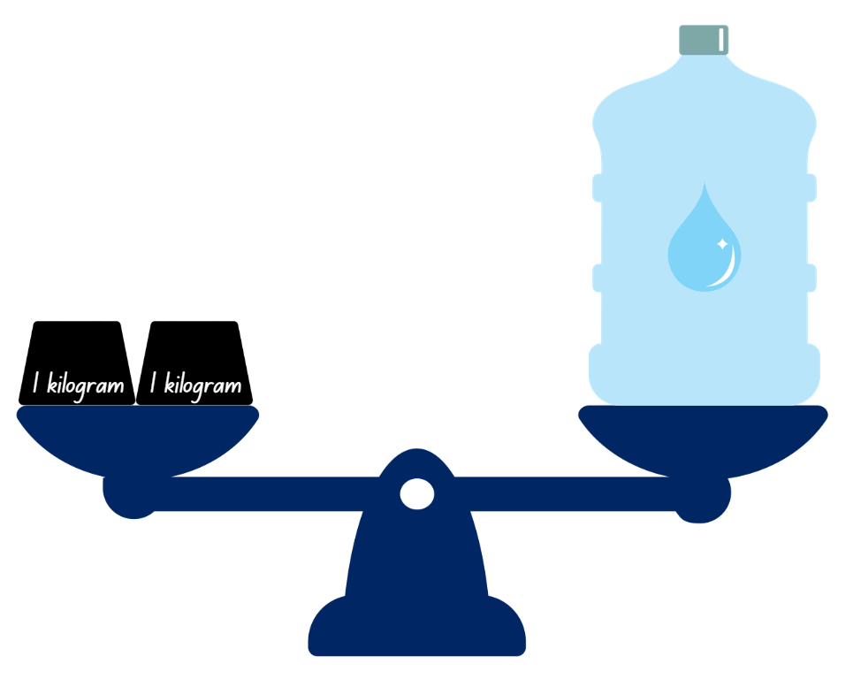

Short response (9)
Record the masses of the objects using the abbreviation for kilograms (kg).
A
B
books
water bottle
Notes:
Short response questions provide brisk paced questions focussing on review of current and previous content to support spaced and interleaved practice.
Syllabus focus area:
Non-spatial measure A

Slide 21

Short response (10)
Find the total of the partially covered array.
Notes:
Short response questions provide brisk paced questions focussing on review of current and previous content to support spaced and interleaved practice.
Syllabus focus area:
Multiplicative relations A

Slide 22





Short response (11)
Identify the quadrilaterals that do and do not have lines of symmetry.
C
E
A
B
D
parallelogram
trapezium
rhombus
square
rectangle
Notes:
Short response questions provide brisk paced questions focussing on review of current and previous content to support spaced and interleaved practice.
Syllabus focus area:
Two-dimensional spatial structure A

Slide 23
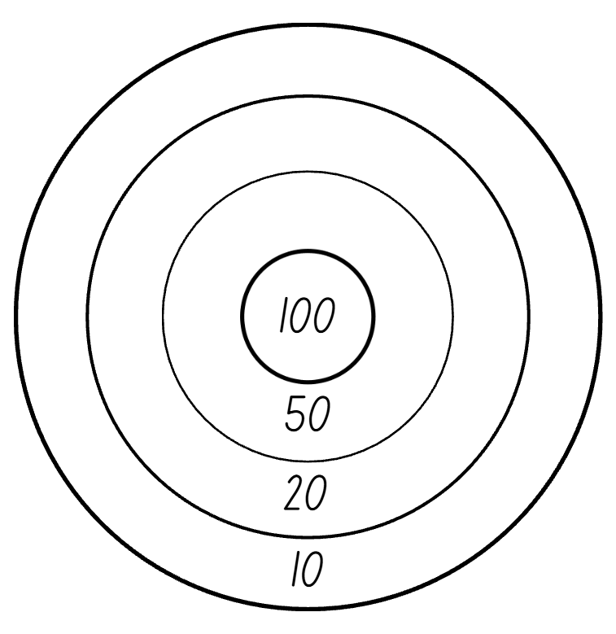
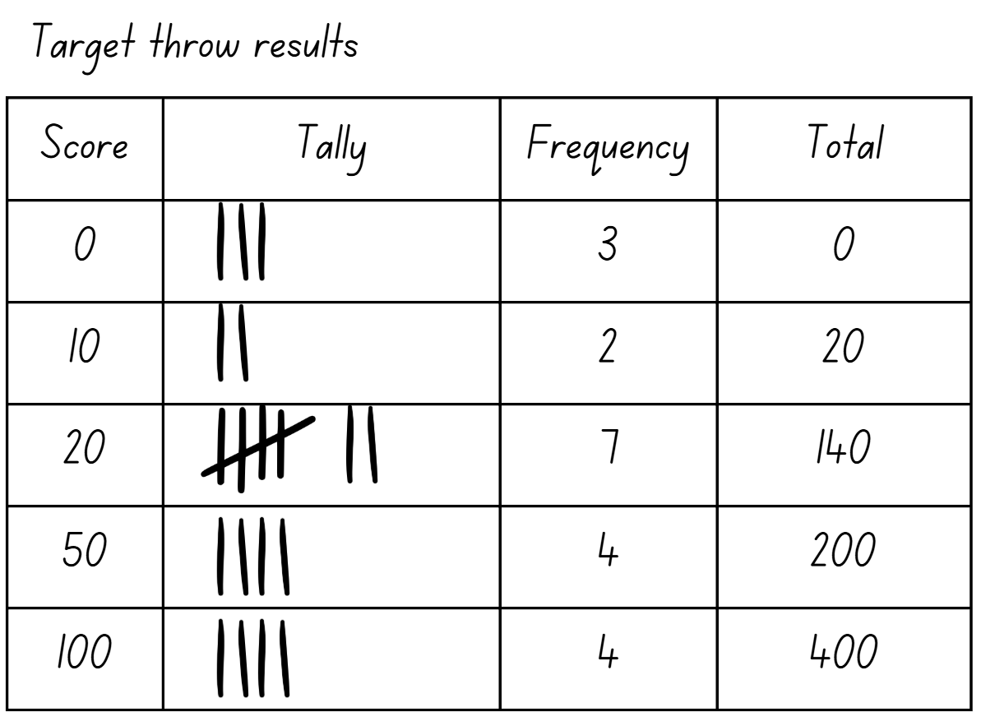
Short response (12)
A Year 2 class collected data on throws students made on a target. Use the tally table to answer the following:
Which score was most common?
Which score was least common?
How many total tosses were recorded?
Notes:
Short response questions provide brisk paced questions focussing on review of current and previous content to support spaced and interleaved practice.
Syllabus focus area:
Data A

Slide 24
Activity 3 – 1000 times as large
248
Place value chart
https://toytheater.com/place-value-chart/
Notes:
This is a developing number sense activity.
Number sense refers to a deep understanding of numbers, including their magnitude, relationships, and the effects of operations on them. It supports fluency and understanding, estimation, flexible thinking, and efficient problem-solving. Number sense activities 1–4 ‘activate’ prior number knowledge and support the learning of new content in the unit. Number sense activities 5–8 ‘loop’ back and provide opportunity for spaced practice with concepts and procedures covered in previous units.
Syllabus focus area:
Representing numbers using place value B
1000 times as large
1. Ask students to estimate the number that is 1000 times as large, without calculating.
2. Ask:
Will the answer be closer to 200 000 or 300 000? How do you know?
3. Reveal the answer, 248 000, and show how each digit shifts 3 places to the left on the interactive place value chart. Emphasise that the digits stay the same, but their value changes.
4. Provide students with a 9-sided dice. Students roll the dice to create a 3- or 4-digit number and:
record the number
make the number 1000 times as large
record how many ones, tens, hundreds and thousands are in the new number.
5. Students select one example and write or explain:
what happened to each digit
why the number became 1000 times larger.
6. Ask students to share their explanations. For example, ‘The 2 moved from the hundreds place to the hundred-thousands place’.

Slide 25
Review of learning 4

Slide 26
True or false (2)
This table has been accurately filled in.
Number rolled | × 10 | × 100 | × 1000
842 | 8420 | 84 200 | 842 000
True | False
Communicate your reasoning.
Notes:
The question on this slide connects to the content being explored in the developing number sense activity (Activity 4)
Syllabus focus area:
Representing numbers using place value B

Slide 27
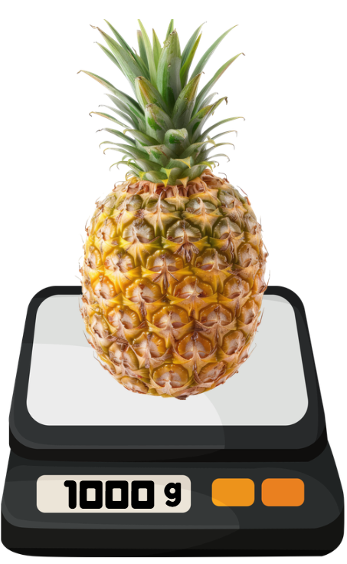
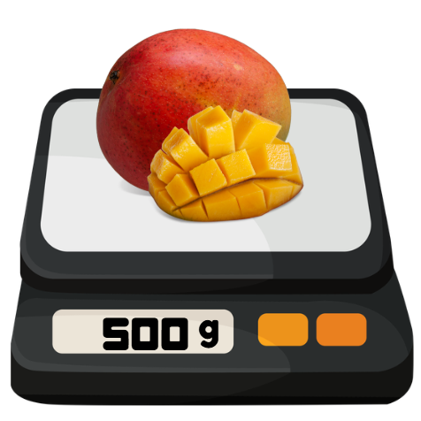
Short response (13)
Record the fruit that has the mass:
equal to half of one kilogram
equal to one kilogram.
A
B
Notes:
Short response questions provide brisk paced questions focussing on review of current and previous content to support spaced and interleaved practice.
Syllabus focus area:
Non-spatial measure B

Slide 28
Short response (14)
Pattern A: 4, 8, 12, 16
Pattern B: 8, 16, 24, 32
What is the relationship between these patterns?
Communicate your reasoning.
Notes:
Short response questions provide brisk paced questions focussing on review of current and previous content to support spaced and interleaved practice.
Syllabus focus area:
Multiplicative relations B

Slide 29
Short response (15)
Which of these letters have:
one line of symmetry
2 or more lines of symmetry
no lines of symmetry
O
E
N
Notes:
Short response questions provide brisk paced questions focussing on review of current and previous content to support spaced and interleaved practice.
Syllabus focus area:
Two-dimensional spatial structure A

Slide 30
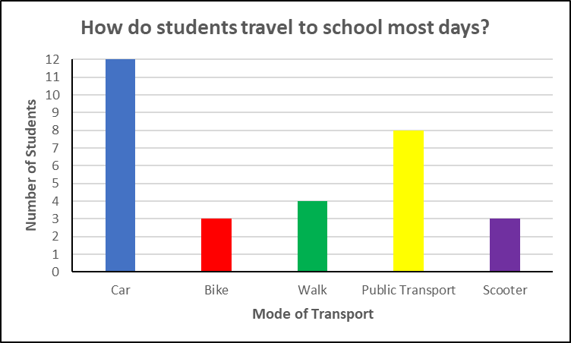
Short response (16)
Eric collected data in a column graph on how students in his class travel to school.
Name the x-axis
Name the y-axis
Choose an appropriate title.
Notes:
Short response questions provide brisk paced questions focussing on review of current and previous content to support spaced and interleaved practice.
Syllabus focus area:
Data A

Slide 31
Activity 4 – place value challenge
Place value chart
https://toytheater.com/place-value-chart/
Notes:
This is a developing number sense activity.
Number sense refers to a deep understanding of numbers, including their magnitude, relationships, and the effects of operations on them. It supports fluency and understanding, estimation, flexible thinking, and efficient problem-solving. Number sense activities 1–4 ‘activate’ prior number knowledge and support the learning of new content in the unit. Number sense activities 5–8 ‘loop’ back and provide opportunity for spaced practice with concepts and procedures covered in previous units.
Syllabus focus area:
Representing numbers using place value B
Place value challenge
1. In pairs, students use a digital device and the interactive place value chart to play ‘Place value challenge’.
Player 1 creates a 2-digit number and gives the digital device to Player 2 who makes the number that is 10 times larger and correctly names the number.
Player 2 then returns the digital device and Player 1, who makes the number that is 100 times larger than the first number, naming the number.
Player 2 makes the number that is 1000 times larger, naming the number.
The next round, Player 2 begins the game by creating a new 2-digit number.
2. After a few rounds, instruct students to start with a 3-digit number and then a 4-digit number.

Slide 32
Review of learning 5

Slide 33
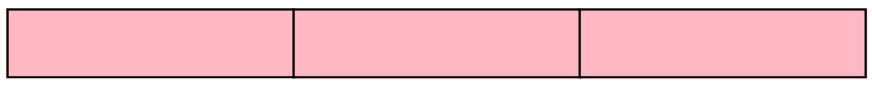
Multiple choice (3)
Which representation shows a third of a length?
A
B
C
D
Communicate your reasoning.
Notes:
This question connects to the content in the developing number sense activity (Activity 5)
Syllabus focus area:
Partitioned fractions A

Slide 34
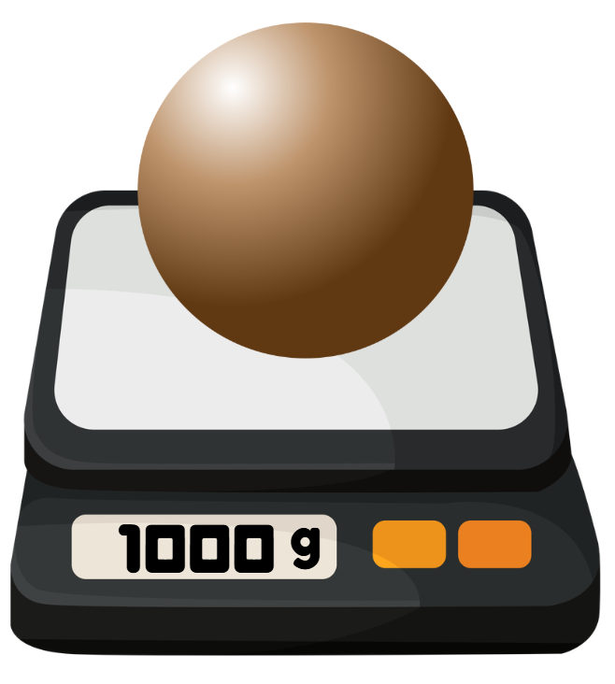
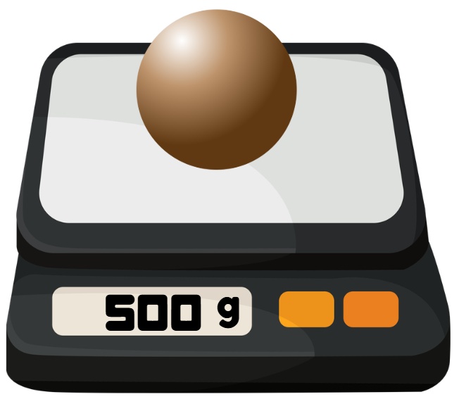
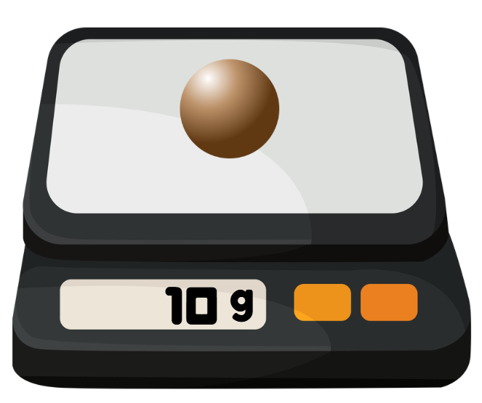
Short response (17)
Record the mass of the clay balls on each digital scale in grams (g) and/or kilograms (kg).
A.
B.
C.
Notes:
Short response questions provide brisk paced questions focussing on review of current and previous content to support spaced and interleaved practice.
Syllabus focus area:
Non-spatial measure B

Slide 35
Short response (18)
If 4 × 5 = 20, what is 8 × 5?
Communicate your reasoning.
Notes:
Short response questions provide brisk paced questions focussing on review of current and previous content to support spaced and interleaved practice.
Syllabus focus area:
Multiplicative relations B

Slide 36
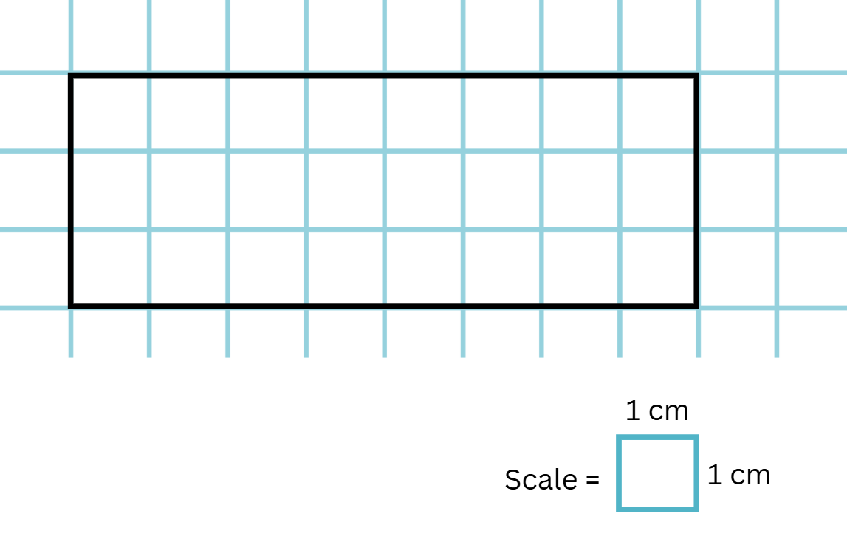
Short response (19)
Record the area of the rectangle in square centimetres using both numerals and words.
Notes:
Short response questions provide brisk paced questions focussing on review of current and previous content to support spaced and interleaved practice.
Syllabus focus area:
Two-dimensional spatial structure A

Slide 37
Short response (20)
Match the time to the nearest 5-minute mark on an analog clock:
4:19 is about…
2:43 is about…
7:48 is about…
10:28 is about…
20 past 4
10 to 8
half-past 10
quarter-to 3
Notes:
Short response questions provide brisk paced questions focussing on review of current and previous content to support spaced and interleaved practice.
Syllabus focus area:
Non-spatial measure A

Slide 38

Activity 5 – making thirds
0
$$\frac{1}{2}$$
1
Notes:
This is a developing number sense activity.
Number sense refers to a deep understanding of numbers, including their magnitude, relationships, and the effects of operations on them. It supports fluency and understanding, estimation, flexible thinking, and efficient problem-solving. Number sense activities 1–4 ‘activate’ prior number knowledge and support the learning of new content in the unit. Number sense activities 5–8 ‘loop’ back and provide opportunity for spaced practice with concepts and procedures covered in previous units.
Syllabus focus area:
Partitioned fractions A
Making thirds
This activity is an adaption of the Thirding strategy from Siemon et al. (2021).
1. Provide students with a fraction strip and writing materials.
2. Revise a half and that 2 halves make a whole.
3. As a class, discuss strategies to make thirds and where the one third would be placed on the number line. Ask if one third is more or less than half and how students know.
4. Use the fraction strip to make folds and explain the thirding strategy to students as follows:
Estimate half on the fraction strip.
Estimate a third as something less than half, leaving room for 2 more equal parts.
Halve the remaining part, making 3 equal parts in total.
8. Students draw a number line representing their fraction strip with thirds marked.
9. Select students to share and explain their strategies and as a class label the number line with thirds.
10. As a class count aloud one third, two thirds, three thirds is one whole.

Slide 39
Review of learning 6

Slide 40

True or false (3)
The red shading in this representation shows one fifth of the length of the fraction strip.
True | False
Communicate your reasoning.
Notes:
The question on this slide connects to the content being explored in the developing number sense activity (Activity 6)
Syllabus focus area:
Partitioned fractions A

Slide 41
Short response (21)
Order the following lengths from
shortest to longest:
1 m 45 cm
2 m 11 cm
1 m 54 cm
Notes:
Short response questions provide brisk paced questions focussing on review of current and previous content to support spaced and interleaved practice.
Syllabus focus area:
Geometric measure A

Slide 42

Short response (22)
Write a number sentences to match the partitioned array.
Notes:
Short response questions provide brisk paced questions focussing on review of current and previous content to support spaced and interleaved practice.
Syllabus focus area:
Multiplicative relations B

Slide 43
Short response (23)
Josh wants to measure the area of the classroom floor using square centimetres.
a) Explain why square centimetres are not a suitable unit.
b) Which unit would be more appropriate?
Notes:
Short response questions provide brisk paced questions focussing on review of current and previous content to support spaced and interleaved practice.
Syllabus focus area:
Two-dimensional spatial structure A

Slide 44
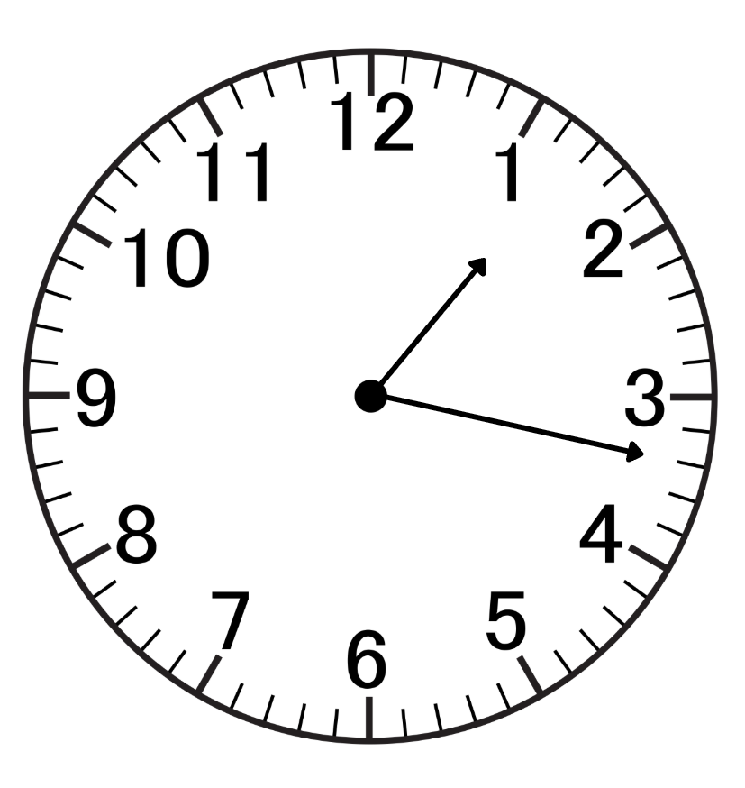
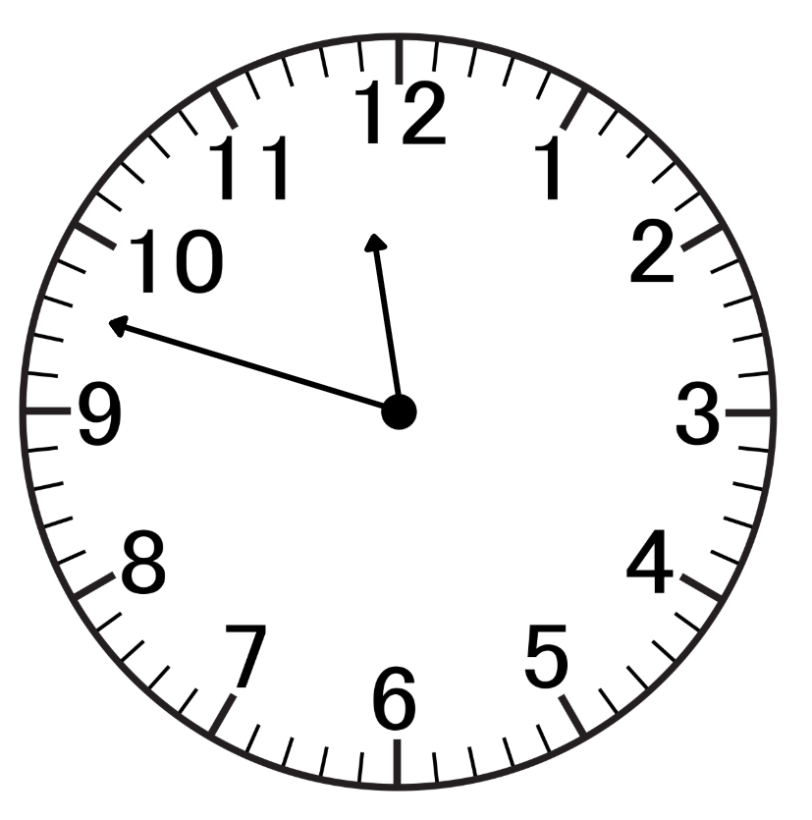
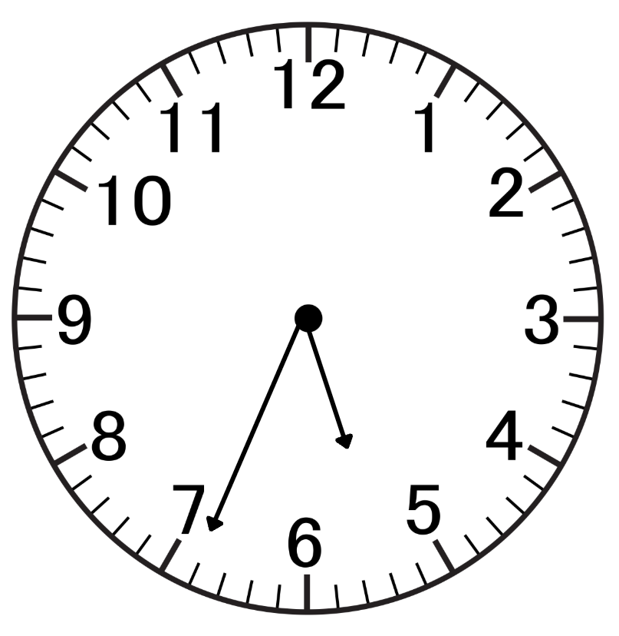
Short response (24)
Record the analog clock times to the minute.
A.
B.
C.
Notes:
Short response questions provide brisk paced questions focussing on review of current and previous content to support spaced and interleaved practice.
Syllabus focus area:
Non-spatial measure A

Slide 45
Activity 6 – creating fifths
0
$$\frac{1}{2}$$
1
Notes:
This is a developing number sense activity.
Number sense refers to a deep understanding of numbers, including their magnitude, relationships, and the effects of operations on them. It supports fluency and understanding, estimation, flexible thinking, and efficient problem-solving. Number sense activities 1–4 ‘activate’ prior number knowledge and support the learning of new content in the unit. Number sense activities 5–8 ‘loop’ back and provide opportunity for spaced practice with concepts and procedures covered in previous units.
Syllabus focus area:
Partitioned fractions A
Creating fifths
This activity is an adaption of the Fifthing strategy from Siemon et al (2021).
1. Provide students with a fraction strip and writing materials. Revise the strategies for identifying thirds in Activity 5.
2. Students fold the fraction strip to show thirds, using the halfway point as a reference.
3. Ask students to consider how they could show fifths on their fraction strip. Ask:
Would a fifth be larger or smaller than a third? How do you know?
Would a fifth be larger or smaller than a quarter? How do you know?
How can you use quarters on your fraction strip to find fifths?
4. Explain the fifthing strategy to students. Have students:
Estimate half, then estimate one quarter.
Estimate one fifth as something slightly less than one quarter.
As 4 more equal parts are needed ... halve and halve again the remaining part.
Fold to create 5 equal parts in total.
5. After folding and checking for 5 equal fifths, students draw a number line that represents their folded fraction strip. They label the parts of the number line to show one fifth, two fifths, three fifths, four fifths, five fifths or one whole.
6. Select students to share their strategies. As a class count aloud one fifth, two fifths, three fifths, four fifths, five fifths is one whole.

Slide 46
Review of learning 7

Slide 47




Multiple choice (4)
Which representation shows a fifth of a length?
A
B
C
D
Communicate your reasoning.
Notes:
This question connects to the content in the developing number sense activity (Activity 7)
Syllabus focus area:
Partitioned fractions A

Slide 48
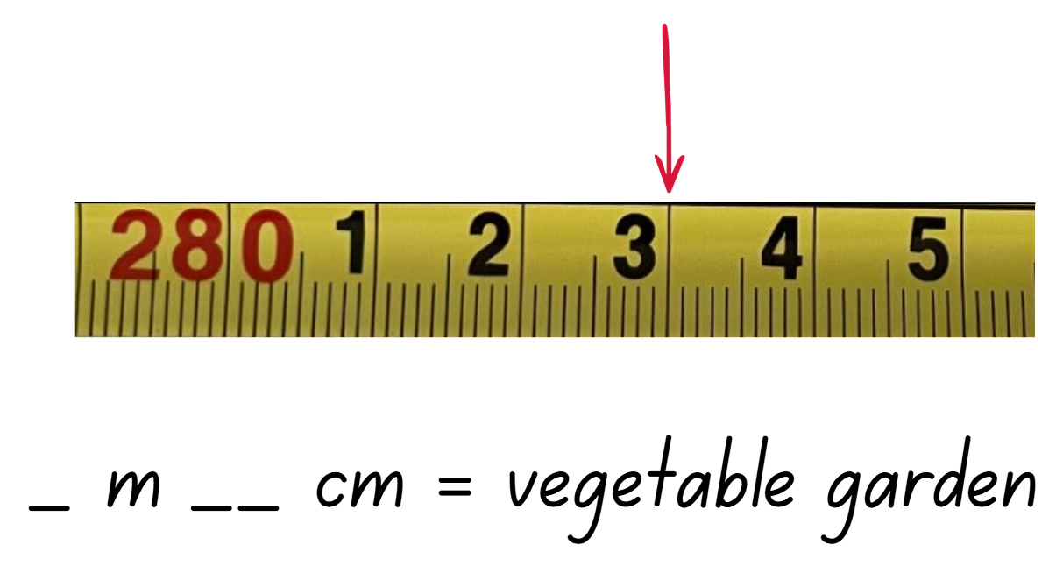
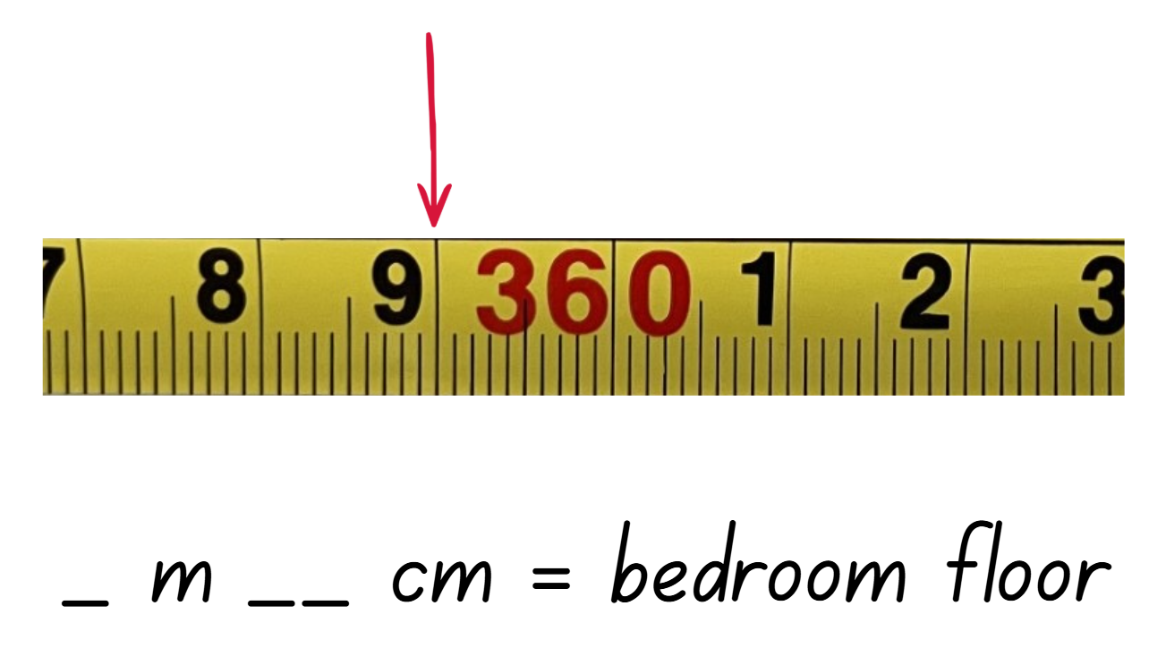
Short response (25)
Shane used a tape measure to measure the length of his vegetable garden and the length of his bedroom.
Record the measurements taken, indicated by the red arrow:
A.
B.
Notes:
Short response questions provide brisk paced questions focussing on review of current and previous content to support spaced and interleaved practice.
Syllabus focus area:
Geometric measure B

Slide 49
Short response (26)
Determine the missing number:
7 × 4 = 2 × __
Notes:
Short response questions provide brisk paced questions focussing on review of current and previous content to support spaced and interleaved practice.
Syllabus focus area:
Multiplicative relations B

Slide 50
Short response (27)
Calculate the area of the rectangle.
Record your answer using numerals and words.
6 metres
4 metres
Notes:
Short response questions provide brisk paced questions focussing on review of current and previous content to support spaced and interleaved practice.
Syllabus focus area:
Two-dimensional spatial structure A

Slide 51
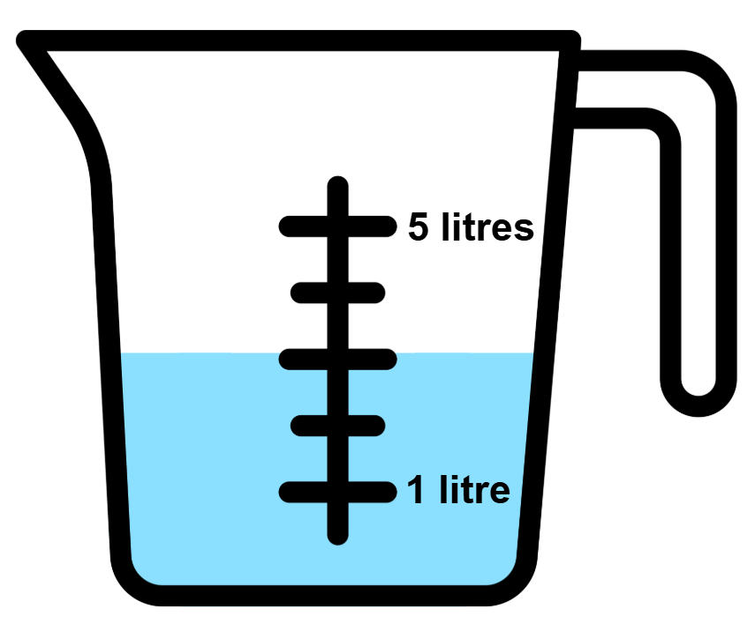
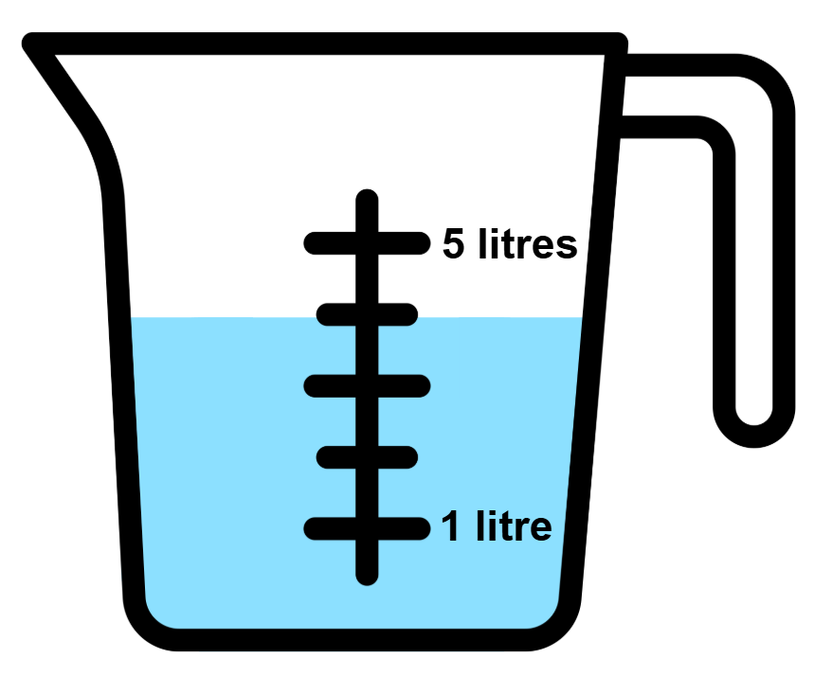
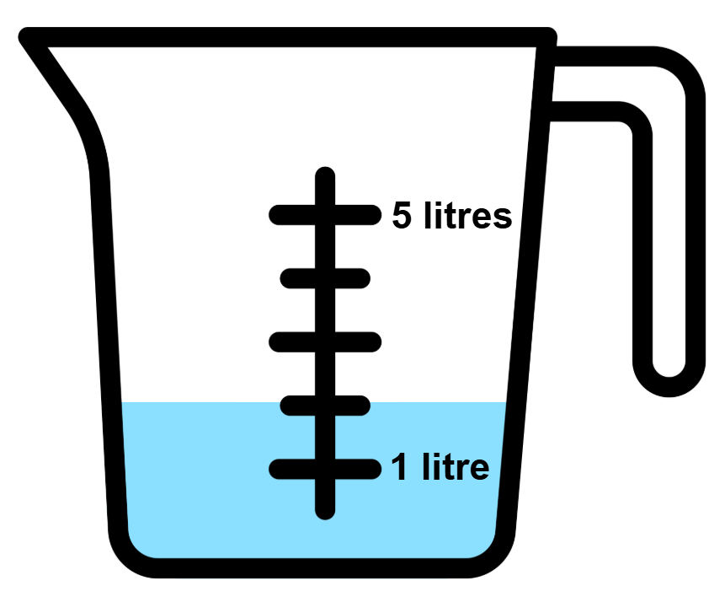
Short response (28)
Record the capacities using the abbreviation for litres (L).
A.
B.
C.
Notes:
Short response questions provide brisk paced questions focussing on review of current and previous content to support spaced and interleaved practice.
Syllabus focus area:
Three-dimensional spatial structure A

Slide 52
Activity 7 – thirds and fifths
0
1
0
1
Notes:
This is a developing number sense activity.
Number sense refers to a deep understanding of numbers, including their magnitude, relationships, and the effects of operations on them. It supports fluency and understanding, estimation, flexible thinking, and efficient problem-solving. Number sense activities 1–4 ‘activate’ prior number knowledge and support the learning of new content in the unit. Number sense activities 5–8 ‘loop’ back and provide opportunity for spaced practice with concepts and procedures covered in previous units.
Syllabus focus area:
Partitioned fractions A
Thirds and fifths
1. Provide students with 2 identical fraction strips and writing materials.
2. Ask students to:
use one strip to show thirds
use the second strip to show fifths.
3. Students draw 2 number lines to represent their fraction strips and label the parts accurately.
4. Ask students to compare the 2 number lines and discuss:
Which fractional parts are larger: thirds or fifths?
How can you tell by looking at the strips and number lines?
5. Ask:
Is one third closer to zero or one than one fifth?
Is two fifths more or less than half? How do you know?
6. Ask students to justify their thinking. For example, position on the number line, relative size.

Slide 53
Review of learning 8

Slide 54

True or false (4)
The blue shading in this representation shows a fifth of the length of the fraction strip.
True | False
Communicate your reasoning.
Notes:
The question on this slide connects to the content being explored in the developing number sense activity (Activity 8)
Syllabus focus area:
Partitioned fractions A

Slide 55
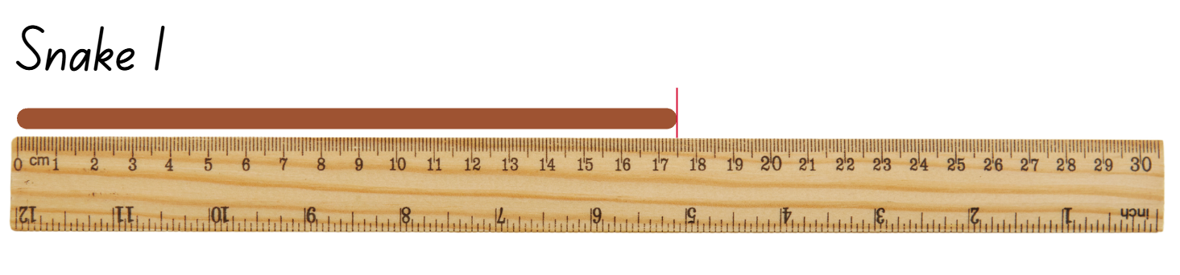
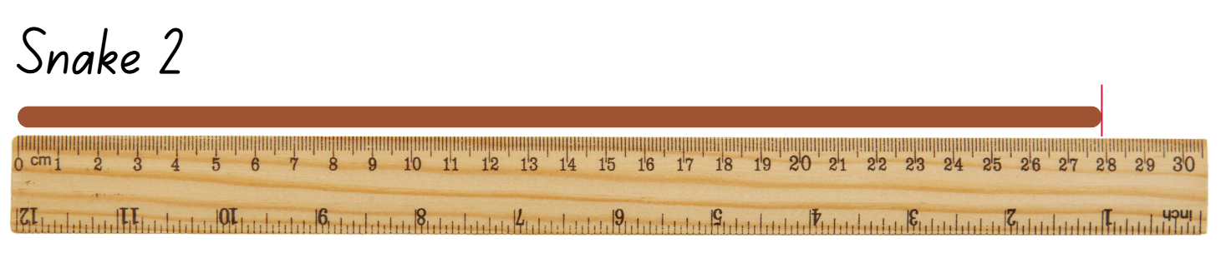
Short response (29)
Record the lengths of the clay snakes using the abbreviation for millimetres (mm).
Notes:
Short response questions provide brisk paced questions focussing on review of current and previous content to support spaced and interleaved practice.
Syllabus focus area:
Geometric measure A

Slide 56
Short response (30)
Record a number sentence to solve:
Mandy bakes some cookies. There are 5 cookies on each tray. She fills 7 trays.
How many cookies did Mandy bake?
Notes:
Short response questions provide brisk paced questions focussing on review of current and previous content to support spaced and interleaved practice.
Syllabus focus area:
Multiplicative relations B

Slide 57
Short response (31)
A square metre is cut into 2 pieces and rearranged to make a new shape that is not a square. The pieces are placed together with no gaps or overlaps.
Does the new shape still have an area of one square metre?
Communicate your reasoning.
Notes:
Short response questions provide brisk paced questions focussing on review of current and previous content to support spaced and interleaved practice.
Syllabus focus area:
Two-dimensional spatial structure A

Slide 58
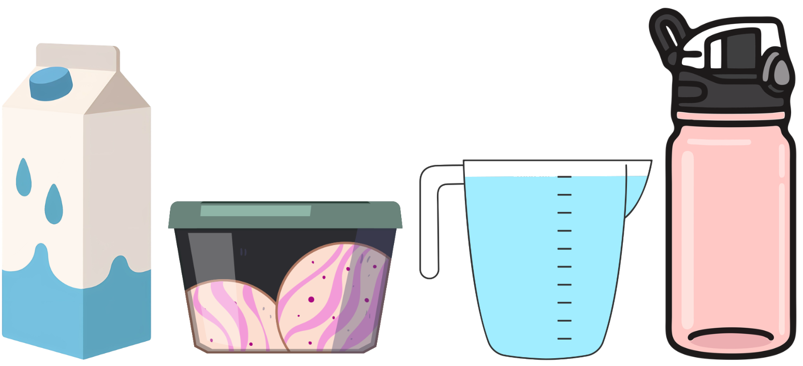
Short response (32)
These containers have a capacity of one litre.
Explain how each container can hold one litre, while being a variety of shapes.
Notes:
Short response questions provide brisk paced questions focussing on review of current and previous content to support spaced and interleaved practice.
Syllabus focus area:
Three-dimensional spatial structure A

Slide 59
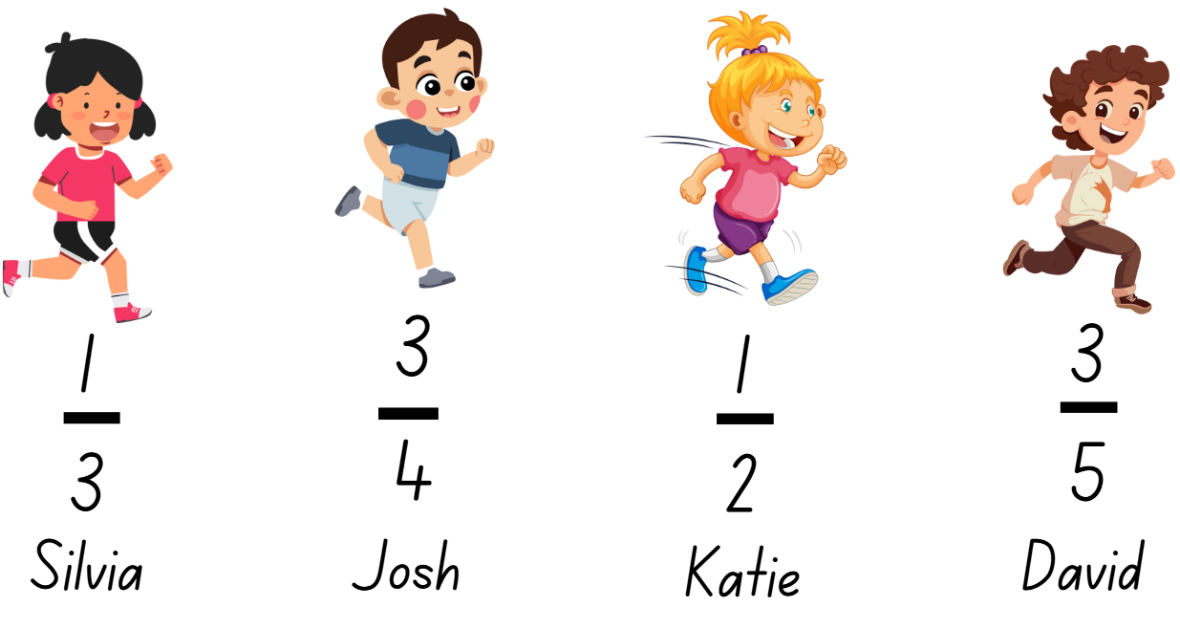
Activity 8 – Who is winning?
Notes:
This is a developing number sense activity.
Number sense refers to a deep understanding of numbers, including their magnitude, relationships, and the effects of operations on them. It supports fluency and understanding, estimation, flexible thinking, and efficient problem-solving. Number sense activities 1–4 ‘activate’ prior number knowledge and support the learning of new content in the unit. Number sense activities 5–8 ‘loop’ back and provide opportunity for spaced practice with concepts and procedures covered in previous units.
Syllabus focus area:
Partitioned fractions A
Who is winning?
1. Provide pairs of students with multiple paper strips and writing materials. Revise how to identify thirds and fifths of a length.
2. Explain that the 4 students are in a race. The fractions show how much of the race they have already completed.
3. Provide pairs of students with identical length fraction strips for each runner and a whiteboard to draw a number line.
4. With their partner, students use a fraction strip to mark and represent the fraction distance for each student. Students then compare the fractional representations for each runner and then use the number line to locate each person’s position in the race and determine who is winning the race.
5. Select students to share and explain their strategies used to identify and represent the position of each fraction.

Slide 60
Double Venn diagram
Object 1
Object 2
Features similar to both objects
Features of object 1
Features of object 2

Slide 61
Frayer
Definition
Facts/Characteristics
Word, term, concept
Examples
Non-examples

Slide 62
Spider map
Idea
Subject

Slide 63
Cline
Concept 1
Concept 2
Word
Word
Word
Word
Word
Word
Word
Word
Word
Word
Word

Slide 64
Compare and contrast

Slide 65
Multiple choice (5)
A
B
C
D

Slide 66
Multiple choice
A
B
C
D
Notes:
This question connects to the content in the developing number sense activity (Activity 3)
Syllabus focus area:
[Focus area A/B]

Slide 67
References (1)
This presentation contains NSW Curriculum and syllabus content. The NSW Curriculum is developed by the NSW Education Standards Authority. This content is prepared by NESA for and on behalf of the Crown in the right of the State of New South Wales. The material is protected by Crown copyright.
Please refer to the NESA Copyright Disclaimer for more information https://educationstandards.nsw.edu.au/wps/portal/nesa/mini-footer/copyright.
NESA holds the only official and up-to-date versions of the NSW Curriculum and syllabus documents. Please visit the NSW Education Standards Authority (NESA) website https://educationstandards.nsw.edu.au/wps/portal/nesa/home and the NSW Curriculum website https://curriculum.nsw.edu.au.
Mathematics K–10 Syllabus © NSW Education Standards Authority (NESA) for and on behalf of the Crown in right of the State of New South Wales, 2022.
National Numeracy Learning Progression © Australian Curriculum, Assessment and Reporting Authority (ACARA) 2010 to present, unless otherwise indicated. This material was downloaded from the Australian Curriculum website (National Numeracy Learning Progression) (accessed 5 February 2026) and was not modified.
New Zealand Ministry of Education (n.d.) ‘Making benchmarks: Length’, Resource, NZ Maths website, accessed 9 February 2026.
NSW Department of Education (2017) Teaching Measurement: Stage 2 and Stage 3 [PDF]. NSW Department of Education Learning and Teaching Directorate.
Siemon D, Warren E, Beswick K, Faragher R, Miller J, Horne Marj, Jazby D, Breed M, Clark J, Brady K (2022) Teaching Mathematics: Foundation to middle years 3rd edn Oxford University Press, Australia.

Slide 68
References (2)
This presentation contains NSW Curriculum and syllabus content. The NSW Curriculum is developed by the NSW Education Standards Authority. This content is prepared by NESA for and on behalf of the Crown in the right of the State of New South Wales. The material is protected by Crown copyright.
Please refer to the NESA Copyright Disclaimer for more information https://educationstandards.nsw.edu.au/wps/portal/nesa/mini-footer/copyright.
NESA holds the only official and up-to-date versions of the NSW Curriculum and syllabus documents. Please visit the NSW Education Standards Authority (NESA) website https://educationstandards.nsw.edu.au/wps/portal/nesa/home and the NSW Curriculum website https://curriculum.nsw.edu.au.
Toy Theater (2023) Place Value Chart, Toy Theater website, accessed 9 February 2026.
Van de Walle J, Karp K, Bay-Williams JM, Brass A, Bentley B, Ferguson S, Goff W, Livy S, Marshman M, Martin D, Pearn C, Prodromou T, Symons D and Wilkie K (2019) Primary and Middle Years Mathematics: Teaching Developmentally, 1st Australian edn, Pearson Education Australia, Melbourne.

Slide 69
Copyright
© State of New South Wales (Department of Education), 2025
The copyright material published in this resource is subject to the Copyright Act 1968 (Cth) and is owned by the NSW Department of Education or, where indicated, by a party other than the NSW Department of Education (third-party material).
Copyright material available in this resource and owned by the NSW Department of Education is licensed under a Creative Commons Attribution 4.0 International (CC BY 4.0) license.
This license allows you to share and adapt the material for any purpose, even commercially.
Attribution should be given to © State of New South Wales (Department of Education), 2025.
Material in this resource not available under a Creative Commons license:
the NSW Department of Education logo, other logos and trademark-protected material
Material owned by a third party that has been reproduced with permission. You will need to obtain permission from the third party to reuse its material.
Links to third-party material and websites
Please note that the provided (reading/viewing material/list/links/texts) are a suggestion only and implies no endorsement, by the New South Wales Department of Education, of any author, publisher, or book title. School principals and teachers are best placed to assess the suitability of resources that would complement the curriculum and reflect the needs and interests of their students.
If you use the links provided in this document to access a third party’s website, you acknowledge that the terms of use, including licence terms set out on the third-party’s website apply to the use which may be made of the materials on that third-party website or where permitted by the Copyright Act 1968 (Cth). The department accepts no responsibility for content on third-party websites.

